Slide 1
Production of atomic and molecular negative ions

Slide 2
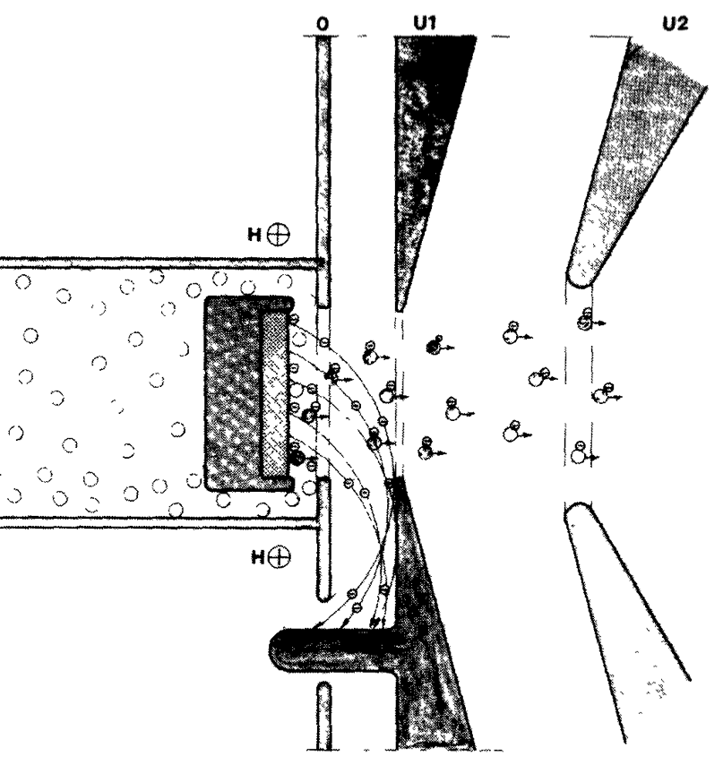
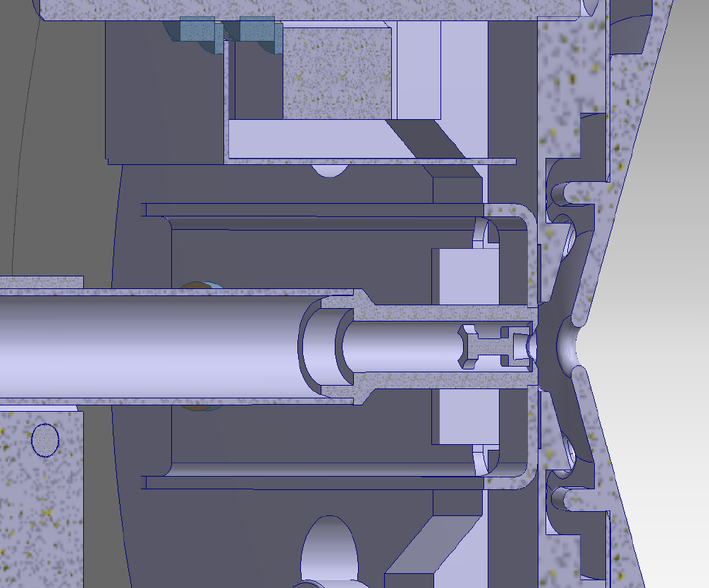
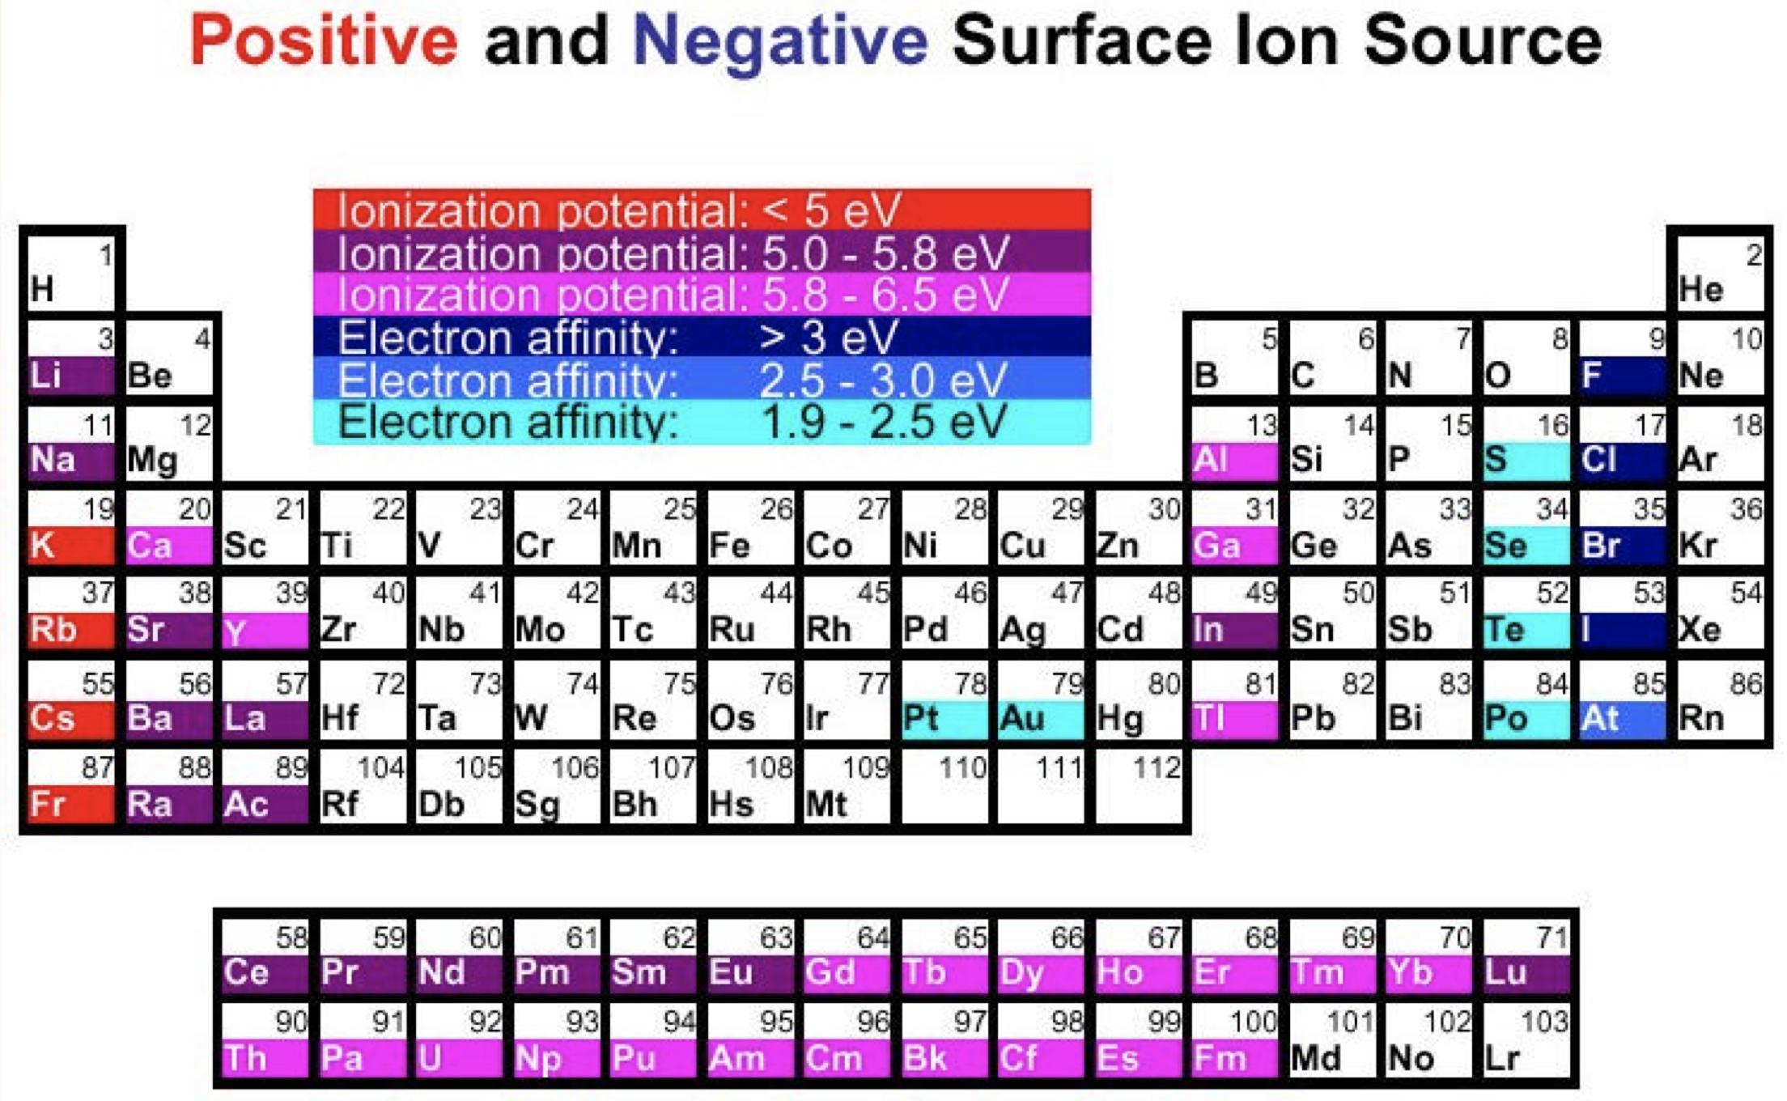
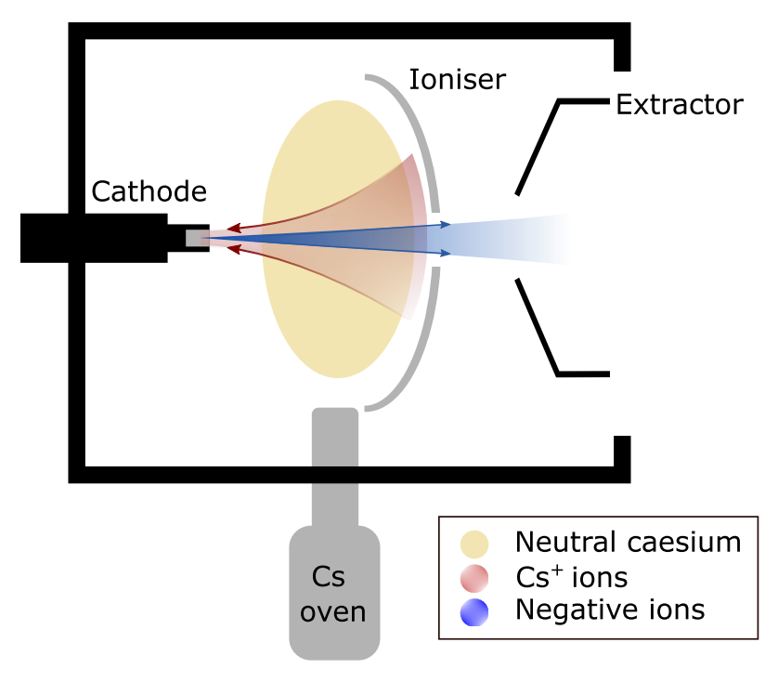
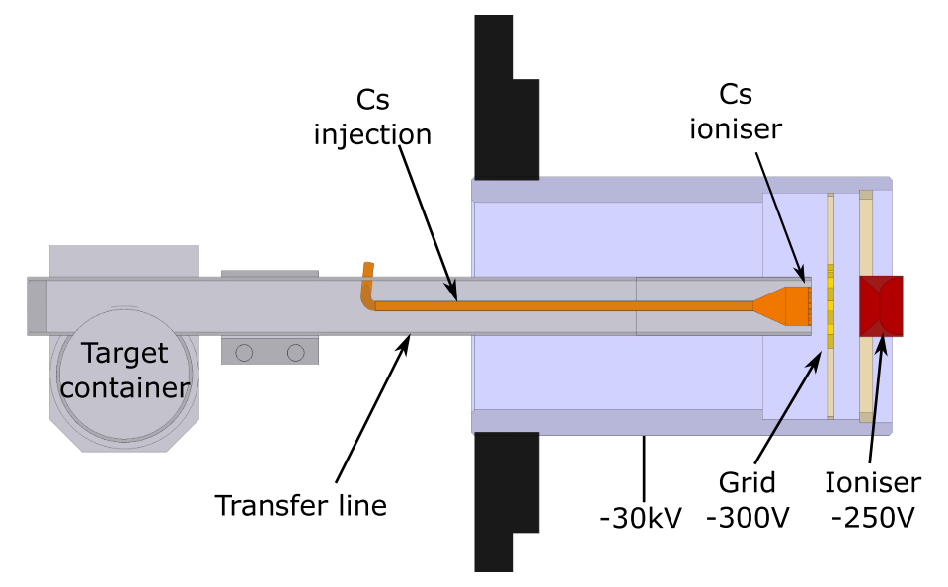
Production and study of radioactive negative ions
Ion source development
Negative surface ion sources
Kinetic ejection negative ion source
Negative ions from FEBIAD
F. Wenander (2003) XXXVIIIth RENCONTRE DE MORIOND Les Arcs
[1] ﻿B. Vosicki et al. NIM Phys. Res. 186.1 (1981), p. 307
[2] D. Leimbach, PhD thesis, JGU Mainz (2021)
[3] ﻿G.D Alton et al. NIMB 170.3 (2000), p. 515
[4] ﻿R. Middleton. NIM Phys Res. 214.2 (1983), pp. 139– 150. 90580-X.

Slide 3
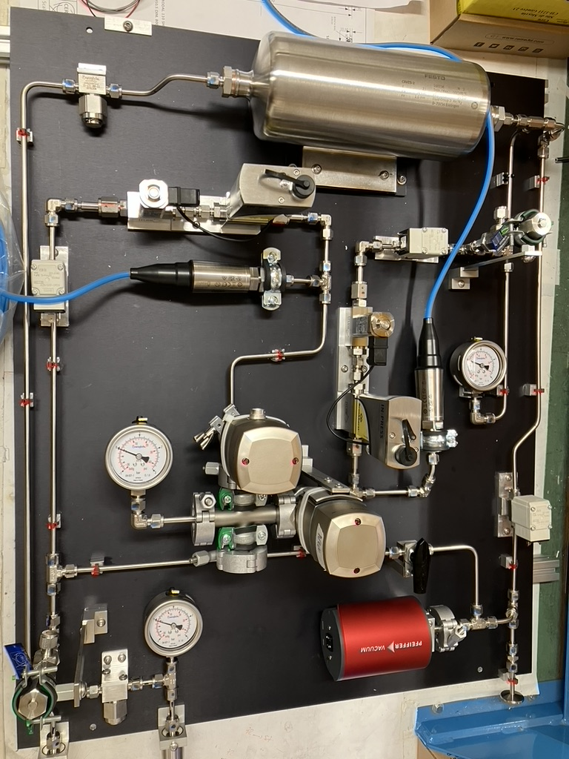
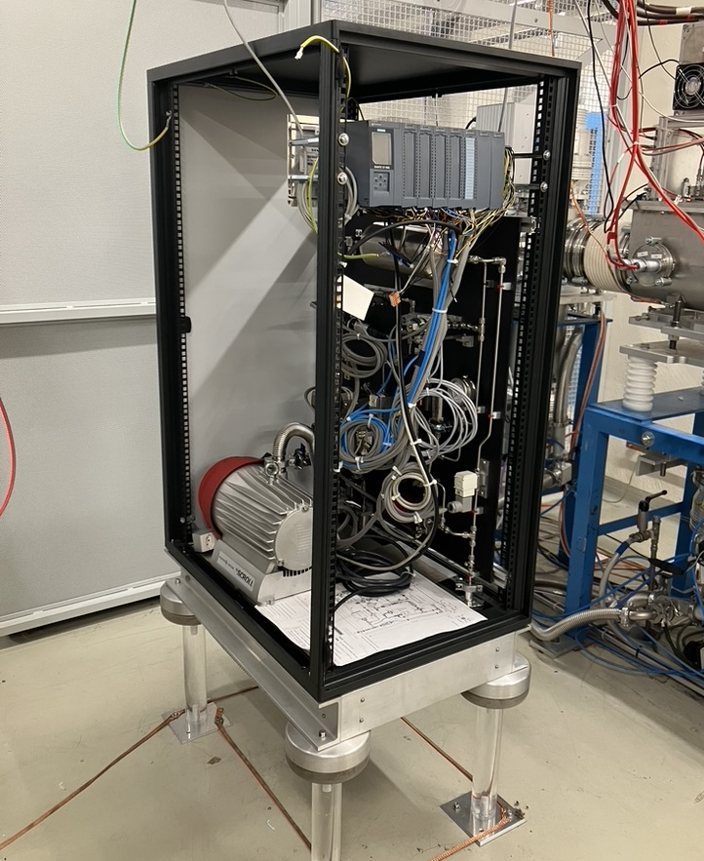
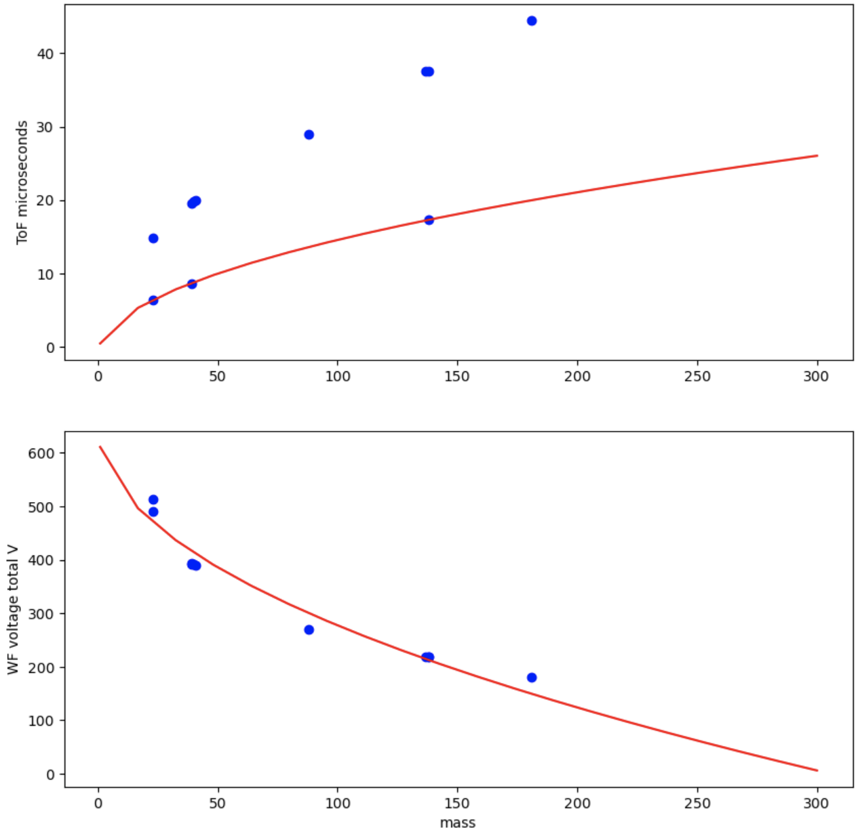
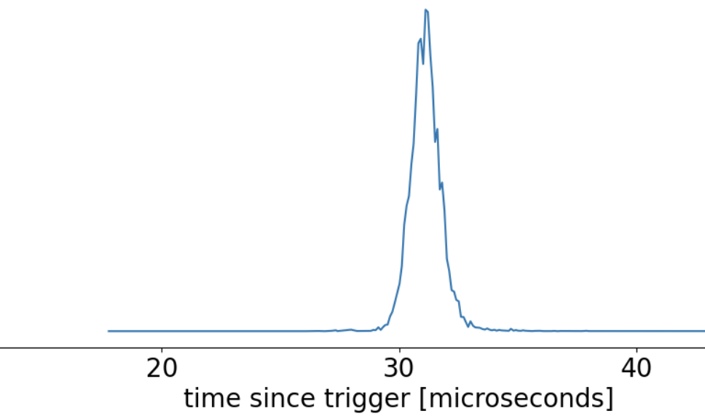
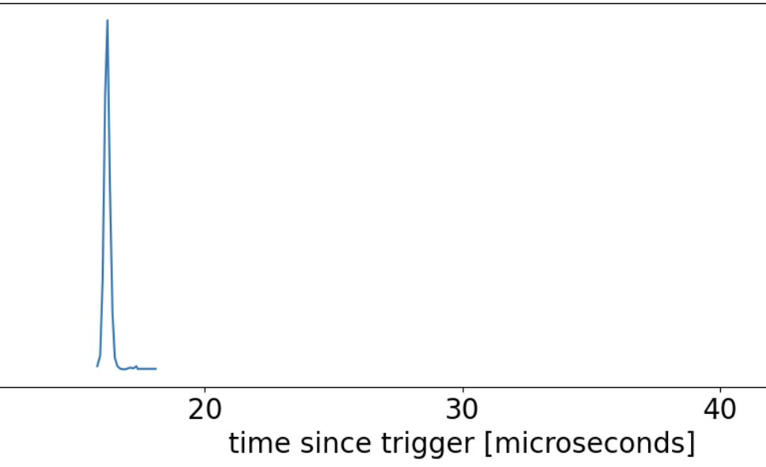
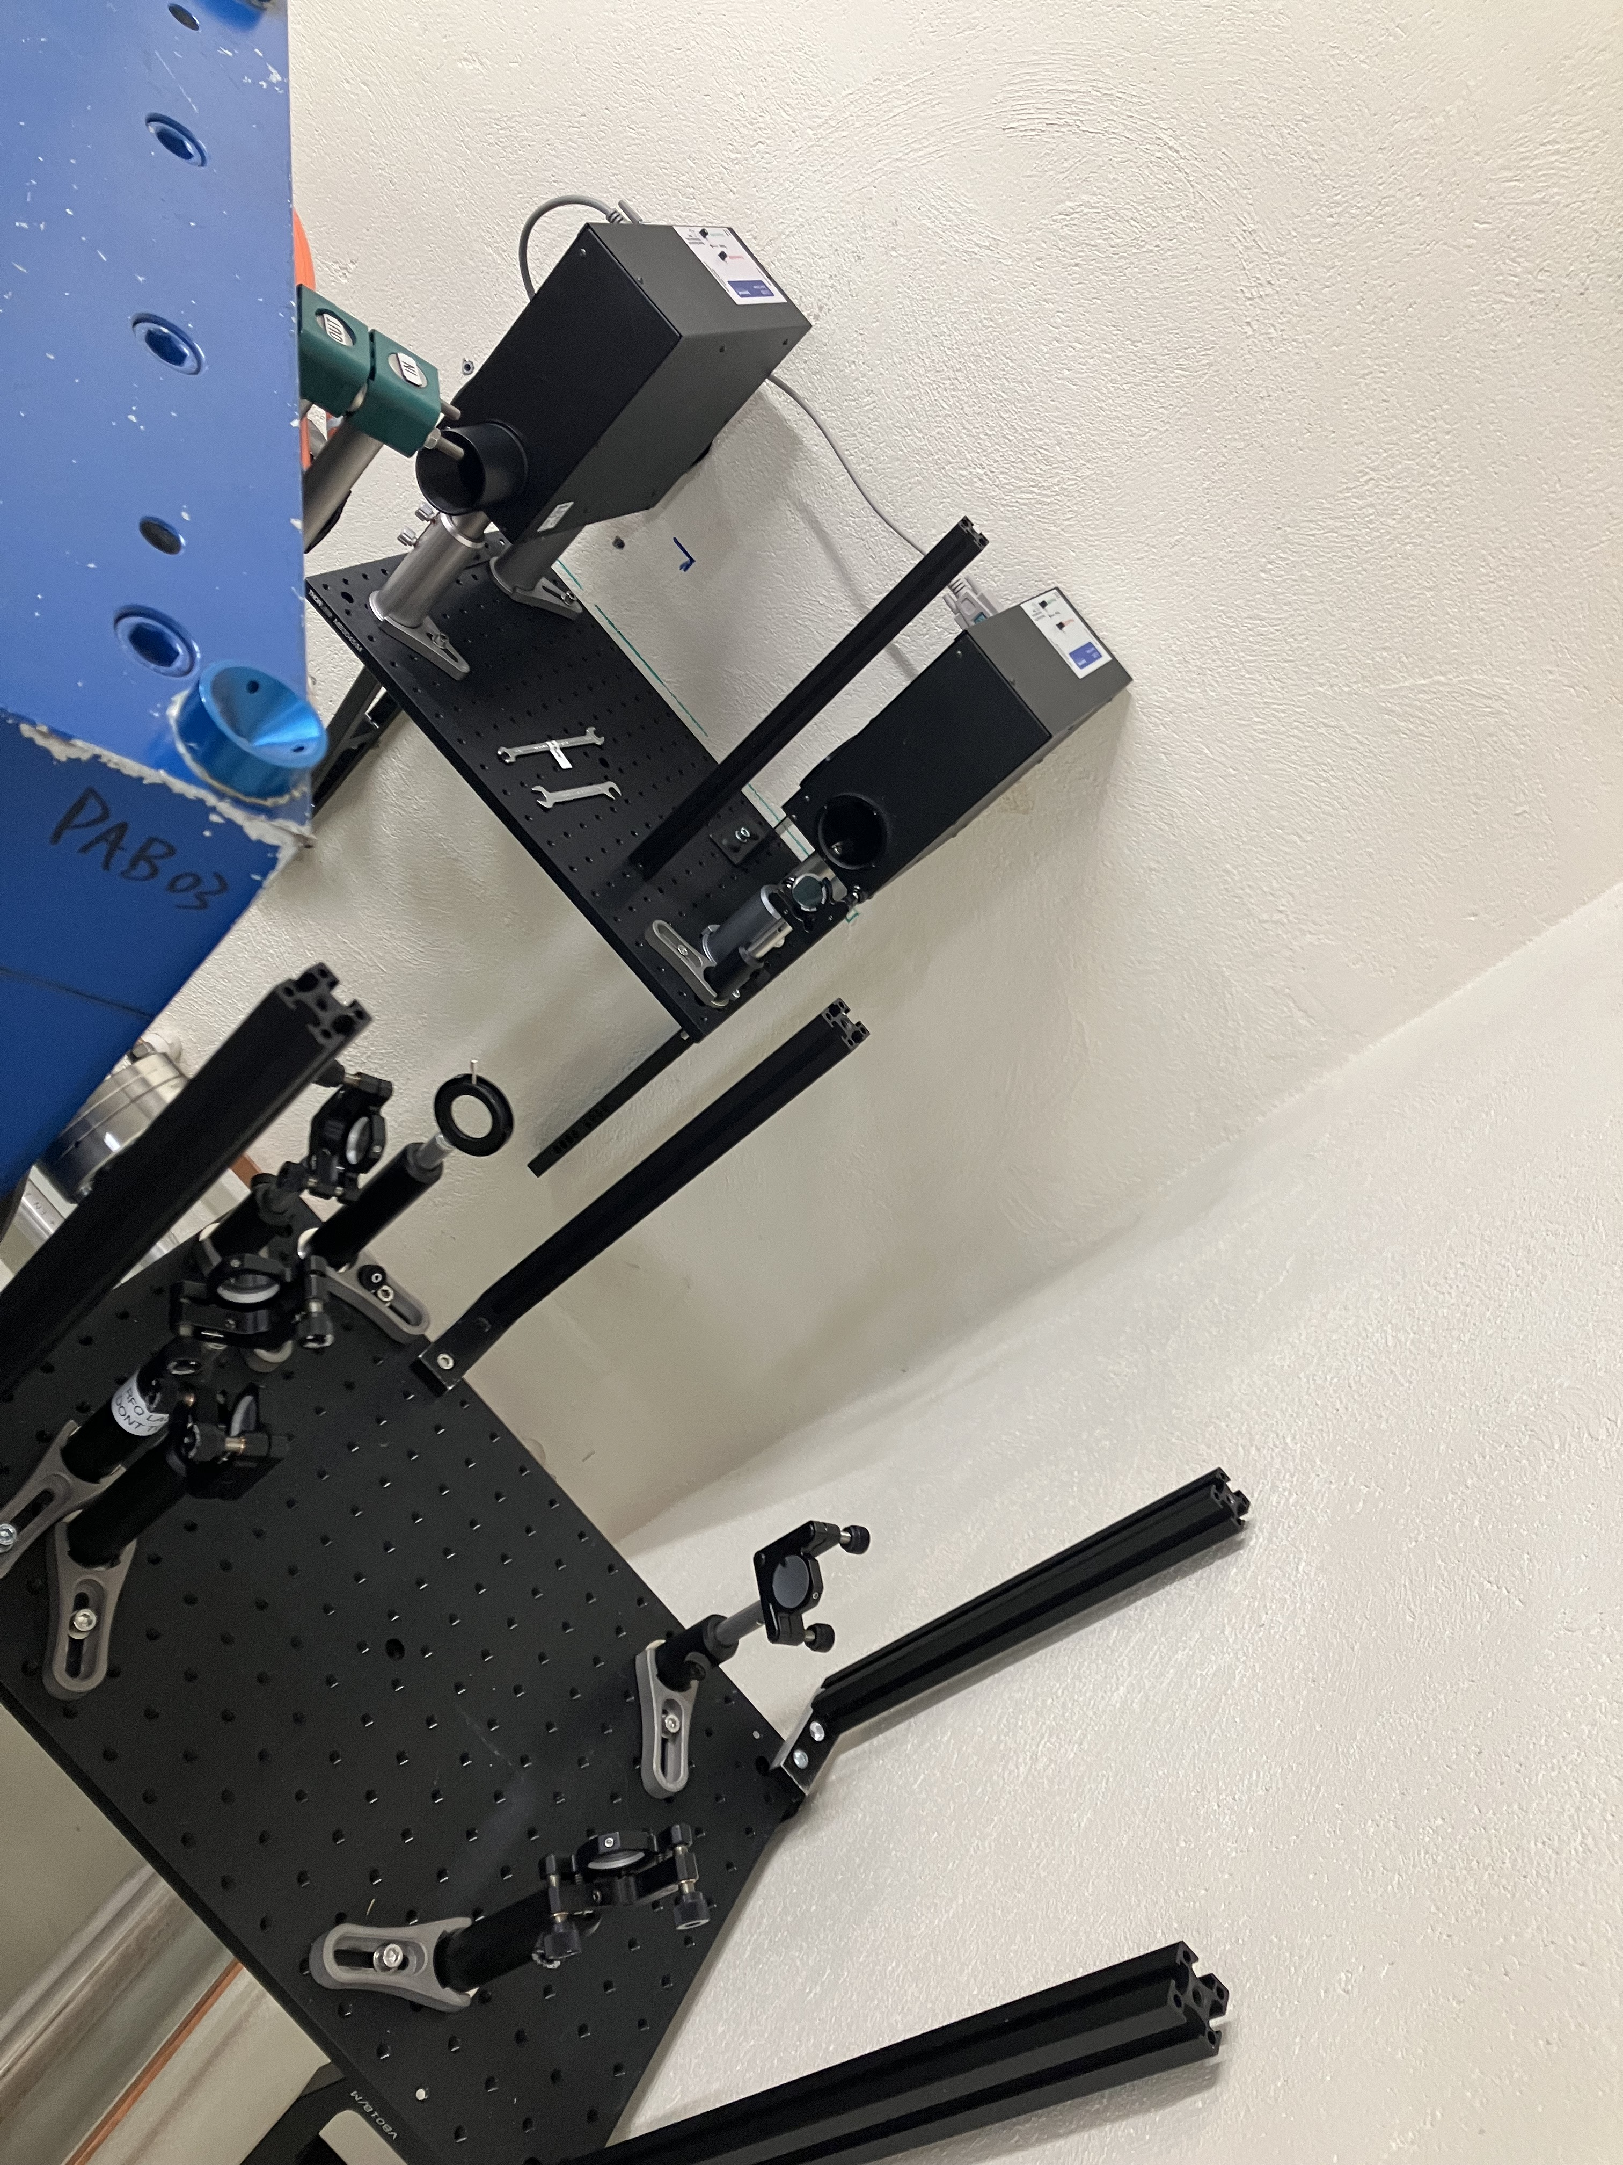
Offline 2 current status
CERN project “RBS-MOL” complete
Wien filter + ToF ID after RFQ
Commissioning Ba⁺+CH₃OH, Ba⁺+ H₂O 🥳
Laser interaction in RFQ
New laser path
Deflectors
Commissioning
Ba⁺ -> Ba²⁺ ⚠️
Ion source
+30 kV
New laser beam path + reference
Extraction
Mass separator
RFQ-cb
MagneToF 2
Einzel lens
Wien filter
Deflectors
+30 kV -RFQ offset

Slide 4
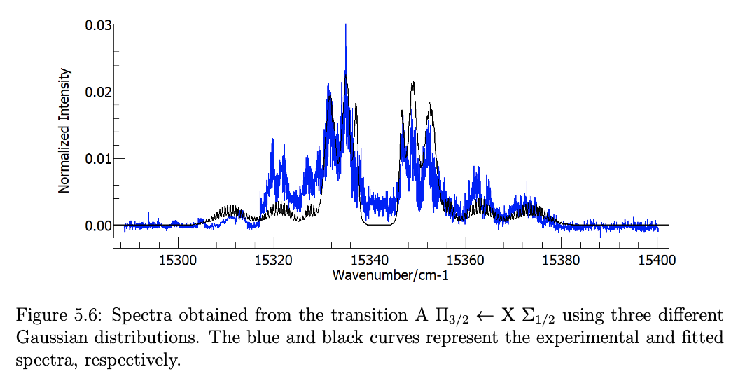
PANIONS PhD project
Source material | Work function [eV]
Molybdenum | 4.15
Tantalum | 4.12
LaB₆ | 2.5-2.7
GdB₆ | 1.5-2.7
SrVO₃ | 1.79 (predicted)
Plan: Production and study of negative molecular beams
Negative ion sources
In-flight photodetachment + depletion or NPD at offline 2
Charge exchange reactions with reactants and trapped ions in RFQ
During LS3: offline tests
To discuss: Alkali vapor charge exchange cells
Comparison with existing RaF state distribution data
Opportunities for collaboration with CRIS?
Plans after LS3?
Carlos M. Fajardo Zambrano
CERN-THESIS-2023-239

