Slide 1

Potential LS3 offline campaign
Proposal by
CRIS local team
Carlos M. Fajardo-Zambrano
Osama Ahmad
Jessica Warbinek
CRIS collaboration meeting, February 2026.

Slide 2
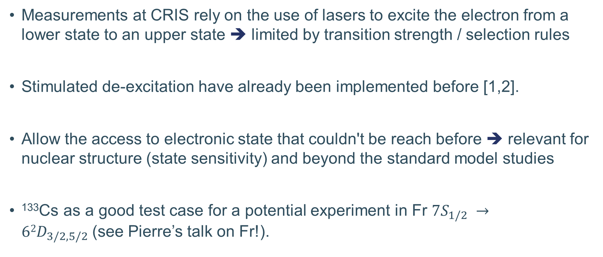
Motivation
Measurements at CRIS rely on the use of lasers to excite the electron from a lower state to an upper state ➔ limited by transition strength / selection rules
Stimulated de-excitation have already been implemented before [1,2].
Allow the access to electronic state that couldn't be reach before ➔ relevant for nuclear structure (state sensitivity) and beyond the standard model studies
¹³³Cs as a good test case for a potential experiment in Fr $7S_{1/2} →62D_{3/2,5/2}$(see Pierre’s talk on Fr!).
[1] Day, J. O., Brekke, E., & Walker, T. G. (2008). Dynamics of low-density ultracold Rydberg gases. Physical Review A—Atomic, Molecular, and Optical Physics, 77(5), 052712.
[2] Comparat, D., & Malbrunot, C. (2019). Laser-stimulated deexcitation of Rydberg antihydrogen atoms. Physical Review A, 99(1), 013418.

Slide 3
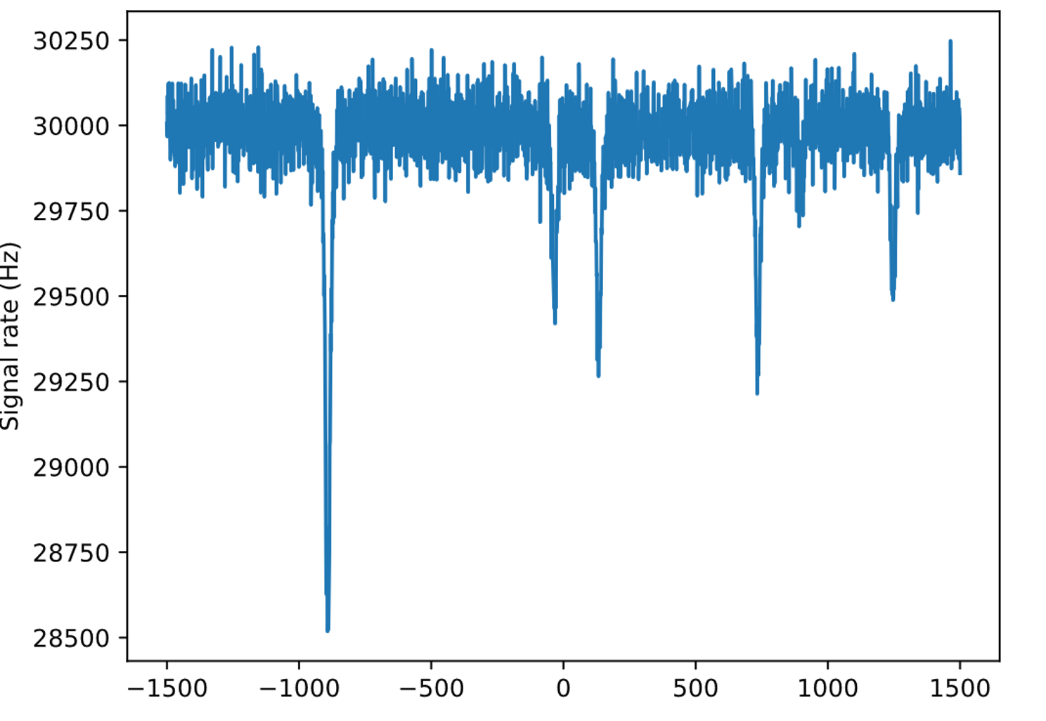
First possible scheme
The “Lambda scheme”
b)
First signal scheme
IP
a)
31408.4677 cm-1
IP
1064
2P_3/2
1064 nm
758.5860 nm (OPO ~ 100GHz)
27681.6782 cm-1
5 ²D_{3/2}
9 ²P_{3/2}
14499.2568 cm-1
361.2497 nm
Double Z-cavity
361.2497 nm
A = 1.4e5
6 ²S_{1/2}
Ground state
6 ²S_{1/2}
[3]
¹³³Cs
¹³³Cs
[3] Figure courtesy of Pierre Lassegues for Francium

Slide 4
5 ²D state spectroscopy using first step
c)
IP
9 ²P_{3/2}
532 nm/OPO
Grating
758.5860 nm
5 ²D_{3/2}
14499.2568 cm-1
361.2497 nm
Double Z-cavity
7 ²S_{1/2}
Ground state
¹³³Cs

Slide 5
Second possible scheme
The “Lambda scheme”
b)
First signal scheme
IP
a)
31408.4677 cm-1
1064
IP
8 ²P_{3/2}
1064 nm
885.563 nm (OPO ~ 100GHz)
5 ²D_{3/2}
8 ²P_{3/2}
25791.508 cm-1
14499.2568 cm-1
387.7245 nm
Double Z-cavity
387.7245 nm
A = 3.9e5
6 ²S_{1/2}
Ground state
6 ²S_{1/2}
¹³³Cs
¹³³Cs

Slide 6
Summary
Two possible first steps 361 or 387 nm (similar strength)
Second step can end in either 5 ²D_{3/2} or 5 ²D_{5/2} (all shown are 5 ²D_{3/2})
Last step is either 1064 nm or 532nm/OPO
IP
IP
1064
1064
9 ²P_{3/2}
8 ²P_{3/2}
758.5860 nm
885.563 nm
361.2497 nm
Double Z-cavity
387.7245 nm
Double Z-cavity
5 ²D_{3/2}
5 ²D_{3/2}
14499.2568 cm-1
14499.2568 cm-1
6 ²S_{1/2}
6 ²S_{1/2}
¹³³Cs
¹³³Cs

Slide 7
Considerations
Schemes have been chose based on available lasers and their power
Laser paths are ready-ish and laser (if lasing) are close in wavelength.
We will need help from experience users to take shifts (7am-3pm, 3pm-11pm)
We could also do a comparison of FIU vs three-step scheme, and background estimation based on source abundances 1 part Cs, 4 parts Rb and 20 parts K.

Slide 8
Thanks for your attention

Slide 9
D state using second step
c)
IP
8 ²P_{3/2}
532 nm/OPO
Grating
885.563 nm
5 ²D_{3/2}
14499.2568 cm-1
387.7245 nm
Double Z-cavity
6 ²S_{1/2}
Ground state

