Slide 1
Study of RaF− anions at CRIS
Jessica Warbinek, Derick Gonzalez-Acevedo
CRIS collaboration meeting 2026, February 2-3

Slide 2
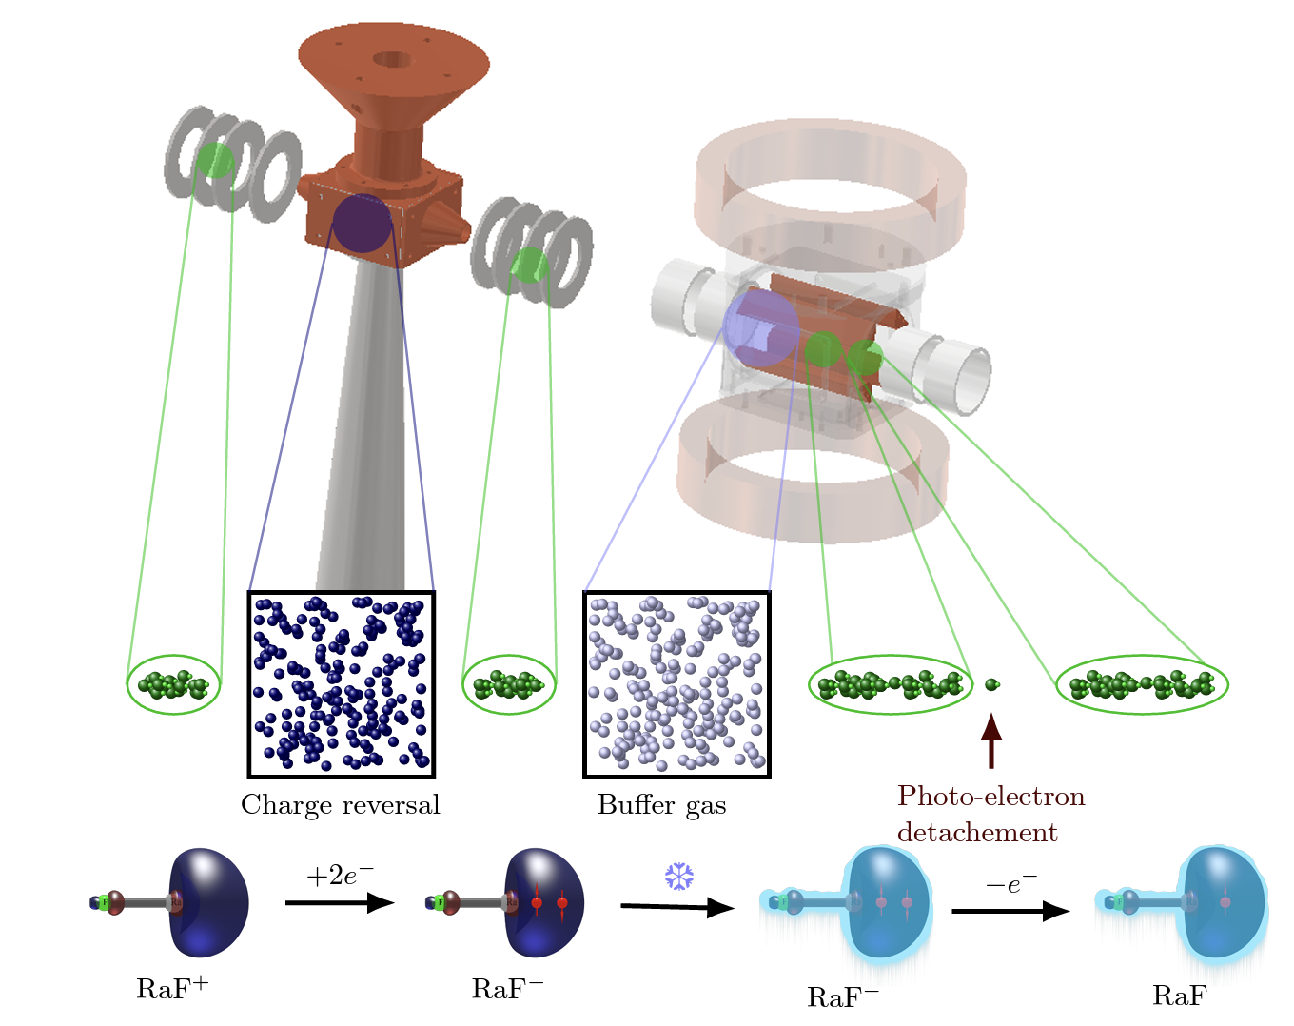
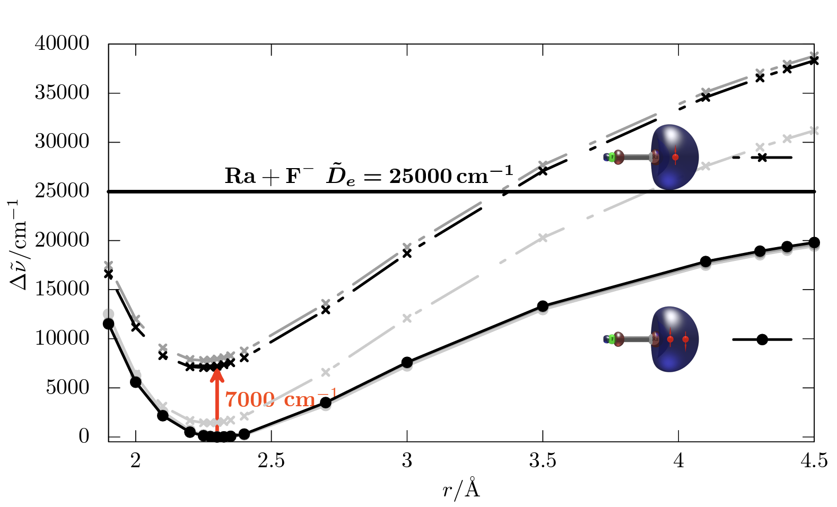
Study of RaF− anions at CRIS
A route towards cooling and trapping RaF
Potential energy curves of RaF and RaF⁻
Electron affinity (EA)
K. Gaul et al., arXiv preprint arXiv:2403.09320 (2024).

Slide 3
Study of RaF− anions at CRIS
A route towards cooling and trapping RaF
Potential energy curves of RaF and RaF⁻
How do we produce RaF-?
Electron affinity (EA)
K. Gaul et al., arXiv preprint arXiv:2403.09320 (2024).

Slide 4
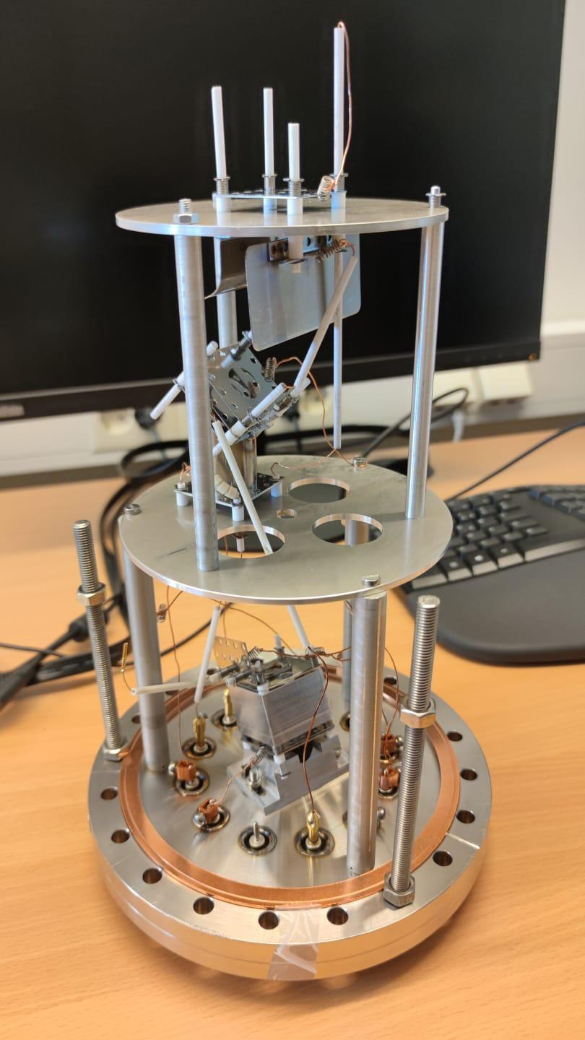
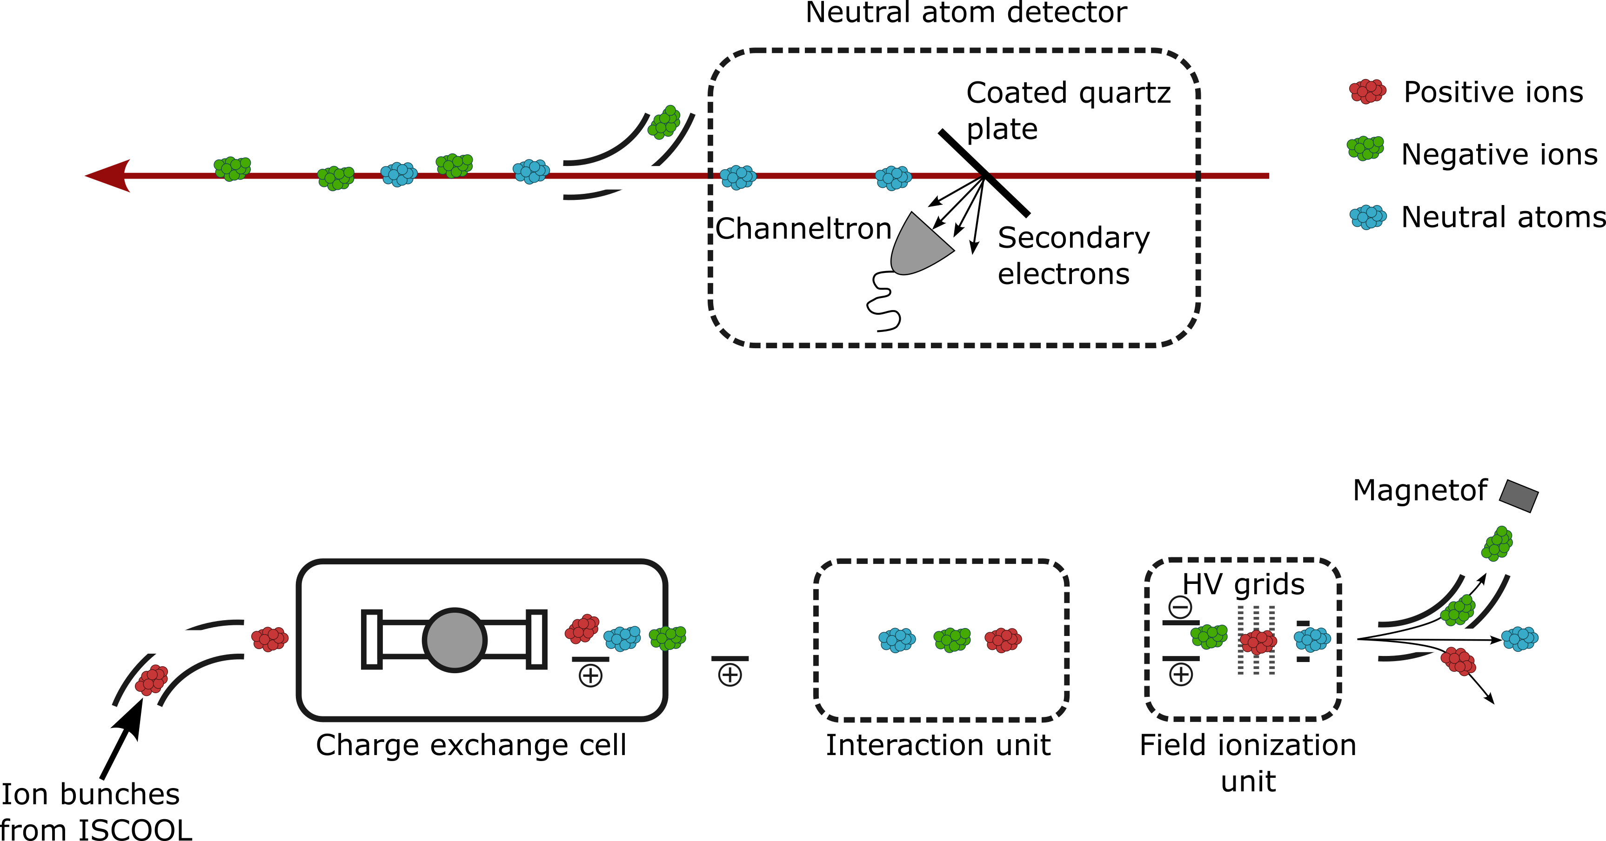
Laser photodetachment of RaF− anions
A⁺
A*
A
CRIS OPO laser
OPO
A⁻

Slide 5
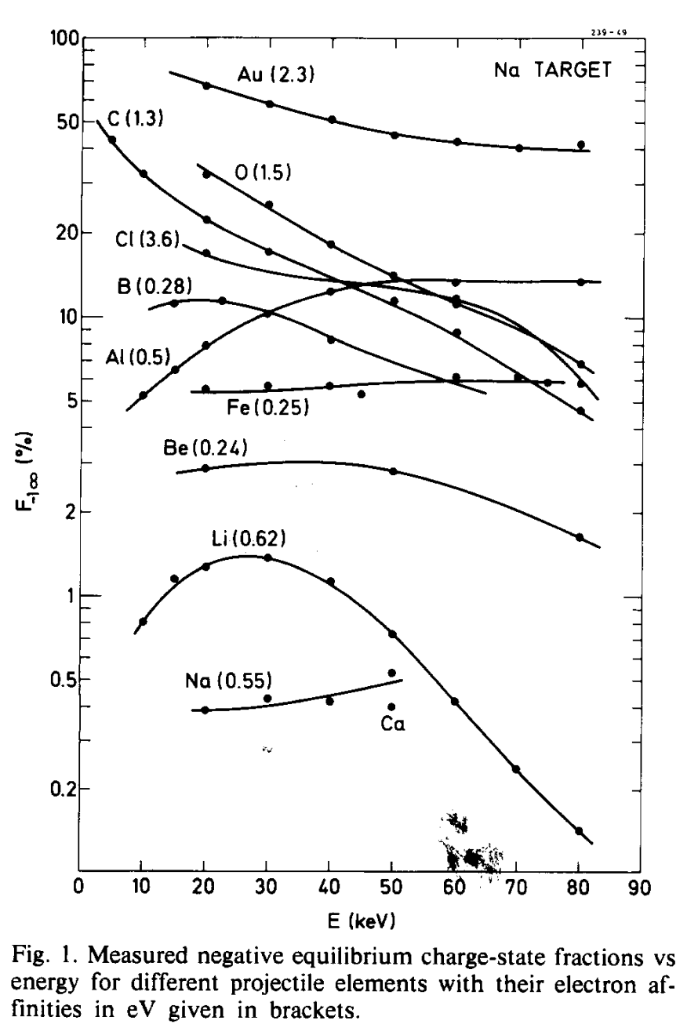

Producing negative ions
Double charge exchange process
$$X^{+}+Y →X+Y^{+}+ΔE1$$
$$X+Y →X^{−}+Y^{+}+ΔE2$$
Two-step double charge exchange process:
Positive ion captures electron in interaction with metal vapor
Yield of negatives is dependent on:
Collision (beam) energy, EA, vapor IP (low) and density
→Minimized energy defects lead to highest yield
J. Heinemeier, P. Hvelplund, Nucl. Instrum. Meth 148, 65-75 (1978).

Slide 6
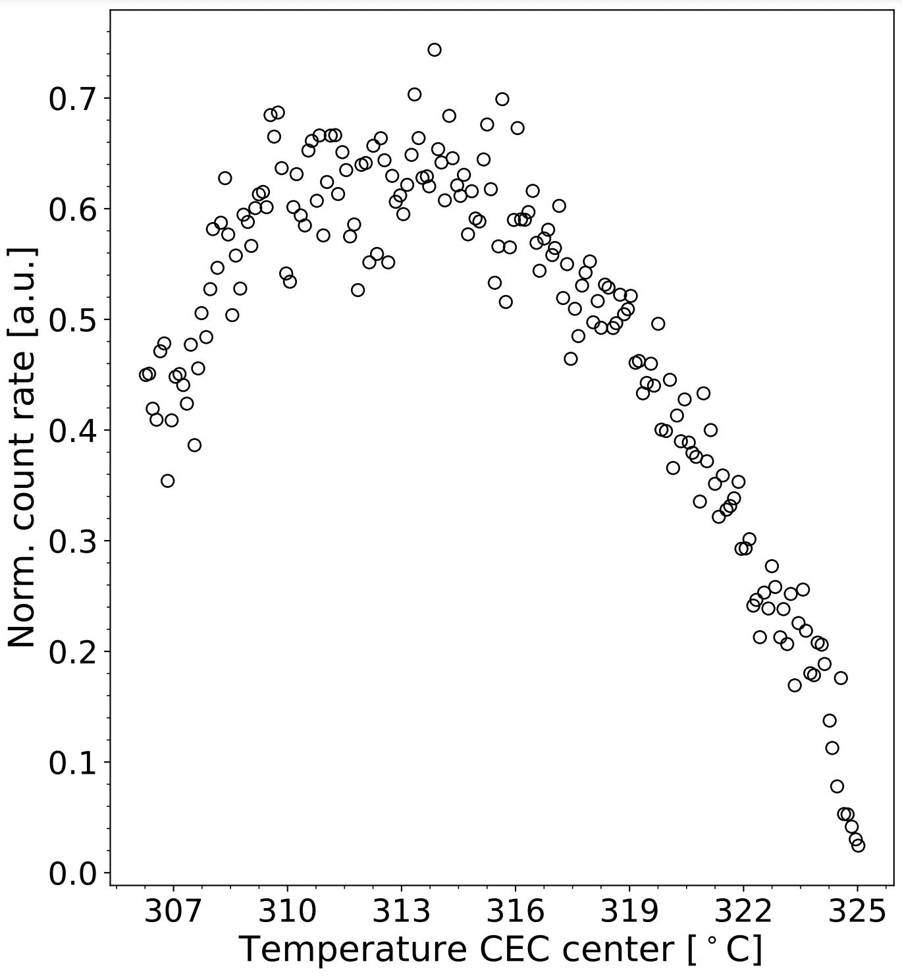
Producing negative ions
Double charge exchange process
$$X^{+}+Y →X+Y^{+}+ΔE1$$
$$X+Y →X^{−}+Y^{+}+ΔE2$$
Two-step double charge exchange process:
Positive ion captures electron in interaction with metal vapor
Yield of negatives is dependent on:
Collision (beam) energy, EA, vapor IP (low) and density
→Minimized energy defects lead to highest yield

Slide 7
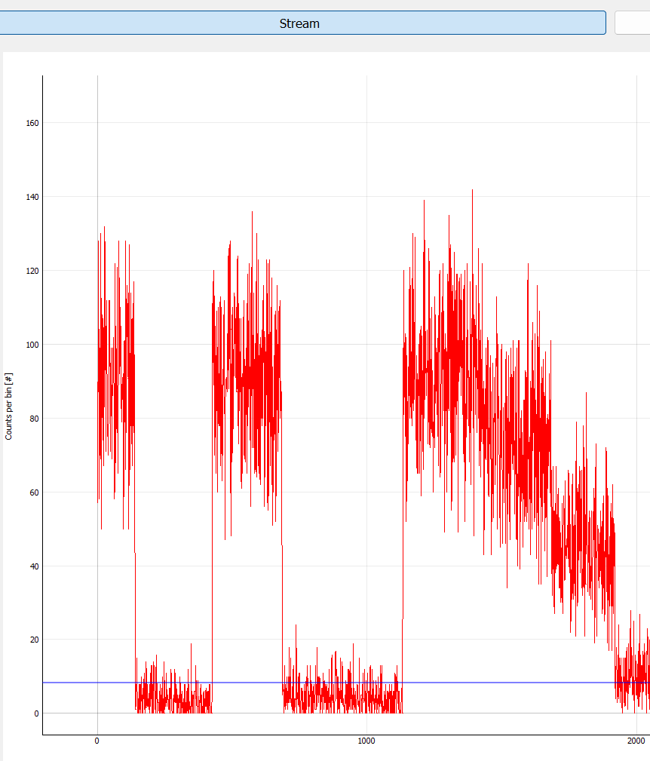
Photodetachment studies
Screenshot from CRIS logbook: First photodetachment
Laser in
Laser scanning
K. Gaul et al., arXiv preprint arXiv:2403.09320 (2024).
First EA determination of an (artificial) radioactive molecule
Laser detuned
In optimal setting: total efficiency estimated to be around 1:1000, full detachment
Analysis ongoing, careful calibration of laser and spectrometer wavenumber

Slide 8
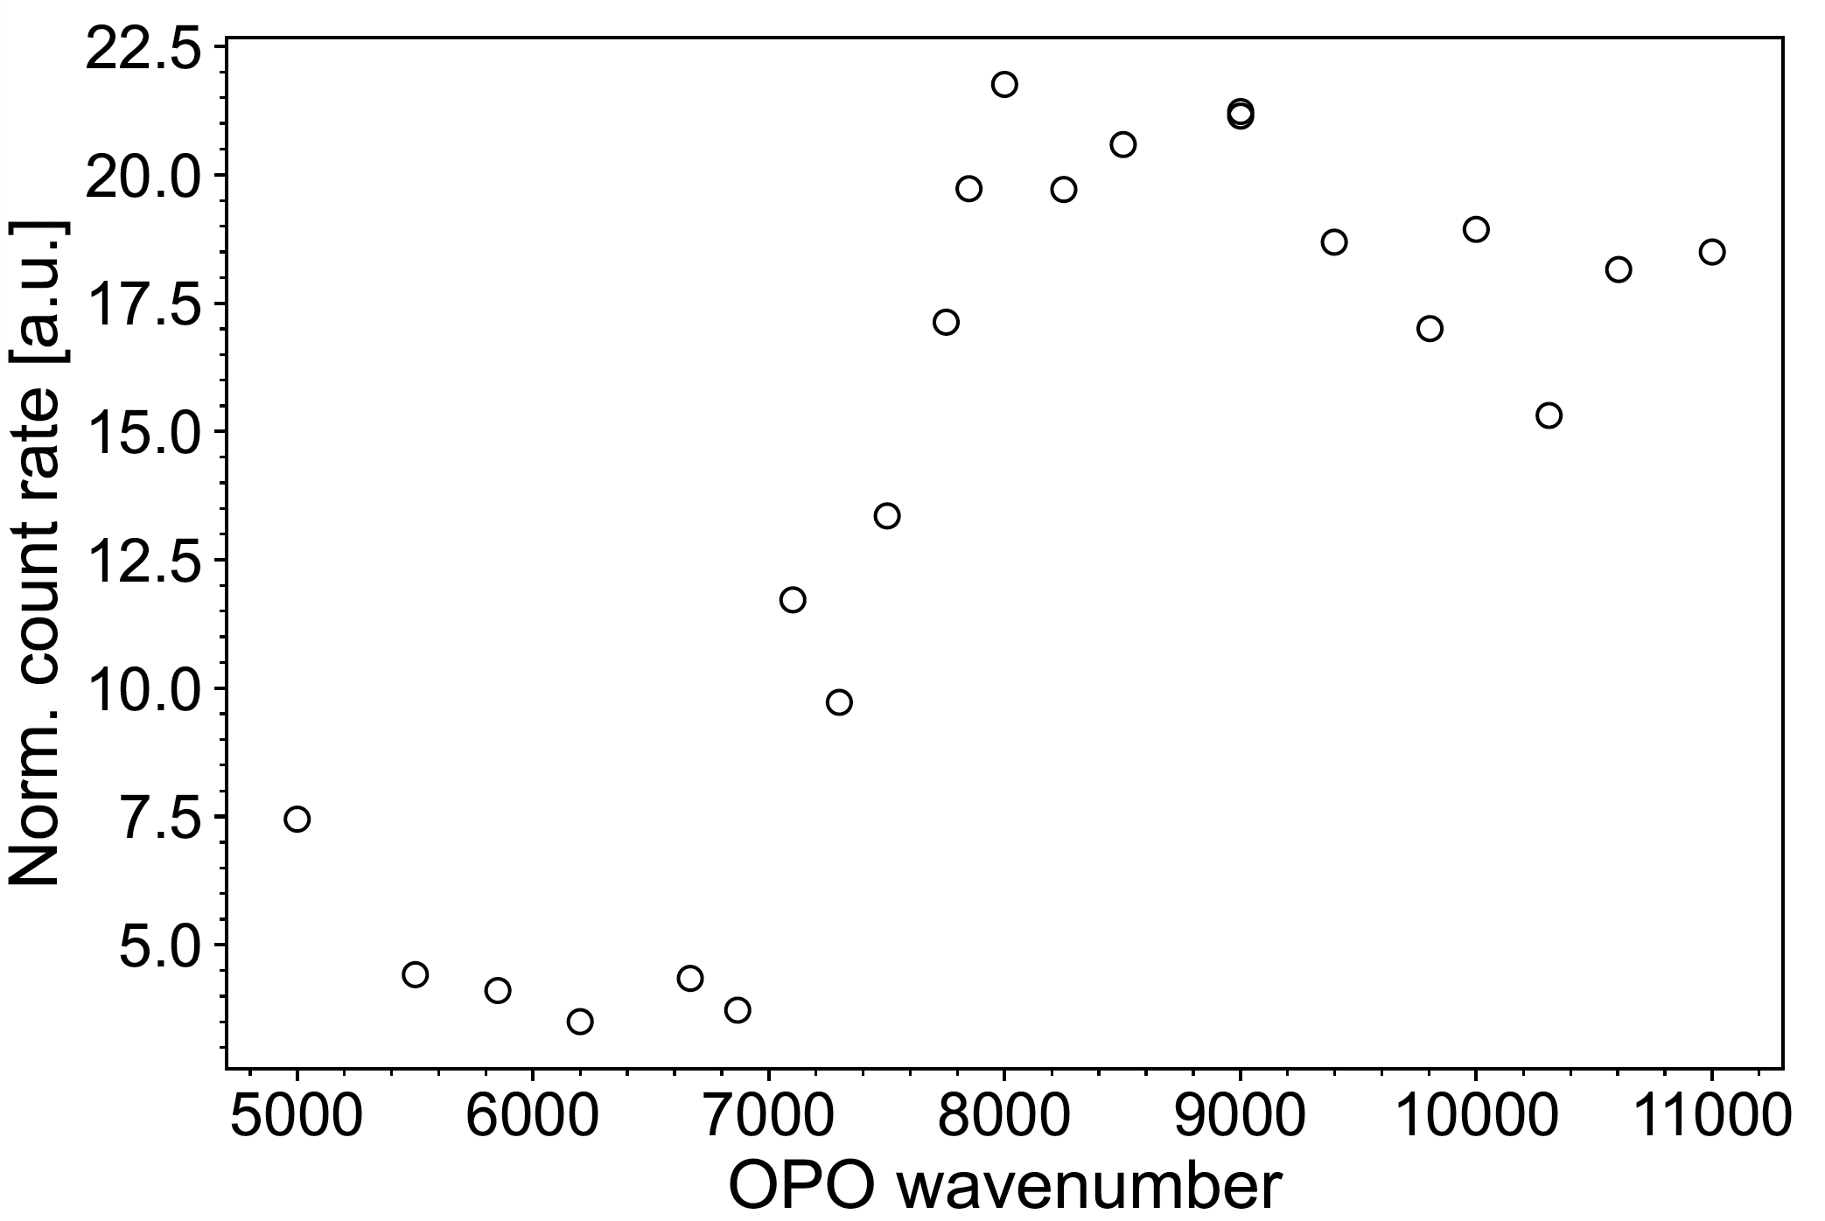
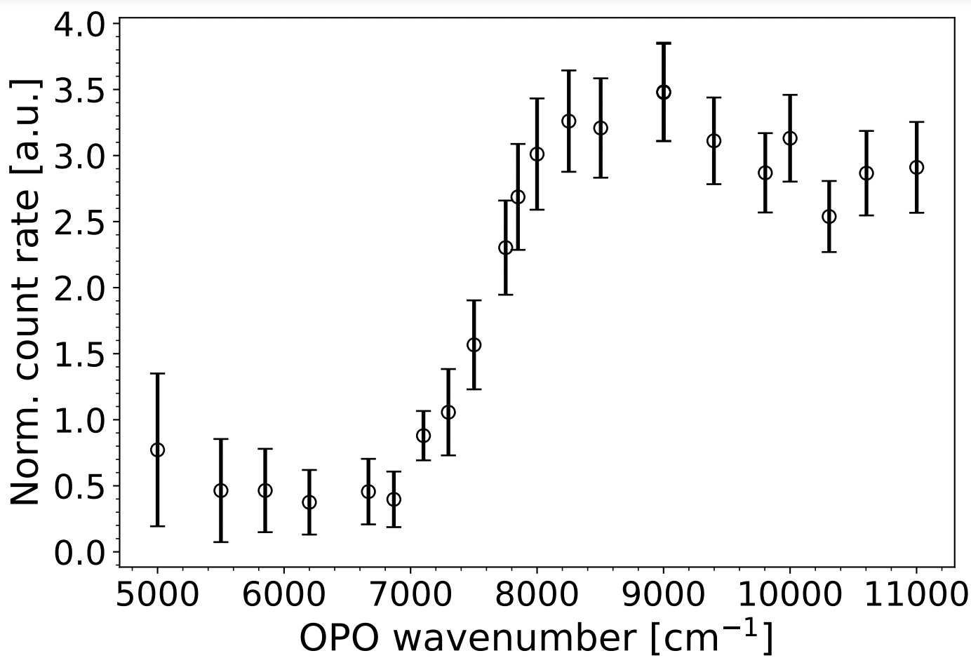
Photodetachment studies
Preliminary
K. Gaul et al., arXiv preprint arXiv:2403.09320 (2024).
First EA determination of an (artificial) radioactive molecule
In optimal setting: total efficiency estimated to be around 1:1000, full detachment
Analysis ongoing, careful calibration of laser and spectrometer wavenumber

Slide 9
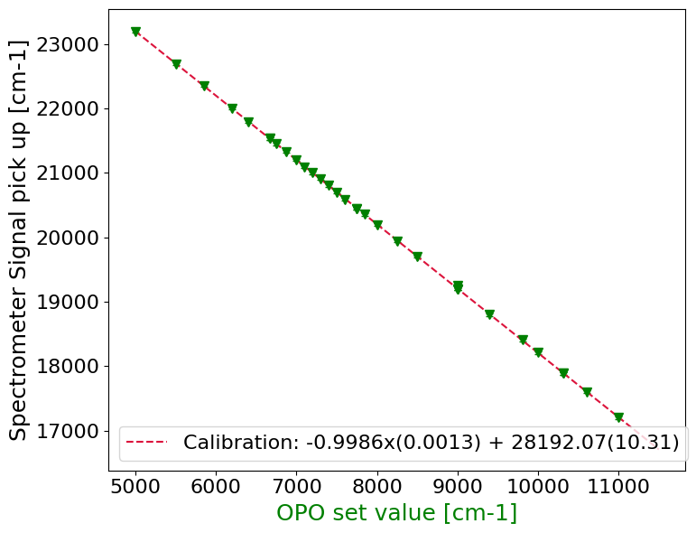
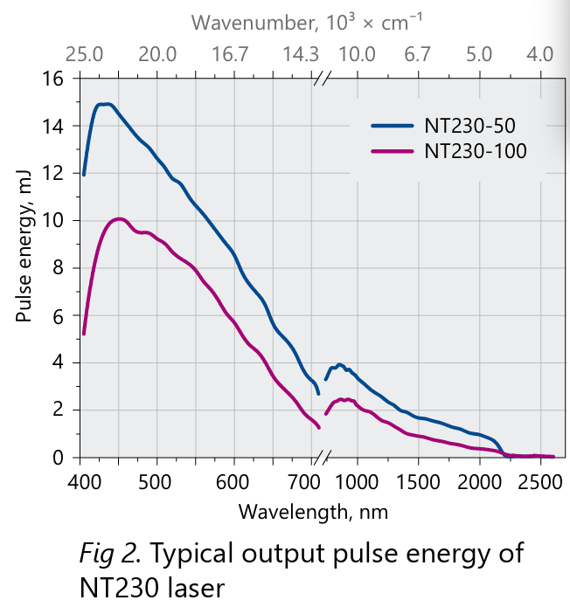
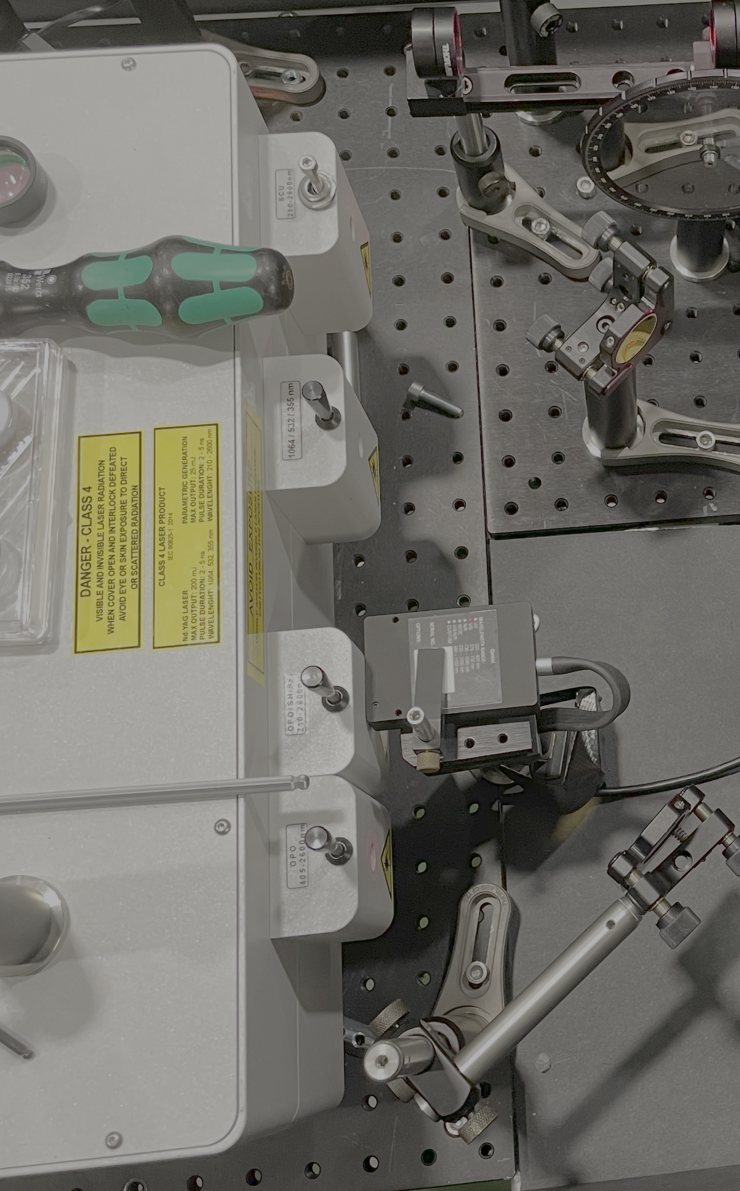
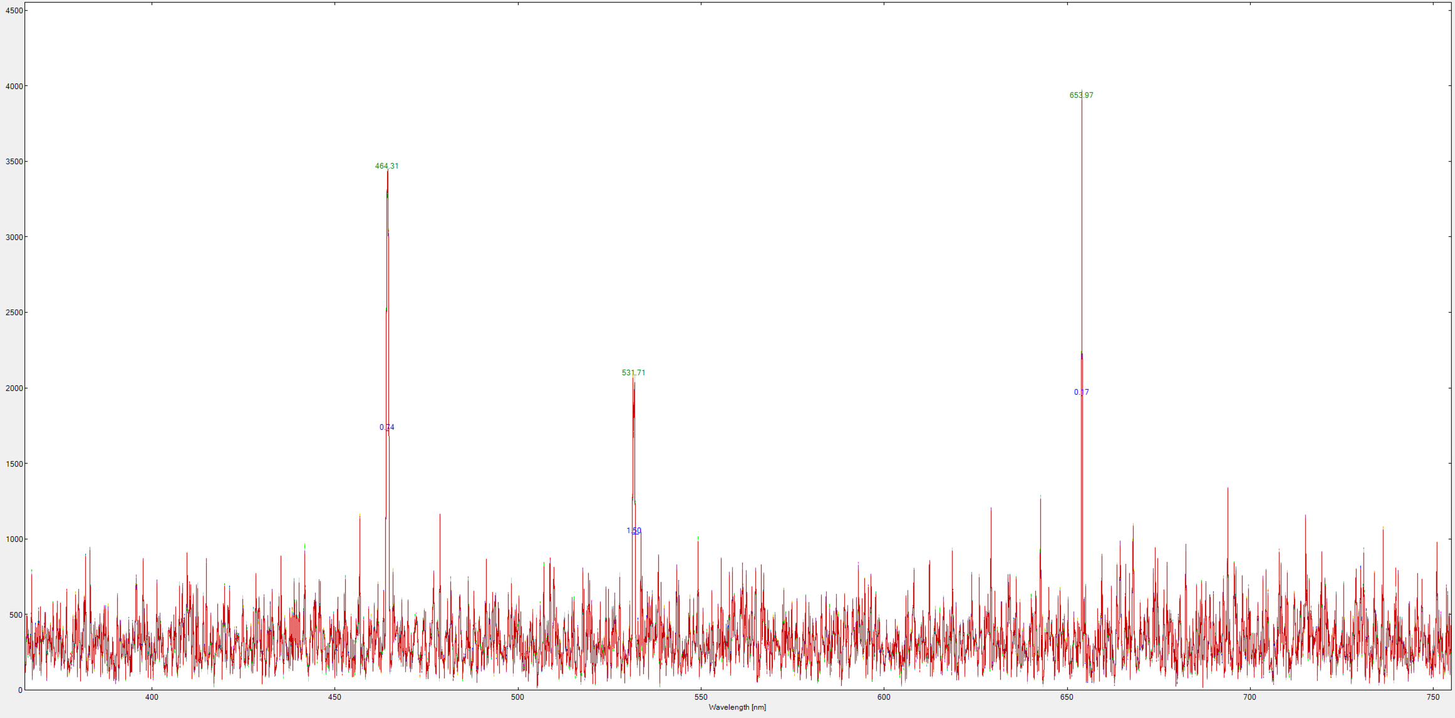
Systematics in data analysis
Set value of OPO idler
Read Signal output with spectrometer
Read Grating / Dyes with spectrometer
Read Grating / Dyes with wavemeters
After experiment finished
Signal
532nm
Idler
OPO: 355 nm
Signal
Careful calibration of OPO vs spectrometer vs wavemeter

Slide 10
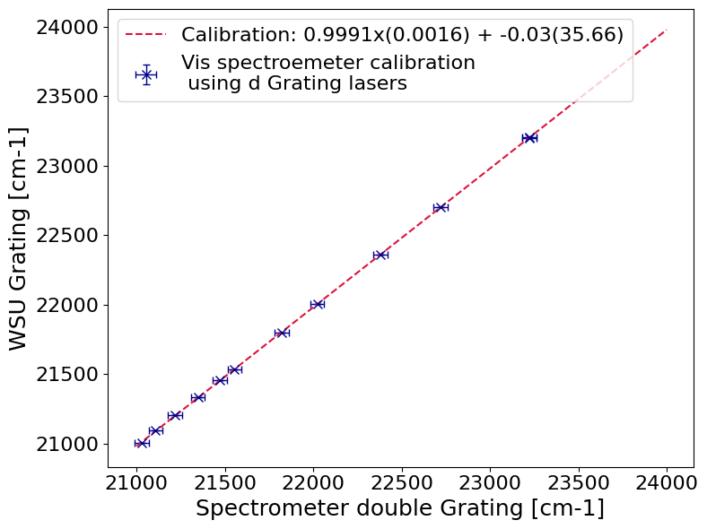
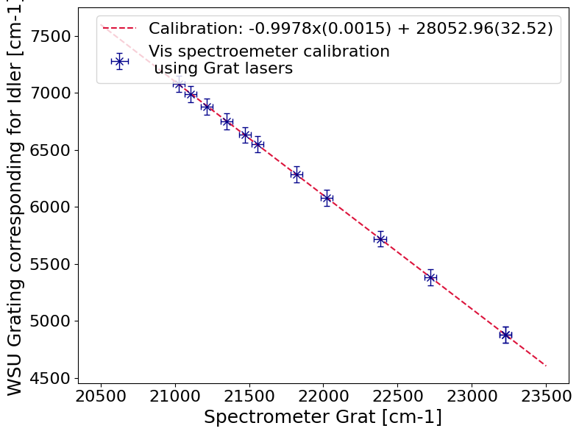
Calibration – step 1
Calibration of the spectrometer itself
Translation of Signal to Idler by calibration of 532 peak

Slide 11
Calibration – step 2
Calibrate OPO with spectrometer:

Slide 12
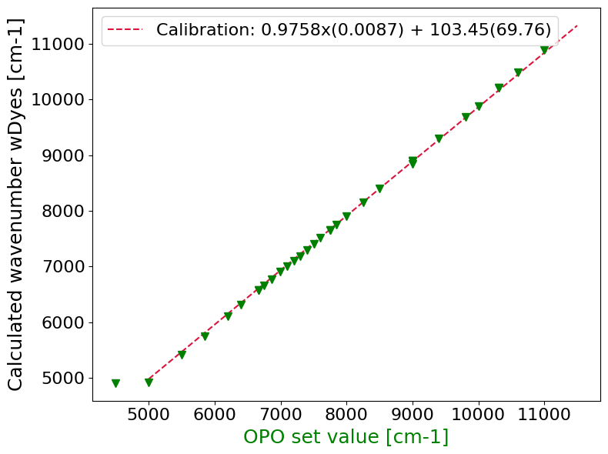

Calibration – step 3
Combine OPO and Spectrometer calibrations
Careful error propagation of every step needed – systematic offset for all measurements

Slide 13
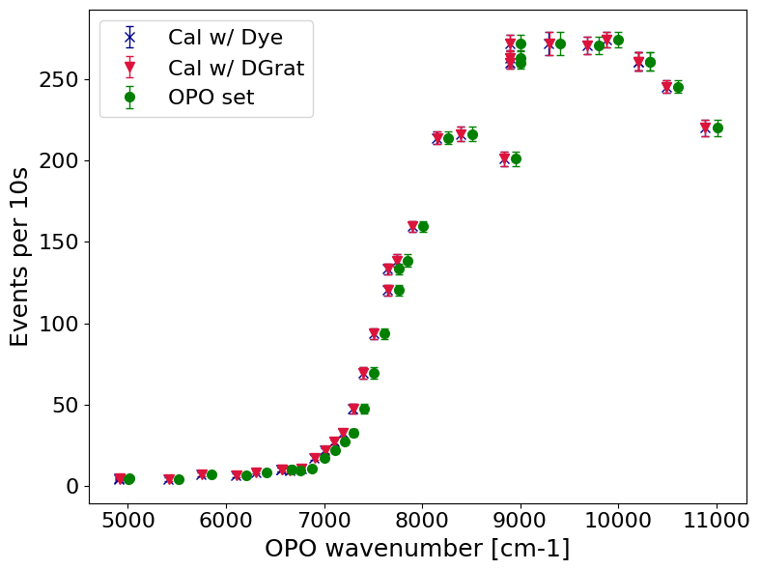
Calibration – step 3
Combine OPO and Spectrometer calibrations
Careful error propagation of every step needed – systematic offset for all measurements

Slide 14
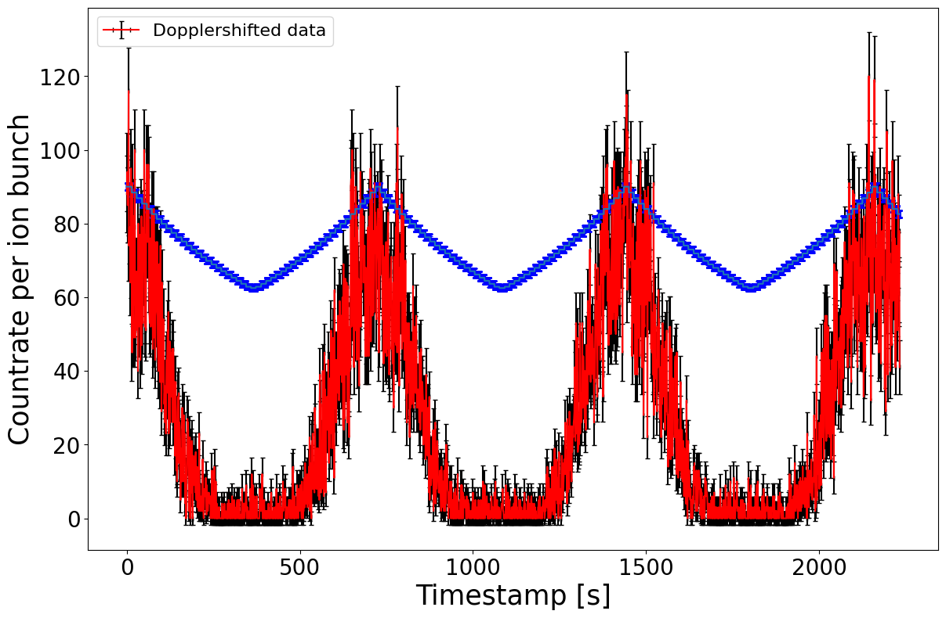
Data analysis
Two scans in total:
One automated laser scan (normal CRIS)
One “manual scan”: point by point
Online analysis

Slide 15
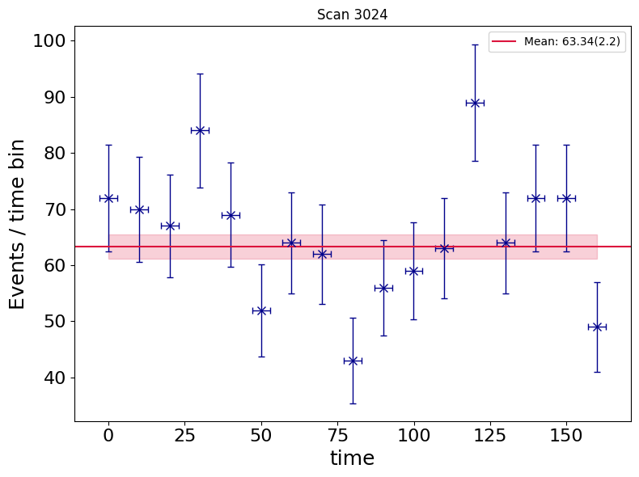
Data analysis
Typically in photodetachment studies
Record beam current of deflected negative ions
Normalize count rate by beam charge integral
Current not sufficient for beam monitoring:
Instead binning of count rate over time to account for fluctuations
Weighted mean and error instead of just bare count rate

Slide 16
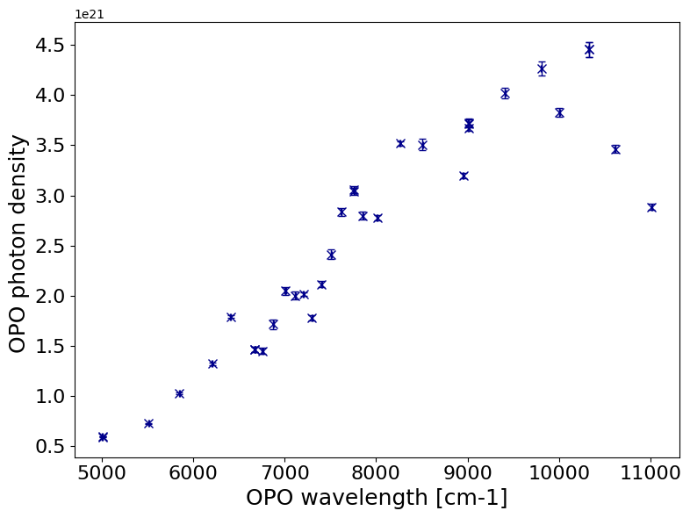
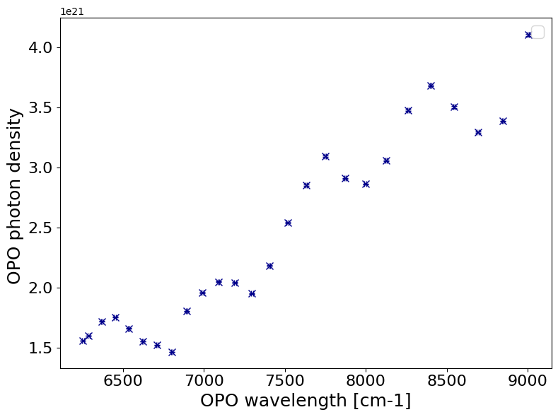
Data analysis – power behavior
manual scan
automated laser scan
How to consider power fluctuations:
Either normalize count rate by photon density
Convolute Wigner with power response function

Slide 17
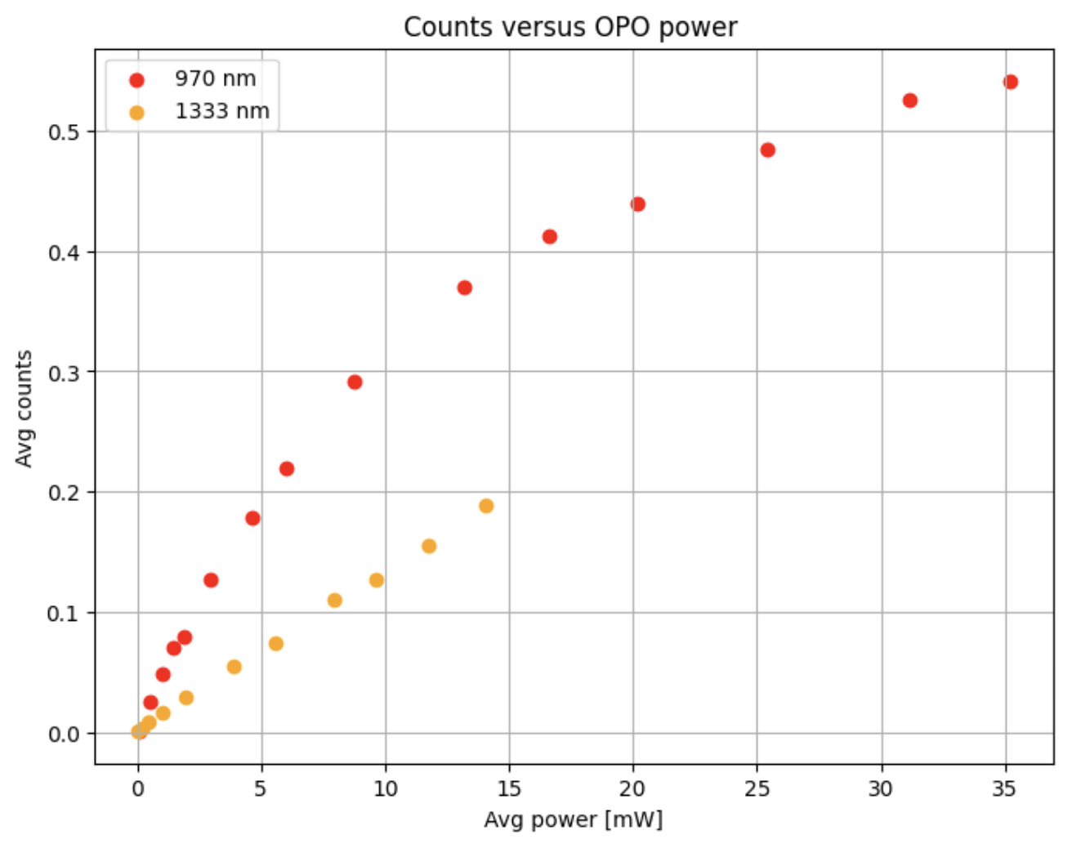
Data analysis – power behavior
manual scan
automated laser scan
How to consider power fluctuations:
Either normalize count rate by photon density
Convolute Wigner with power response function

Slide 18
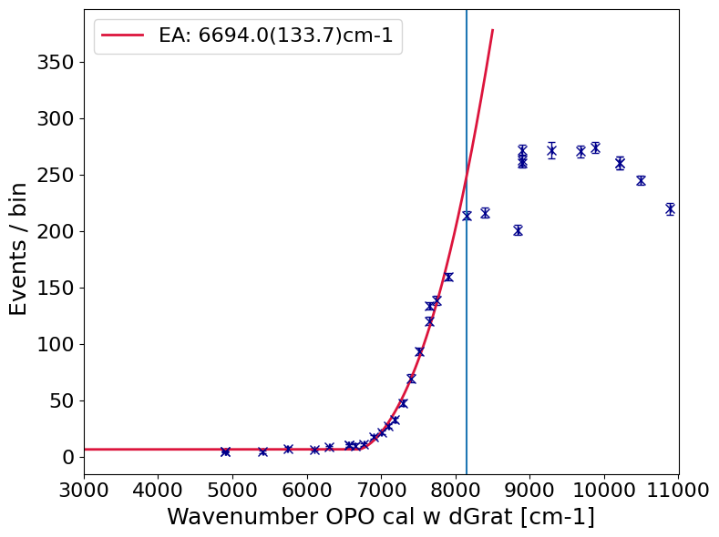
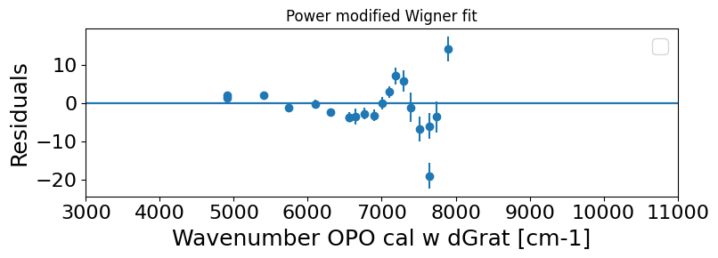

Data analysis – manual scan
No correction for photon density
$$σ_{Wigner}=a+b∙{(E−EA)}^{l+1/2}$$
$$σ_{ModWigner}=a+poly(E, p1, p2, p3, …)∙b∙{(E−EA)}^{l+1/2}$$

Slide 19
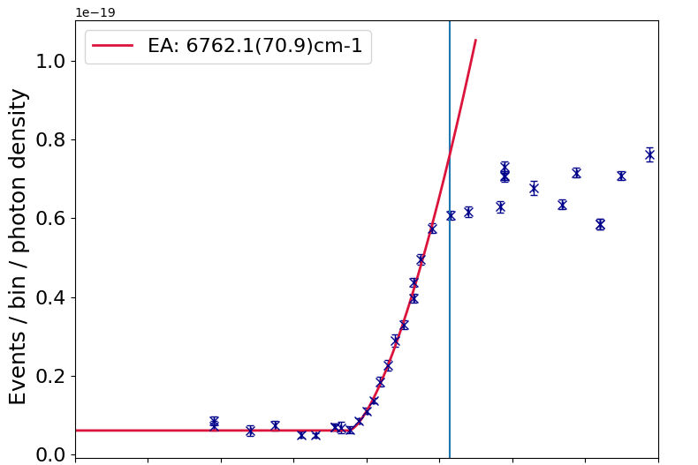
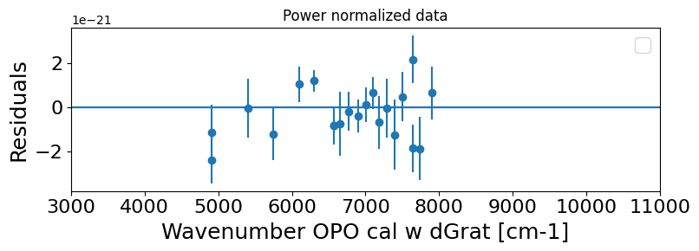
Data analysis – manual scan
No correction for photon density
Wigner modified by power response
Data normalized to photon density
$$σ_{Wigner}$$
$$σ_{ModWigner}$$
$$σ_{Wigner}$$

Slide 20
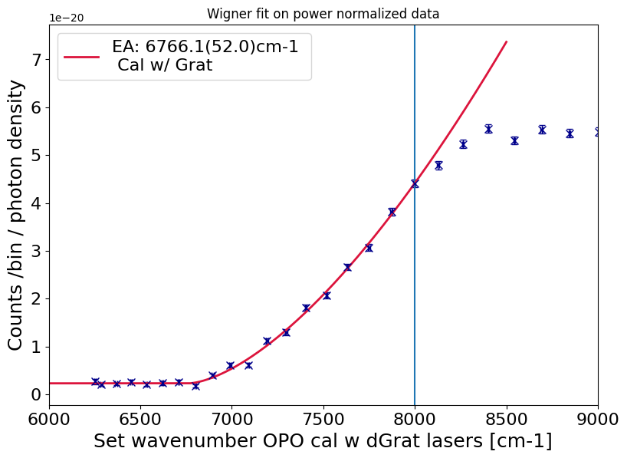
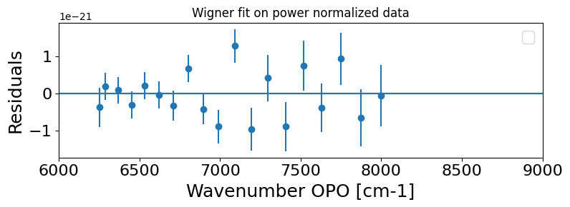
Data analysis
Data normalized to photon density
manual scan
automated laser scan

Slide 21
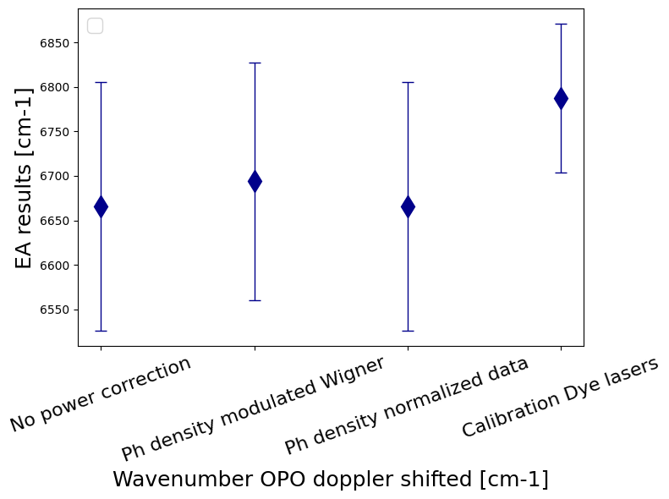
Comparison of results
Results for only automated scan:
Pretty independent from treatment of power response
Linear in ROI, so not much effect
Only statistical errors from fit

Slide 22
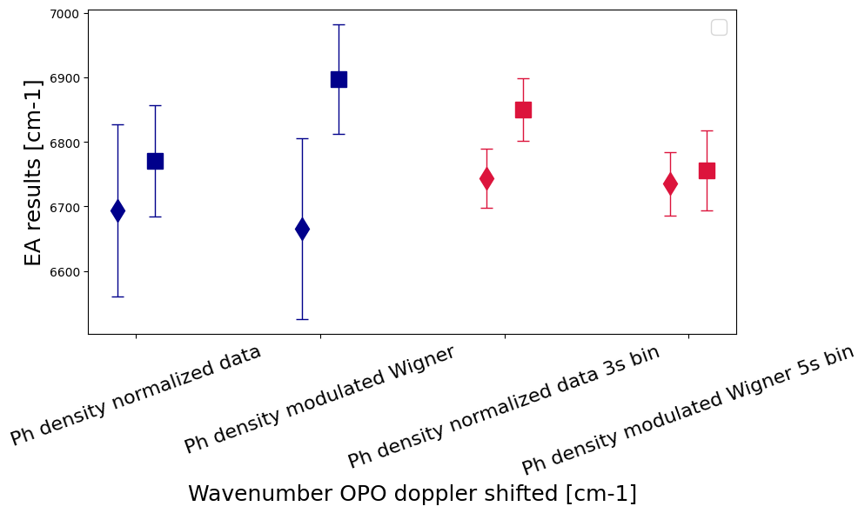
Comparison of results
Results for only automated scan:
Pretty independent from treatment of power response
Linear in ROI, so not much effect
Only statistical errors from fit
Automated scan
Derick [62]
Manual scan
Jessica [70]

Slide 23
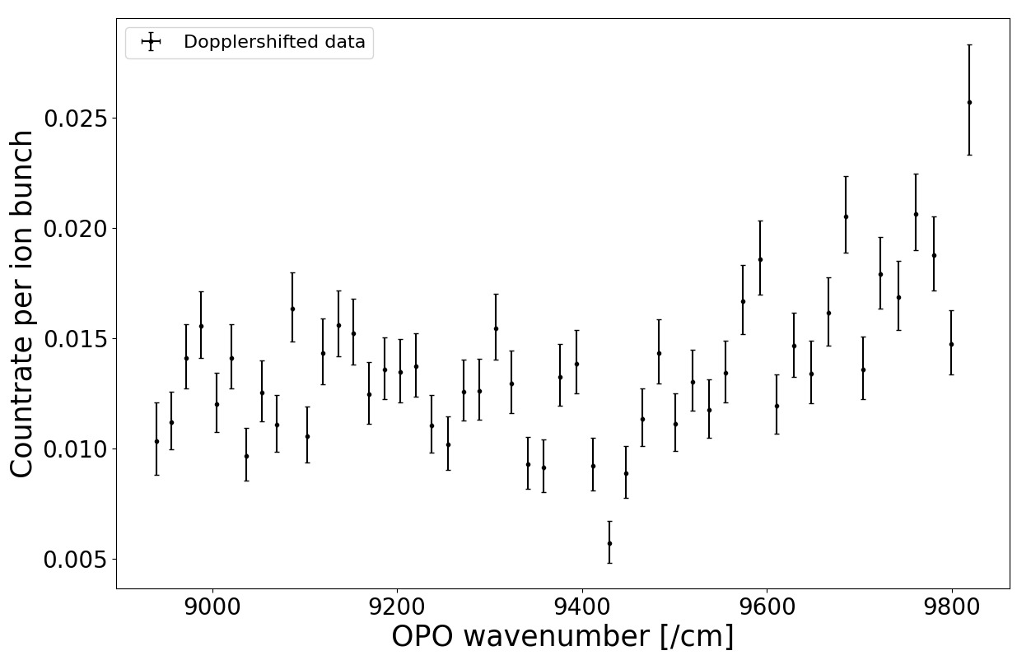
Confirmation of measurements?
Confirmation of results with known EA of a molecule ?
Electron affinity of UO₂⁻ known: 1.16 eV: 9356 cm⁻¹
J. Czekner et al., J. Chem. Phys. 141(24), 244302 (2014).
Two round trip sweeps
Loosing beam while measuring, initial sweep more pronounced
First look: agreement with literature within uncertainties to be considered
Maybe U0₂⁻ data from Po⁻?
UO₂⁻
Thanks to Bram

Slide 24
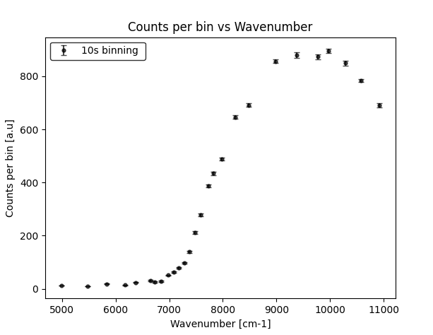

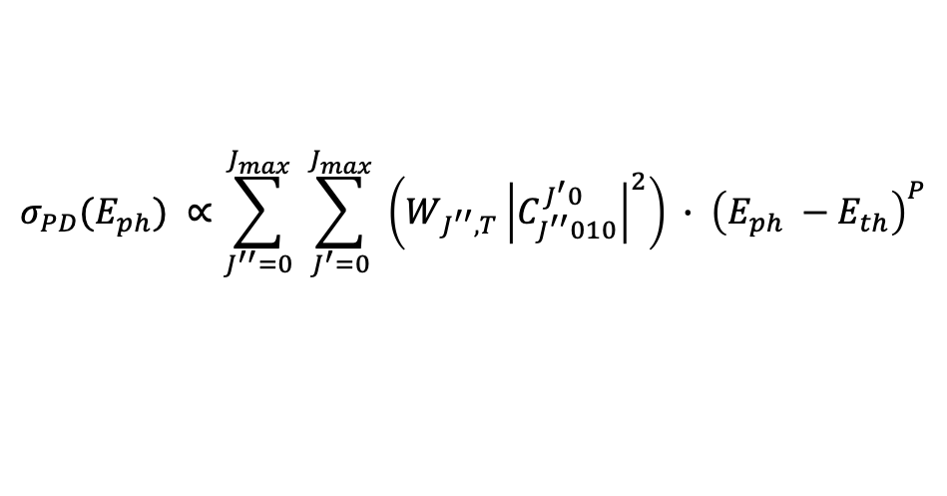
Effects of excited states
Rotational levels model
Seen threshold $≠$ electron affinity
$$σ_{PD}(E_{ph}) ∝\sum_{J^{′′}=0}^{J_{max}}{ \sum_{J^{′}=0}^{J_{max}}{ \left(W_{J^{′′},T}{\left|C_{J^{′′}010}^{J^{′}0}\right|}^{2}\right) ∙ {\left(E_{ph} −E_{th}\right)}^{P}}}$$
Rotational structure
Modified Wigner’s law
(P is non-integer)
where $E_{th}=EA −\left(B^{′′}∙J^{′′}\left(J^{′′}+1\right)\right)+ \left({B^{′}∙J}^{′}\left(J^{′}+1\right)\right)$
Was used for CN- at 16 K in a trap
Need to adapt it to our setup (add vibrations, etc.)
Photodetachment from excited vibrational/rotational states
M. Simpson et al., J. Chem. Phys. 153, 184309 (2020).

Slide 25
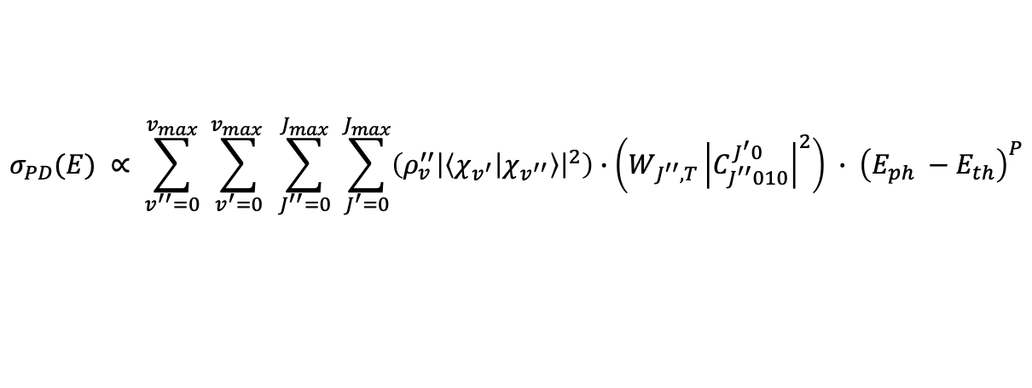
Adding vibrational states
Molecule dipole moment mixes different partial waves
(P non-interger)
$$σ_{PD}(E) ∝ \sum_{v^{′′}=0}^{v_{max}}{ \sum_{v^{′}=0}^{v_{max} }{ \sum_{J^{′′}=0}^{J_{max}}{ \sum_{J^{′}=0}^{J_{max}}{\left(ρ_{v}^{′′}{\left|\left\langle χ_{v^{′}} | χ_{v^{′′}}\right\rangle \right|}^{2}\right)∙\left(W_{J^{′′},T}{\left|C_{J^{′′}010}^{J^{′}0}\right|}^{2}\right) ∙ {\left(E_{ph} −E_{th}\right)}^{P}}}}}$$
Vibrational structure
Rotational structure
Modified Wigner’s law
where $E_{th}=EA −\left(ω^{′′}\left(v^{′′}+\frac{1}{2}\right)+B^{′′}∙J^{′′}\left(J^{′′}+1\right)\right)+ \left(ω^{′}\left(v^{′}+\frac{1}{2}\right)+{B^{′}∙J}^{′}\left(J^{′}+1\right)\right)$
Anion rotational and vibrational energies
Neutral rotational and vibrational energies

Slide 26
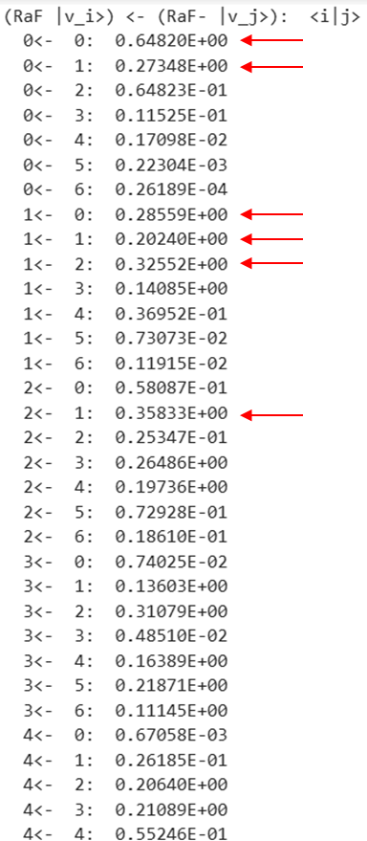



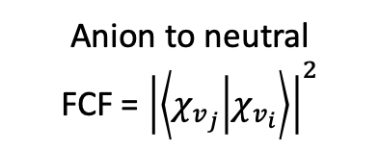
Adding vibrational states
Molecule dipole moment mixes different partial waves
(P non-interger)
Anion to neutral
FCF = ${\left|\left\langle χ_{v_{j}} | χ_{v_{i}}\right\rangle \right|}^{2}$
$$σ_{PD}(E) ∝ \sum_{v^{′′}=0}^{v_{max}}{ \sum_{v^{′}=0}^{v_{max} }{ \sum_{J^{′′}=0}^{J_{max}}{ \sum_{J^{′}=0}^{J_{max}}{\left(ρ_{v}^{′′}{\left|\left\langle χ_{v^{′}} | χ_{v^{′′}}\right\rangle \right|}^{2}\right)∙\left(W_{J^{′′},T}{\left|C_{J^{′′}010}^{J^{′}0}\right|}^{2}\right) ∙ {\left(E_{ph} −E_{th}\right)}^{P}}}}}$$
Molecular constants:
Vibrational structure
Rotational structure
Modified Wigner’s law
$$ω^{′′}=383 \left(35\right) cm^{−1}$$
$$B_{v=0}^{′′}=0.181 \left(9\right) cm^{−1}$$
$$B_{v=1}^{′′}=0.180 \left(9\right) cm^{−1}$$
where $E_{th}=EA −\left(ω^{′′}\left(v^{′′}+\frac{1}{2}\right)+B^{′′}∙J^{′′}\left(J^{′′}+1\right)\right)+ \left(ω^{′}\left(v^{′}+\frac{1}{2}\right)+{B^{′}∙J}^{′}\left(J^{′}+1\right)\right)$
Anion rotational and vibrational energies
Neutral rotational and vibrational energies
Values thanks to Konstantin Gaul

Slide 27

Adding vibrational states
Molecule dipole moment mixes different partial waves
(P non-interger)
Anion to neutral
FCF = ${\left|\left\langle χ_{v_{j}} | χ_{v_{i}}\right\rangle \right|}^{2}$
Different models for $ρ_{v}^{′′}$
$$σ_{PD}(E) ∝ \sum_{v^{′′}=0}^{v_{max}}{ \sum_{v^{′}=0}^{v_{max} }{ \sum_{J^{′′}=0}^{J_{max}}{ \sum_{J^{′}=0}^{J_{max}}{\left(ρ_{v}^{′′}{\left|\left\langle χ_{v^{′}} | χ_{v^{′′}}\right\rangle \right|}^{2}\right)∙\left(W_{J^{′′},T}{\left|C_{J^{′′}010}^{J^{′}0}\right|}^{2}\right) ∙ {\left(E_{ph} −E_{th}\right)}^{P}}}}}$$
Molecular constants:
Vibrational structure
Rotational structure
Modified Wigner’s law
$$ω^{′′}=383 \left(35\right) cm^{−1}$$
$$B_{v=0}^{′′}=0.181 \left(9\right) cm^{−1}$$
$$B_{v=1}^{′′}=0.180 \left(9\right) cm^{−1}$$
where $E_{th}=EA −\left(ω^{′′}\left(v^{′′}+\frac{1}{2}\right)+B^{′′}∙J^{′′}\left(J^{′′}+1\right)\right)+ \left(ω^{′}\left(v^{′}+\frac{1}{2}\right)+{B^{′}∙J}^{′}\left(J^{′}+1\right)\right)$
Anion rotational and vibrational energies
Neutral rotational and vibrational energies
Values thanks to Konstantin Gaul

Slide 28
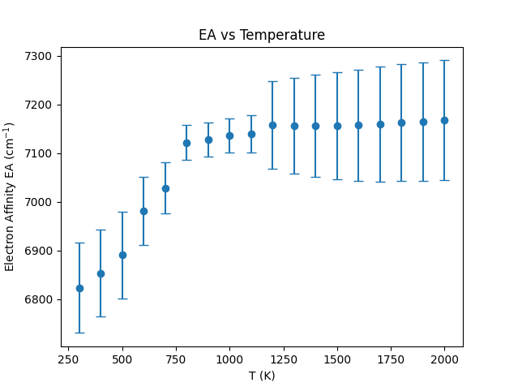
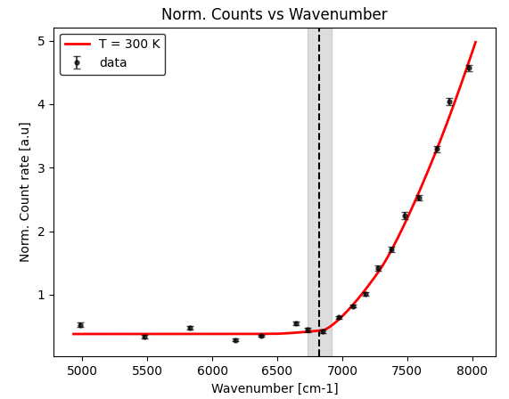

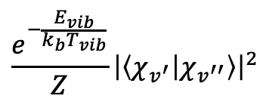


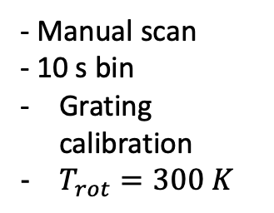
Assuming vibrational thermalization
$$\frac{e^{−\frac{E_{vib}}{k_{b}T_{vib}}}}{Z}{\left|\left\langle χ_{v^{′}} | χ_{v^{′′}}\right\rangle \right|}^{2}$$
To obtain a systematic error
$$ρ_{v}^{′′}{\left|\left\langle χ_{v^{′}} | χ_{v^{′′}}\right\rangle \right|}^{2}$$
Temperature for vibrations is unclear: Could range from 300 K to 2000 K
- Manual scan
- 10 s bin
Grating calibration
$T_{rot}=300 K$
$$EA=6824 \left(93\right)cm^{−1}$$
$$EA=6824 \left(93\right) \left[344\right] cm^{−1}$$
Looking into a non-thermal model

Slide 29
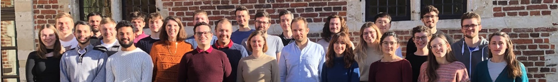








Acknowledgments
CRIS collaboration

Slide 30
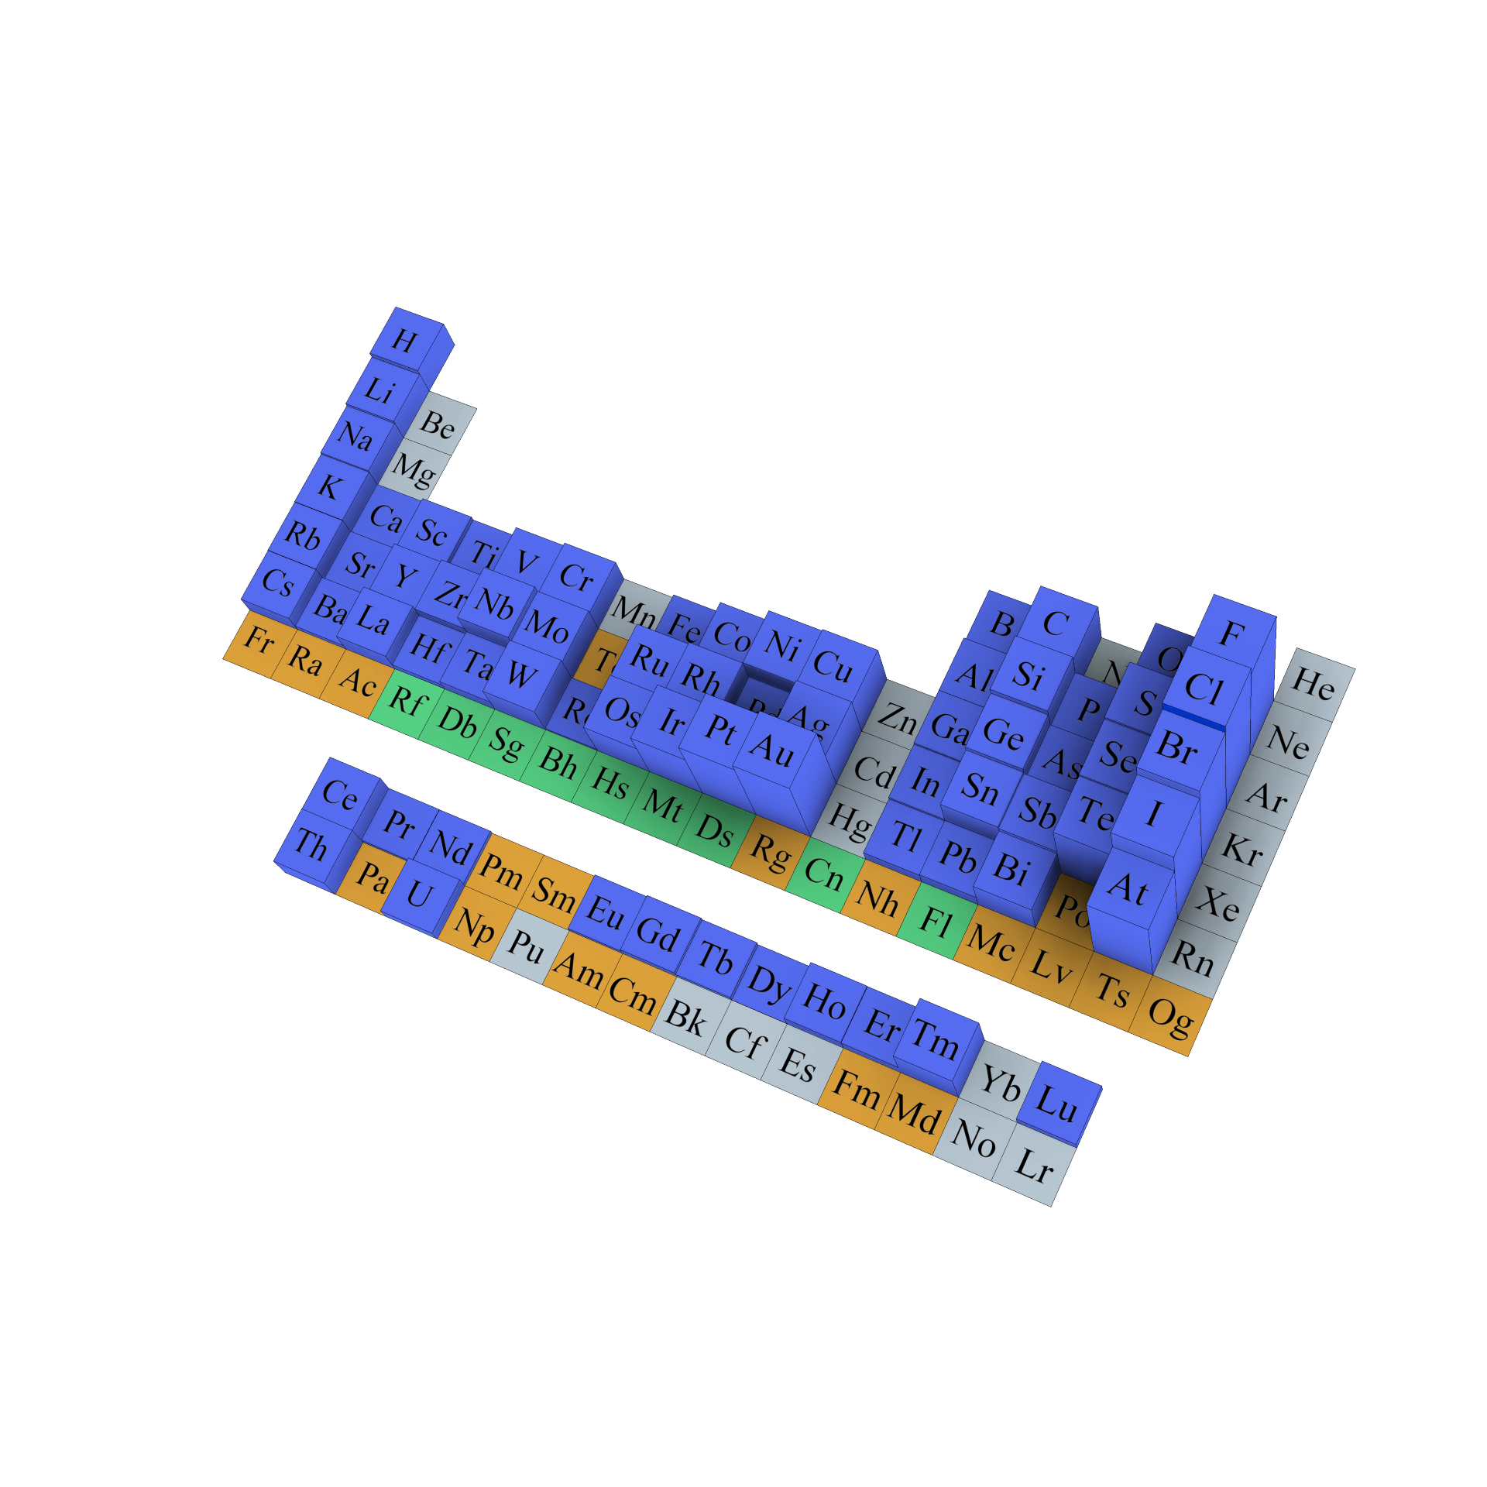
New opportunities with negative ions
Photodetachment studies for several elements outstanding:
EA unknown for (almost all) radioactive species
Atomic negative ion studies after double-charge exchange in CRIS -> reduces ISOLDE to negative trouble
Photodetachment studies in molecular negative ions for astrophysical insight
Candidates for laser cooling

Slide 31
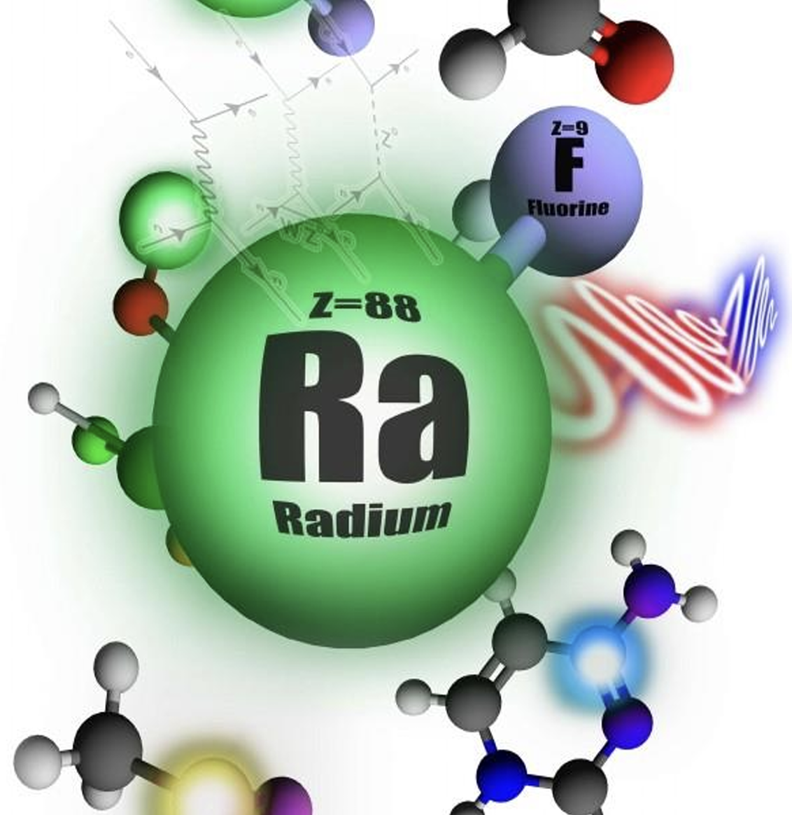

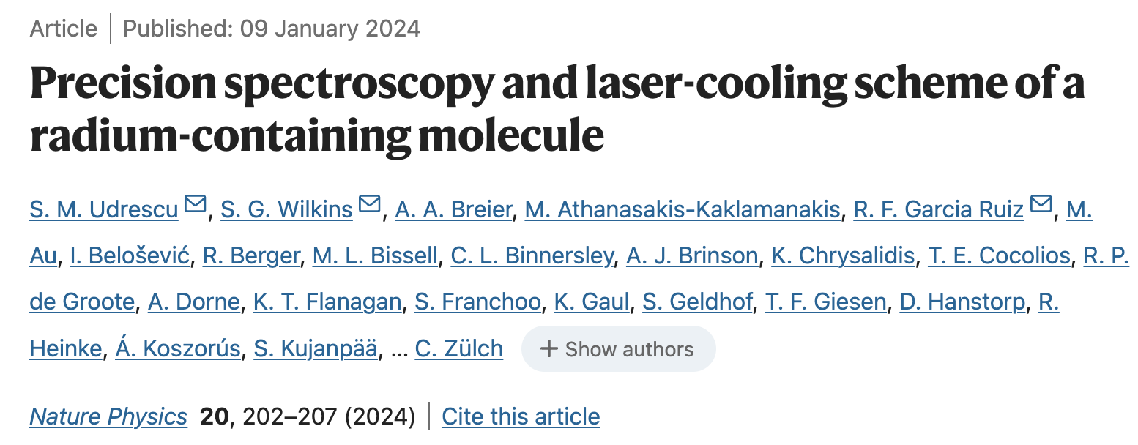

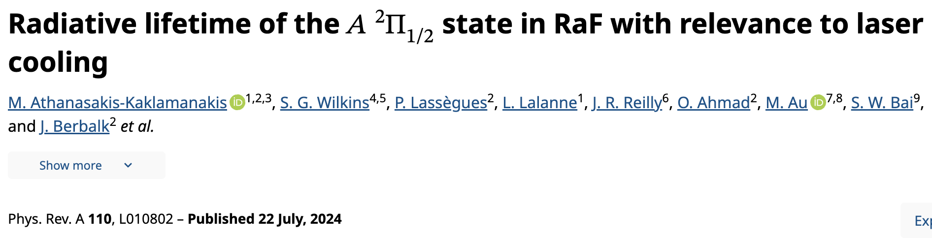
The RaF journey at CRIS
Electron correlations in RaF via spectroscopy of excited states
Ionization potential of radium monofluoride
arxiv.org/abs/2408.14673
arxiv.org/abs/2308.14862
accepted in Nature Comm (2023)
$${\hat{H}}^{RaF}={\hat{H}}_{el}+{\hat{H}}_{vib}+{\hat{H}}_{rot}+{\hat{H}}_{hfs}+…+{\hat{H}}_{P,T}$$
?
Magnetic dipole interaction
arXiv:2311.04121, submitted (2023)
Electric quadrupole interaction
In preparation
Notes:
The Hamiltonian of RaF:

Slide 32
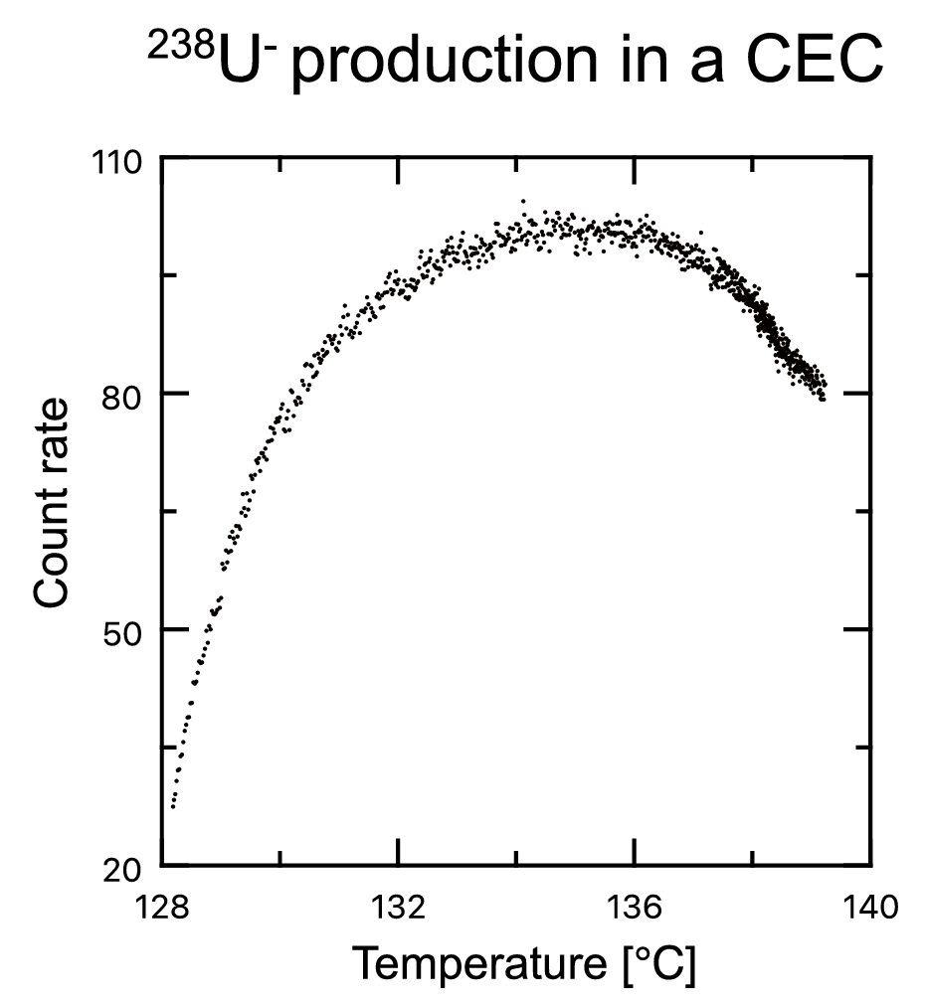
Study of RaF− anions at CRIS
A⁺
A*
Charge exchange for neutralisation
A
Double charge exchange
A⁻
K. Gaul et al., arXiv preprint arXiv:2403.09320 (2024).
M. Nichols et al., Nucl. Instrum. Meth. B 541, 264-267 (2023).

Slide 33
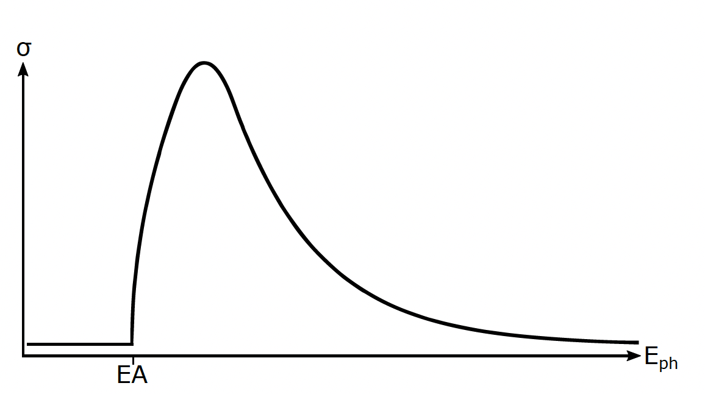
Laser photodetachment of RaF− anions
A⁺
A*
Observe laser photodetachment
Electron affinity (EA):
Onset in detachment cross section
A
CRIS OPO laser
OPO
A⁻

Slide 34
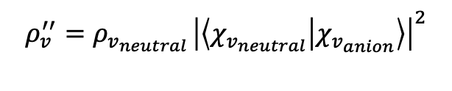

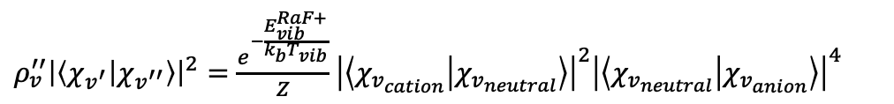
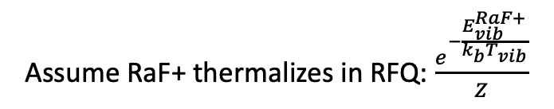

Assuming no thermalization
Assume that the vibrational FCF dominate the vibrational population after the CEC from RaF to RaF-
$$ρ_{v}^{′′}{\left|\left\langle χ_{v_{neutral}} | χ_{v_{anion}}\right\rangle \right|}^{2}$$
$ρ_{v}^{′′}{\left|\left\langle χ_{v^{′}} | χ_{v^{′′}}\right\rangle \right|}^{2}=\frac{e^{−\frac{E_{vib}^{RaF+}}{k_{b}T_{vib}}}}{Z}$ ${\left|\left\langle χ_{v_{cation}} | χ_{v_{neutral}}\right\rangle \right|}^{2}{\left|\left\langle χ_{v_{neutral}} | χ_{v_{anion}}\right\rangle \right|}^{4}$
$$ρ_{v}^{′′}=ρ_{v_{neutral }}{\left|\left\langle χ_{v_{neutral}} | χ_{v_{anion}}\right\rangle \right|}^{2}$$
$$ρ_{v_{neutral }} =ρ_{v_{cation}}{\left|\left\langle χ_{v_{cation}} | χ_{v_{neutral}}\right\rangle \right|}^{2}$$
Assume RaF+ thermalizes in RFQ: $\frac{e^{−\frac{E_{vib}^{RaF+}}{k_{b}T_{vib}}}}{Z}$

