Slide 1

Molecules as probes of nuclear structure: laser spectroscopy of 223RaF
February 2026
Carlos M. Fajardo-Zambrano.
Supervisor: Prof. Dr. Gerda Neyens.
Co-supervisor: Dr. Michail Athanasakis-Kaklamanakis

Slide 2
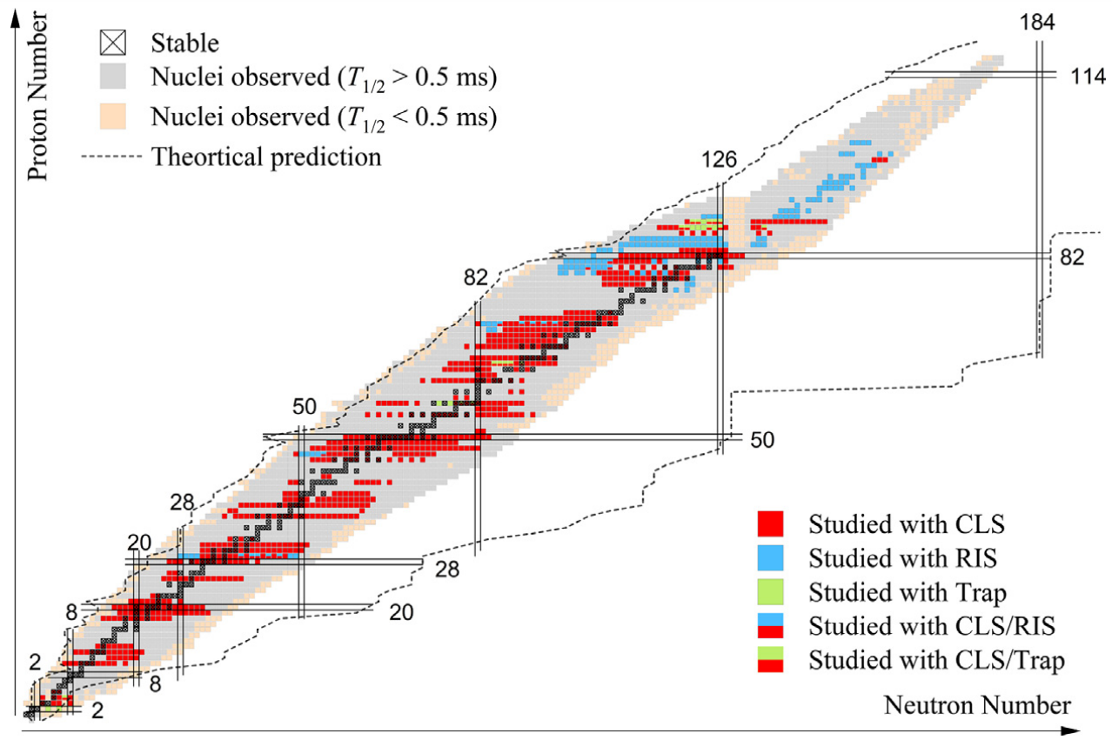
Isotopes studies with laser spectroscopy up to (Oct 2022)
More than one thousand isotopes and isomers have been measured using laser spectroscopy techniques.
Despite this, several regions of the nuclear chart have not yet been measured ➔ limited by production and sensitivity to nuclear observables.
[1] Yang, X. F., Wang, S. J., Wilkins, S. G., & Ruiz, R. G. (2023). Laser spectroscopy for the study of exotic nuclei. Progress in Particle and Nuclear Physics, 129, 104005.

Slide 3
Molecular spectroscopy as an alternative (paper draft)
²²⁵RaF Science paper showed the extraction of the magnetic dipole moment and nuclear magnetization distribution in a short live radioactive molecule.
²²³RaF as the first measurement of the quadrupole moment in a short live radioactive molecule ➔ Paper focus on the extraction of nuclear electromagnetic properties using molecules.
Extension of the broadband ^{223,225,226}RaF isotope shift PRL paper to high resolution.
Outlook on elements with no laser accessible transitions in their atomic/ion form, highly reactive elements and elements with a poor sensitivity to the electric quadrupole moment
[2] Wilkins, S. G., et al (2025). Observation of the distribution of nuclear magnetization in a molecule. Science, 390(6771), 386-389.
[3] Udrescu, S. M., et al (2021). Isotope shifts of radium monofluoride molecules. Physical Review Letters, 127(3), 033001.

Slide 4

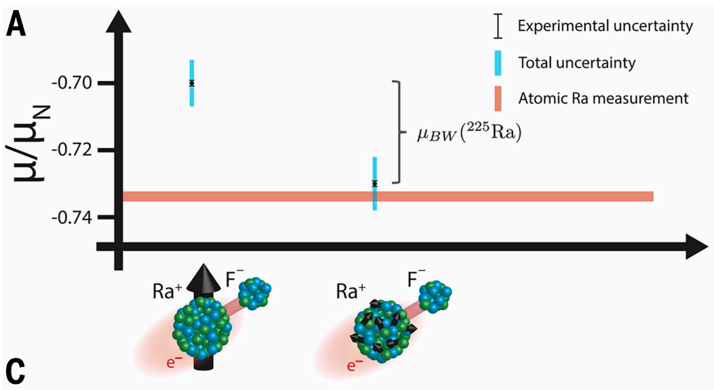

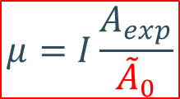
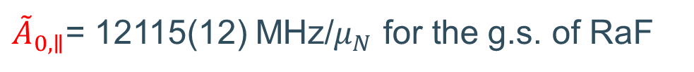
Magnetic moment assuming a point-like nucleus
$A_{exp}=A_{0}$
${\tilde{A}}_{0,∥}$= 12115(12) MHz/$μ_{N}$ for the g.s. of RaF
Private communication L. Stripnikov [4]
$$μ=I\frac{A_{exp}}{{\tilde{A}}_{0}}$$
➔ Point like magnetic moment is deduced from
Note: Error bar threaten as = stat + sys
For ²²⁵RaF (I=1/2): ➔ μ₀ = -0.7042(32) μ_{N} [2]
μ_{real}= -0.7338(15) μ_{N}
[4]
For ²²³RaF (I=3/2): ➔ μ₀ = +0.2598(7) μ_{N}
μ_{real}= 0.2703(19) μ_{N}
[4]
Real mu’s: from ABMR (for ^{223,25}Ra)
(this includes the finite magnetization distribution)
^{223,225}RaF are sensitive to nuclear finite magnetizations
[2] Wilkins, S. G., et al (2025). Observation of the distribution of nuclear magnetization in a molecule. Science, 390(6771), 386-389.
[4] Skripnikov, L. V. et al.(2020).. The Journal of Chemical Physics, 153(11).
[5] Arnold, E., et al. (1987). Direct measurement of nuclear magnetic moments of radium isotopes. Physical Review Letters, 59(7), 771.

Slide 5



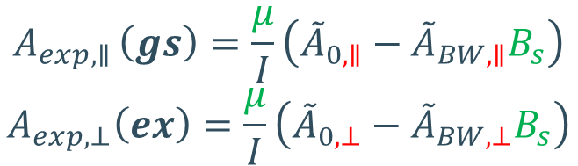

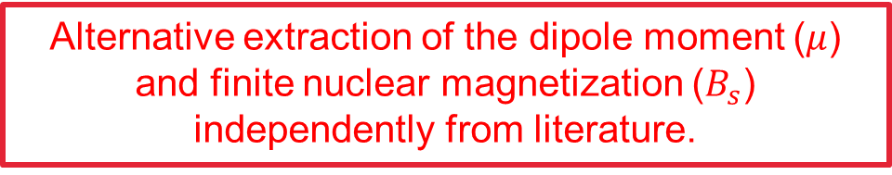
The real magnetic dipole moment from ²²³RaF
Considering the finite magnetization in the RaF molecule [4], the measured magnetic dipole coupling constant can be expressed as,
${\tilde{A}}_{0}$is similar to $B/J$in atoms
$$A_{BW}=\frac{μ}{I}{\tilde{A}}_{BW}B_{s}$$
$$A_{exp}=A_{0}−A_{BW}$$
$$A_{exp}=\frac{μ}{I}({\tilde{A}}_{0}−{\tilde{A}}_{BW}B_{s})$$
$$A_{0}=\frac{μ}{I}{\tilde{A}}_{0}$$
The parameters highlighted in red are defined only by the electronic wavefunction – calculated.
Those in green only depend on the nuclear wave function – our unknowns.
$$A_{exp,∥ }\left(gs\right)=\frac{μ}{I}\left({\tilde{A}}_{0,∥}−{\tilde{A}}_{BW,∥}B_{s}\right)$$
$$A_{exp,⊥}\left(ex\right)=\frac{μ}{I}\left({\tilde{A}}_{0,⊥}−{\tilde{A}}_{BW,⊥}B_{s}\right)$$
Alternative extraction of the dipole moment ($μ$) and finite nuclear magnetization ($B_{s}$) independently from literature.
Systems of 2 equations and 2 unknowns
[4] Skripnikov, L. V. (2020).. The Journal of Chemical Physics, 153(11).

Slide 6
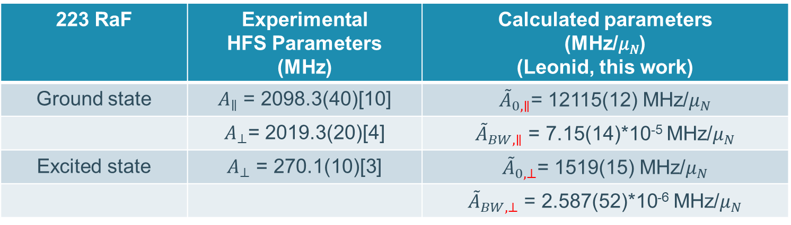
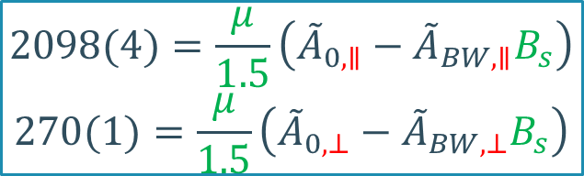
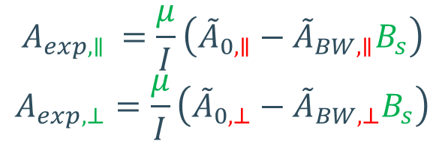
Hyperfine parameters in ²²³RaF (I=3/2)
The experimental magnetic dipole coupling constants for ²²³RaF are fitted from the HFS spectra. Calculated HFS parameters, along with the extracted hyperfine parameters (experimental and calculated) are also shown:
223 RaF | Experimental HFS Parameters (MHz) | Calculated parameters (MHz/𝜇_{𝑁}) (Leonid, this work)
Ground state | $A_{∥}$ = 2098.3(40)[10] | ${\tilde{A}}_{0,∥}$= 12115(12) MHz/$μ_{N}$
 | $A_{⊥}$= 2019.3(20)[4] | ${\tilde{A}}_{BW,∥}$ = 7.15(14)*10⁻⁵ MHz/$μ_{N}$
Excited state | $A_{⊥}$ = 270.1(10)[3] | ${\tilde{A}}_{0,⊥}$= 1519(15) MHz/$μ_{N}$
 |  | ${\tilde{A}}_{BW,⊥}$ = 2.587(52)*10⁻⁶ MHz/$μ_{N}$
$$A_{exp,∥ }=\frac{μ}{I}\left({\tilde{A}}_{0,∥}−{\tilde{A}}_{BW,∥}B_{s}\right)$$
$$A_{exp,⊥}=\frac{μ}{I}\left({\tilde{A}}_{0,⊥}−{\tilde{A}}_{BW,⊥}B_{s}\right)$$
$$2098(4)=\frac{μ}{1.5}\left({\tilde{A}}_{0,∥}−{\tilde{A}}_{BW,∥}B_{s}\right)$$
$$270(1)=\frac{μ}{1.5}\left({\tilde{A}}_{0,⊥}−{\tilde{A}}_{BW,⊥}B_{s}\right)$$

Slide 7
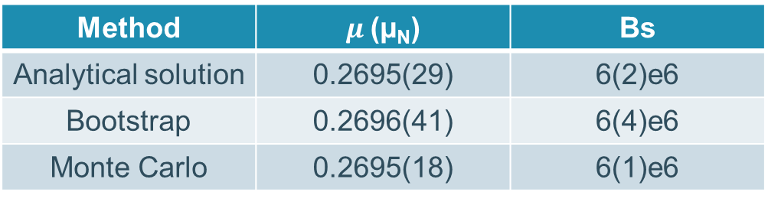
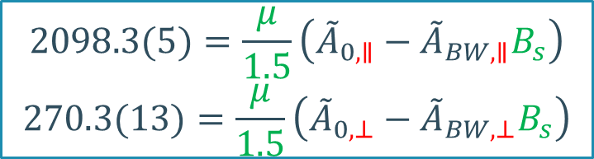
Extract magnetic dipole moment and B_{s} for ²²³RaF
By solving the set of equations using three different methods:
$$2098.3(5)=\frac{μ}{1.5}\left({\tilde{A}}_{0,∥}−{\tilde{A}}_{BW,∥}B_{s}\right)$$
$$270.3(13)=\frac{μ}{1.5}\left({\tilde{A}}_{0,⊥}−{\tilde{A}}_{BW,⊥}B_{s}\right)$$
Method | $μ$(µ_{N}) | Bs
Analytical solution | 0.2695(29) | 6(2)e6
Bootstrap | 0.2696(41) | 6(4)e6
Monte Carlo | 0.2695(18) | 6(1)e6
Note: Dominated by statistical error bar [Systematic error bars added as
Error = stat + sys]
μ_{literature}= 0.2703(7) μ_{N} [5]
Excellent agreement between molecules and atoms/ions!
Literature value is relative to µ(²²⁵Ra), measure with ABMR (without hyperfine anomaly)
The hyperfine anomaly between ²²³Ra and ²²⁵Ra is negligible!
[5] Lynch, K. M., et al. (2018). Laser-spectroscopy studies of the nuclear structure of neutron-rich radium. Physical Review C, 97(2), 024309.

Slide 8
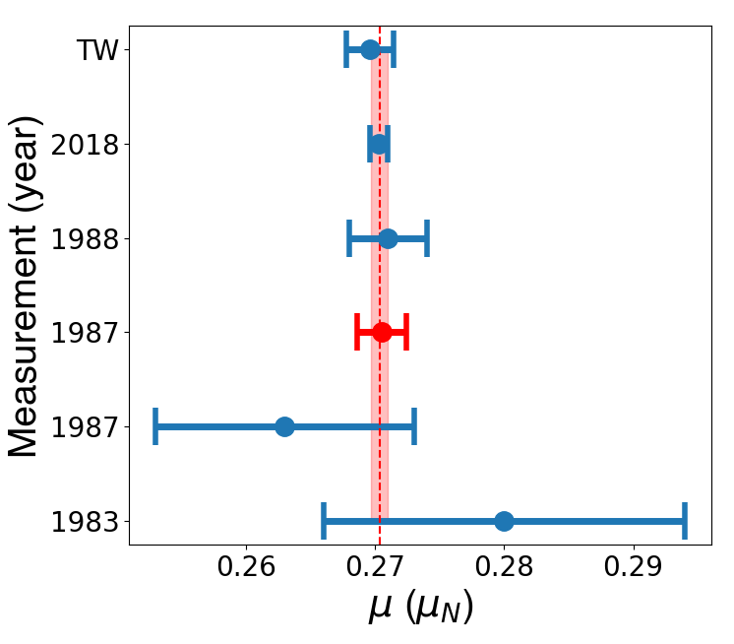
²²³Ra magnetic dipole moment in literature
Excellent agreement between the magnetic dipole moment retrieved using atomic, ionic and molecular measurements on ²²³Ra.
[1] Ahmad, S. A., et al. (1983) Physics Letters B, 133(1-2), 47-52.(Atom and Ion)
[2] Wendt, K. et al. (1987) Atoms, Molecules and Clusters, 4, 227-241. (Atom and Ion)
[3] Arnold, E., et al. (1987) PRL, 59(7), 771. (Ion ABMR)
[4] Neu, W., et al. (1988) D Atoms, Molecules and Clusters, 11, 105-111. (Ion)
[5] Lynch, K. M et al. (2018) Physical Review C, 97(2), 024309. (Atom)
[6] Bieroń, J., & Pyykkö, (2005) P. Physical Review A—Atomic, Molecular, and Optical Physics, 71(3), 032502. (EFG re-evaluation)
TW ➔ This work (Molecule)
Value in red is the ABMR measurement (µ_{real})

Slide 9
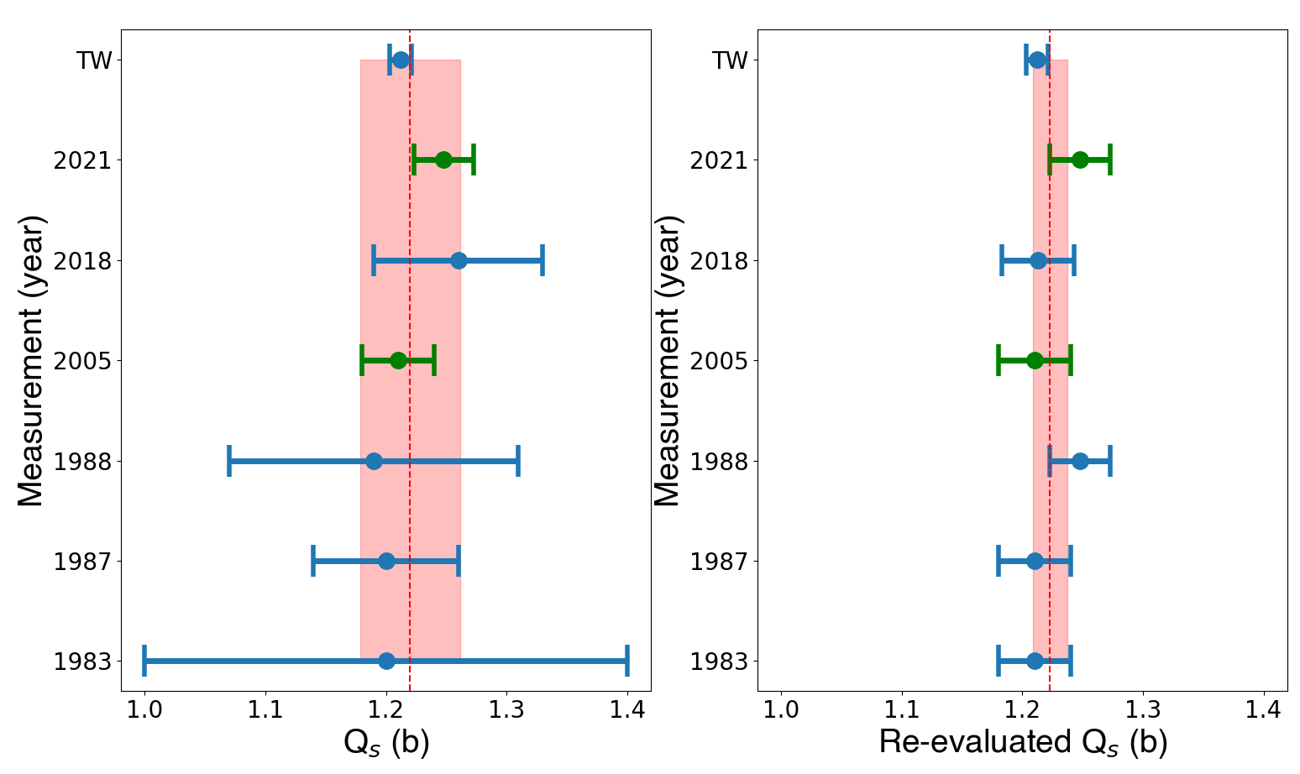
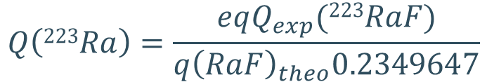
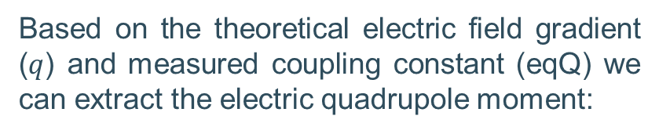
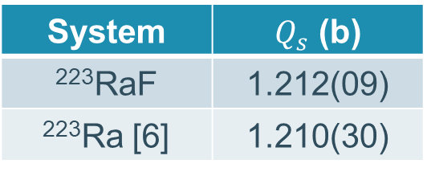
Electric quadrupole moment in ²²³RaF
Based on the theoretical electric field gradient ($q$) and measured coupling constant (eqQ) we can extract the electric quadrupole moment:
$$Q\left(223Ra\right)=\frac{eqQ_{exp}(223RaF)}{q{\left(RaF\right)}_{theo}0.2349647}$$
New theoretical estimation have reduced the uncertainty by a factor of 3 ➔ Can be used to re-evaluate other Ra isotopes
System | $Q_{s}$ (b)
²²³RaF | 1.212(09)
²²³Ra [6] | 1.210(30)
Values in green are re-evaluations of the EFG on the atom (2005) and ion (2021)
[5] Lynch, K. M., (2018). Laser-spectroscopy studies of the nuclear structure of neutron-rich radium. Physical Review C, 97(2), 024309.
[6] Bieroń, J., & Pyykkö, P. (2005). Physical Review A—Atomic, Molecular, and Optical Physics, 71(3), 032502.

Slide 10
²²³Ra electric quadrupole moment in literature
Excellent agreement between atomic, ionic and molecular measurements on ²²³Ra.
[1] Ahmad, S. A., et al. (1983) Physics Letters B, 133(1-2), 47-52. (Atom) Taken from the ratio with ²²⁹Ra, which moment is extrapolated from ²²⁶Ra and ²²⁸Ra Coulomb excitation B(E2) transitions.
[2] Wendt, K. et al. (1987) Atoms, Molecules and Clusters, 4, 227-241. (Atom)
[3] Neu, W., et al. (1988) D Atoms, Molecules and Clusters, 11, 105-111. (Ion)
[4] Bieroń, J., & Pyykkö, (2005) P. Physical Review A—Atomic, Molecular, and Optical Physics, 71(3), 032502. (EFG atom)
[5] Lynch, K. M et al. (2018) Physical Review C, 97(2), 024309. (Atom)
[6] Li, F. C., et al (2021). Journal of Physics B: Atomic, Molecular and Optical Physics, 54(14), 145004. (EFG ion)
TW ➔ This work (Molecule)
Values in green are re-evaluations of the EFG on the atom (2005) and ion (2021)

Slide 11
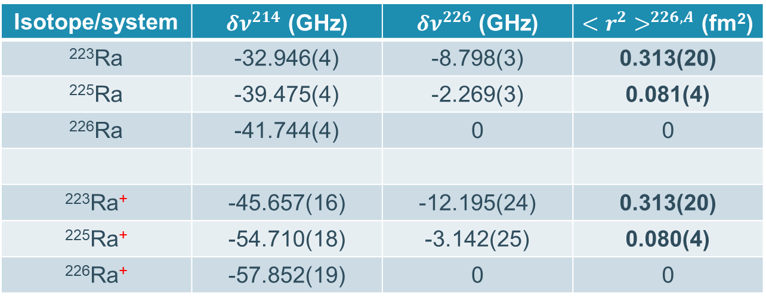
Change in charge radii
The charge radii in Ra isotopes have been extracted both in Ra and Ra⁺. The reference isotope is ²¹⁴Ra.
To make ²²⁶Ra the reference isotope, the isotope shift between ^{223,225,226}Ra was subtracted and the change in charge radii was calculated using the literature F and M factor from both the atomic (714nm transition) and ionic (468nm transition) data.
Isotope/system | $δν^{214}$ (GHz) | $δν^{226}$ (GHz) | $<r^{2}>^{226,A}$ (fm²)
²²³Ra | -32.946(4) | -8.798(3) | 0.313(20)
²²⁵Ra | -39.475(4) | -2.269(3) | 0.081(4)
²²⁶Ra | -41.744(4) | 0 | 0
²²³Ra⁺ | -45.657(16) | -12.195(24) | 0.313(20)
²²⁵Ra⁺ | -54.710(18) | -3.142(25) | 0.080(4)
²²⁶Ra⁺ | -57.852(19) | 0 | 0
F = -28.75(144) GHz
M= -305(177)GHz
F = -39.81(199) GHz
M= -990(351)GHz
[5] Lynch, K. M., (2018). Laser-spectroscopy studies of the nuclear structure of neutron-rich radium. Physical Review C, 97(2), 024309.
[7] Wansbeek, L. W., (2012). Charge radii of radium isotopes. Physical Review C—Nuclear Physics, 86(1), 015503.

Slide 12
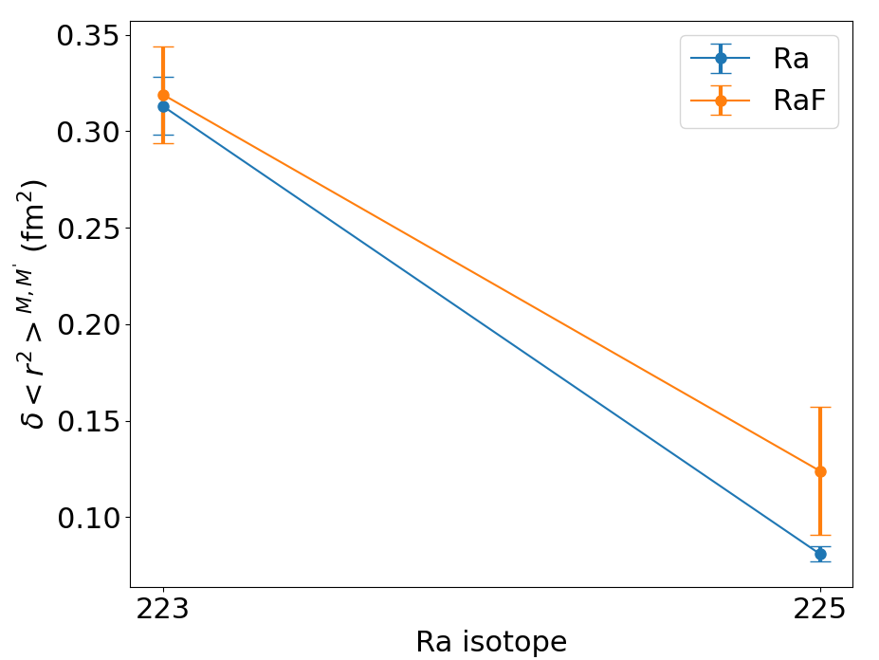
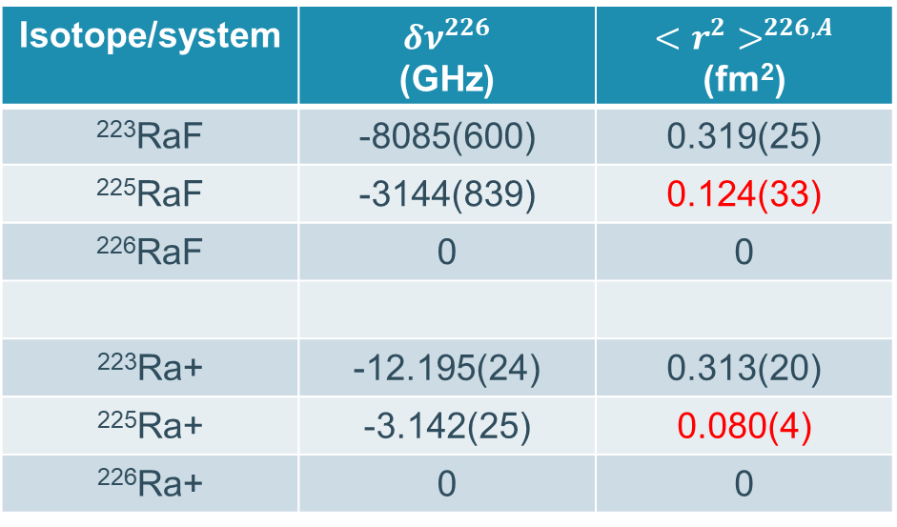
Change in charge radii
Using the total energy of the $A {2Π}_{1/2}←X 2Σ_{1/2}$ transition, and the F and M factors from the broad band isotope shift RaF paper, we can extract the change in charge radii in ^{223,225,226}RaF.
Isotope/system | $δν^{226}$ (GHz) | $<r^{2}>^{226,A}$ (fm²)
²²³RaF | -8085(600) | 0.319(25)
²²⁵RaF | -3144(839) | 0.124(33)
²²⁶RaF | 0 | 0
²²³Ra+ | -12.195(24) | 0.313(20)
²²⁵Ra+ | -3.142(25) | 0.080(4)
²²⁶Ra+ | 0 | 0
Based on ²²⁵RaF Wilkins, S. G., et al (2025) and Udrescu, S. M., (2024).
²²⁵RaF is ~1GHz off from atomic data
[2] Wilkins, S. G., et al (2025). Observation of the distribution of nuclear magnetization in a molecule. Science, 390(6771), 386-389.
[3] Udrescu, S. M., et al (2021). Isotope shifts of radium monofluoride molecules. Physical Review Letters, 127(3), 033001.
[8] Udrescu, S. M., et al (2024). Precision spectroscopy and laser-cooling scheme of a radium-containing molecule. Nature Physics, 20(2), 202-207.

Slide 13
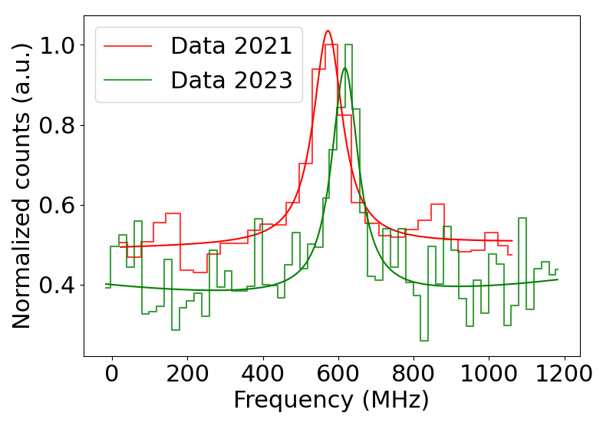
²²⁶RaF in 2021 and 2023
In the 2023 campaign, some measurements of ^{225,226}RaF in high resolution where performed.
Thus, we can compare the measurements of ²²⁶RaF in high resolution from 2021 with the new data.
Shift of the same HFS transition in ²²⁶RaF by 45(6)MHz (two different scans were analyzed).
Relativity consistent between two different experimental campaigns ☺

Slide 14
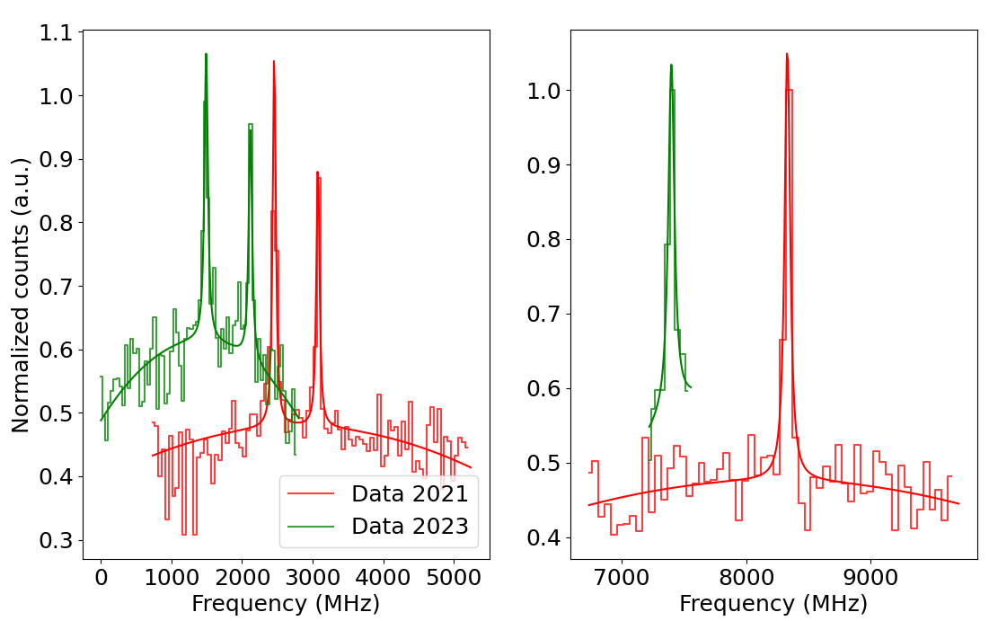
²²⁵RaF in 2021 and 2023
Like the previous analysis, the ²²⁵RaF can be compared between 2021 and 2023 in the same HFS transition.
Shift of the same HFS transition by 986(5)MHz!
Not related to the reference diode. It remain nicely lock on the same transition (if diode is not included the shift is around ~970MHz).

Slide 15
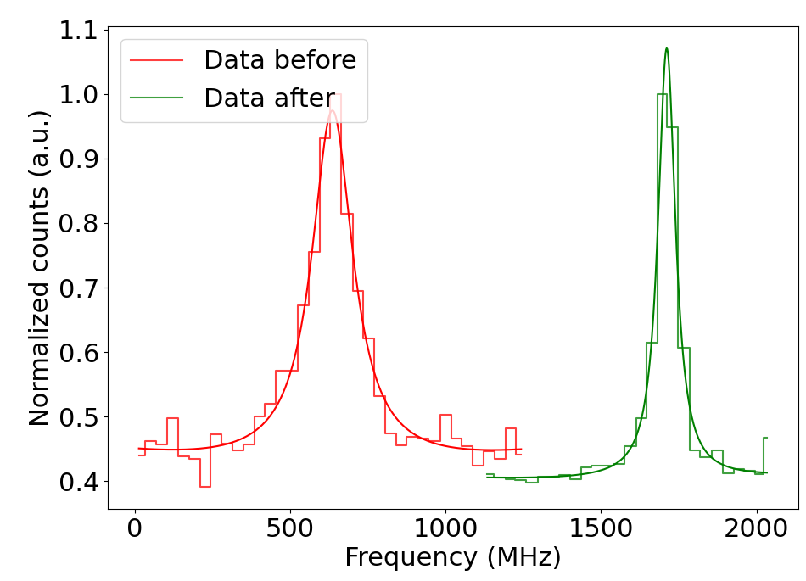
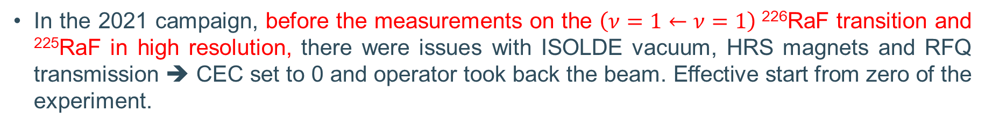
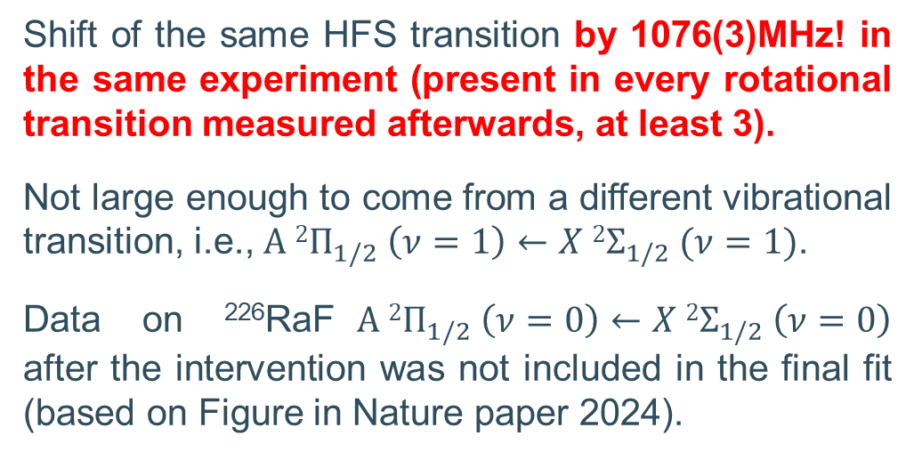
A possible explanation using ²²⁶RaF
In the 2021 campaign, before the measurements on the $\left(ν=1←ν=1\right)$²²⁶RaF transition and ²²⁵RaF in high resolution, there were issues with ISOLDE vacuum, HRS magnets and RFQ transmission ➔ CEC set to 0 and operator took back the beam. Effective start from zero of the experiment.
Shift of the same HFS transition by 1076(3)MHz! in the same experiment (present in every rotational transition measured afterwards, at least 3).
Not large enough to come from a different vibrational transition, i.e., $A {2Π}_{1/2} \left(ν=1\right)←X 2Σ_{1/2} (ν=1)$.
Data on ²²⁶RaF$A {2Π}_{1/2} \left(ν=0\right)←X 2Σ_{1/2} \left(ν=0\right)$ after the intervention was not included in the final fit (based on Figure in Nature paper 2024).
[8] Udrescu, S. M., Wilkins, S. G., Breier, A. A., Athanasakis-Kaklamanakis, M., Garcia Ruiz, R. F., Au, M., ... & Zülch, C. (2024). Precision spectroscopy and laser-cooling scheme of a radium-containing molecule. Nature Physics, 20(2), 202-207.
Notes:
Scan 4068 also present the shift since it does not math the fitted spectra by ~1GHz. (This was the first high-res after the intervention). However, such HFS was not measured before the intervention.

Slide 16
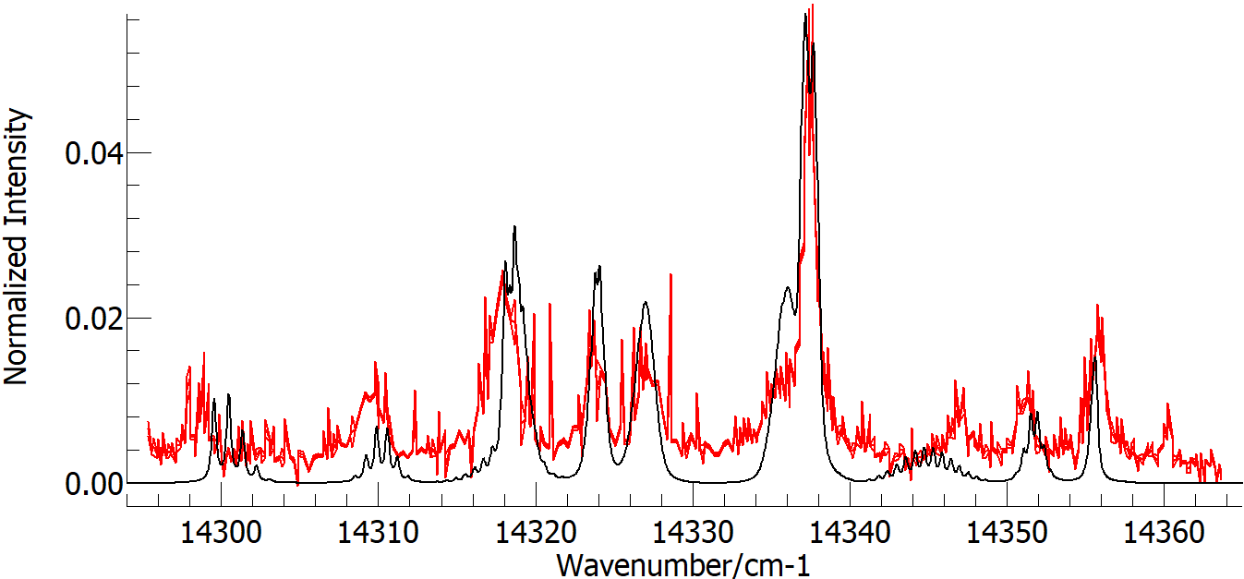
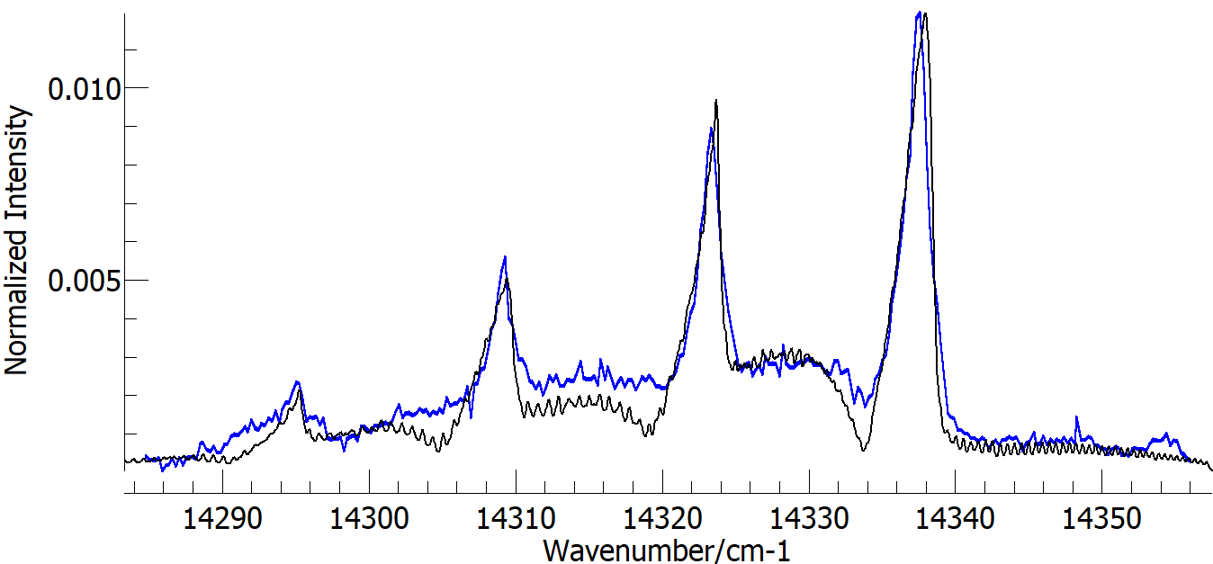
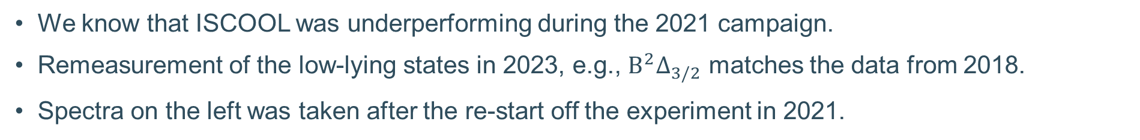
A reminder of ISCOOL from 2021
2021
2023
We know that ISCOOL was underperforming during the 2021 campaign.
Remeasurement of the low-lying states in 2023, e.g., $B^{2}Δ_{3/2}$ matches the data from 2018.
Spectra on the left was taken after the re-start off the experiment in 2021.

Slide 17
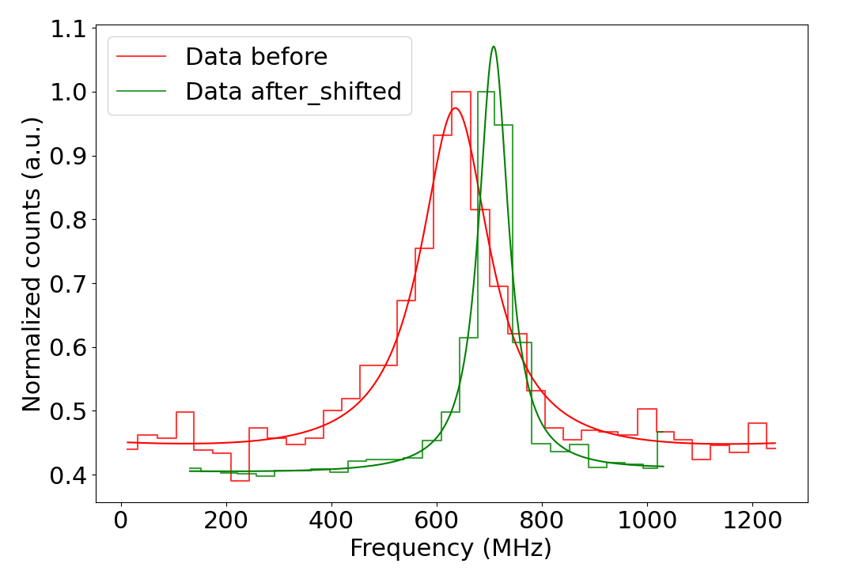
A possible explanation
The recorded voltage of ISCOOL is different before and after the intervention by ~295V. This corresponds to roughly ~1GHz shift in the laser frequency in ²²⁶RaF. Could this be the reason?
Recorded voltage of ISCOOL after the intervention is lower ➔ shift up in frequency.
If the average ISCOOL voltage from before the intervention is used (instead of recorded) the data would match (~73MHz difference [preliminary]).
There is no recorded data on ²²⁵RaF before the intervention, so it is not possible to compare within the same experiment.
Preliminary
[6] Udrescu, S. M., Wilkins, S. G., Breier, A. A., Athanasakis-Kaklamanakis, M., Garcia Ruiz, R. F., Au, M., ... & Zülch, C. (2024). Precision spectroscopy and laser-cooling scheme of a radium-containing molecule. Nature Physics, 20(2), 202-207.
Notes:
Scan 4068 also present the shift since it does not math the fitted spectra by ~1GHz. (This was the first high-res after the intervention). However, such HFS was not measured before the intervention.

Slide 18
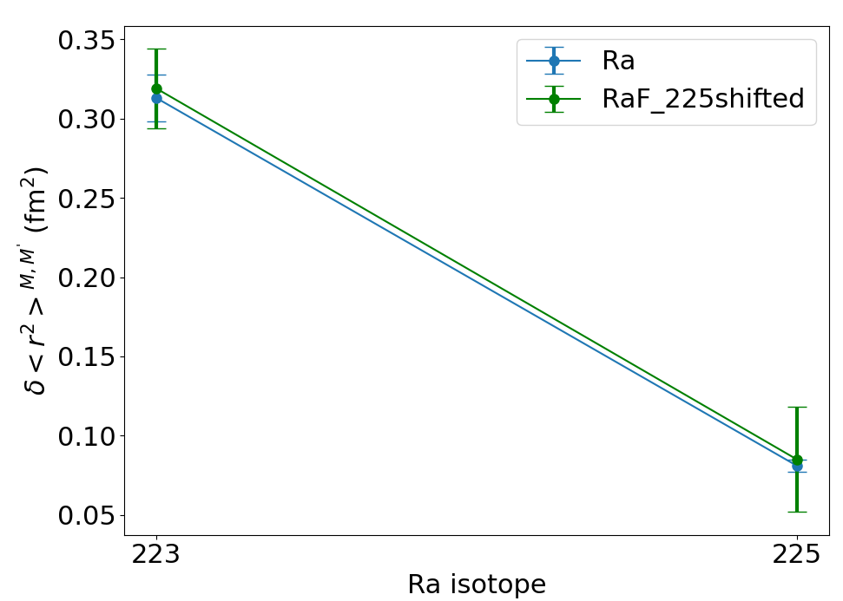
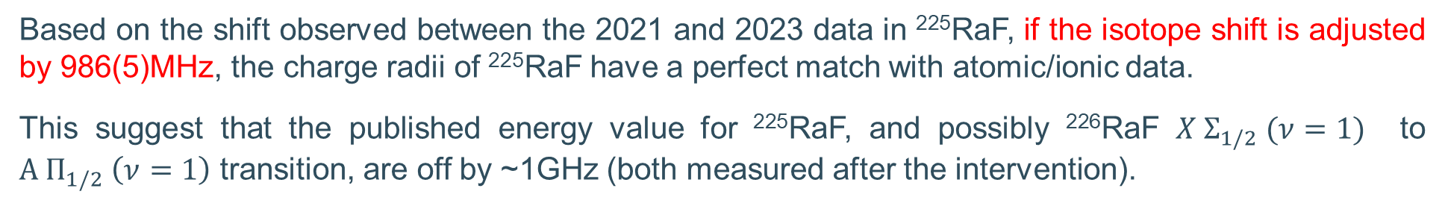
Change in charge radii (²²⁵RaF shifted)
Based on the shift observed between the 2021 and 2023 data in ²²⁵RaF, if the isotope shift is adjusted by 986(5)MHz, the charge radii of ²²⁵RaF have a perfect match with atomic/ionic data.
This suggest that the published energy value for ²²⁵RaF, and possibly ²²⁶RaF $X Σ_{1/2} (ν=1)$ to $A Π_{1/2} \left(ν=1\right)$ transition, are off by ~1GHz (both measured after the intervention).

Slide 19
Conclusions and outlook
The conventional laser spectroscopy observables in RaF are in great agreement with their atomic counterpart (literature independent).
Waiting for theoretical input to compared the finite magnetization distribution in ²²³Ra
Energy of the ²²⁵RaF data should be double checked?
Initial draft already written

Slide 20
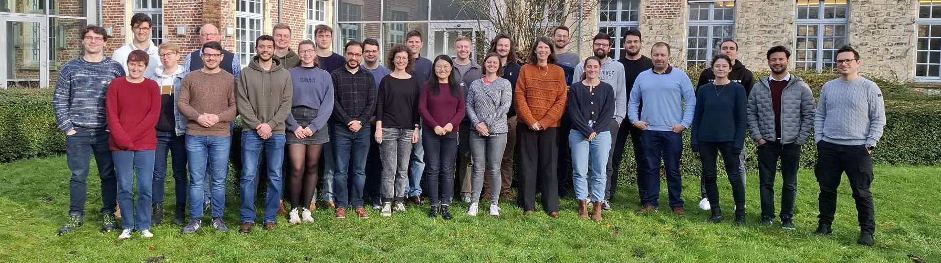








Acknowledgments

Slide 21
Thanks for your attention

Slide 22
Backup slides

Slide 23
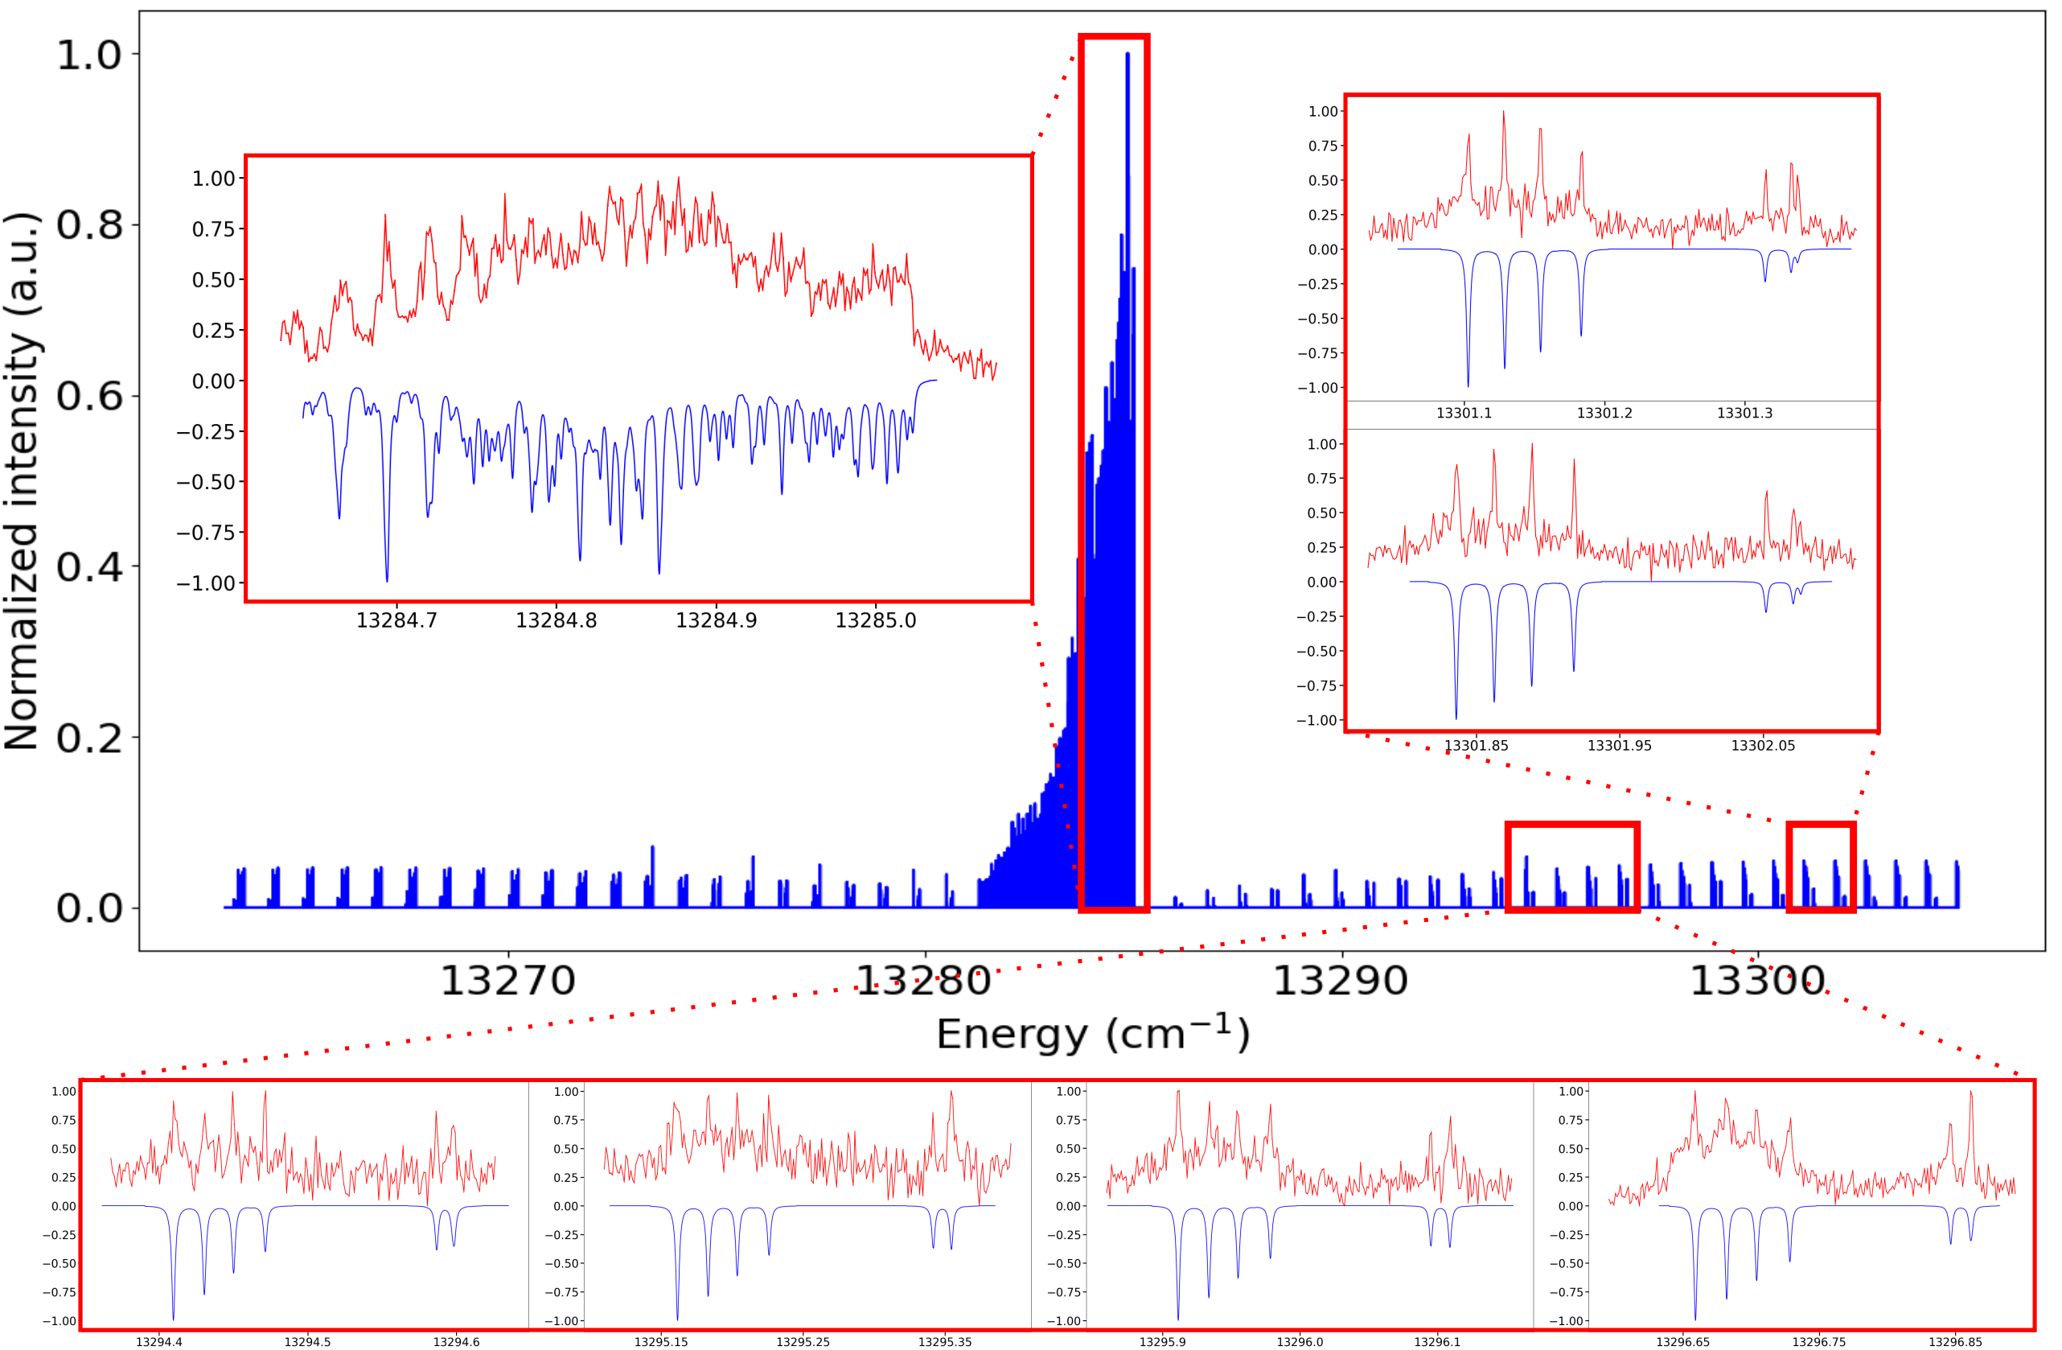
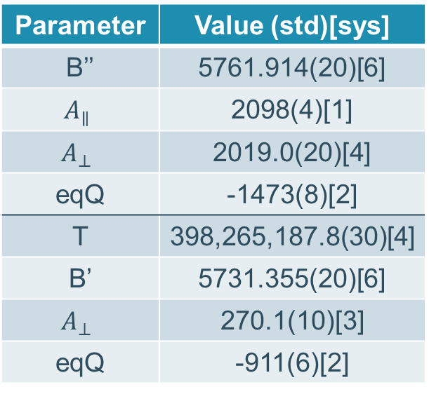
Total ²²³RaF spectra (PGOPHER).
Parameter | Value (std)[sys]
B’’ | 5761.914(20)[6]
$$A_{∥}$$ | 2098(4)[1]
$$A_{⊥}$$ | 2019.0(20)[4]
eqQ | -1473(8)[2]
T | 398,265,187.8(30)[4]
B’ | 5731.355(20)[6]
$$A_{⊥}$$ | 270.1(10)[3]
eqQ | -911(6)[2]
6 different R-branch lines were measured ➔ 6 HFS spectra.

Slide 24
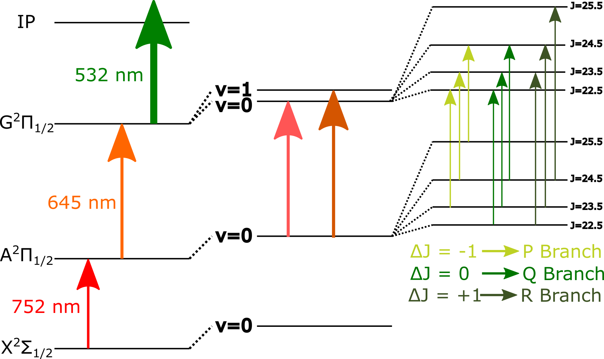
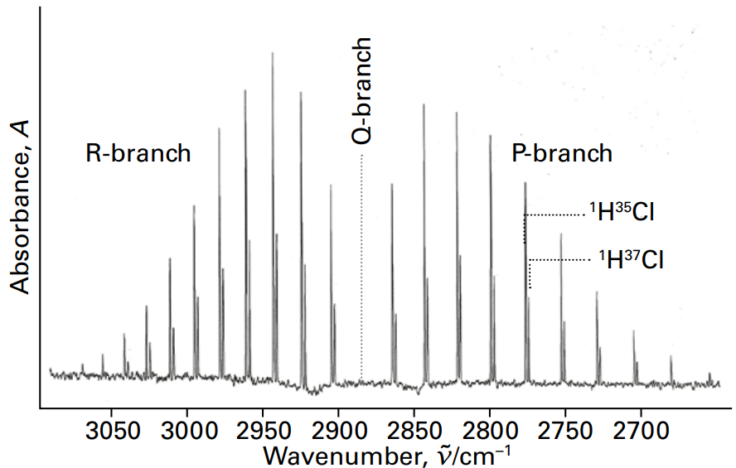

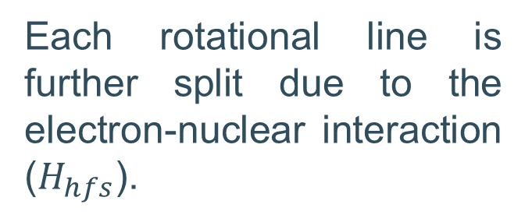


Laser spectroscopy on molecules
The spectrum of a rovibrational transition is divided in three different branches: R ($ΔJ=+1$), Q ($ΔJ=0$), P ($ΔJ=−1$).
Each rotational line is further split due to the electron-nuclear interaction ($H_{hfs}$).
Typical textbook spectrum for HCl
$$H_{el}$$
$$H_{vib}$$
$$H_{rot}$$
[15] Atkins, Physical chemistry, P. Atkins, P. W., & de Paula, J. (2014).

Slide 25
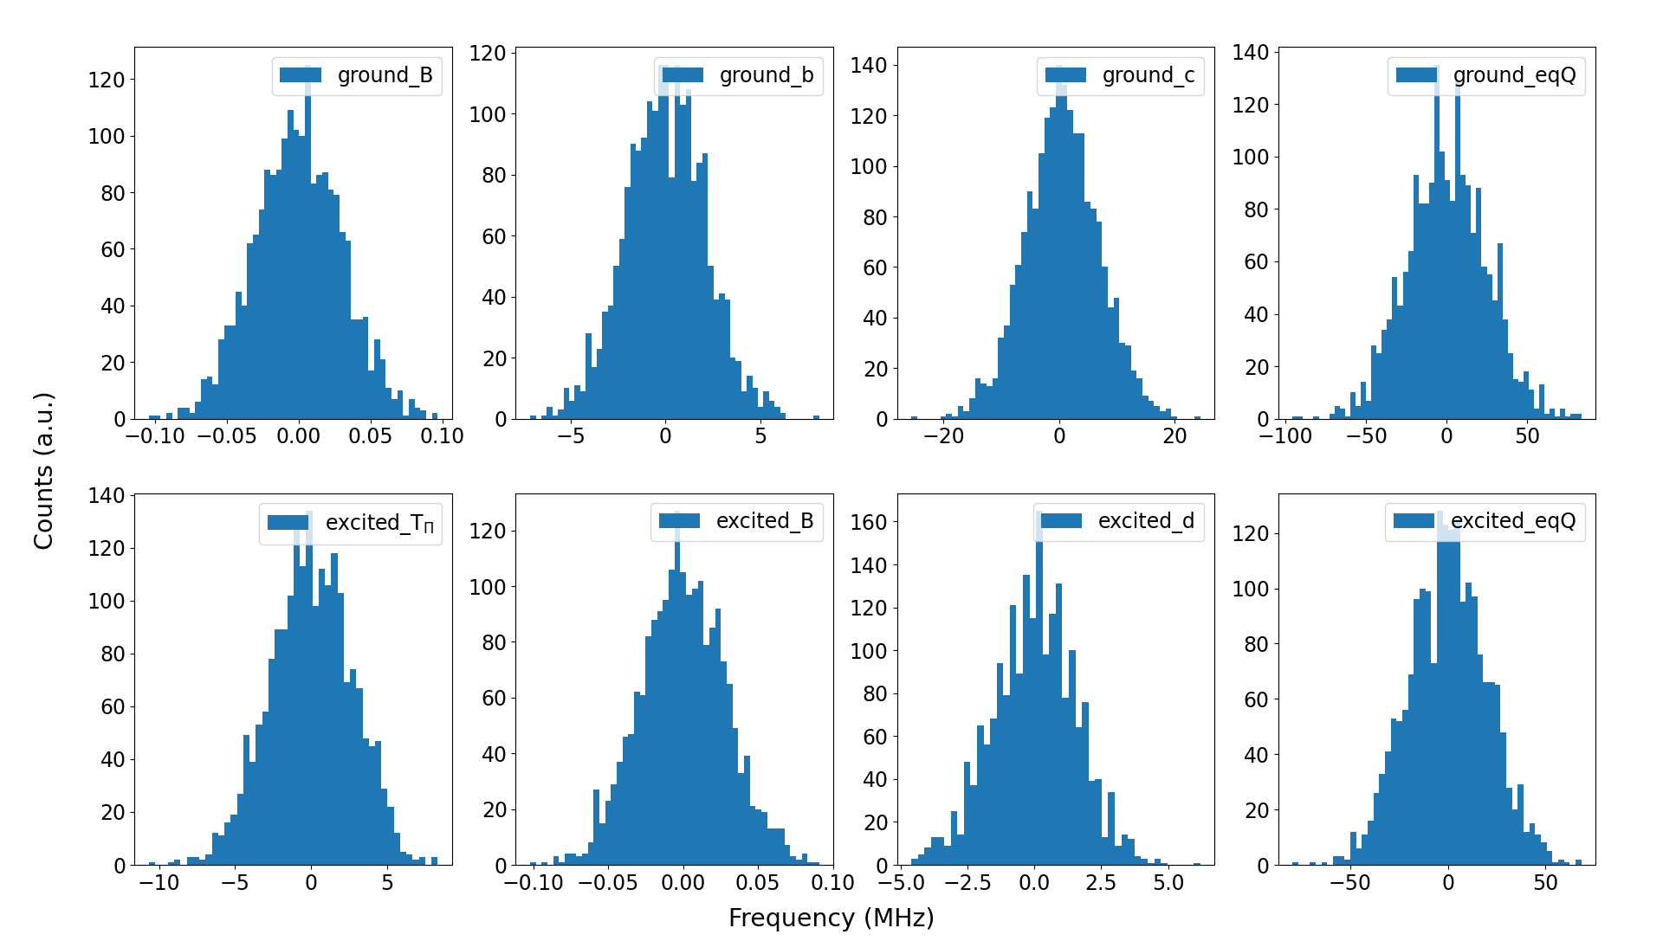
Final fit and estimation of statistical errors
The fitting was automatize using Python.
Based on the uncertainty in each HFS peak, a Gaussian distribution was created: (centroid = HFS peak centroid) and (width = HFS peak uncertainty).
Re-fitting of the spectra with new peak centroids taken from the Gaussians.
Store the fitted molecular constants and re-fit the spectra (total = 5000).
The retrieved distribution from each constant gives its nominal value and uncertainty.

Slide 26
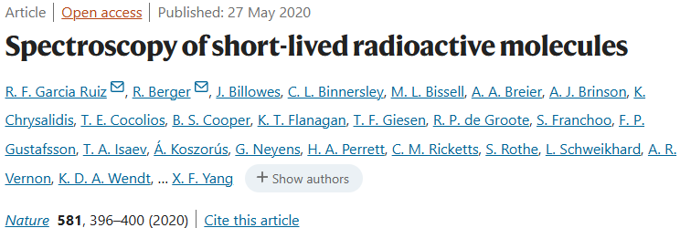
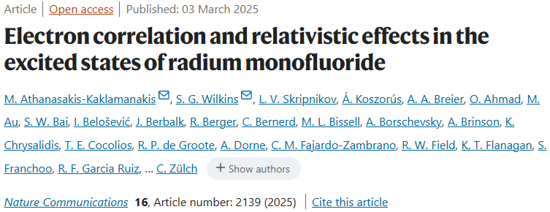
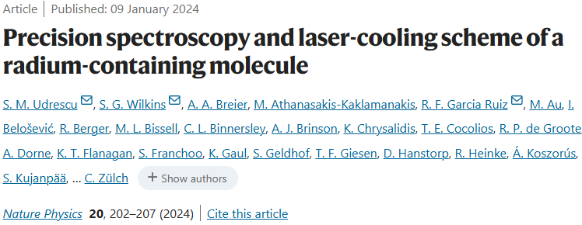

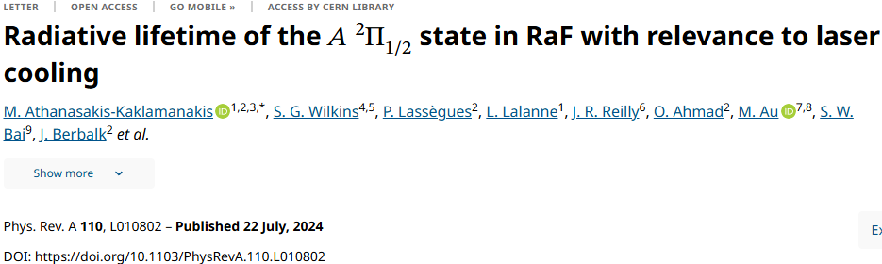
The RaF journey at CRIS
H_{RaF} =
H_{el} + H_{vi}
+ H_{rot}
+ H_{hfs}
Magnetic dipole moment
arXiv:2311.04121, submitted Science (2023)
Electric quadrupole moment
In preparation (2025)

