Slide 1
LS3 at CRIS
Plans, things to do, things that change
Jessica Warbinek

Slide 2
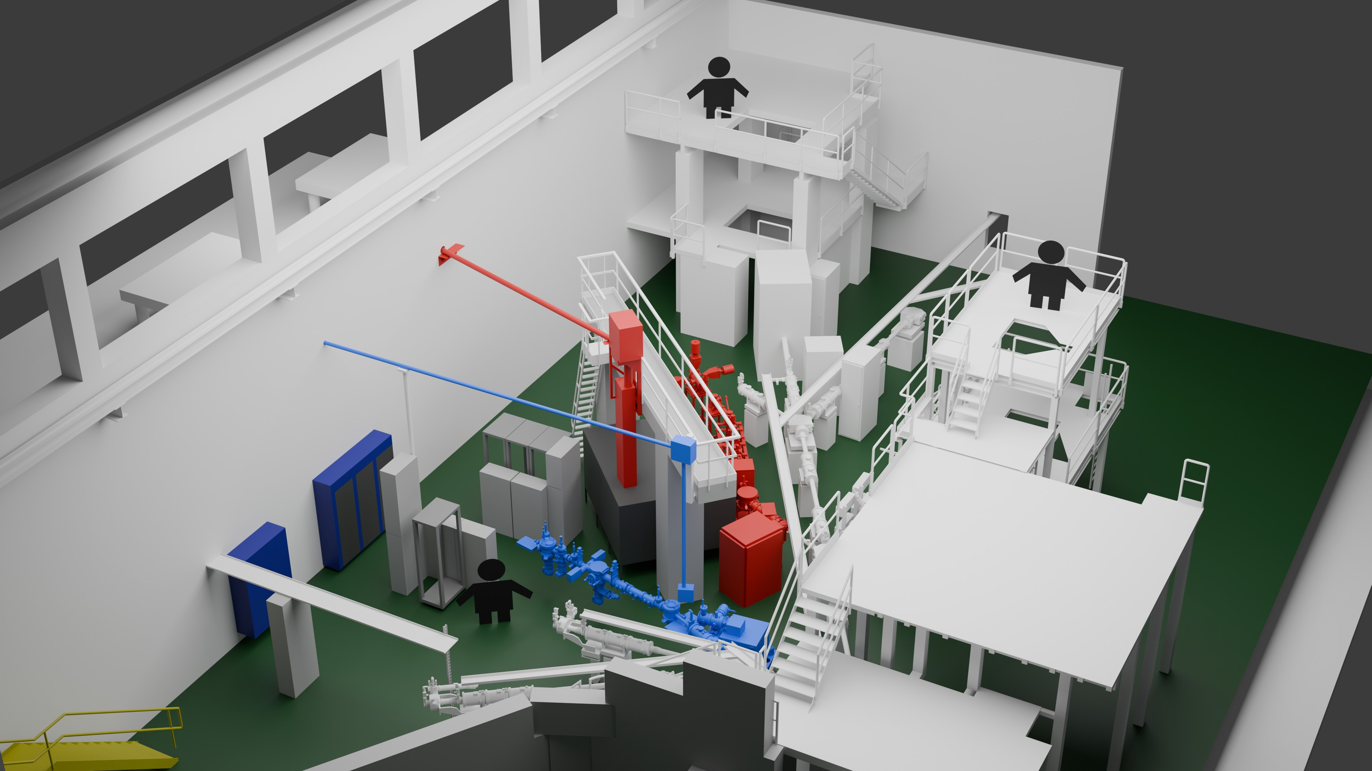
Current situation
Concrete structure/ laser transport:
Not up to safety specs (stairs)
Takes a lot of space
Laser lab not up to current safety requirements
Needs to be replaced
CRIS laser lab
COLLAPS laser lab
CRIS laser tent
Laser beam delivery via a concrete structure

Slide 3
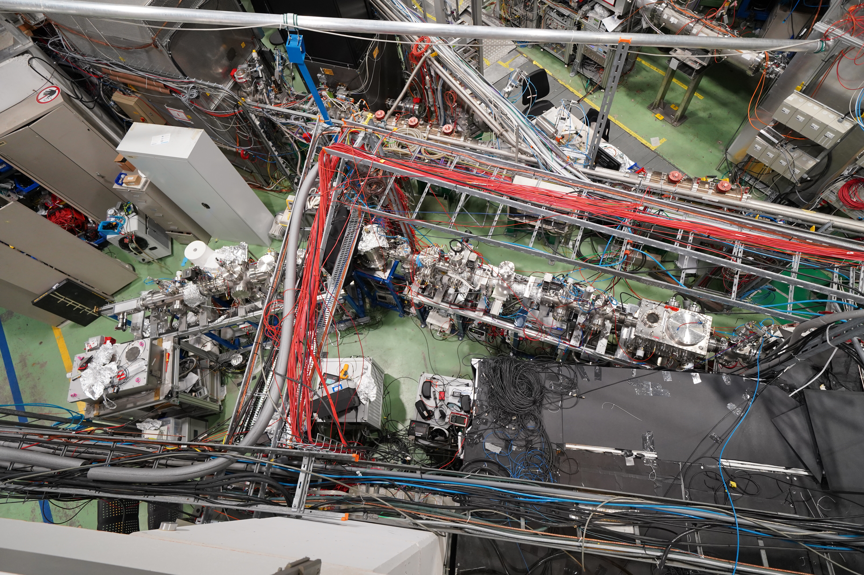
Current situation
Space limited
Cabinets and racks take a lot of space
Very little space for computer work / desk

Slide 4
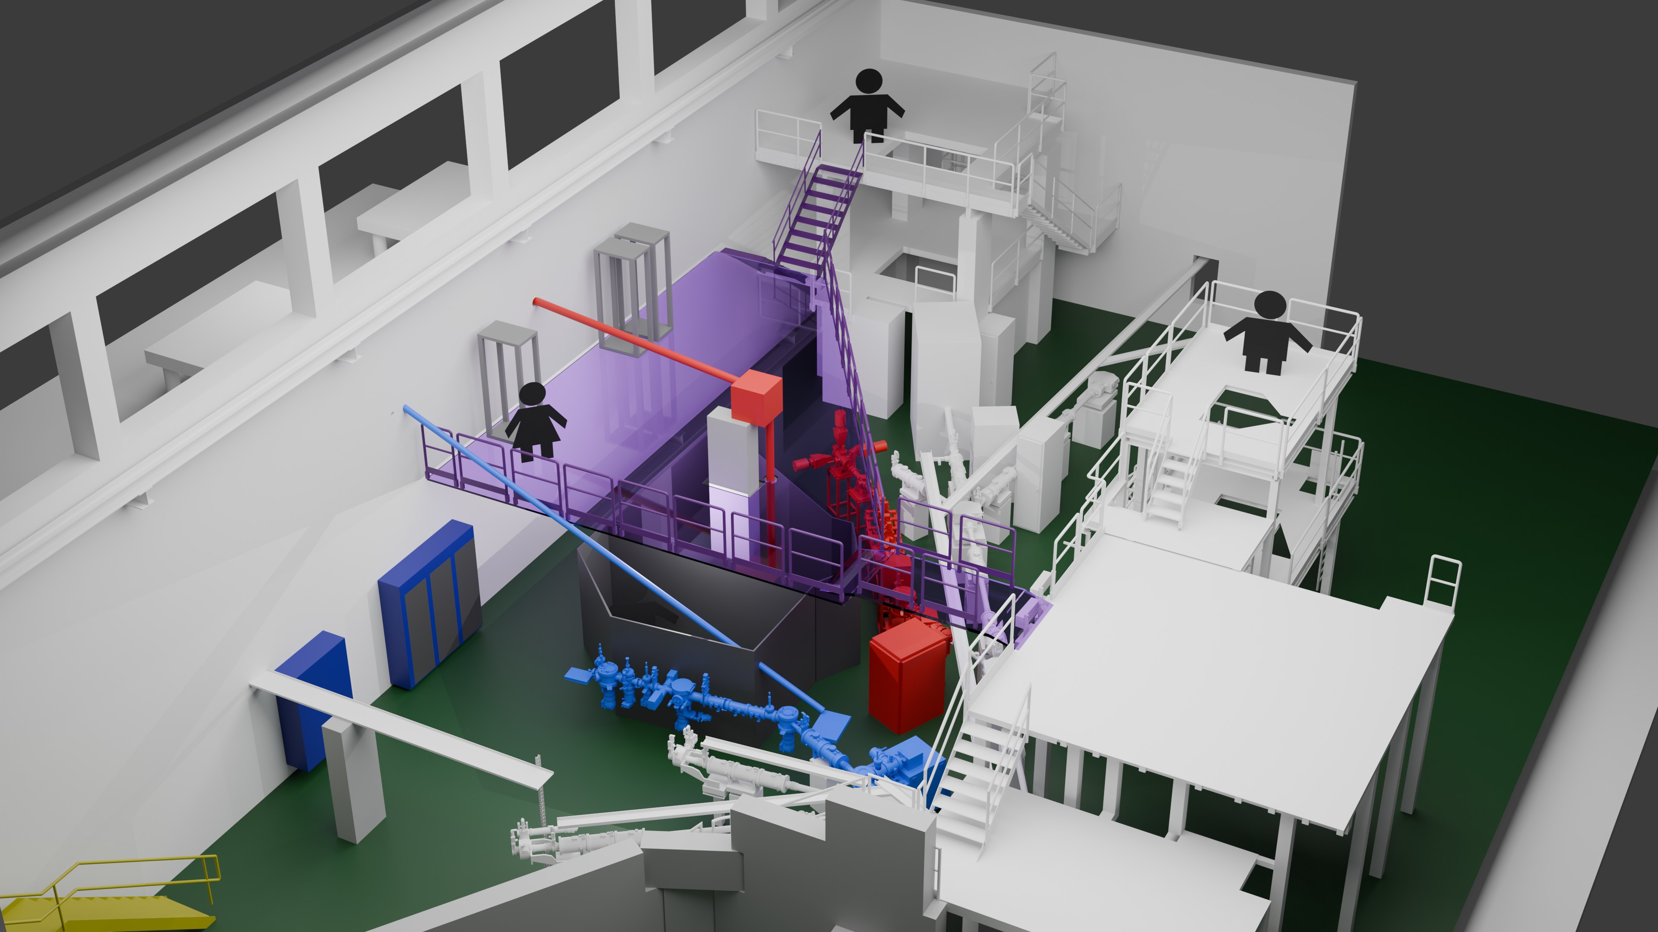
Update plans - platform
Concrete structure/ laser transport:
Not up to safety specs (stairs)
Takes a lot of space
Laser lab not up to current safety requirements
Needs to be replaced
Safety exit (downwards)
Walkway?
Connection?
Figure by Liss / Tim

Slide 5
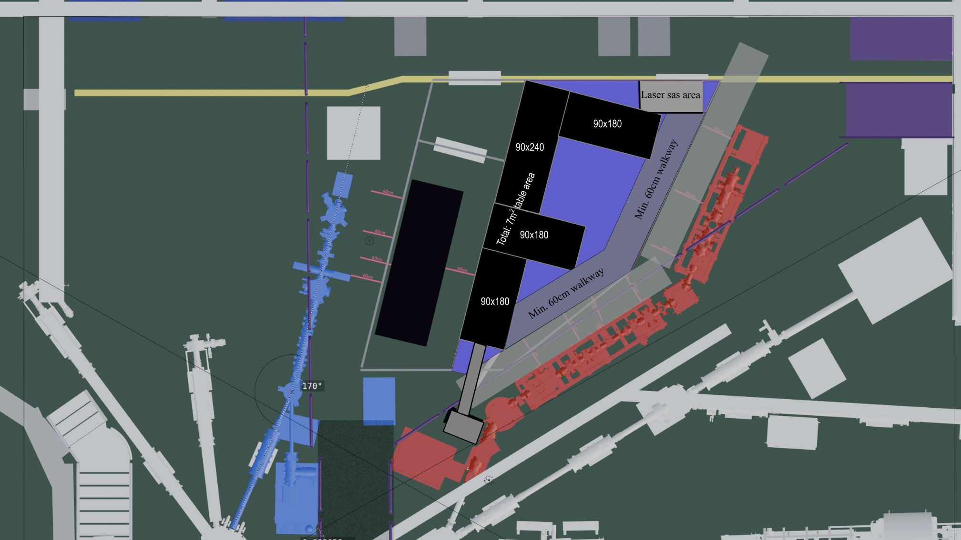
60cm walkway outside

Slide 6
Discussion with Safety, Erwin, Luis, Hanne, …
  No walkway from entrance?
  80(!)cm space needed
  Platform at min height (～3m)
  Sliding door for laser lab entrance?
  Other access: stairs where?
  Laser tube upstairs: clearance of 2m?
  How to fix the pillar stable enough
Currently working with CERN integration
  Laser tables horizontal?! – no :)
  Probably not as much laser table space, how much min?
  Space to CRIS beamline with DSS
  Moving cabletrays behind CRIS
  Stairs?
Financials
  Luis applied for funding ～ 50k
  Safety improvement – this Budget?
60cm walkway outside

Slide 7
General - We need people – things to solve
Shortterm:
  Isoltrap platform construction April – June?
  our cabinets need to go to the side
  Sending lasers to their hosts during LS: which and where?
  ….. More things?
Midterm:
  Frontend: new designs, simulations
  Emptying the downstairs area:
  Cabinets, laser tent disassembly, removal of equipment, …
Longterm:
  Removal of frontend, commissioning, new frontend, Platform, laser cabin….

