Slide 1


9 months evaluation
Field Ionization Unit (FIU) @ CRIS
CRIS Collaboration meeting 2026
Osama Ahmad

Slide 2
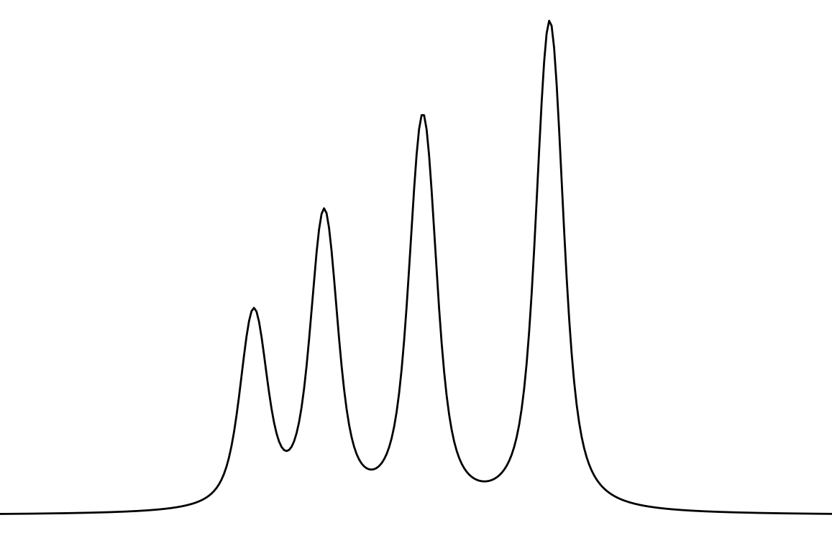
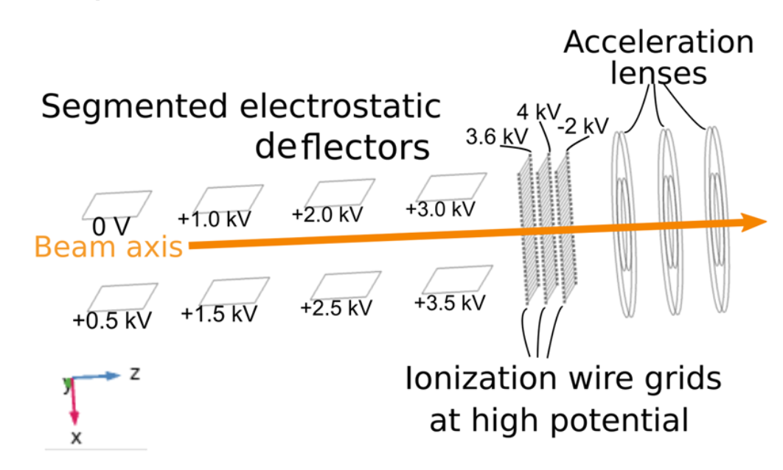
Field Ionization
Reducing the background contributions from:
Collisional ionization
Laser related background, especially from high power non-resonant step
FIU via Rydberg state makes high power laser obsolete
AI
Non-res
IP
Rydberg
Hyperfine Structure (HFS) :
Electric field ionization of Rydberg states in a collinear geometry
F₁
F₂
F₃
F₄
Department of Physics and Astronomy (IKS)
01
A. Vernon et al., Sci. Rep. 10, 12306 (2020).

Slide 3
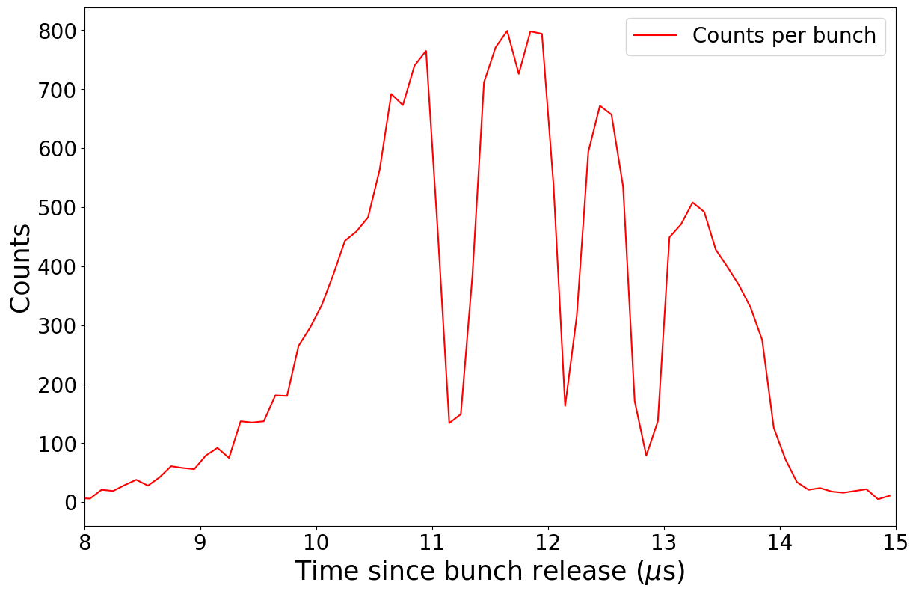
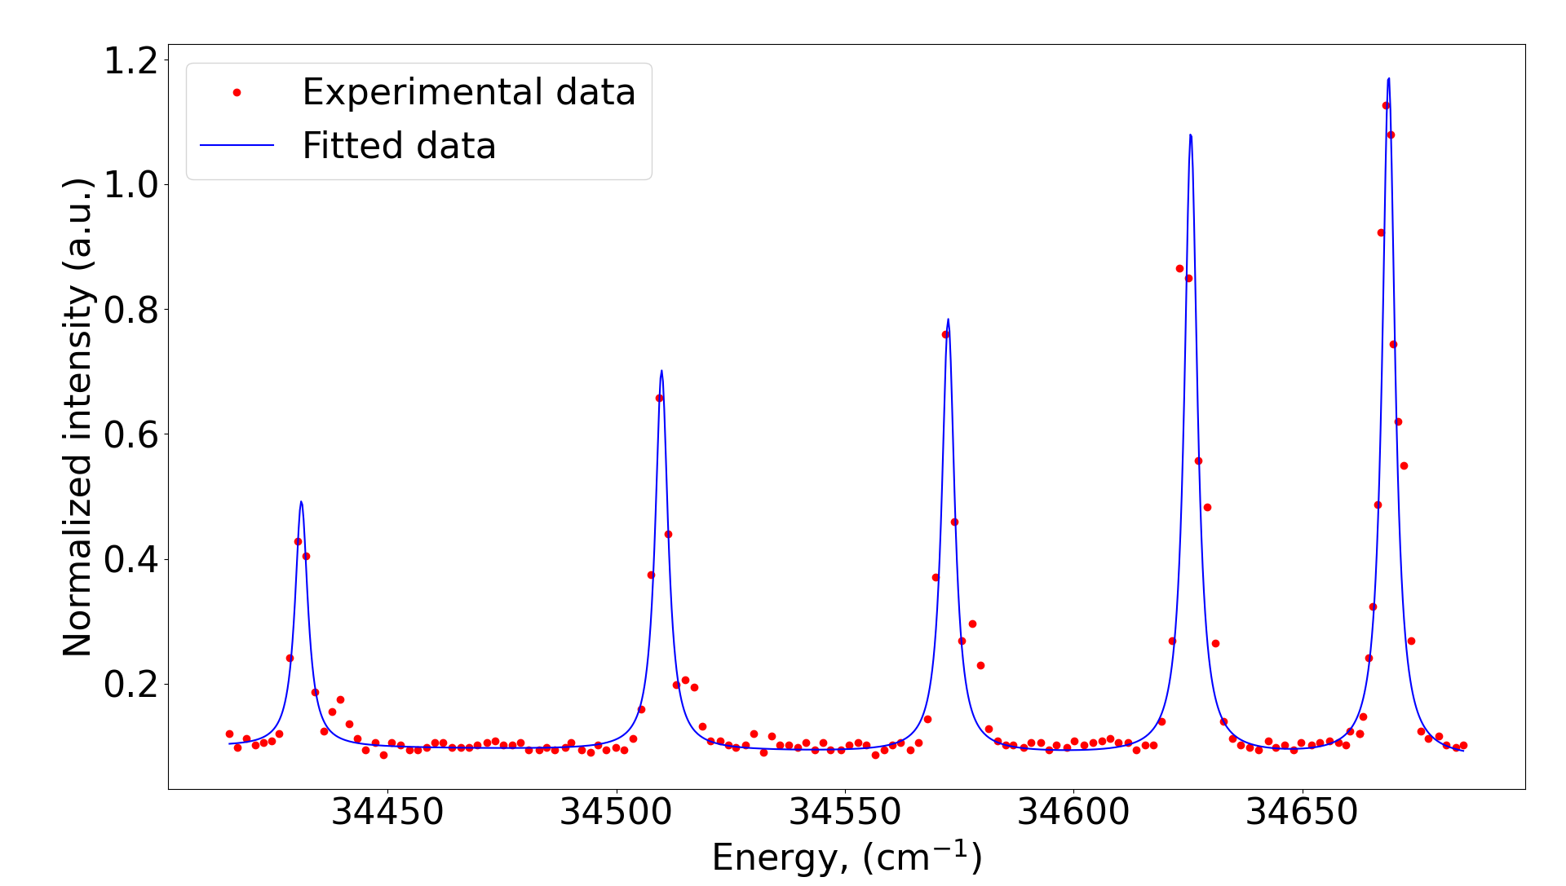
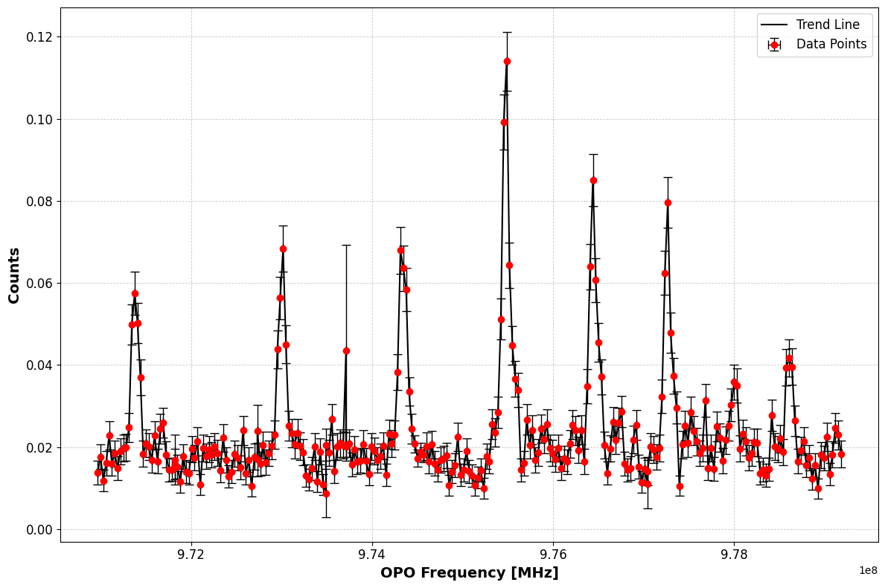
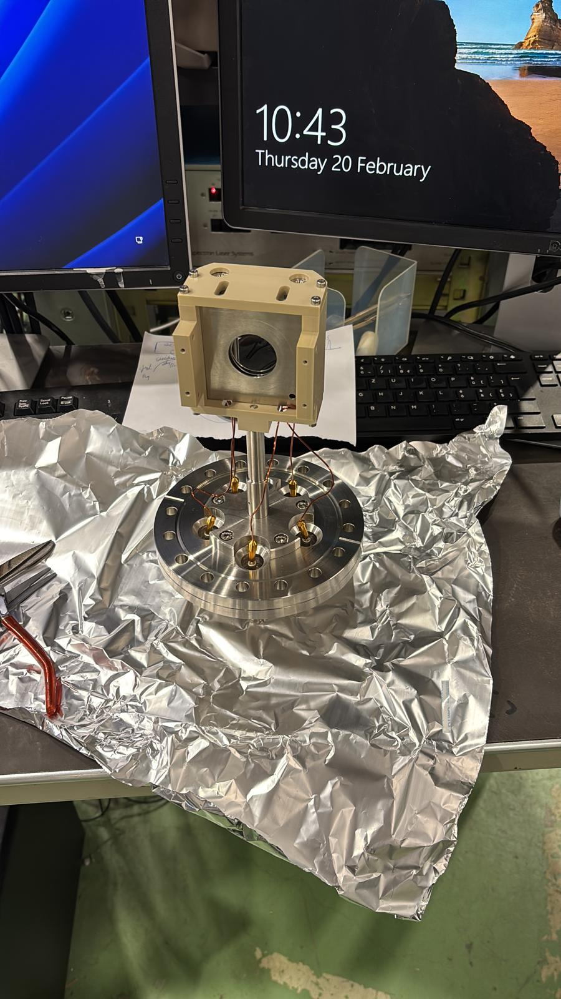
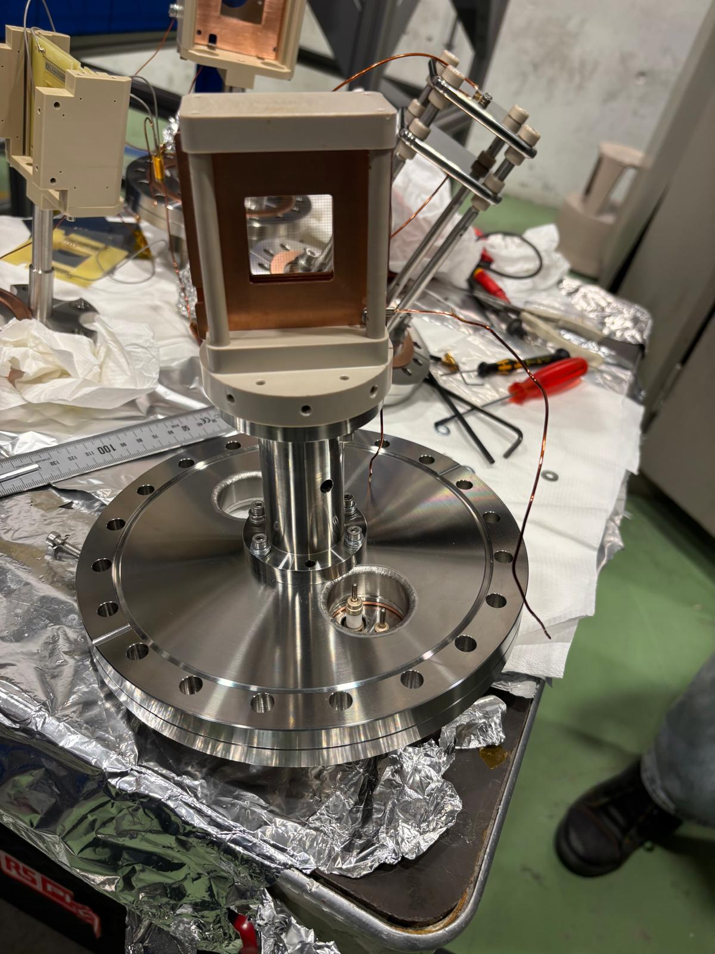
Timeline
March 2024
April 2024
October 2024
November 2024
February 2025
Installing FIU at CRIS
FIU commissioning I
Understood the dips
First online implementation
Improvements in FIU
New Rydberg series observed in Fr
Which series? Ask Pierre
High-lying rydbergs (n=24) affected strongly by Stark shift
Atoms at locations with strong field along beamline not rydberg excited → field ionization not effectful
Resolved with lower CEC deflector potentials and lower rydbergs (n=18, K)
Department of Physics and Astronomy (IKS)
02

Slide 4
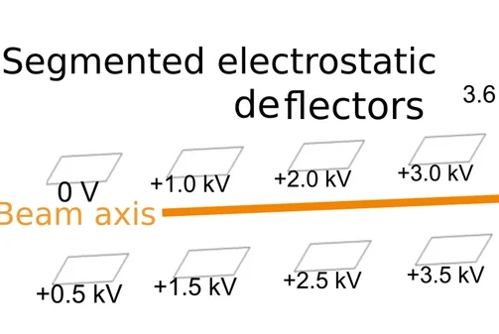
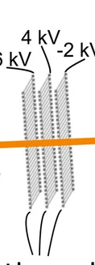
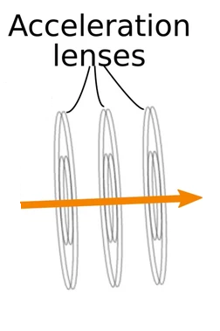
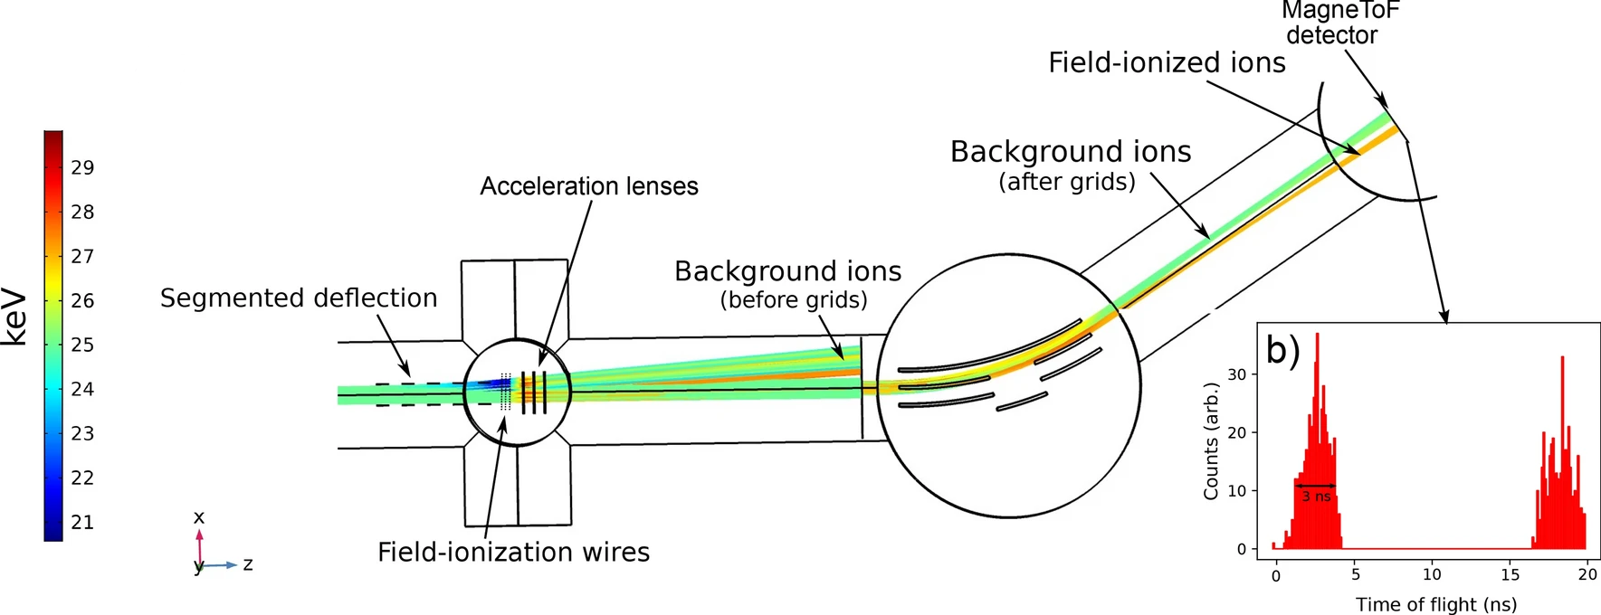
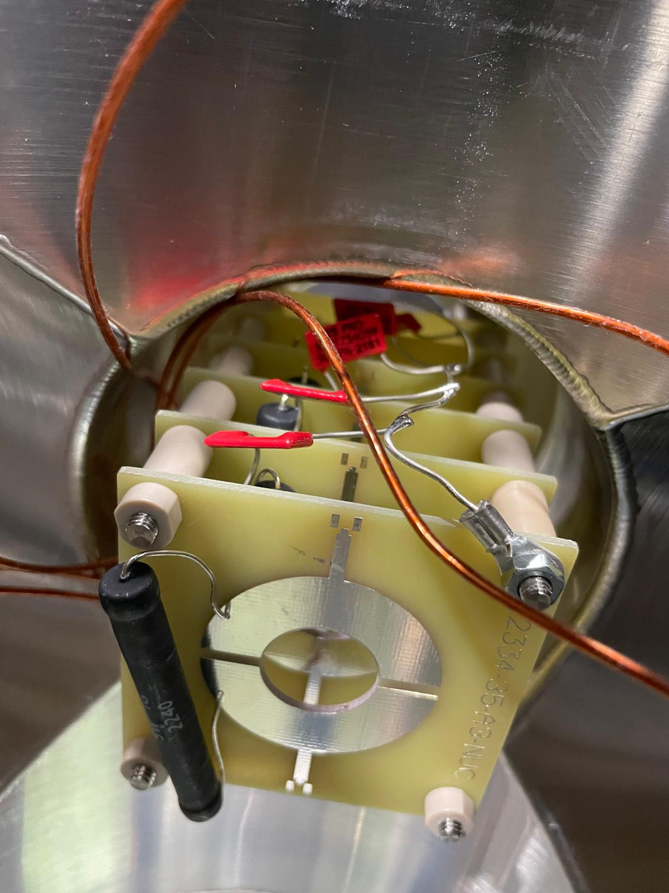
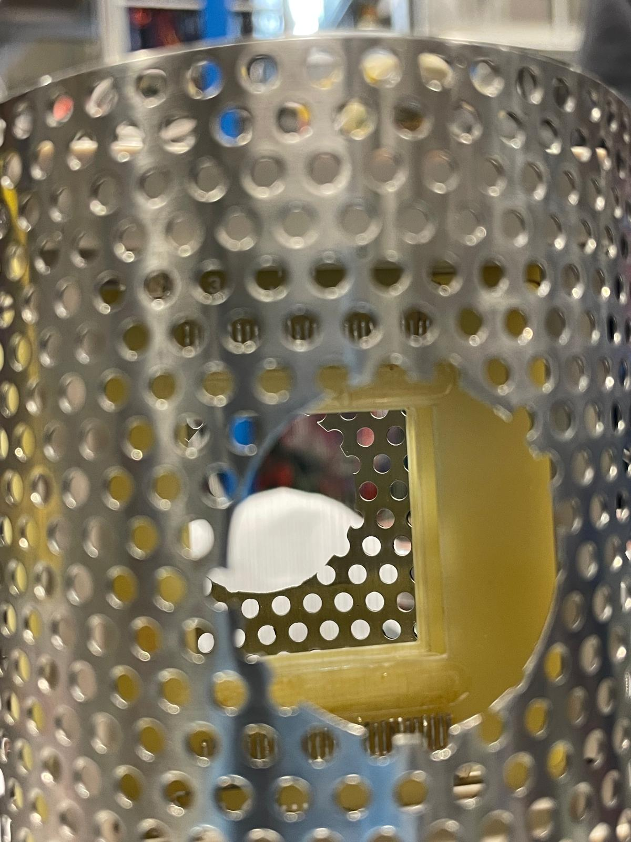
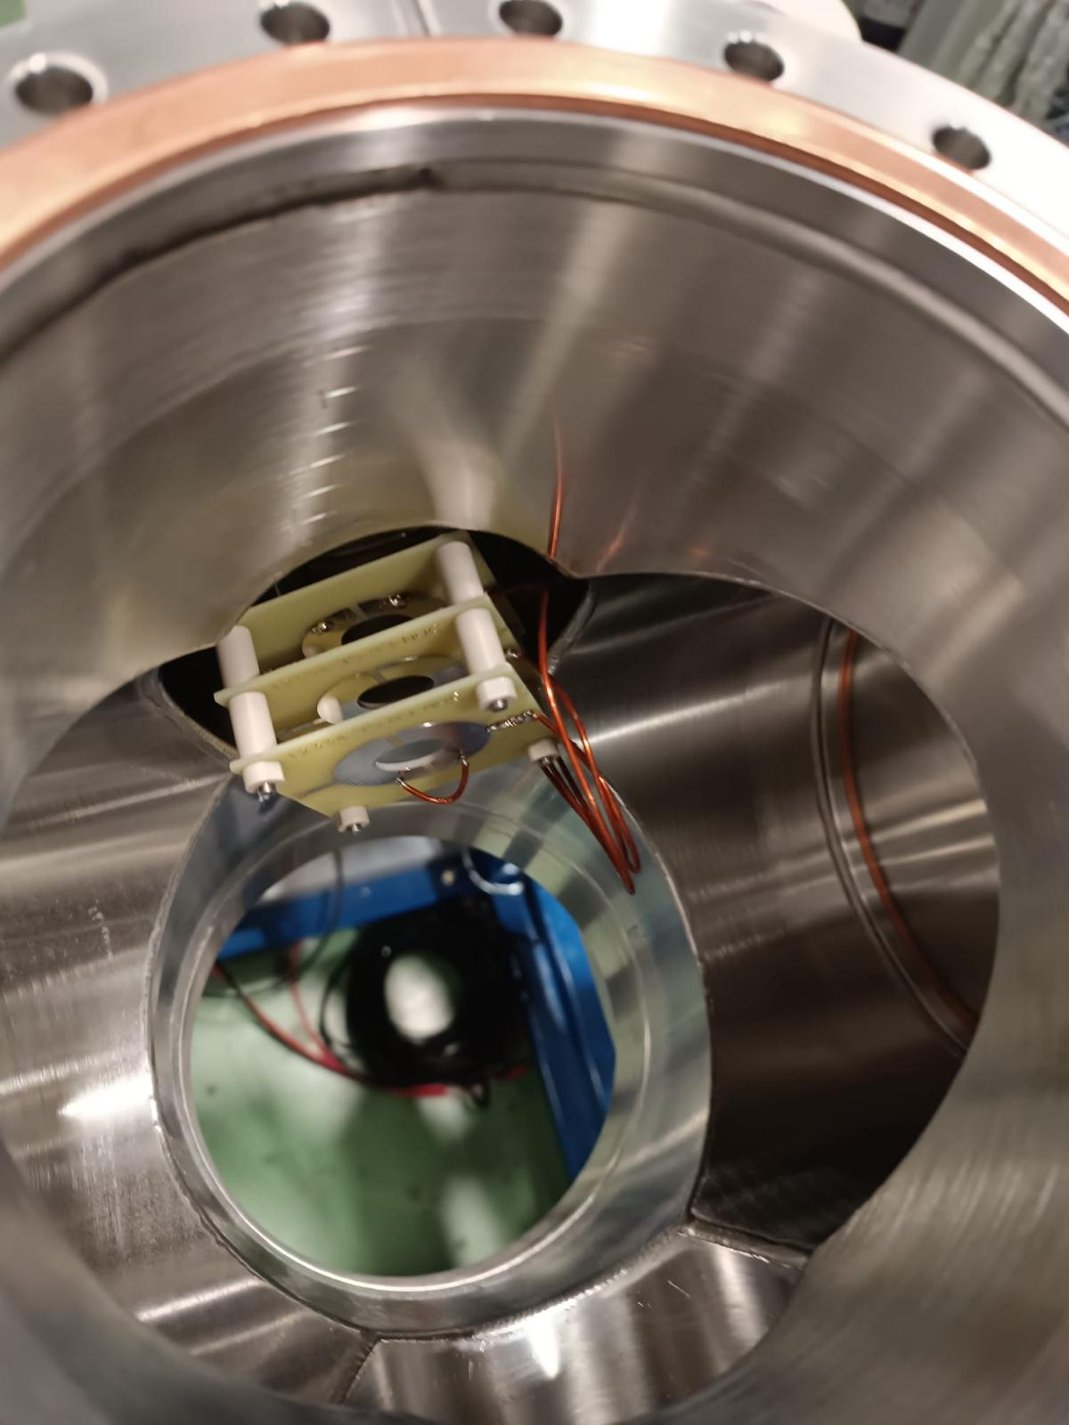
Previous design (1.0)
Acceleration lenses are redundant with our bunch width.
Limitation in vacuum in IR
Grids shortening issues.
Deflectors
Grids
Acceleration lenses
Department of Physics and Astronomy (IKS)
03
A. Vernon et al., Sci. Rep. 10, 12306 (2020).

Slide 5
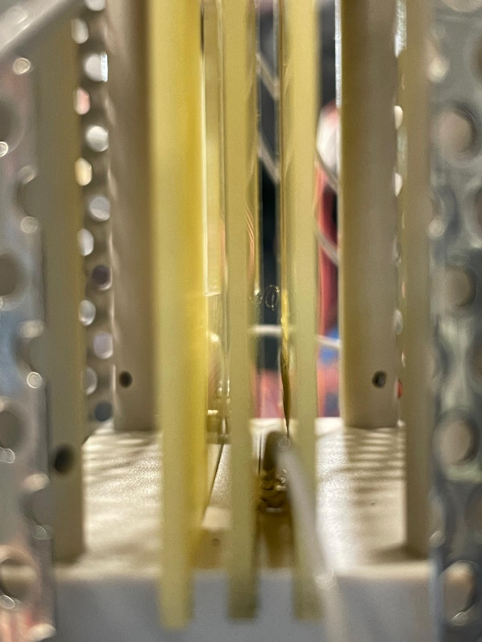
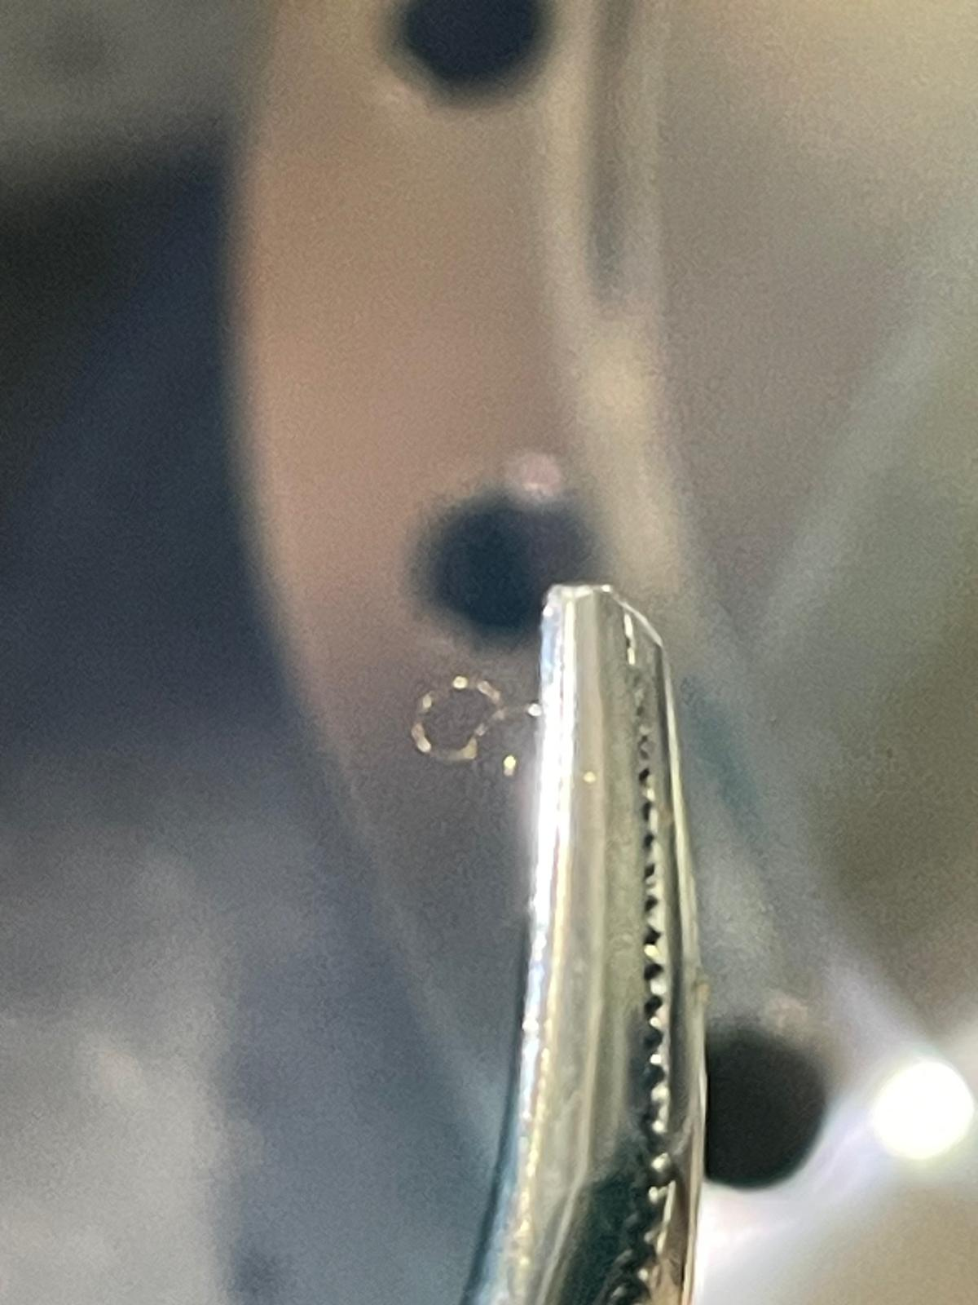
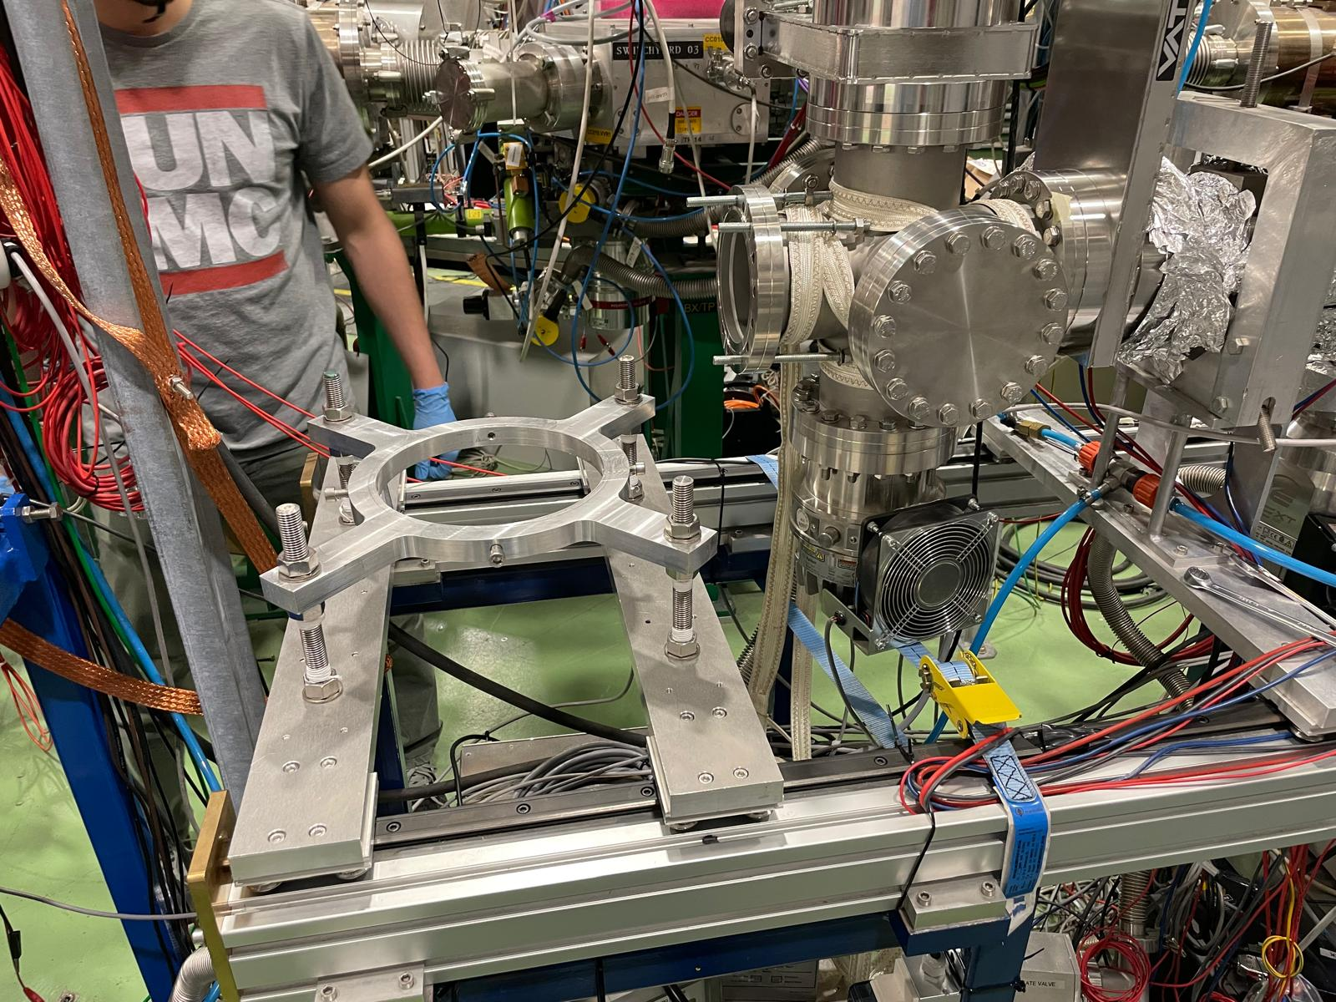
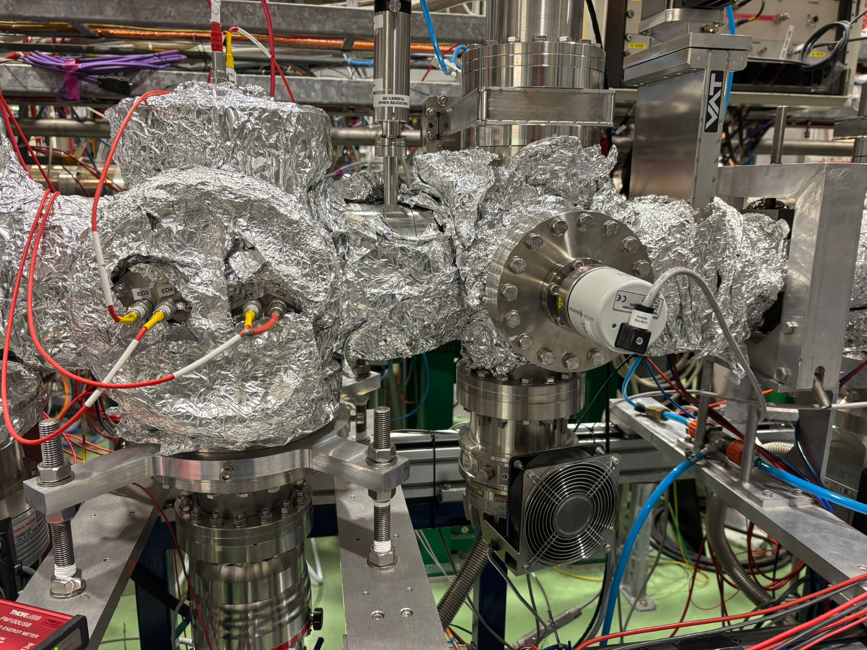

Problems
GRIDS SHORTENING
ASSEMBLY
Department of Physics and Astronomy (IKS)
04

Slide 6
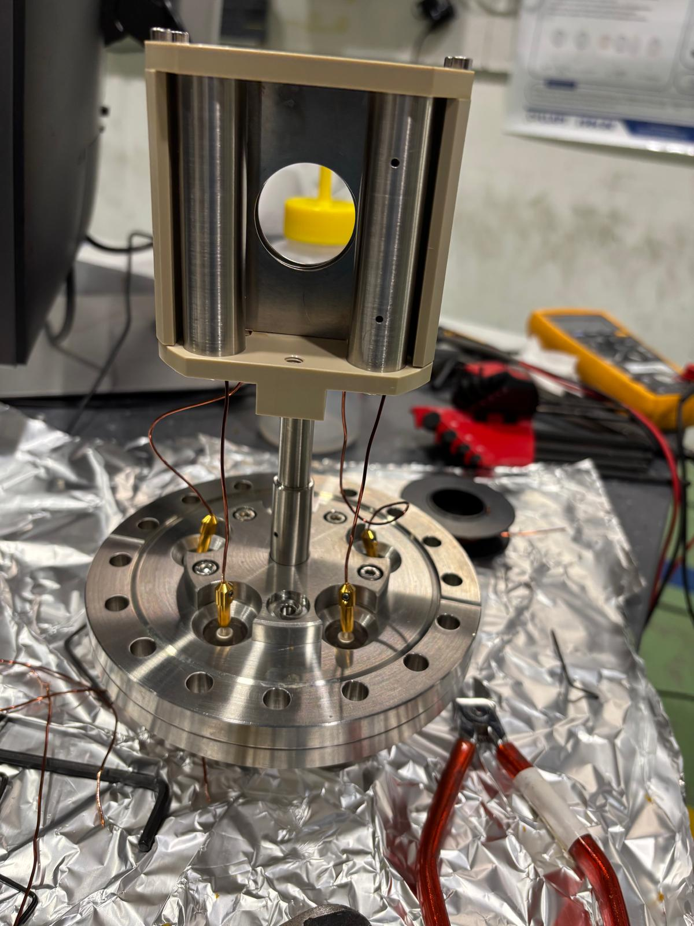
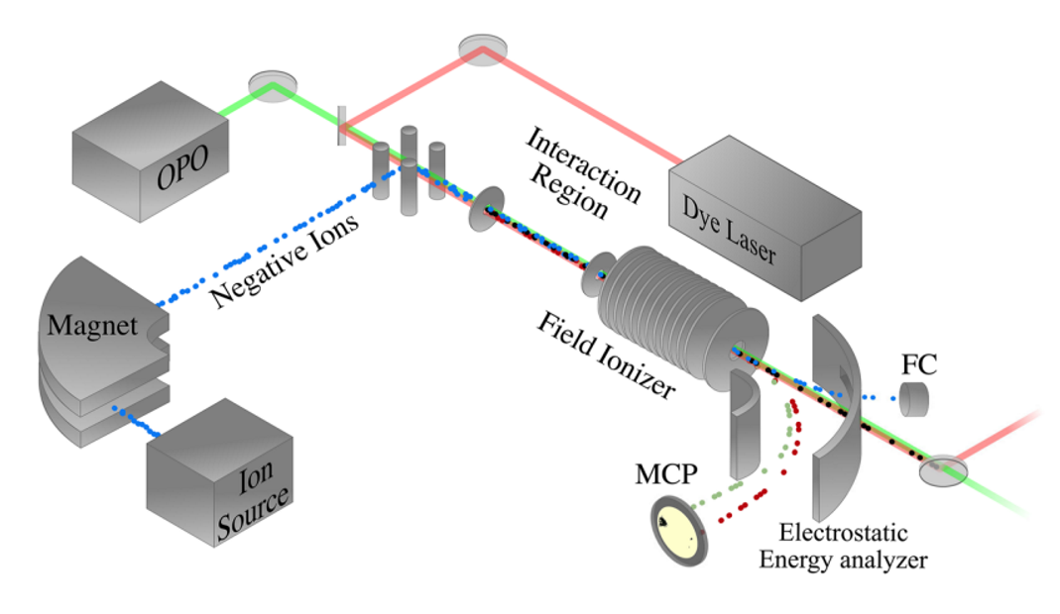
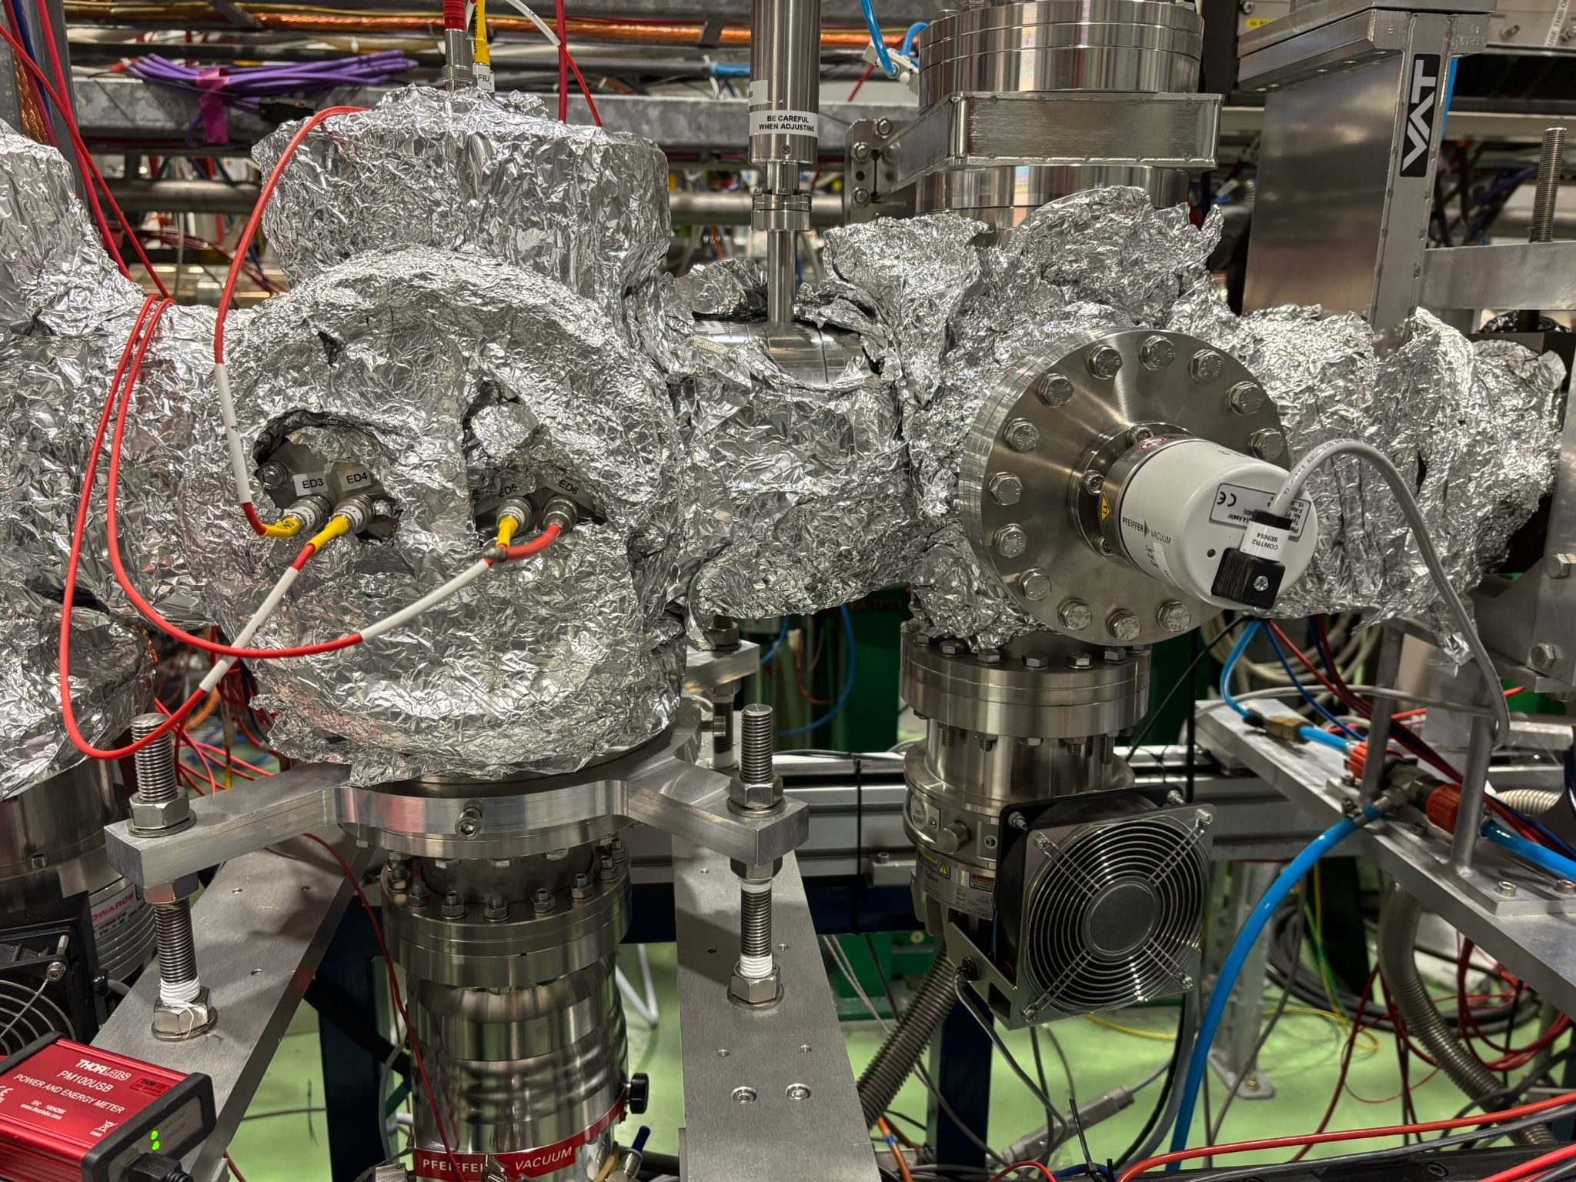
New proposed design
Based on GUNILLA setup in Gothenberg.
Position for new deflectors
Instead of GRIDS, using a set of parallel coaxial circular plates.
First plate is at ground potential, ensuring a field free interaction region.
All the other plates can be individually biased.
Designing the deflectors like plates, similar to the CEC deflectors (instead of rings with PCB)
Field Ionizer Schematics.Rev. Sci. Instrum. 93, 065004 (2022); doi: 10.1063/5.0061736 Department of Physics and Astronomy (IKS)
05

Slide 7
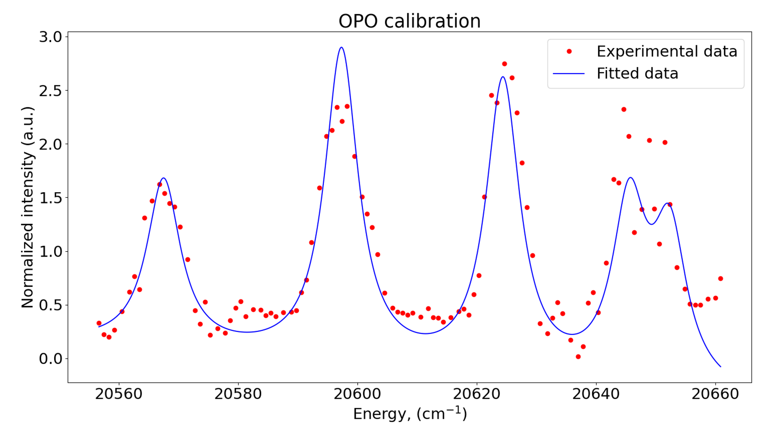
New design (2.0)
Assembled and installed in the beamline in the first week of March
Tests performed during ISCOOL commissioning.
No field ions even went up to 2500V on PLATE 2.
Bender electrodes did work
The diameter of the hole was 28 mm, electric field gradient not strong enough to ionize.
ALTERNATE OPTION (2.1)
Back to grids model with copper plates (instead of PCBs) with thicker wire.
Currently using only two grids (three grids cannot fit)
The new deflectors (plates) installed.
Commissioning with offline source (K) done in May before Ar beamtime.
Figure thanks to C.M Fajardo - Zambrano Department of Physics and Astronomy (IKS)
06

Slide 8
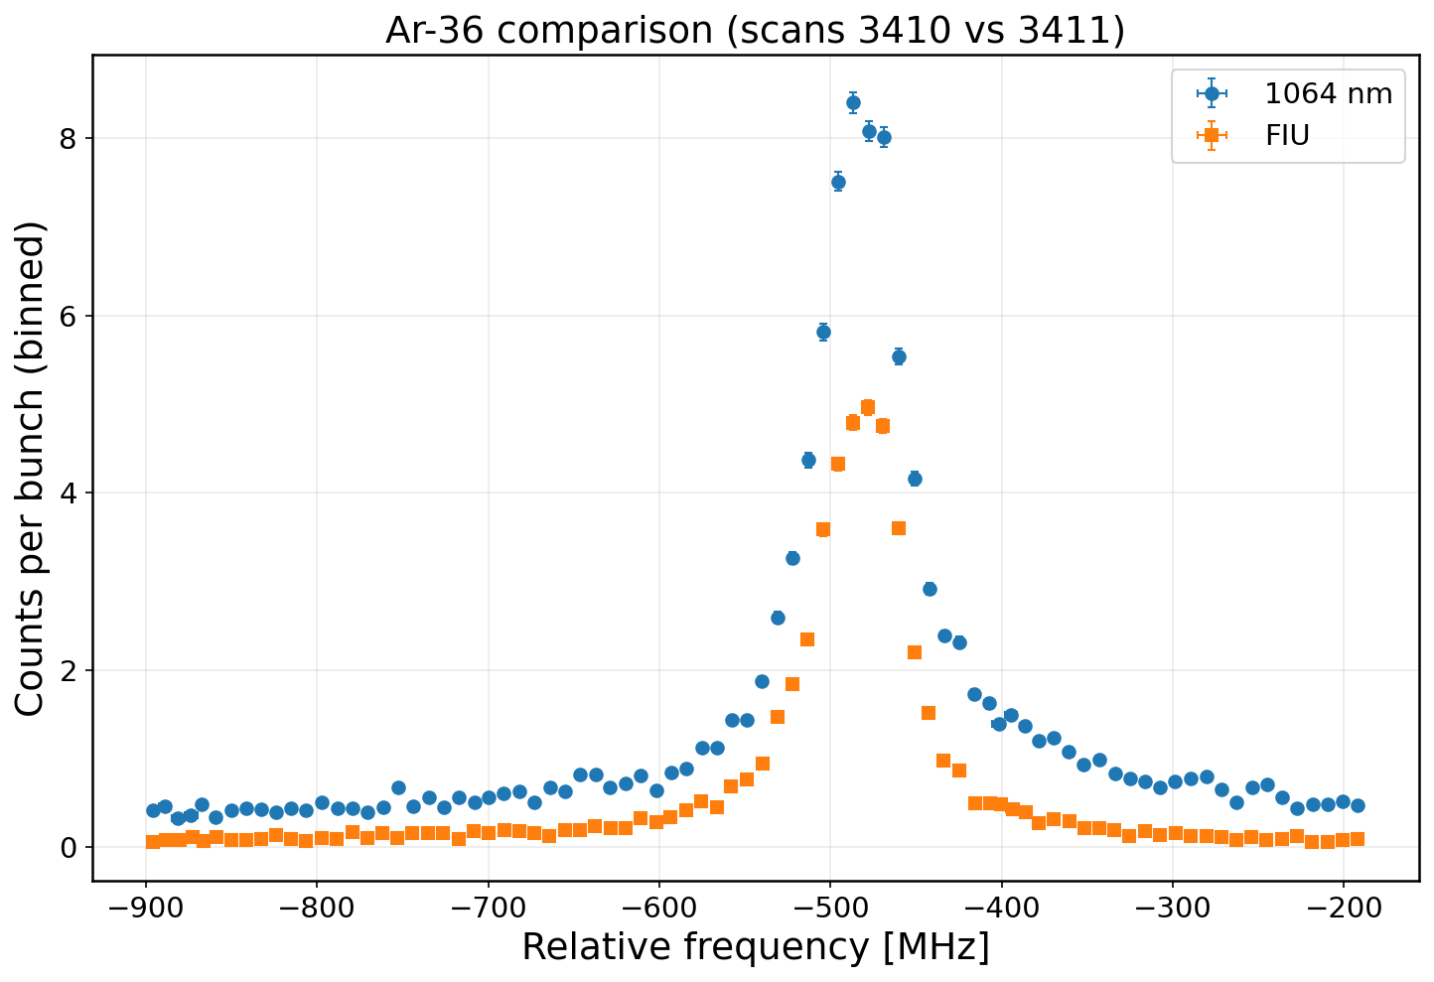
FIU vs 1064
Department of Physics and Astronomy (IKS)
07

Slide 9
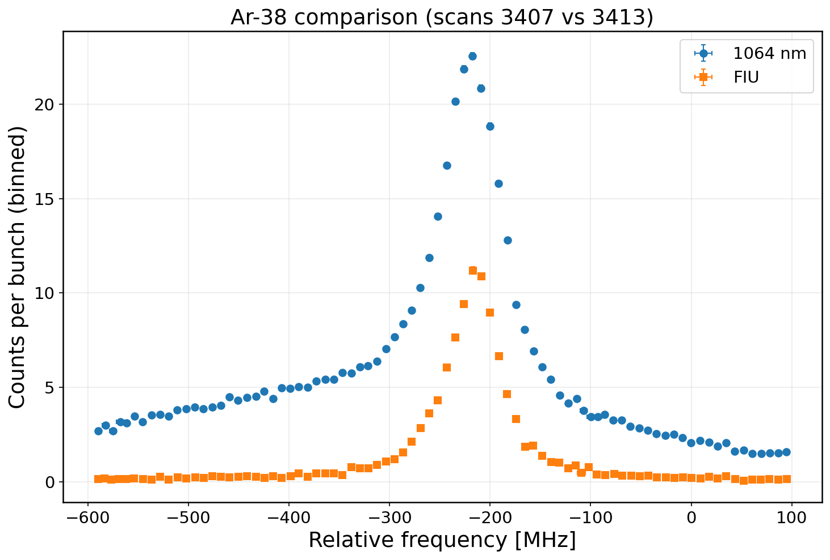
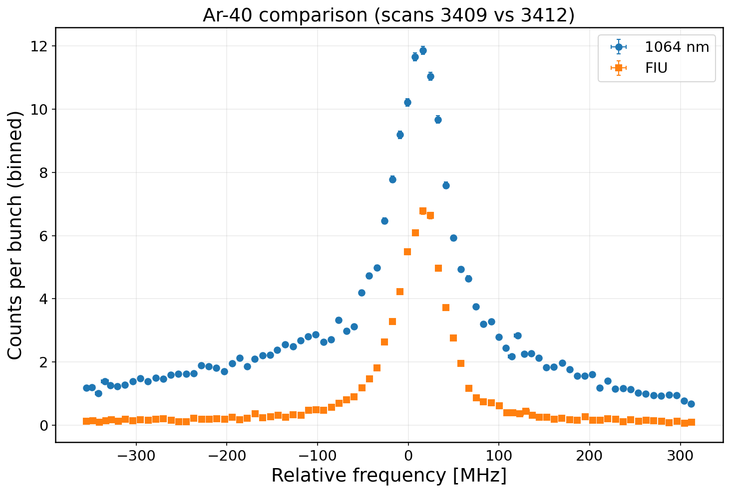
FIU vs 1064
Department of Physics and Astronomy (IKS)
08

Slide 10
Outlook
Signal/Bck needs to be looked into.
Depending upon the potential applied on the grids, bender needs to be tuned to recover the full beam.
Ionization of rydbergs 300 cm⁻¹ below the IP with FIU.
Was planned to be used for IP measurement in RaF and also for AcF.
Versatile tool to search for Rydberg’s and atomic studies.
Plans for LS3 offline campaign.
Department of Physics and Astronomy (IKS)
09

Slide 11
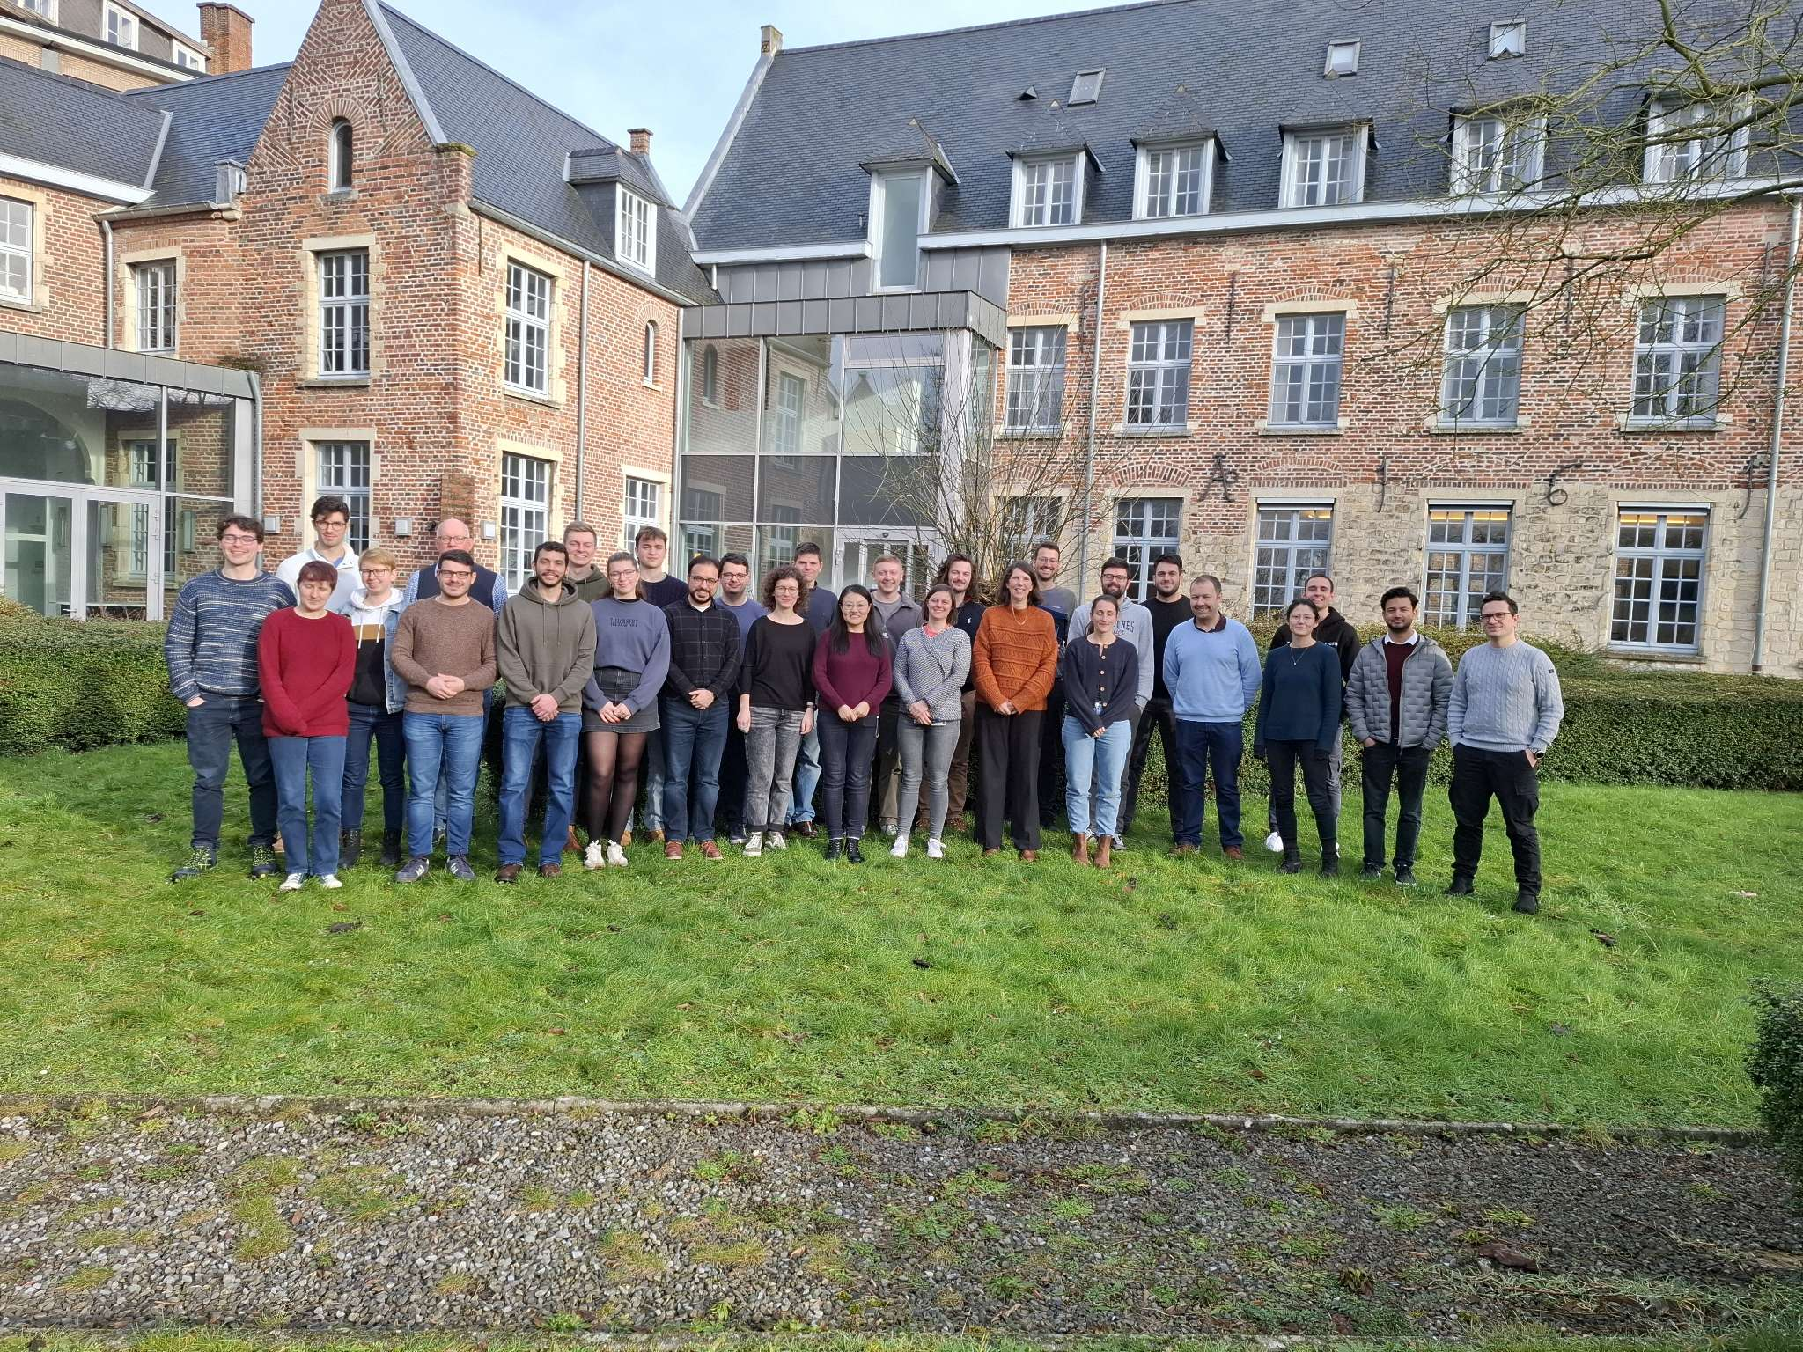








THANK YOU

