Slide 1
Update from Leuven labs

Slide 2
Gas-jet laser-rf double resonance

Slide 3
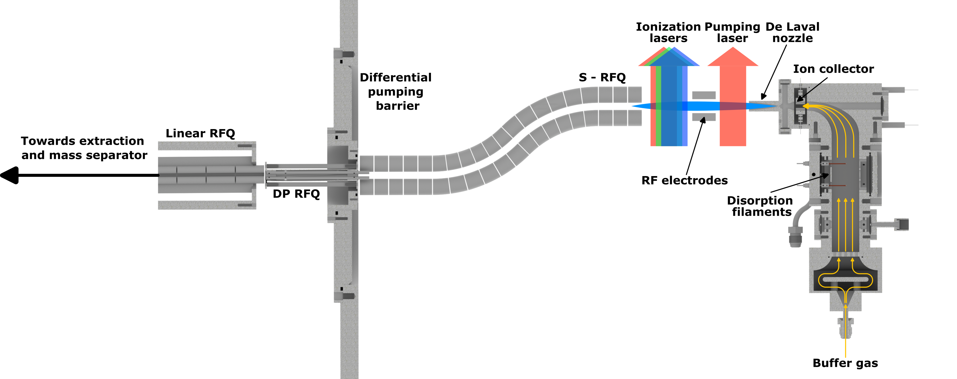
Tests in December 2025
PDA+ 355nm
OPO
Na dispenser
60 mm Jet length
~120us Time of Flight

Slide 4
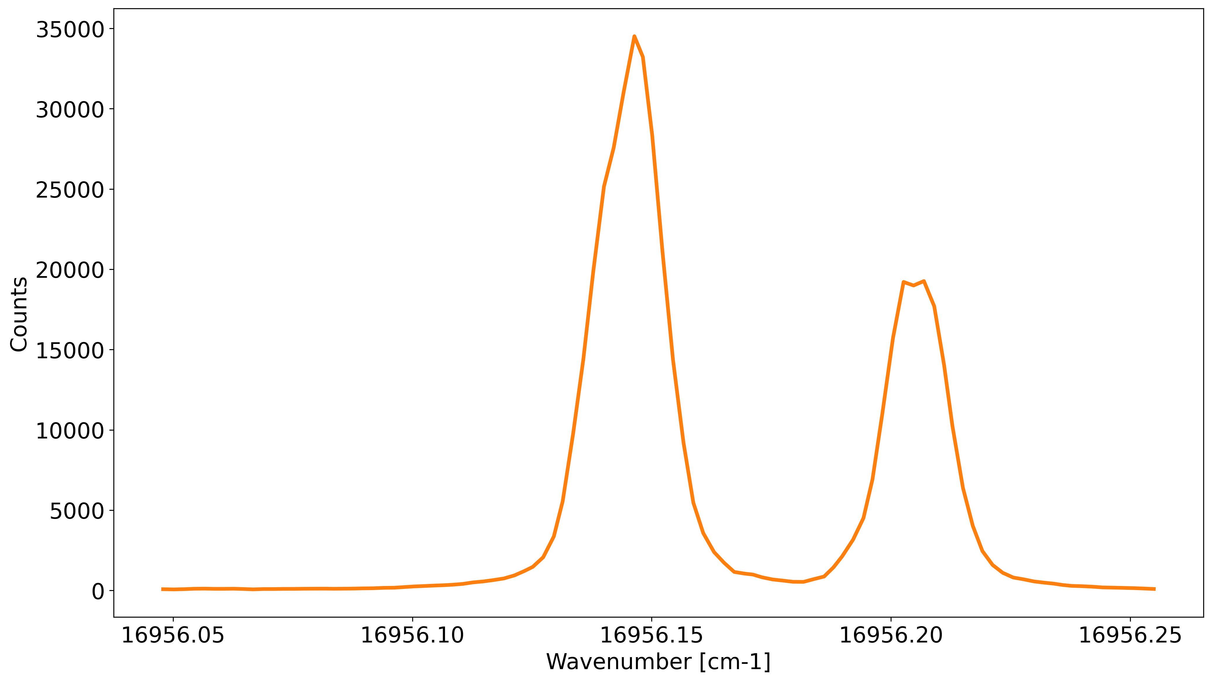
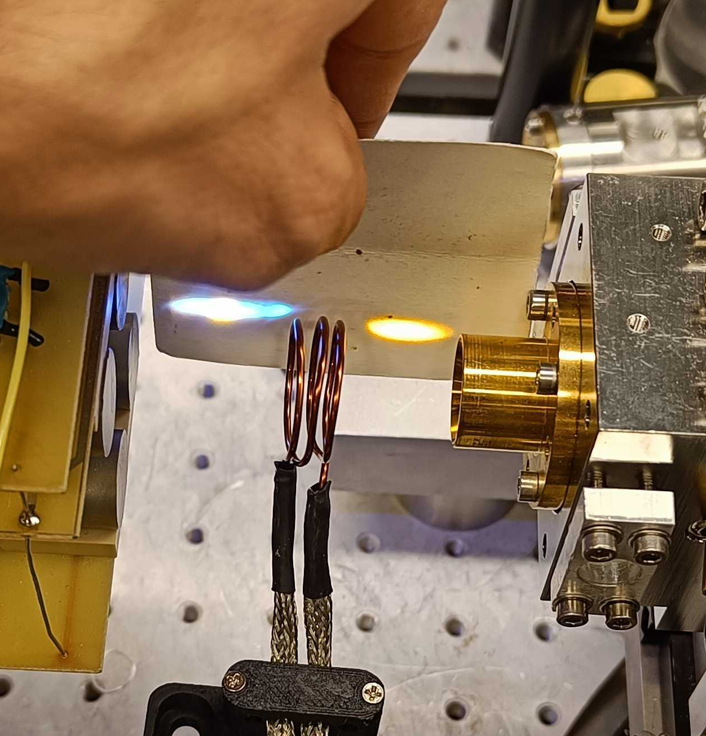
Laser Scan
No pump laser

Slide 5
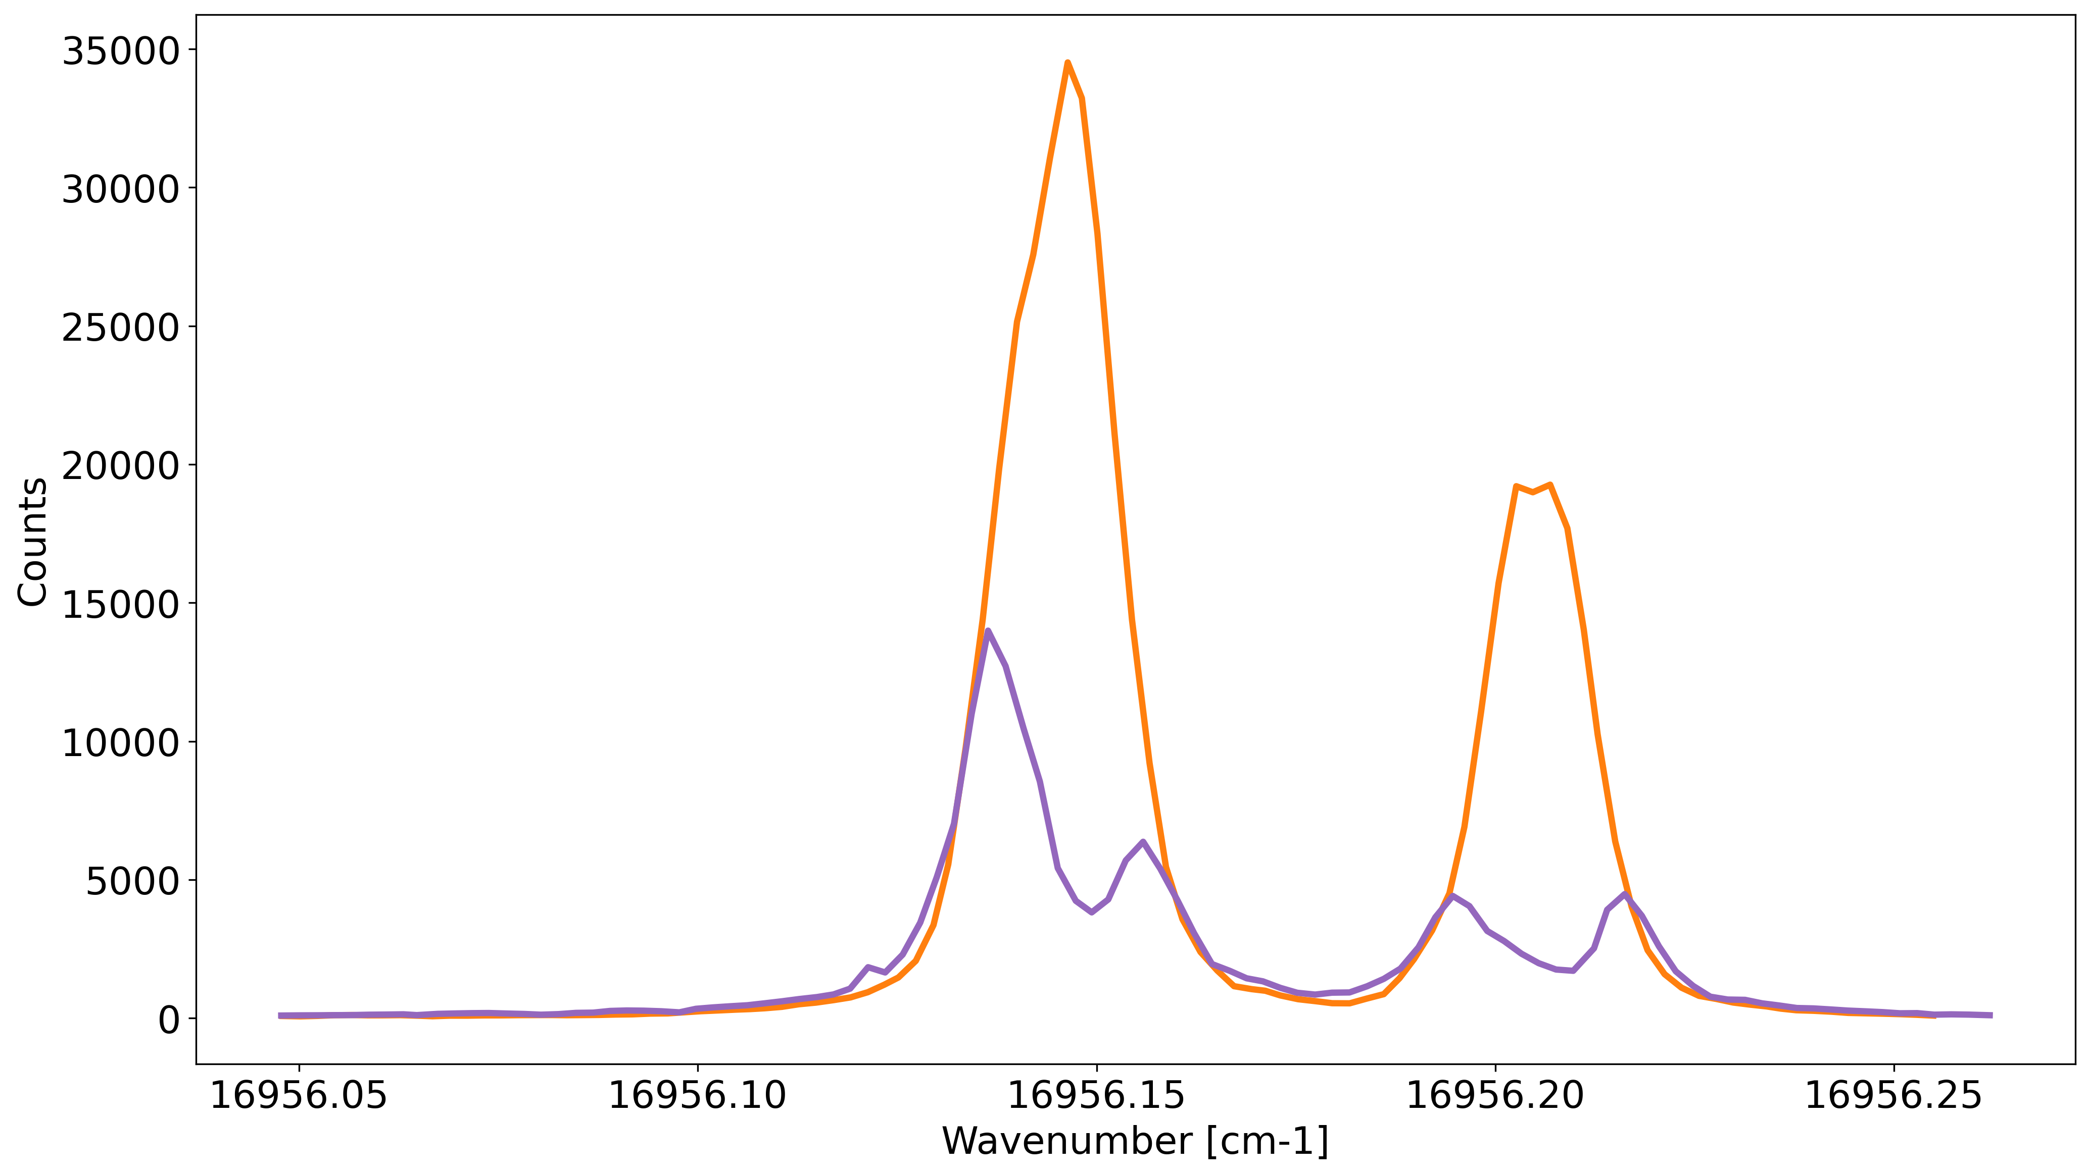
Pumping effect
~85% pumping reduction
~90% pumping reduction

Slide 6
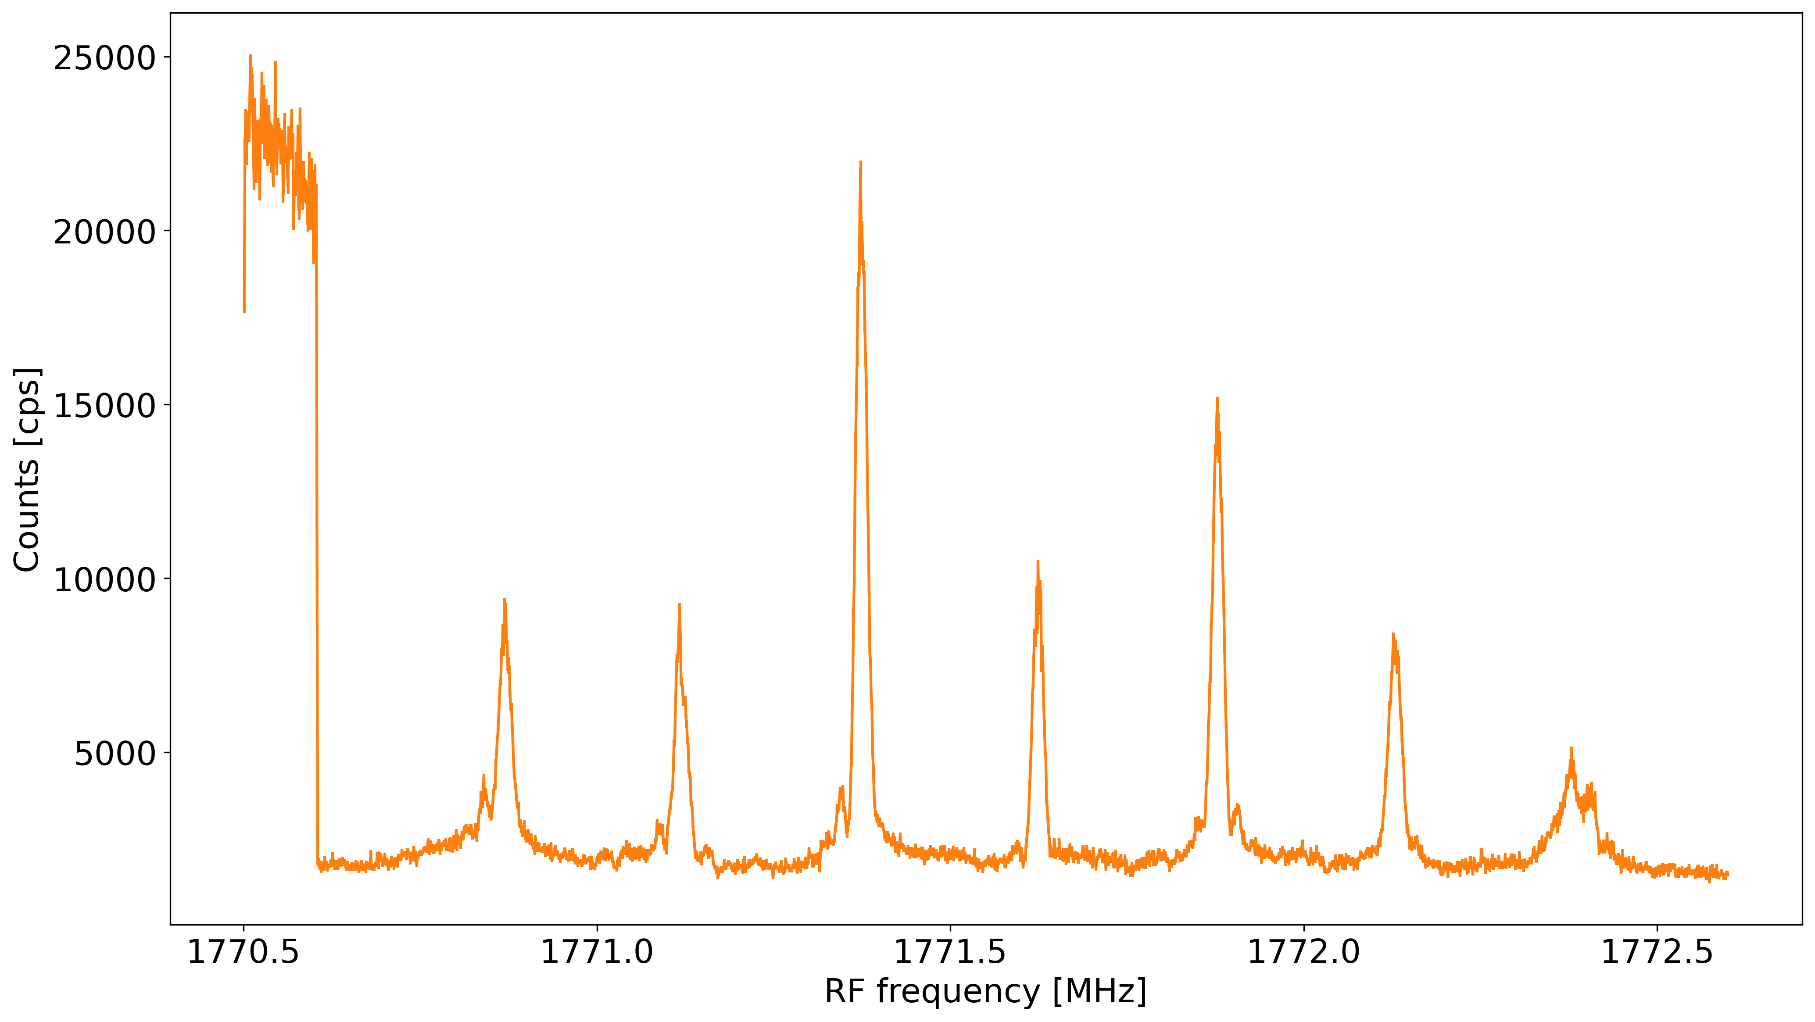
Testing the RF
RF Generator (SG6000L)
2.5PPM systematic (4.4kHz @ 1.7GHz)
Pump off
5dBm
~20KHz FWHM
Pump on

Slide 7
Rabi called
π
2π
3π

Slide 8
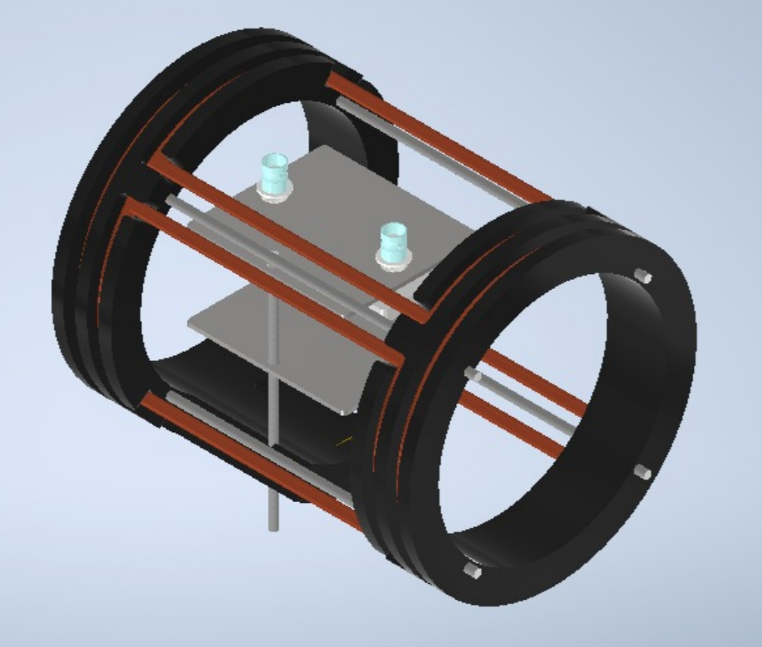
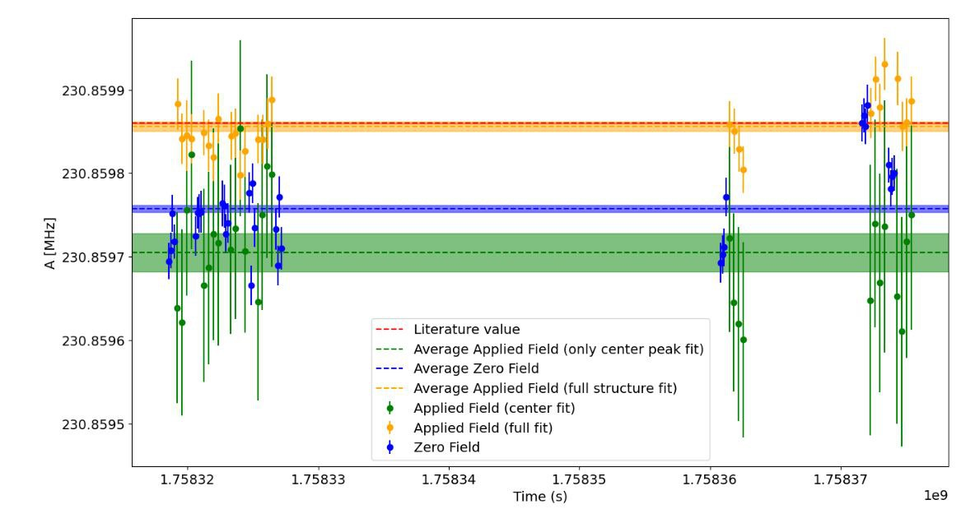
Future plans
Include Helmholtz coils for active field control
Ramsey spectroscopy for sqrt(2) better linewidth + systematics
Longer jets:
10 cm jet planned in two weeks
up to 40 cm possible in principle…
We believe we can reach a few 10 Hz statistical precision very easily
Systematics: likely also 10s-100 Hz – to be investigated
ABU work with 25 kHz linewidth: few 10 Hz. But full control is key.

Slide 9
Ion traps

Slide 10

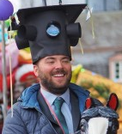
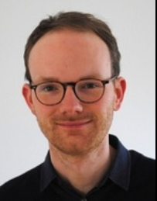


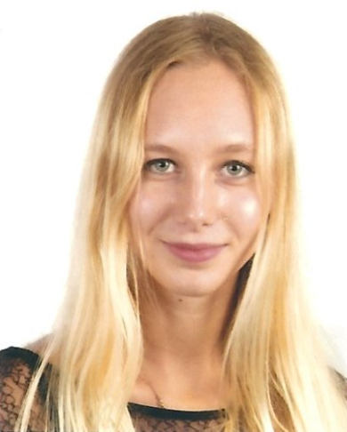
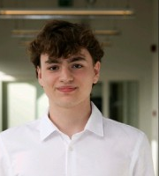
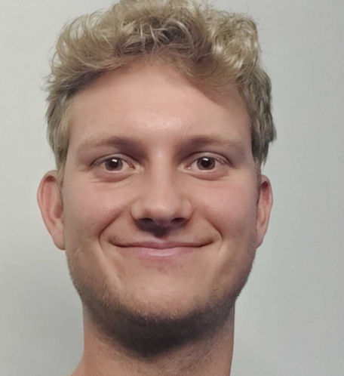
Summary
Fast and efficient trapping and cooling to μK!
Single-ion spectroscopy is possible for selected elements
Including non-E1 transitions
10 keV Sr⁺ beam
μeV Sr⁺ sample
~ 1 second, ε= ~10%
PD
PD
PD
PhD
PhD
PhD
PhD
PhD

Slide 11
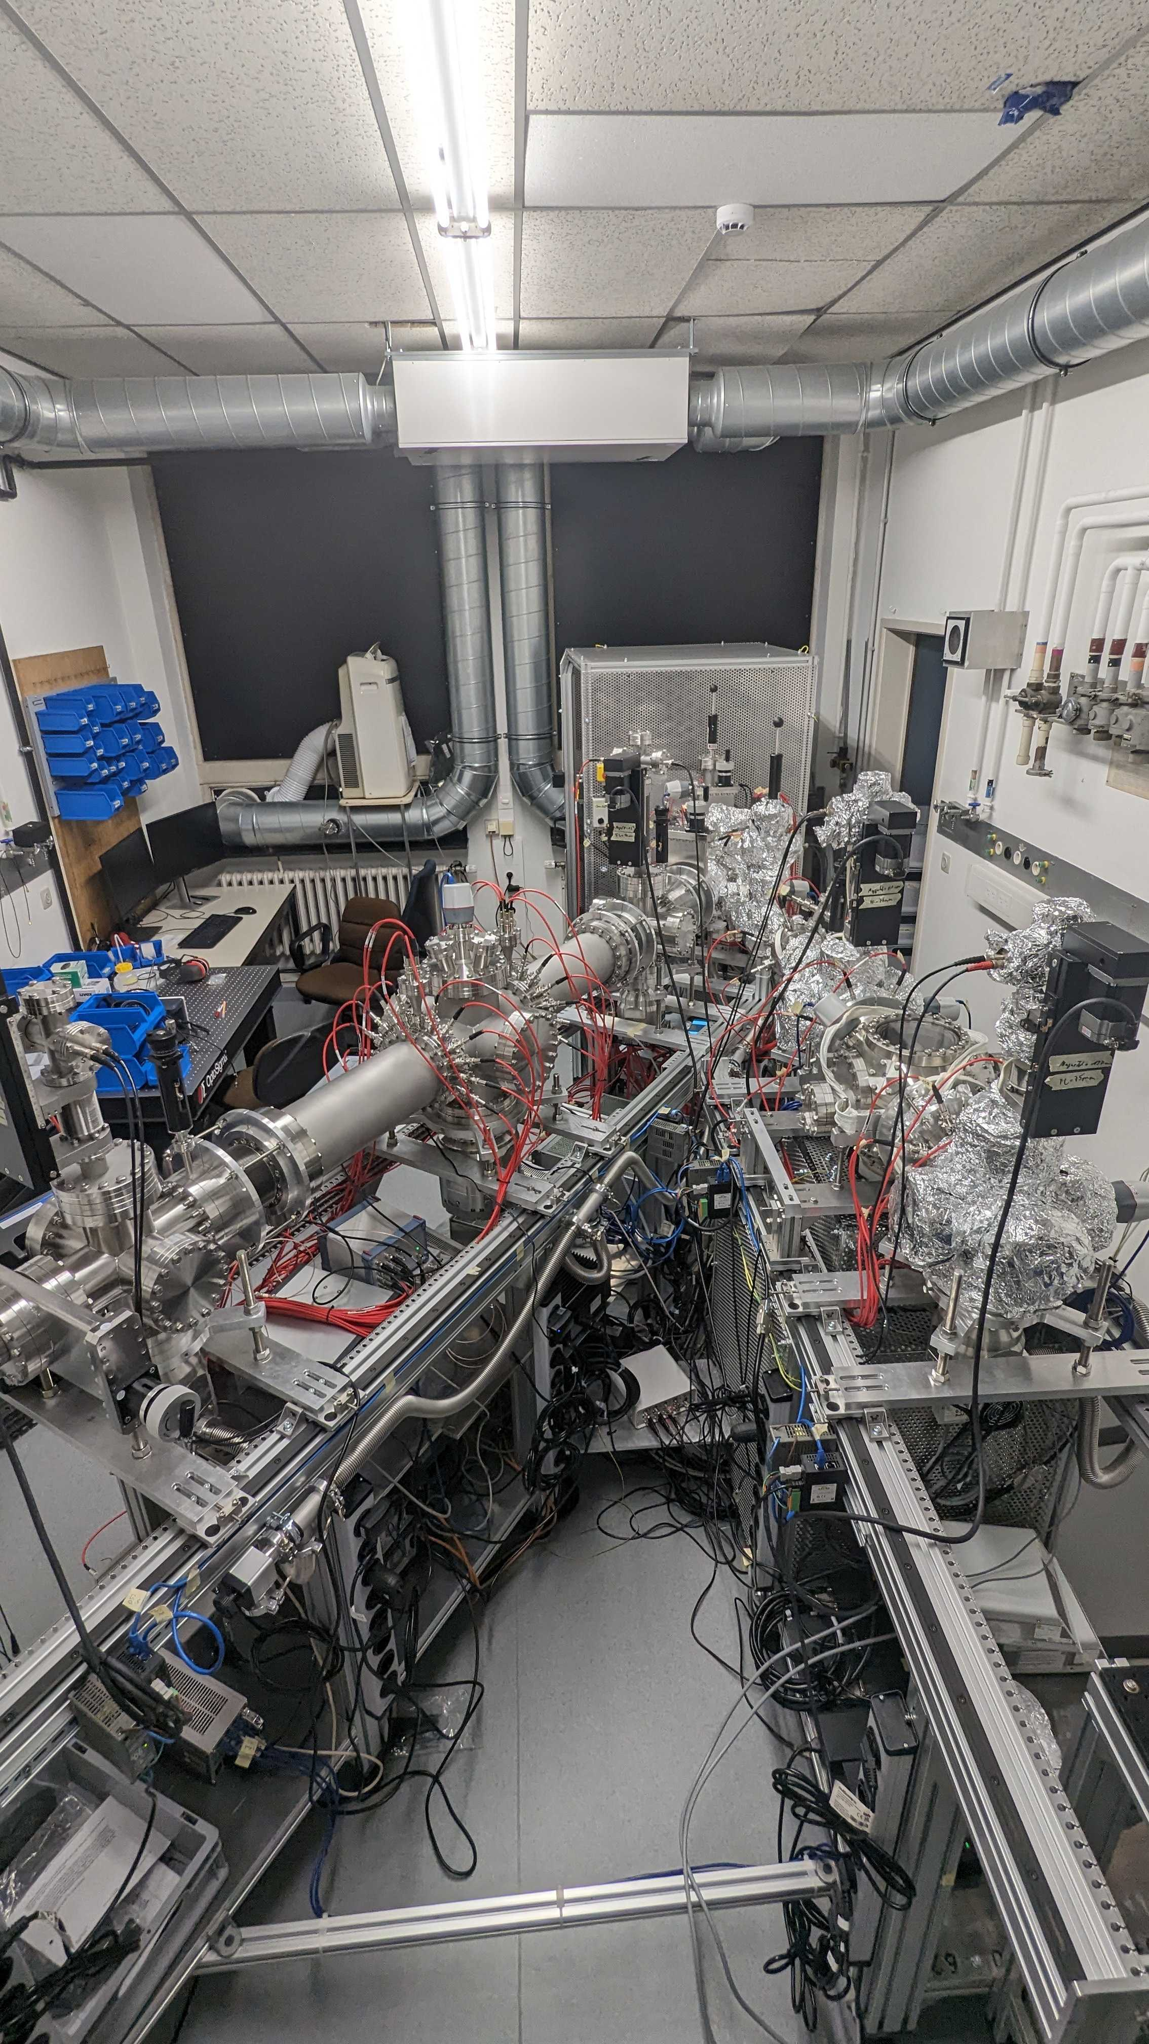
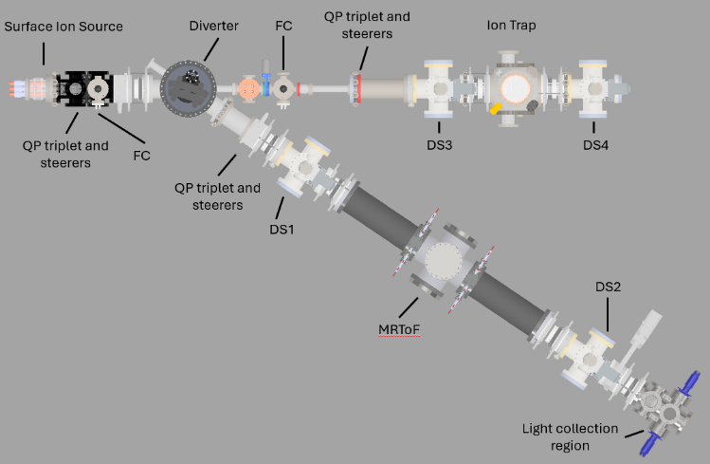
Offline development lab @KUL
Electronics: either in-house developments (RF amplifier, fast DC switching of trap segments, BNGates) or commercial (TDC, HV switches)
In-house CAD designs for all parts made and available
October ‘24

Slide 12
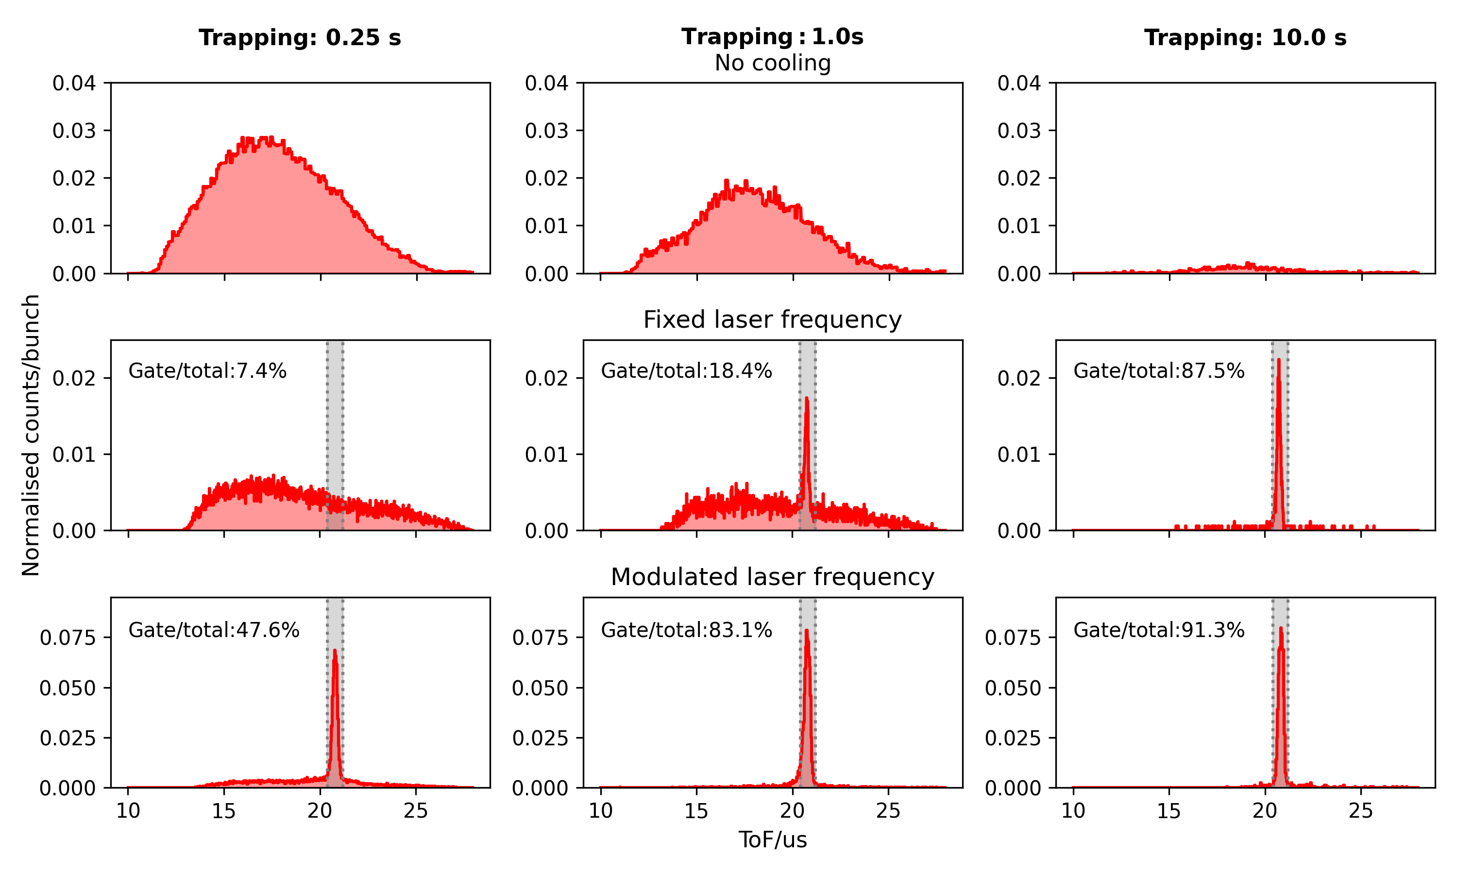
Laser cooling: reduced velocity spread
Time of flight
Around 30% of ions are trapped
Storage time: few seconds

Slide 13
Laser cooling: reduced velocity spread
Around 15% of ions are trapped, cooled and extracted
Timescale: order of a few seconds; storage time is minutes!
Temperature?

Slide 14
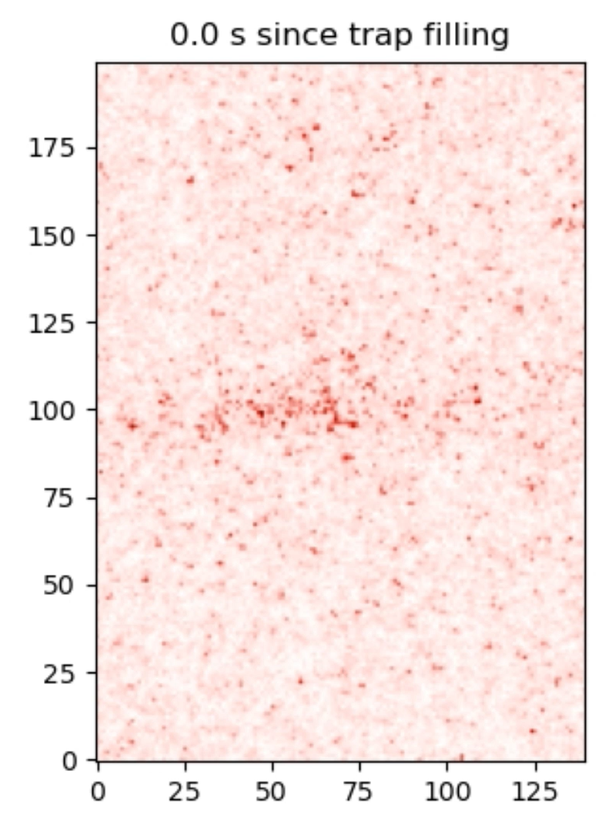
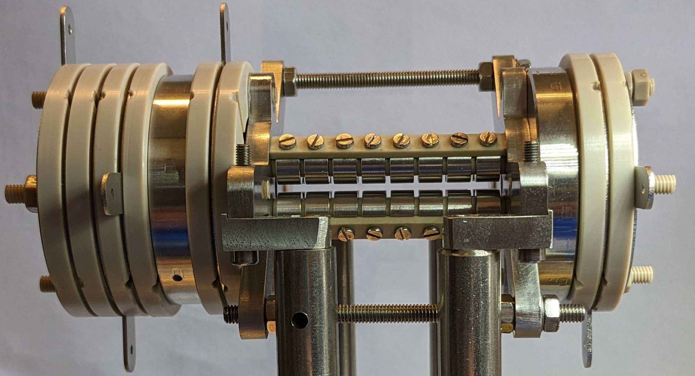
Laser cooling: ions become extremely localized
Realtime video, 400 ms exposure time per frame
Proves the temperature is a few mK.
10 cm

Slide 15
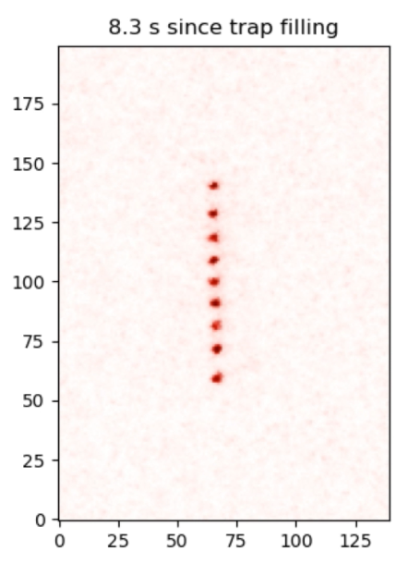
Laser cooling: ions become extremely localized
Realtime video, 400 ms exposure time per frame
Proves the temperature is a few mK.
10 cm

Slide 16
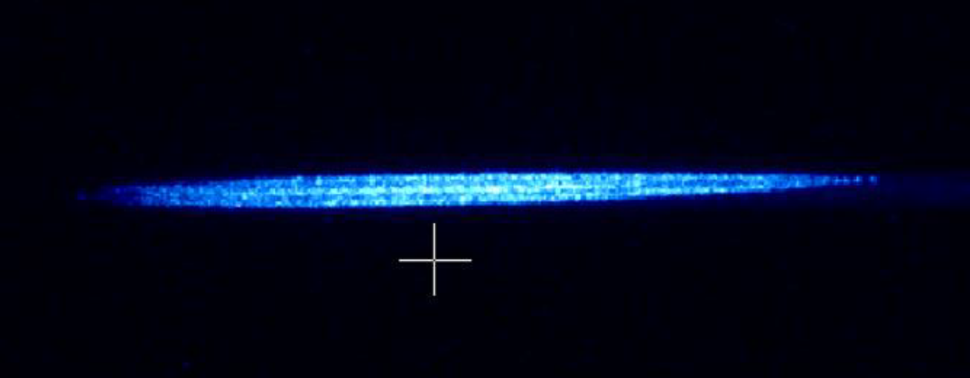
3D ion crystal of probably 200 ions
We’ve made non-crystallized samples of thousands, probably at a few kelvin

Slide 17
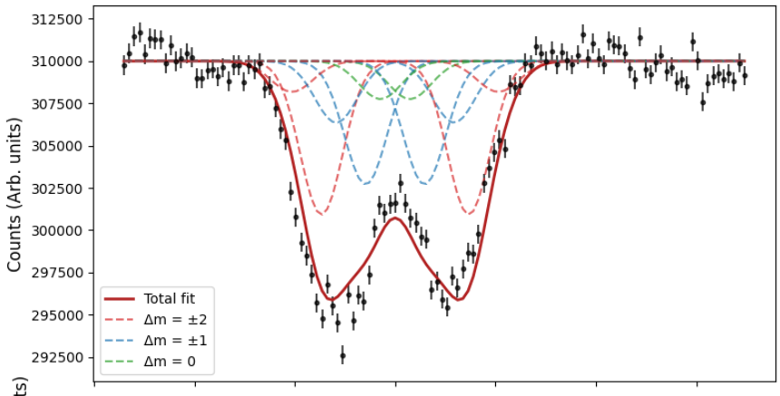
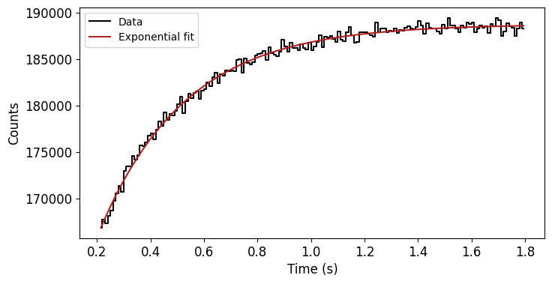
Shelving spectroscopy
E2 transition S_{1/2} to D_{5/2}
Removes ion from the cooling cycle, so fluorescence stops
Zeeman substructure apparent
First results (Dec 2025):
Likely micromotion-limited
Also, an upgraded laser system is required
Scan of E2 line
P_{1/2}
D_{5/2}
422nm
1092nm
D_{3/2}
Lifetime of D_{5/2}
674nm
S_{1/2}

Slide 18
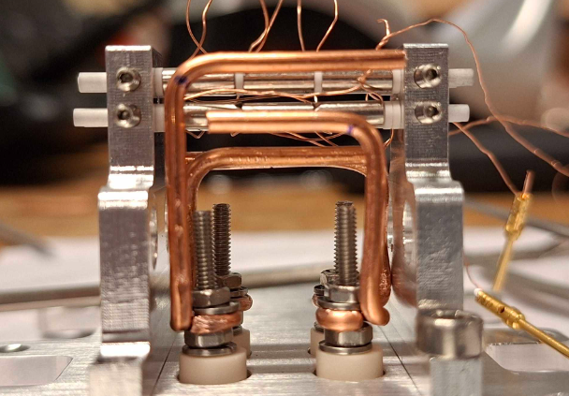
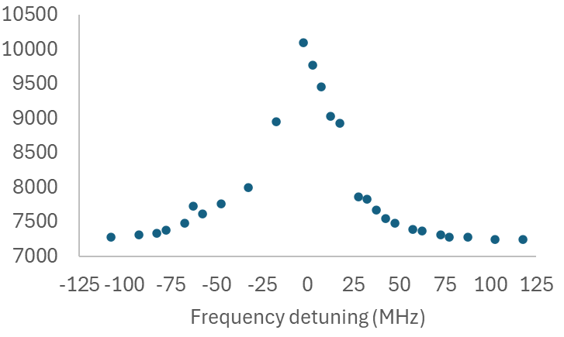
Spectroscopy with single ions – optimized geometry
Smaller geometry, easier to bring optics close
Optimized for precision spectroscopy
Pressure: 1e-11 mbar
Improved efficiency, signal 10k/s
Scan with a single ion, 3 minutes data taking
Clearly compatible with study of exotic isotopes.

Slide 19
Next steps
We are currently shipping an improved copy of the setup will be moved to the IGISOL radioactive facility in Finland.
Large ‘cooling trap’ will be coupled to the small ‘spectroscopy trap’
December 2025
Now
Equipment move to IGISOL
February 2026
Design completed
Offline commissioning
June 2026
Can we study long-lived samples in KU Leuven?
Coupling tested
Application on radioactive ions
Early 2027

Slide 20
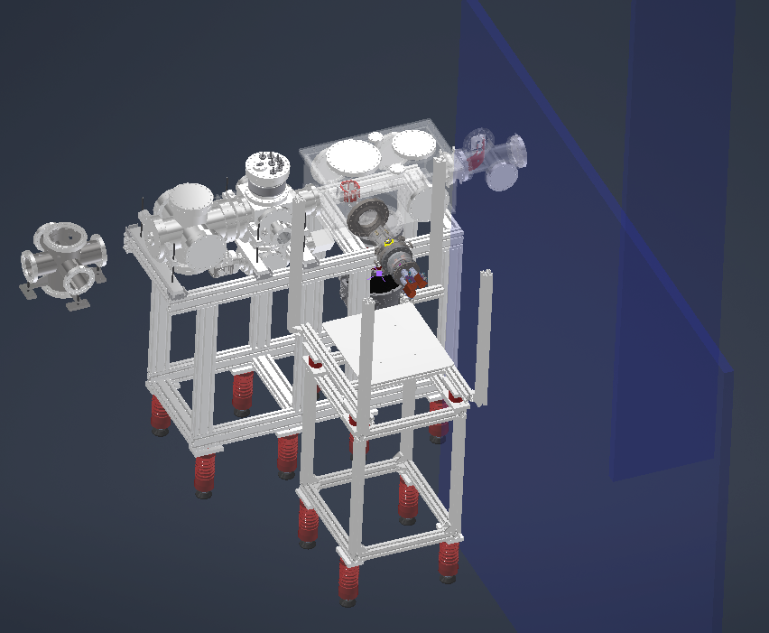
RFQ
P Trap

Slide 21
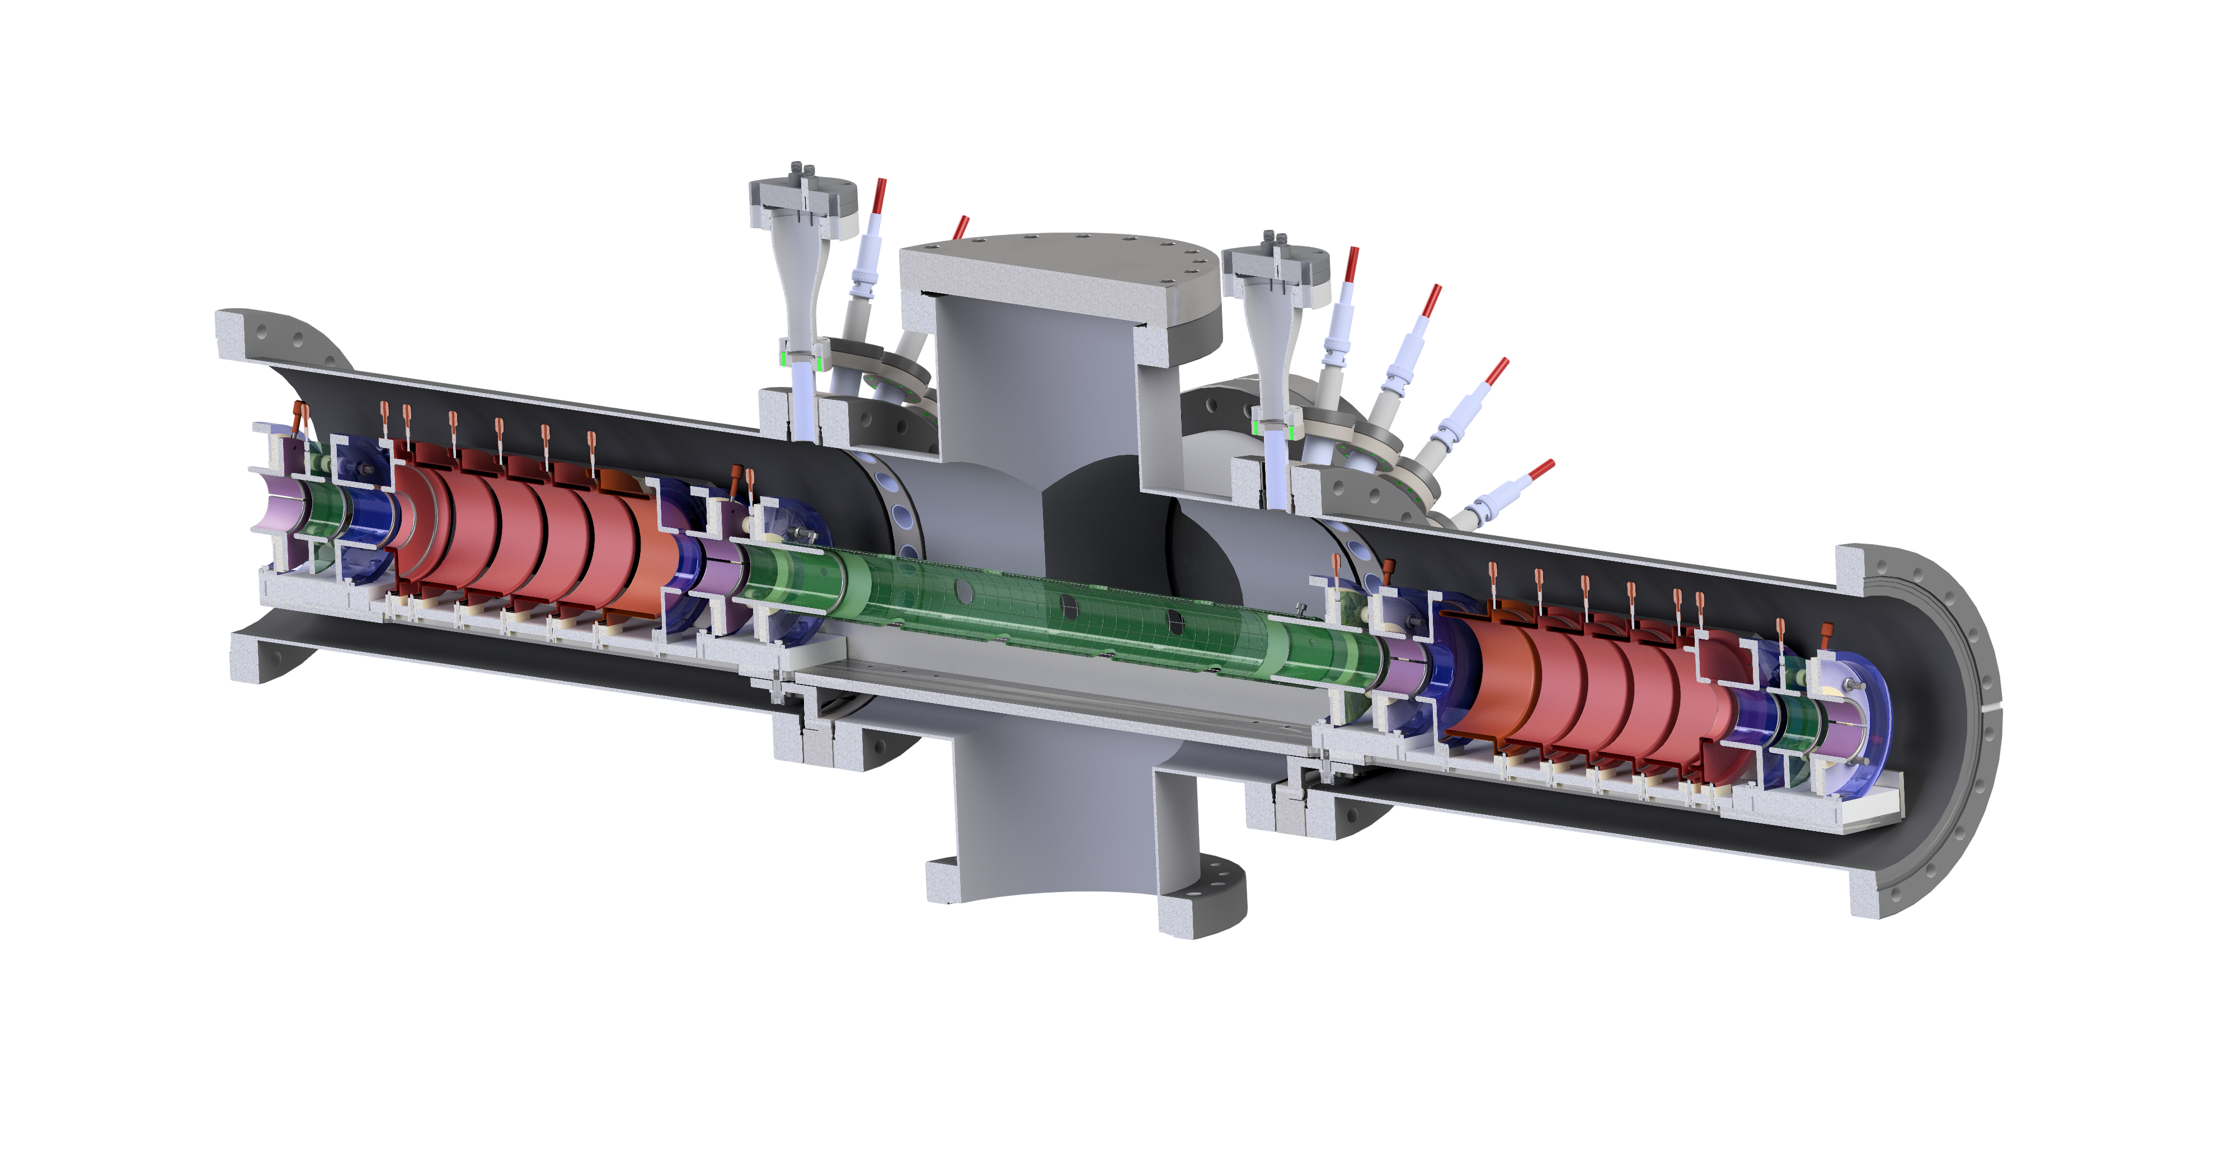
MR-TOF
Electrostatic mirrors
Deflectors
Einzel lens
120 mm
Pulsed drift tube
Steerers

Slide 22
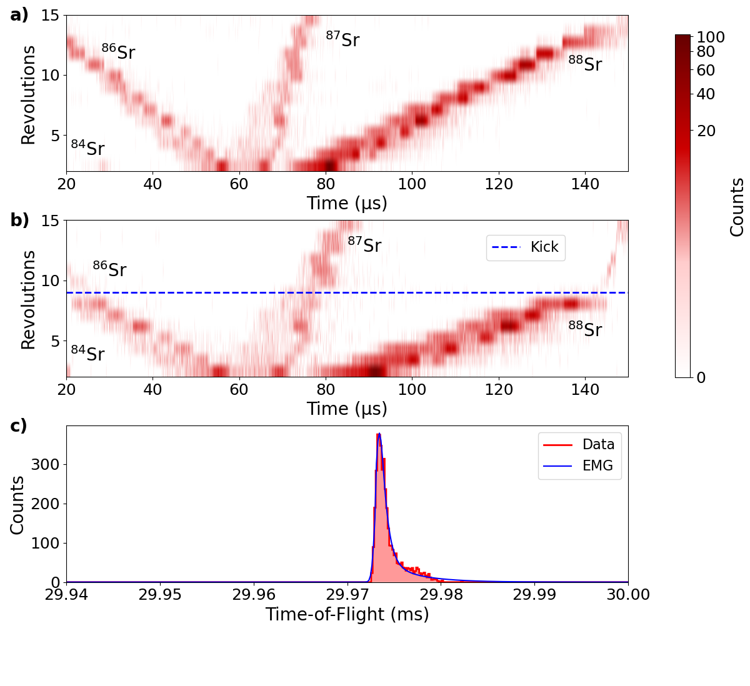
MR-ToF commissioning
MR-ToF commissioned with natural Sr
Deflection efficiency > 90%
Installation of the BNG allowed production of ≈ 170 ns bunches
Mass resolving power after 400 revolutions:
43,097 ± 546
PhD student claims he can get 80k with more tuning (limited by FWHM of the ion bunch)
Notes:
MRTOF kicker
The addition of a Bradbury-Nielsen gate to the beamline allowed the production of 100 ns ion bunches, compared to the previous 1 µs bunches (see Fig.3). As a result, the mass resolving power was increased by more than a factor of three, reaching 43,097 ± 546 after 400 revolutions. At present, the mass resolution is limited by the FWHM of the ion bunch, which is around 170 ns.

Slide 23
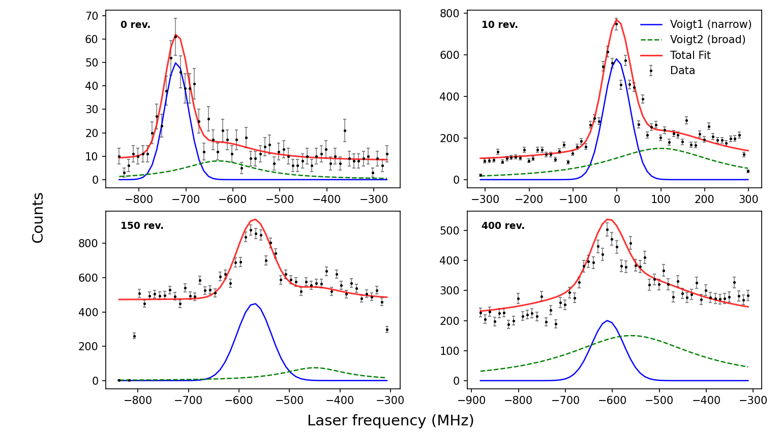
CLS after MR-ToF
Isobaric separation techniques to fluorescence laser spectroscopy
Efficiency: <1:1000
Background: about 1 kHz
MR-ToF introduces shift of resonance frequency
32 MHz correspond to 1 V shift in energy
Tail arising from the chopping of the beam
Notes:
Performing laser spectroscopy after a MR-ToF enables the application of isobaric separation techniques to fluorescence laser spectroscopy. This approach is being tested using the offline ion beamline at KU Leuven.
Preliminary results, presented in Figure 4, show collinear laser spectroscopy measurements on ⁸⁸Sr⁺. A resonance frequency shift of up to 700 MHz is observed after varying numbers of MR-ToF revolutions. Which corresponds to 22V shift of the ions fter the mrtof. This shift is attributed to changes in the ion kinetic energy introduced during multiple reflections. Ongoing studies aim to identify and understand the mechanisms responsible for these energy variations.
S_{1/2} to P_{1/2} transition in ⁸⁸Sr⁺

Slide 24
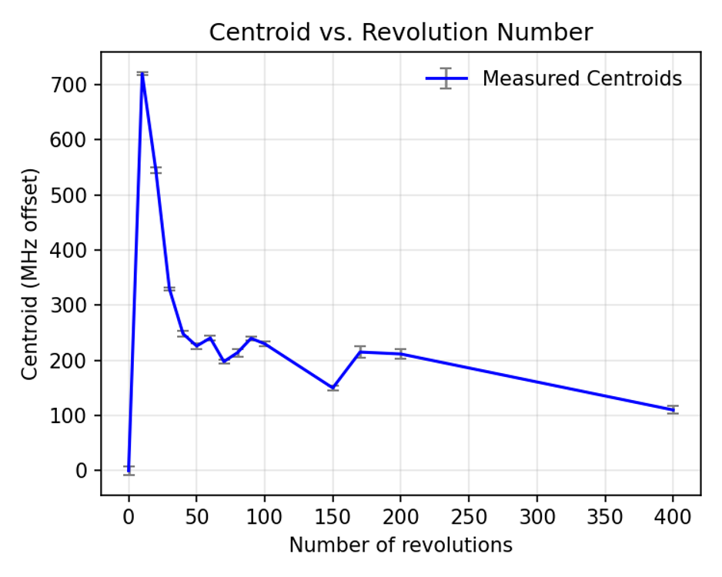
Centroid shift for different revolutions
Largest shift of the centroid at 10 revolutions
Possible explanation is the switching of the pulsed drift tube
Ions are ejected before pulsed drift tube reaches 0 V
Further study to understand the shifts

Slide 25
Future plans
MR-TOF works well – we understand how to build and tune it
Improve the HV switch of the MRTOF and explore the limits of S/B with pure beams (interest for JYU experiments)
Looking to have some fun with optical pumping or driving forbidden transitions in the MR-TOF
PhD students came with the idea to move the beamline into our ‘precision trap lab’ to give the beamline more space to grow, and to connect the traps together…
We are waiting for a clear plan ☺
Building our own RFQ-CB
Copy of existing design, likely Beijing design
New PhD student (Lotte) starts Augst 2026

