Slide 1



High-resolution laser spectroscopy of gold isotopes at CRIS: IS737
CRIS Collaboration meeting 2026
Osama Ahmad
02/02/2026
Supervisor: Prof. dr. Gerda Neyens
Co-supervisor: Dr. Jessica Warbinek

Slide 2
Outline
Background
Motivation
Results: Spin confirmation
Results: Magnetic dipole moments and HFA
Results: Electric Quadrupole moments
Conclusion/ Outlook
Department of Physics and Astronomy (IKS)

Slide 3

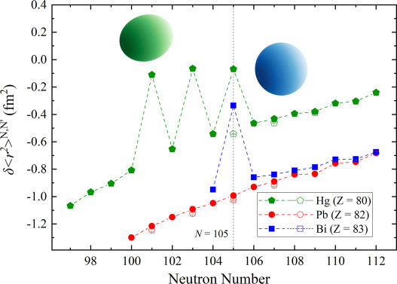
Background
How’s the behavior in Au isotopes?
Large shape staggering in Hg (Z=80) from N = 105 to 100 [1];
Same phenomenon in Bi (Z=83) exactly at N = 105 and similar magnitude as Hg [2];
In contrast, Pb (Z=82) isotopes remain spherical down to N = 101 [3]
[1] J.Bonn et. al, Physics Letters B Volume 38, Issue 5, 1972, Pages 308-311;
[2] A. Barzakh, et al. Phys. Rev. Lett. 127, 192501(2021) ;
[3] H. De. Witte et al., Phys. Rev. Lett., 98,112502 (2007)
Department of Physics and Astronomy (IKS)
01

Slide 4
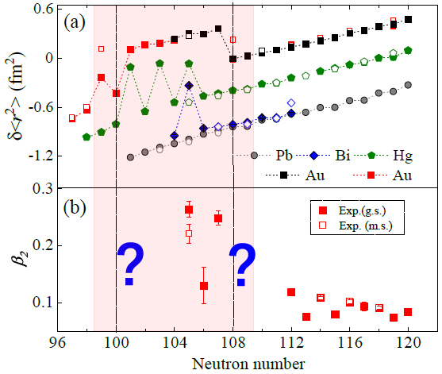
Physics motivation
The scenario is very different in Au (Z=79) [1]
Strong increase in charge radii at N = 101-107
Proposed “Island of deformation”
At N = 99 & N = 108 (¹⁷⁸Au,¹⁸⁷Au), indication for shape coexistence
Charge radii and quadrupole moments are a probe for deformation: study Q_{s} for isotopes in the proposed ‘island of deformation’ and for the isotopes with shape coexistence: proposal IS737 [2]
Goals: measure spins of N = 102,103,104. Q_{s} for isotopes in the island of deformation and the high-spin isomers
[1] J.G Cubiss et. al ., Phys. Rev. Lett., 131,202501 (2023)
[2] X.F. Yang, S.W Bai, G. Neyens, L. Lalanne et al., proposal IS737
Department of Physics and Astronomy (IKS)
02

Slide 5
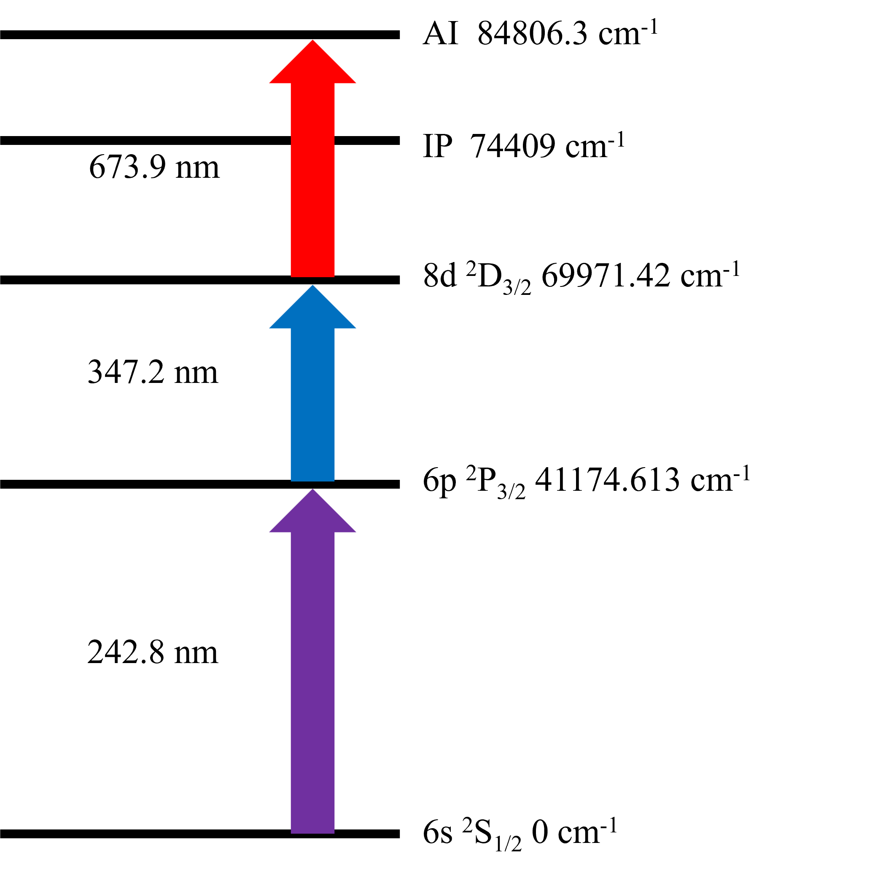
Laser schemes
5d¹⁰6p ²P_{3/2}
5d¹⁰6p ²P_{1/2}
COLLAPS, 1994
627.8 nm
CRIS
RILIS
242.8 nm
267.6 nm
5d⁹6s² ²D_{3/2}
5d¹⁰6s ²S_{1/2}
CRIS
Spectroscopy steps used for Au in literature
Department of Physics and Astronomy (IKS)
Figure adopted: Passler et. al, Quadrupole moments and nuclear shapes of neutron-deficient gold isotopes. Nuclear Physics A580 (1994)
03

Slide 6
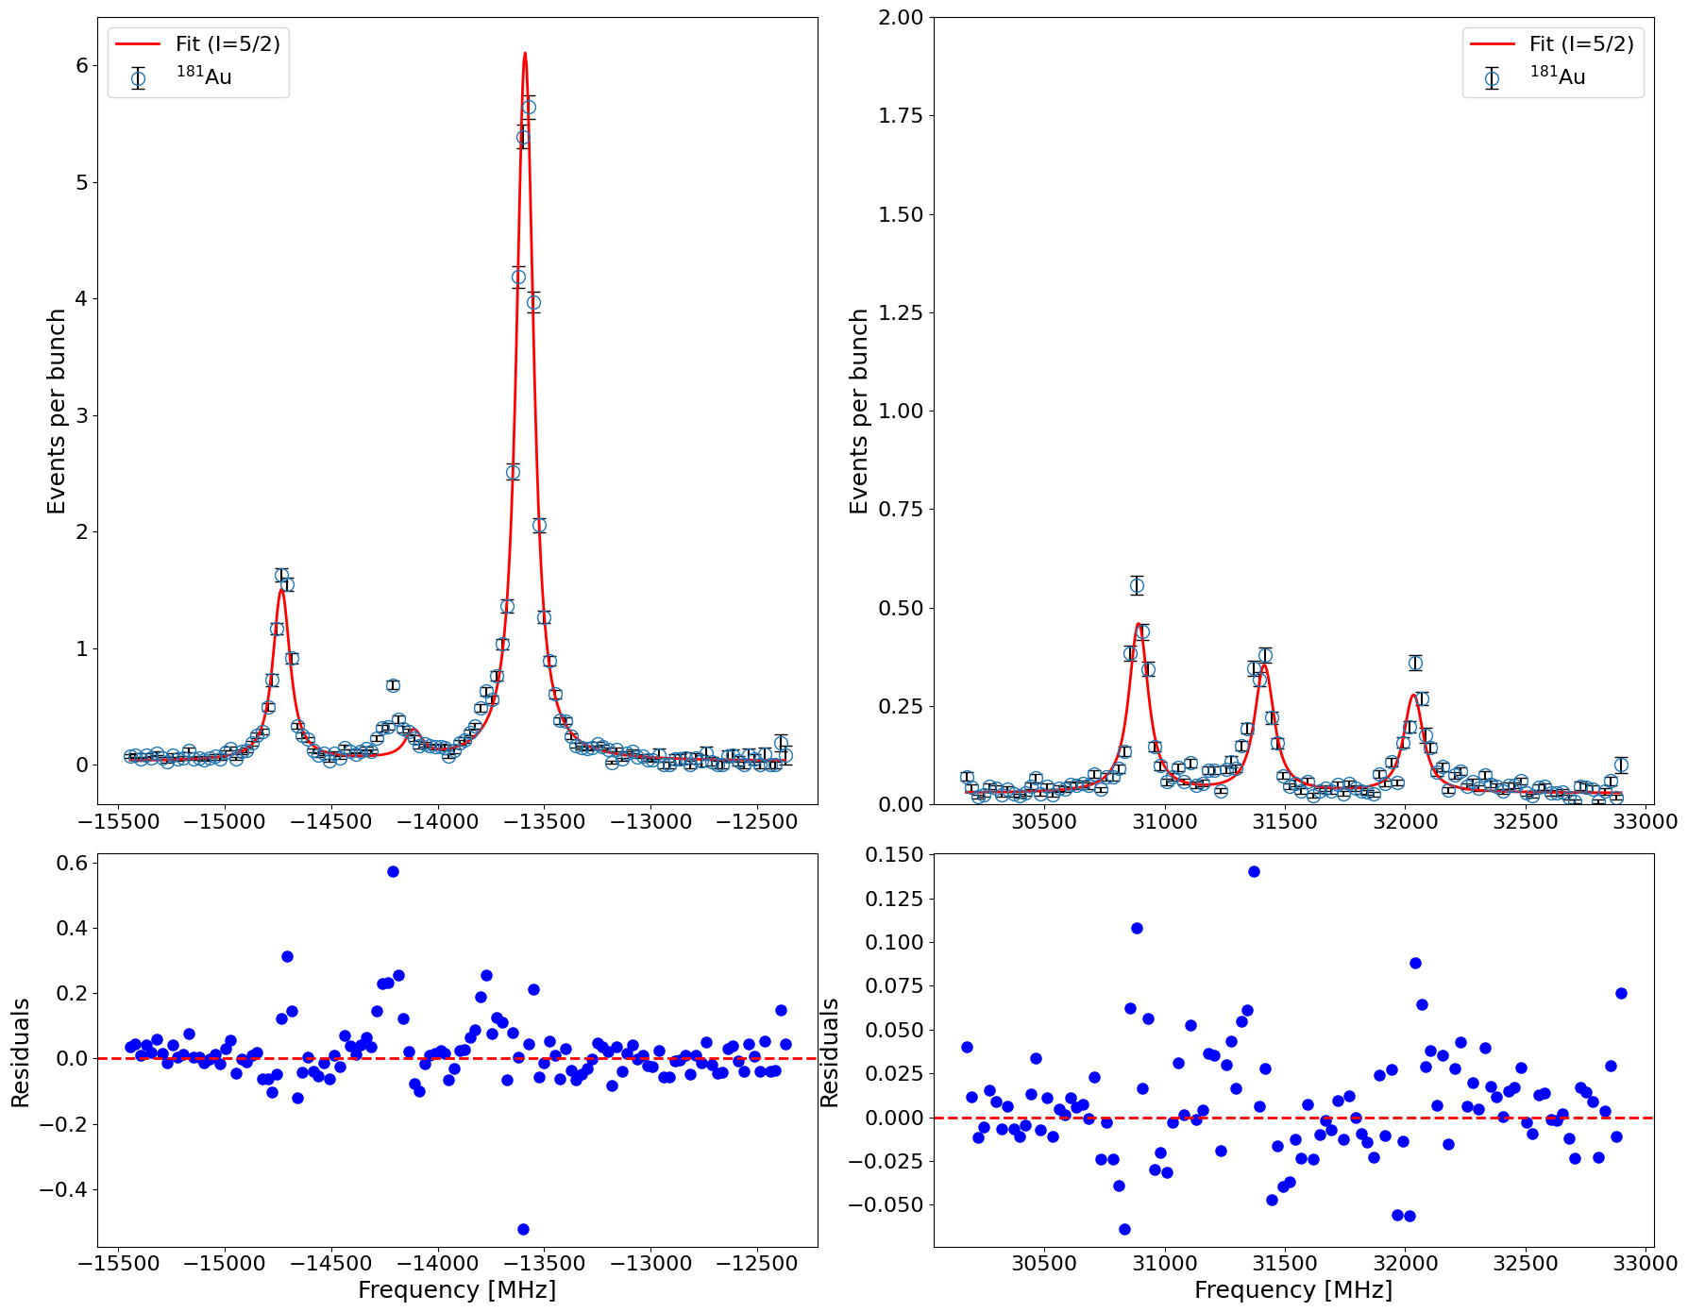

Spin assignment for ¹⁸¹⁻¹⁸³ Au
For ¹⁸¹Au, ¹⁸²Au and ¹⁸³Au: Spin assignment is tentative in the literature.
¹⁸¹Au
I = 5/2
Isotope | Half-life | I^{π}
¹⁸¹Au₁₀₂ | 13.7 s | (3/2⁻)
¹⁸²Au₁₀₃ | 15.5 s | (2⁺)
¹⁸³Au₁₀₄ | 42.8 s | (5/2⁻)
No. of observed resonance peaks
Possible spins for 181,182 and 183: we observe 6 peaks in HFS for a transition from J = 1/2 to J = 3/2
Possible spins for ¹⁸¹Au & ¹⁸³Au: 3/2, 5/2, 7/2
&
For ¹⁸²Au: 2,3,4,5
2. Fit quality:
Department of Physics and Astronomy (IKS)
04

Slide 7
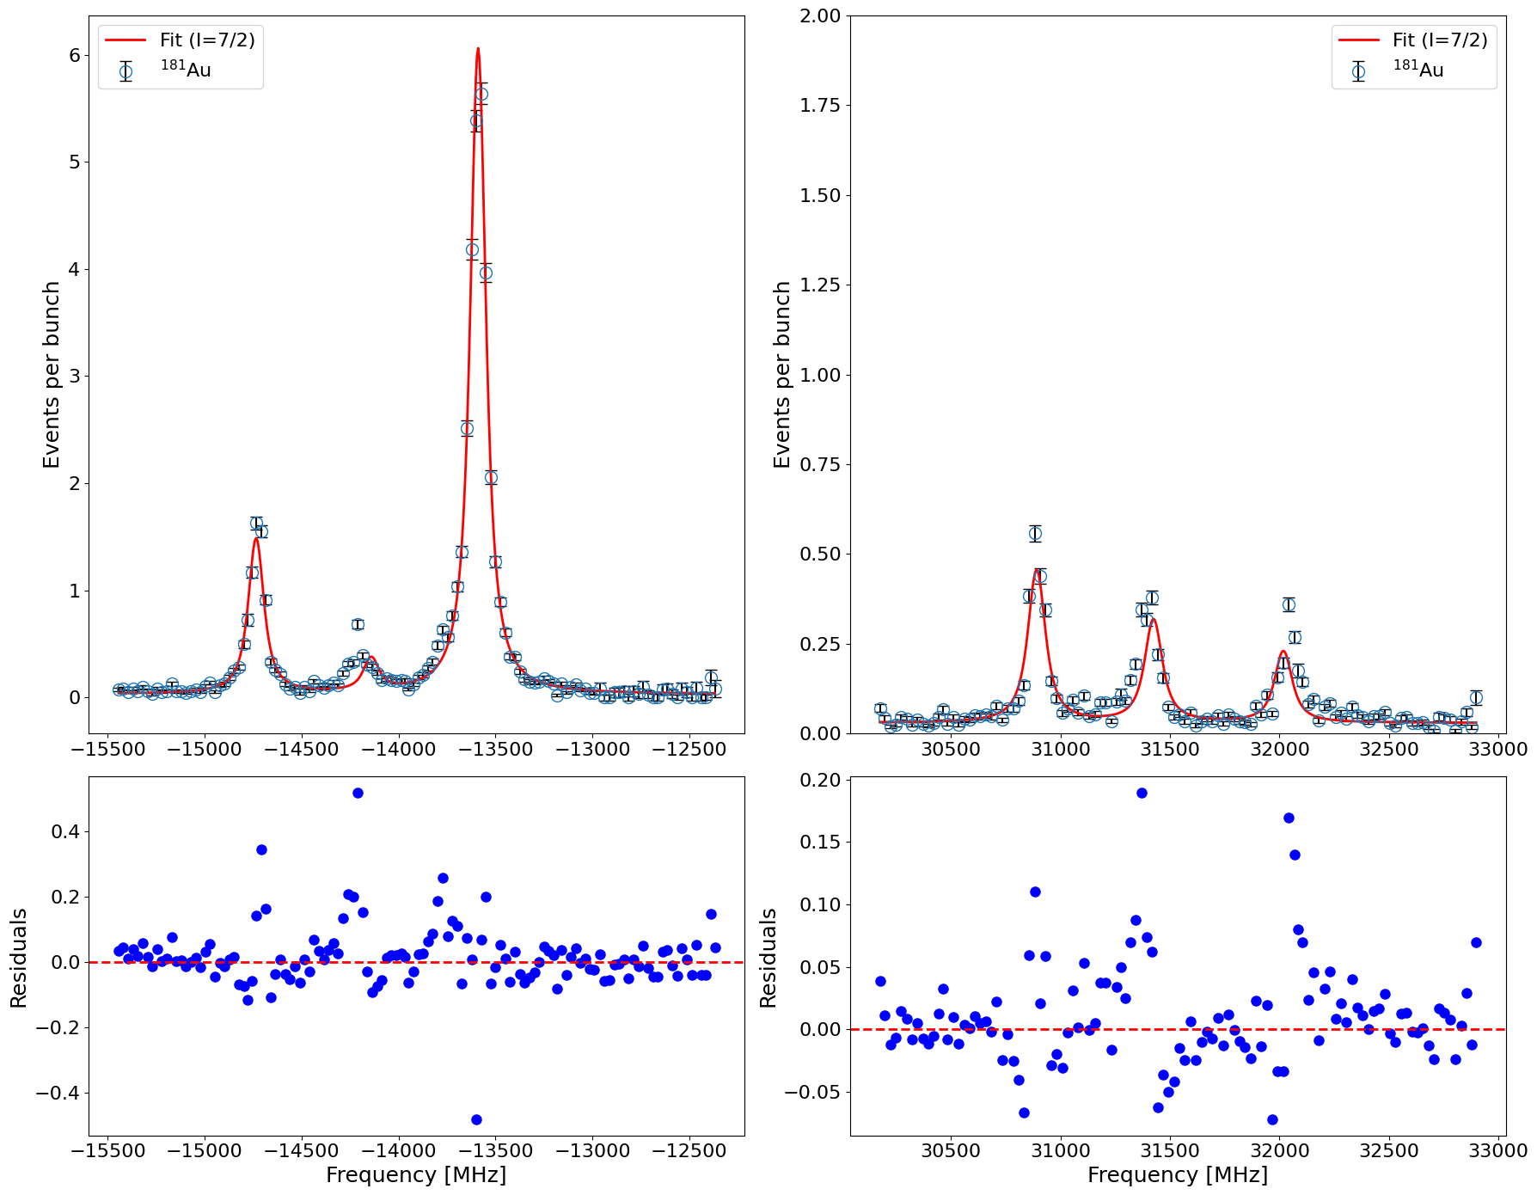
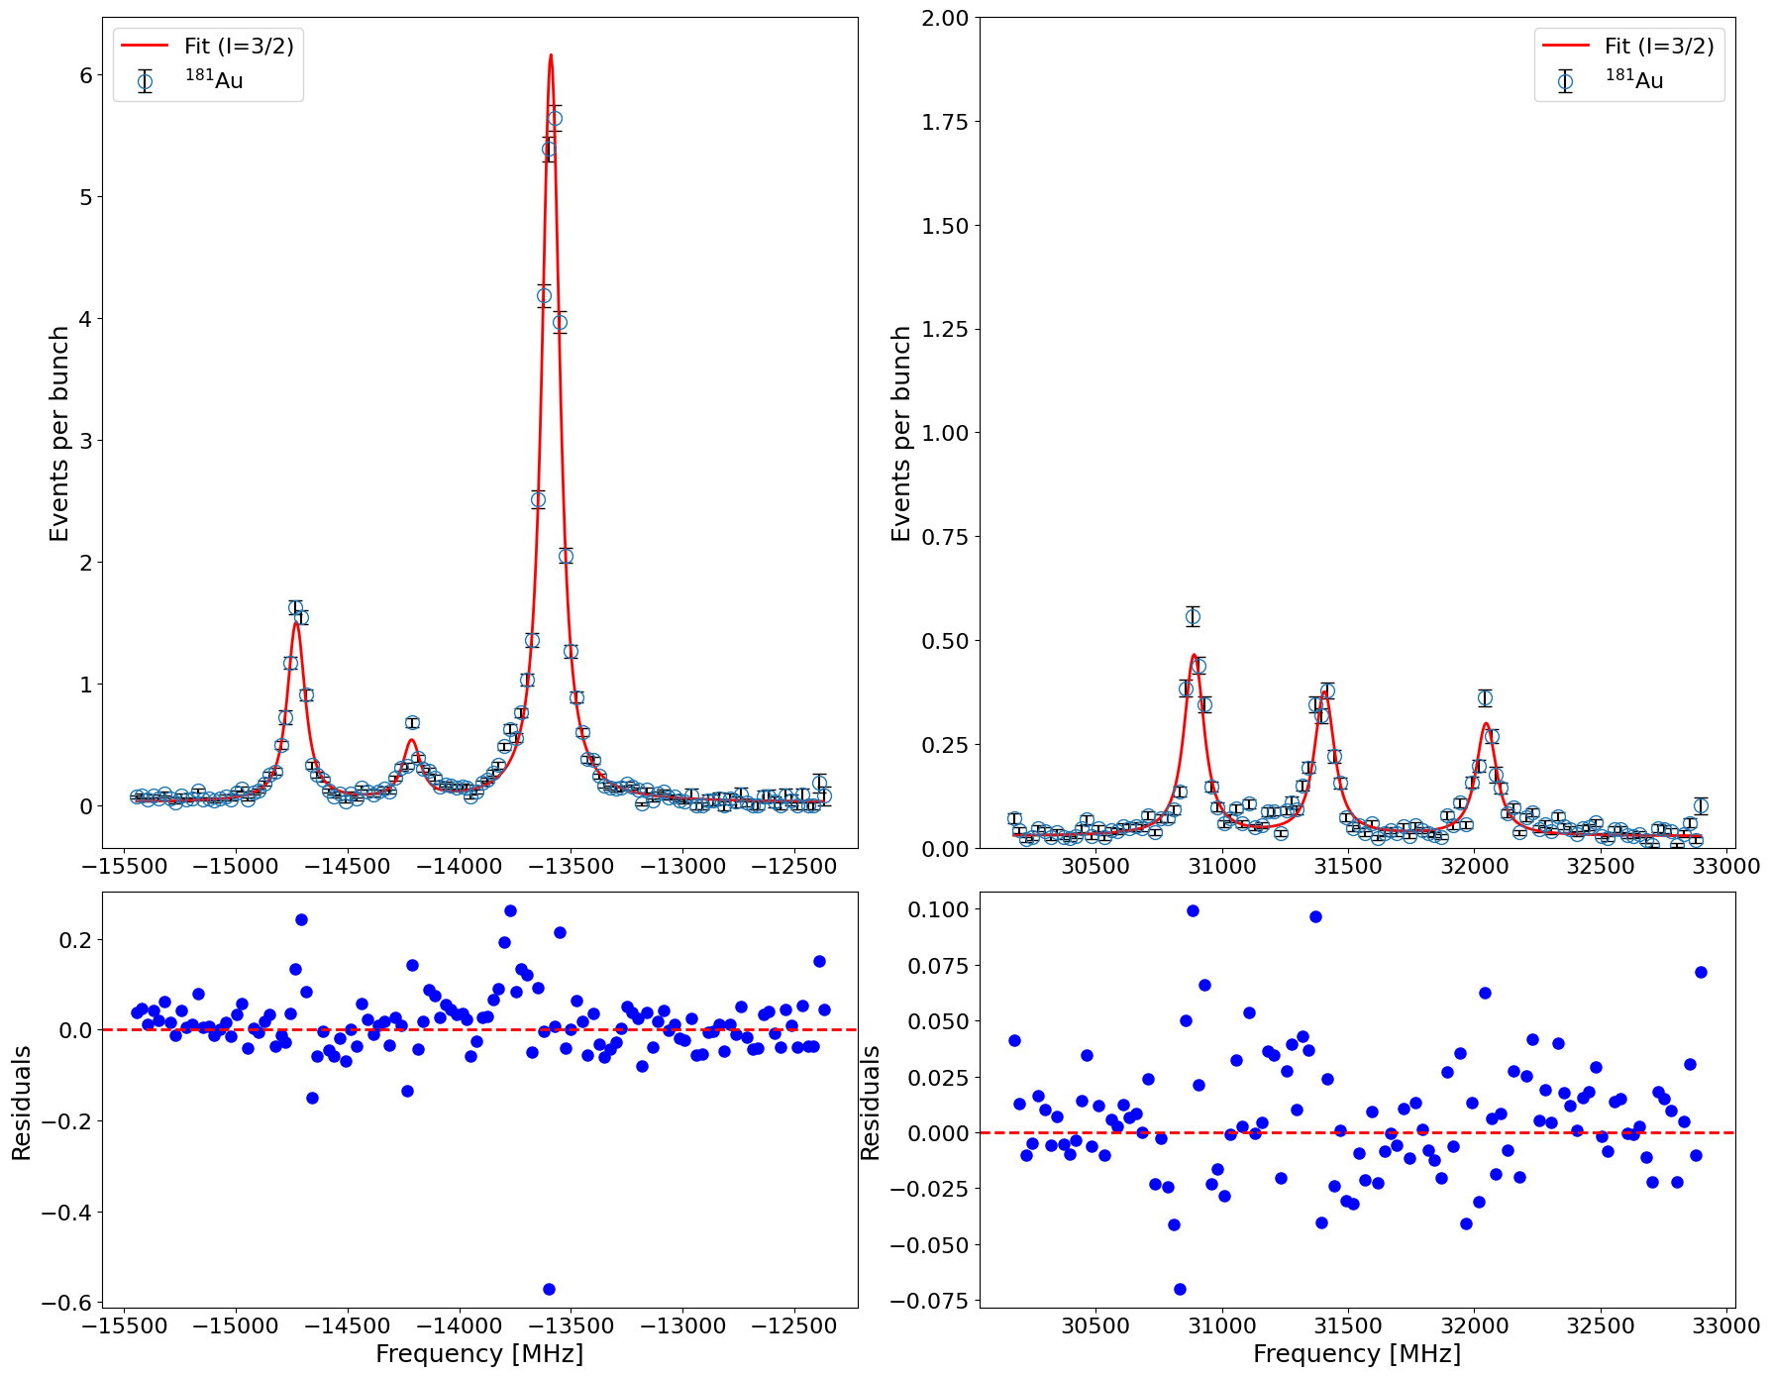

Spin assignment: ¹⁸¹Au
Spins of ¹⁸²Au (I=2) and ¹⁸³Au (I=5/2) established in similar way.
¹⁸¹Au
I = 7/2
¹⁸¹Au
I = 3/2
Isotope | Spin | A(6s ²S_{1/2}) | A(6p ²P_{3/2}) | B(6p ²P_{3/2}) | Centroid | A_{u}/A_{l} | χ²_{red}
181 | 3/2 | 22809.6(18) | 124.6(7) | 765.8(21) | 3046.09(11) | 0.005 | 6.01
181 | 5/2 | 15382.6(14) | 174.3(5) | -217.7(48) | 5039.9(17) | 0.011 | 8.81
181 | 7/2 | 11539.8(13) | 135.63(43) | -177(6) | 5937.7(19) | 0.012 | 9.64
Department of Physics and Astronomy (IKS)
05

Slide 8
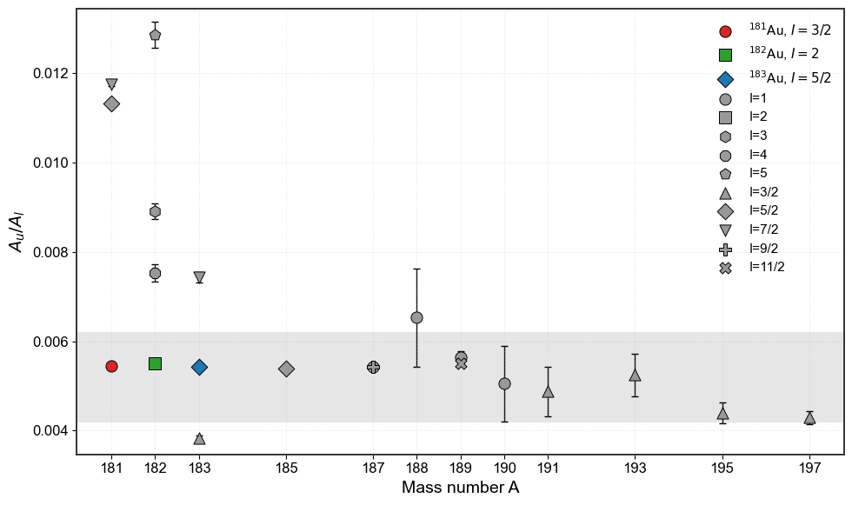
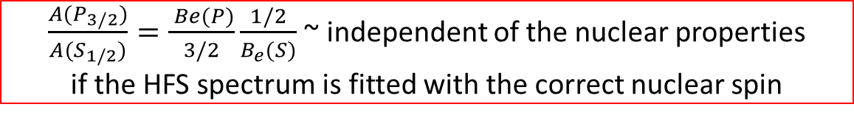
Alternative method: based on the ratio of A(P_{3/2})/A(S_{1/2})
3. A_{u}/A_{l} ratio: Considering small contribution from hyperfine anomaly, the ratio of magnetic dipole HFS parameters of two atomic states R = A_{u}/A_{l} remains constant across the isotopic chain
$\frac{A(P_{3/2})}{A(S_{1/2})}=\frac{ Be(P)}{3/2}\frac{1/2}{B_{e}(S)}$ ~ independent of the nuclear properties
if the HFS spectrum is fitted with the correct nuclear spin
Isotope | Spin | A_{u}/A_{l}
181 | 3/2 | 0.00545
182 | 2 | 0.00550
183 | 5/2 | 0.00543
185 | 5/2 | 0.00538
187 | 1/2 | 0.00542
187m | 9/2 | 0.00543
188 | 1 | 0.00655
189 | 1/2 | 0.00564
189m | 11/2 | 0.00550
190 | 1 | 0.00525
191 | 3/2 | 0.00489
193 | 3/2 | 0.00526
195 | 3/2 | 0.00440
197 | 3/2 | 0.00439
New spin assignments
¹⁸¹Au: 3/2;
¹⁸²Au:2;
¹⁸³Au: 5/2
Department of Physics and Astronomy (IKS)
11
06

Slide 9
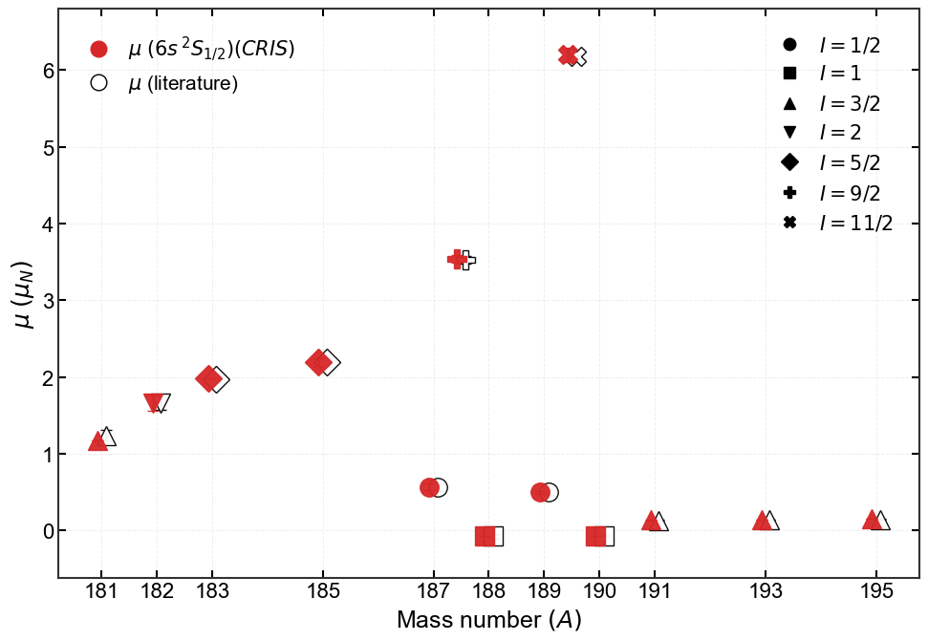

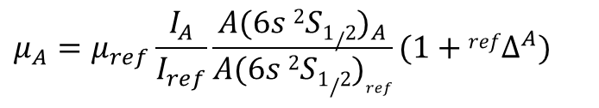
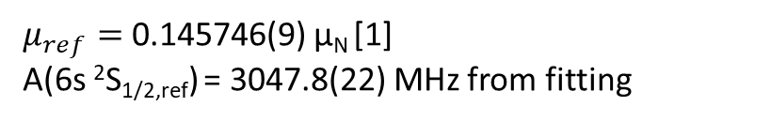
Magnetic dipole moments (μ)
$$μ_{A}=μ_{ref}\frac{I_{A}}{I_{ref}}\frac{{A(6s 2S1/2)}_{A}}{{A(6s 2S1/2)}_{ref}}(1+{refΔ}^{A})$$
μ calculated with HFA correction [2-3]
μ errors mainly come from relative hyperfine anomaly calculation (RHFA)
The standard approach [2]: μ without available RHFA information are evaluated with empirical ML rule.
$μ_{ref}=$0.145746(9) μ_{N} [1]
A(6s ²S_{1/2,ref}) = 3047.8(22) MHz from fitting
[1] Measurement of the Nuclear Magnetic Dipole Moment of Au¹⁹⁷ and Hyperfine Structure Measurements in the Ground States of Au¹⁹⁷, Ag¹⁰⁷, Ag¹⁰⁹ and K³⁹. Zeitschrift fur Physik 200, 456-466 (1967)
[2] Hyperfine anomaly in gold and magnetic moments of I = 11/2⁻ gold isomers. Physical Review C 101, 3 (Mar. 2020), 034308.
[3] Bazarkh et. al, Shape coexistence in ¹⁸⁷Au studied by laser spectroscopy. PHYSICAL REVIEW C 101, 064321 (2020)
Magnetic dipole moments CRIS (red) comparison to literature values (black)
Department of Physics and Astronomy (IKS)
07

Slide 10
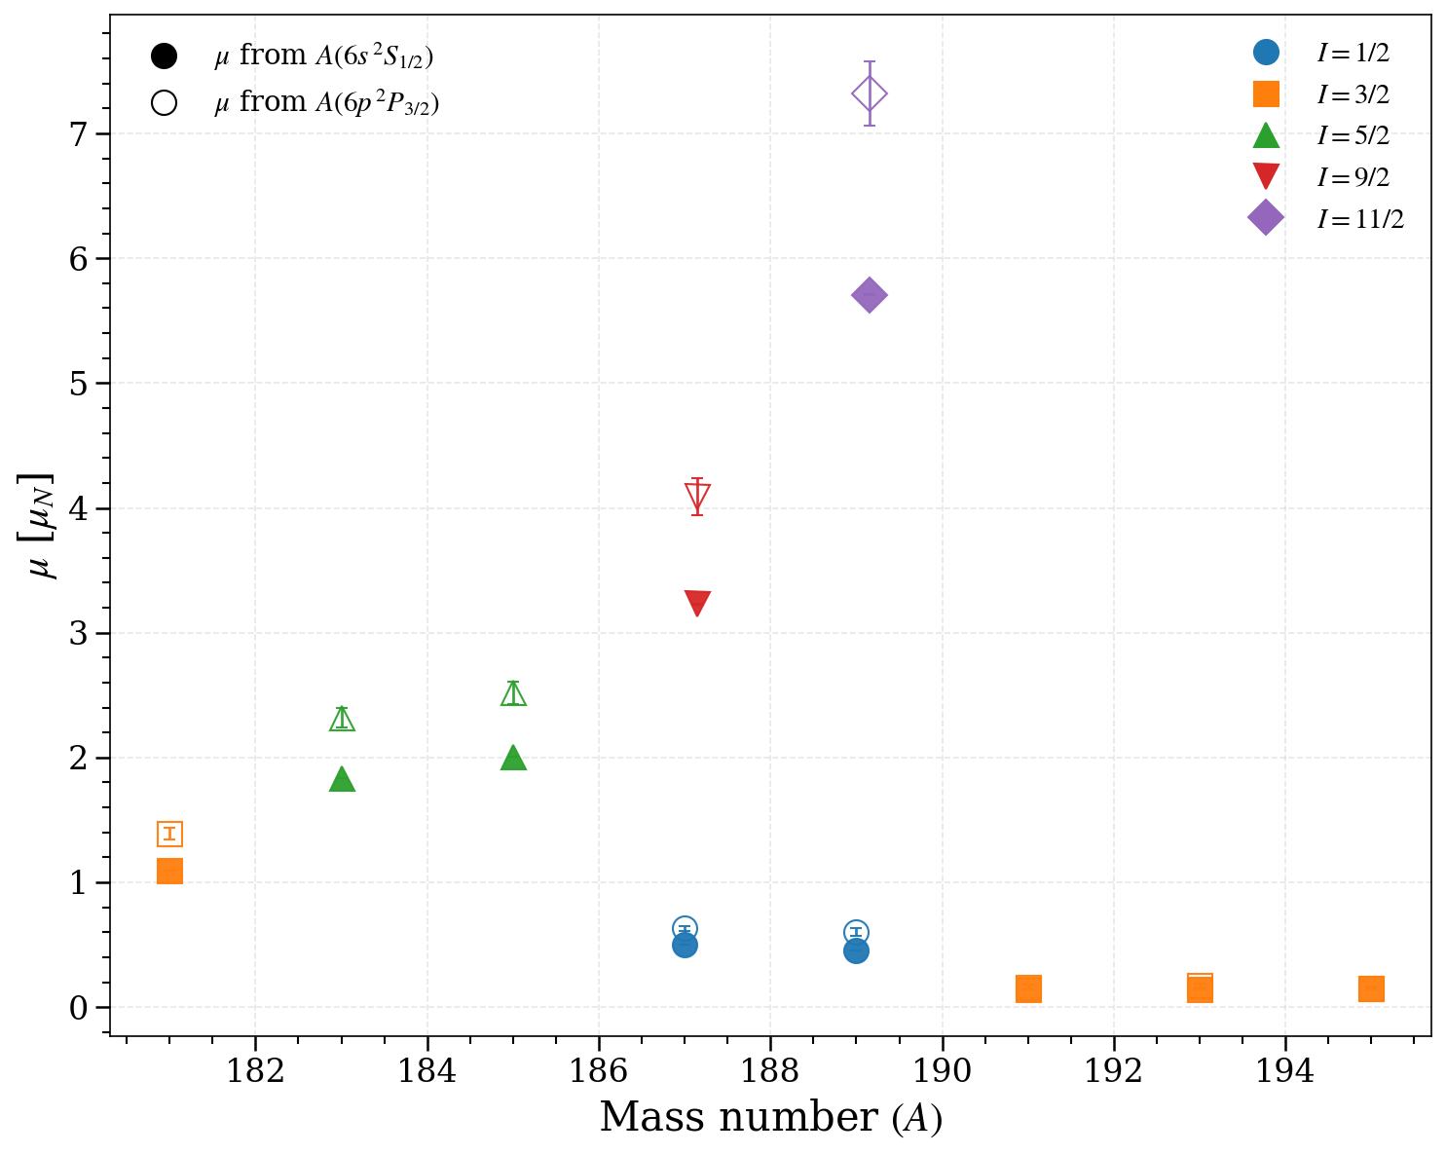
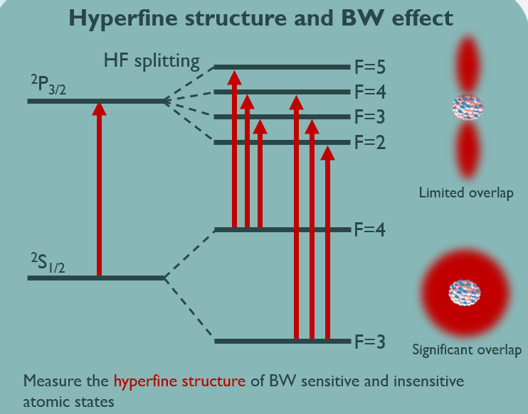
Results: μ from A(P_{3/2}) and A(S_{1/2}): without HFA correction
Poster by Dr. Bram van den Borne (ISOLDE workshop):
Probing the nuclear magnetisation distribution with the Bohr-Weisskopf effect using collinear laser spectroscopy
Hyperfine Anomaly (HFA): non-uniform distribution of magnetization over the nucleus (BW effect)
μ values from both levels are very different, in particular for large μ
Need to take into account HFA to get reliable μ-values
Department of Physics and Astronomy (IKS)
13
08

Slide 11
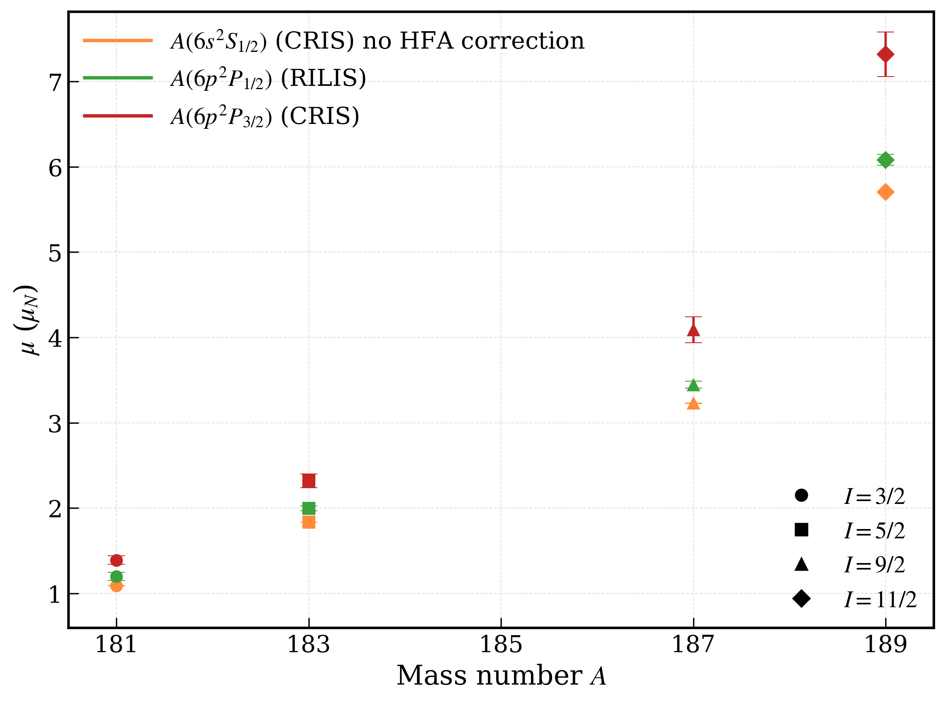
Comparison: uncorrected μ from A(S_{1/2}), A(P_{1/2}) and A(P_{3/2})
Table: Magnetic moments from this work and RILIS [1-3]
Isotope | Spin | μ(6s ²S_{1/2}) [nm] | μ(6p ²P_{3/2}) [nm] | μ(6p ²P_{1/2}) [nm]
181 | 3/2 | 1.090(1) | 1.39(5) | 1.20(5)
183 | 5/2 | 1.835(1) | 2.32(8) | 2.00(3)
187m | 9/2 | 3.229(2) | 4.1(2) | 3.45(4)
189m | 11/2 | 5.706(4) | 7.3(3) | 6.08(6)
HFA uncorrected for 6s ²S_{1/2}
μ from 6s ²S_{1/2} (without HFA correction) doesn’t agree to μ from 6p ²P_{1/2} (without HFA correction)
μ from 6p ²P_{3/2} disagrees from both the values
[1] Cubiss et. al, Deformation versus Sphericity in the Ground States of the Lightest Gold Isotopes. PHYSICAL REVIEW LETTERS 131, 202501 (2023)
[2] Bazarkh et. al, Shape coexistence in ¹⁸⁷Au studied by laser spectroscopy. PHYSICAL REVIEW C 101, 064321 (2020)
[3] Bazarkh et. al, Hyperfine anomaly in gold and magnetic moments of I^{π} = 11/2− gold isomers . PHYSICAL REVIEW C 101, 034308 (2020)
Department of Physics and Astronomy (IKS)
09

Slide 12


Comparison: corrected μ from A(S_{1/2}) to uncorrected from A(P_{1/2}) and A(P_{3/2})
Table: Magnetic moments from this work and RILIS
Isotope | Spin | μ(S_{1/2}) [nm] | μ(P_{3/2}) [nm] | μ(P_{1/2}) [nm]
181 | 3/2 | 1.18(5) | 1.39(5) | 1.20(5)
183 | 5/2 | 1.98(8) | 2.32(8) | 2.00(3)
187m | 9/2 | 3.5(1) | 4.1(2) | 3.45(4)
189m | 11/2 | 6.2(3) | 7.3(3) | 6.08(6)
HFA correction done using “standard prescription” for 6s ²S_{1/2} [1]
$μ=A\left(6s 2S_{1/2}\right)∗I$/ 29005 $±$ 0.012 μ_{N}
These are indicative μ using Ekström’s ML-based standard prescription. Uncertainty dominated by the model ( ̴ 4% conservative)
HFA calculations for 6p ²P_{3/2} needed
[1]. C. Ekström, L. Robertsson, S. Ingelman, G. Wannberg, and I. Ragnarsson, Nucl. Phys. A348, 25 (1980)
Department of Physics and Astronomy (IKS)
10

Slide 13
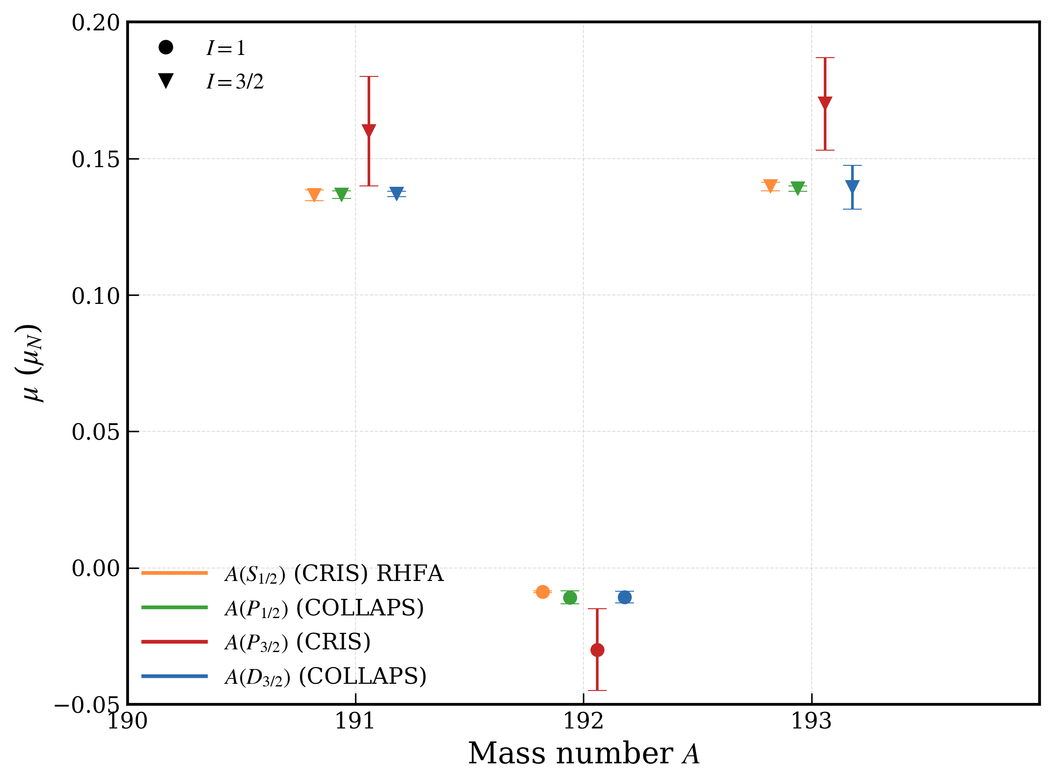
More comparison: corrected μ from A(S_{1/2}) to uncorrected from A(P_{1/2}), A(P_{3/2}), A(D_{3/2})
μ_{S1/2} are corrected using the RHFA except ¹⁹²Au.
μ_{S1/2} agree well with μ_{P1/2} and μ_{D3/2}
μ_{P3/2} stands out
[1]. Passler, G et. al, Quadrupole moments and nuclear shapes of neutron deficient gold isotopes. Nuclear Physics A580 (1994) 173-212
Department of Physics and Astronomy (IKS)
11

Slide 14
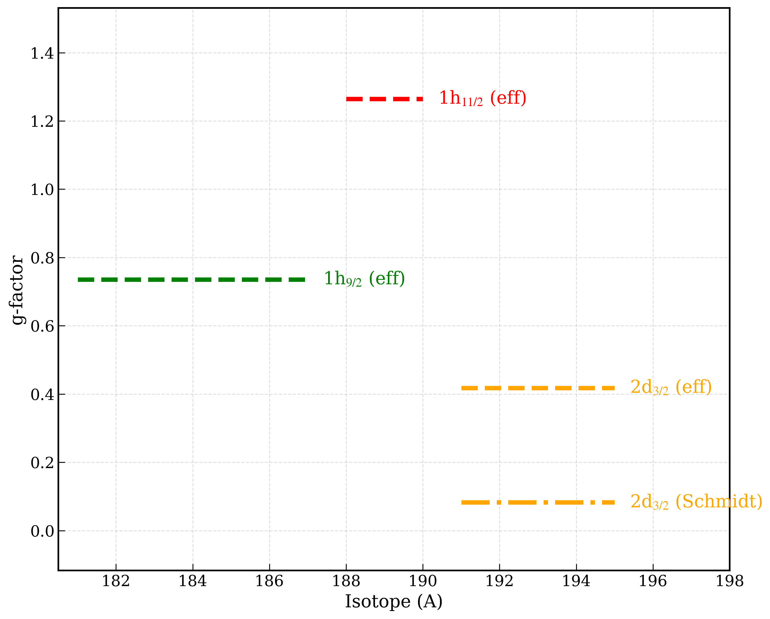
Configurations and HFA in odd Au isotopes
Magnetic dipole moments (g-factors) provide key information on the underlying single-particle nature of a nuclear configuration.
Effective-g factors are calculated with quenching factor of 0.7 for g_{s}
Department of Physics and Astronomy (IKS)
12

Slide 15
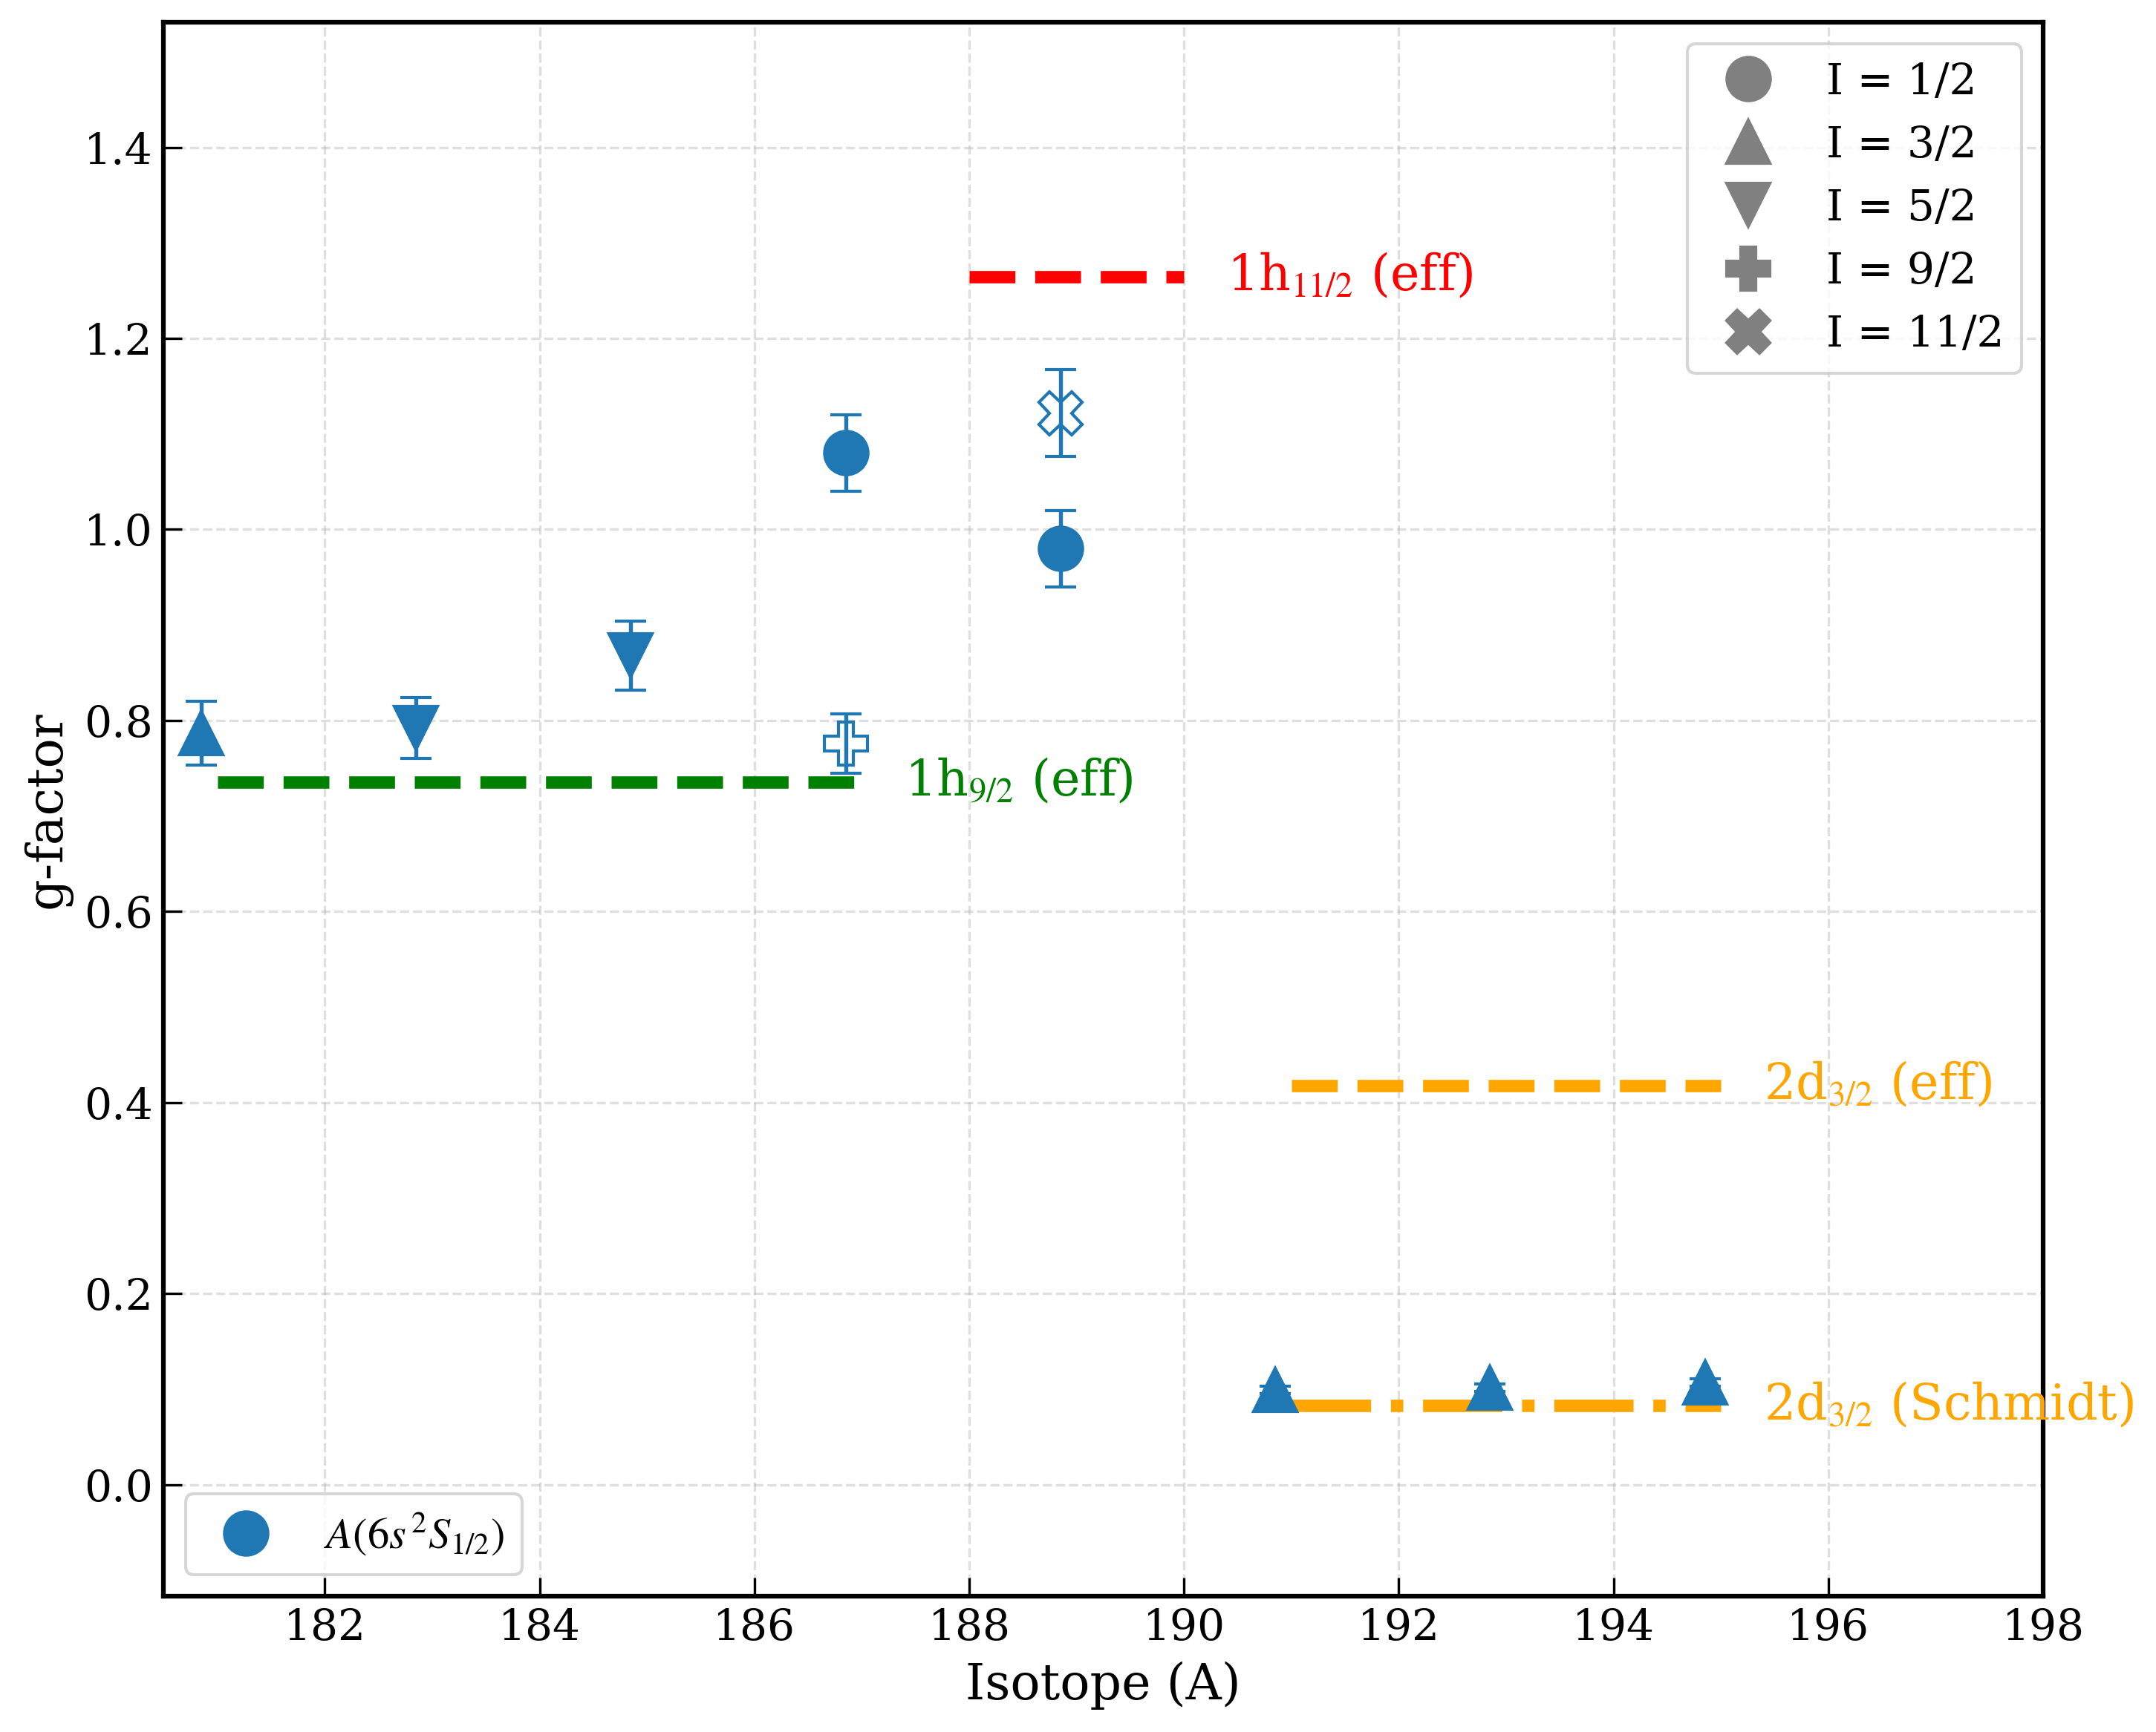
Configurations and HFA in odd Au isotopes
Magnetic dipole moments (g-factors) provide key information on the underlying single-particle nature of a nuclear configuration.
11/2
1/2
11/2
1/2
Effective-g factors are calculated with quenching factor of 0.7 for g_{s}
1/2
1/2
9/2
9/2
g-factors extracted from A(6s ²S_{1/2})
with HFA correction
3/2
5/2
5/2
3/2
5/2
5/2
Department of Physics and Astronomy (IKS)
13

Slide 16
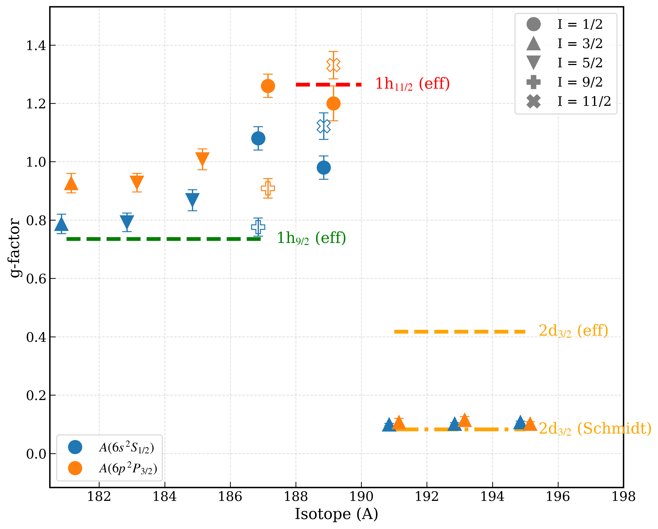
Configurations and HFA in odd Au isotopes
Magnetic dipole moments (g-factors) provide key information on the underlying single-particle nature of a nuclear configuration.
1/2
11/2
Effective-g factors are calculated with quenching factor of 0.7 for g_{s}
1/2
9/2
g-factors extracted from A(6s ²S_{1/2})
with HFA correction
3/2
5/2
5/2
g-factors extracted from A(6p ²P_{3/2})
μ (g-factor) changes especially for lighter gold isotopes (bigger μ values).
Theoretical input for HFA is therefore needed!!
Department of Physics and Astronomy (IKS)
14

Slide 17

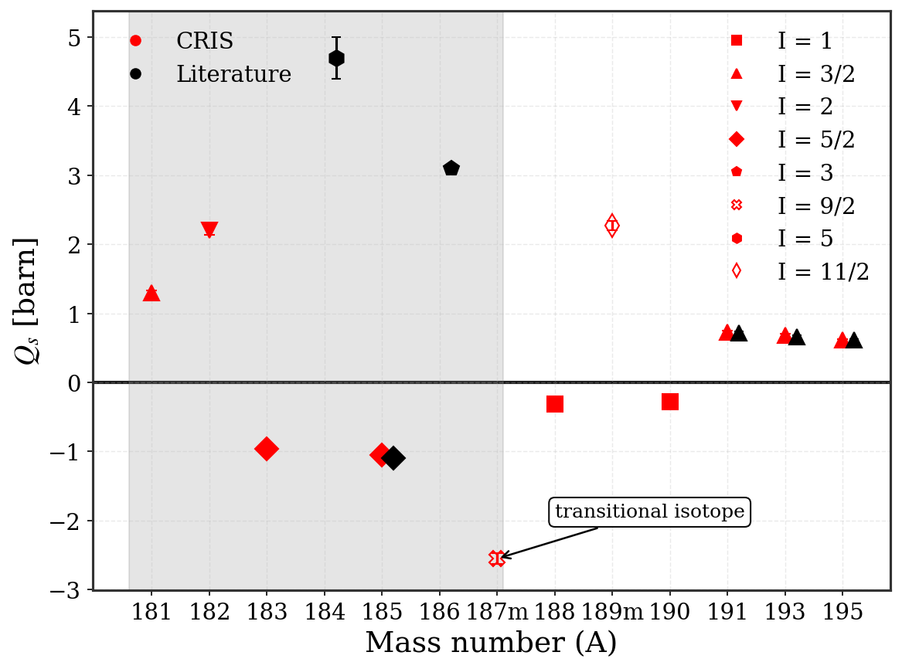
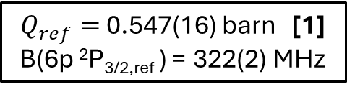
Electric quadrupole moments (Q_{s})
$Q_{ref}=$0.547(16) barn [1]
B(6p ²P_{3/2,ref} ) = 322(2) MHz
Table Q_{s} red ones from CRIS measurements, and the black ones are the literature values.
Isotope | Spin | B(6p ²P_{3/2}) | Q_{s} [b] (this work) | Q_{s} [b] (literature)
181 | 3/2 | 764(5) | 1.274(39)
182 | 2 | 1301(6) | 2.17(7)
183 | 5/2 | -566(3) | - 0.94(3)
184 | 5 |  | - | 4.7(3)
185 | 5/2 | -622(2) | -1.04(3) | -1.1(1)
186 | 3 |  | - | 3.10(6)
187m | 9/2 | -1508(10) | -2.52(8)
188 | 1 | -186(3) | -0.31(1)
189m | 11/2 | 1339(9) | 2.23(7)
190 | 1 | -167(2) | -0.280(9)
191 | 3/2 | 428(5) | 0.71(2) | 0.72(2)
192 | 1 | -130(1) | -0.220(7) | -0.228(8)
193 | 3/2 | 402(3) | 0.67(2) | 0.66(2)
195 | 3/2 | 361(2) | 0.60(2) | 0.61(2)
Q_{s} of 7 new states measured.
Good agreement with literature values
Department of Physics and Astronomy (IKS)
15
[1] Powers, R. J., et. al. Muonic ¹⁹⁷Au: A test of the weak-coupling model. NPA 230 (1997) 413

Slide 18
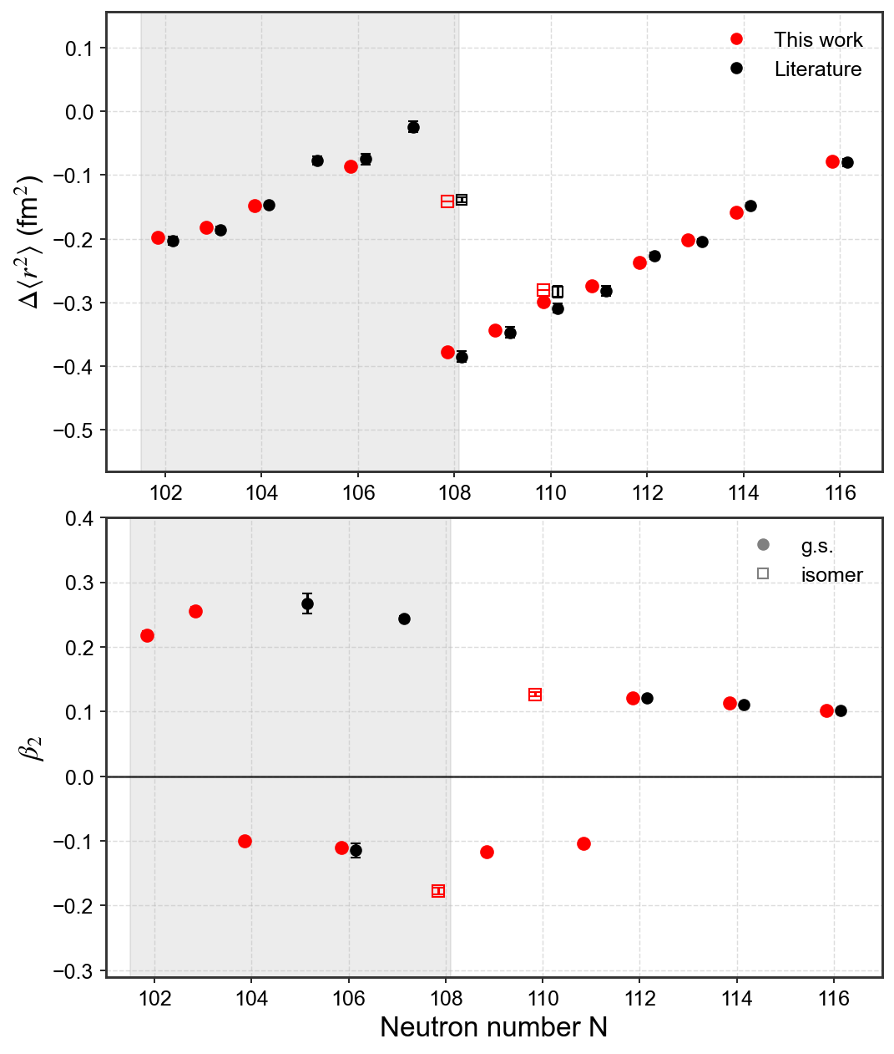


Q_{s} & Island of deformation
Strong coupling (K = I) assumed to extract β₂ (axial deformation)
Positive‑Q (^{181,182}Au, ^{184,186}Au) reaches β₂ ≈ 0.25 (rigid prolate).
Negative‑Q (^{183,185}Au)
smaller β₂ ≈ -0.10 – -0.11 (moderate oblate) – hints of triaxiality or higher order deformation?
Q_{s} > 0
Q_{s} < 0
Theory input required!!
Department of Physics and Astronomy (IKS)
16

Slide 19
Conclusion and Outlook
Spin assignment for ¹⁸¹Au,¹⁸²Au and ¹⁸³Au confirmed.
Magnetic dipole moments extracted from different electronic levels are significantly different from P_{3/2}.
HFA correction needed from theory to constrain the magnetic moments.
HFA in P_{3/2}? (Similar to Tl)
Quadrupole moments for 7 new states measured including high spin isomers: ^{187m}Au and ^{189m}Au
¹⁸³Au and ¹⁸⁵Au have negative Q_{s} (moderate oblate) while other isotopes in the “island of deformation” have positive Q_{s} (rigid prolate).
Theoretical input needed to understand the mechanism.
Department of Physics and Astronomy (IKS)
17

Slide 20
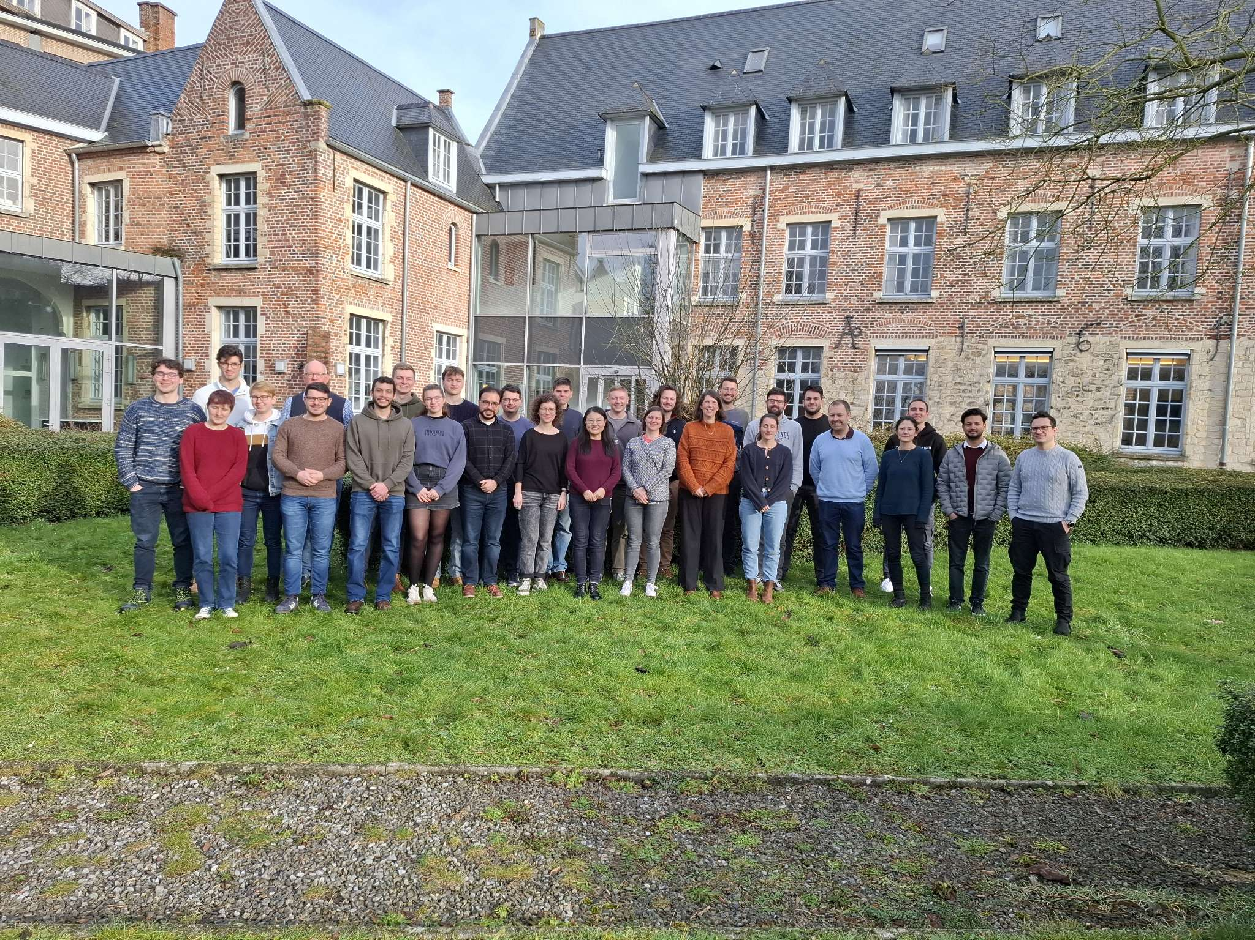








THANK YOU

Slide 21
BACKUP SLIDES

Slide 22
Hyperfine anomaly references for S_{1/2}
Isotope | Spin | RHFA (S_{1/2}) | Reference | DOI
182 | 2 | 0.17(7) | Laser-assisted decay spectroscopy for the ground states of ^{180,182}Au Phys. Rev. C 102, 024312 – Published 11 August, 2020 | https://doi.org/10.1103/PhysRevC.102.024312
185 | 5/2 | 0.09(3) | Hyperfine anomaly in gold and magnetic moments of 𝐼^{𝜋}=11/2⁻ gold isomers. Phys. Rev. C 101, 034308 – Published 20 March, 2020 | https://doi.org/10.1103/PhysRevC.101.034308
187 | 1/2 | 0.13(8) | Hyperfine anomaly in gold and magnetic moments of 𝐼^{𝜋}=11/2⁻ gold isomers. Phys. Rev. C 101, 034308 – Published 20 March, 2020 | https://doi.org/10.1103/PhysRevC.101.034308
187m | 9/2 | 0.095(16) | Shape coexistence in ¹⁸⁷Au studied by laser spectroscopy. Phys. Rev. C 101, 064321 – Published 25 June, 2020 | https://doi.org/10.1103/PhysRevC.101.064321
189 | 1/2 | 0.09(3) | Hyperfine anomaly in gold and magnetic moments of 𝐼^{𝜋}=11/2⁻ gold isomers. Phys. Rev. C 101, 034308 – Published 20 March, 2020 | https://doi.org/10.1103/PhysRevC.101.034308
189m | 11/2 | 0.086(16) | Hyperfine anomaly in gold and magnetic moments of 𝐼^{𝜋}=11/2⁻ gold isomers. Phys. Rev. C 101, 034308 – Published 20 March, 2020 | https://doi.org/10.1103/PhysRevC.101.034308
191 | 3/2 | -0.012(14) | Hyperfine anomaly in gold and magnetic moments of 𝐼^{𝜋}=11/2⁻ gold isomers. Phys. Rev. C 101, 034308 – Published 20 March, 2020 | https://doi.org/10.1103/PhysRevC.101.034308
193 | 3/2 | -0.005(11) | Hyperfine anomaly in gold and magnetic moments of 𝐼^{𝜋}=11/2⁻ gold isomers. Phys. Rev. C 101, 034308 – Published 20 March, 2020 | https://doi.org/10.1103/PhysRevC.101.034308
194 | 1 | 0.018 (33) | Hyperfine anomaly in gold and magnetic moments of 𝐼^{𝜋}=11/2⁻ gold isomers. Phys. Rev. C 101, 034308 – Published 20 March, 2020 | https://doi.org/10.1103/PhysRevC.101.034308
Table with references from where the hyperfine anomaly for 6s ²S_{1/2} have been taken. All of these values except for 182 and 187m are also available in the ‘Table of hyperfine anomaly in atomic systems – 2023’ by JR Persson. https://doi.org/10.1016/j.adt.2023.101589
Department of Physics and Astronomy (IKS)

Slide 23
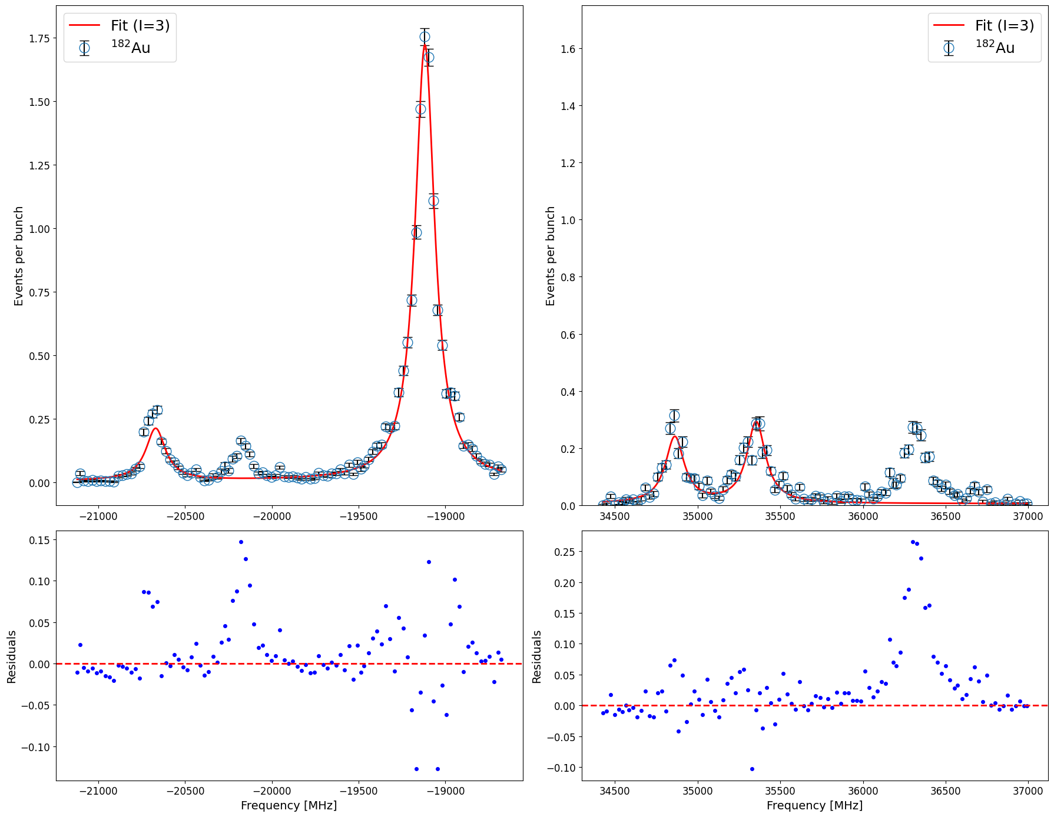
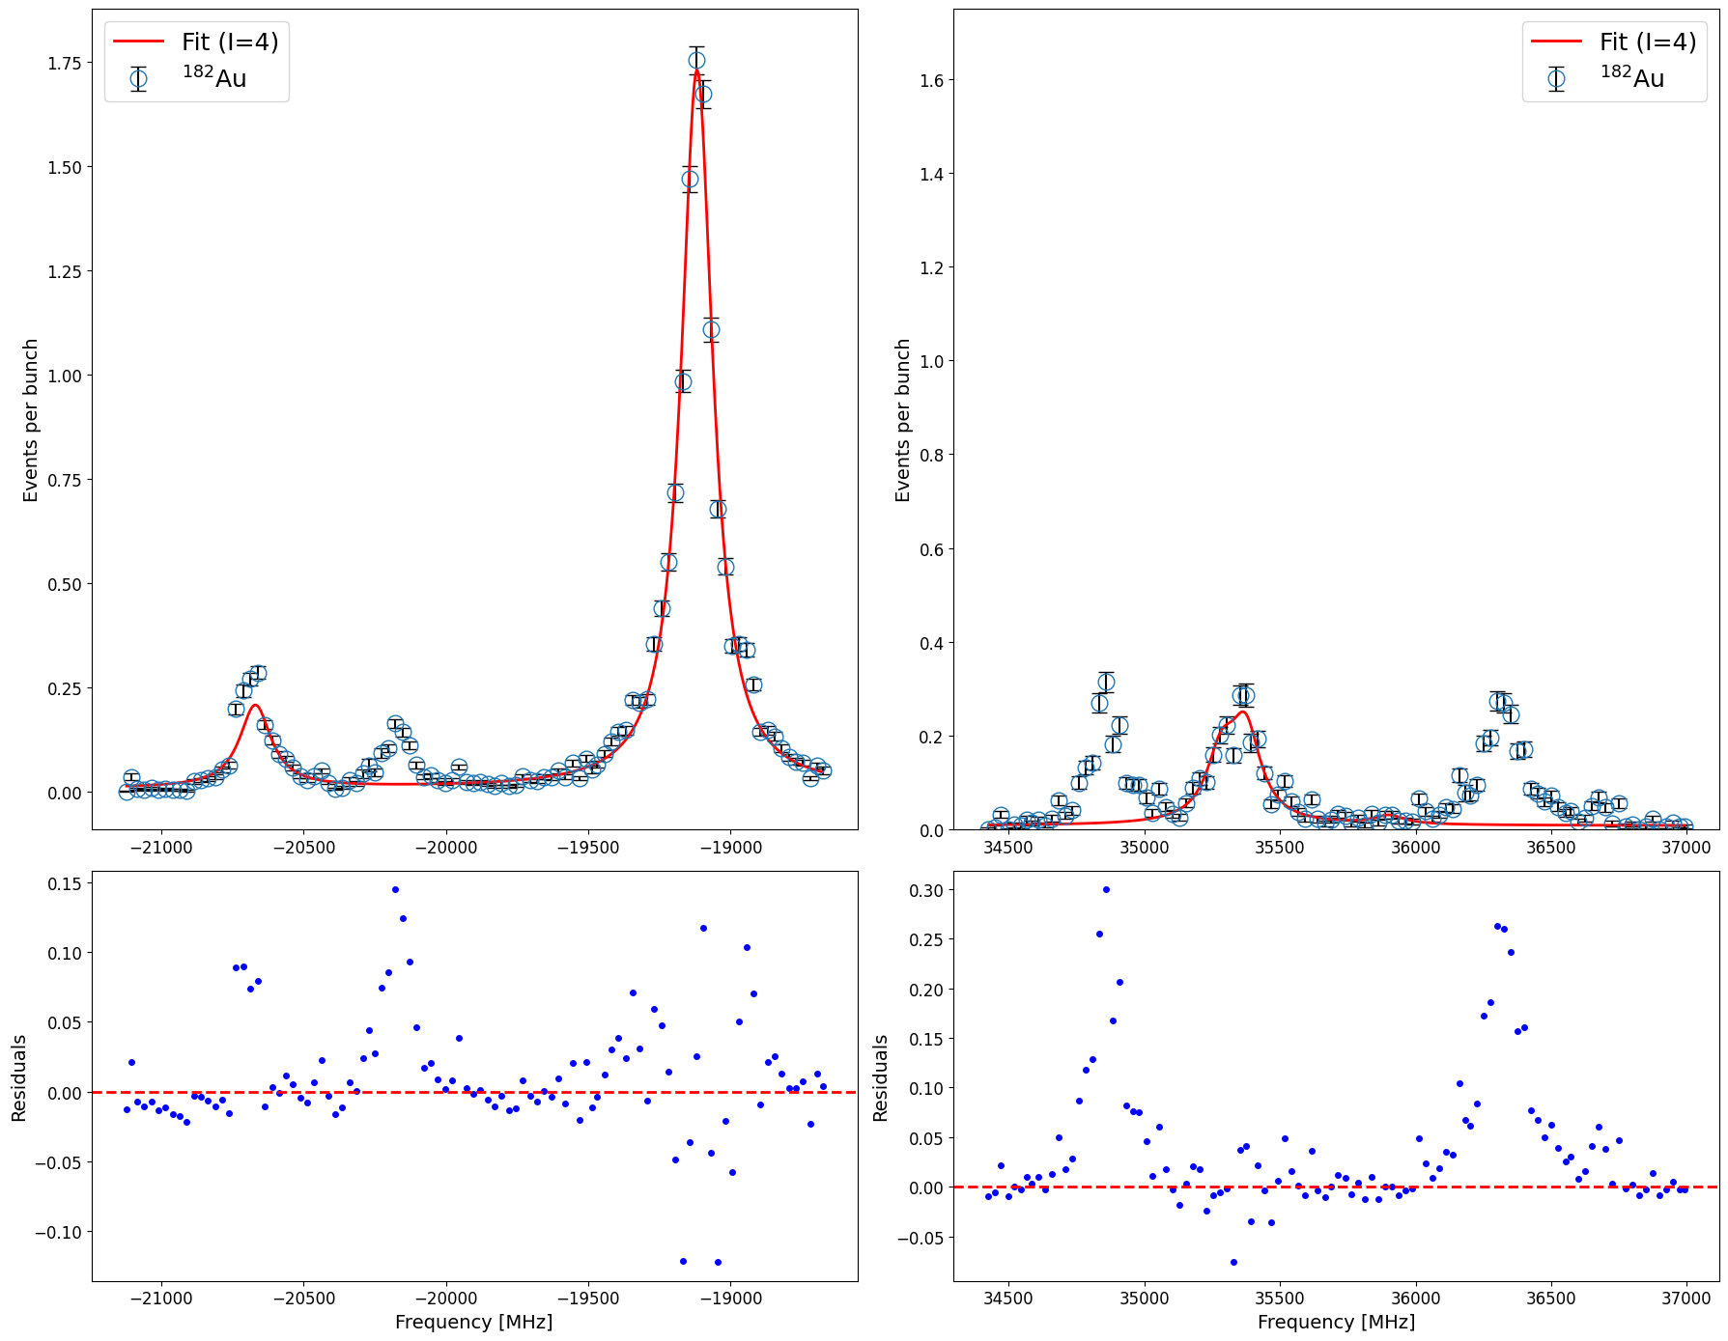
Spin assignment: ¹⁸²Au
I = 3
I = 4
Isotope | Spin | A(6s ²S_{1/2}) | A(6p ²P_{3/2}) | B(6p ²P_{3/2}) | Centroid | A_{u}/A_{l} | χ²_{red}
182 | 3 | 15865.9(77) | 141.5(27) | 1219(16) | 3739.4(66) | 0.009 | 17.39
182 | 4 | 12434(8) | 93.6(24) | 1377(49) | 4844(14) | 0.007 | 21.24
Department of Physics and Astronomy (IKS)
07

Slide 24
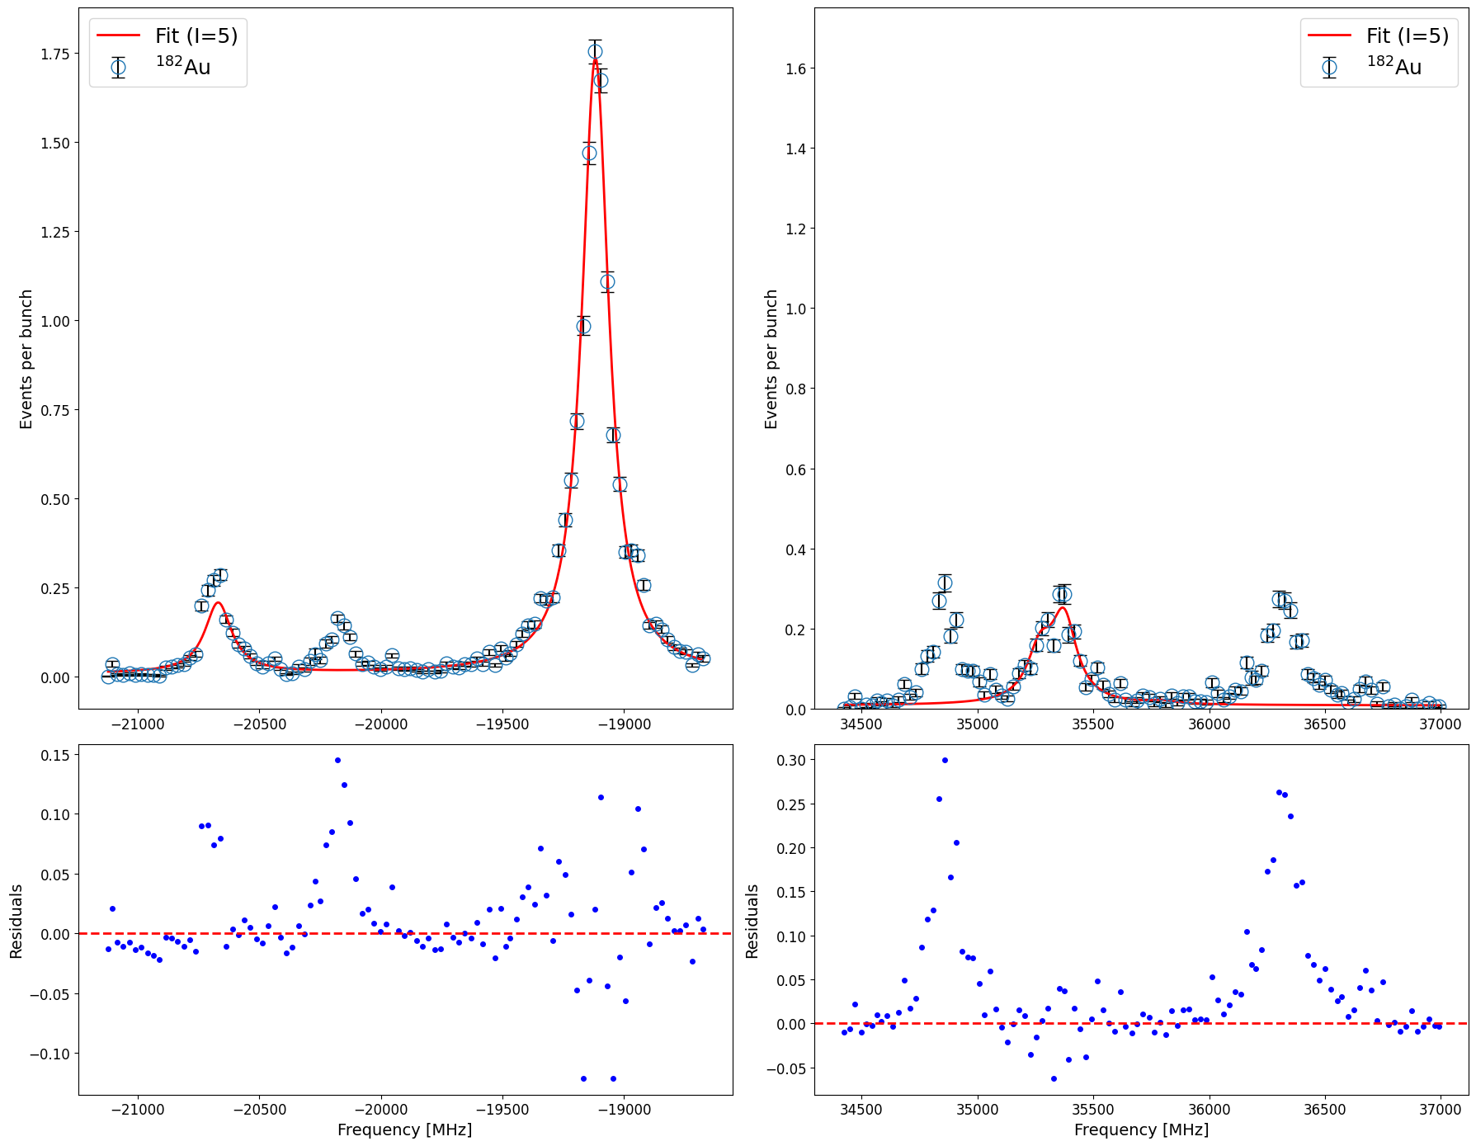
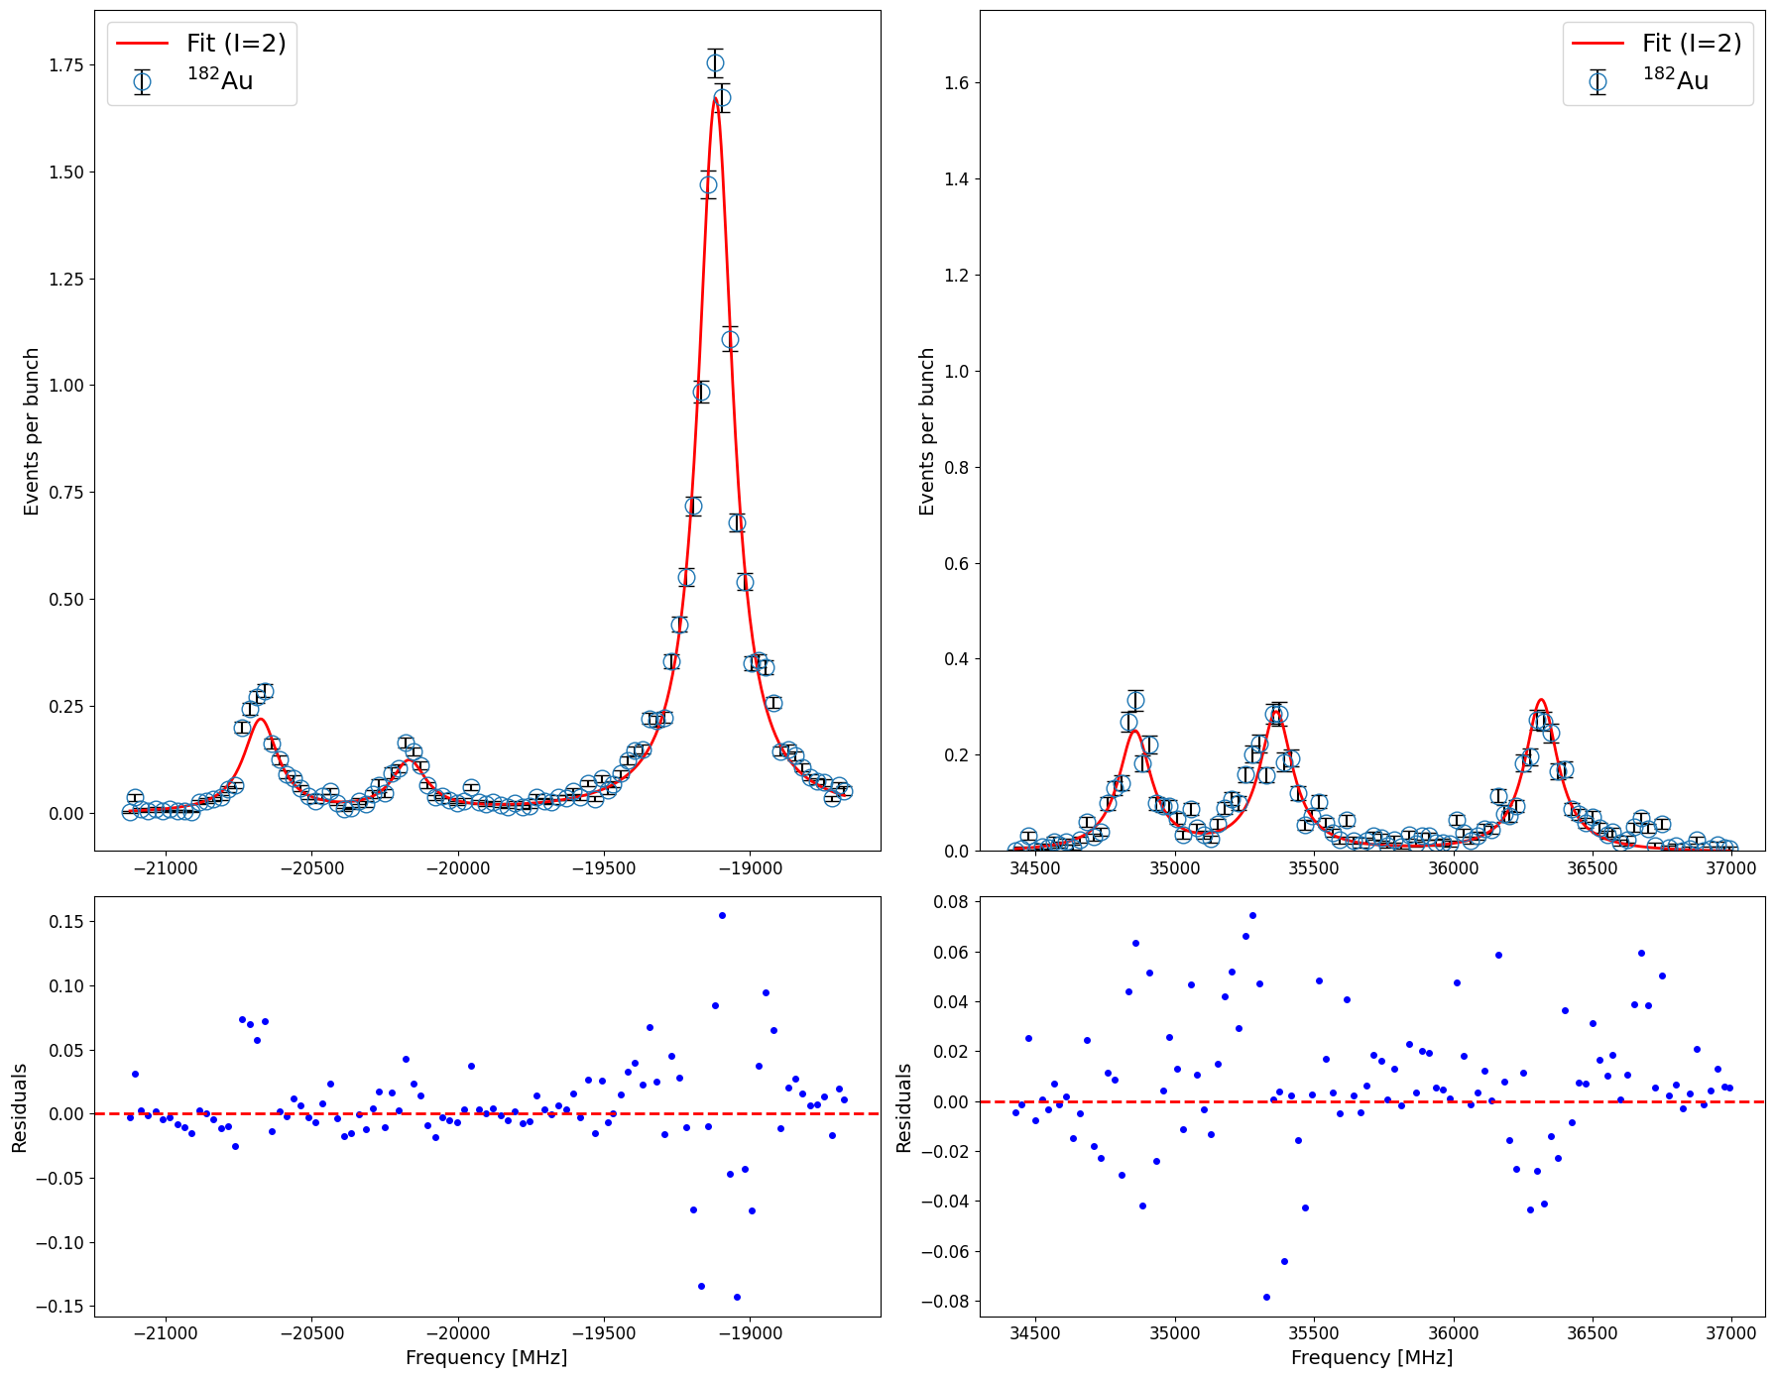
Spin assignment: ¹⁸²Au
I = 5
I = 2
Isotope | Spin | A(6s ²S_{1/2}) | A(6p ²P_{3/2}) | B(6p ²P_{3/2}) | Centroid | A_{u}/A_{l} | χ²_{red}
182 | 5 | 10267(11) | 132(3) | 1070(29) | 5294(14) | 0.013 | 21.34
182 | 2 | 22212.03(29) | 121(1) | 1295.2(46) | 2408(2) | 0.005 | 6.70
Department of Physics and Astronomy (IKS)

Slide 25
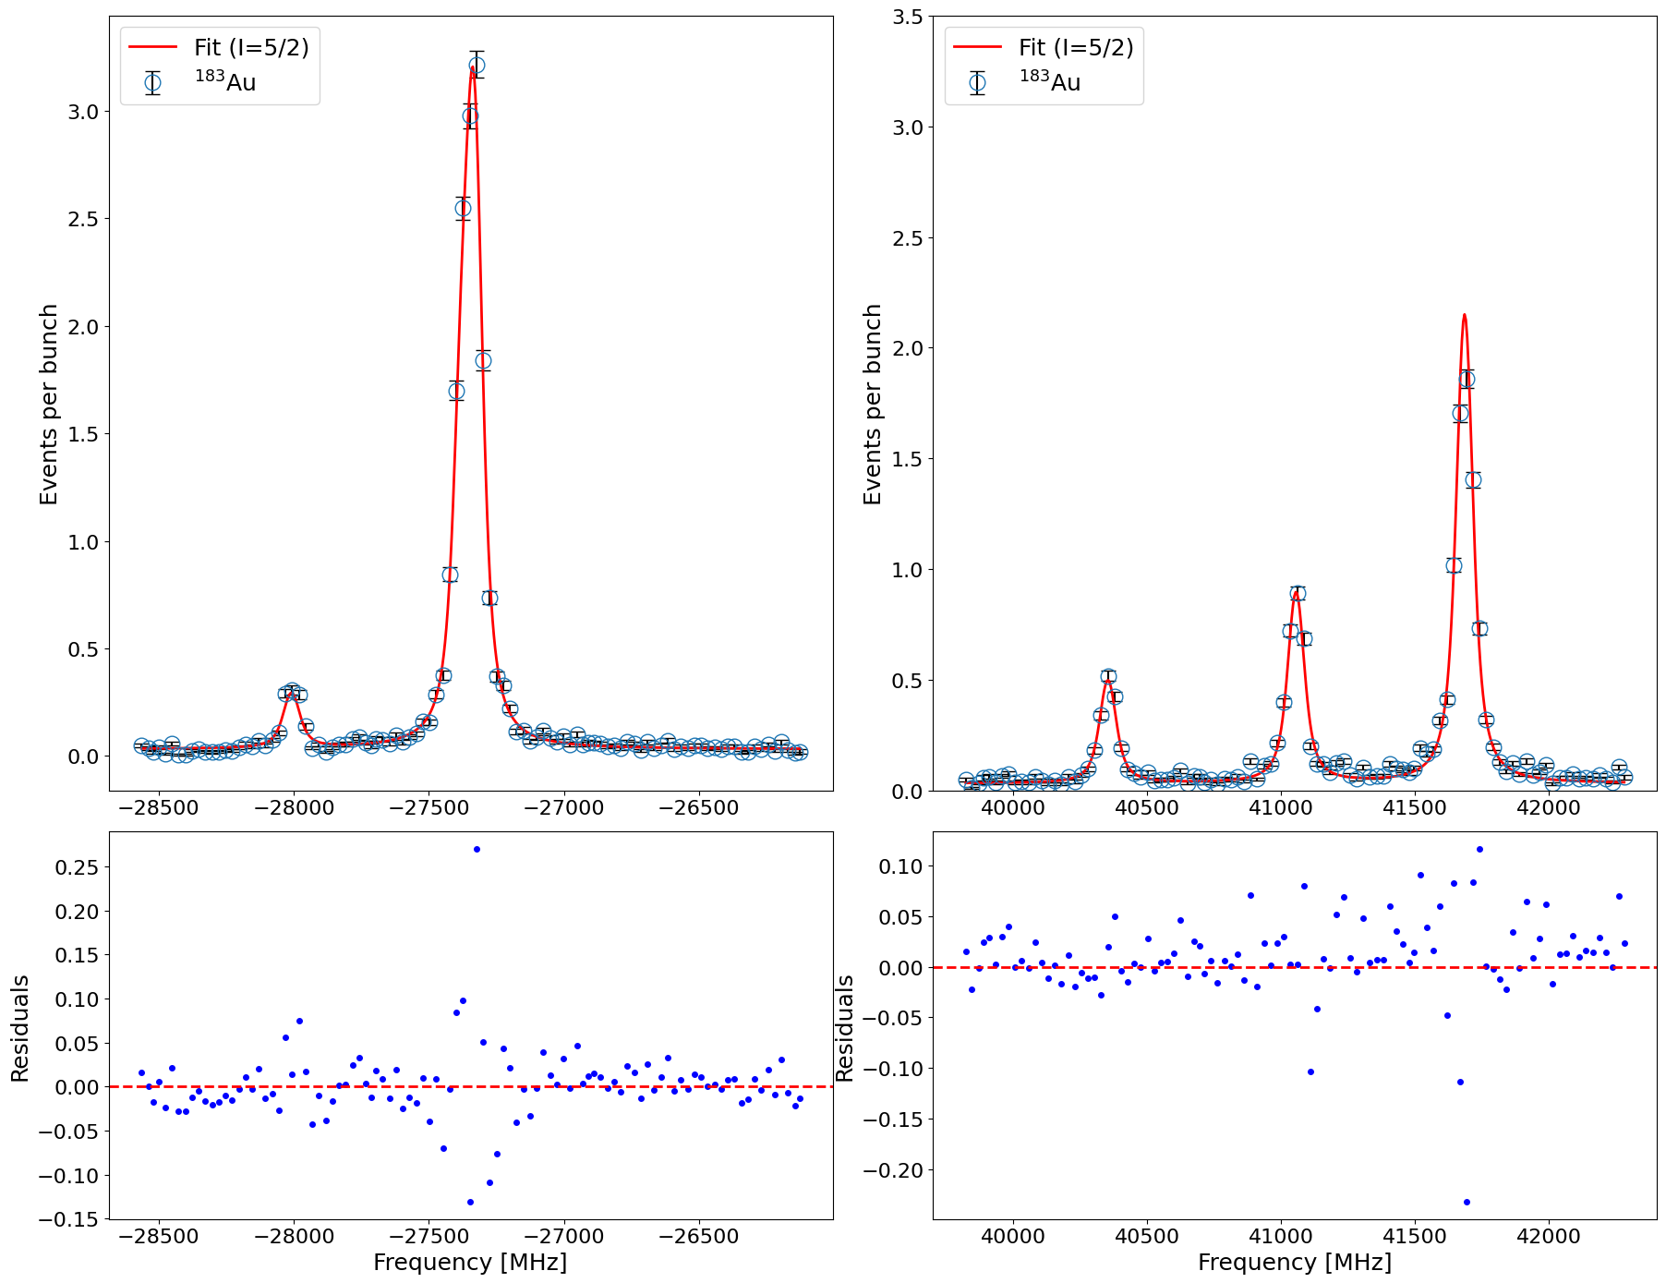
Spin assignment: ¹⁸³Au
I = 5/2
Isotope | Spin | A_{l} | A_{u} | B_{u} | Centroid | A_{u}/A_{l} | Red Chi^2
183 | 5/2 | 23021.5(13) | 125(1) | -566.2(26) | 1118.1(17) | 0.005 | 6.74
Department of Physics and Astronomy (IKS)

Slide 26
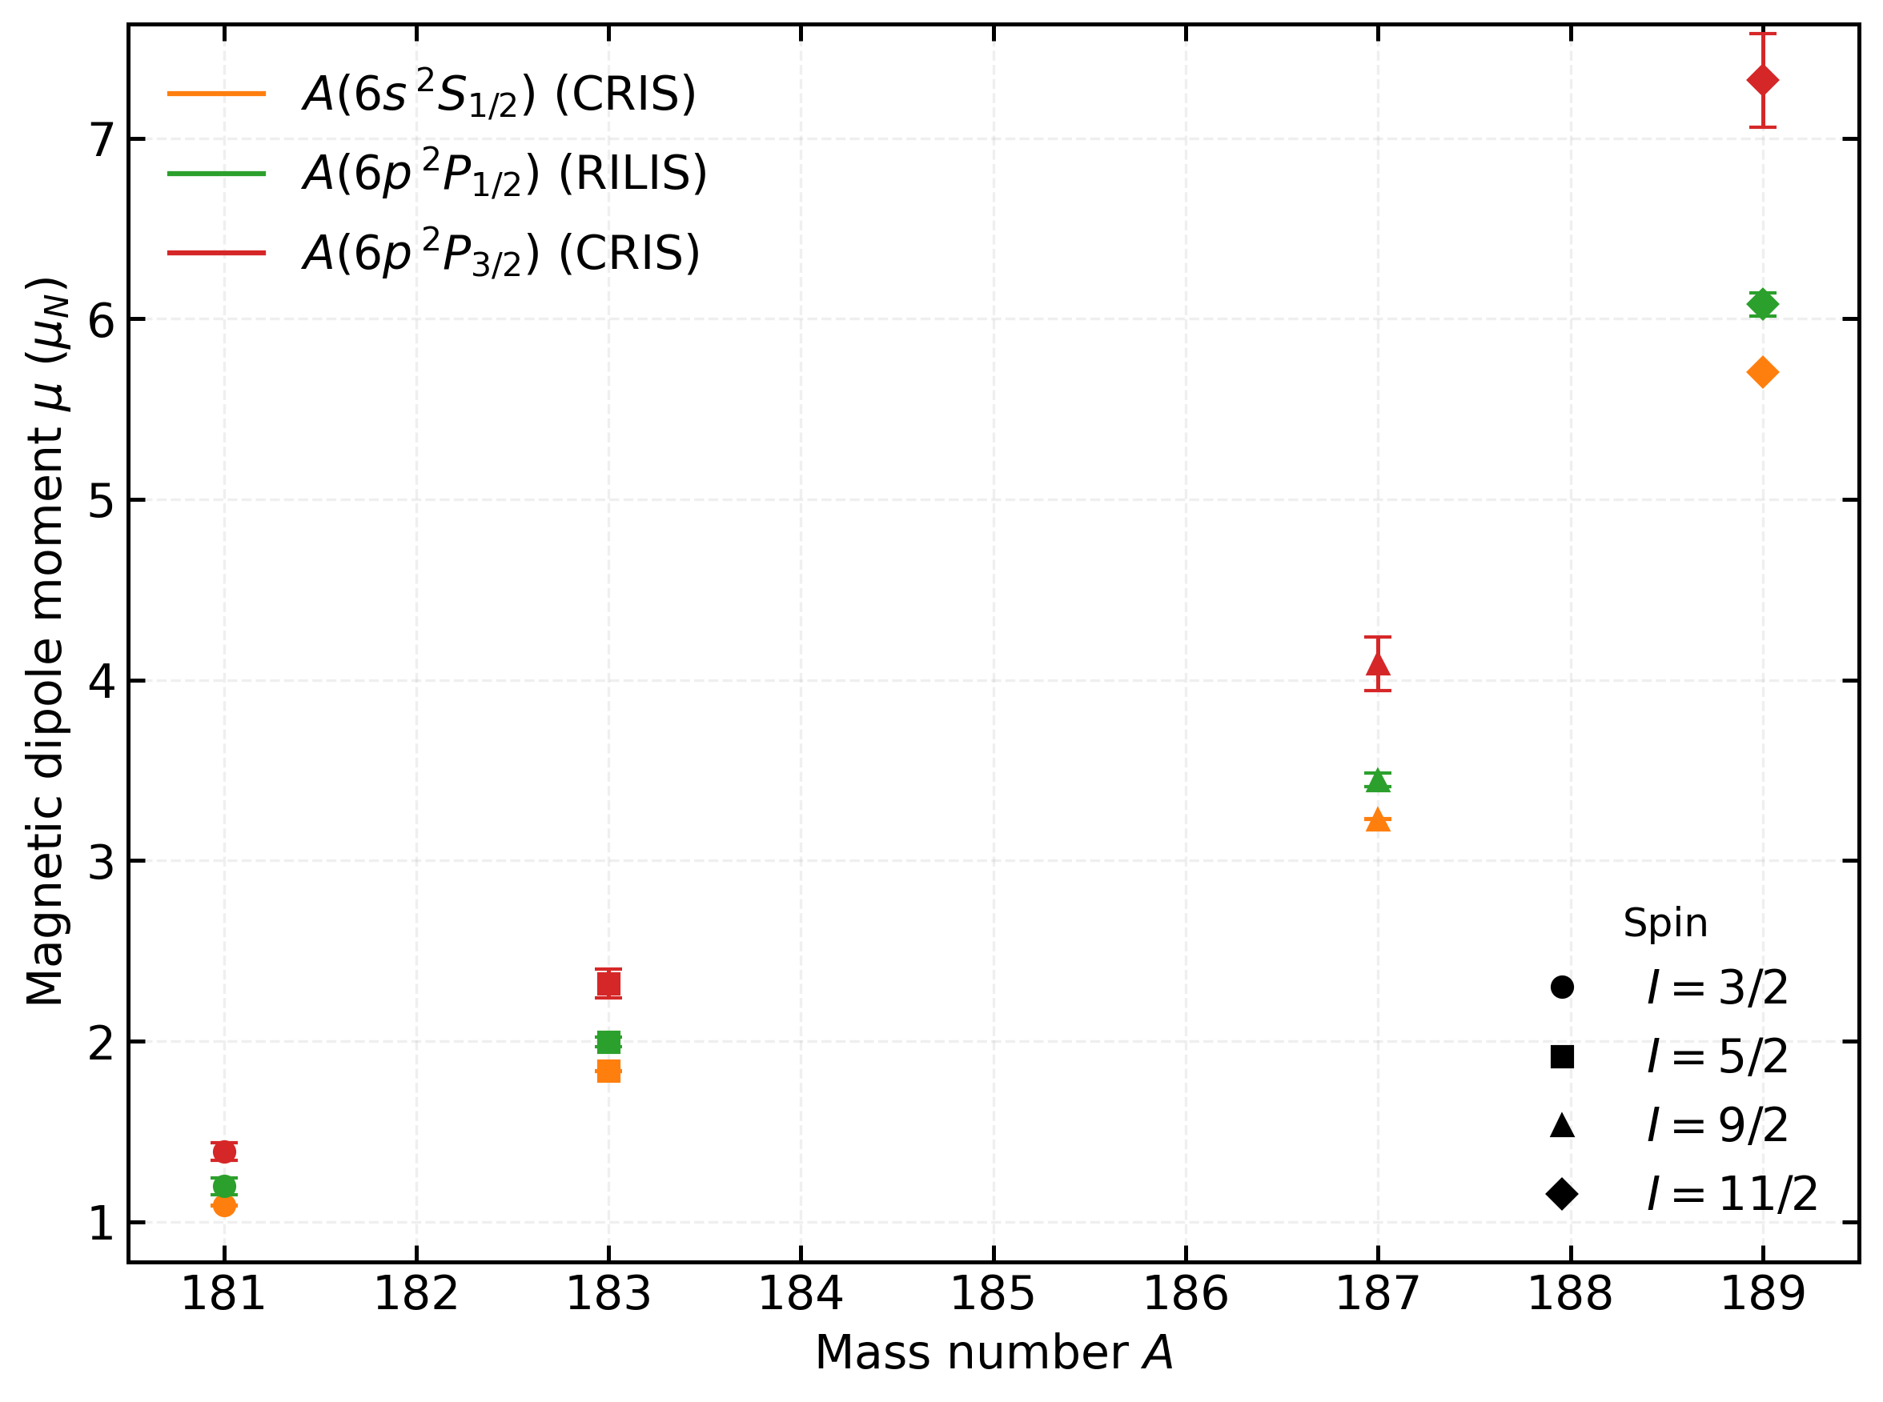
μ from A(6s ²S_{1/2}), A(6p ²P_{1/2}) and A(6p ²P_{3/2})
μ [nm] A(6s²S_{1/2}) | μ [nm] A(6s²S_{1/2})
1.0944(48) | 1.0907(8)
1.8349 (32) | 1.835(1)
3.2230(129) | 3.229(2)
5.7170(74) | 5.706(4)
μ [nm] A (6p²P_{1/2}) | μ [nm] A(6p²P_{3/2})
1.1983(472) | 1.39(5)
1.997(27) | 2.32(8)
3.45(4) | 4.09(15)
6.08(6) | 7.32(26)
μ from RILIS and μ from CRIS from A(6s ²S_{1/2})
μ from RILIS A(6p²P_{1/2}) and from CRIS A(6p²P_{3/2})
No hyperfine anomaly contribution is taken here. μ from A(6s ²S_{1/2}) is overlapping from both RILIS and from this work.
μ from A(6p ²P_{1/2}) (RILIS) is bigger in all the cases than μ from A(6s²S_{1/2}) and always smaller than μ from A(6p²P_{3/2}) (cris).
HFA is largest in 6s ²S_{1/2} .
Can we trust the μ from A(6p ²P_{3/2})? Theory input needed
Department of Physics and Astronomy (IKS)

Slide 27
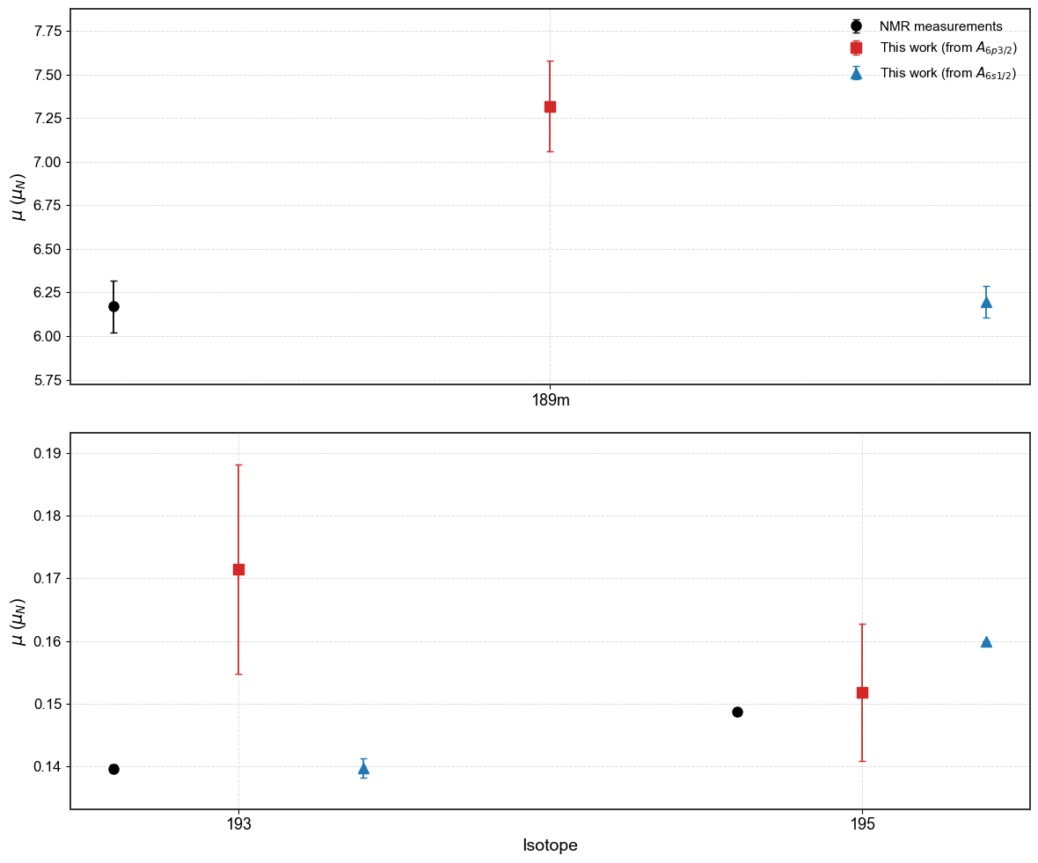
Comparison of μ with NMR measured values
Isotope | μ (NMR) | μ [nm] (cris) A(6P_{3/2}) | μ [nm](cris) A(S_{1/2})
189m | 6.17(15)ª | 7.31(26) | 6.196(91)
193 | 0.1396(6)^{b} | 0.172(17) | 0.1397(16)
195 | 0.1487(6)^{b} | 0.152(11) | 0.16
For ^{189m}Au and ¹⁹³Au, the HFA contribution for A_{6s1/2} are 0.086(16) and -0.005(11). For ¹⁹⁵Au, the HFA contribution is not available in the literature for either 6s_{1/2} or 6p_{3/2}.
a) Walle van E. et. al. Internal field distribution on Au in the Au-Fe system in the limit of very small concentration. Phys. Rev. B 34, 2014(R) – Published 1 August, 1986
b) Hinfurtner, B. et. al. Measurements of spectroscopic quadrupole moments of neutron deficient Au isotopes with quadrupole-interaction-resolved NMR-ON. Nuclear Physics A Volume 562, Issue 2, 20 September 1993, Pages 205-217
Comparison of the the magnetic dipole moment values with NMR measurements to that of obtained from A_{6s1/2} and A_{6p3/2}.
Department of Physics and Astronomy (IKS)
18

Slide 28

Comparison: corrected μ from A(S_{1/2}) to uncorrected from A(P_{1/2}) and A(P_{3/2})
Table: Magnetic moments from this work and RILIS [1-3]
Isotope | Spin | μ(6s ²S_{1/2}) [nm] | μ(6p ²P_{3/2}) [nm] | μ(6p ²P_{1/2}) [nm]
181 | 3/2 | 1.18 | 1.39(5) | 1.20(5)
183 | 5/2 | 1.98 | 2.32(8) | 2.00(3)
187m | 9/2 | 3.54(5) | 4.09(20) | 3.45(4)
189m | 11/2 | 6.196(91) | 7.32(30) | 6.08(6)
HFA correction taken into account for 6s ²S_{1/2}
181-183 standard prescription. 187m and 189m RHFA value
[1] Cubiss et. al, Deformation versus Sphericity in the Ground States of the Lightest Gold Isotopes. PHYSICAL REVIEW LETTERS 131, 202501 (2023)
[2] Bazarkh et. al, Shape coexistence in ¹⁸⁷Au studied by laser spectroscopy. PHYSICAL REVIEW C 101, 064321 (2020)
[3] Bazarkh et. al, Hyperfine anomaly in gold and magnetic moments of I^{π} = 11/2− gold isomers . PHYSICAL REVIEW C 101, 034308 (2020)
Department of Physics and Astronomy (IKS)

Slide 29
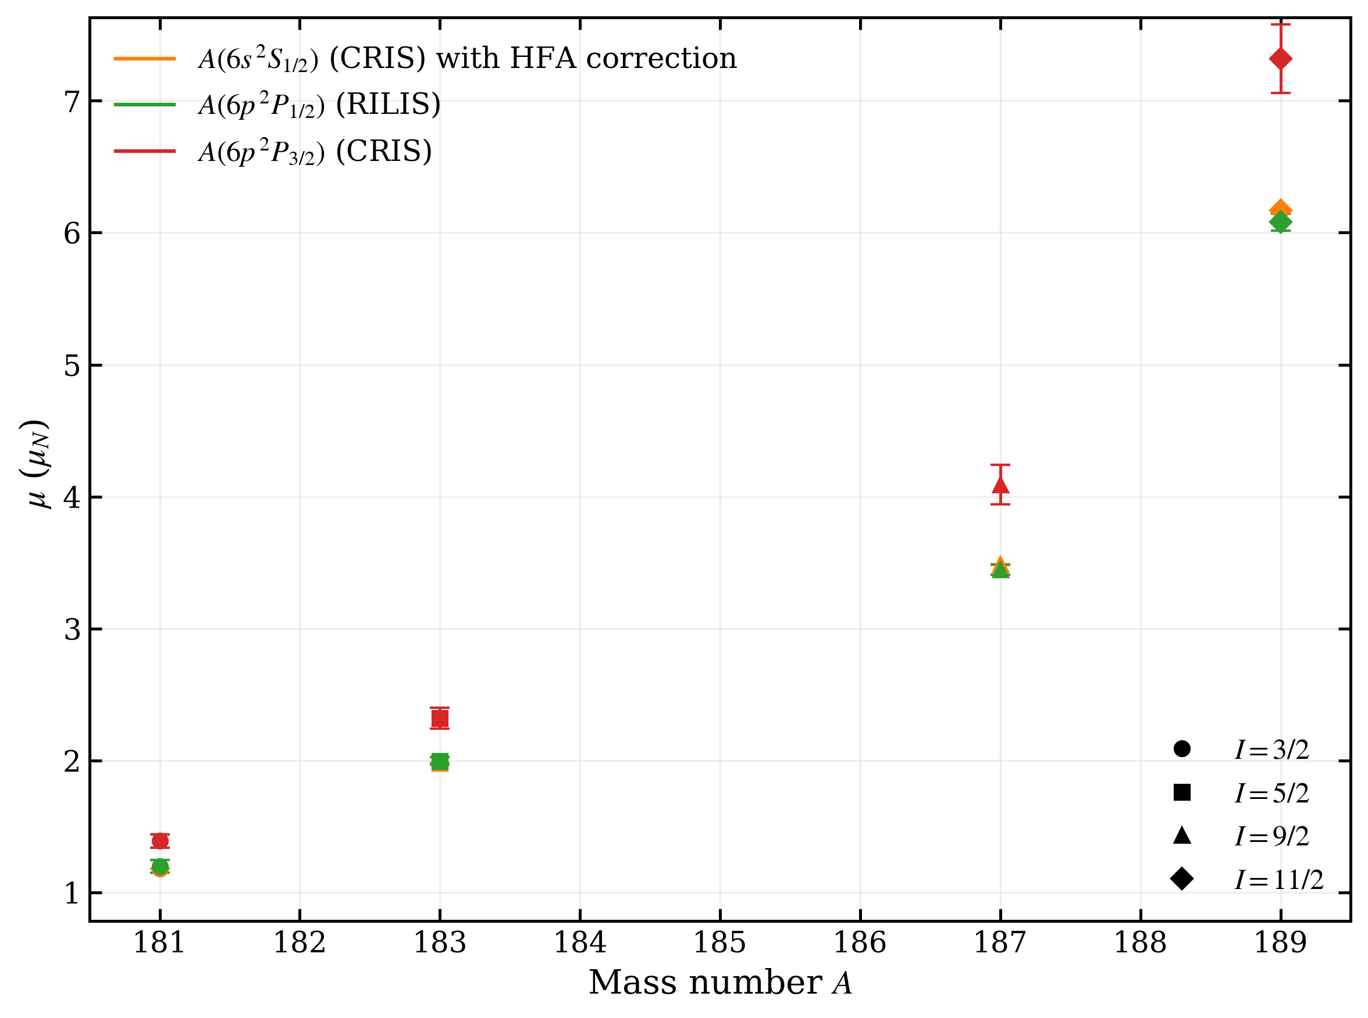
Comparison: corrected μ from A(S_{1/2}) to uncorrected from A(P_{1/2}) and A(P_{3/2})
Table: Magnetic moments from this work and RILIS [1-3]
Isotope | Spin | μ(6s ²S_{1/2}) [nm] | μ(6p ²P_{3/2}) [nm] | μ(6p ²P_{1/2}) [nm]
181 | 3/2 | 1.18 | 1.39(5) | 1.20(5)
183 | 5/2 | 1.98 | 2.32(8) | 2.00(3)
187m | 9/2 | 3.49 | 4.09(2) | 3.45(4)
189m | 11/2 | 6.17 | 7.32(3) | 6.08(6)
HFA correction taken into account for 6s ²S_{1/2} using ML rule for all.
[1] Cubiss et. al, Deformation versus Sphericity in the Ground States of the Lightest Gold Isotopes. PHYSICAL REVIEW LETTERS 131, 202501 (2023)
[2] Bazarkh et. al, Shape coexistence in ¹⁸⁷Au studied by laser spectroscopy. PHYSICAL REVIEW C 101, 064321 (2020)
[3] Bazarkh et. al, Hyperfine anomaly in gold and magnetic moments of I^{π} = 11/2− gold isomers . PHYSICAL REVIEW C 101, 034308 (2020)
Department of Physics and Astronomy (IKS)

Slide 30
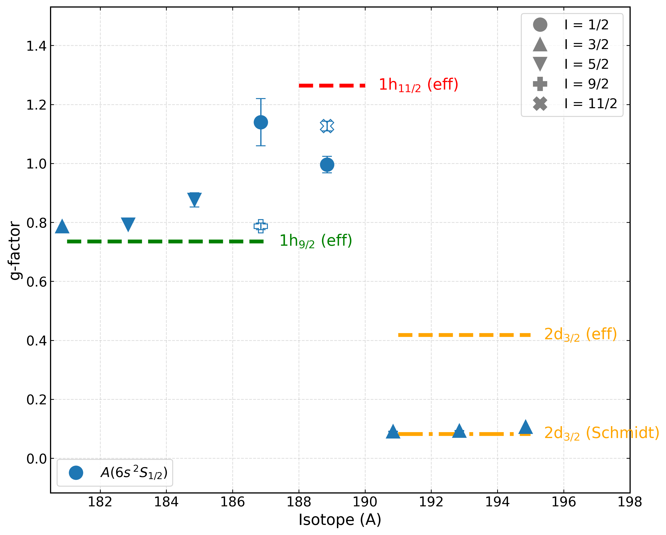
Configurations and HFA in odd Au isotopes
Magnetic dipole moments (g-factors) provide key information on the underlying single-particle nature of a nuclear configuration.
1/2
11/2
Effective-g factors are calculated with quenching factor of 0.7 for g_{s}
1/2
9/2
g-factors extracted from A(6s ²S_{1/2})
with HFA correction
3/2
5/2
5/2
Department of Physics and Astronomy (IKS)

Slide 31
Results: μ from A(P_{3/2}) and A(S_{1/2})., without considering HFA correction
Full symbol: S_{1/2}
Open symbol: P_{3/2}
Table with magnetic moments from A(6s ²S_{1/2}) and A(6p ²P_{3/2}), relative to μ from stable ¹⁹⁷Au
Isotope | Spin | μ [nm] A (6s ²S_{1/2}) | μ [nm] A (6p ²P_{3/2})
181 | 3/2 | 1.0907(8) | 1.39(5)
183 | 5/2 | 1.835(1) | 2.32(8)
185 | 5/2 | 2.0071(15) | 2.52(9)
187 | 1/2 | 0.4996(4) | 0.63(2)
187m | 9/2 | 3.229(2) | 4.09(15)
189 | 1/2 | 0.4568(4) | 0.60(3)
189m | 11/2 | 5.706(4) | 7.32(26)
191 | 3/2 | 0.1381(2) | 0.16(2)
193 | 3/2 | 0.1404(2) | 0.172(17)
195 | 3/2 | 0.1481(1) | 0.152(11)
μ values from both levels are very different, in particular for large μ
Need to take into account HFA to get reliable μ-values
Department of Physics and Astronomy (IKS)
13

Slide 32
Hyperfine A-parameter for P_{1/2} (literature) compared to that of S_{1/2} and P_{3/2} do we understand the HFA ?
From RILIS: A(S_{1/2}) and A(P_{1/2}) values
CRIS: A(S_{1/2}) and A(P_{3/2}) values from this work.
Isotope | Spin | A(S_{1/2}) [MHz] | A(S_{1/2}) / A(P_{1/2}) | A(P_{1/2}) [MHz]
181 | 3/2 | 22900(100) | 0.1155(45)^{[1]} | 2645(104)
183 | 5/2 | 23037(40) | 0.1148(15) ^{[1]} | 2645(35)
187m | 9/2 | 22480(90) | 0.1128(11) ^{[2]} | 2536(27)
189m | 11/2 | 32625(42) | 0.1122(11)^{[3]} | 3661(36)
Isotope | Spin | A(S_{1/2}) [MHz] | A(P_{3/2}) [MHz]
181 | 3/2 | 22809.7(17) | 124.42(67)
183 | 5/2 | 23021.6(13) | 125.05(46)
187m | 9/2 | 22511.4(11) | 122.26(81)
189m | 11/2 | 32540.5(8) | 179.23(70)
From my fits of reference isotope ¹⁹⁷Au:
A(S_{1/2}) = 3047.8(22) MHz,
A(P_{3/2}) = 13.09(46) MHz
A(S_{1/2})(¹⁹⁷Au) = 3049.660092(7) MHz [4];
A(P_{1/2}) (¹⁹⁷Au) = 321.7(12) MHz [5]
[1] Cubiss et. al, Deformation versus Sphericity in the Ground States of the Lightest Gold Isotopes. PHYSICAL REVIEW LETTERS 131, 202501 (2023)
[2] Bazarkh et. al, Shape coexistence in ¹⁸⁷Au studied by laser spectroscopy. PHYSICAL REVIEW C 101, 064321 (2020)
[3] Bazarkh et. al, Hyperfine anomaly in gold and magnetic moments of I^{π} = 11/2− gold isomers . PHYSICAL REVIEW C 101, 034308 (2020)
[4] H. Dahmen and S. Penselin, Z. Phys. 200, 456 (1967)
[5] G. Passler, Nucl. Phys. A 580, 173 (1994).
Department of Physics and Astronomy (IKS)

Slide 33
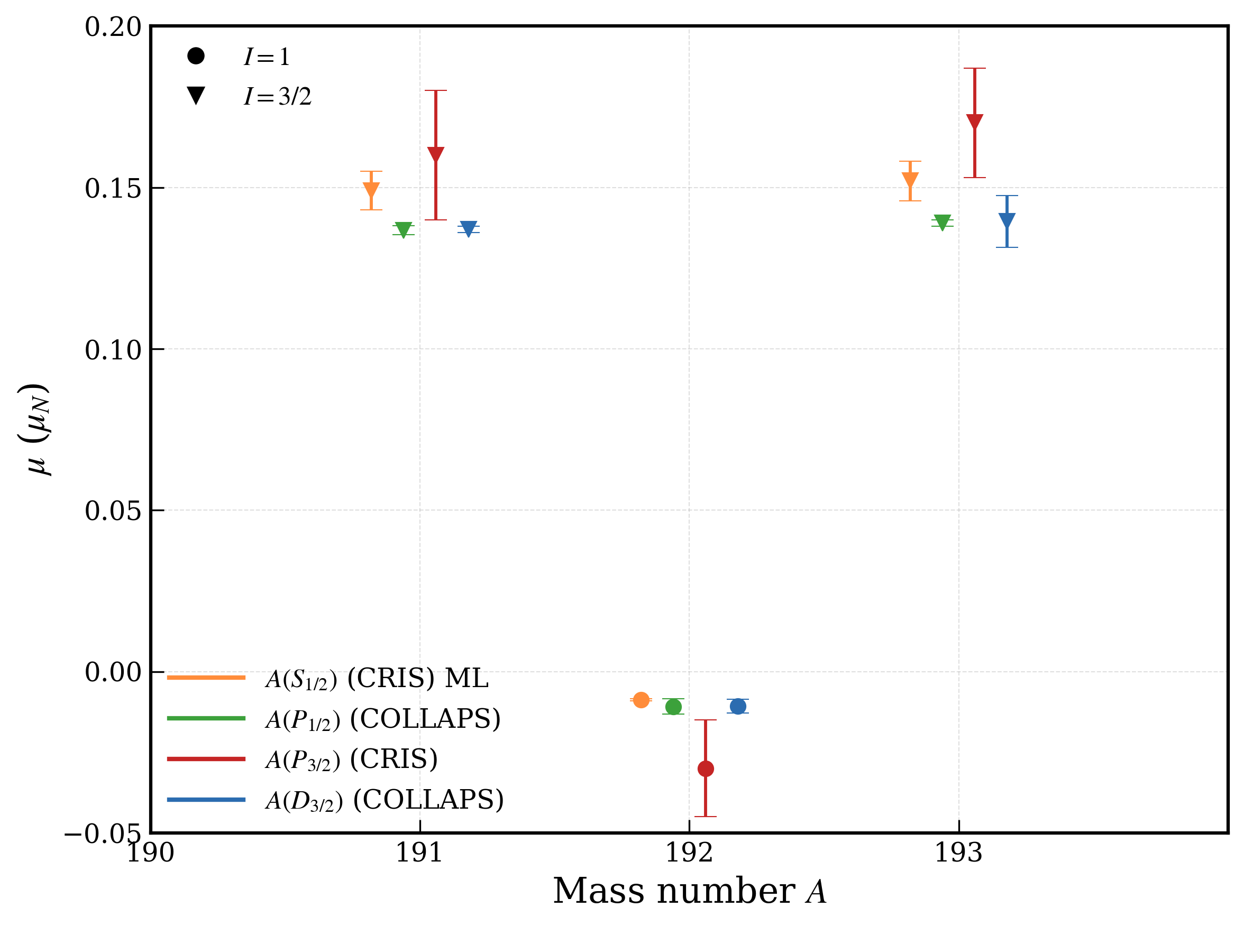
Comparison: corrected μ from A(S_{1/2}) to uncorrected from A(P_{1/2}), A(P_{3/2}) & A(D_{3/2})
Table: Magnetic moments from this work with ML and COLLAPS
Isotope | Spin | μ(S_{1/2}) [nm] | μ(P_{3/2}) [nm] | μ(P_{1/2}) [nm] | μ(D_{3/2}) [nm]
191 | 3/2 | 0.149(6) | 0.16 (2) | 0.1367 (14) | 0.137 (1)
192 | 1 | -0.0087(35) | -0.030(15) | -0.0108 (24) | -0.0107 (21)
193 | 3/2 | 0.152(6) | 0.170 (17) | 0.139 (1) | 0.139 (8)
[1]. Passler, G et. al, Quadrupole moments and nuclear shapes of neutron deficient gold isotopes. Nuclear Physics A580 (1994) 173-212
Department of Physics and Astronomy (IKS)
11

Slide 34
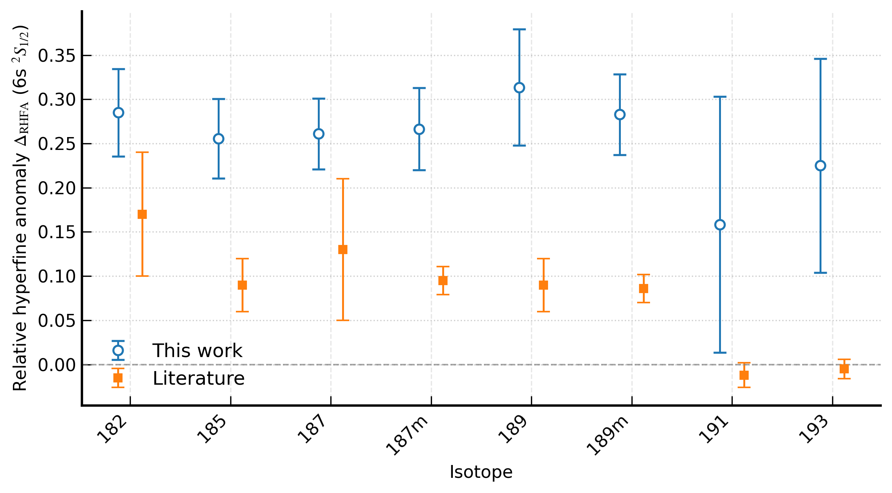
HFA for 6s ²S_{1/2} (literature vs this work)
RHFA comparison with literature for 6s ²S_{1/2} from this work
Department of Physics and Astronomy (IKS)

Slide 35
Values from the fit
Isotope | Spin | Data Sets | A_{6s1/2}[MHz] | Weighted mean A_{6s1/2} [MHz] | A_{6p3/2} [MHz] | Weighted mean A_{6p3/2} [MHz] | B_{6p3/2} [MHz] | Weighted mean B_{6p3/2} [MHz] | Centroid [MHz] | Weighted mean Centroid [MHz]
181 | 3/2 | (1866+1868), (1976+1977) | 22809.6(18), 22810 (5) | 22809.7(17) | 124.6(7), 122.5(21) | 124.42(67) | 765.8(21), 751.3(48) | 763.5(19) | 3046.1(11), 3053.3(26) | 3047.2(1)
182 | 2 | (1994+1995), (2023+2024) | 22216.9(32), 22212(3) | 22214(2) | 125.1(14), 120.7(11) | 122.32(85) | 1308.1(53), 1295.2(46) | 1300.7(35) | 2413.8(26), 2408.1(2) | 2410.2(16)
183 | 5/2 | (1857+1859), (1974+1975) | 23021.5(13), 23022.8(43) | 23021.6(13) | 125(1), 126.1(23) | 125.05(46) | -566.2(25), -559(16) | -566(3) | 1118.14(17), 1122.9(61) | 1118.5(16)
185 | 5/2 | (1847 +1849), (1921+1922), (1924+1923) | 25183.2(7), 25184.3(12), 25182.5(9) | 25183.2(5) | 134.4(4), 135.9(4), 136.6(4) | 135.56(24) | -622(2), -620(3), -621(3) | -621.4(14) | -1260.2(12), -1262.2(13), -1254.5(14) | -1259(1)
187 | 1/2 | (1837+1839), (1845+1844), (1906+1907), (1959+1960) | 31335.2(30), 31363.2(54), 31345.4(68), 31340(4) | 31341.8(21) | 168.3(13), 171.3(19), 174.3(29), 170(2) | 169.94(88) | - - - - | - | 10355(1), 10352.5(16), 10359.5(2), 10358.3(11) | 10356(1)
187m | 9/2 | (1961+1962), (2013+2014) | 22511.5(14), 22511.2(17) | 22511.4(11) | 121.5(13), 122.7(10) | 122.26(81) | -1500(15) -1513(13) | -1507.1(98) | 966.7(56), 955.7(44) | 960(4)
188 | 1 | (2001 +2002), (2025+2026) | -1996(10), -2006.9(54) | -2004.7(48) | -11.4(48), -13.6(25) | -13.1(22) | -181.5(47), -188.1(29) | -186.3(25) | 9002.1(40), 9005.2(29) | 9004.2(24)
189 | 1/2 | (1949+1948), (1966+1967) | 28661(22), 28654(10) | 28654.8(93) | 172.2(92), 159.5(43) | 161.7(39) | - - | - | 7280.8(24), 7263(4) | 7277(2)
189m | 11/2 | (1968+1969+1970), (2003+2004+2005) | 32541(1), 32539.3(15) | 32540.5(8) | 179(1), 181(2) | 179.23(70) | 1337.4(96), 1350(21) | 1339.5(87) | 6520.7(43), 6503.7(98) | 6518(4)
Department of Physics and Astronomy (IKS)
04

Slide 36
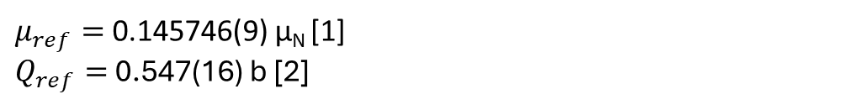
Values from the fit
Isotope | Spin | Data Sets | A_{6s1/2}[MHz] | Weighted mean A_{6s1/2}[MHz] | A_{6p3/2}[MHz] | Weighted mean A_{6p3/2}[MHz] | B_{6p3/2} [MHz] | Weighted mean B_{6p3/2} [MHz] | Centroid [MHz] | Weighted mean Centroid [MHz]
190 | 1 | (1998+1999), (2029+2028) | -1990.8(46), -2010.6(53) | -1999.3(35) | -9.6(23), -10.6(24) | -10.1(17) | -166.4(34), -168.3(28) | -167.5(22) | 6303.4(32), 6304.6(27) | 6304.1(21)
191 | 3/2 | (1972+1973), (2006+2008) | 2885(5), 2891.2(42) | 2888.7(32) | 15.6(21), 12.3(23) | 14.1(16) | 424(4), 431.8(51) | 427(3) | 4871(3), 4854(4) | 4865.3(21)
192 | 1 | (1831), (1833)
193 | 3/2 | (1876+1877) | 2935.5(3) | 2935.5 (3) | 15.4(14), | 15.4(14) | 402.4(35) | 402.4(35) | 1798.7(22) | 1798.7(22)
195 | 3/2 | (1872+1874), (1873+1875) | 3099.5(29), 3097(2) | 3097.7(16) | 15(1) 13.1(1) | 14(1) | 362(3), 359.3(21) | 360.2(17) | -1317.4(22), -1309(1) | -1311(1)
Obtained from the 197Au reference scan fitting
A_{6s1/2,ref} = 3047.8(22) MHz
A_{6p3/2,ref} = 13.09(46) MHz
B_{6p3/2,ref} = 322.9(1.1) MHz
$μ_{ref}=$0.145746(9) μ_{N} [1]
$Q_{ref}=$0.547(16) b [2]
[1] Measurement of the Nuclear Magnetic Dipole Moment of Au¹⁹⁷ and Hyperfine Structure Measurements in the Ground States of Au¹⁹⁷, Ag¹⁰⁷, Ag¹⁰⁹ and K³⁹. Zeitschrift fi.ir Physik 200, 456-466 (1967)
[2] Powers, R. J., et. al. Muonic ¹⁹⁷Au: A test of the weak-coupling model. Nuclear Physics A 230, 3 (Sept. 1974), 413–444.
Department of Physics and Astronomy (IKS)
05

Slide 37
Scatter error vs weighted mean error
Isotope | Spin | A_{6s1/2}[MHz] | Scatter error | Scatter error > weighted mean error | A_{6p3/2}[MHz] | Scatter error | Scatter error > weighted mean error | B_{6p3/2}[MHz] | Scatter error | Scatter error > weighted mean error
181 | 3/2 | 22809.7(17) | 0.116 | False | 124.42(67) | 0.62 | False | 763.5(19) | 5.21 | True
182 | 2 | 22214(2) | 2.39 | True | 122.32(85) | 2.10 | True | 1300.7(35) | 6.35 | True
183 | 5/2 | 23021.6(13) | 0.37 | False | 125.05(46) | 0.21 | False | -566(3) | 1.15 | False
185 | 5/2 | 25183.2(5) | 0.408 | False | 135.56(24) | 0.669 | True | -621.4(14) | 0.66 | False
187 | 1/2 | 31341.8(21) | 5.60 | True | 169.94(88) | 1.05 | True | - | - | -
187m | 9/2 | 22511.4(11) | 0.12 | False | 122.26(81) | 0.599 | False | -1507.1(98) | 6.0 | False
188 | 1 | -2004.7(48) | 4.24 | False | -13.1(22) | 0.92 | False | -186.3(25) | 2.95 | True
189 | 1/2 | 28654.8(93) | 2.8 | False | 161.7(39) | 4.84 | True | - | - | -
189m | 11/2 | 32540.5(8) | 0.7 | False | 179.23(70) | 0.636 | False | 1339.5(87) | 4.75 | False
190 | 1 | -1999.3(35) | 9.81 | True | -10.1(17) | 0.51 | False | -167.5(22) | 0.90 | False
191 | 3/2 | 2888.7(32) | 3.08 | False | 14.1(16) | 1.65 | True | 427(3) | 3.76 | True
193 | 3/2 | 2936 (3) | 3 | One dataset | 15.4(14) | 1.4 | One dataset | 402.4(35) | 3.5 | One dataset
195 | 3/2 | 3097.7(16) | 1.13 | False | 13.63(71) | 0.86 | True | 360.2(17) | 1.3 | False
Department of Physics and Astronomy (IKS)
07

Slide 38
A_{6p3/2}/A_{6s1/2} ratio and error
Isotope | Spin | A_{6s1/2}[MHz] | A_{6p3/2}[MHz] | A_{6p3/2}/A_{6s1/2} | Weighted-mean error | Scatter error | Scatter error > Weighted mean error
181 | 3/2 | 22809.7(17) | 124.42(67) | 0.00545 | 0.000029 | 0.0000276 | False
182 | 2 | 22214(2) | 122.32(85) | 0.00551 | 0.000038 | 0.000095 | True
183 | 5/2 | 23021.6(13) | 125.05(46) | 0.00543 | 0.0000198 | 0.00000924 | False
185 | 5/2 | 25183.2(5) | 135.56(24) | 0.00538 | 0.00000953 | 0.0000266 | True
187 | 1/2 | 31341.8(21) | 169.94(88) | 0.00542 | 0.000028 | 0.00003376 | True
187m | 9/2 | 22511.4(11) | 122.26(81) | 0.00543 | 0.000036 | 0.0000266 | False
188 | 1 | -2004.7(48) | -13.1(22) | 0.00655 | 0.00111 | 0.000461 | False
189 | 1/2 | 28654.8(93) | 161.7(39) | 0.00564 | 0.000135 | 0.000169 | True
189m | 11/2 | 32540.5(8) | 179.23(70) | 0.00551 | 0.0000215 | 0.0000195 | False
190 | 1 | -1999.3(35) | -10.1(17) | 0.00506 | 0.00083 | 0.000256 | False
191 | 3/2 | 2888.7(32) | 14.1(16) | 0.00488 | 0.000544 | 0.000571 | True
193 | 3/2 | 2936 (3) | 15.4(14) | 0.00526 | 0.000465 | 0.000465 | Same (only one dataset)
195 | 3/2 | 3097.7(16) | 14(1) | 0.00443 | 0.000208 | 0.000178 | False
197 | 3/2 | 3047.8(22) | 13.09(46) | 0.00429 | 0.000151 | 0.000282 | True
Global weighted mean A_{6p3/2}/A_{6s1/2} = 0.005437931 with 0.00000715 as weighted mean error and 0.0000172 as scatter error.
Department of Physics and Astronomy (IKS)
06

Slide 39
More comparison: corrected μ from A(S_{1/2}) to uncorrected from A(P_{1/2}), A(P_{3/2}), A(D_{3/2})
μ_{S1/2} are corrected using the ML rule. μ_{S1/2} don’t agree very well with other μ
μ_{S1/2} are corrected using the RHFA. μ_{S1/2} agree well with μ_{P1/2} and μ_{D3/2}
[1]. Passler, G et. al, Quadrupole moments and nuclear shapes of neutron deficient gold isotopes. Nuclear Physics A580 (1994) 173-212
Department of Physics and Astronomy (IKS)
11

Slide 40
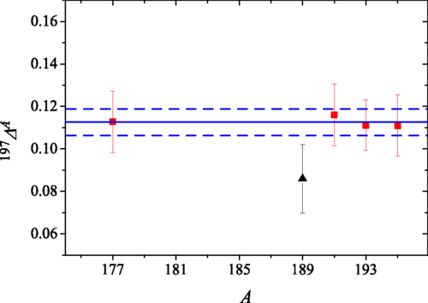
189m A(S_{1/2}): CRIS vs Literature
A(S_{1/2}) [MHz] (cris) | A(S_{1/2}) [MHz] (lit)
32541 (1) | 32652 (42)
1.5 sigma difference
Relative hyperfine anomaly for 11/2⁻ gold isomers [2].
[1]. Wallmeroth, K et. al, Nuclear shape transition in light gold isotopes. Nuclear Physics A 493 (1989) 224-252
[2]. A.E Bazarkh et. al, Hyperfine anomaly in gold and magnetic moments of I^{π} = 11/2⁻ gold isomers
Figure from [2] Department of Physics and Astronomy (IKS)
11

