Slide 1



Atomic physics studies of the heaviest alkaline
P. Lassègues, R. P. de Groote, A. Kastberg et al.
1

Slide 2
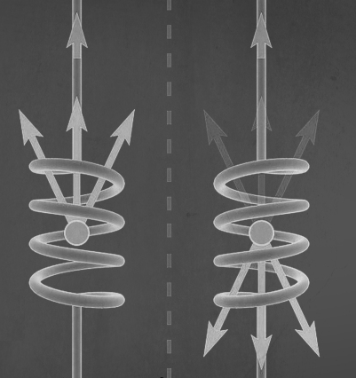

General motivation – Parity non-conservation
Studies of parity non-conservations (PNC) is a unique signature of weak interaction.
Most precise measurement performed on 6${}_{}^{2}{S_{1/2}}$ → 7${}_{}^{2}{S_{1/2}}$ transition in Cs, achieving a precision of 0.35 ${\text{\%}}^{(1)}$.
PNC amplitude in the 7${}_{}^{2}{S_{1/2}}$ →6${}_{}^{2}{D_{3/2,5/2}}$ transitions in Fr is predicted to be more than 50 times larger than in the 6${}_{}^{2}{S_{1/2}}$ → 7${}_{}^{2}{S_{1/2}}$ transition in ${\text{Cs}}^{(2)}$.
« Parity non-conservation » Artistic rendition of the Wu experiment - Aleksandra Sokół
${}^{(1)}$Wood, C. S., S. C. Bennett, D. Cho, B. P. Masterson, J. L. Roberts, C. E. Tanner, et C. E. Wieman. « Measurement of Parity Nonconservation and an Anapole Moment in Cesium ». Science 275, nº 5307 (1997)
${}^{(2)}$Roberts, B. M., V. A. Dzuba, et V. V. Flambaum. « Parity nonconservation in Fr-like actinide and Cs-like rare-earth-metal ions ». Phys. Rev. A 88, nº 1
Notes:
Studies of parity non-conservations (PNC) form one of the current frontiers in the search for physics beyond the standard model (BSM)
the most precise measurement was performed on the 6S1/2 → 7S1/2 transition in Cs with the use of a spin-polarized atomic beam, achieving a precision of 0.35%.
the PNC amplitude in the 7S1/2 → 6D3/2,5/2 transitions in Fr is predicted to be almost 4 times larger than the 7S1/2 → 8S1/2 transition in Fr and more than 50 times larger than in the 6S1/2 → 7S1/2 transition in Cs.
This experiment is our third-generation measurement of PNC in atomic cesium. Conceptually, the experiment is similar to our previous two (6, 9). As a beam of atomic cesium passes through a region of ~er~endicular electric, magnetic, and laser fields, we excite the highly forbidden 6.5 to 7S transition. The handedness of this region is reversed by reversing each of the field directions. The parity violation is apparent as a small modulation in the 6s-7S excitation rate that is synchronous with all of these reversals

Slide 3
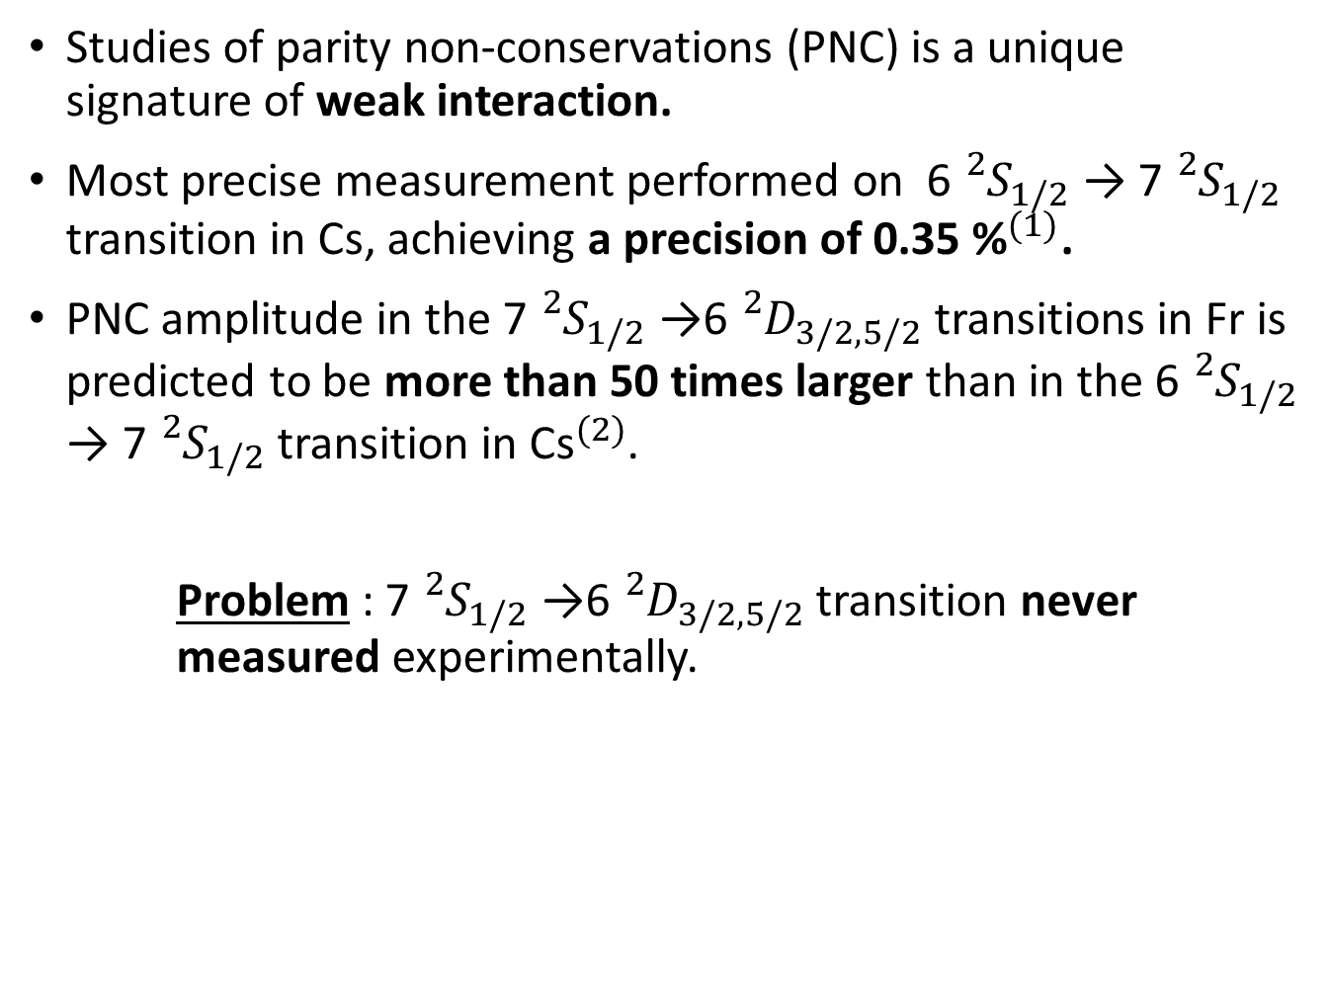
General motivation – Parity non-conservation
Studies of parity non-conservations (PNC) is a unique signature of weak interaction.
Most precise measurement performed on 6${}_{}^{2}{S_{1/2}}$ → 7${}_{}^{2}{S_{1/2}}$ transition in Cs, achieving a precision of 0.35 ${\text{\%}}^{(1)}$.
PNC amplitude in the 7${}_{}^{2}{S_{1/2}}$ →6${}_{}^{2}{D_{3/2,5/2}}$ transitions in Fr is predicted to be more than 50 times larger than in the 6${}_{}^{2}{S_{1/2}}$ → 7${}_{}^{2}{S_{1/2}}$ transition in ${\text{Cs}}^{(2)}$.
Problem : 7${}_{}^{2}{S_{1/2}}$ →6${}_{}^{2}{D_{3/2,5/2}}$ transition never measured experimentally.
« Parity non-conservation » Artistic rendition of the Wu experiment - Aleksandra Sokół
${}^{(1)}$Wood, C. S., S. C. Bennett, D. Cho, B. P. Masterson, J. L. Roberts, C. E. Tanner, et C. E. Wieman. « Measurement of Parity Nonconservation and an Anapole Moment in Cesium ». Science 275, nº 5307 (1997)
${}^{(2)}$Roberts, B. M., V. A. Dzuba, et V. V. Flambaum. « Parity nonconservation in Fr-like actinide and Cs-like rare-earth-metal ions ». Phys. Rev. A 88, nº 1
Notes:
Studies of parity non-conservations (PNC) form one of the current frontiers in the search for physics beyond the standard model (BSM)
the most precise measurement was performed on the 6S1/2 → 7S1/2 transition in Cs with the use of a spin-polarized atomic beam, achieving a precision of 0.35%.
the PNC amplitude in the 7S1/2 → 6D3/2,5/2 transitions in Fr is predicted to be almost 4 times larger than the 7S1/2 → 8S1/2 transition in Fr and more than 50 times larger than in the 6S1/2 → 7S1/2 transition in Cs.
This experiment is our third-generation measurement of PNC in atomic cesium. Conceptually, the experiment is similar to our previous two (6, 9). As a beam of atomic cesium passes through a region of ~er~endicular electric, magnetic, and laser fields, we excite the highly forbidden 6.5 to 7S transition. The handedness of this region is reversed by reversing each of the field directions. The parity violation is apparent as a small modulation in the 6s-7S excitation rate that is synchronous with all of these reversals

Slide 4








Atomic 6D-states in neutral Fr
FIU
IP
n${}_{ }^{2}{P_{ }}$/n${}_{ }^{2}{F_{ }}$
9${}_{ }^{2}{P_{3/2}}$
9${}_{ }^{2}{P_{1/2}}$
8${}_{ }^{2}{P_{3/2}}$
~611 nm
N-scheme:
4 steps Ionization
8${}_{ }^{2}{P_{1/2}}$
~912 nm
6${}_{ }^{2}{D_{5/2}}$
6${}_{ }^{2}{D_{3/2}}$
365 nm
Excitation to 9P lvl
Additional laser driving depopulation into the 6D state → dip in ion rate
Excitation to Rydberg states (+plus bonus of characterizing Rydberg series)
Field ionization = previous new developments necessary
7${}_{ }^{2}{S_{1/2}}$

Slide 5
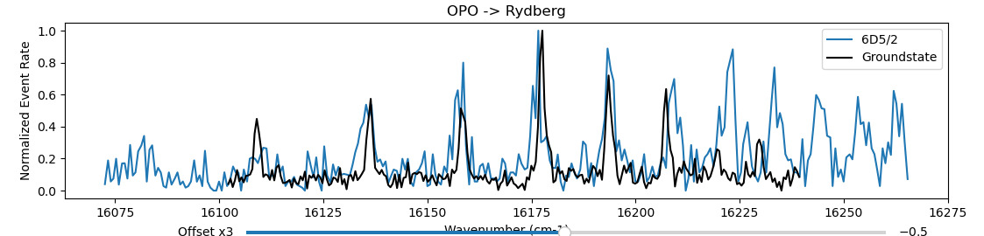
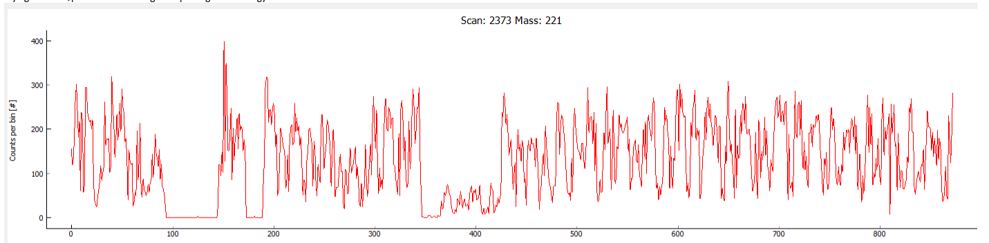


More Atomic measurements in neutral Fr !
Fluctuations of the Beam:
Unable to do High precision Spectroscopy
At least 2 shifts losts
Same problem during Antimony ? And Gold ?
VERY PRELIMINARY !
6${}_{ }^{2}{D_{3/2}}$
365 nm
~608 nm
7${}_{ }^{2}{S_{1/2}}$

Slide 6
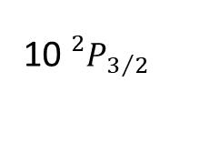
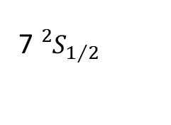
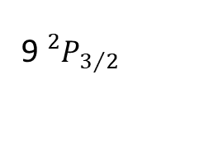
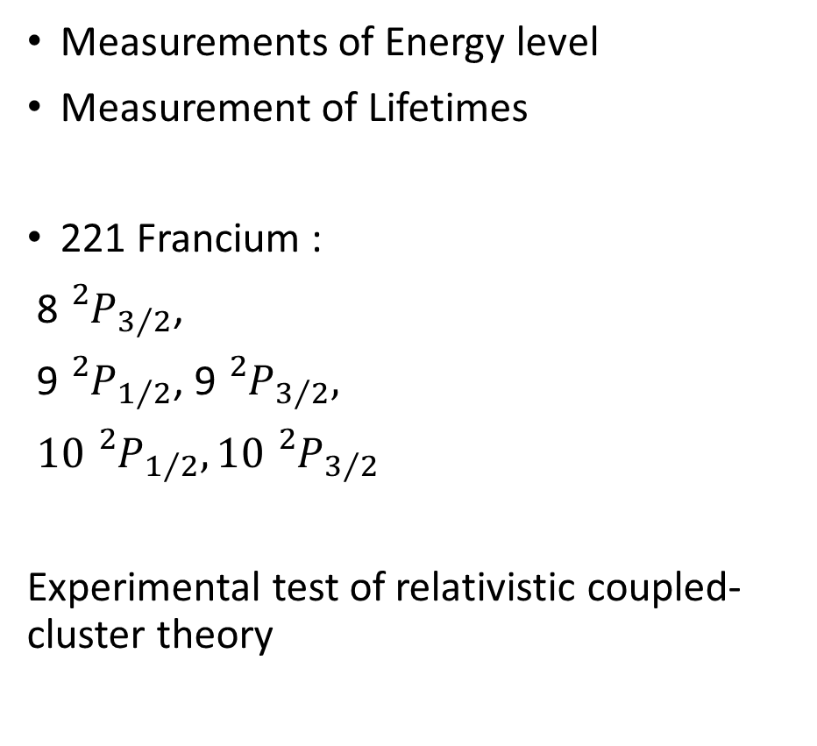
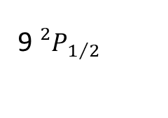
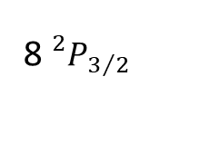
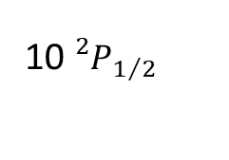
Atomic studies in 221 Francium
Fr
10${}_{}^{2}{P_{3/2}}$
1064 nm
Measurements of Energy level
Measurement of Lifetimes
221 Francium :
8${}_{}^{2}{P_{3/2}}$,
9${}_{}^{2}{P_{1/2}}$, 9${}_{}^{2}{P_{3/2}},$
$\text{10}{}_{}^{2}{P_{1/2}},\text{10}{}_{}^{2}{P_{3/2}}$
Experimental test of relativistic coupled-cluster theory
10${}_{}^{2}{P_{1/2}}$
342 nm
9${}_{}^{2}{P_{3/2}}$
344 nm
9${}_{}^{2}{P_{1/2}}$
365 nm
8${}_{}^{2}{P_{3/2}}$
368 nm
422 nm
7${}_{}^{2}{S_{1/2}}$

Slide 7
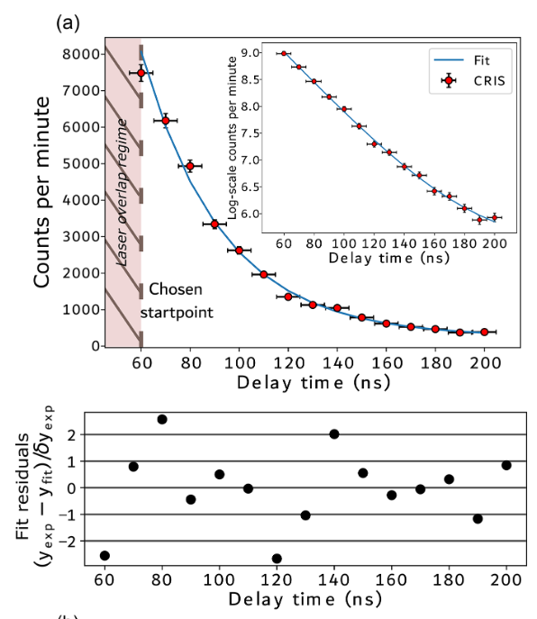
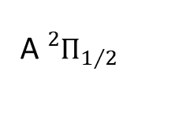
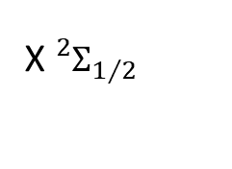
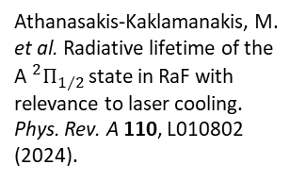
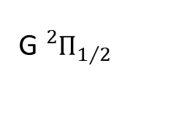
Results December 2023
Fr
RaF
10${}_{}^{2}{P_{3/2}}$
1064 nm
532 nm
10${}_{}^{2}{P_{1/2}}$
342 nm
G${}_{}^{2}{Π_{1/2}}$
9${}_{}^{2}{P_{3/2}}$
344 nm
646 nm
9${}_{}^{2}{P_{1/2}}$
365 nm
8${}_{}^{2}{P_{3/2}}$
A${}_{}^{2}{Π_{1/2}}$
368 nm
Athanasakis-Kaklamanakis, M. et al. Radiative lifetime of the A${}_{}^{2}{Π_{1/2}}$state in RaF with relevance to laser cooling. Phys. Rev. A 110, L010802 (2024).
753 nm
422 nm
7${}_{}^{2}{S_{1/2}}$
X${}_{}^{2}{Σ_{1/2}}$

Slide 8
Energy Levels

Slide 9
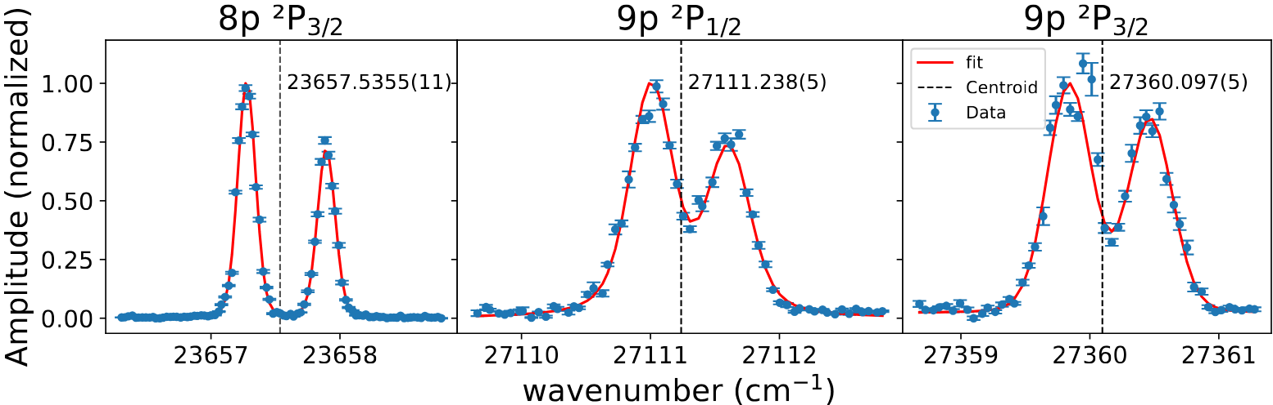
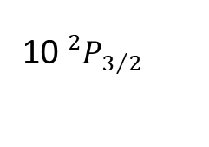
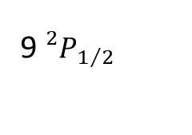
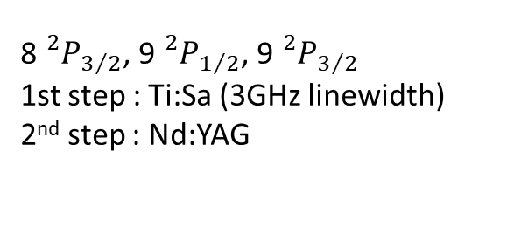
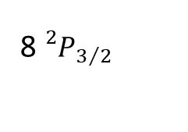
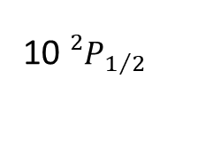
Energy levels
Fr
10${}_{}^{2}{P_{3/2}}$
1064 nm
10${}_{}^{2}{P_{1/2}}$
342 nm
9${}_{}^{2}{P_{3/2}}$
344 nm
9${}_{}^{2}{P_{1/2}}$
365 nm
8${}_{}^{2}{P_{3/2}}$
368 nm
8${}_{}^{2}{P_{3/2}}$, 9${}_{}^{2}{P_{1/2}}$, 9${}_{}^{2}{P_{3/2}}$
1st step : Ti:Sa (3GHz linewidth)
2nd step : Nd:YAG
422 nm
7${}_{}^{2}{S_{1/2}}$

Slide 10
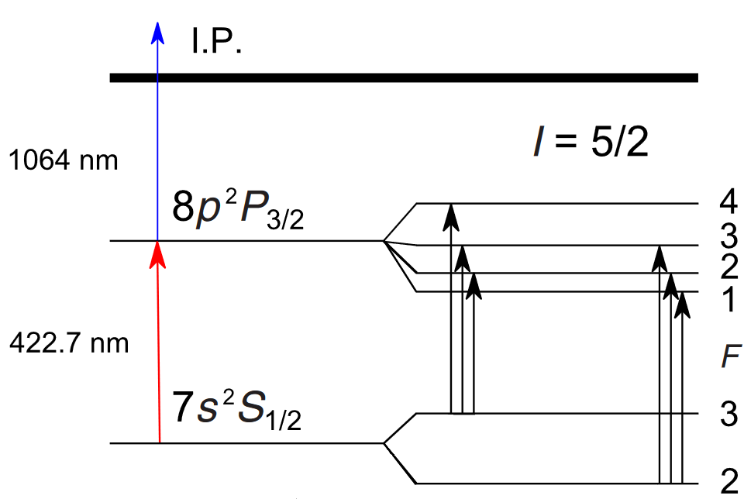
Energy levels
Fr
10${}_{}^{2}{P_{3/2}}$
1064 nm
10${}_{}^{2}{P_{1/2}}$
342 nm
9${}_{}^{2}{P_{3/2}}$
344 nm
9${}_{}^{2}{P_{1/2}}$
365 nm
8${}_{}^{2}{P_{3/2}}$
368 nm
8${}_{}^{2}{P_{3/2}}$, 9${}_{}^{2}{P_{1/2}}$, 9${}_{}^{2}{P_{3/2}}$
1st step : Ti:Sa (3GHz linewidth)
2nd step : Nd:YAG
422 nm
7${}_{}^{2}{S_{1/2}}$

Slide 11
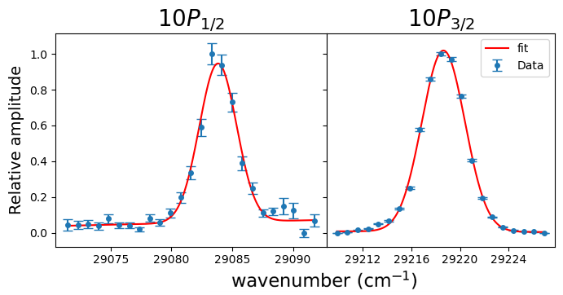

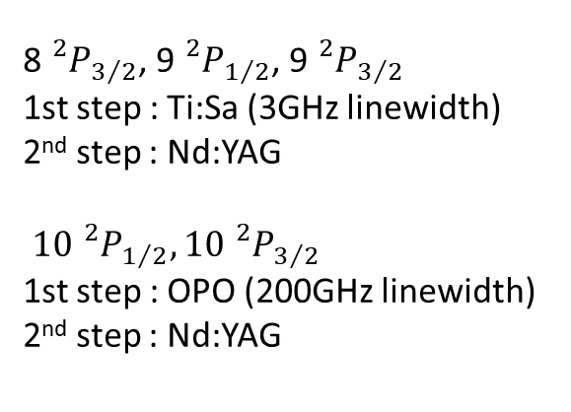

Energy levels
Fr
10${}_{}^{2}{P_{3/2}}$
1064 nm
10${}_{}^{2}{P_{1/2}}$
342 nm
9${}_{}^{2}{P_{3/2}}$
344 nm
9${}_{}^{2}{P_{1/2}}$
365 nm
8${}_{}^{2}{P_{3/2}}$
368 nm
8${}_{}^{2}{P_{3/2}}$, 9${}_{}^{2}{P_{1/2}}$, 9${}_{}^{2}{P_{3/2}}$
1st step : Ti:Sa (3GHz linewidth)
2nd step : Nd:YAG
$\text{10}{}_{}^{2}{P_{1/2}},\text{10}{}_{}^{2}{P_{3/2}}$
1st step : OPO (200GHz linewidth)
2nd step : Nd:YAG
422 nm
7${}_{}^{2}{S_{1/2}}$

Slide 12
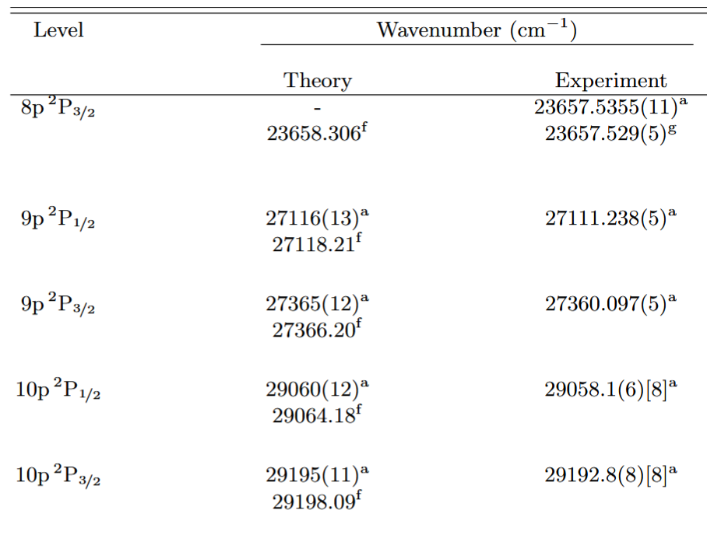
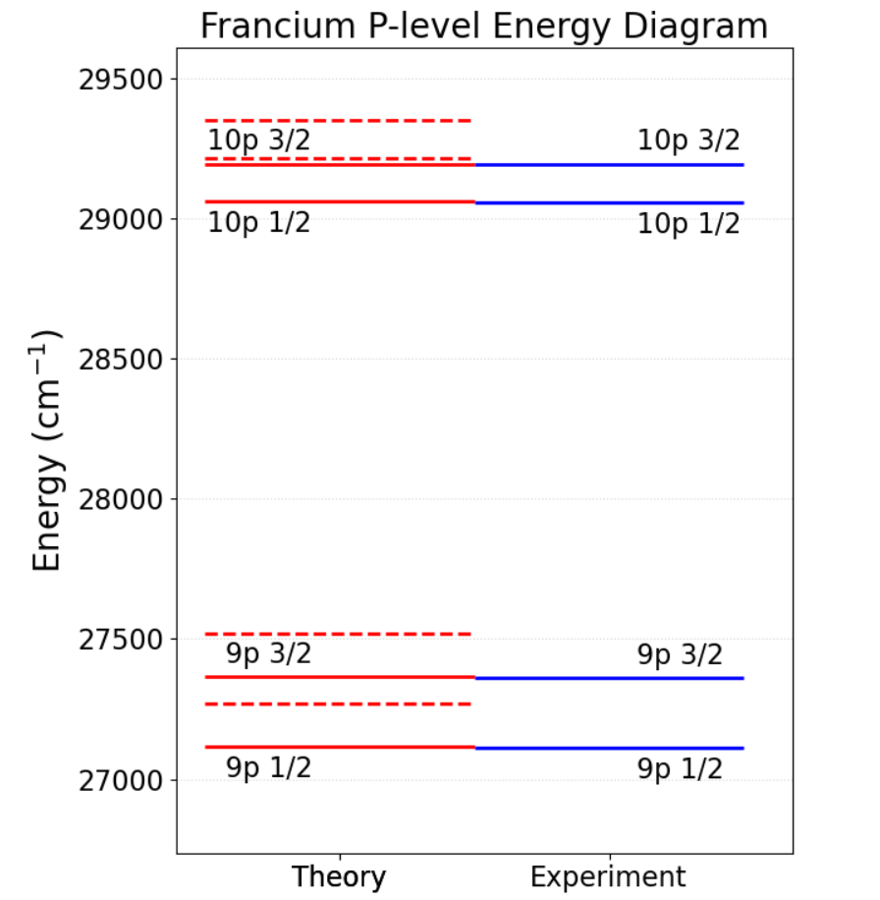
Energy levels

Slide 13
Energy levels
Experiment :
Two step scheme from the ground state
Theory :
RCCSDT (Relativistic Coupled-Cluster with Single, Double, and Triple excitations) method referenced to the ionization potential.

Slide 14
Energy levels
Experiment :
Two step scheme from the ground state
Theory :
RCCSDT (Relativistic Coupled-Cluster with Single, Double, and Triple excitations) method referenced to the ionization potential.
-Systematic offset from RCCSDT calculations.
Missing contributions (higher-order excitations beyond triples, high-ℓ orbitals, QED effects) state-independent energy shift.
RCCSDT captures the essential state-dependent correlation physics in francium.

Slide 15
Lifetimes

Slide 16
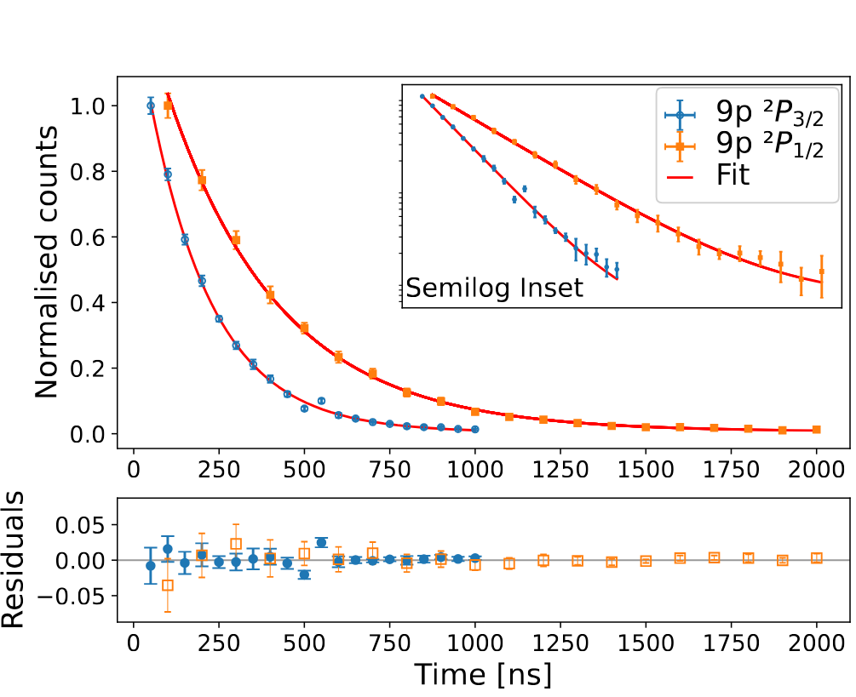
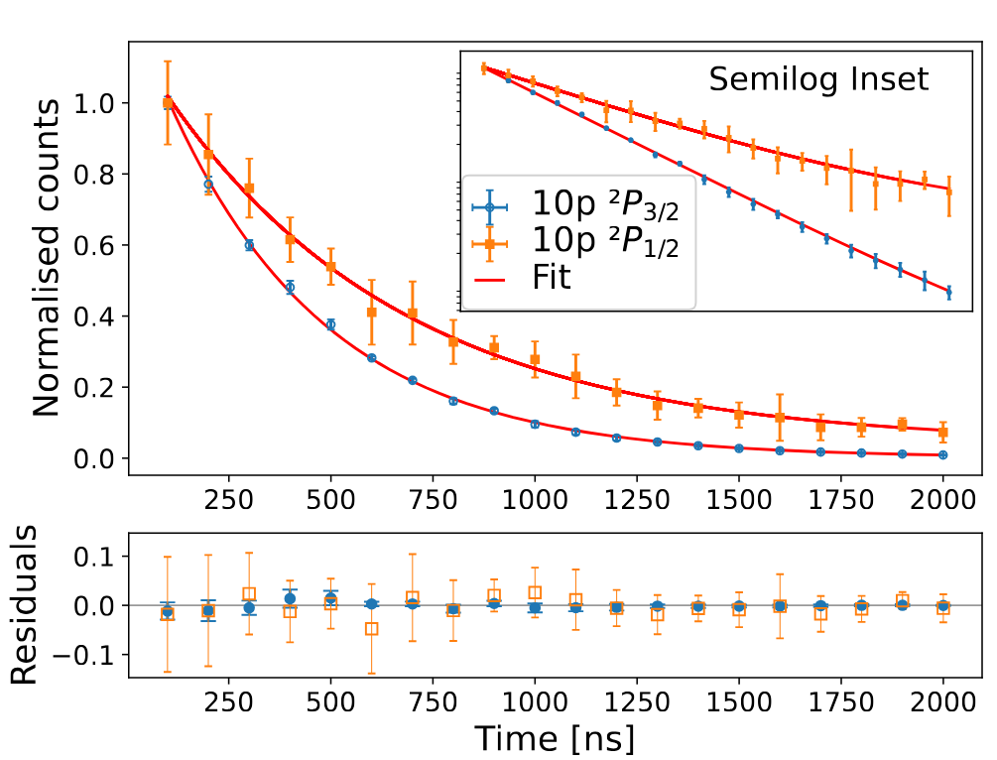
Atomic studies in Fr : Lifetimes

Slide 17
Atomic studies in Fr : Lifetimes
Possible Variations for final results:
Laser Overlap regime
I
422nm
1064nm
∆t
t

Slide 18
Atomic studies in Fr : Lifetimes
Possible Variations for final results:
Laser Overlap regime
I
422nm
1064nm
∆t
t

Slide 19
Atomic studies in Fr : Lifetimes
Possible Variations for final results:
Laser Overlap regime
PRELIMINARY
I
422nm
1064nm
∆t
t

Slide 20
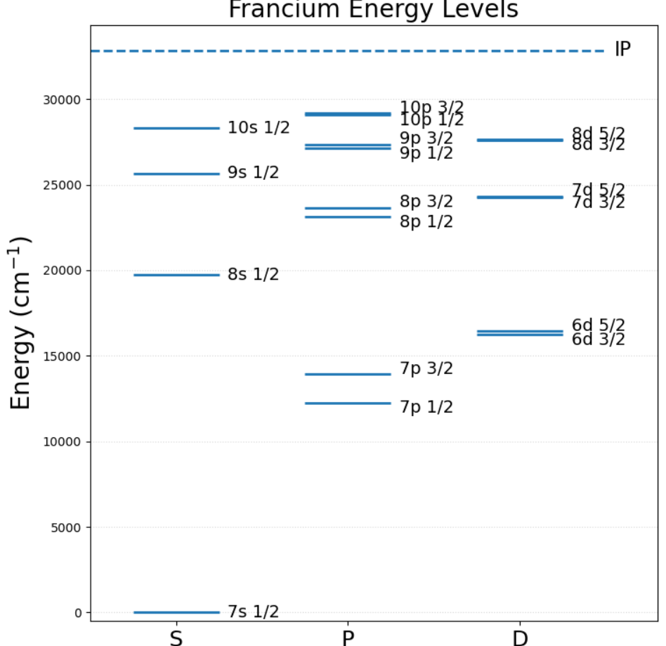
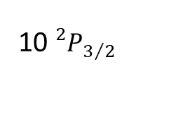
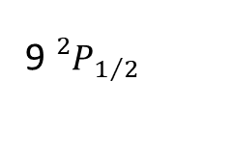
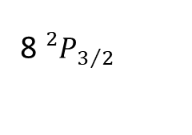
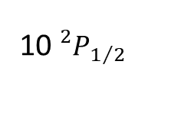
Fr
10${}_{}^{2}{P_{3/2}}$
1064 nm
10${}_{}^{2}{P_{1/2}}$
342 nm
9${}_{}^{2}{P_{3/2}}$
344 nm
9${}_{}^{2}{P_{1/2}}$
365 nm
8${}_{}^{2}{P_{3/2}}$
368 nm
422 nm
7${}_{}^{2}{S_{1/2}}$

Slide 21
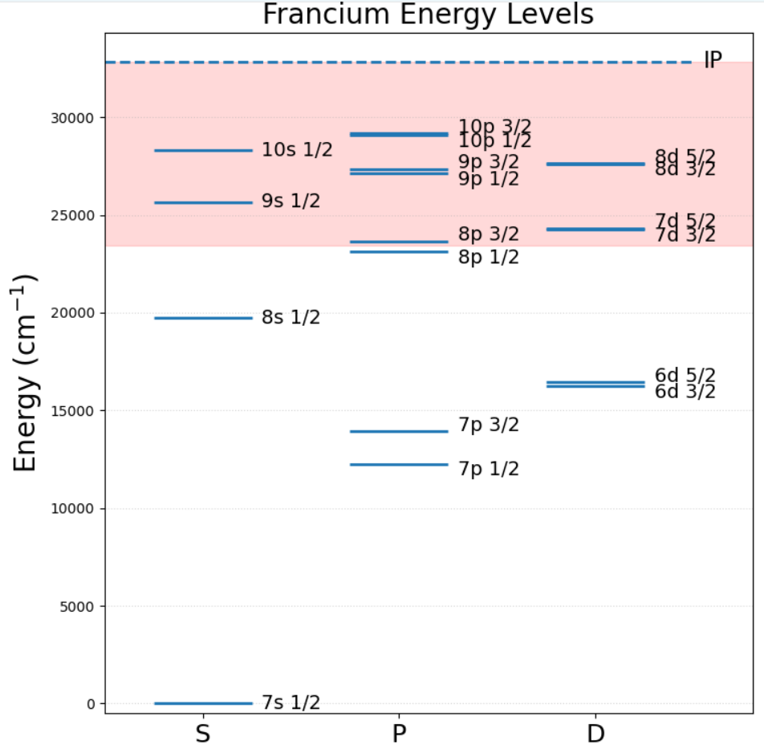
Fr
10${}_{}^{2}{P_{3/2}}$
1064 nm
10${}_{}^{2}{P_{1/2}}$
342 nm
9${}_{}^{2}{P_{3/2}}$
344 nm
9${}_{}^{2}{P_{1/2}}$
365 nm
8${}_{}^{2}{P_{3/2}}$
368 nm
422 nm
7${}_{}^{2}{S_{1/2}}$

Slide 22
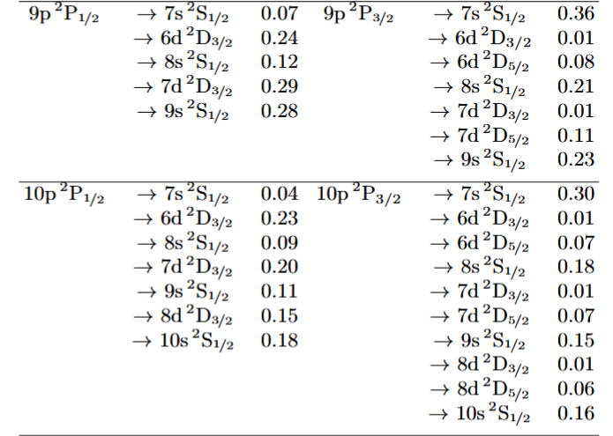

Slide 24
57%
35%
64%
46%

Slide 25
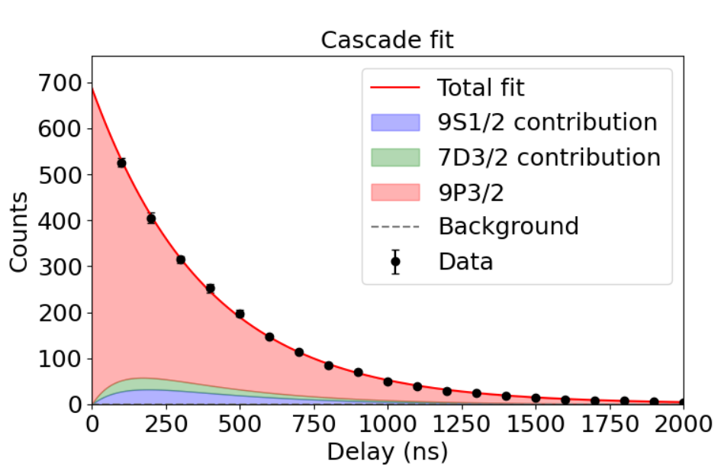
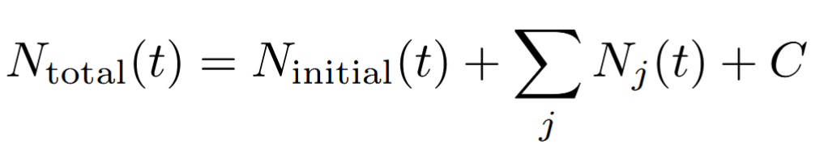
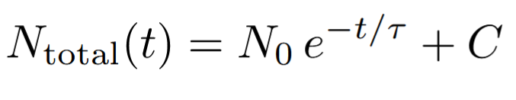
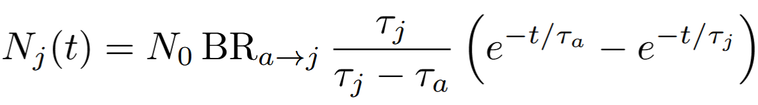

Slide 26
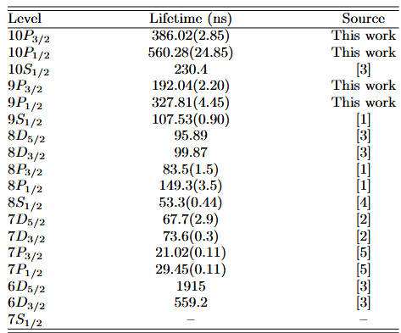

Slide 27
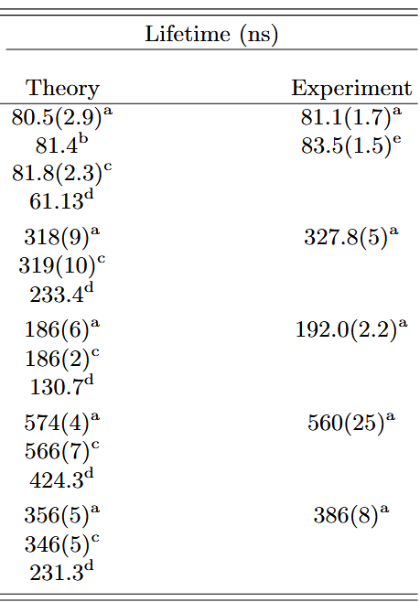

Slide 28
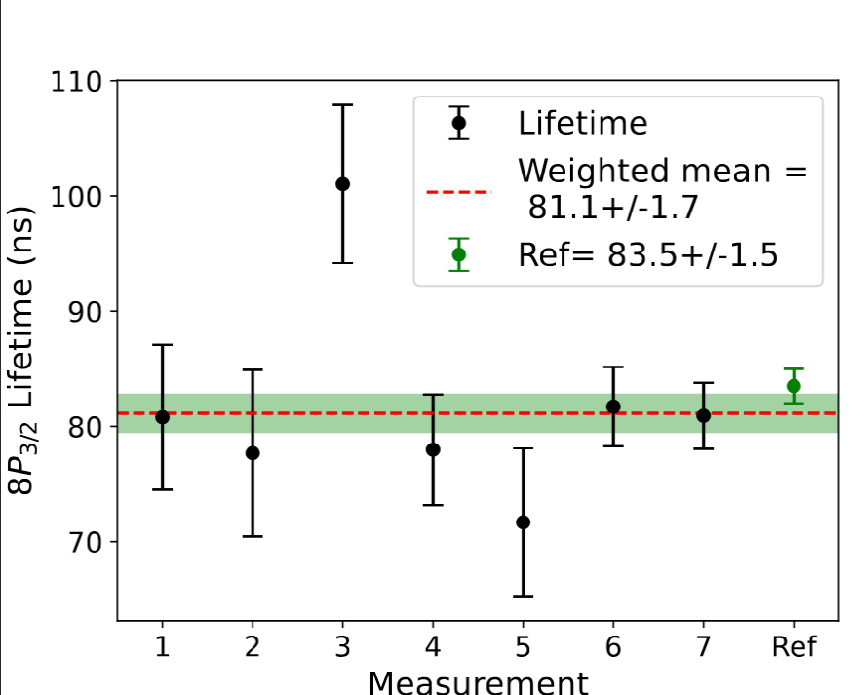
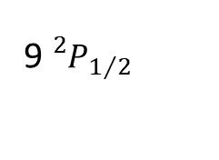
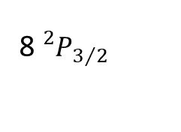
8p3/2 Lifetime reference
Fr
1064 nm
9${}_{}^{2}{P_{3/2}}$
9${}_{}^{2}{P_{1/2}}$
365 nm
368 nm
8${}_{}^{2}{P_{3/2}}$
422 nm
7${}_{}^{2}{S_{1/2}}$

Slide 29
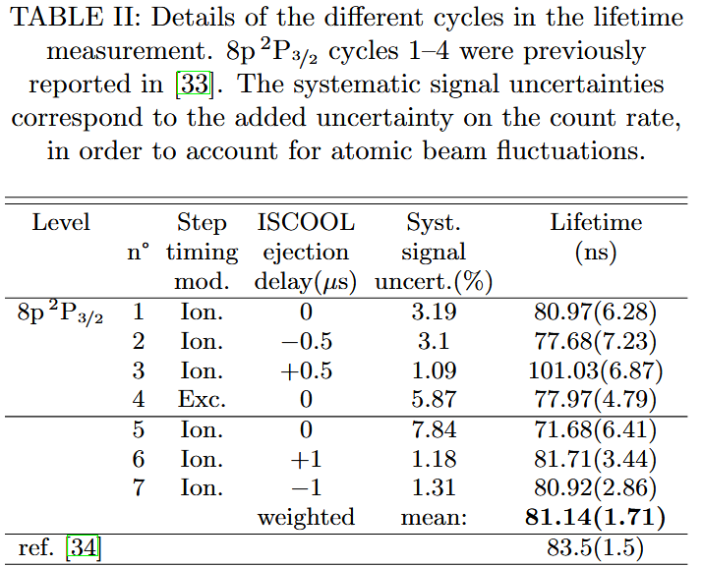
8p3/2 Lifetime reference

Slide 30
Main Objective

Slide 31










General motivation – Parity non-conservation
1064 nm
10${}_{ }^{2}{P_{3/2}}$
Towards the measurements of Parity non-conservation (PNC) in Fr
10${}_{ }^{2}{P_{1/2}}$
9${}_{ }^{2}{P_{3/2}}$
9${}_{ }^{2}{P_{1/2}}$
To date: Most accurate measurement performed on 6 ²𝑆_{1/2} → 7 ²𝑆_{1/2} transition in Cs, relative uncertainty of 0.35 %.
Predicted PNC amplitude in the 7 ²𝑆_{1/2} →6 ²𝐷_{3/2,5/2} transitions in Fr: more than 50 times larger
8${}_{ }^{2}{P_{3/2}}$
8${}_{ }^{2}{P_{1/2}}$
6${}_{ }^{2}{D_{5/2}}$
6${}_{ }^{2}{D_{3/2}}$
7${}_{ }^{2}{S_{1/2}}$
${}^{(1)}$Wood, C. S., S. C. Bennett, D. Cho, B. P. Masterson, J. L. Roberts, C. E. Tanner, et C. E. Wieman. « Measurement of Parity Nonconservation and an Anapole Moment in Cesium ». Science 275, nº 5307 (1997)
${}^{(2)}$Roberts, B. M., V. A. Dzuba, et V. V. Flambaum. « Parity nonconservation in Fr-like actinide and Cs-like rare-earth-metal ions ». Phys. Rev. A 88, nº 1

Slide 32


Atomic 6D-states in neutral Fr
IP
9${}_{ }^{2}{P_{3/2}}$
9${}_{ }^{2}{P_{1/2}}$
8${}_{ }^{2}{P_{3/2}}$
8${}_{ }^{2}{P_{1/2}}$
6${}_{ }^{2}{D_{5/2}}$
6${}_{ }^{2}{D_{3/2}}$
Experimentally identifying the 6D levels
Direct excitation forbidden → need different route
~608 nm
7${}_{ }^{2}{S_{1/2}}$

Slide 33

Atomic 6D-states in neutral Fr
IP
Simulated spectra of the 8P1/2 → 6D3/2 transitions
1064 nm
n${}_{ }^{2}{P_{ }}$/n${}_{ }^{2}{F_{ }}$
9${}_{ }^{2}{P_{3/2}}$
9${}_{ }^{2}{P_{1/2}}$
8${}_{ }^{2}{P_{3/2}}$
Lambda-scheme:
Driving population into 6D states via 9P
8${}_{ }^{2}{P_{1/2}}$
~912 nm
6${}_{ }^{2}{D_{5/2}}$
6${}_{ }^{2}{D_{3/2}}$
365 nm
Two step ionization scheme → detect laser ions
Additional laser driving depopulation into the 6D state → dip in ion rate
~608 nm
7${}_{ }^{2}{S_{1/2}}$

Slide 34
Atomic 6D-states in neutral Fr
FIU
IP
n${}_{ }^{2}{P_{ }}$/n${}_{ }^{2}{F_{ }}$
9${}_{ }^{2}{P_{3/2}}$
9${}_{ }^{2}{P_{1/2}}$
8${}_{ }^{2}{P_{3/2}}$
~611 nm
N-scheme:
4 steps Ionization
8${}_{ }^{2}{P_{1/2}}$
~912 nm
6${}_{ }^{2}{D_{5/2}}$
6${}_{ }^{2}{D_{3/2}}$
365 nm
Excitation to 9P lvl
Additional laser driving depopulation into the 6D state → dip in ion rate
Excitation to Rydberg states (+plus bonus of characterizing Rydberg series)
Field ionization = previous new developments necessary
7${}_{ }^{2}{S_{1/2}}$

Slide 35







Atomic 6D-states in neutral Fr
FIU
IP
n${}_{ }^{2}{P_{ }}$/n${}_{ }^{2}{F_{ }}$
9${}_{ }^{2}{P_{3/2}}$
9${}_{ }^{2}{P_{1/2}}$
8${}_{ }^{2}{P_{3/2}}$
~611 nm
N-scheme:
4 steps Ionization
8${}_{ }^{2}{P_{1/2}}$
~912 nm
6${}_{ }^{2}{D_{5/2}}$
6${}_{ }^{2}{D_{3/2}}$
365 nm
Excitation to 9P lvl
Additional laser driving depopulation into the 6D state → dip in ion rate
Excitation to Rydberg states (+plus bonus of characterizing Rydberg series)
Field ionization = previous new developments necessary
7${}_{ }^{2}{S_{1/2}}$

Slide 36


Atomic 6D-states in neutral Fr
FIU
IP
n${}_{ }^{2}{P_{ }}$/n${}_{ }^{2}{F_{ }}$
9${}_{ }^{2}{P_{3/2}}$
9${}_{ }^{2}{P_{1/2}}$
8${}_{ }^{2}{P_{3/2}}$
~611 nm
8${}_{ }^{2}{P_{1/2}}$
~912 nm
6${}_{ }^{2}{D_{5/2}}$
6${}_{ }^{2}{D_{3/2}}$
365 nm
Excitation to 9P lvl
Additional laser driving depopulation into the 6D state → dip in ion rate
Excitation to Rydberg states (+plus bonus of characterizing Rydberg series)
Field ionization = previous new developments necessary
7${}_{ }^{2}{S_{1/2}}$

Slide 37
Atomic 6D-states in neutral Fr
FIU
IP
n${}_{ }^{2}{P_{ }}$/n${}_{ }^{2}{F_{ }}$
9${}_{ }^{2}{P_{3/2}}$
9${}_{ }^{2}{P_{1/2}}$
8${}_{ }^{2}{P_{3/2}}$
~611 nm
8${}_{ }^{2}{P_{1/2}}$
~912 nm
6${}_{ }^{2}{D_{5/2}}$
6${}_{ }^{2}{D_{3/2}}$
365 nm
Excitation to 9P lvl
Additional laser driving depopulation into the 6D state → dip in ion rate
Excitation to Rydberg states (+plus bonus of characterizing Rydberg series)
Field ionization = previous new developments necessary
7${}_{ }^{2}{S_{1/2}}$

Slide 38


Atomic 6D-states in neutral Fr
FIU
IP
n${}_{ }^{2}{P_{ }}$/n${}_{ }^{2}{F_{ }}$
9${}_{ }^{2}{P_{3/2}}$
9${}_{ }^{2}{P_{1/2}}$
8${}_{ }^{2}{P_{3/2}}$
~611 nm
8${}_{ }^{2}{P_{1/2}}$
~912 nm
6${}_{ }^{2}{D_{5/2}}$
6${}_{ }^{2}{D_{3/2}}$
365 nm
Excitation to 9P lvl
Additional laser driving depopulation into the 6D state → dip in ion rate
Excitation to Rydberg states (+plus bonus of characterizing Rydberg series)
Field ionization = previous new developments necessary
7${}_{ }^{2}{S_{1/2}}$

Slide 39
Atomic 6D-states in neutral Fr
IP
n${}_{ }^{2}{P_{ }}$/n${}_{ }^{2}{F_{ }}$
9${}_{ }^{2}{P_{3/2}}$
9${}_{ }^{2}{P_{1/2}}$
8${}_{ }^{2}{P_{3/2}}$
~611 nm
8${}_{ }^{2}{P_{1/2}}$
~912 nm
6${}_{ }^{2}{D_{5/2}}$
6${}_{ }^{2}{D_{3/2}}$
365 nm
Excitation to 9P lvl
Additional laser driving depopulation into the 6D state → dip in ion rate
Excitation to Rydberg states (+plus bonus of characterizing Rydberg series)
Field ionization = previous new developments necessary
7${}_{ }^{2}{S_{1/2}}$

Slide 40

Atomic 6D-states in neutral Fr
FIU
IP
n${}_{ }^{2}{P_{ }}$/n${}_{ }^{2}{F_{ }}$
9${}_{ }^{2}{P_{3/2}}$
PRELIMINARY
9${}_{ }^{2}{P_{1/2}}$
8${}_{ }^{2}{P_{3/2}}$
~611 nm
8${}_{ }^{2}{P_{1/2}}$
6${}_{ }^{2}{D_{5/2}}$
6${}_{ }^{2}{D_{3/2}}$
Charge exchange population
∼2%
7${}_{ }^{2}{S_{1/2}}$

Slide 41
Atomic 6D-states in neutral Fr
FIU
IP
n${}_{ }^{2}{P_{ }}$/n${}_{ }^{2}{F_{ }}$
9${}_{ }^{2}{P_{3/2}}$
PRELIMINARY
9${}_{ }^{2}{P_{1/2}}$
8${}_{ }^{2}{P_{3/2}}$
~611 nm
8${}_{ }^{2}{P_{1/2}}$
6${}_{ }^{2}{D_{5/2}}$
VERY PRELIMINARY !
6${}_{ }^{2}{D_{3/2}}$
Charge exchange population
∼2%
First FIU online implementation
New Rydberg series observed
7${}_{ }^{2}{S_{1/2}}$

Slide 42

Atomic 6D-states in neutral Fr
IP
n${}_{ }^{2}{P_{ }}$/n${}_{ }^{2}{F_{ }}$
9${}_{ }^{2}{P_{3/2}}$
PRELIMINARY
9${}_{ }^{2}{P_{1/2}}$
8${}_{ }^{2}{P_{3/2}}$
~611 nm
8${}_{ }^{2}{P_{1/2}}$
6${}_{ }^{2}{D_{5/2}}$
6${}_{ }^{2}{D_{3/2}}$
Excitation to 9P lvl
Additional laser driving depopulation into the 6D state → dip in ion rate
Excitation to Rydberg states (+plus bonus of characterizing Rydberg series)
Field ionization = previous new developments necessary
7${}_{ }^{2}{S_{1/2}}$

Slide 43
Lifetime measurements of 6D_{5/2}
IP
1064 nm
n${}_{ }^{2}{P_{ }}$/n${}_{ }^{2}{F_{ }}$
9${}_{ }^{2}{P_{3/2}}$
9${}_{ }^{2}{P_{1/2}}$
8${}_{ }^{2}{P_{3/2}}$
8${}_{ }^{2}{P_{1/2}}$
~912 nm
6${}_{ }^{2}{D_{5/2}}$
6${}_{ }^{2}{D_{3/2}}$
Excitation to 9P lvl
Additional laser driving depopulation into the 6D state → dip in ion rate
Excitation to Rydberg states (+plus bonus of characterizing Rydberg series)
Field ionization = previous new developments necessary
7${}_{ }^{2}{S_{1/2}}$

Slide 44

Lifetime measurements of 6D_{5/2}
IP
1064 nm
n${}_{ }^{2}{P_{ }}$/n${}_{ }^{2}{F_{ }}$
9${}_{ }^{2}{P_{3/2}}$
9${}_{ }^{2}{P_{1/2}}$
8${}_{ }^{2}{P_{3/2}}$
8${}_{ }^{2}{P_{1/2}}$
~912 nm
Lifetime measurements by delaying excitation laser
6${}_{ }^{2}{D_{5/2}}$
6${}_{ }^{2}{D_{3/2}}$
Excitation to 9P lvl
Additional laser driving depopulation into the 6D state → dip in ion rate
Excitation to Rydberg states (+plus bonus of characterizing Rydberg series)
Field ionization = previous new developments necessary
7${}_{ }^{2}{S_{1/2}}$

Slide 45

Lifetime measurements of 6D_{5/2}
IP
1064 nm
n${}_{ }^{2}{P_{ }}$/n${}_{ }^{2}{F_{ }}$
9${}_{ }^{2}{P_{3/2}}$
9${}_{ }^{2}{P_{1/2}}$
8${}_{ }^{2}{P_{3/2}}$
8${}_{ }^{2}{P_{1/2}}$
~912 nm
Lifetime measurements by delaying excitation laser
6${}_{ }^{2}{D_{5/2}}$
6${}_{ }^{2}{D_{3/2}}$
Charge exchange population
∼2%
7${}_{ }^{2}{S_{1/2}}$

Slide 46
Atomic 6D-states in neutral Fr
FIU
IP
n${}_{ }^{2}{P_{ }}$/n${}_{ }^{2}{F_{ }}$
9${}_{ }^{2}{P_{3/2}}$
9${}_{ }^{2}{P_{1/2}}$
8${}_{ }^{2}{P_{3/2}}$
~611 nm
8${}_{ }^{2}{P_{1/2}}$
N-scheme:
Work indirectly !
~912 nm
6${}_{ }^{2}{D_{5/2}}$
6${}_{ }^{2}{D_{3/2}}$
365 nm
Excitation to 9P lvl
Additional laser driving depopulation into the 6D state → dip in ion rate
Excitation to Rydberg states (+plus bonus of characterizing Rydberg series)
Field ionization = previous new developments necessary
7${}_{ }^{2}{S_{1/2}}$

Slide 47
Atomic 6D-states in neutral Fr
FIU
IP
Simulated spectra of the 8P1/2 → 6D3/2 transitions
1064 nm
n${}_{ }^{2}{P_{ }}$/n${}_{ }^{2}{F_{ }}$
9${}_{ }^{2}{P_{3/2}}$
9${}_{ }^{2}{P_{1/2}}$
8${}_{ }^{2}{P_{3/2}}$
~611 nm
8${}_{ }^{2}{P_{1/2}}$
N-scheme:
Work directly ?
~912 nm
6${}_{ }^{2}{D_{5/2}}$
6${}_{ }^{2}{D_{3/2}}$
365 nm
Excitation to 9P lvl
Additional laser driving depopulation into the 6D state → dip in ion rate
Excitation to Rydberg states (+plus bonus of characterizing Rydberg series)
Field ionization = previous new developments necessary
~608 nm
7${}_{ }^{2}{S_{1/2}}$

Slide 48
More Atomic measurements in neutral Fr !
FIU
IP
1064 nm
n${}_{ }^{2}{P_{ }}$/n${}_{ }^{2}{F_{ }}$
9${}_{ }^{2}{P_{3/2}}$
9${}_{ }^{2}{P_{1/2}}$
VERY PRELIMINARY !
8${}_{ }^{2}{P_{3/2}}$
~611 nm
8${}_{ }^{2}{P_{1/2}}$
~912 nm
6${}_{ }^{2}{D_{5/2}}$
6${}_{ }^{2}{D_{3/2}}$
365 nm
Good opportunity to Scan all P serie to IP
Further tests on λ and N Scheme
Search for D level Fine and Hyperfine structure
~608 nm
7${}_{ }^{2}{S_{1/2}}$

Slide 49


Conclusion
Atomic studies in 221 Francium :
New atomic levels identified in Fr
Lifetime measurements performed for excited P-states
Identified 6D state (broadband)
New Rydberg series observed

Slide 50









Acknowledgments
CRIS collaboration

