Slide 1


Silver at CRIS: Update
Bram van den Borne
Prof. Gerda Neyens
Prof. Ruben de Groote
CRIS collaboration meeting 2026

Slide 2
Story for papers
Review of g-factors for Z = 43 to 49 for odd-even isotopes
  Finished calculations & (very) preliminary draft ready
Odd-odd isotopes similarity between silver and indium
  Still running HFODD calculations
Charge radii both low res and high res from CRIS
  Reevaluation with F and M factors from Leonid
Requirement: Paper with Leonid with calculated hf magnetic field and EFG needs to be submitted (draft is ready)
Or we merge 2. and 3. to one paper

Slide 3
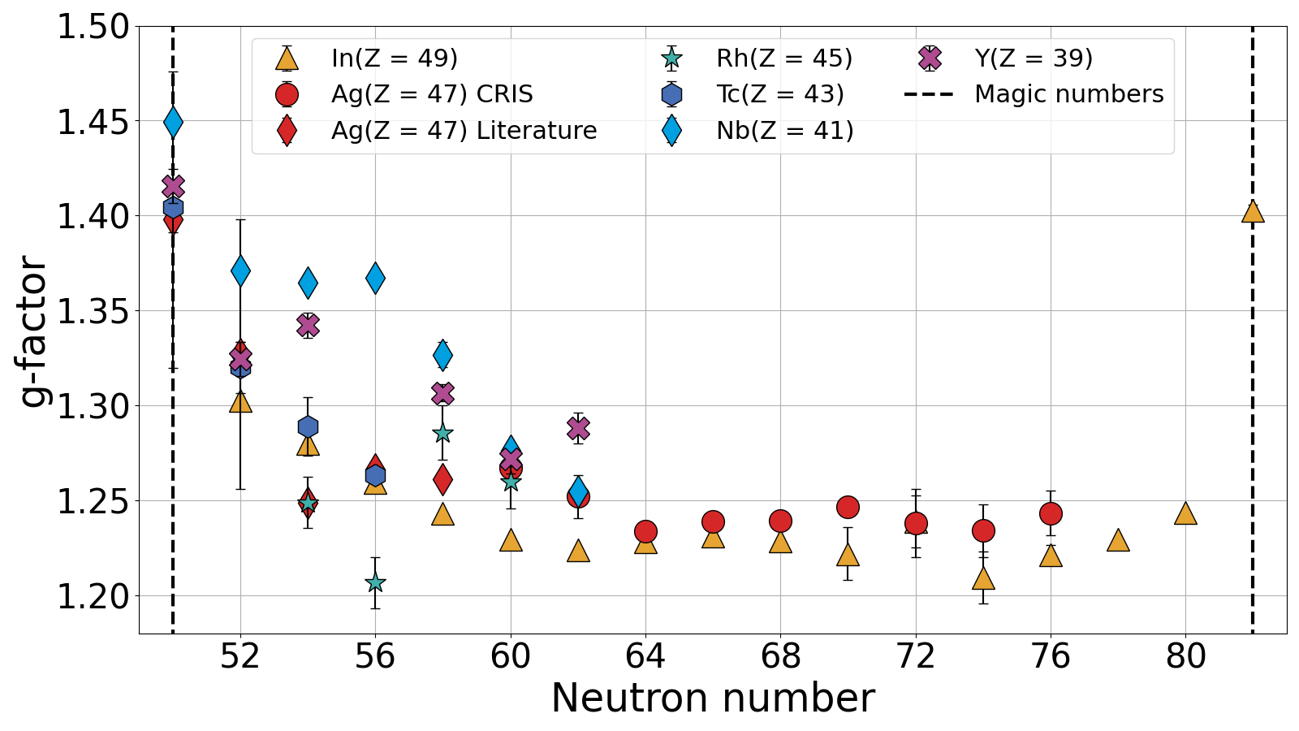
Paper 1: odd-evens
Similarity between all positive parity high-spin states
Only deviation at Z = 39 & 41

Slide 4
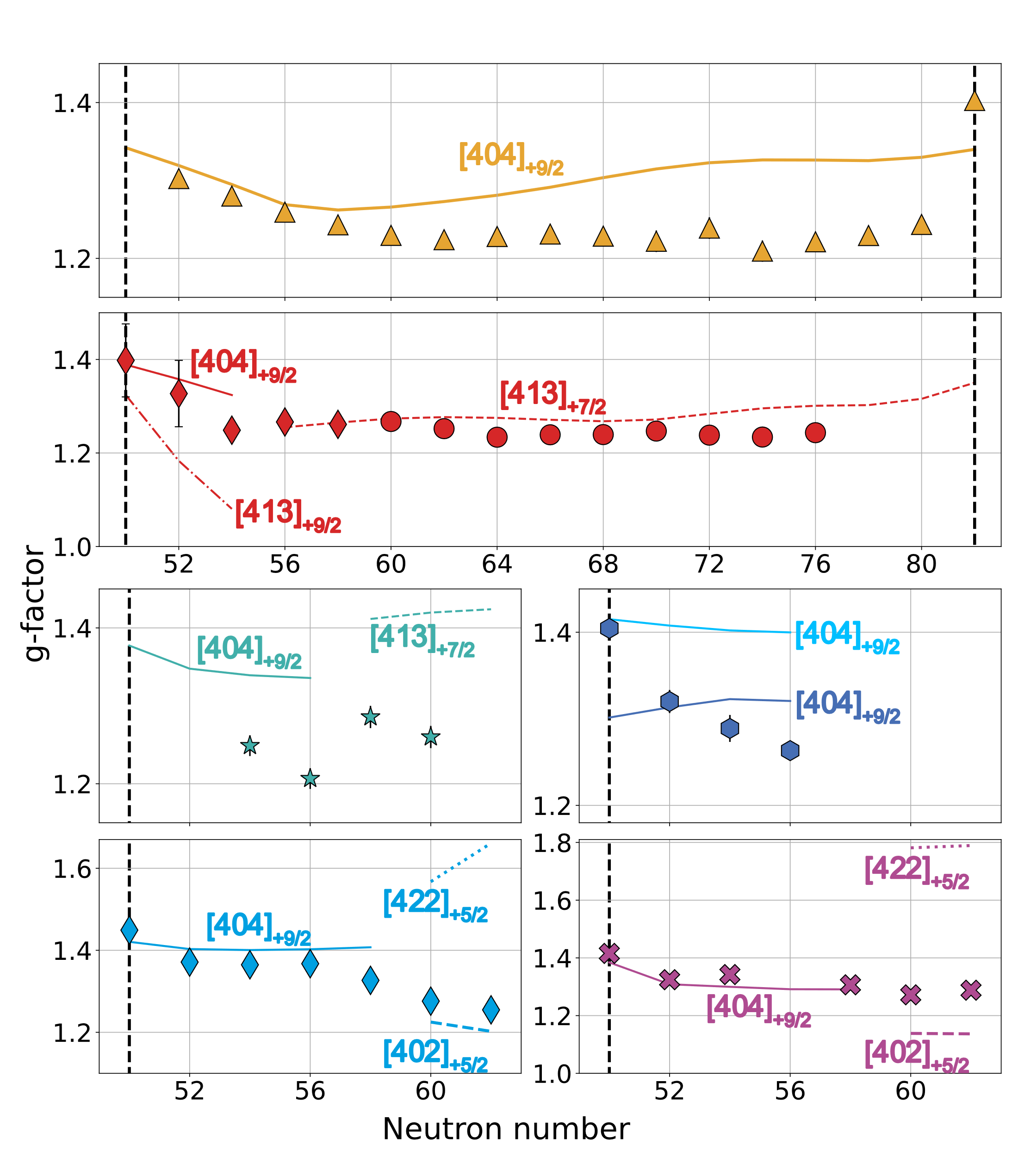
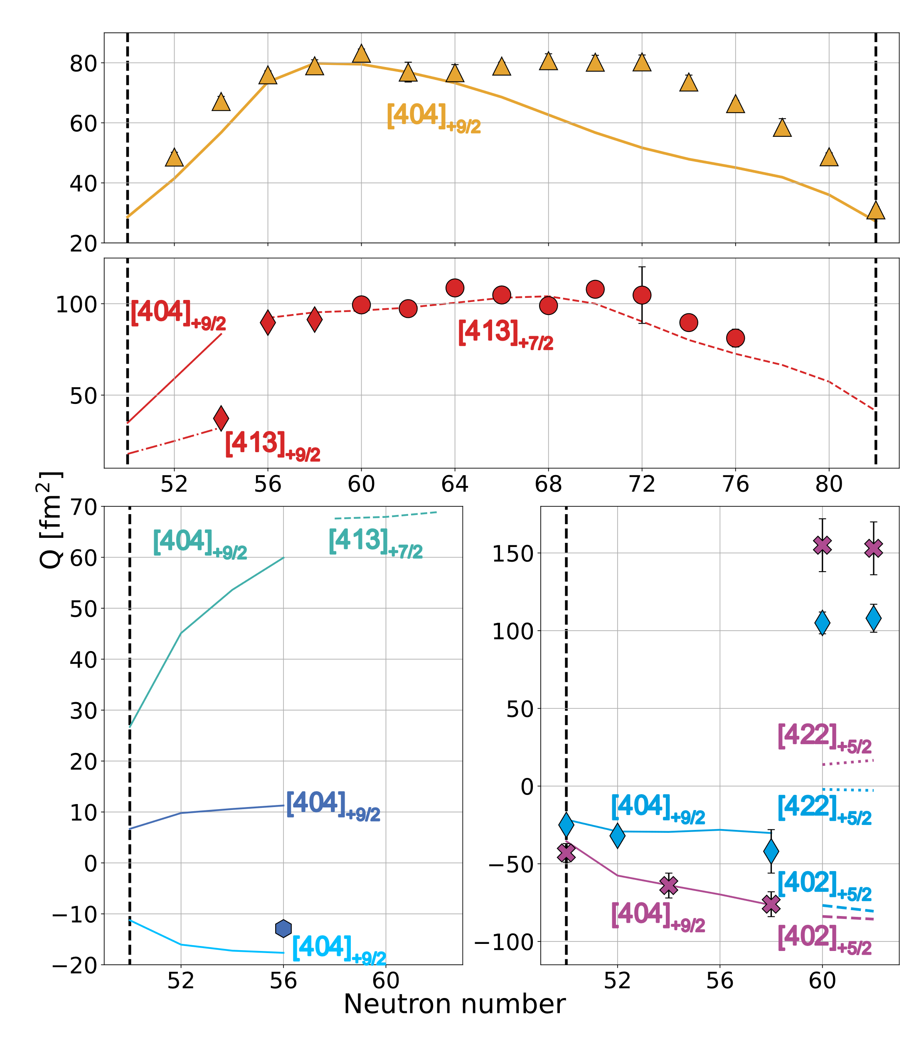
Special thanks to Jacek Dobaczewski for providing and helping with HFODD
Skyrme force parameter set from global analysis^{[1]}
[1] P. L. Sassarini, et al., J. Phys. G: Nucl. Part. Phys. 49, 11LT01 (2022).

Slide 5

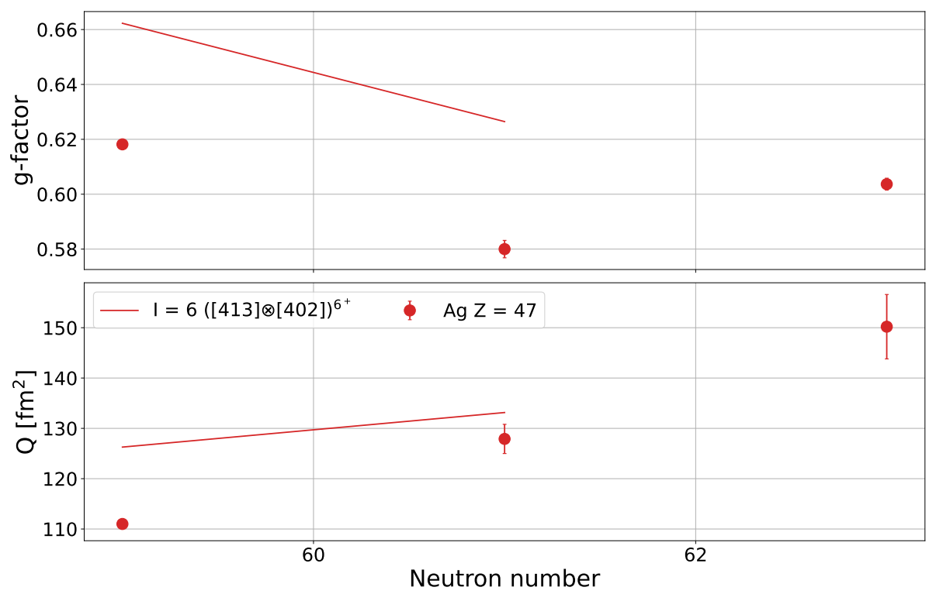
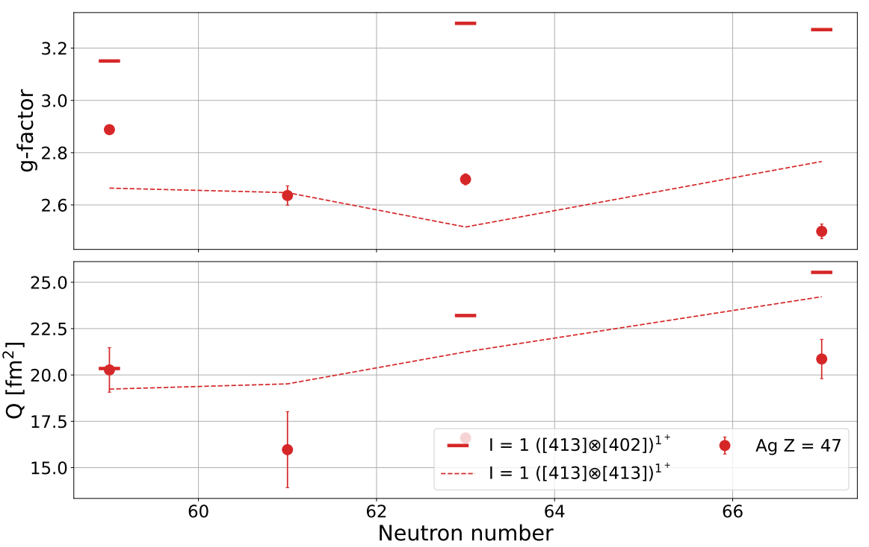
Paper 2: odd-odds
Globally fitted Skyrme force parameter set
Good* agreement for dipole and quadrupole moments
So far odd-odd nuclei have not* been investigated with HFODD
I = 6⁺
I = 1⁺

Slide 6
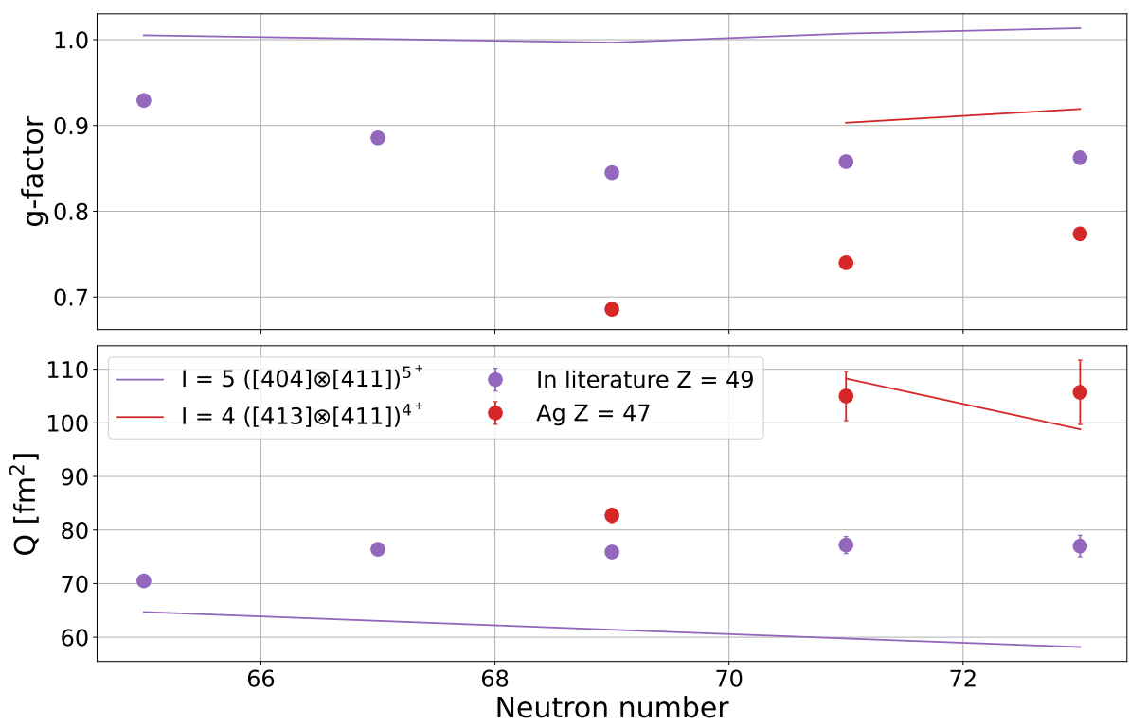
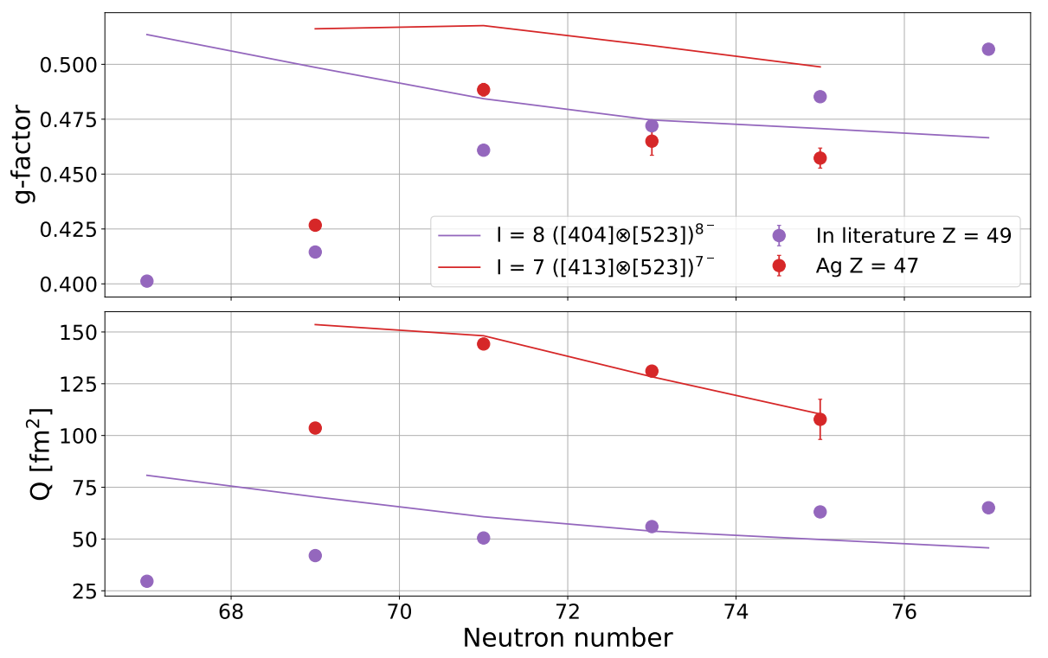
Paper 2: odd-odds
Globally fitted Skyrme force parameter set
Reasonable agreement for dipole and quadrupole moments in silver, but not in indium!
I = 5⁺
I = 4⁺
I = 8⁻
I = 7⁻

Slide 7
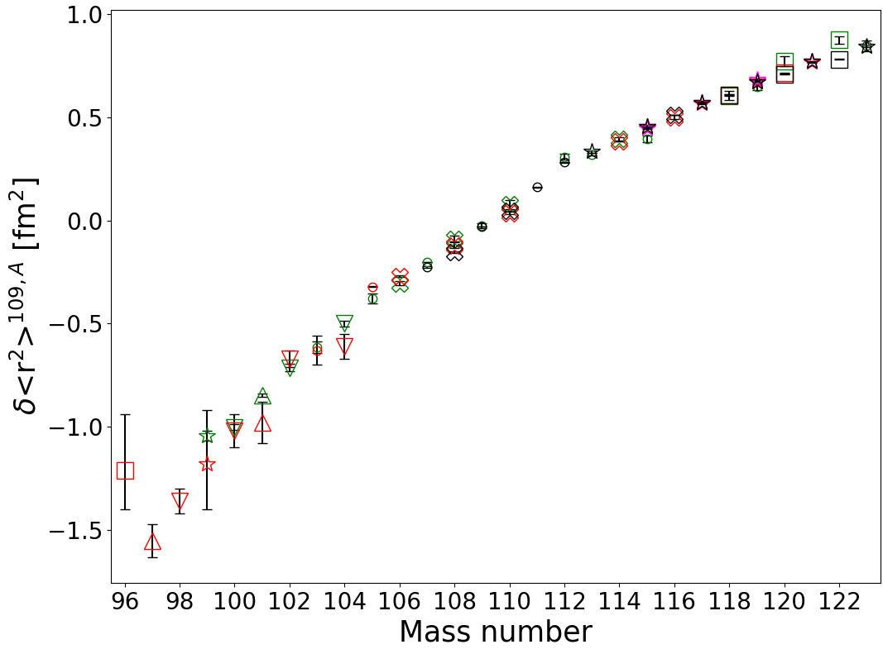
3. Charge radii
Literature
Low resolution CRIS
High resolution CRIS
IGISOL
CRIS data removes weird “staggering” in literature at n-def
New measurements at ^{111,112}Ag
¹¹²Ag deviates slightly from trend
  Q = 0.73(2)[8] eb
  Only 2⁻ state in chain

Slide 8
Summary
Paper with Leonid needs to be published before publishing CRIS results
First preliminary draft on odd-evens with HFODD calculations ready
Merge the charge radii with odd-odds into one paper?
  Similar to IGISOL odd-odd paper on n-rich silver https://doi.org/10.1103/PhysRevC.111.014329

Slide 9
Suggestions & questions?

Slide 10
Two laser spectroscopy runs
2021 low resolution run
2022 high resolution run
S_{1/2} to P_{1/2} transition
99m-110,112-115,118-120,122-123Ag measured
Odd-even
  I = 7/2 fully resolved
  I = 1/2 unresolved
Odd-odd mostly unresolved
Heavily constrained fits
Analysis
  Sonja (odd-even?)
  Bram (finished)
S_{1/2} to P_{3/2} transition
¹⁰⁶⁻¹²³Ag measured
  ^{106m}Ag not measured
Odd-even
  I = 7/2 fully resolved
  I = 1/2 mostly resolved
Odd-odd resolved
Analysis
  Sonja (almost finished?)
  Bram (finished)

Slide 11
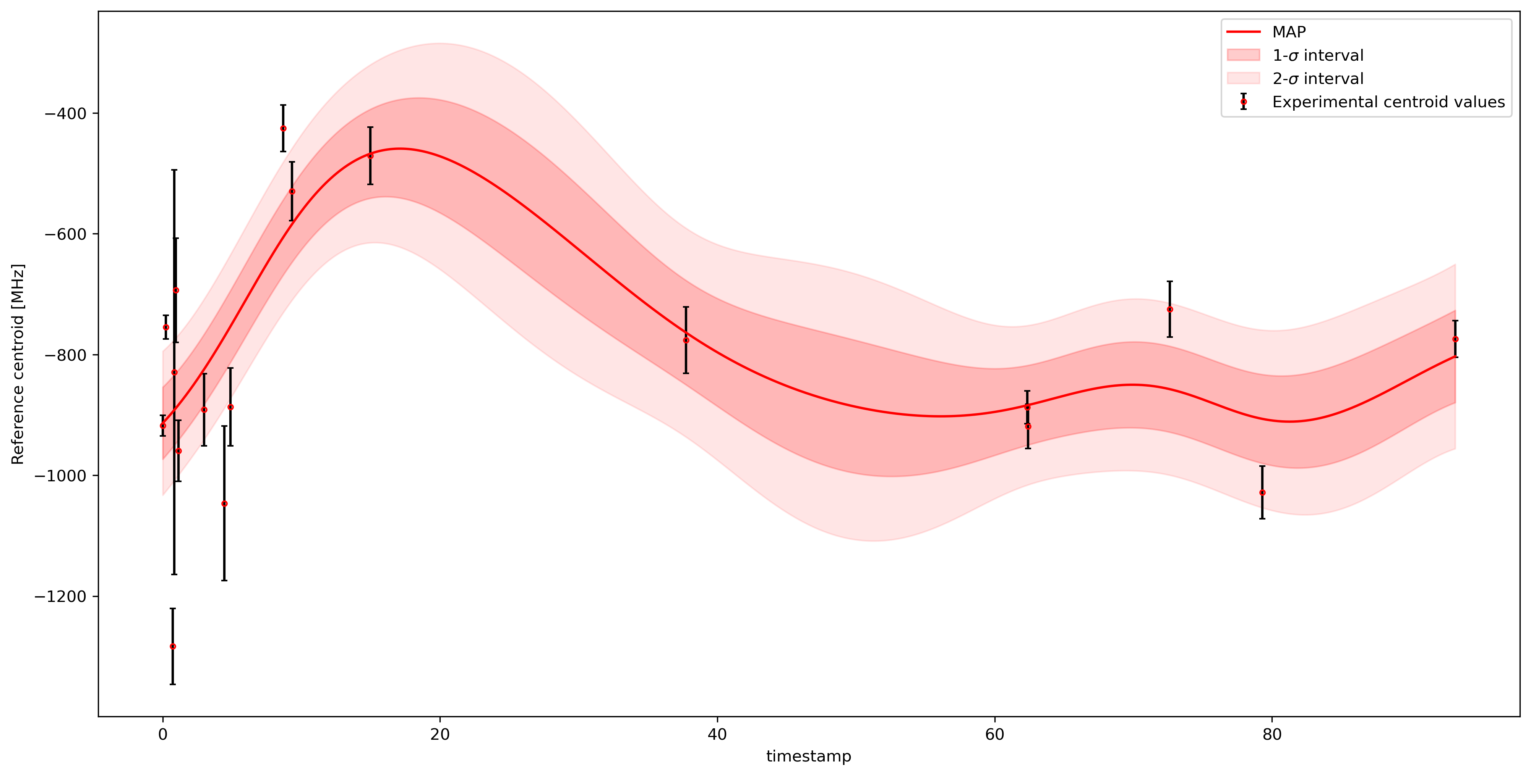
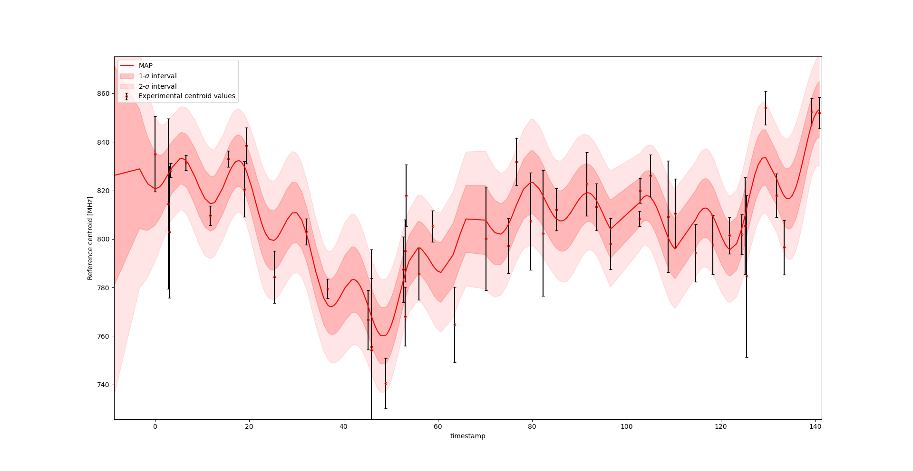
GP regression
2021
2022
More consistency between all scans of same isotope

Slide 12
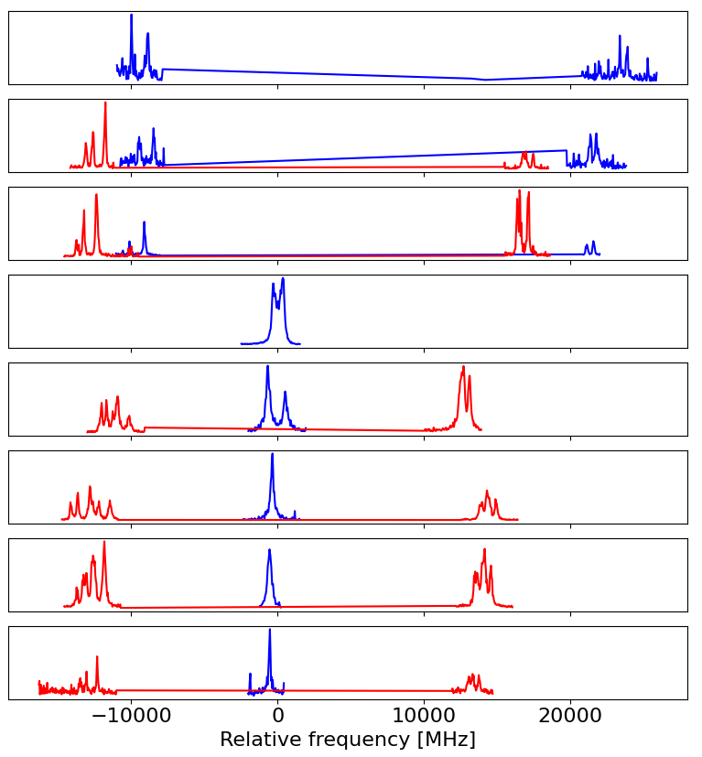
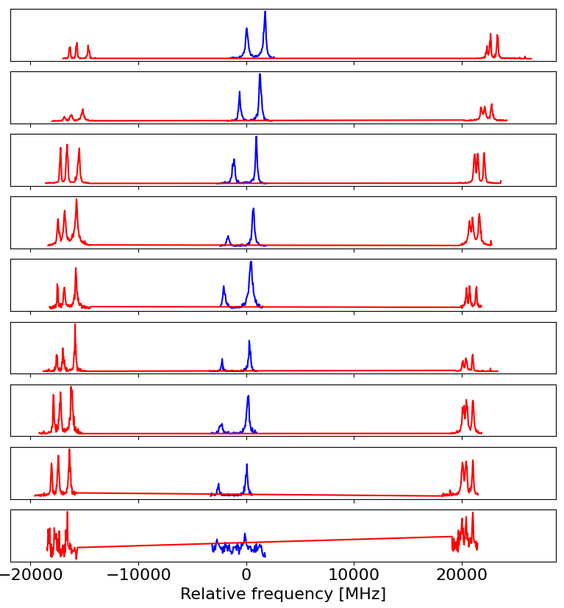
106
107
108
109
110
111
113
112
115
116
117
118
119
120
121
122
123

