Slide 1

Study of the n-rich Argon isotopes around N = 28 shell
CRIS Collaboration, 2nd Feb 2026
Charlie Agg

Slide 2
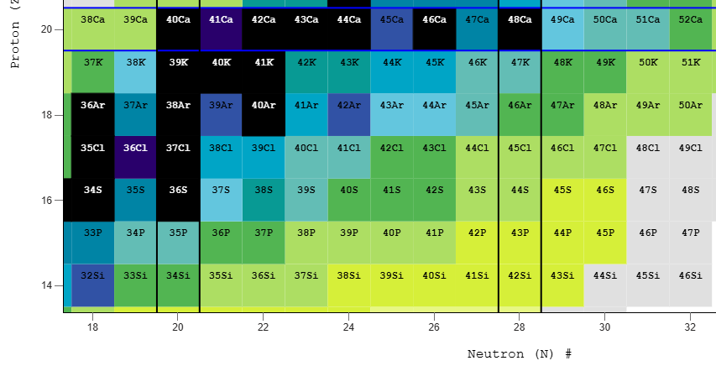
Onset of deformation
N = 28 shell closure responsible for doubly-magic Ca-48
Deformed ground state and excited spherical state in S-44 demonstrate breakdown of this shell closure, to complete disappearance in Si-42
Changes in ground-state nuclear properties along Ar isotope chain will reveal how collective behaviour evolves with decreasing protons in the d_{3/2} orbital
Strong shell closure
A. Gade et al., Phys. Rev. Lett. 102, 182502 (2009).
Z Meisel et al. Phys. Rev. Lett., 114, 022501, (2015).
M. Mougeot et al., Phys. Rev. C 102, 014301 (2020).
D. Mengoni et al., Phys. Rev. C 82, 024308 (2010).
Increasing deformation
Disappearance of shell closure
Notes:
The motivation behind this experiment is to confirm the nature of the N=28 shell gap, responsible for the doubly-magic nature of Ca-48, in the evolution
Shell closure is beginning to erode with S-44, as demonstrated by evidence of shape coexistence in a deformed prolate ground state and spherical excited 0+ state.
This is thought to result from the gradual transition from the spherical, doubly-magic Ca-48, to the deformed Si-42.
Measurements of the nuclear characteristics of the mean-square charge radii and nuclear moments along the Argon isotope chain, and the strength of the shell closure in Ar-46 will shed light on the onset of collectivity at N = 28.
->model dependence

Slide 3
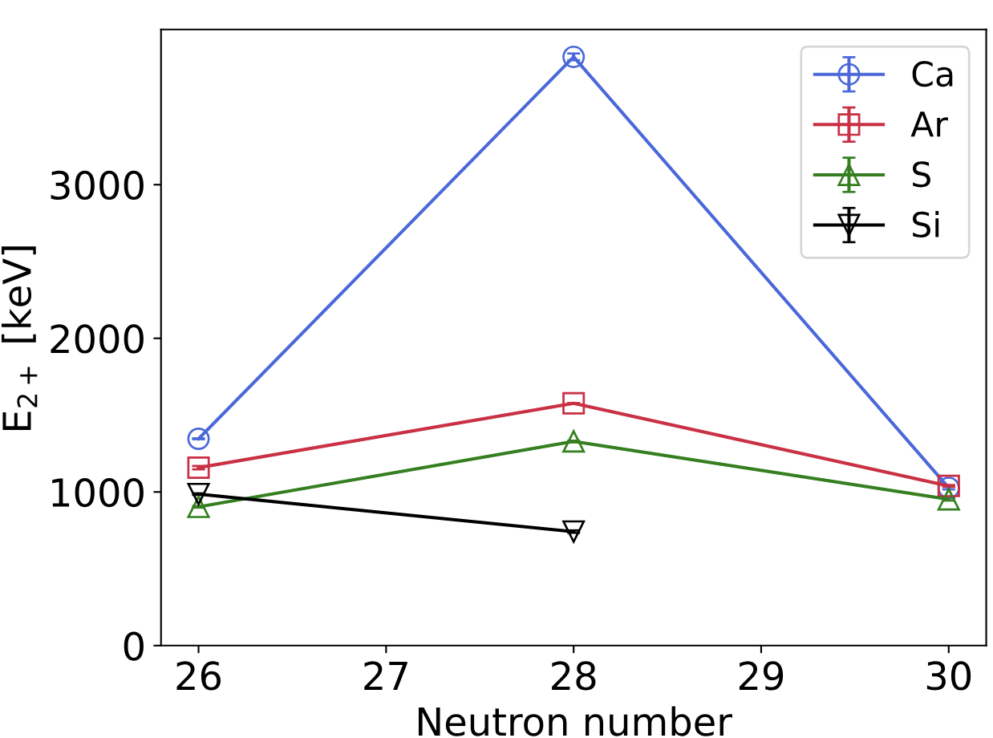
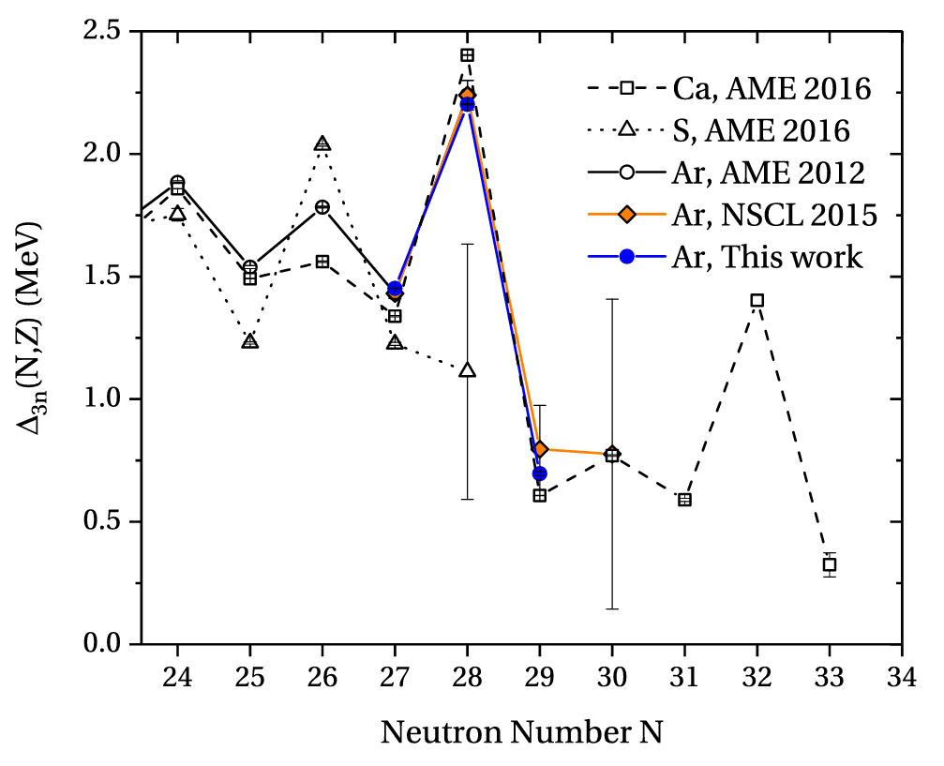
Evidence for shell closure in Ar
High lying E(2+) excitation energy at N=28
Mass measurements and S_{2n} values indicate strong shell gap
Lifetime measurements suggest erosion of shell gap beneath Ar
A. Gade et al., Phys. Rev. Lett. 102, 182502 (2009).
Z Meisel et al. Phys. Rev. Lett., 114, 022501, (2015).
M. Mougeot et al., Phys. Rev. C 102, 014301 (2020).
D. Mengoni et al., Phys. Rev. C 82, 024308 (2010).

Slide 4
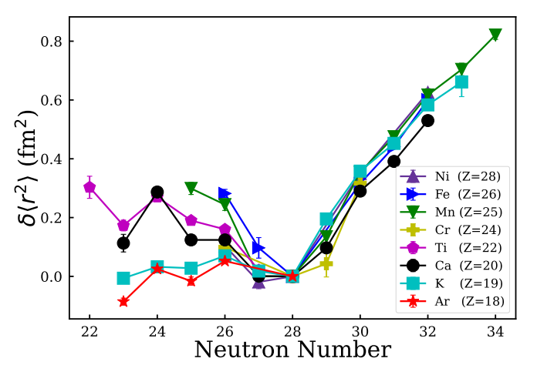
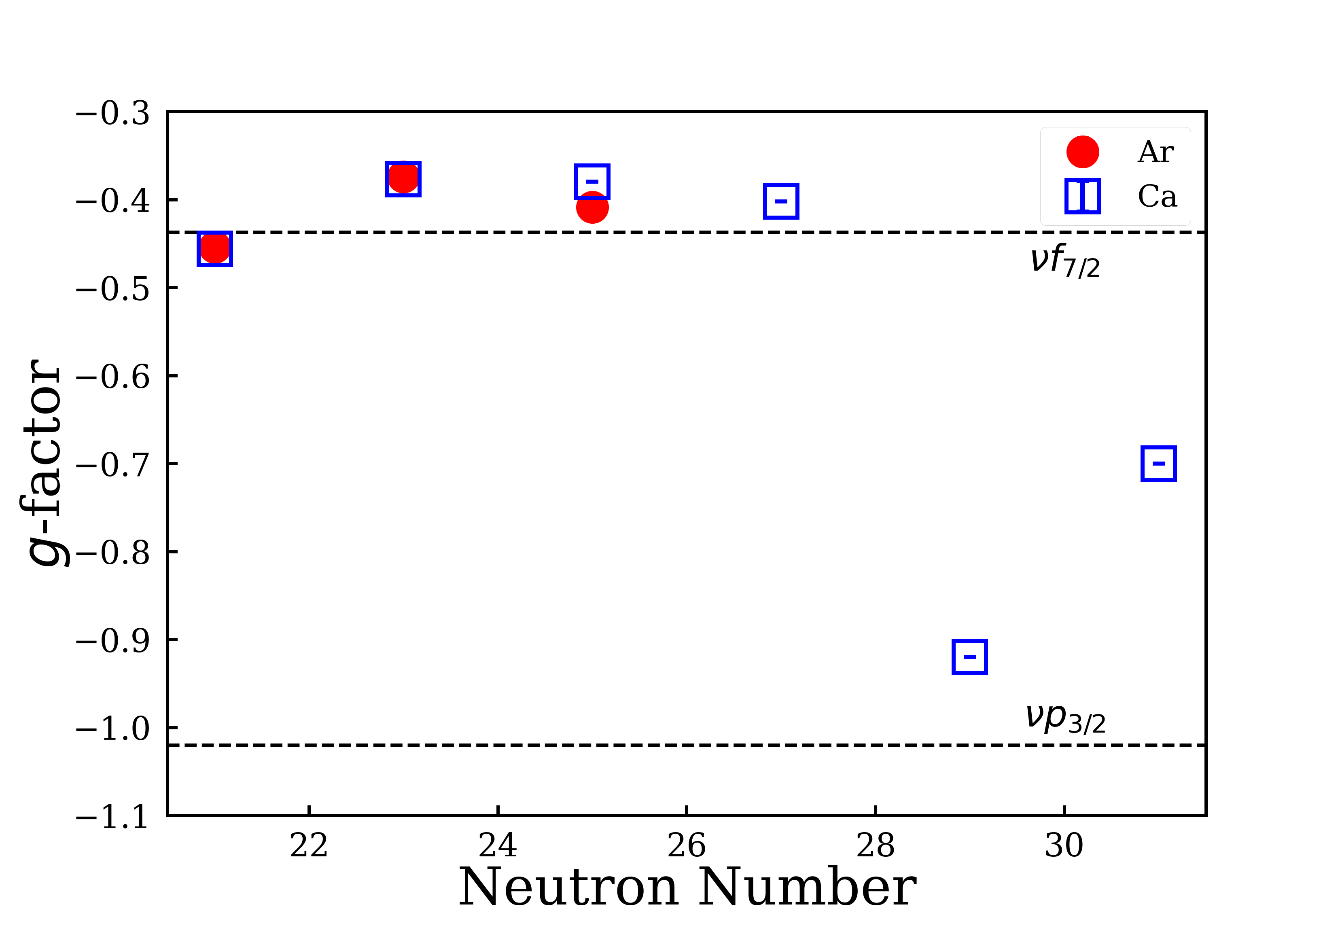
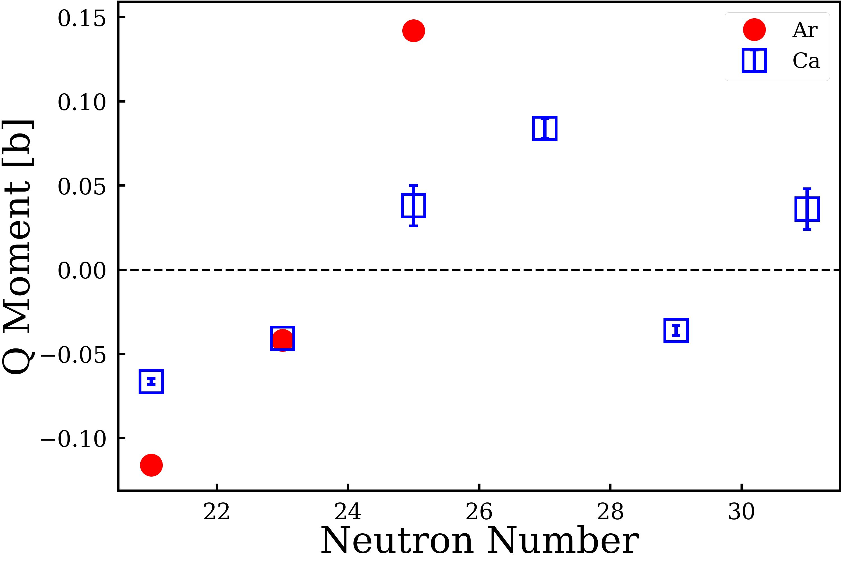
Spins and Nuclear moments in odd-N Ar nuclei
Establish severity of kink in changing mean-square charge radii
Ar isotopes below N = 28 shell gap experimental g-factors and quadrupole moments closely follow trend of Ca
Measurements beyond the shell closure used to investigate signs of collectivity.
K. Blaum et al., Nucl. Phys. A 799, 30–45 (2008).
A. Klein et al., Nucl. Phys. A 607.1 1-22. (1996).
F. Sommer et al., Phys. Rev. Lett., 129, 132501. (2022).
Á . Koszorús et al., Nature Physics 17.4 439-443. (2021)
R.A. Radhi et al., Phys. Rev. C 97, 064312. (2018).

Slide 5
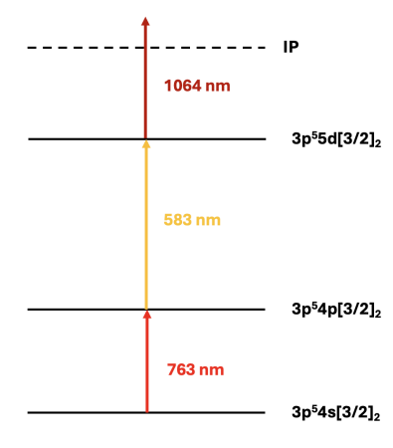
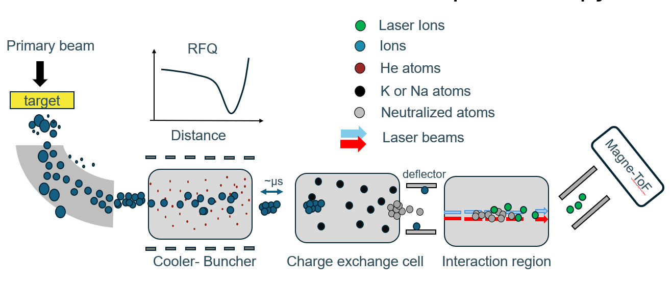
Colinear Resonance Ionisation Spectroscopy
Uranium carbide target (UC_{x}), cold plasma ion source reducing contamination
3-step scheme enhance selectivity and reduce background
4s[3/2]₂ -> 4p[3/2]₂ transition previously used by COLLAPS in 2008
Fundamental wavelengths used, high power available
InnoLas
PDL
JyvIs
K. Blaum et al., Nucl. Phys. A 799, 30–45 (2008).
Klein, A., et al. Nucl. Phys. A 607.1 1-22. (1996).
Fig: Angelos Karadimas

Slide 6
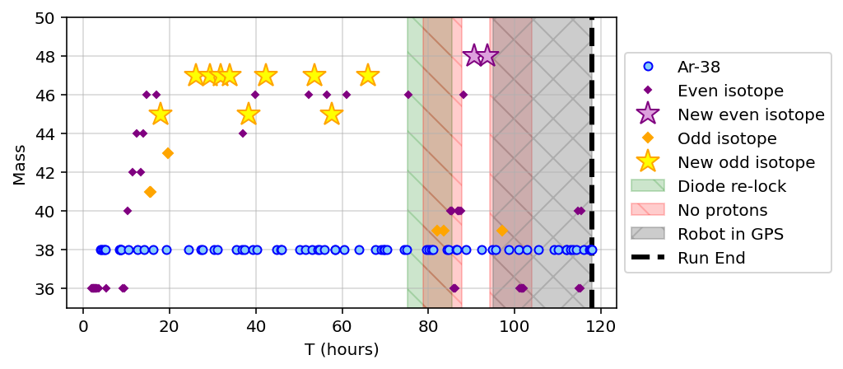
Summary of Run
Mass | Scans
36 | 26
38 | 77
39 | 3
40 | 10
41 | 1
42 | 2
43 | 1
44 | 3
45 | 3
46 | 8
47 | 7
48 | 3
~142 scans total
Notes:
Last Ar-39 scan (3384) taken with no protons. Signal rate was decreasing.

Slide 7
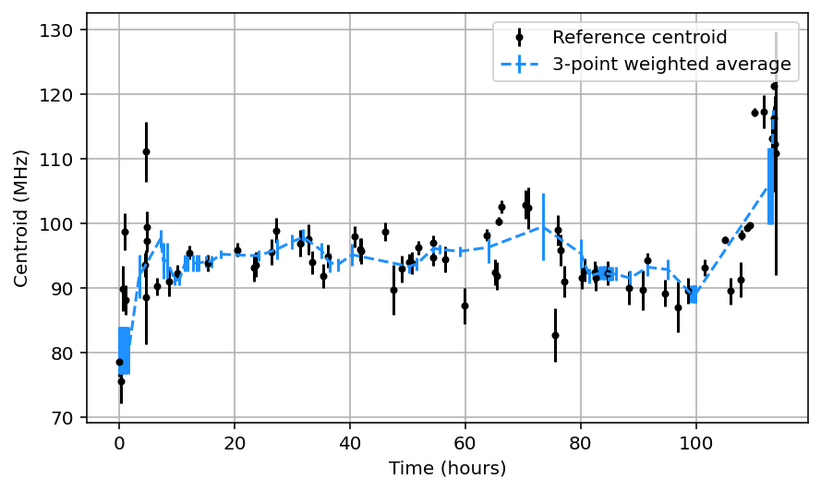
Reference Behaviour – Ar-38
Extant problems with reference behaviour
Iscool + diode recording
  Diode jump correction
Introducing a parasitic Voigt stabilizes the WM of reference centroid, but uncertainties on individual scans can increase.
Asymmetry in spectra of even isotopes, and fitting this stabilizes centroid

Slide 8
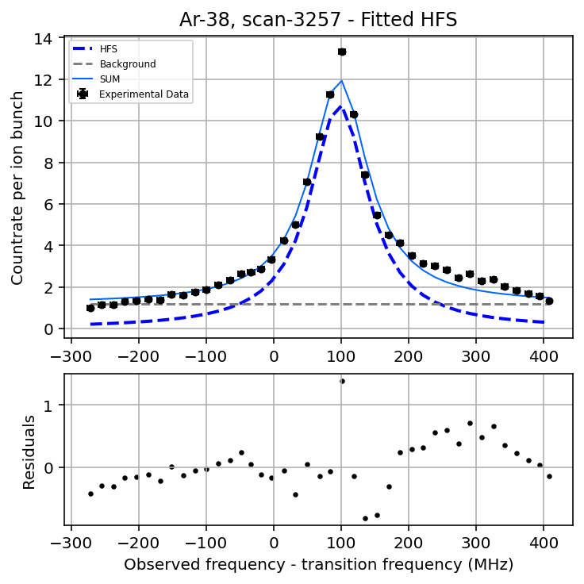
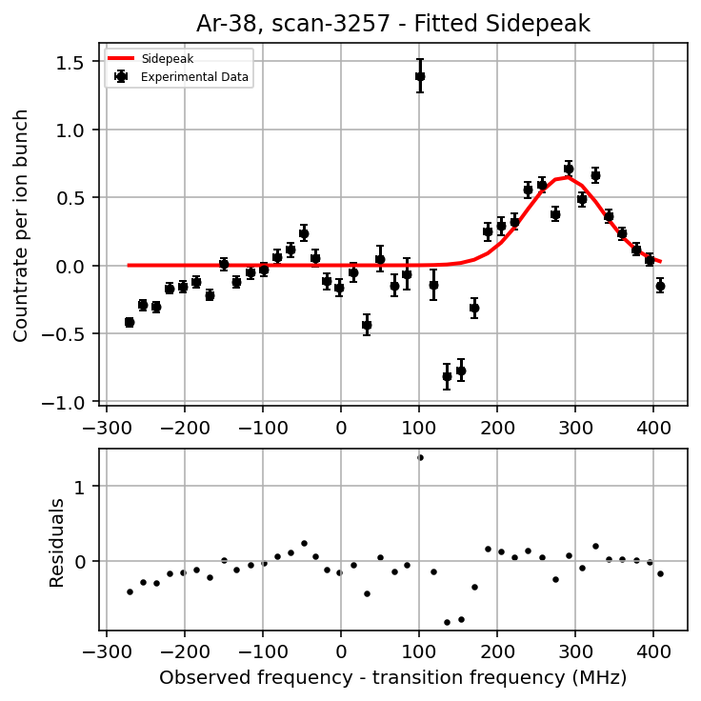
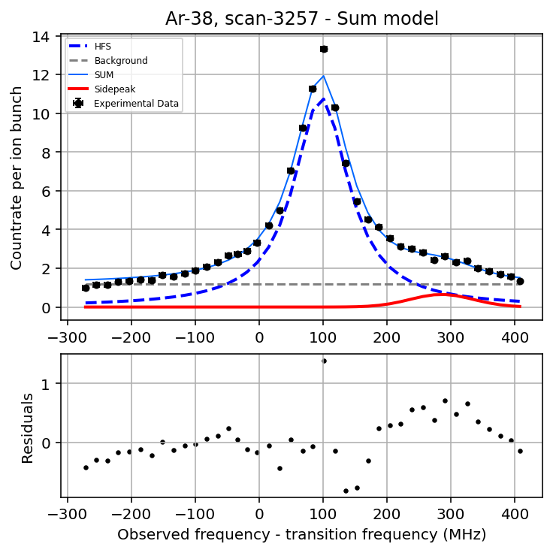
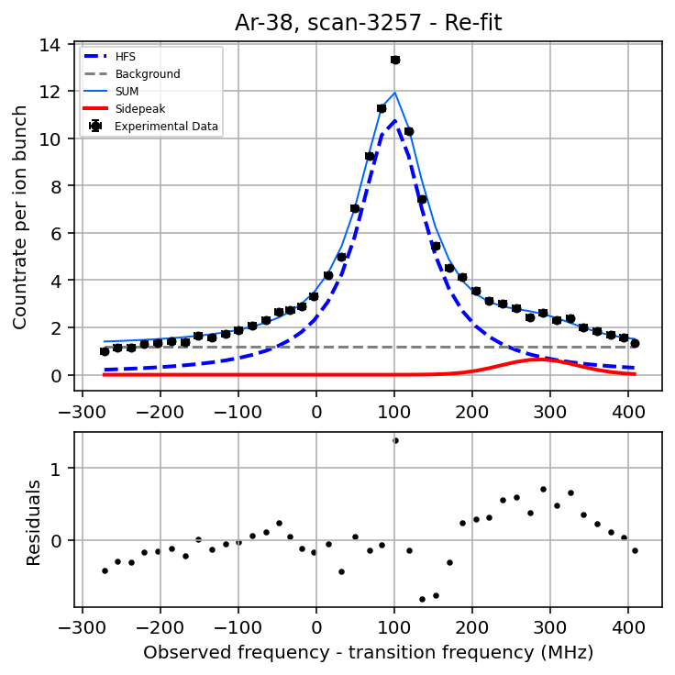
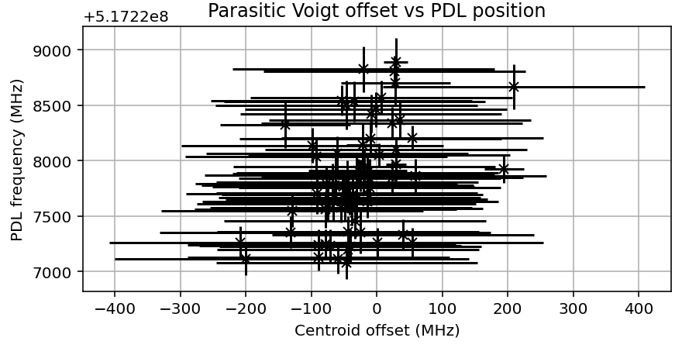
Parasitic Voigt fitting
Create SUM model
Fit with HFS only
Fit Voigt function to residuals
Create SUM model
Re-fit both functions at once
Fitting parasitic Voigt separately prevents mis-identifying main HFS
Requires perturbation of both models before re-fitting to avoid local minima

Slide 9
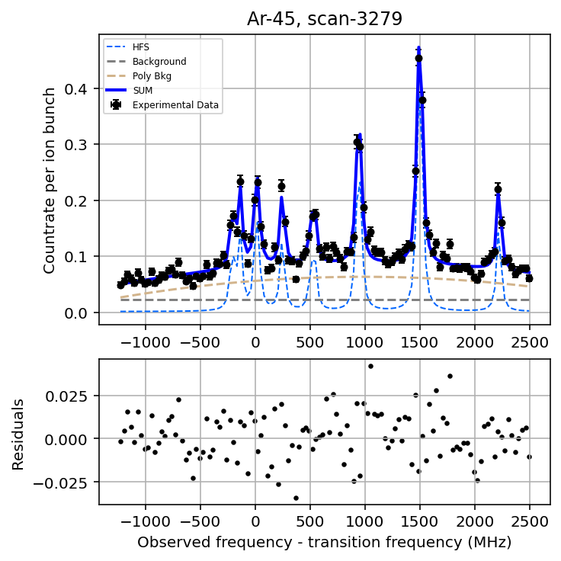
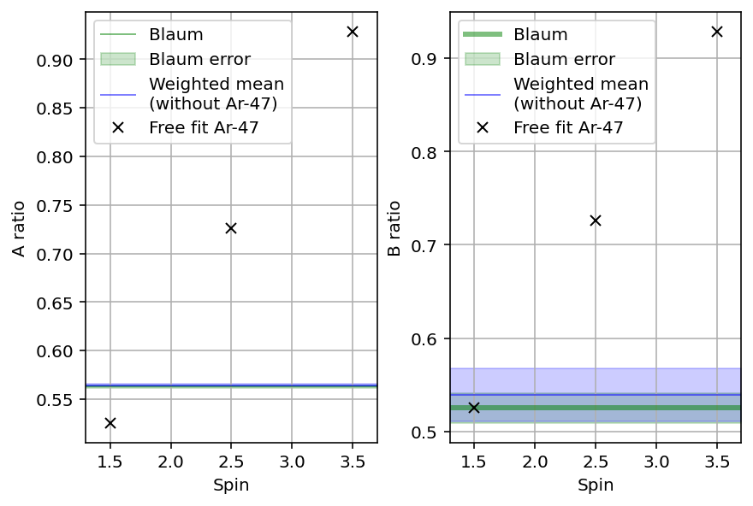
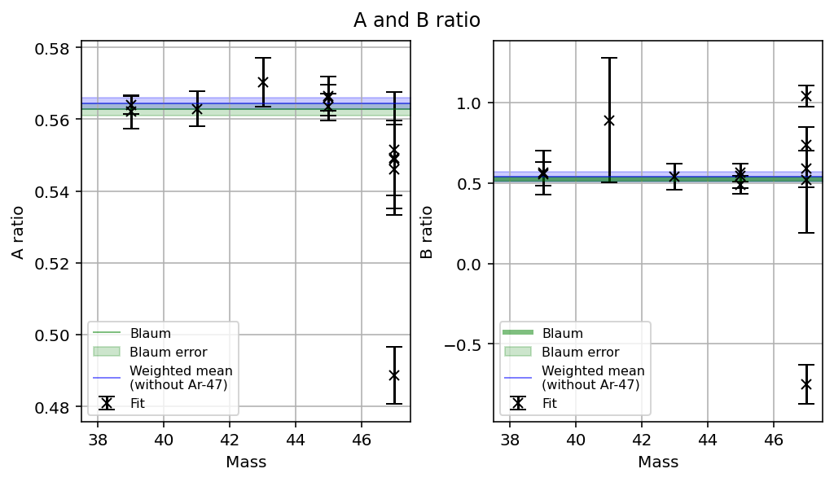
Fitting of odd-odd spectra
Polynomial background to account for higher baseline in center of HFS
  (CEC effects, position of 2nd step laser)
 | Au/Al | Bu/Bl
Blaum (2008) | 1.777 ± 0.005 | 1.903 ± 0.057
Current work | 1.777 ± 0.003 | 1.887 ± 0.084
K. Blaum et al., Nucl. Phys. A 799, 30–45 (2008).

Slide 10
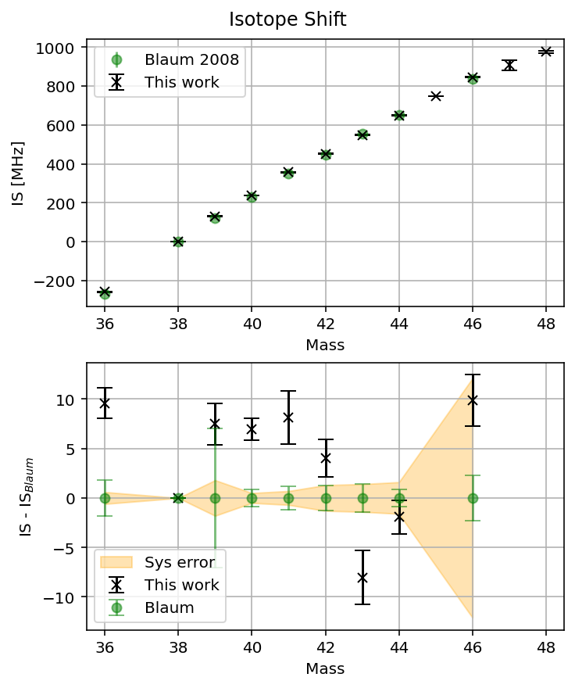
Isotope Shift
Mass | δν^{38,A} (MHz) | Lit
36 | -258.0(1.5) | −267.5(1.8)[0.6]
38 | 0 | 0
39 | 129.9(2.1) | 122.4(7.0)[1.8]
40 | 236.5(1.1) | 231.7(0.9)[0.5]
41 | 357.2(2.7) | 349.1(1.2)[0.7]
42 | 451.4(1.9) | 447.4(1.3)[1.3]
43 | 548.6(2.7) | 556.7(1.4)[1.4]
44 | 647.7(1.7) | 649.6(0.9)[1.6]
45 | 748.3(1.3) | -
46 | 845.1(2.6) | 835.2(2.3)[12.1]
47 | 906(27) | -
48 | 975.4(4.9) | -
K. Blaum et al., Nucl. Phys. A 799, 30–45 (2008).

Slide 11
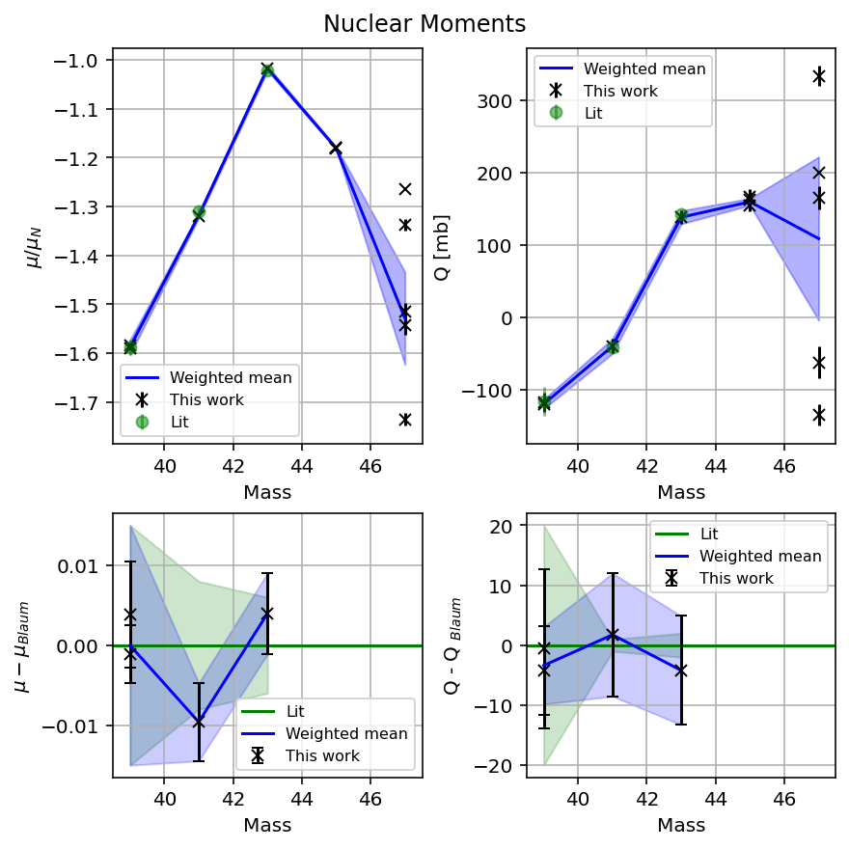
Nuclear moments
Nuclear moments were derived from A- and B-factors from the lower level 4s[3/2]₂
Q obtained using;
B(4s[3/2]₂) /Qs = −1.01 MHz/mb
As used by COLLAPS in 2008
Mass | I | μ / μ_{N} | Qs [mb]
39 | 7/2 | -1.580 (15) | -120.4 (6.4)
41 | 7/2 | -1.318 (4) | -40 (10)
43 | 5/2 | -1.017 (5) | 137 (9)
45 | 7/2 | -1.180 (2) | 159 (5)
47 | 3/2 | -2.13 (13) | 108 (100)
Notes:
Blaum in 2008 had determined this Q calibration factor by Breit-Wills analysis on p3/2 hole in Ar-37.

Slide 12
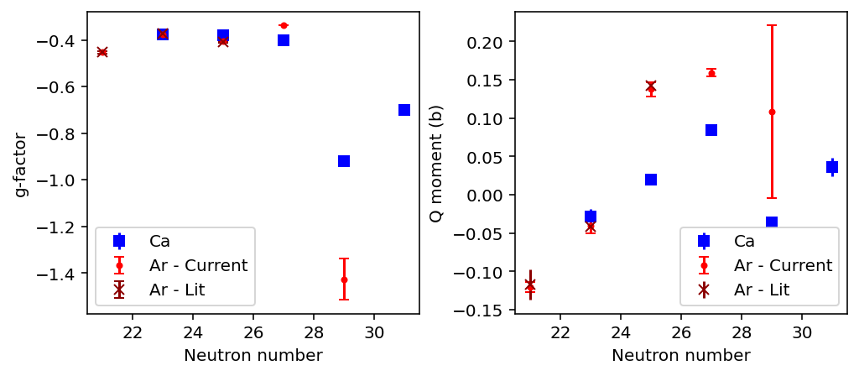
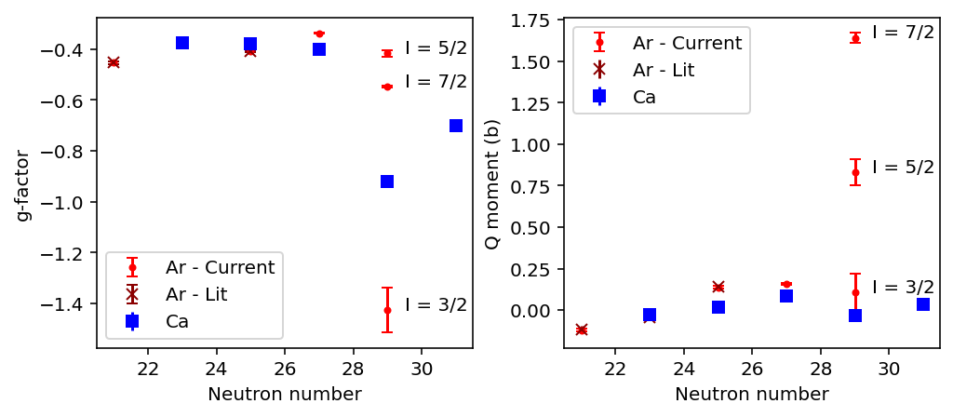
Calcium – g-factors and quadrupole moments
Diverse ground-state spins along Ar chain points to complex wavefunction, as collective behaviour emerges from Ca to S
Ar-45 g-factor consistent with f_{7/2} configuration
Ar-47 g-factor demonstrates sudden shift in structure
Quadrupole moments larger than the Ca- isotones – onset of deformation
Mass | I
39 | 7/2
41 | 7/2
43 | 5/2
45 | 7/2
47 | 3/2

Slide 13
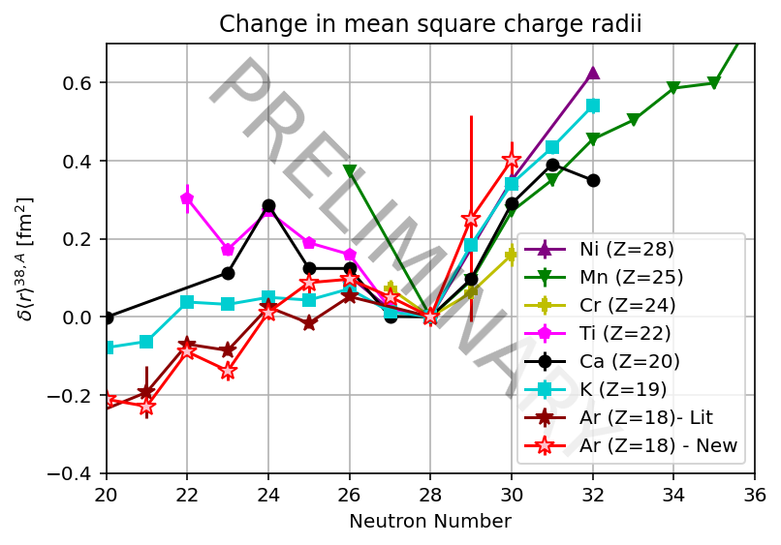
Change in Mean-square Charge Radii
Mass | δ<r²> (fm²) | Lit
36 | -0.175(14) | −0.084(18)[29]
38 | 0 | 0
39 | 0.018(20) | 0.044(67)[12]
40 | 0.122(10) | 0.167(9)[35]
41 | 0.073(25) | 0.151(12)[43]
42 | 0.223(18) | 0.262(12)[62]
43 | 0.299(26) | 0.221(14)[66]
44 | 0.308(16) | 0.289(9)[81]
45 | 0.263(12) | -
46 | 0.211(25) | 0.237(22)[78]
47 | 0.46(26) | -
48 | 0.612(47) | -
K. Blaum et al., Nucl. Phys. A 799, 30–45 (2008).

Slide 14
Thank you!
CRIS Collaboration, 2nd Feb 2026
Charlie Agg

Slide 15
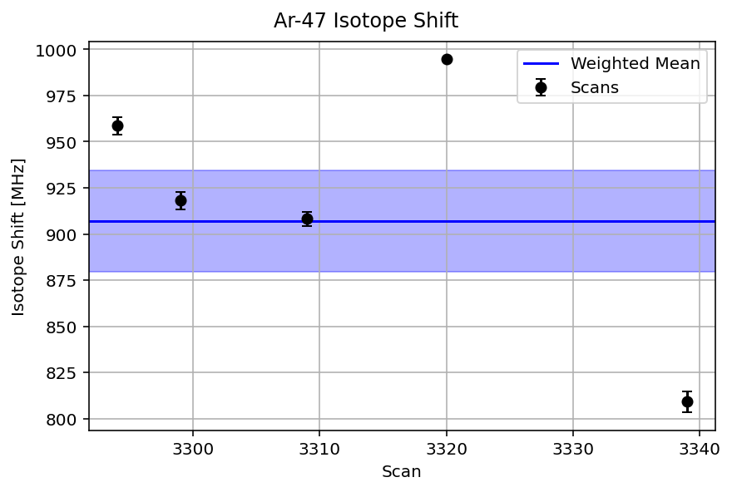
Ar-47 – Isotope shift scatter

Slide 18
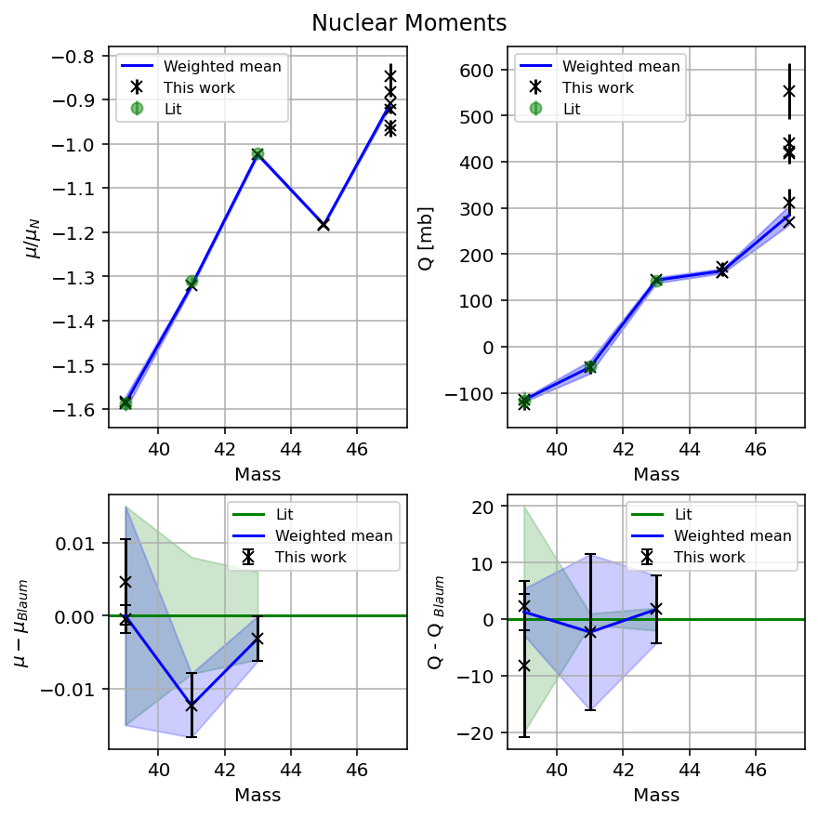
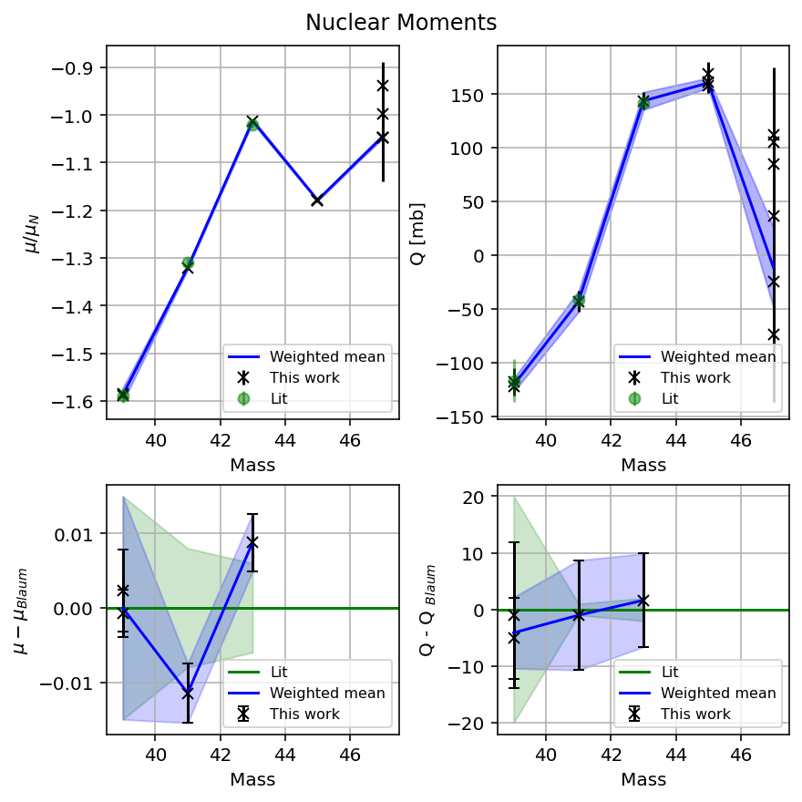
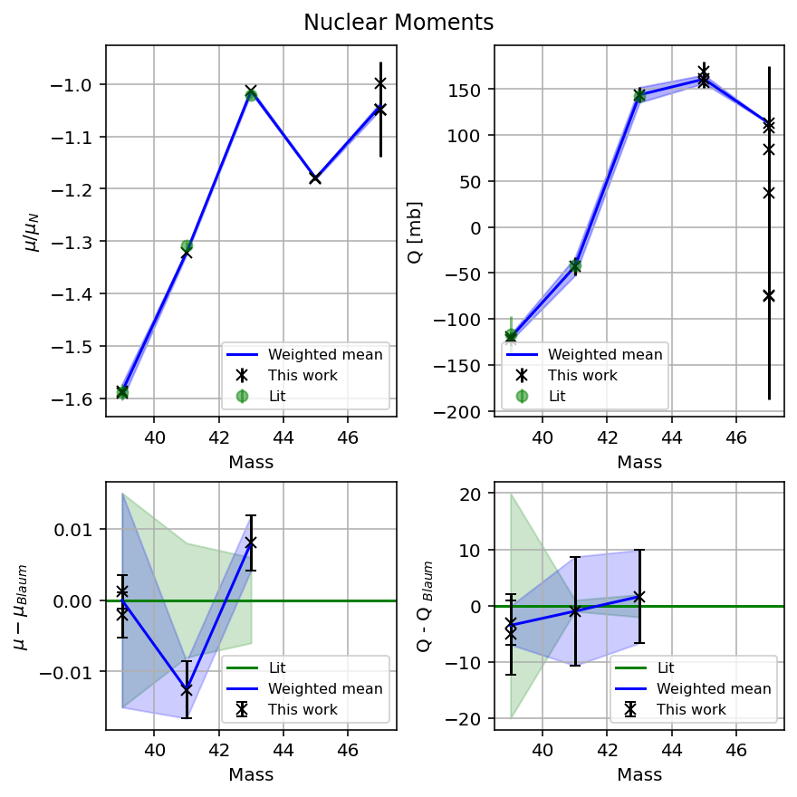
Free A,B ratios | Fixed ratios (mine) | Fixed ratios (Lit)
Racah=True

Slide 19
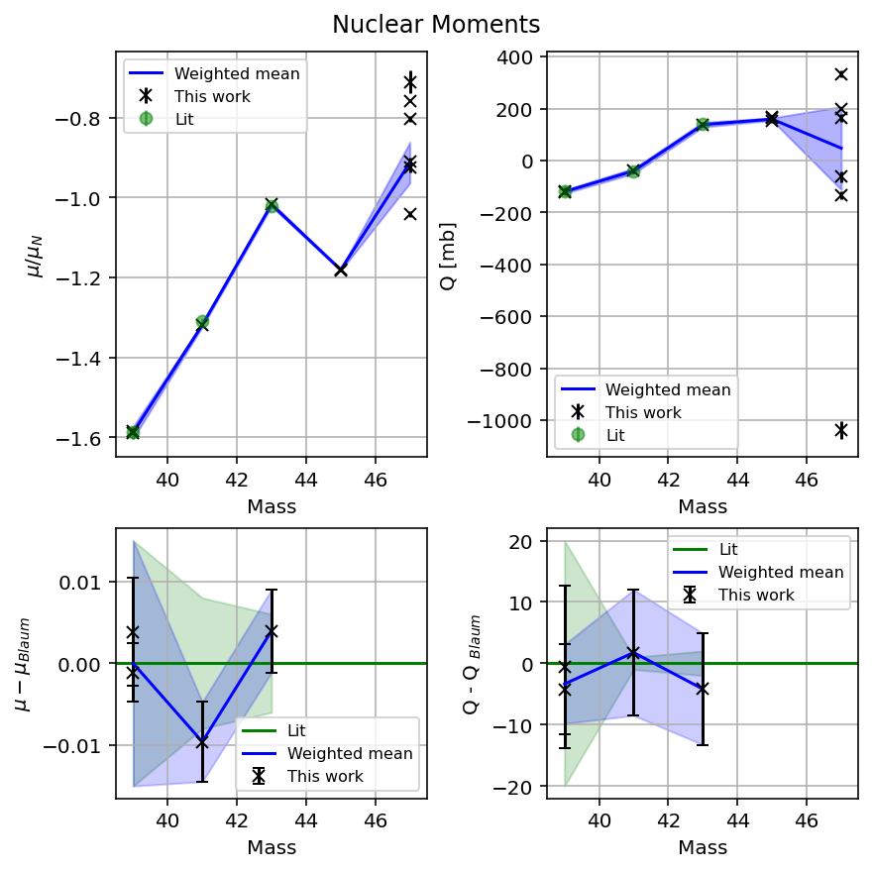
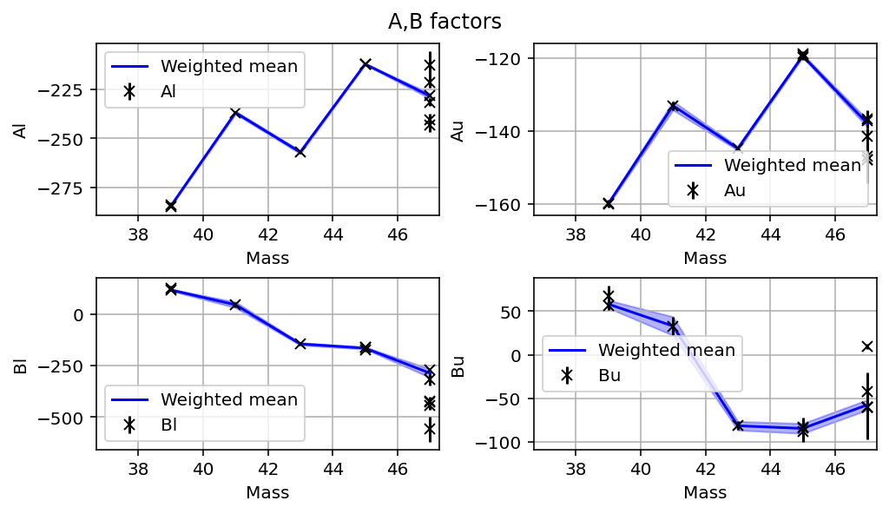
Free A/B ratios

Slide 20
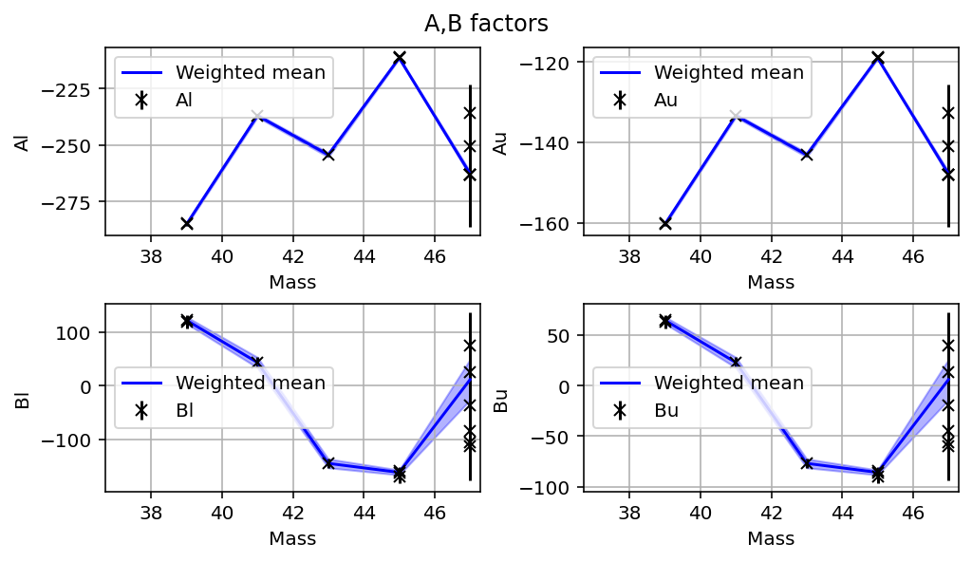
Fixed A/B ratios

Slide 21
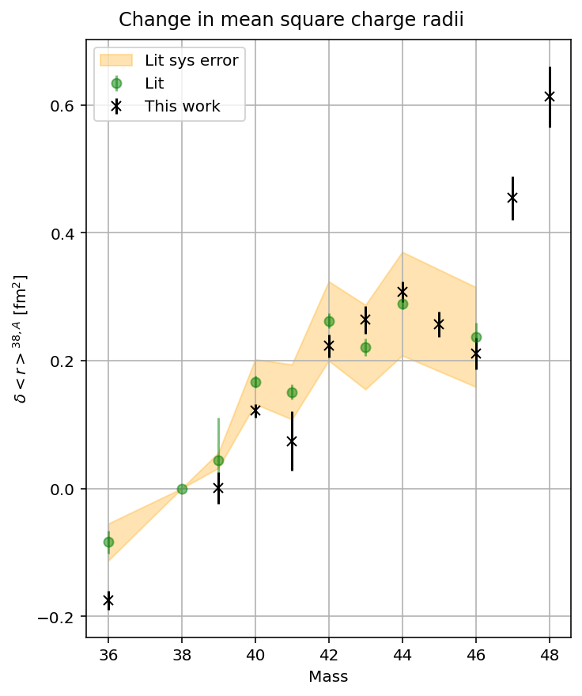
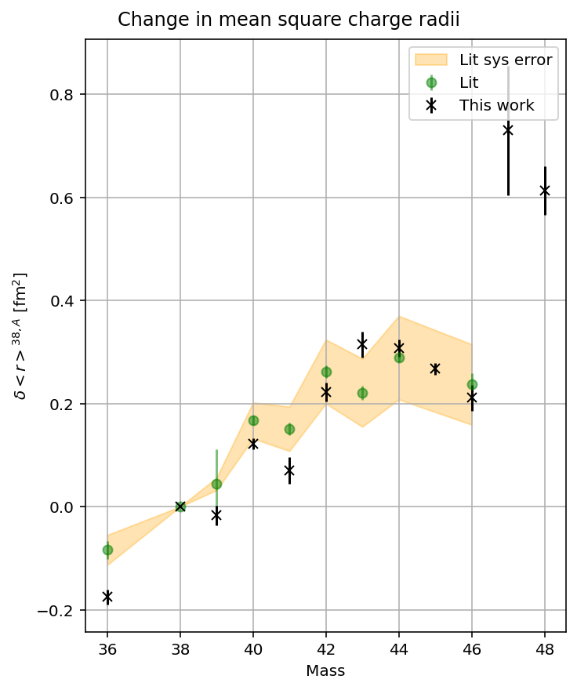
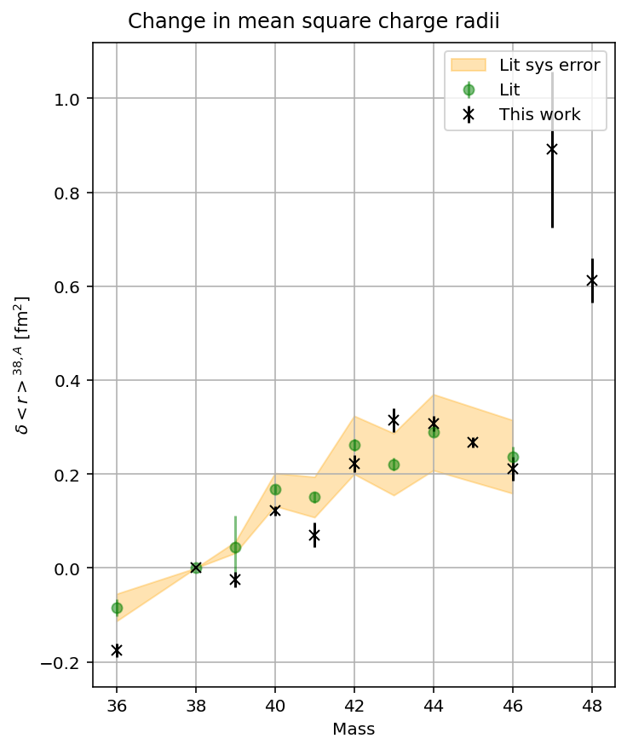
Free A,B ratios | Fixed ratios (mine) | Fixed ratios (Lit)
Racah=True

Slide 22
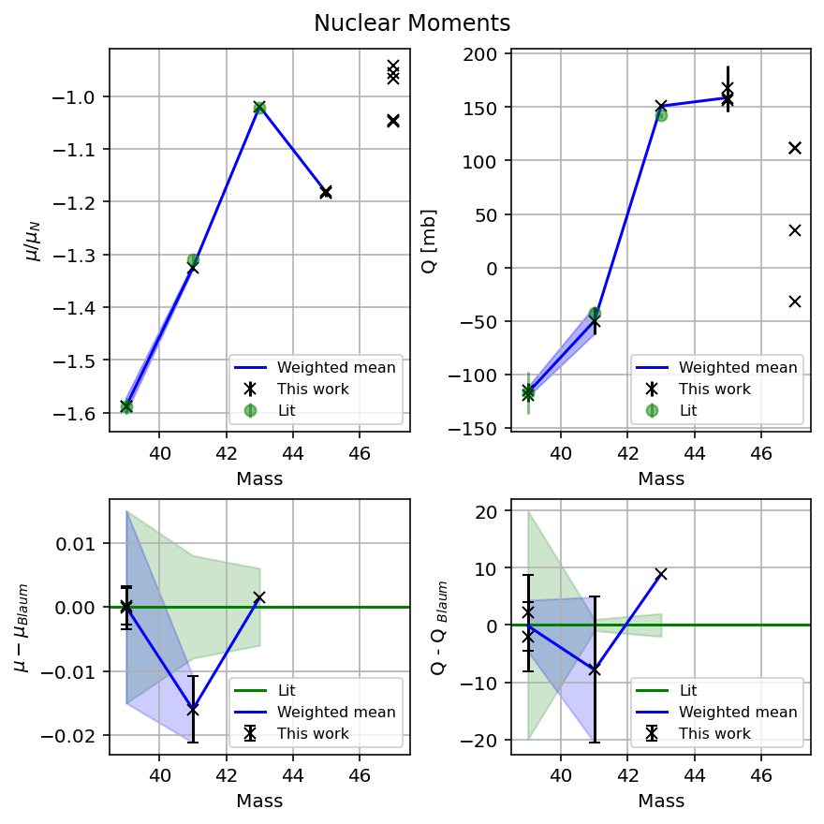
AB ratios (mine)
Racah = True // Racah = False

Slide 23
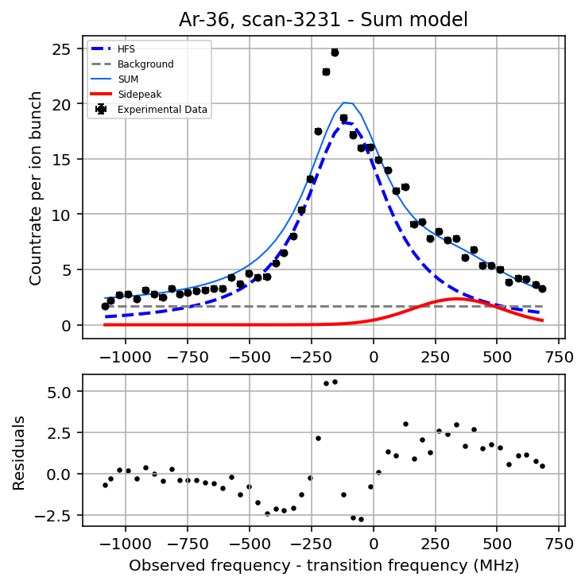
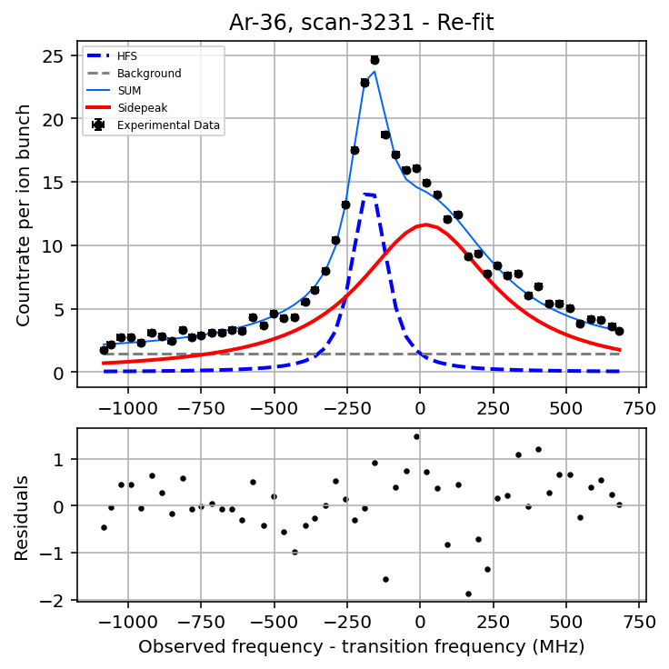
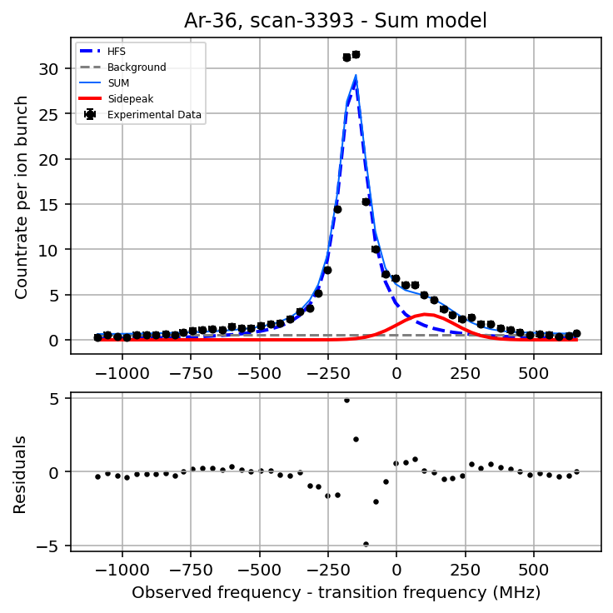
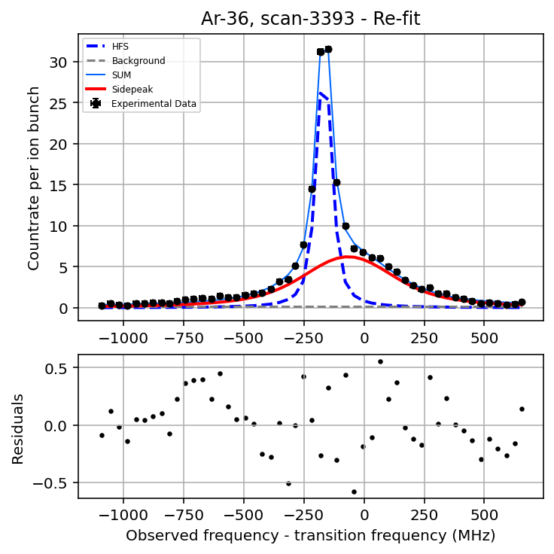
Problems with this fitting procedure
Parameters need perturbation before re-fitting to successfully estimate errors.
Poor at locating mean Voigt frequency if closely overlapping with main HFS
Artificial reduction in HFS linewidth
  A = 5.2e+05 s-1
  Linewidth ~ 4 MHz

