Slide 1


Collinear Resonance Ionization Spectroscopy of Argon (Z=18) Isotopes
CRIS Collaboration Meeting 2/2/2026
Angelos Karadimas
Supervisor: Agi Koszorus
Co – Supervisor: Gerda Neyens

Slide 2
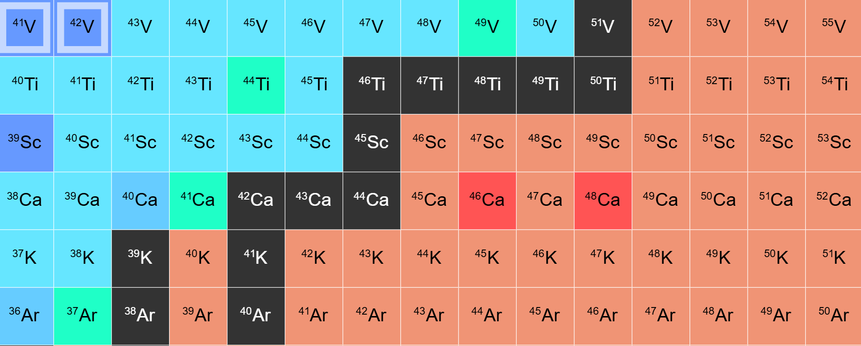
CRIS experiment in Argon (Z=18) Isotopes
Z=20
Neutrons in d_{3/2}
N=20
Neutrons in f_{7/2}
N=28
Neutrons in p_{3/2}
Nuclear chart for the region of interest, highlighted in yellow the isotopes that studied.
Figure from: Colorful Nuclide Chart

Slide 3
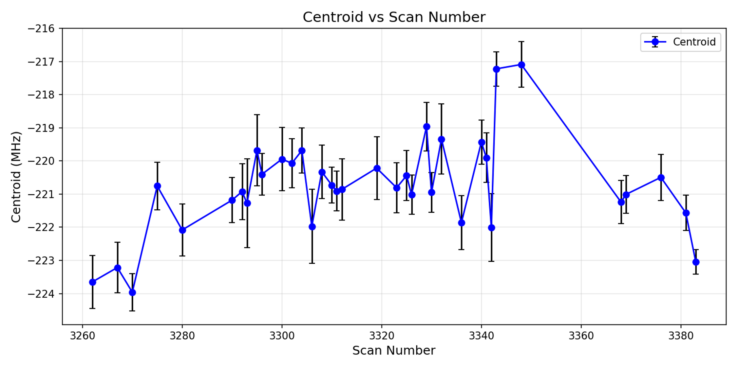
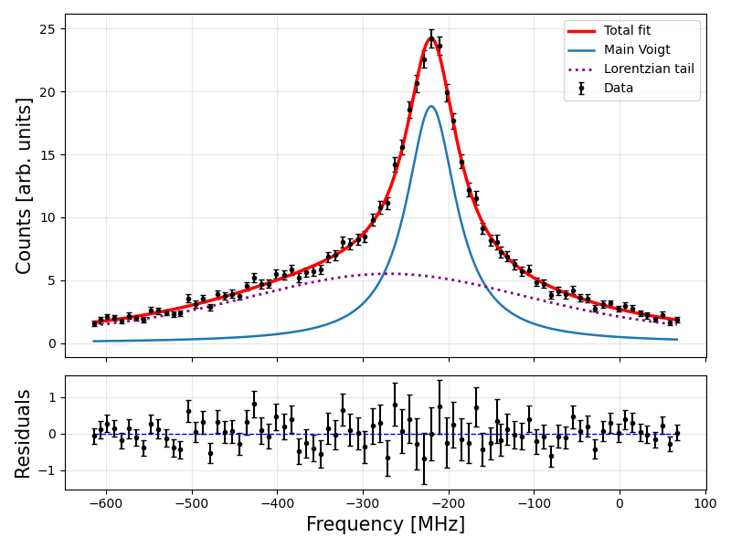
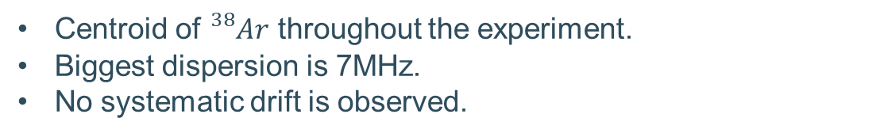
Centroid evolution during the run
Centroid of ${}_{}^{38}{Ar}$ throughout the experiment.
Biggest dispersion is 7MHz.
No systematic drift is observed.

Slide 4
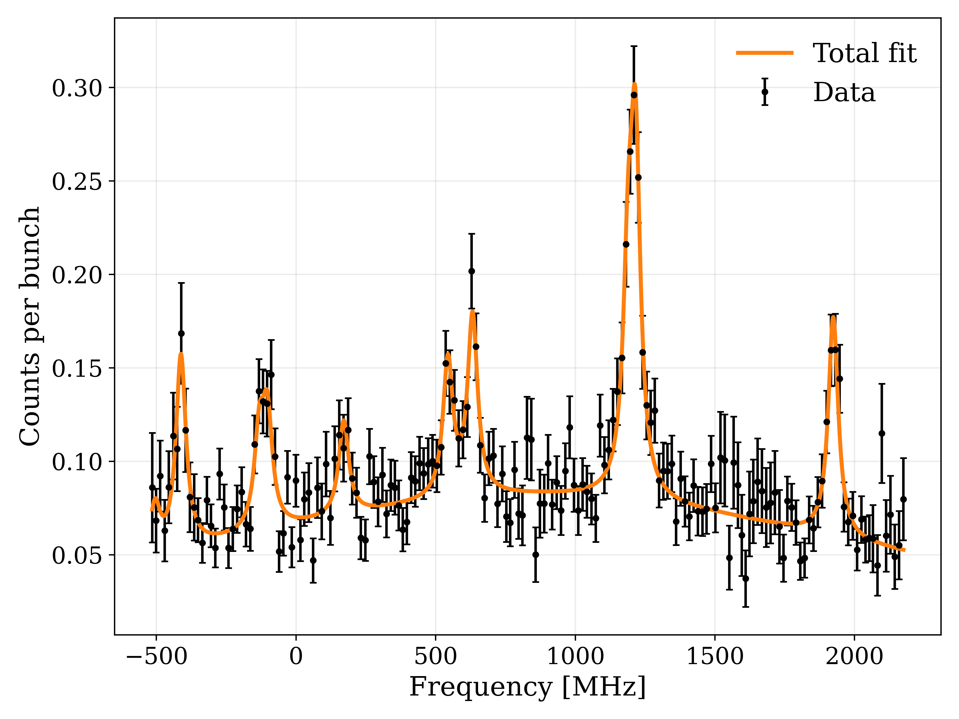
Odd - Even Isotopes
Hyperfine fits performed for all odd-A isotopes.
A and B constants extracted with good precision.
On the left side the most exotic odd even case we managed to measure.
Sum of 4 independent scans in order to obtain significant statistics.
Example: Hyperfine structure of ${}_{}^{47}{Ar}$

Slide 5
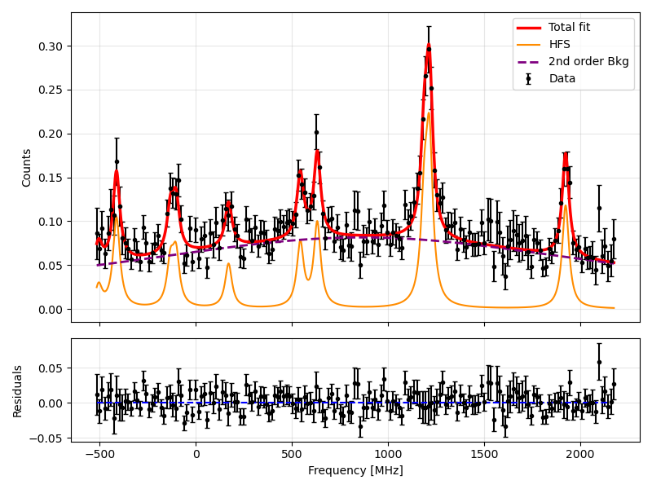
Hfs fit for odd even isotopes
2nd order polynomial background required to optimize HFS fit.
Elevated background near spectrum center.
Lorentzian tail overlap
Due to voltage scan steering at spectrum edges.

Slide 6
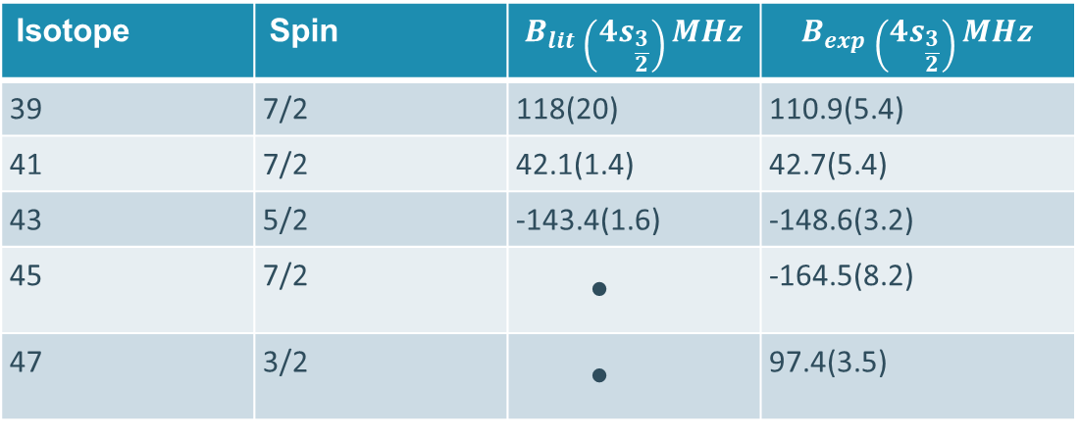
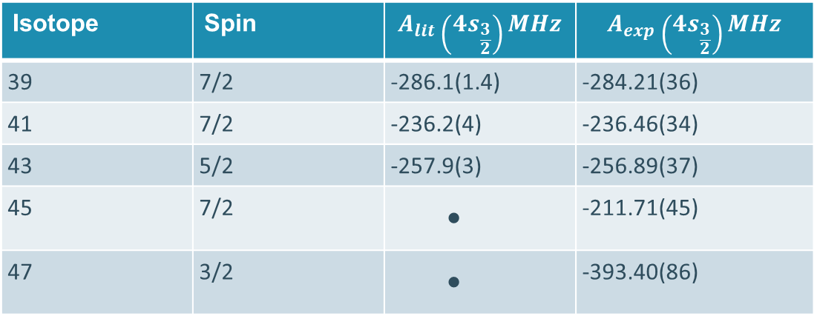

Hyperfine parameters comparison
Isotope | Spin | $$A_{lit}\left({4s}_{\frac{3}{2}}\right)MHz$$ | $$A_{exp}\left({4s}_{\frac{3}{2}}\right)MHz$$
39 | 7/2 | -286.1(1.4) | -284.21(36)
41 | 7/2 | -236.2(4) | -236.46(34)
43 | 5/2 | -257.9(3) | -256.89(37)
45 | 7/2 |  | -211.71(45)
47 | 3/2 |  | -393.40(86)
Good agreement with literature and new values added for ${}_{}^{45,47}{Ar}$.
Isotope | Spin | $$B_{lit}\left({4s}_{\frac{3}{2}}\right)MHz$$ | $$B_{exp}\left({4s}_{\frac{3}{2}}\right)MHz$$
39 | 7/2 | 118(20) | 110.9(5.4)
41 | 7/2 | 42.1(1.4) | 42.7(5.4)
43 | 5/2 | -143.4(1.6) | -148.6(3.2)
45 | 7/2 |  | -164.5(8.2)
47 | 3/2 |  | 97.4(3.5)

Slide 7
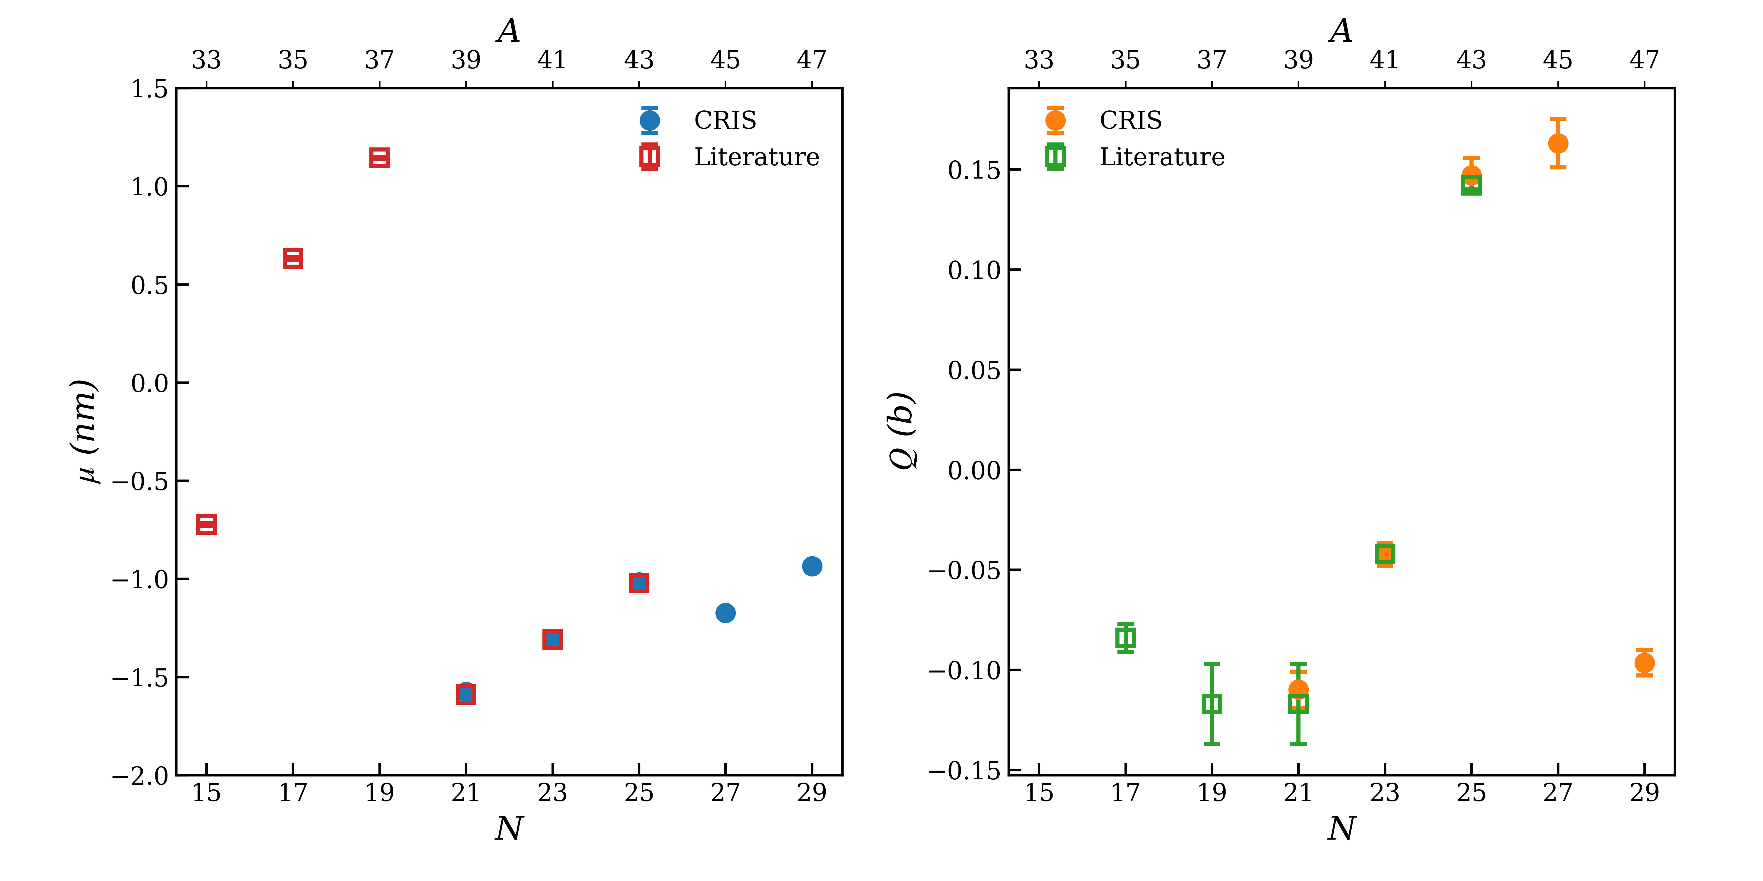




Electromagnetic moments
$${1d}_{3/2}$$
$${2s}_{1/2}$$
$${1f}_{7/2}$$
$${2p}_{3/2}$$
Figure: Left magnetic dipole moments and right electric quadrupole moments for the isotopic chain of Ar.
Excellent agreement with literature values, two new isotopes observed, at N=27 and N=29 → probe the magicity of N=28

Slide 8
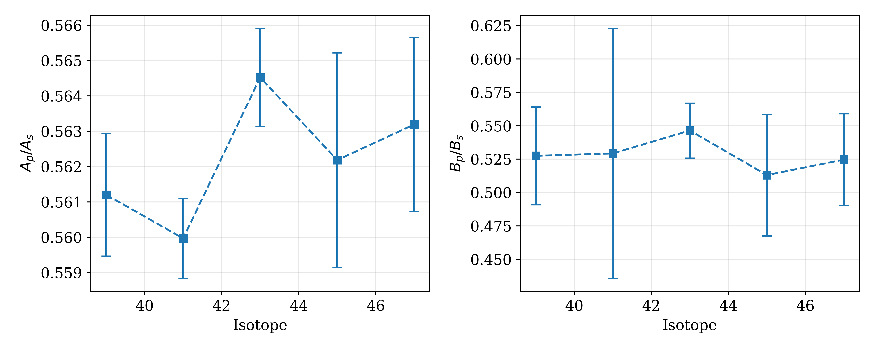
Hyperfine A and B ratios across the Ar isotopes
A and B ration remain constant across isotopes without imposing any constraints.
Best-fit conversion of the A ratio assigns spin I=3/2 to ${}_{}^{47}{Ar}$ and I=7/2 to ${}_{}^{45}{Ar}$ .

Slide 9
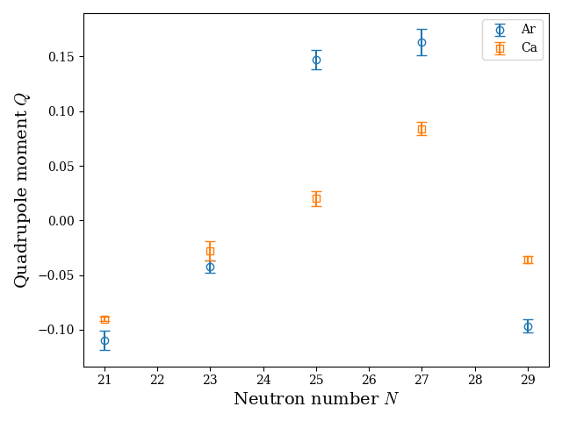

Comparison with Ca isotopes across $f_{7/2}$
Similar evolution of quadrupole moments in Ar and Ca isotopes.
More pronounced single particle character in Ca compared to Ar.

Slide 10
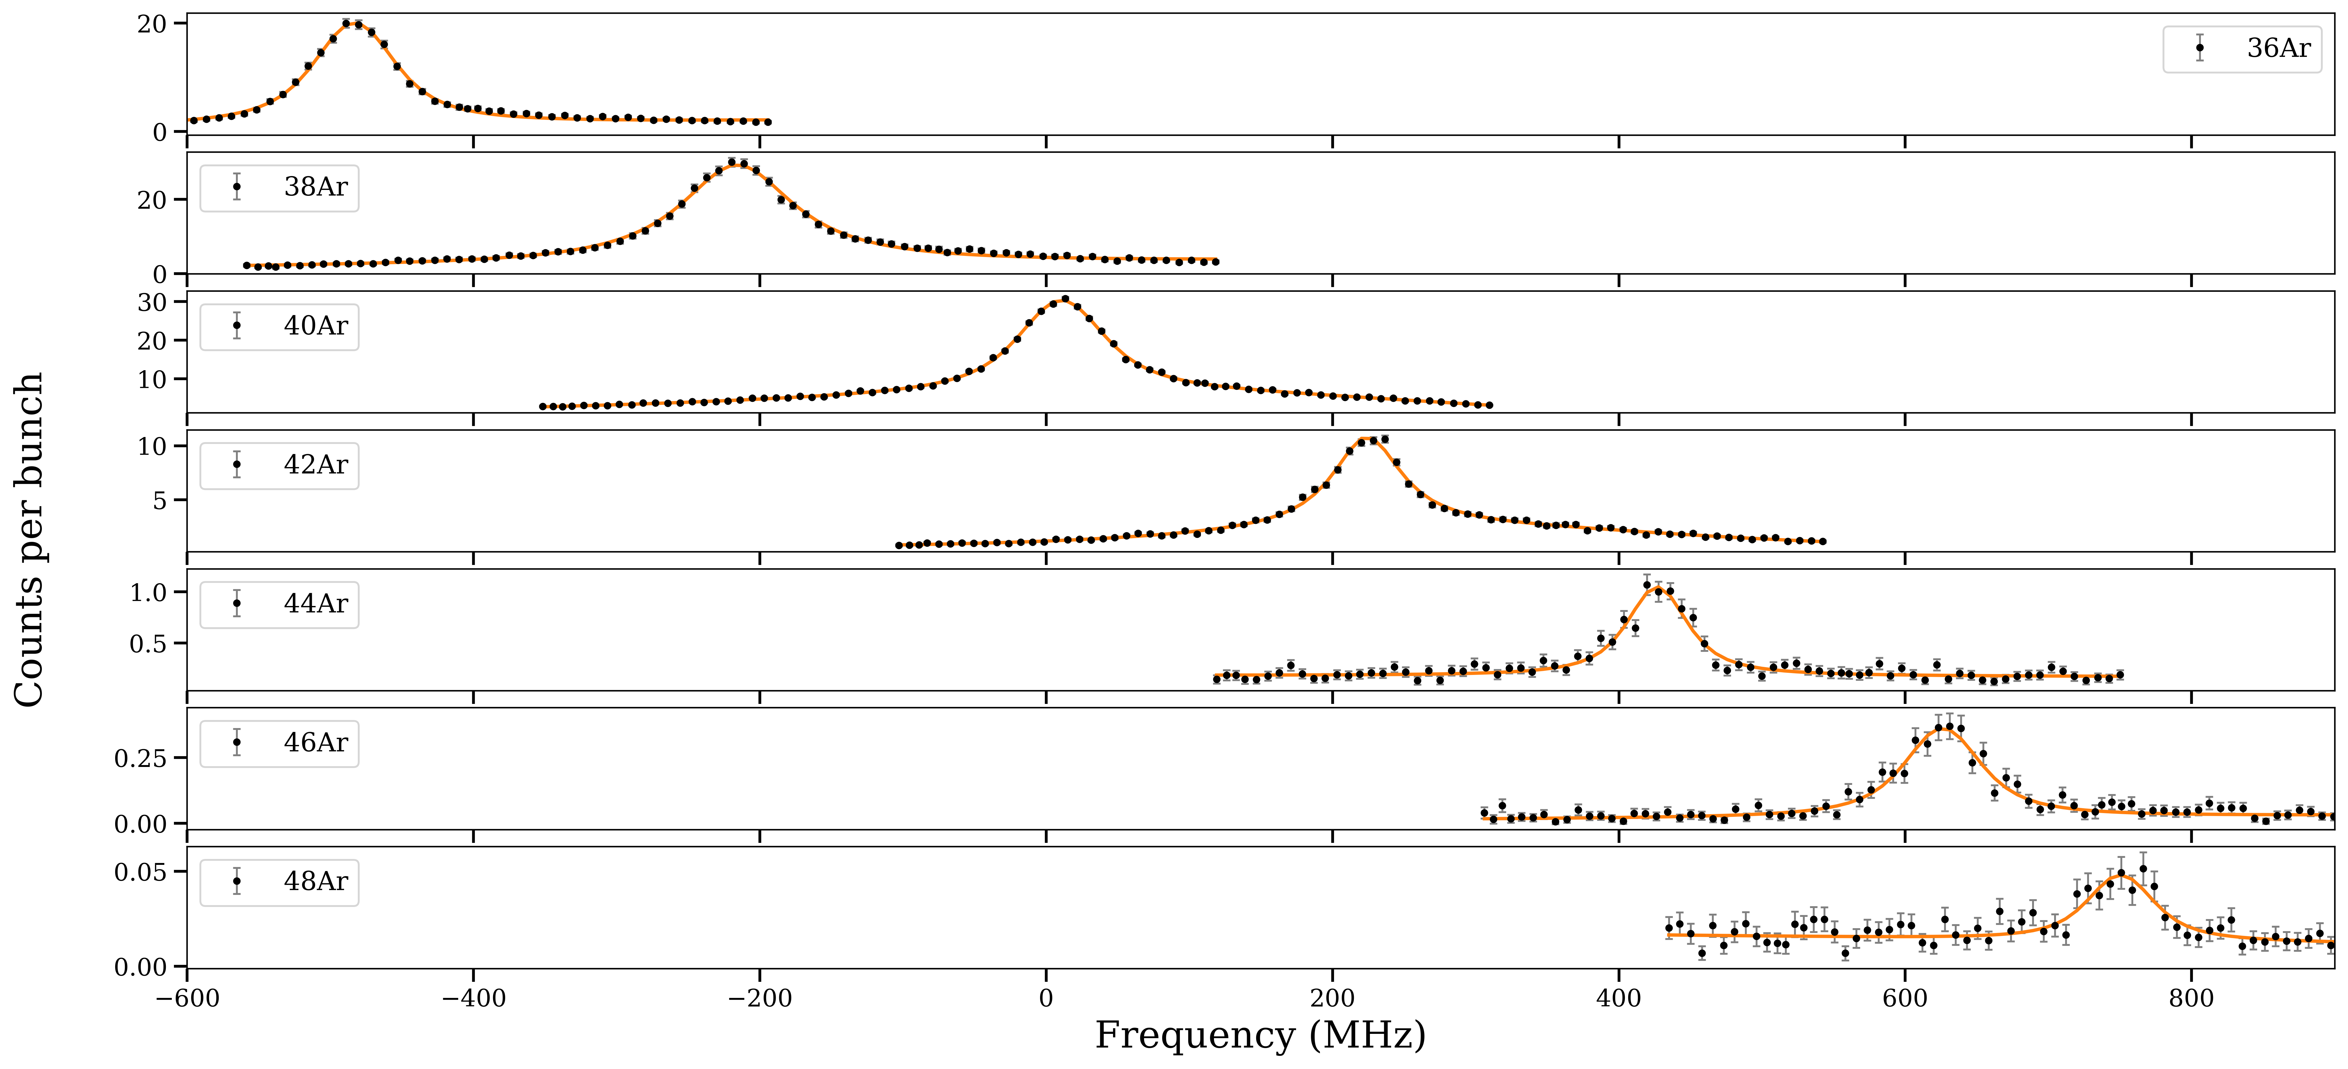






Even – Even Isotopes
$${δν}^{36,38}$$
$${δν}^{40,38}$$
$${δν}^{42,38}$$
$${δν}^{44,38}$$
$${δν}^{46,38}$$
$${δν}^{48,38}$$
Figure: Even - even argon isotopes evolution over frequency.

Slide 11
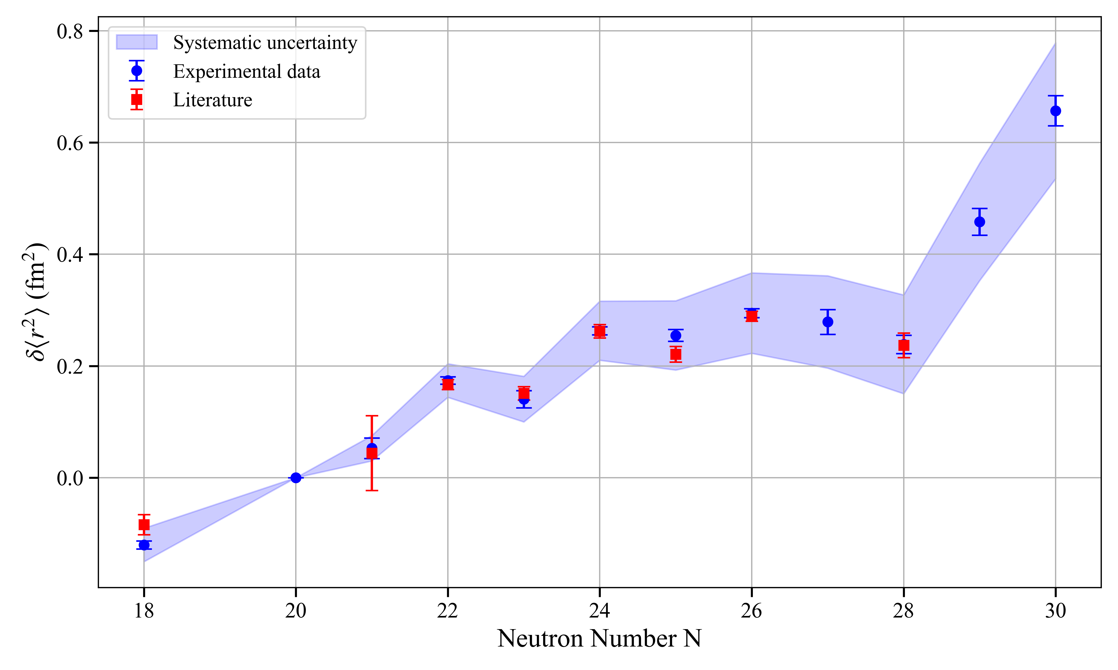
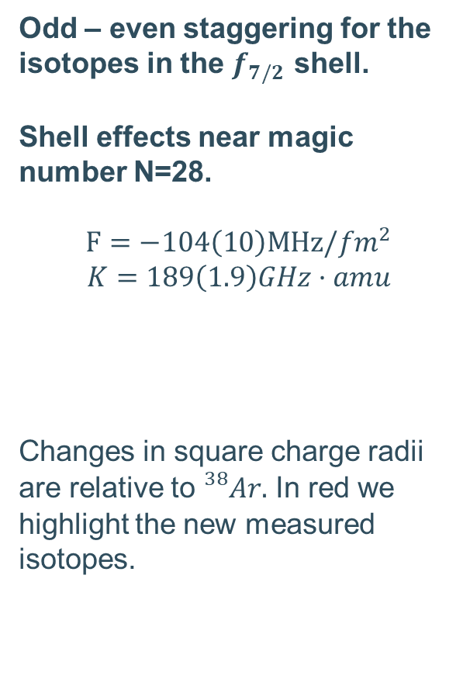
Charge radii of Argon isotopes
$$δν=F⋅δ<r^{2}> +\frac{M\left(m_{A}−m_{38}\right)}{m_{A}{·m}_{38}}$$
Odd – even staggering for the isotopes in the $f_{7/2}$ shell.
Shell effects near magic number N=28.
$$F=−104\left(10\right)MHz/{fm}^{2}$$
$$K=189\left(1.9\right)GHz·amu$$
Changes in square charge radii are relative to ${}_{}^{38}{Ar}.$ In red we highlight the new measured isotopes.
Figure: Changes in square charge radii for the isotopic chain of Ar.

Slide 12
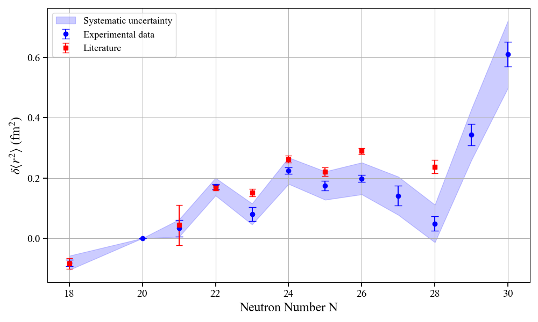
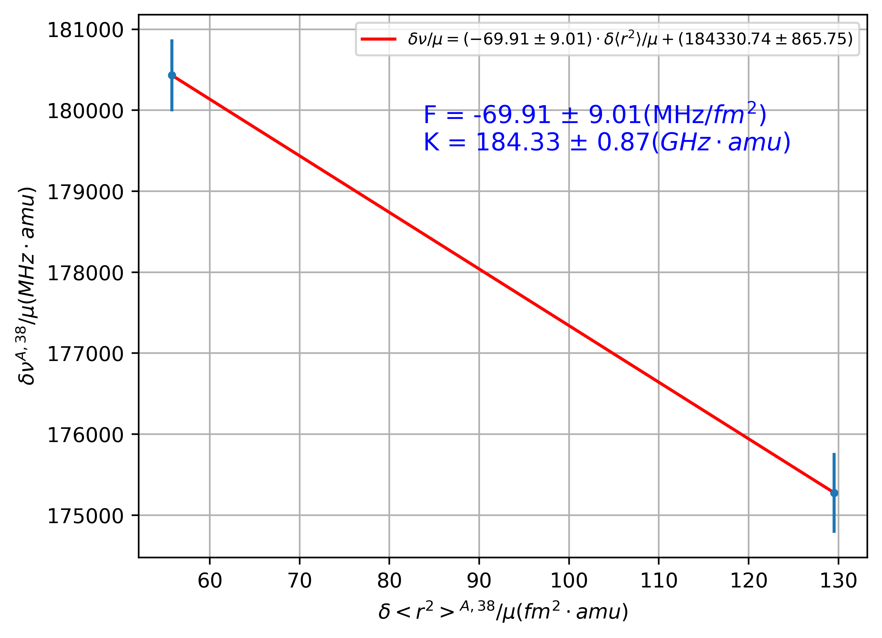
Charge radii from my Kingplot
Absolute radii obtained from the work of Fricke:
https://doi.org/10.1006/adnd.1995.1007

Slide 13
        Thank you for your attention!

