Slide 1
Collinear resonance ionization of neutron-deficient indium: closing up on N = 50
Jessica Warbinek, Simone Casci
Collaboration meeting 2026

Slide 2
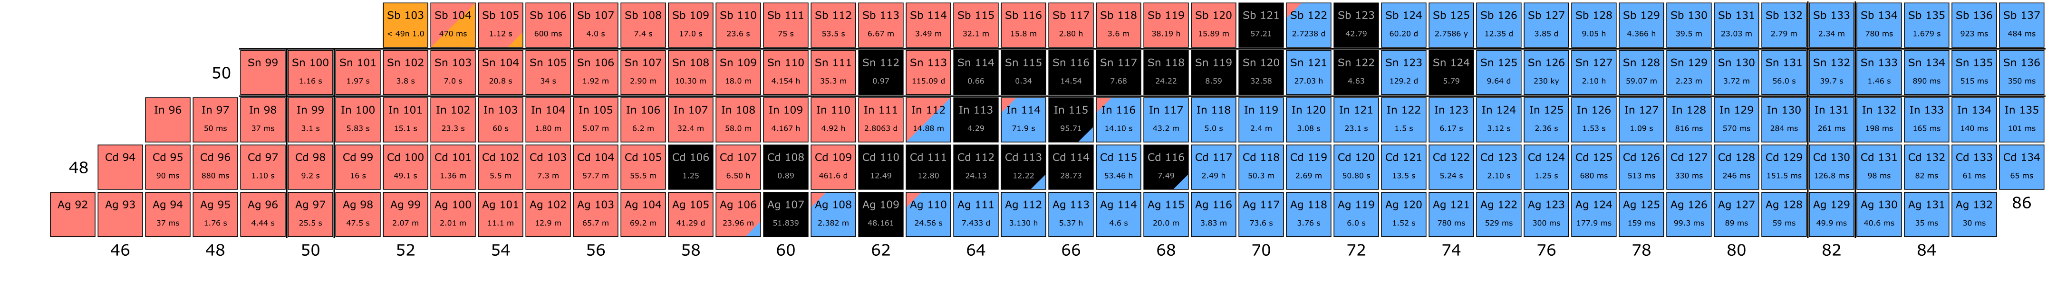
Introduction
This proposal
(Un-)published laser spectroscopy
Studying the shell structure around doubly magic ¹⁰⁰Sn
Testing the shell model under extreme conditions
Robustness of N=50 near Z=50, towards dripline
Proton-neutron interactions near shell closure
Role of electro-weak currents
Notes:
Heaviest self-conjugate and doubly magic nucleus, stable wrt heavy-particle emission
Investigate p-n correlations based on coupling of sp states to doubly magic core
N=Z nuclei: best lab to test np-interactions, isospin symmetry & mixing, evolution of nucl. shapes

Slide 3
Previous indium runs at CRIS
This proposal
(Un-)published laser spectroscopy
Recent CRIS results
Studying the shell structure around doubly magic ¹⁰⁰Sn
Testing the shell model under extreme conditions
Robustness of N=50 near Z=50, towards dripline
Proton-neutron interactions near shell closure
Role of electro-weak currents
Studying In isotopes at CRIS, with one p-hole to ¹⁰⁰Sn
Studying nuclear structure evolution approaching N=50 and N=82
Correlations of single proton hole with n / n-holes
^{99,100}In: pin-point the evolution of nuclear structure, sensitive to the presence of mixed configurations, benchmarking nuclear theory, investigating magicity of N=50
Notes:
Heaviest self-conjugate and doubly magic nucleus, stable wrt heavy-particle emission
Investigate p-n correlations based on coupling of sp states to doubly magic core
N=Z nuclei: best lab to test np-interactions, isospin symmetry & mixing, evolution of nucl. shapes

Slide 4
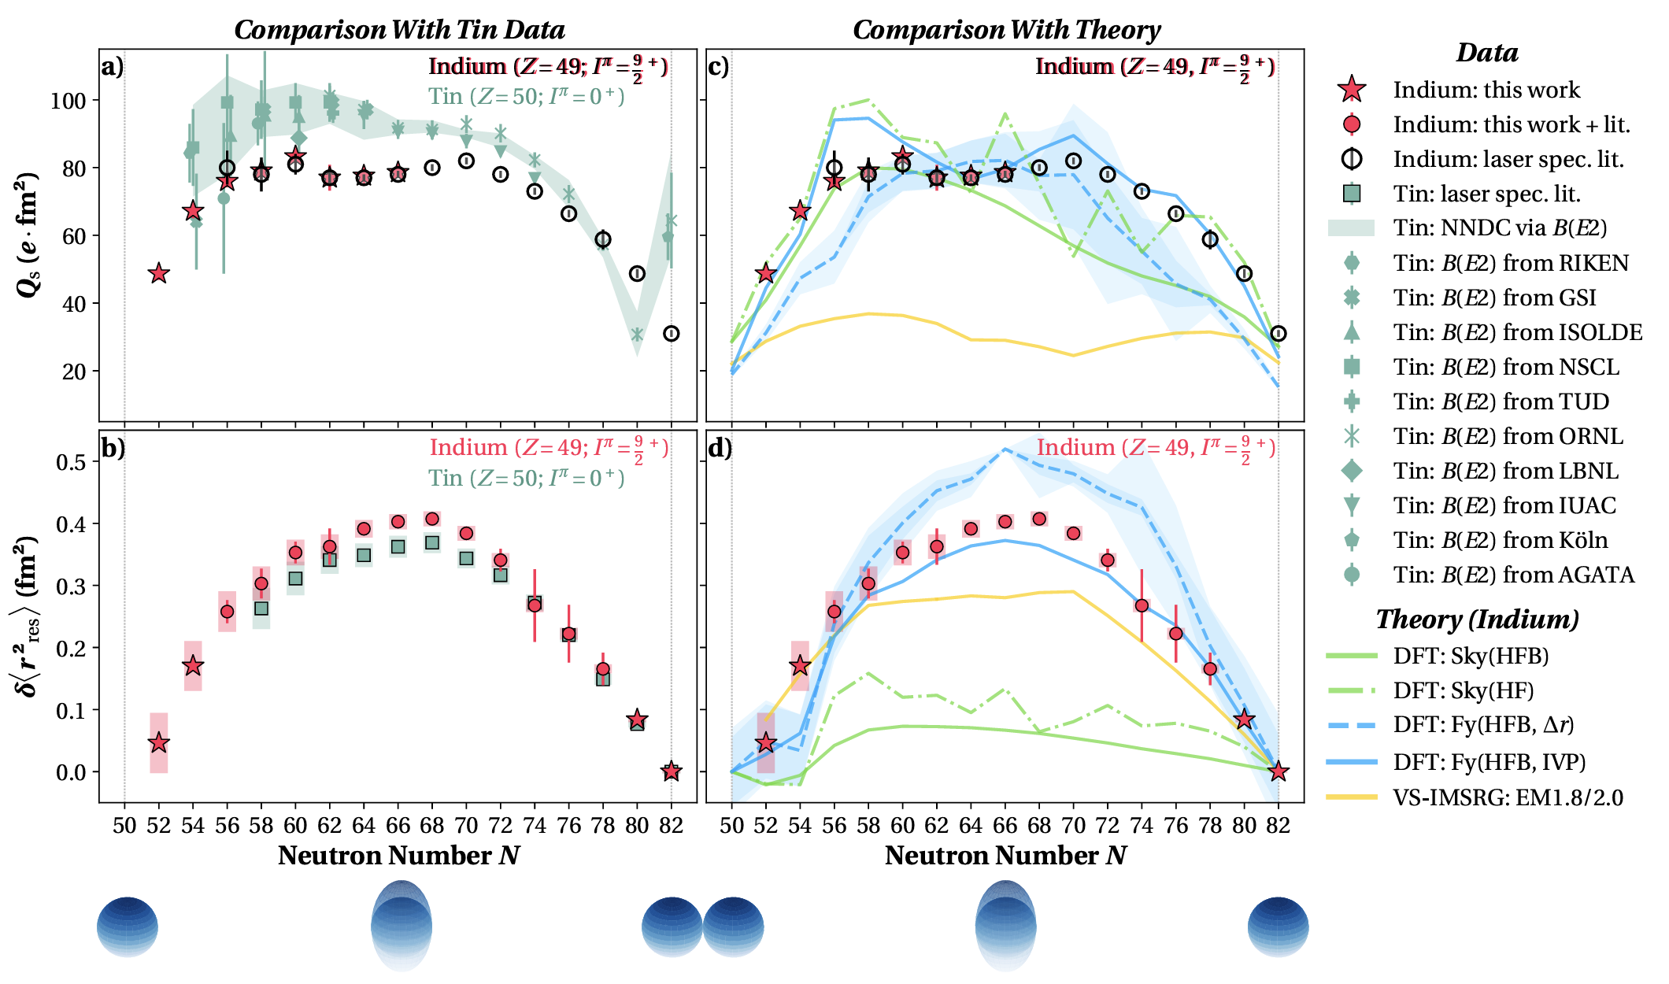
Charge radii of neutron-deficient In
Changes in mean square charge radii:
A sensitive probe to study the evolution of nuclear size and deformation
Benchmarking nuclear theory models:
Predictions for indium by DFT and ab-
initio frameworks available,
discrepancies observed towards N=50
Kink in charge radii: probe for shell closure
Odd-even staggering: many body correlations & local effects
M. Reponen et al., Nat. Commun. 12, 4596 (2021).
J. Karthein et al., Nat. Phys. (2024).
J. Karthein et al., arXiv preprint 2310.15093 (2023).
Notes:
OES: Need to tie systematics together, very sensitive on that.

Slide 5
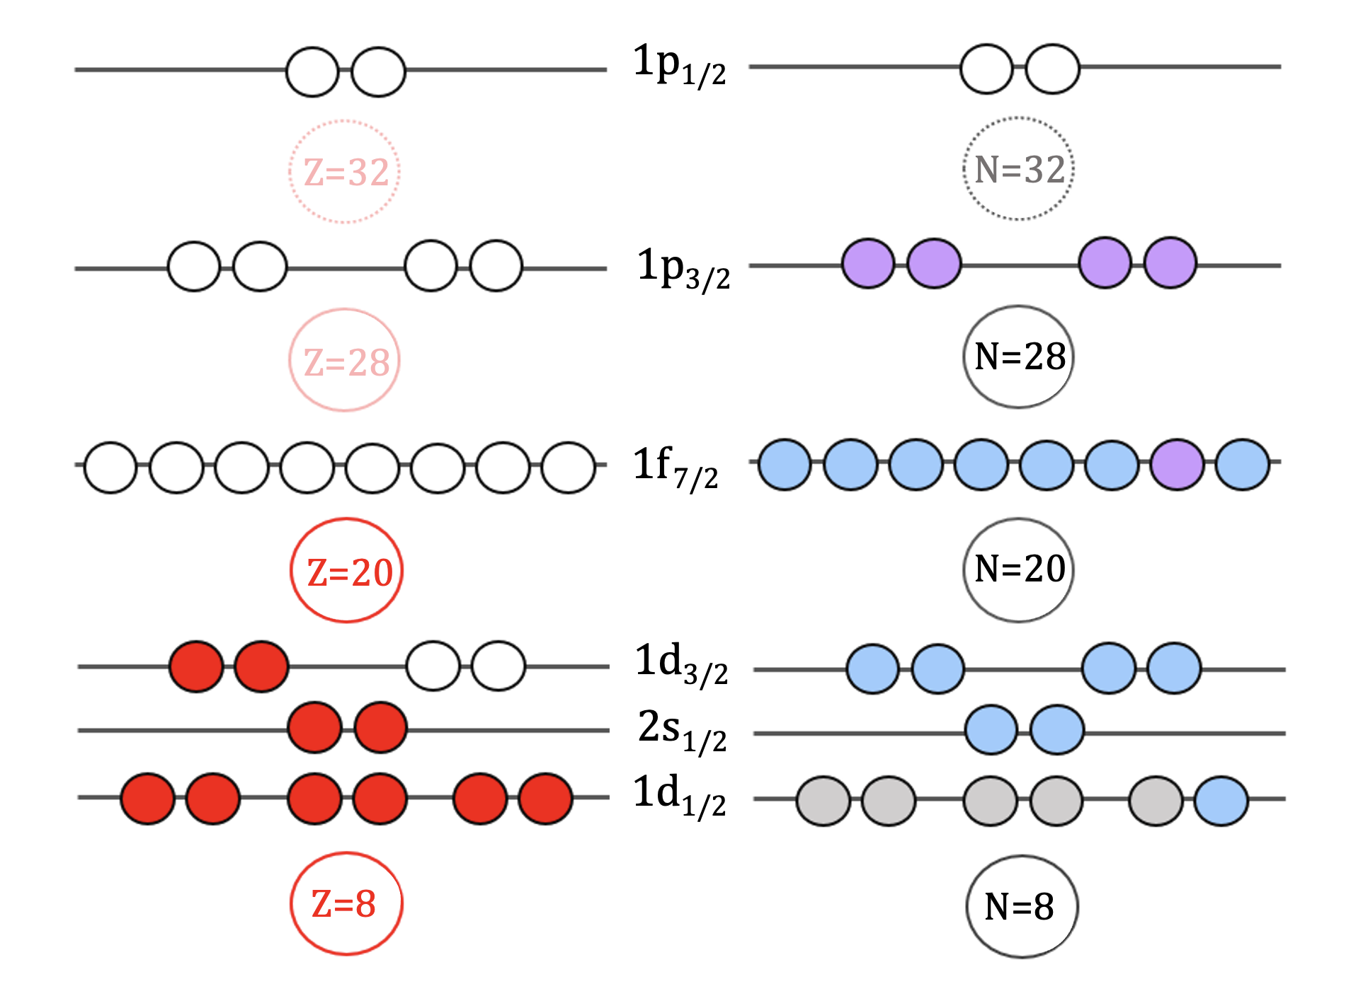
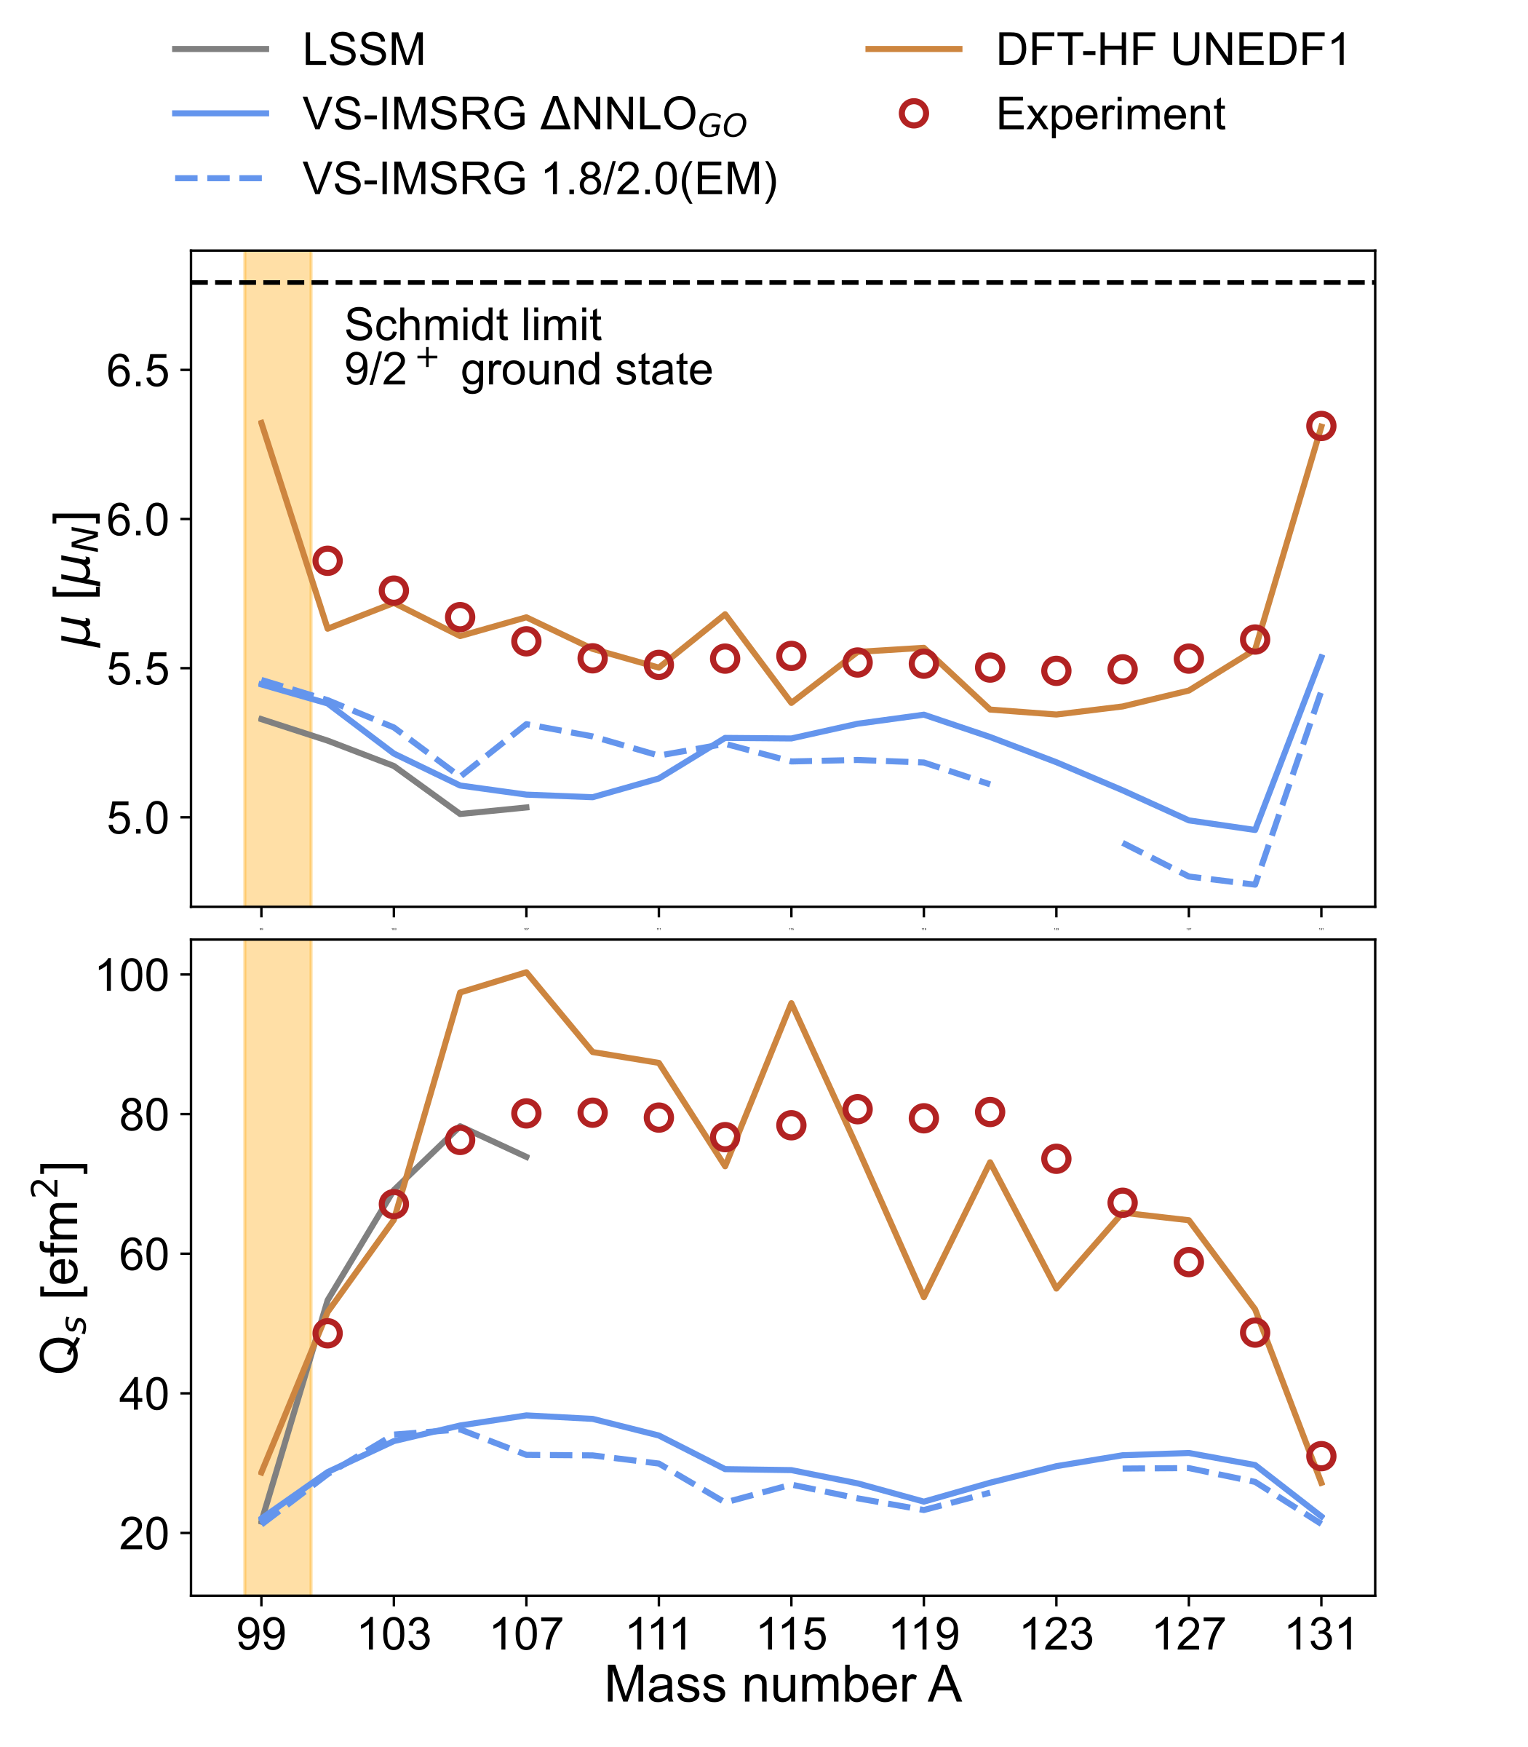
Nuclear moments and spins of In nuclei
Electric quadrupole moments:
Reflects the evolution of collectivity towards mid-shell
Probe arising collectivity beyond shell closure
Reflects arising deformation
Magnetic dipole moments:
A sensitive probe to study the interplay between the single particle structure and many-body correlations.
Reflect the strength of a shell closure
Ordering of shell model levels and leading configuration for odd-odd nuclei
L. Nies et al., Phys. Rev. Lett. 131, 022502 (2023).
A. Vernon et al., Nature 607, 260–265 (2022).
T. Miyagi et al., Phys. Rev. Lett. 132, 232503 (2024).
J. Karthein et al., Nat. Phys. (2024).
J. Karthein et al., arXiv preprint 2310.15093 (2023).
Notes:
Magnetic moments: sensitive probe to study interplay of …
Measure the spin of…
Extract g-factors, compare to Ca. Investigate presence of mixed configurations
The g-factors remain nearly constant close to the f_{7/2} single particle value.
If the moments of ^{45,47}Ar are similar to Ca, this confirms the presence of the N=28 shell gap

Slide 6
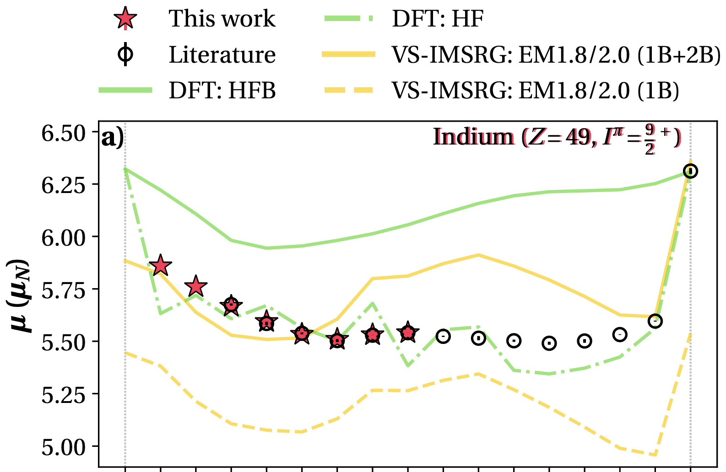
Nuclear moments and spins of In nuclei
Electric quadrupole moments:
Reflects the evolution of collectivity towards mid-shell
Probe arising collectivity beyond shell closure
Reflects arising deformation
Magnetic dipole moments:
A sensitive probe to study the interplay between the single particle structure and many-body correlations.
Reflect the strength of a shell closure
Ordering of shell model levels and leading configuration for odd-odd nuclei
L. Nies et al., Phys. Rev. Lett. 131, 022502 (2023).
A. Vernon et al., Nature 607, 260–265 (2022).
T. Miyagi et al., Phys. Rev. Lett. 132, 232503 (2024).
J. Karthein et al., Nat. Phys. (2024).
J. Karthein et al., arXiv preprint 2310.15093 (2023).
Notes:
Magnetic moments: sensitive probe to study interplay of …
Measure the spin of…
Extract g-factors, compare to Ca. Investigate presence of mixed configurations
The g-factors remain nearly constant close to the f_{7/2} single particle value.
If the moments of ^{45,47}Ar are similar to Ca, this confirms the presence of the N=28 shell gap

Slide 7
Nuclear moments and spins of In nuclei
Electric quadrupole moments:
Reflects the evolution of collectivity towards mid-shell
Probe arising collectivity beyond shell closure
Reflects arising deformation
Magnetic dipole moments:
A sensitive probe to study the interplay between the single particle structure and many-body correlations.
Reflect the strength of a shell closure
Ordering of shell model levels and leading configuration for odd-odd nuclei
?
(6⁺)
9/2⁺
(6⁺)
9/2⁺
6⁺
9/2⁺
7⁺
9/2⁺
7⁺
9/2⁺
7⁺
9/2⁺
L. Nies et al., Phys. Rev. Lett. 131, 022502 (2023).
A. Vernon et al., Nature 607, 260–265 (2022).
T. Miyagi et al., Phys. Rev. Lett. 132, 232503 (2024).
J. Karthein et al., Nat. Phys. (2024).
J. Karthein et al., arXiv preprint 2310.15093 (2023).
Notes:
Magnetic moments: sensitive probe to study interplay of …
Measure the spin of…
Extract g-factors, compare to Ca. Investigate presence of mixed configurations
The g-factors remain nearly constant close to the f_{7/2} single particle value.
If the moments of ^{45,47}Ar are similar to Ca, this confirms the presence of the N=28 shell gap

Slide 8
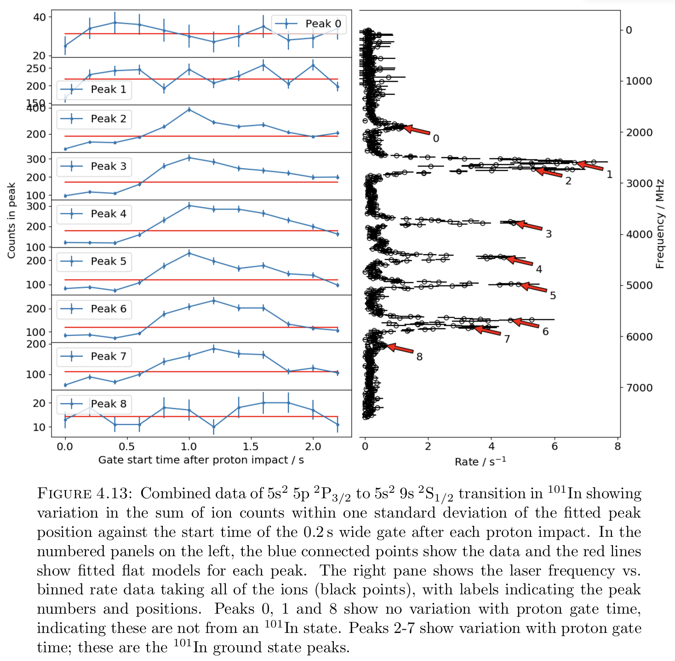
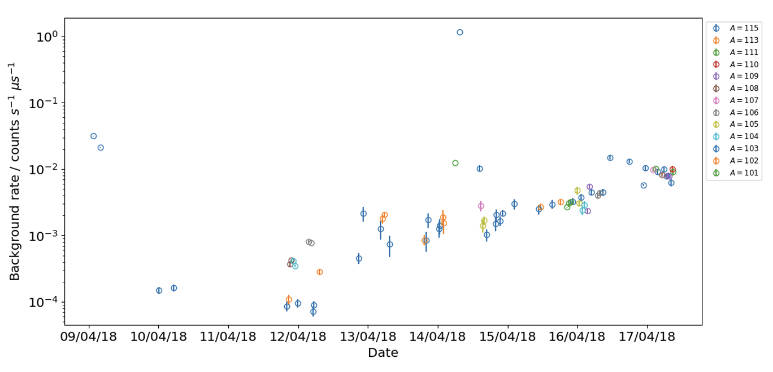
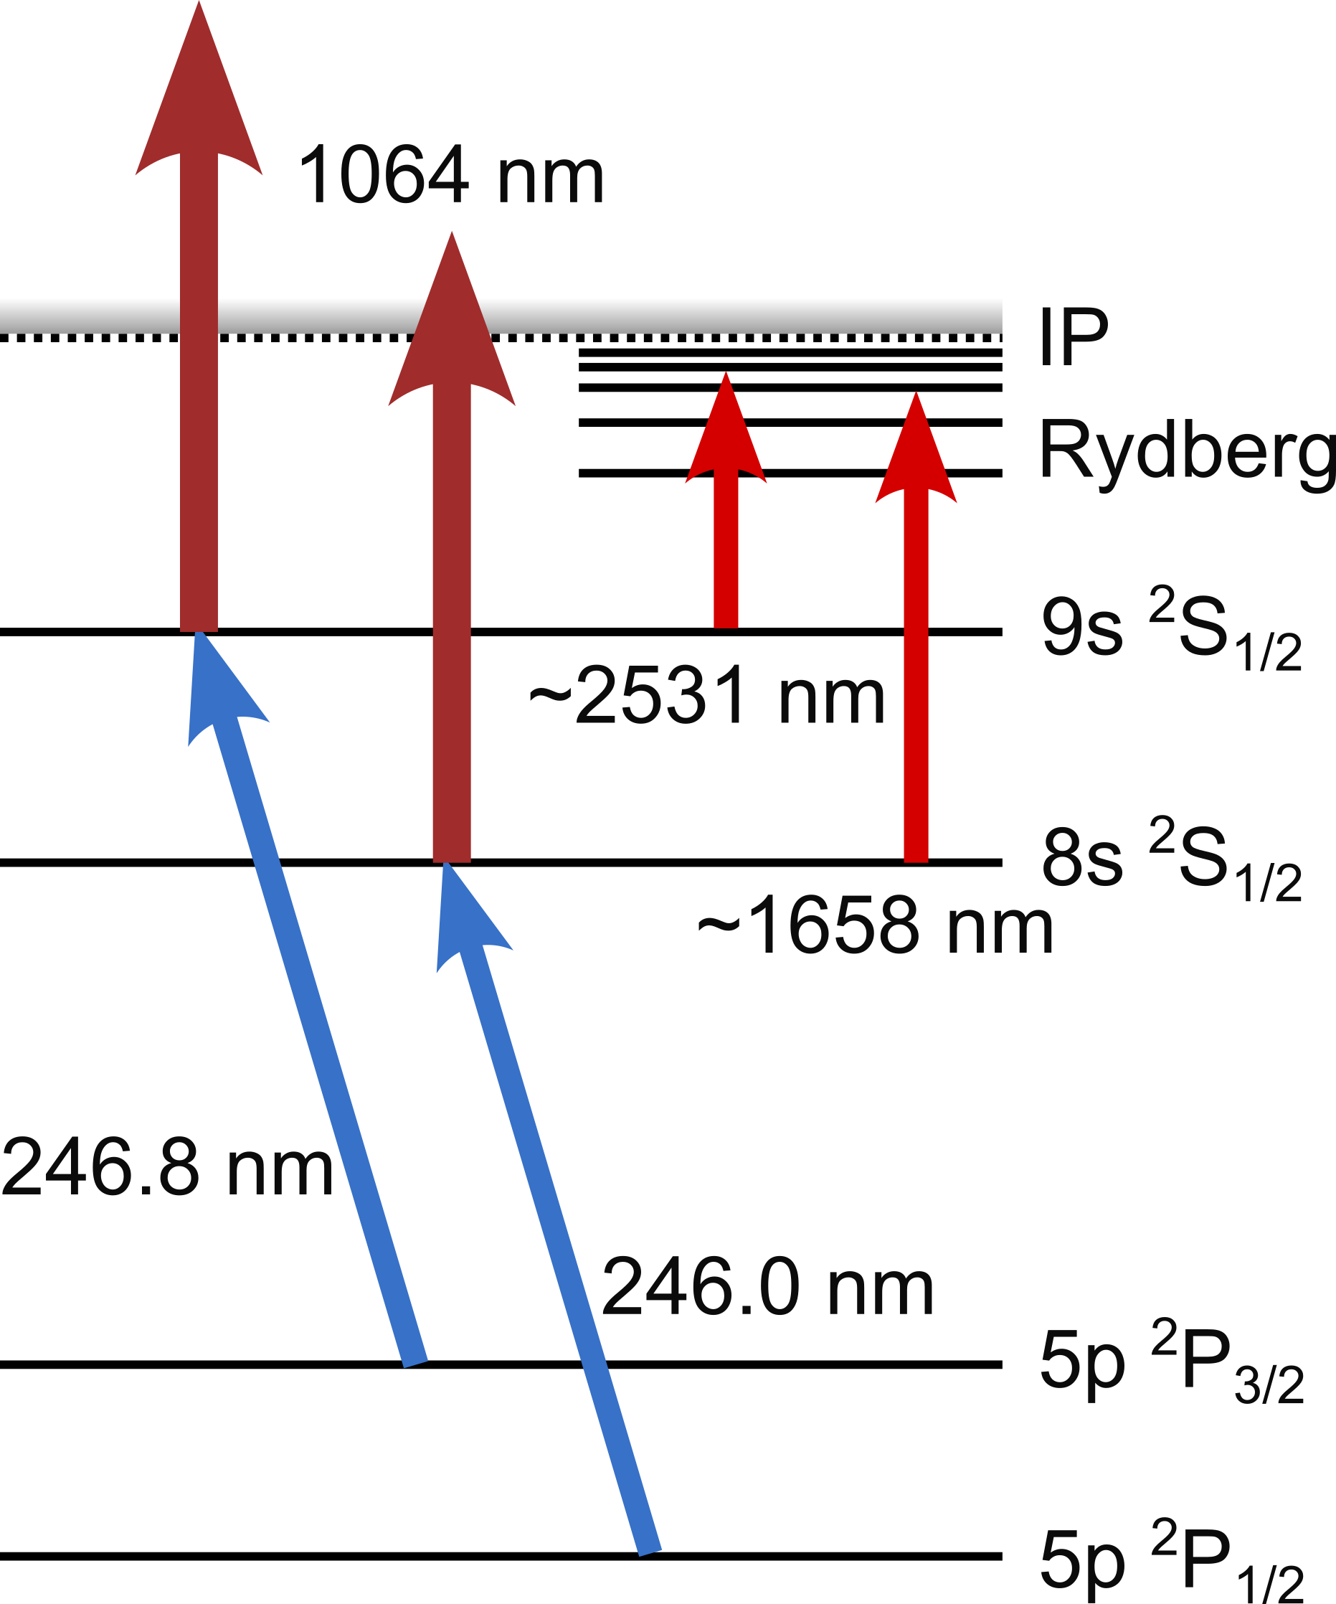
Limitations in previous runs
Increasing background from long-lived contaminants decay on magnetof
→ FIU? + Tape station for suppression
Resonant background observed
Suspected to come from 1064nm step
⁹⁹In
⁸⁰Sr
3.11 s
106.3 m
Molybdenum contamination from target
C. Ricketts, PhD thesis (2021).

Slide 9
Wavelength scanner
New wavelength scanner
Working well, no issues
Constant scanning on proton impact
Used extensively throughout campaign
Will be useful for many more runs to come after LS
Tanks Carlos!

Slide 10
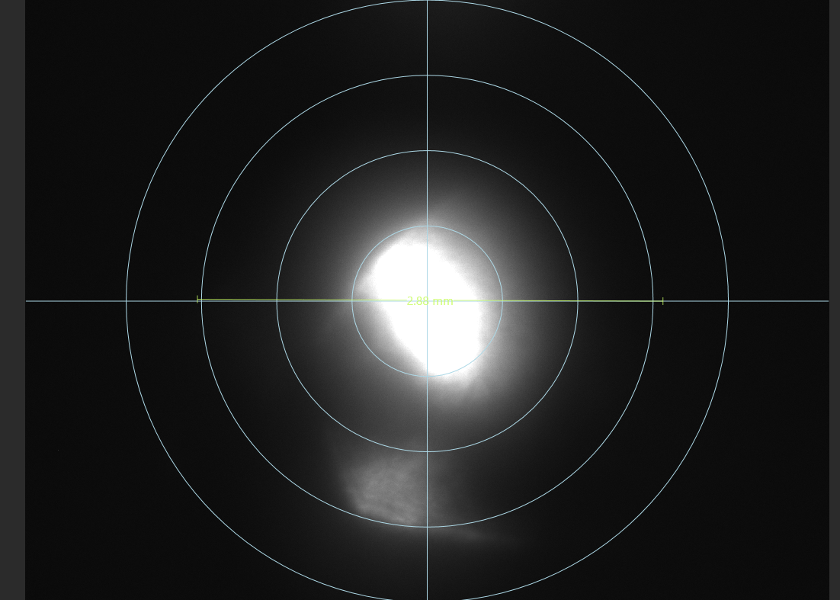
Laser reference system
Monitoring systems installed to observe the beams stability over the run
Good traceability of laser position and power
Camera checking back-reflection stability
Photodiodes to monitor timing on the pico-scope
Laser adjustment after optimization done very easy
Change of transition within few minutes

Slide 11
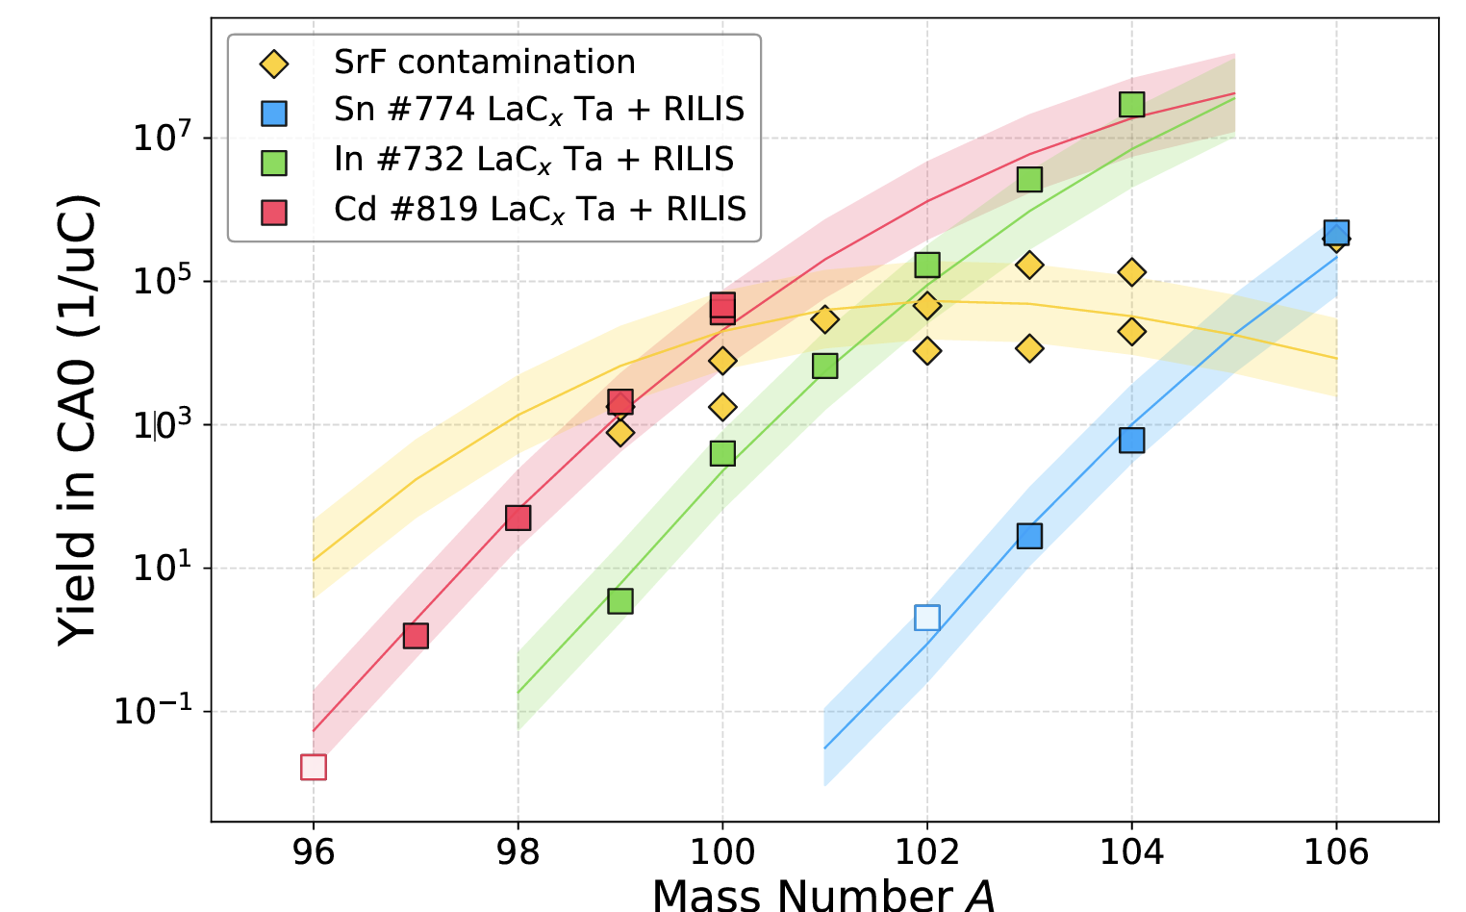
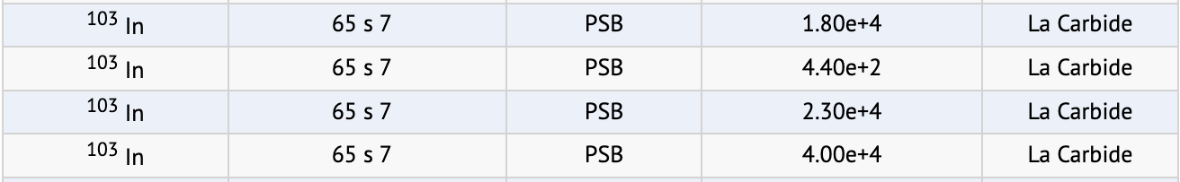
Start-up of run
Proton scan/yield checks on Tuesday 16/09
Only 1D scan on 26Na done
Optimization of transmission to Tapestation
Yield: 6.4E4/uC
Yield found lower than expected
Optimization of target/ion source using 102In
Ion source heated/target cooled: total beam found at 100nA for opt.

Slide 12
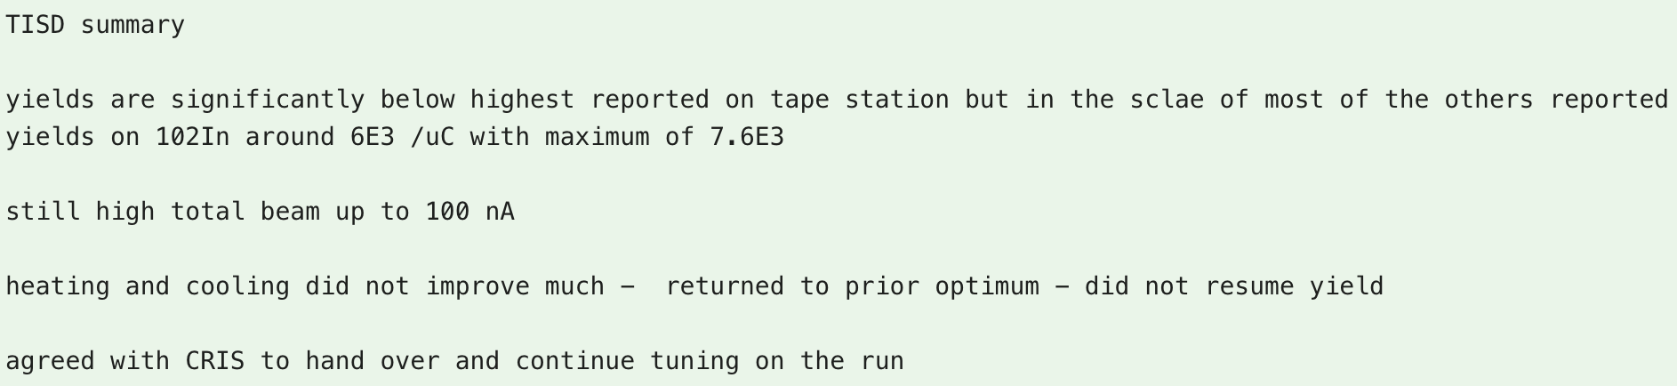
Start-up of run
Proton scan/yield checks on Tuesday 16/09
Only 1D scan on 26Na done
Optimization of transmission to Tapestation
Yield: 6.4E4/uC
Yield found lower than expected
Optimization of target/ion source using 102In
Ion source heated/target cooled: total beam found at 100nA for opt.

Slide 13
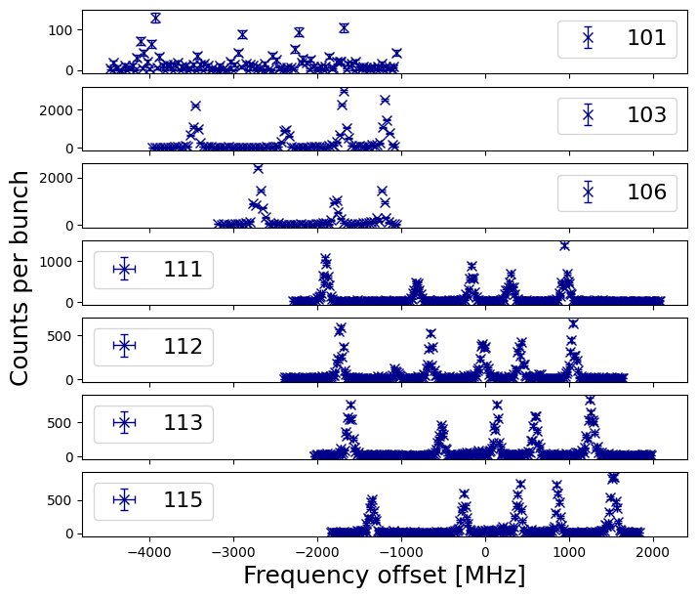
Reference scans of literature data
Yield > 8x lower
Wednesday 17/09
DSS comm. case
NEW!
Efficiencies of
1/100 in bb
1/500 in nb (<70 MHz!)
Reference

Slide 14
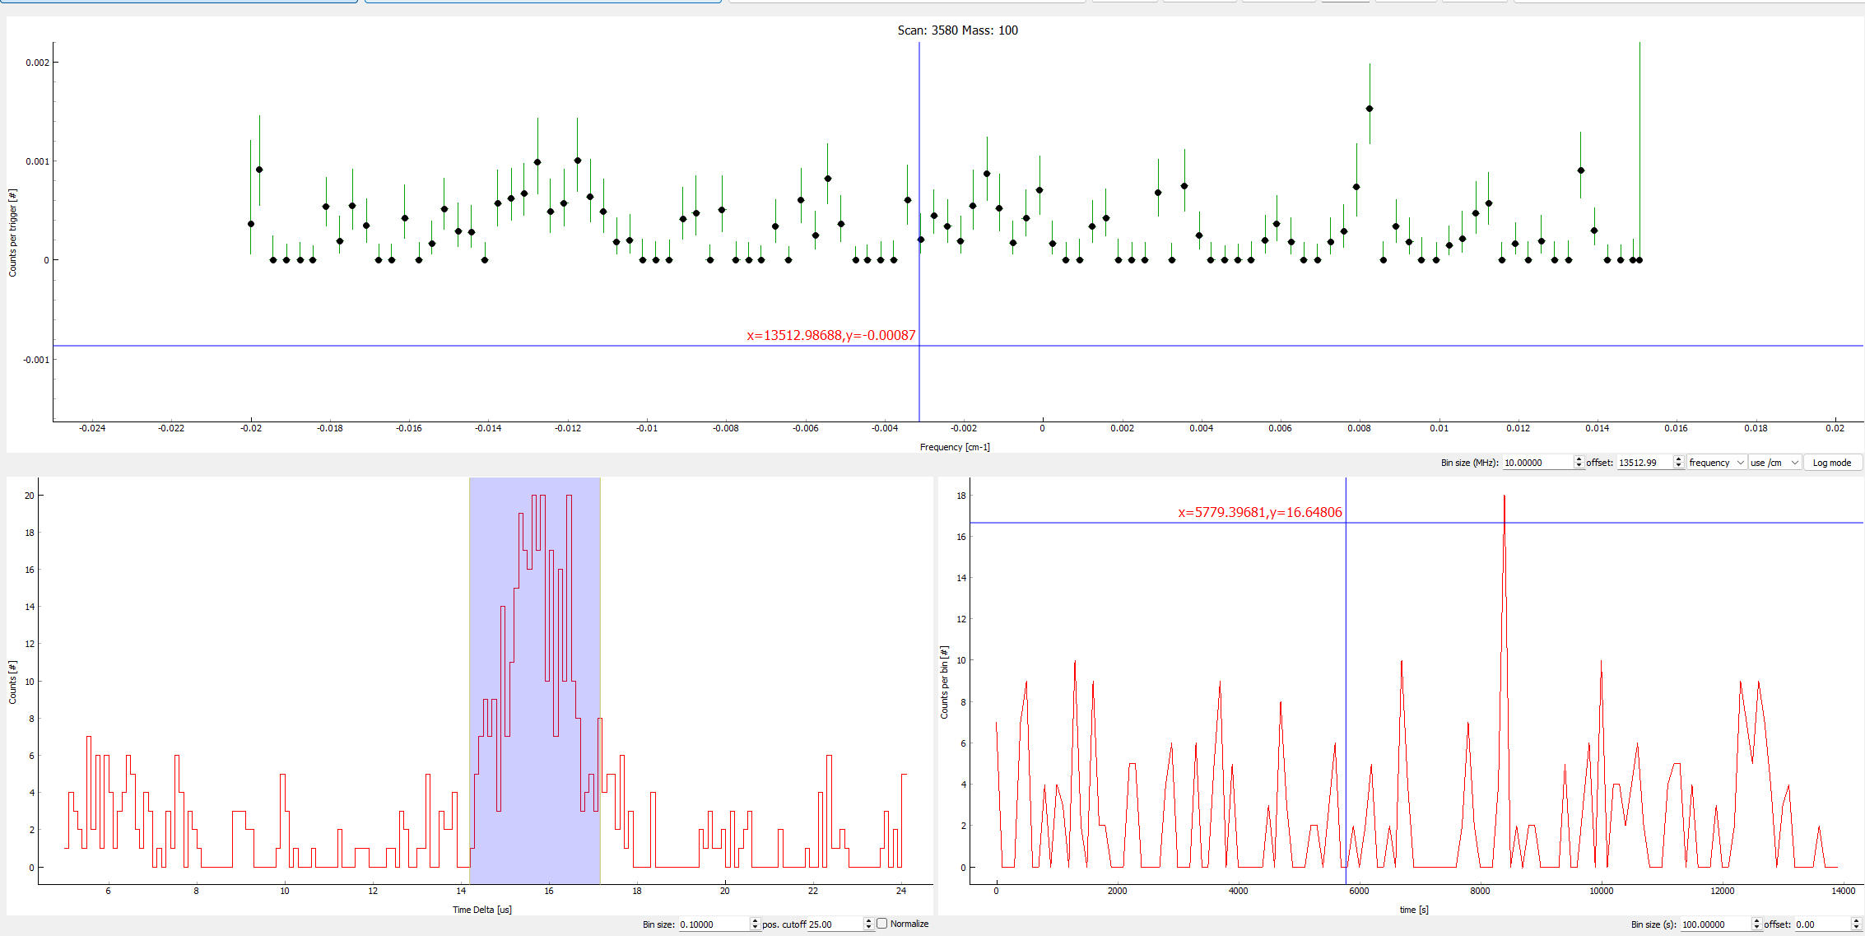
Scans of 100In, no hardware p-gating
Hints of peaks where they were expected
Scanned only the left peak a few times to confirm, seemed persistent

Slide 15
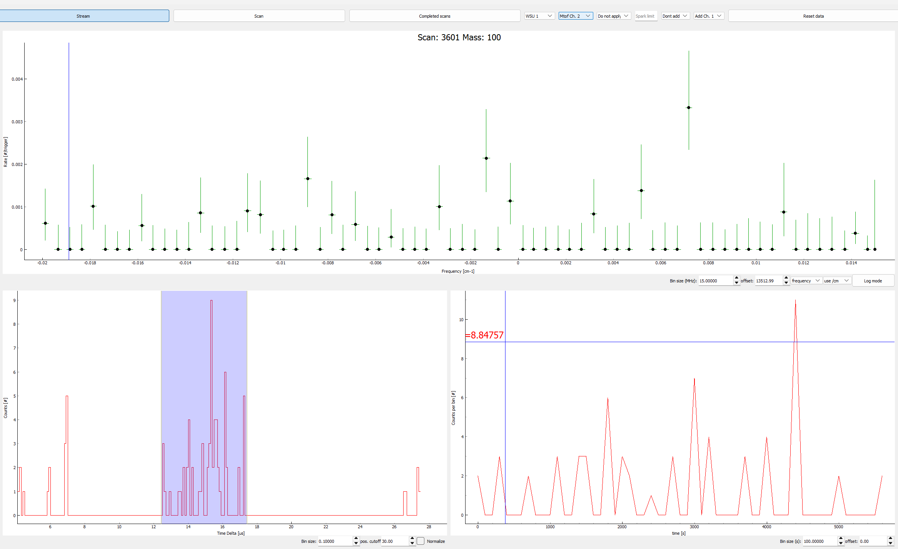
Background dependent on supercycle
One swipe only
Background despite hardware p gating high
-> LHC filling, many consecutive pulses to HRS
In: fast release
SrF: slow, basically constant

Slide 16
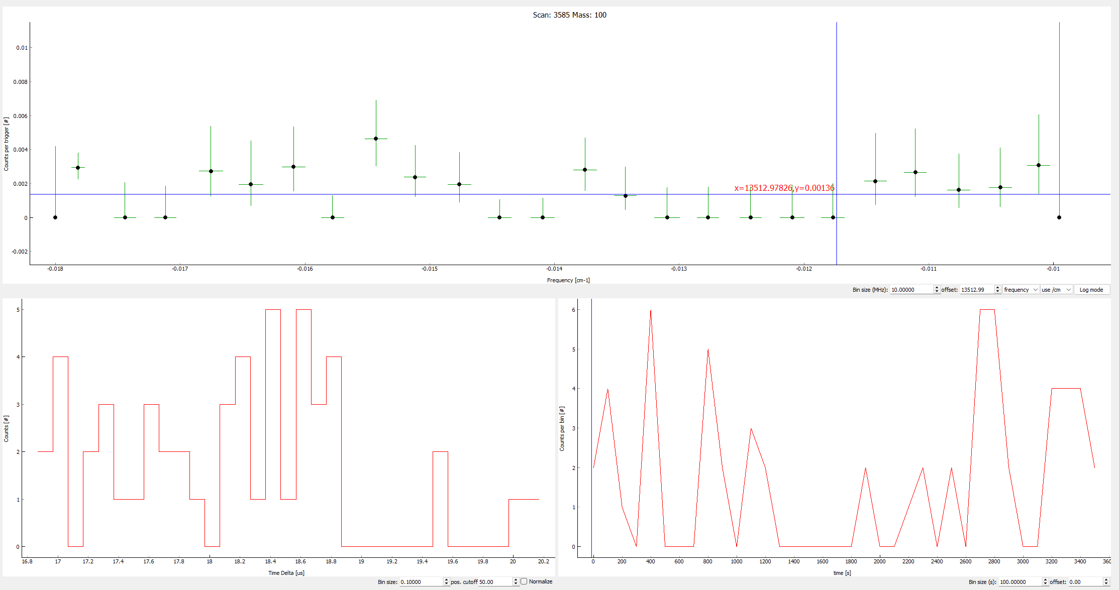
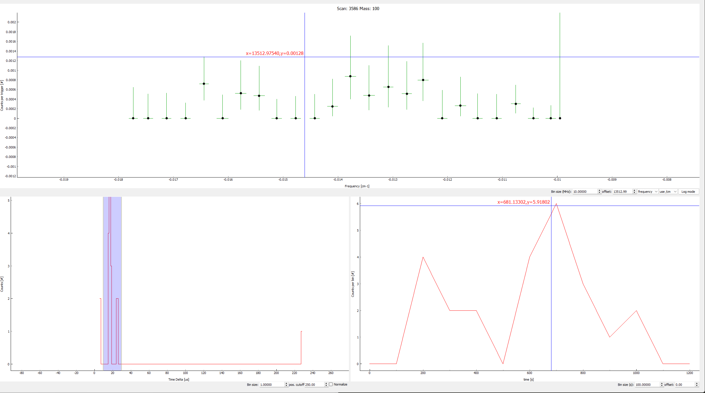
Things we tried…
Collisional background? Reduction on Microtof?
Same noise as on magnetof, but 2x less ions
Laser background? 1064 contribution?
Move 1064 in time BEFORE the UV step, scanning region around first peak

Slide 17
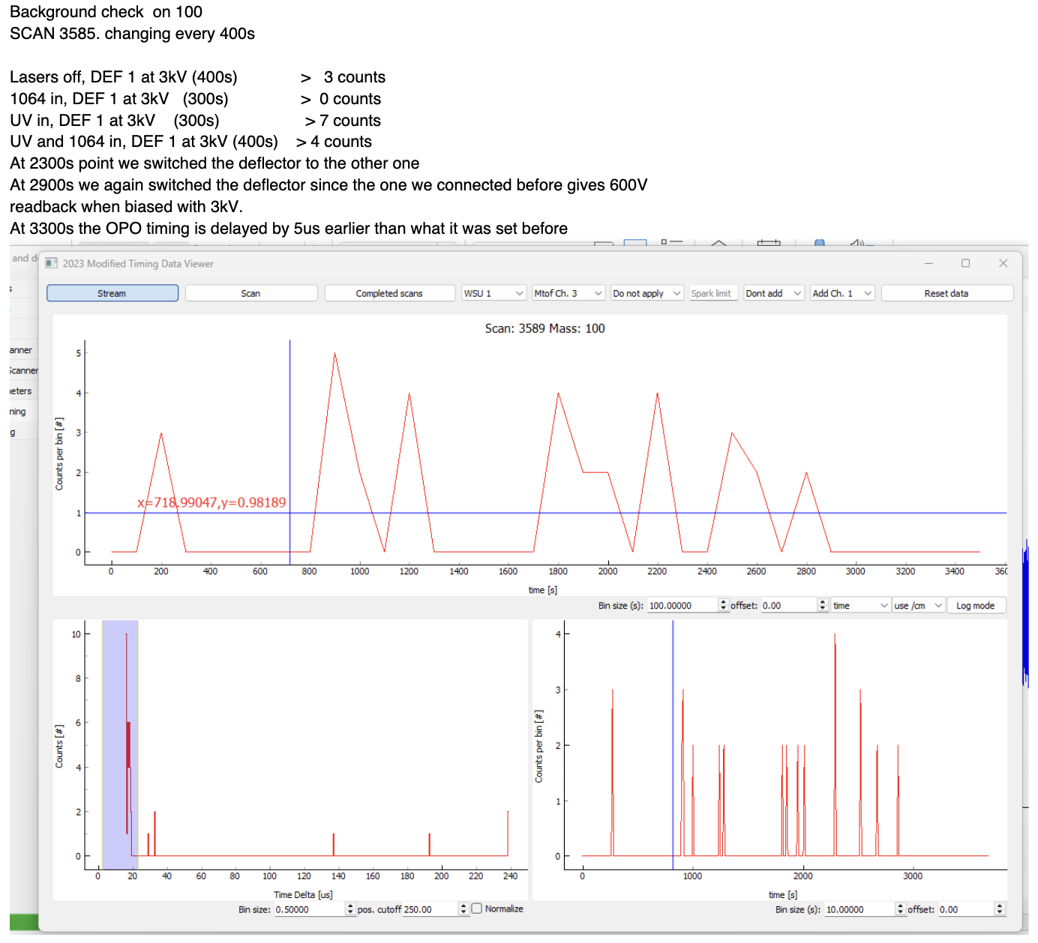
Things we tried:
The Jordan scheme:
Tried to set OPO to 340nm 4.5us earlier in time, overlapped with In scheme (path was set up in preparation)
Idea: ionize and deflect SrF directly after the CEC
Risk to enhance SrF if happening too late/after Defl

Slide 18
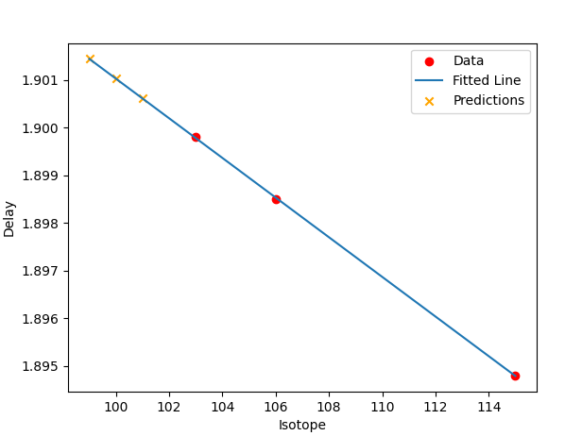
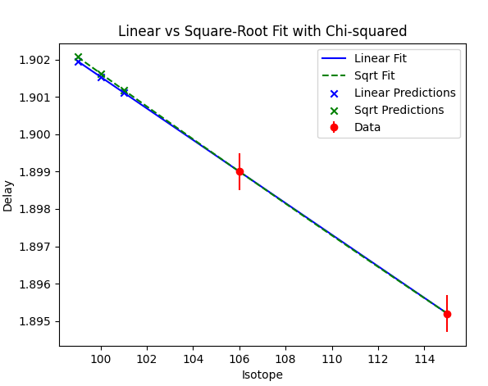
Things we tried…
Going through all isotopes well produced and tune iscool timing on signal rate – linear fit to guess optimal delays for exotic cases
And tried it again 2 days later
All consistent, not much change considering the bunch width

Slide 19
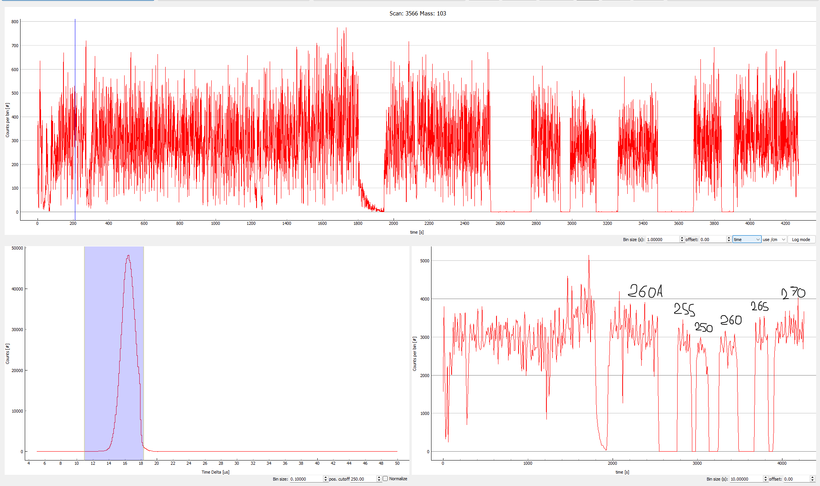
Optimization of target/line
Cooling line decreased yield, heating the line brought it back
Target temp. decreased slightly, no change
Later: also p spot moved and optimized on CRIS signal, later moved back (no change/maybe worse?)

Slide 20
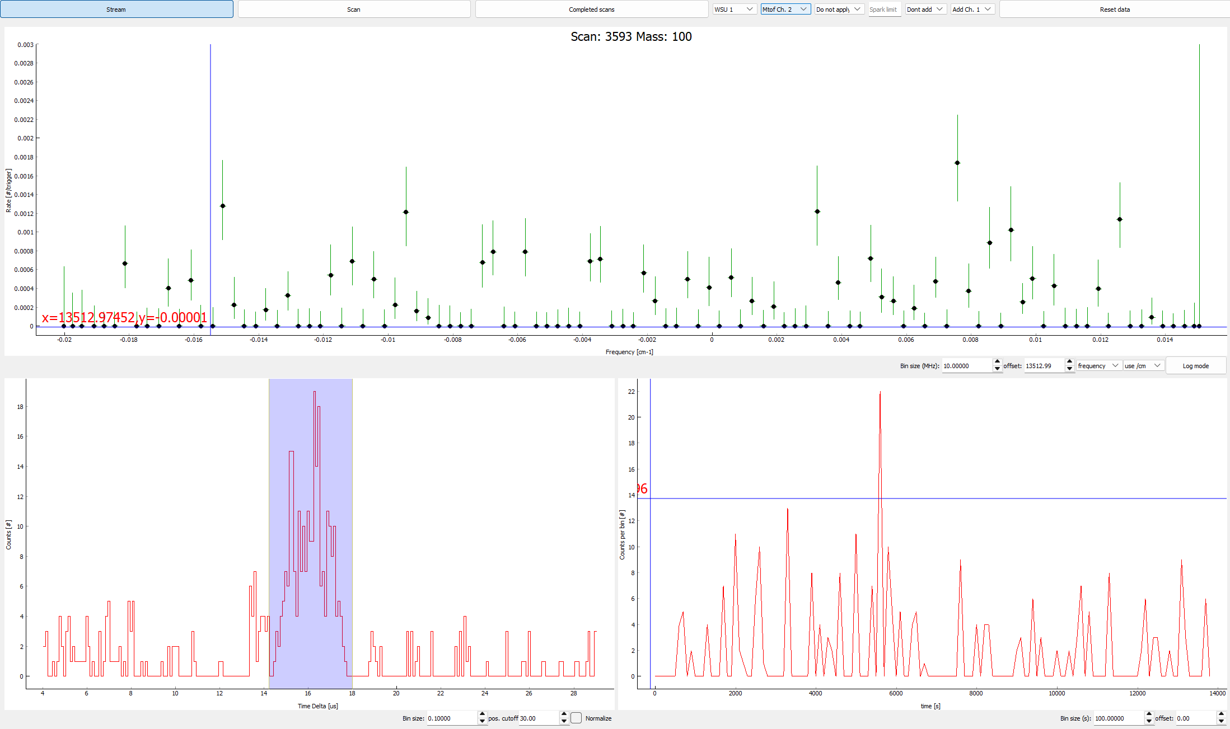
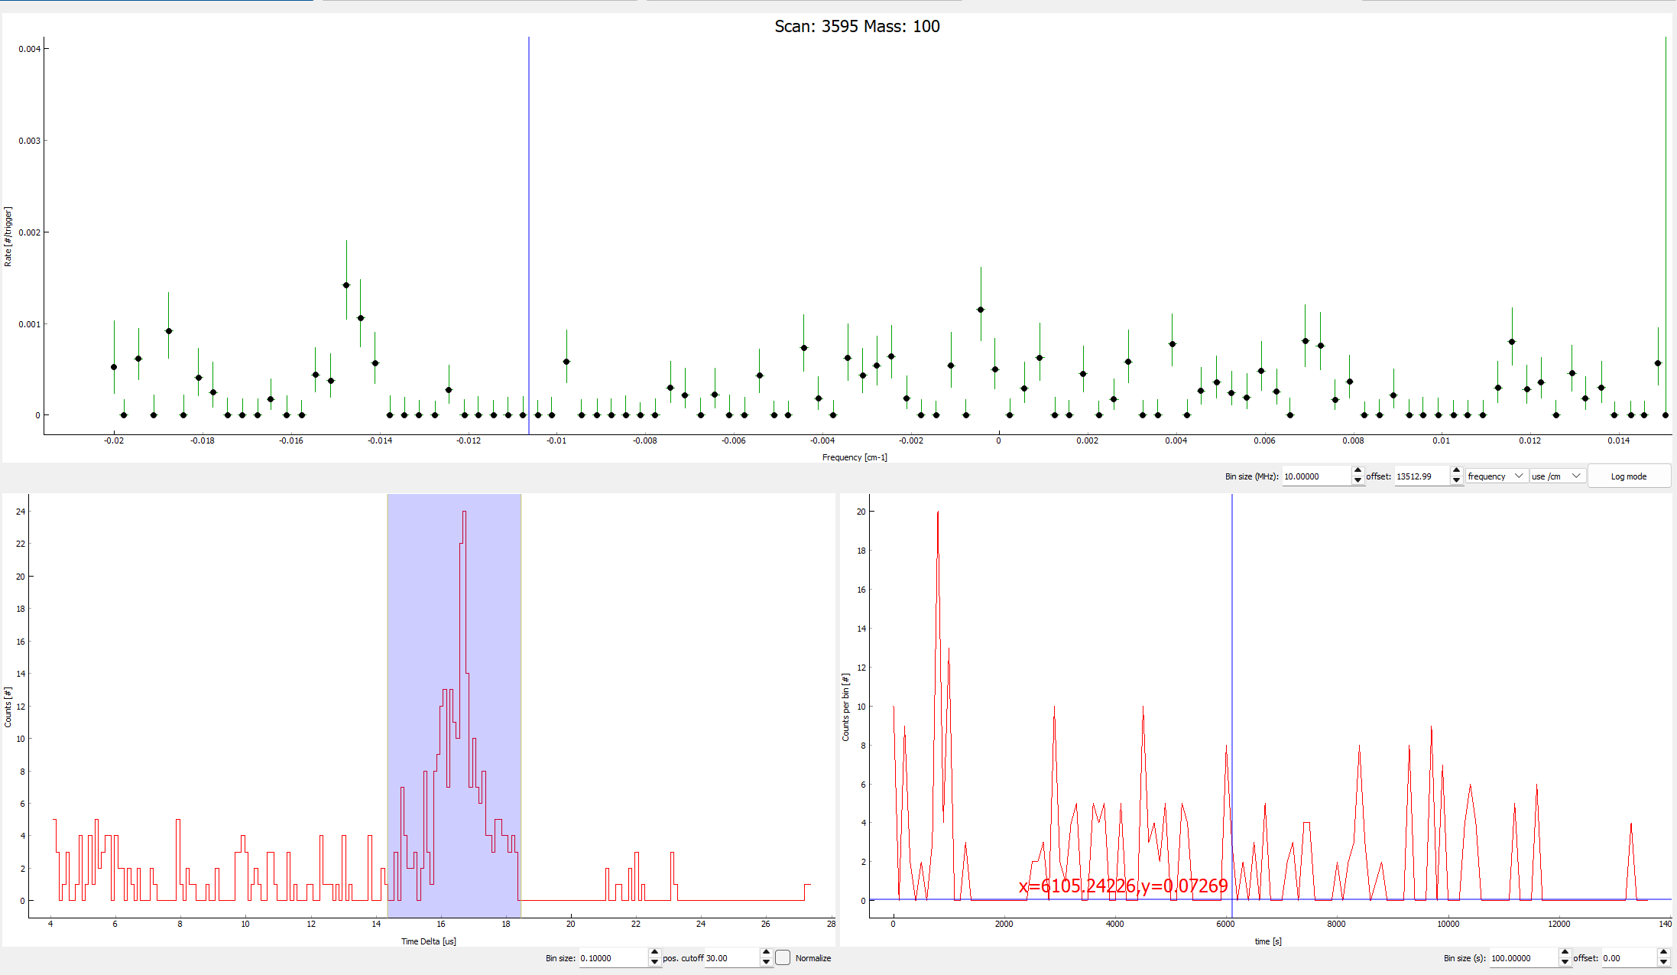
Sometimes… and sometimes…
Night 20/09
Morning 21/09
Software gating code at this point not yet reliably working
Decided for hardware p-gating – need to make decision, not to loose time

Slide 21
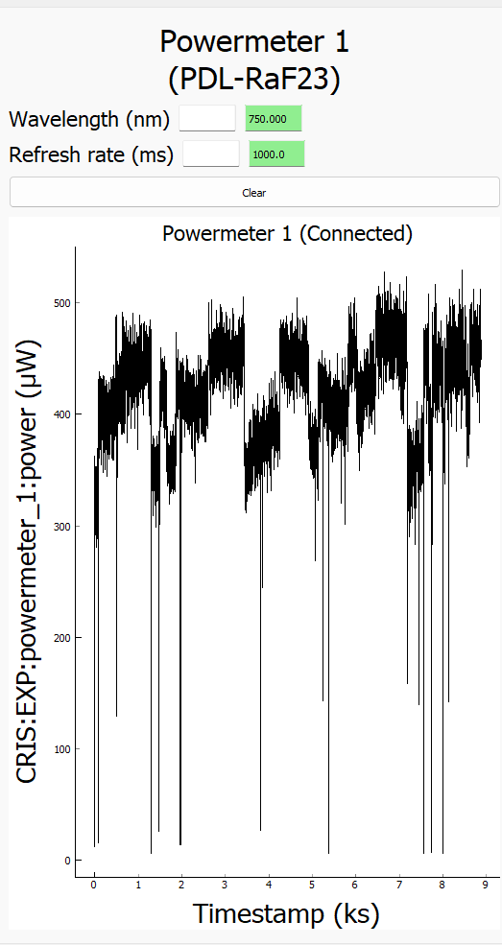
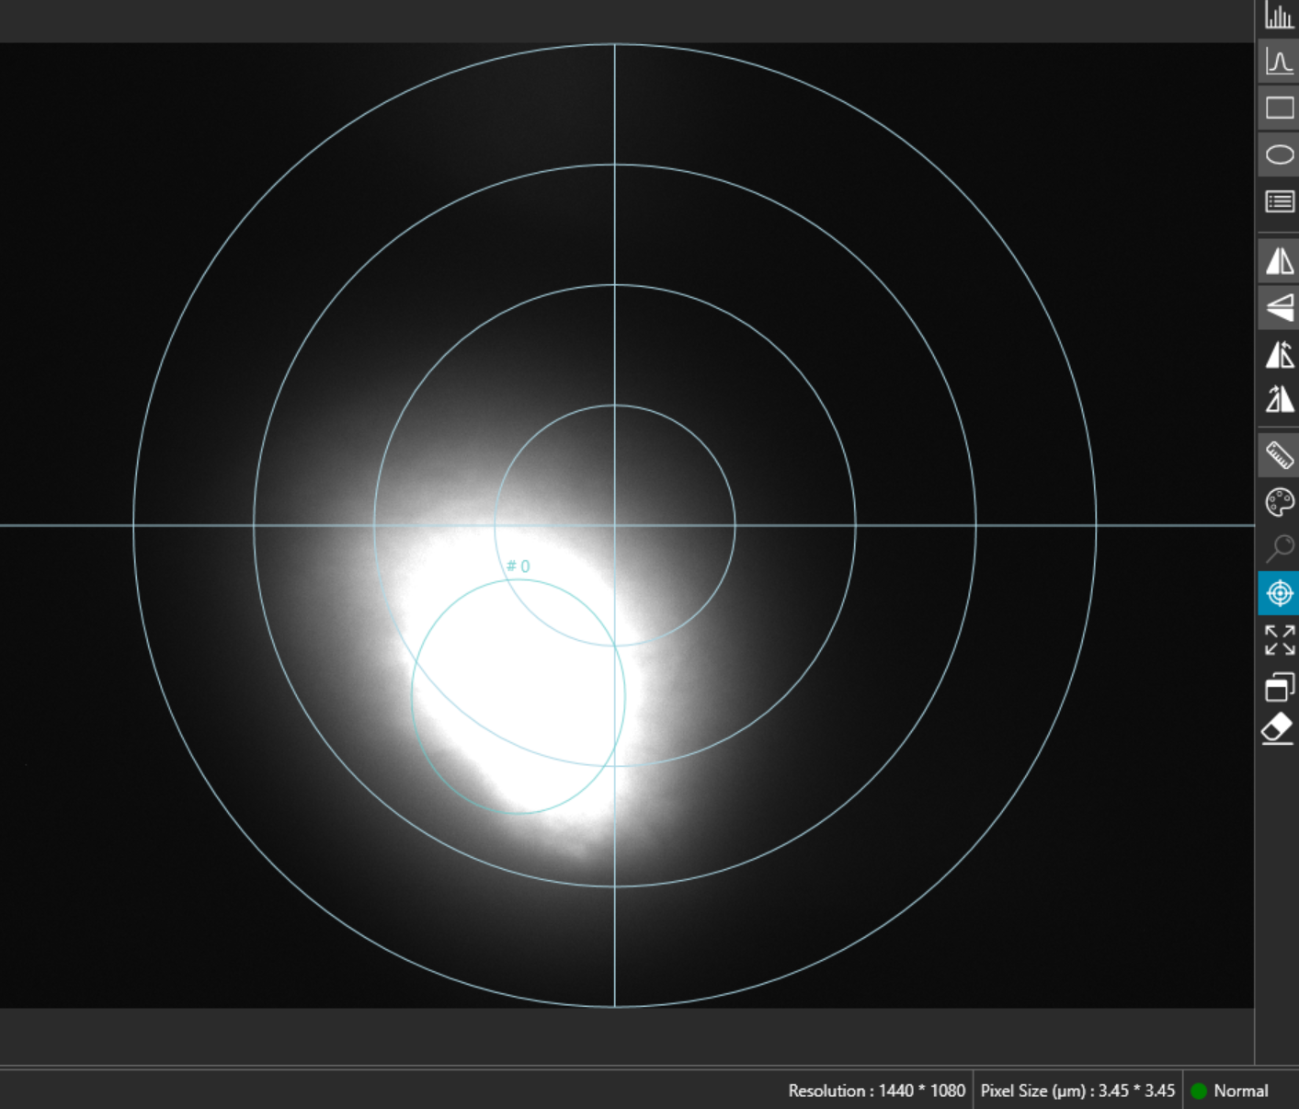
Laser steering/ hysteresis in laser scanning?
Laser slightly moving?
Change in power meter pick up read-back?
Suspicion: laser not the same when going up or down → voltage scanning

Slide 22
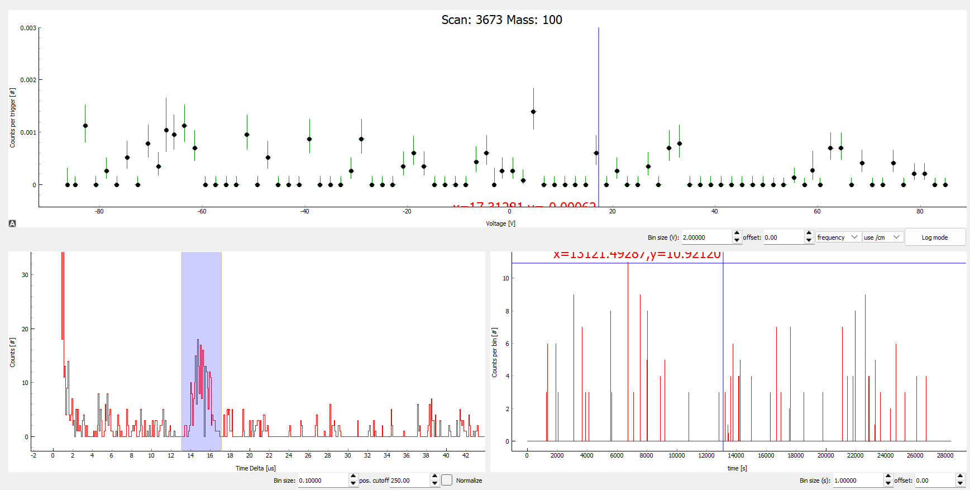
Last night: all accumulated spectra

Slide 23
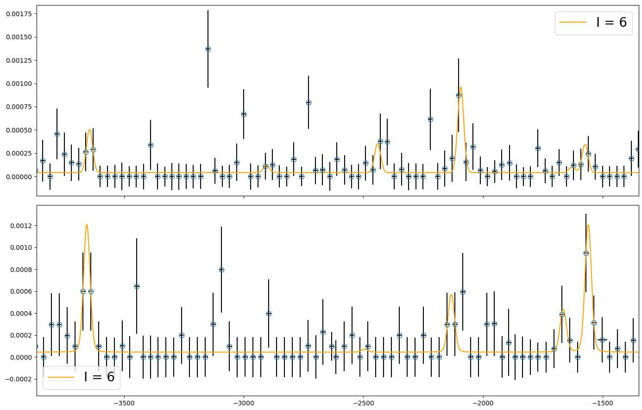
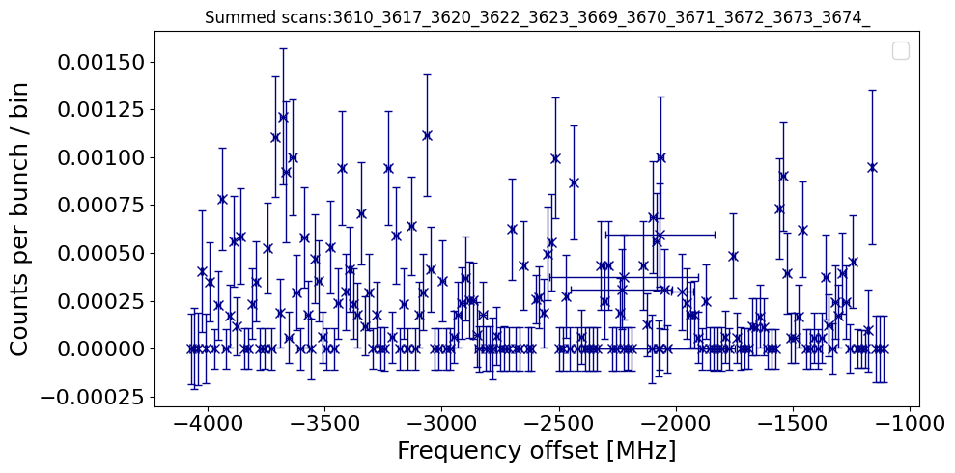
100In a quick sneak peak
Voltage scans only
Hardware p-gating: blind tagger after 1.1s
Booster: tried to stick to our desired pulse sequence
Saw during run a correlation between more background and too many pulses back-to-back
In-depth event by event analysis required – on it
Eyeballing scaling up rate on ”peak”: 0.05/s → 35 ions/s produced
>10x lower yield than expected

Slide 24
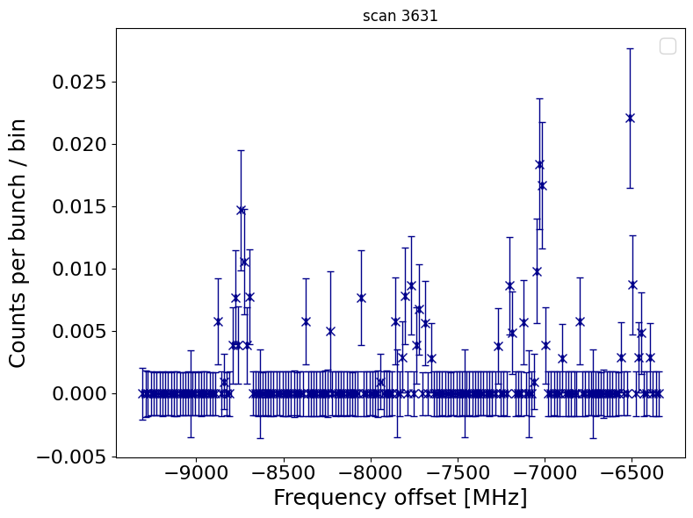
Back to 101In before/after p were gone
Single swipe!
60000pps of contaminants on cup, likely SrF
Yield: 400-500
Expected >6600

Slide 25
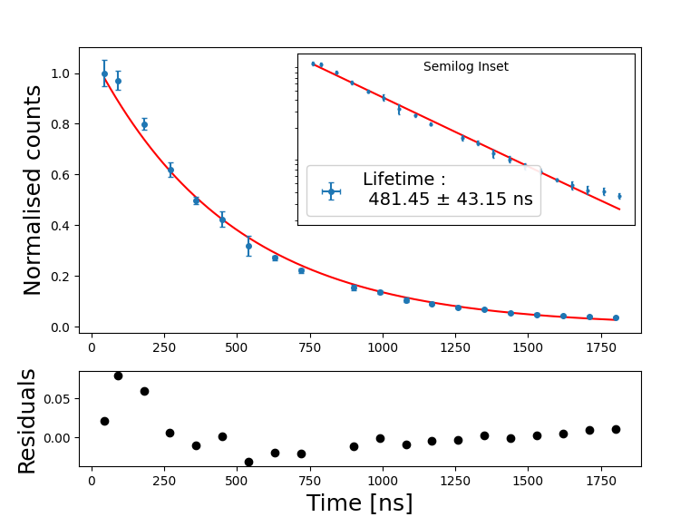
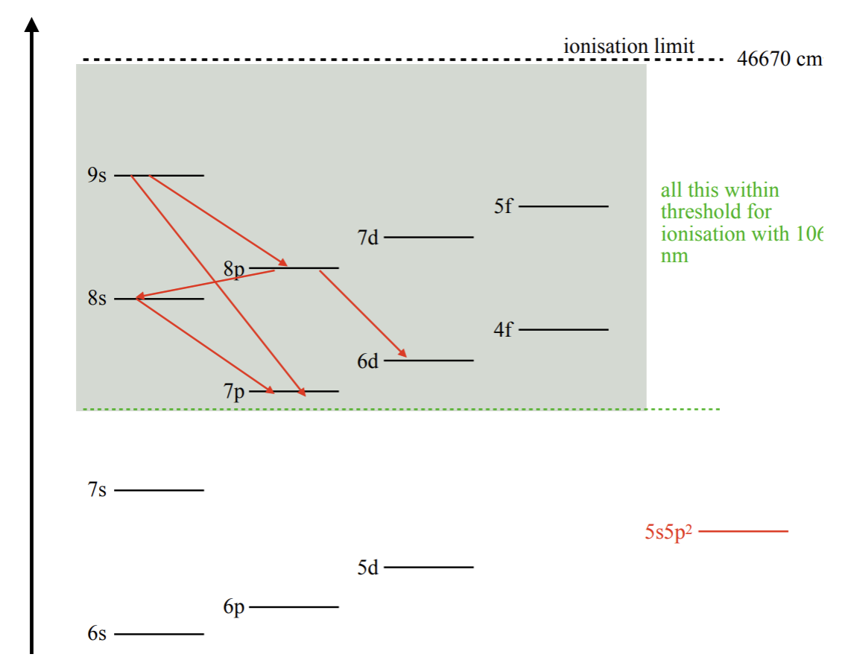
Use time during target change

Slide 26
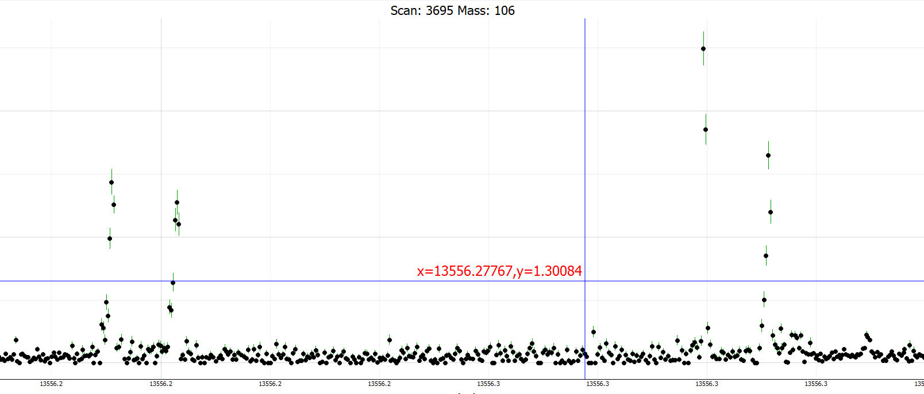
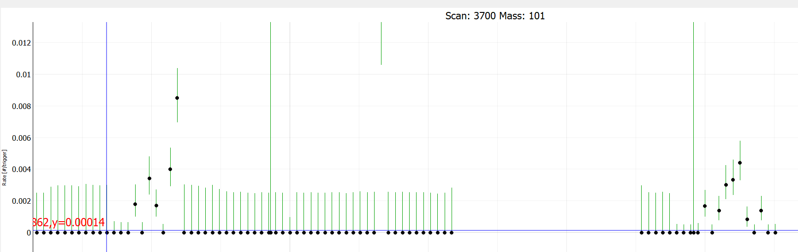
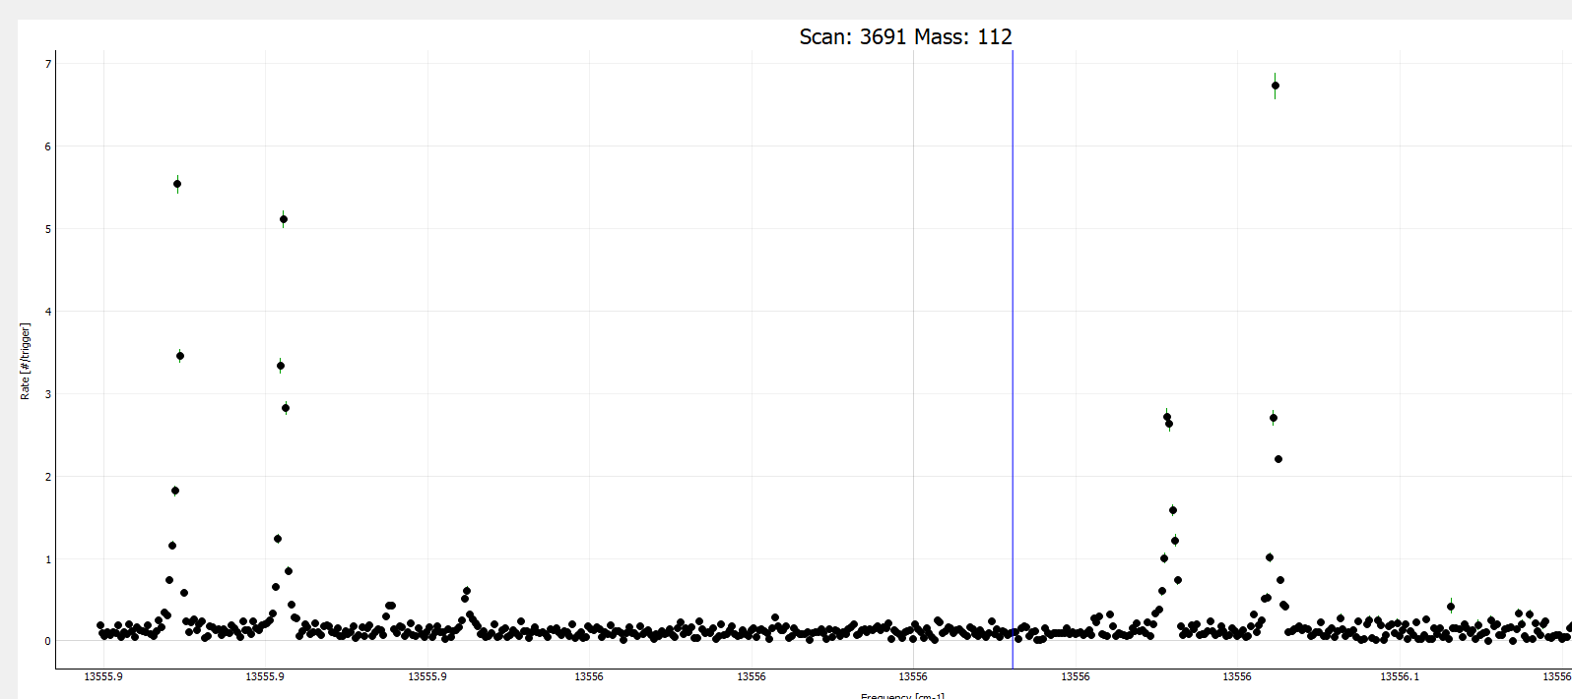
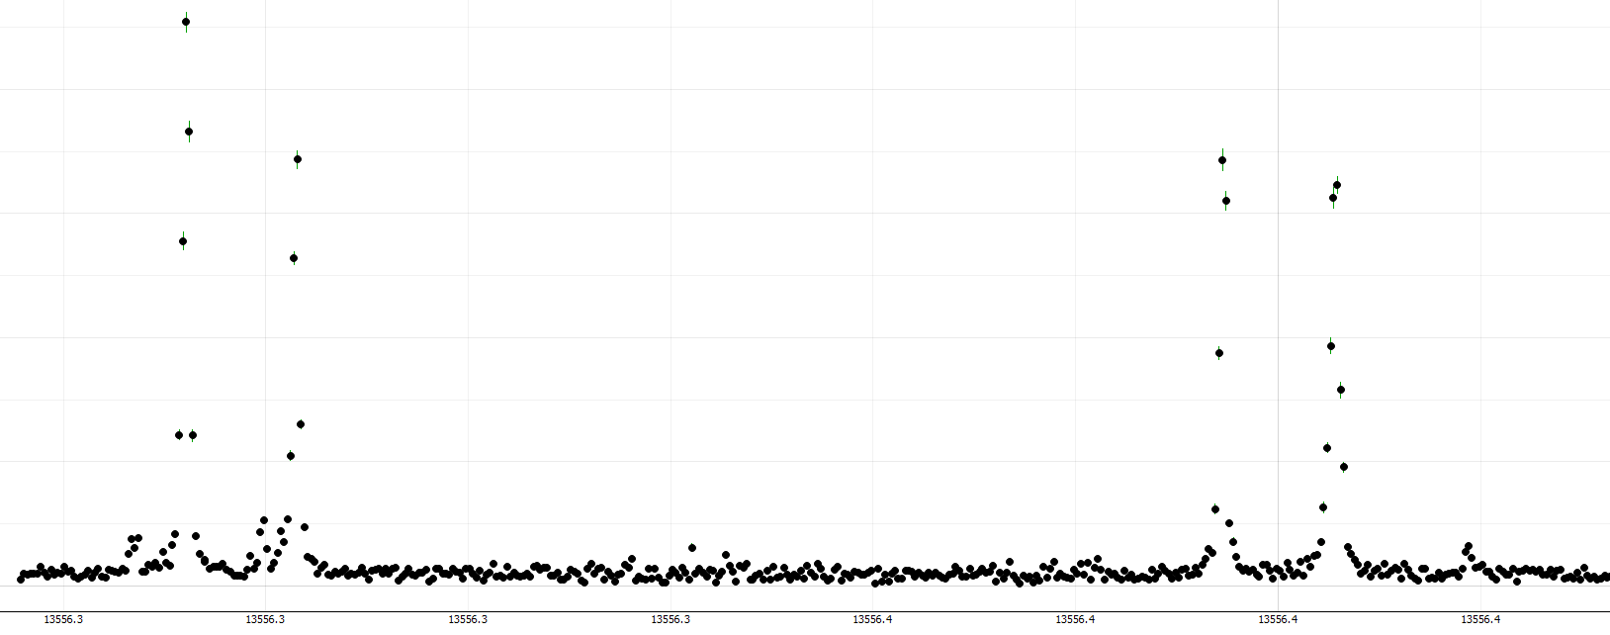
Reference scans
¹⁰⁶In
DSS comm. case
Tuesday 23/09:
Weaker transition, far from saturation, eff. 2x lower
¹¹⁵In
¹⁰¹In left side
¹¹³In
Measured again
¹¹⁸In
Measured again
¹¹²In
NEW!
¹⁰⁴In DSS decay case ^{104m}In

Slide 27
Limitations in previous runs
Only for 103 opt a problem for few hours
Background from UV
(RILIS and CRIS)
Increasing background from long-lived contaminants decay on magnetof
Resonant background observed
Suspected to come from 1064nm step
Molybdenum contamination from target

Slide 28
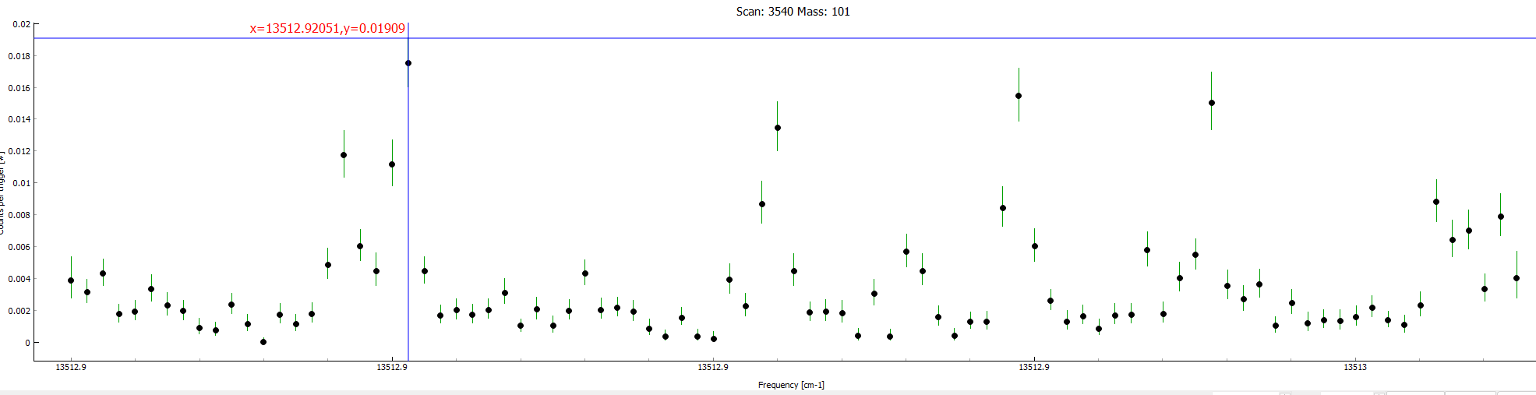
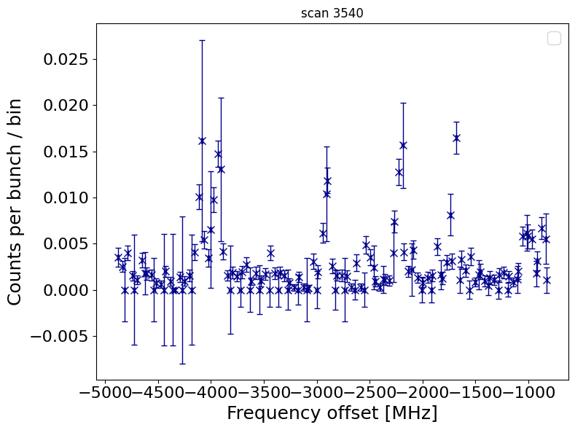
Limitations in previous runs
Resonant background observed
Suspected to come from 1064nm step
Molybdenum contamination from target

Slide 29
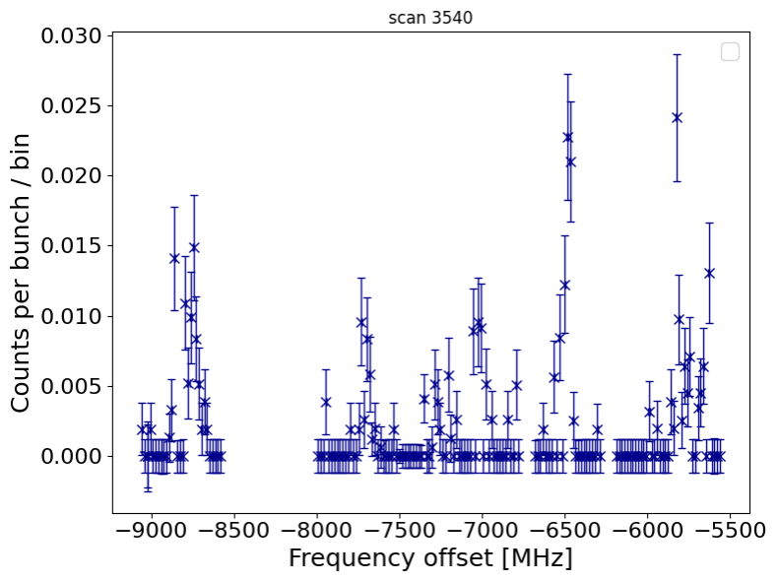
Limitations in previous runs
Background from UV
(RILIS and CRIS)
Resonant background observed
Suspected to come from 1064nm step
After hardware p-gating and supercycle control
Molybdenum contamination from target

Slide 30
Outlook – what’s next
Going through all data,
voltage and laser scans
– event by event
Software gating of p-pulses with timber data
Software gating of supercycle irregularities
Gating of laser power fluctuations / loosing lock
Gating of observed double counting
¹¹²In to be added to odd-odd charge radii paper (David / Kara)
Analysis of decay data for DSS commissioning (Simone)

Slide 31
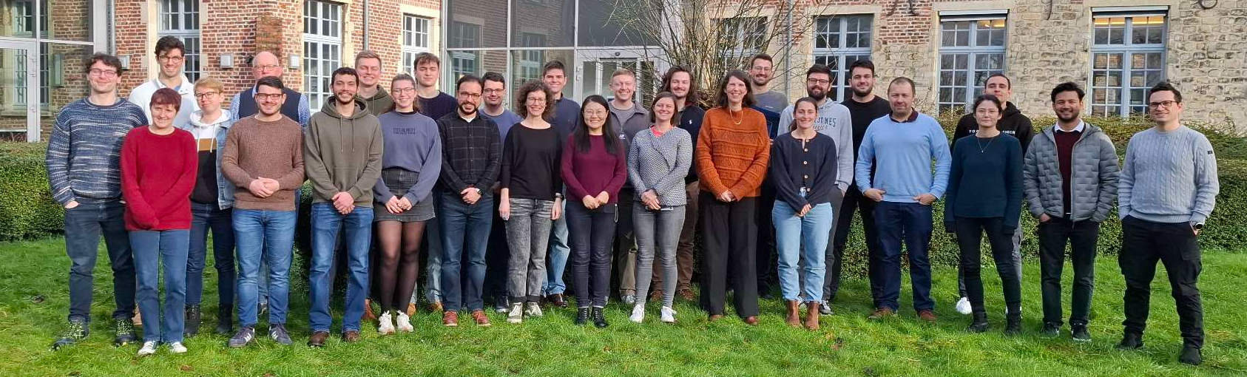







Acknowledgments
CRIS collaboration

Slide 32
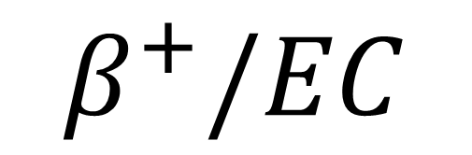
¹⁰⁶In
We produce indium to measure cadmium!
$$β^{+}/EC$$
¹⁰⁶Cd
Notes:
Shifting topic from the laser spectroscopy: in this part of the experiment we do not explore the structure of indium further, we study the structure of its beta-decay daughter: cadmium.

Slide 33
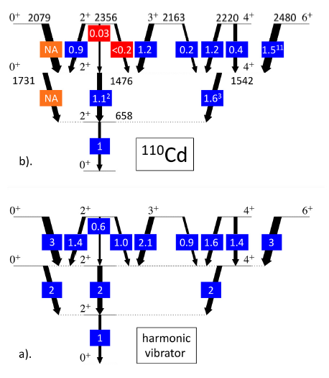
Structure of cadmium
Excitation energies:
quadrupole vibrational structure
B(E2) values disagree
What can explain this abundance of excited states with low-spin?
D. Denkins, J. Wood, Nuclear Data, IOP 2023

Slide 34
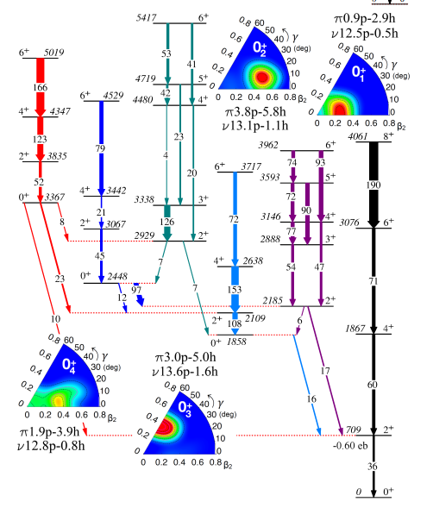
Structure of cadmium
Beyond mean field calculations and experimental values suggest multiple shape coexistence in ^{110,112,114}Cd
Do nuclear low-energy vibrations exist at all?
Traces of shape coexistence:
  Presence of excited 0⁺ states
  Enhanced E2 transitions in-band
  Enhanced E0 transitions
  → Input from beta-decay studies
P. E. Garrett, T. R. Rodriguez, PRL 2019
Notes:
By re-arranging the level into a rotational-like structure (you see in this picture the arrangement in bands of states differing by 2 units of angular momentum, according to the B(E2) values), there is evidence of multiple shape coexistence in a rotational model. This relates to one of the fundamental questions in nuclear physics research: do vibrational states at low energy exist?

Slide 35
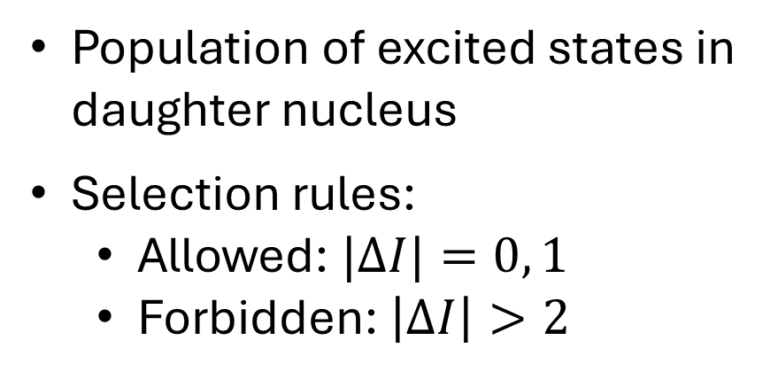
Beta decay
7⁺
0
6⁺
¹⁰⁶In
6⁺
Population of excited states in daughter nucleus
Selection rules:
  Allowed: $|ΔI|=0, 1$
  Forbidden: $\left|ΔI\right|>2$
…
4⁺
2⁺
0⁺
¹⁰⁶Cd

Slide 36
Beta decay spectroscopy
7⁺
1009,03 27,4
8,3 %
0
997,8 41,4
10,6 %
6.2 min
6⁺
¹⁰⁶In
Measure:
Gamma ray energies, intensities
Coincidences
Half-life
Deduce:
Excitation energies
Effective beta-feeding
Spin-parity (tentatively)
2502,92
6⁺
2491,72
(2)⁺
2347,43
…
861,1 90
4⁺
1493,59
632,6 100
2⁺
632,51
0⁺
0
¹⁰⁶Cd
Notes:
What can we measure? Gamma ray energies, intensities, coincidences → Level scheme, energy of the states, effective beta-feeding, tentative spin and parity assignments based on the selection rules.

Slide 37
The beta decay of ¹⁰⁶In
2⁺
28,6
5.2 min
7⁺
1009,03 27,4
8,3 %
0
997,8 41,4
10,6 %
6.2 min
6⁺
¹⁰⁶In
2502,92
6⁺
12,4 %
Isomeric state in ¹⁰⁶In
Beta-decay feeding inconsistent with the selection rules
  → Poor separation of the 2⁺ and the 7⁺
Many more states!
2491,72
1714,9 16,1
(2)⁺
2347,43
861,1 10
7,2 %
…
10 %
861,1 90
4⁺
1493,59
632,6 100
37,7 %
< 7 %
632,6 100
2⁺
632,51
0⁺
0
¹⁰⁶Cd
Notes:
The decay scheme of 106In is not quite simple and contains several inconsistencies. We think that previous studies could be affected by their isomeric purity.

Slide 38
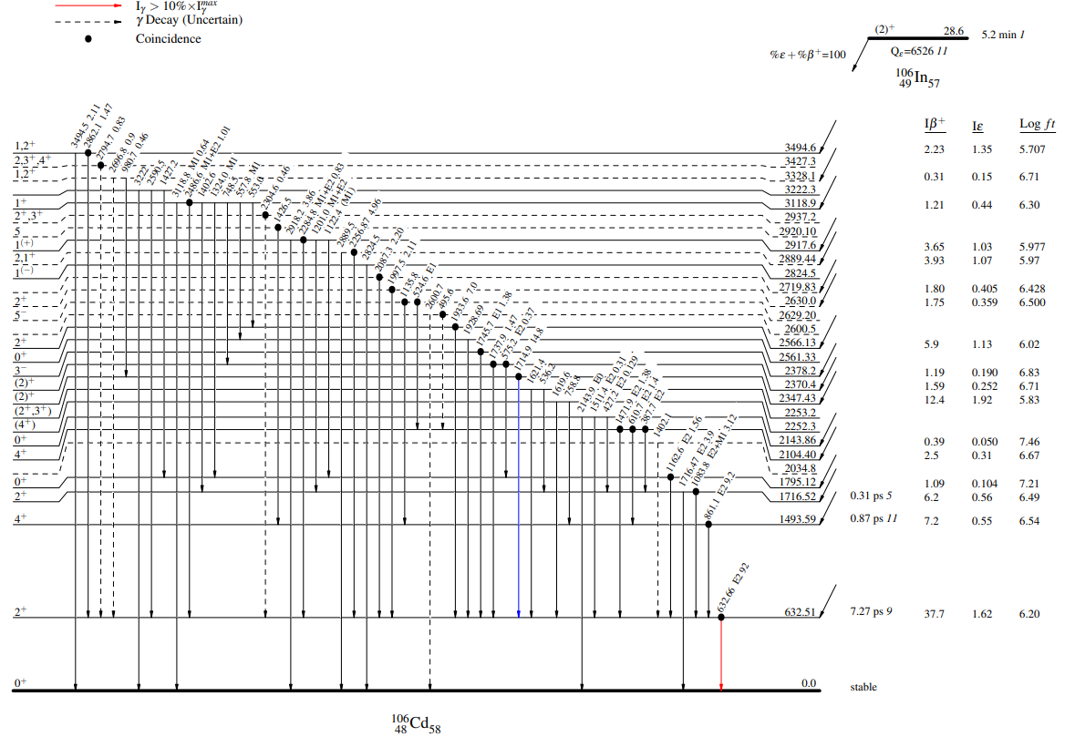
The beta decay of ¹⁰⁶In
Isomeric state in ¹⁰⁶In
Beta-decay feeding inconsistent with the selection rules
  → Poor separation of the 2⁺ and the 7⁺
Many more states!
Notes:
The decay scheme of 106In is not quite simple and contains several inconsistencies. We think that previous studies could be affected by their isomeric purity.

Slide 39
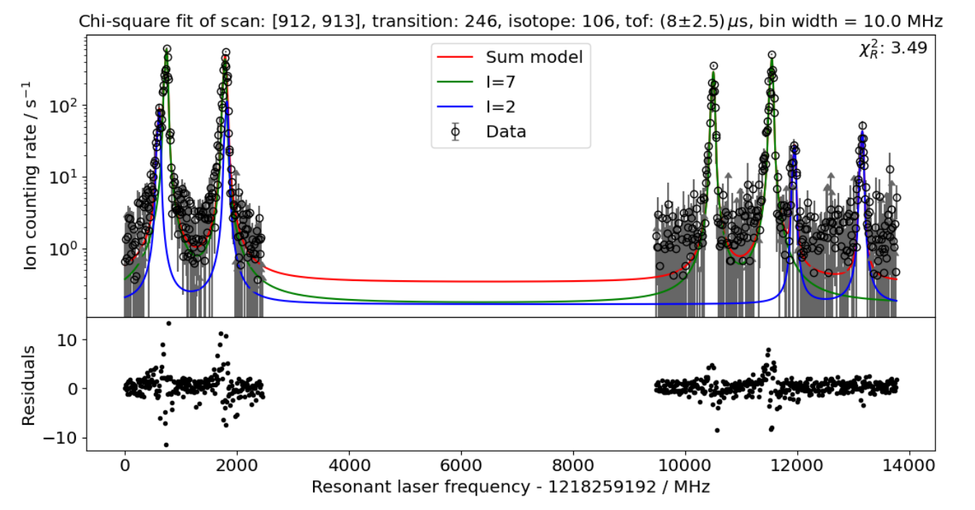
Why CRIS?
We can separate the two states by changing the laser frequency!
At this frequency, ions with spin I = 2 reach the end of CRIS
C. M. Ricketts, PhD thesis, 2021

Slide 40



Beta-decay spectroscopy at CRIS
Charge Exchange Cell
Ion dump
Interaction Region (10⁻¹⁰ mbar)
Lasers
ISCOOL
34º
IP
34º
MagneTOF
9s ²S_{1/2}
8s ²S_{1/2}
Tape station
246.0 nm
246.8 nm
Beta detector
High Resolution
Separator
5p ²P_{3/2}
5p ²P_{1/2}
Ion beam production and separation
Collinear laser ionization
Decay spectroscopy
Gamma detectors
Target (LaC_{x})
Protons 1.4 GeV, 2 μA
Decay Spectroscopy Station
Notes:
Most of you are already familiar with the first two parts of the experiment, which in fact remain the same, but for this study we combine CRIS with a decay spectroscopy station, which I am going to discuss in the next slide.

Slide 41
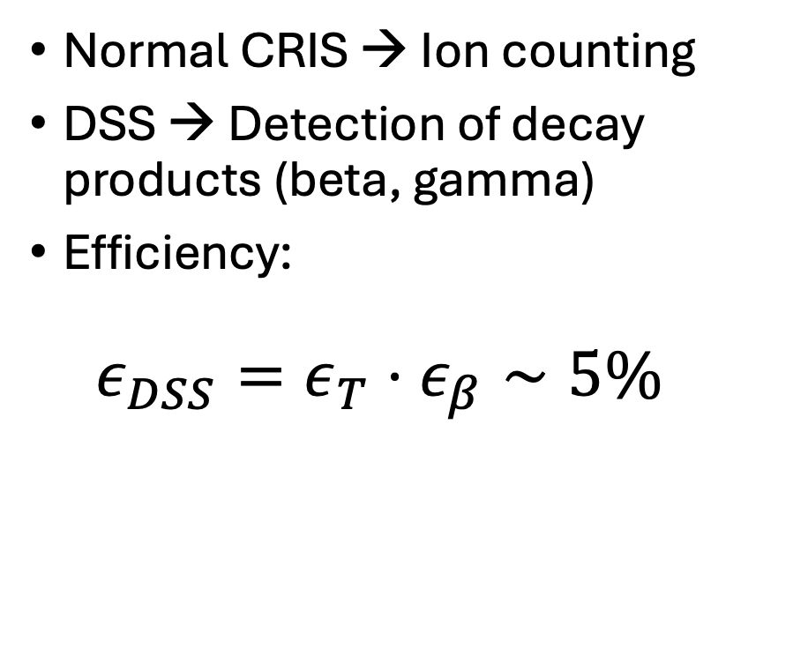
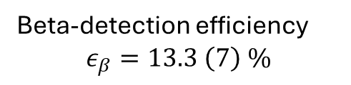

The DSS
Tape
Normal CRIS → Ion counting
DSS → Detection of decay products (beta, gamma)
Efficiency:
  $$ε_{DSS}=ε_{T}⋅ε_{β}∼5\%$$
MagneTOF
MicroTOF
SiPM
Ion beam
4 mm
Plastic scintillator
HPGe detectors
Beam transmission MagneTOF – tape
$$ε_{T}=38 \left(2\right) \%$$
Beta-detection efficiency
$$ε_{β}=13.3 \left(7\right) \%$$

Slide 42
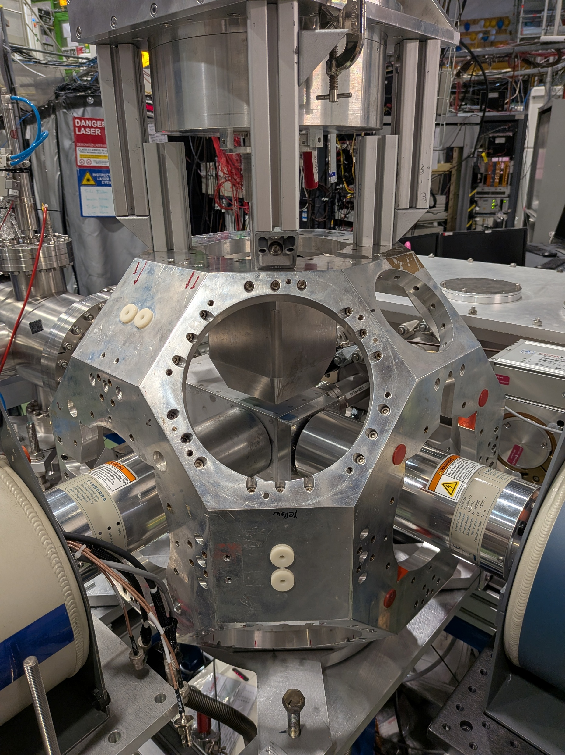
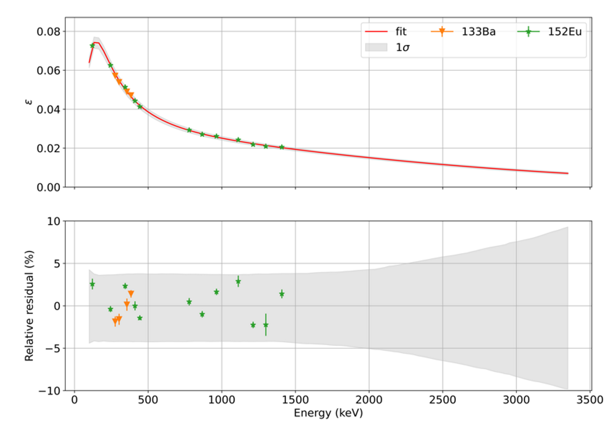
The DSS
Gamma detection efficiency:
M. Heines, detectorefficiency, 2025

Slide 43





The DSS for future users
CAEN DAQ + COMPASS software on pccris 32
Germanium detectors and scintillators from external supplier (e.g. IDS, Leuven…)
Detection chamber with beta/alpha detectors
Frame for germanium detectors
Tape system + tape controller (pccris 32) + manual in cris logbook

Slide 44



The experiment
2⁺
28.6 keV
5.2 (1) min
$$β^{+}/EC$$
7⁺
0.0 keV
6.2 (1) min
$$β^{+}/EC$$
¹⁰⁶In
Background
¹⁰⁶Cd
stable
Ion counts
Laser frequency (cm⁻¹)

Slide 45

The experiment

Slide 46

The experiment
Population of excited states with low spin

Slide 47


State purification
Laser off-resonance by ~400 MHz
Off-resonance is dominated by I = 7
On-resonance
(I = 2)
Off-resonance
(I = 7)
(I = 7)
Counts
Laser frequency (cm⁻¹)

Slide 48


Purity in gamma rays
Pure I = 2
Pure collisional ions (I = 7)
Relative gamma-ray intensities → Beta-decay feedings

Slide 49

Relative gamma-ray intensities

Slide 50
Relative gamma-ray intensities
Higher beam purity (~ 2 times)
Enhanced population of low-spin states

Slide 51

Relative gamma-ray intensities
Pointing towards a more accurate beta-feedings for forbidden transitions
$$ΔI=2$$
2⁺
Literature
7.2%
< 3%
By this work
4⁺
10%
3%
2⁺
0⁺

Slide 52

Summary and Outlook
Summary:
Beta decay spectroscopy on ^{106m,g}In
Commissioning the DSS: $ε_{DSS} \sim 5\%$
CRIS improves the beam purity by a factor 2 with respect to previous studies, suggesting more accurate beta-feedings
Outlook:
Analysis of coincidences, half-life, updated beta-feedings
Input for investigating shape coexistence in light Cd isotopes
Notes:
Re-adapt

Slide 53
Thank you!

Slide 54
Extra slides

Slide 55






Beam dynamics
Tape
MicroTOF
We measure $N_{β−γ}$ and $N_{γ}$
Transmission MicroTOF-tape:
  $ε_{T}=1 −{\frac{N_{γ}^{after tape}}{N_{γ}^{before tape}} }_{}^{}=76 (3) \%$
Beta-efficiency:
$ε_{β}=\frac{N_{β−γ}^{on−tape}}{N_{γ}^{on−tape}}≈ \frac{N_{β−γ}}{N_{γ}⋅ε_{T}}=13.6 \left(6\right)\%$
Ion beam
4 mm
Resonant ions
SiPM
Collisional ions
Plastic scintillator
$$N_{γ}^{after tape}$$
$$N_{γ}^{before tape}$$

Slide 56

Beta-efficiency
Simulations: $ε_{β}=68\%$
Measurements: $ε_{β}=13,6 \%$
Possible reasons:
  The gain was set too high on the signal and the detector was operating in saturation
  The beta-detector is not great

Slide 57




Catalin, for ISOLDE Fast Tapestation 2022
¹³³Ba
¹⁰⁶In
Low energy gammas (E_{γ}<400 keV)
Low energy gammas (E<400 keV)
Betas in saturation
Beta spectrum

Slide 58
¹⁰⁶In, I = 7
78 (4) %
¹⁰⁴In, I = 6
68 (6) %

Slide 59




Beta-decay spectroscopy of ^{106,104}In
Notes:
Here, show a picture of beta-gamma spectra of the different states compared to each other.

Slide 61

Start-up of run
Monday 15/09
Quick beamtune to CRIS, ISCOOL tuning
Periodic oscillations in combination of RILIS/MM
Less pronounced with MM off
Transmission stuck at 75%?
Tuesday: beamtune on 138Ba, 32% transmission unsuppressed (37% in Ar)

Slide 62

DSS first tests
Implant 106In for 15min until saturation is reached, let it decay
Meantime: back to 115 ref and back to scanning 100In
More from Simone later :)

Slide 63


Back to 101In before/after p were gone
Single swipe!
60000pps of contaminants on cup, likely SrF
Yield: 400-500
Expected >6600

Slide 64
After full round of optimization…
Very noisy/doubting
LHC filling, ISO_HRS got 5p pulses back to back
P-gating not working then, enhanced SrF contribution?

Slide 65

P positions on target
Proton scan on radiogenic 115 on CRIS signal
Maybe of 10% gain

Slide 66



Things we tried… DSS
Tried to sit in gs: 5s half life, beta- tagging
Increased beamgate: 40cps on microtof, 4 betas/s after tuning
Biggest problem: 0.5cps background→ too much for 100In

Slide 67


Challenge: low yields and large contamination
⁸⁰Sr¹⁹F
In 2 days of measurements: no decrease in yield for ⁹⁹In
⁹⁹In
Main contamination ^{81,80}SrF yields known from ISOLTRAP
→ CRIS technique selective, previously handled 3 orders of magnitude and more higher contamination
08/21/2021 06:46:33.580
L. Nies et al., Phys. Rev. Lett. 131, 022502 (2023).
 | Half live | Yields (/2μC) | Shifts | New results
¹¹²⁻¹²²In | > 1s | > 10⁴ | 3 | Reference
¹⁰⁰In | 5.65(6) s | 3 × 10² | 3 | I, μ, Q_{s}, δ〈r²〉
⁹⁹In | 3.1(2) s | 5 × 10⁰ | 15 | I, μ, Q_{s}, δ〈r²〉
Stable |  | CRIS setup | 3 (no protons)
20 ions/s
Measurement done in 1 shift, single ion counting
Similar CE cross section and transition strength
Similar complex HFS
Notes:
2 orders of magnitude more for 99In
Previous CRIS runs on n-deficient In:
Accidental Mo contamination in target container: increased background on mass 100 hindered ¹⁰⁰In in 2018
Background for ¹⁰¹In from laser scheme on SrF observed

