Slide 1

Measurement of Po electron affinity
Proposal by
Miranda Nichols and Dag Hanstorp
IS728
Carlos M. Fajardo-Zambrano
Jessica Warbinek
CRIS collaboration meeting, February 2026.

Slide 2
Motivation
Measurements of negative ion’s electron affinity (EA) allows the direct study of electron-electron correlations ➔ benchmark atomic theoretical models beyond the independent particle model.
EA measurements of heavy elements, where relativistic effect are of great importance, is scarce.
Study of Po chemical properties ➔ relevant for Gen IV nuclear reactors and uranium mining
Po⁻ can’t be produce in a conventional LaB₆ negative surface ion source ➔ use of double exchange at CRIS
[1] Nichols, M., et al (2023). Measuring the electron affinity of polonium (No. CERN-INTC-2023-011).

Slide 3



Production of negative ions at CRIS
Produced by double charge exchange with an alkali vapor,
One-step charge exchange:
Two-step double charge exchange:
$$X^{+}+Y →X+Y^{+}+ΔE1$$
$$X^{+}+Y →X+Y^{+}+ΔE1$$
$$X+Y →X^{−}+Y^{+}+ΔE2$$
Po⁺
K
Po
Po⁺
K
Po⁻
Standard CRIS technique
Production of negative ions:
Dependent on ΔE₂ = IP – EA
High temperature/density needed
Not so clear ion to negative ion alignment procedure

Slide 4
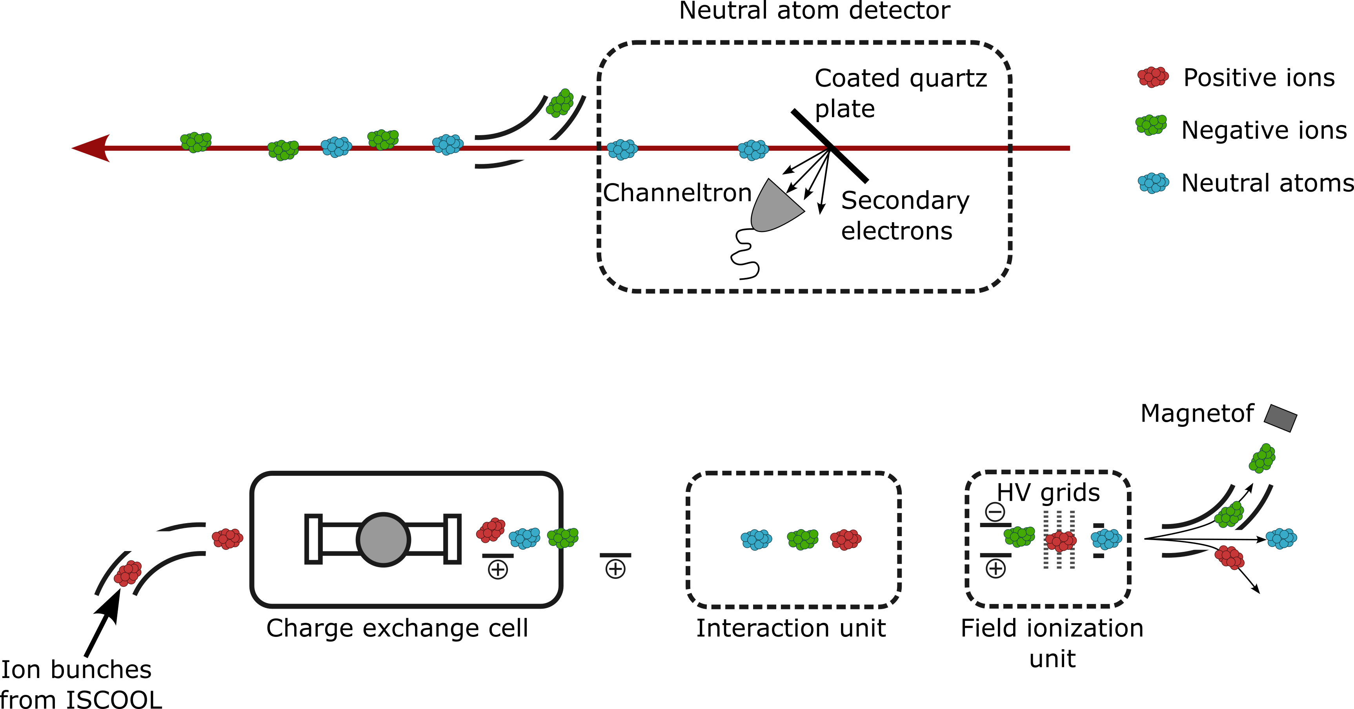
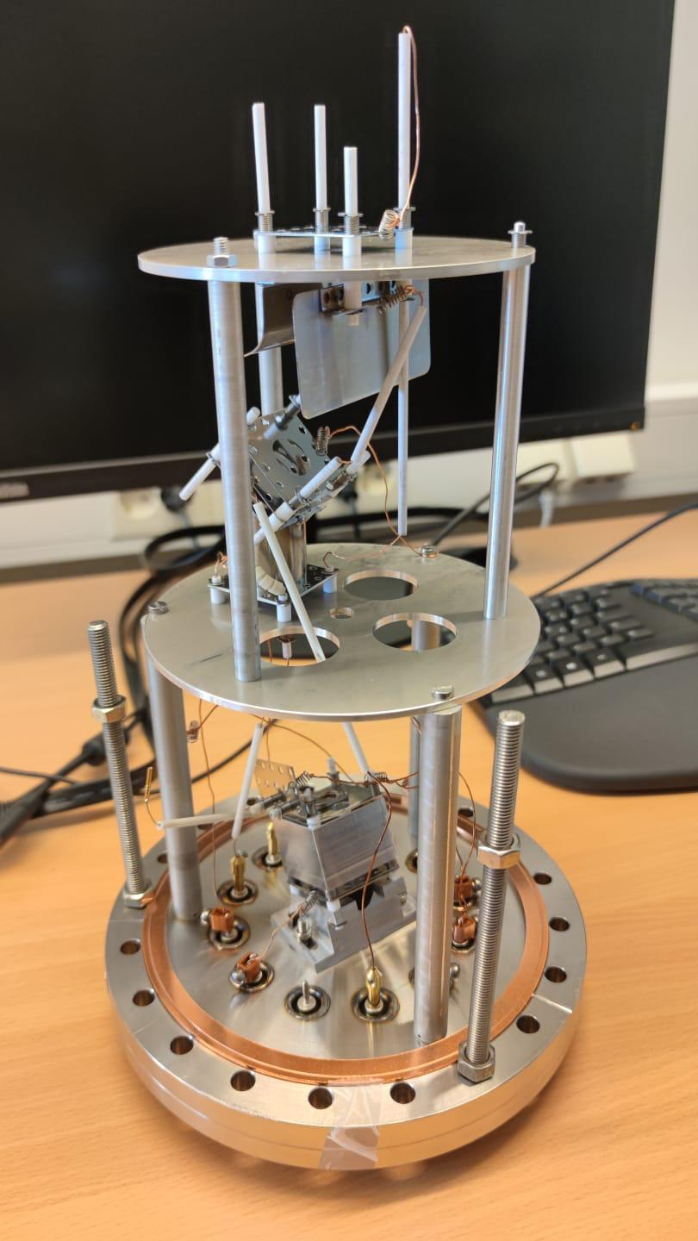
Study of negative ions at CRIS
Po
laser
Po⁻
Figures courtesy of Jessica Warbinek

Slide 5
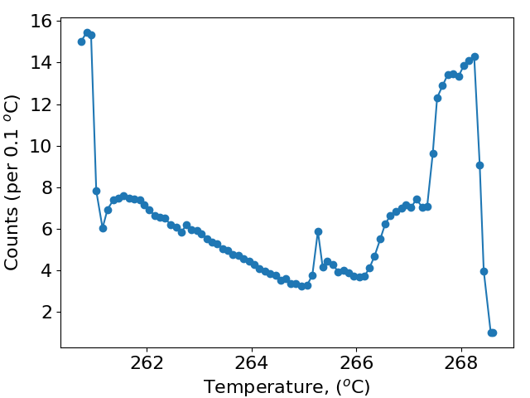
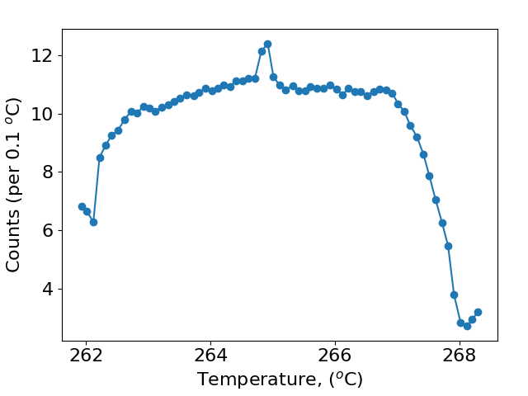
Production of negative ions during Po 2025
Heating Up on UO⁻
Cooling down on UO⁻
Strange spikes and drops were seen across the run (both heating up and down).
Could be related to the different problems present during the run (ISOLDE vacuum leaks, hanging cable in CB0, …)
Limited number of curves as they require a large time to record, but they all exhibit similar behavior

Slide 6
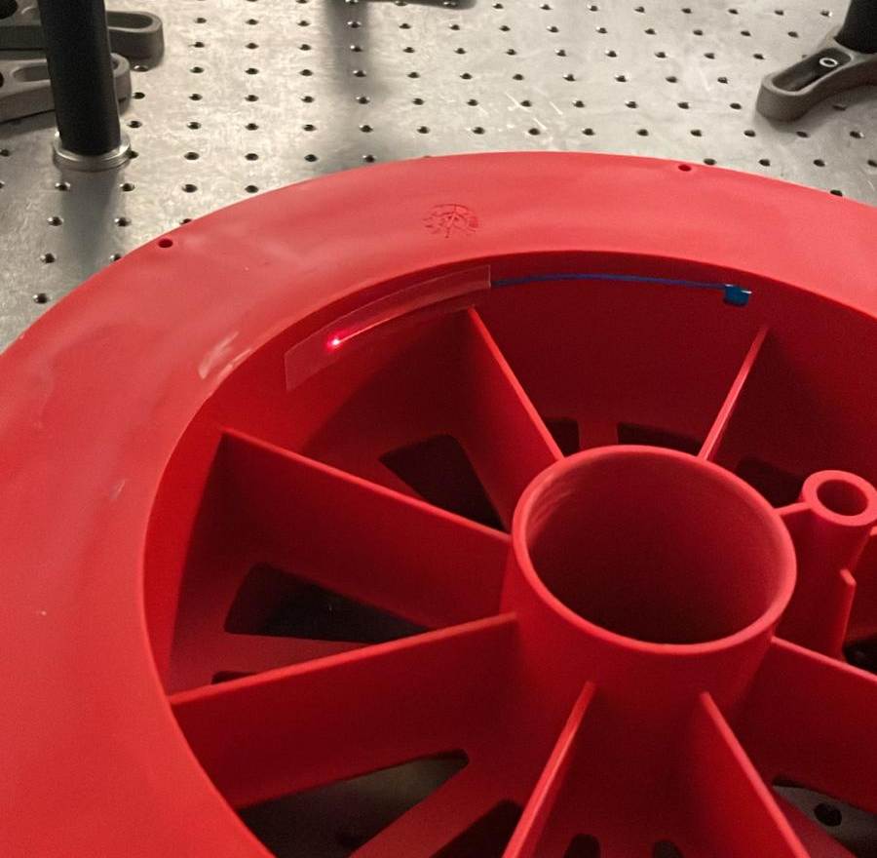
Laser photo detachment of Po⁻
Prediction by theory using relativistic CCSD(T) + Breit +QED corrections
EA = 1.469 eV or 11848 cm⁻¹
Different laser systems implemented:
Bare fiber from the laser lab
OPO
FWHM ~ 100GHz
Z-cavity
FWHM ~ 9GHz
JyvIS
FWHM ~ 20MHz

Slide 7
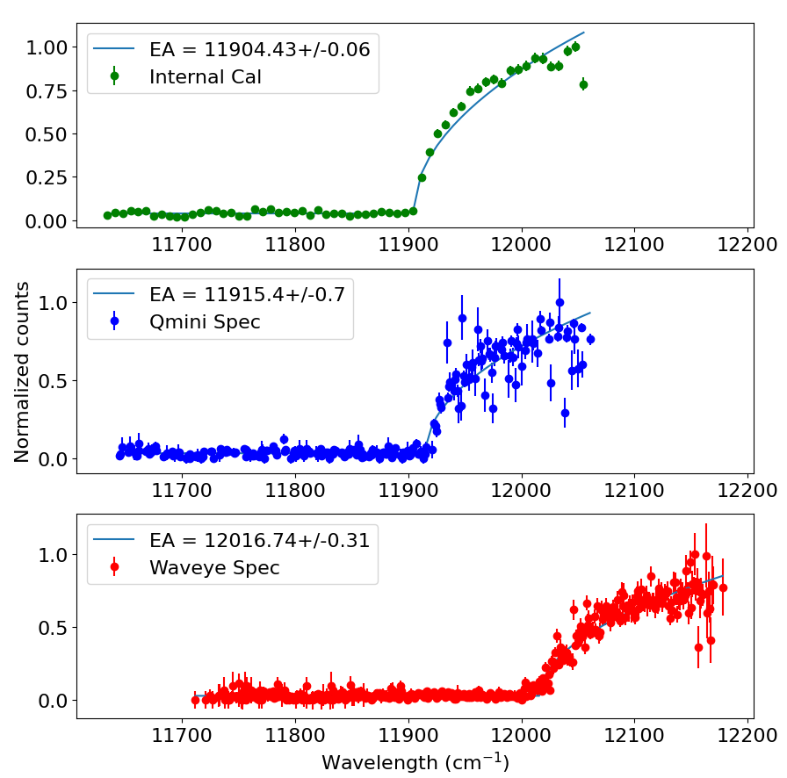
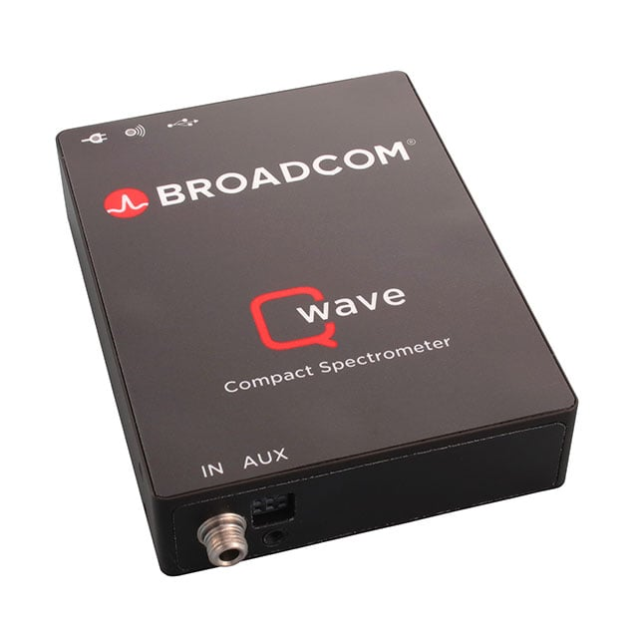
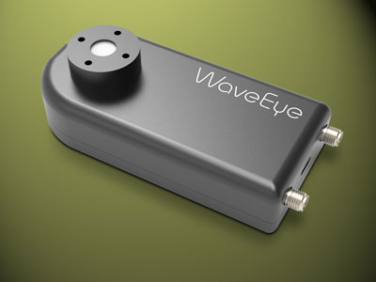
EA measurements with the OPO
Given the large linewidth of the OPO two spectrometers were implemented and recorded (5 scans)
Qmini
Waveye
Resolution: 0.5 nm
Accuracy: 0.2 nm
Range: 750-1030 nm
Resolution: 0.002nm
Accuracy: 0.1 nm
Range: 450-950 nm

Slide 8
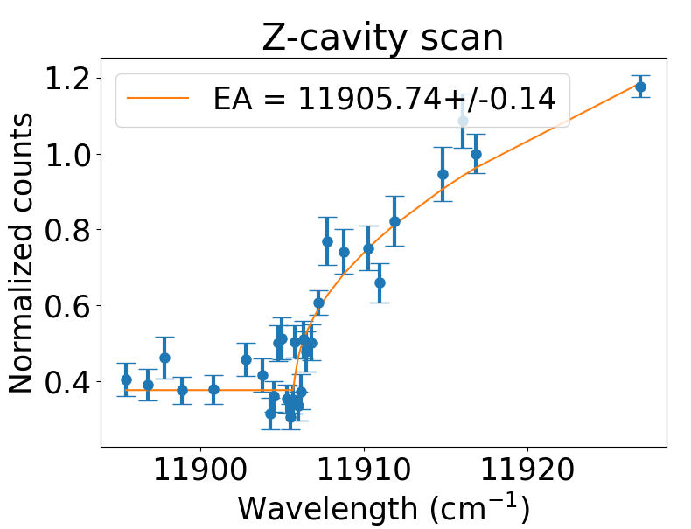
Z-cavity EA measurement
Special thanks to Dr. Pierre Lassegues
Each data point of as an individual scan of ~ 60sec
“Reference” normalization scan were taken every five scans (Po⁻ beam intensity).
Normalized in power, time and incoming beam (interpolation between reference scans)
Preliminary

Slide 9
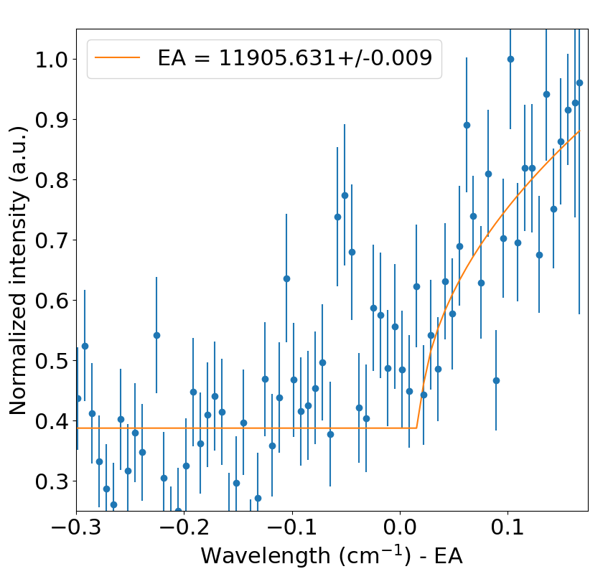
JyvIS EA measurement
Special thanks to Dr. Anjali Ajayakumar
Continuous scan of the EA threshold (normalized in power)
Last scan before complete lost in ISCOOL transmission (17pA before and 1.4 after ISCOOL) ➔ effective premature end of the beamtime
Likely to be dominated by systematic error bars
Preliminary

Slide 10
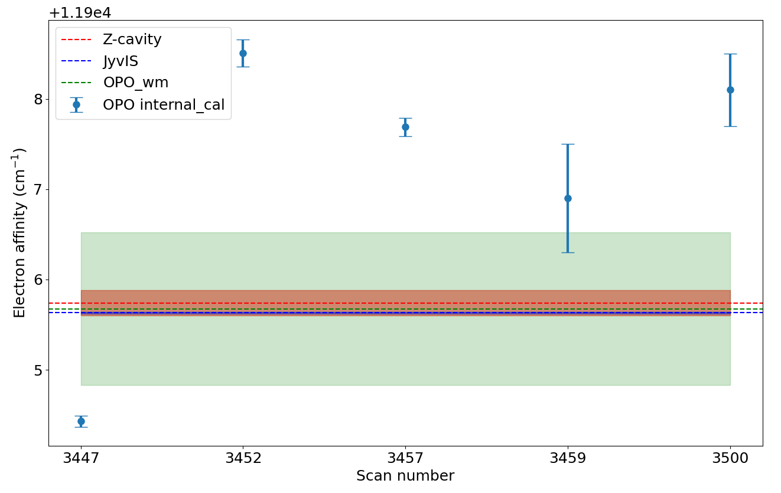
EA measurements
Comparison of measured EA using the different laser systems.
Agreement between theory and experiment of 99.5%.
Preliminary
Laser | EA
OPO | 11905.675(846)
Z-cavity | 11905.743(140)
JyvIS | 11905.631(9)
Results form three different laser systems agree with each other
(Preliminary)

Slide 11
Systematic errors
Have not been included yet, but some of them are:
ISCOOL voltage offset and variation.
Wavemeter accuracy (Reference diode not recorded - AC trip during the run).
Laser/ion overlapping angle (incoming and exiting laser position were saved ☺).
Energy shift due to double charge exchange process

Slide 12
Conclusions and outlook
Electron affinity (EA) of Po⁻ have been successfully measured using three different laser systems with good agreement between them.
No clear production curve of Po- was obtained due to beam instabilities and ISOLDE disturbances.
Isotope shift measurements in negative ions ➔ higher sensitivity to the specific mass shift (due to electron correlations).
Study of other proposed negative ions, e.g., Fr.

Slide 13
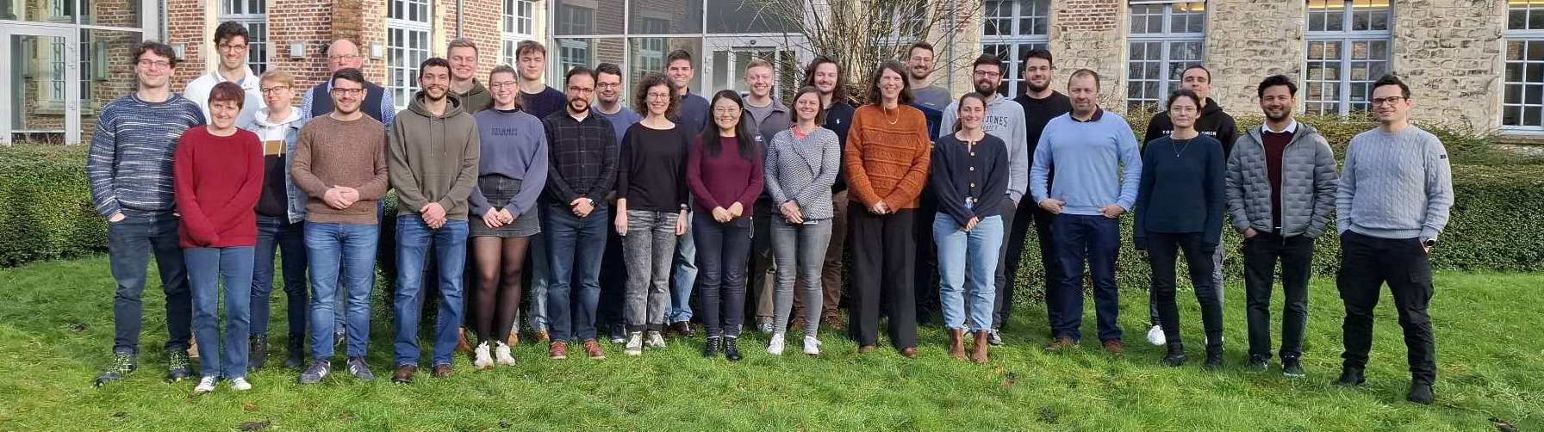








Acknowledgments

Slide 14
Thanks for your attention

Slide 15
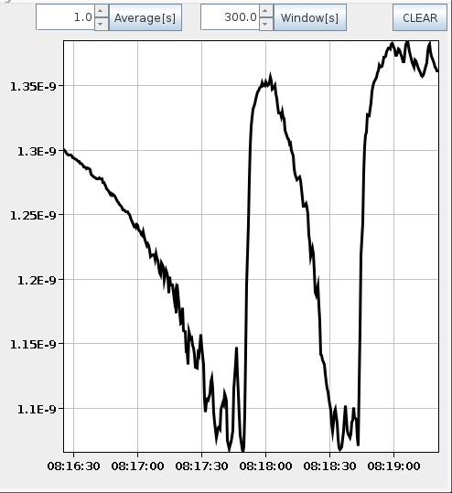
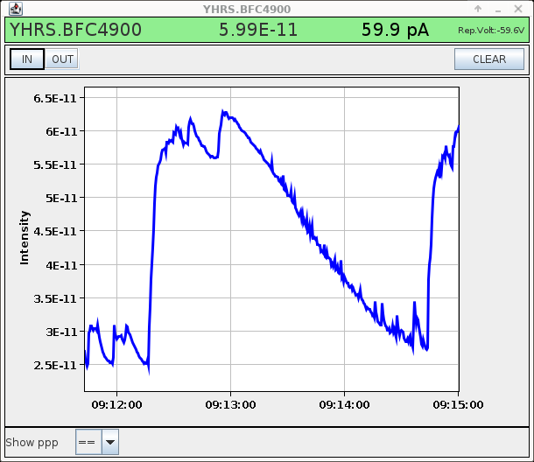
Beam fluctuations at the end of the beamtime
Fluctuations in the target voltage induced a 20% beam variation in the total beam faraday cup ➔ produced a change of 100% the beam before ISCOOL every ~2 min
Total beam
Beam before ISCOL
Could only be solved after fully re-booting the target heating (cooling the target down and heating up)

Slide 16
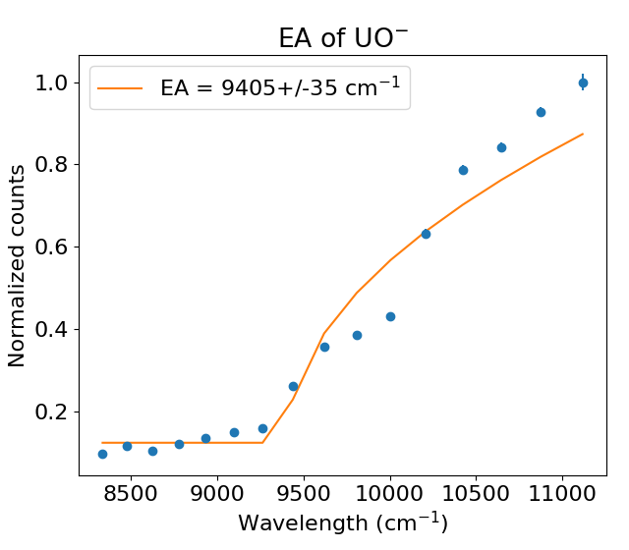
Electron affinity of UO
One quick scan of UO- electron affinity before going for Po-
Considerably discrepancy with literature 9200(6) cm-1
[2] Czekner, J., Lopez, G. V., & Wang, L. S. (2014). High resolution photoelectron imaging of UO− and UO2− and the low-lying electronic states and vibrational frequencies of UO and UO2. The Journal of Chemical Physics, 141(24).

Slide 17
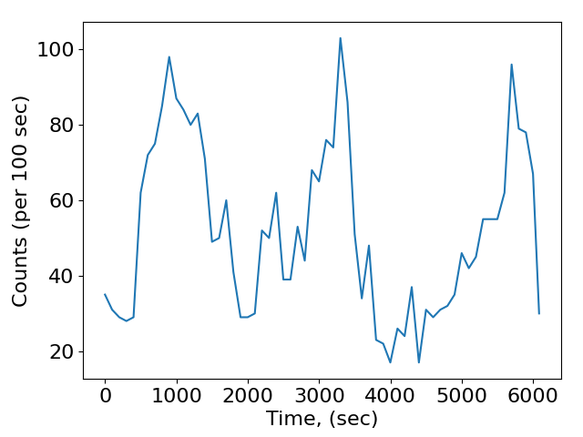
Counts per 100 sec JyvIS scan
No clear drop in counts during the scan despite zero transmission through ISCOOL in the following hour. Thus, all the data has been included for the fitting.

