Slide 1
CRIS Collaboration Meeting
Antimony – analysis updates
Abigail McGlone
2nd February 2026

Slide 2
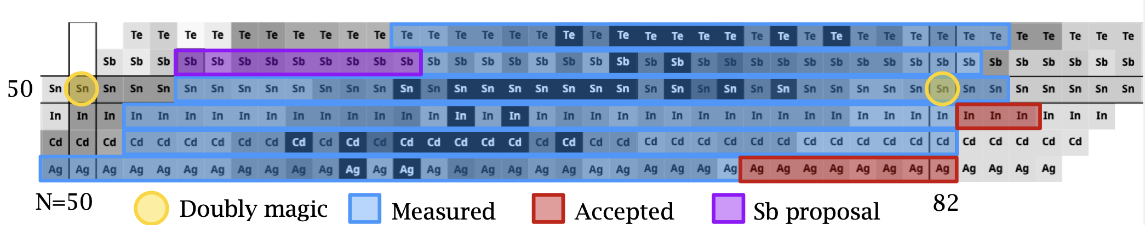
A little reminder:
Single proton above magic Z=50
Existing measurements from COLLAPS ideal for comparison
At CRIS: Measurements of ¹¹¹⁻¹²³Sb – 111 for the first time

Slide 3
Where we last left off:
Issues with the ToF profile
Bl is known to be very small from literature – if the B ratio is not fixed, Bl is wildly overestimated.
On masses 116, 118 and120 a higher intensity isomer present makes ground state fitting more difficult
Diode unlocked during experiment – had to use GPR to interpolate

Slide 4
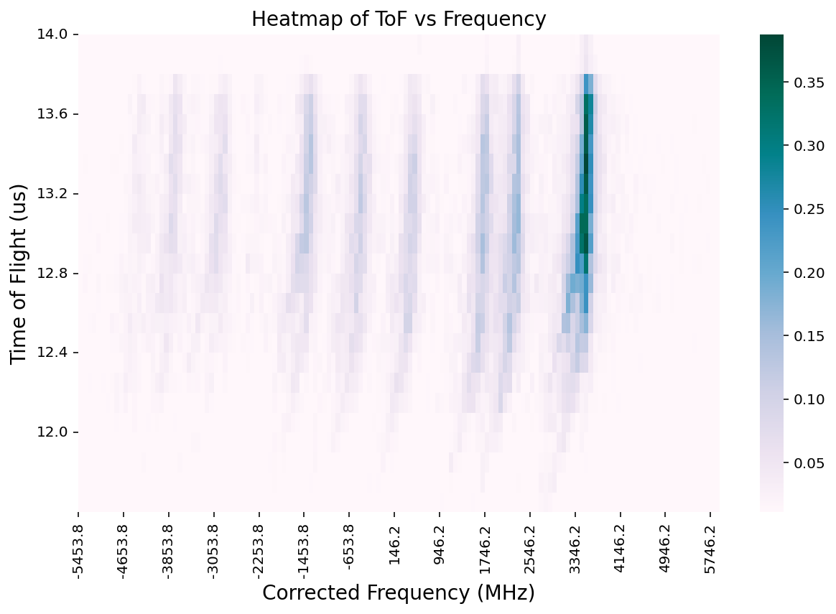
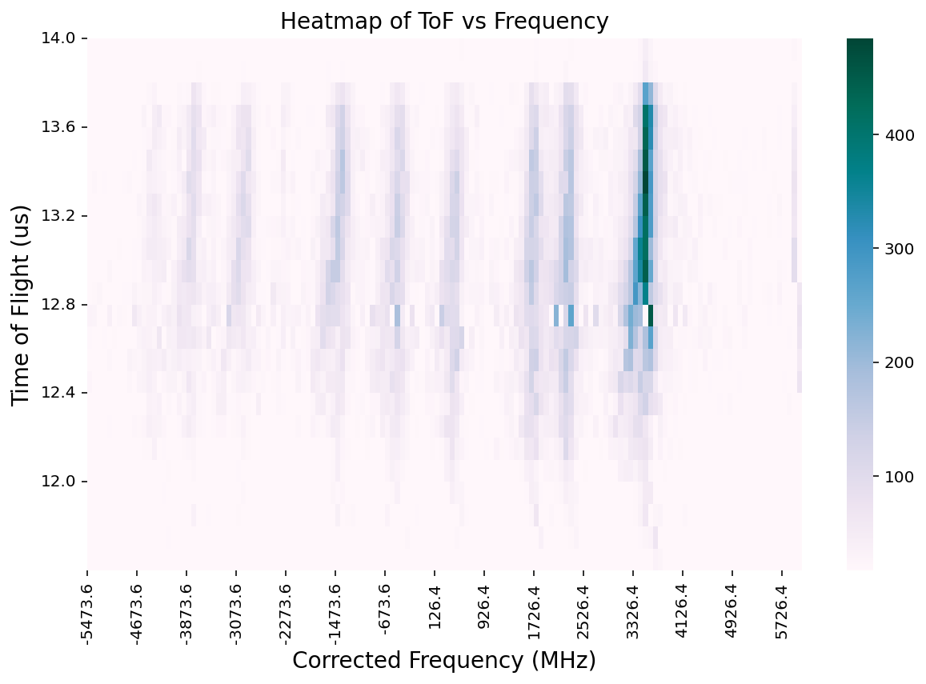
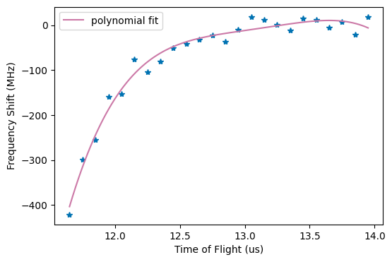
ToF corrections
Fitted the highest intensity peak for 1 ns slices of ToF
Plotted peak centroid against ToF
Fit using a multi-order polynomial – gives a correction on centroid with respect to the ToF
Applied correction to each slice
This is able to correct the distortion
But there is an energy spread not accounted for

Slide 5
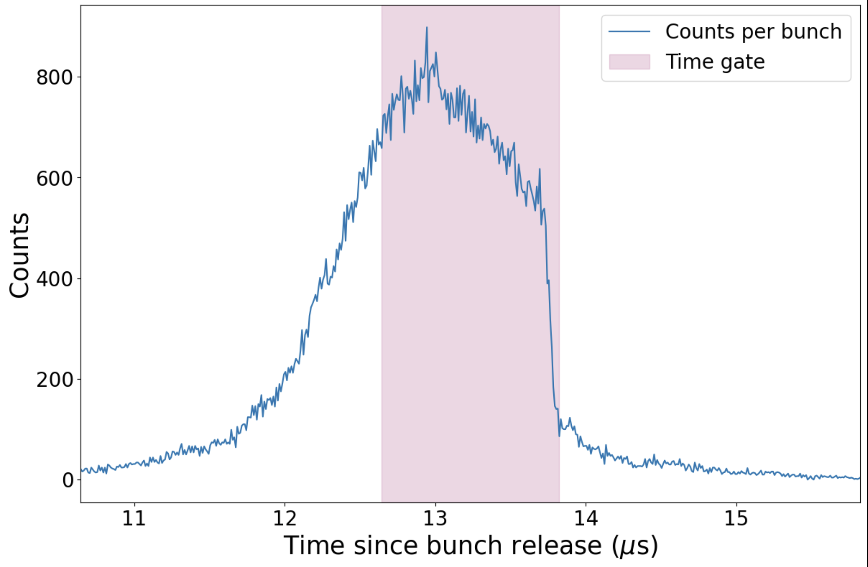
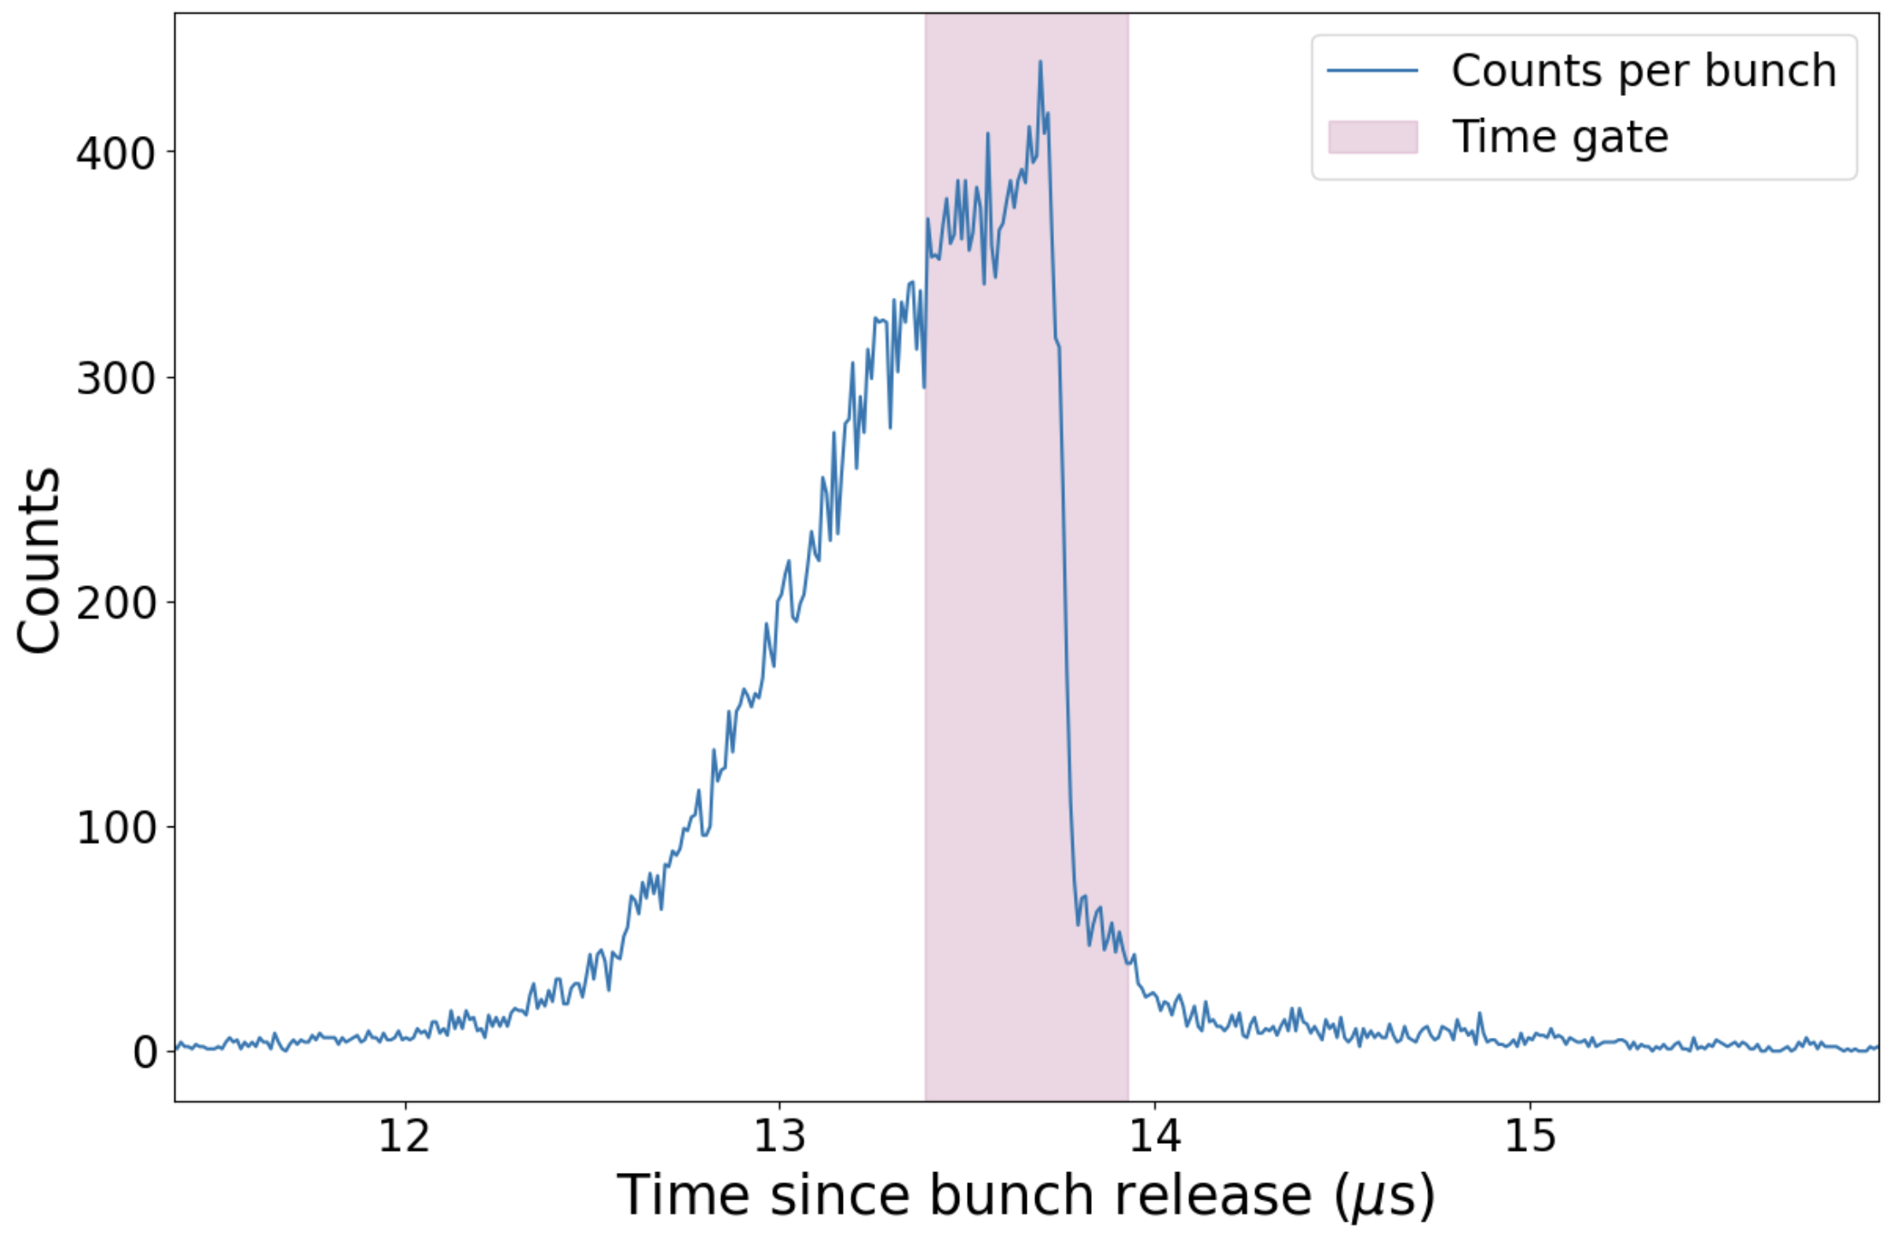
ToF corrections
Does not significantly improve FWHM or fit statistics – see below
Energy spread and additional uncertainty from correction makes errors of corrected fits much larger
The only thing that does improve fits is taking a ToF gate. Cut at time where the counts reach 80% of the maximum
Cannot have a specific time cut as often the ISCOOL delay was set differently
 | Uncorrected | Corrected | 80% ToF gate
Centroid (MHz) | 326(1) | 367(4) | 352(2)
FWHM (MHz) | 279(3) | 294(9) | 213(6)
Au | 542.6(3) | 550.3(7) | 546(3)
Bu | -469(3) | -445(6) | -454(3)

Slide 6
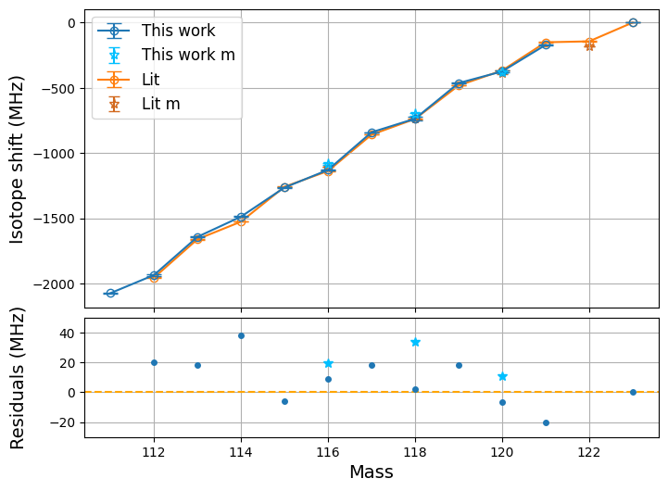
Isotope Shifts
PRELIMINARY
Good agreement with literature
Maximum 40 MHz difference from COLLAPS measurements
¹¹¹Sb seems sensible

Slide 7
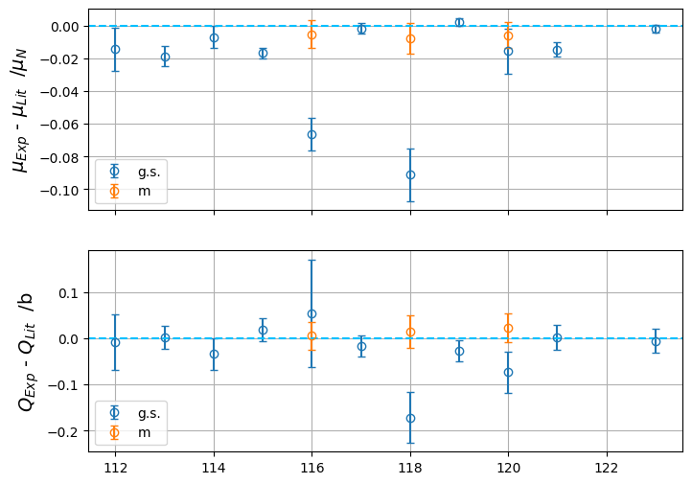
Moments
Somewhat consistent, but not always within errors. Still some improvement to be made
Main issues with the g.s. of 116,118,120 where the highly dominant isomer is present
PRELIMINARY

Slide 8
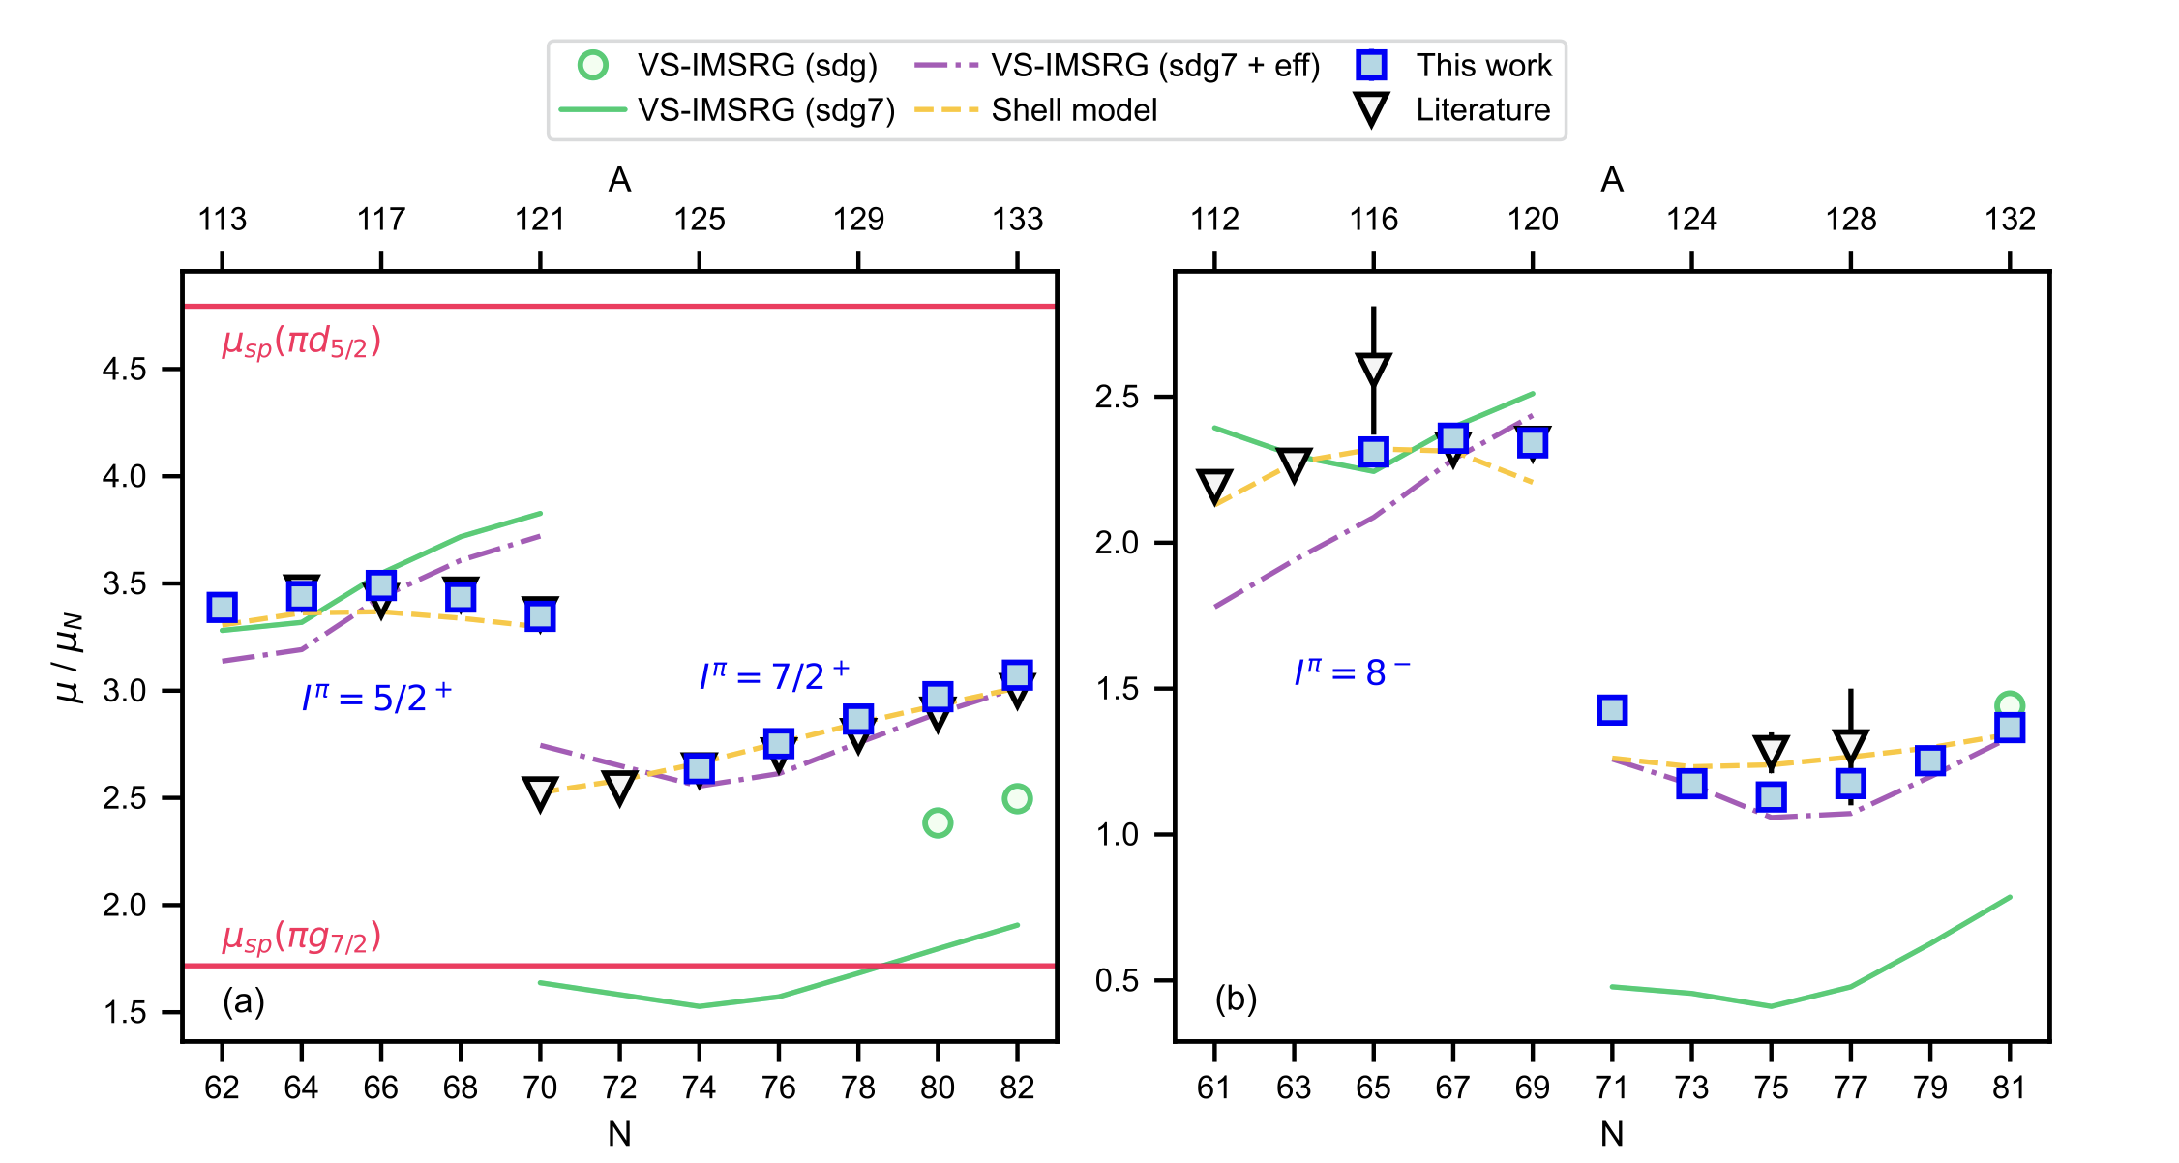
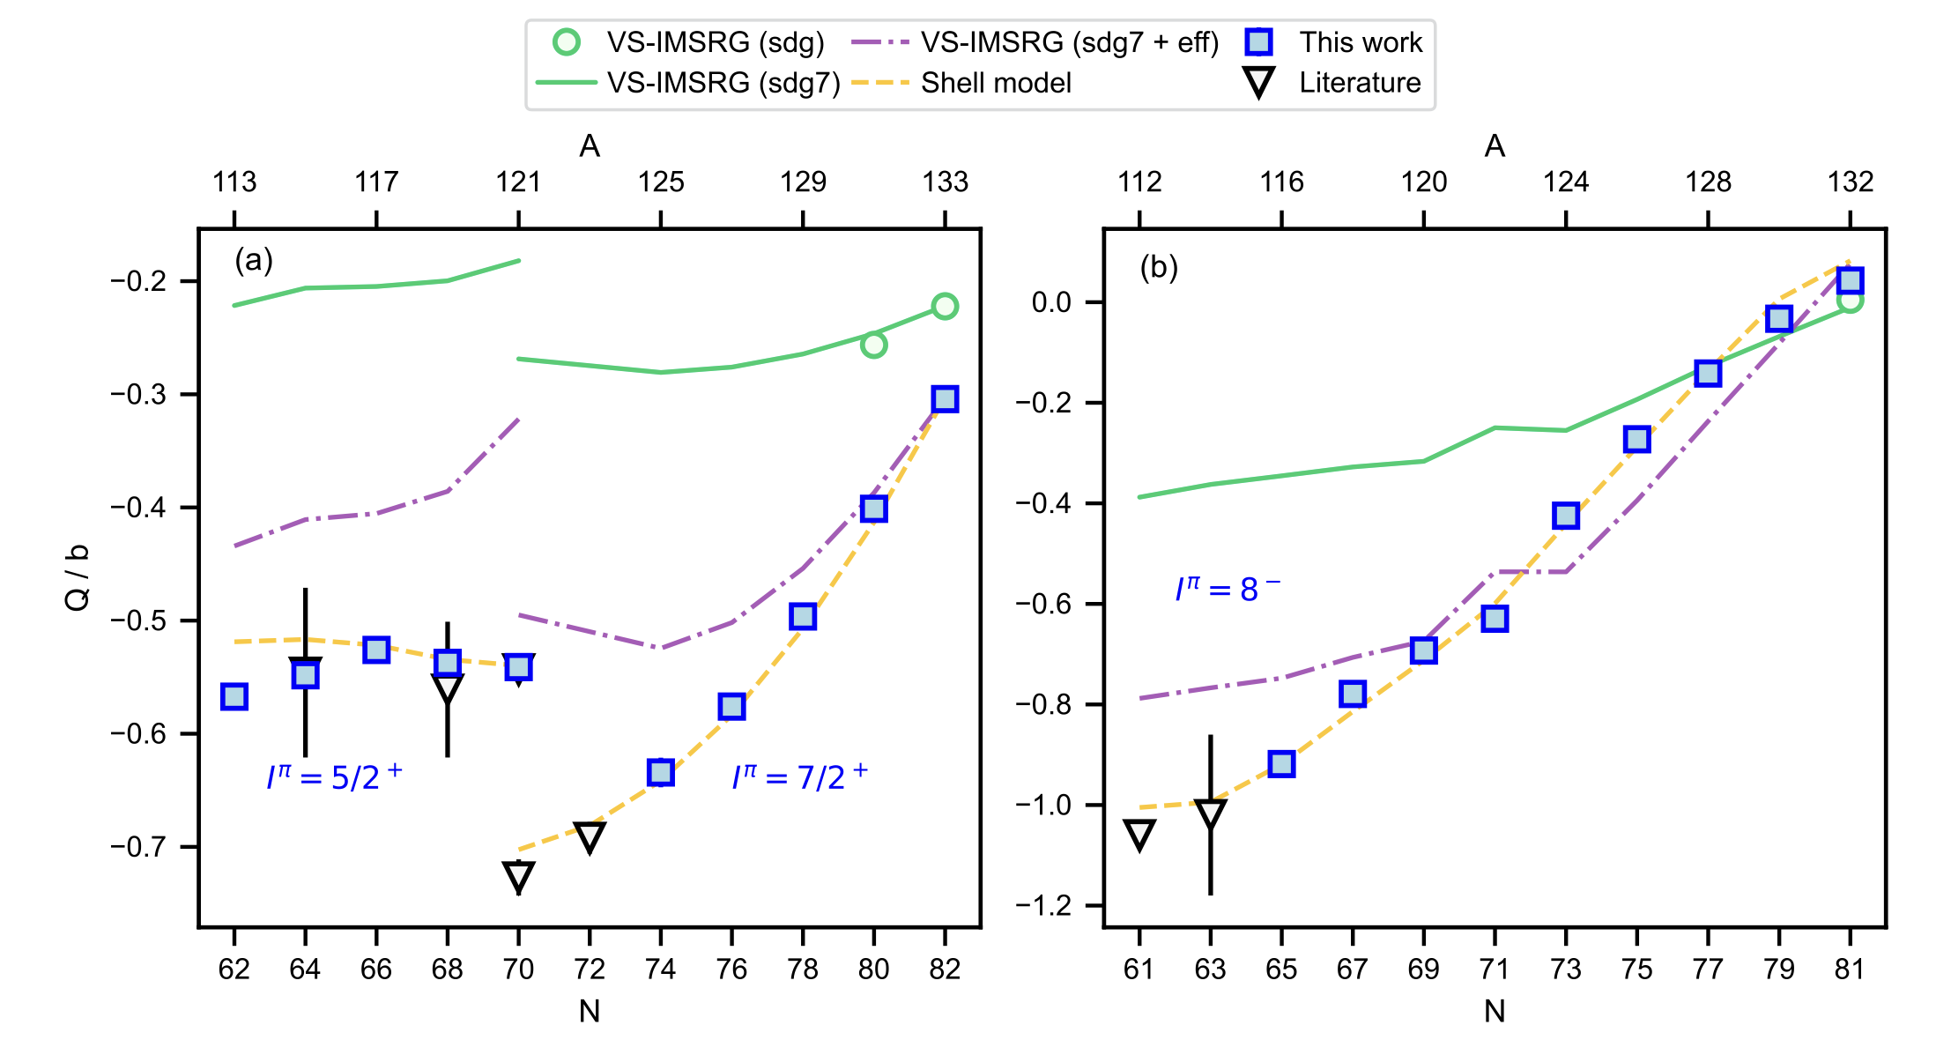
Moment Theory
Calculations only down to 112
This shows COLLAPS moments against shell model and VS-IMSRG theory
Most well described by the shell model, same picture for our measurements
Odd-odds only show 8- isomer not g.s.
Lechner et al. (2023). Electromagnetic moments of the antimony isotopes 112–133 Sb. Physics Letters B, 847, 138278. https://doi.org/10.1016/j.physletb.2023.138278

Slide 9
1. S. Gamrath et al., “MCDHF calculations of isotope shifts in neutral antimony”, Journal of Quantitative Spectroscopy and Radiative Transfer 218, 38–45 (2018)
New F&M calculations
COLLAPS had pre-existing ab-initio MCDHF calculations for F and M¹ with estimated reliability of 15%
The calculations admitted difficulties in recreating Kms, with approx. uncertainty of 25%
We have obtained new F and M calculations from Ekman and Jönsson. Still MCDHF but using the much-improved GRASP2k code.
From papers using this to re-evaluate F and M factors an error of 5-8% from known values was obtained.
 | F (GHz u) | M (GHz u)
2018 | 2.980 | -560.288
2025 | 2.706 | -158.400

Slide 10
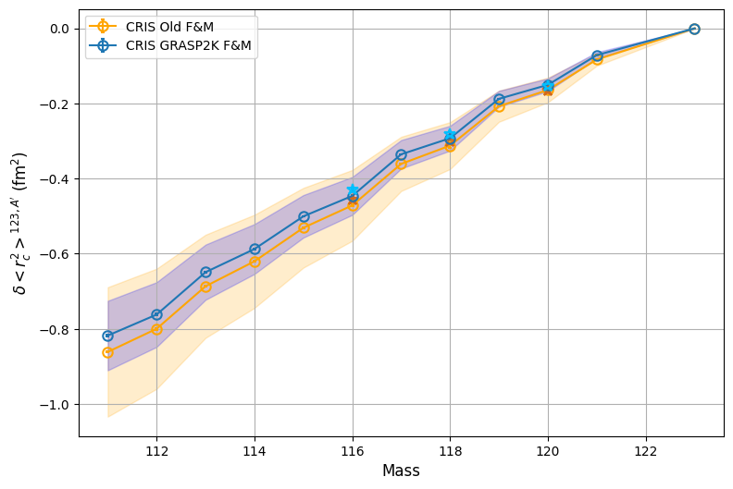
New F&M calculations
Charge radii calculated with both F and M evaluations
Changes gradient slightly within uncertainty, but GRASK2k 2025 has smaller associated errors
PRELIMINARY

Slide 11
What next?
Extending moment predictions to 111
Clarification of uncertainty on new F and M values
Discussions about charge radii publication – COLLAPS have yet to publish IS and charge radii.

Slide 12
Thank you

Slide 13
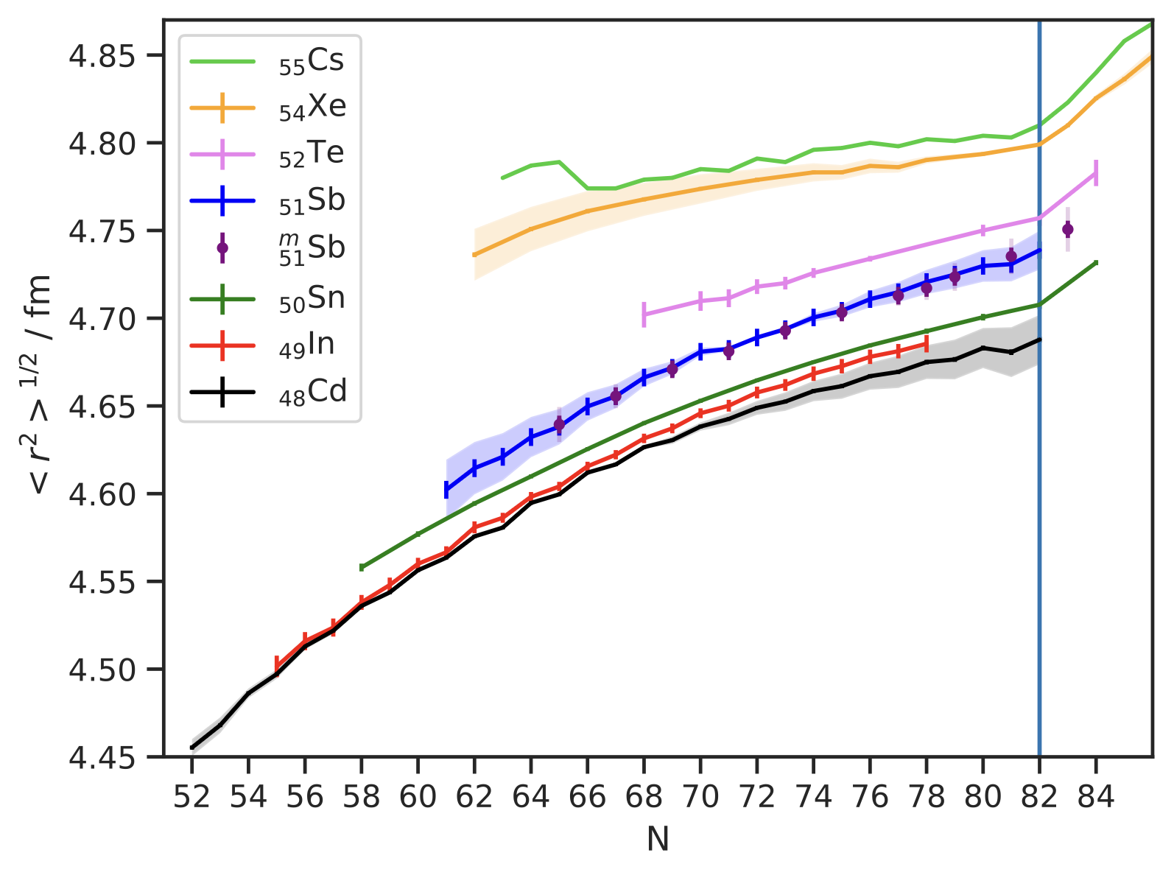
Charge radii of region
Our measurements are between shell, no kinks. But reasonable gradient.
Gradient change of new F&M values is small on a global scale
Lechner, S. (2021). Laser spectroscopy of antimony isotopes and the design of a cryogenic Paul Trap. PhD thesis.

Slide 14
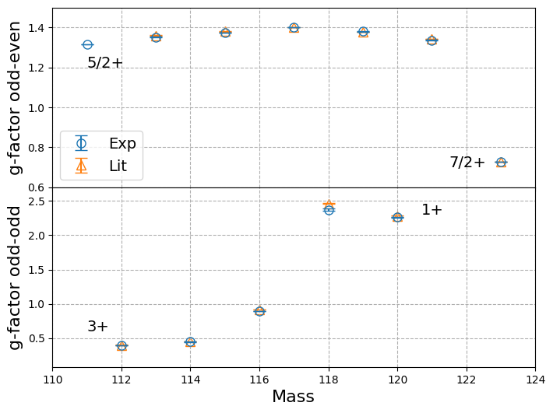
G-factors
G.s. only
PRELIMINARY

