Slide 1
Status update of the CRIS experiment 2025
Jessica Warbinek
on behalf of the CRIS collaboration
CRIS collaboration meeting 2026, February 2

Slide 2
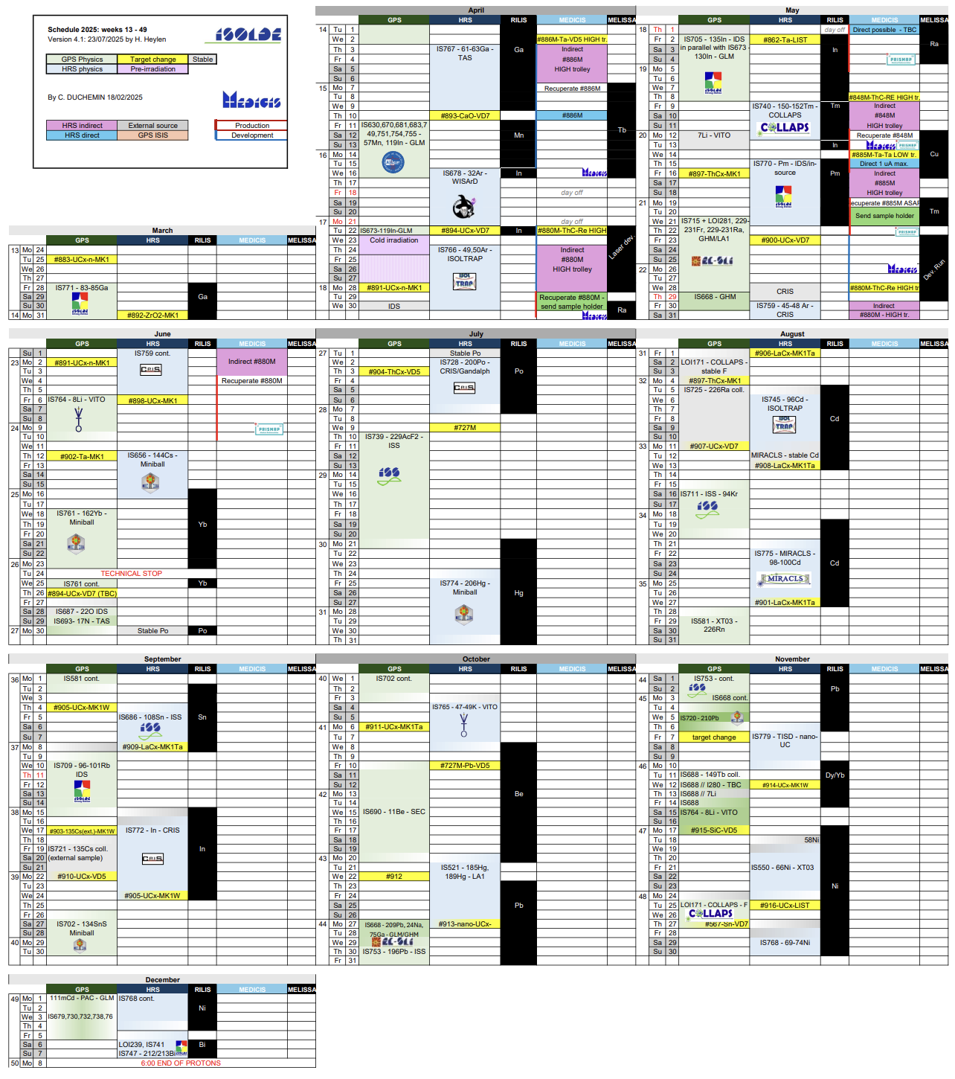
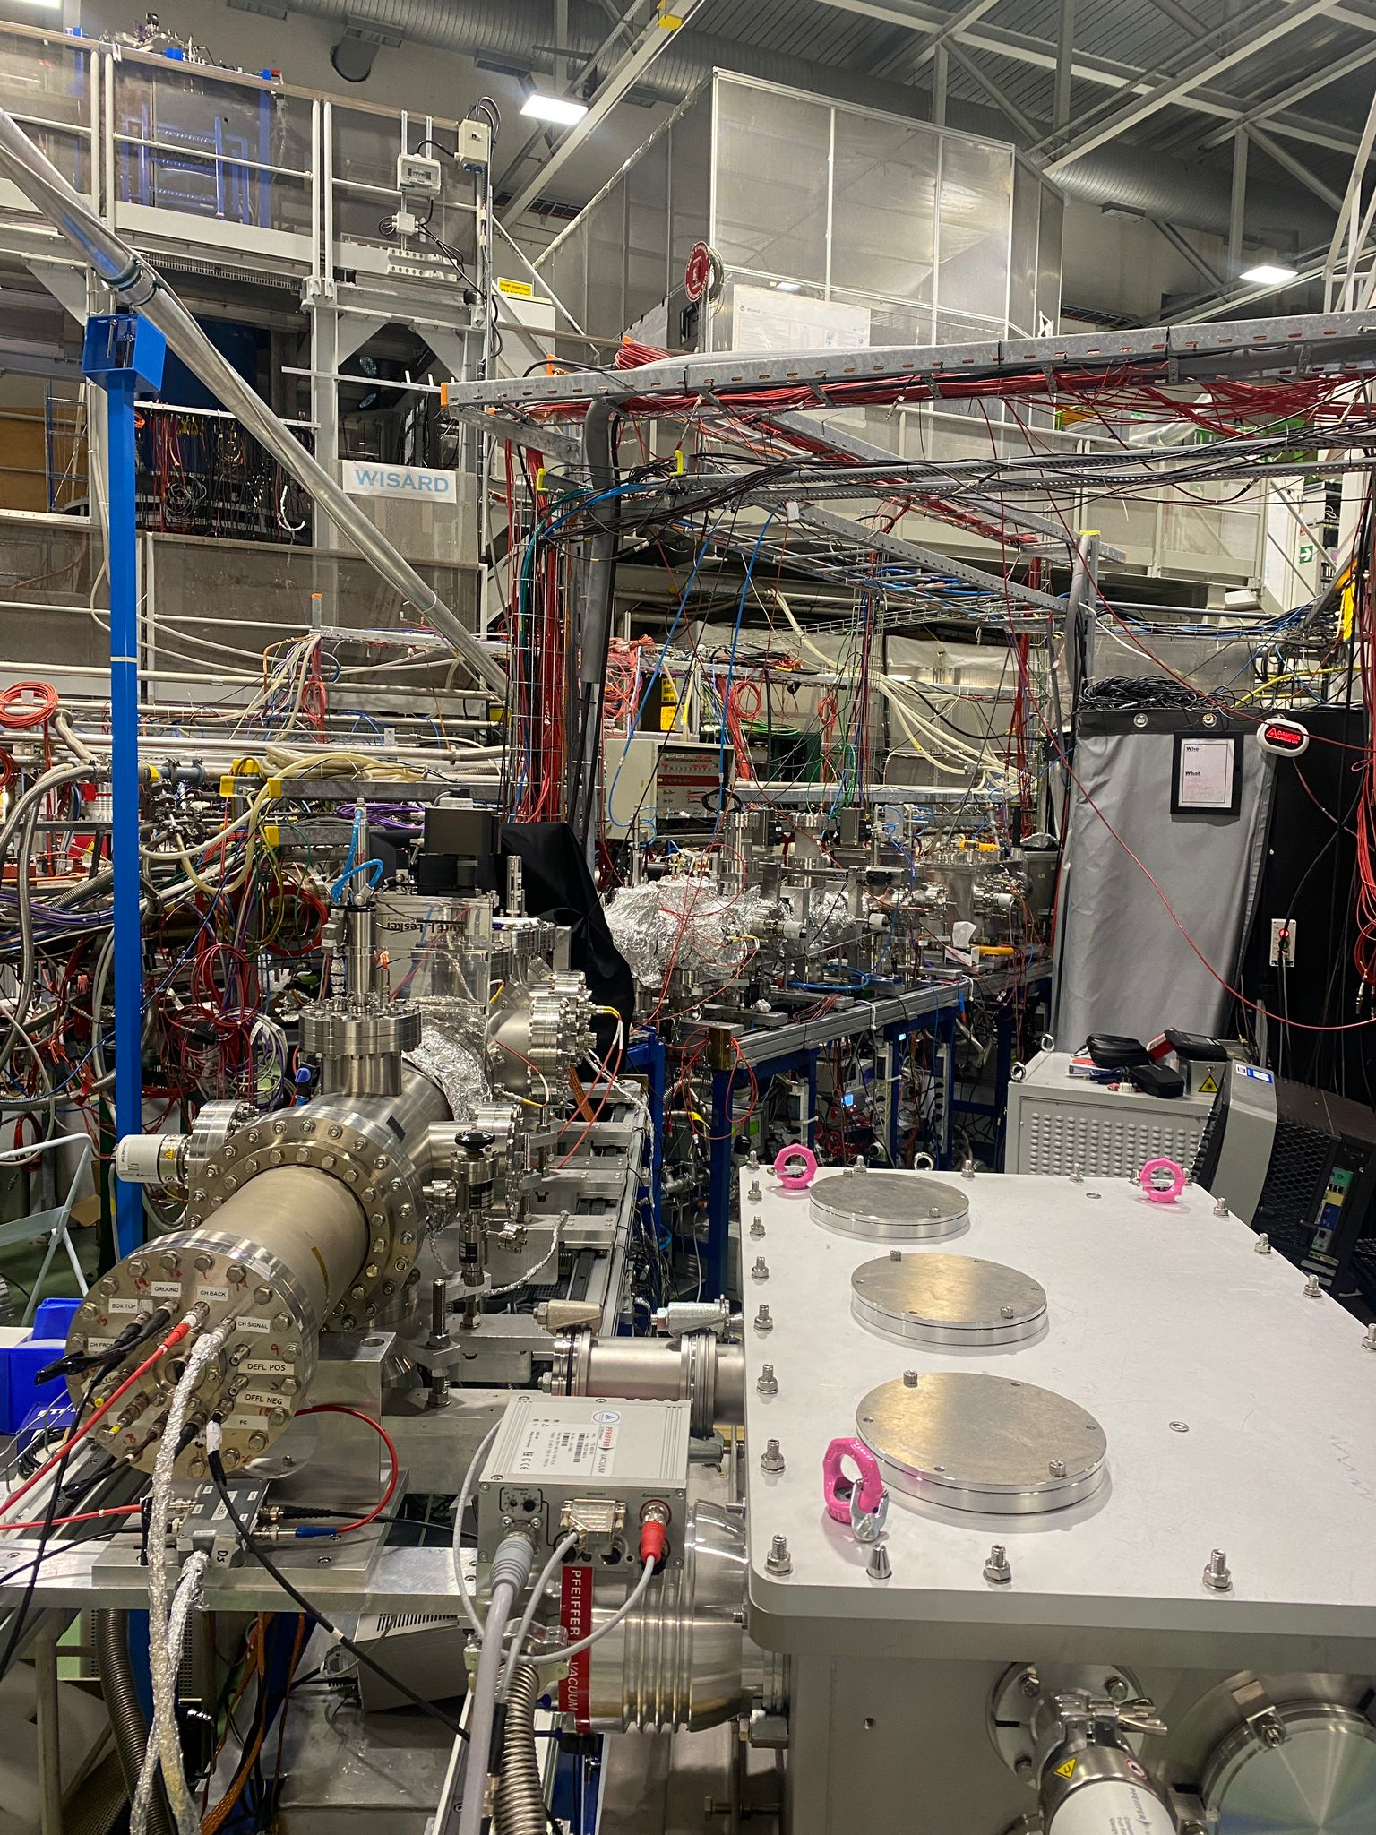

Experimental campaign 2025
GANDALPH @ CRIS: Po⁻
CRIS beginning of 2025
ISCOOL commissioning
FIU
RIP Ar
N-rich Ar
DSS commissioning
DSS
Neutral particle detector
N-deficient In

Slide 3
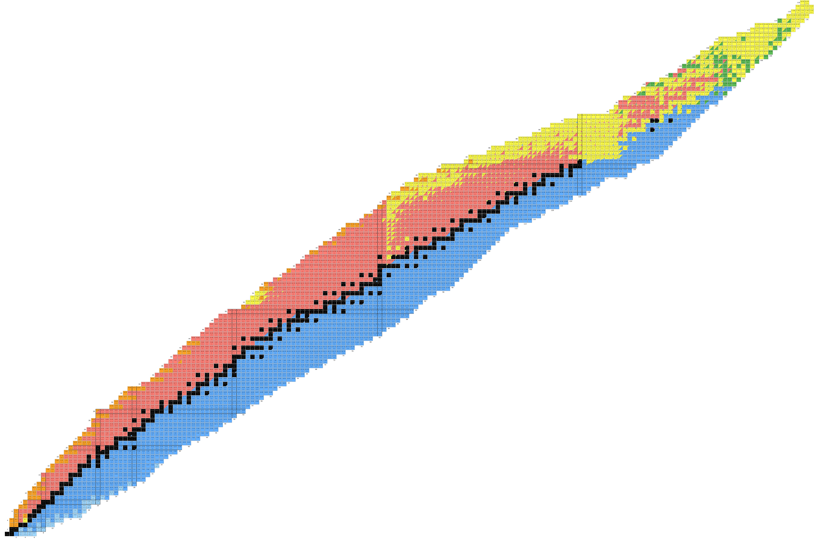
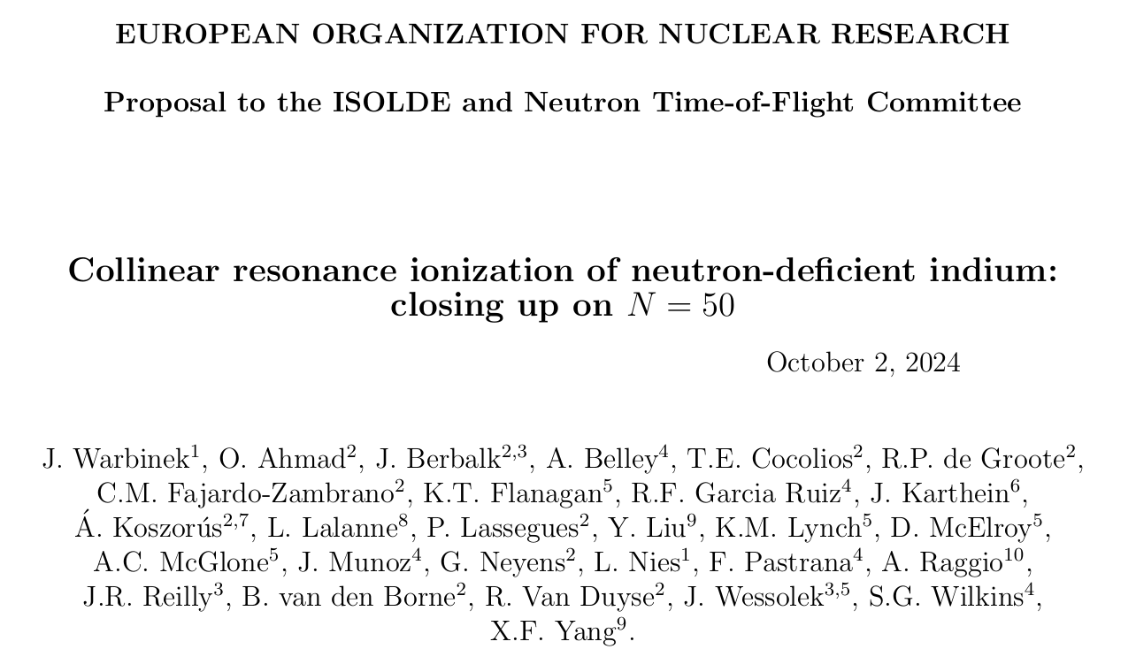
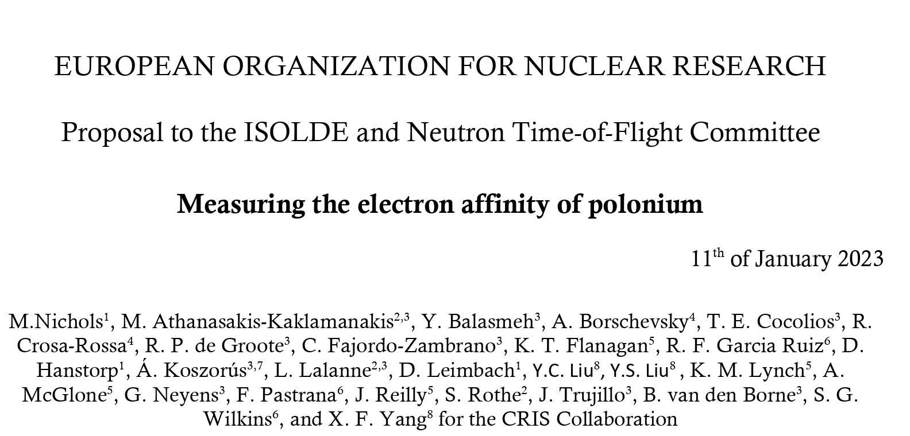
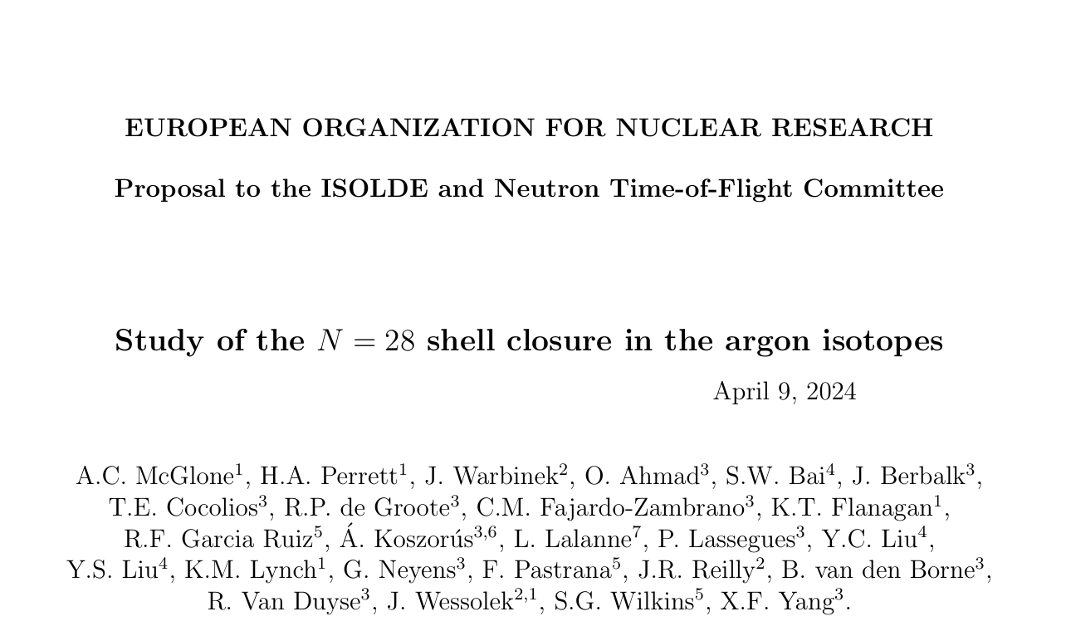
Experimental campaign 2025

Slide 4

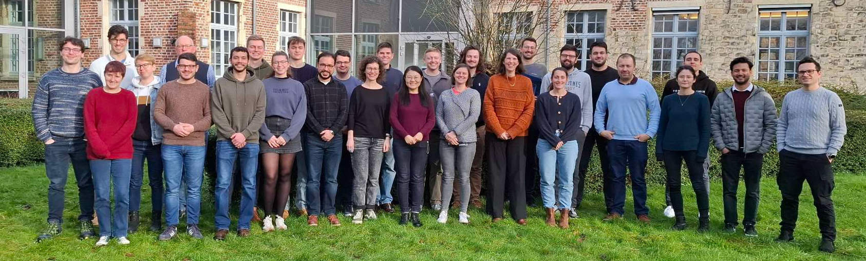
Happenings aside of physics in the lab
Successful PhD defenses
Recent CRIS publications:
Athanasakis-Kaklamanakis, M., et al. "Laser spectroscopy and CP-violation sensitivity of actinium monofluoride." Nature 648.8094 (2025): 562-568.
Wilkins, S. G., et al. "Observation of the distribution of nuclear magnetization in a molecule." Science 390.6771 (2025): 386-389.
Lalanne, L., et al. "Cr 61 as a doorway to the N= 40 island of inversion." Physical Review C 112.3 (2025): L031301.
Athanasakis-Kaklamanakis, Michail, et al. "Electron correlation and relativistic effects in the excited states of radium monofluoride." Nature Communications 16.1 (2025): 2139.
Gustafsson, F. P., et al. "Charge radii measurements of exotic tin isotopes in the proximity of N= 50 and N= 82." Phys. Rev. Lett. 135, 222501 (2025)
Dr. van den Borne
Dr. Heines
Dr. Urquiza-Gonzalez
New people at CRIS/ISOLDE:
Luis Fraile as ISOLDE spokesperson
Letitia di Giulio replaces Olga Betramello
Oscar Fjeld as new technical support
Collaboration meeting 2025

Slide 5
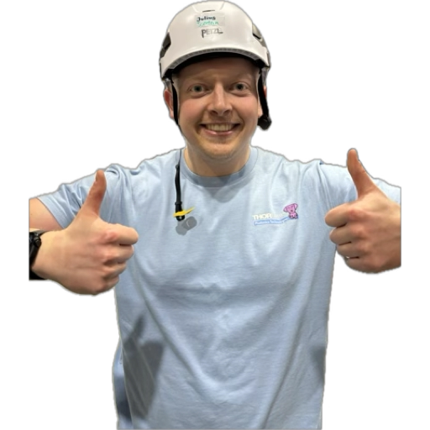

Local team 2025 – development and preparation
ISCOOL
FIU
Ar
Po
Ion source
In
Ni
DSS
Jan | Feb | Mar | Apr | May | Jun | Jul | Aug | Sep | Oct | Nov | Dec
Jessica
Osama
Carlos
Simone
Bram
Justus
David
Angelos
Pierre
Helped and joined for every beamtime this year

Slide 6
Local team 2025 – beamtimes
ISCOOL
FIU
Ar
Po
Ion source
In
Ni
Pm
DSS
Jan | Feb | Mar | Apr | May | Jun | Jul | Aug | Sep | Oct | Nov | Dec
Jessica
Osama
Carlos
Simone
Bram
Justus
David
Angelos
Pierre

Slide 7

Local team 2026?
Jan | Feb | Mar | Apr | May | Jun | Jul | Aug | Sep | Oct | Nov | Dec
Jessica
Carlos
Osama
Justus
David

Slide 8
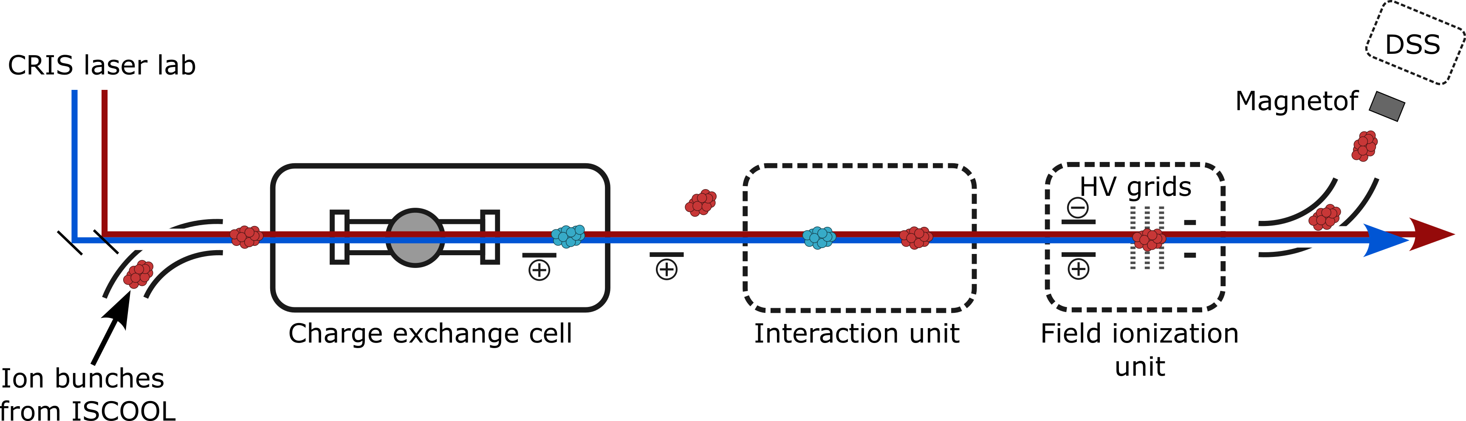
Lab status report – CRIS beamline
Detector systems:
Main magnetof working flawless
MiniTofs after CEC/Bender broken: new ones delivered
DSS commissioned, microtof as new useful tool
Neutral particle detector: commissioned and used
Charge exchange cell:
Regular contamination, but RP happy
Strict CECs differentiation: clean for short-lived, contaminated CEC for molecules / long-lived
Field ionization unit:
Change of design in April
Tests off-line
On-line commissioning with Ar
ISCOOL:
SY intervention during YETS
Commissioning with CRIS in March
Narrow bunches and stable references
Way less instabilities seen in CRIS
New upgrades planned (Lukas ☺)
Vacuum system:
Turbo pumps dying (QT1 – replaced, IR - ?)
High 10⁻¹⁰mbar in IR with valves closed, 10⁻⁹ open
Failure of Turbo in QT1 before Po: weight moved the whole beamline up by 3cm

Slide 9
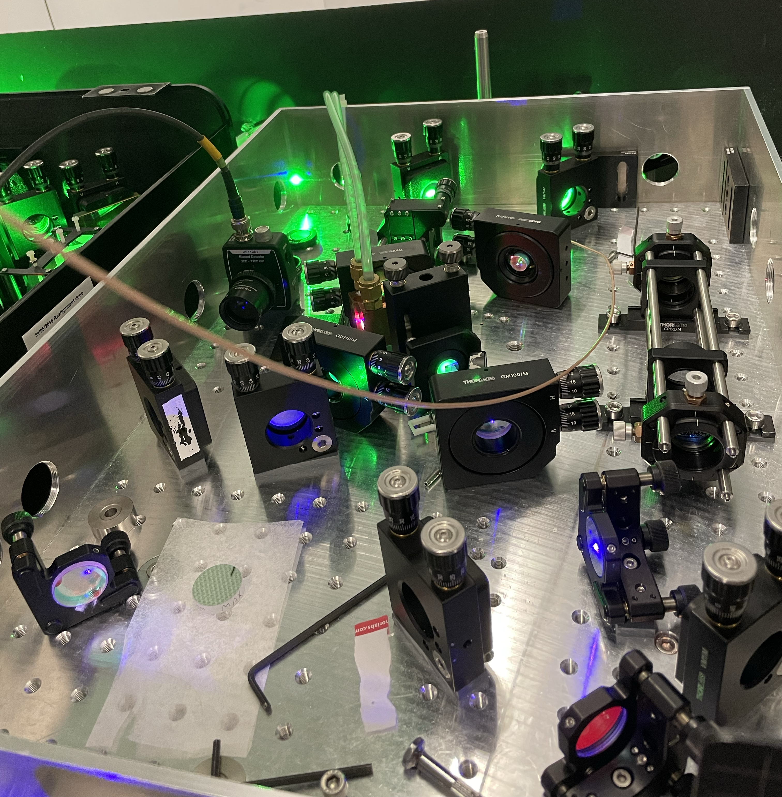
Lab status report – laser labs
Matisse and Jyvis:
Working reliably and stable all year long
Jyvis doubled, tripled with good power
Matisse: seading
Drifts/vibrations in ISOHALL there but limited
Z Cavity / Grating / Nd:YFL:
Working but giving lower power
Grating (crystal?) still to be checked
Nd:YLF: out of order for most of the time
Chiller went to Litron twice
Lee laser back! Used for Ar and In
New bare fibre for negative ion work
Dye lasers:
PDL working fine, burned resonator dye cell from OPO pumping (to be replaced eventually)
Cobra up to specs, working reliable
OPO:
Working reliable in the tent
Beneficial addition for FIU work
NEW temporary DLA for OPO at the end of the beamline
Dual head / Trili:
Dualhead shipped to Man, chiller failure
Trili working ok after maintenance
NEW: Innolas pump laser, high output, stable, reliable (also the company), dream
Picoscope dying sometimes ☹

Slide 10
Safety
2025 year of way more strict safety: more procedures, blocked experiments, bad vibes
Lab work partly disposed (again!), strict rule for required procedures
Safety inspections and new beam clearance before every run needed
Operation during year: not blocked but sometimes tight (partially hampered)
10 new procedures
  Laser operation / alignment procedures
  Laser usage more strictly restricted to trained personnel
Updated experiment safety file before every run

Slide 11
Financial update 2025
Carry-Over from 2025 | 122,204 CHF (74,934 CHF in 2024)
Annual collaboration contributions | 120,000 CHF
Expenses in 2025: New ion source Laser repairs Optics / Dye / Laser safety DSS Detectors Gases / chemicals E-pool Transport costs Other consumables, operation | - 4,806 CHF - 4,807 CHF (one in warranty) - 9,991 CHF - 8,743 CHF ∼80,000 CHF - 7,064 CHF -1,256 CHF -3,326 CHF -2,743 CHF -7,458 CHF
Account status today: | 187,941.56 CHF
Extra: Innolas pump laser:
79,052 CHF

Slide 12
CRIS financial plan for 2026
(New TiSa pump laser? | 85,000 CHF)
New Grating laser | 10,000-15,000 CHF
New chiller for TiSas upstairs? | 3,000 CHF
Picoscope / cheaper alternative | 200 CHF
Restgas analyzer | 5,000 CHF
New power supply for ion source | < 10,000CHF??
Operational costs | < 10,000 CHF
Safety | XXX
Total | = < 35,000 CHF
Contributions 2025 + carry-over 2024 | 120,000 + 187,941.56 CHF
Platform
Laser cabin
New frontend

Slide 13
Upgrades in 2025

Slide 14
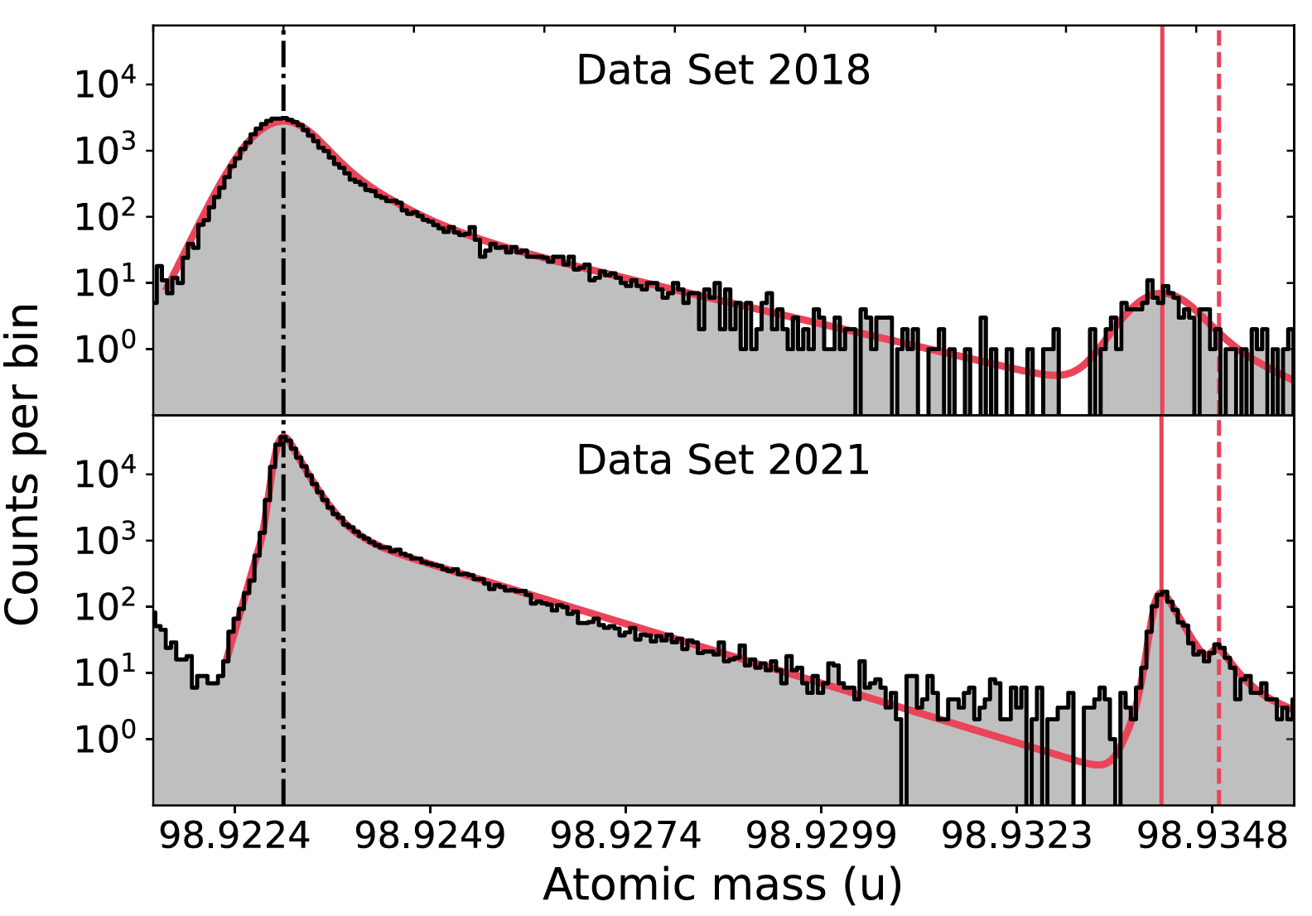
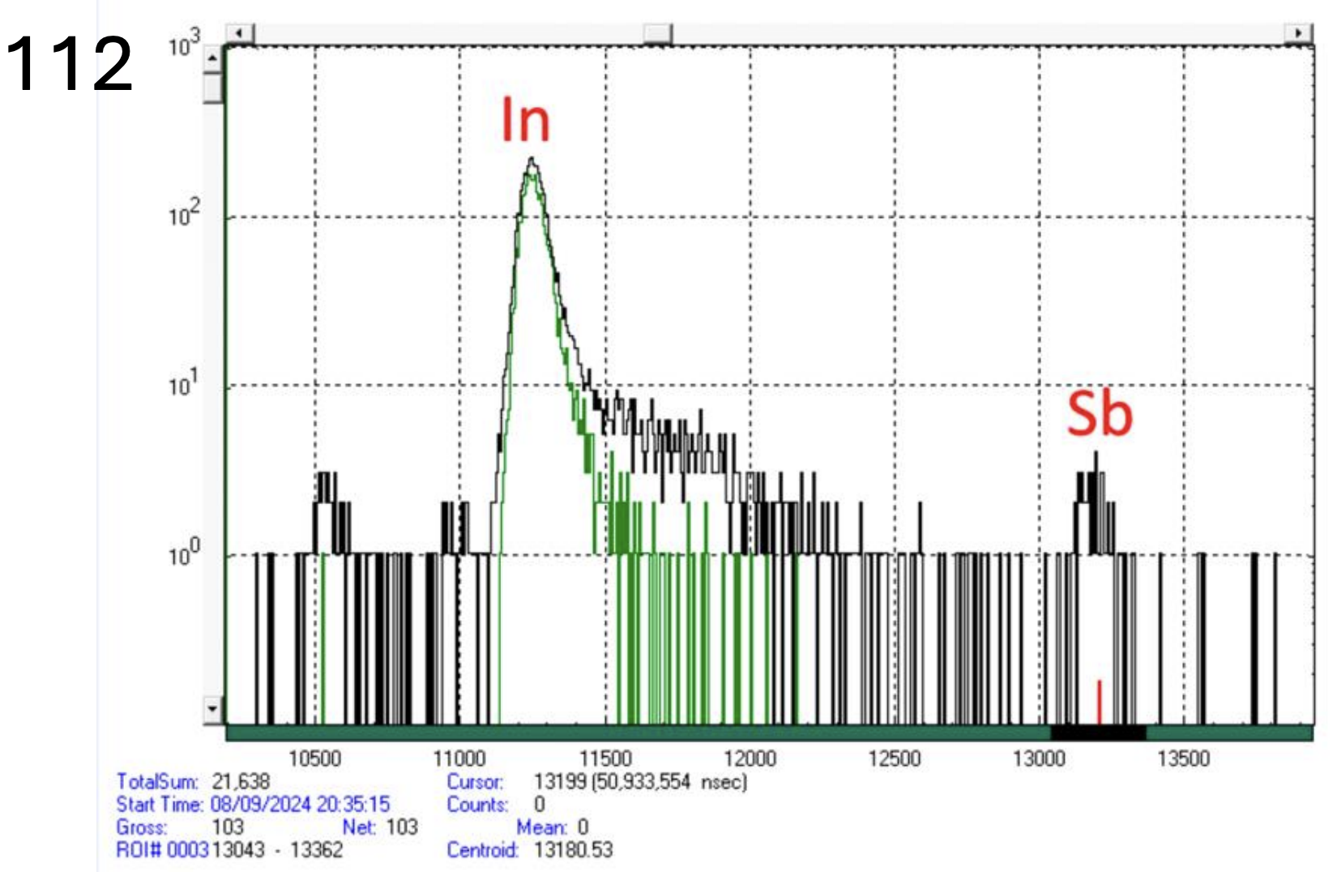
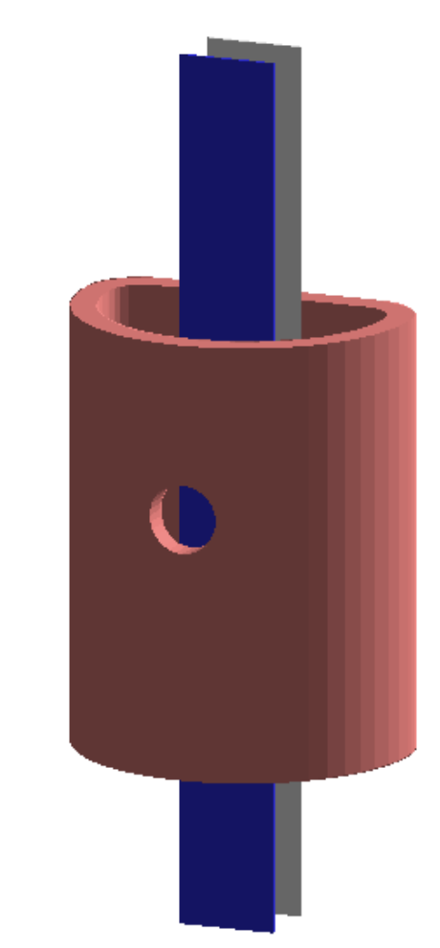
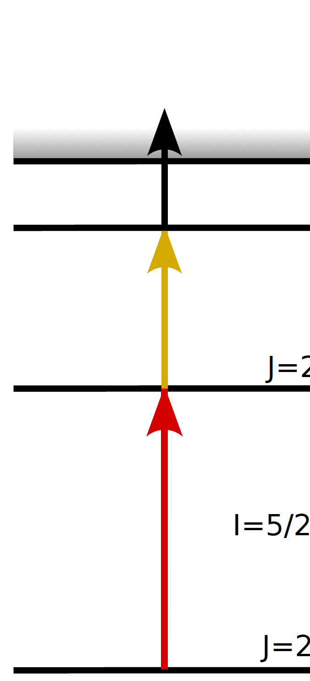
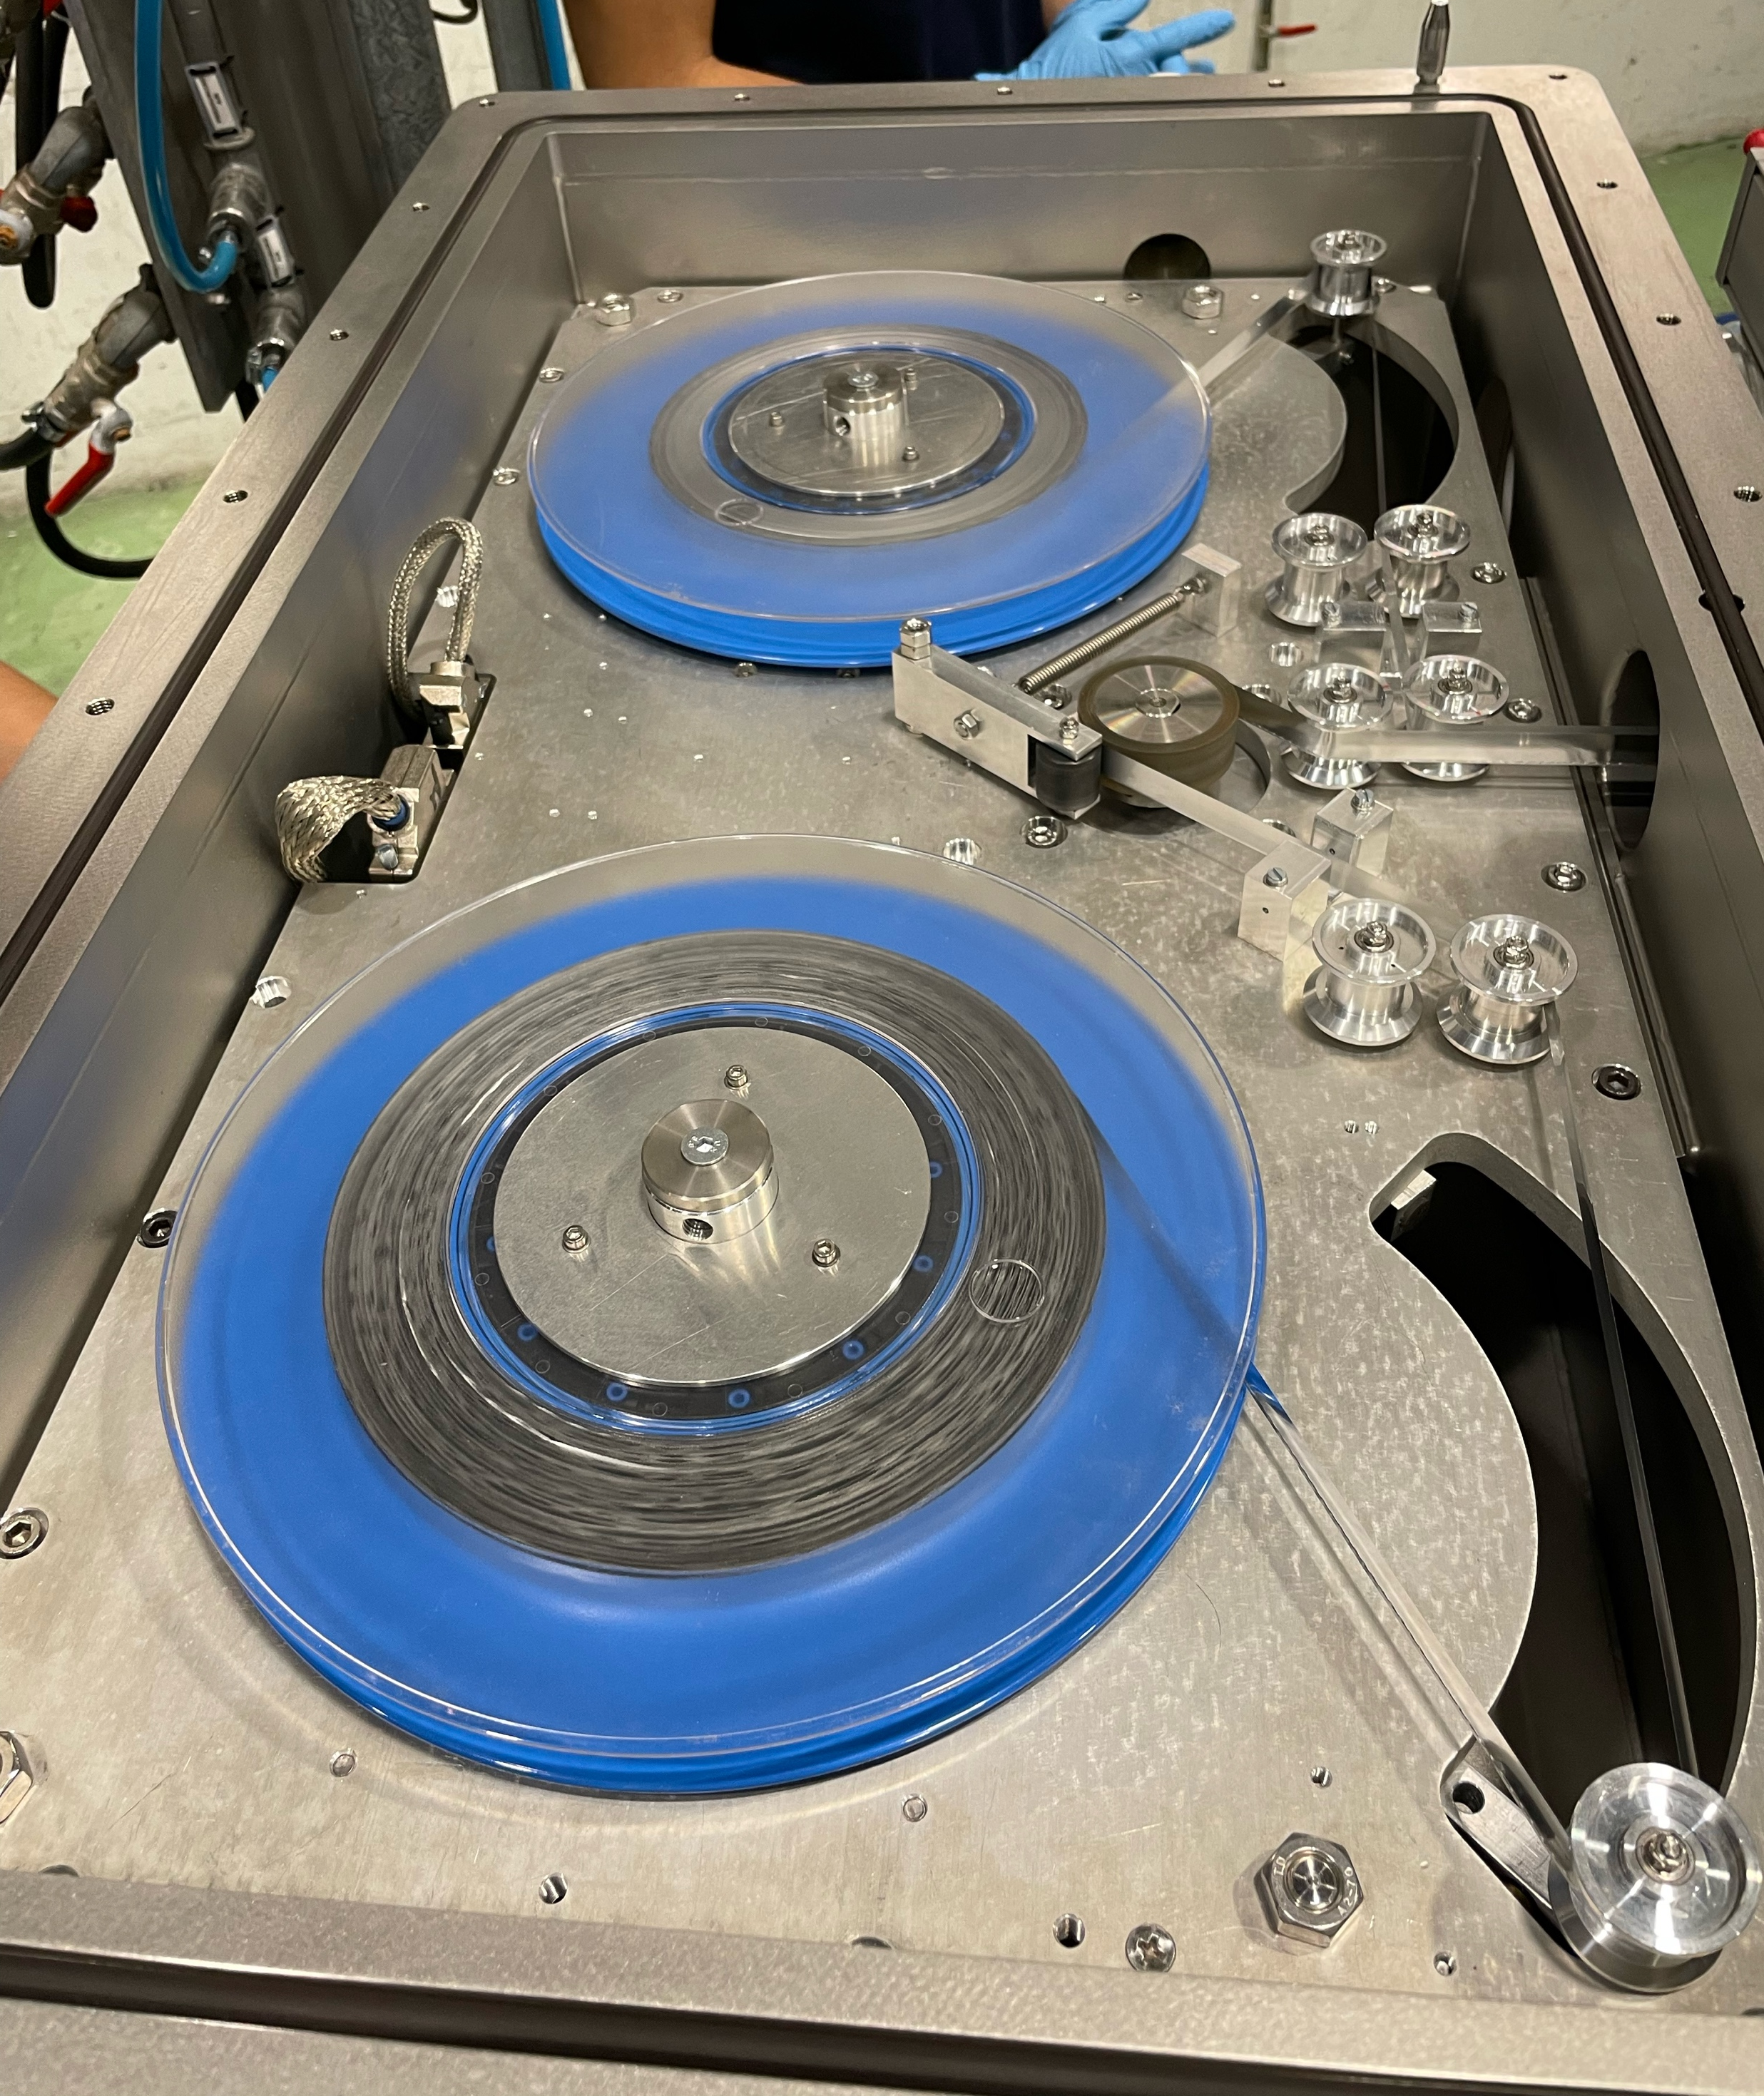
Challenges: low yields and large contamination
112
CRIS technique selective, previously handled 3 orders of magnitude and more of higher contamination, case specific
Upgraded CRIS decay station available with new plastic scintillators
08/21/2021 06:46:33.580
1064 nm
Thanks to ISOLTRAP for beam composition test
Background contributions from
Collisional ionization
Laser related background, especially from high power non-resonant step
Upgraded CRIS DSS for increased sensitivity
New CRIS developments offer further background reduction by 2 orders of magnitude
Notes:
2 orders of magnitude more for 99In
Previous CRIS runs on n-deficient In:
Accidental Mo contamination in target container: increased background on mass 100 hindered ¹⁰⁰In in 2018
Background for ¹⁰¹In from laser scheme on SrF observed

Slide 15
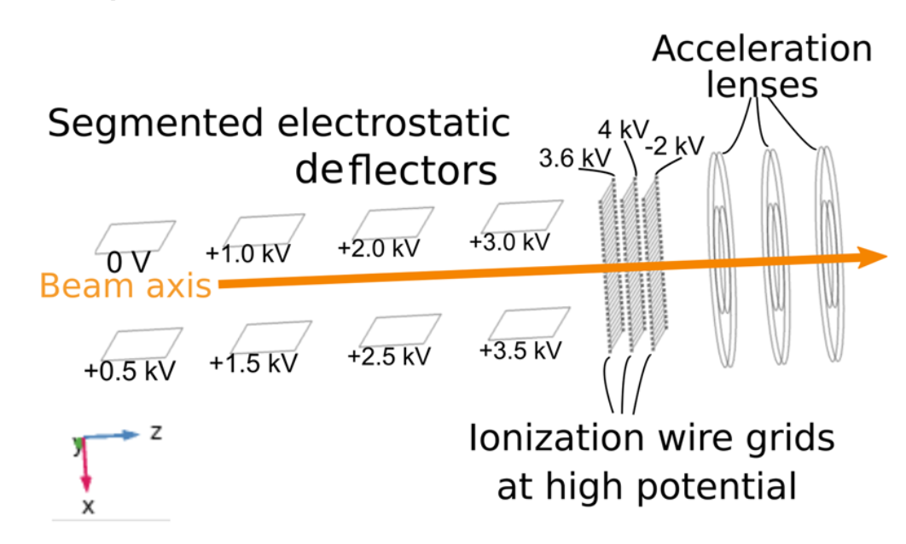
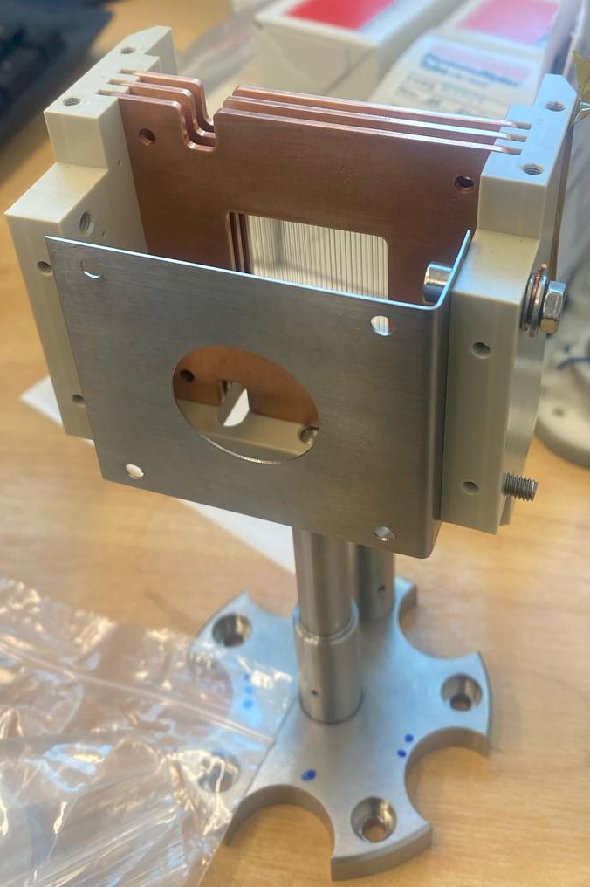
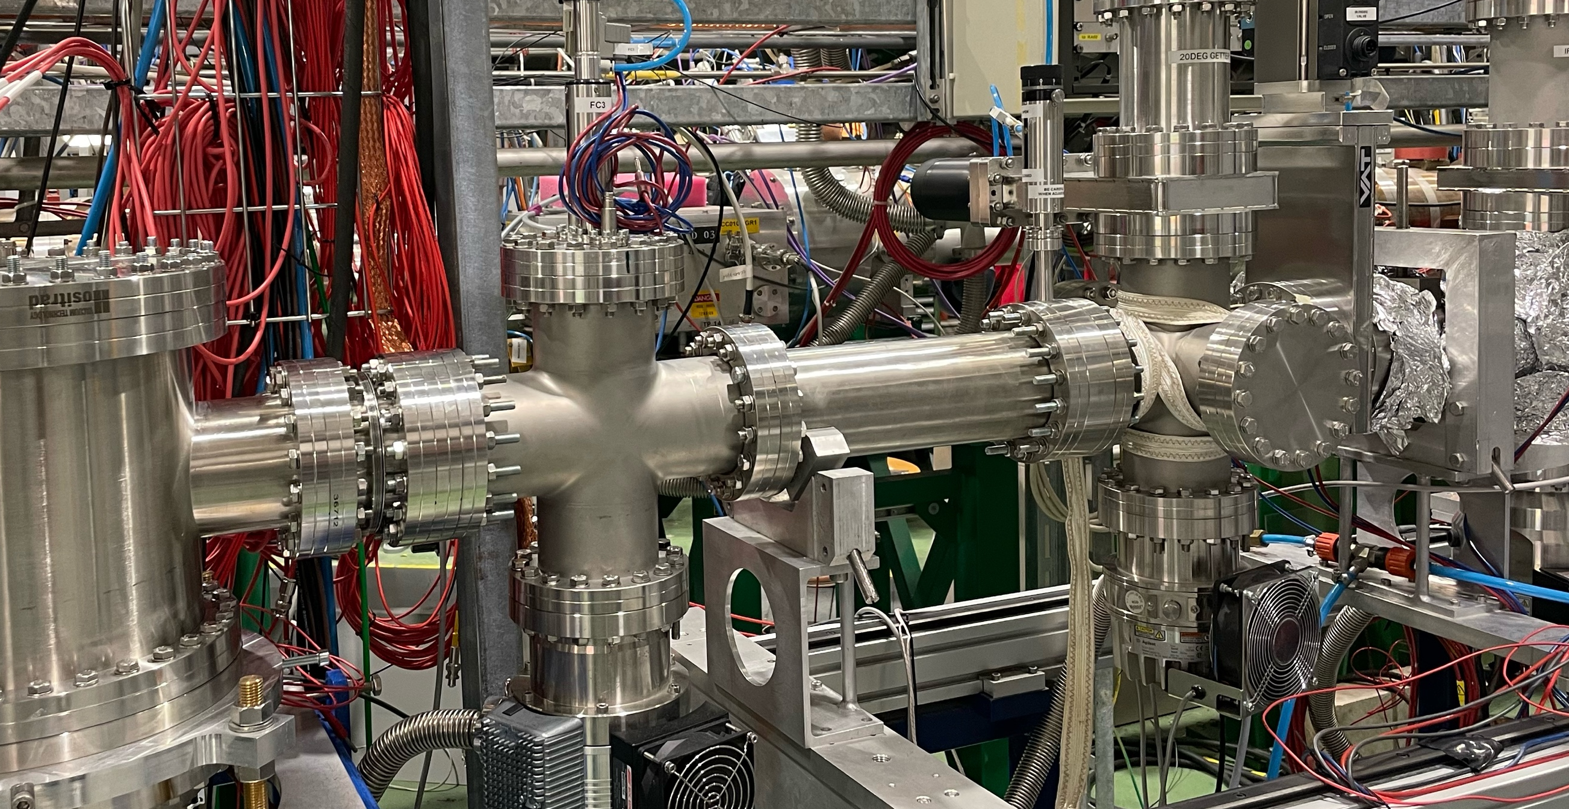
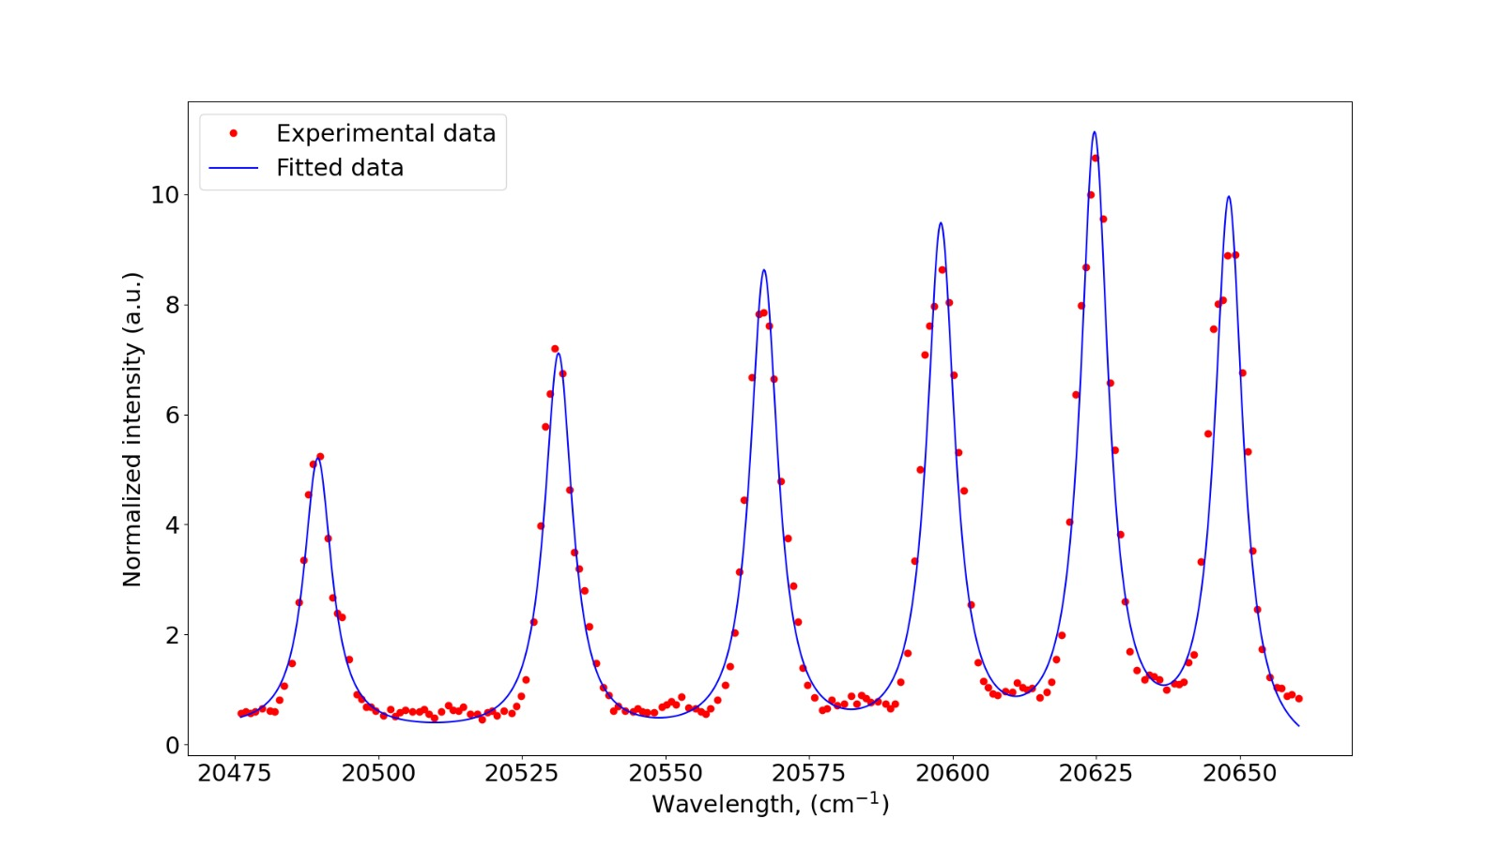
FIU off- and on-line commissioning in 2025
Continuing resurrection of surface ion source, large & “stable” beams for commissioning
Field ionization via Rydberg states
High power laser obsolete
New atomic physics opportunities
Commissioning with stable Ar
Rydberg states
Reduction of interaction window
Minimizing collisional background
A. Vernon et al., Sci. Rep. 10, 12306 (2020).
C. Schulz et al., J. Phys. B 24, 4831, (1991).

Slide 16
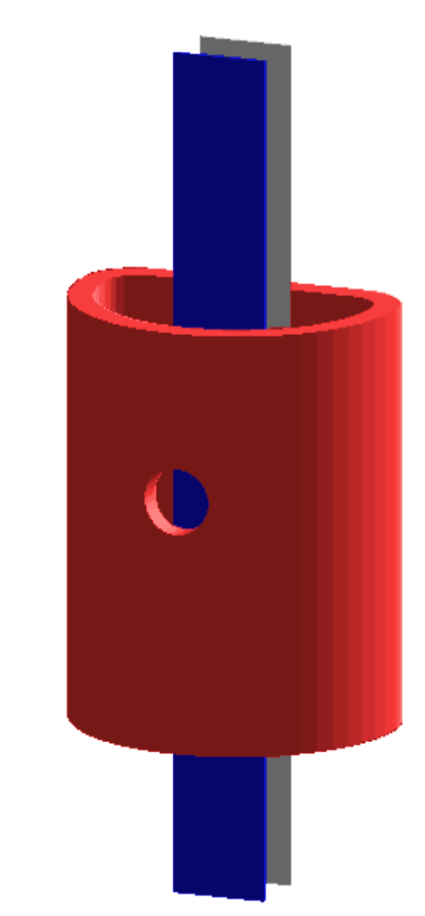
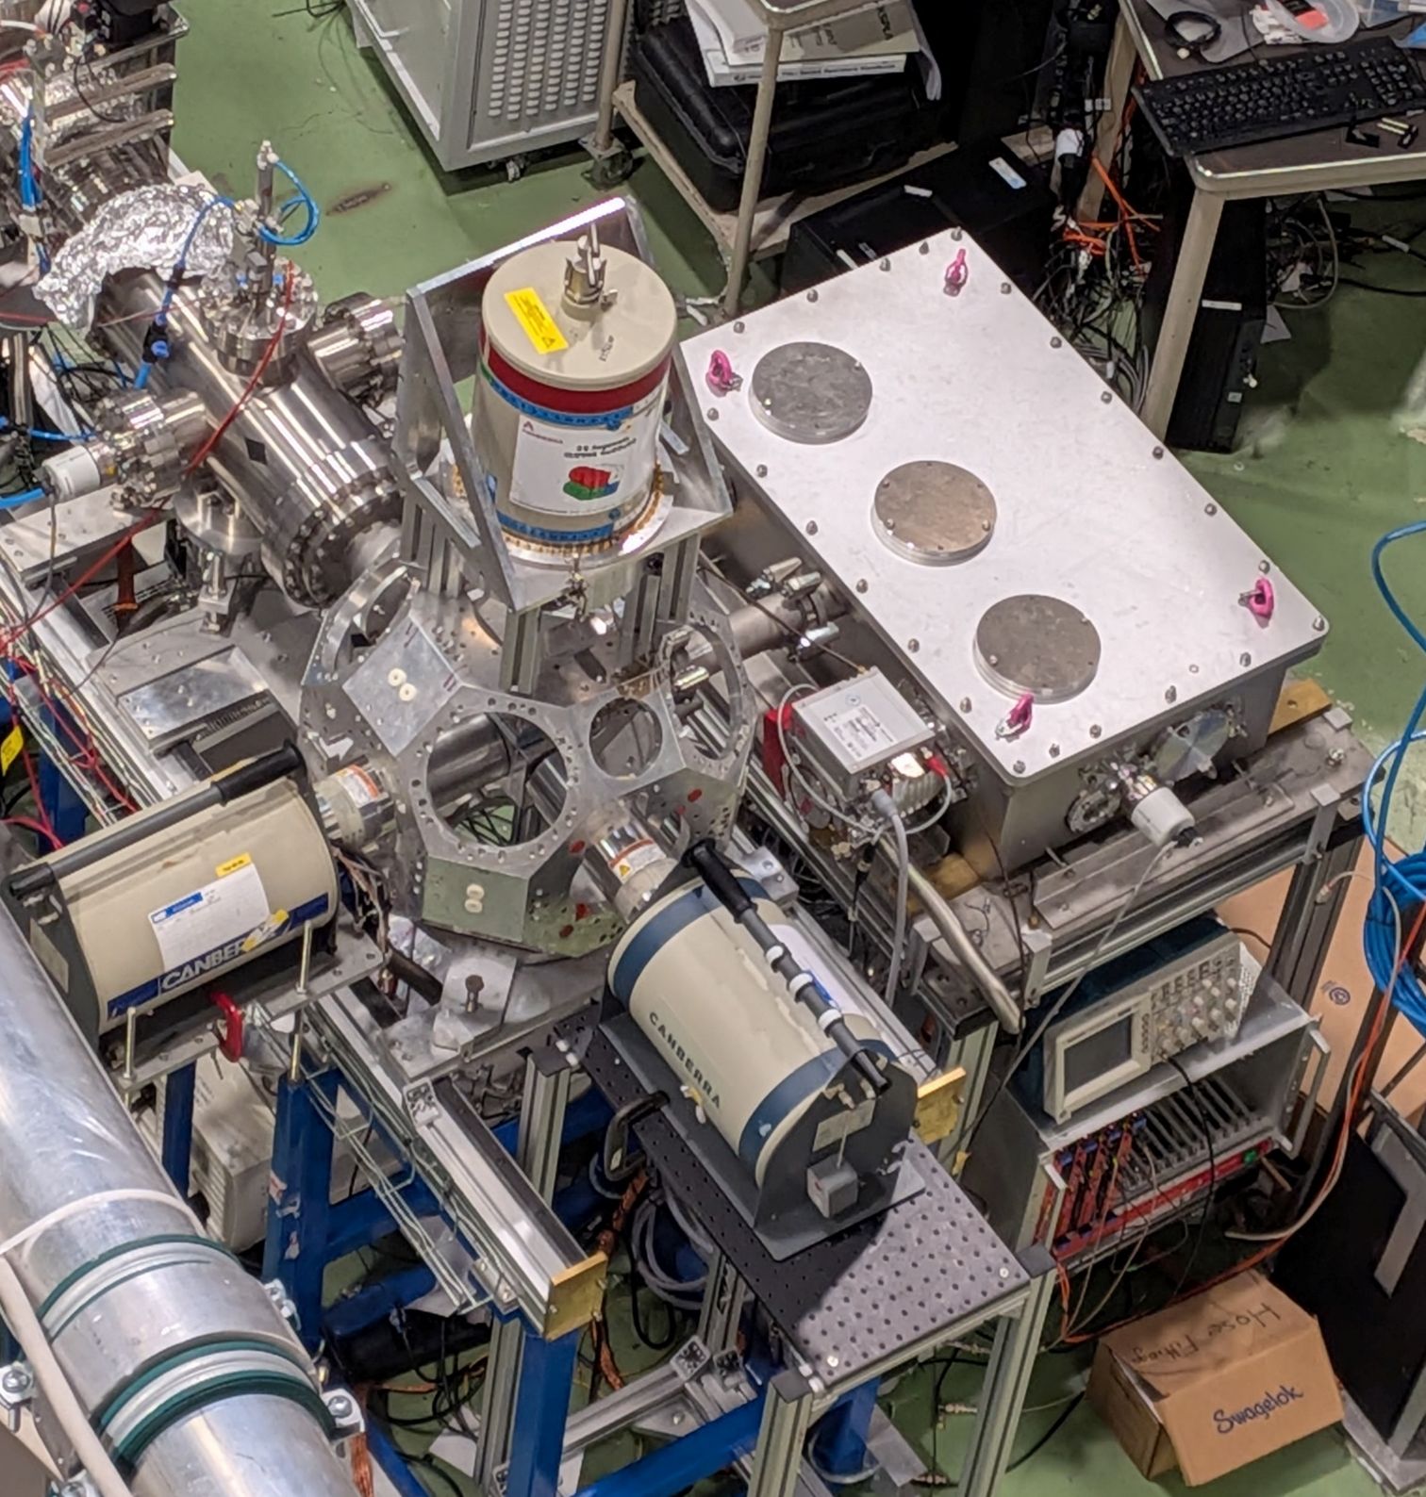
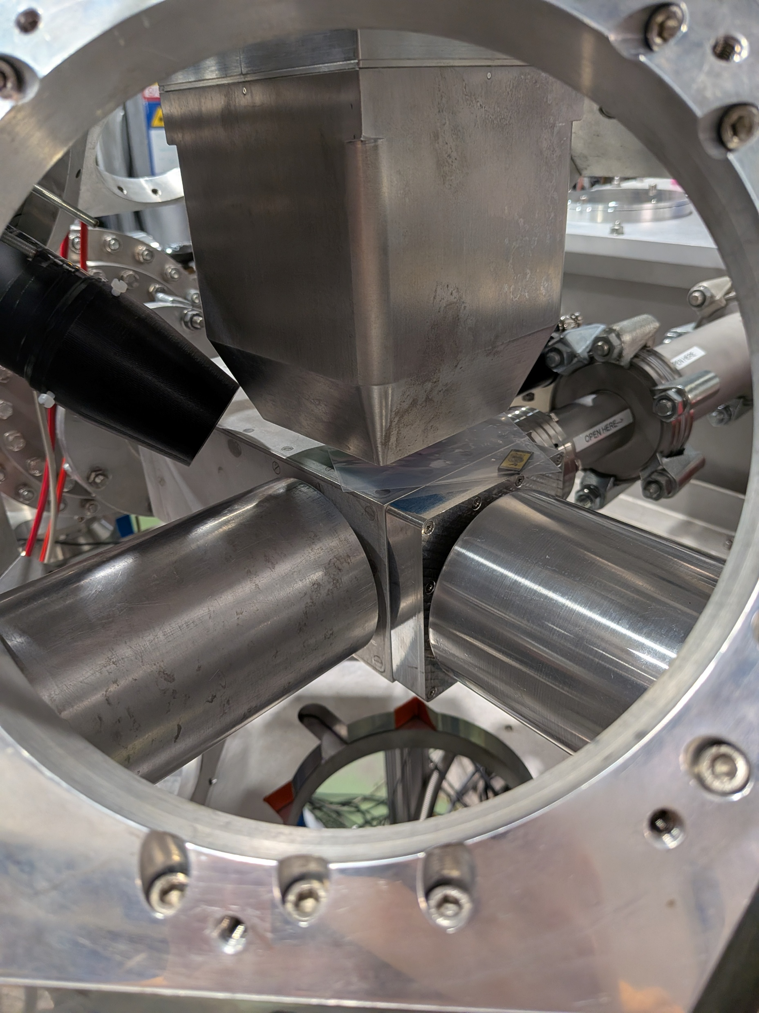
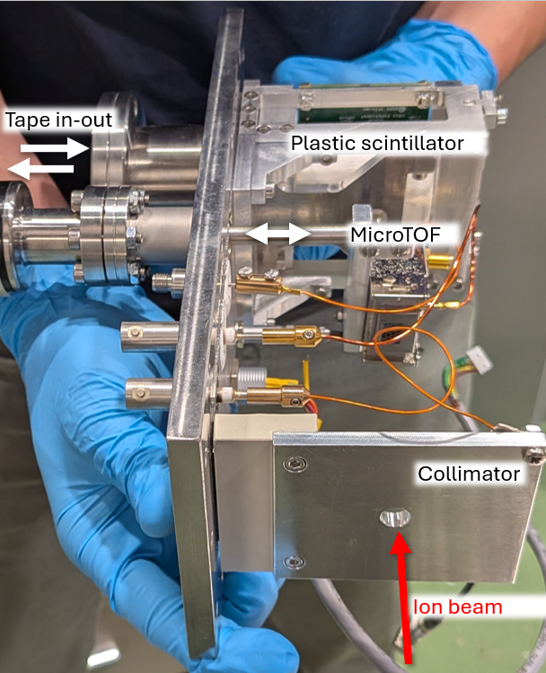
CRIS Decay Spectroscopy Station (DSS)
HPGe clover
LaBr detectors
Tape station
HPGe detectors

Slide 17
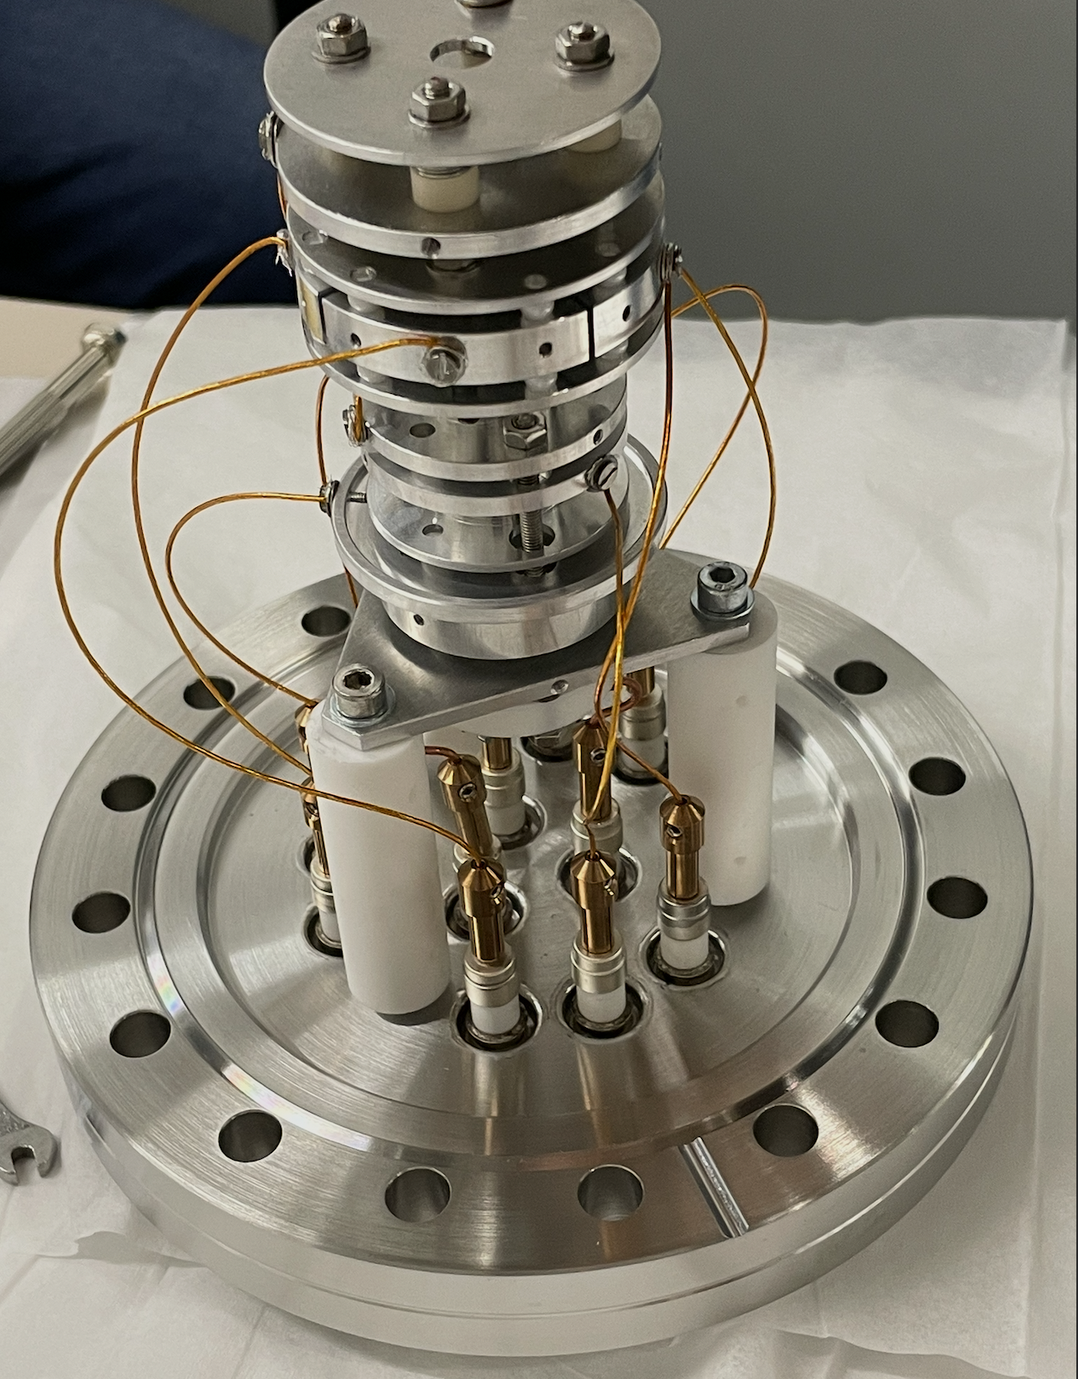
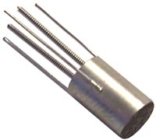
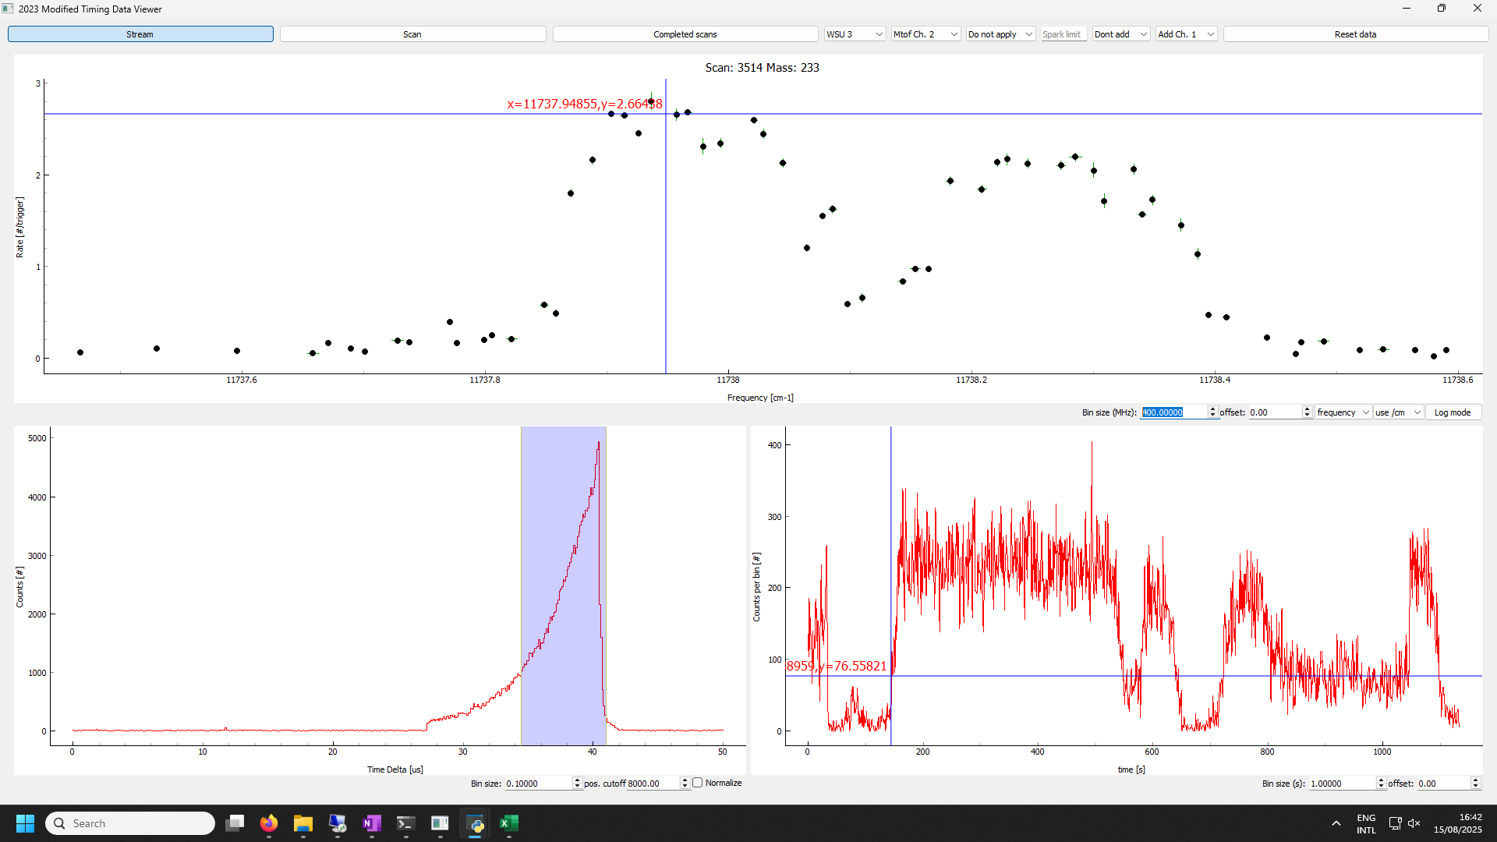
New off-line ion source
Cs: First step scan grating laser
Heat Wave pellet
Isoltrap pellet for commissioning
New pellet with K, Rb, Cs mix for balanced beams
Intense beams (nA) on demand
Still low and unstable beams after 90 Bender: (old) ion source steerers and extraction

Slide 18
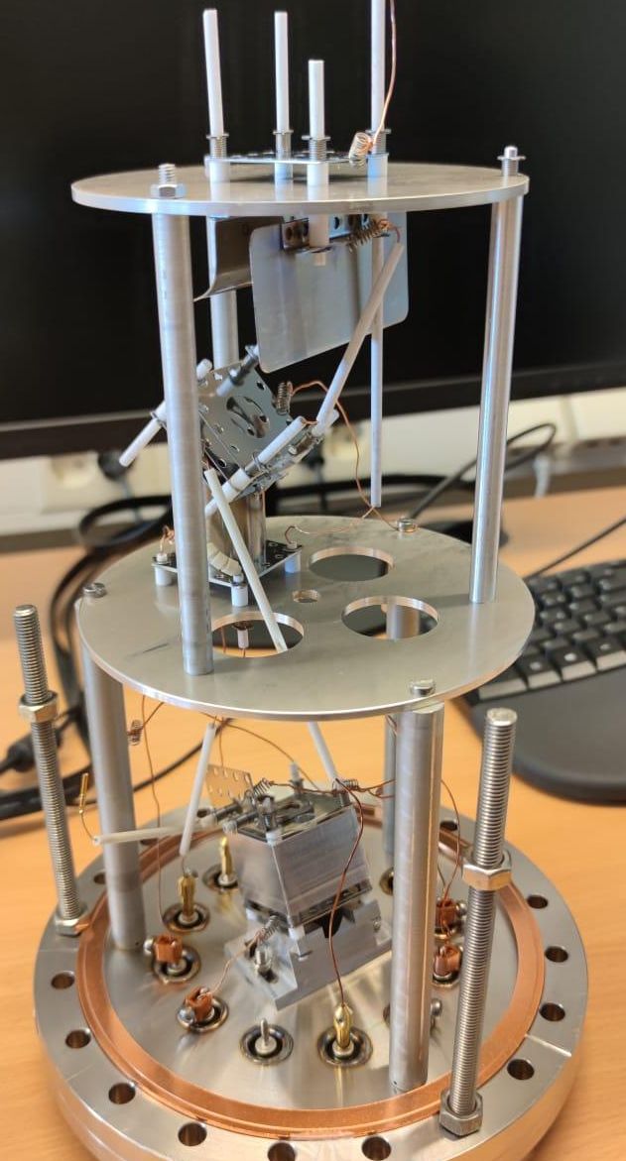
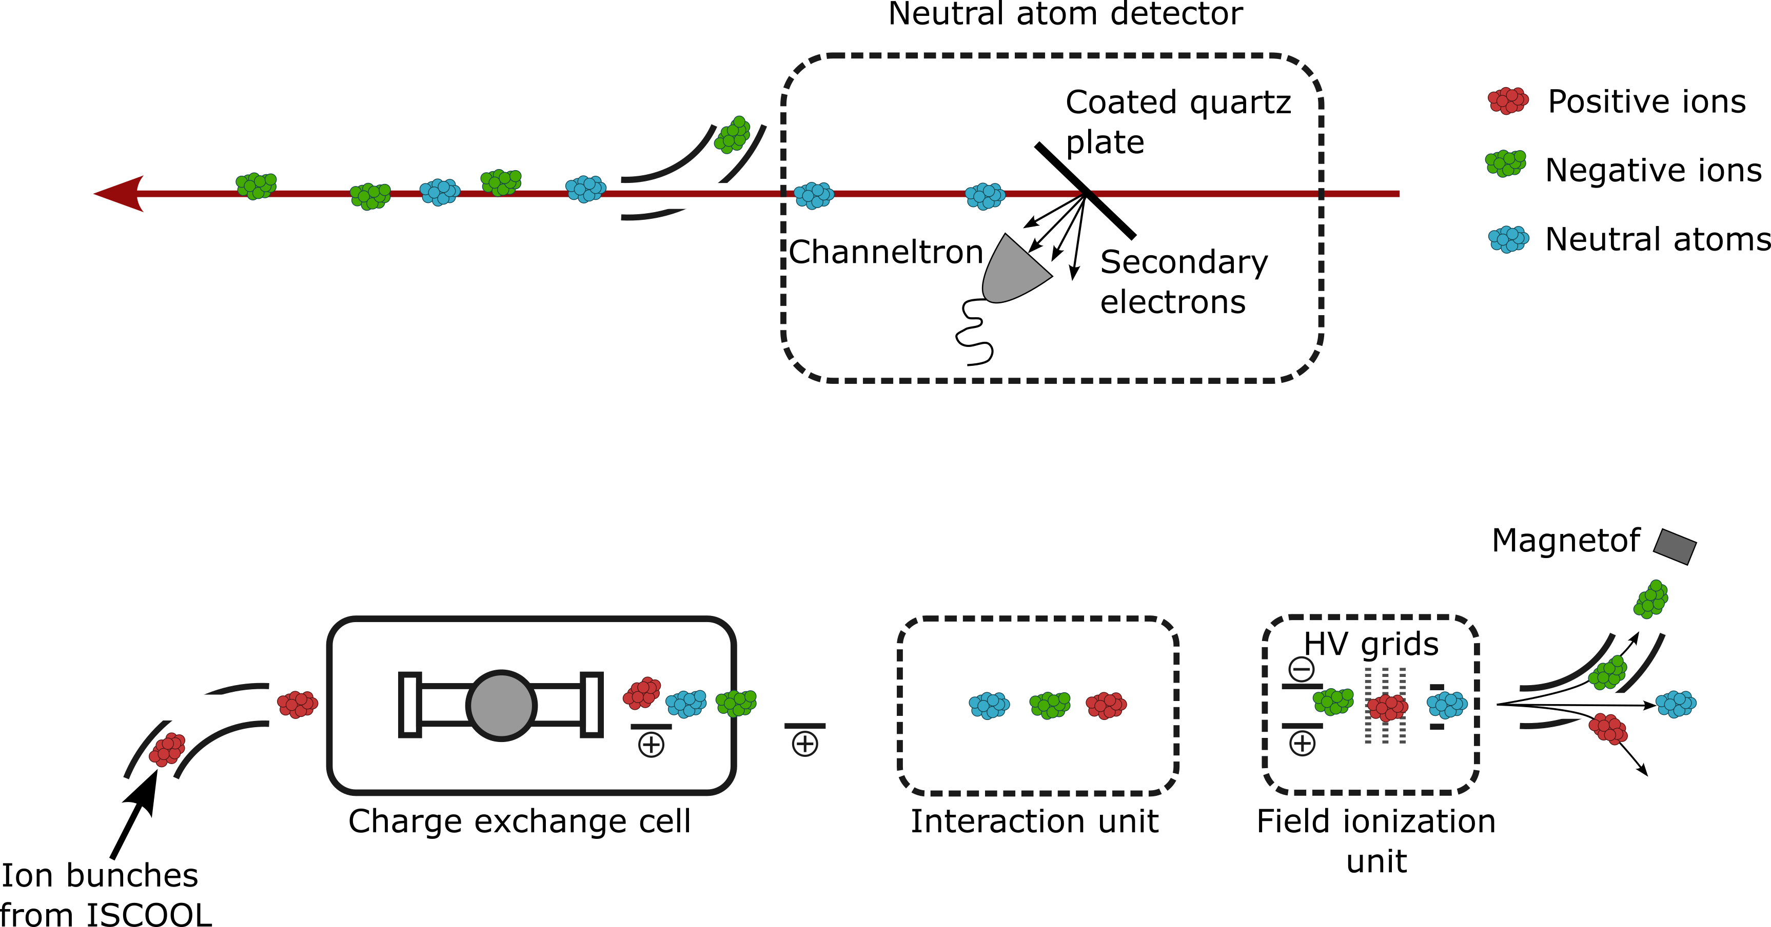
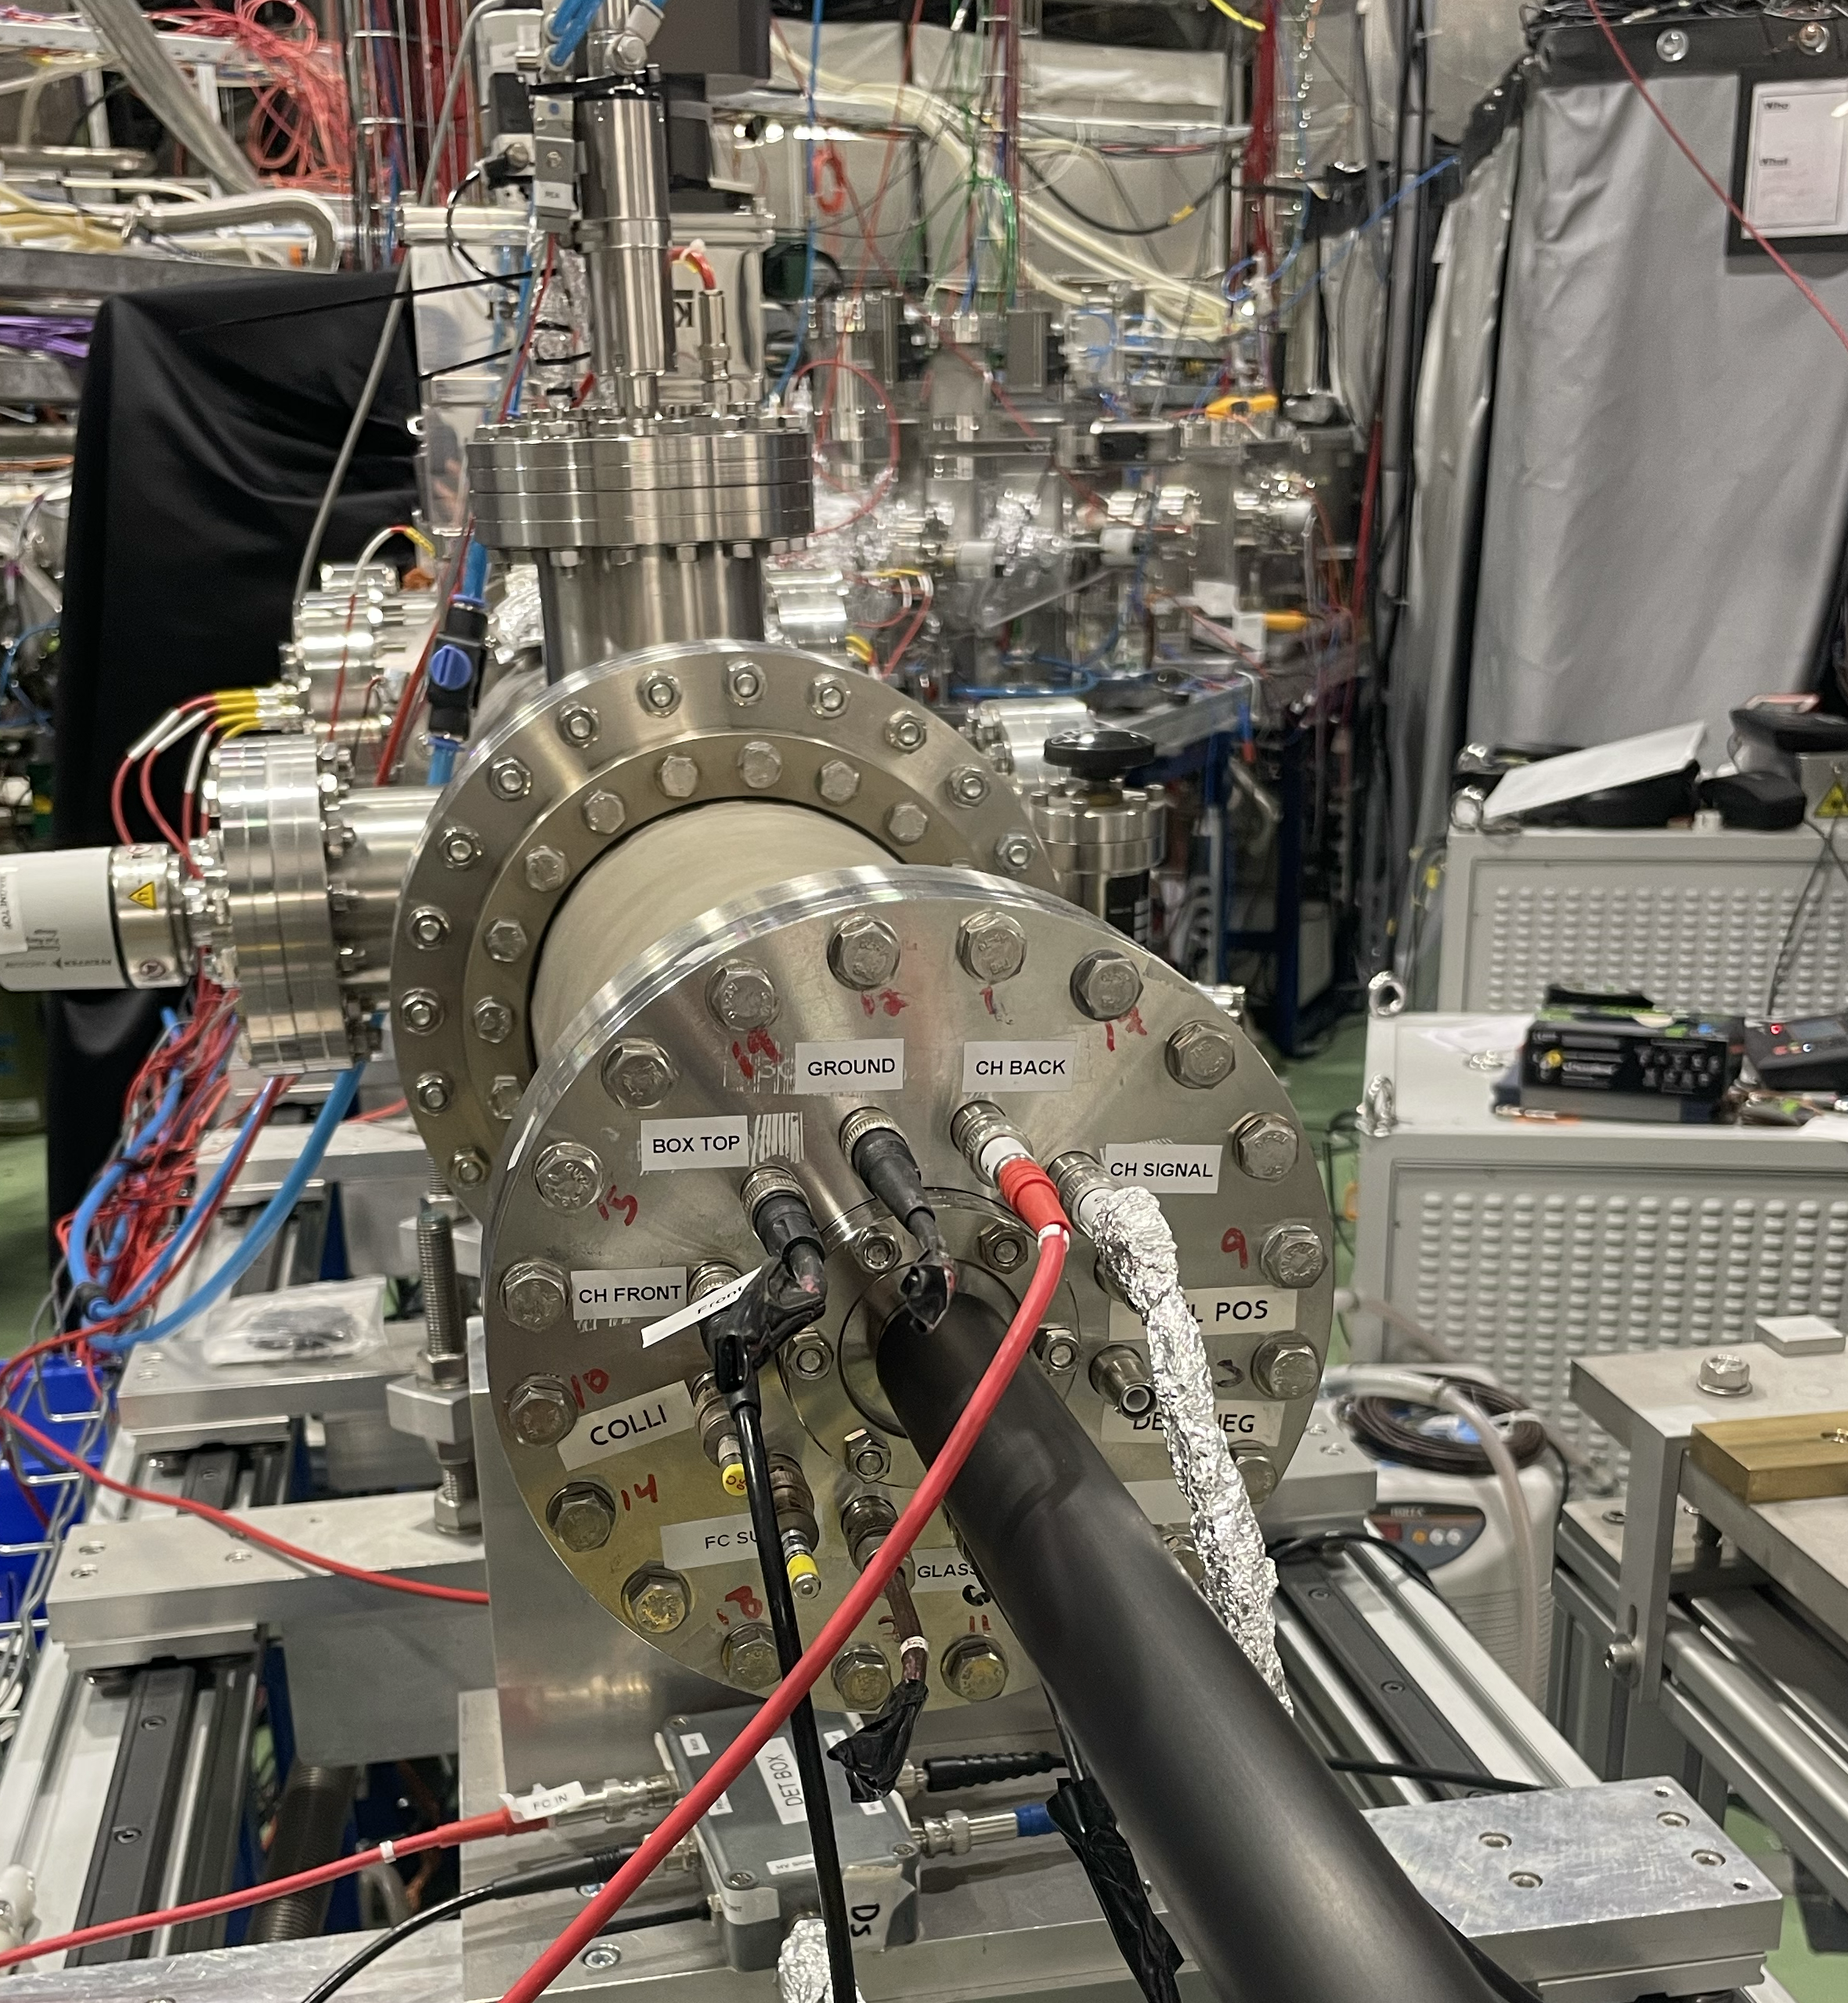
Upgrades for negative ions @ CRIS
GANDALPH type neutral atom detector installed and commissioned at CRIS
OPO

Slide 19
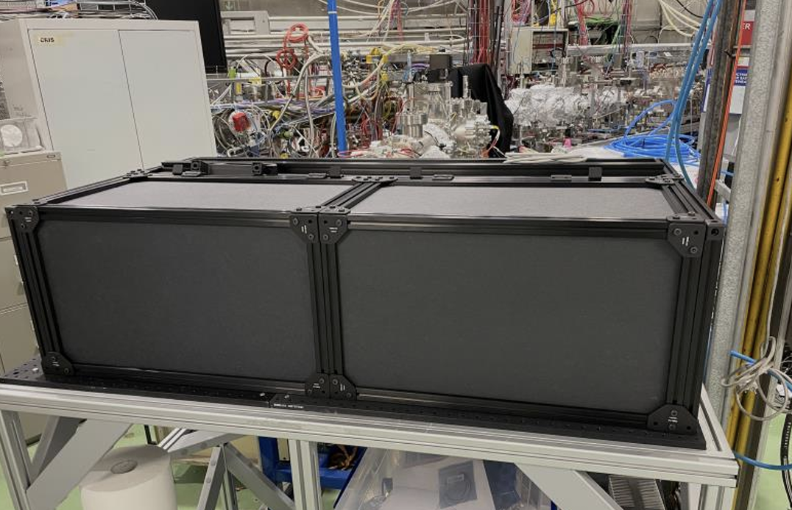
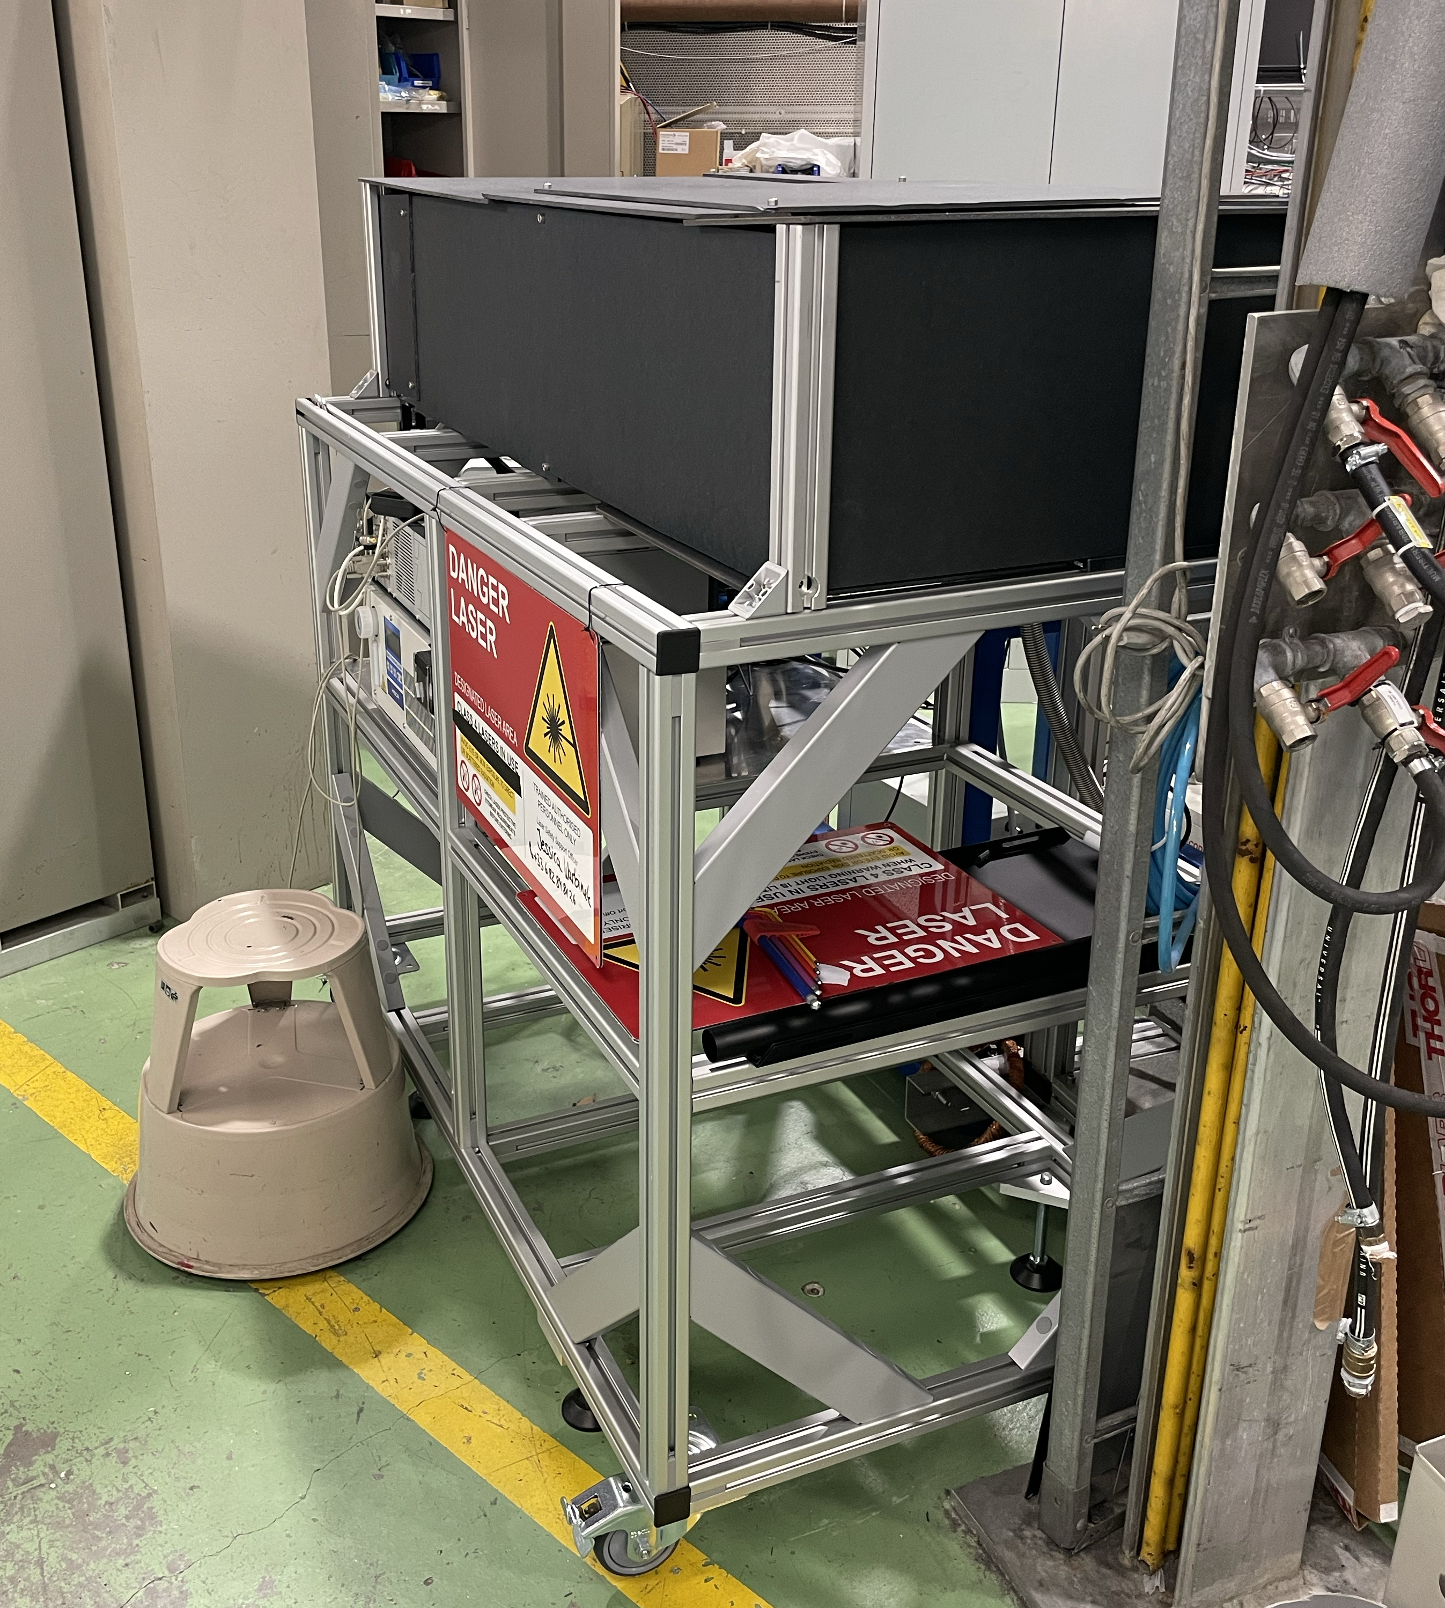
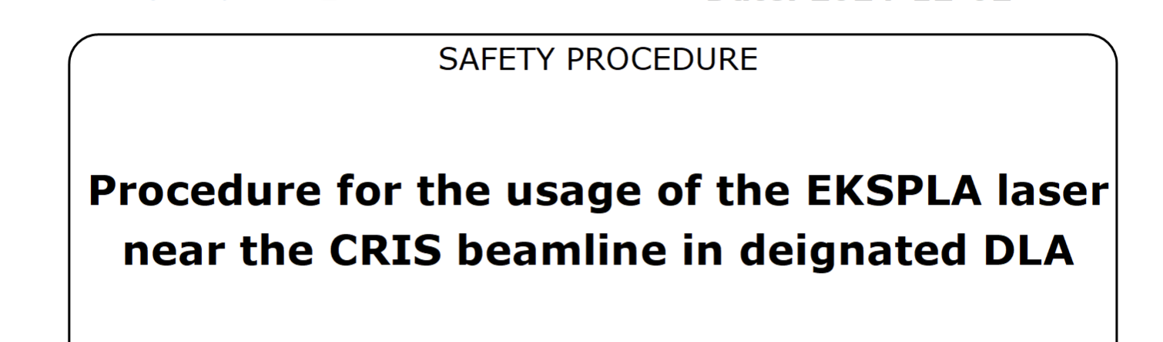
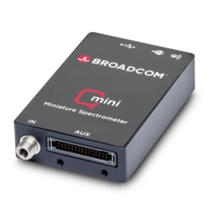
Upgrades for negative ions @ CRIS
Movable DLA created for laser operation at the end of the beamline
Final arrangement not completed
Safety paperwork done and approved
OPO
New bare fibre for TiSa transport: < 50% transmission

Slide 20
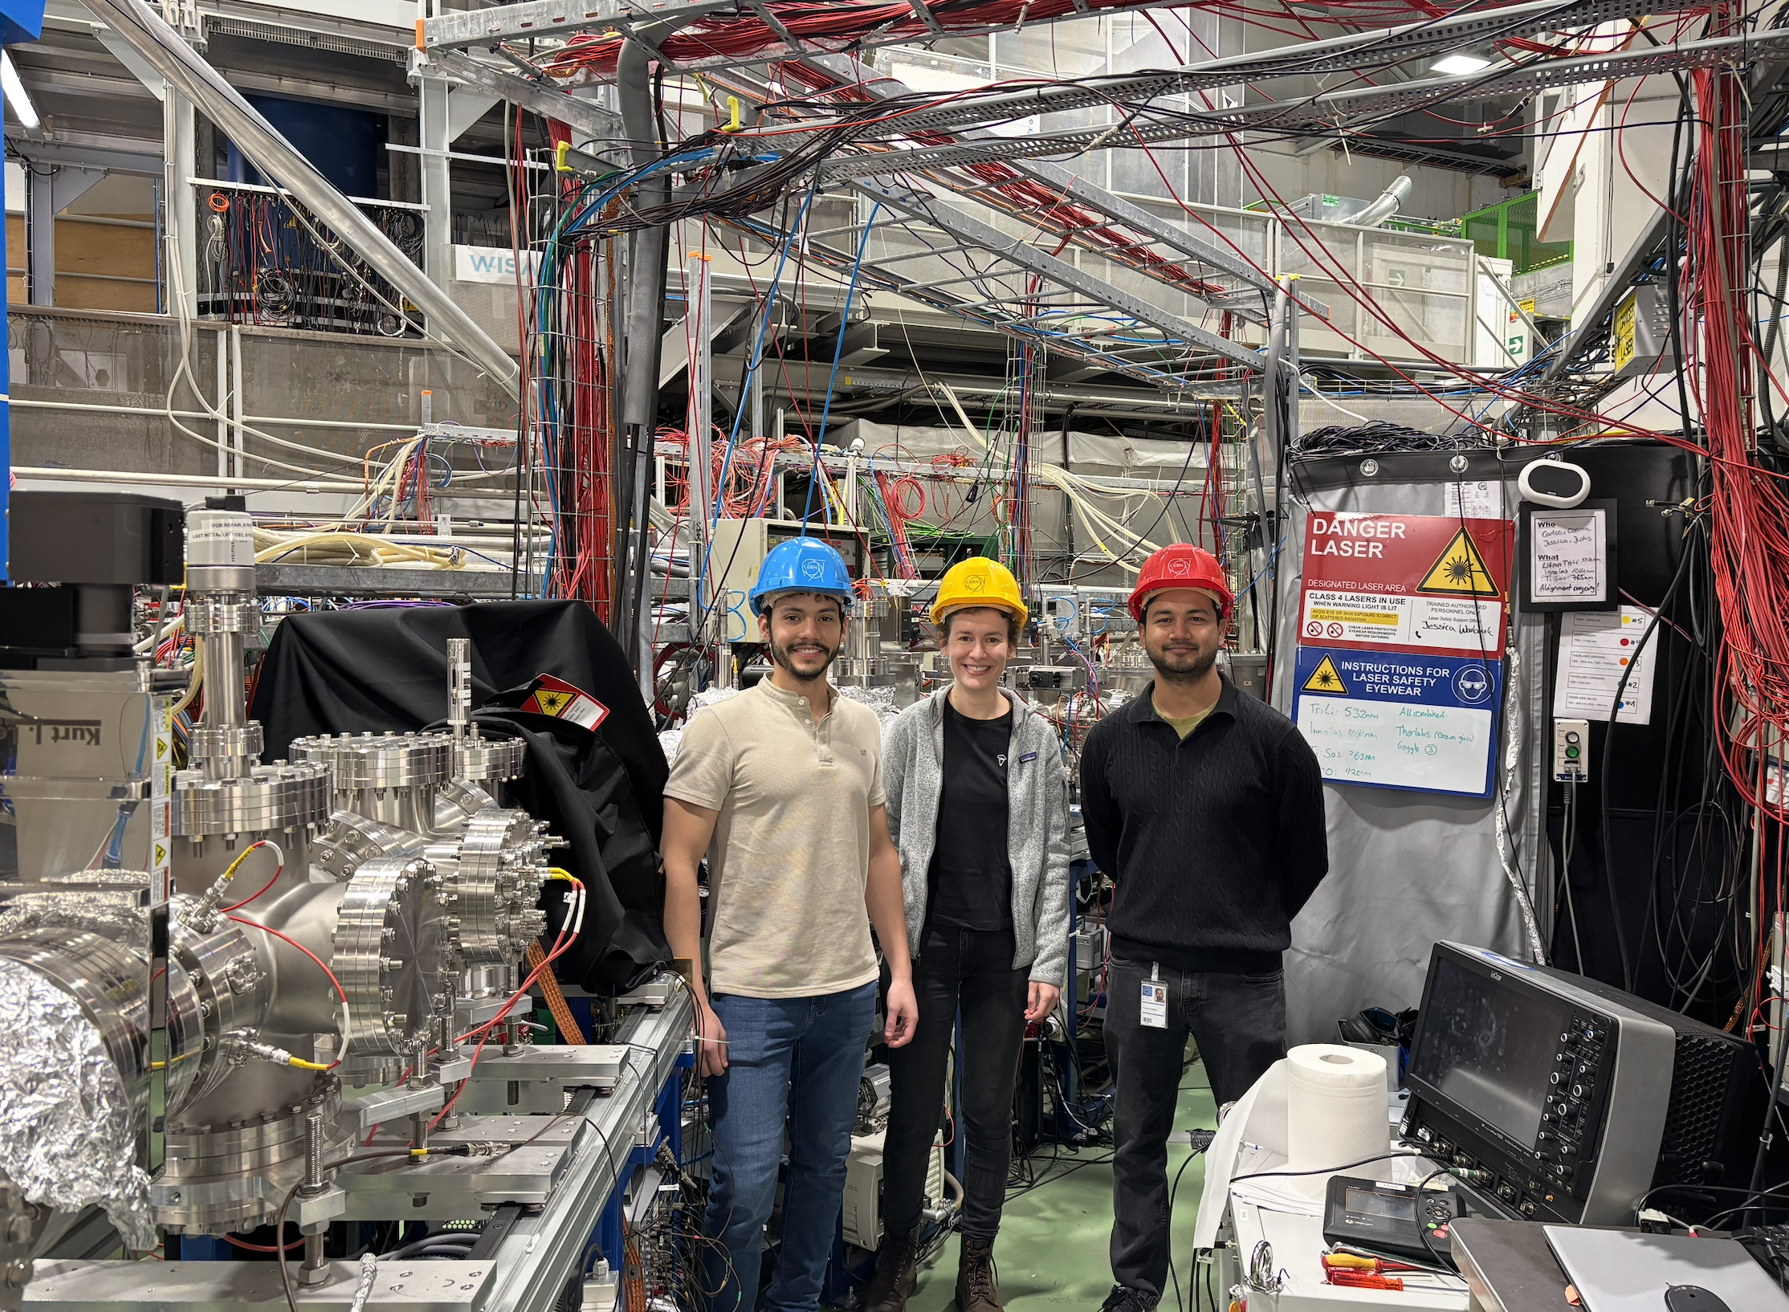

Conclusions & Outlook for 2025
  Successful physics campaigns in 2025
  Laser spectroscopy across the nuclear chart
  Online implementation of FIU 2.0
  First narrowband laser photodetachment studies
  First implementation of full DSS array
  Outlook for 2026
  CRIS in sleepy mode – until off-line campaign?
  Laser transport to their hosts over shutdown – which and where?
  Platform, laser cabin, new frontend of CRIS, new ion source?
  Cleaning up…
CRIS team 2025
Peace - out

Slide 21







Acknowledgments
CRIS collaboration

