Slide 1
LC with Energy Recovery
K. Yokoya
EPFL meeting 2025-1210

Slide 2
Introduction
Most popular direction of extension of linear colliders beyond Higgs is the energy upgrade
It is also possible to go to much higher luminosities using the energy recovery technology
Several ideas have been proposed. Among them ERLC, ReLiC and Ghost Colliders are being considered
I am giving an introduction to these ideas with emphasis on beam dynamics issues. Obviously, very, very brief in 20 minutes.

Slide 3
Two Schemes
Deceleration after beam collision is essential for energy recovery
What to do after deceleration?
Put the beam into a damping ring (DR) and wait (milliseconds) until the beam quality, damaged by the beam-beam interaction, is restored. Then, accelerate the beam again
ReLiC
After a weak damping (e.g., by wigglers), reaccelerate the beam again
ERLC, Ghost Collider
acc
dec
DR
acc
dec

Slide 4
Energy Transfer
There are many varieties of energy transfer schemes from the beam to be decelerated and the beam to be accelerated
Must be in the same RF cavity or in the two electrically connected cavities
How to avoid collision in cavities?
ERLC,
Ghost 1
ReLiC
Ghost 2
Timing difference
2 right and 2 left going beams
Don’t care collision
Twin-Axis cavity

Slide 5
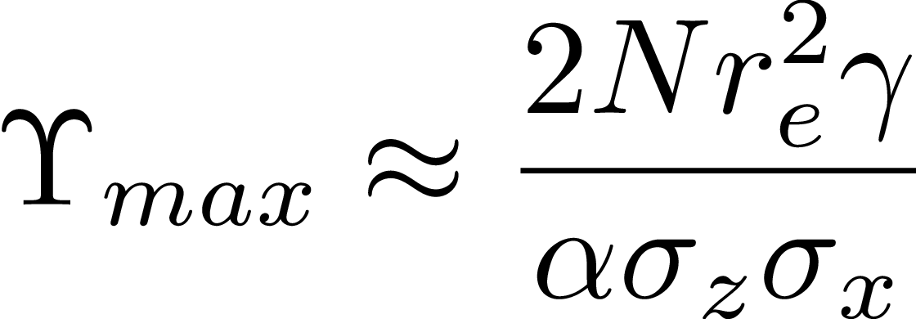
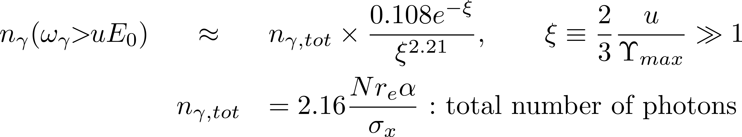
Common Problem: Tail of Beamstrahlung
High-energy tail of beamstrahlung causes low energy electrons/positrons
They cannot be accepted by the DR (or the beam transport line for [B])
Energy compressor (bunch expander)
The important parameter is the critical energy (divided by E₀)
The number of photons with energy > $uE_{0}$ is

Slide 6
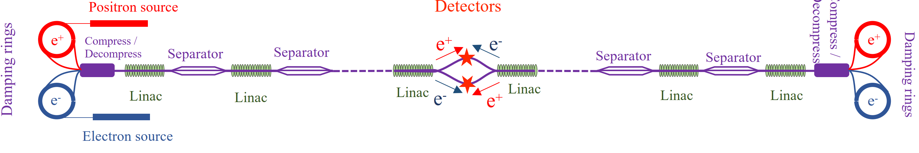
ReLiC
polarized e⁺e⁻ Recycling Linear Collider with high high-energy, high luminosity reach (V. Litvinenko, T.Roser, et.al.)
SNOWMASS2021
See V. Litvinenko LCWS2025 for the latest
2 linacs each accelerates e+/e- and decelerates e+/e-
Beams cooled every cycle in DR
linear collider concept
Do not care about beam-beam tune shift
Avoid collisions of oppositely running beams by time separation
2IPs, e+/e- and e-/e;

Slide 7
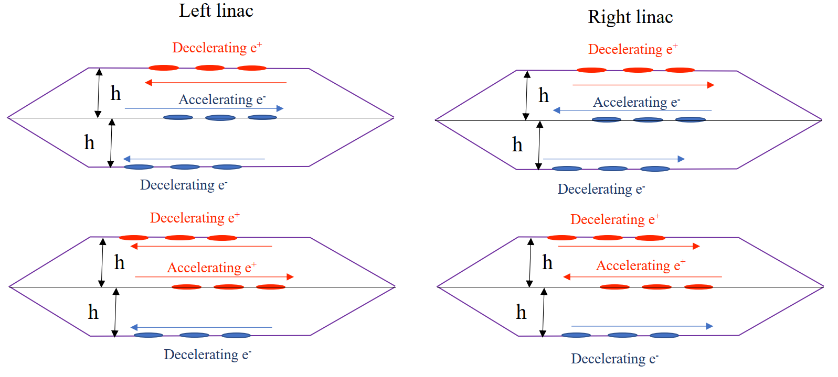
Acceleration/Deceleration Scheme
All 4 beams (acc e+, acc e-, dec e+, dec e-) all go through cavity center
180 degrees of for e+/e- same direction
acc and dec beams do not encounter in cavities
They encounter in the sections between cavities where acc and dec beams are separated by electro-magneto separators
h must be estimated. Original value too small

Slide 8
Beam Current Limitation
Energy loss by synchrotron radiation in DR
E_{DR} = 2.5 GeV, for example
Each particle stay in DR for 2 damping time → energy loss 2x2.5 = 5 GeV
Every particle loose 5GeV from IP to IP
If beam current is 100 mA, for example, the total radiation loss = 100mA x 5GeV = 500MW
Max beam current < ~10mA per beam
Parameters in the next page say the beam current in linacs = 12mA
This presumably means 3mA for each beam
Must go to large bunch population
In contrast, ERLC must go to low bunch population to avoid HOM loss → too high beam current
Accordingly,
Very high disruption
Very small vertical emittance
Note: horizontal beam size must be large to suppress Upsilon

Slide 9
Suggested Parameters of ReLiC
CM Energy | GeV | 250 | 550
Length of 1 accelerator | km | 14.25 | 14.25
Accel. gradient | MV/m | 12.55 | 27.6
Bunches per train |  | 5 | 21
Particles per bunch | 10¹⁰ | 2.5 | 2.5
Collision frequency | MHz | 1.5 | 1.5
Beam currents in linacs | mA | 12 | 12
εx, norm | μm.rad | 4 | 4
εy, norm | nm.rad | 1 | 1
βx | m | 2.2 | 4
βy (matched) | mm | 0.19 | 0.36
σx | μm | 6 | 6
σy | nm | 0.9 | 0.9
Disruption param Dx |  | 0.01 | 0.01
Disruption param Dy |  | 87 | 88
Total luminosity | 10³⁴ | 140 | 153
Cavity Q0 4x10¹⁰
Temperature 4.5K (Nb3Sn)
σ_{z} not found
Parameters are changing
Here, I use
https://agenda.linearcollider.org/event/10624/attachments/40242/63966/LCVision_Generic_backup_EPPSU.pdf

Slide 10
Key Technologies for ReLiC
CW cavity
High Q (>10¹¹ if 1.5K). Ideal if Nb3Sn cavity developed
HOM damping
But twin-axis cavity not needed
DR:
Very low vertical emittance (ε_{ny}=1nm),
Cf. ε_{ny}=20nm in ILC DR
Short damping time (~ 1ms)
large energy acceptance (>~10%)
Bunch separation O(ns), beam current > 1A
Sokolov-Ternov polarization (Vladimir says possible)
MHz rate injection/extraction kicker, O(ns) rise/fall
Bunch compressor: ~15x at 10GeV

Slide 11
Key Technologies for ReLiC (cont’d)
Small emittance increase in the main linacs
Increase of normalized emittance << 1nm
(ILC ~15nm in single pass)
Flat beam control (emittance ratio ~4000)
Design of Final Focus System
High disruption (Dy ~ 100)
Luminosity loss
How much (transverse) damping time needed to restore the emittance?

Slide 12
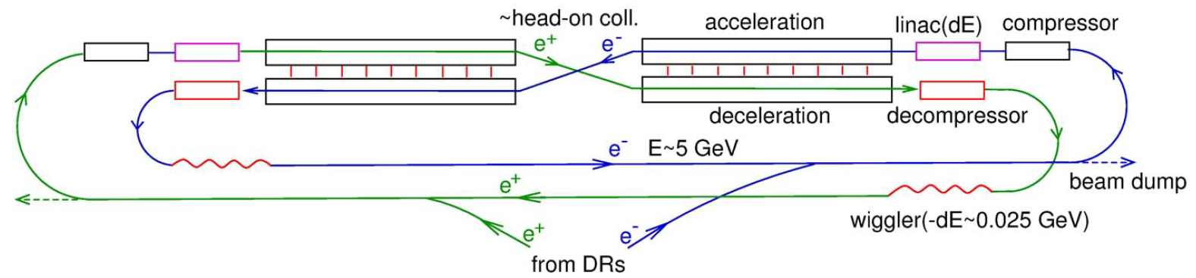
ERLC (Energy Recovery Linear Collider)
Proposed by V. Telnov
LCWS21 telnov-lcws21.pdf
arXiv: 2105.11015 (May 2021)
JINST 16 (2021)12, P12025
At first proposed for Ecm=250GeV
Possible energy upgrade has been discussed in the v3
e-e- Collider is proposed recently (LCWS2025) I do not touch it here.

Slide 13
Outline of ERLC
ILC-like structure plus
Inverse FFS (Final Focus System) after collision
Decelerating linac from 125GeV to ~5GeV
Bunch length decompressor
Turn around, wiggler (1/200 = 25MeV loss), another turn around
Energy Recovery : Electrons during deceleration create RF which accelerates positrons (vice versa)
Deceleration and acceleration linacs must be “linked”
“link” by couplers (LCWS) is almost impossible due to high power
So, “link” by Twin Axis Cavity → To be discussed later
In spite of the name “ERLC” and its shape, the principle of the entire system is more like circular collider
Concept of the beam-beam tune-shift limit plays an important role
Must also work as damping rings

Slide 14
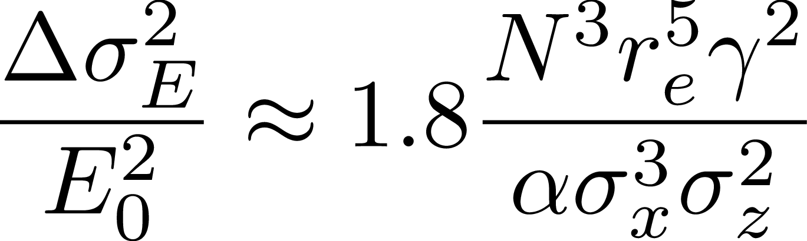
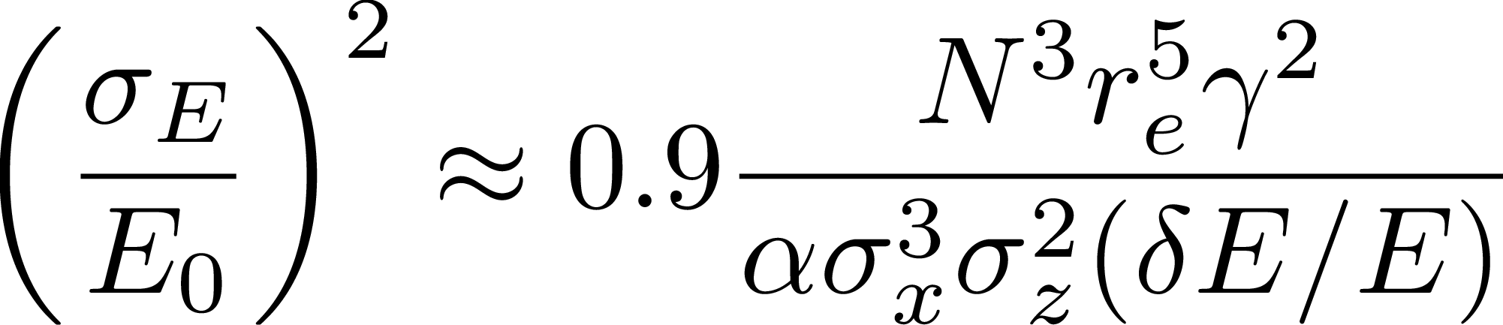
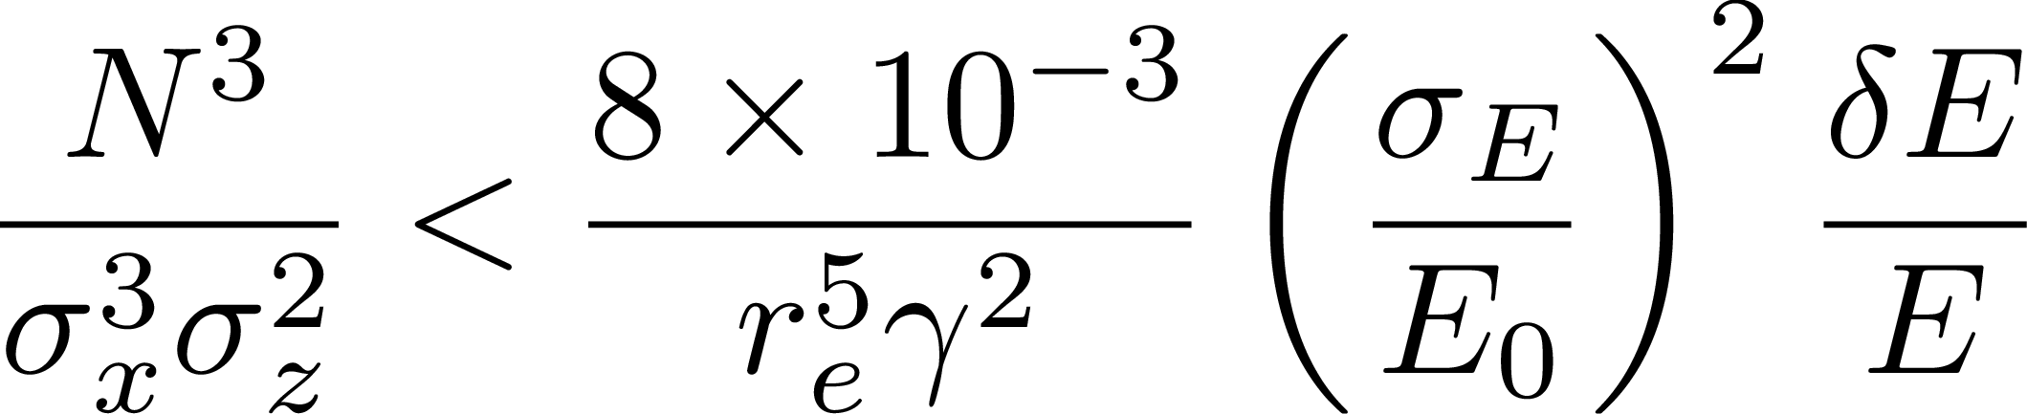
Basic Conditions (1)
Energy spread due to the beamstrahlung
The energy spread created by one collision
Equilibrium with the damping (δΕ_{wiggler} /E_{DR} = 1/200)
Gives the equilibrium
Then, the constraint at IP

Slide 15
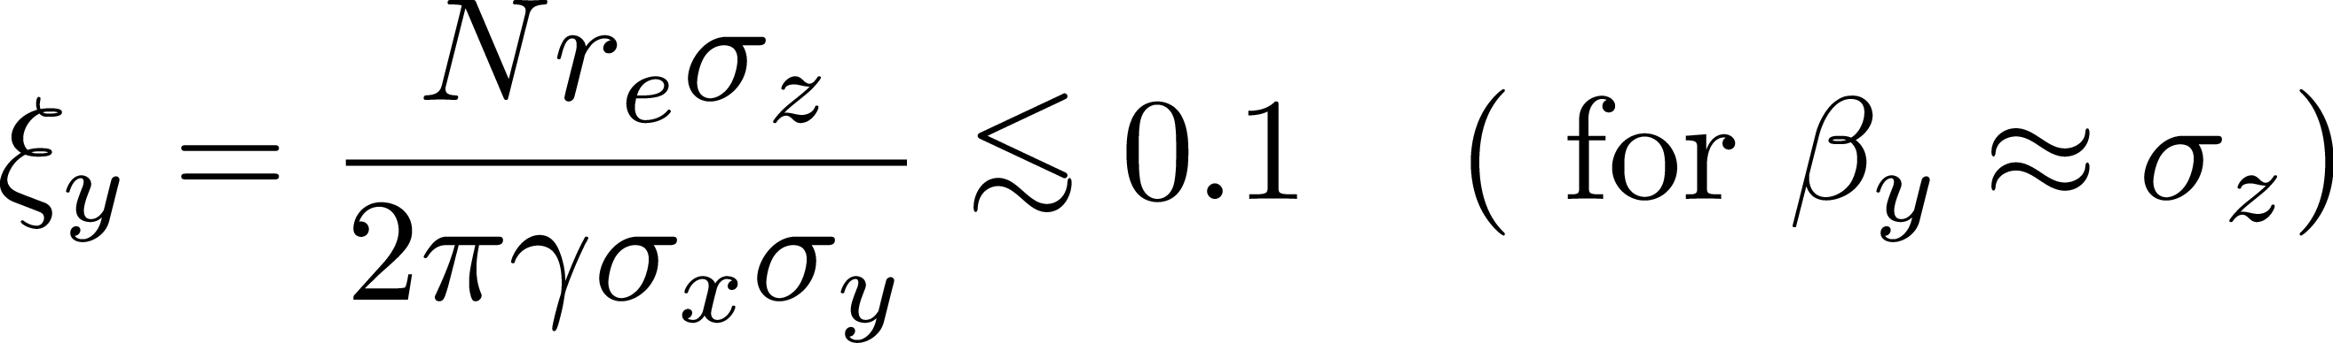
Basic Conditions (2)
Beam-beam tune-shift limit
Same as in circular colliders

Slide 16
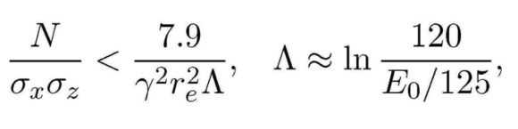
Basic Conditions (3)
Beam lifetime due to the beamstrahlung tail
Beamstrahlung creates long low-energy tail of electron/positron distribution
They are lost when the momentum bandwidth of the ring is exceeded, causing beam lifetime
After beam-beam, the beam is decelerated 125GeV → 5GeV (relative energy spread increased).
Bunch decompressor necessary after deceleration: assume energy spread x 1/10, bunch length x 10)
Assume the momentum bandwidth of 5GeV line ~ 3%
Then, the acceptance at IP is η = 0.03 x 10/25 = 1.2%
Required lifetime n_{col} ~ 10⁶ turns
Telnov, LCWS2025

Slide 17
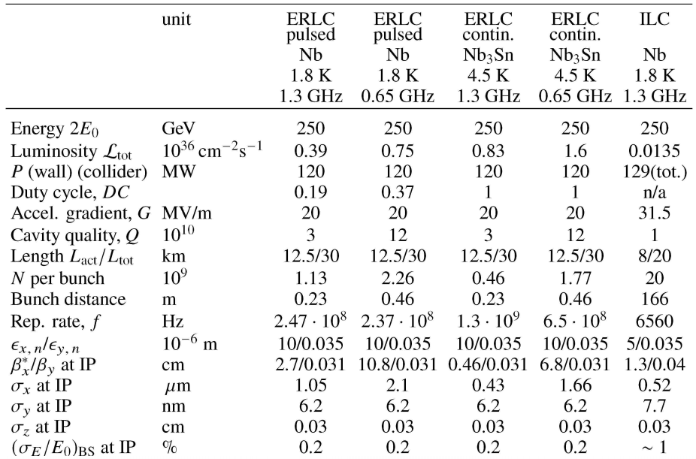
Latest Parameters of ERLC (250GeV)
Beam current 235 mA
Too high !!
Telnov, LCWS2025

Slide 18
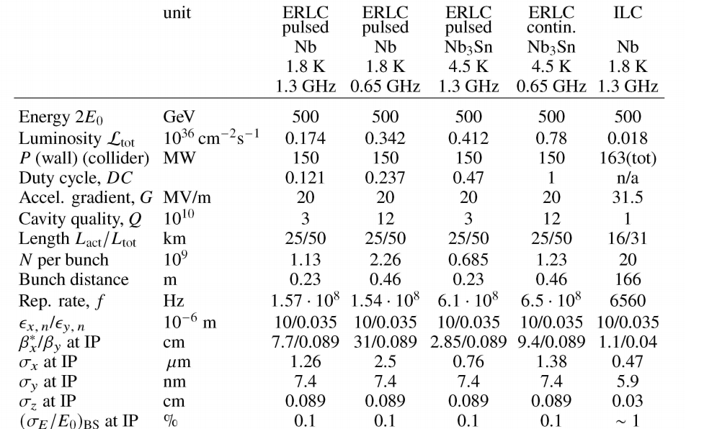
Latest Parameters of ERLC (500GeV)
Telnov, LCWS2025

Slide 19
AC Power and Cost
Evaluation by European Strategy for Particle Physics -- Accelerator R&D Roadmap
https://arxiv.org/abs/2207.02095
Page195
In the first version,
Refrigeration 92 MW
RF compensation of HOM loss 30M W
Compensation of energy loss in wiggler 5.3 MW
Total Wall Plus Power ~130 MW (Others --- DR, BDS, etc, may be ~15 MW)
More detailed estimation strongly depends on the HOM extraction, cavity Q₀, choice of duty cycle (ideally, CW), refrigeration efficiency, etc.
Cost: presumably more than 2 x ILC

Slide 20
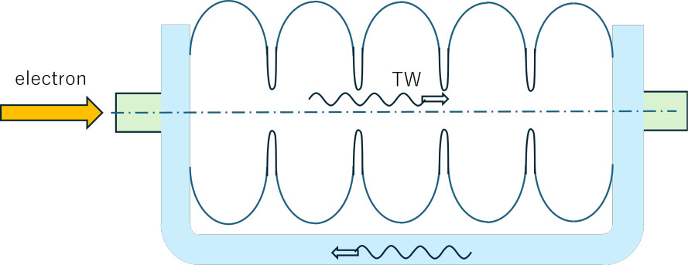
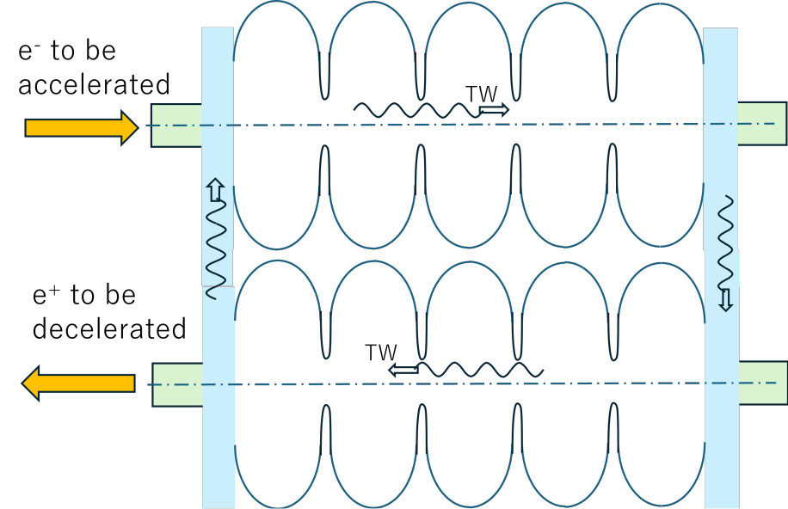
TW Twin-Axis Cavity
ERLC requires twin-axis cavity
Travelling Wave idea
S. Belomestnykh, et.al. arxiv 2307.06248.pdf. 2209.01074.pdf
SW = TW(right)+TW(left)
TW(left) does not contribute in acceleration
Use waveguide for the return wave
This idea can be adopted in ERLC twin-axis cavity
KY LCWS2024, ERL2024
Can effectively gain factor ~1.7

Slide 21
Beam Dynamics Issues (1): General
The entire system is a damping ring with extraordinary long insertion (~ 20km) of
BC (bunch compressor)
Acceleration linac
FFS
IP (beam-beam)
FFS
Deceleration linac
BD (bunch decompressor)
Damping time
25MeV energy loss by wigglers and arc magnets
Longitudinal : 200 turns
Transverse : 400 turns

Slide 22
Beam Dynamics Issues (2) Transverse
Damping time is 400 turns
Stochastic effects accumulate over 400 turns, e.g.,
Dogleg in FFS (to create dispersion necessary for chromaticity correction)
Linacs due to the geoid-following orbit (ILC)
Bunch compressors
Emittance increase in the linacs due to misalignment and wakes
ERLC adopts 35nm of vertical normalized emittanceat IP (same as ILC)
ILC expects ~15nm increase in the linac (20nm → 35nm)
Crazy number if multiplied by 400
Major part of ~15nm would not accumulate
But how large is the cumulative component?
Chromatic filamentation
Ground motion faster than ~10 kHz
Also, beam-beam disruption?
Careful studies are needed

Slide 23
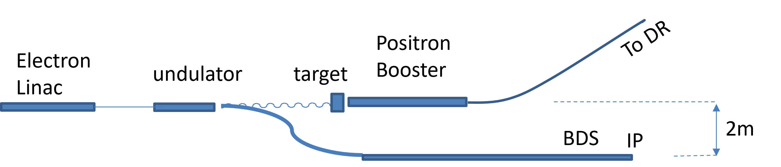
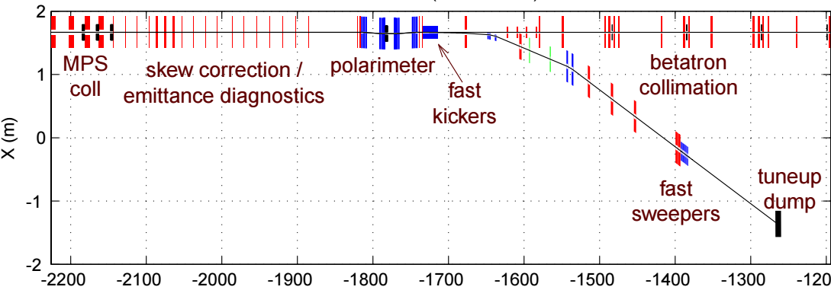
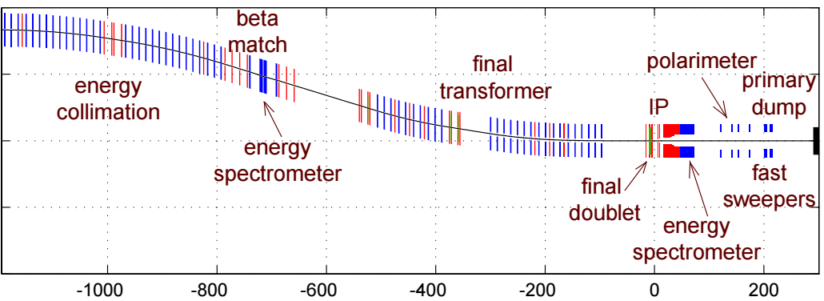
Bending Fields in ILC (1)
Bunch compressor
Vertical bend by off-center orbit in the quads to follow the earth’s curvature
Dogleg for positron generation →
Bends in Final Focus System
To create dispersion
ILC FFS is designed for E_{beam}=500 GeV
Δε_{xn} at 250GeV is 1/64, but not small enough compared with 1/400
→ must be a bit longer

Slide 24
Bending Fields in ILC (2)
Crossing angle →
The beam line must come back to the main linac tunnel after IP
A rough calculation shows this is marginal for E_{CM}=500GeV (no problem for E_{CM}= 250GeV)
One more km may be needed
Telnov proposes (nearly) head-on collision
Need a good optics design
Note: hor/ver emittances in Telnov’s parameter set are the same as in ILC TDR
14mrad
2.2km
LCF@CERN should think about
Crossing angle
Terrain-following linacs
Tunnel crosssection
Linac tunnel

Slide 25
Summary of ERLC
There are many issues to be studied but there seems to be no showstopper
Emittance preservation
But
High AC power consumption
High cost, > 2 x ILC
Required R&D
Twin-axis cavity. TW type suggested.
Cryomodule design with efficient HOM absorber
Higher Q? Other SC material?
How many years? 10 years? 20 years?
If these problems are solved, ERLC may be a candidate of future luminosity upgrade of ILC
But, perhaps, too expensive for energy upgrade

Slide 26
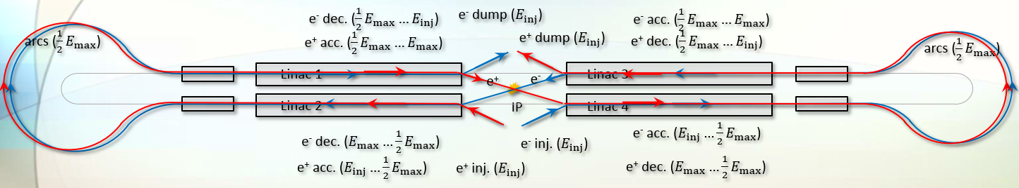
Ghost Collider (1)
Modify Telnov’s ERLC like (idea by Erk Jensen)
This is not DR
Split each linac into 2 (4 linacs of half length)
Turn around at reach end at the energy Emax/2
Electron and positron in the same bucket, one accelerated and the other decelerated
Energy transfer within each cavity (twin-axis cavity is not needed)
Almost no longitudinal HOM
Disadvantage
High energy arc at E=Emax/2 (synchrotron radiation loss)
Energy upgrade extremely expensive
Large energy ratio between electron and positron at the same location
BPM for 4 beams (right/left going, electron/positron)
Transverse HOM may be excited (electron and positron orbits may split due to misalignment, etc) but may be milder (?)

Slide 27
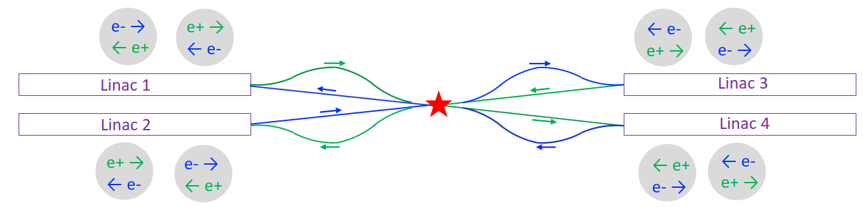
Ghost Collider (2) (A. Hutton)
Further improvement for higher luminosity
Charge mixture at the IP
Collision of mixed (e+ plus e-) bunches
No beamstrahlung (1st order)
To do this, insert chicanes after linac to make a delay of λ/2
Problems
Mixed-charge FFS
Round beam ?? βx = βy, εx = εy
Energy upgrade difficult

Slide 28


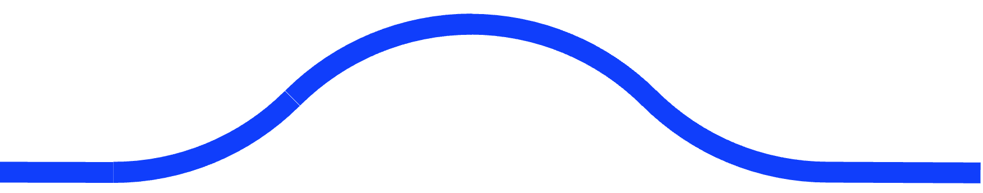


Ghost Collider(3) : Even more greedy idea
SRF Linac
Chicanes
SRF Linac
Arc
Arc
IP
LCWS2025
Single linac
All 4 beams in the same linac
Right (left)-going electron (positron)
Don’t care about collisions in the linac
Neutral beams !!
I cannot make a list of beam dynamics issues

Slide 29
Summary
ReLiC, ERLC, Ghost Collider, all evolving
Each having many R&D items
SCRF
Beam dynamics issues
ReLiC
Design of DR
Preserve 1nm emittance
Beam-beam interaction Dy~100
ERLC
High current beam dynamics (HOM, etc)
Horizontal emittance
Ghost Collider
Too many

