Slide 1



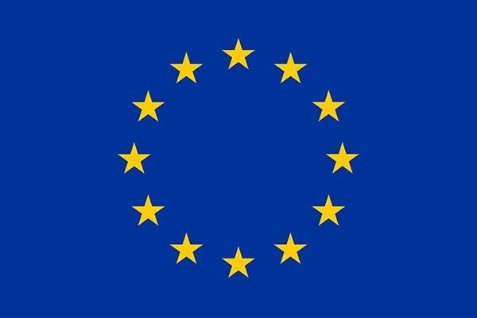
Instability Tolerance and Energy Recovery Efficiency Studies for Future ERL-based Colliders
December 10th 2025
Supervisors: Mike Seidel and Tatiana Pieloni
Acknowledgements: Andrea Latina, David Amorim, Elias Metral, Julien Michaud, Alex Fomin, Carmelo Barbagallo, Akira Miyazaki, Shahnam Zadeh, Rama Calaga, Sosoho-abasi Udongwo
Funded by the European Union. Views and opinions expressed are however those of the authors only and do not necessarily reflect those of the European Union or the European Commission. Neither the European Union nor the granting authority can be held responsible for them.

Slide 2
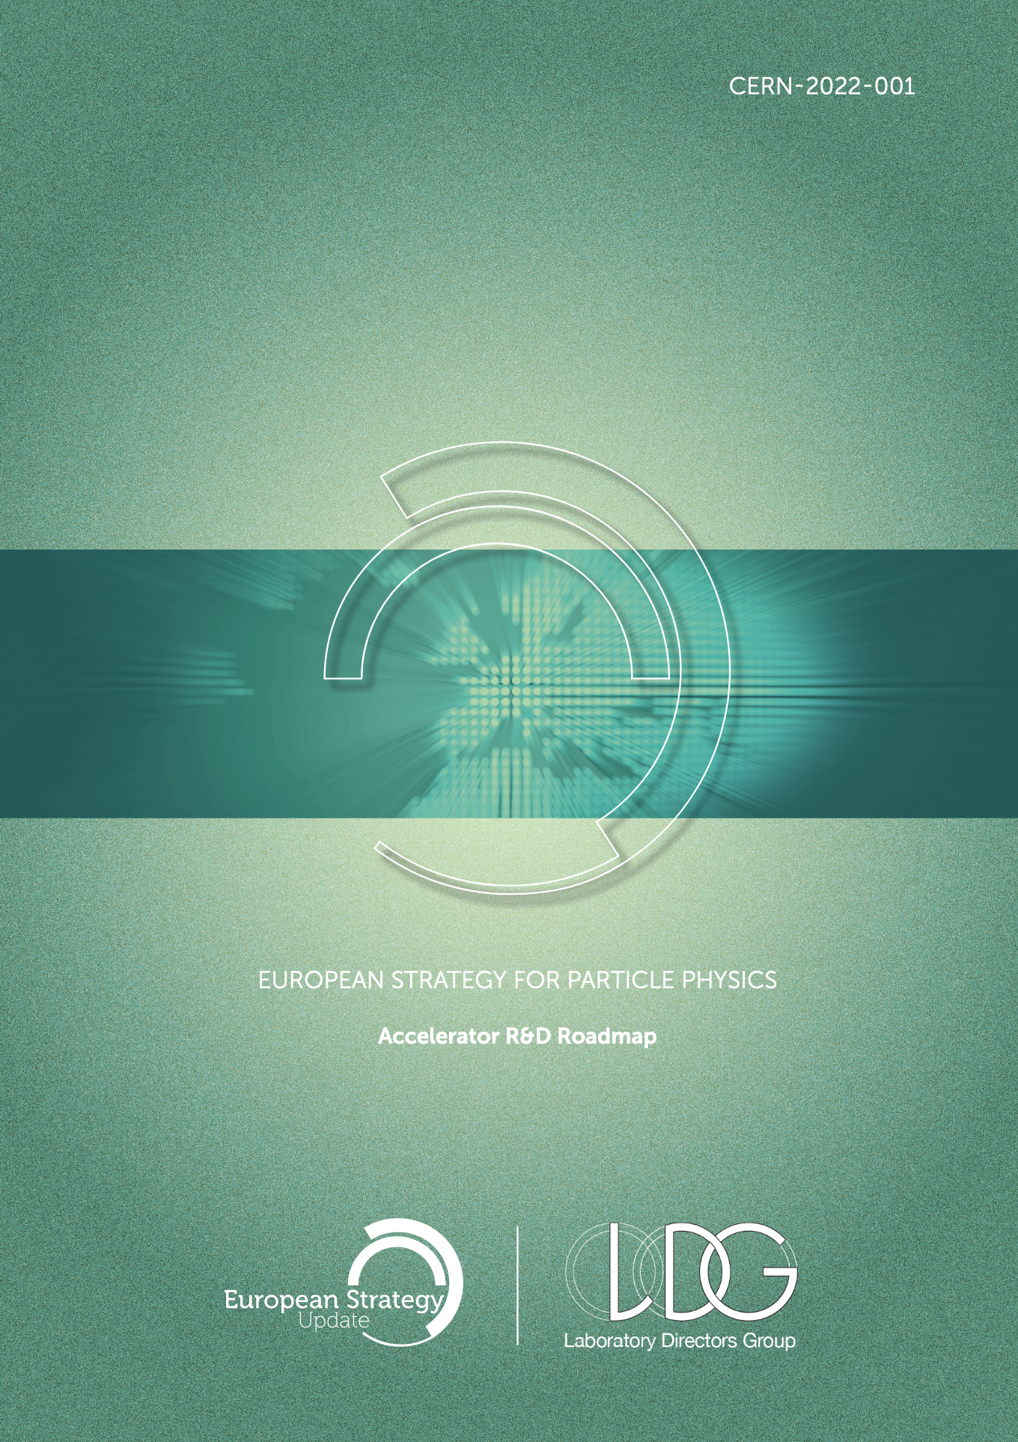
Current development of energy recovery
European Strategy for Particle Physics: Accelerator R&D Roadmap [1]:
  Development of efficient/sustainable superconducting radiofrequency technology
Innovate for Sustainable Accelerating Systems (iSAS)
  Development of SRF technologies
    RF power source with smart digital control systems
    FE-FRT tuners
    4.2-4.5 K superconducting cavities
    FP and HOM couplers
Integration of SRF technologies
  Retrofit into existing ESS cryomodule
  Parametric design of a sustainable cryomodule
  Future ERL facilities

Slide 3
Research goals
Beam Dynamics for ERL-based accelerators with energy-efficient cryomodules
Single- and multi-bunch instability studies in the iSAS cryomodules
Energy-recovery efficiency studies
➔ Can energy recovery be used for future high-power colliders?

Slide 4
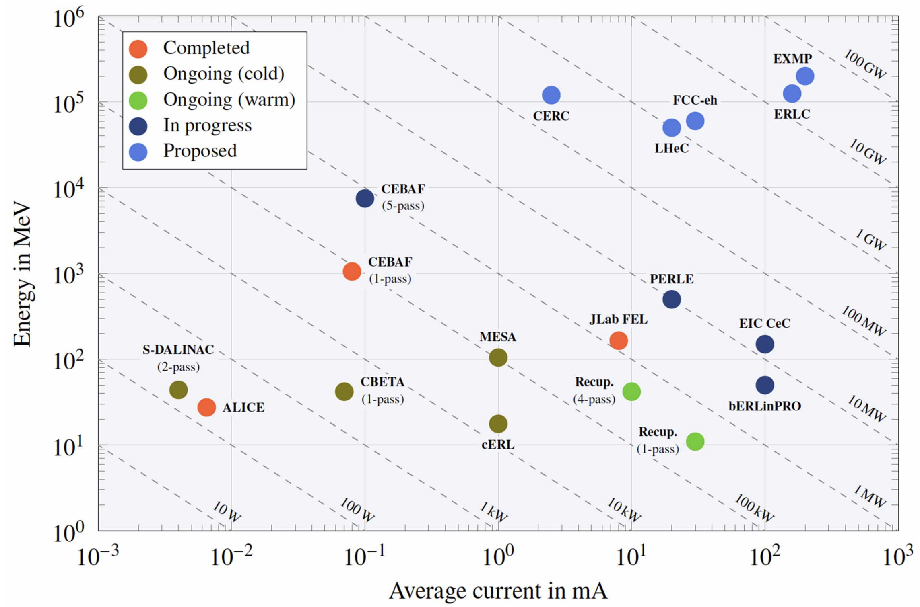
Scaling (economic)
4
Technology
Figure 1: Schematic plot of particle energy (MeV) and average current (mA) of past, ongoing, and future ERL facilities [2].

Slide 5
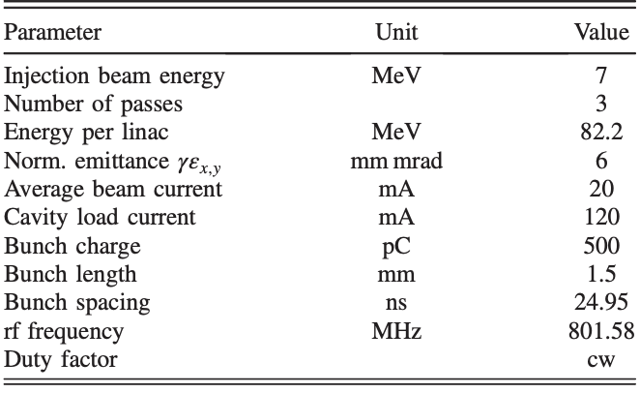
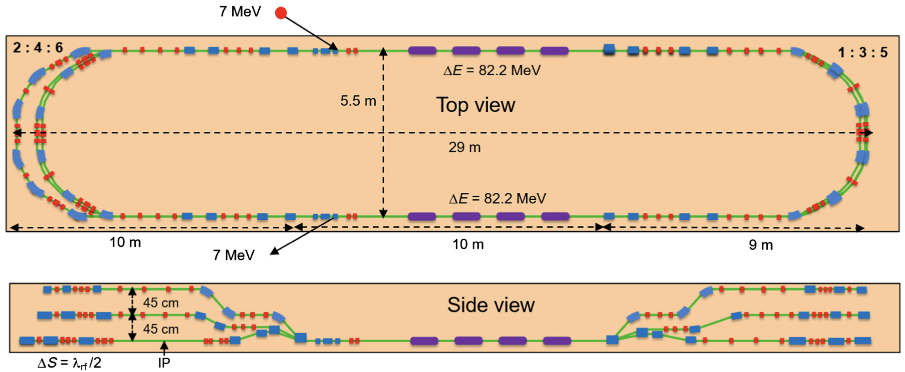
Powerful Energy Recovery Linac for Experiments (PERLE)
Compact one/three/six-pass ERL
89/250/500 MeV, 20 mA ➔ maximum 10 MW
RF technology / ERL test facility
Similar beam to LHeC
Step towards ERL colliders
Figure 2: Schematic overview of the PERLE 500 MeV.

Slide 6
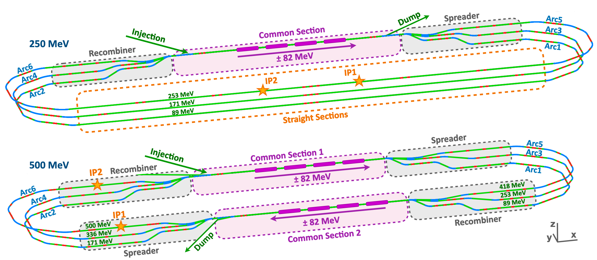
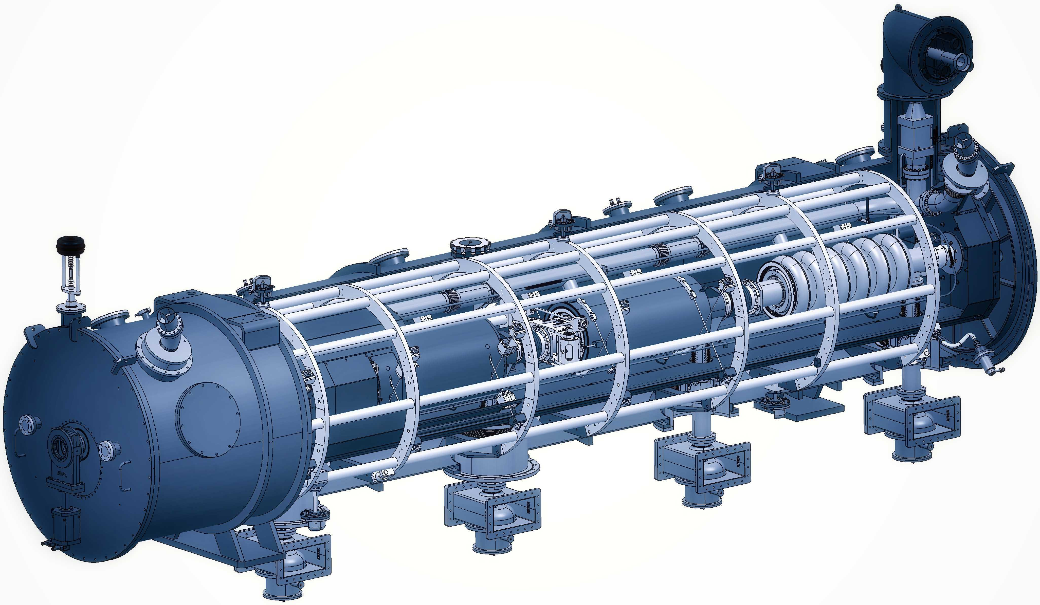
PERLE/ESS
iSAS
Beam dynamics stay the same!

Slide 7
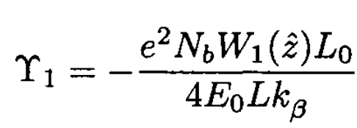
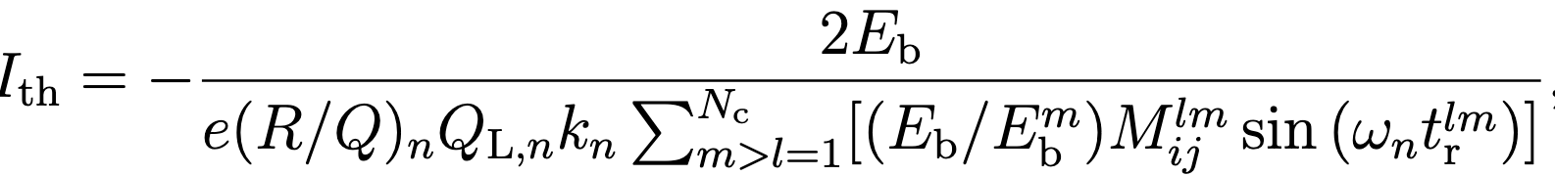
Single- and multi-bunch instability studies
Particle tracking simulations on updated PERLE 89 MeV, 250 MeV, (500 MeV) lattices with iSAS/PERLE cavities
  Single-bunch BBU
  Response parameter threshold
  Multi-bunch BBU
  Multi-pass current threshold
  Calculate overall thresholds on whole HOM spectrum and dependency on HOM parameters, bunch parameters, etc. [tel-04805279,arXiv:2409.02798v1]
  Beam loading
  ➔ Compensated by energy recovery
  BUT effect of accelerating phase, bunch parameters, filling pattern, etc.
Feedback loop to fundamental and HOM coupler designs

Slide 8
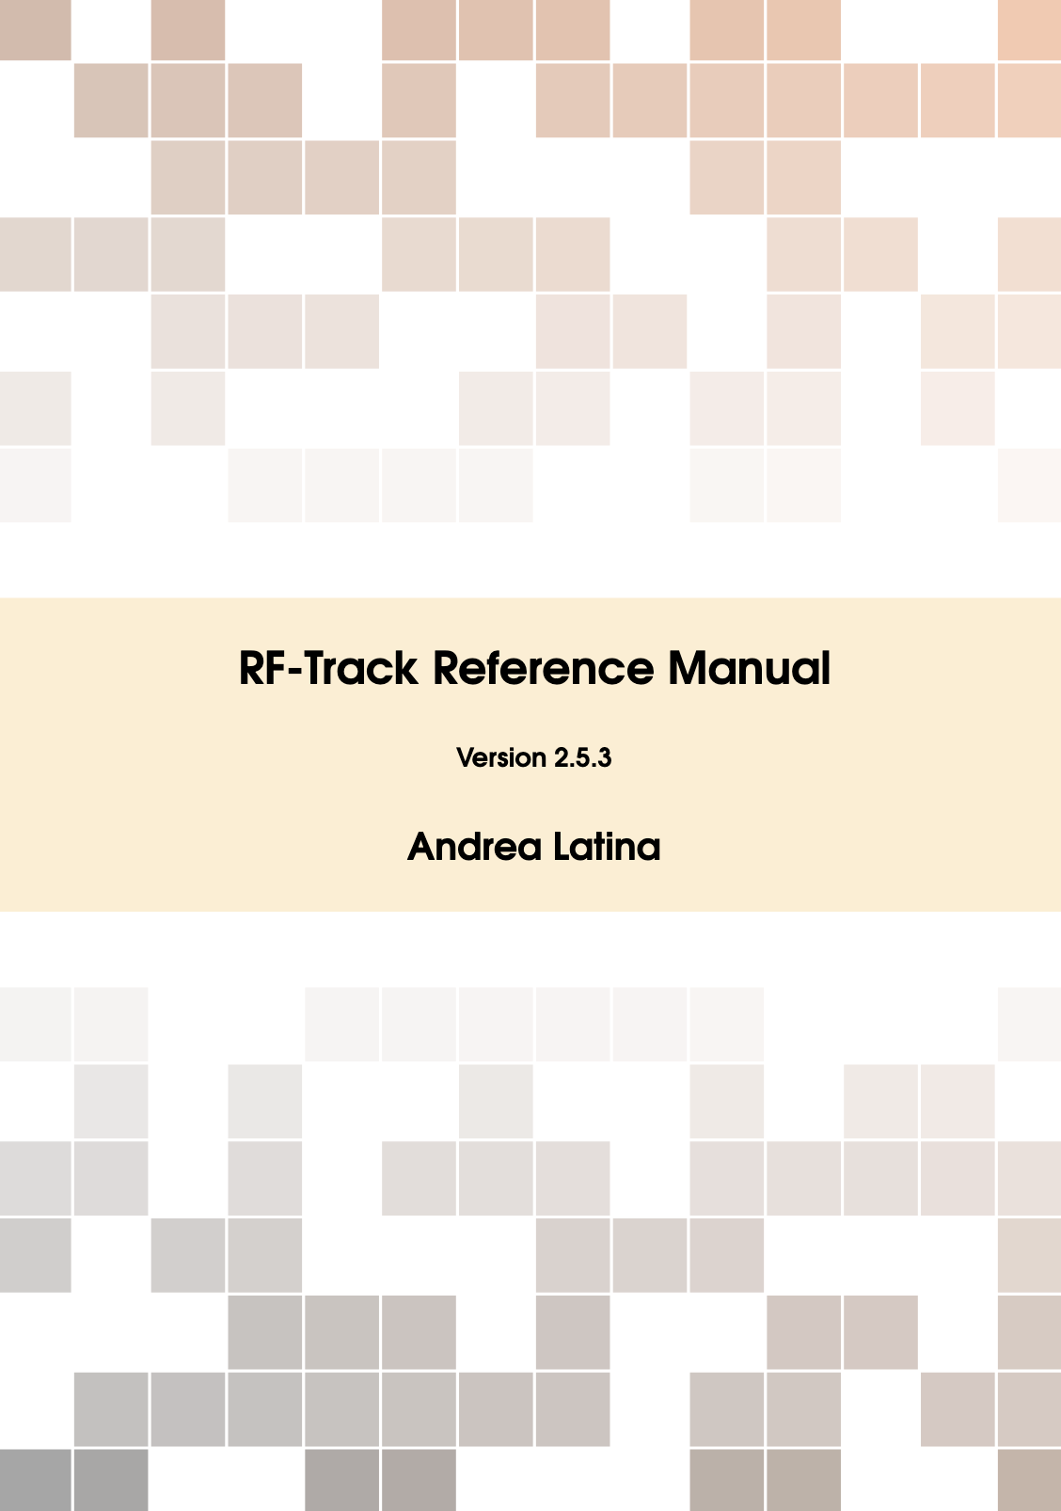
RF-Track
Modular, flexible, and fast with Python interface
Complex 1D, 2D, 3D EM fieldmaps
Single- and multi-bunch tracking at different beam energies and bunch spacings ➔ ERL!
Collective effects: synchrotron radiation, space charge, wakefields
Custom collective effects, elements, fields, etc
Interfaced with Xsuite ➔ beam-beam effects at IP
Developed at CERN ➔ easy integration of new features
However...
Optimised for linacs
No multi-pass recirculation yet ➔ can be implemented to allow for complete ERL simulations

Slide 9
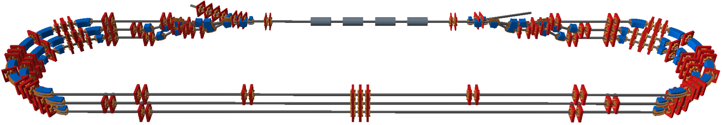
Model of recirculating ERL’s
Completed full multi-pass recirculation ERL model
  Lattice is split up in separate beamlines connected by spreader and recombiner sections
  Tracking bunches individually in the beamlines
  Recirculated to SHARED linac ➔ directed to beamlines depending on beam parameters (for example beam energy)
  Many simulations stitched together ➔ causality!
Figure 3: Schematic overview of the PERLE 250 MeV lattice in the BDSIM/Geant4 visualiser.

Slide 10
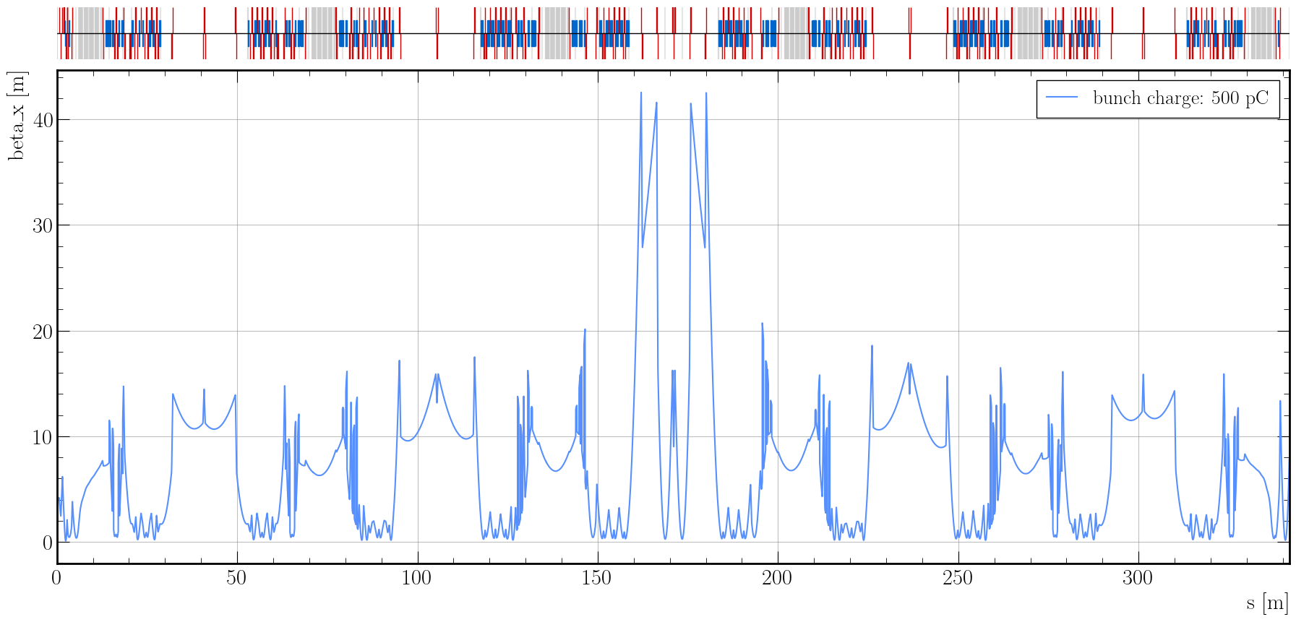
Recirculation model of PERLE
Imported old 250 MeV PERLE lattice [A. Fomin] from MAD-X
  Reproduce optics ➔ recirculation model works
  Simulate each individual element in the lattice
Figure 4: Statistical horizontal beta function of a single bunch passing through the PERLE 250 MeV lattice.

Slide 11
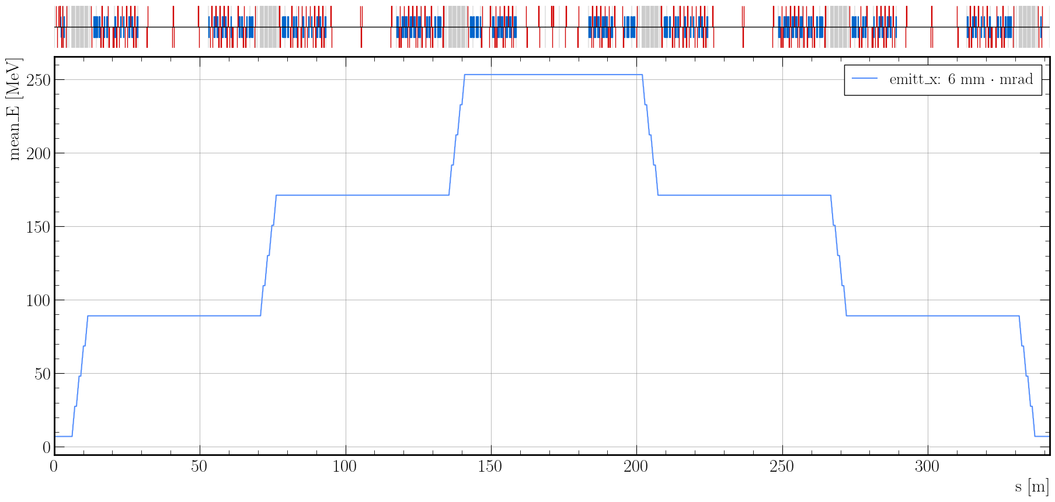
Recirculation model of PERLE
Figure 5: Mean beam energy of a single bunch passing through the PERLE 250 MeV lattice.

Slide 12
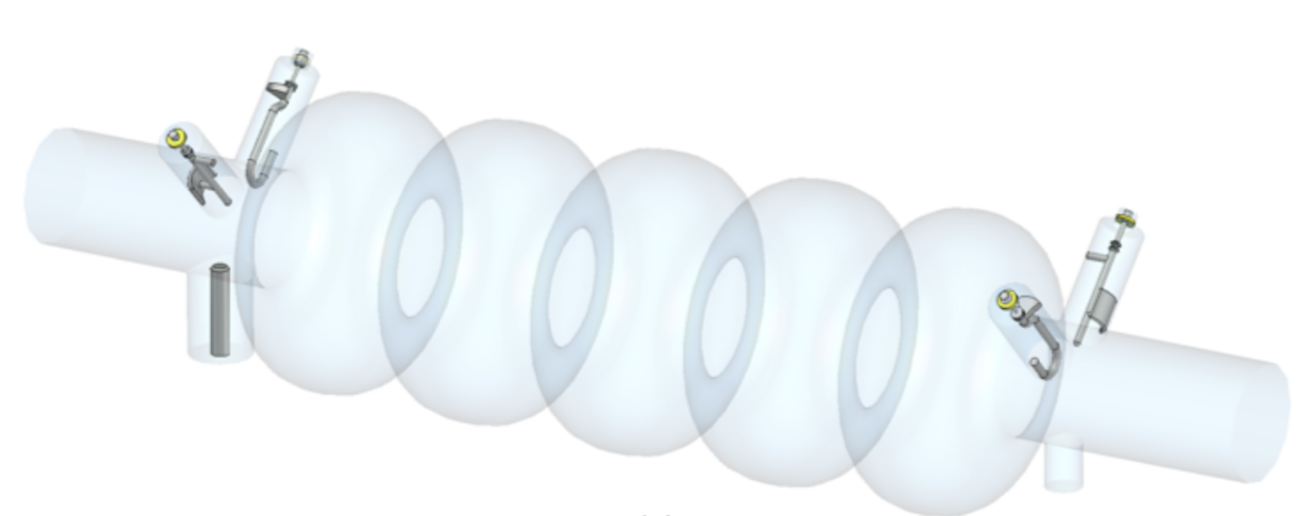
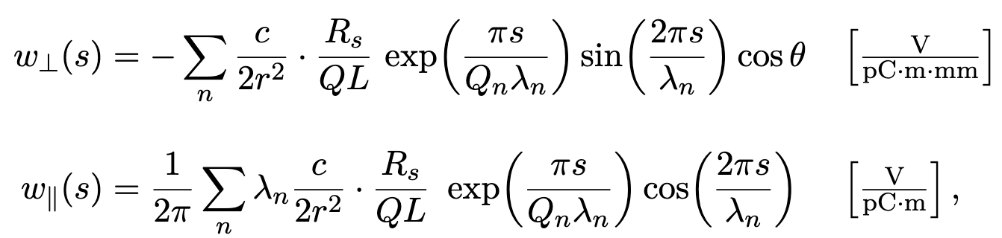
RF-Track wakefield model
RF-Track wakefield models [3,4,5]:
  Dipole modes
  Extended for azimuthally asymmetric structures
  Dressed cavity is asymmetric due to FP and HOM couplers
  Asymmetric excitation of HOM
Long-range wakes do not work in recirculation model!
Longitudinal wake incorrect
Figure 6: RF-Track’s broadband dipole transverse and longitudinal wakefield functions.
Figure 7: 5 half-wave cell dressed-cavity of iSAS/PERLE with 2H2P HOM-damping scheme [C. Barbagallo].

Slide 13
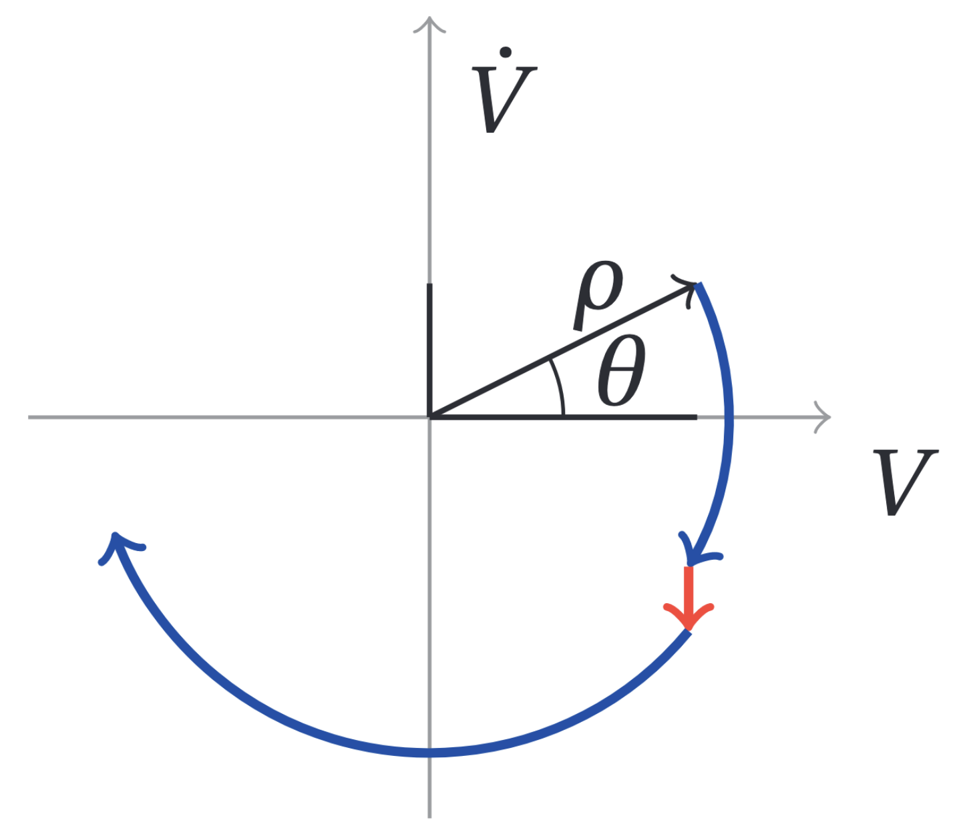
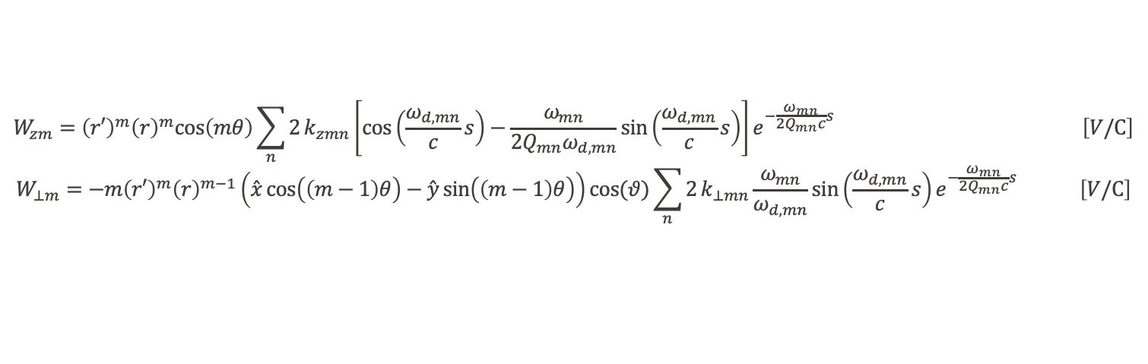
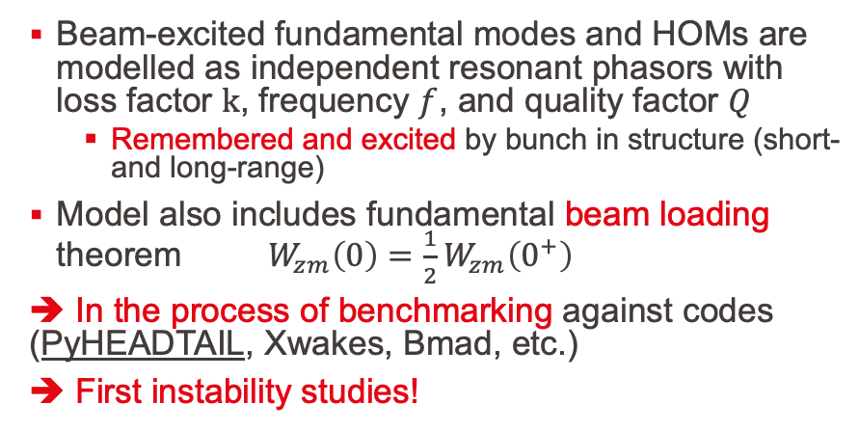
New RF-Track wakefield model (recirculation)
Wake potentials for azimuthally asymmetric structures for m-order HOM mode:
$$W_{zm}={\left(r′\right)}^{m}{\left(r\right)}^{m}cos\left(mθ\right)\sum_{n}{2}k_{zmn}\left[cos\left(\frac{ω_{d,mn}}{c}s\right)−\frac{ω_{mn}}{2Q_{mn}ω_{d,mn}}sin\left(\frac{ω_{d,mn}}{c}s\right)\right]e^{−\frac{ω_{mn}}{2Q_{mn}c}s} \left[V/C\right]$$
$$W_{⊥m}=−m{\left(r′\right)}^{m}{\left(r\right)}^{m−1}\left(\overset{ˆ}{x}cos\left(\left(m−1\right)θ\right)−\overset{ˆ}{y}sin\left(\left(m−1\right)θ\right)\right)cos(θ)\sum_{n}{2}k_{⊥mn}\frac{ω_{mn}}{ω_{d,mn}}sin\left(\frac{ω_{d,mn}}{c}s\right)e^{−\frac{ω_{mn}}{2Q_{mn}c}s} \left[V/C\right]$$
Beam-excited fundamental modes and HOMs are modelled as independent resonant phasors with loss factor $k$, frequency $f$, and quality factor $Q$
  Remembered and excited by bunch in structure (short- and long-range)
Model also includes fundamental beam loading theorem $W_{zm}\left(0\right)=\frac{1}{2}W_{zm}\left(0^{+}\right)$
➔ In the process of benchmarking against codes (PyHEADTAIL, Xwakes, Bmad, etc.)
➔ First instability studies!
Figure 8: Time evolution of HOM phasor [D. Pellegrini].

Slide 14
Research goals relevant
Beam Dynamics for ERL-based accelerators with energy-efficient cryomodules
Single- and multi-bunch stability studies in the iSAS/PERLE cryomodules
  Single- and multi-bunch beam breakup and beam loading studies
Energy-recovery efficiency studies

Slide 15
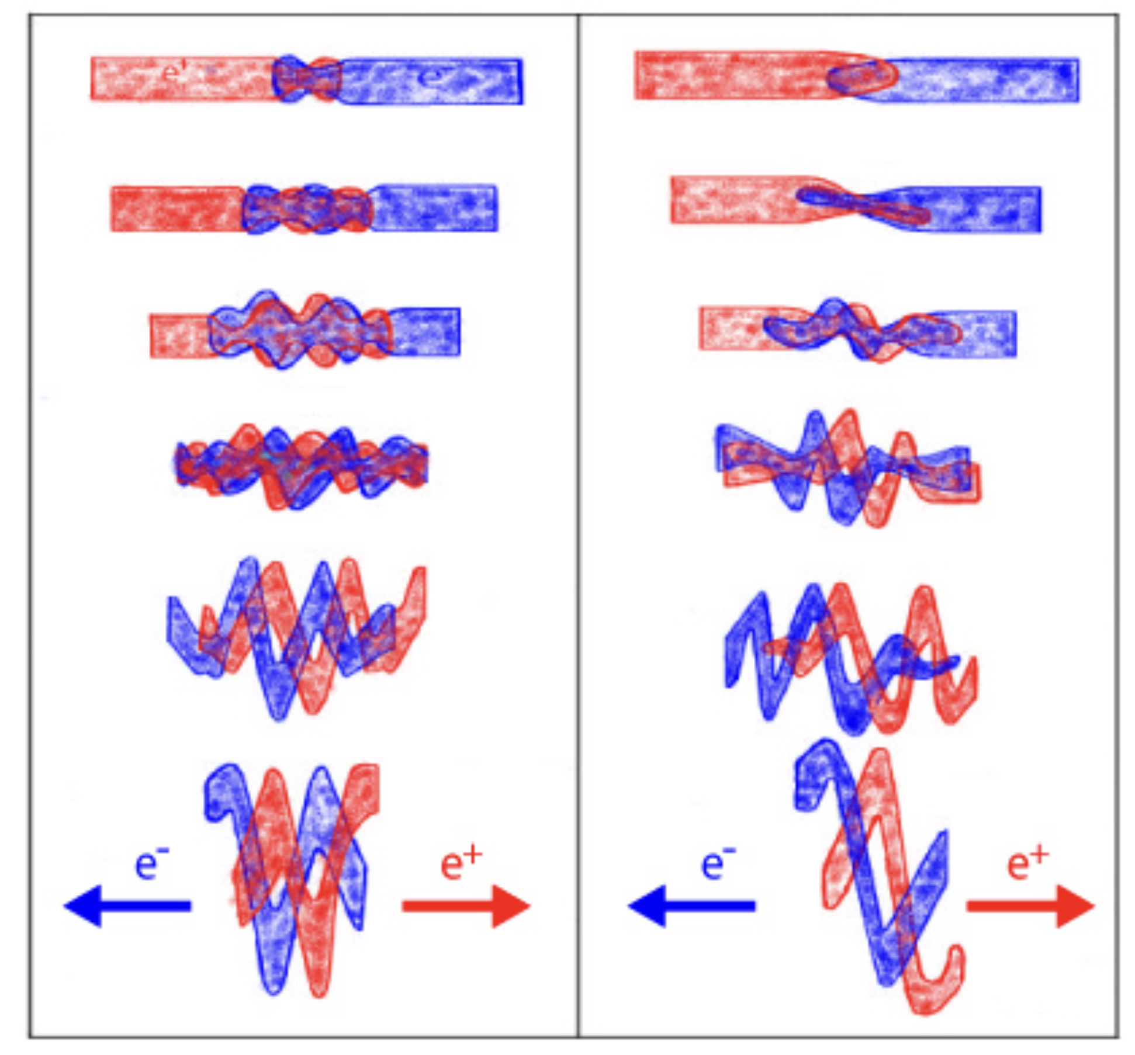
Energy-recovery efficiency studies
General energy-recovery efficiency simulation studies after the degradation of beams
  Synchrotron radiation + beam-beam effects in Xsuite (interfaced with RF-Track)
  Parameter scans at the IP
Future project specific parameter study
  PERLE
    Synchrotron radiation + Inverse Compton Scattering (IP1) and electron scattering on ions (IP2)
  ERL colliders
    LHeC, FCC-eh, FCC-ee ERL/CERC ERLC, ReLiC, Ghost Collider, CLERC, etc.
Figure 9: The effect of the beam-beam interaction on two colliding bunches at discrete time intervals during head-on collision (left) and with a slight vertical offset (right) [N. Solyak].
Can energy recovery be used for future high-power accelerators/colliders?

Slide 16
Bibliography
[1] C. Adolphsen et al., “European strategy for particle physics -- accelerator R&D roadmap,” CERN Yellow Rep. Monogr., vol. 1, pp. 1–270, Mar. 2022, doi: 10.23731/CYRM-2022-001.
[2] C. Adolphsen, K. Andre, D. Angal-Kalinin, and Others, “The development of energy-recovery linacs,” Cornell University, Fermilab-pub-22-509-ad, Jlab-acp-22-3666, July 2022. doi: 10.48550/arxiv.2207.02095.
[3] K. L. Bane, “Short-range dipole wakefields in accelerating structures for the NLC,” SLAC-PUB-9663, 812954, Mar. 2003. doi: 10.2172/812954.
[4] A. W. Chao, Physics of collective beam instabilities in high energy accelerators. in Wiley series in beam physics and accelerator technology. New York: Wiley, 1993.
[5] K. L. F. Bane, P. B. Wilson, and T. Weiland, “Wake fields and wake field acceleration,” in AIP Conference Proceedings, AIP, Mar. 1985, pp. 875–928. doi: 10.1063/1.35182.
[6] J. Olivares Herrador, A. Latina, A. Aksoy, N. Fuster Martínez, B. Gimeno, and D. Esperante, “Implementation of the beam-loading effect in the tracking code RF-track based on a power-diffusive model,” Front. Phys., vol. 12, p. 1348042, Feb. 2024, doi: 10.3389/fphy.2024.1348042.

Slide 17
Additional slides

Slide 18
The Innovate for Sustainable Accelerating Systems (iSAS)
Advancement of superconducting radiofrequency (SRF) technologies:
  RF power source with smart digital control systems and ferroelectric fast reactive tuner (FE-FRT) tuners to compensate rapidly cavity detuning from mechanical vibrations (energy savings up to a factor of 3)
  Superconducting cavities that operate with high performance at 4.2-4.5 K (energy savings up to a factor of 3)
  FP couplers to load and couple the RF power from the source to the cavities
  HOM couplers for damping of Higher-Order Modes (HOM’s) excited by high-current particle beams
  ➔ Efficient recovery of the energy of recirculating beams back into the cavities (energy savings up to a factor of 10)
Integration of SRF technologies:
  Existing/future research infrastructures and industrial applications
  Retrofit into existing ESS cryomodule (PERLE)
  Parametric design of
  a sustainable linear accelerator cryomodule and
  into energy-recovery linear accelerators (ERL’s)

Slide 19
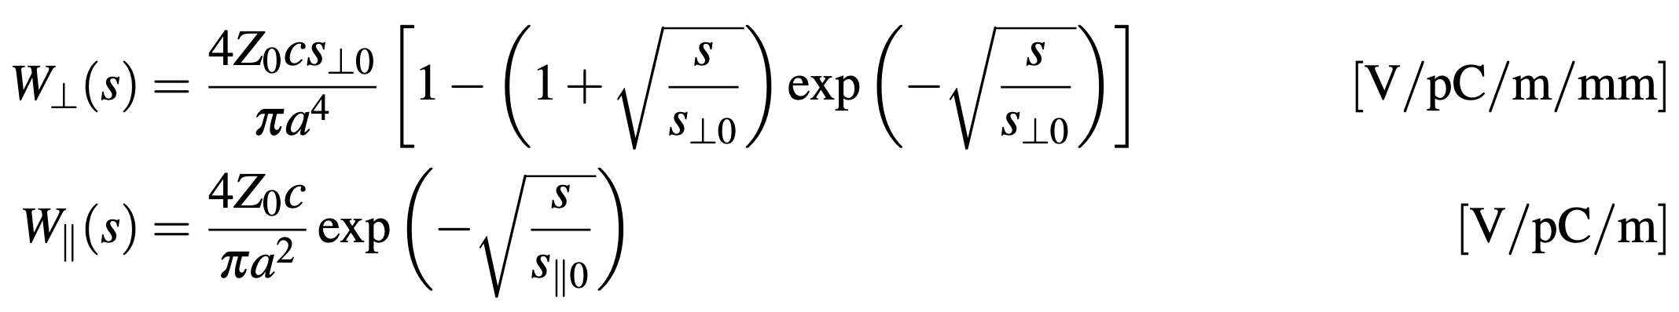
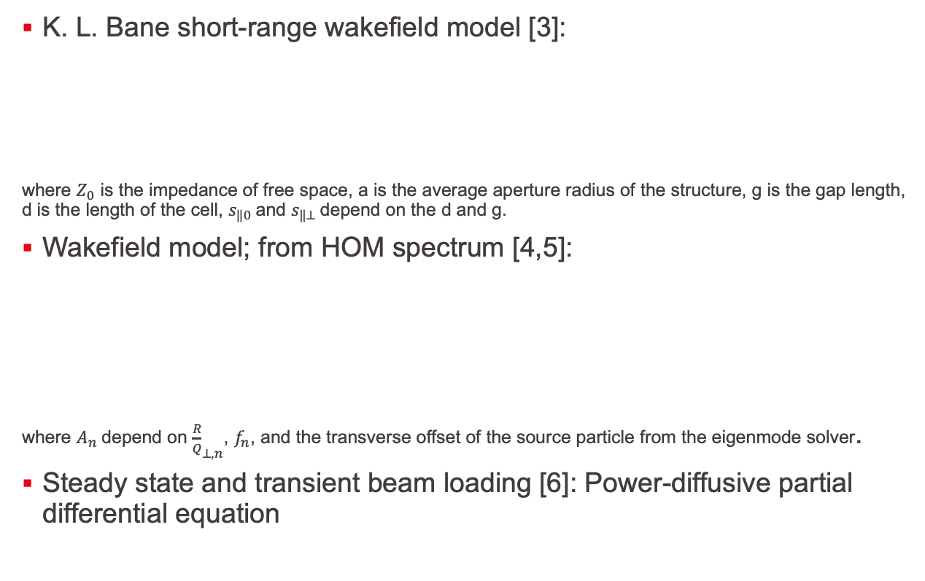
Current wakefield model in RF-Track
K. L. Bane short-range wakefield model [3]:
where $Z_{0}$ is the impedance of free space, a is the average aperture radius of the structure, g is the gap length, d is the length of the cell, $s_{‖0}$and $s_{‖⊥}$depend on the d and g.
Wakefield model; from HOM spectrum [4,5]:
where $A_{n}$depend on ${\frac{R}{Q}}_{⊥, n}$, $f_{n}$, and the transverse offset of the source particle from the eigenmode solver.
Steady state and transient beam loading [6]: Power-diffusive partial differential equation

