Slide 1


DiRAC: Applying for computing time
Chris Johnson
Resource Allocation Manager, DiRAC HPC Facility
Swansea, 3rd July 2026
The CCP-TEPP Summer School in Software Skills for Particle Physics

Slide 2

Outline
Who am I
Other compute
RAC calls
Applying to RAC
  Scaling case
  Amount of resources
Running a parallel code
  CFD example
  Discretisation
  Parallelisation
  Exercise
Notes:
6.5 yrs

Slide 3
Acknowledgements
Material comes from DiRAC
  Mark Wilkinson (DiRAC Director)
  Simon Hands (DiRAC Community Development Director)
EPCC MSc courses
  David Henty (leads EPCC’s HPC training activities)
  Weronika Filinger (EPCC training)
Et al.
Notes:
6.5 yrs

Slide 4
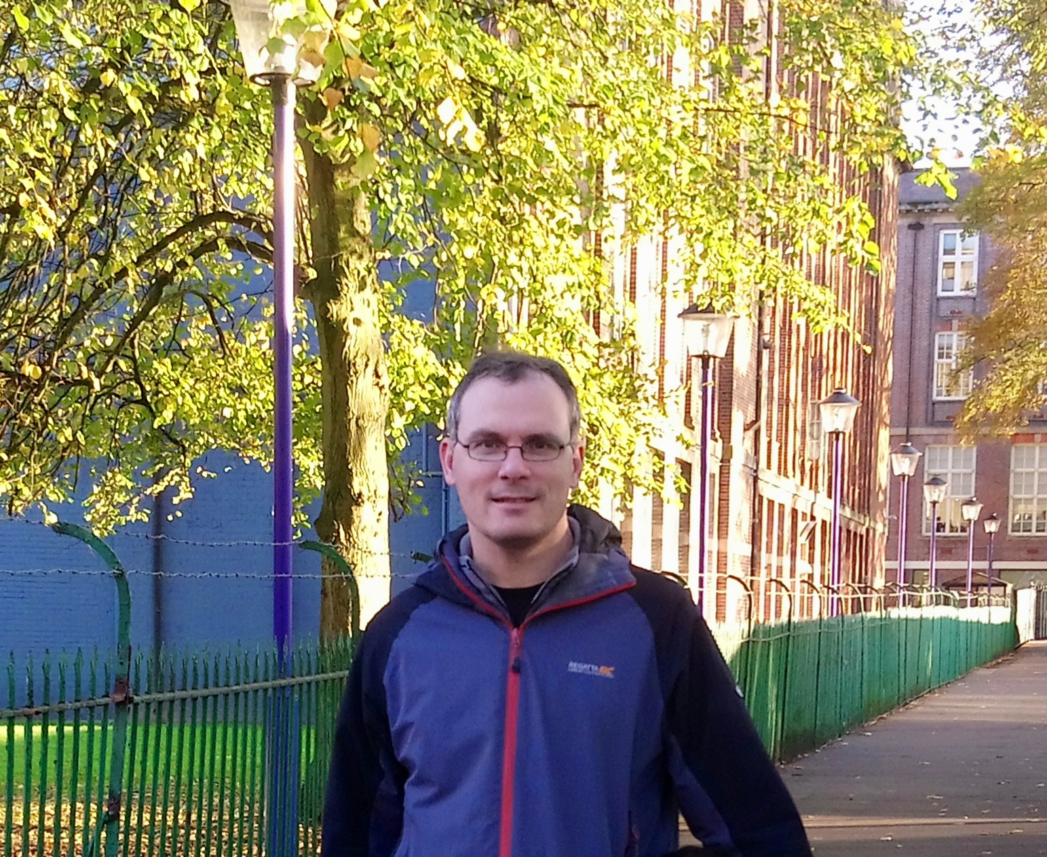

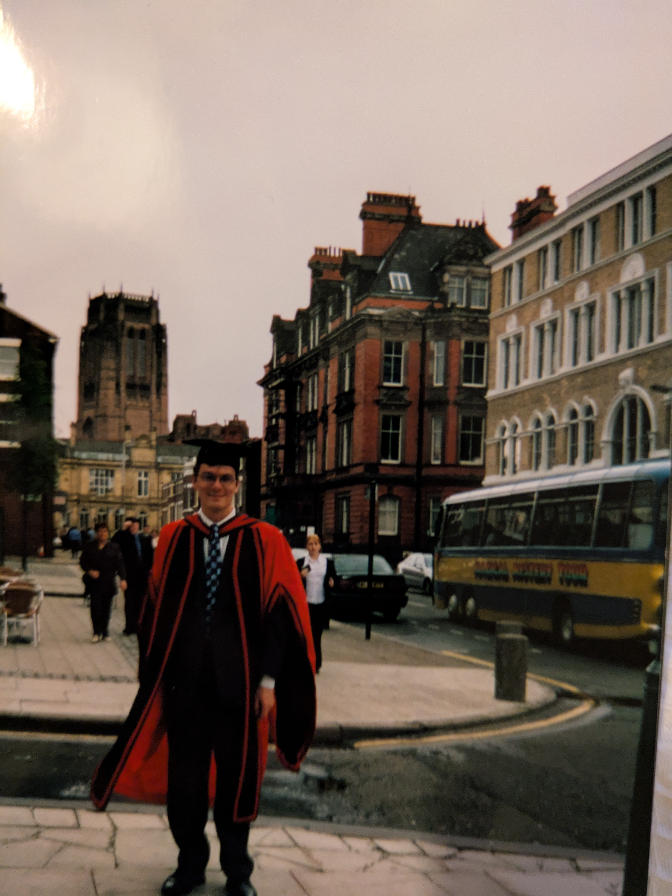
Background
Maths/Physics degree (1994-97)
Computing MSc (1997-98)
Theoretical particle physics (Lattice QCD) PhD (1998-2001)
  Involved eigensolvers (Lanczos) and parallel computers (Cray T3E)
Joined EPCC in 2001
  Worked on HPC projects and courses, coord MSc numerical algorithms course, user support, focussed on funding calls
  Presently manage resources for DiRAC (including helping with yearly RAC calls), jointly run MSc projects course and coord eCSE software development calls
Notes:
6.5 yrs

Slide 5
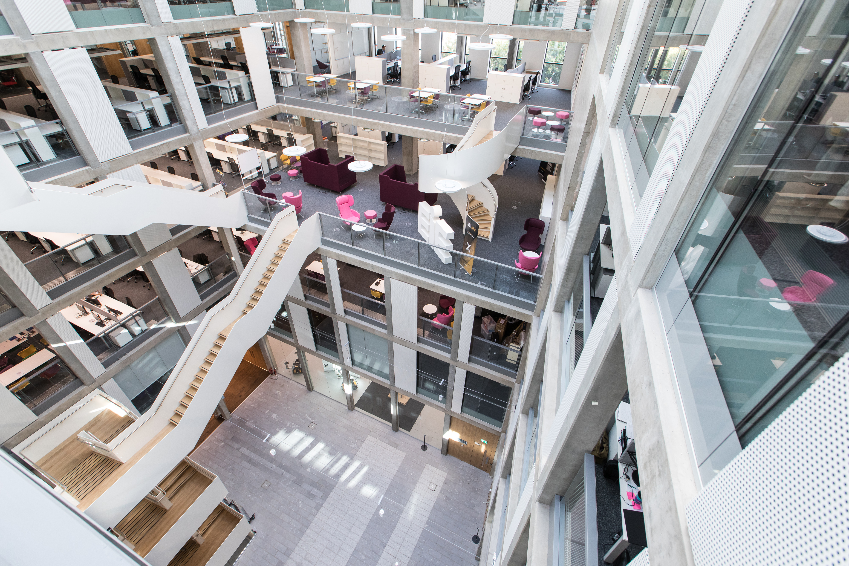
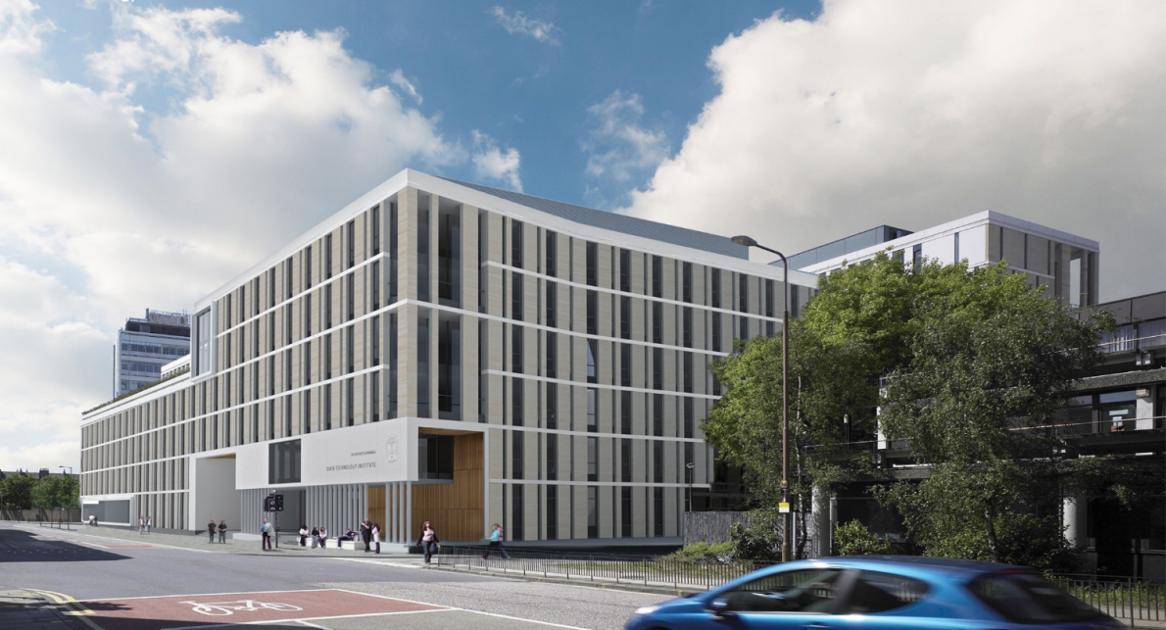
What is EPCC?
Founded in 1990 (originally Edinburgh Parallel Computing Centre)
A self-funding institute at The University of Edinburgh
Running national parallel systems since Cray T3D in 1994
  Around 140 staff
  Now located in the Bayes Centre just south of city centre
  Advanced Computing Facility (ACF) located ~6 miles south of city centre
Notes:
6.5 yrs

Slide 6
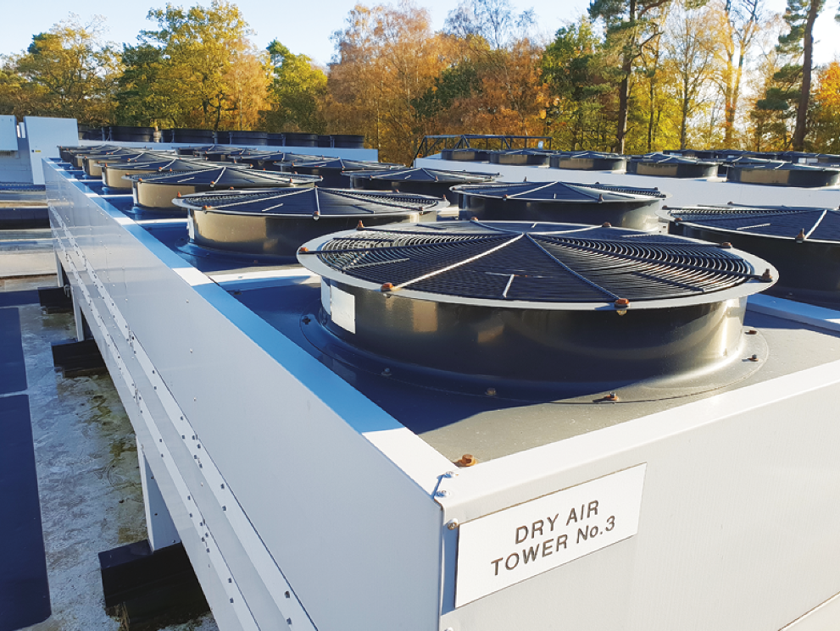
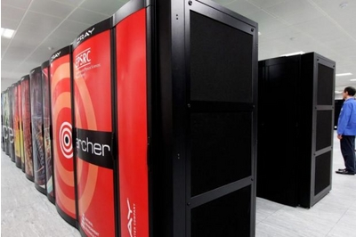
EPCC’s Advanced Computing Facility
ACF was built in 1970s
4 computer rooms
Also associated plant rooms
Cooling is a major part of running a supercomputer…
…fortunately in Scotland it’s often cold!

Slide 7
Notes:
5,860 nodes: 5,276 standard memory, 584 high memory (512 GiB, 4 GiB per node). 4 compute nodes each with 4xMI210

Slide 8

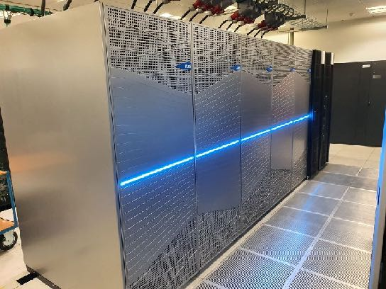


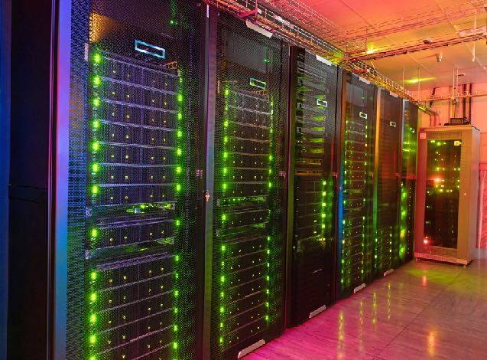




The DiRAC HPC Facility
Memory Intensive
“COSMA8”
(Durham)
Extreme Scaling
“Tursa”
(Edinburgh)
UK Public Compute Ecosystem
(UK Compute Roadmap 2025)
528 TB RAM
Large-scale cosmological simulations
704 Nvidia A100 GPUs
Large lattice-QCD simulations
Data Intensive “CSD3”
(Cambridge)
Data Intensive
“DIaL” (Leicester)
Heterogeneous architecture for complex simulation and modelling workflows
Heterogeneous architecture for complex simulation and modelling workflows
Facility Office (UCL)
Notes:
Benefits of distribution: leverage effort; distribute expertise
Defining characteristics:
Science driven: all planning underpinned by science case for STFC Frontier Science Theory
Scientifically productive: maximise delivery of high impact science within the funding envelope
Efficient and cost effective: as lean as possible, consistent with science programme
Pro-active and Responsive: take advantage of funding/engagement opportunities
Innovative: leadership in both hardware and software
Rapidly evolving: 3-year re-design cycle required

Slide 9
The DiRAC HPC Facility
National facility for PPAN Theory Communities
Data challenges growing rapidly:
  individual simulations 10Pb+
  Increasing use of AI/ML techniques to enhance simulation methods
Access for non-STFC researchers:
  AI models of the cancer genome (Miller et al)
  UK-LLM (Stenetorp et al.), the first LLM to be trained solely using UK-based computing resources, was trained on DiRAC (Tursa cluster)
Training
    Innovation
Training
Large-scale compute
services
RSE support
Notes:
Co-Design requires that we ask the following questions for a particular class of user problem.​
How many flops do we need to process a unit amount of data?​
How large are all of these data?​
On what timescale do we require a calculation, or an ensemble of calculations, to be completed on for them to be useful or impactful?In co-design,the problem context is thus critically important. ​
Problems can be aggregated by their characteristics (e.g. which algorithms they use) to produce designs and recipes, but that is very muchan area of ongoing innovation.​
Compare size of
0.5 PB is current size of cosmo simulations on Cosma8 => 500 nodes on Cosma8 = 1000 high member nodes on Archer2 but only 584 deployed; => 2000 standard nodes or 38% of Archer2 standard nodes.
Tursa flops: 5.23 PF linpack x 176/112 = 8.2 PF; 40% of Archer 2 linpack flops (19.54 PF)
=> Two DiRAC capability systems each perform at ~40% of Archer 2.

Slide 10
Collaborative co-design of DiRAC services
Science case
Peer-reviewed, scientific justification for resources DiRAC Board, DiRAC Community
Workflow assessment
Technical case
Peer-reviewed, high-level technical specifications Technical Directorate (TD), Research Software Engineering (RSE) team, Community
Co-design with industry partners
Technical design
Individual service specifications
TD, Technical Working Group, RSE team, Community
Science case determines both scale and design of DiRAC services
Co-design applies to both hardware and software (middleware and applications)
Notes:
Co-Design requires that we ask the following questions for a particular class of user problem.​
How many flops do we need to process a unit amount of data?​
How large are all of these data?​
On what timescale do we require a calculation, or an ensemble of calculations, to be completed on for them to be useful or impactful?In co-design,the problem context is thus critically important. ​
Problems can be aggregated by their characteristics (e.g. which algorithms they use) to produce designs and recipes, but that is very muchan area of ongoing innovation.​
Compare size of
0.5 PB is current size of cosmo simulations on Cosma8 => 500 nodes on Cosma8 = 1000 high member nodes on Archer2 but only 584 deployed; => 2000 standard nodes or 38% of Archer2 standard nodes.
Tursa flops: 5.23 PF linpack x 176/112 = 8.2 PF; 40% of Archer 2 linpack flops (19.54 PF)
=> Two DiRAC capability systems each perform at ~40% of Archer 2.

Slide 11

National Compute Resources (NCRs)
UKRI is investing in NCRs to build an integrated public compute ecosystem to meet a wide range of needs
NCRs will complement flagship investments – NNSS and AIRR. Smaller scale services that will support research across the UKRI remit
NCR model is an evolution of approaches to supporting ‘Tier 2’-scale compute
Phase 1 services will come online during FY26/27.
Phase 2 NCR specification during FY26/27 with deployments expected to start in FY27/28.
Current DiRAC CPU services supported until at least March 2028
DiRAC users may apply to use NCRs
Tursa users may be awarded NCR time after end of Tursa service in September 2027 – subject to on-going discussions between STFC and UKRI DRI
Notes:
Please replace photo of presenter with a portrait of your own. 1) Send the geometric shape overlay to the back – Right-Click > Send to Back > Send to Back. 2) Replace image – use the guides provided to correctly position it. 3) Send your portrait to the back so that the geometric overlay re-appears over the portrait.

Slide 12

NCR Phase 1: specifications
CPU-based systems
Cirrus NCR (University of Edinburgh): 640 compute nodes consisting of 2 x AMD Turin CPUs; 184,320 cores; 200Gbps interconnect
Charger NCR (UCL/DataVita): 200-235 x Intel Xeon 6980P CPUs; 37000 cores; 400Gb/s interconnect; 8 Blackwell RTX Pro 6000 visualisation GPUs, ~850 CPU cores
Isambard 3 (existing service, University of Bristol): 380 Nodes consisting of NVIDIA Grace-Grace CPUs; 54,720 cores; 200Gb/s interconnect
GPU-based systems
Baskerville NCR (University of Birmingham): 200x Nvidia B200 GPUs; 23 nodes; 400Gb/s interconnect
Zenith NCR (University of Cambridge): 28 nodes consisting of 8 AMD MI355X GPUs (224 total); 400 Gb/s interconnect
Mary Coombs NCR (Daresbury): 628 NVIDIA H100 GPUs (157 nodes), Infiniband NDR200 interconnect
Notes:
Please replace photo of presenter with a portrait of your own. 1) Send the geometric shape overlay to the back – Right-Click > Send to Back > Send to Back. 2) Replace image – use the guides provided to correctly position it. 3) Send your portrait to the back so that the geometric overlay re-appears over the portrait.

Slide 13



Wider compute ecosystem:
AI Research Resource (AIRR)
Isambard AI: 5,448 Nvidia GH200 superchips
DAWN: 768 Intel Data Centre GPU Max 1550
Access Routes open:
  Rapid Access
  Gateway Innovator
If your work uses any AI then AIRR is open to you
  If not – stay tuned….

Slide 14


Wider compute ecosystem: EuroHPC
UK is a full member of the EuroHPC Joint Undertaking
Through EuroHPC Access Calls, UK-based applicants can access EuroHPC systems, including the JUPITER
We encourage applications for access
https://eurohpc-ju.europa.eu/access-our-supercomputers/eurohpc-access-calls_en
Planning workshops on EuroHPC access.
Notes:
Please replace photo of presenter with a portrait of your own. 1) Send the geometric shape overlay to the back – Right-Click > Send to Back > Send to Back. 2) Replace image – use the guides provided to correctly position it. 3) Send your portrait to the back so that the geometric overlay re-appears over the portrait.

Slide 15
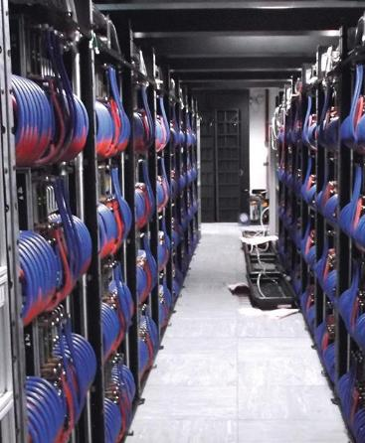
Next National Supercomputing Service (NNSS)
UKRI-led project for a new National Supercomputing Service that will be based at EPCC in Edinburgh
Pan-UKRI service and part of a wider compute ecosystem
Investment of up to £750m for:
  Hardware
  Host site and operating costs (e.g., electricity)
  Service provision
  Software programme
Service currently planned to go live in Q4 2027
Lattice QFT requirements are part of specification
  Grid is one of the procurement benchmarks
  Exact hardware configuration will depend on tender bids
Tursa supported until Sept 2027
  mitigation plan under development for gap between Tursa and NNSS.
Notes:
Please replace photo of presenter with a portrait of your own. 1) Send the geometric shape overlay to the back – Right-Click > Send to Back > Send to Back. 2) Replace image – use the guides provided to correctly position it. 3) Send your portrait to the back so that the geometric overlay re-appears over the portrait.

Slide 16
NNSS: system and vision
Likely 1000-1500 nodes (4 GPUs per node)
NNSS will target mission-driven research and support strategic national goals, with a focus on Grand Challenges
Grand Challenges:
  Will be outcome-based
  Defined around societal challenges and government missions.
  Science grand challenges should be defined in terms that government will recognise (e.g. relevance to solving broader problems)
Notes:
Please replace photo of presenter with a portrait of your own. 1) Send the geometric shape overlay to the back – Right-Click > Send to Back > Send to Back. 2) Replace image – use the guides provided to correctly position it. 3) Send your portrait to the back so that the geometric overlay re-appears over the portrait.

Slide 17
RAC calls (compute resources)
Seedcorn proposals:
  Up to 3 months: code/system testing; proposal preparation
  Light-touch review process: decisions within ~1 week
  Allocations up to 100k CPU core hours or 1k GPU hours
Resource Allocation Committee (RAC) calls
  Project categories: small (up to 12 months) and large (up to 3 years)
  Bids may request use of more than one DiRAC service
  No bid may ask for >80% of a given DiRAC machine
  Annual calls – open in June; close in September, projects start following April
  Next call: RAC19 – for allocations starting in April 2027
Discretionary proposals
  Requests that don’t fit into the above
  Contact DiRAC Director

Slide 18
RAC calls (humans effort)
RSE effort
  Projects from 3 months to multiple years (typically 3-12 person months effort)
  help optimise codes, improve workflows, and port to new hardware, but not to develop new science capability
  5 FTE of staff effort available

Slide 19
Applying for DiRAC resources – next call!
Access to DiRAC resource via an annual call from the Resource Allocation Committee (RAC)
RAC is an STFC-supported standing committee, completely independent of DiRAC
Open to all researchers including ECRs
This year’s deadline for RAC19: Thursday 17th September 2026 16:00 UK time https://dirac.ac.uk/getting-access/
Apply via UKRI’s The Funding Service portal
  Webinar: Wednesday 8th July at 1:30-3:30pm (zoom)
RAC calls are routinely oversubscribed: the resource awarded may be tapered according to ranking, provided the project remains feasible

Slide 20
DiRAC RAC – constructing a technical case
Resource Allocation Committee (RAC) calls
  Every RAC proposal requires a scientific case and a technical case
  We’ll concentrate here on the technical case
    In particular resources being requested and scaling case
  Technical case form consists of 6 sections, including
    codes to be used (status and underlying dependencies)
    Performance and scaling of codes to be used
      Previously had separate weak/strong scaling – now have one scaling section where you give whatever scaling is appropriate (weak, strong, or both weak and strong)
    What jobs are to be run (typical and largest)…
    …and where (request specific systems)
    Compute resources requested
      Split into years (and quarters for first year)
    Storage requested
    Data production/transfer

Slide 21
Performance metrics
Fundamental measurement is the runtime T
  we can vary the number of processes P or the problem size N
  N measures the amount of computation, e.g. number of grid points
Speed up
  typically
Parallel efficiency
  typically
Serial efficiency
  typically

Slide 22
Scaling
Scaling
Scaling is how the performance of a parallel application changes as the number of processors is increased
There are two different types of scaling:
  Strong Scaling – total problem size stays the same as the number of processors increases
  Weak Scaling – the problem size increases at the same rate as the number of processors, keeping the amount of work per processor the same
Strong scaling is generally more useful and more difficult to achieve than weak scaling
Need to consider intra-node scaling (making use of cache/shared memory within a node) and inter-node scaling (where data has to be sent to and from nodes)
  Ideally show both!
Should show scaling relative to minimum no. of cores or nodes that can be run for a given problem size
Scaling isn’t everything
  Should also profile code and show optimisations that have been done
  Poor codes (e.g. with lots of unnecessary computation) will scale better! However, not a good use of resources

Slide 23
Strong scaling

Slide 24
Weak scaling
Runtime (s)
No. of processors

Slide 25
Modelling speedup
A typical program has two categories of components
  inherently serial sections: can’t be run in parallel
  potentially parallel sections
Classic examples of serial
  initialisation or file IO (in parallel just do it from a single process)
In practice, “serial” includes all parallel overheads
  any operation that does not benefit from parallelisation
  this includes reduction operations, halo swapping, ...

Slide 26
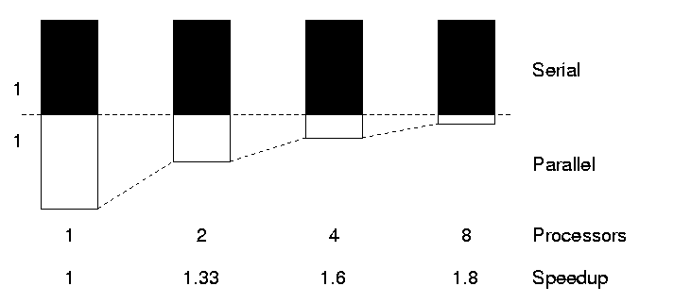
The serial section of code
“The performance improvement to be gained by parallelisation is limited by the proportion of the code which is serial”
Gene Amdahl, 1967

Slide 27
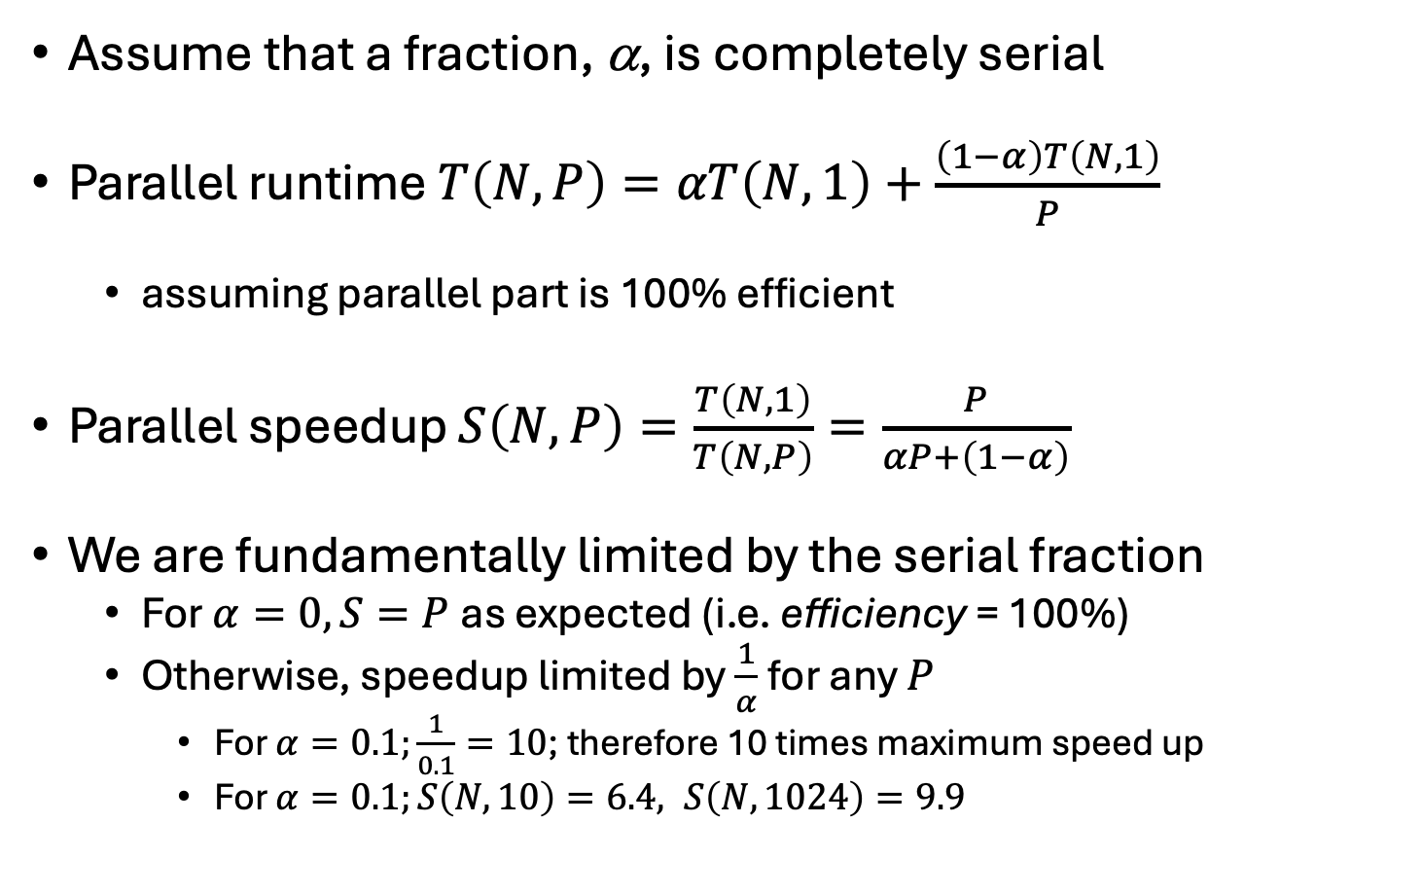
Amdahl’s law
Assume that a fraction, α, is completely serial
Parallel runtime $T\left(N,P\right)=αT\left(N,1\right)+\frac{\left(1−α\right)T\left(N,1\right)}{P}$
  assuming parallel part is 100% efficient
Parallel speedup $S\left(N,P\right)=\frac{T\left(N,1\right)}{T\left(N,P\right)}=\frac{P}{αP+\left(1−α\right)}$
We are fundamentally limited by the serial fraction
  For $α=0, S=P$as expected (i.e. efficiency = 100%)
  Otherwise, speedup limited by $\frac{1}{α}$for any $P$
    For $α=0.1;\frac{1}{0.1}=10$; therefore 10 times maximum speed up
    For $α=0.1;S\left(N,10\right)=6.4, S\left(N,1024\right)=9.9$

Slide 28
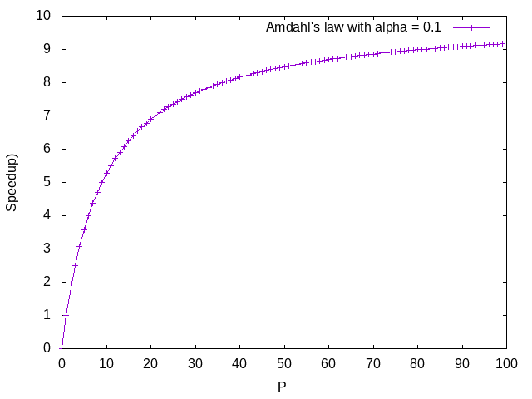
Example

Slide 29
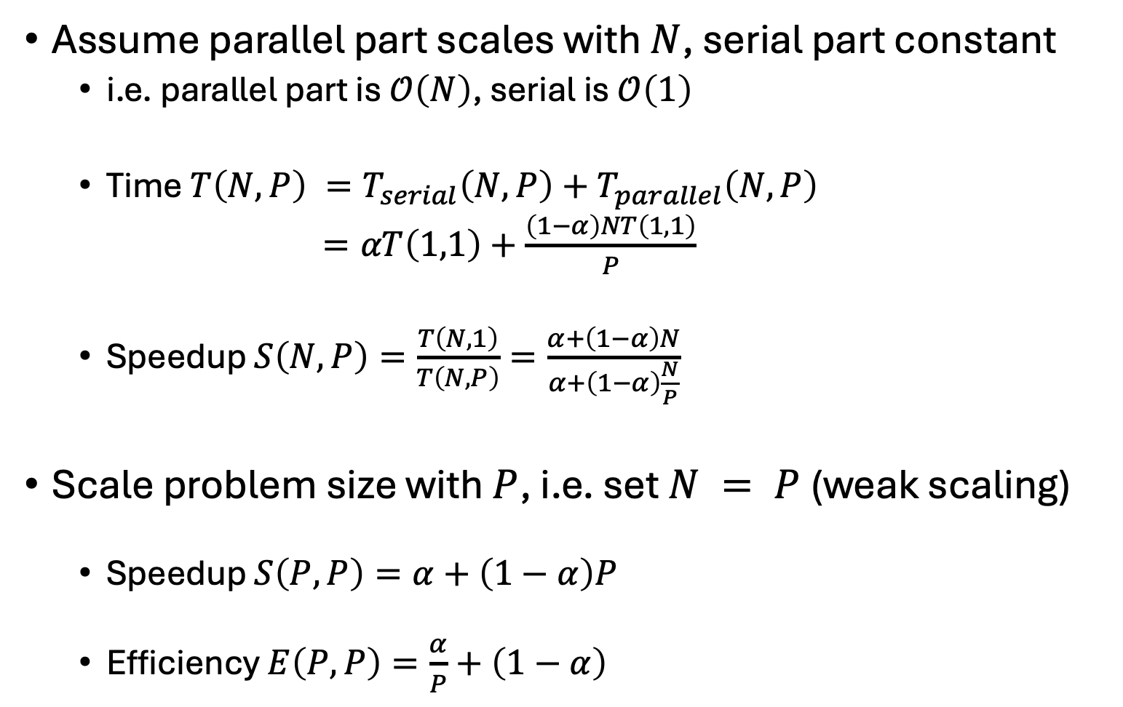
Utilising Large Parallel Machines
Assume parallel part scales with $N$, serial part constant
  i.e. parallel part is $𝒪\left(N\right)$, serial is $𝒪\left(1\right)$
  Time $T\left(N,P\right) =T_{serial}\left(N,P\right)+T_{parallel}\left(N,P\right)$
  $=αT\left(1,1\right)+\frac{\left(1−α\right)NT\left(1,1\right)}{P}$
  Speedup $S\left(N,P\right)=\frac{T\left(N,1\right)}{T\left(N,P\right)}=\frac{α+\left(1−α\right)N}{α+\left(1−α\right)\frac{N}{P}}$
Scale problem size with $P$, i.e. set $N = P$(weak scaling)
  Speedup $S\left(P,P\right)=α+\left(1−α\right)P$
  Efficiency $E\left(P,P\right)=\frac{α}{P}+\left(1−α\right)$

Slide 30
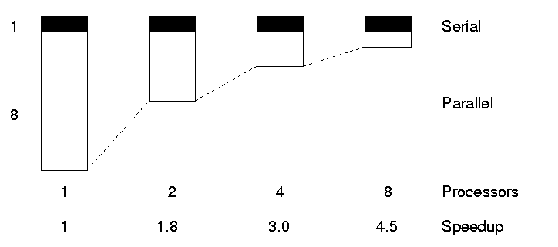
Gustafson’s Law
We need larger problems for larger numbers of CPUs
Whilst we are still limited by the serial fraction, it becomes less important

Slide 31
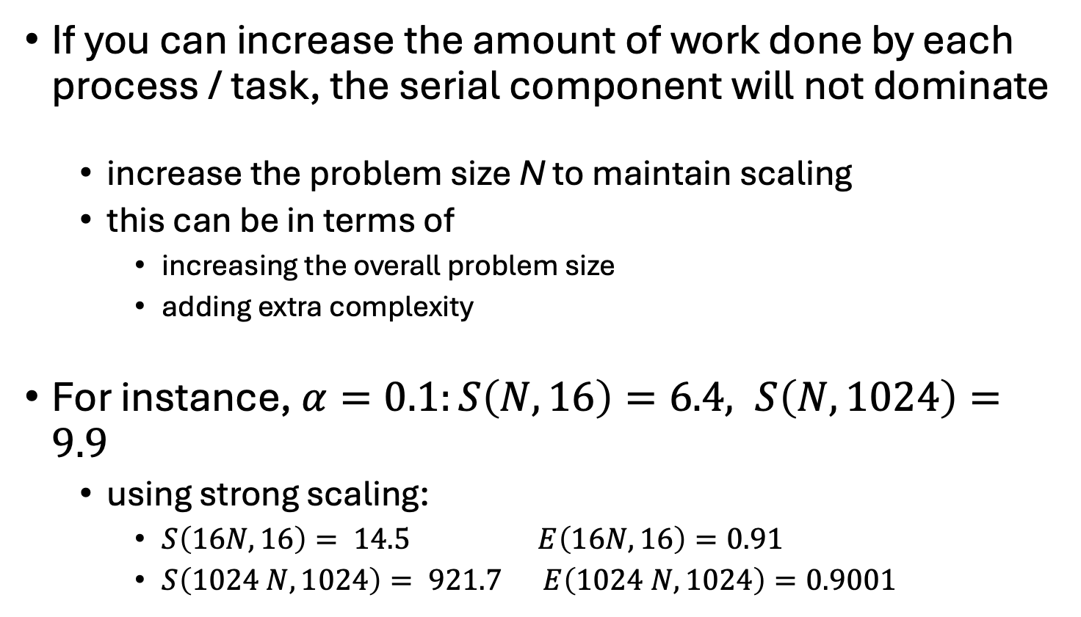
Gustafson’s Law
If you can increase the amount of work done by each process / task, the serial component will not dominate
  increase the problem size N to maintain scaling
  this can be in terms of
    increasing the overall problem size
    adding extra complexity
For instance, $α=0.1:S\left(N,16\right)=6.4, S\left(N,1024\right)=9.9$
  using strong scaling:

Slide 32
Plotting
Performance metrics
Think carefully whenever you plot data
  what am I trying to show with the graph?
  is it easy to interpret?
  can it be interpreted quantitatively?
Default plotting options are rarely what you want
  default colours can be hard to read (e.g. yellow on white)
  default axis limits may not be sensible
  ...
Explain (in words) what it is you are trying to show
  Is this strong or weak scaling data?
  How does this relate to the jobs you will run?
Example data
  MPI traffic model on multiple (24-core) nodes of ARCHER

Slide 33
Hard to interpret small N data here
Performance metrics

Slide 34
log/log can make trends in data too similar
Performance metrics

Slide 35
Normalised data easier to compare
Performance metrics
use single-node (24-core) performance as baseline here

Slide 36
Efficiency plots can be useful too
Performance metrics

Slide 37
log/lin efficiency if many points at small P
Performance metrics

Slide 38
Don’t just accept the default options
Performance metrics
In this chart the x-axis doesn’t have a meaningful scale

Slide 39
Proposals – what to ask for?
In most cases (e.g. RAC) proposals candidates are asked for “how much” of each resource is needed
Requests usually given in core or CPU hours or GPU hours
  For an individual job this is the number of cores (or GPUs) used multiplied by the number of hours the job runs for
  Should then be summed over the entire project
Typically CPU hours really mean core hours – but you need to check
Sometimes node hours – but make sure you know which - or your request may be out by factors of 10s or 100s (Cirrus has 288 cores for example)
There are some moves towards using, eg, kwhrs
  Early days and may not have relevant data
Note also sometimes nodes can only be used exclusively
  If you are only using half the cores of a node (e.g. the code doesn’t scale well within a node, but you need all the memory) then you may be charged for the whole node. You need to check this!
For DiRAC you need to give a yearly breakdown per machine
  And a quarterly breakdown for year 1 if you don’t want the time evenly (this cant always be satisfied)

Slide 40
Computational Fluid Dynamics
Computational Fluid Dynamics (CFD)
Algorithm, implementation and the problem

Slide 41
Fluid Dynamics
Study of the mechanics of fluid flow, liquids and gases in motion.
Commonly requires HPC.
Continuous systems typically described by partial differential equations.
For a computer to simulate these systems, these equations must be discretised onto a grid.
One such discretisation approach is the finite difference method.
This method states that the value at any point in the grid is some combination of the neighbouring points
Notes:
41
41

Slide 42
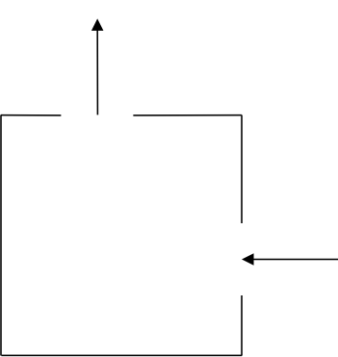
The Problem
Determining the flow pattern of a fluid in a cavity
  a square box
  inlet on one side
  outlet on the other
For simplicity, we assume zero viscosity for this exercise
Flow in
Flow out
Notes:
42
42

Slide 43








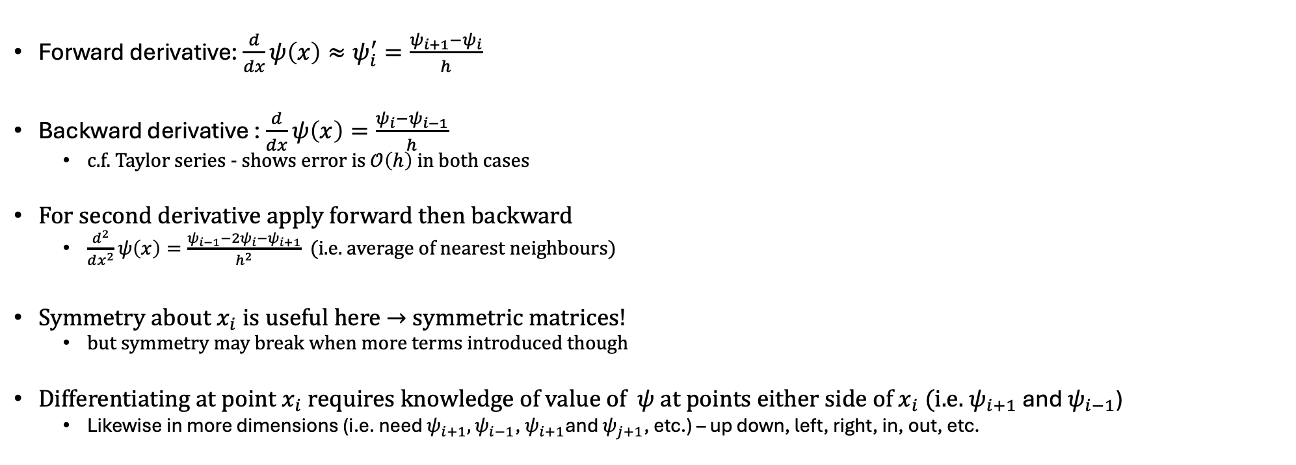










Derivatives and discretisation
$$ψ\left(x\right)$$
$$ψ_{2}$$
$$ψ_{3}$$
$$ψ_{4}$$
$$ψ_{5}$$
$$ψ_{1}$$
$$ψ_{0}$$
$$h$$
$x$ and $ψ\left(x\right)$ continuous
$$x$$
Forward derivative: $\frac{d}{dx}ψ\left(x\right)≈ψ_{i}^{′}=\frac{ψ_{i+1}−ψ_{i}}{h}$
Backward derivative : $\frac{d}{dx}ψ\left(x\right)=\frac{ψ_{i}−ψ_{i−1}}{h}$
  c.f. Taylor series - shows error is $𝒪\left(h\right)$ in both cases
For second derivative apply forward then backward
  $\frac{d^{2}}{dx^{2}}ψ\left(x\right)=\frac{ψ_{i−1}−{2ψ_{i}−ψ}_{i+1}}{h^{2}}$ (i.e. average of nearest neighbours)
Symmetry about $x_{i}$ is useful here → symmetric matrices!
  but symmetry may break when more terms introduced though
Differentiating at point $x_{i}$ requires knowledge of value of $ψ$ at points either side of $x_{i}$ (i.e. $ψ_{i+1}$and $ψ_{i−1}$)
  Likewise in more dimensions (i.e. need $ψ_{i+1},ψ_{i−1}$, $ψ_{i+1}$and $ψ_{j+1}$, etc.) – up down, left, right, in, out, etc.
$$x_{0}$$
$$x_{1}$$
$$x_{2}$$
$$x_{3}$$
$$x_{4}$$
$$x_{5}$$
$x_{i}$ and $ψ_{i}$ discrete

Slide 44

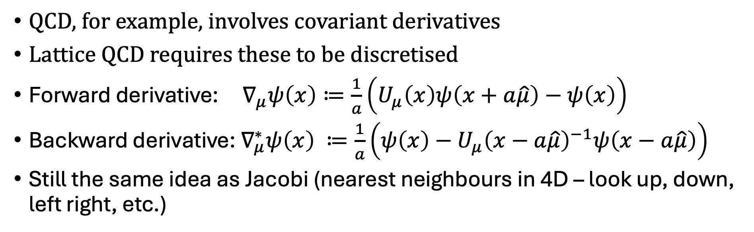



QCD connection
QCD, for example, involves covariant derivatives
Lattice QCD requires these to be discretised
Forward derivative: $∇_{μ}ψ\left(x\right)≔\frac{1}{a}\left(U_{μ}\left(x\right)ψ\left(x+a\hat{μ}\right)−ψ\left(x\right)\right)$
Backward derivative: $∇_{μ}^{∗}ψ\left(x\right) ≔\frac{1}{a}\left(ψ\left(x\right)−{U_{μ}\left(x−a\hat{μ}\right)}^{−1}ψ\left(x−a\hat{μ}\right)\right)$
Still the same idea as Jacobi (nearest neighbours in 4D – look up, down, left right, etc.)
$$x+a\hat{υ}$$
$$x+a\hat{υ}+a\hat{μ}$$
$$x$$
$$x+a\hat{μ}$$

Slide 45
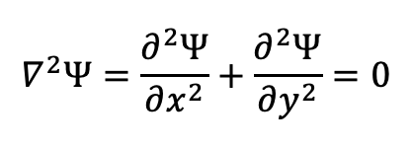

The maths
In two dimensions, easiest to work with the stream function Ψ
At zero viscosity, Ψ satisfies:
$$∇^{2}Ψ=\frac{∂^{2}Ψ}{∂x^{2}}+\frac{∂^{2}Ψ}{∂y^{2}}=0$$
With finite difference form:
$$Ψ_{i−1,j}+Ψ_{i+1,j}+Ψ_{i,j−1}+Ψ_{i,j+1}−4Ψ_{i,j}=0$$
Jacobi iterative method can be used to find solutions
With boundary values fixed, stream function can be calculated for each point by averaging value at that point with its four nearest neighbours.
  process continues until the algorithm converges on a solution which stays unchanged by the averaging.
  iterative methods are a very common computational approach used for solving systems of equations
Notes:
45
45

Slide 46

Jacobi iterative method
To solve:
Repeat for many iterations:
  loop over all points i and j:
  psinew[i][j] = 0.25*( psi[i+1][j] + psi[i-1][j] +
  psi[i][j+1] + psi[i][j-1] )
  copy psinew back to psi for next iteration
In the Fortran version of the code, array notation (arrays of size m x n) removes explicit loops:
  psinew(1:m,1:n) = 0.25*(psi(2:m+1, 1:n) + psi(0:m-1, 1:n) +
  psi(1:m, 2:n+1) + psi(1:m, 0:n-1) )
$$Ψ_{i+1,j}+Ψ_{i−1,j}+Ψ_{i,j+1}+Ψ_{i,j−1}−4Ψ_{i,j}=0$$
Notes:
46
46

Slide 47
Notes
Finite viscosity gives more realistic flows
  introduces a new field zeta related to the vorticity
  equations a bit more complicated but same basic approach
Terminating the process
  larger problems require more iterations
  fixed number of iterations OK for performance measurement but not if we want an accurate answer
  compute the RMS change in psi and stop when it is small enough
There are many more efficient methods than Jacobi
  But Jacobi is the simplest and easy to parallelise

Slide 48
Parallelisations
Parallelisations
How does our code take advantage of multiple processes?

Slide 49
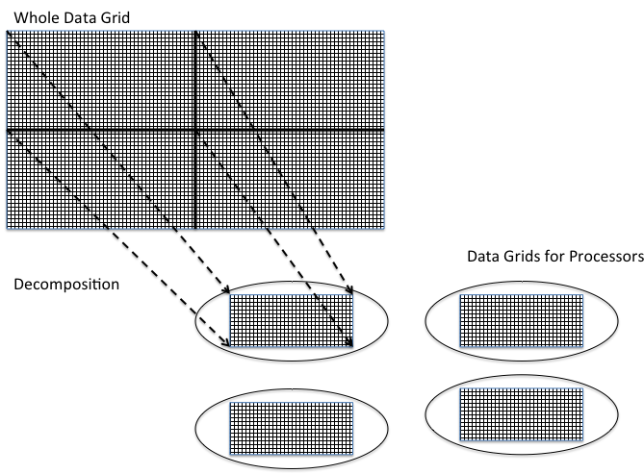
Parallel Programming – Grids
The algorithm involves calculating the value at each grid point by combining it with the value of its neighbours.
Same amount of work needed to calculate each grid point – ideal for the geometric decomposition approach.
Grid is broken up into smaller grids and one is allocated to each process.
Notes:
49
49

Slide 50
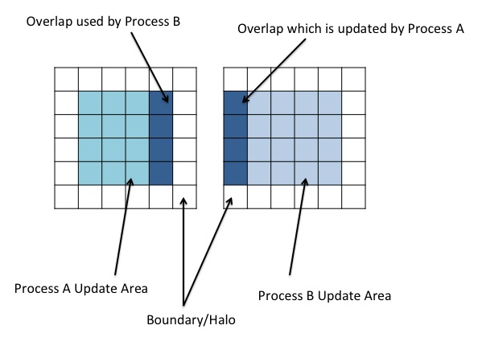
Parallel Programming – Halo Swapping
Points on the edge of a grid present a challenge. Required data is shipped to a remote processor. Processes must therefore communicate.
Solution is for processor grid to have a boundary layer on adjoining sides.
Layer is not writable by the local process.
Updated by another process which in turn will have a boundary updated by the local process.
Layer is generally known as a halo and the inter-process communication which ensures their data is correct and up to date is a halo swap.
Notes:
50
50

Slide 51
Data is exchanged via calls to MPI library
Explore the code! e.g. rank 0 sends “right”
MPI_Send(&x[m][1],n,MPI_DOUBLE,rank+1,tag,comm)
Last rank receives from the left
MPI_Recv(&x[0][1],n,MPI_DOUBLE,rank-1,tag,comm,&status);
MPI communication

Slide 52
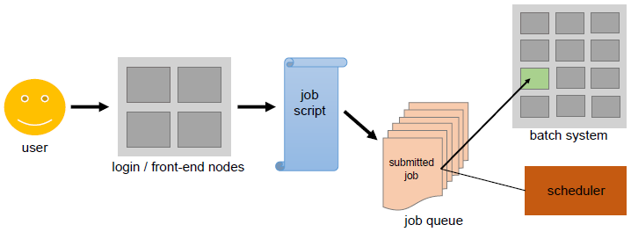

Running a parallel code: Batch systems
Most HPC systems use some form of “queuing”
User logs in to login node
Job then runs on compute nodes, via scheduler
Batch script required (parallel codes can’t usually be run directly). E.g.
>./a.out ✘
Error
>
> cat myscript.slurm
#!/bin/bash
#SBATCH -p scarf
#SBATCH -n 32
#SBATCH -t 30
#SBATCH -o %J.log
#SBATCH -e %J.err
mpirun ./a.out
> sbatch myscript.slurm
Submitted batch job 3133179
$$✔$$
Source: https://hpc-wiki.info/hpc/Scheduling_Basics

Slide 53
Compiling and running the code
  ssh into scarf, e.g.
  > ssh -i .ssh/privatekey.pem tmp01@ui1.scarf.rl.ac.uk
  Copy the tar file
  > cp /work4/training/ccptepp/cfd-par-scarf.tar .
  Expand tar file:
  > tar -xvf cfd-par-scarf.tar
  This should give you the files you need for the exercise
  Load the relevant mode to give you a compiler, mpi env to run e.g.
  > module load intel
  Change directory to where the code is, e.g.
  > cd cfd-par/C-MPI/
  Compile the code using “make” (can ignore warnings for Fortran)
  > make
  Edit files as required, e.g.
  > vi cfd.slurm
  Submit the job (using the reservation)
  > sbatch --reservation=ccp-tepp cfd.slurm
  Check on progress, e.g.
  > squeue -u $USER
  Look at output, should contain timing info 😊, e.g.
  > cat 3146976.log
  …or error ☹️ (some info goes to std error anyway)
  > cat 3146976.err

Slide 54
Practical
Compile and run the code on Scarf
  try different numbers of cores - change number of cores using –np flag
    mpirun -np 16 ./cfd 32 5000
  try to use multiple nodes (i.e. more than 32 cores)
  for different problem sizes (change scale factor (the 1st arg to cfd)
    1 gives 36 x 36
    Probably need scale factor > 32 to see benefit of multiple cores
  Can run more than one parallel job in a script. E.g.
  mpirun -np 16 ./cfd 32 5000
  mpirun -np 32 ./cfd 32 5000
  or in a loop
  for scale_factor in 1 4 8
  do
  mpirun ./cfd $scale_factor 5000
  done
All this slide (and previous one) available in
/work4/training/ccptepp/cfd.README

Slide 55
Over to you…
Details of the exercise

