Slide 1
Welcome!
CCP-TEPP Summer School 2026

Slide 2
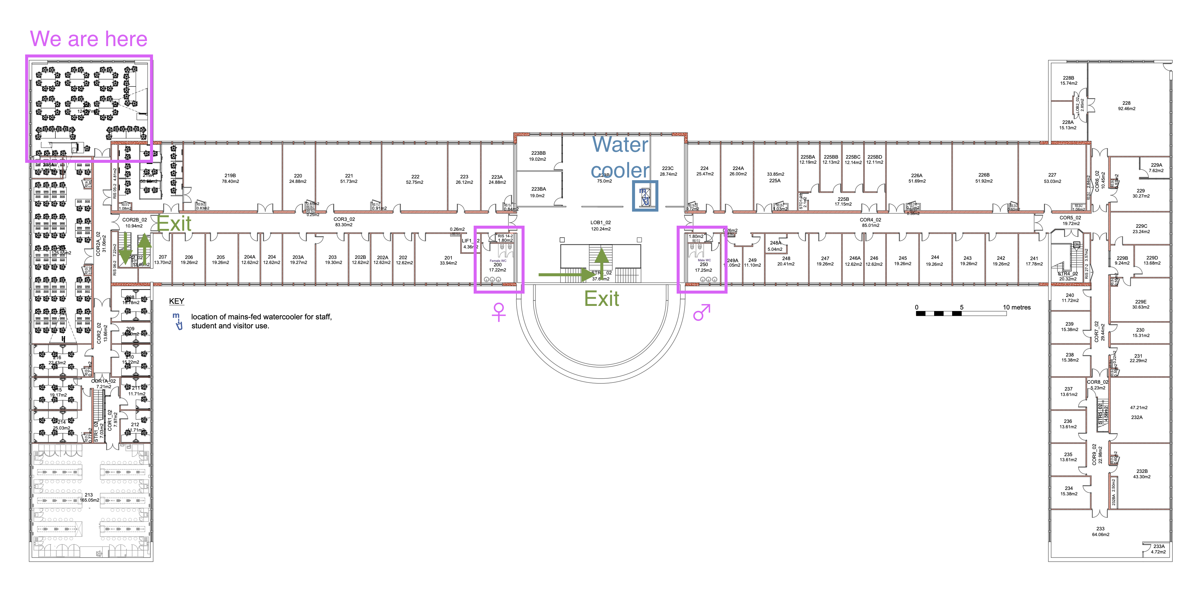
Housekeeping

Slide 3
Housekeeping
Fire alarms tested on Tuesday morning
  Any other time, treat as an emergency
Please follow the Carpentries Code of Conduct
  https://docs.carpentries.org/policies/coc/

Slide 4
Food
Lunch
  Harbwr, Fulton House—vouchers
Evening meal
  Monday–Wednesday: Harbwr, Fulton House—prepaid
  Thursday: Langlands Brasserie—more details on Thursday
  Friday: No organised meal
Breaks
  In this room

Slide 5
What is CCP-TEPP?
Project to form a
  Still in scoping phase
  Trying things to see what works
  Aiming to form a community that can obtain further funding
Collaborative Computational Project
  UK-specific structure for supporting computational research
  Only recently available outside of specific non-PP areas
  Supported by STFC National Labs
in Theoretical and Experimental Particle Physics
  Including, but not limited to
    Collider physics
    Lattice quantum field theory
    Amplitudes
    Particle astrophysics

Slide 6
What has CCP-TEPP done?
Roadmap for particle physics software
Knowledge exchange workshop
Docathon
Hadrons hackathon

Slide 7
Roadmap outcomes
Challenges common across theory and experiment include:
  Documentation of code
  Reproducibility of analysis workflows
  Sharing of data
  Testing and quality assurance of software
  Getting access to appropriate, necessary computing resources
  Developing the skills to do these things as part of the standard development process
This school aims to develop all of the above skills!

Slide 8
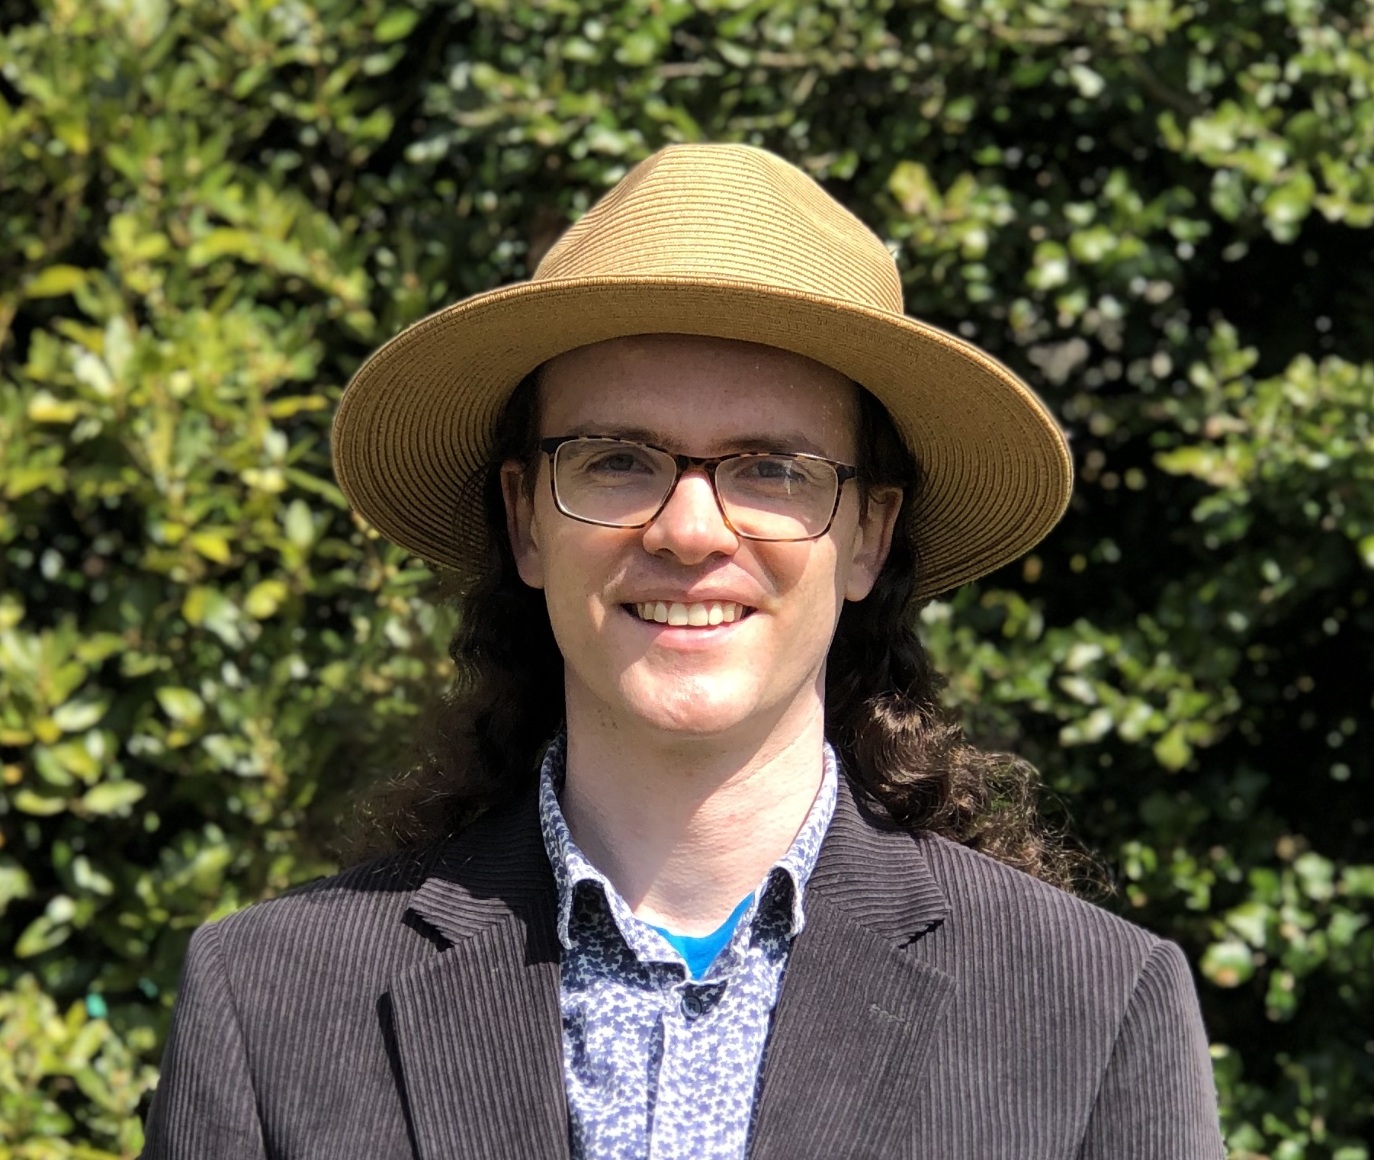
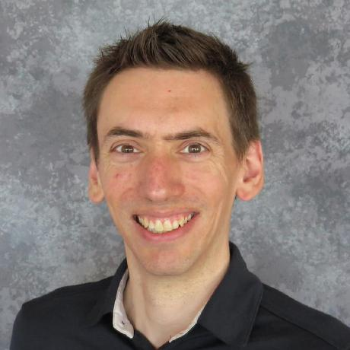
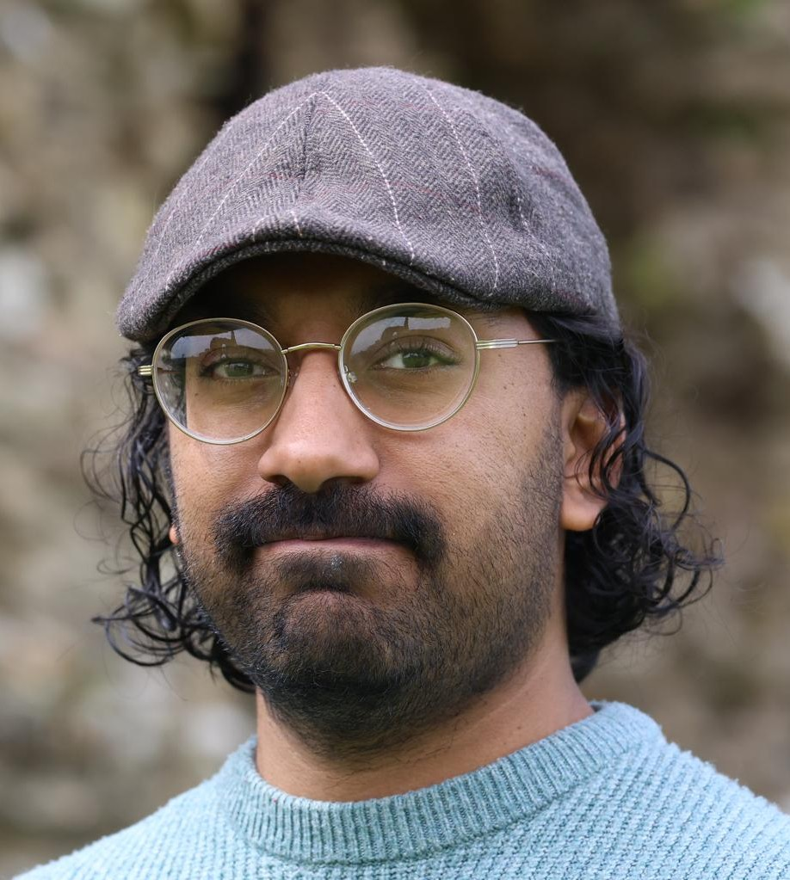
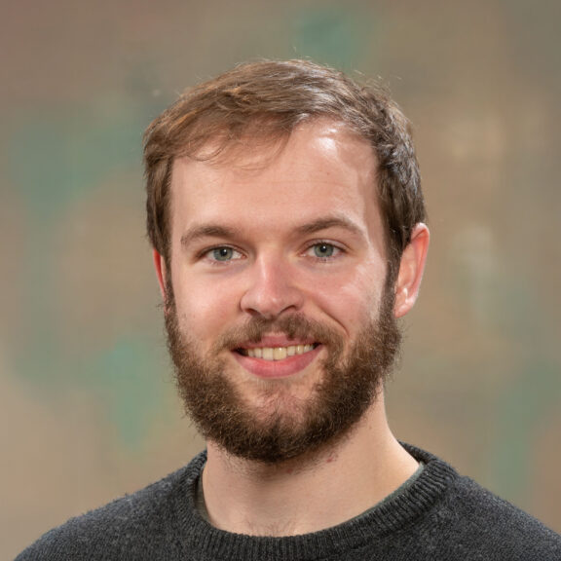
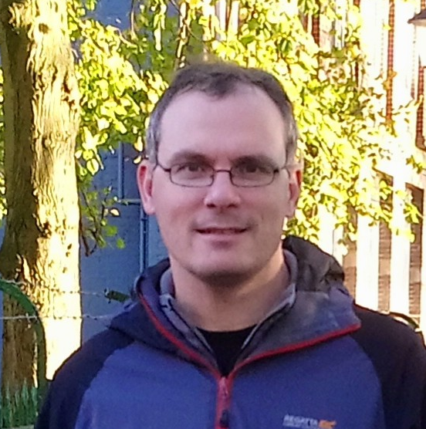
Who are we?
Arriving later this week
Ed Bennett
they/them
Swansea University
Ben Morgan
he/him
University of Warwick
Alastair Dewhurst
STFC National Labs
Gaurav Ray
he/him
Swansea University
Andrew Lister
he/him
STFC National Labs
Chris Johnson
he/him
University of Edinburgh

Slide 9
Live coding
Instructors will write and run code in front of you
You should follow along and do the same on your machine
  If you hit issues, ask for help
  Once you have done it, you’ve demonstrated that you can
  C.f. watching along but not doing, then you try afterwards and hit all the problems
At various points we will stop for challenges to have the chance to apply the techniques rather than only following along

Slide 10
Agenda for Monday
AM:
  Workshop: Automated reproducible analysis with Snakemake
PM:
  Talk: Open Science
  Workshop: Automated testing in C++

Slide 11
Agenda for Tuesday
AM:
  Workshop: Automated testing in C++
PM:
  Talk: Open software development
  Workshop: Automated reproducible analysis with Snakemake

Slide 12
Agenda for Wednesday
AM:
  Workshop: Automated testing in C++
PM:
  Talk: Working with open data
  Workshop: Automated testing in C++
  Workshop: Introduction to software documentation

Slide 13
Agenda for Thursday
AM:
  Workshop: Automated reproducible analysis with Snakemake
  Workshop: Introduction to software documentation
PM:
  Talk: Publishing open data
  Workshop: Introduction to software documentation
Early finish—dinner

Slide 14
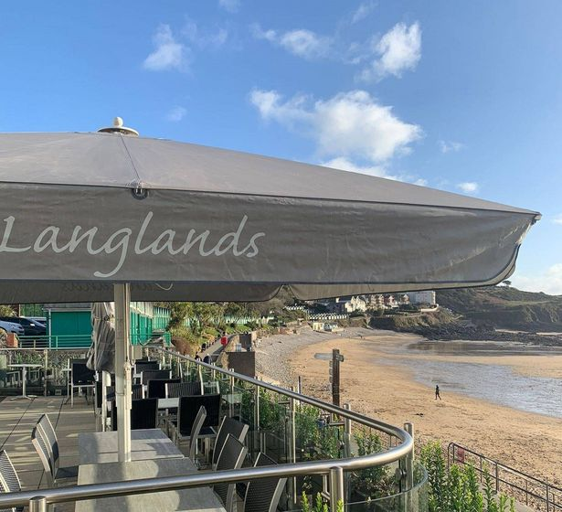
Dinner
Langlands Brasserie, 7pm
Very pleasant walks
  We’ll finish early to give time to get there
  Transport info on next slide
Two courses
  Starter and main
  Pay for your own alcohol
  We’ll walk for ice cream afterwards

Slide 15
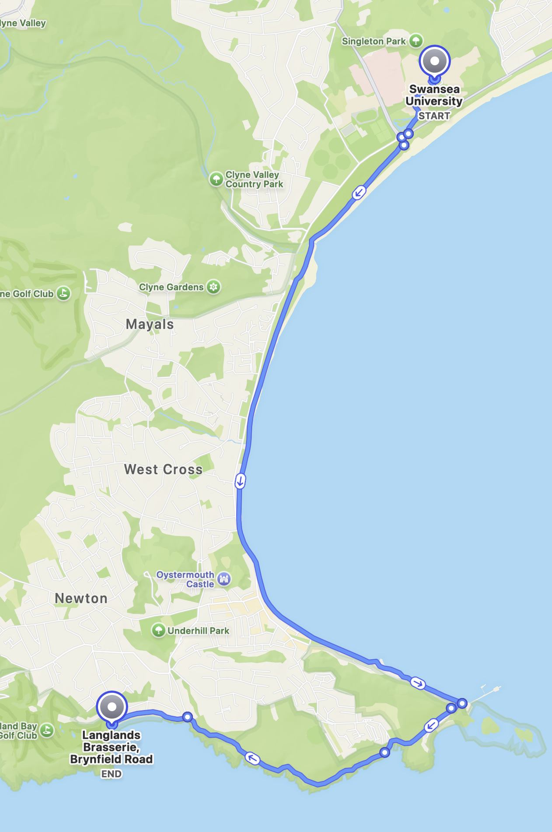
Dinner transport
You are here
~2 hour walk from here along coast path
Or bus part way
  3A bus to Bracelet Bay (35 minutes) plus 40-minute coastal walk
  Or 1 or 2 bus to Newton Road (12 minutes) plus 1-hour coastal walk via Bracelet Bay
Or bus most of the way:
  1 or 2 bus to Caswell Road (16 minutes)
  Ten minute walk from there
All buses depart from Boating Lake, to the south of campus
Or talk to us if you want to car pool
Boating Lake
Newton Road
Caswell Road
Bracelet Bay
Food is here

Slide 16
Agenda for Friday
AM
  Workshop: High performance techniques
PM
  Talk: Getting access to computing time
  Workshop: Preparing a technical assessment when applying for computing time

Slide 17
Feedback
We will send a feedback form
Please complete it

