Slide 1

Nottingham – Glasgow Optical Work on Alumina Coatings
15th January 2026
Scott Fitzgerald
On behalf of the Glasgow coatings group

Slide 2
Introduction – Why is alumina interesting?
To improve the sensitivity of gravitational wave detectors, future test-mass coatings require reduced thermal noise.
Mirror coatings have alternating layers of materials with low and high refractive indices.
Silica (SiO₂) is often used as a low-index layer but is unsuitable for use in cryogenic detectors because of a mechanical loss peak at 20K.
Al₂O₃ is interesting for cryogenic detectors to replace SiO₂ as a low-index partner material for coating stacks.
Previously investigated by R. Robie, M. Abernathy, S. Penn, D. Crooks et al, I. Pinto, J. Franc et al, M. Molina-Ruiz and others.
1

Slide 3
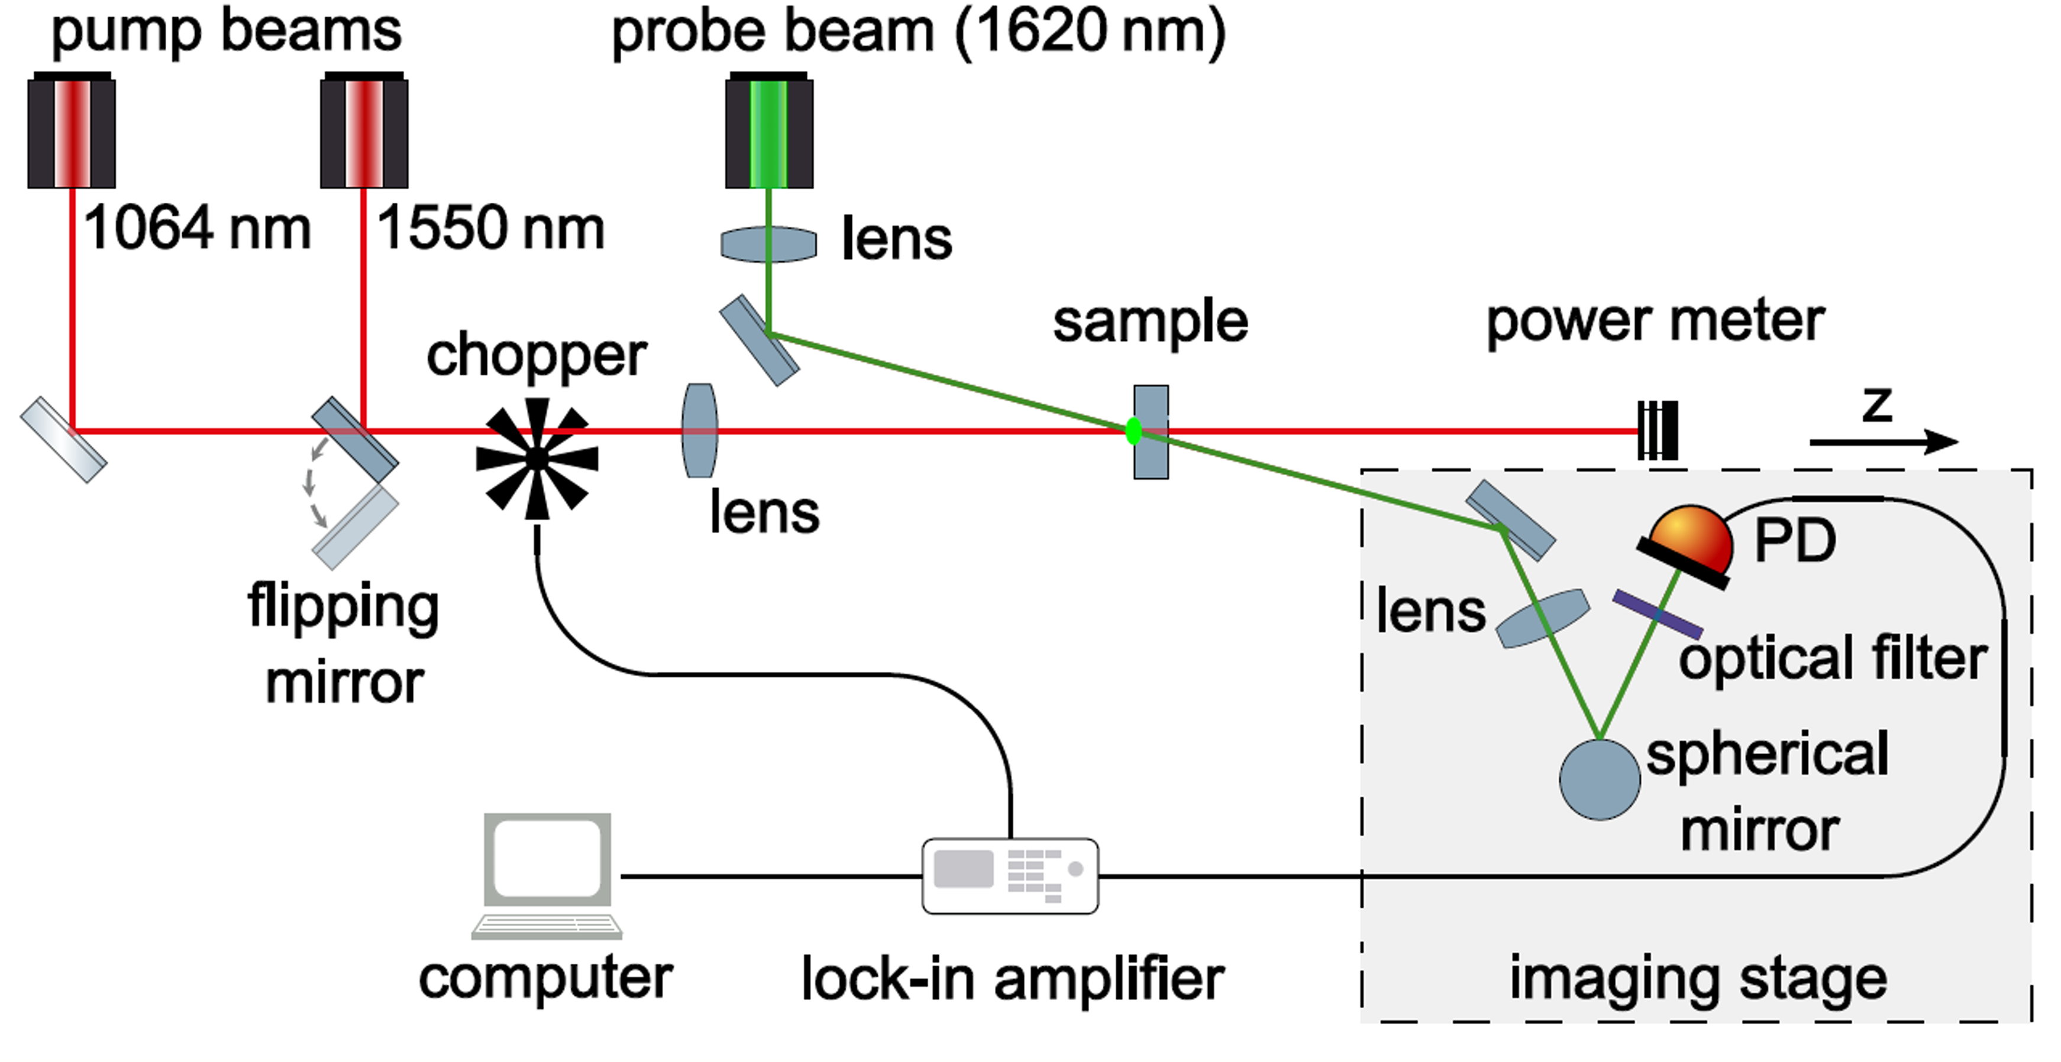
Optical investigations of Al₂O₃
Photothermal common-path interferometry (PCI) used to measure absorption.
Works by measuring the effect of a thermal lens generated by a pump beam on a crossing probe beam.
More absorption = stronger thermal lens, so more measured effect.
Effect of heat-treatment on absorption of Al₂O₃ deposited by Reactive Low Voltage Ion Plating measured at 1064nm and 1550nm.
Heat treatment is usually used to improve optical absorption and reduce the loss of coating materials.
2

Slide 4
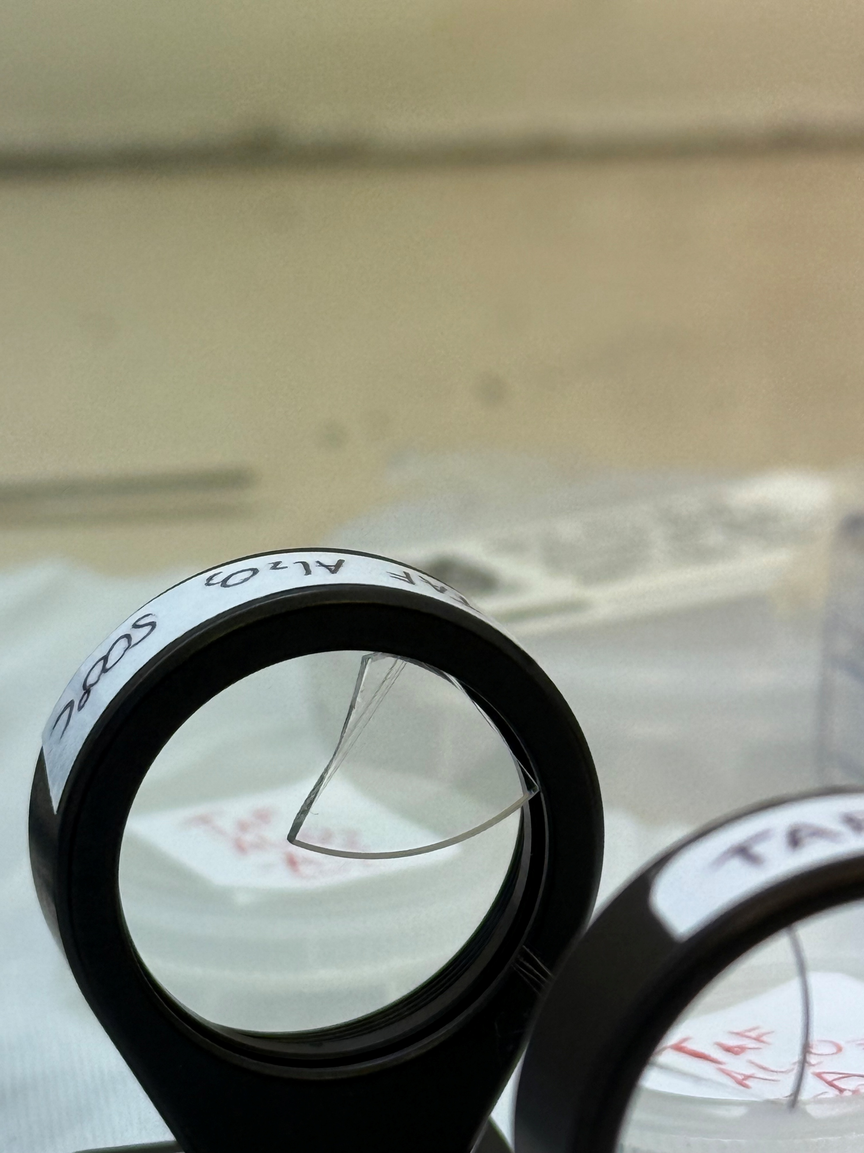
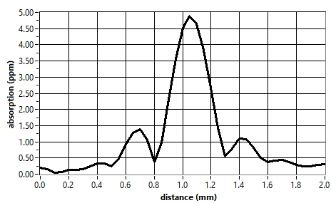
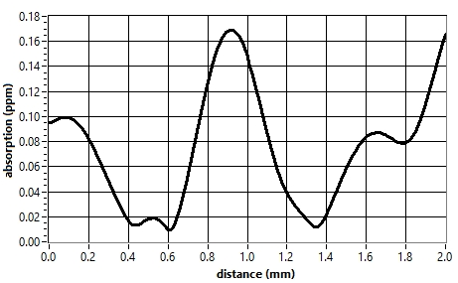
Al₂O₃ absorption measurements
3
ppm = parts per million 1ppm = 0.0001%
1064 nm measurements: as deposited mean absorption of ~5ppm, drops to ~0.2ppm after 500°C HT.
1550 nm measurements: as deposited mean absorption of ~4.2ppm, drops to ~1.7ppm after 550°C HT.
Al₂O₃ A2 slice ADP Absorption Measurement - 1064nm
Al₂O₃ A2 slice 500°C Absorption Measurement - 1064nm
Measurements by S. Fitzgerald and G. McGhee

Slide 5
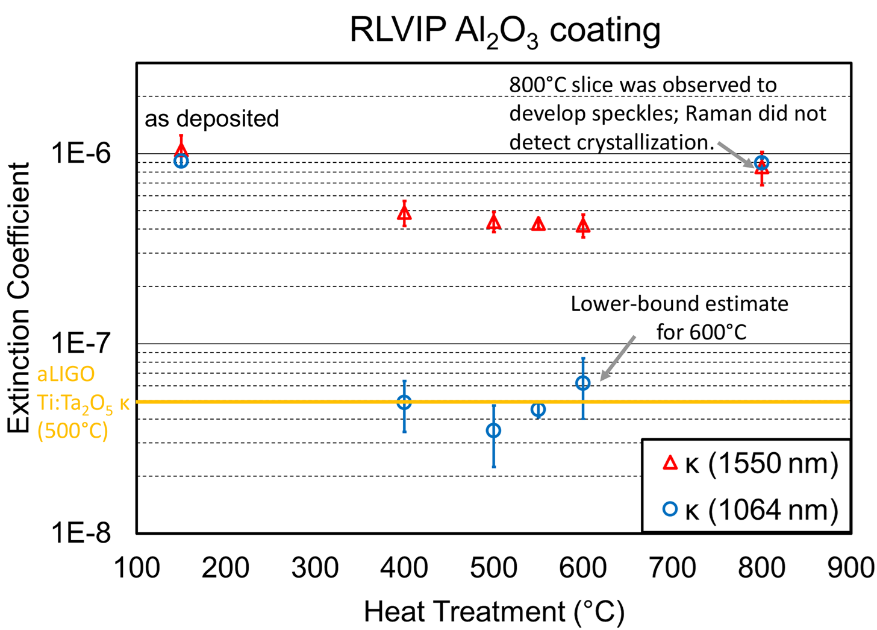
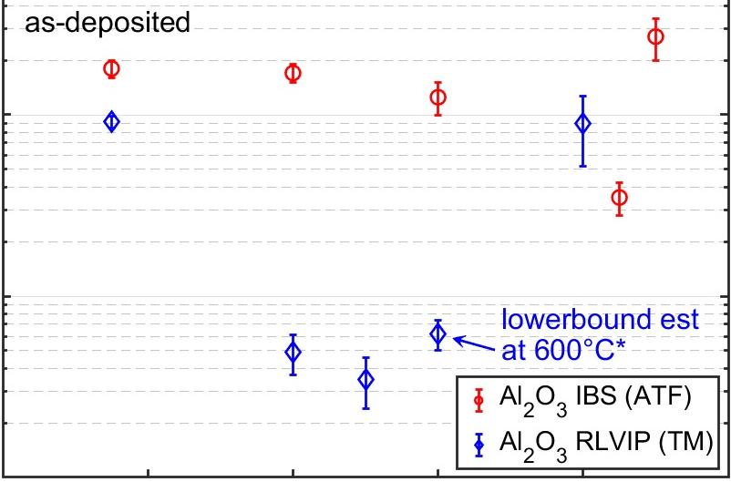
κ is a measure of thickness-independent absorption.
Order of magnitude variation between IBS and RLVIP Al₂O₃.
Order of magnitude variation between 1064 nm and 1550 nm.
RLVIP Al₂O₃ has comparable κ to aLIGO coatings at 1064 nm.
4

Slide 6
Summary
Ongoing Work
RLVIP Al₂O₃ coating investigated at 1064nm and 1550nm.
Heat treated to 400°C, 500°C, 550°C, 600°C and 800°C.
Sub-0.2 ppm absorption minimum for 1064nm at 500°C (500nm coating) for RLVIP deposition.
Order of magnitude improvement in absorption vs IBS Al₂O₃.
Investigating heat treatment time vs absorption.
Modelling for possible stack designs.
5

Slide 7
Thank you! Any questions?
s.fitzgerald@research.gla.ac.uk

