Slide 1

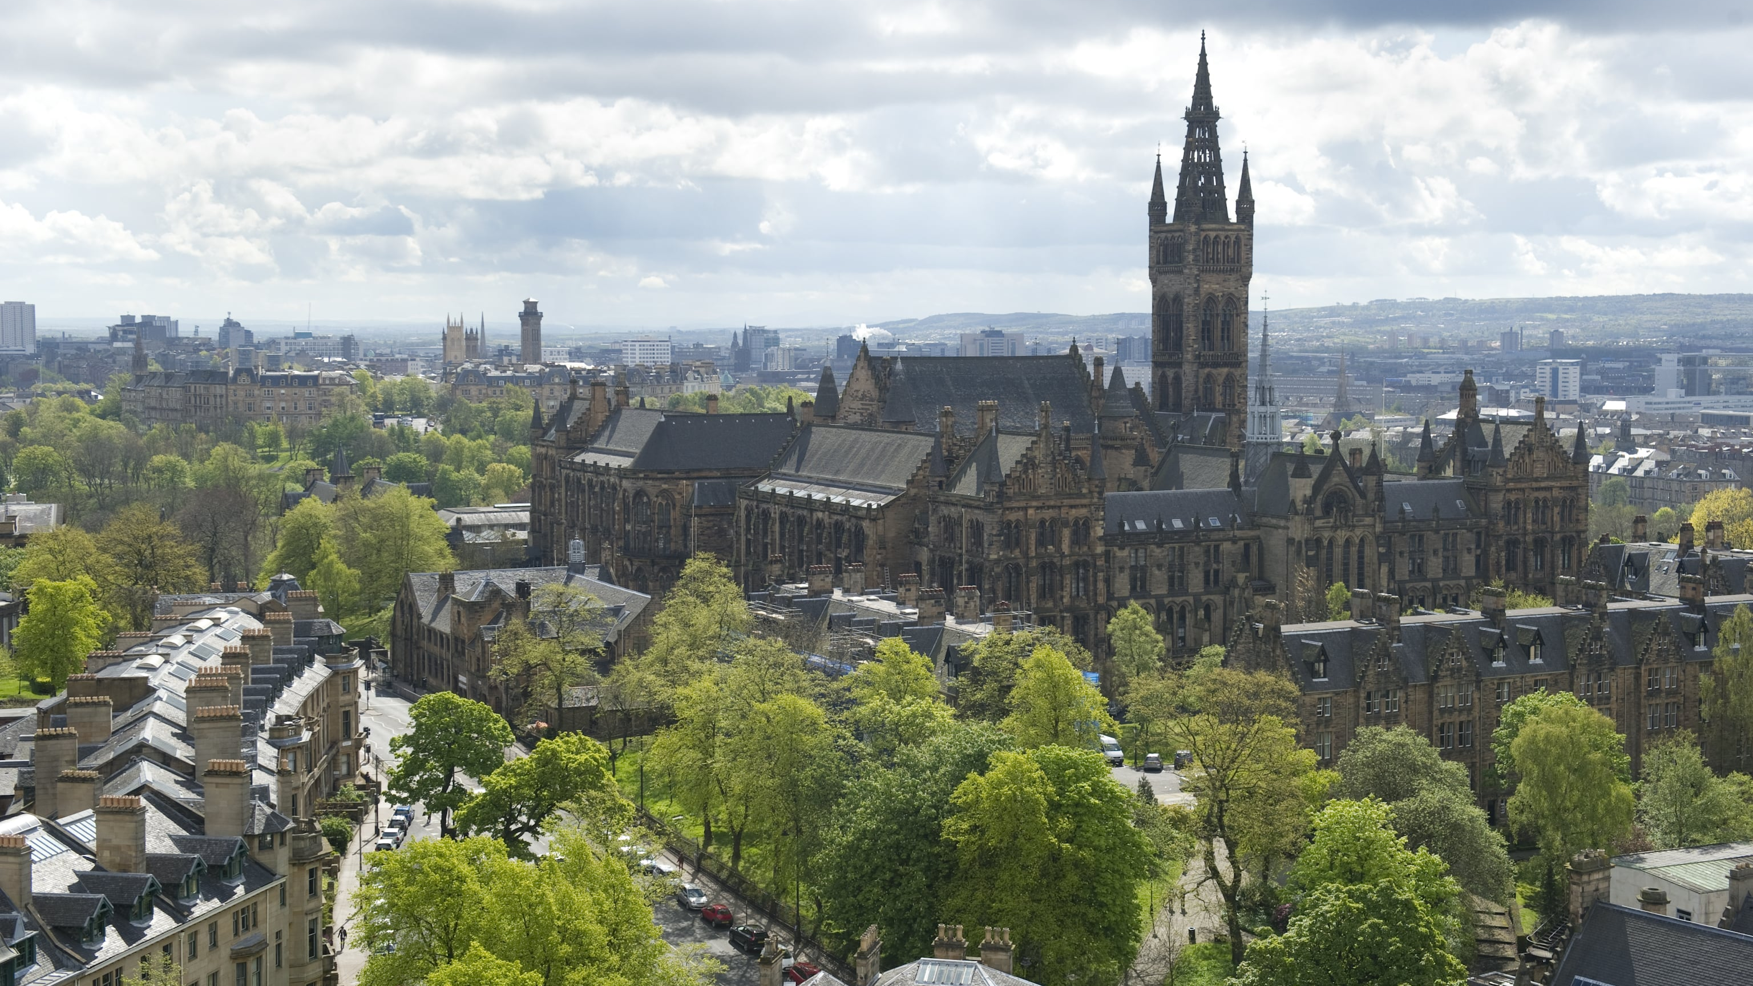
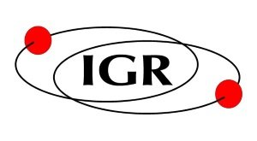
An overview of coatings and core optics research in Glasgow
GW:UK Nottingham – Graeme I. McGhee – 2026 / 01 / 15

Slide 2
9 Institute for Gravitational Research members currently work on future GWD optics solutions.
In this flash talk we’ll go over some of our current activities and one project briefly.

Slide 3
Scott Fitzgerald Margot Hennig
Stuart Hill
Sir Jim Hough
Sean MacFoy
Iain W. Martin Graeme I. McGhee
Peter G. Murray Sheila Rowan
9 Institute for Gravitational Research members currently work on future GWD optics solutions.
In this flash talk we’ll go over some of our current activities and one project briefly.

Slide 4
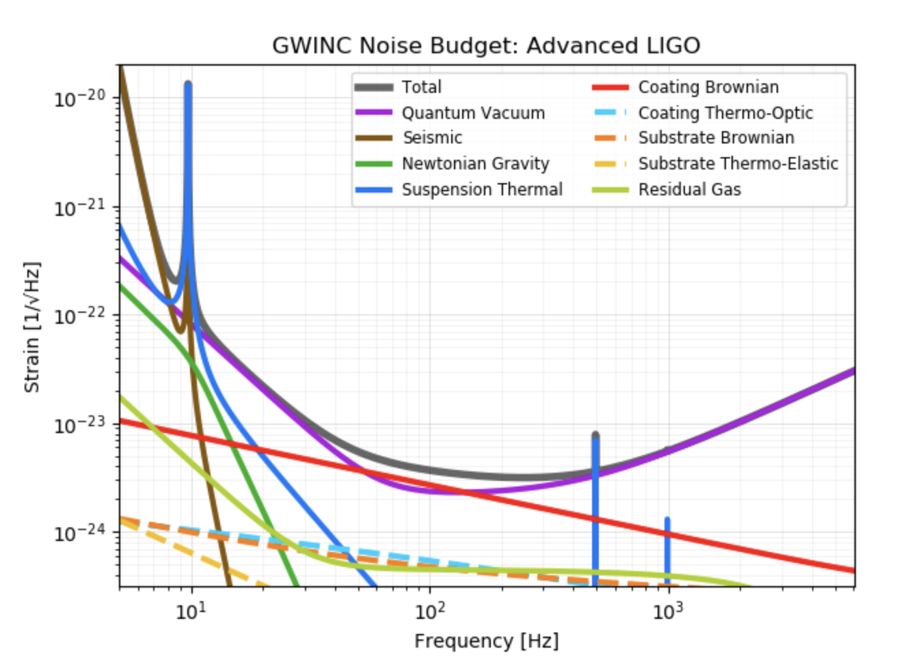
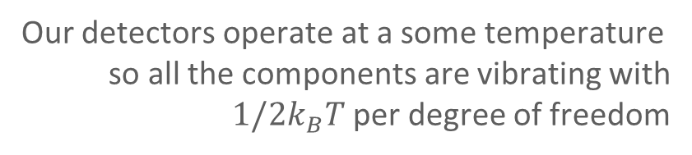
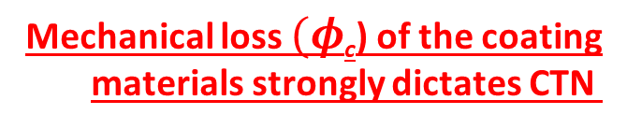
2.
THE
COATING
THERMAL NOISE
PROBLEM
Our detectors operate at a some temperature so all the components are vibrating with $1/2k_{B}T$ per degree of freedom
Coating Brownian Thermal Noise (CTN)
Front surface vibrations of the mirror coatings limit the sensitivity of GW detectors in their most sensitive range (50Hz-150Hz)
Mechanical loss $(φ$_{c}) of the coating
materials strongly dictates CTN
aLIGO Noise Budget
https://git.ligo.org/gwinc/pygwinc

Slide 5
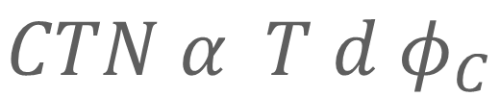
2.
THE
COATING
THERMAL NOISE
PROBLEM
$$CTN α T d φ_{C}$$
Our detectors operate at a some temperature so all the components are vibrating with $1/2k_{B}T$ per degree of freedom
Coating Brownian Thermal Noise (CTN)
Front surface vibrations of the mirror coatings limit the sensitivity of GW detectors in their most sensitive range (50Hz-150Hz)
Mechanical loss $(φ$_{c}) of the coating
materials strongly dictates CTN
aLIGO Noise Budget
https://git.ligo.org/gwinc/pygwinc

Slide 6
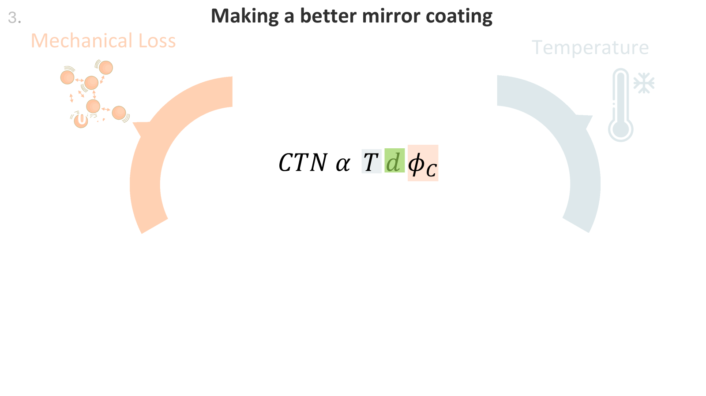

Slide 7
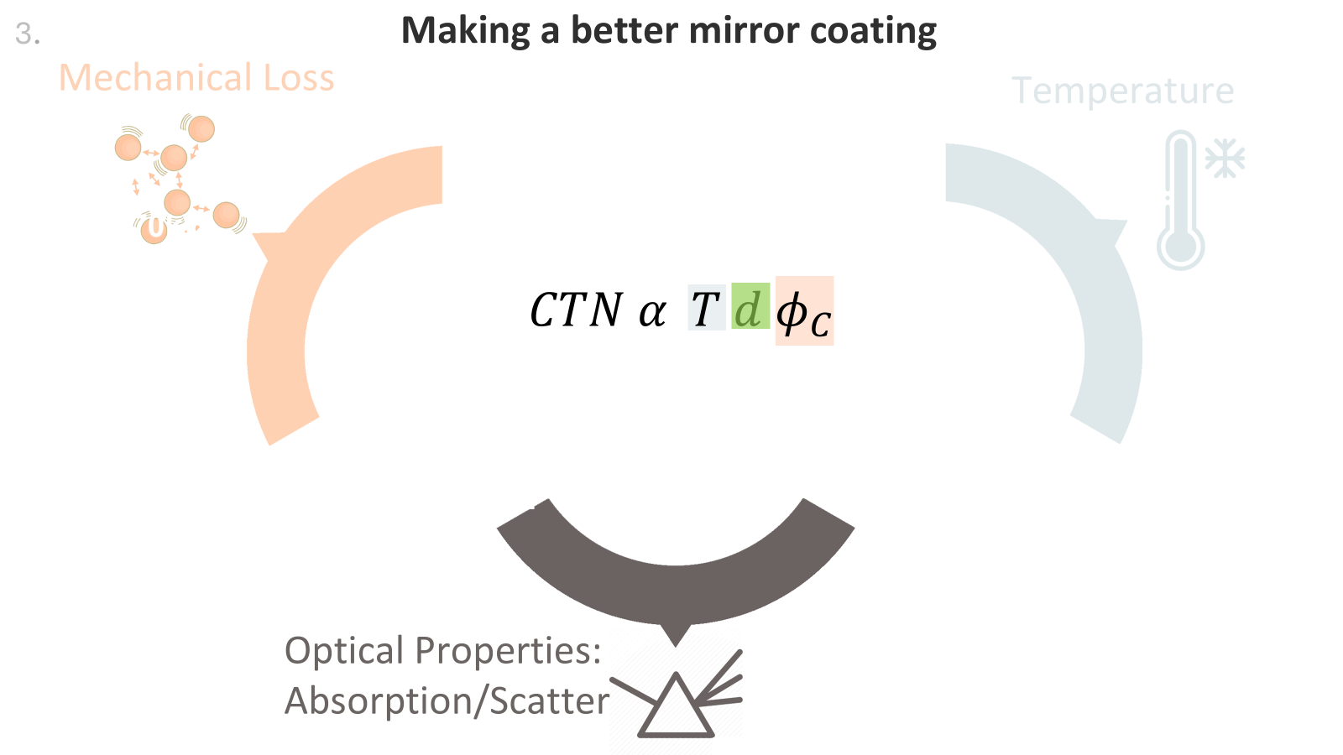

Slide 8
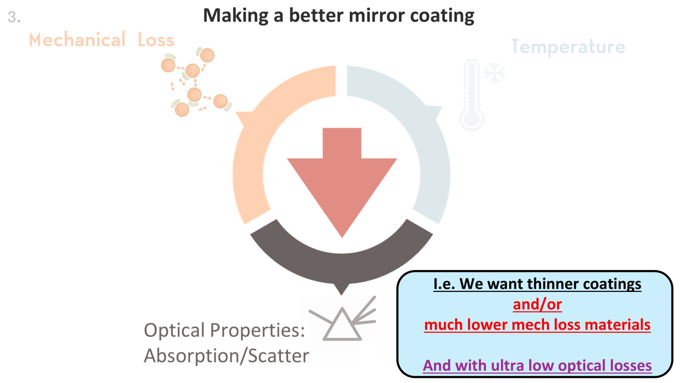

Slide 9
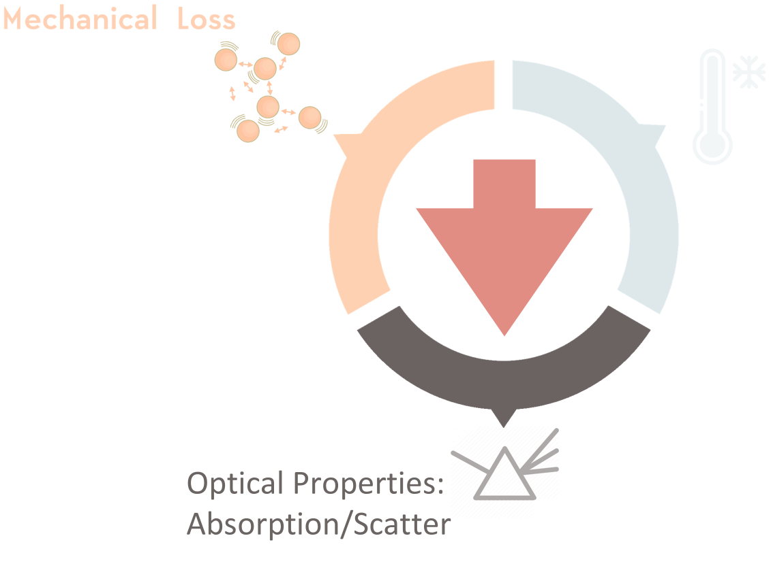
The kinds of work we do…
We measure mechanical loss (room temperature and cryogenic) to understand thermal noise performance.
We measure optical absorption loss of coatings at different wavelengths of interest for future GWDs.
We develop mirror designs of different layer structures and materials to optimise the various key properties.
This work is supported by extensive high precision characterisation facilities - e.g. ellipsometry for thickness and refractive index measurements, surface profiling, Raman spectroscopy for structure.
If we can help characterize your samples let us know ☺.
4.

Slide 10
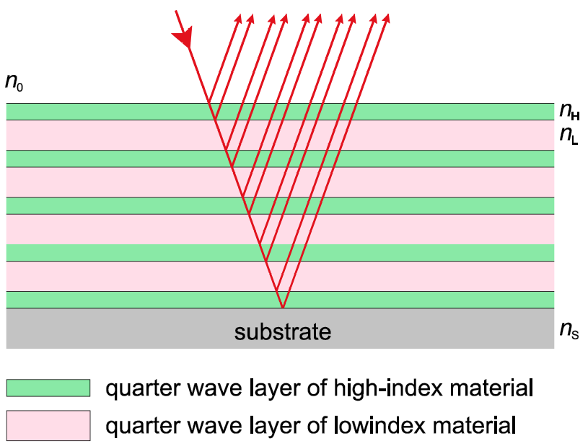
Currently coatings are made by stacking near quarter wave layers of two materials of different refractive-index (n). (SiO₂ + TiO₂-doped-Ta₂O₅) And they are produced via Ion Beam Sputtering due to its track record of low losses and high uniformity.
For future room temperature detectors: The majority of current global research is in finding replacement high-n materials TiO₂-doped-Ta₂O₅.
New Oxides (TiO₂:SiO₂, TiO₂:GeO₂, better TiO₂:Ta₂O₅)
Silicates
(aSi, aSi-H, SiN_{x})
Crystalline Coatings
(AlGaAs, pure-TiO₂, thin bulk top-layers)
5.

Slide 11
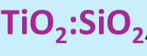
Currently coatings are made by stacking near quarter wave layers of two materials of different refractive-index (n). (SiO₂ + TiO₂-doped-Ta₂O₅) And they are produced via Ion Beam Sputtering due to its track record of low losses and high uniformity.
For future room temperature detectors: The majority of current global research is in finding replacement high-n materials TiO₂-doped-Ta₂O₅.
New Oxides (TiO₂:SiO₂, TiO₂:GeO₂, better TiO₂:Ta₂O₅)
Silicates
(aSi, aSi-H, SiN_{x})
Crystalline Coatings
(AlGaAs, pure-TiO₂, thin bulk top-layers)
At Glasgow currently
5.

Slide 12
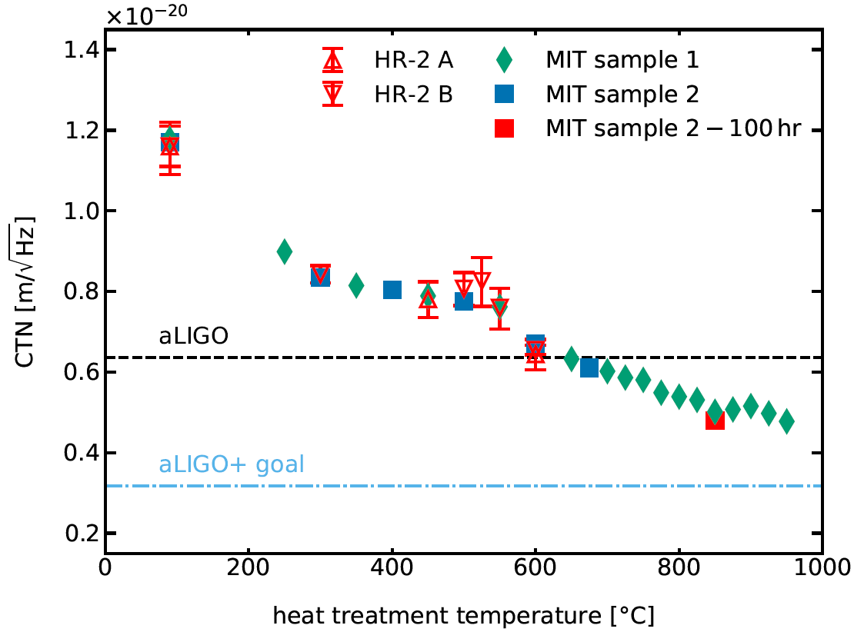
6.
Project A: TiO₂:SiO₂ development
SiO₂ is a ultra low optical loss and lowest mechanical loss among the oxides.
TiO₂ has some of the highest-n among the oxides (i.e. can be made thinnest). Thus a mixed-high-n-material can be promising!
We’ve previously demonstrated this material’s promising performance, with full reflectivity optics with better CTN than aLIGO, with comparable/better scatter, and ultra low absorption
We previously pioneered this material’s development [G. I. McGhee et al. PhysRevLett.131.171401], and now we are working in collaboration with EPOC and Virgo to further improve it.

Slide 13
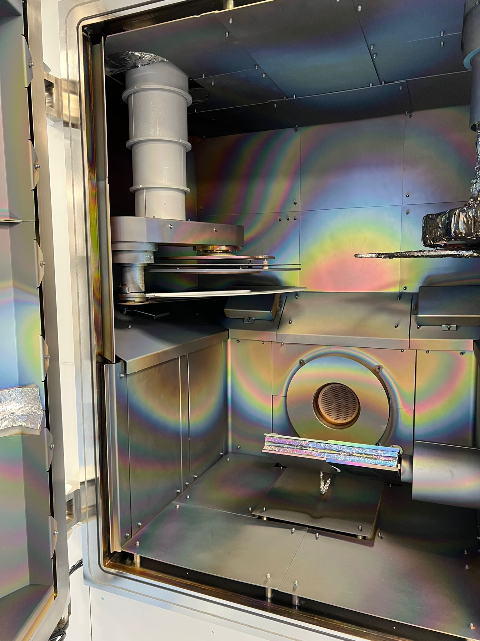
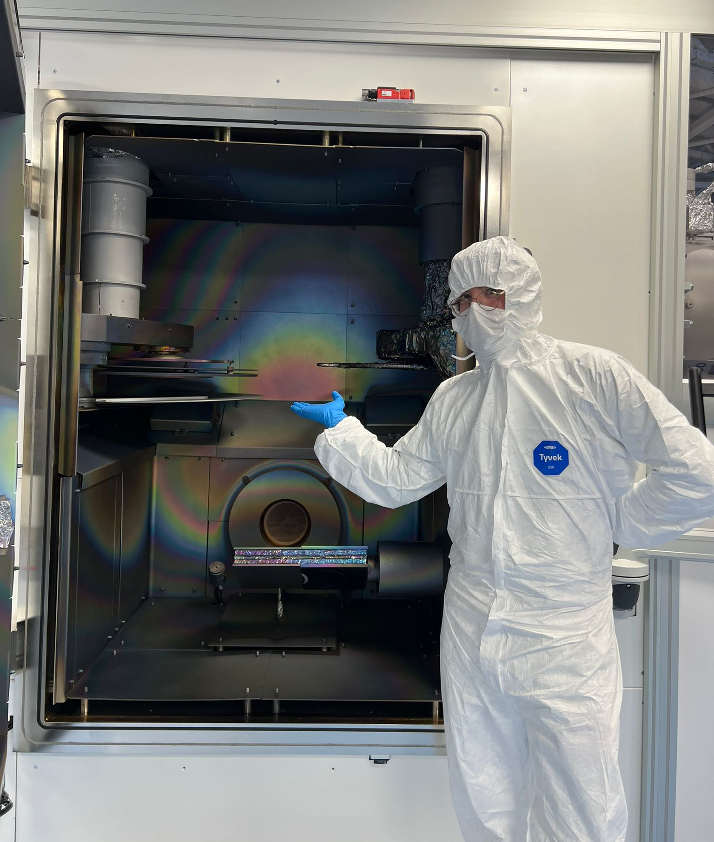
6.
Project A: TiO₂:SiO₂ development
SiO₂ is a ultra low optical loss and lowest mechanical loss among the oxides.
TiO₂ has some of the highest-n among the oxides (i.e. can be made thinnest). Thus a mixed-high-n-material can be promising!
EPOC: Extreme Performance in Optical Coatings The UK’s first large-area IBS, high-precision coatings facility. Overseen by Strathclyde, UofG, and UWS GWD optics teams, plus industry partners.
ME
We previously pioneered this material’s development [G. I. McGhee et al. PhysRevLett.131.171401], and now we are working in collaboration with EPOC and Virgo to further improve it.

Slide 14
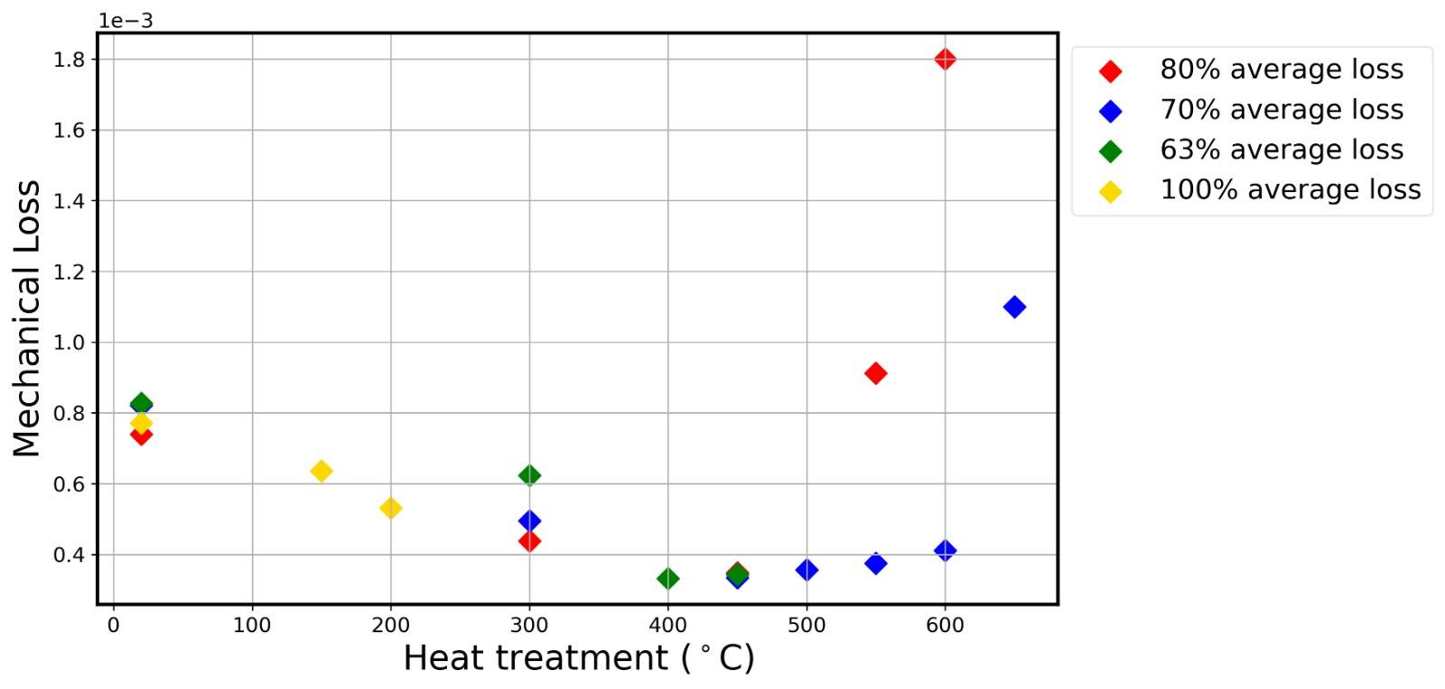
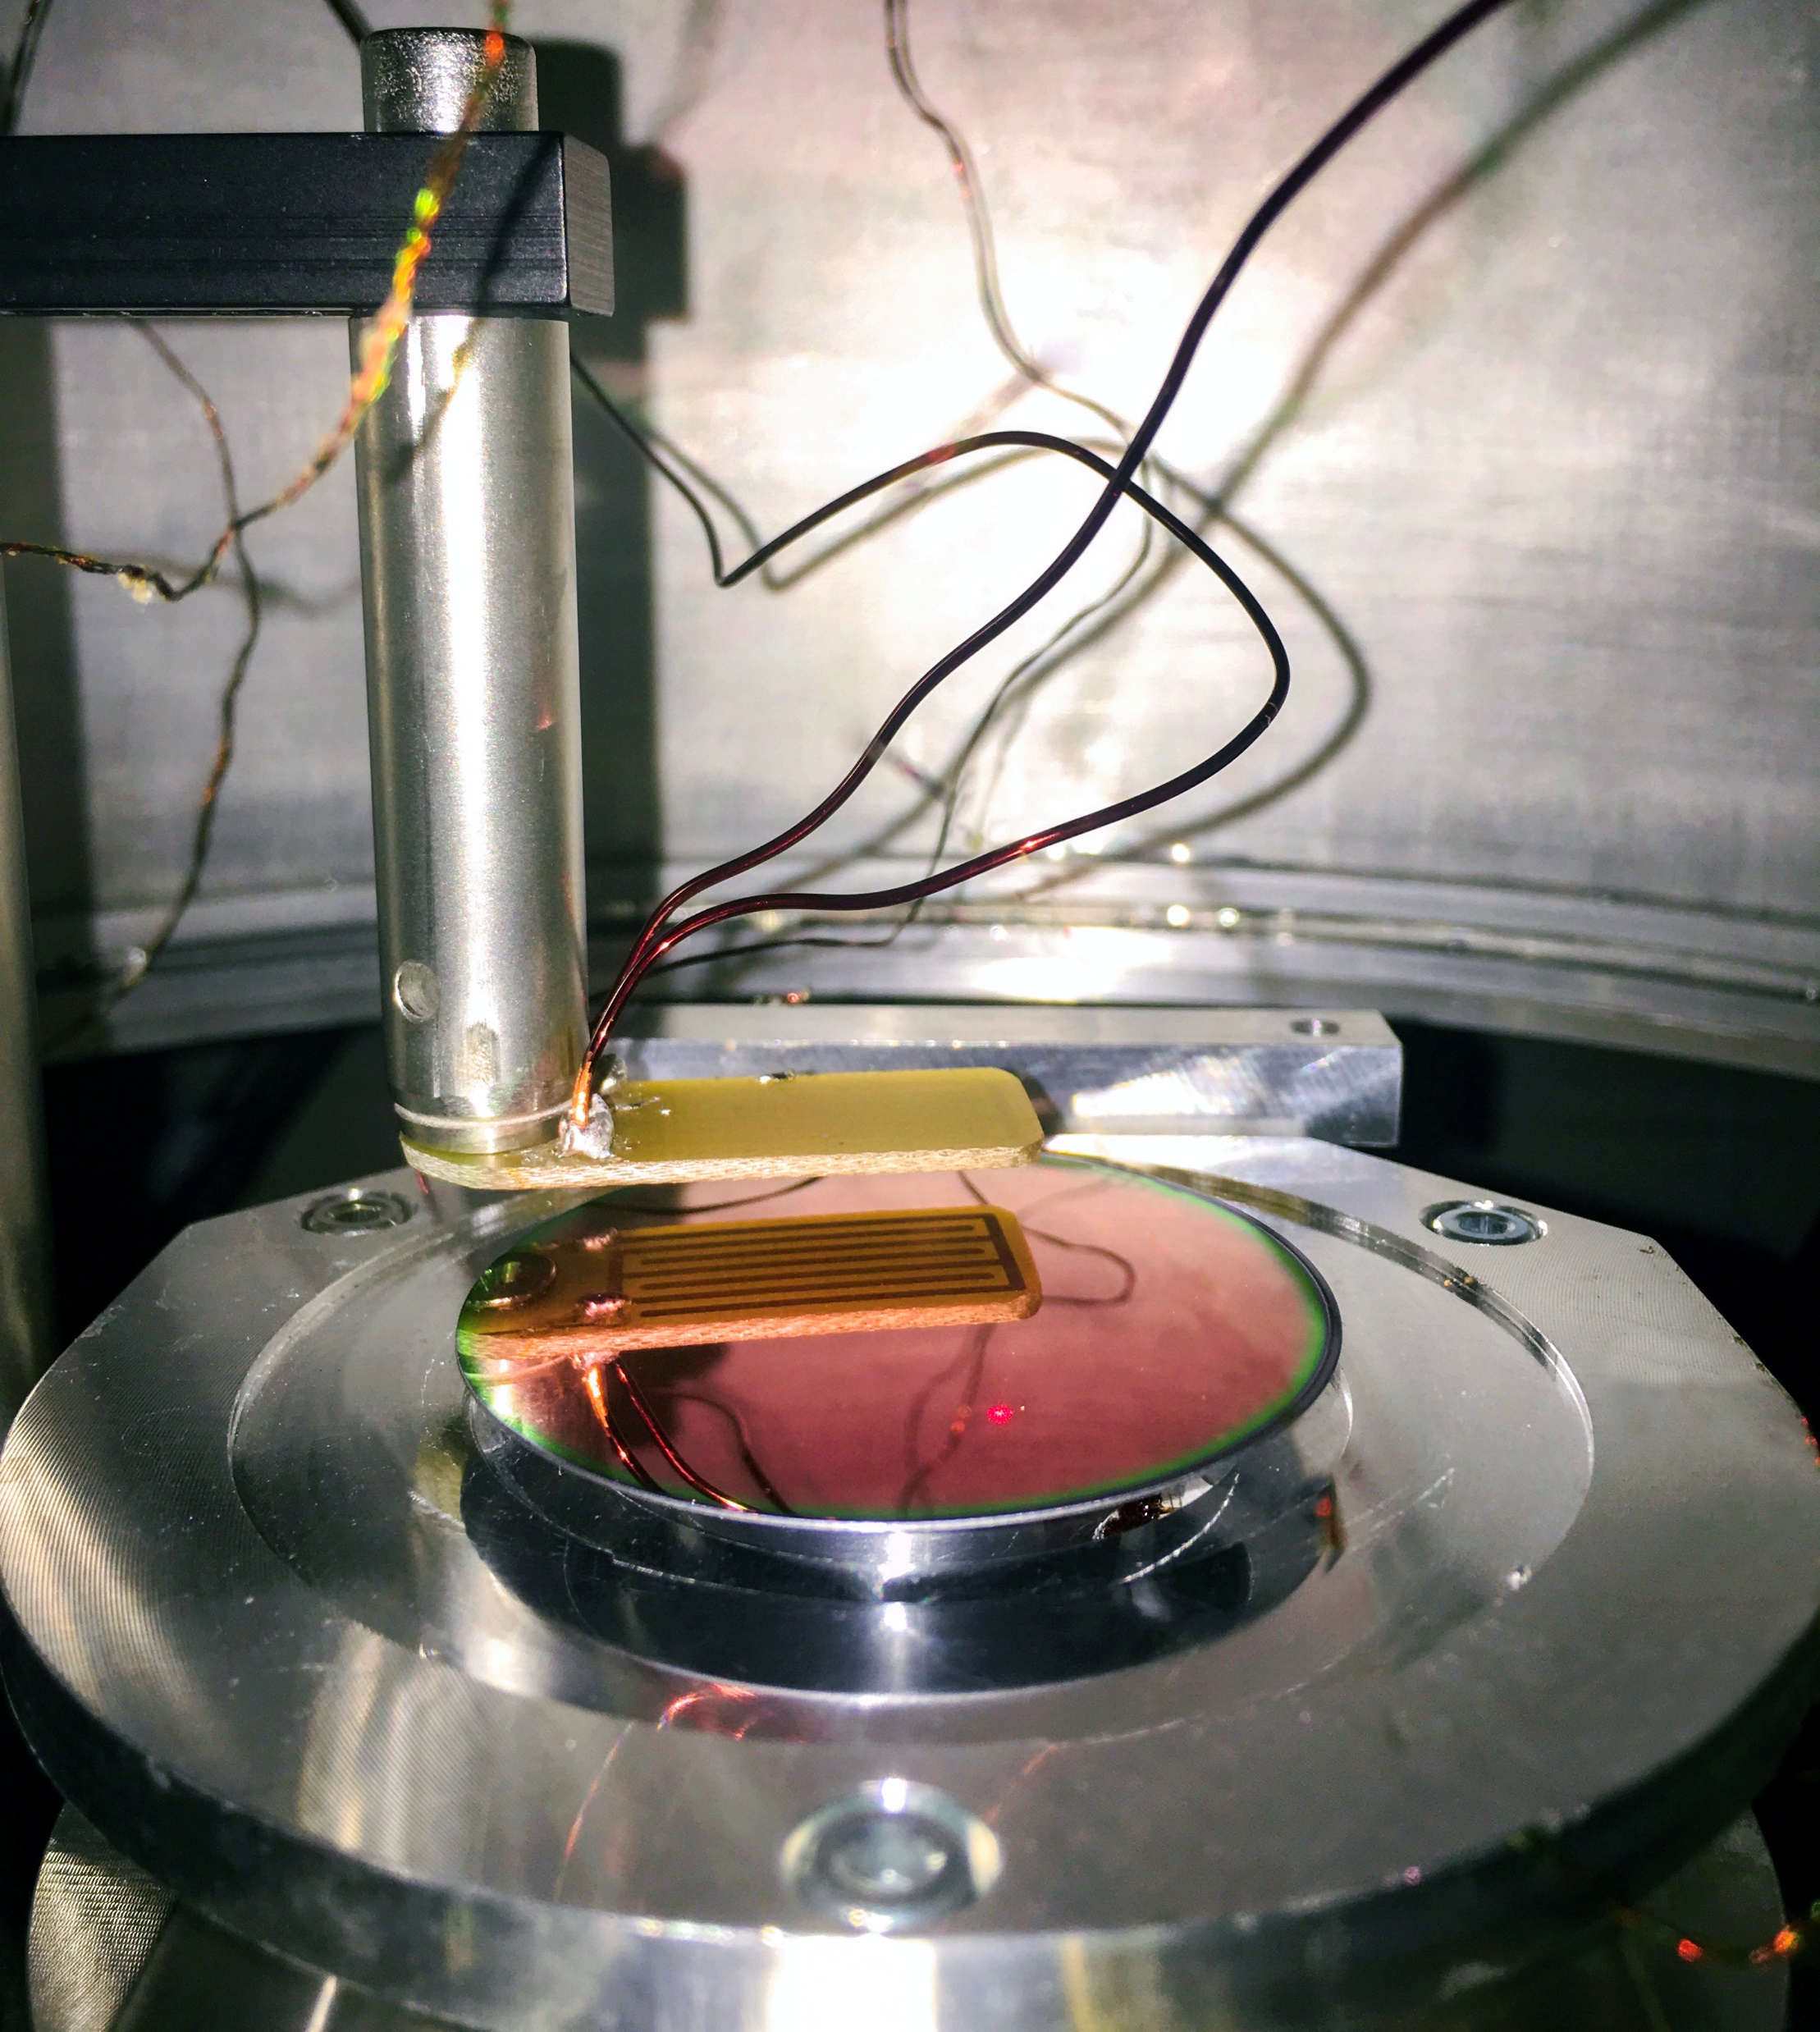
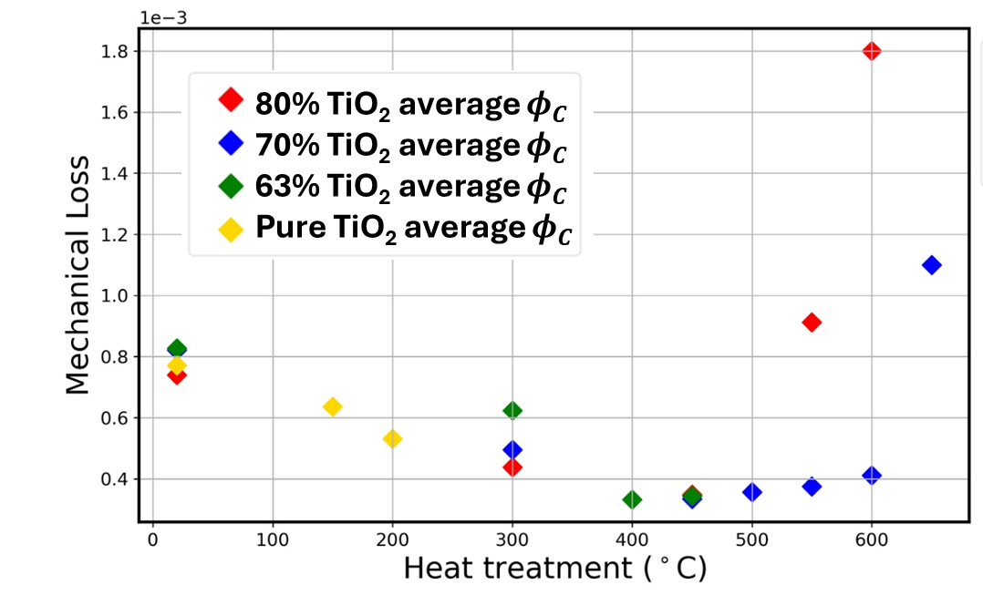

7.
Project A: TiO₂:SiO₂ development
Recent works have included producing coatings of many different mixing ratios and measuring the effects on the mechanical and optical properties – greatly expanding our parameter space, and leading to interesting new results.
80% TiO₂ average $φ_{C}$ 70% TiO₂ average $φ_{C}$
63% TiO₂ average $φ_{C}$
Pure TiO₂ average $φ_{C}$
S. Hill, P. G. Murray, G. I. McGhee
We have also been studying coating stress and defect suppression on heat treatment.

Slide 15
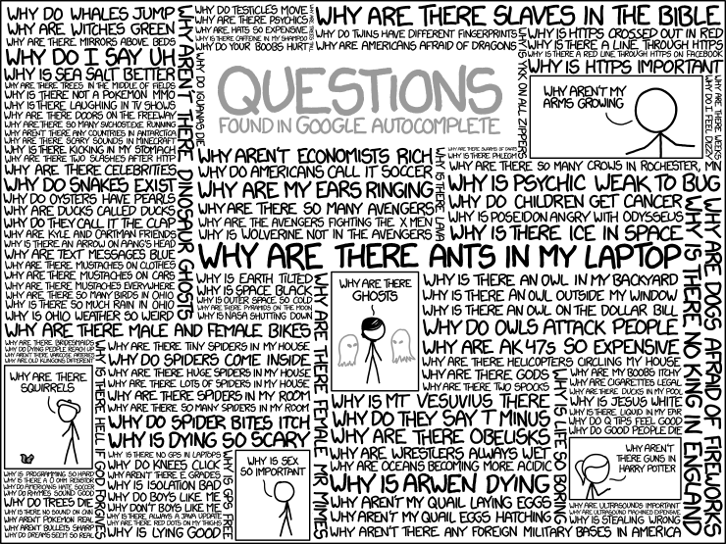
Thanks for listening!
Ref: https://xkcd.com/1256/
Any questions?

Slide 16
BONUS PROJECT FLASH SLIDES FOR THOSE INTERESTED ONLINE

Slide 17
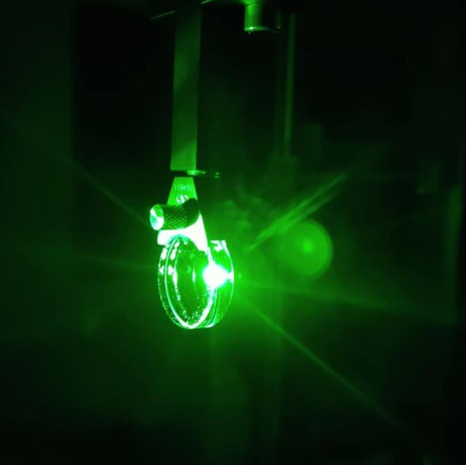
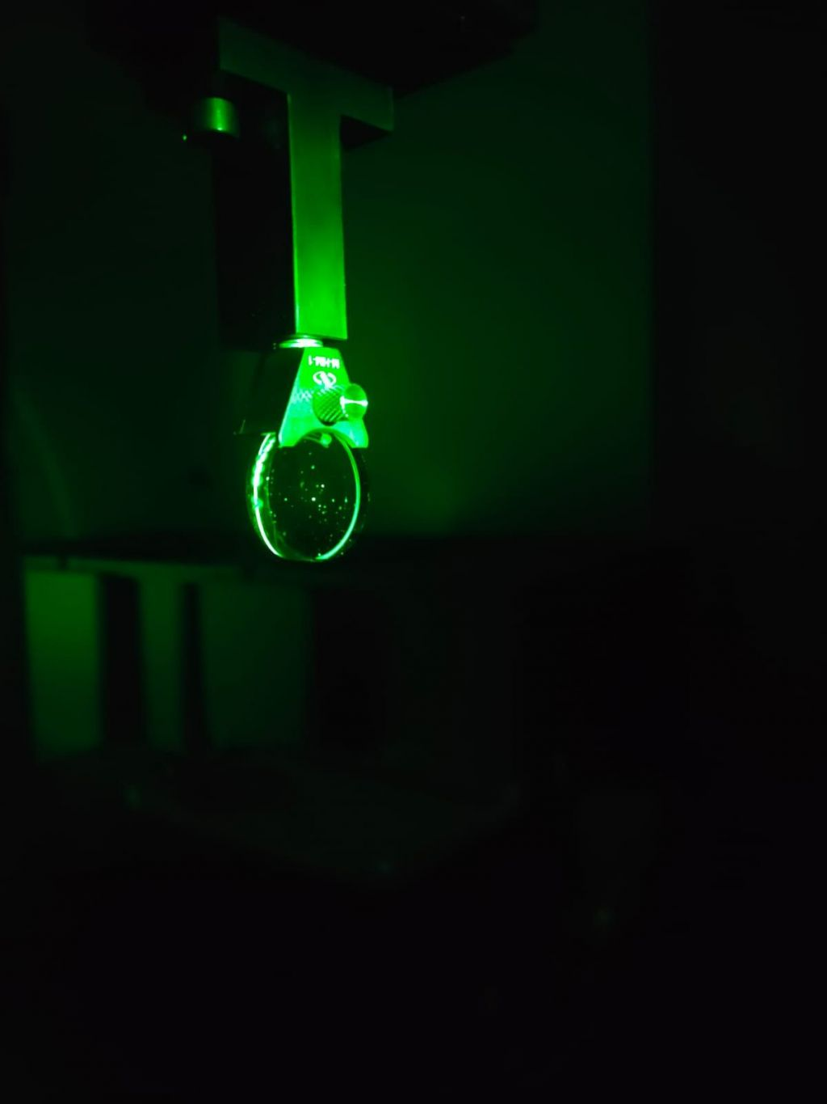
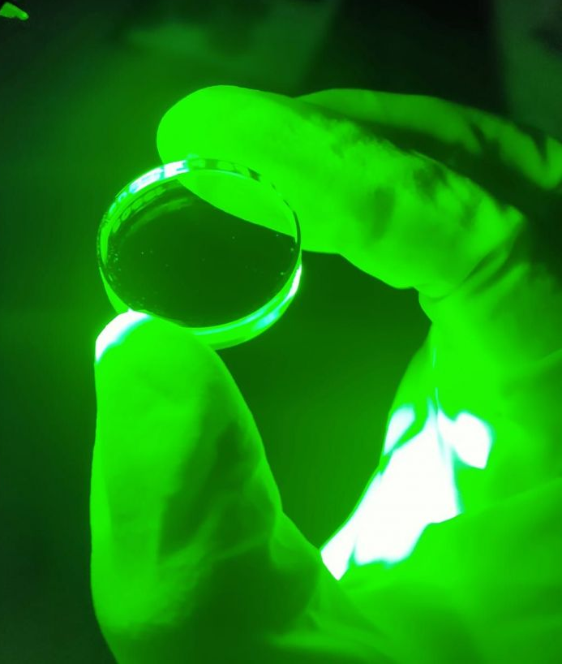
8.
Project B: Studying Optical Losses together with the Institut Fresnel
We have been verifying the total optical losses of prospective coating candidates with Glasgow measuring optical absorption and Institut Fresnel the optical scatter.
Over the past few months we’ve studied:
EPOC IBS TiO₂:SiO₂
Virgo IBS TiO₂:GeO₂
Glasgow RLVIP aSi
made with a different production technique The coating showed remarkably low scatter and (slightly) lower than expected absorption
Absorption of aSi is in general too high for GWDs. We are suppressing this for our coatings in different clever ways (multi-material/bulk top-layer projects).
We recently started a collaboration with our colleagues at Institut Fresnel into verifying the optical losses of key coatings interesting for A+ upgrades and beyond.

Slide 18
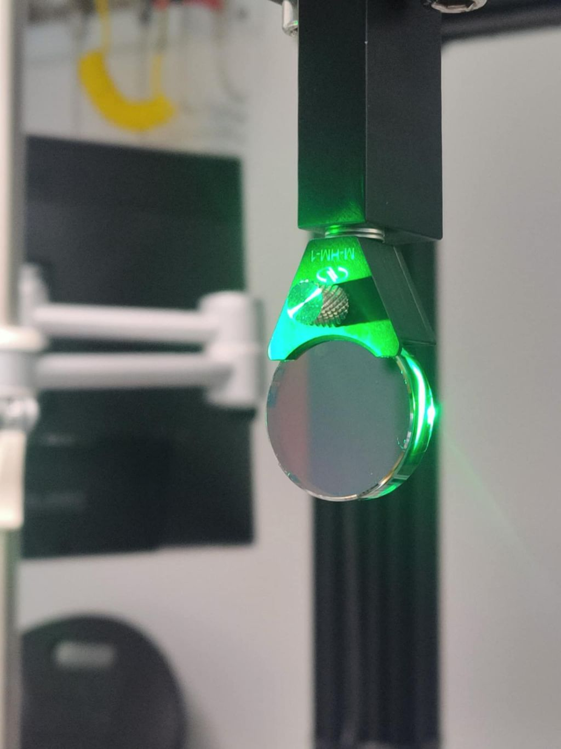
Project C: Multi-material coatings with aSi for 1064nm
Amorphous silicon is a material with ultra low mechanical loss which improve even further at cryogenic temperatures of interest.
It has roughly double the ref-index of most other candidate materials. (i.e. can make much thinner coating stacks with it.)
But it has incredibly high absorption, which is particularly high at 1064nm.
We have made bespoke coating designs, tailored for the next GWD upgrades, which bury aSi below other materials, producing overall improved coatings at 1064nm.

Slide 19
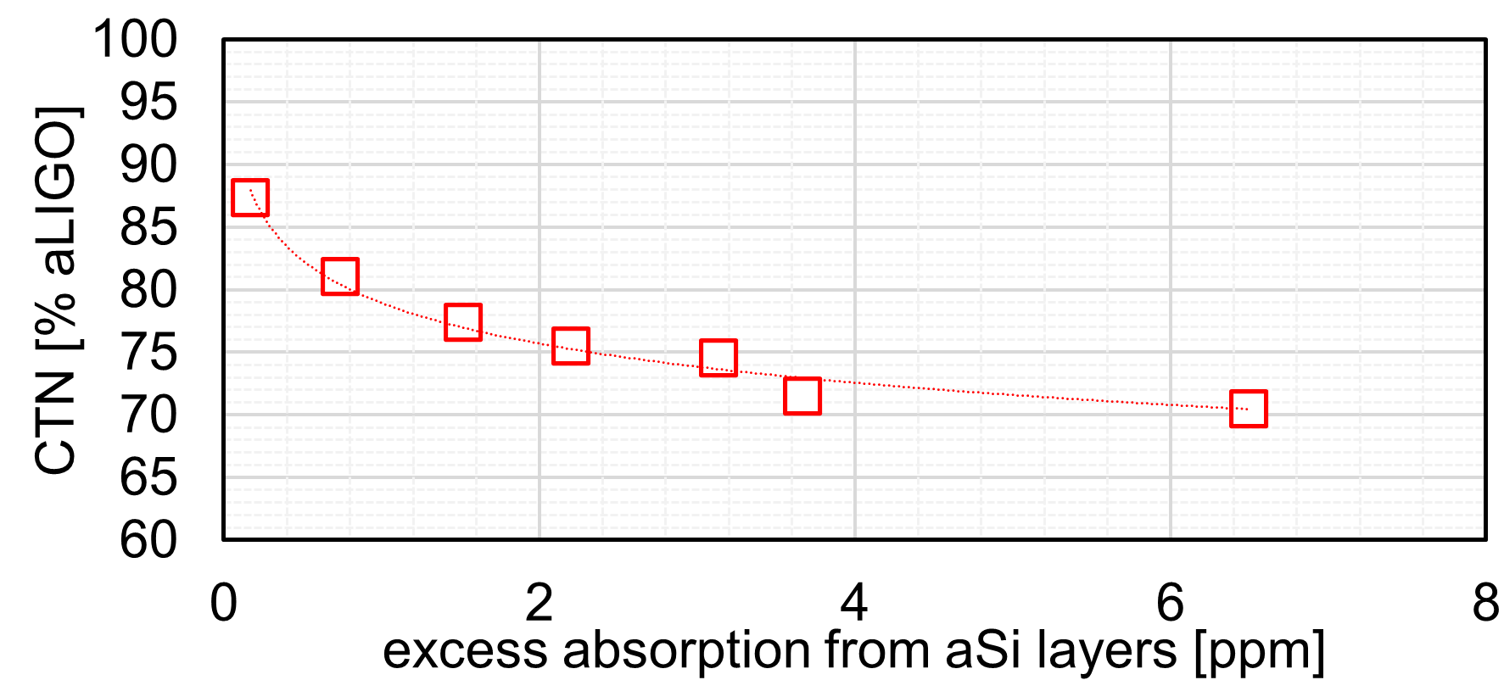
Project C: Multi-material coatings with aSi for 1064nm
We expect to suppress the absorption of the aSi layers by a factor of ~×1000,
thus maintaining <1ppm absorption despite operating at 1064nm.
We plan to report conclusive results in summer.
Simulation of replacing some aLIGO layers with some layers (L) of our aSi
2L
3LA
3LB
4LA
5LA
4LB
5LB
We have made bespoke coating designs, tailored for the next GWD upgrades, which bury aSi below other materials, producing overall improved coatings even at 1064nm.

