Slide 1

Optimising Thermal Compensation in Gravitational Wave Detectors
Ruaraidh Dumbreck
Cardiff University

Slide 2
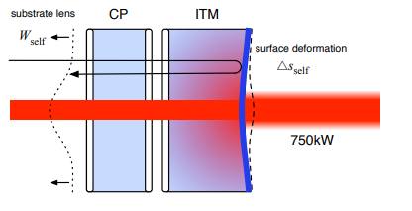
Test mass Thermal lensing
Thermal lensing produces a distorted wavefront (W_{self})
These wavefront distortions will
Increased asymmetry between the arms
Higher order spatial mode coupling
Reduction in stability of cavity control loops
Arm power
Fig 2: Thermal lensing effect on the wavefront [1]
[1] A. F. Brooks, B. Abbott, M. A. Arain et al “Overview of Advanced LIGO Adaptive Optics,” Applied Optics, vol. 55, p. 8256, Oct. 2016. arXiv:1608.02934
Notes:
More obvious saggita (edit)

Slide 3
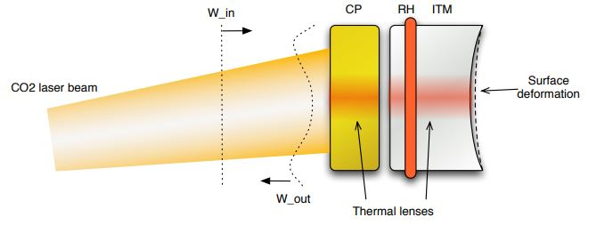
Thermal compensation System (TCS)
TCS consists of:
Ring heater
10 μm CO₂ laser system
Hartmann Wavefront Sensor
Fig 3: Ring heater and the CO₂ laser positions and the resulting counteracting wavefront [2]
[2] A. Brooks and A. Heptonstall, “TCS beam shaping: optimum and achievable beam profiles for correcting thermo-refractive lensing (not thermo-elastic surface deformation),”.
Notes:
Emphasise that TCS is necessary for detection

Slide 4
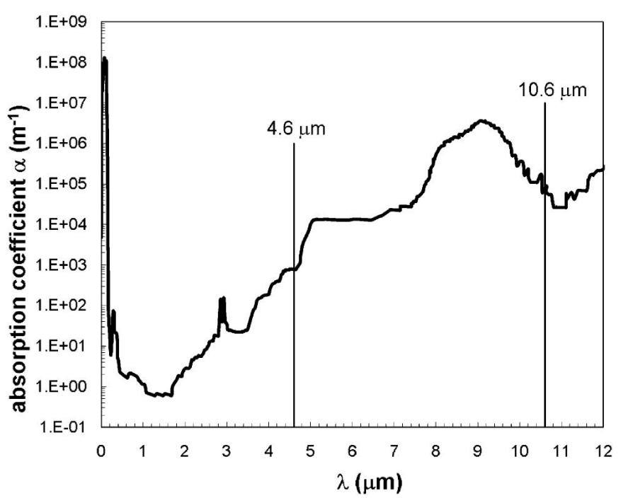
Our research
~ 3 μm laser
Stabilised intensity
Noise coupling
Better power efficiency
COMSOL modelling
Design and build cavity to convert 1550 nm laser light to 3100 nm
3.1 µm
Fig 6: Room temperature absorption
spectrum of fused silica [4]
[4] S. T. Yang, M. J. Matthews, S. Elhadj et al, “Comparing the use of mid-infrared versus far-infrared lasers for mitigating damage growth on fused silica,” Applied Optics, vol. 49, pp. 2606–2616, May 2010. Publisher: Optica Publishing Group.
Notes:
Depth vs dn/dt

Slide 5
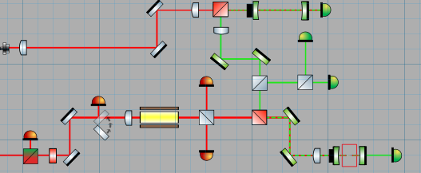
Proposed Experiment
Diagnostic cavity
1550 nm laser light
3100 nm laser light
1550 nm laser light
3100nm generation cavity

Slide 6
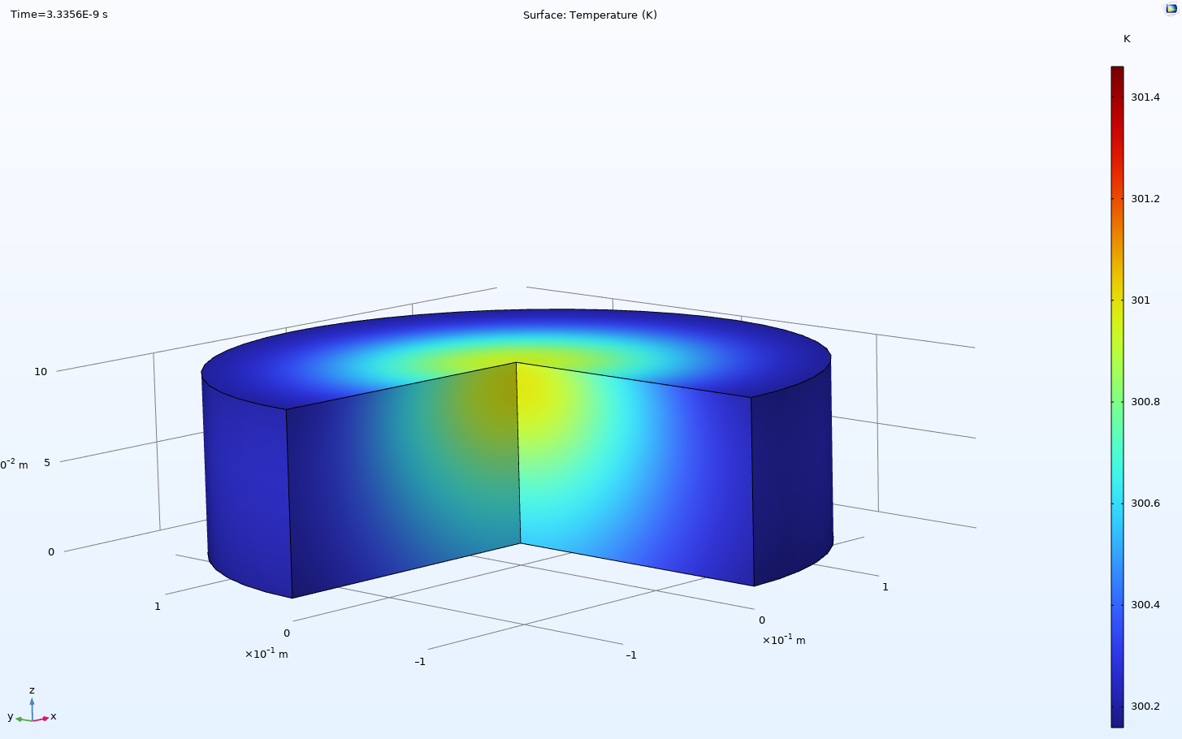
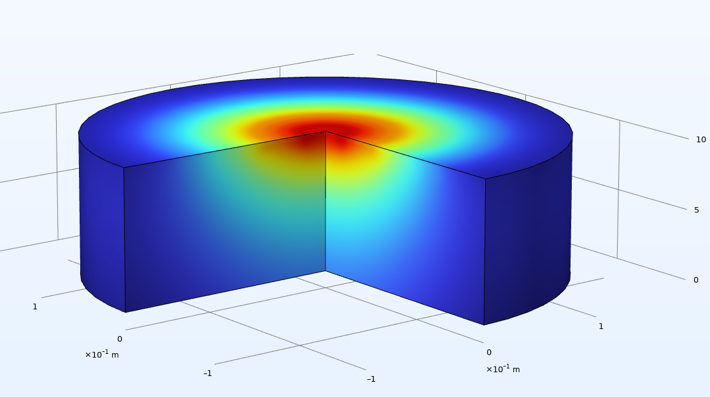
Preliminary results
Surface Temperature (K)
Surface Temperature (K)
Fig 7a : Laser heating Simulation of Compensating plate using 10 µm laser
Fig 7b : Laser heating Simulation of Compensating plate using 3 µm laser
Fig 7b : Laser heating Simulation of Compensating plate using 3 µm laser [5]
Fig 7a : Laser heating Simulation of Compensating plate using 10 µm laser [5]

