Slide 1
Source Inference for Bursts
James Neeson, Patrick Sutton
Cardiff University

Slide 2


Current State of the Field
CBCs
Bursts
Detection:
Signal Reconstruction:
Source Inference:

Slide 3

Quadrupole Moment
Measured
Unknown
Chosen
Notes:
Mode decomposition -> Invert for mode coefficients

Slide 4
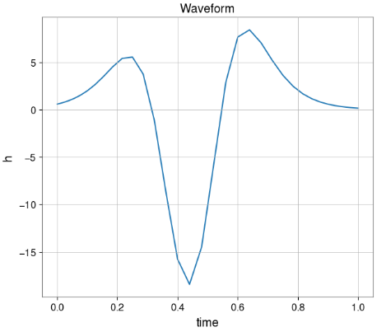
The Space Pancake

Slide 5
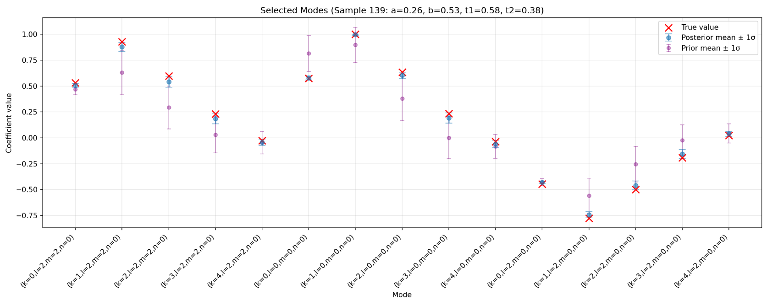

Slide 6
Conclusions
- We need methods to perform Source Inference for Bursts
We can try to reconstruct the density directly, but this is an ill-posed inverse problem
We need ways of putting generic physics constraints into our algorithm to solve this
Notes:
If it works – make model more realistic and go again
If it doesn’t – add more constraints and go again
Repeat until we either have a realistic supernova model or we have converged with current supernova parameter estimation efforts

