Slide 1


Long Short-Term Memory for
Early Warning Detection of GWs Signals
Reem Alfaidi
GW:UK@Nottingham
15 Jan 2026

Slide 2
1. The Aim of the Work
Using the LSTM model as a proof of principle for early warning detection of GW signals from compact binary coalescence (CBC).
Developing and extending the LSTM-based framework for early warning detection of gravitational-wave signals, focusing on binary neutron stars.

Slide 3
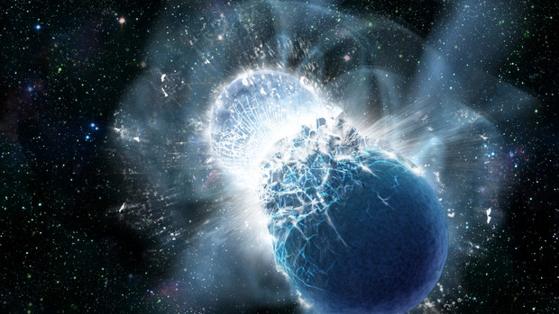
2. Motivation of Early Warning Detection
GW170817
LIGO and Virgo Detectors.
1.7 seconds
Gamma Ray Burst
Fermi Gamma-Ray Burst Monitor and the INTEGRAL satellite.
Multi-Messenger Astronomy Era.

Slide 4
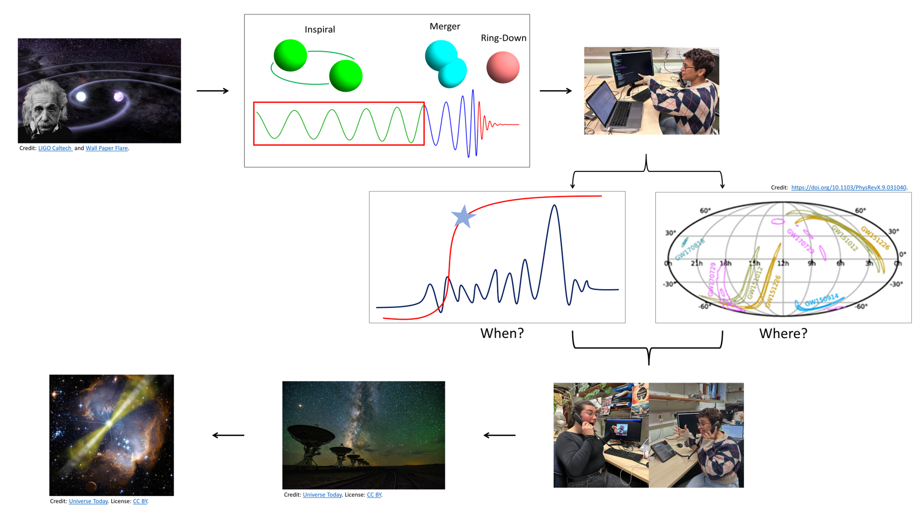
2. Motivation of Early Warning Detection

Slide 5

3. Advantages of Using LSTM
Why Machine Learning?
Computational Efficiency (After Training).
Fast Analysis of Large Data.
No Need for a Template Bank.
Captures long-term temporal structure (inspiral).

Slide 6
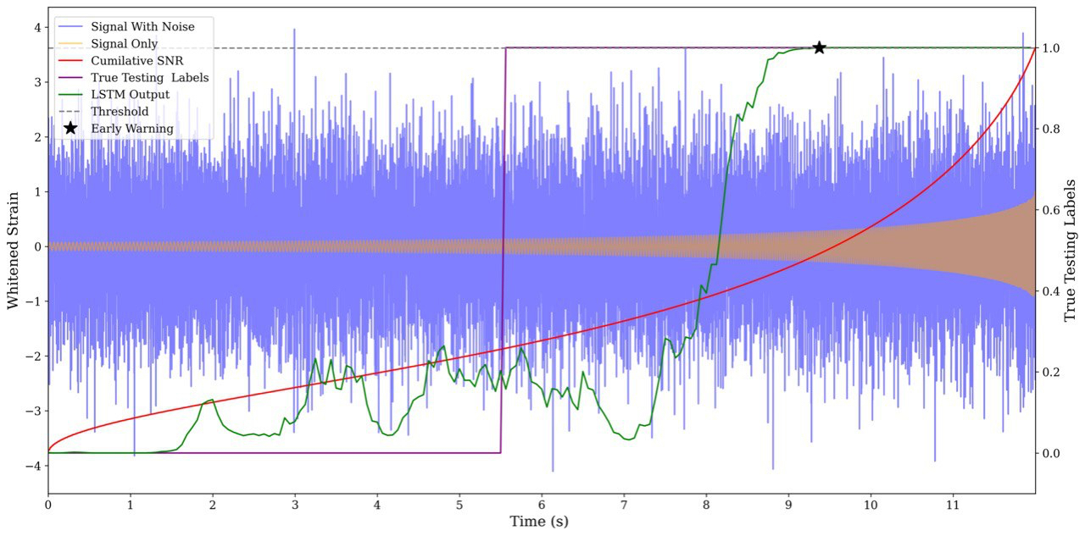
4. Previous Work: Proof of Principle
Goal
Demonstrate feasibility of LSTM-based early-warning detection.
Setup
Single LIGO detector.
Simulated BBH signals in Gaussian noise.
Key Result
Early warning up to 5.3 s before merger.
Fixed false-alarm rate: 1 per day.
Competitive with idealised matched filtering. arXiv:2402.04589
Detection!
LSTM Output
LSTM prediction for signal and noise.

Slide 7
5. Extending the Method
Why BNS?
Longer inspiral in the detector band.
Prime sources for multi-messenger astronomy.
Greater early-warning potential.

Slide 8
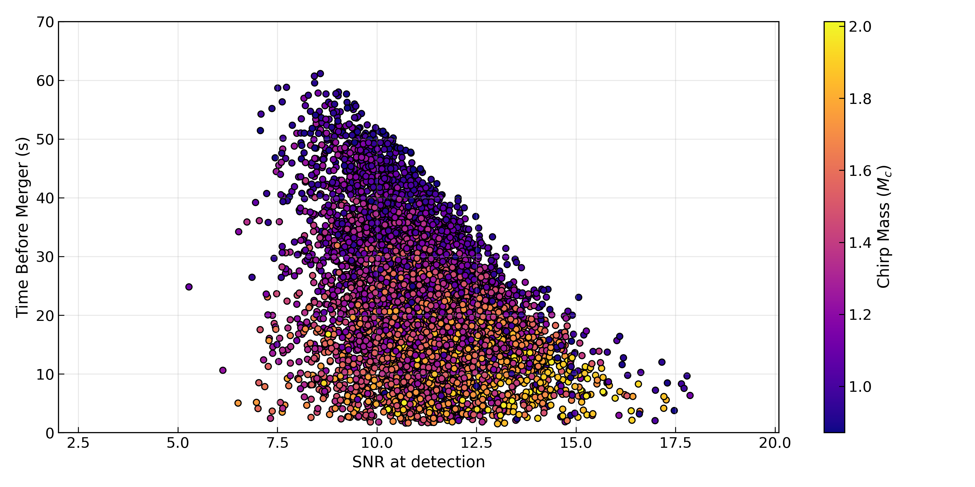
6. New Work: Early Warning for BNS
Goal
Apply the LSTM early-warning framework to the inspiral phase of binary neutron star signals.
Method
Trained and evaluated on simulated BNS inspiral signals.
Fixed false-alarm rate: 1 per week.
Key Result
Detection achieved up to ~60 s before merger.
Detection time increases for lower chirp-mass systems.

Slide 9
7. Impact and Outlook
Impact
Earlier alerts for electromagnetic follow-up.
Strong potential for real-time multi-messenger astronomy.
Outlook
Application to real detector data.
Extension to multi-detector source localization.

Slide 10
Thank you for your attention
Do you have any questions?

