Slide 1
Summary of the Pisa Workshop on Precision Vertex Detectors for FCCee: Oct 30-31, 2025
Carl Haber, Christoph Paus

Slide 2
Program
Group Presentations: 7 European groups + a US survey
Constraints and Requirements: Physics requirements and Backgrounds
Layout and Simulation: Layout comparisons, alternatives, exp from Belle II, background rejection
Sensor R&D: ~6 different MAPS sensors/projects were discussed
Mechanical Developments: beam pipe,
Systems and Readout
Discussion

Slide 3
The next 4 slides were shown by me concerning the US community and interests

Slide 4
Data
The data is inaccurate
The community was surveyed in an EOI process in Spring of 2024 for the MIT US FCCee Workshop
A resurvey was performed recently with only partial responses
The surveys overstate the actual effort underway at present
Why?
Little current funding
Many immediate efforts – HL-LHC etc
The data likely understates the eventual effort, once FCCee is approved
Note: the US community just recently received guidance from funding agencies to focus on FCCee at CERN as the next major collider project

Slide 5
# of Institutes Survey
Area of Interest | Future | Currently
MAPS Design | 7 | 2
MAPS Test | 11
Vertex Detector Design | 6
Outer Tracker | 4 | 2
Low Mass Mechanics | 5 | 1
PID | 3 | 3
Sil Wrapper | 5
S/W Tools | 3 | 2
Simulation | 5 | 2
Readout | 3

Slide 6
What are the current efforts?
MAPS design using ASIC capabilities at national labs
R&D on straw tubes for the outer tracker
Low mass materials for wire chambers
Fast timing (LGAD) developments for ATLAS/CMS/EPIC, and R&D (none of this is specifically for FCCee but is relevant)
Development of s/w tools
Performance simulation efforts
All the national labs are involved in either current R&D or in organizational roles

Slide 7
Strengths and capabilities for longer term
ASIC and electronics design
MAPS
dN/dx
AI/ML in front ends
Readout/DAQ
Low mass mechanics
Tracker systems and assembly
Powering
Tracking software
Physics performance simulation

Slide 8
Constraints and Requirements
Every aspect of the Physics program needs an excellent vertex
HIGGS: Jet flavour identification (tagging) of b-, c-, g-, tau- etc… Measure of Higgs couplings
Z: Jet flavour identification (inclusive tagging) but also exclusive tagging for HF EWK observables Rb, Rc, AFB(b,c)
W: Jet flavour identification (tagging/calibration), CKM parameters Vcb
FLAVOUR: precise reconstruction of PV/SV/TV for flavour physics e.g.:
time dependent CPV measurement
rare decays like B → K*τ+τ-
τ precise lifetime measurement
[ BSM: long lived particle signatures ]

Slide 9
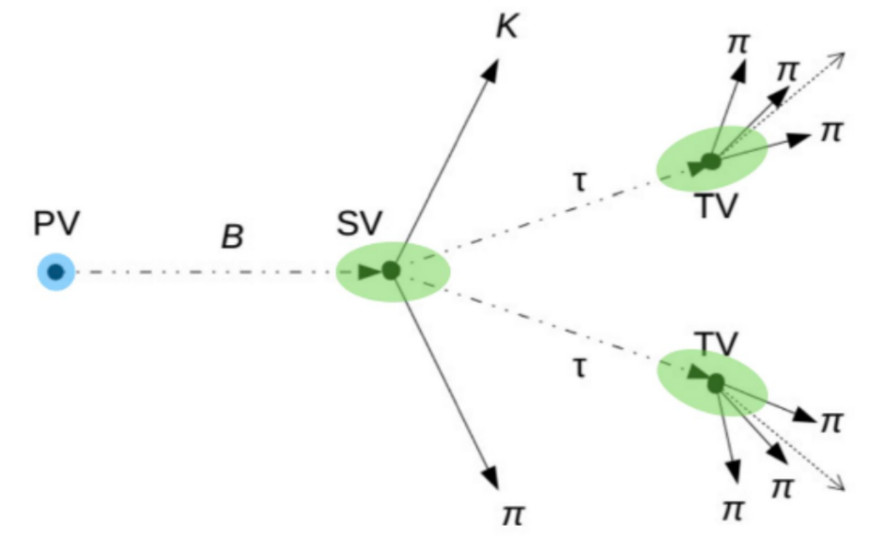
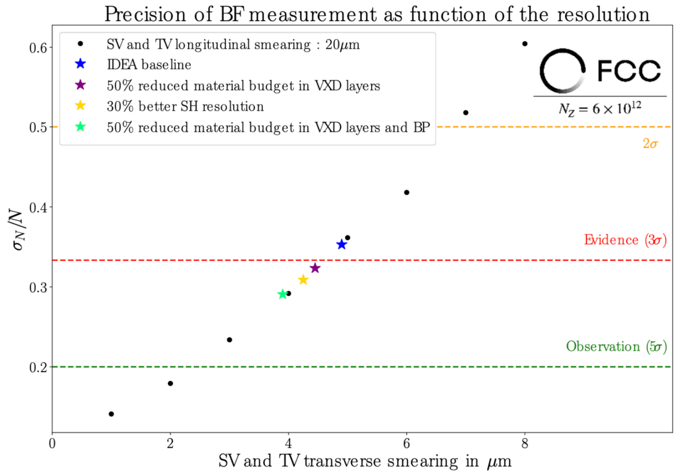
Constraints and Requirements
B → K*τ+τ-
Key elements
low material budget
special lightweight and smallest possible radius beampipe ~ 10 mm
minimum vertex tracker material: main issue is resolution
short distance to the beam: default location 12 mm … maybe closer?
impact is significant
performance goal is ±3 μm to see B → K*τ+τ-

Slide 10
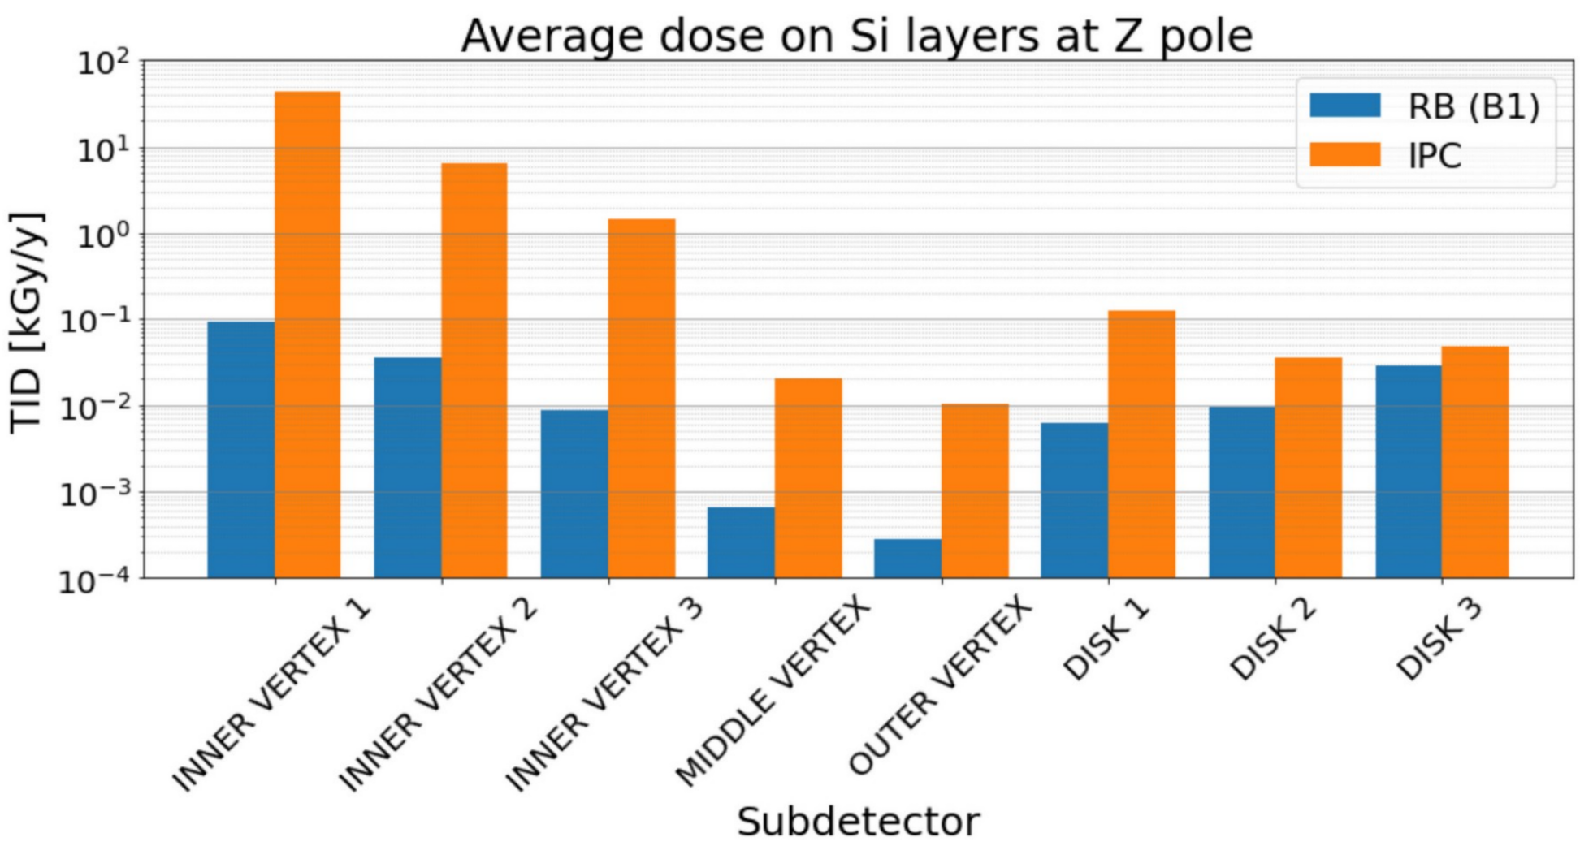
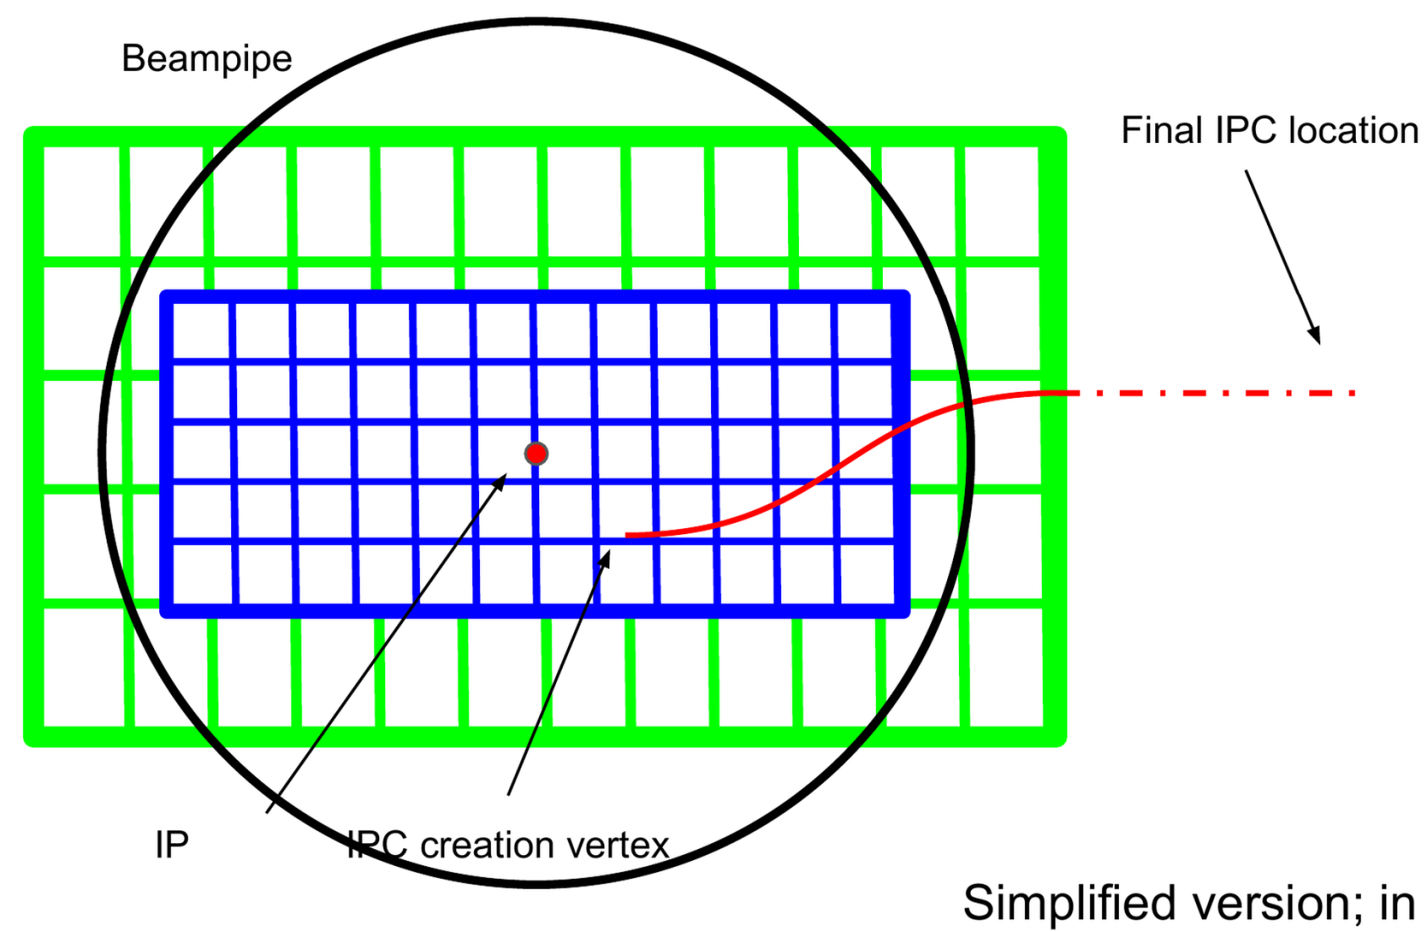
Constraints and Requirements
Most stringent constraints
beam induced background (BIB) dominated by incoherent pair creation (IPC) right after radiative Bhabha (RB)
studies ongoing … standardized samples and cross check Guinea Pig versus WarpX are planned
possibly normalize programs to LEP data?
Guinea Pig
simulation grid
for IPC creation

Slide 11
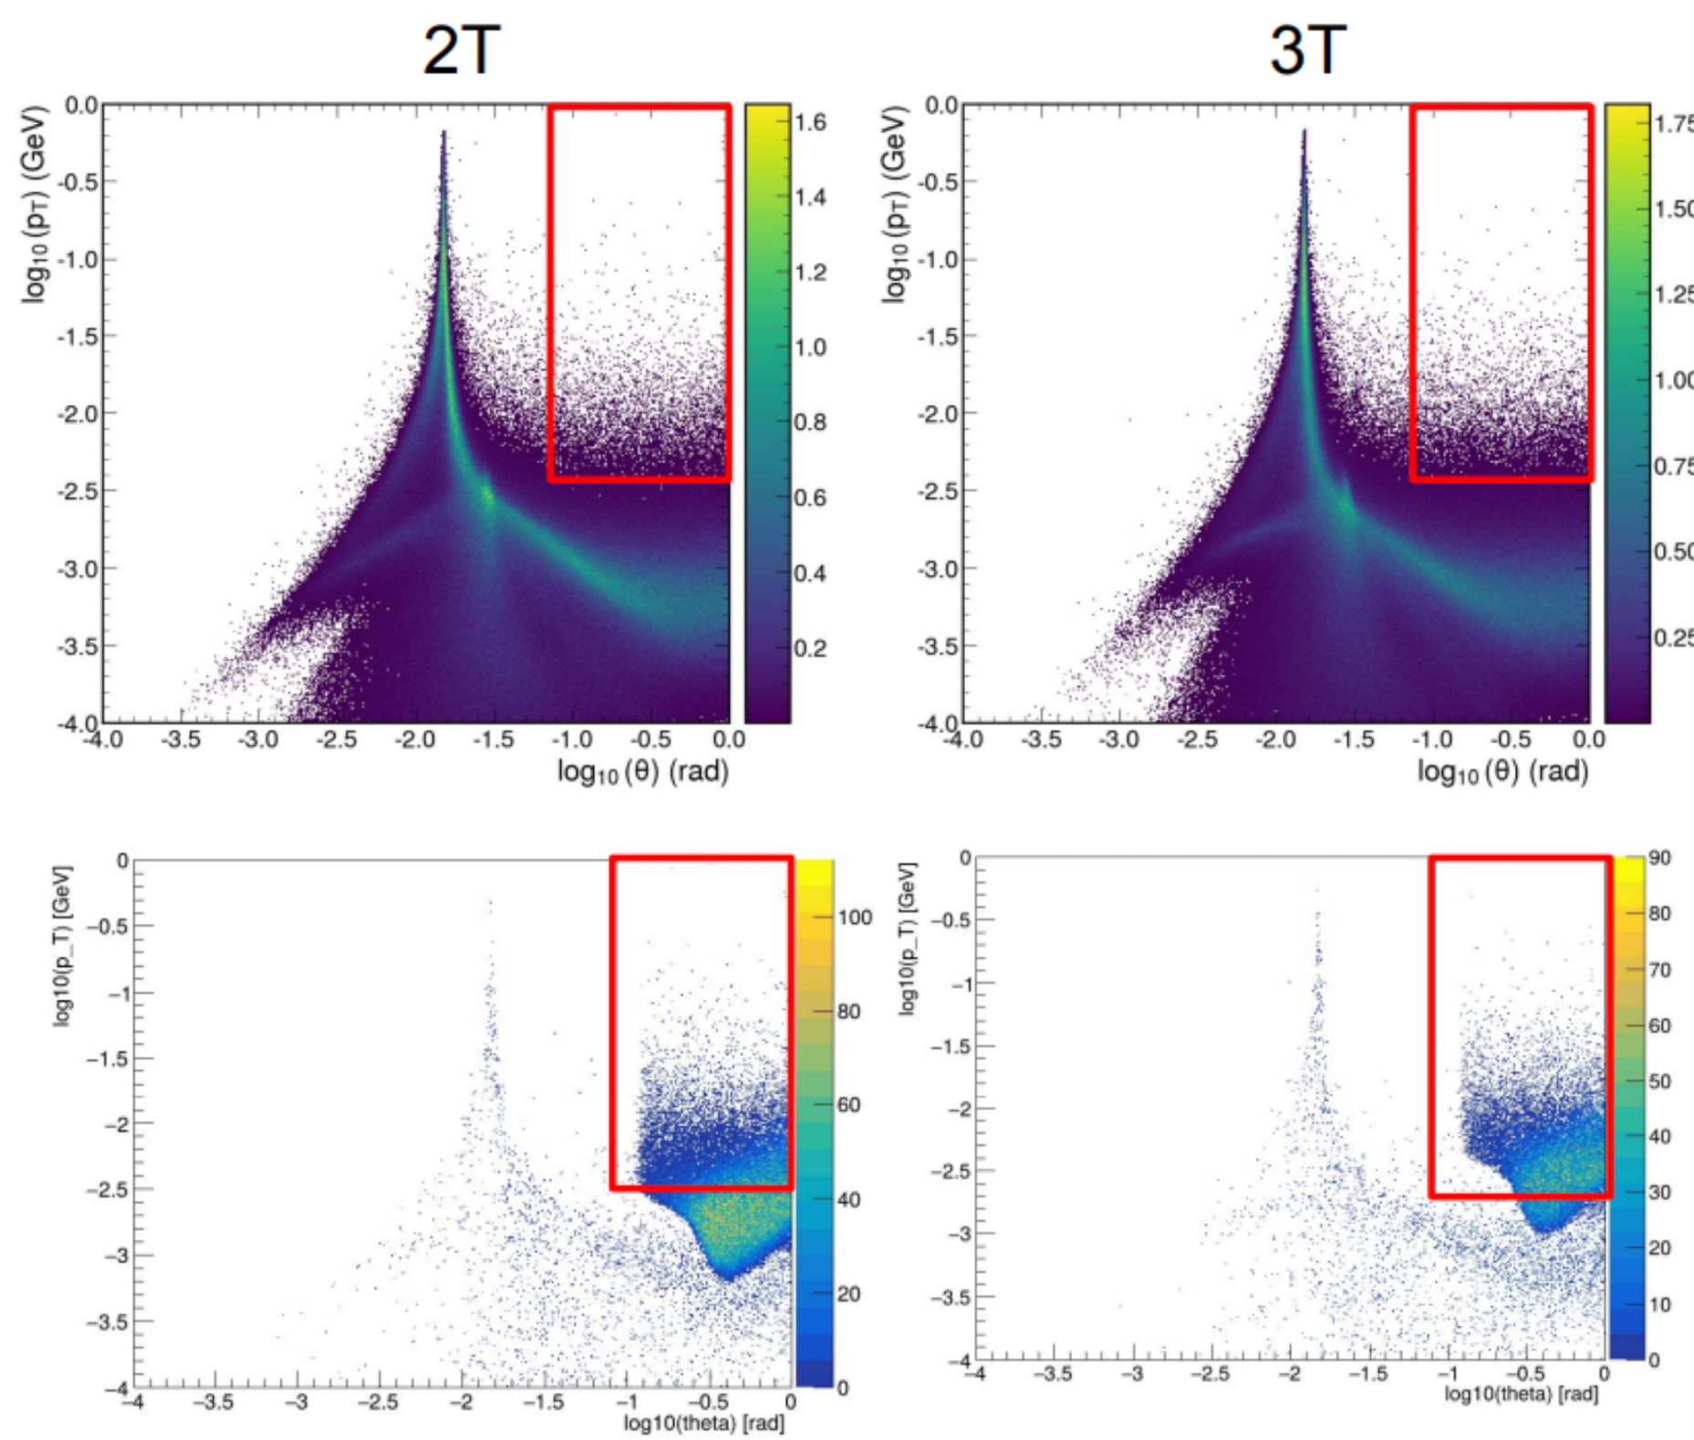
Constraints and Requirements
Most stringent constraints
present status of occupancy from full simulation not yet fully converged
beam crossing generator under study: occupancy is at the upper end
can we cool the power and does the chip function?

Slide 12
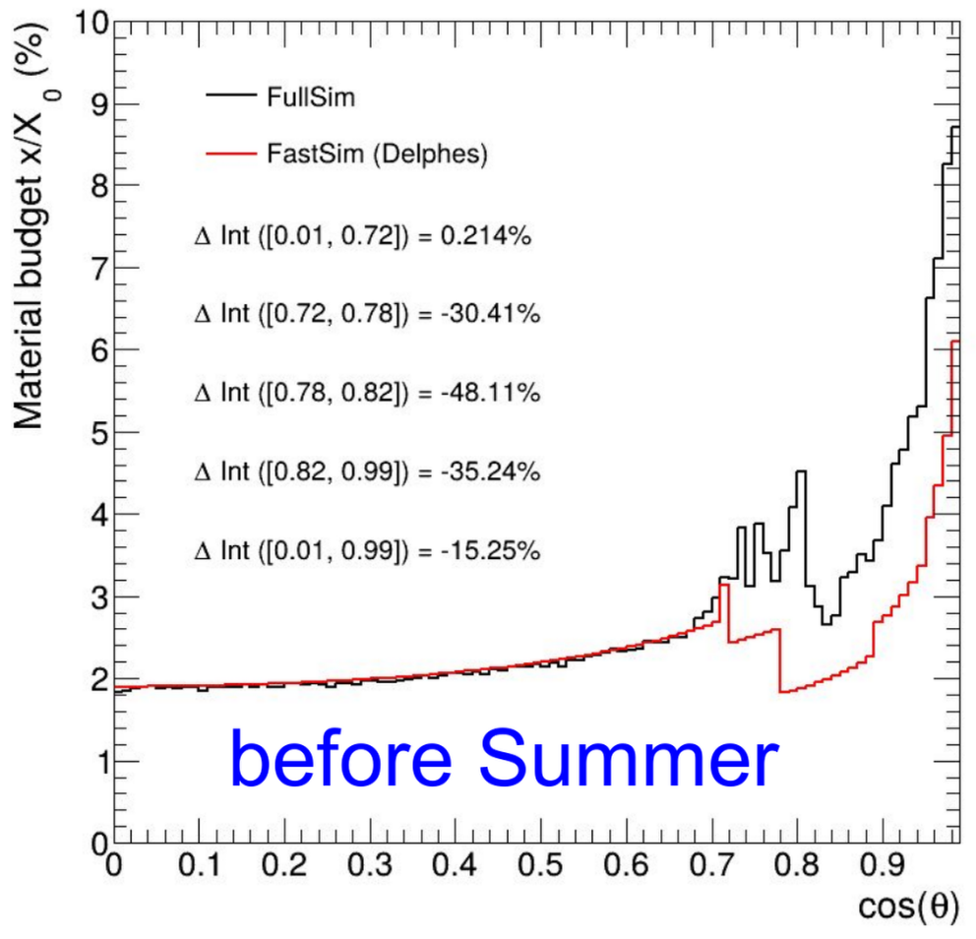
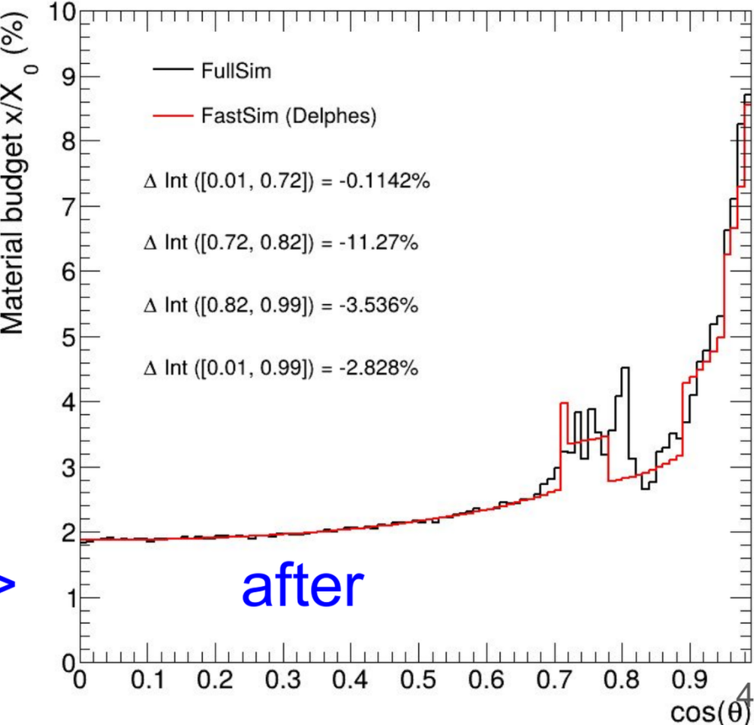
Layout and Simulation
Parametric simulation was carefully compared to full simulation and various fixes applied
Various geometries implemented and tested:
Short Barrel Geometry (aiming to use bent stitched MAPS)
Reduced barrel length (~10 cm).
First Layer on Top of Beam Pipe
Moves first layer closer to IP (without entering the beam pipe).
First Layer Inside the Beam Pipe
More aggressive layout, innermost radius moved to 8–10 mm.
Requires re-engineering of beam pipe and cooling strategy.
Gains are as expected: see presentation for details

Slide 13
Sensor R&D
TPSCo 65nm imaging technology, DRD7, ALICE ITS3, advanced stitching
Fermilab: LGADs, FCFD, Arcadia bench tests, 3D integration, Skywater
OCTOPUS: 14 members aim at thin vtx for FCCee, DRD3 full WG structure, TPSCo 65 nm, optimized for FCCee specs,
Spatial resolution: 3 µm • Time resolution: 5 ns • Power consumption: < 50 mW/cm2 • Hit rate: 100 MHz/cm2
Novel electrode geometry
ARCADIA and Lfoundry 110 (INFN): a broad project targeting colliders, astro, x-rays, medical; includes gain layers (LGAD), thick depletion layers
2nd ARCADIA talk on characterization and test beams
NAPA: SLAC based, ~ns timing, MAPS
CE-65 (TPSCo 65) characterization project

Slide 14
Sensor R&D comments
US has good stand-alone efforts, with significant expertise, and interest, particularly related to fast timing applications
Very significant, well funded, large collaborations in Europe on MAPS

Slide 15
Mechanical
INFN LNF and Pisa are undertaking detailed studies and prototyping of the vertex region including
Beam pipe: design, mockup of IR, paraffin cooling
Cooling
Services
Support tube
Air cooling study: prototype system at INFN-Pisa (lab tour)
Curved MIMOSIS: French project to gain direct experience with sensor bending using existing MIMOSIS sensors, aimed at FCCee

Slide 16
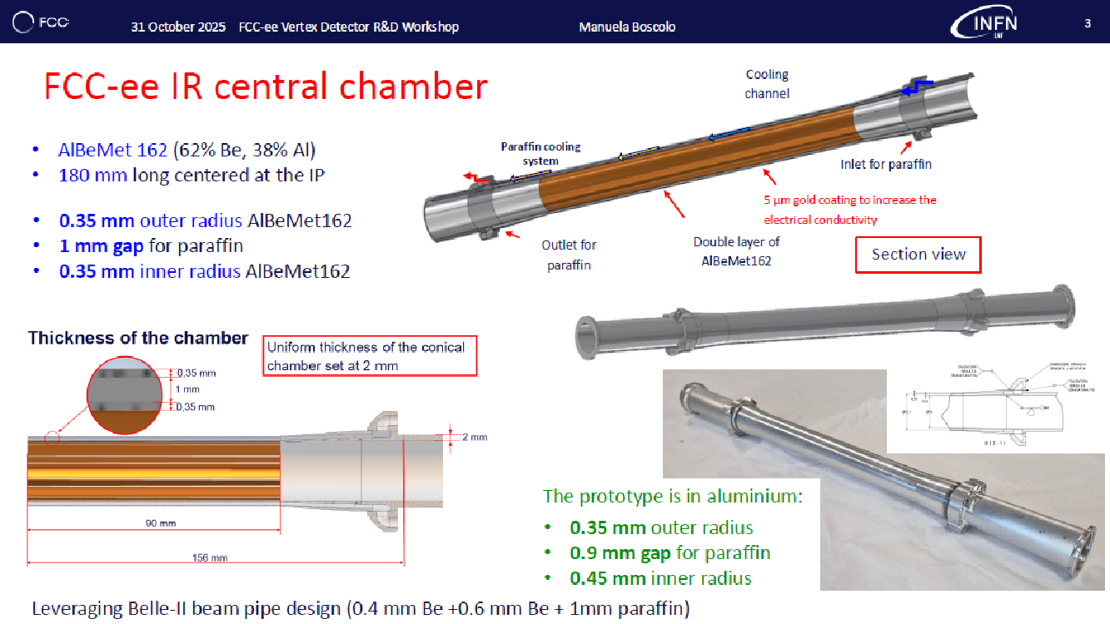

Slide 17
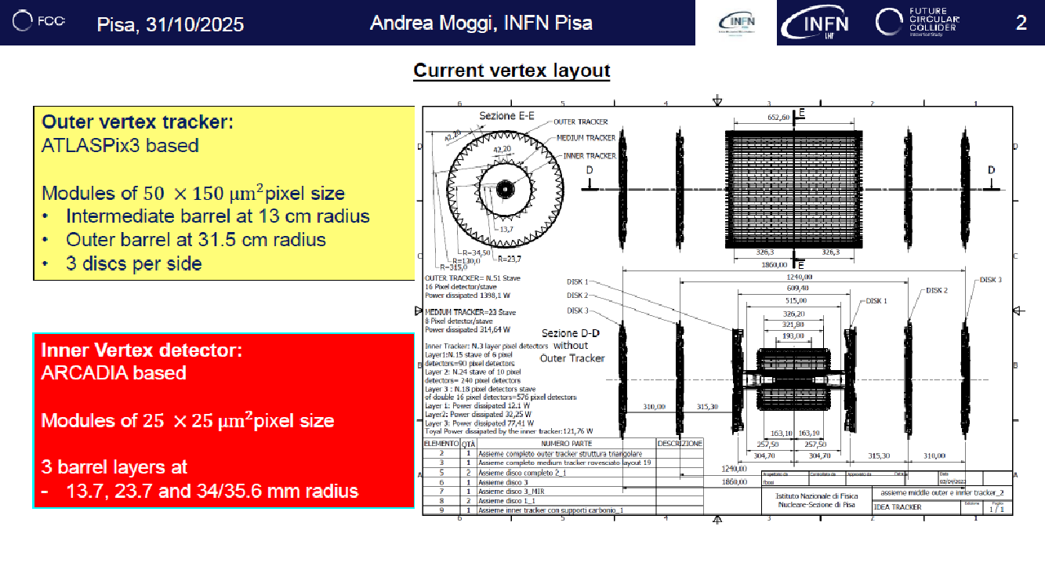

Slide 18
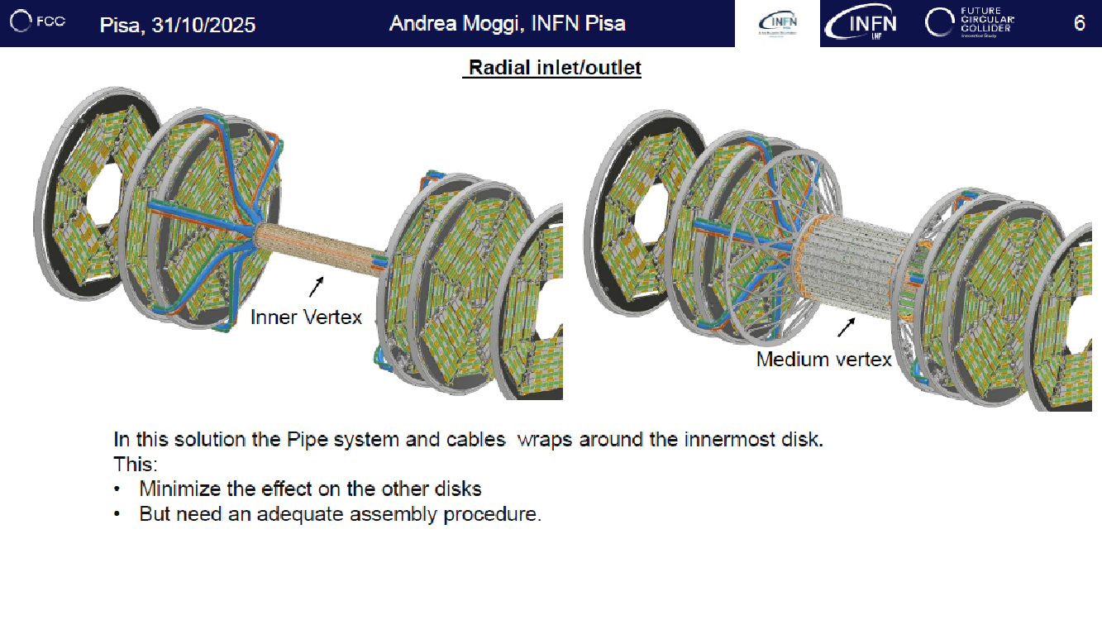

Slide 19

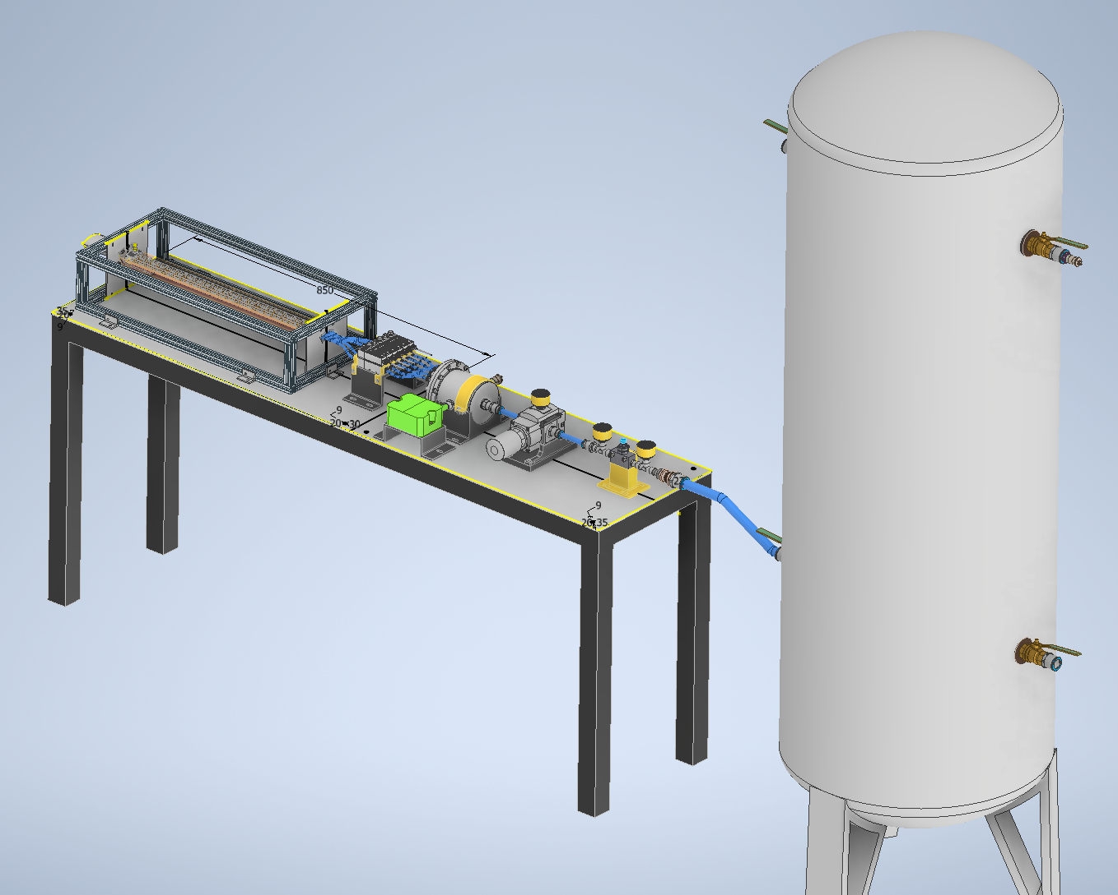
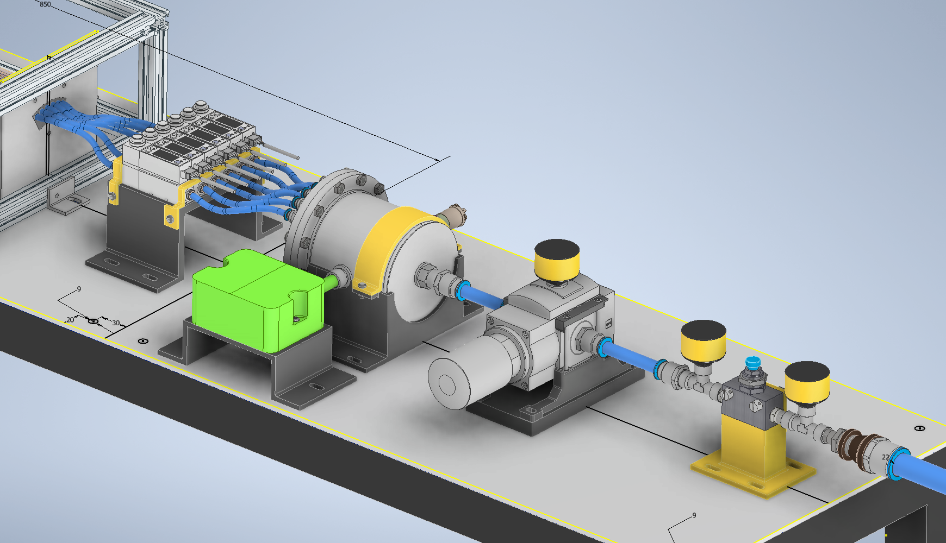
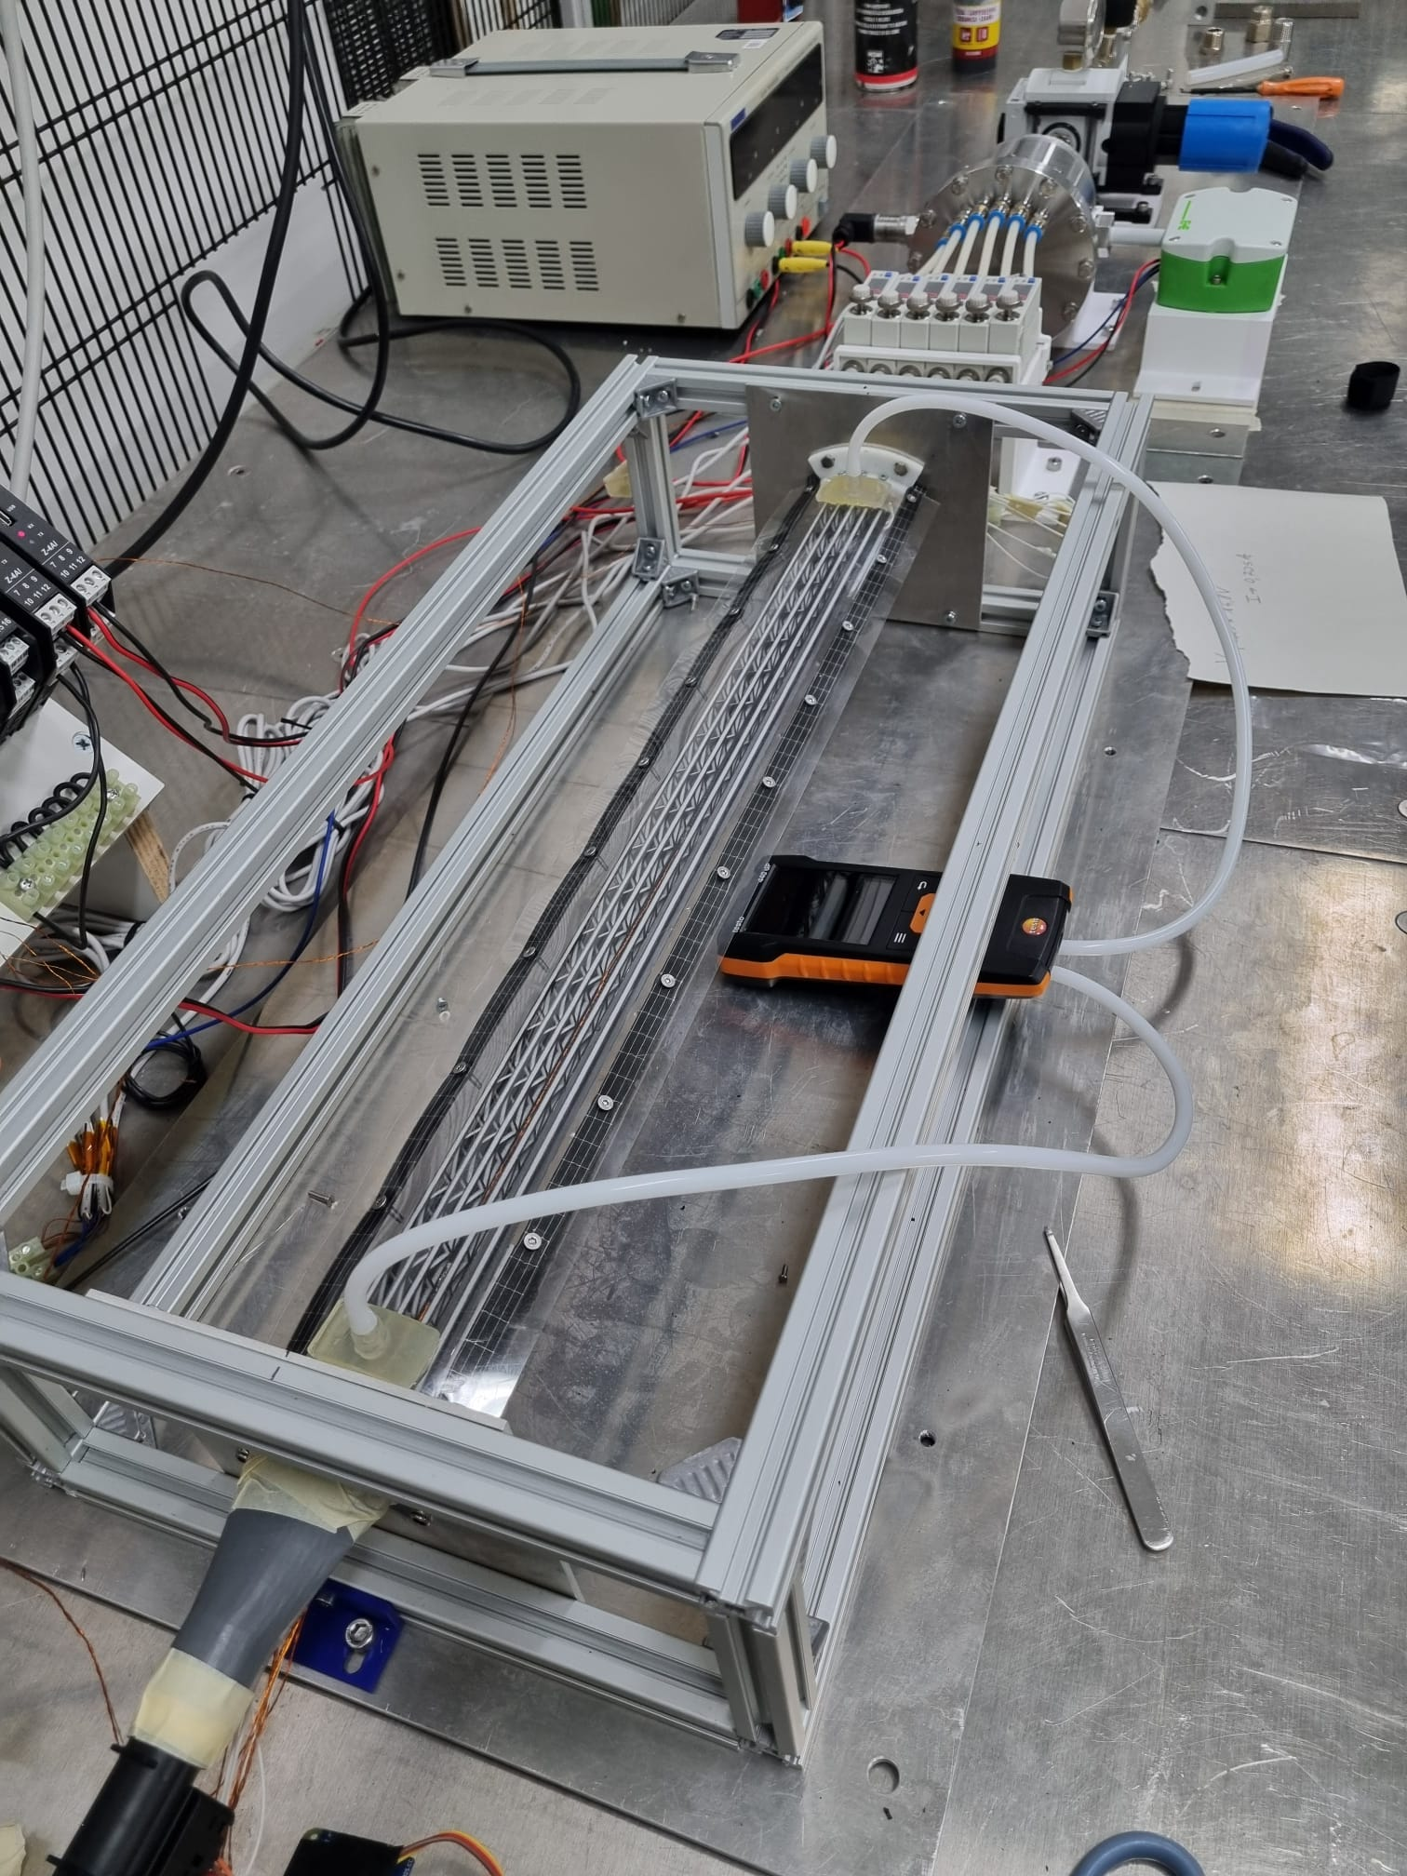
FCC-ee vertex detector R&D workshop, Pisa 31/10/25
Gherardo Ammirabile, INFN Pisa
Flowmeters
Serbatoio
H
E
A
T Exch
6 bar
0.5 m³
Absolute Pressure sensor
Diffuser
Test section
Settling chamber
Drier
Temperature/Humidity sensor
Valve group
RTD
380 mm
Test section
1600 mm
Designed to:
Be adaptable
Be controlled
Allow CFD result verification

Slide 20
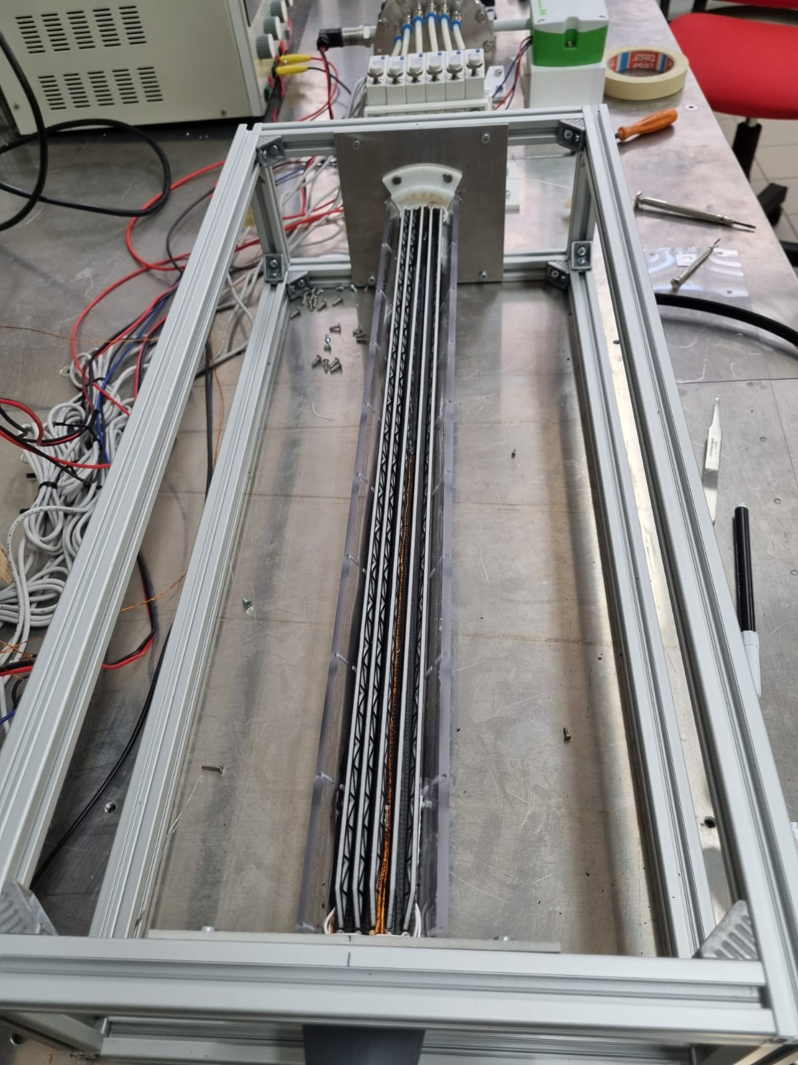
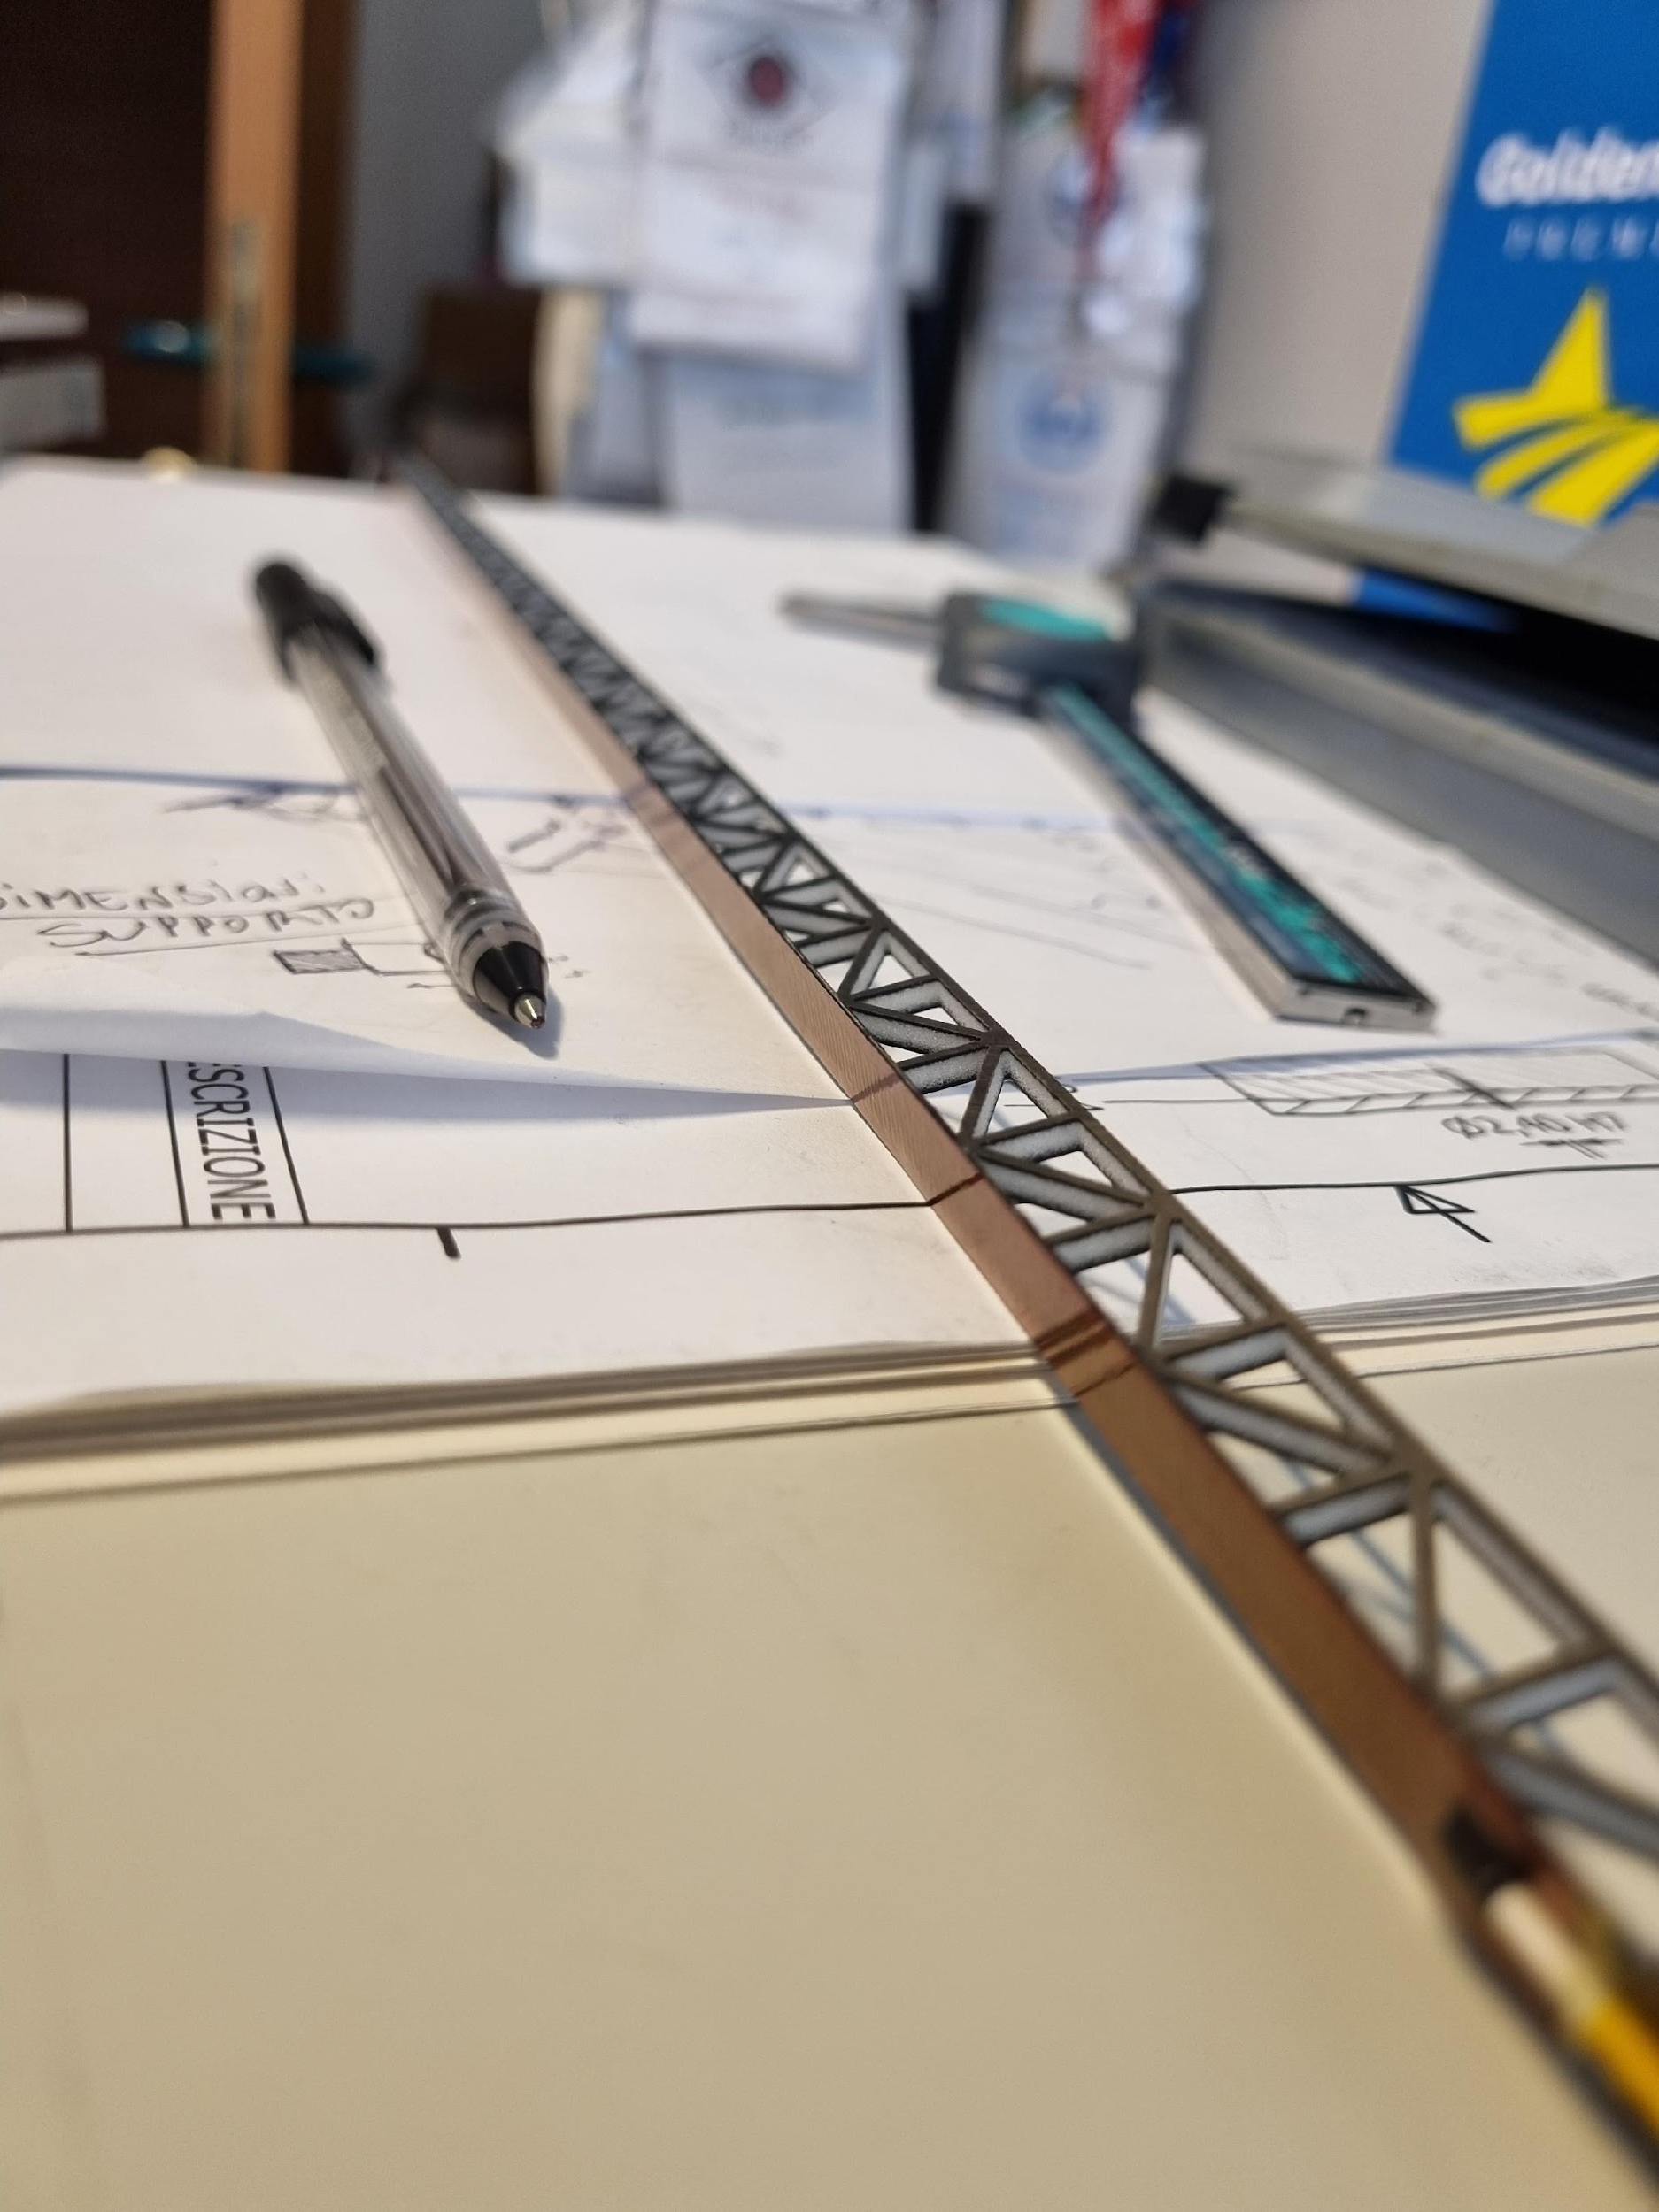
FCC-ee vertex detector R&D workshop, Pisa 31/10/25
Gherardo Ammirabile, INFN Pisa
CONCLUSIONS:
The air cooling system seems to be
adequate for the case study
The compressed air system is stable and dynamic, allowing continuous testing for different solutions
It’s possible to control and monitor the properties of the air being introduced into the test section in terms of:
- Flow rate (Pressure)
- Humidity
- Temperature
The maximum flow rate required for cooling is determined by the vibration allowed by the structure

Slide 21
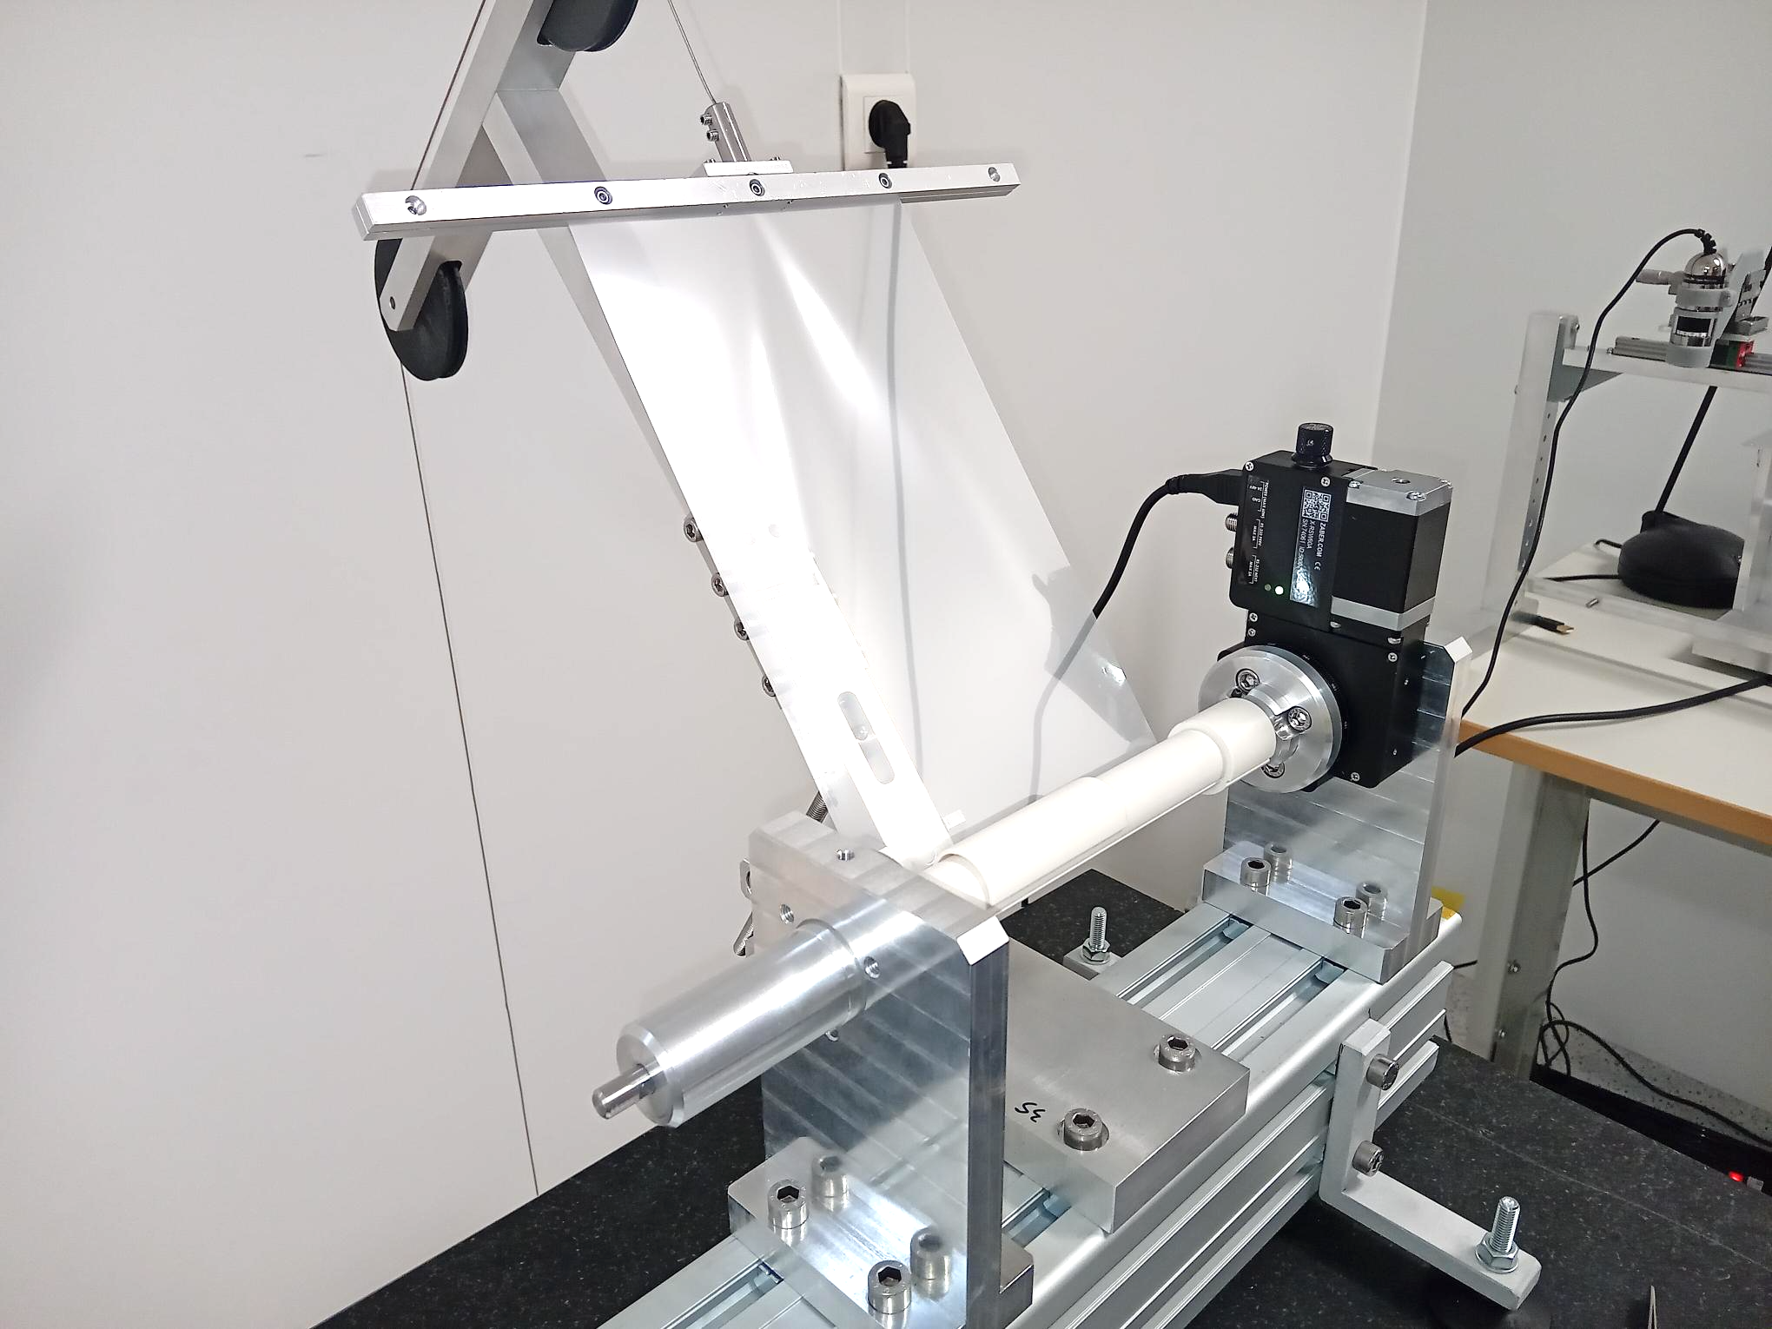
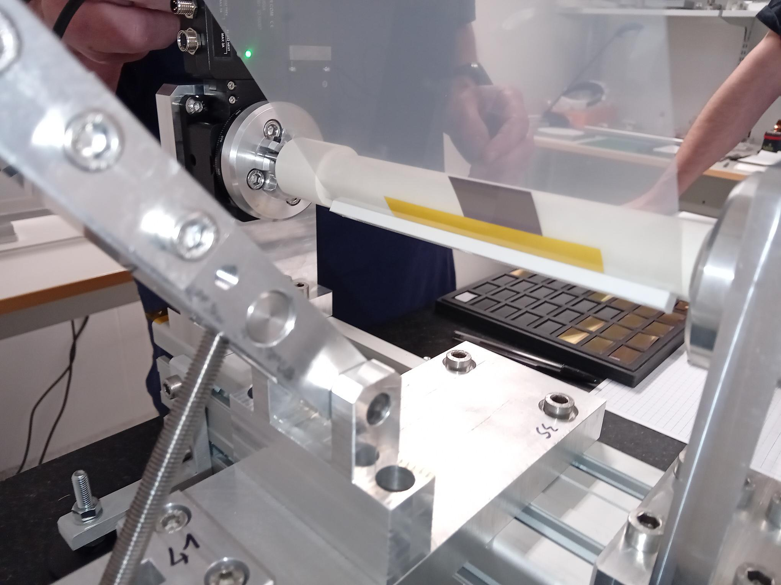
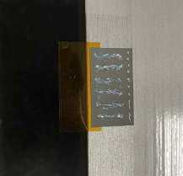

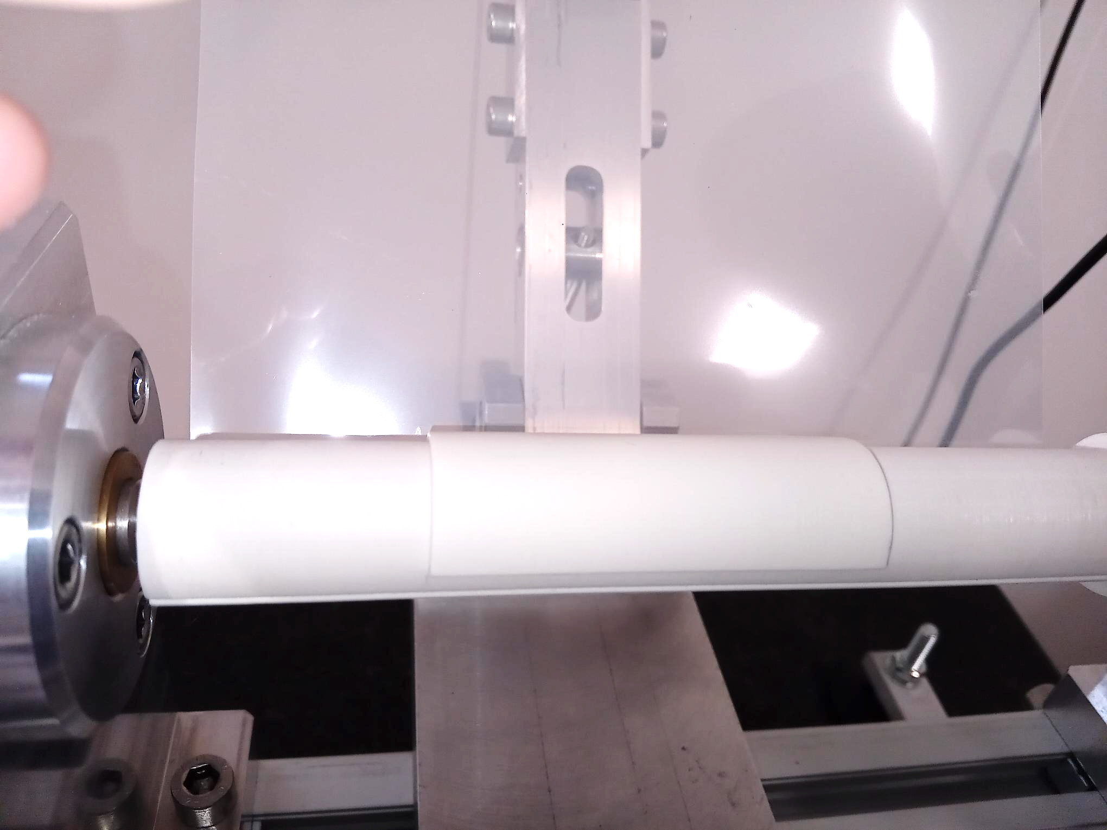
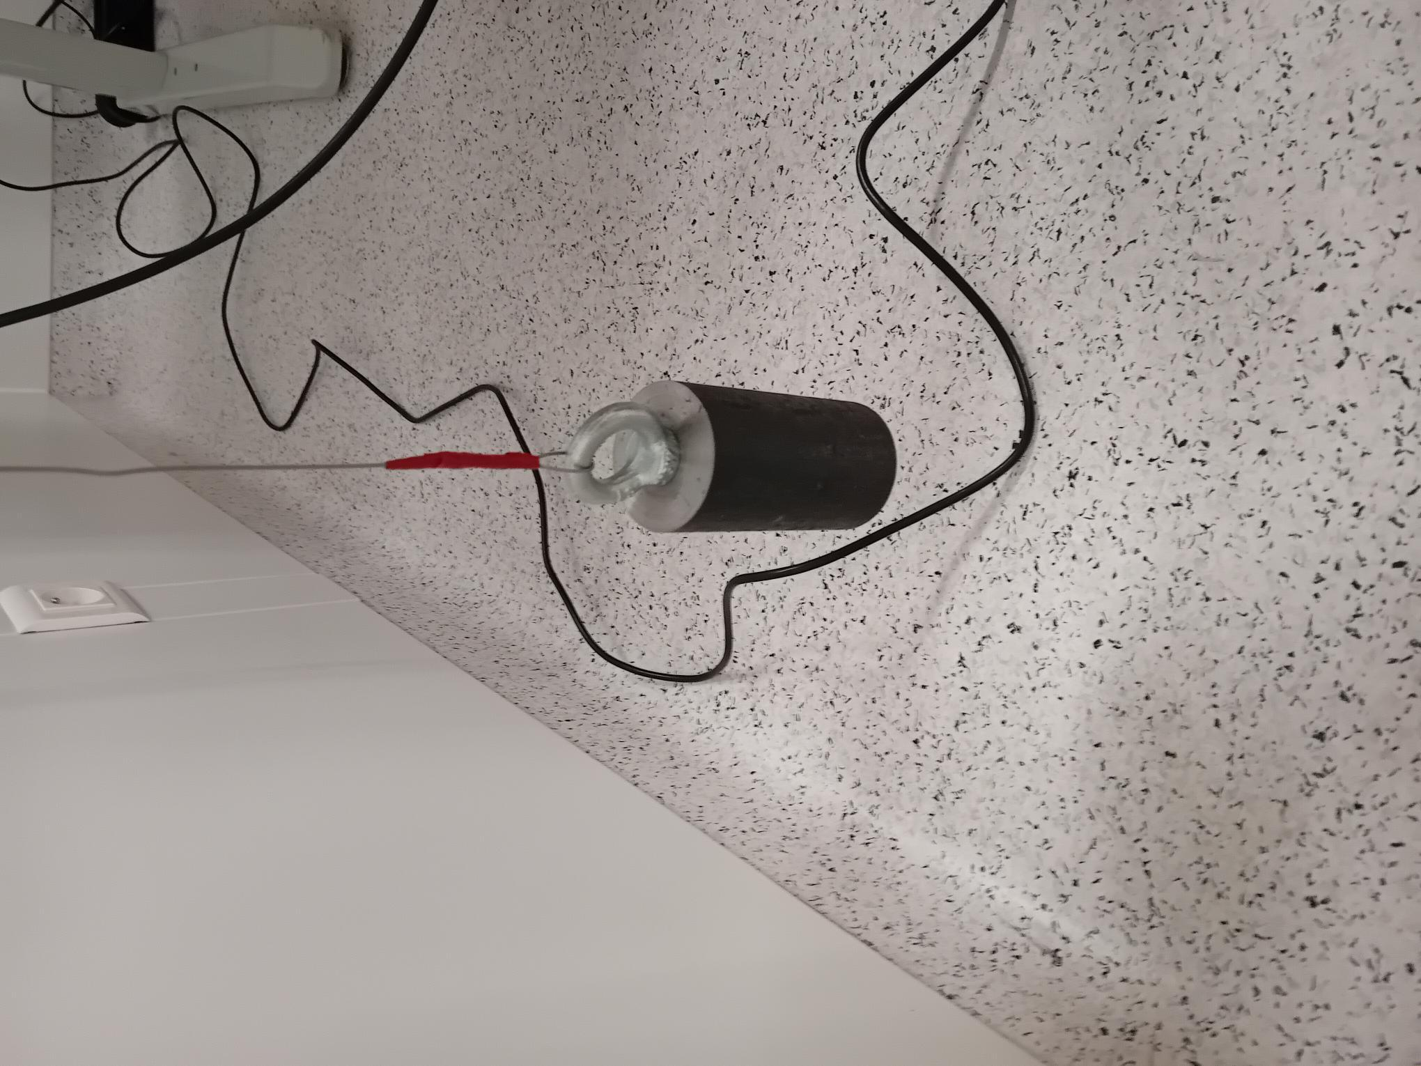
Sensor Bending
Millar foil
Sensor
Sensor support
Mandrell
counterweight

Slide 22
System and Readout
ATLAS pixels serial power (cancelled)
EIC serial power (cancelled)
Serial power and flex R&D: CCF + Oxford consortium looking at low mass flex, system design and test, novel in-house PCB fabrication, leveraging ATLAS pixel chip efforts
Low mass packaging R&D: Trento/Torino/FBK: Al PCB integrated with ALPIDE, HEP and space applications, hi-freq design and test, low mass in-house process
Wireless communications
Trigger vs triggerless readout (Christoph)
bottomline: triggerless is desired and potentially possible, but more studies needed

Slide 23
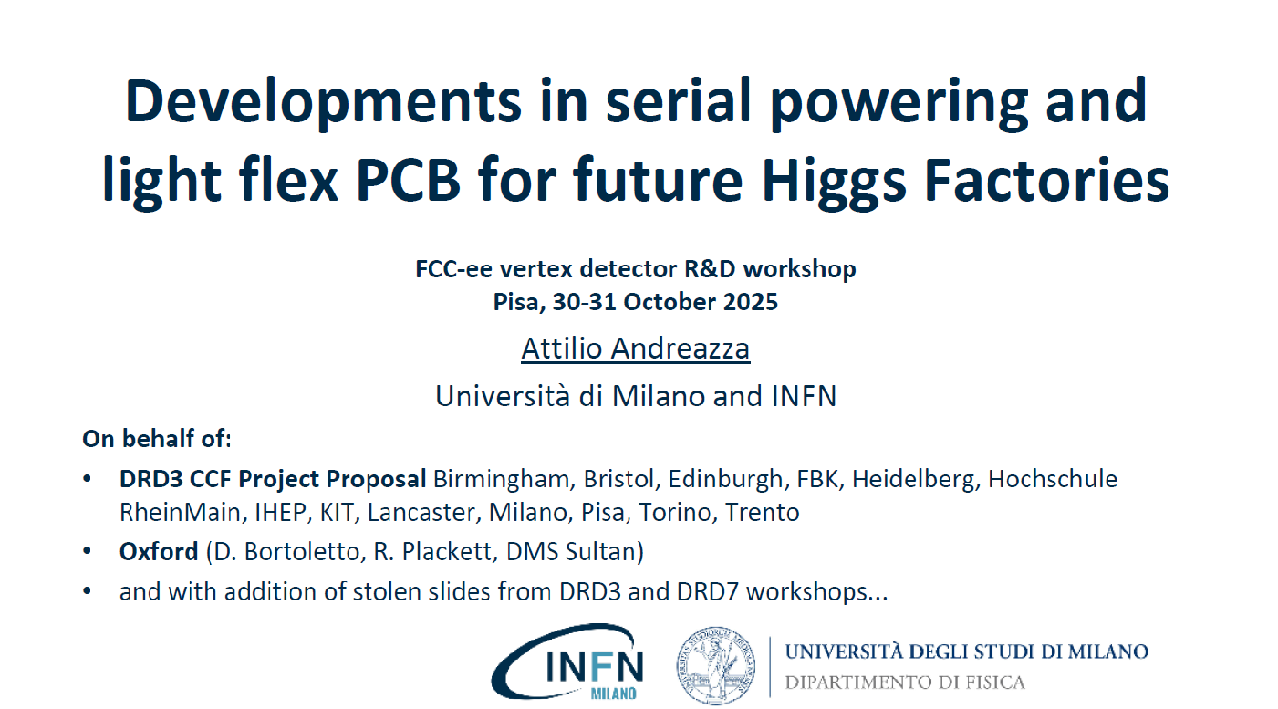

Slide 24
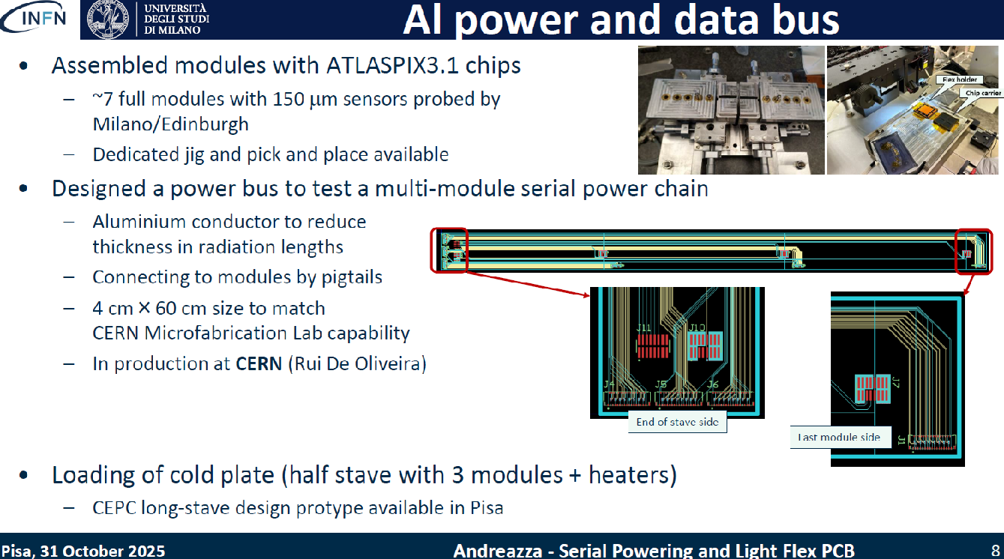

Slide 25
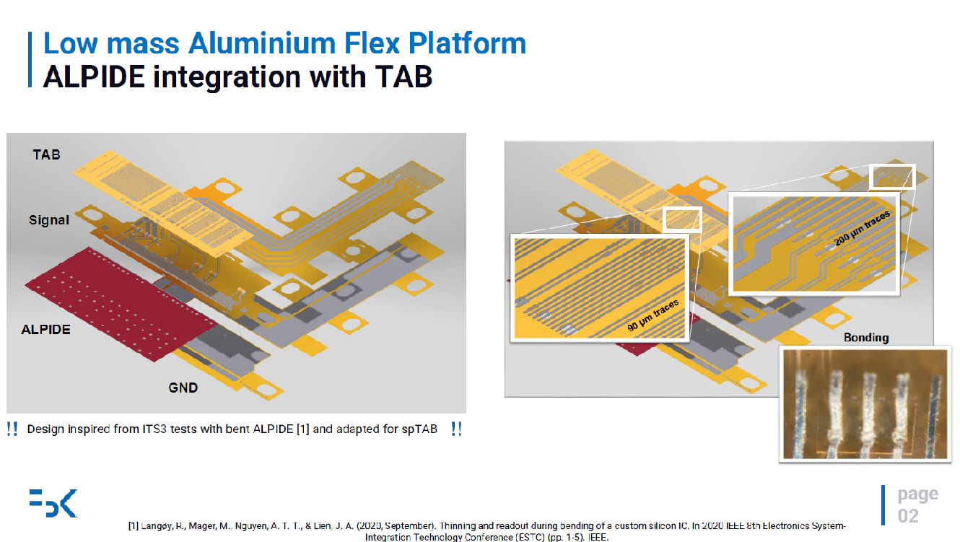

Slide 26
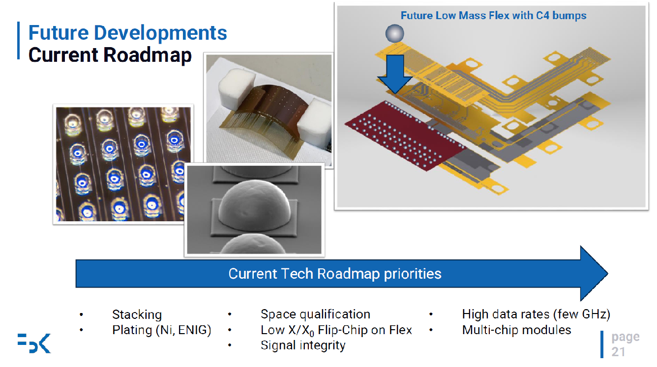

Slide 27
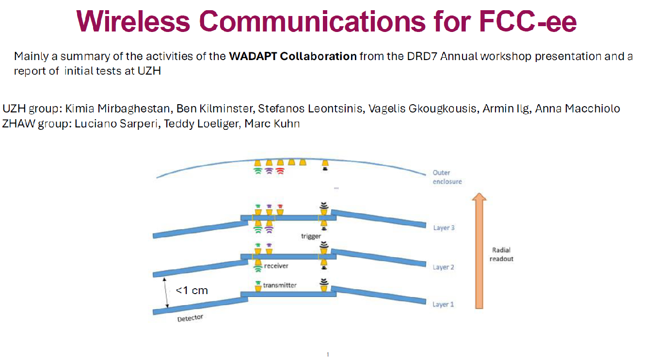

Slide 28
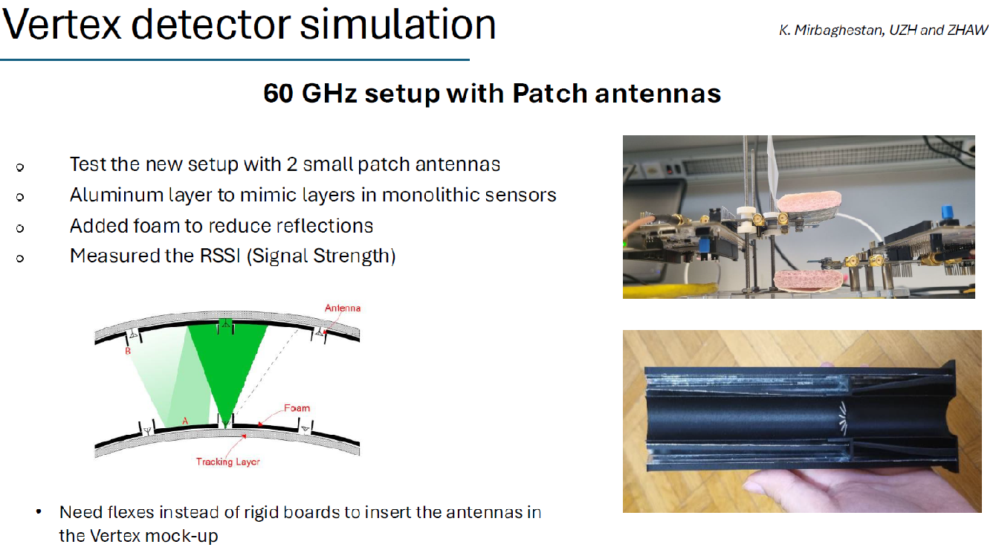

Slide 29
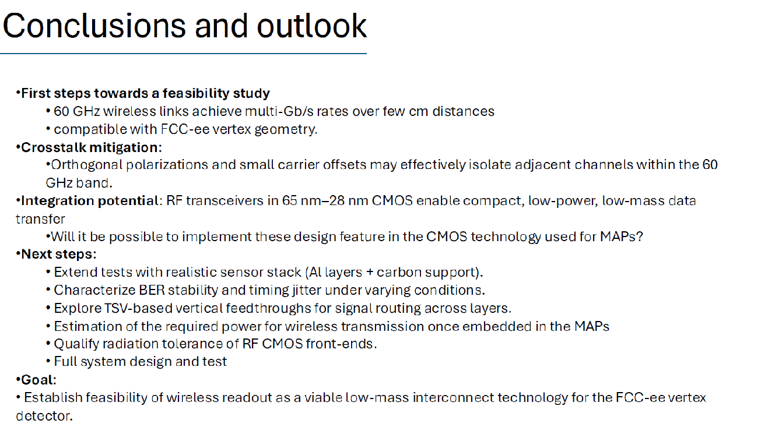

Slide 30
Discussion
The workshop concluded with a discussion session. The notes are posted at https://docs.google.com/document/d/1ulksumSiOGZRIyY9EpyfTOrVTL4iTLWTgo3P353giDA/edit?tab=t.0
Requirement and Constraints
Layout and Simulation
1st layer VTX on the beam pipe? Heat, vibrations, inside not favored by accelerator
Reconstruction software for integrated study of vertex+gaseous tracker + silicon wrapper around the corner
Need to develop this centrally, together
Compare VXD layouts in full simulation e.g. also in terms of jet flavour tagging
Final uncertainty on physics observable to actually compare layouts
Need PhD students to contribute to high-level reconstruction and case studies
B⁰ → K^{*0} τ⁺τ⁻ , strange Yukawa, …?
Integrated optimization of inner vertex + beam pipe (maybe it’s overall better to be at larger radius but have a lower-X₀ beam pipe instead?)
Issues around larger B field, wrapper layer

Slide 31
Discussion continued
Sensors
Inner vertex
achieving 3-5 micron resolution
100 MHz/cm^2
time resolution actually needed inner layers vs power budget?
dead space from stitching
Outer vertex
timing layer here considering higher B field etc
could pixelated LGADs be an integrated solution?
Impact of (unknown?) foundry schedules
3D is it a real possibility? FCCee time frame, cost? value added?

Slide 32
continued
Mechanical
beam pipe mock-up: carbon fiber outer shell could be very interesting
beam pipe mock-up: vibrational studies
beam pipe mock-up: how to connect the inner Vertex
beam pipe mock-up: how to connect properly support the lumical and stability measurements
beam pipe mock-up: installation sequence
service integration: again vibration studies, interplay between relatively heavy and rigid services with very light mechanical structure and air flow
service integration: sequence of installation and service connection
curved sensors: more experience is needed also from other institutes
curved sensors: study different support structures and installation sequence
air cooling: vibration and stability studies, different types of fluids (air, nitrogen, helium), temperature of the air etc.

Slide 33
continued
Systems and Readout
Al tapes attractive for mass but a niche technology
20-25 year time frame, vendor stability? In-house?
Serial systems shown were small scale, need to “get serious” about engineering a large scale system
Serial protection, bypass, monitoring, low noise operation, etc
Are there radiation issues for wireless systems?

Slide 34
Opportunities or strategy points
Layout and simulation - already starting up
MAPS effort to ramp up
3D?
wafer bending technology, develop US experience here
Fast timing, a US area of expertise
Inner timing layer?
role of LGADs in outer vertex
Large serial demonstrators, system design, protection etc
Advanced packaging
Mechanical prototyping

