Slide 1
GSF Discussion session

Slide 2
Low-energy enhancement
- Can we generalize how the LEE strength/onset behaves.
Where is it expected to occur?
LEE systematic from models/experiments?

Slide 3
Low-energy enhancement
- Can we generalize how the LEE strength/onset behaves.
Where is it expected to occur?
LEE systematic from models/experiments?
and the scissors mode
- How clear is the connection?

Slide 4
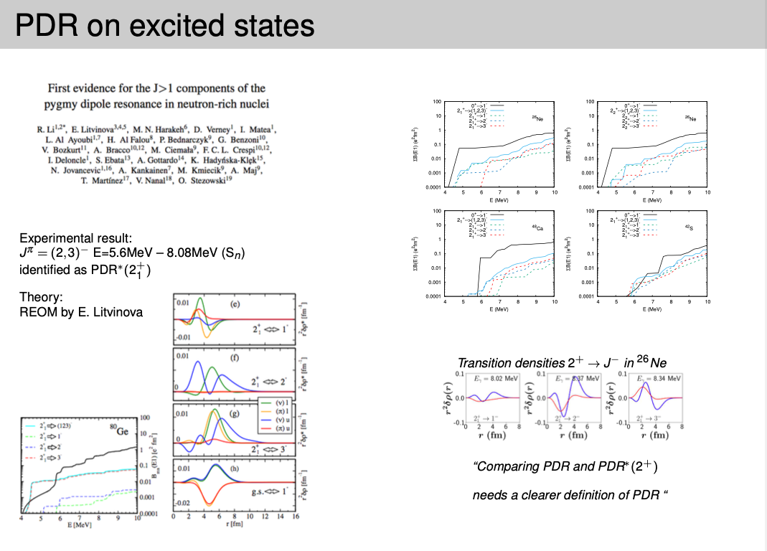
Pygmy Dipole Resonance
PDR on excited states:
what is the definition
of a PDR?

Slide 5
Pygmy Dipole Resonance
Oslo method across many Sn isotopes shows “constant” strength.
From models an increase is expected.
Is the PDR expected to obey the BA hypothesis?

Slide 6
E2 component of the GSF
Should it be considered
  Compare to situation of M1 which was “ignored” for a long time

Slide 7
Coordinated experimental efforts to measure same nuclei with different techniques and perform a thorough and “honest” assessment of strengths and weaknesses of experimental techniques
In reality this does not seem to happen.
What needs to be done to change that?
Are there any priority experiments we should focus on?

Slide 8
We have decades worth of data. Much progress in analytical techniques, uncertainty treatment, etc.
Is it worthwhile for targeted reanalysis of data
  E.g. Oslo/NRF data
  With full model and systematic uncertainty budget

Slide 9
Best practices for analyzing and publishing data
Could we agree on some basics?
  Provide data tables in supplementary material
  Uncertainty budget
How to make our results more “visible” to end users?
  Are our results used outside of this community?

Slide 10
Any other burning topics?

