Slide 1


Statistical properties of ¹³³Xe and the ¹³²Xe(n,γ) cross section
H. C. Berg bergh@frib.msu.edu
10th Workshop on Nuclear Level Density and Gamma Strength
19.05.2026

Slide 2


Why ¹³³Xe - Nuclear Plasma Interactions
e⁻
Nuclear Excitation by Electron Capture (NEEC)
Measuring the isomer to ground state ratio
S_{n}
(n,2n)
Nuclear levels
Atomic orbitals
Isomer (2 days)
¹³⁴Xe
Ground state (5 days)
Animation: D. L. Bleuel, private communication (2019).
¹³³Xe

Slide 3
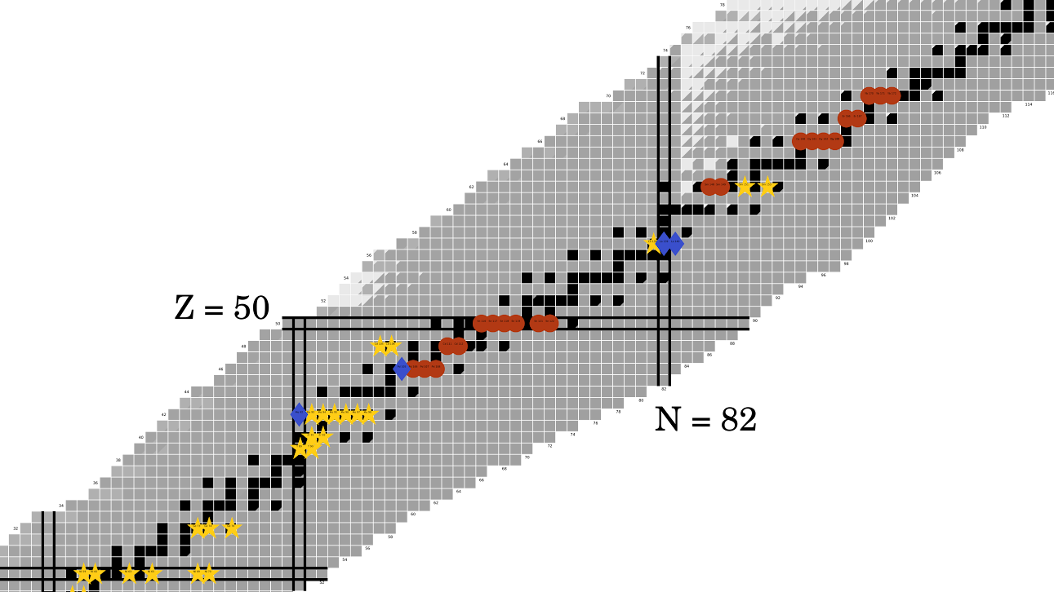
Low energy enhancement
¹³³Xe
J. E. Midtbø et al., Phys. Rev. C98, 064321, (2018).

Slide 4
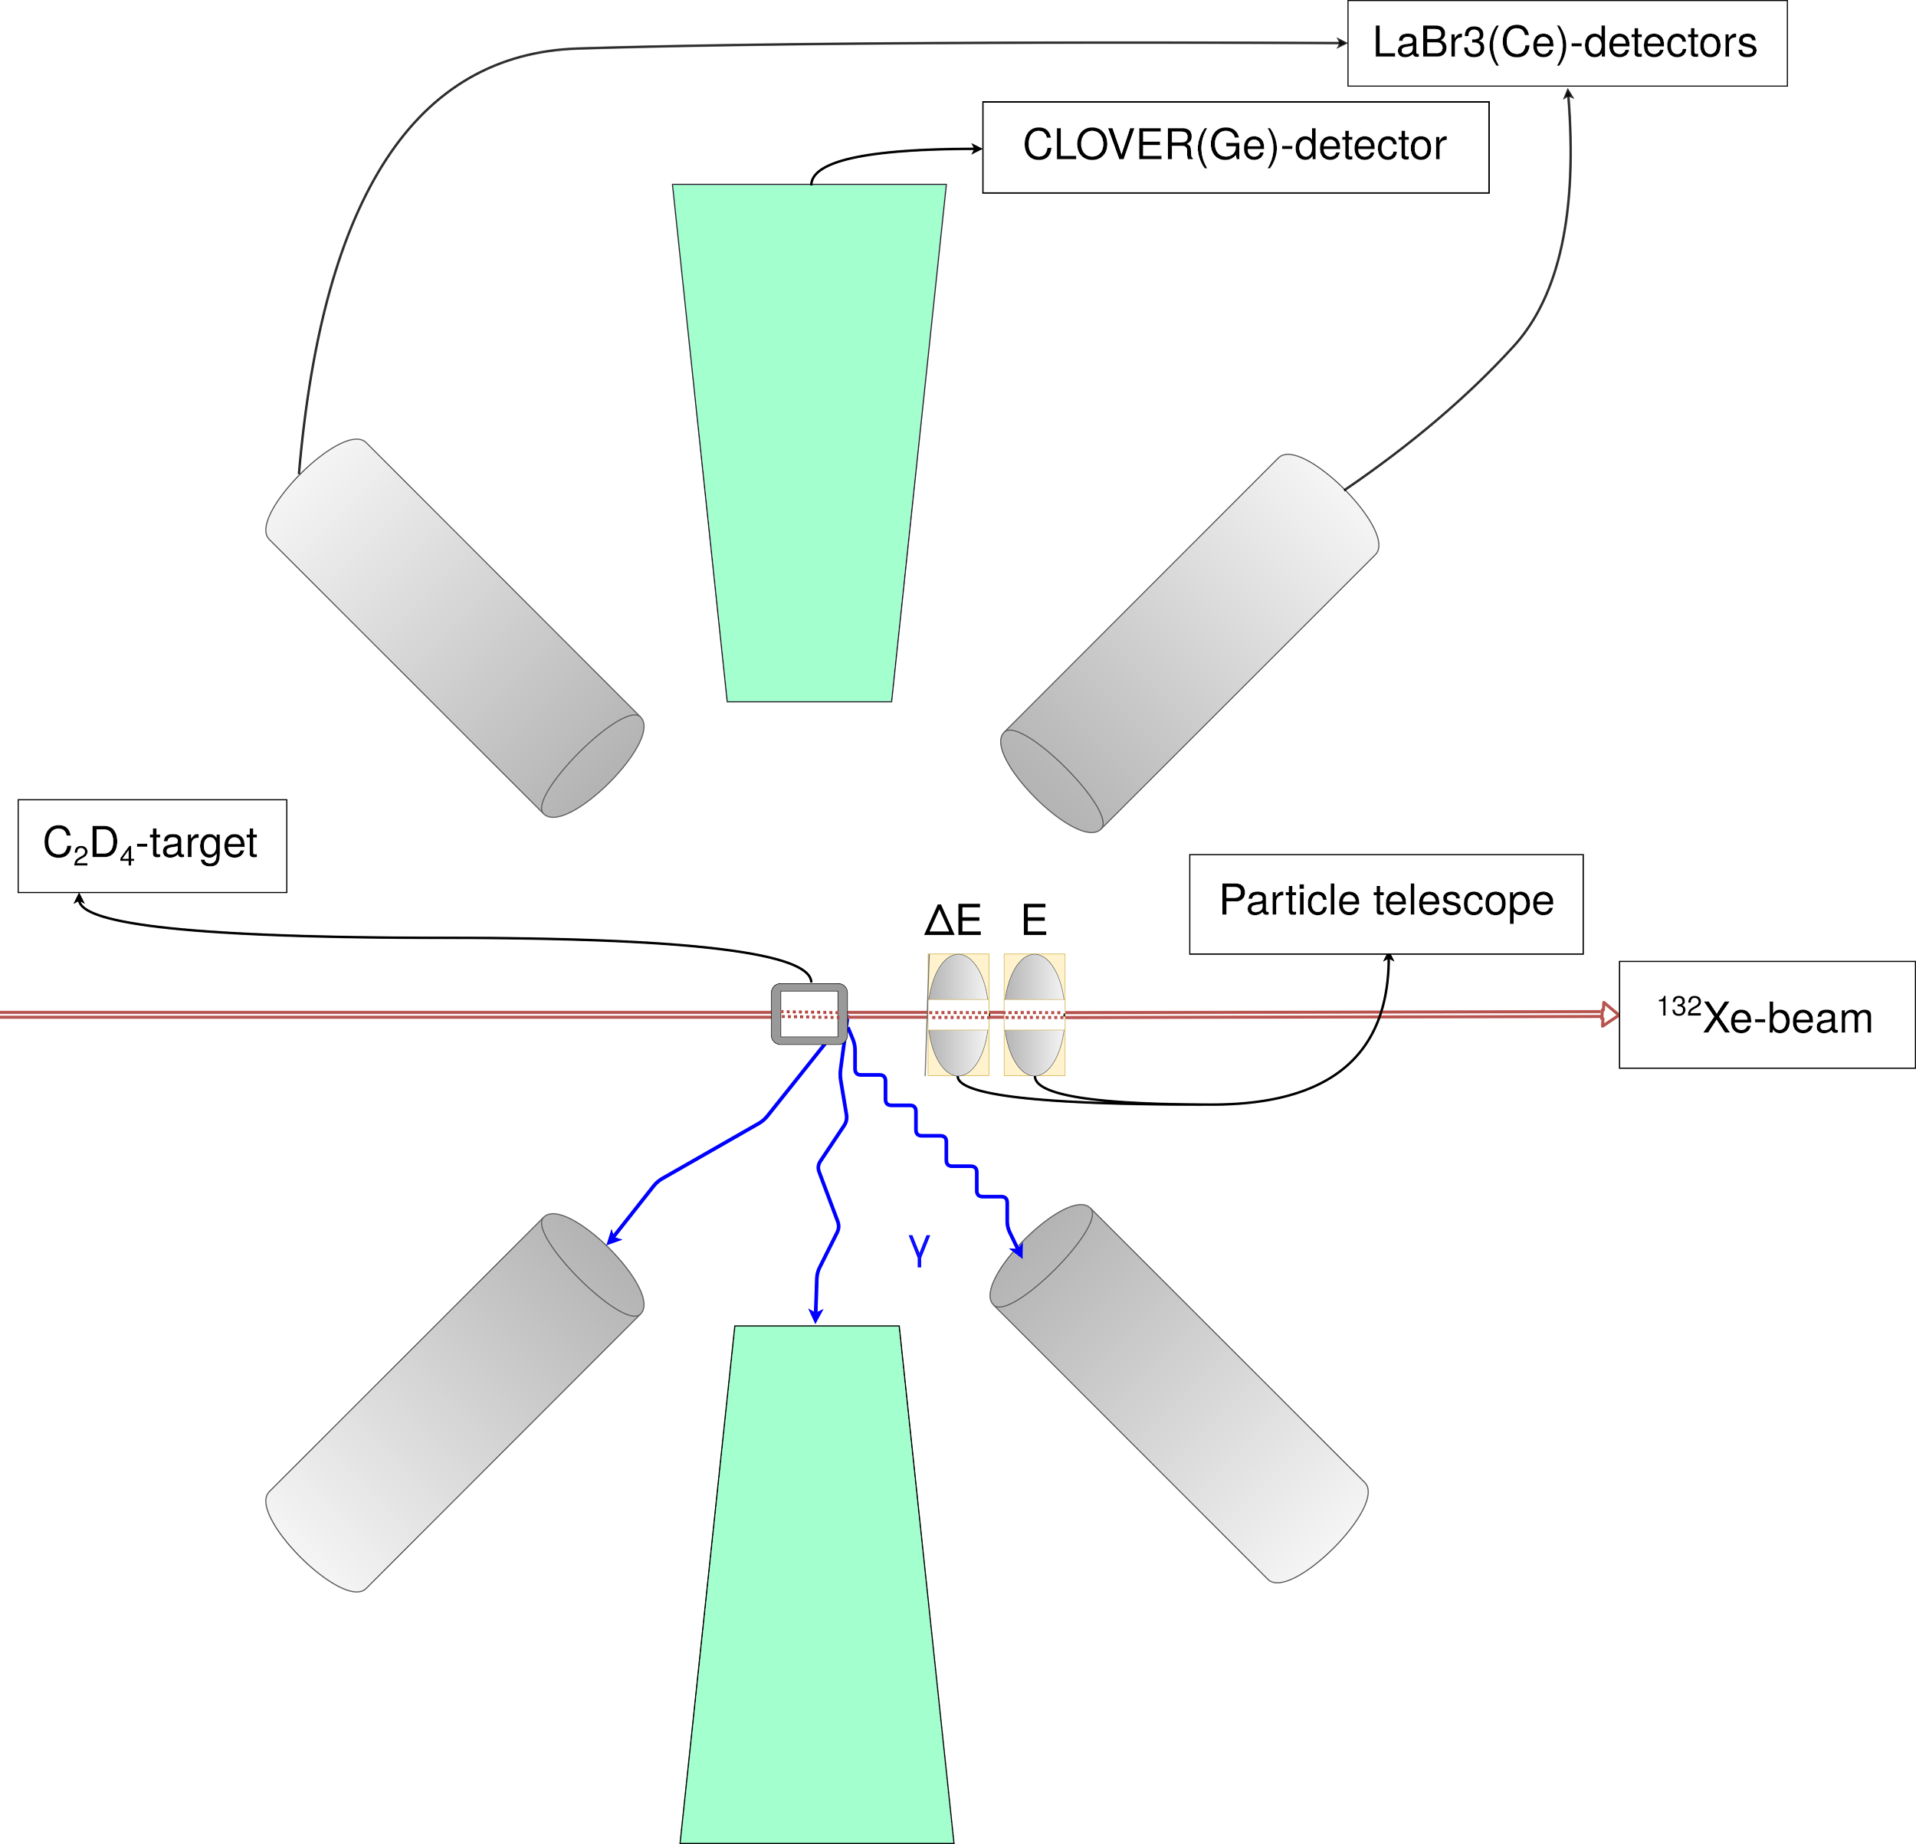
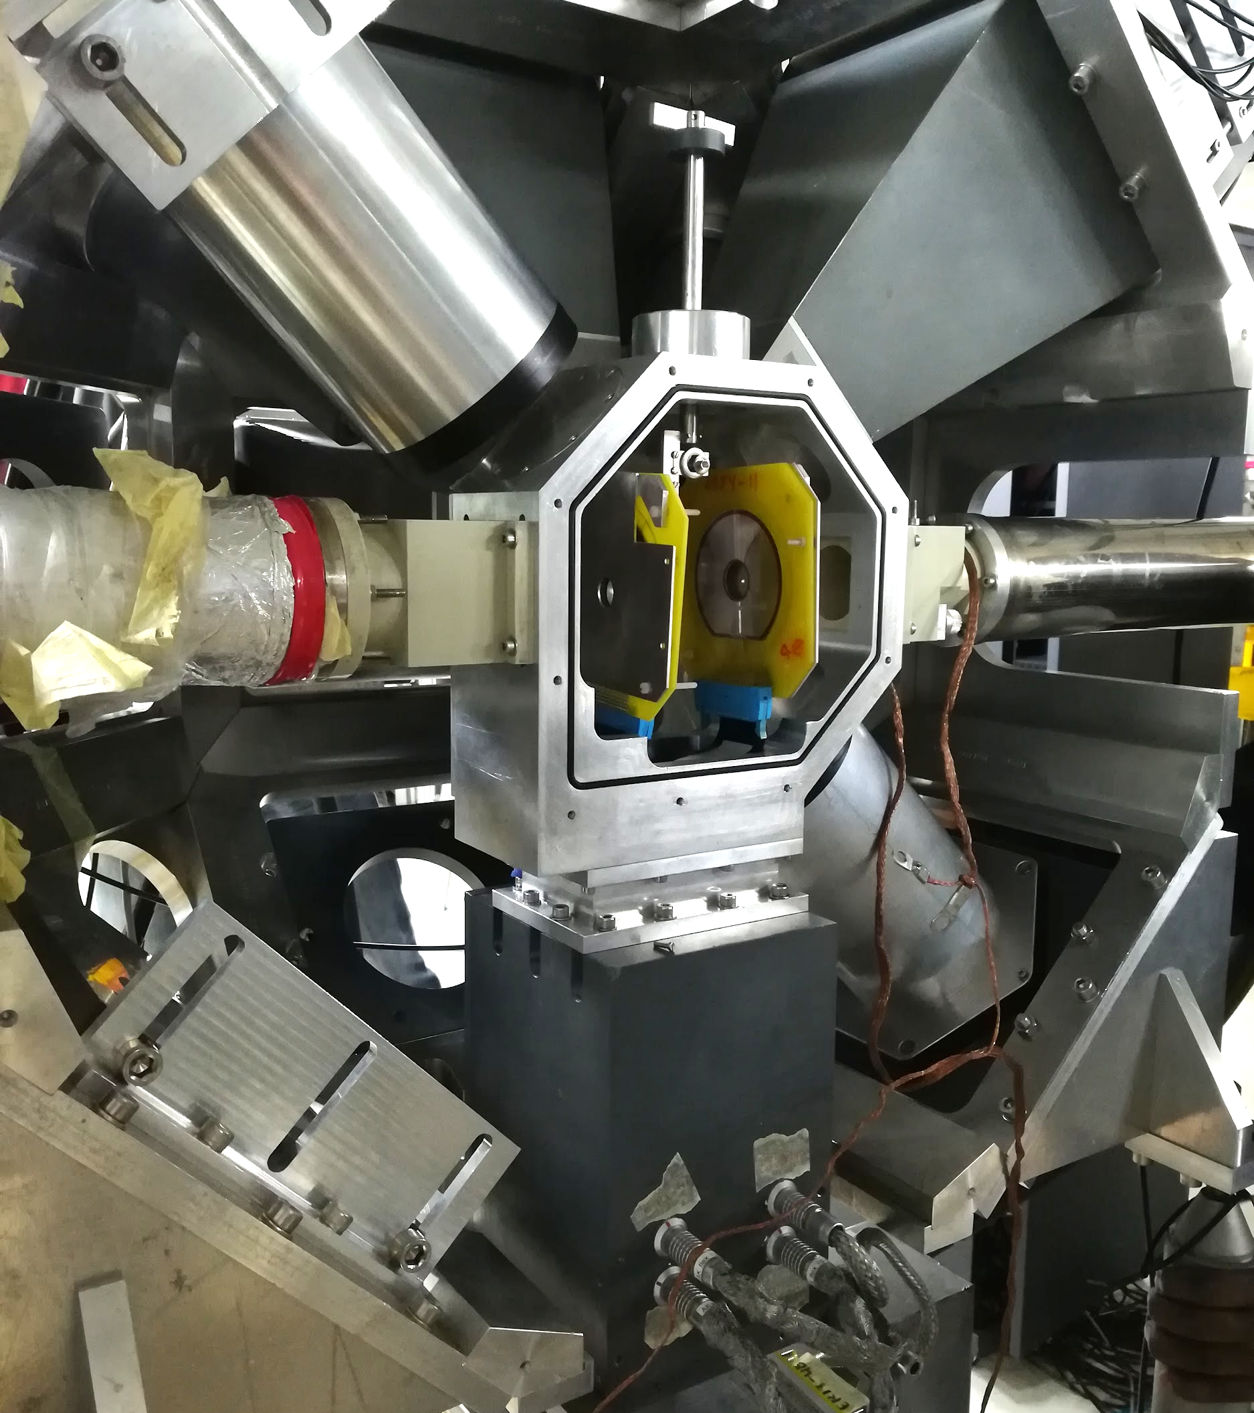
Experiment
@ 4.01 MeV/nucleon

Slide 5
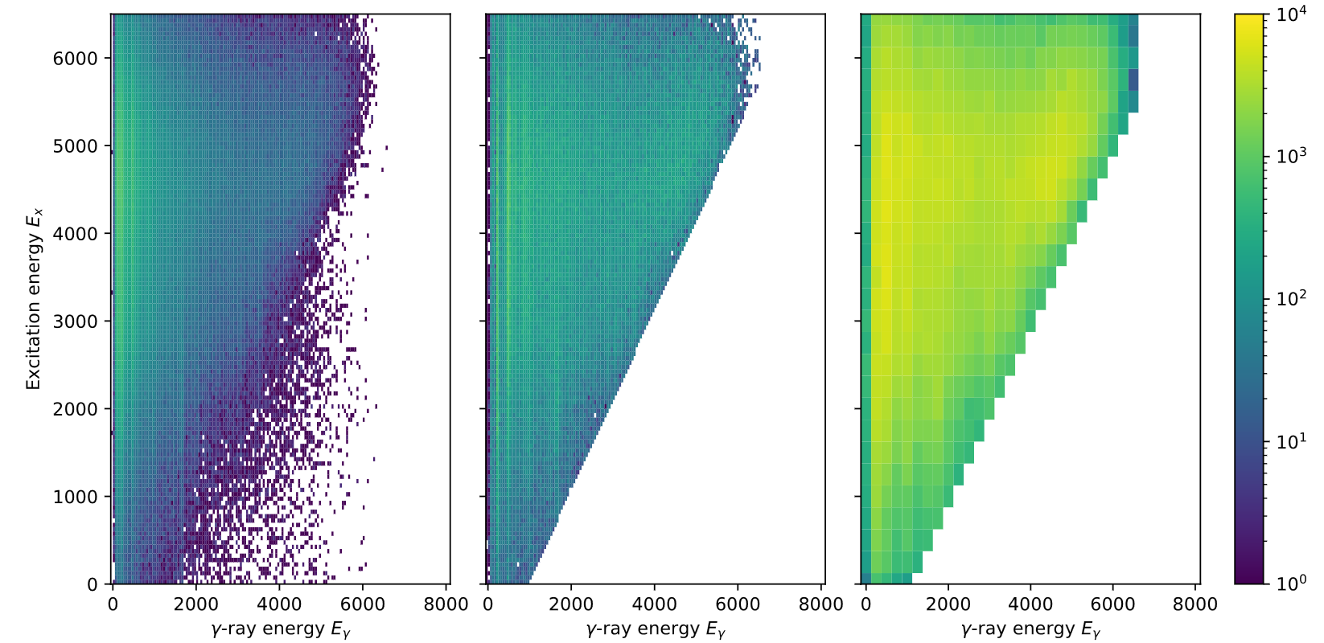
Oslo method
Raw
Ufolded
FG

Slide 6
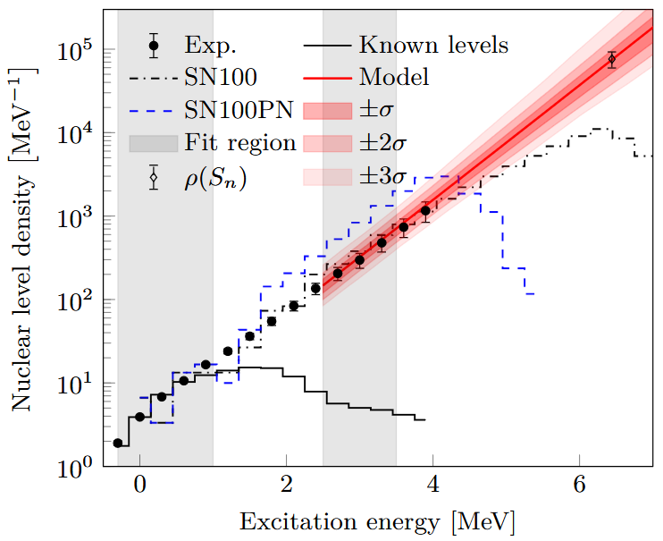

Normalization
Likelihood function to find parameters for normalization simultaneously
Constant temperature model extrapolation at the same time

Slide 7
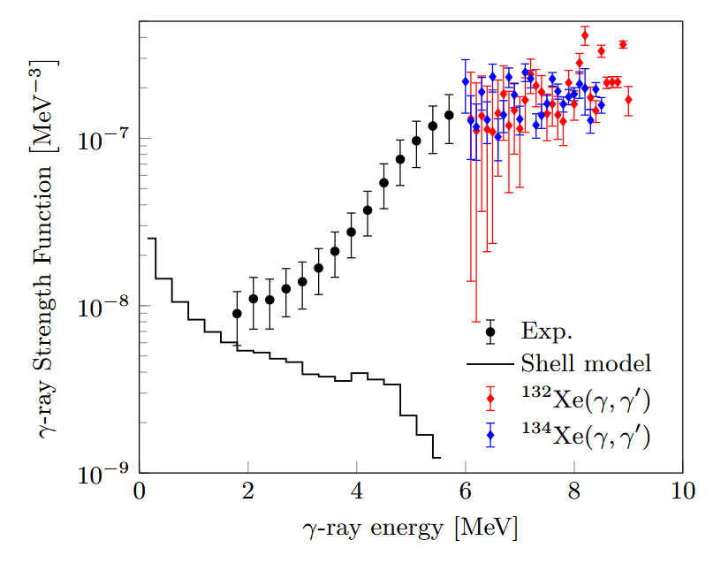
Normalization
Likelihood function to find parameters for normalization simultaneously
Constant temperature model extrapolation at the same time

Slide 8
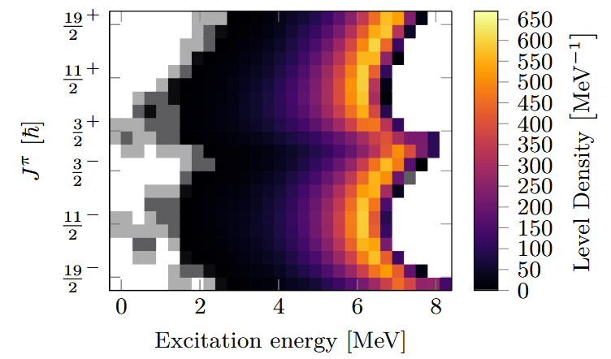
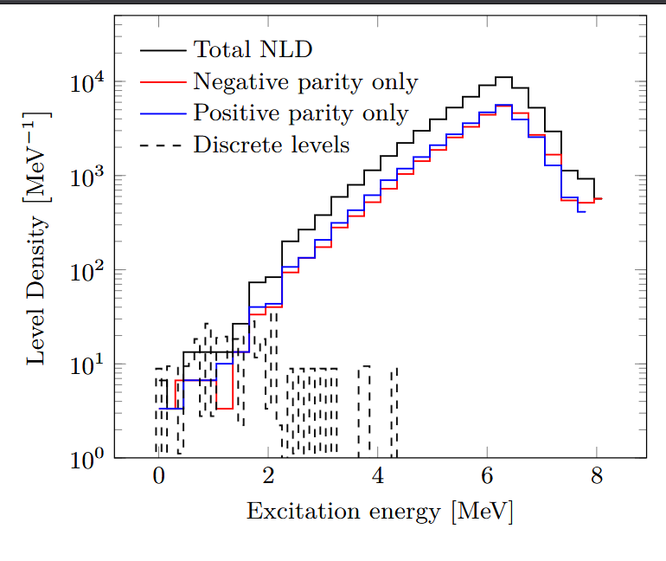
Shell model calculations NLD
Allows us to look at spin dependence

Slide 9
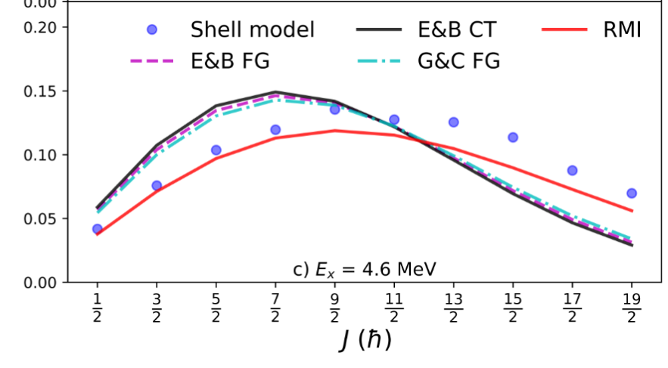
Shell model calculations NLD
g(J, E_{x})
Allows us to look at spin dependence, inform spin cut-off parameter

Slide 10
Shell model and experimental data
Excellent agreement with our measured NLD for SN100
SN100PN overshoots
CT extrapolation higher than shell model prediction

Slide 11
Shell model and experimental data
Only M1 contribution
f_{M1}

Slide 12
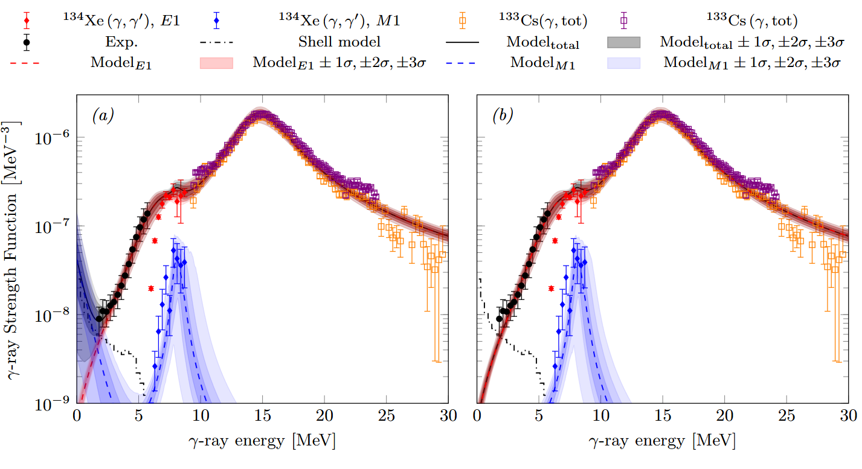
gSF parametrization
Upbend or no upbend?

Slide 13
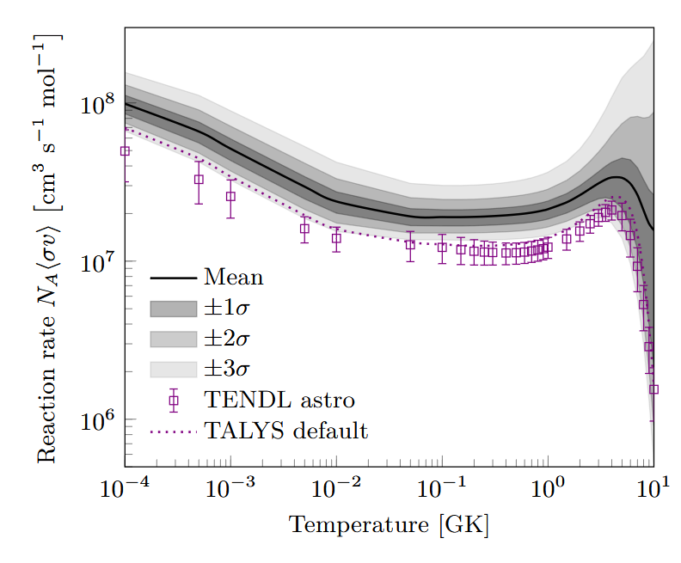
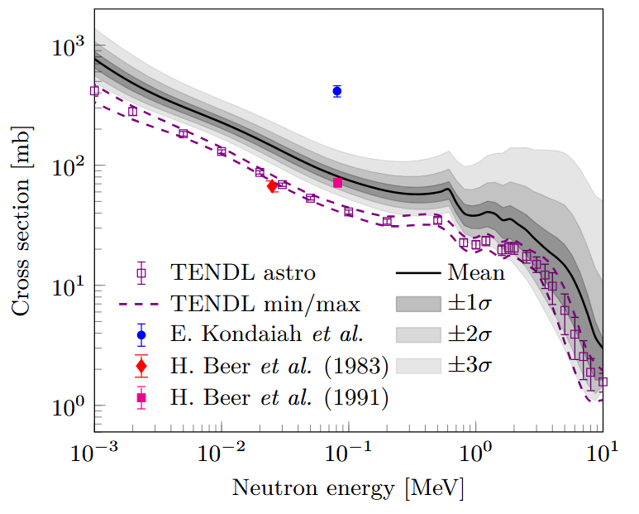
Constraining neutron capture on ¹³²Xe

Slide 14
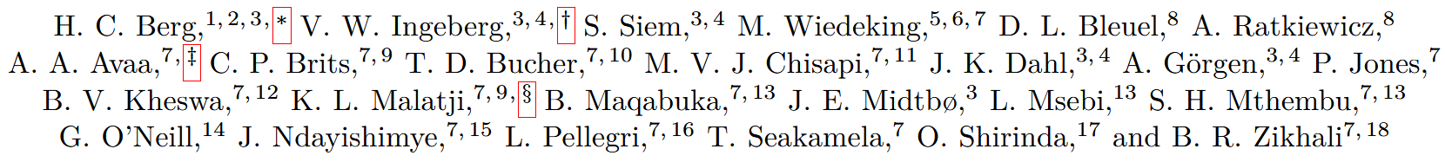

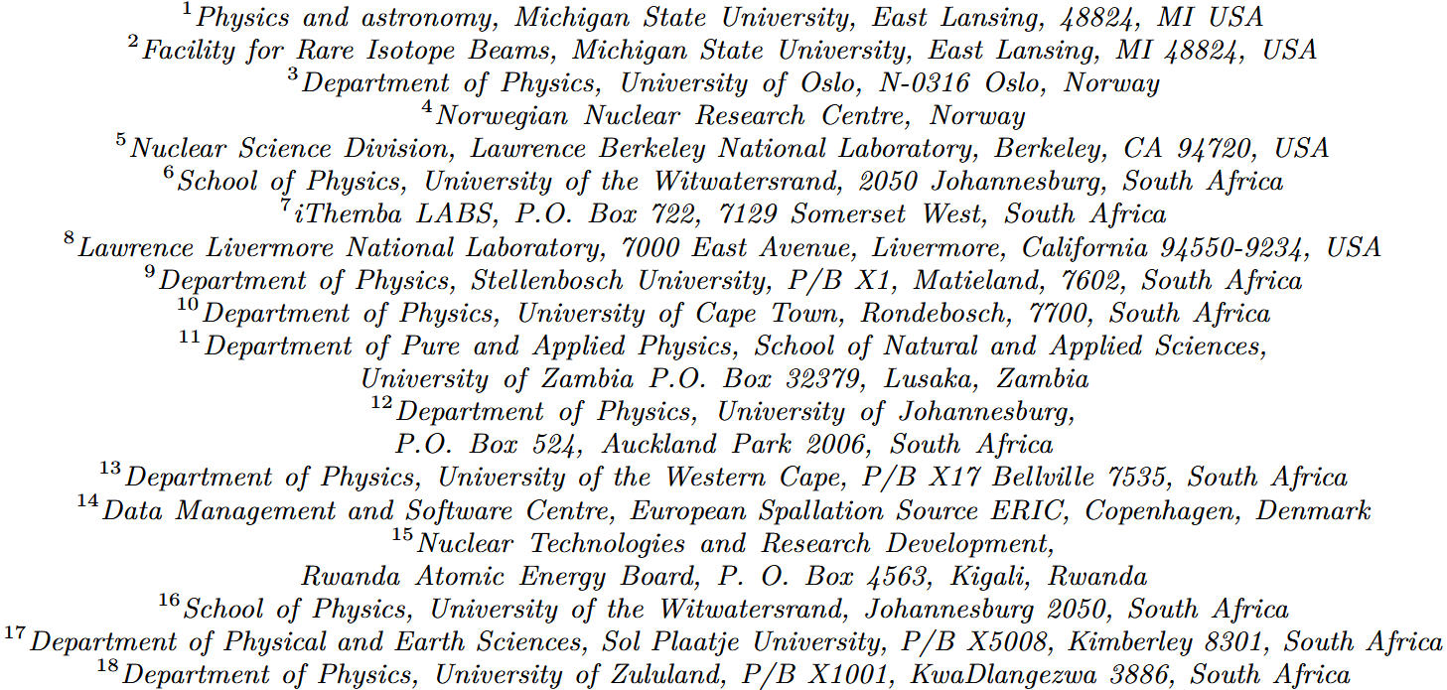
Thank you!

