Slide 1
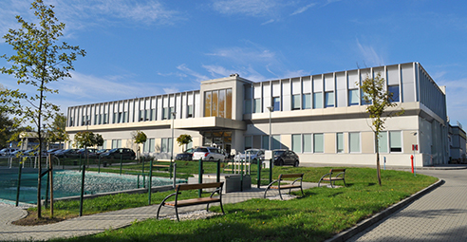

Exploring PDR & ISGQR Strengths with Inelastic Proton Scattering at the Krakow CCB
A. Giaz
INFN-Milano

Slide 2
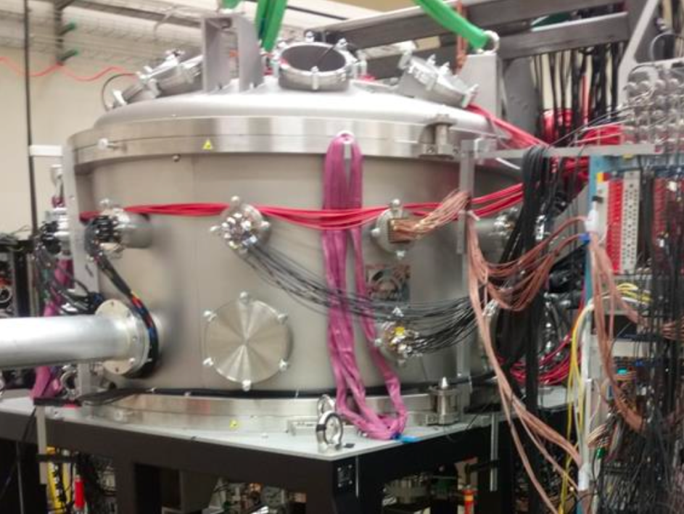

Outline
Motivations
  ISGQR $γ$-decay in ¹²⁰Sn & ²⁰⁸Pb
  PDR in A = 60 mass region
    Complementary experiment hot PDR
Experimental setup
The experimental techniques
Preliminary results
Conclusion & Perspectives
1

Slide 3
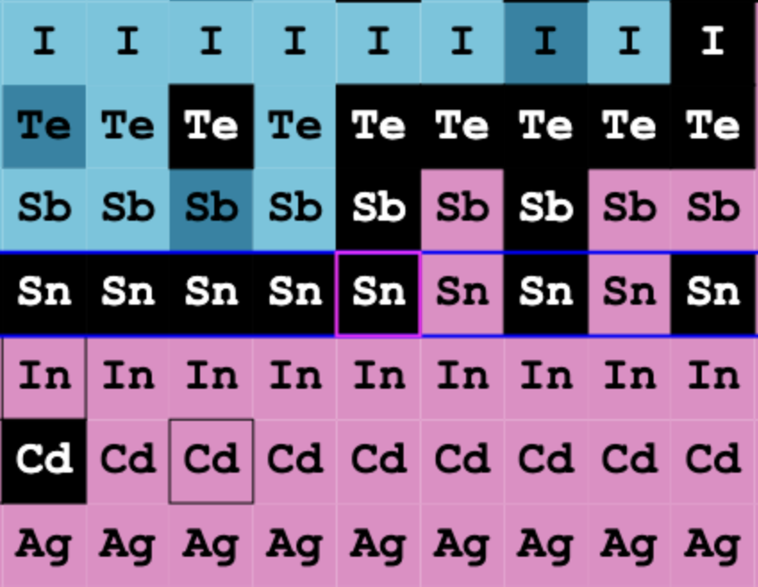
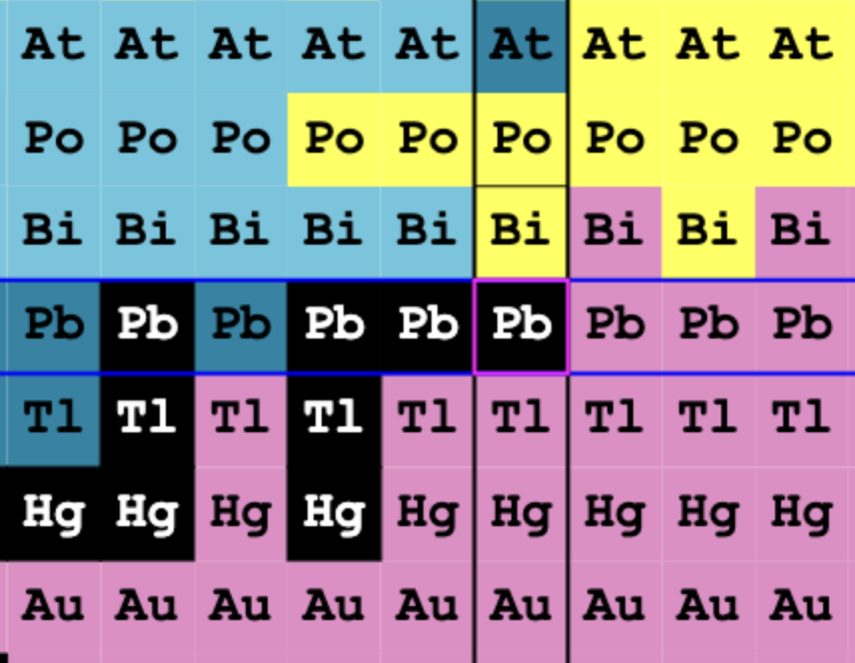
Motivation: ISGQR in ¹²⁰Sn & ²⁰⁸Pb
ISGQR $γ$ decay

Slide 4
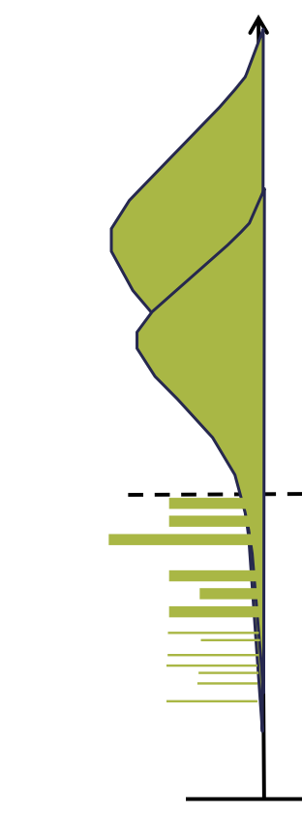
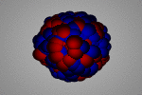
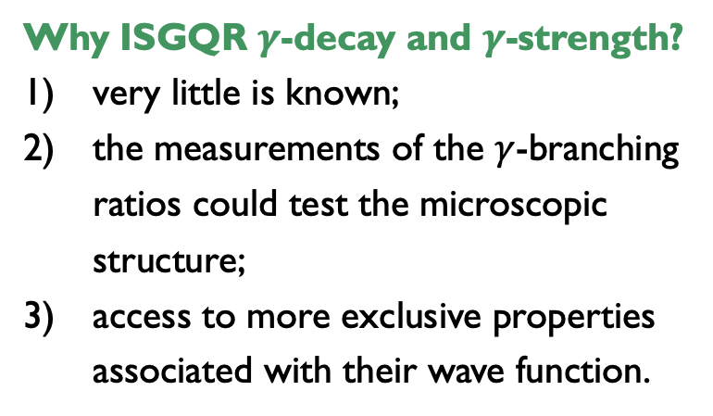
Motivation: ISGQR in ¹²⁰Sn
Aim: measure the ISGQR gamma decay in ²⁰⁸Pb & ¹²⁰Sn with inelastic proton scattering
A Resonance:
Macroscopically: oscillation of n and p;
Microscopically: superposition of p-h excitations;
GDR
Why ISGQR $γ$-decay and $γ$-strength?
very little is known;
the measurements of the $γ$-branching ratios could test the microscopic structure;
access to more exclusive properties associated with their wave function.
g.s.
S_{n}
E*
3

Slide 5
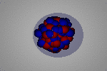
Motivation: ISGQR in ¹²⁰Sn
Aim: measure the ISGQR gamma decay in ²⁰⁸Pb & ¹²⁰Sn with inelastic proton scattering
A Resonance:
Macroscopically: oscillation of n and p;
Microscopically: superposition of p-h excitations;
PDR
GDR
Why ISGQR $γ$-decay and $γ$-strength?
very little is known;
the measurements of the $γ$-branching ratios could test the microscopic structure;
access to more exclusive properties associated with their wave function.
g.s.
S_{n}
E*
3

Slide 6
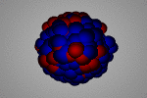
Motivation: ISGQR in ¹²⁰Sn
Aim: measure the ISGQR gamma decay in ²⁰⁸Pb & ¹²⁰Sn with inelastic proton scattering
A Resonance:
Macroscopically: oscillation of n and p;
Microscopically: superposition of p-h excitations;
PDR
GQR
GDR
Why ISGQR $γ$-decay and $γ$-strength?
very little is known;
the measurements of the $γ$-branching ratios could test the microscopic structure;
access to more exclusive properties associated with their wave function.
g.s.
S_{n}
E*
3

Slide 7
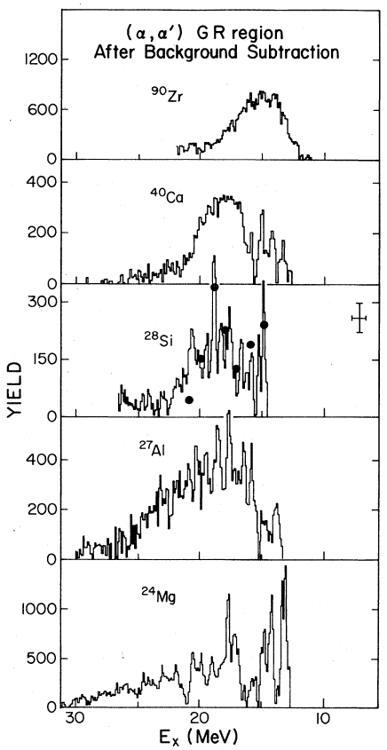
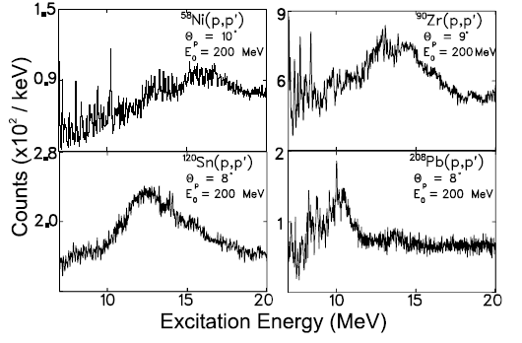
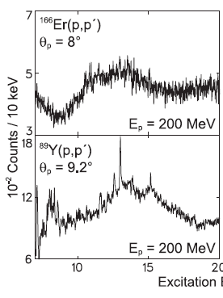
ISGQR
First evidence of GQR observed in 1971 via inelastic electron scattering, confirmed in 1972 and later with proton scattering.
Observed in nuclei (16 ≤ A ≤ 238): fragmented strength in light nuclei, Gaussian/Lorentzian shape in heavy nuclei.
D.H. Youngblood et al.,Phys. Rev. C15, 1644 (1977)
A. Shevchenko et al., PRL, 93 (2004) 122501-1
A. Shevchenko et al., PRCC 79, 044305 (2009)
4

Slide 8
ISGQR
First evidence of GQR observed in 1971 via inelastic electron scattering, confirmed in 1972 and later with proton scattering.
Observed in nuclei (16 ≤ A ≤ 238): fragmented strength in light nuclei, Gaussian/Lorentzian shape in heavy nuclei.
Structure, fragmented strength, decay and γ-decay to g.s. and excited states
needed to be investigated
D.H. Youngblood et al.,Phys. Rev. C15, 1644 (1977)
A. Shevchenko et al., PRL, 93 (2004) 122501-1
A. Shevchenko et al., PRCC 79, 044305 (2009)
4

Slide 9
ISGQR γ-decay, previous measurements: ²⁰⁸Pb
Heavy-ion inelastic scattering: ²⁰⁸Pb(¹⁷O, ¹⁷O′ γ), E_{beam} = 381 MeV
J.Beene et al., PRC 39 (1989)1307
5

Slide 10
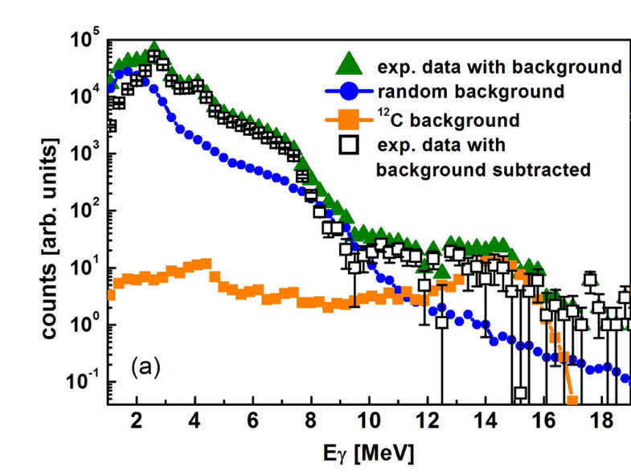
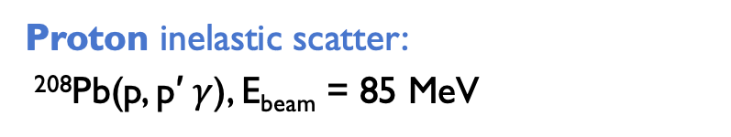
ISGQR γ-decay, previous measurements: ²⁰⁸Pb
Heavy-ion inelastic scattering: ²⁰⁸Pb(¹⁷O, ¹⁷O′ γ), E_{beam} = 381 MeV
Proton inelastic scatter:
²⁰⁸Pb(p, p′ $γ$), E_{beam} = 85 MeV
J.Beene et al., PRC 39 (1989)1307
B. Wasilewska et al. PRC 105, (2022) 014310
5

Slide 11
ISGQR γ-decay, previous measurements: ²⁰⁸Pb
Heavy-ion inelastic scattering: ²⁰⁸Pb(¹⁷O, ¹⁷O′ γ), E_{beam} = 381 MeV
Proton inelastic scatter:
²⁰⁸Pb(p, p′ $γ$), E_{beam} = 85 MeV
Difficult to measure
very small probability ~10⁻⁴
J.Beene et al., PRC 39 (1989)1307
B. Wasilewska et al. PRC 105, (2022) 014310
5

Slide 12
ISGQR γ-decay, previous measurements: ²⁰⁸Pb
Heavy-ion inelastic scattering: ²⁰⁸Pb(¹⁷O, ¹⁷O′ γ), E_{beam} = 381 MeV
Proton inelastic scatter:
²⁰⁸Pb(p, p′ $γ$), E_{beam} = 85 MeV
Difficult to measure
very small probability ~10⁻⁴
To have a better picture:
different mass regions
¹²⁰Sn at 200 MeV & ²⁰⁸Pb at 155 MeV
J.Beene et al., PRC 39 (1989)1307
B. Wasilewska et al. PRC 105, (2022) 014310
5

Slide 13
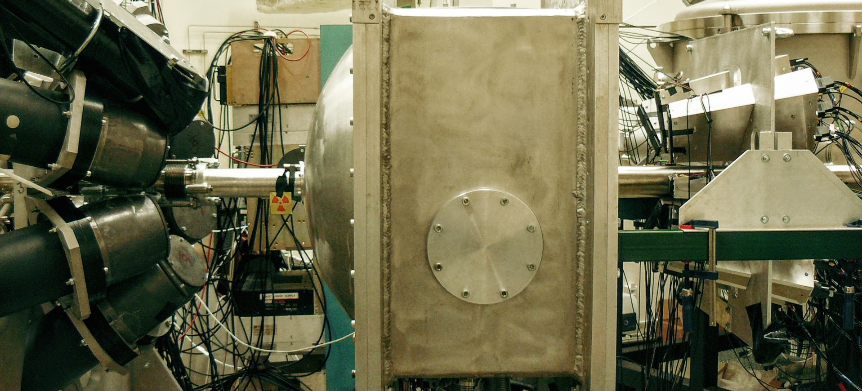
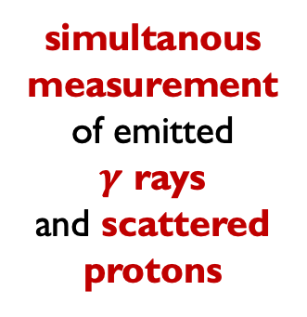
First experiment: ISGQR γ-decay in ²⁰⁸Pb
p @ 85 MeV on ²⁰⁸Pb target 48 mm (54.5 mg/cm²) thick
HECTOR (8 BaF₂)
(γ-rays)
vacuum scattering chamber
KRATTA
16 CsI telescopes
at angles
8.9° - 14.3°
with resolution 1.8°
(protons)
simultanous measurement
of emitted
$γ$ rays
and scattered protons
Courtesy of M. Kmiekic
6

Slide 14
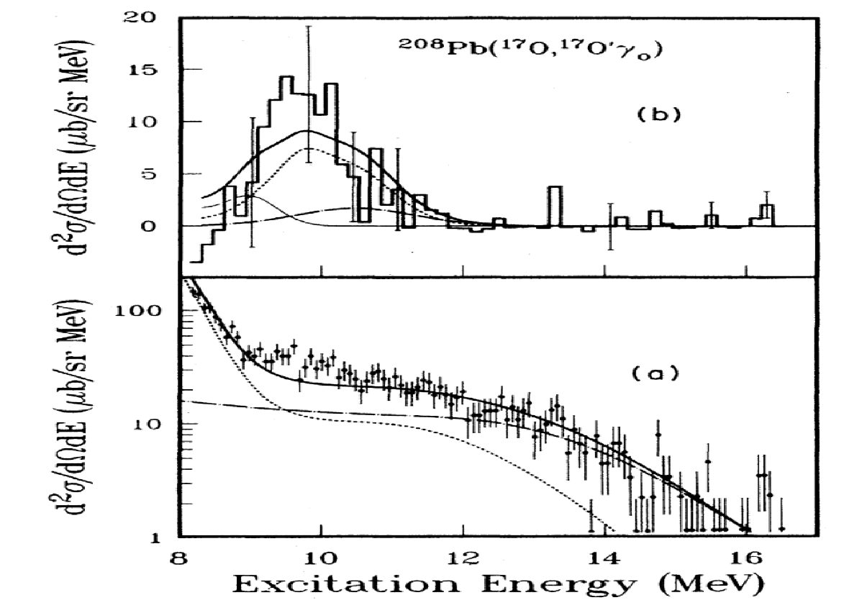
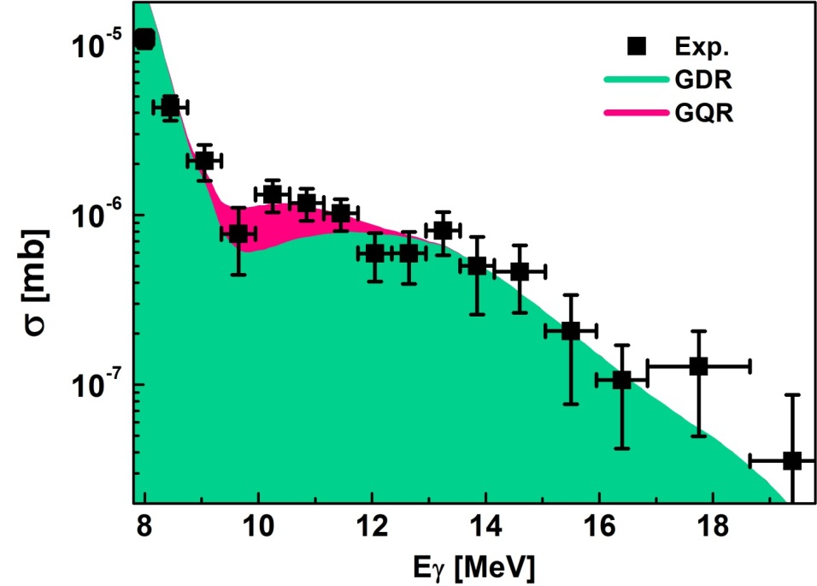

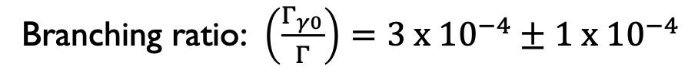
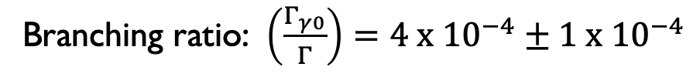
ISGQR γ-decay in ²⁰⁸Pb
²⁰⁸Pb(¹⁷O, ¹⁷O′ γ), @ 381 MeV
²⁰⁸Pb(p, p′ $γ$), @ 85 MeV
J.Beene et al., PRC 39 (1989)1307
B. Wasilewska et al. PRC 105, (2022) 014310
Branching ratio: $\left(\frac{Γ_{γ0}}{Γ}\right)=4 x {10}^{−4}±1 x{ 10}^{−4}$
Branching ratio: $\left(\frac{Γ_{γ0}}{Γ}\right)=3 x {10}^{−4}±1 x{ 10}^{−4}$
Courtesy of M. Kmiekic
7

Slide 15
ISGQR γ-decay in ²⁰⁸Pb
²⁰⁸Pb(¹⁷O, ¹⁷O′ γ), @ 381 MeV
²⁰⁸Pb(p, p′ $γ$), @ 85 MeV
Observation,
for the 2nd time
of the gamma decay
of the GQR
J.Beene et al., PRC 39 (1989)1307
B. Wasilewska et al. PRC 105, (2022) 014310
Branching ratio: $\left(\frac{Γ_{γ0}}{Γ}\right)=4 x {10}^{−4}±1 x{ 10}^{−4}$
Branching ratio: $\left(\frac{Γ_{γ0}}{Γ}\right)=3 x {10}^{−4}±1 x{ 10}^{−4}$
Courtesy of M. Kmiekic
7

Slide 16
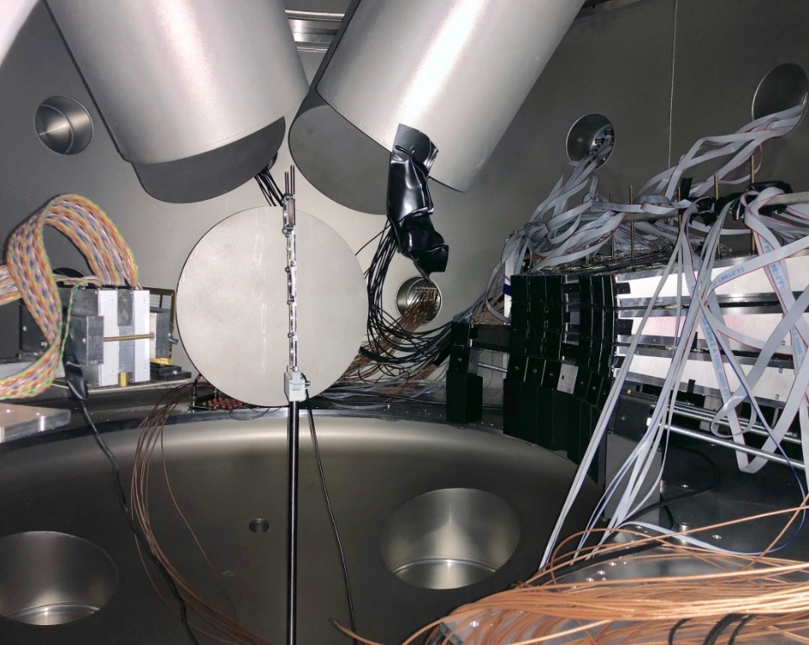
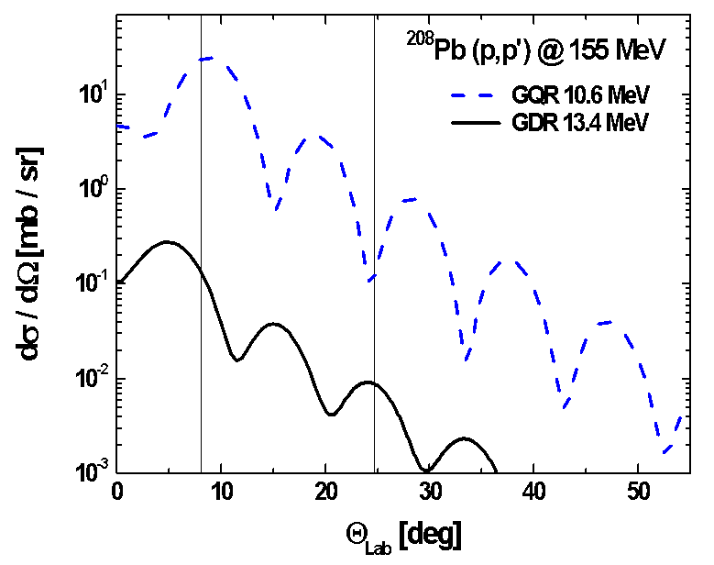
ISGQR γ-decay in ²⁰⁸Pb: New Measurement
²⁰⁸Pb (p,p’$γ$)@155 MeV
LaBr₃
KRATTA
GQR
PARIS
Beam
GDR
Target
New setup – better γ energy resolution
Higher beam energy – enchancement of GQR
Courtesy of M. Kmiekic
8

Slide 17
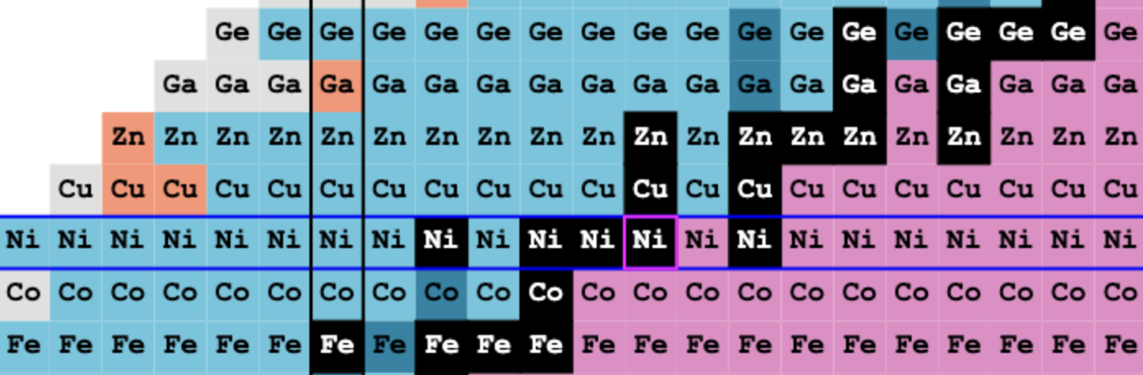
Motivation: PDR in A=60 mass Region
Ni chain and ^{64,66}zn isotopes

Slide 18
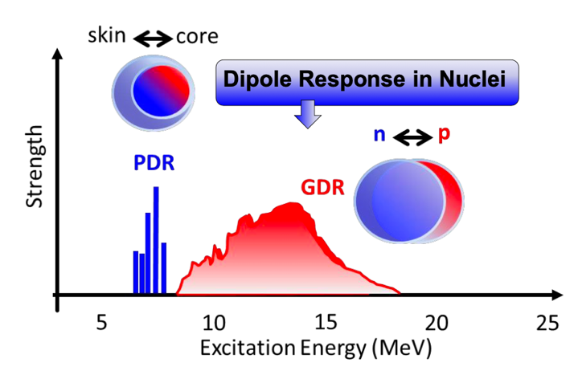
Motivation: Pygmy resonance
PDR has been mostly interpreted as collective oscillation of neutron skin against the core
Manifests itself as
E1 strength concentration around the particle binding energy
10

Slide 19
Motivation: Pygmy resonance
PDR has been mostly interpreted as collective oscillation of neutron skin against the core
Manifests itself as
E1 strength concentration around the particle binding energy
Theory: Different approaches give varied predictions in terms of collectivity, strength and line-shape of the PDR
A broad systematic study it is necessary using complementary approaches.
10

Slide 20
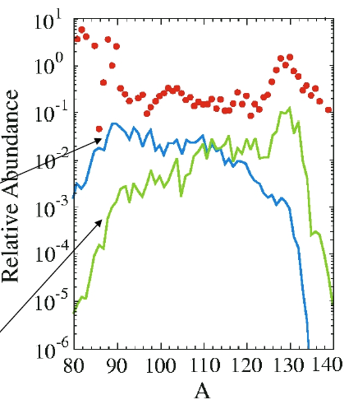
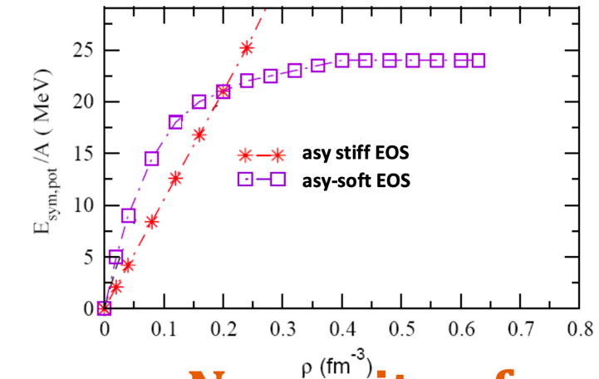
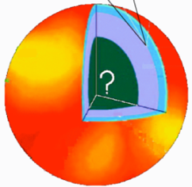
Importance of pygmy resonance
Implications beyond nuclear
structure of the low-lying E1
strength:
Possible impact on the
r-process nucleosynthesis
related to determination of nuclear symmetry energy (n rich matter)
can be used for neutron skin thickness determination (neutron stars)
r-process
exp
Theory
Symmetry term of EOS
Theory + Pygmy
S.Goriely, PLB, 436, 10 (1998)
From
n-skin thickness
to
n-star radius
11

Slide 21
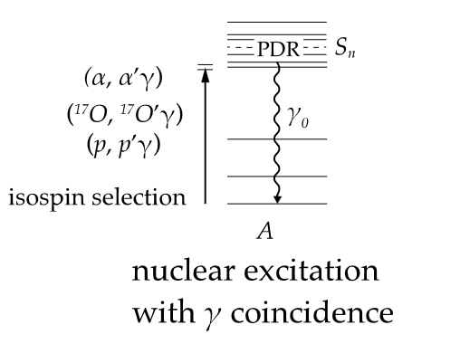
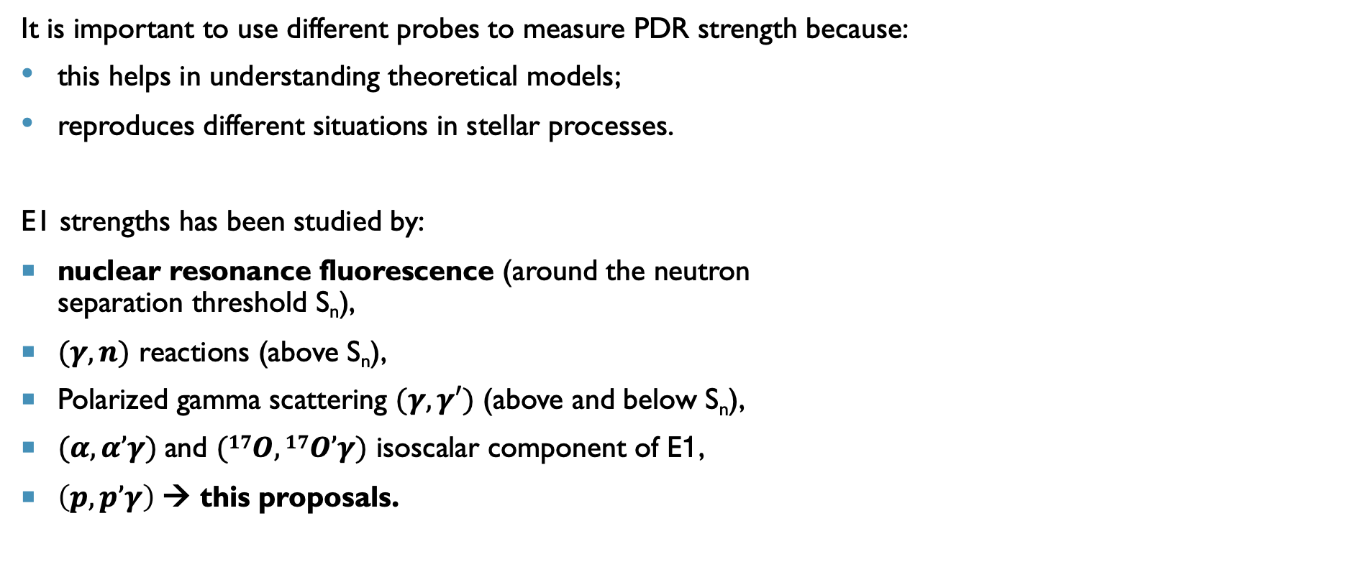
How to study Pygmy strength?
It is important to use different probes to measure PDR strength because:
this helps in understanding theoretical models;
reproduces different situations in stellar processes.
E1 strengths has been studied by:
nuclear resonance fluorescence (around the neutron
separation threshold S_{n}),
$(γ,n)$ reactions (above S_{n}),
Polarized gamma scattering $(γ,γ′)$ (above and below S_{n}),
$(α,α’γ)$and $(17O,17O’γ)$ isoscalar component of E1,
$\left(p,p’γ\right)$→ this proposals.
A. Bracco, et al., Phys. Progr. in Part. and Nucl. Phys,106, (2019), 360
12

Slide 22
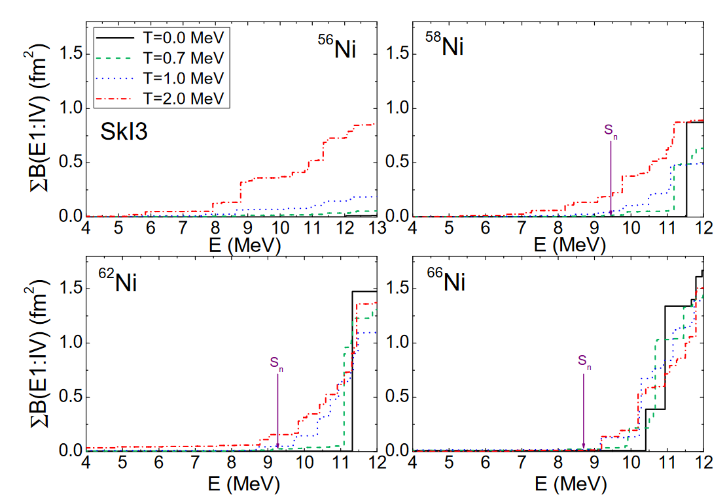
Pygmy in Nickel Chain
Why Ni chain?
PDR strength and position change as a function of the N/Z ratio
A lot of Ni isotopes are experimental available
Ni is part of the r-process
N/Z
E. Yüksel et al., Eur. Phys. J. A (2019) 55: 230
13

Slide 23
Pygmy in Nickel Chain
Why Ni chain?
PDR strength and position change as a function of the N/Z ratio
A lot of Ni isotopes are experimental available
Ni is part of the r-process
March- June 2024
N/Z
⁵⁸Ni is not far away from the N=Z
⁶²Ni N/Z = 1.21
E. Yüksel et al., Eur. Phys. J. A (2019) 55: 230
13

Slide 24
Pygmy in Nickel Chain
Why Ni chain?
PDR strength and position change as a function of the N/Z ratio
A lot of Ni isotopes are experimental available
Ni is part of the r-process
Febraury – November 2025
March- June 2024
N/Z
⁵⁸Ni is not far away from the N=Z
⁶²Ni N/Z = 1.21
⁶⁴Ni has the highest N/Z among stable nuclei
E. Yüksel et al., Eur. Phys. J. A (2019) 55: 230
13

Slide 25
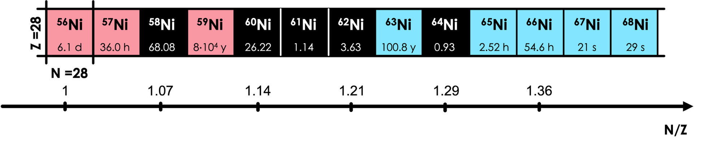
Complementary Experiments – Hot PDR
HOT-PDR: measurements at finite temperature
To build a nucleus with a T, fusion evaporation reactions are needed
Gamma yield from the CN decay.
Two campaigns at IFIN Romania: ⁵⁶Ni, ⁶⁰Ni, ⁶²Ni & ⁶⁴Ni, ⁶⁶Ni
³²S + ²⁴Mg
³⁴S + ²⁶Mg
³⁶S + ²⁶Mg
¹⁶O + ⁴⁸Ca
¹⁶⁸O + ⁴⁸Ca
⁶²Ni and ⁶⁴Ni were measured in both cases (T=0 & T>0)
13

Slide 26
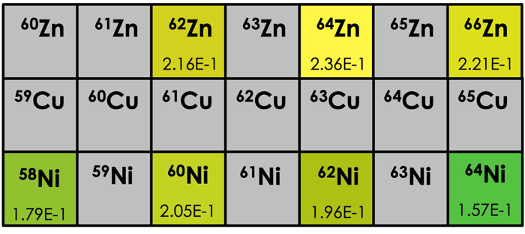
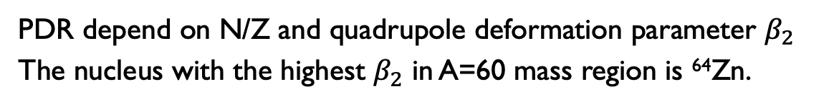
New Experiment: PDR in ⁶⁴Zn & ⁶⁶Zn
Why ⁶⁴Zn?
PDR depend on N/Z and quadrupole deformation parameter $β_{2}$
The nucleus with the highest $β_{2}$ in A=60 mass region is ⁶⁴Zn.
R. Massarczyk et al. Phys. Rev. Lett. 112, 072501 (2014)
14

Slide 27
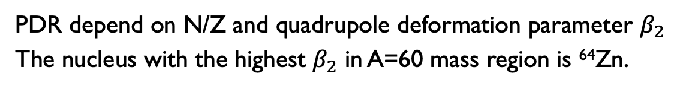
New Experiment: PDR in ⁶⁴Zn & ⁶⁶Zn
Why ⁶⁴Zn?
PDR depend on N/Z and quadrupole deformation parameter $β_{2}$
The nucleus with the highest $β_{2}$ in A=60 mass region is ⁶⁴Zn.
This year: from 15th May
In this case, too, a complementary experiment on HOT-PDR in Zn isotopes will be proposed at the IFIN-HH tandem.
R. Massarczyk et al. Phys. Rev. Lett. 112, 072501 (2014)
14

Slide 28
New Experiment: PDR in ⁶⁴Zn & ⁶⁶Zn
Why ⁶⁴Zn?
⁶⁶Zn has same N/Z of ⁶²Ni
PDR depend on N/Z and quadrupole deformation parameter $β_{2}$
The nucleus with the highest $β_{2}$ in A=60 mass region is ⁶⁴Zn.
This year: from 15th May
In this case, too, a complementary experiment on HOT-PDR in Zn isotopes will be proposed at the IFIN-HH tandem.
R. Massarczyk et al. Phys. Rev. Lett. 112, 072501 (2014)
14

Slide 29
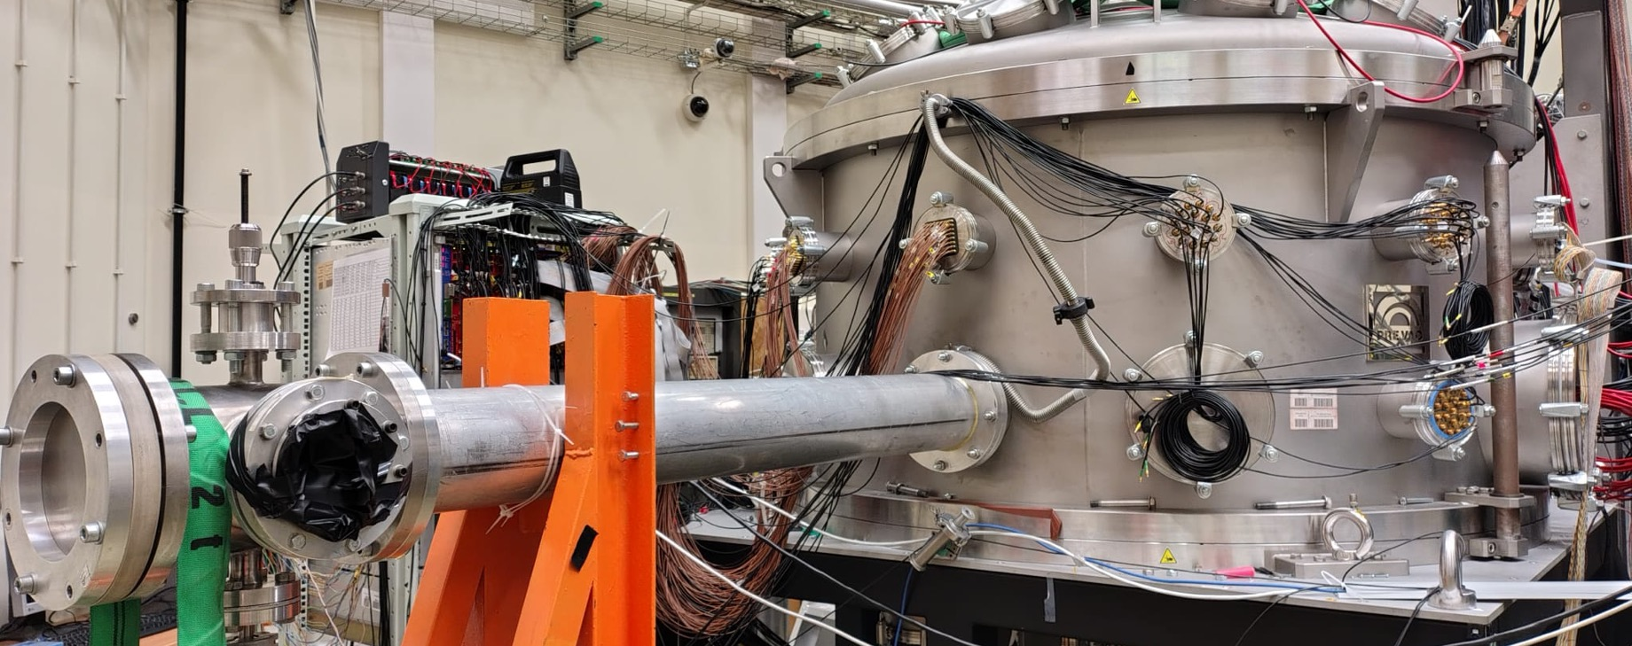
ExPERIMENTAL SETUP & tecnique
GQR & PDR using $(p,p^{′})$

Slide 30
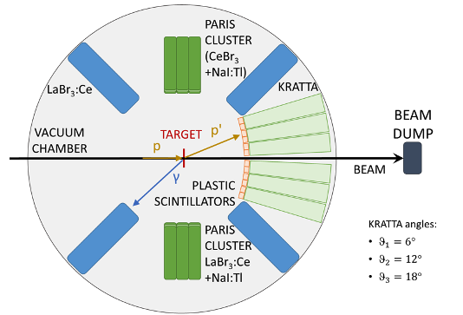
The Experimental SETUP
GQR TARGETs:
²⁰⁸Pb
¹²⁰Sn
PROTON BEAM:
155 MeV ²⁰⁸Pb
200 MeV ¹²⁰Sn
16

Slide 31
The Experimental SETUP
PDR TARGETs:
⁶⁴Ni 30 mg/cm² ⁶²Ni 100 mg/cm²
⁵⁸Ni 200 mg/cm²
⁶⁴Zn 80 mg/cm²
PROTON BEAM:
180 MeV
0.4 nA
16

Slide 32
The Experimental SETUP
PDR TARGETs:
⁶⁴Ni 30 mg/cm² ⁶²Ni 100 mg/cm²
⁵⁸Ni 200 mg/cm²
⁶⁴Zn 80 mg/cm²
PROTON BEAM:
180 MeV
0.4 nA
PARIS DETECTORS:
Phoswich
CeBr₃ or LaBr₃:Ce + NaI
Energy range up to 20 MeV.
4 LaBr₃:Ce
Size: 3.5” x 8”
16

Slide 33
The Experimental SETUP
PDR TARGETs:
⁶⁴Ni 30 mg/cm² ⁶²Ni 100 mg/cm²
⁵⁸Ni 200 mg/cm²
⁶⁴Zn 80 mg/cm²
PROTON BEAM:
180 MeV
0.4 nA
32 KRATTA TELESCOPES:
6 column of 5 detectos each
Resolution:
2 MeV (FWHM)
Angular resolution: 0.8°
PARIS DETECTORS:
Phoswich
CeBr₃ or LaBr₃:Ce + NaI
Energy range up to 20 MeV.
4 LaBr₃:Ce
Size: 3.5” x 8”
16

Slide 34
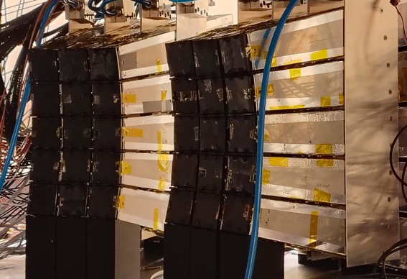
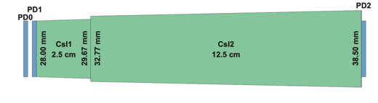


The SETUP KEY STRengths
PD2
LaBr₃:Ce + PARIS
CsI1
2.5 cm
CsI2
12.5 cm
Plastics
PD0
$$γ$$
p’
KRATTA TELESCOPES
+ PLASTIC Scintillators
PD1
p
17

Slide 35
The SETUP KEY STRengths
PD2
LaBr₃:Ce + PARIS
CsI1
2.5 cm
CsI2
12.5 cm
Plastics
PD0
$$γ$$
p’
KRATTA TELESCOPES
+ PLASTIC Scintillators
PD1
p
Key strengths of the setup:
Three-layer particle identification
Sub-nanosecond time resolution
Wide angular coverage
High efficiency
17

Slide 36



The experimental technique
p’
p
²⁰⁸Pb – ¹²⁰Sn
⁵⁸Ni - ⁶²Ni - ⁶⁴Ni
⁶⁴Zn - ⁶⁶Zn
$$γ$$
18

Slide 37
The experimental technique
p’
KRATTTA
p
²⁰⁸Pb – ¹²⁰Sn
⁵⁸Ni - ⁶²Ni - ⁶⁴Ni
⁶⁴Zn - ⁶⁶Zn
Proton gate → E_{p’}
$$γ$$
18

Slide 38

The experimental technique
p’
KRATTTA
p
²⁰⁸Pb – ¹²⁰Sn
⁵⁸Ni - ⁶²Ni - ⁶⁴Ni
⁶⁴Zn - ⁶⁶Zn
Proton gate → E_{p’}
$$γ$$
Large-volume
LaBr₃:Ce
$γ$ prompt
18

Slide 39

The experimental technique
p’
KRATTTA
p
²⁰⁸Pb – ¹²⁰Sn
⁵⁸Ni - ⁶²Ni - ⁶⁴Ni
⁶⁴Zn - ⁶⁶Zn
Proton gate → E_{p’}
$$γ$$
Large-volume
LaBr₃:Ce
$γ$ prompt
E* = E_{beam} - E_{p’}
18

Slide 40
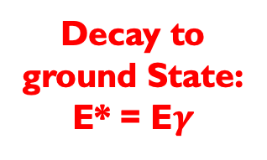
The experimental technique
p’
KRATTTA
p
²⁰⁸Pb – ¹²⁰Sn
⁵⁸Ni - ⁶²Ni - ⁶⁴Ni
⁶⁴Zn - ⁶⁶Zn
Proton gate → E_{p’}
$$γ$$
Large-volume
LaBr₃:Ce
Decay to ground State:
E* = E$γ$
$γ$ prompt
E* = E_{beam} - E_{p’}
18

Slide 41
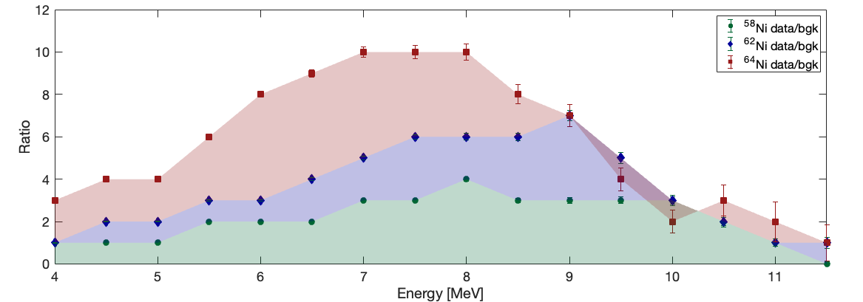
measumerement results: PDR in Ni Isotopes
⁵⁸Ni, ⁶²Ni preliminary results & ⁶⁴Ni online Results

Slide 42

Decay to the ground state: ⁶²Ni & ⁵⁸Ni
Plastic vs
LaBr₃:Ce
Time resolution Plastic vs LaBr₃:ce is about an 0.9 ns FWHM
$γ$ prompt
20

Slide 43
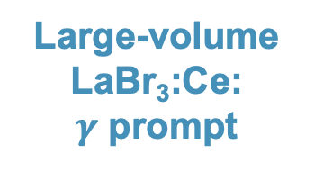
Decay to the ground state: ⁶²Ni & ⁵⁸Ni
⁶²Ni
Large-volume
LaBr₃:Ce:
$γ$ prompt
Plastic vs
LaBr₃:Ce
Time resolution Plastic vs LaBr₃:ce is about an 0.9 ns FWHM
$γ$ prompt
20

Slide 44
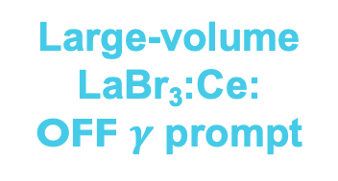
Decay to the ground state: ⁶²Ni & ⁵⁸Ni
⁶²Ni
Large-volume
LaBr₃:Ce:
$γ$ prompt
⁶²Ni
Large-volume
LaBr₃:Ce:
OFF $γ$ prompt
Plastic vs
LaBr₃:Ce
Time resolution Plastic vs LaBr3:ce is about an 0.9 ns FWHM
Background events shoud be subtracted from the data
$γ$ prompt
20

Slide 45
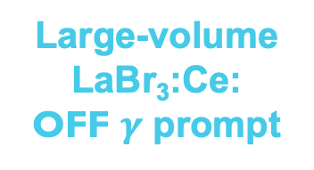
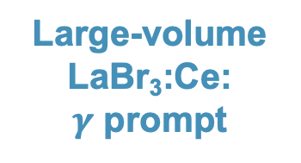
Decay to the ground state: ⁶²Ni & ⁵⁸Ni
⁶²Ni
Large-volume
LaBr₃:Ce:
$γ$ prompt
y-axis projection to extract the γ decay to the ground state
⁶²Ni
Large-volume
LaBr₃:Ce:
OFF $γ$ prompt
21

Slide 46
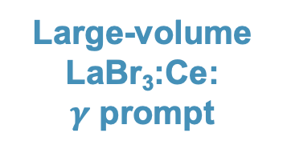
Decay to the ground state: ⁶²Ni & ⁵⁸Ni
⁶²Ni
Large-volume
LaBr₃:Ce:
$γ$ prompt
Large-volume
LaBr₃:Ce:
$γ$ prompt
y-axis projection to extract the γ decay to the ground state
⁶²Ni
Large-volume
LaBr₃:Ce:
OFF $γ$ prompt
21

Slide 47
Decay to the ground state: ⁶²Ni & ⁵⁸Ni
⁶²Ni
Large-volume
LaBr₃:Ce:
$γ$ prompt
Large-volume
LaBr₃:Ce:
$γ$ prompt
y-axis projection to extract the γ decay to the ground state
⁶²Ni
Large-volume
LaBr₃:Ce:
OFF $γ$ prompt
Large-volume
LaBr₃:Ce:
OFF $γ$ prompt
21

Slide 48
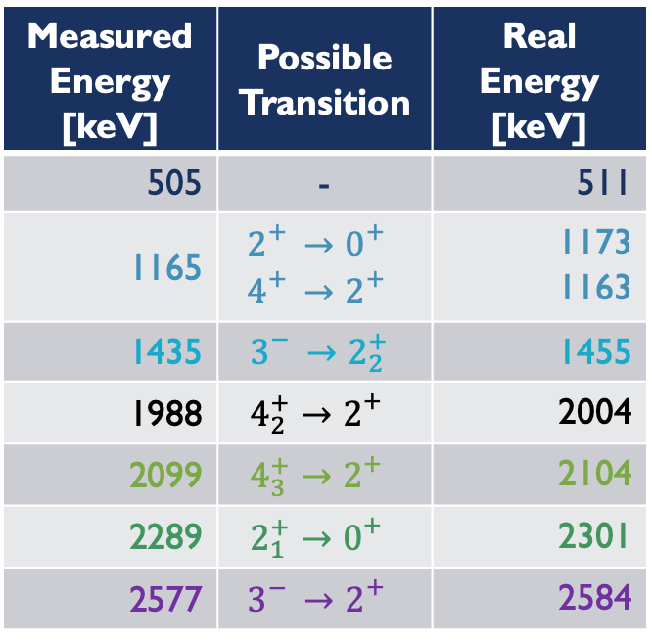
LaBr₃:ce: ⁶²Ni LOW ENERGY TRANSITIONS
The calibration need to be refined
Measured Energy [keV] | Possible Transition | Real Energy [keV]
505 | - | 511
1165 | $$2_{}^{+}→0_{}^{+}$$ $$4_{}^{+}→2_{}^{+}$$ | 1173 1163
1435 | $$3_{}^{−}→2_{2}^{+}$$ | 1455
1988 | $$4_{2}^{+}→2_{}^{+}$$ | 2004
2099 | $$4_{3}^{+}→2_{}^{+}$$ | 2104
2289 | $$2_{1}^{+}→0_{}^{+}$$ | 2301
2577 | $$3_{}^{−}→2_{}^{+}$$ | 2584
1173 keV
1163 keV
PRELIMINARY
2099 keV
2584 keV
511 keV
1455 keV
2099 keV
1988 keV
21

Slide 49
LaBr₃:ce: ⁶²Ni & ⁵⁸Ni HIGH ENERGY SPECTRA
⁶²Ni
N/Z = 1.21
Pygmy expected
Preliminary
Preliminary
16

Slide 50
LaBr₃:ce: ⁶²Ni & ⁵⁸Ni HIGH ENERGY SPECTRA
⁶²Ni
N/Z = 1.21
Pygmy expected
Preliminary
Preliminary
⁵⁸Ni
N/Z = 1.07
No Pygmy or negligible Pygmy expected
16

Slide 51
LaBr₃:ce: ⁶²Ni & ⁵⁸Ni HIGH ENERGY SPECTRA
⁶²Ni
N/Z = 1.21
Pygmy expected
Preliminary
Maurizio
Giunta’s
bachelor thesis
Preliminary
⁵⁸Ni
N/Z = 1.07
No Pygmy or negligible Pygmy expected
16

Slide 52
PDR in Ni Isotopes
Preliminary
Preliminary
The data for ⁶⁴Ni are based on a semi-online analysis.
Courtesy of M. kmiekic
22

Slide 53
PDR in Ni Isotopes
⁶²Ni & ⁶⁴Ni
N/Z = 1.21
N/Z = 1.29
Pygmy expected
Preliminary
Preliminary
The data for ⁶⁴Ni are based on a semi-online analysis.
Courtesy of M. Kmiekic
22

Slide 54
PDR in Ni Isotopes
⁶²Ni & ⁶⁴Ni
N/Z = 1.21
N/Z = 1.29
Pygmy expected
Preliminary
⁵⁸Ni
N/Z = 1.07
No Pygmy or negligible Pygmy expected
Preliminary
The data for ⁶⁴Ni are based on a semi-online analysis.
Courtesy of M. Kmiekic
22

Slide 55
PDR in Ni Isotopes
⁶²Ni & ⁶⁴Ni
N/Z = 1.21
N/Z = 1.29
Pygmy expected
Preliminary
Maurizio Giunta’s Bachelor
&
Kacper
Proszowski’s
Master
⁵⁸Ni
N/Z = 1.07
No Pygmy or negligible Pygmy expected
Preliminary
The data for ⁶⁴Ni are based on a semi-online analysis.
Courtesy of M. kmiekic
22

Slide 56

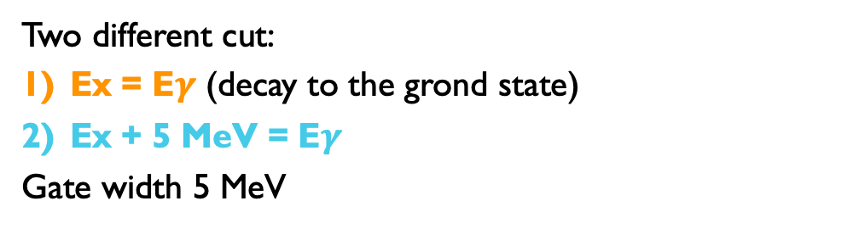
PDR DECAY to Ground state
⁶²Ni
Large-volume
LaBr₃:Ce:
$γ$ prompt
Two different cut:
Ex = E$γ$ (decay to the grond state)
Ex + 5 MeV = E$γ$
Gate width 5 MeV
23

Slide 57
PDR DECAY to Ground state
⁶²Ni
Large-volume
LaBr₃:Ce:
$γ$ prompt
Preliminary
Two different cut:
Ex = E$γ$ (decay to the grond state)
Ex + 5 MeV = E$γ$
Gate width 5 MeV
PDR decays to the ground state
23

Slide 58
⁶⁴Ni ONLINE Results
Evidence of discrete states with a selection on KRATTA small angles.
20° -27°
8° -17°
Preliminary
24

Slide 59
⁶⁴Ni ONLINE Results
Evidence of discrete states with a selection on KRATTA small angles.
20° -27°
8° -17°
Preliminary
24

Slide 60
⁶⁴Ni ONLINE Results
Evidence of discrete states with a selection on KRATTA small angles.
8° -17°
Preliminary
24

Slide 61
⁶⁴Ni ONLINE Results
Evidence of discrete states with a selection on KRATTA small angles.
8° -17°
Preliminary
24

Slide 62
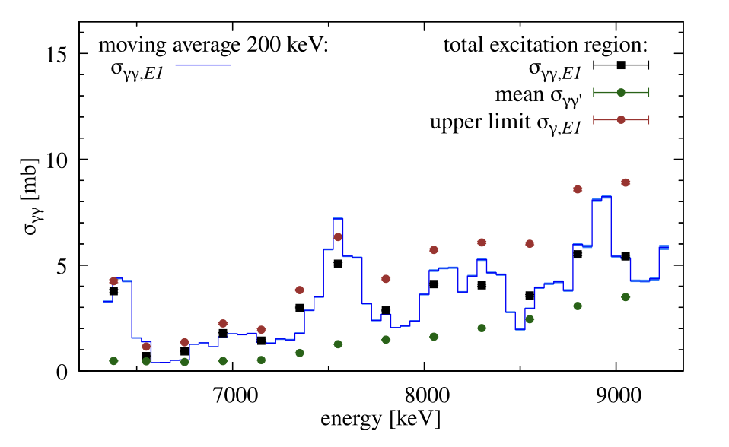
⁶⁴Ni ONLINE Results
Evidence of discrete states with a selection on KRATTA small angles.
At KRATTA small angle: structures at the same energy of literature. Other structures at lower energy.
8° -17°
Preliminary
M. Muescher et al Phys. Rev. C 109, 044318 (2024)
24

Slide 63
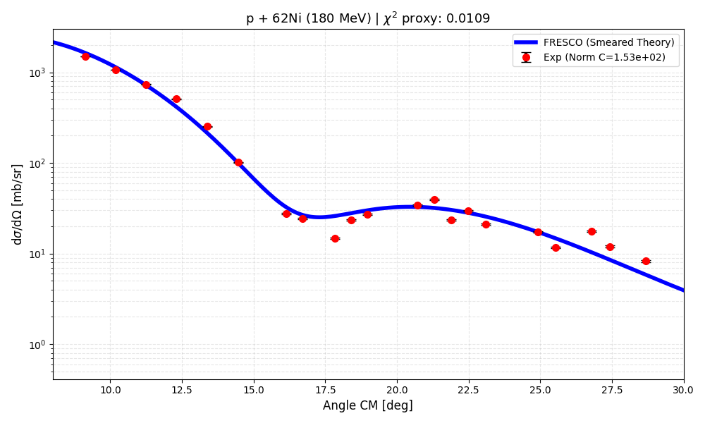
Elastic cross section
By using plastic angles, the elastic cross section can be reproduced over the angular range from 8° to 30°.
Preliminary
Courtesy of M. Ciemała
25

Slide 64

Elastic cross section
By using plastic angles, the elastic cross section can be reproduced over the angular range from 8° to 30°.
It was previously measured in Osaka for ⁵⁸Ni at 200 MeV. We can compare our data with those results.
Preliminary
Courtesy of M. Ciemała
Y. Takeda, Mem. Fac. Sci. Kyoto Univ., Ser. Phys., 44, 1, (2003)
25

Slide 65
Elastic cross section
By using plastic angles, the elastic cross section can be reproduced over the angular range from 8° to 30°.
It was previously measured in Osaka for ⁵⁸Ni at 200 MeV. We can compare our data with those results.
Preliminary
Courtesy of M. Ciemała
Y. Takeda, Mem. Fac. Sci. Kyoto Univ., Ser. Phys., 44, 1, (2003)
25

Slide 66




measumerement results: ISGQR in ¹²⁰Sn & ²⁰⁸Pb
¹²⁰Sn (p,p’$γ$) @ 200 MeV
GQR +GDR
ISGQR $γ$-DECAY

Slide 67


DECAY to The Ground State: ²⁰⁸Pb
At 155 MeV larger GQR excitation cross section than measured for 85 MeV
γ prompt
TOF [ns]
Random
background
Eγ [keV]
γ-decay to the g.s.
Eγ [keV]
E* [MeV]
Courtesy of M. Kimieck
27

Slide 68

DECAY to The Ground State: ²⁰⁸Pb
At 155 MeV larger GQR excitation cross section than measured for 85 MeV
γ prompt
TOF [ns]
3⁻
(2.6 MeV)
Random
background
2⁺ (4.1 MeV)
Eγ [keV]
pygmy
states
γ-decay to the g.s.
Counts (300 keV/ch)
GQR
GDR
Eγ [keV]
Preliminary
E* [MeV]
Eγ [keV]
Courtesy of M. Kimieck
27

Slide 69
DECAY to The Ground State: ²⁰⁸Pb
At 155 MeV larger GQR excitation cross section than measured for 85 MeV
γ prompt
TOF [ns]
3⁻
(2.6 MeV)
Random
background
2⁺ (4.1 MeV)
Piotr
Mroz’s
Master
Eγ [keV]
pygmy
states
γ-decay to the g.s.
Counts (300 keV/ch)
GQR
GDR
Eγ [keV]
Preliminary
E* [MeV]
Eγ [keV]
Courtesy of M. Kimieck
27

Slide 70

ISGQR Decay to Ground state: ²⁰⁸Pb
Comparison of the ISGQR decay measured at 85 MeV (preovius setup) and at 155 MeV (current setup)
GDR
Preliminary
GQR
B. Wasilewska et al. PRC 105, (2022) 014310
Courtesy of M. Kimieck
28

Slide 71
ISGQR Decay to Ground state: ¹²⁰Sn
¹²⁰Sn
Courtesy of S. Panwar
29

Slide 72

ISGQR Decay to Ground state: ¹²⁰Sn
¹²⁰Sn
Low Energy Part
1171 keV 2⁺→0⁺
Counts (2 keV/ch)
1229 keV 3⁻→2⁺
1023 keV 4⁺→2⁺
1294 keV 4⁺→2⁺
1472 keV 4⁺→2⁺
Eγ [keV]
Courtesy of S. Panwar
29

Slide 73
ISGQR Decay to Ground state: ¹²⁰Sn
¹²⁰Sn
Preliminary data 50% of statisctics
LaBr₃+Paris
High Energy Part
Low Energy Part
1171 keV 2⁺→0⁺
Preliminary
Counts (2 keV/ch)
1229 keV 3⁻→2⁺
1023 keV 4⁺→2⁺
1294 keV 4⁺→2⁺
1472 keV 4⁺→2⁺
Eγ [keV]
Courtesy of S. Panwar
29

Slide 74
ISGQR Decay to Ground state: ¹²⁰Sn
¹²⁰Sn
Preliminary data 50% of statisctics
LaBr₃+Paris
High Energy Part
GQR +GDR
Low Energy Part
1171 keV 2⁺→0⁺
Preliminary
Counts (2 keV/ch)
1229 keV 3⁻→2⁺
1023 keV 4⁺→2⁺
1294 keV 4⁺→2⁺
1472 keV 4⁺→2⁺
Eγ [keV]
Courtesy of S. Panwar
29

Slide 75




Elastic cross section: ²⁰⁸Pb & ¹²⁰Sn
DWBA calcualtions with FRESCO code
p + ²⁰⁸Pb @ 155 MeV
p + ¹²⁰Sn @ 200 MeV | $χ^{2}$/N = 0.0012
36.755)
${dσ}/{dΩ}$ [mb/sr]
Preliminary
Preliminary
Theta [deg]
Courtesy of M. Ciemała
30

Slide 76

Comparison with osaka data
It was previously measured in Osaka for ¹²⁰Sn at 200 MeV (same nucleus and same energy). We can compare our data with those results.
Courtesy of M. Ciemała
31

Slide 77
Comparison with osaka data
Osaka
It was previously measured in Osaka for ¹²⁰Sn at 200 MeV (same nucleus and same energy). We can compare our data with those results.
Krakow
Preliminary
Courtesy of M. Ciemała
31

Slide 78



γ-ray angular distribution
The plaastic detector granularity allows us to extract the angular distribution (transition character).
$$γ$$
$$θ$$
p
p’
Courtesy of M. Ciemała
32

Slide 79

γ-ray angular distribution
The plaastic detector granularity allows us to extract the angular distribution (transition character).
$$γ$$
Preliminary
$$θ$$
p
p’
Courtesy of M. Ciemała
32

Slide 80
Summary
PDR in Ni isotopes and ISGQR γ-decay in ¹²⁰Sn and ²⁰⁸Pb measured via proton inelastic scattering at CCB Kraków
Experimental setup presented
  highlighting key strengths
PDR – preliminary results:
  PDR strength increases with N/Z
  High-energy γ rays observed only after angular selection
ISGQR γ-decay – preliminary results
TAKE HOME MESSAGE: The setup demonstrates strong potential for these studies, while the results remain preliminary due to ongoing data analysis.
33

Slide 81
Prespectives
Wide angular coverage
  extraction of γ-transition character and PDR and GR character
PARIS array
  access to γ-ray polarization information
New experiment started on May 15th
  PDR in Zn isotopes as a function of deformation
New proposal
  study of GR in excitation-energy spectra (no γ detectors required)
Theoretical calculations (E. Lanza)
  interpretation of the experimental results
34

Slide 82



Collaborators
INFN and Uni Milano (Italy): A. Giaz, O. Wieland, F. Crespi,
G. Benzoni, S. Bottoni, A. Bracco, S. Brambilla, F. Camera, F. Conca,
G. Corbari, D. Genna, M. Giunta, S. Leoni, M. Luciani, B. Million,
IFJ PAN Krakow (Poland): M. Ciemała, M. Kmiecik, P. Bednarczyk,
N. Cieplicka-Orynczak, B. Fornal, K. Gajewska, J. Grębosz, M. Krzysiek, P. Kulessa J. Łukasik, A. Maj, M. Matejska-Minda, K. Mazurek, P. Mroz, S. Panwar, P. Pawłowski, K. Proszowski, B. Sowicki, M. Ziębliński,
University of Groningen (The Netherlands):
M.N. Harakeh,
INFN LNL e Uni Padova (Italy): M. Balogh,
D. Stramaccioni, J.J. Valiente-Dobon
GANIL (France): M. Lewitowicz,
IJCLab Orsay (France): A. Dey, C. Hiver, I. Matea, J. Wilson,
CEA Saclay (France): P. Miriot-Jaubert, M. Vandebrouck,
SLCJ UW (Poland): K. Hadyńska-Klęk, P. Napiorkowski,
USTHB Algiers (Algeria): N. Benouaret,
Ithemba (South Africa): R. Neveling, L. Pellegri,
IFJ PAN Krakow (Poland) & IPHC Strasburg (France):
C. Schmitt,
ELI-NP Bucharest: D. Balabanski, A. Kusoglu, P-A Söderström,
R. S. Ban,
IKP Cologne (Germany): A. Bohn, A Zilges.
NIPNE Bucharest: M. Stanoiu,
RCNP Osaka: A. Tamii,
TU Darmstadt: J. Isaak,
INFN Catania: E. Lanza.
35

Slide 83

Thank you for the attention!

Slide 84
Backup slides

Slide 85





Polarization measurements with PARIS
Parity distinction:
On basis of scattering ratio vertical ($⊥$PARIS) horizontal ($⊥$PARIS)
//PARIS
$⊥$PARIS
Paris Cluster 1
Paris Cluster 2
37

