Slide 1

Measurements and Modeling of ⁹³Nb(n,xn𝛾)
Keenan E. J. Myers
Department of Nuclear Engineering
University of California - Berkeley
https://nucleardata.berkeley.edu

Slide 2
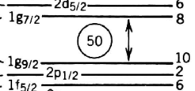
Why Study Niobium?
Several Applications
Superconducting magnets
Fusion power systems
Radiochemical Tracer¹
Long-lived states populated by single-step reactions
Ground state at spin from g 9/2
Inelastic reactions allow us to prove the distribution of spin
135.5 keV
10.15 day
(2)+
30.8 keV
16.12 y
½-
92Nb 7+
3.47E+7 y
93Nb 9/2+
681.7 keV
3.19 hr
7+
90Y
2-
64.053 hr
1 D.R. Nethaway THE ⁹³Nb(n,2n) ^{92m}Nb CROSS SECTIONS (1977)
Notes:
edit motivation

Slide 3
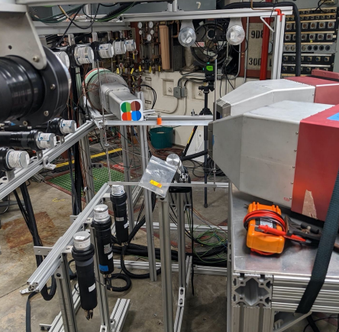
Gamma Energy Neutron Energy Spectrometer for Inelastic Scattering - GENESIS
Located at the 88-Inch Cyclotron GENESIS¹ uses a beam of neutrons generated through Thick Target Deuteron Break-up Neutron Source providing a pulsed broad spectrum of neutrons allowing for time of flight energy measurements²
¹ J.M. Gordon et al. NIM A1061 (2024) 169120.
https://doi.org/10.1016/j.nima.2024.169120
² J.T. Morrell et al. PRC 108, 024616 (2023).
https://doi.org/10.1103/PhysRevC.108.024616

Slide 4
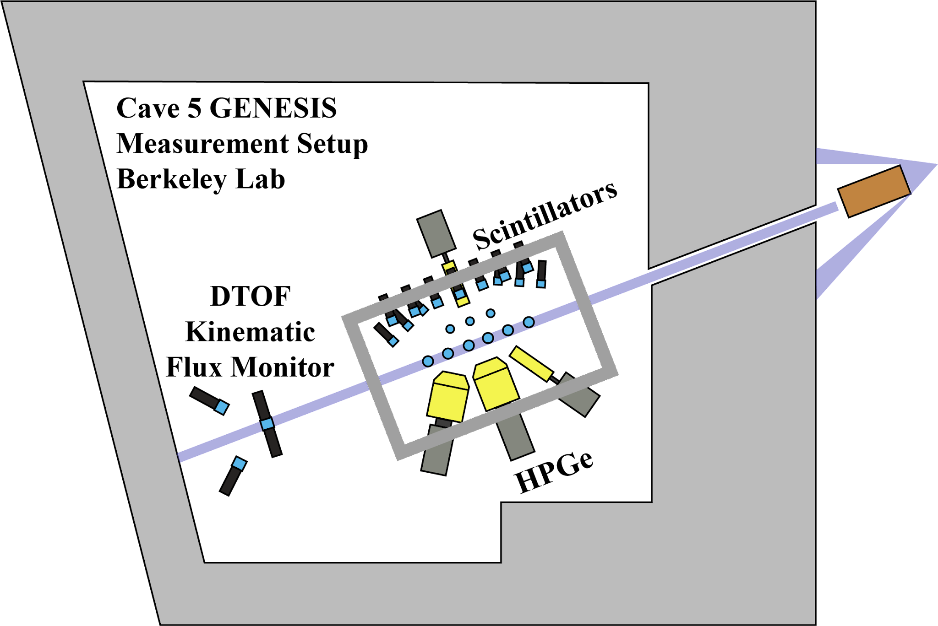
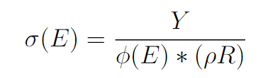
The 88-Inch Cyclotron at LBNL
Cyclotron accelerator facility
For our experiments, the 88-Inch cyclotron accelerates deuterons for thick target deuteron break up
Provides a pulsed neutron source and RF signal as characterized by Jon Morrell¹
88” Cyclotron
Neutron Monitor
Morrell, J. (2021). Next-Generation Isotope Production via Deuteron Breakup [PhD Dissertation]. UC Berkeley.
Notes:
John Morrell, thesis work characterizing TTDB also worked towards
breakup (via proton stripping), compound fusion evaporation reactions, and pre-equilibrium reactions.

Slide 5
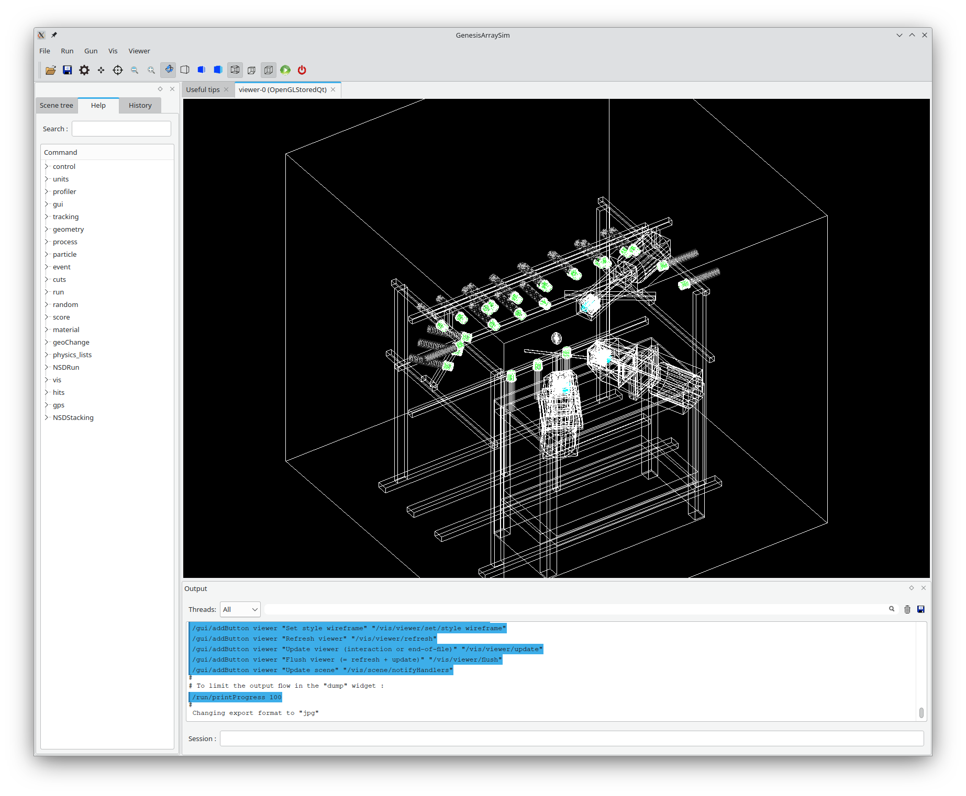
Experiment
10 days of beam in 2023
7 Days with the target
3 days of blank
Oval shaped to maximize mass in the beam line
26 Organic Scintillators
3 High Purity Germanium Clovers

Slide 6
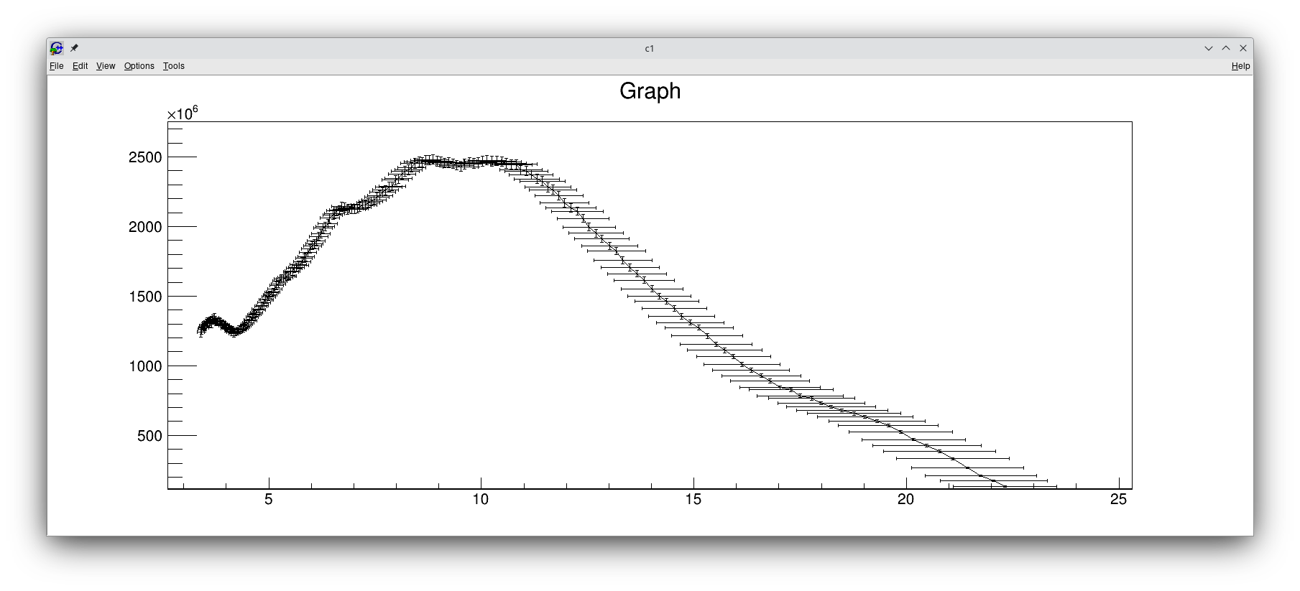
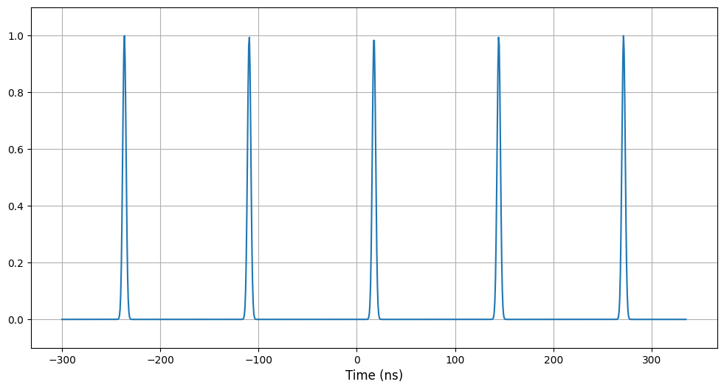
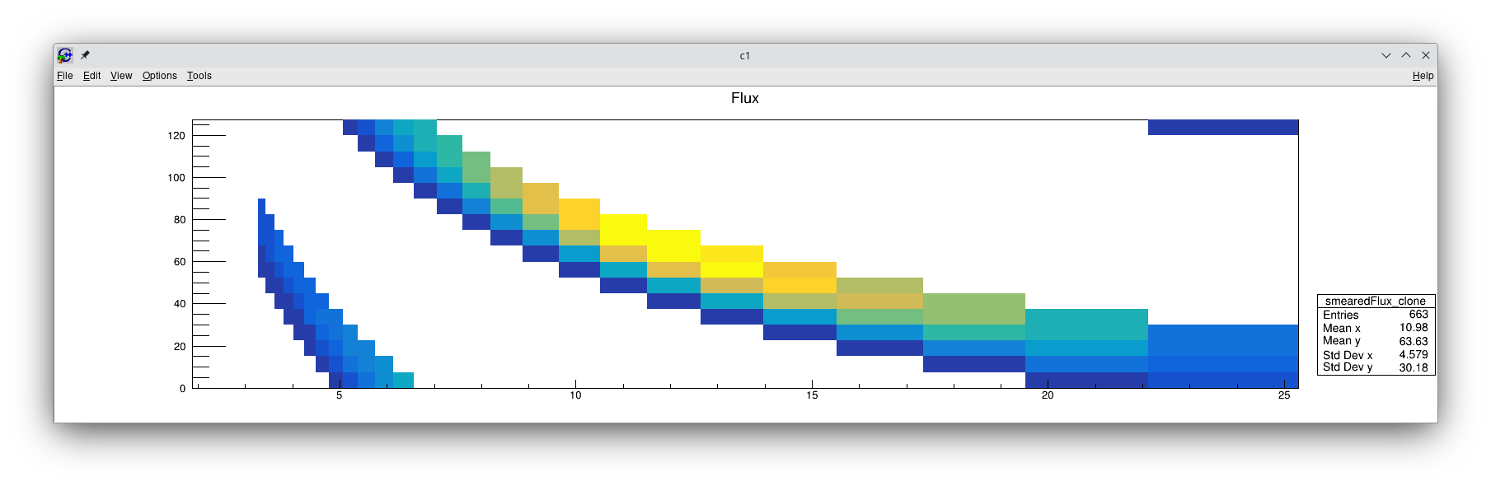
Incident Neutron Energies
Neutron Spectrum
We experience multiple incident neutron energies at a given time, we call this frame overlap
Due to this, we require a neutron flux matrix
Flux (n/uC/Sr/MeV)
5
10
15
20
25
Neutron Energy
Demonstration of RF signal
120
100
80
Time Since RF (ns)
60
40
20
0
0
5
10
15
20
Neutron Energy (MeV)
Notes:
our flight path is about 7.3m long
this gives us the need to prepare our observables in terms of multiple energies,
so how do that, lets start with gamma

Slide 7
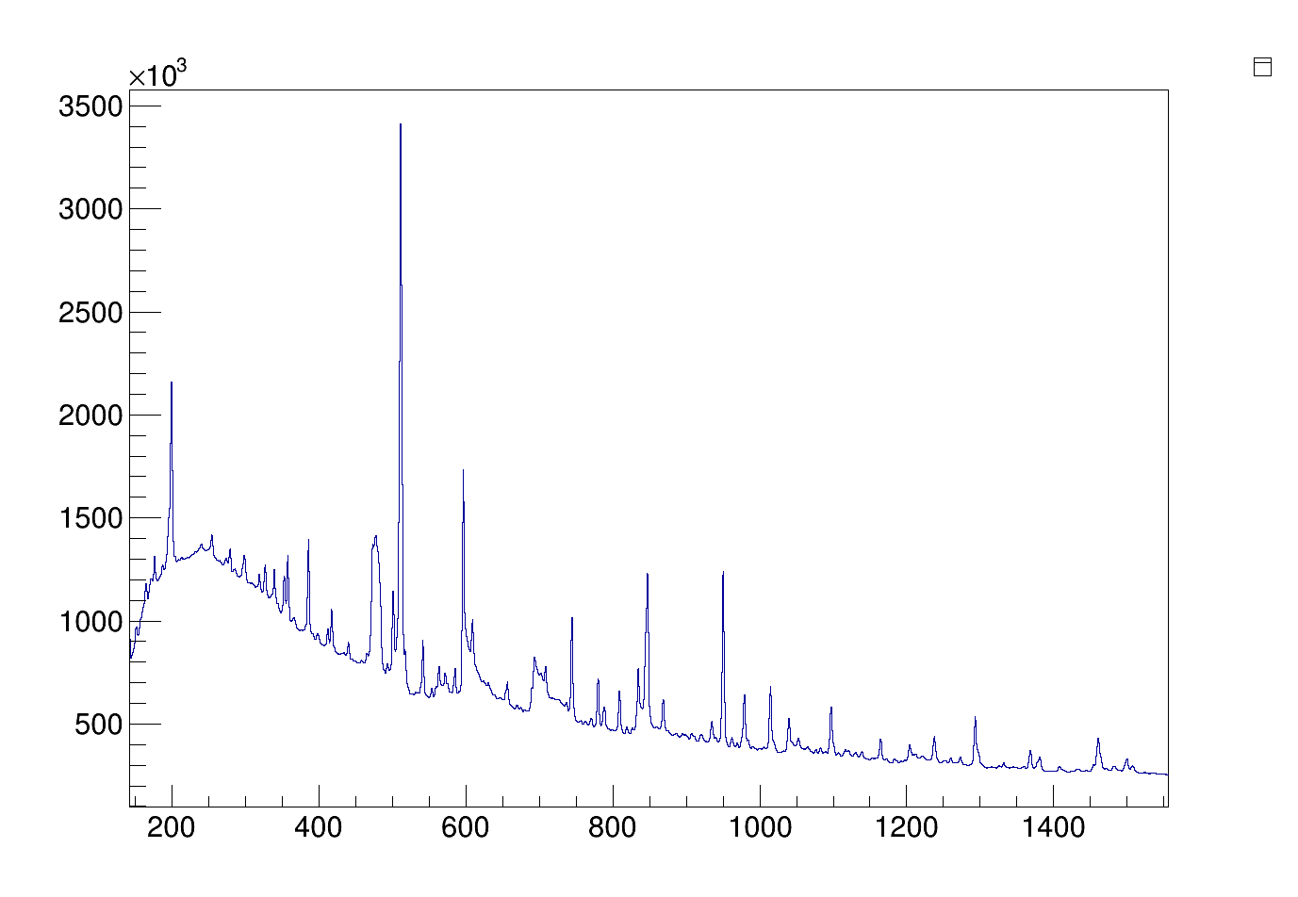
Niobium Spectra
(n,2n)
(n,𝛄n’)
(n,𝛄n’)
(n,2n)
Counts
(n,𝛄n’)
(n,𝛄n’)
(n,2n)
(n,𝛄n’)
Energy keV
Notes:
this spectra needs to be processed, background subtraction time slices, how do we facilitate that

Slide 8
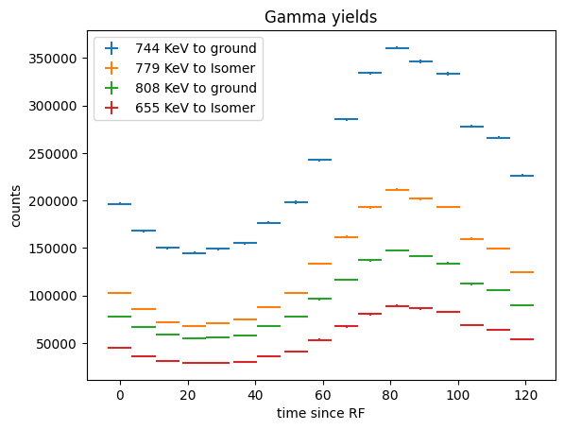
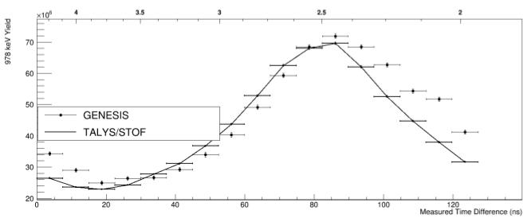
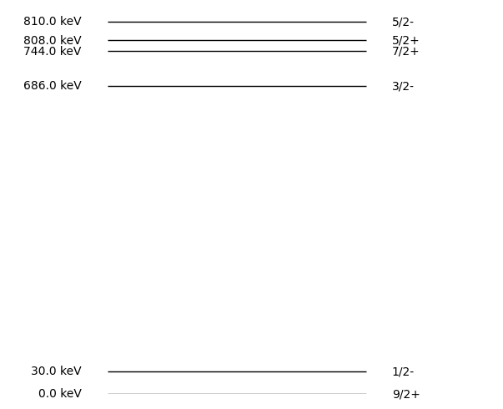
⁹³Nb Gamma Yields
Fitting Each time slice provides us with gamma yields as a function of time
Counts
120
100
Time Since RF (ns)
80
Time Since RF (ns)
60
40
20
0
0
5
10
15
20
Neutron Energy (MeV)
Notes:
2 even electric
2 odd magnetic

Slide 9
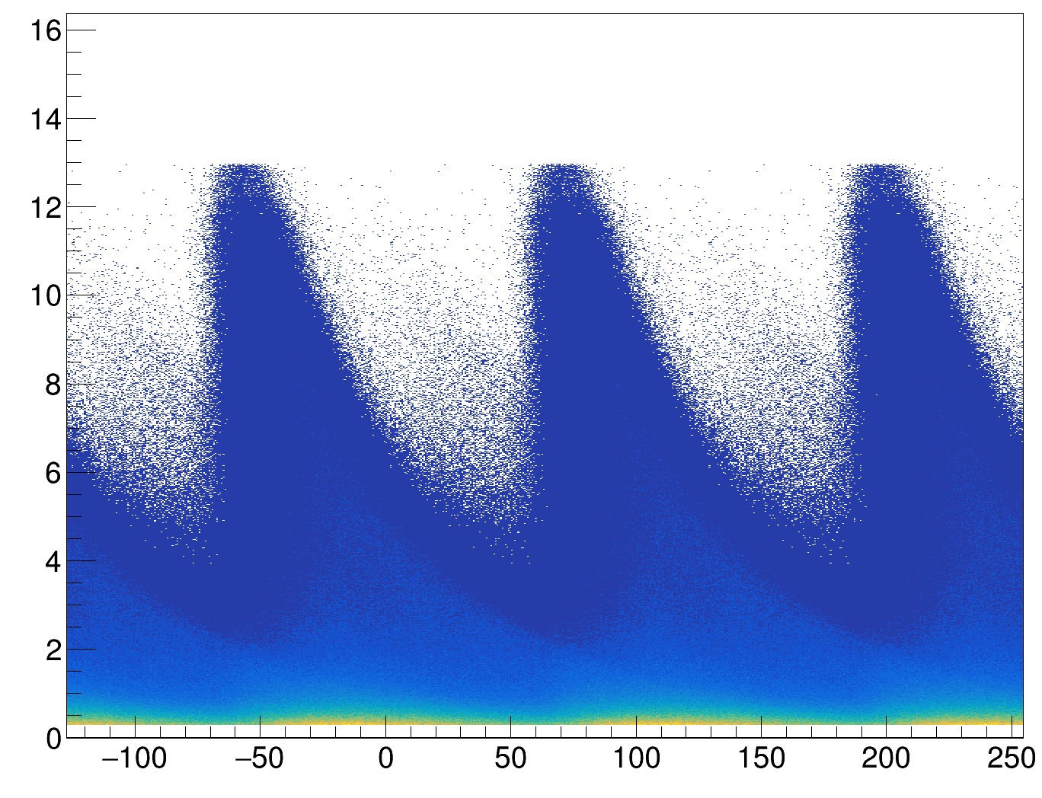
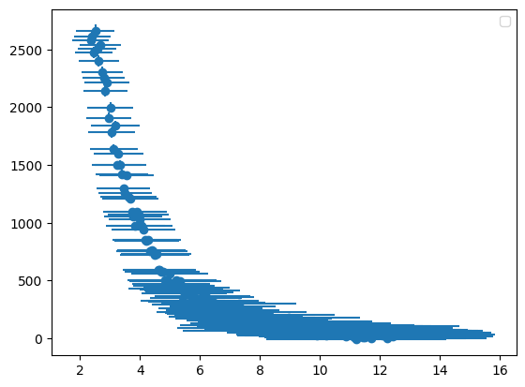
Neutron Observables
For Neutrons what we observe is light yield as a function of total time of flight this can be modeled with an array response function
additionally we can observe ToF from correlated neutron-gamma events to extract neutron energy
Light yield (MeVee)
Neutron Energy (MeV)
TToF (ns)

Slide 10
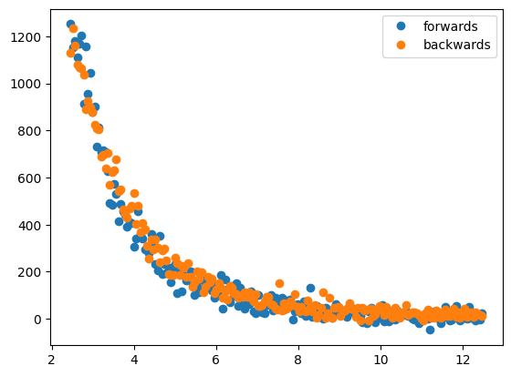
Outgoing Neutron Energy and Angle
Selection of individual detectors allows us to select specific angles to observe angular impacts of
Counts
Neutron Energy (MeV)

Slide 11
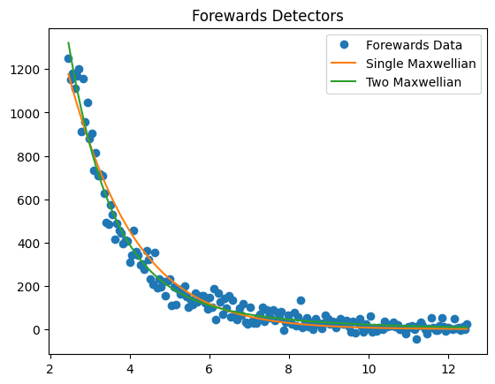
Nuclear Temperature
We can fit a Maxwellian to the outgoing neutron energies allowing us to estimate temperature
Fitting two Maxwellians provide a better fit than single Maxwellians as well as providing a primary temperature of 877 KeV (97%)and a secondary temperature of 2480 KeV (3%)
Counts
Neutron Energy (MeV)

Slide 12
Modeling With CoH3
CoH3 is being used for our model predictions
CoH3 is a Hauser-Feshbach Modeling code
written at Los Alamos it used for evaluation of nuclear data
combining CoH3 predictions with array responses we are able to perform forward modeling calculations
CoH3 Calculation:
LD/nOMP
Array Response:
Neutron and gamma response
GENESIS Gamma Data:
Neutron Light yield, gamma peak yields
Predicted Observable: Neutron light yield vs TOF and Gamma yield vs TOF
𝝌² minimization

Slide 13
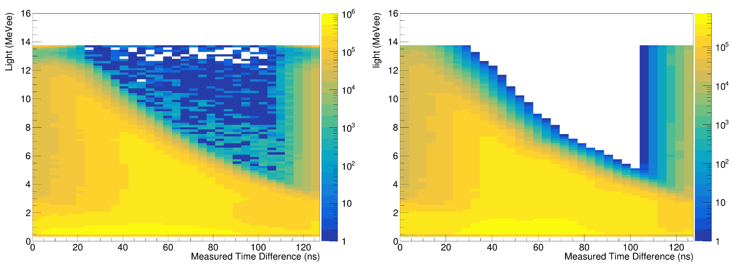
Neutron ToF Modeling
using array response and flux convolved with model prediction we are able to predict the light yield observed in each detector
Experimental Data
Model Prediction

Slide 14
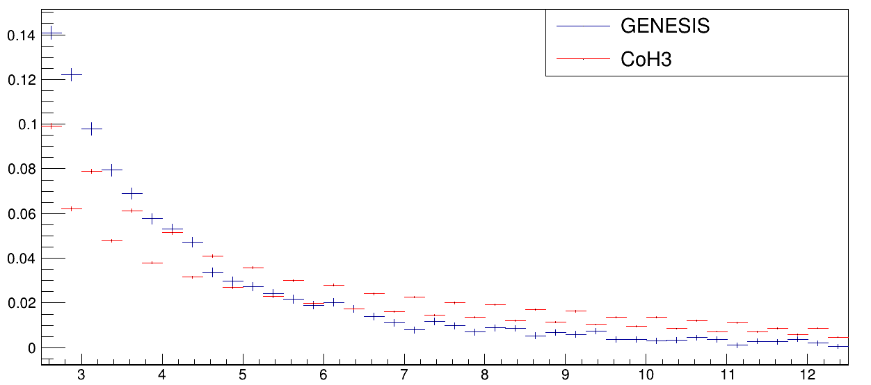
Outgoing Neutron Energy Model
By ignoring elastic scattering we are able to compare modeled outgoing neutron energies with observed, this is new functionality
Relative Neutron Counts
Neutron Energy (MeV)

Slide 15
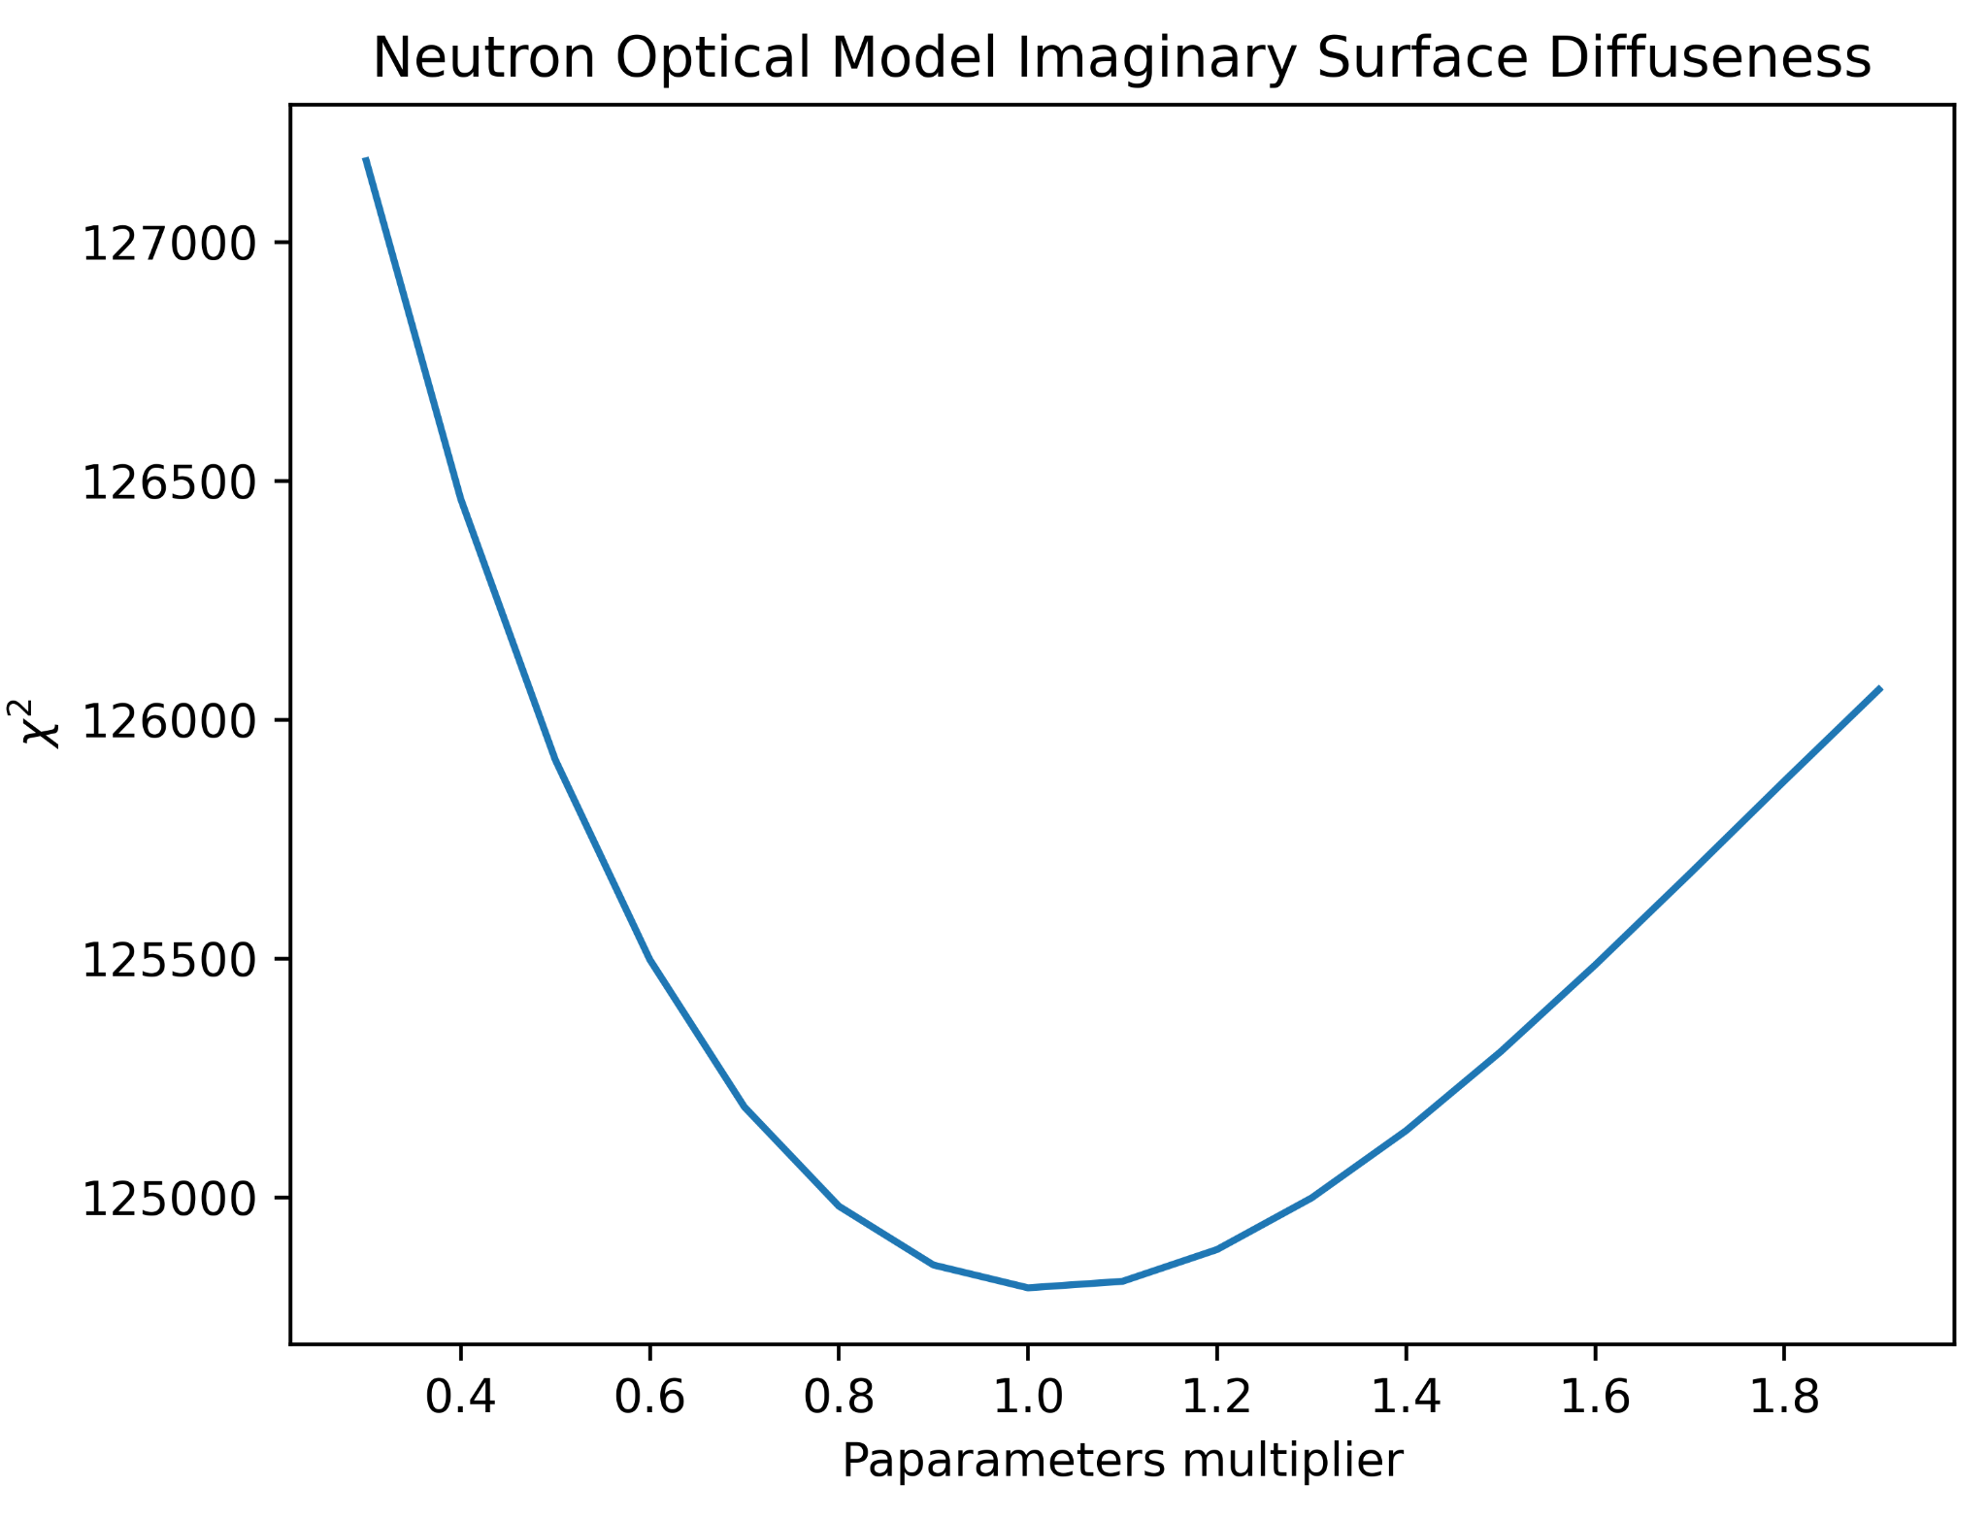
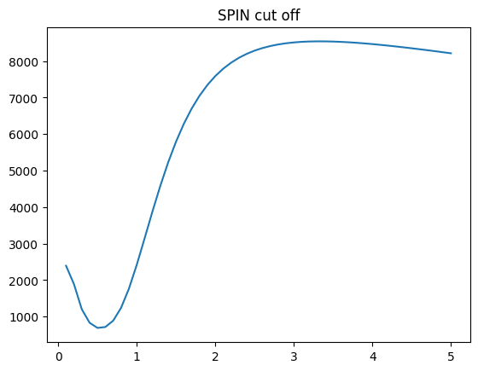
comparing predictions as we tweak values
scanning over individual terms allows us to select terms for minimization
Looking primarily at neutron optical terms with neutrons
Gamma data is used to primarily fix the level density terms
Parameter multiplier
ꭓ²
Parameter multiplier

Slide 16
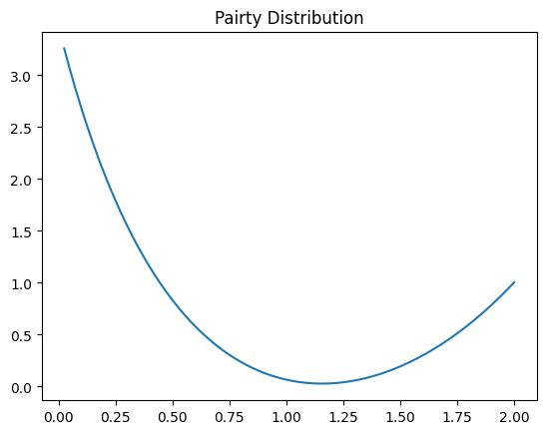
CoH Expanded Capabilities
CoH3 allows for tweaking the distribution of parities in the continuum
Comparing the ratio of the strongest gamma from a negative state and a positive state to show the impact of this parameter
779 KeV (810 KeV 5/2-)
808 KeV (808 KeV 5/2+)
ꭓ²
Parameter multiplier

Slide 17
CoH Parameter Optimization Strategy
Modeling for minimization has focused on efficiency adjusted ratios of gamma yields
CoH provides the ability to minimize against the parity distribution in the quasi-continuum
Neutron modeling has explored both absolute neutron modeling as well as ratios between different angled detectors
Additionally work is being done to compare CoH3 to Talys minimizations
Current additional efforts are underway to minimize against outgoing neutron energy

Slide 18



Collaborators On the work shown today
J.A. Brown¹, L. A. Bernstein^{1,2} ,
J.M. Gordon², B.L. Goldblum^{2,1} T. Laplace¹,
J. Morrell¹, K. Myers¹, S. M. Tannous¹, D.L. Bleuel³
¹ University of California-Berkeley Dept. of Nuclear Engineering
² Lawrence Berkeley National Laboratory
²Lawrence Livermore National Laboratory
Work supported by the Stewardship Academic Alliance Grant at UC Berkeley
^{Award Grant DE-NA-0004064}
Notes:
eddit

