Slide 1
Uranium 238 Neutron Scattering and Fission Yield Measurements
Speero Milad Tannous
10th Workshop on Nuclear Level Density and Gamma Strength
https://nucleardata.berkeley.edu

Slide 2
Why ²³⁸U?
²³⁸U and the fission process is important to many applications.
Astrophysics (It’s in space somewhere)
Thermal Nuclear Reactors
Fast Nuclear Reactors
Superfast (thermo)Nuclear Reactors

Slide 3
Our Experiments
An inelastic scattering experiment aimed at resolving differences in partial γ-production cross-sections
2. A new fission experiment to look at γ-production
distributions in ²³⁸U fission products

Slide 4
Our Experiments
An inelastic scattering experiment aimed at resolving differences in partial γ-production cross-sections
2. A new fission experiment to look at γ-production
distributions in ²³⁸U fission products

Slide 5
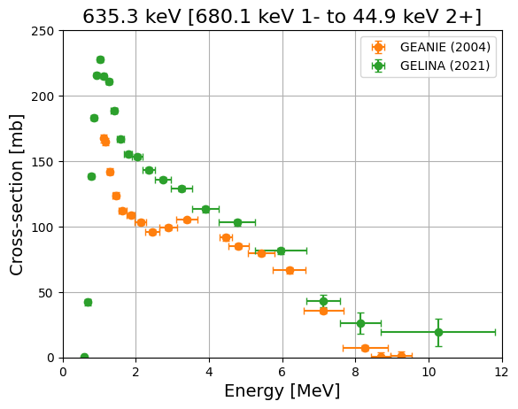
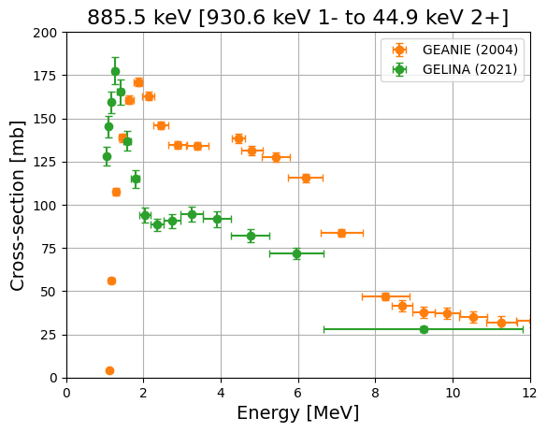
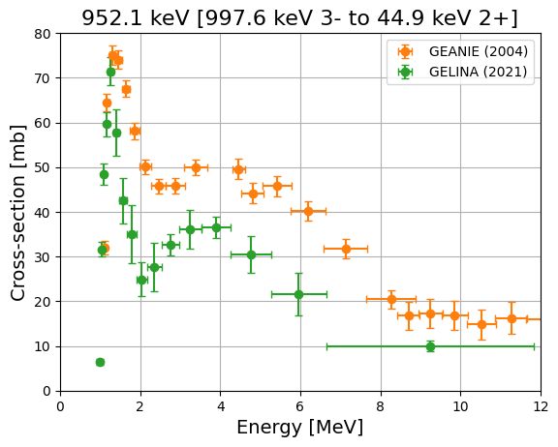

Previous Partial Gamma (n,n’) Measurements
997.6 keV 3⁻
________
930.6 keV 1⁻
________
680.1 keV 1⁻
________
518.1 keV 8⁺
________
307.2 keV 6⁺
________
148.4 keV 4⁺
________
44.1 keV 2⁺
________
0.0 keV 0⁺
________
²³⁸U
1. N. Fotiades et al. Measurements and Calculations of U-238(n,xng) Partial Gamma-ray Cross Sections. Physical Review C, 69(2), February 2004.
2. M. Kerveno et al., Measurement of ²³⁸U(𝑛,𝑛′⁢𝛾) Cross Section Data and their Impact on Reaction Models. Phys. Rev. C 104, 044605 (2021).
Notes:
Combo of coax and planar (planar have higher energy res)
Neutrons from 800 Mev proton spallation tungsten
20 meter flight path
% neutron res

Slide 6
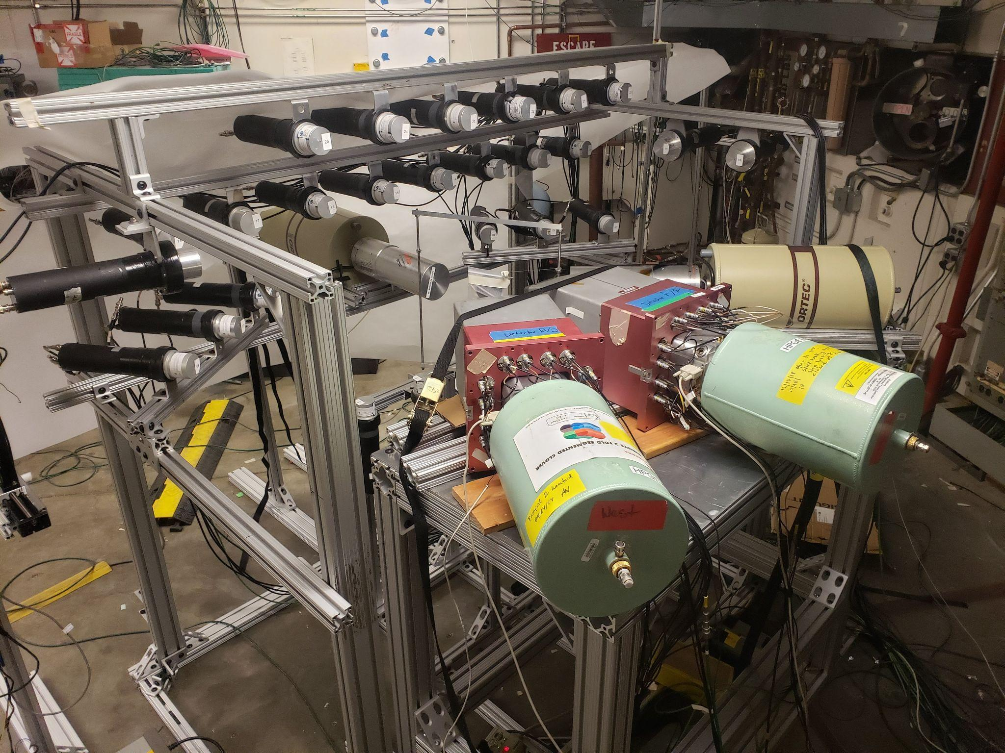
Gamma Energy Neutron Energy Spectrometer for Inelastic Scatter - GENESIS 2.0
26 EJ-309 Liquid Scintillators
2 HPGe Clovers
Notes:
POPTOPS have much worse timing and energy res

Slide 7
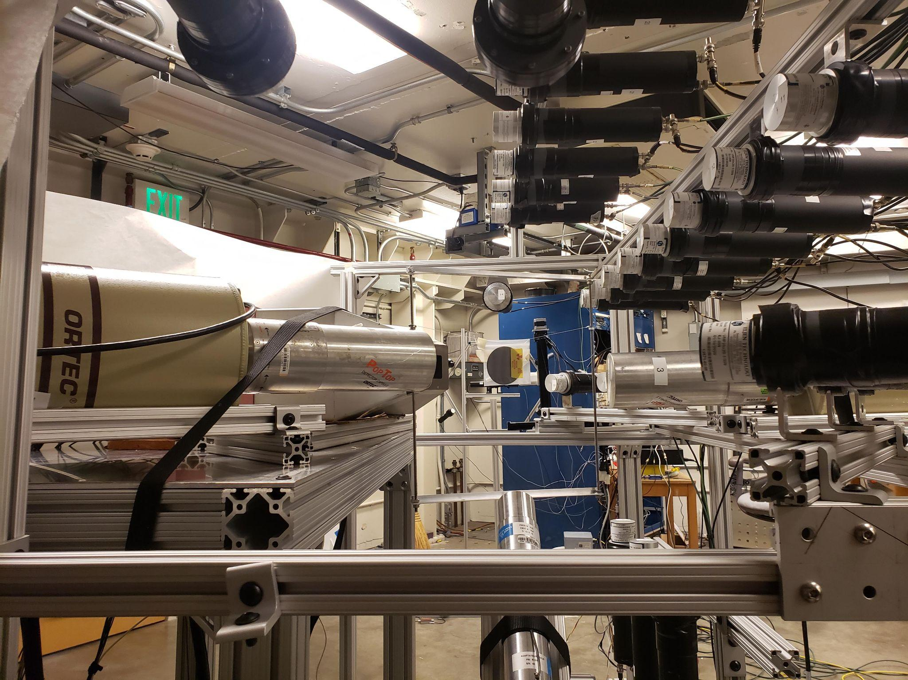
Our Experiment to Measure Partial Gamma Production Cross-sections
10 days experiment from 3/31-4/9/21
14 MeV deuteron beam
54 gram circular natural uranium target
108 hours on uranium target
Flux determined by double TOF spectrometer

Slide 8
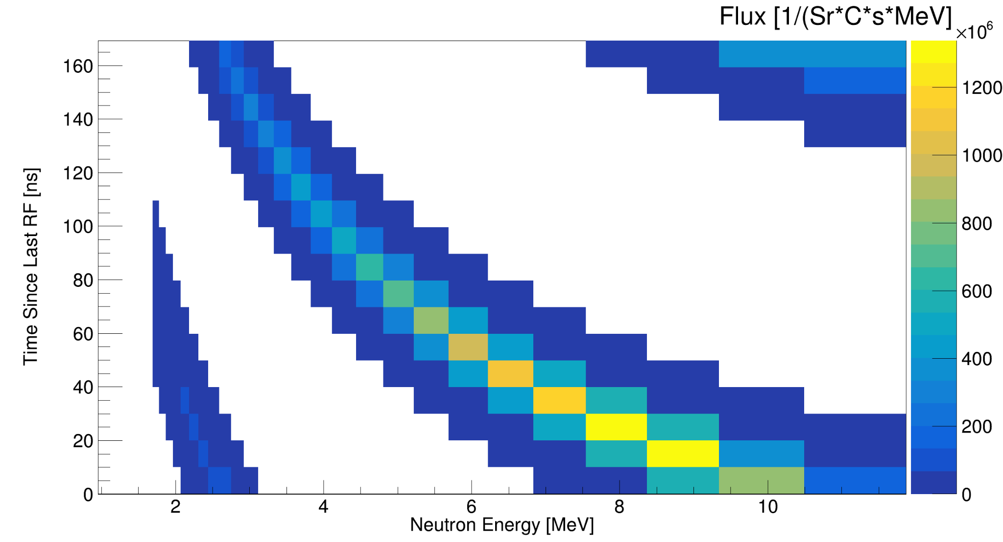
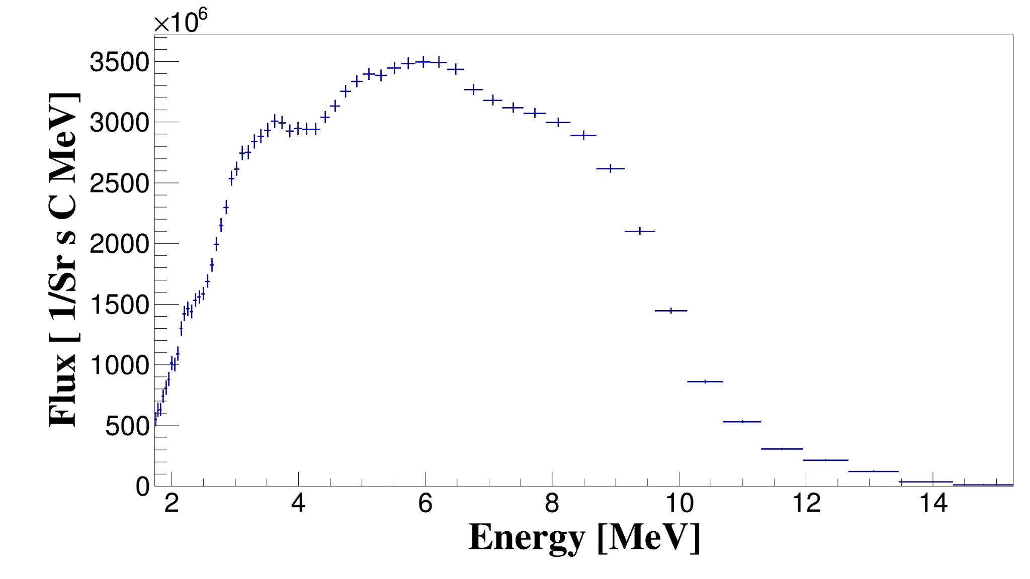
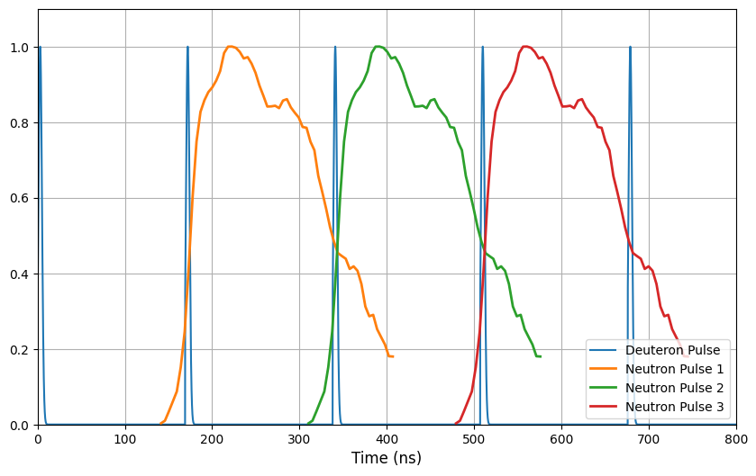
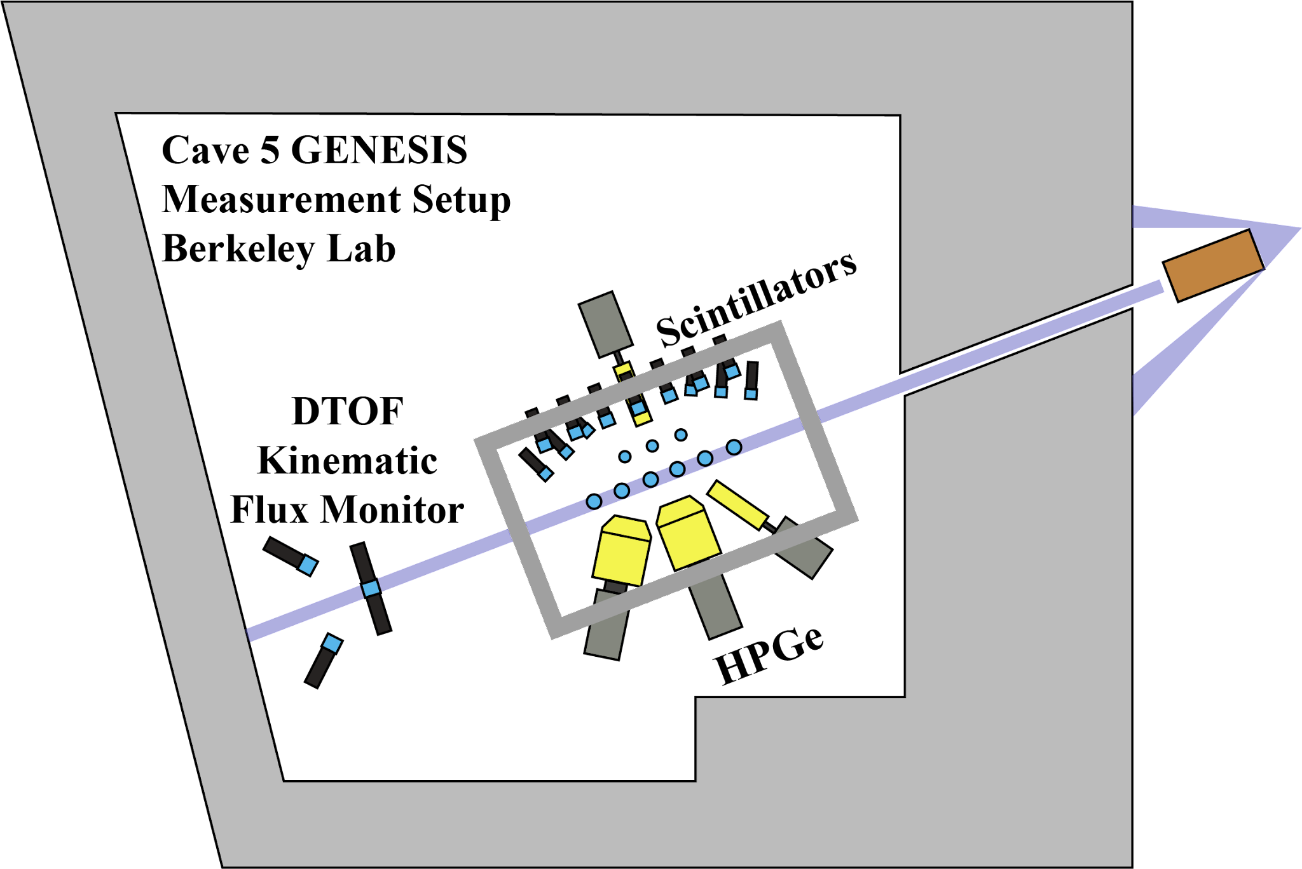
Neutron Beams at the 88” Cyclotron
Flux [1/(Sr*uC*MeV)]
Time since Last RF [ns]
Flux [n/(Sr uC MeV)]
Flux [n/(Sr uC MeV)]
Energy [MeV]
Neutron Energy [MeV]
88” Cyclotron
Time [ns]
Neutron Monitor
Notes:
The carbon breakup process forms a range of neutron energies for each deuteron pulse

Slide 9
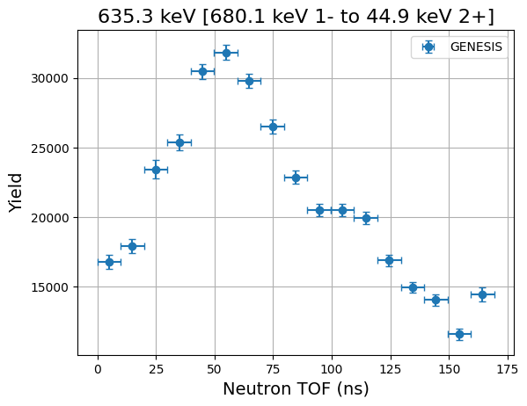
What GENESIS Measures - Yields!
Flux [1/(Sr*uC*MeV)]
Time since Last RF [ns]
Gamma Yield
Neutron Energy [MeV]
Time since Last RF [ns]

Slide 10
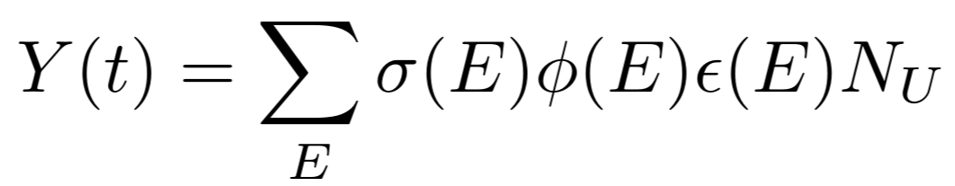
Bringing GEANIE and GELINA Measurements into Time of Flight Space
Flux [1/(Sr*uC*MeV)]
Time since Last RF [ns]
Neutron Energy [MeV]

Slide 11
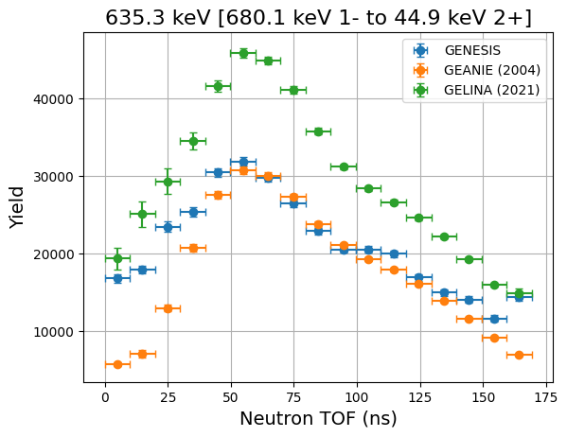
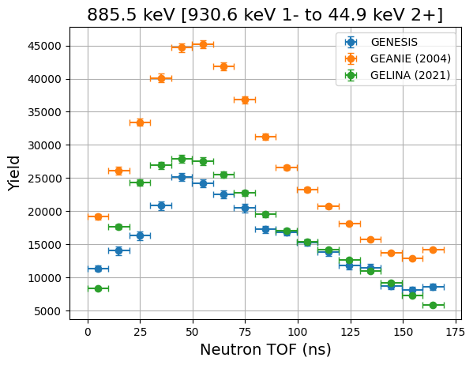
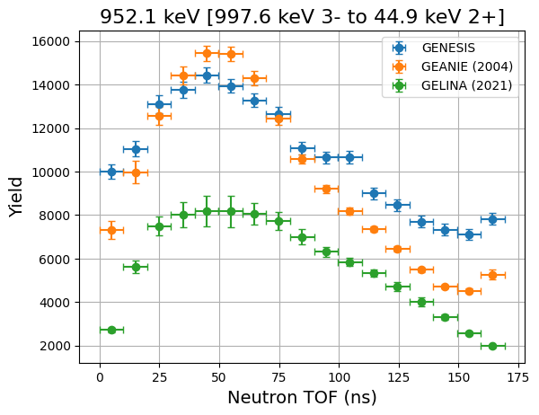
Results
The GENESIS data closely matches the GEANIE convolved yields for the 635.3 keV and 952.1 keV transitions and the GELINA yields for the 885.5 keV transition.

Slide 12
Our Experiments
An inelastic scattering experiment aimed at resolving differences in partial γ-production cross-sections
2. A new fission experiment to look at γ-production
distributions in ²³⁸U fission products

Slide 13
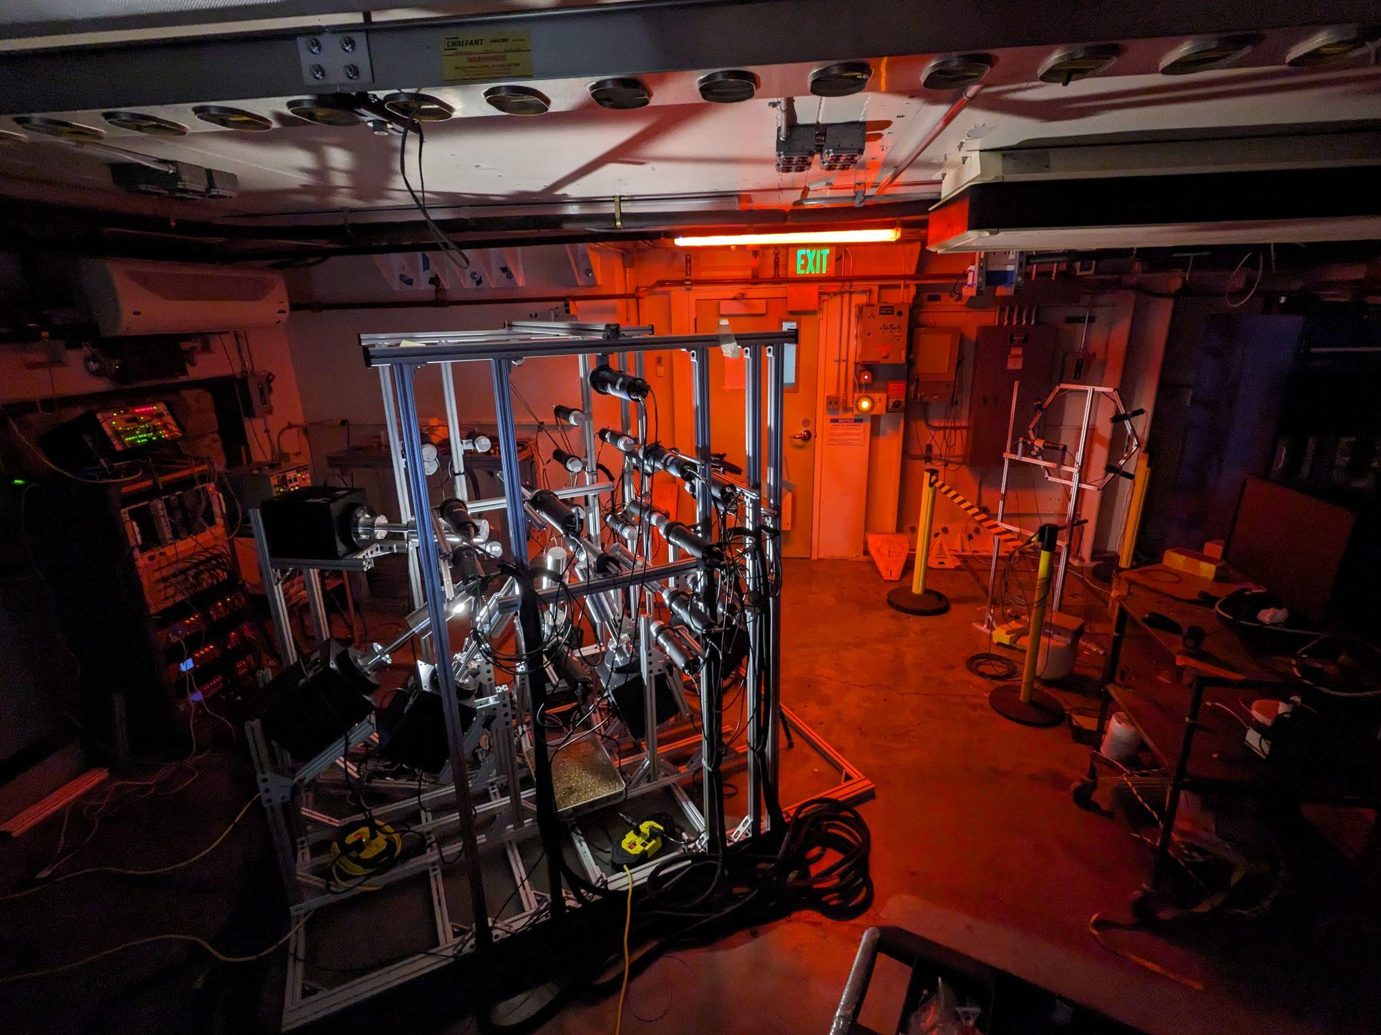
Gamma Energy Neutron Energy Spectrometer for Inelastic Scatter - GENESIS 3.0
Upgraded our array to replace the HPGe Clovers with 7 mechanically cooled single crystal detectors.
We now cover 7 angles so we can resolve angular distributions.
Notes:
POPTOPS have much worse timing and energy res

Slide 14
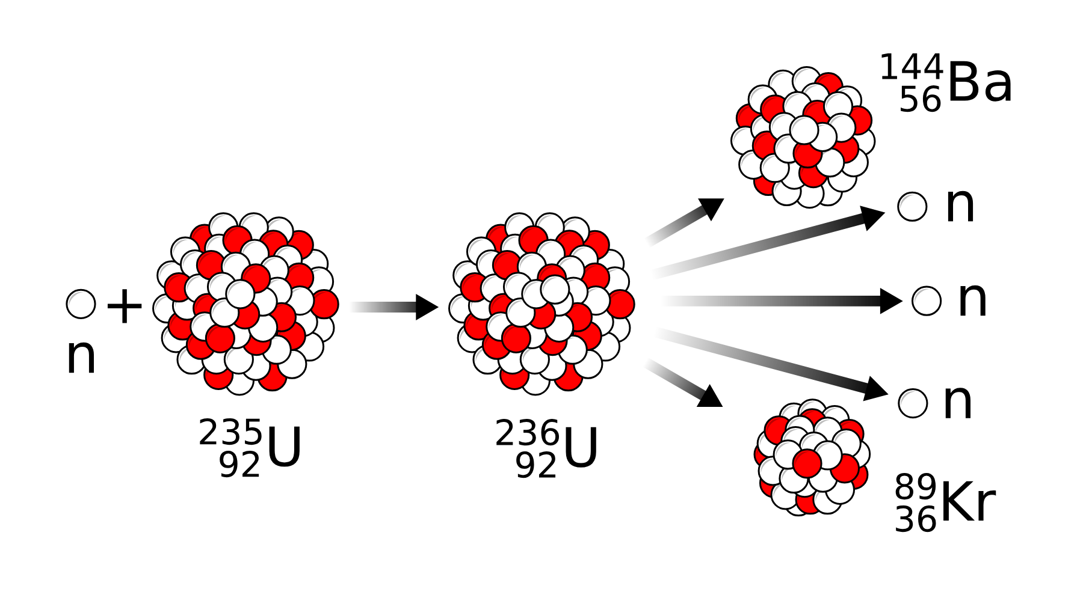
Fission Gamma Yields
Y = 0.084%
________
⁹⁸Rb
t_{1/2} = 115 ms
Y = 2.26%
β-
^{n}
^{n}
434.1 keV 6⁺
__________
^{n}
^{n}
²³⁸U
²³⁹U
215.6 keV 0⁺
__________
144.7 keV 2⁺
__________
0.0 keV 0⁺
__________
⁹⁸Sr
t_{1/2} = 653 ms

Slide 15
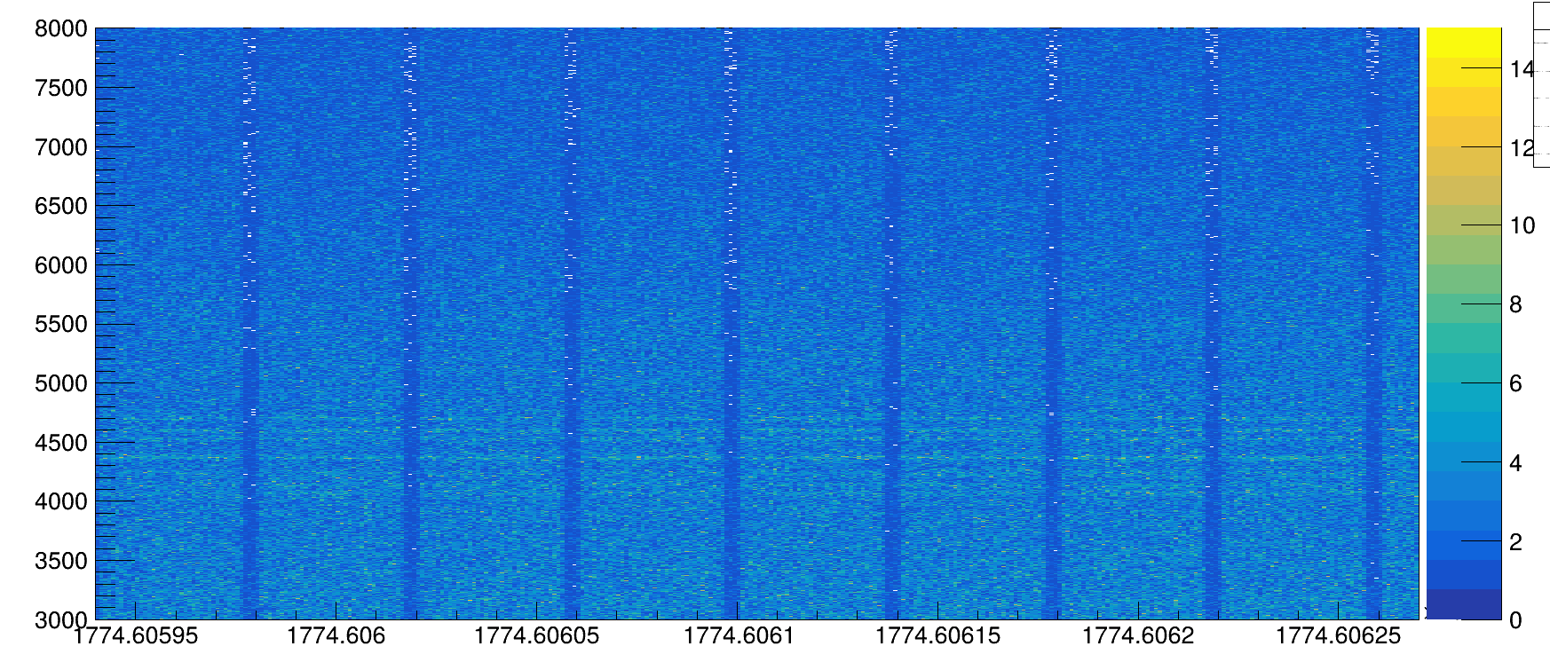

Have you tried turning it off and back on again?
By sweeping the beam, we can look at the beta decay of all of the fission products in the beam off data to normalize our gamma yields.
ADC
88” Cyclotron
Neutron Monitor
Neutron Monitor
Time [s]
Notes:
Specific isomers include:
Te-132 t_{1/2}=28.1 us E_{s}=1925 E_{g} =151 keV
Sb-131 t_{1/2}=90.5 us E_{s}=1676 E_{g} =450,1226 keV
title = {Fission fragment isomers populated via $^{6}\mathrm{Li}+^{232}\mathrm{Th}$},
author = {Ressler, J. J. and Caggiano, J. A. and Francy, C. J. and Peplowski, P. N. and Allmond, J. M. and Beausang, C. W. and Bernstein, L. A. and Bleuel, D. L. and Harke, J. T. and Fallon, P. and Hecht, A. A. and Jordan, D. V. and Lesher, S. R. and McMahan, M. A. and Palmer, T. S. and Phair, L. and Scielzo, N. D. and Swearingen, P. G. and Warren, G. A. and Wiedeking, M.},
Calc = 6*10^9 fissions over 3 day pulsed run with 50% duty

Slide 16
Beta Normalization
Y = 0.084%
________
⁹⁸Rb
t_{1/2} = 115 ms
Y = 2.26%
β-
^{n}
^{n}
434.1 keV 6⁺
__________
^{n}
^{n}
²³⁸U
²³⁹U
We can use the beta decays to subtract out the ⁹⁸Rb β- contribution and then normalize gamma counts with the decay to ⁹⁸Y to determine population rates.
215.6 keV 0⁺
__________
144.7 keV 2⁺
__________
0.0 keV 0⁺
__________
β-
119.3 keV γ
Ι =74.0%
⁹⁸Sr
t_{1/2} = 653 ms
________
⁹⁸Y
t_{1/2} = 548 ms

Slide 17
Summary
An inelastic scattering experiment aimed at resolving differences in partial γ-production cross-sections
The GENESIS data closely matches the GEANIE convolved yields for the 635.3 keV and 952.1 keV transitions and the GELINA yields for the 885.5 keV transition.
2. A new fission experiment to look
at γ-production distributions in
²³⁸U fission products
The experiment was run in March 2026 and analysis is underway.
ADC
Time [s]

Slide 18



Acknowledgements
L. A. Bernstein^{1,2}, D.L. Bleuel³,
J.A. Brown¹, J.M. Gordon², B.L. Goldblum^{2,1},
T. Laplace¹, K.E.J. Myers¹, and R. Vogt³
¹ University of California-Berkeley Dept. of Nuclear Engineering
² Lawrence Berkeley National Laboratory
³Lawrence Livermore National Laboratory
Work supported by the Stewardship Academic Alliance Grant at UC Berkeley
^{Award Grant DE-NA-0004064}

Slide 19
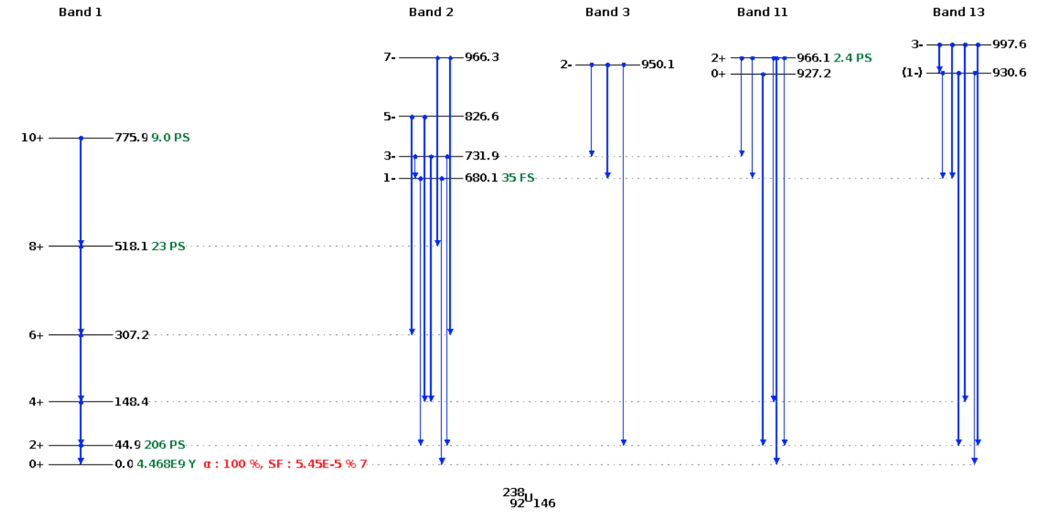
Inelastic Scattering in Uranium

Slide 20
