Slide 1
Detection of γ-ray from laser plasma using nuclear emulsion
Tamii-lab , Osaka University
M2 Toma Hori
Notes:
Hello, everyone.
My name is Toma Hori from Osaka University.
Today, I would like to talk about my research,
"Detection of gamma-rays from laser plasma using nuclear emulsion."

Slide 2
Outline
1. Introduction
- Reactions in plasma induced by high-intensity lasers
- Nuclear Reactions in Laser Plasmas
- Our Goal
- Challenges
2. Experiment
- Facility
- Setup
3. Detector Detail
- What is Emulsion?
4. Analysis
- Event selection
- Result
- BG fit & true event calculation
- Flux calculation
5. Summary
Notes:
Here is the outline of my presentation today.
First, in the Introduction, I will talk about the background and goal of this research.
Second, in the Experiment part, I will explain the facility and our experimental setup.
Third, since we are using a unique detector, I will submerge into the details of this detector. Finally, I will present the analysis and results of our experiment.

Slide 3
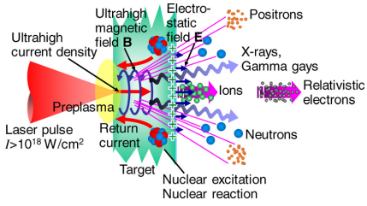
Introduction(1/4)：Reactions in plasma induced by high-intensity lasers
“Review of laser-driven ion sources and their applications “
Hiroyuki Daido, Mamiko Nishiuchi and Alexander S Pirozhkov
→ Diverse and complex phenomena are occurring
Notes:
When a solid target is irradiated with a high-intensity laser,
the surface turns into plasma,
which induces a variety of nuclear and particle reactions.
As you can see, laser-plasmas create highly diverse and complex environments where various phenomena take place.

Slide 4
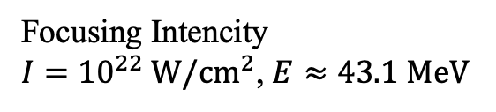
Introduction(2/4)：Nuclear Reactions in Laser Plasmas
Known facts：In
Known facts：Out
Focusing Intencity
$I={10}^{22} W/cm^{2}$, $E≈43.1 MeV$
Observation of electrons at the tens MeV
Nuclear reactions are expected to occur within the laser plasma
Why laser-driven nuclear reactions are significant
・ A unique approach compared to accelerator-based experiments
Accelerator
Collide high-energy particle at low-density
Laser
Collide low-energy photons at high-density
・Observation of nuclear reactions in ultra-high electromagnetic fields
Notes:
As a known fact of laser-plasma, we have two key aspects.
On the "In" side, the focusing intensity reaches 10 to the 22 watt par square cm ,which corresponds to a ponderomotive energy of 43.1 MeV.
On the "Out" side, electrons are observed at tens of MeV.
Therefore, nuclear reactions are expected to occur within the laser plasma.
Now, why are laser-driven nuclear reactions so significant?
First, they offer a unique approach compared to accelerator-based experiments.
While accelerators collide high-energy particles at low density, lasers collide low-energy photons at high density.
Second, they enable the observation of nuclear reactions in ultra-high electromagnetic fields.
These are the reasons why laser-driven nuclear reactions are significant.

Slide 5
Introduction(3/4) ：Our Goal
Goal：
Clarify the mechanism of laser-driven nuclear reactions
through precise analysis of γ-rays emitted from laser plasma.
We want to Measure!
Notes:
Therefore, our goal is to
Clarify the mechanism of laser-driven nuclear reactions
through the precise analysis of gamma-rays emitted from laser plasma.

Slide 6

Introduction(4/4) ：Challenges, Our approach
However, direct measurements of γ-rays emitted from laser plasma have not yet been achieved.
Challenges in γ-ray measurements
・ Signal pile-up due to a lot of radiations emitted in an extremely short time
(${10}^{7} \sim /cm^{2}$)
(~ ns)
・ Limited number of laser shots per day, making it difficult to obtain sufficient statistics
・ Shot-to-shot variations in laser characteristics
Our approach
・Using nuclear emulsion : A detector with excellent spatial resolution.
・Record all radiation tracks from a single shot without pile-up.
Precisely detect γ-rays in emulsion
⇒ Measure γ-ray energy, direction, and flux directly
Notes:
However, direct measurements of gamma-rays emitted from laser plasma have not yet been achieved.
This is due to the following three challenges:
First, signal pile-up occurs because a lot of radiations is emitted in an extremely short time.
Specifically, about 10^7 to 10^8 particles per square centimeter are emitted within a nanosecond order.
Second, there is a limited number of laser shots available per day, making it difficult to obtain sufficient statistics.
Third, the laser characteristics change from shot to shot.
To overcome these challenges, our approach is using nuclear emulsion, emulsion is a detector with excellent spatial resolution.
This allows us to record all radiation tracks from a single shot without any pile-up.
By precisely detecting gamma-rays in the emulsion, we can directly measure the gamma-ray energy, direction, and flux.

Slide 7
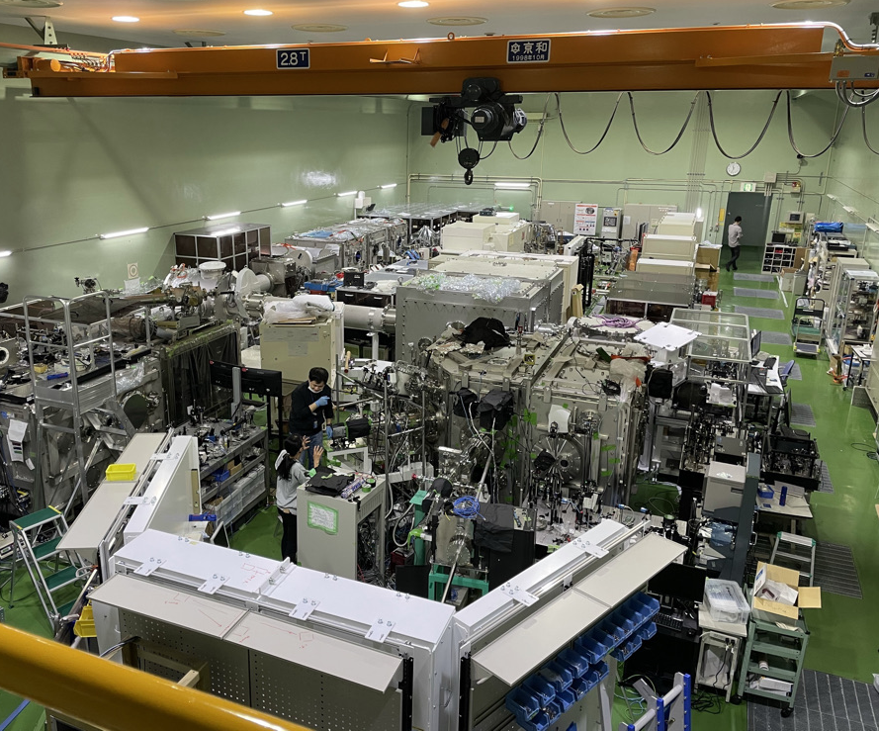
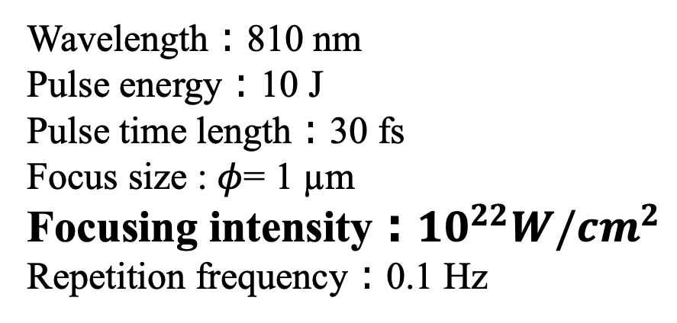
Experiment (1/2): Facility
Kansai Photon Science Institute (KPSI)
Laser：J-KAREN-P
Wavelength：810 nm
Pulse energy：10 J
Pulse time length：30 fs
Focus size : $φ$= 1 µm
Focusing intensity：${10}^{22}W/cm^{2}$
Repetition frequency：0.1 Hz
Notes:
Next, I will explain our experiment.
We used the J-KAREN-P petawatt laser system at KPSI in Japan.
KPSI is short for Kansai Photon Science Institute.
This is laser property.
Wavelength：810 nm
Pulse energy：10 J
Pulse time length：30 fs
And the focus size is 1 µm in diameter.
This means the focusing intensity reaches 10 to the 22 watt par square of cm.
Repetition frequency：0.1 Hz

Slide 8
Experiment (1/2): Facility
Kansai Photon Science Institute , QST , Japan
Laser：J-KAREN-P
Beam
Wavelength：810 nm
Pulse energy：10 J
Pulse time length：30 fs
Focus size : $φ$= 1 µm
Focusing intensity：${10}^{22}W/cm^{2}$
Repetition frequency：0.1 Hz
Target
Detector
Vacuum Chamber
Notes:
This diagram shows our experimental setup.
The laser, which is generated in the back room, is guided into the vacuum chamber and focused onto the target.
As for the detector, we placed it right here, outside of the vacuum chamber.

Slide 9
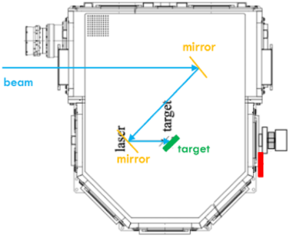

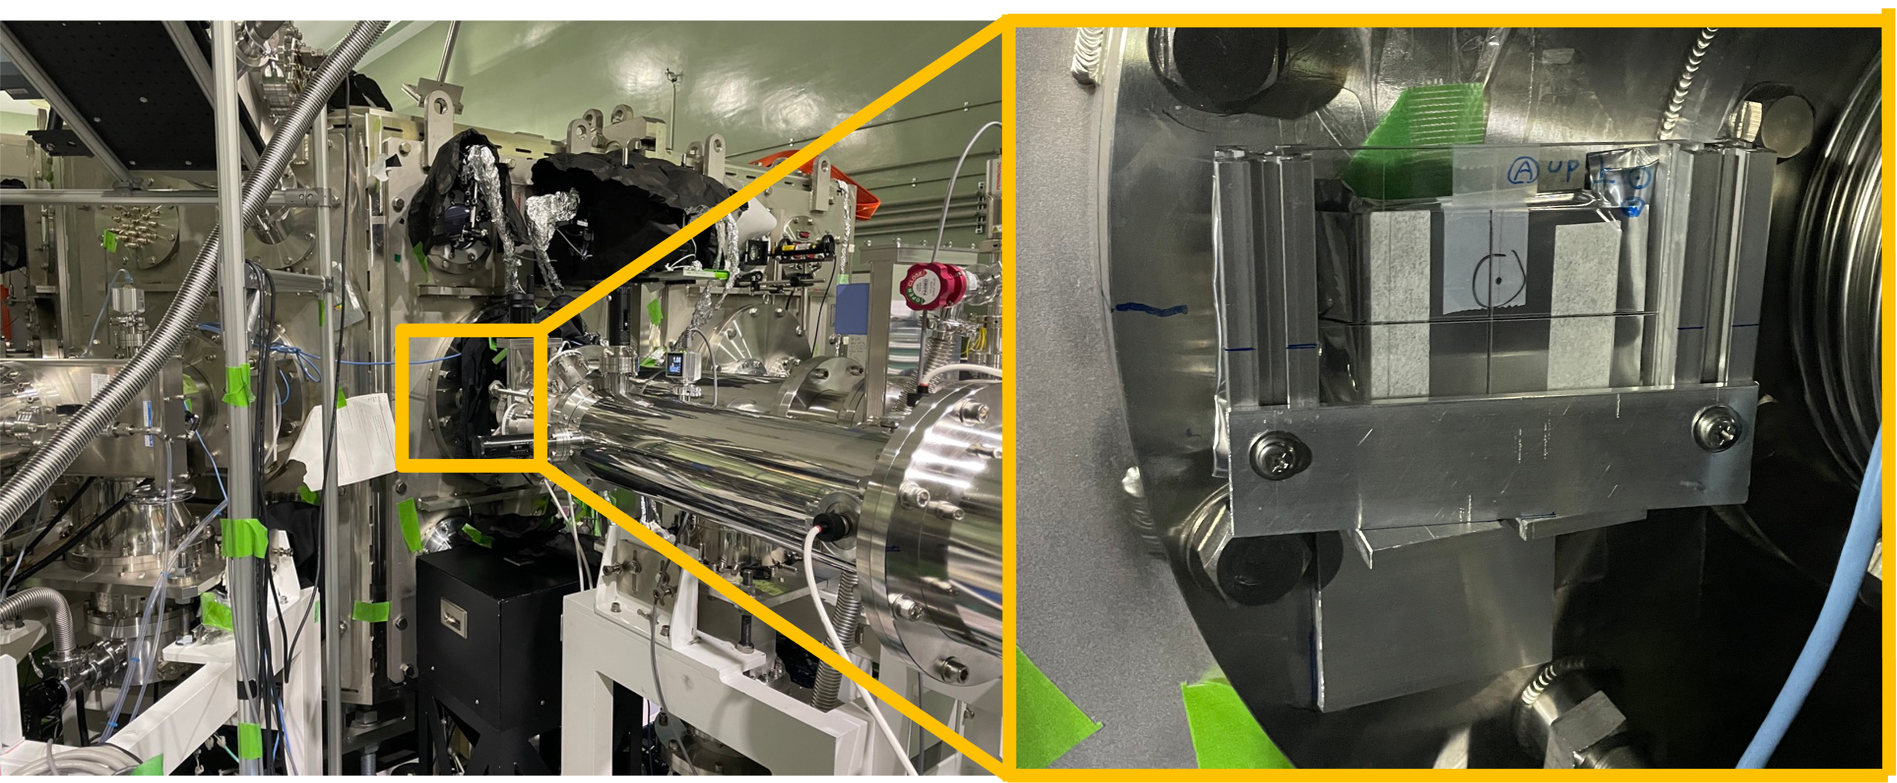
Experiment (2/2): Setup
Laser shot : 1 shot
Target : Ag 5µm
γ
Detector : Emulsion Stack
30 layers＋2 Changeable Seat
30 layers
2 CSs
Put only experiment time
Size : 50 mm × 60 mm
Location : On the outer surface of the vacuum chamber (20 mm SUS wall), positioned at 0°
Distance from target : 1023.9 mm
Notes:
For this setup,
a single laser shot was fired.
As the target, we used a 5 µm thick silver foil.
For the detector, we used a nuclear emulsion stack.
This stack consists of a 30-layer main body and
two changeable sheets used to exclude background tracks
recorded outside of the experiment.
The dimensions of the stack are 50mm by 60mm.
It was positioned at 0 degrees on the outer surface of the vacuum chamber,
which has a 20mm stainless steel wall.
The distance from the target to the detector is shown here.

Slide 10
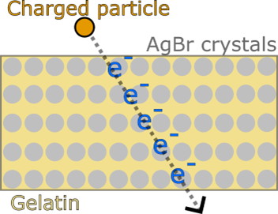
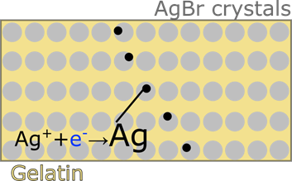
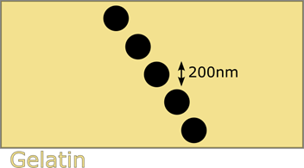
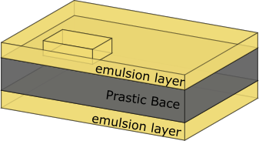
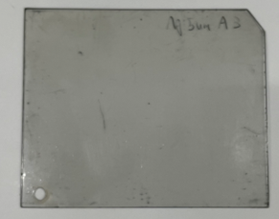
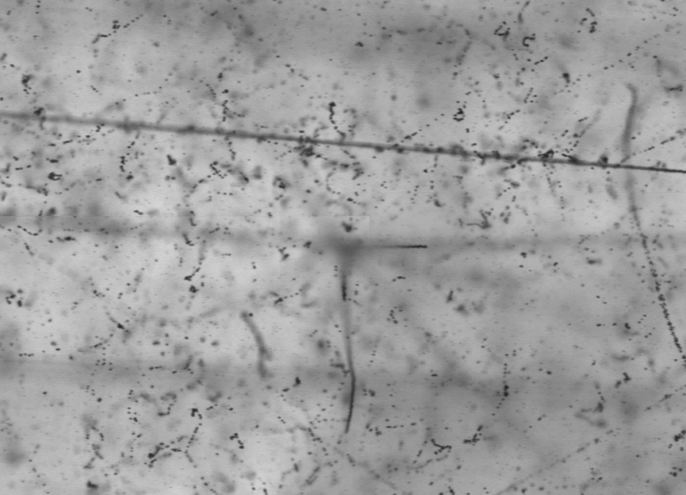
Detector Details : What is Nuclear Emulsion？
Nuclear Emulsion： 3D Track Detector
that records charged-particle trajectories with “high spatial resolution”
High spatial resolution ：≈ 1 μm (The size of the AgBr crystals ：200 nm) , ${10}^{14}$channels/${cm}^{3}$
→ Can clearly separate individual tracks even in ultra-high radiation environments.
Develop,
fix
Grain
80μm
200μm
225 μm
80μm
Real emulsion tracks
→Scan & digitized tracks
Notes:
Nuclear emulsion is a unique detector.
Let me explain its principles and characteristics.
Nuclear emulsion is a type of 3D track detector that records charged-particle trajectories with high spatial resolution.
Historically, it has been used in the discovery of the pion and charm hadrons,
as well as in the first observation of tau neutrino interactions.
Its high spatial resolution is approximately 1µm,
which depends on the size of AgBr crystals, which is about 200nm.
This corresponds to a detector channel density of approximately 10^14 channels/cubic cm.
Thanks to this ultra-high density, we can clearly separate individual tracks even in extremely high-radiation environments.
As shown here, a nuclear emulsion plate consists of a plastic base coated on both sides with an emulsion layer.
Inside this emulsion layer, AgBr crystals are embedded uniformly within gelatin.
When a charged particle passes through and causes ionization,
electrons are captured by silver ions inside the AgBr crystals, forming latent image specks of silver.
Through the chemical processes of development and fixation, these grow into silver grains.
This is a real photograph of the emulsion.
When magnified under a microscope, you can clearly see the radiation tracks.
By scanning these tracks with an scanning system, we can digitize them into 3D track data.

Slide 11
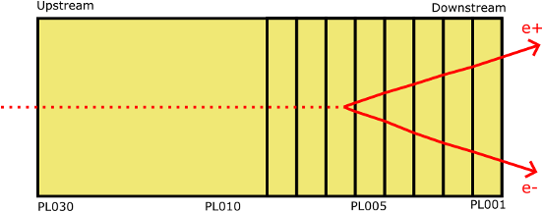
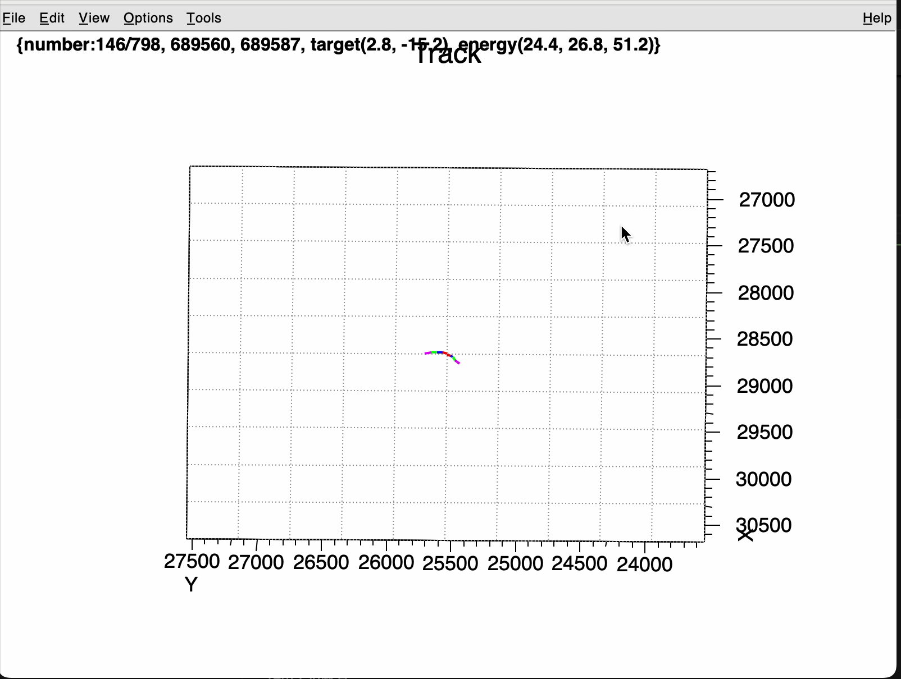
Analysis(1/4): Event selection
No upstream tracks
(2) Track connected through 5 downstream layers
(3) There are pair tracks within 5 µm
(4) The distance between the pair tracks is increasing
Notes:
Next, I will talk about our experimental analysis.
To select gamma-ray events from the recorded tracks via pair production, we applied the following four criteria:
First, there are no upstream tracks.
Second, the tracks must be connected through 5 downstream layers.
Third, a pair of tracks must be located within 5 µm of each other.
And fourth, the distance between these two paired tracks must be increasing.
By applying these criteria, we can successfully filter out events like this one shown here.

Slide 12
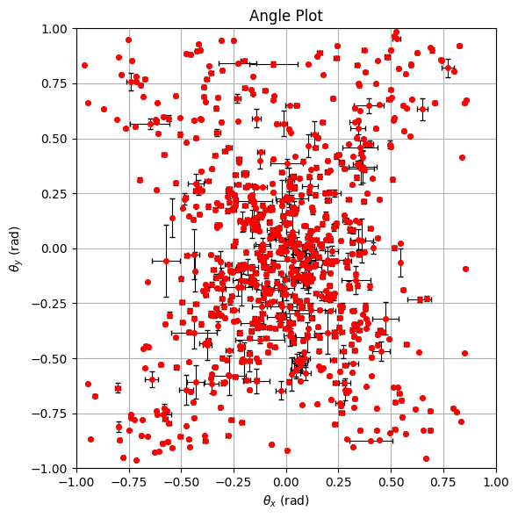
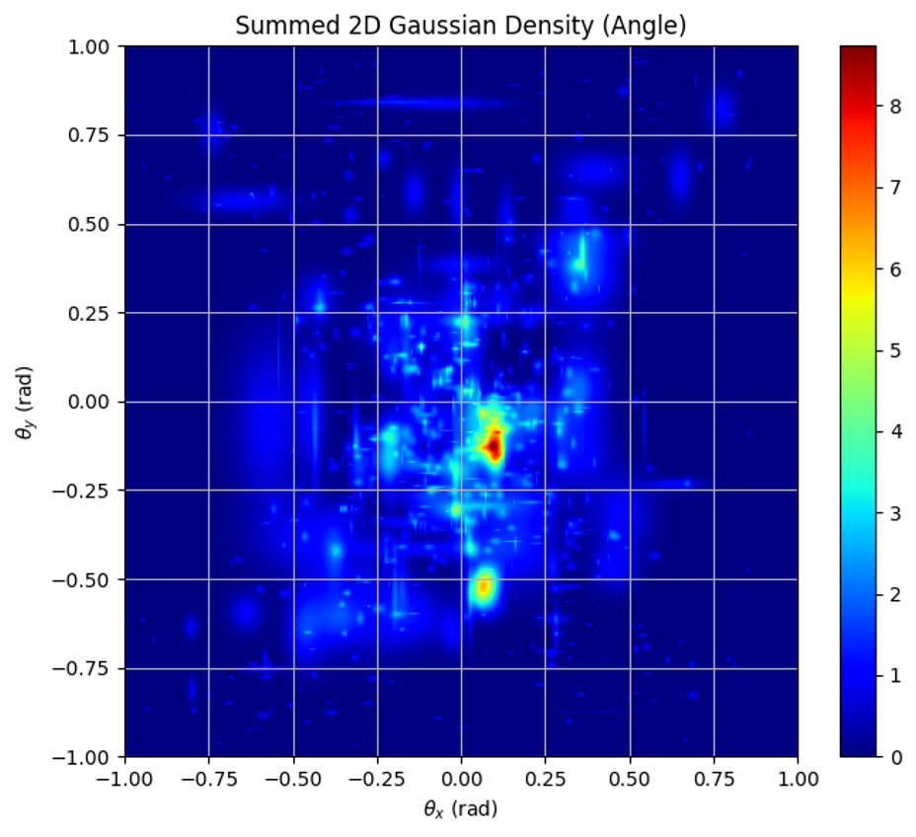
Analysis(2/4): Result (Angle)
A total of 798 γ-ray events were identified
From Target??
Observed a peak structure near the target direction in the angular distribution
Notes:
By using this selection method, a total of 798 gamma-ray events were identified.
These two plots show the angular distribution of the observed gamma-rays at the detector position, reconstructed from the pair-production tracks.
For both figures, the horizontal axis represents the angle in the x-direction, and the vertical axis represents the angle in the y-direction.
The plot on the right is a heat map generated by summing up the events from the left plot, using Gaussian distributions that take the experimental error bars into account.
As a result, we successfully observed a peak structure near the target direction in the angular distribution.

Slide 13
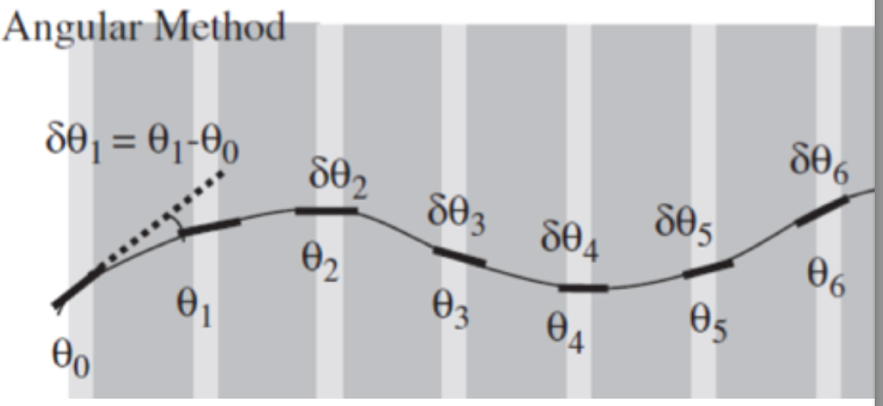
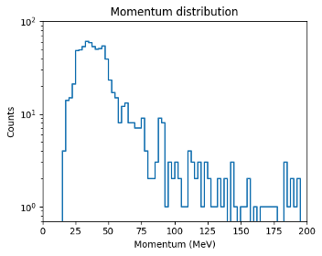
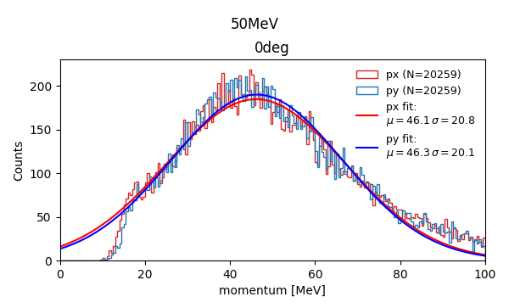
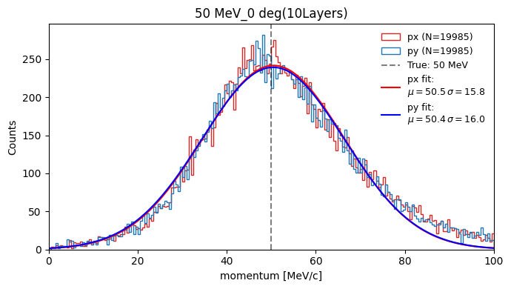
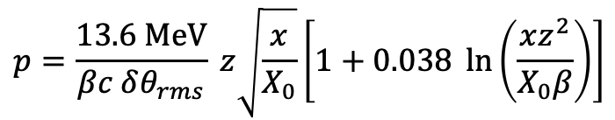
Analysis(2/4): Result (Momentum)
Calculating method
$$p=\frac{13.6 MeV}{βc δθ_{rms}} z\sqrt{\frac{x}{X_{0}}}\left[1+0.038 \ln\left(\frac{xz^{2}}{X_{0}β}\right)\right]$$
・Observe gamma rays in the tens of MeV range
・As the energy increased, they disappeared rapidly
Calibration search
Emulsion stack
Constant momentum
electrons
Experimental data
Simulation data
Notes:
Next, we calculated the gamma-ray momentum from the angular deviation between each layer.
We successfully observed gamma-rays in the tens of MeV range.
As the energy increased, the event rate disappeared rapidly.
Furthermore, since gamma-ray momentum measurements using angular deviation are not well-studied in this low energy range, we also performed a calibration.
For this calibration, we investigated the detector's response
when constant momentum electrons were injected into the emulsion,
approaching it from both experimental and simulation data.

Slide 14
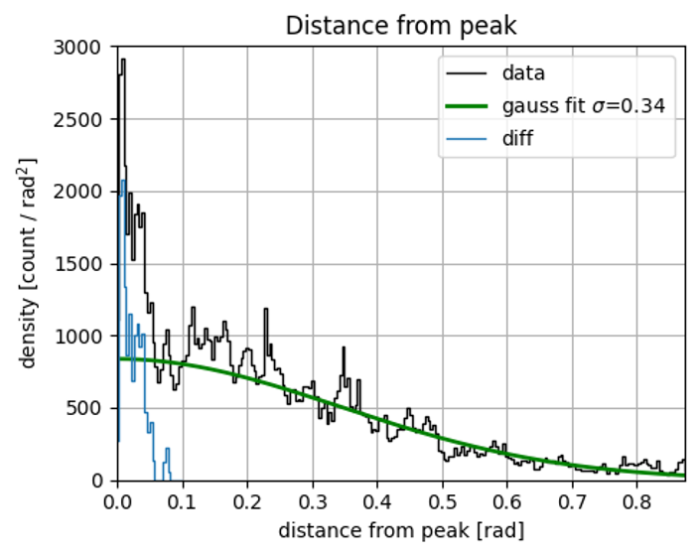
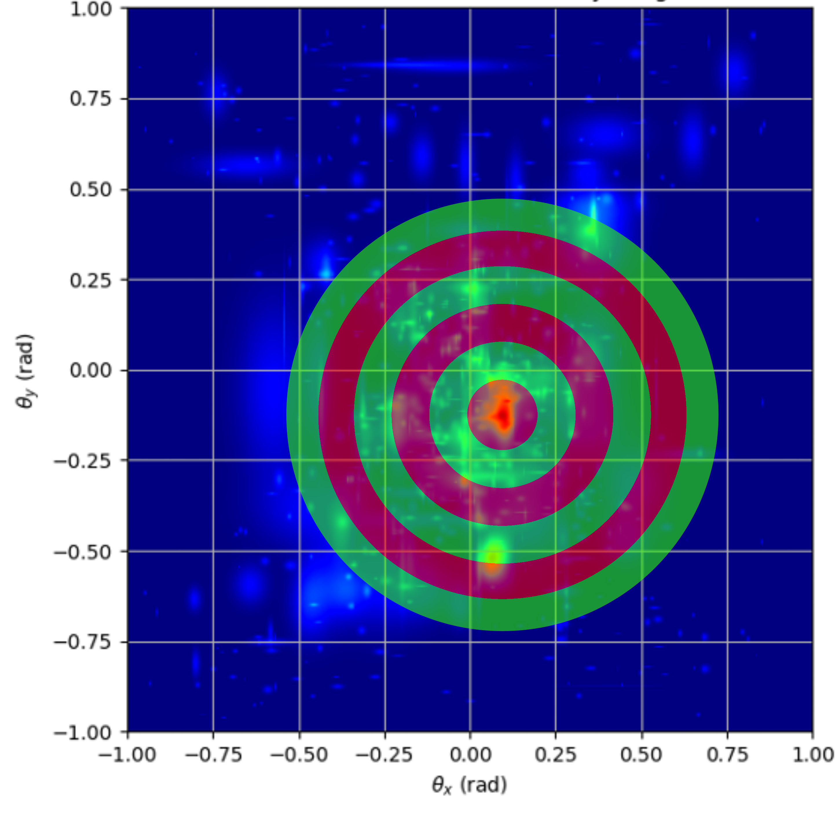
Analysis(3/4): BG fit & true event calculation
Fit the background assuming a Gaussian distribution
fit
True event = 8.90 ± 2.98 [count]
Notes:
Furthermore, we estimated the background intensity using the gamma-ray angular heat map discussed earlier.
This graph plots the probability density within a donut-shaped region centered around the expected peak position.
The black line represents our original data.
Assuming the background radiates symmetrically from the target direction, we fitted the range from 0.2 to 0.8 rad using a Gaussian distribution, shown as the green line.
Then, by subtracting the green line from the black line, we obtained the blue line, which represents the signal component.
Finally, by integrating this blue line, we calculated the true number of events to be 8.899 Plus and minus 2.98 counts.

Slide 15
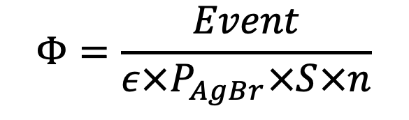

Analysis(4/4): Flux calculation
The γ-ray flux Φ from the target,
assuming that γ-rays are emitted isotropically from the target
$$Φ=\frac{Event}{ε×P_{AgBr}×S×n}$$
$$≈4.68×{10}^{7}±1.5×{10}^{7} [counts/(sr⋅shot)]$$
$Event$：Number of true event (8.899 ± 2.98 count)
𝜖： The probability of a track being recorded through 5 emulsion layers（${0.86}^{5∗2}$）
$P_{AgBr}$： Probability of $e^{+}e^{−}$pair production within 4 emulsion layers ($4.5×{10}^{−4}$)
𝑆：Area of the γ-ray search region on the emulsion ($20cm^{2}$ ÷ (102.39 cm)^2 [sr])
𝑛：Number of laser shots (1 shot)
Notes:
Next, I calculated the gamma-ray flux.
The gamma-ray flux Phi, from the target, assuming that gamma-rays are emitted isotropically from the target, is expressed by this formula:
Event is Number of true event
Epsilon is The probability of a track being recorded through 5 emulsion layers
P_AgBr is The probability of $e^{+}e^{−}$pair production within 4 emulsion layers
S is Area of the γ-ray search region on the emulsion
n is Number of laser shots
Consequently, we obtained a final gamma-ray flux of 4.68 times 10^7 counts per steradian per shot.

Slide 16
Summary , Future Works
Aiming for direct measurement of γ-rays from laser-produced plasma using emulsion.
Conducted experiments using J-KAREN-P and successfully observed 798 γ-rays events.
The γ-ray flux per laser shot for the Ag 5 µm target was $4.68×{10}^{7}±1.6×{10}^{7}$ [count/ $sr⋅shot$].
Future Works
・Evaluate the validity of the observed flux through comparisons with simulations.
Notes:
To summarize my presentation:
We aimed for the direct measurement of gamma-rays from laser-produced plasma using nuclear emulsion.
We conducted experiments using the J-KAREN-P laser system and successfully observed 798 gamma-ray events.
Third, the gamma-ray flux per laser shot for the 5µm-thick silver target was evaluated to be 4.68 times 10^7 pm 1.6 times 10^7 counts per steradian per shot.
As for future works, we will evaluate the validity of this observed flux through detailed comparisons with simulations.
Thank you very much for your kind attention.

Slide 17
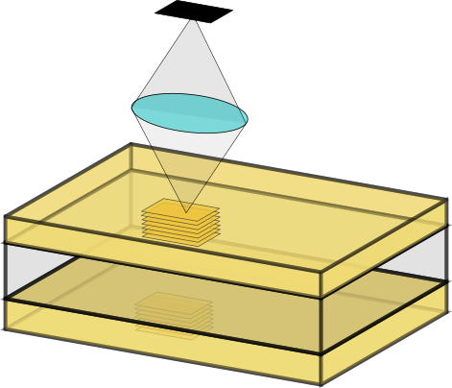
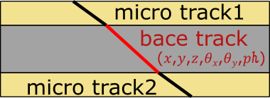
Detector Details (2/2)：How to get particle tracks
Scanning device：HTS-2 (Hyper-track selector 2)
The world‘s fastest emulsion scanning device (F Lab ,Nagoya University)
How to scan
Image sensor
・Capture a series of images while shifting the focal plane through the emulsion depth
・Obtain positions(x,y,z) of Grains (silver crystals) through binarization
・Link Grains to create microtracks
・Connect the two microtracks (front and back) to form a base track
The base track contains information such as position, angle, and pulse height.
how many Grains are connected
Connecting 30 base tracks (30 emulsion layers ), we can reconstruct 3D particle trajectories.

Slide 18
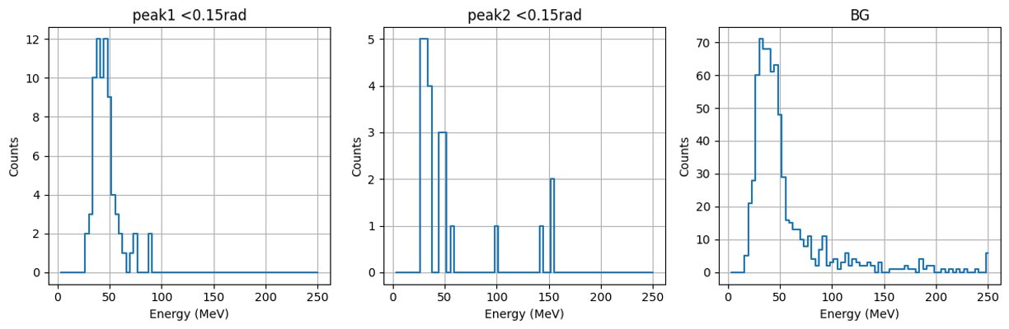
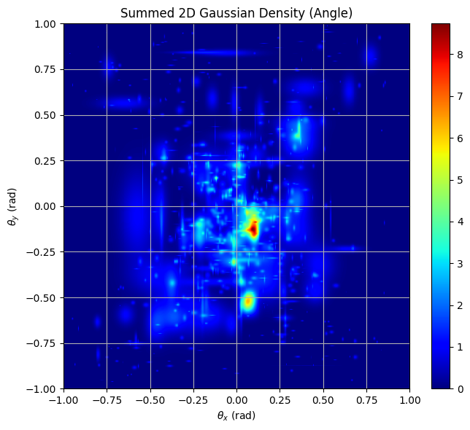
Experiment in 2021

Slide 19
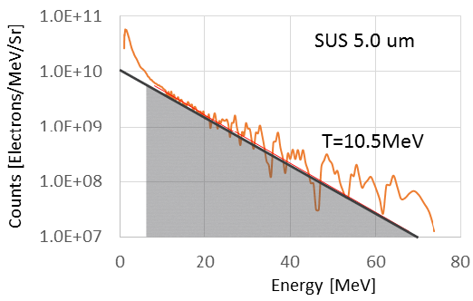
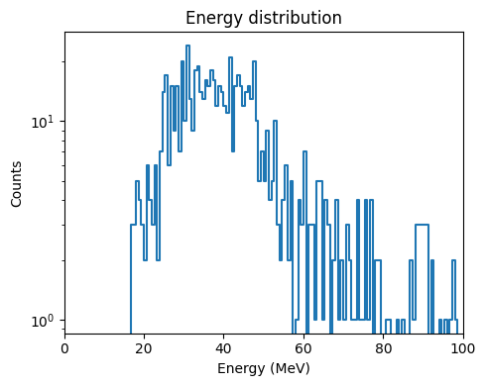
Analysis(2/4): Result (Energy)

Slide 20
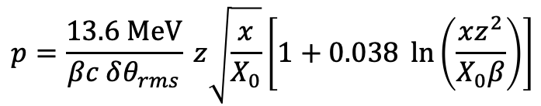
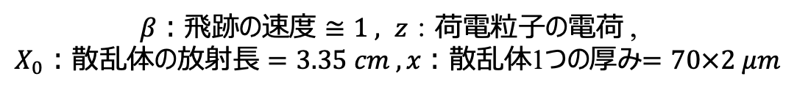
キャリブレーション実験(3/4)：角度ずれを利用した運動量計算
Trackにはレイヤーをまたぐときの角度ずれが記録されている
1 trackにおける$δθ$のRMSを計算することでそのtrackの運動量が計算できる
$$p=\frac{13.6 MeV}{βc δθ_{rms}} z\sqrt{\frac{x}{X_{0}}}\left[1+0.038 \ln\left(\frac{xz^{2}}{X_{0}β}\right)\right]$$
$β：飛跡の速度≅1 , z：$荷電粒子の電荷 ,
$X_{0}：散乱体の放射長=3.35 cm , x：$散乱体1つの厚み$=70×2 μm$

Slide 21
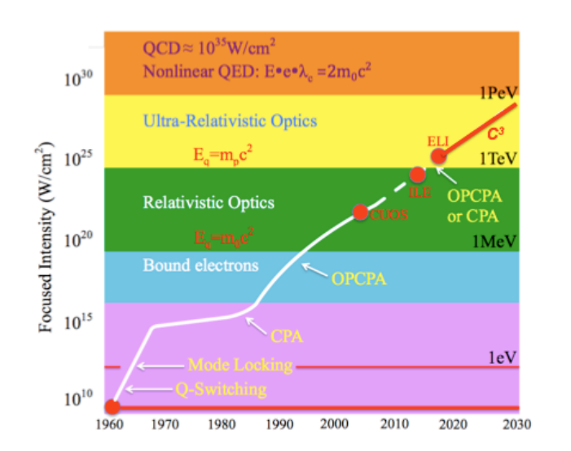
Exawatt-Zettawatt pulse generation and applications
G.A. Mourou , N.J. Fisch , V.M. Malkin , Z. Toroker , E.A. Khazanov , A.M. Sergeev , T. Tajima , B. Le Garrec

Slide 22
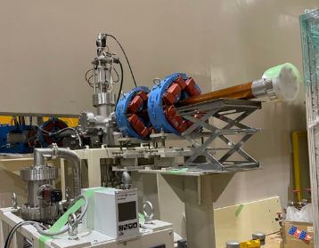
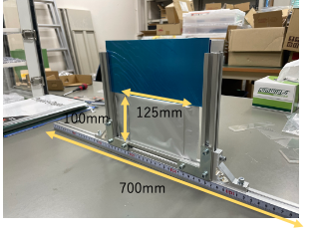
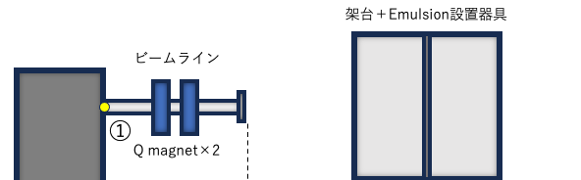
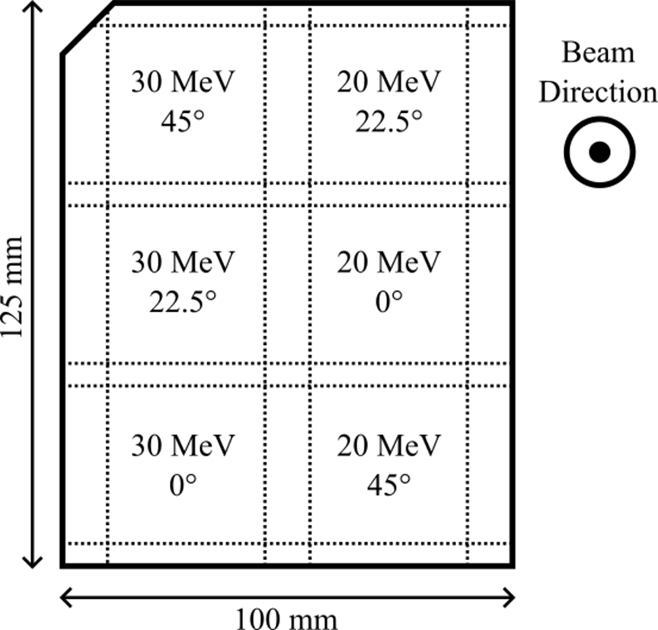
キャリブレーション実験(1/4)：実験セットアップ
プラズマから発生するγ線は数十MeV
数十MeVという低エネルギー領域では検出効率や運動量分解能が著しく劣化する可能性がある
→一定エネルギーの電子を入射させてefficiencyと運動量分解能を決定する
電子ビーム
電子ビーム口
エマルションスタック
Facility：線形加速器 (KAKEN,KyotoUni)
20,30,40,50 MeVの電子ビームを0,22.5deg,45degに傾けたエマルションに照射
Emulsion stack：100 mm × 125 mm × 16 layers × 2 stack
→ 35 mm四方の範囲で６つに区分けして使う

Slide 23
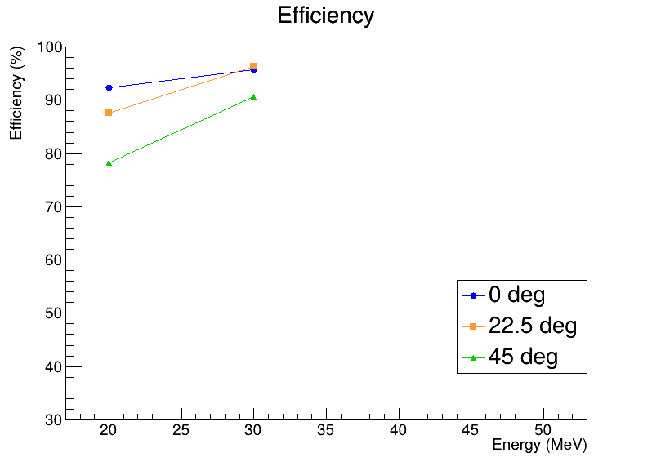
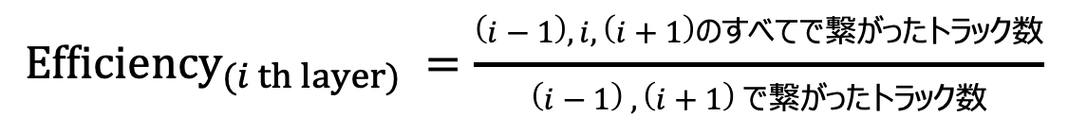
キャリブレーション実験(2/4)：Calculate efficiency
$${Efficiency}_{(i th layer)} =\frac{\left(i−1\right),i,\left(i+1\right)のすべてで繋がったトラック数}{\left(i−1\right) , \left(i+1\right) で繋がったトラック数}$$
それぞれの角度・エネルギーで上流2枚目のefficiencyの計算を行った
0degではスキャン装置の故障により正確な値が出なかった
→エネルギーが小さいほど、角度がきついほど
efficiencyは低くなる傾向がある
→低エネルギーの粒子が斜めに入射すると電磁散乱によってトラックが曲がりすぎて飛跡検出がうまく行われない可能性がある
→フィットして関数を作る（40,50MeVがまだ、、、）

Slide 24
キャリブレーション実験(3/4)：角度ずれを利用した運動量計算
Trackにはレイヤーをまたぐときの角度ずれが記録されている
1 trackにおける$δθ$のRMSを計算することでそのtrackの運動量が計算できる
$$p=\frac{13.6 MeV}{βc δθ_{rms}} z\sqrt{\frac{x}{X_{0}}}\left[1+0.038 \ln\left(\frac{xz^{2}}{X_{0}β}\right)\right]$$
$β：飛跡の速度≅1 , z：$荷電粒子の電荷 ,
$X_{0}：散乱体の放射長=3.35 cm , x：$散乱体1つの厚み$=70×2 μm$

Slide 25
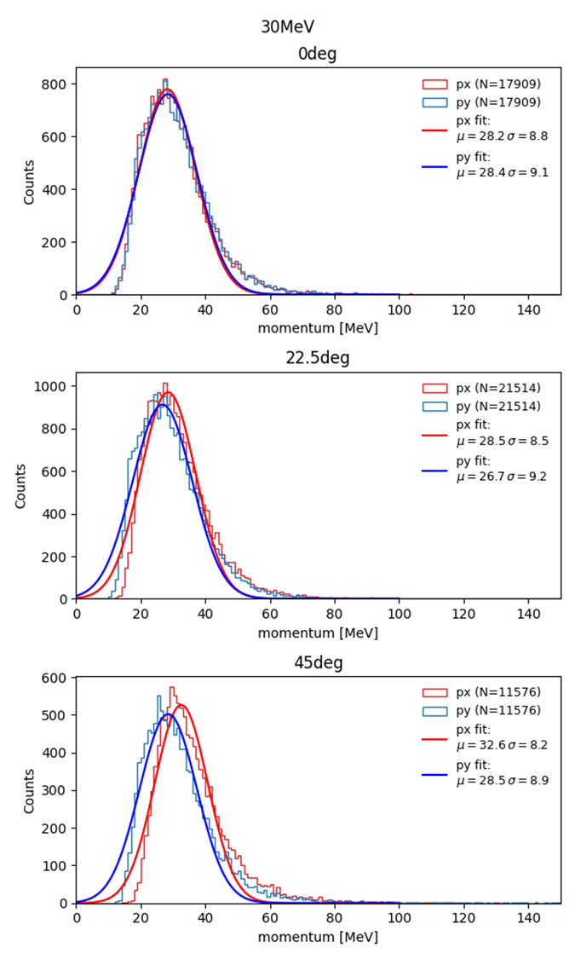
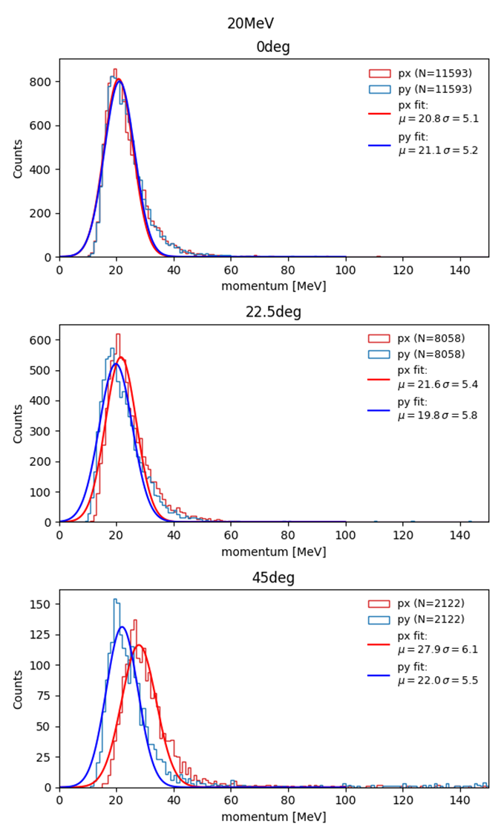
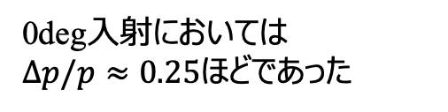
キャリブレーション実験(4/4)：角度ずれを利用した運動量計算
20,30MeVの入射ビームに対しての
運動量分解能をx,y方向で計算した
入射ビームの運動量のばらつきは十分に小さい
入射角度が大きくなると同じはずのx,y方向の分布が異なってくる
→考慮できていない誤差の可能性
0deg入射においては
$Δp/p≈0.25$ほどであった
→40MeV,50MeVでも解析を進める
→0degでエネルギーにフィットした関数を作る
45degとかはおかしくなるのできる

Slide 26
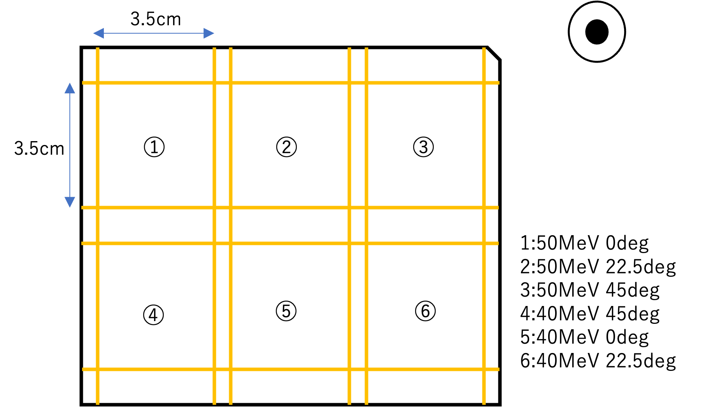
Calibration experiment
プラズマから発生するγ線は数十MeV
Emulsionは高エネルギーの観測で使われるためこの領域の性能がわからない
→一定エネルギーの電子を入射させてefficiencyと運動量分解能を測定する必要がある
Beam direction
入射粒子： 20,30,40,50 MeVの電子ビーム by linac(KAKEN,Kyoto,JAPAN)
Emulsion stack：100 mm × 125 mm × 16 layers
→ 35 mm四方の範囲で６つに区分けして使う
Emulsion stackを２つ使用して0,22.5deg,45degに傾けた各エネルギーの電子ビームを計12区画に照射する

Slide 27
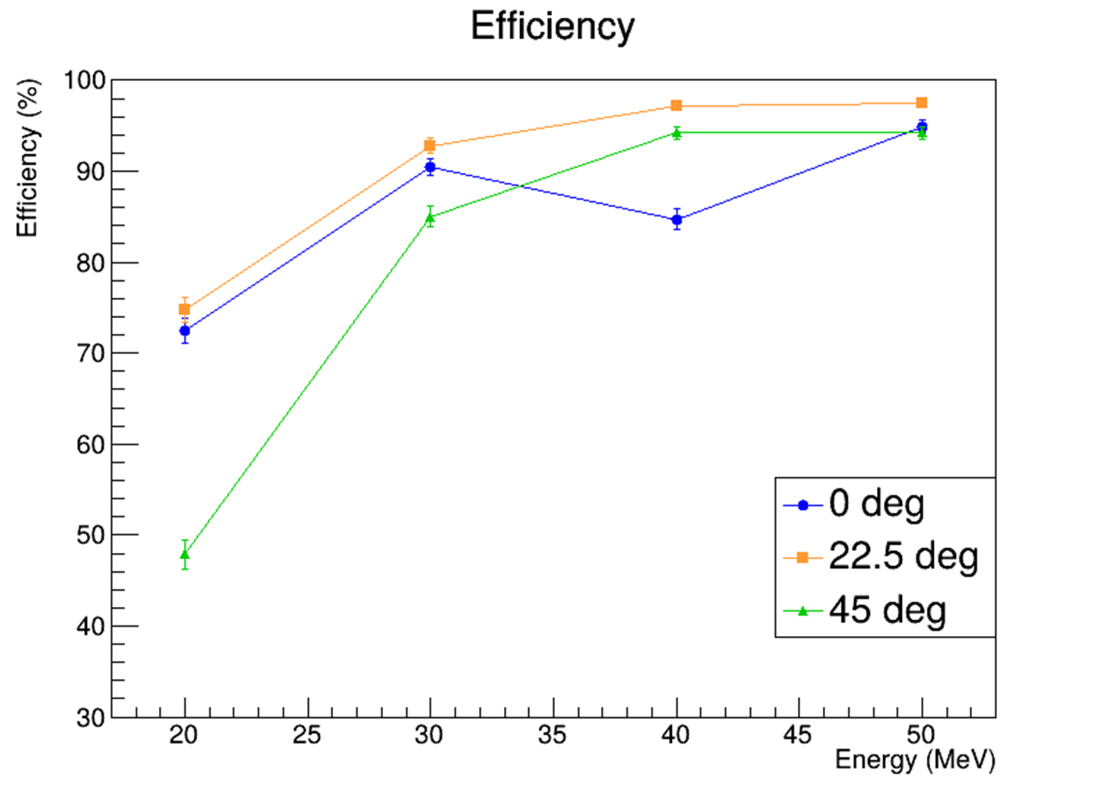
Calculate efficiency
$${Efficiency}_{(i th layer)} =\frac{Number of linked tracks between the \left(i−1\right), i, and\left(i+1\right) layers }{Number of linked tracks between the \left(i−1\right) and \left(i+1\right) layers}$$
それぞれの角度・エネルギーで上流2枚目のefficiencyの計算を行った
0degではスキャン装置の故障により正確な値が出なかった
→エネルギーが小さいほど、角度がきついほど
efficiencyは低くなる傾向がある
→低エネルギーの粒子が斜めに入射すると電磁散乱によって
トラックが曲がりすぎて飛跡検出がうまく行われない可能性がある

Slide 28
Abstract
・Laserプラズマ由来のγ線の直接測定を目指している
・位置分解能に優れたemulsionを使用するアプローチをとっている
・QSTのペタワットレーザーを使用して実験を行った
→emulsionのスキャンを行おうとしている

Slide 29
Abstract
・We aim to direct measure of γ-rays from laser-produced plasmas.
・We take an approach using nuclear emulsion detectors
・Conducted experiments using the PW laser system at QST
→Now working on emulsion scanning and data analysis
Notes:
Here is the abstract for this presentation.
We aim to direct measure of γ-rays from laser-produced plasmas.
We take an approach using nuclear emulsion detectors
We conducted experiments using the petawatt laser system at QST.
We are working on emulsion scanning and data analysis.

Slide 30
Why detection of γ-ray from laser plasma?
Achievable focusing intensity of laser is increasing
→ Nuclear reactions may occur in the laser plasma!
Why laser-driven nuclear reactions are significant
・Potential to discover new physics by observing nuclear reactions in ultra-high electromagnetic field environments
Accelerator
Collide high-energy particle at low-density
Laser
Collide low-energy photons at high-density
Exawatt-Zettawatt pulse generation and applications
G.A. Mourou , N.J. Fisch , V.M. Malkin , Z. Toroker , E.A. Khazanov , A.M. Sergeev , T. Tajima , B. Le Garrec
Goal：
Clarify the structure of laser-driven nuclear reactions
through precise analysis of γ-rays emitted from laser plasma.
Want to Measure!
Gamma rays
Review of laser-driven ion sources and their applications
Hiroyuki Daido, Mamiko Nishiuchi and Alexander S Pirozhkov
Notes:
First, Let me explain the motivation of this research.
Due to advances in laser technology, such as the CPA method,
the achievable focusing intensity of laser has been increasing. (図を指しながら)
Electrons emitted from laser-produced plasmas can reach energies of several tens of MeV.
This means that
Nuclear reactions may occur in the laser plasma.
So, you may wonder
“Why laser-driven nuclear reactions are significant?”
There are several reasons, but one key point is:
They have the potential to reveal new physics in
ultra-high electromagnetic field environments.
In accelerator-based experiments, we collide high-energy particles at low density.
In contrast, laser-based systems collide low-energy photons at extremely high density.
We expect that new physics may appear in this high-density environment.
Therefore, our goal is to:
Clarify the structure of laser-driven nuclear reactions through precise analysis of γ-rays emitted from laser plasma.
This figure shows various reaction channels in the plasma, and in this work, we focus on precisely measuring this part.

Slide 31
Why use nuclear emulsion?
However, direct measurements of γ-rays emitted from laser plasma have not yet been achieved.
Challenges in γ-ray measurements
・ Signal pile-up due to a lot of radiations emitted in an extremely short time
・ Limited number of laser shots per day, making it difficult to obtain sufficient statistics
・ Shot-to-shot variations in laser characteristics
Our approach
・Use nuclear emulsion ,to record a lot of radiations without pile-up
・Furthermore, it can simultaneously detect particles at various positions in a single laser shot.
Precisely detect electron–positron pairs produced by γ-rays in emulsion
⇒ Measure γ-ray energy, direction, and flux directly
Notes:
However, direct measurements of γ-rays emitted from laser plasma have not yet been achieved.
There are mainly three challenges.
First, Signal pile-up due to a lot of radiations emitted in an extremely short time.
Second, Limited number of laser shots per day, making it difficult to obtain sufficient statistics.
Third, Shot-to-shot variations in laser characteristics.
To overcome these challenges, we use nuclear emulsion, which allow us to record a lot of radiations without pile-up and simultaneously detect particles at various positions in a single laser shot.
By precisely detecting electron–positron pairs produced by γ-rays in the emulsion, we can measure the γ-ray energy, direction, and flux directly.

Slide 32
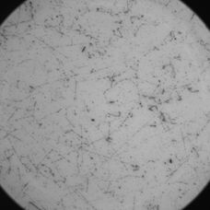
What is nuclear emulsion?
Nuclear Emulsion：A type of photographic film、used for particle measurement a long time
Strong Point
・Ultra-high spatial resolution：≈200 nm (The size of the AgBr crystals)
→ Can clearly separate individual tracks even in ultra-high radiation environments.
Develop,
fix
80μm
200μm
300μm
80μm
Real emulsion tracks
Notes:
Next, I will explain what is nuclear emulsion.
Nuclear emulsion is a type of photographic film that has long been used for particle detection.
Its strong point is its ultra-high spatial resolution,
which is determined by the size of AgBr crystals — typically about 200 nm.
Thanks to this high resolution, we can clearly separate individual tracks
even in ultra-high radiation environments.
Now, I will explain how nuclear emulsions work.
A nuclear emulsion consists of a plastic base film about 200 μm thick, coated with an emulsion layer about 80 μm thick.
The emulsion layer contains uniformly distributed AgBr crystals.
When a charged particle passes through the emulsion, ionization occurs and electrons are released.
These electrons are trapped by Ag⁺ ions in AgBr crystals, forming Ag atoms.
When about four Ag atoms cluster together, they become stable and form a latent image center.
During development and fixation, silver grains grow from these centers, resulting in visible grains of about 200 nm in size.
Here is an example of actual particle tracks in emulsion.
A nuclear emulsion consists of a plastic base film about 200 μm thick, coated with an emulsion layer about 80 μm thick.
エマルションはこのようにプラスチックでできた200μm厚のベースフィルムに、80μmほどの厚さで乳剤を塗布したものです。
The emulsion layer contains uniformly distributed AgBr crystals.
乳剤には極小の臭化銀の結晶が均一に並んでいます。
When a charged particle passes through the emulsion, ionization occurs and electrons are released.
フィルムに荷電粒子が通過すると電離により電子がはじかれます。
These electrons are trapped by Ag⁺ ions in AgBr crystals, forming Ag atoms.
この電子がAgBr結晶内のAg+にトラップされて、Ag+はAgになります。
When about four Ag atoms cluster together, they become stable and form a latent image center.
このAg原子が4つほど固まると安定に存在するようになります。
During development and fixation, silver grains grow from these centers, resulting in visible grains of about 200 nm in size.
そこに現像や定着の作業をすることで、このAg原子の塊を起点にAgの塊が生まれます。その大きさは200nmほどです。
Here is an example of actual particle tracks in emulsion
実際のトラックの様子はこれです。(図)

Slide 33

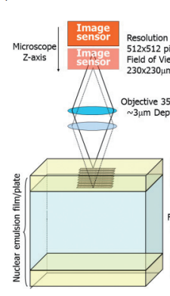
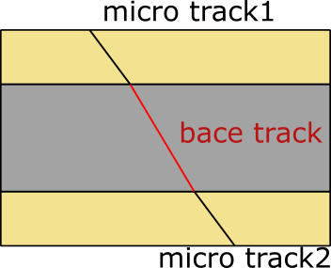

Emulsion scan in
The emulsion must be scanned and digitized for analysis.
Scanning device：HTS-2(Hyper-track selector nuclear emulsion readout system 2)
The world‘s fastest emulsion scanning device (F Lab ,Nagoya University)
ピントの合う位置を深さ方向に変えながらエマルションを撮影
2値化によってGRAIN (銀の粒)を取得
Hyper-track selector nuclear emulsion readout system aimed at scanning an area of one thousand square meters
Masahiro Yoshimoto1,2,∗, Toshiyuki Nakano1 , Ryosuke Komatani1 , and Hiroaki Kawahara
GRAINをつなぎ合わせマイクロトラックを作る
エマルションの表裏二つのマイクロトラックをつなぎ合わせてベーストラックを生成する
ベーストラックには位置、角度、パルスハイト（何個のGrainがつながっているか）といった情報が入っている
$(x,y,z,θ_{x},θ_{y},ph,$)
→base trackをトラックの基本単位としてエマルションを重ねることで粒子の軌跡の変化を追える
→このようにデータ化したトラックにアルゴリズムでカットをかける事で目的のトラックのみを選び出す

Slide 34
Emulsion scan in
The emulsion must be scanned and digitized for analysis.
Scanning device：HTS-2 (Hyper-track selector 2)
The world‘s fastest emulsion scanning device (F Lab ,Nagoya University)
How to scan
Image sensor
・Capture a series of images while shifting the focal plane through the emulsion depth
・Obtain GRAINs (silver crystals) through binarization
・Link GRAINs to create microtracks
・Connect the two microtracks (front and back) to form a base track
The base track contains information such as position, angle, and pulse height.
how many GRAINs are connected
Stacking multiple emulsion layers and connecting base tracks,
we can reconstruct 3D particle trajectories.
→By applying cuts to the digitized tracks, we extract only the desired particle tracks.
Notes:
Once tracks are recorded in the emulsion, the films must be scanned and digitized for data analysis.
We use HST-2 (Hyper Track Selector-2). This is the world’s fastest nuclear-emulsion scanning system, developed at Nagoya University (F-Lab).
Now, I will briefly explain the scanning.
First, the system captures a series of images while shifting the focal plane through the emulsion depth.
Then, Obtain GRAINs (These are silver crystals) through binarization.
By linking the GRAINs, microtracks are created within each emulsion layer.
Next, the microtracks on the front and back sides are connected to form a base track.
The basetrack contain information such as position, angle, and pulse height (pulse height is how many GRAINs are connected)
By stacking multiple emulsion layers and connecting base tracks,
we can reconstruct 3D particle trajectories.
Finally, By applying cuts to the digitized 3D tracks, we extract only the desired particle tracks.

Slide 35
Summary, Future works
Summary
・ We aim to directly measure γ-rays generated from laser-produced plasmas.
・ We employ nuclear emulsion detectors with high spatial resolution to overcome pile-up and track identification challenges.
Future works
・ Scan the emulsions used in the experiment to identify electron–positron pair production events
・ Calibrate the efficiency and momentum resolution for low-momentum electrons
→ Improve the precision of γ-ray energy and flux measurements
Notes:
In summary,
We aim to directly measure γ-rays generated from laser-produced plasmas.
And we employ nuclear emulsion detectors with high spatial resolution to overcome pile-up and track identification challenges.
For future work
First, we will scan the emulsions used in the experiment to identify electron–positron pair production events
Next, we will calibrate the efficiency and momentum resolution for low-momentum electrons
Finally, we will improve the precision of γ-ray energy and flux measurements
That’s all.
Thank you for your attention.

Slide 36
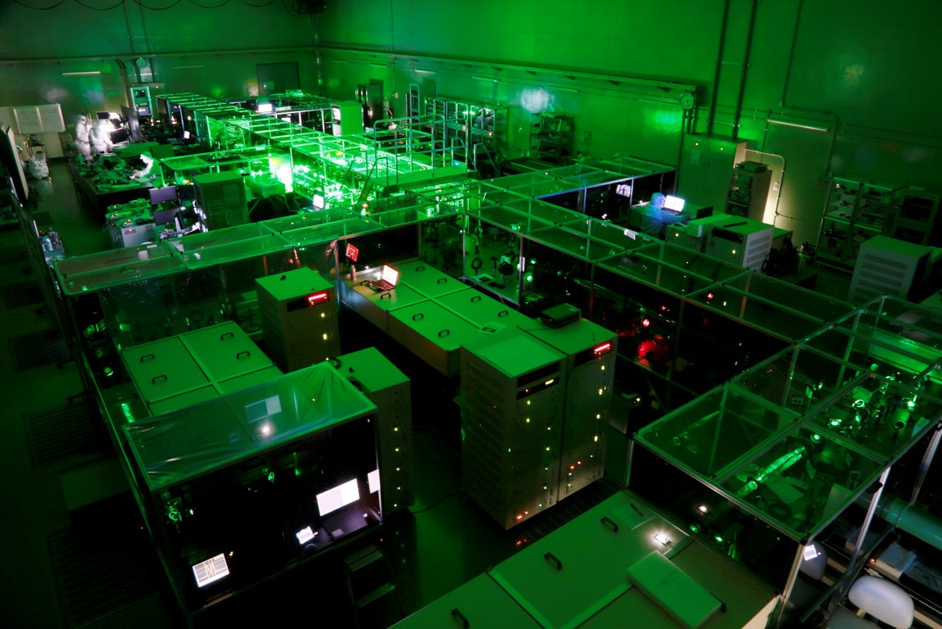

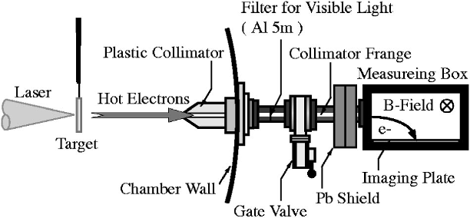
laser

