Slide 1

Neutron transmission as a surrogate to tightly constrain neutron capture rates on radionuclides*
Experiendo cognoscitur
Th. Stamatopoulos¹, P. Koehler¹, C. Blough², E. Bond³, S. Chasapoglou¹, A. Couture¹, B. DiGiovine⁴, S. Essenmacher¹, M. Hochanadel⁵, D. Kral¹, A. Marenco⁶, A. Matyskin⁷, V. Mocko³, T. Morrow¹, J. Morrell³, E. O’Brien³, E. Renner¹, G. Rusev³, D. Schmidt², J. Svoboda¹, J. Ullmann¹, C. Vermeulen³
Physics Division, Los Alamos National Laboratory, 87545, NM, USA
Materials Science and Technology Division, Los Alamos National Laboratory, 87545, NM, USA
Chemistry Division, Los Alamos National Laboratory, 87545, NM, USA
Weapons Engineering Verification & Validation Division, Los Alamos National Laboratory, 87545, NM, USA
Sigma Division, Los Alamos National Laboratory, 87545, NM, USA
Plutonium Supply and Disposition Division, Los Alamos National Laboratory, 87545, NM, USA
Radiation Science & Engineering Center, College of Engineering, Pennsylvania State University, 6801, PA, USA
*Funded by LANL/LDRD-DR,OES, NCSP
10th Workshop on Nuclear Level Density and Gamma Strength, Oslo, Norway
May,18th – 22nd, 2026
LA-UR-26-xxxxx

Slide 2
Table of Contents
Motivation
Neutron transmission measurements
Neutron transmission at LANL
A few highlights
A sneaky peak in the future

Slide 3
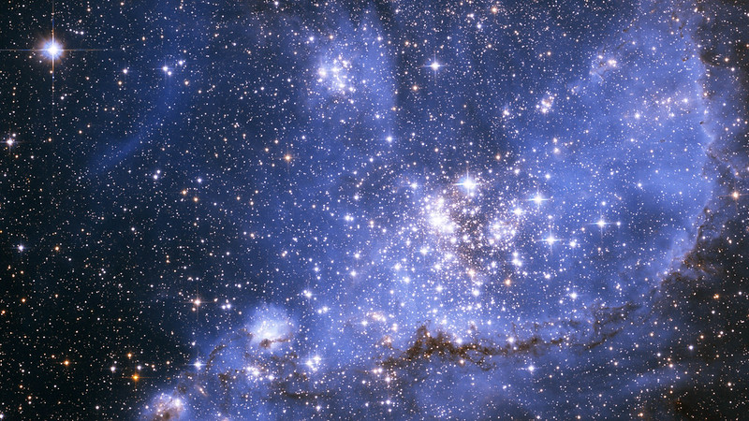
Neutron-induced reaction studies

Slide 4
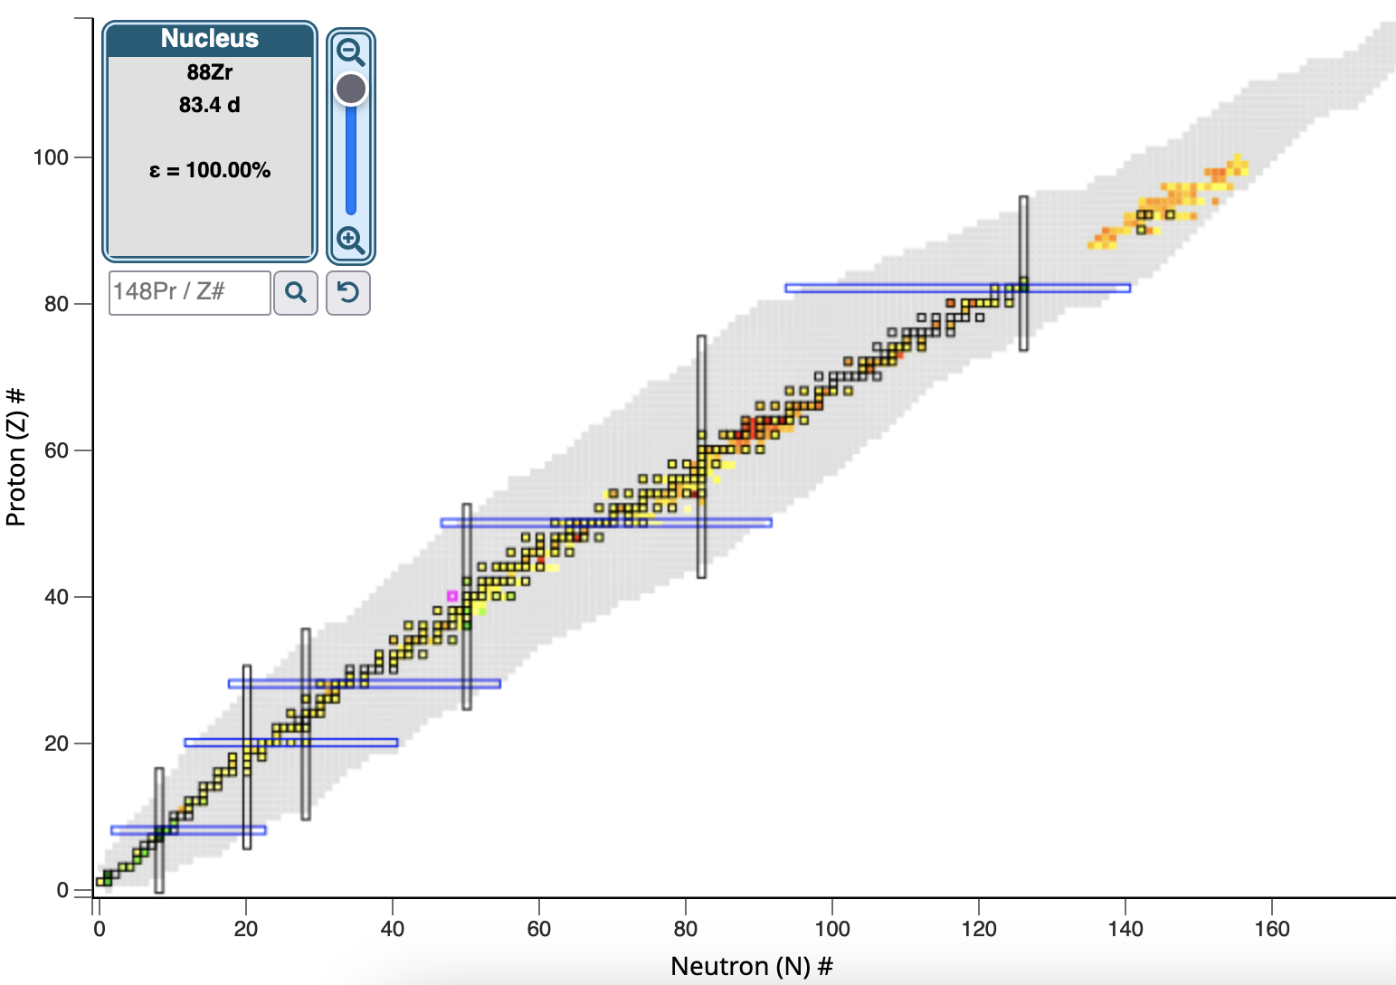
The what-we-know
Capture cross sections at thermal are known mostly for stable isotopes and actinides
Notes:
This work is focused on the (n,g) process. Measuring neutron capture rates it not trivial for radioactive nuclei. Just for fun look at the known (n,g) cross section for 25meV neutron energy. All the grey boxes are unknown. The gray squares are typically radionuclides.

Slide 5
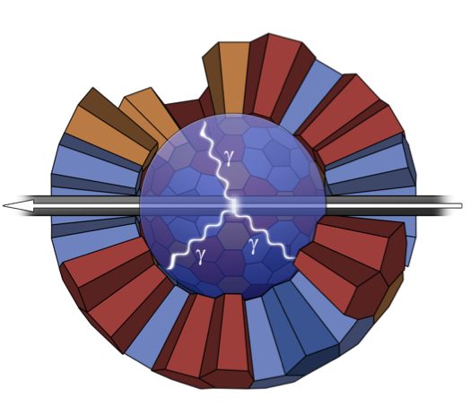
Neutron capture measurements
Neutrons impinge on a sample
Gamma detectors are close to the sample and detect the gammas from the de-excitation.
Works fine for stable or moderately radioactive samples.
What about unstable nuclides?
A new indirect technique is proposed:
Neutron transmission experiments to measure the (n,tot) cross section
R-Matrix fits of the resonances seen in the transmission spectrum
Fit results to calibrate the Nuclear Statistical Model and tightly constrain (n,γ)

Slide 6
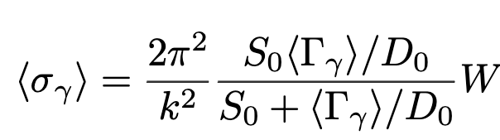
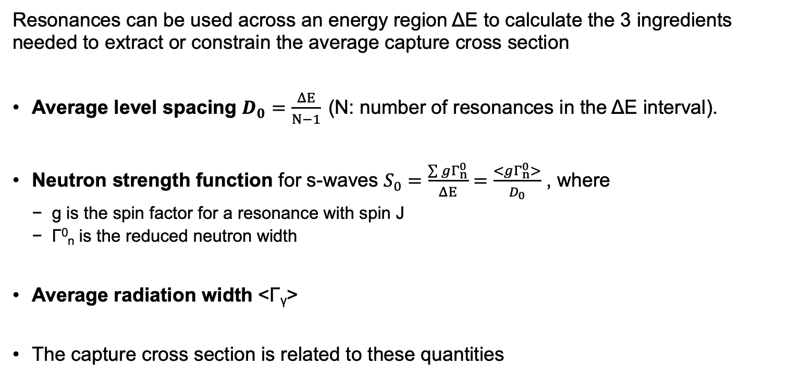

The technique in a nutshell
Resonances can be used across an energy region ΔΕ to calculate the 3 ingredients needed to extract or constrain the average capture cross section
Average level spacing $D_{0}=\frac{ΔE}{N−1}$ (N: number of resonances in the ΔΕ interval).
Neutron strength function for s-waves $S_{0}=\frac{\sum{gΓ_{n}^{0}}}{ΔE}=\frac{<gΓ_{n}^{0}>}{D_{0}}$ , where
g is the spin factor for a resonance with spin J
Γ⁰_{n} is the reduced neutron width
Average radiation width <Γ_{γ}>
The capture cross section is related to these quantities
$$=f(\text{Γ},\text{Γ}\text{n}, D_{0})$$
k : Wave number
W : Width fluctuation factor
Notes:
n the Hauser-Feshbach formalism, the width fluctuation factor represents the effect of the statistical fluctuations in the nuclear levels on the width (or probability) of a particular reaction channel. It accounts for the fact that the widths of these levels are not fixed values but can vary due to the uncertainty principle of quantum mechanics. Essentially, it helps to adjust the predicted cross sections for nuclear reactions to better match experimental data.

Slide 7
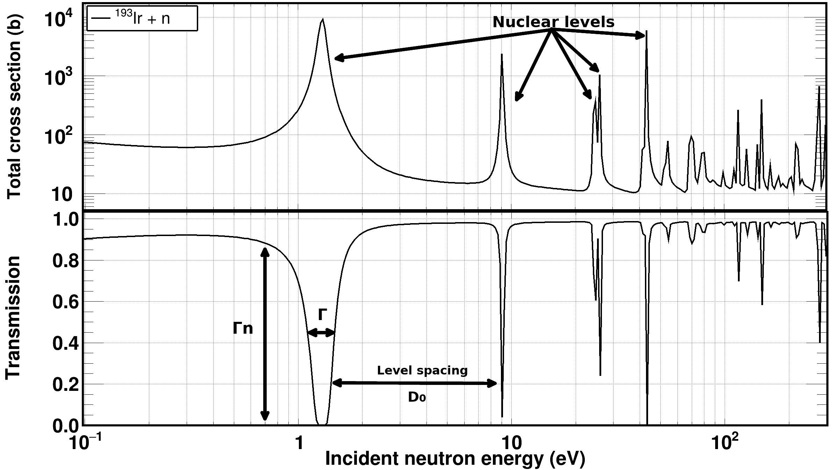
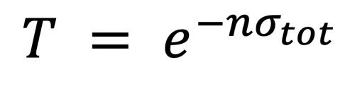

The technique in a nutshell
$$=f(\text{Γ},\text{Γ}\text{n}, D_{0})$$

Slide 8
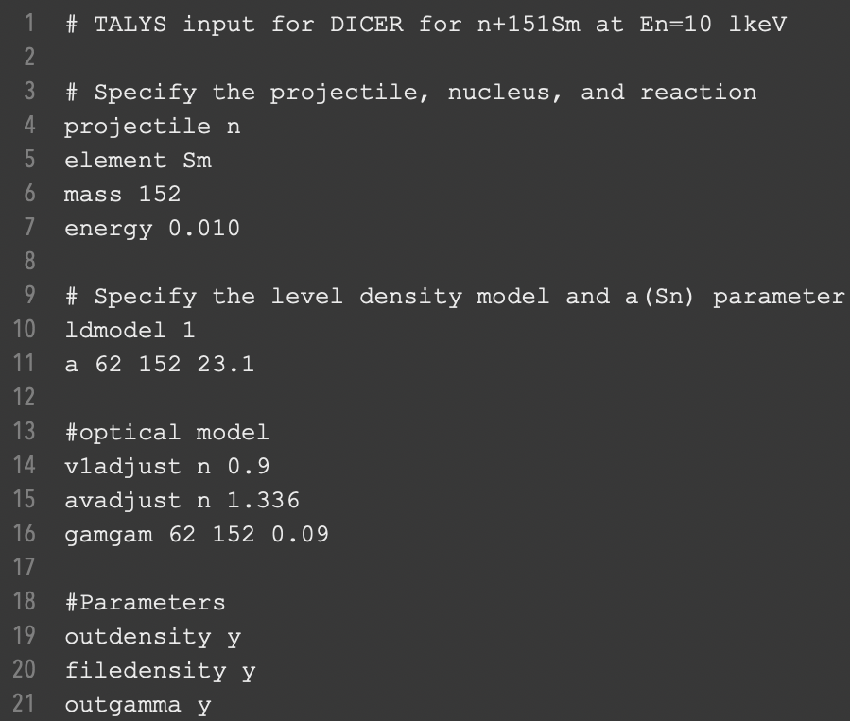
Proof of principle: in brief
Data on ¹⁵¹Sm(n,tot) from Kirouac and Einland (10.1103/PhysRevC.11.895)
Resonance data up to 300 eV (120 resonances)
Resonances were fitted with SAMMY
13 Γ_{γ} values were obtained
<Γ_{γ}> = 96.5(14) meV
Level spacing D₀ = 1.10(7) eV
Strength function 10⁴xS₀ = 3.58(59)
TALYS was adjusted to these values and compared with recent (n,γ) data
Level density parameter α(S_{n})
Optical model potential depth
Optical model potential diffuseness
Photon strength function was normalized to give the <Γ_{γ}> value https://nds.iaea.org/talys/tutorials/talys.pdf
Good agreement with the data in EXFOR

Slide 9
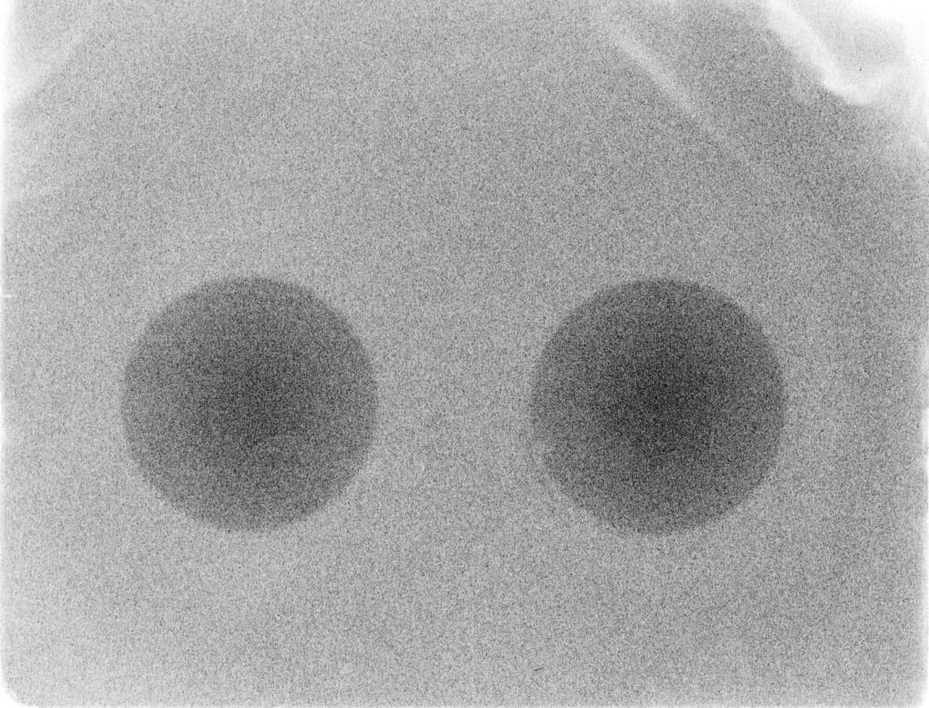
Neutron transmission measurements

Slide 10
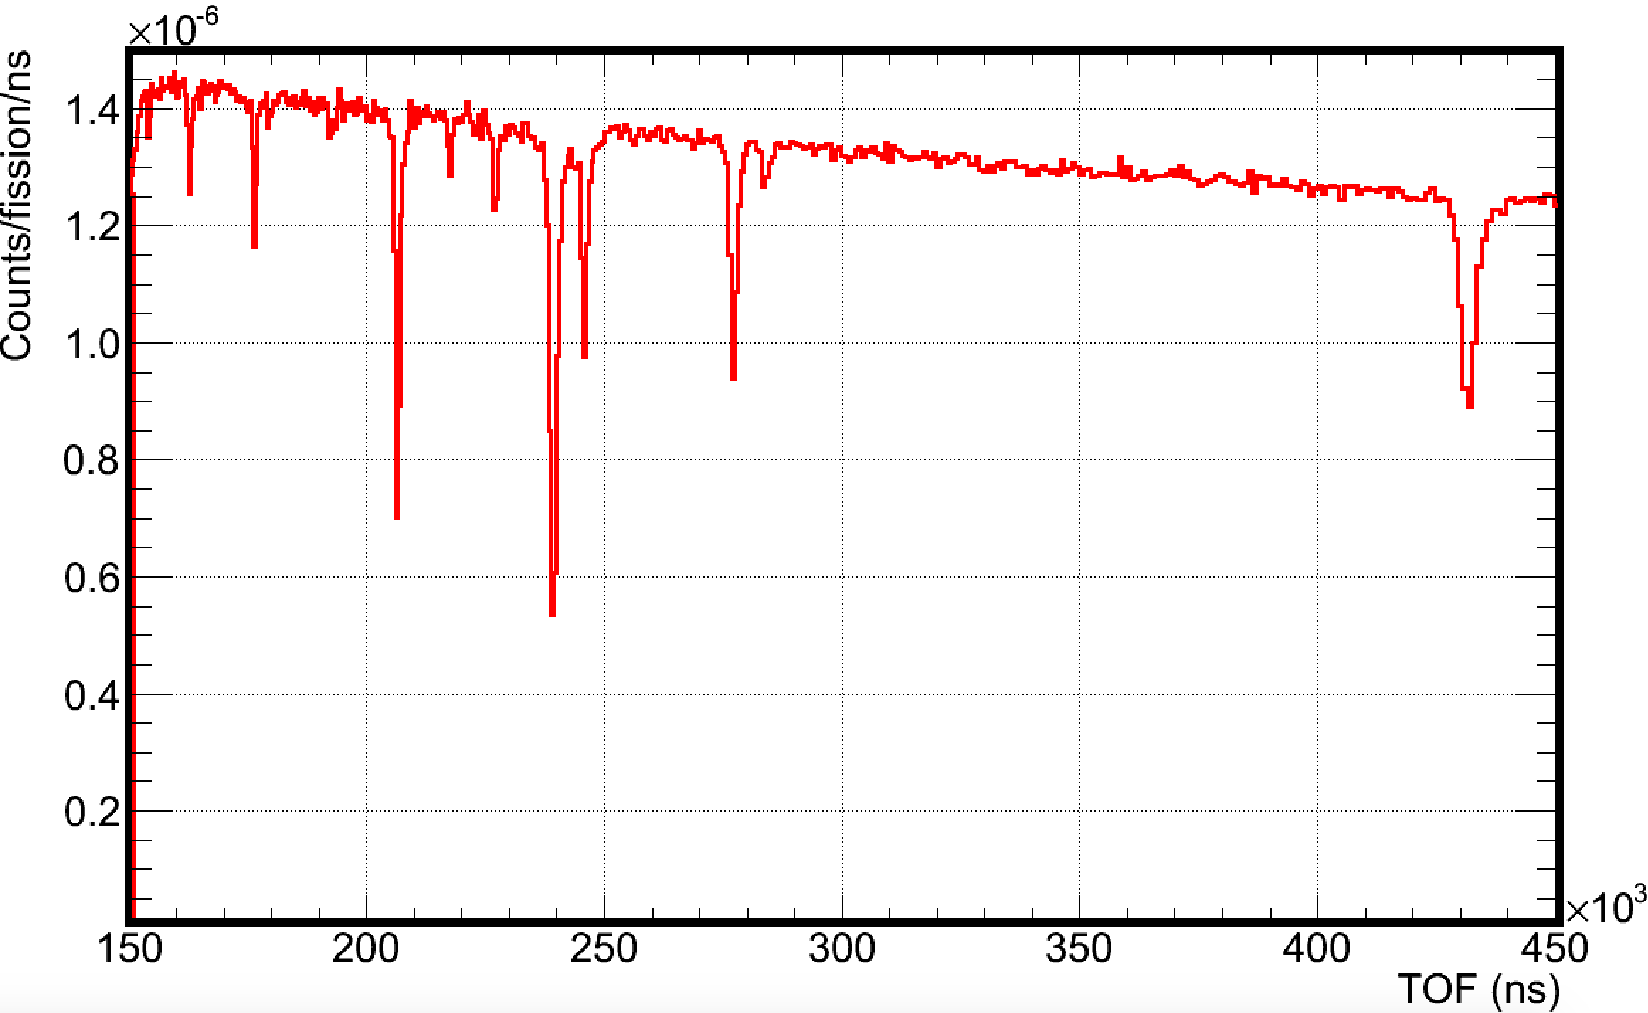
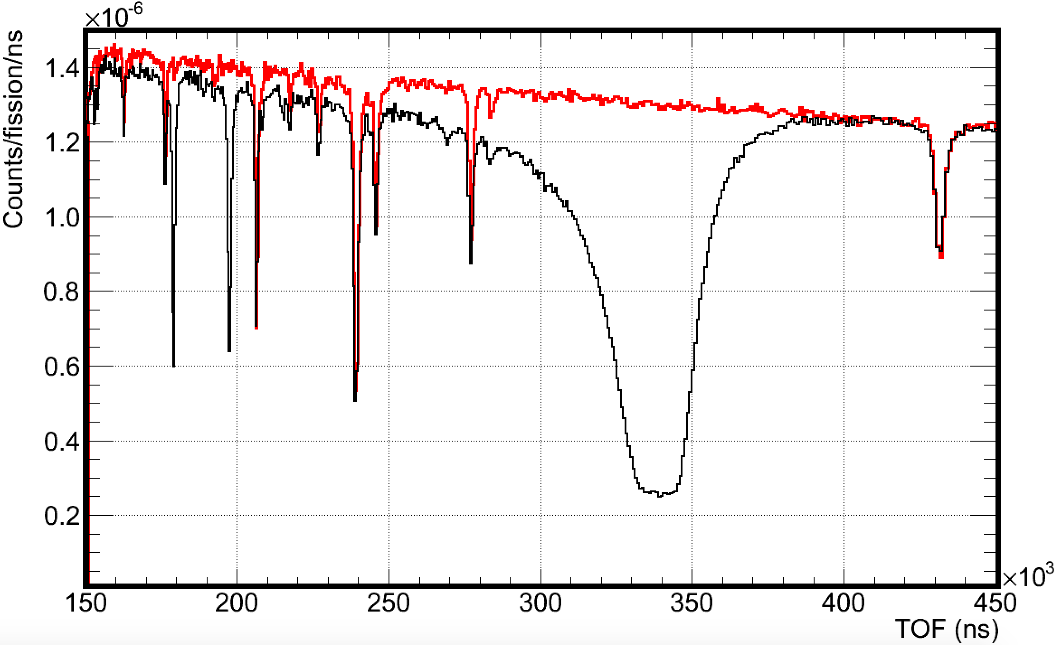

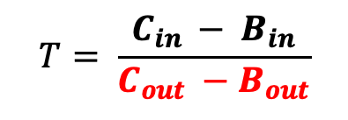
Traditional transmission measurements: How to
The neutron spectrum (C_{out}) and backgrounds (B_{out}) are recorded by a neutron detector (sample out)
A sample, (~cm in diameter), is installed and absorption dips appear (sample in)
The transmission T is the ratio sample in/out
Transmission measurements provide information on the total (Γ) and neutron (Γ_{n}) widths and the level spacing (D₀) Γ : Transmission dip width Γ_{n} : Transmission dip depth D₀: Distance between transmission dips
~10m
~10m
Collimator
Neutron
detector
Neutron
beam
Γ
$$T= \frac{C_{in }− B_{in}}{C_{out} −B_{out}}$$
Γ_{n}
D₀
$$=f(\text{Γ},\text{Γ}\text{n}, D_{0})$$

Slide 11
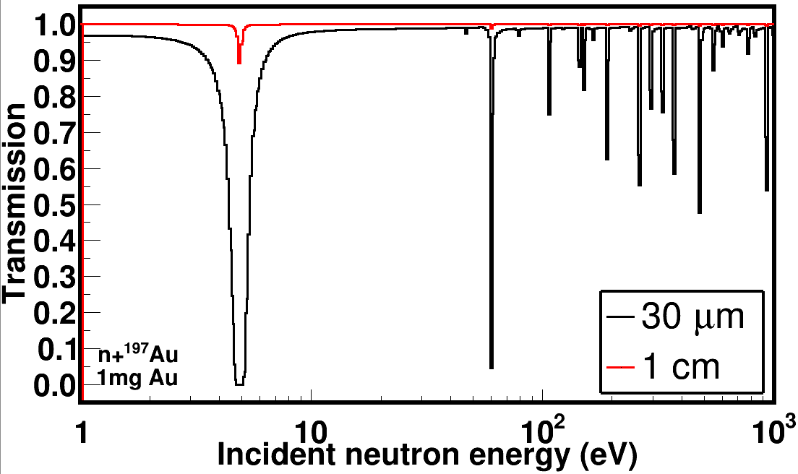
Traditional transmission measurements: Challenges
Example: we only have 1mg of Au and our collimator is 1cm in diameter
Cylindrical Au sample: 1 cm diameter → Length = 0.7μm → areal density = 3.882e-6 at/b.
The sample is too thin to observe resonances.
We need to have a longer (or thicker) sample to see resonance dips.
If areal density = 1e-3 at/b → Length = 169 μm (chose “any” value) → 30μm diameter
Limited mass
Hard to produce large amounts of radioactive materials (budget, half-lives)
Dose rates
Given mass and length restrict the volume.
Reducing the diameter seems to be a solution

Slide 12
Traditional transmission measurements: More challenges
Sample cycling is needed therefore a positioning system must be utilized.
Positioning systems have a finite accuracy and that’s a serious bottleneck, in cycling small and radioactive samples
Repositioning precision and risk mitigation
Precise repeatability of the sample’s position, relative to the collimation system, is not necessarily ensured.
What if…the sample didn’t have to move…?

Slide 13
Non-traditional measurements: Binocular approach
Binocular mode of operation: Simultaneous measurement of sample in and out
2 non-parallel beam lines, 1mm in diameter that point to the same area on the neutron production target.
No precise repositioning concerns, as long as the sample is precisely positioned beforehand: metrology network ~10μm and ~10 mdeg accuracy
Knowing where a pencil lead is positioned across the length of a basketball court
Added bonus: measurements are completed in half the time!
Not to scale
Collimator
Target/moderator
Neutron
detectors
Neutron
beam
~15m
~15m

Slide 14
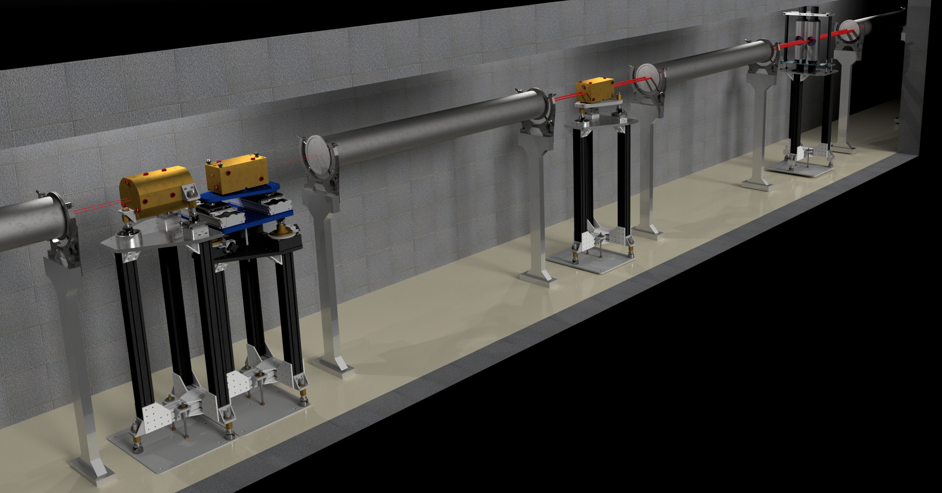
Neutron transmission at LANL

Slide 15
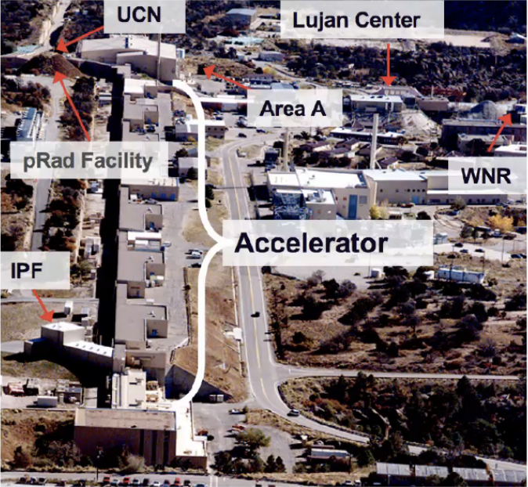
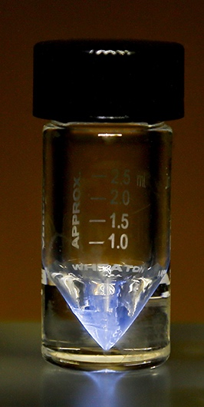
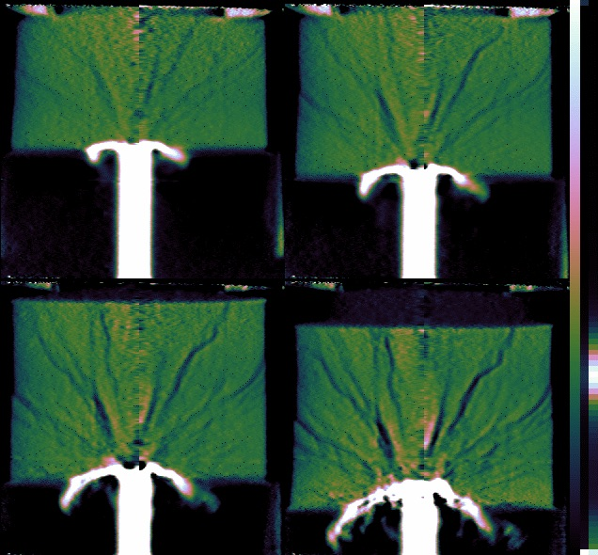
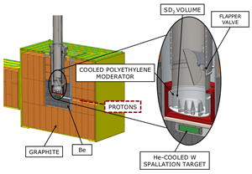
LANSCE: The Los Alamos Neutron Science Center
1 km long LINAC
Up to 800 MeV protons
Multi-user proton (p) and neutron (n) facility
Isotope Production Facility (IPF) (100 MeV p)
Proton irradiation (pRad) (800 MeV p)
Ultra Cold Neutrons (UCN) (<300 neV n)
Lujan Center (meV – keV n)
WNR (keV – MeV n)
Target 4 (500 - 800 MeV p)

Slide 16
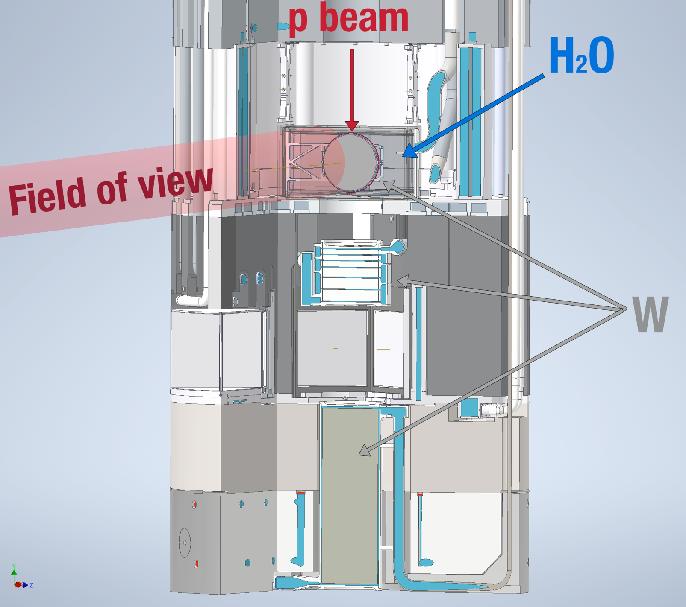
Mark-IV (M4) : New neutron target at Lujan, est. 2022
800MeV protons impinge on a 3-way split W target.
DICER points to the H₂O moderator and the target
P. Koehler
Simulation

Slide 17
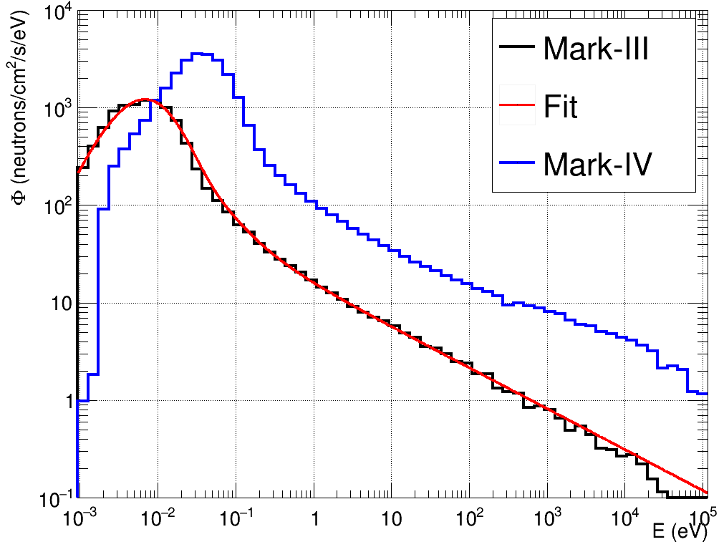
Neutron spectrum
Mark-IV provides an enhanced keV spectrum compared to Mark-III
Mark-IV is expected to improve the neutron energy resolution
Preliminary
S. Chasapoglou
Th. Stamatopoulos

Slide 18
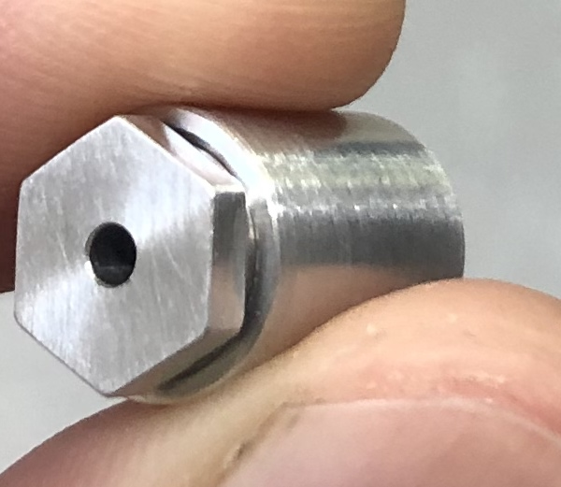
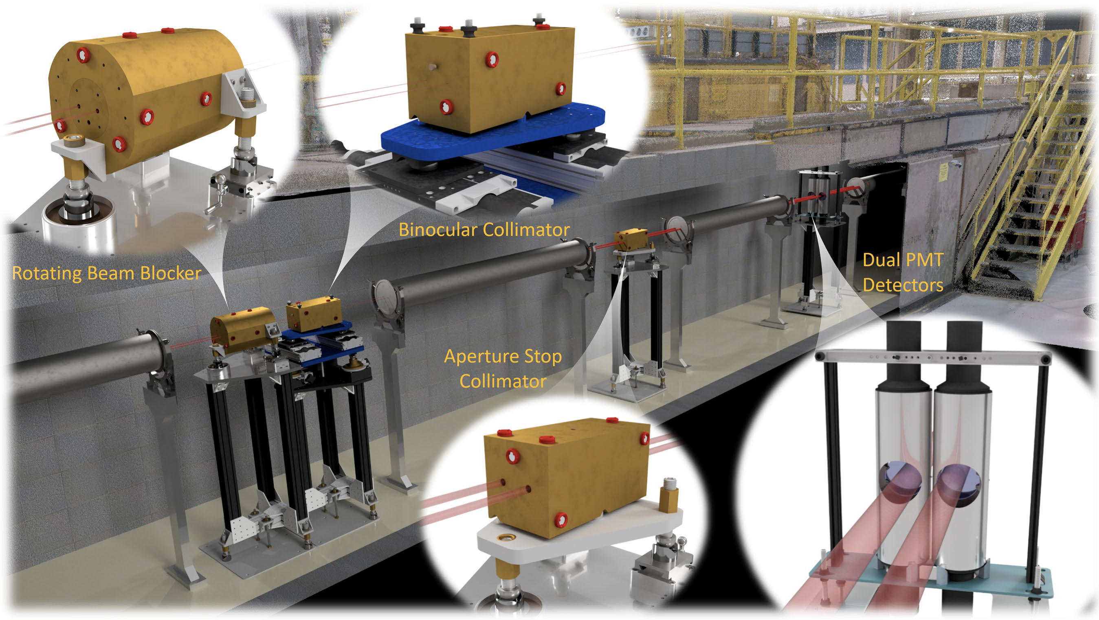
Description of the apparatus:
Device for Indirect Capture Experiments on Radionuclides
P. Koehler
Th. Stamatopoulos
A. Couture
B. DiGiovine
G. Rusev
J. Ullmann
A. Stamatopoulos et al., NIMA (1025) 166166, 2022
A. Stamatopoulos et al., IEEE Trans. Nucl. Science 70, (2023)
A. Stamatopoulos et al., Neutron News 33, 12 – 14 (2022)

Slide 19
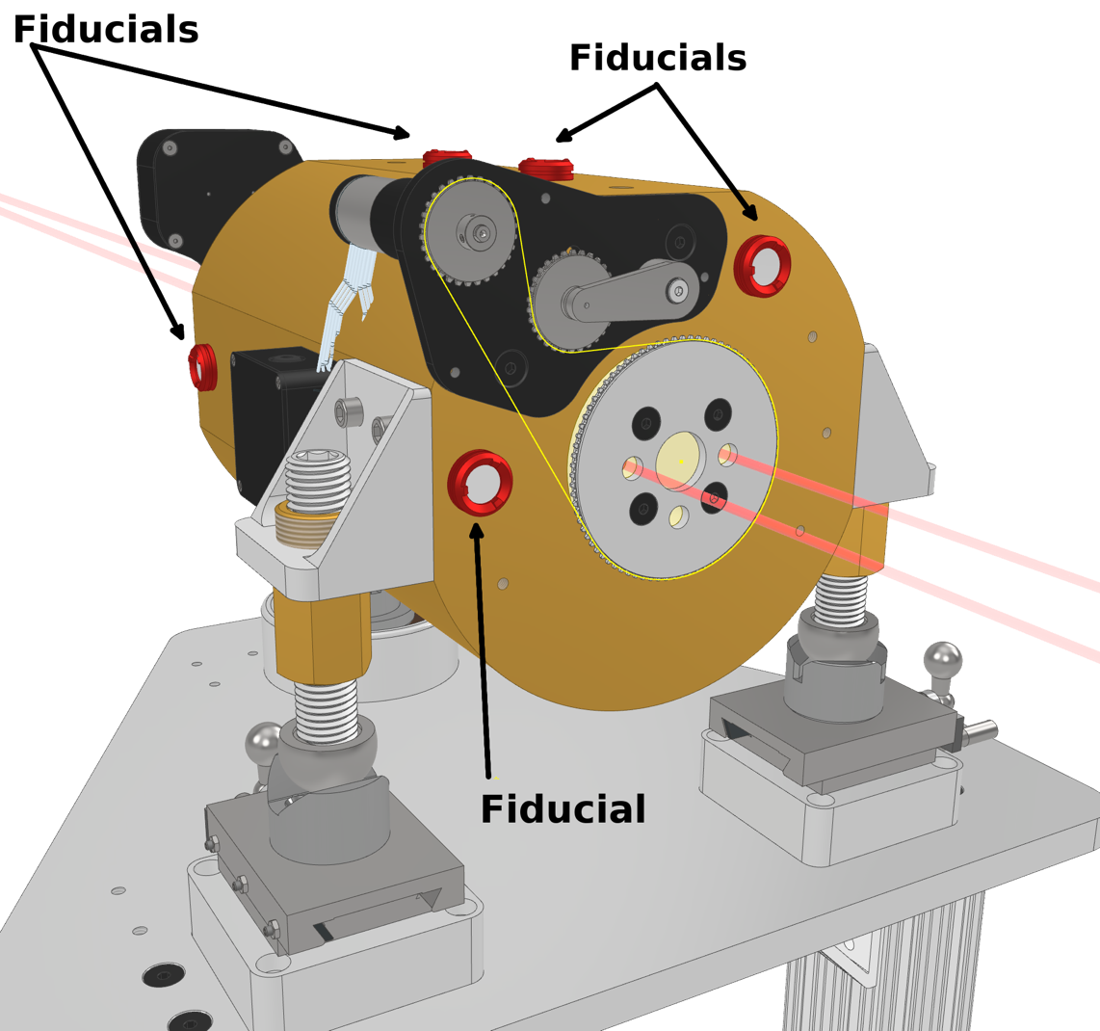
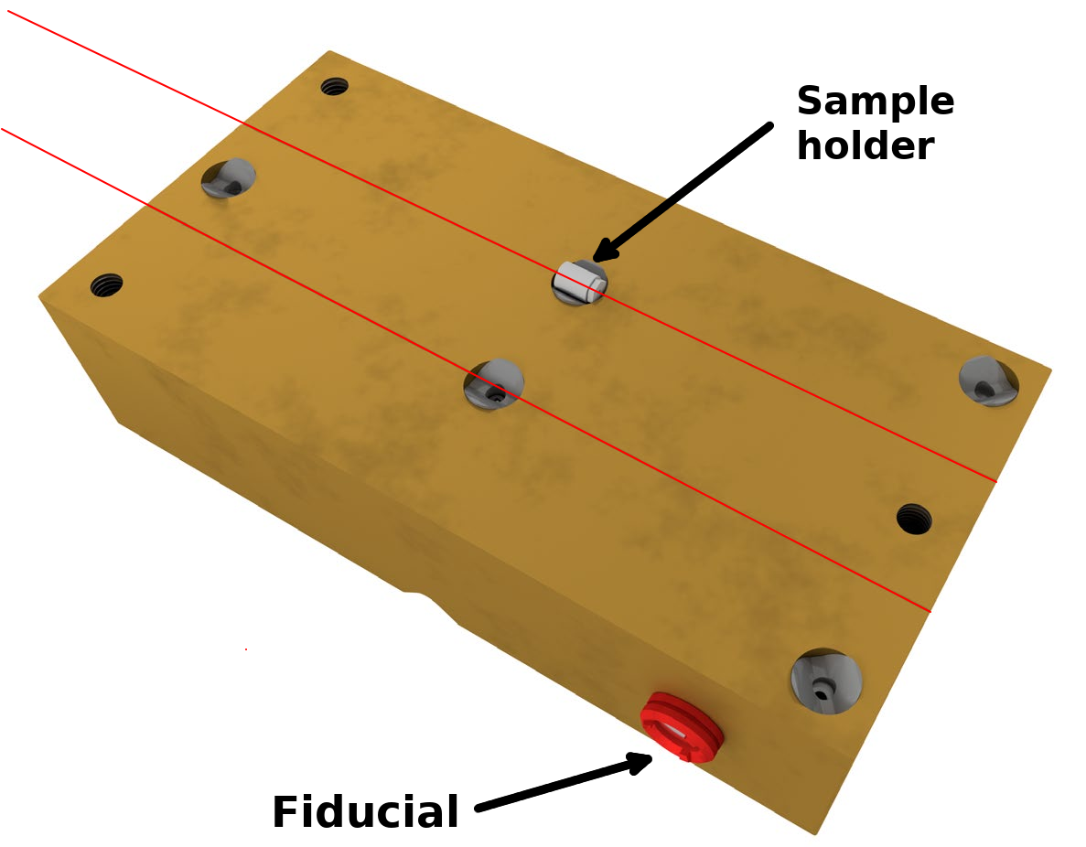
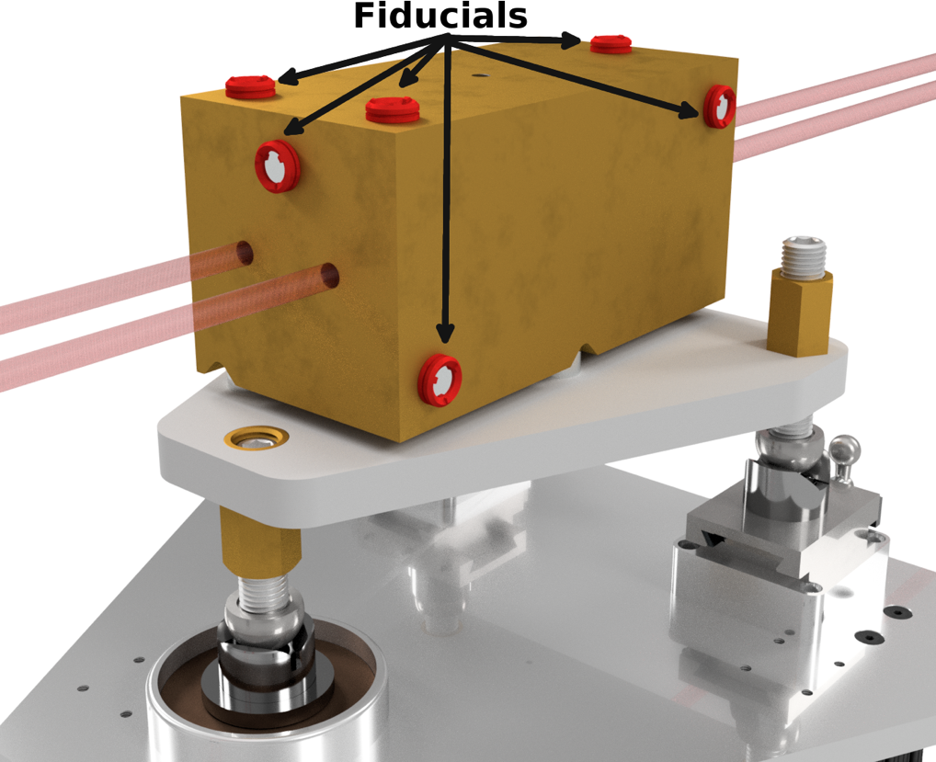
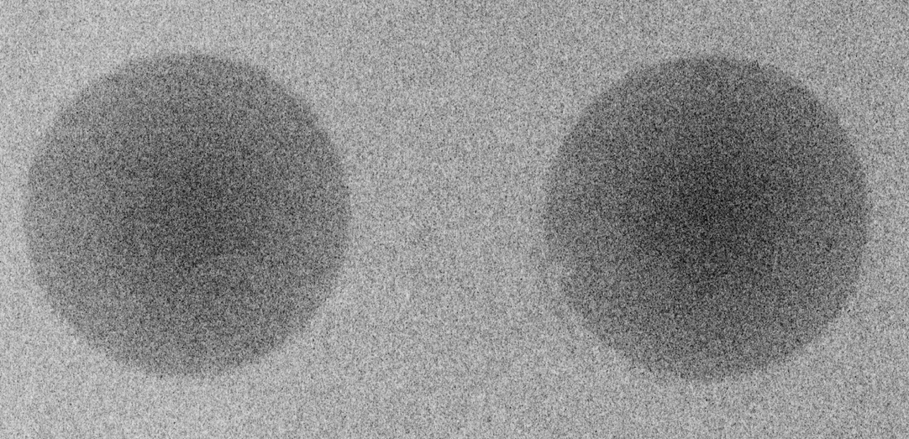
Sophisticated collimation system
Rotating beam blocker
Binocular collimator
Aperture stop
Cuts off the beam penumbra
Ensures two sharp beam spots at a 31 m, 9.5 cm in diameter
Rotating inner cylinder with 3 holes
30 cm in length
Provides 0 - 2 beams
Stepped design to avoid neutron stream paths
Remotely controlled
Divided in a top and bottom part
Sample is installed in the collimator in the Maxwell kinematic stops
1.5 cm length, 1 cm diameter sample envelope
1 mm collimation
Kinematic stops ensure repeatability when installing the top part.

Slide 20
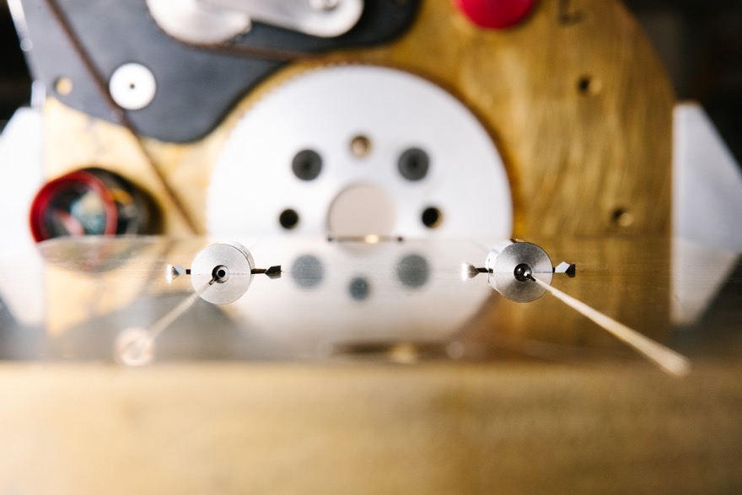
Sophisticated collimation system
Rotating beam blocker
Binocular collimator
Aperture stop

Slide 21
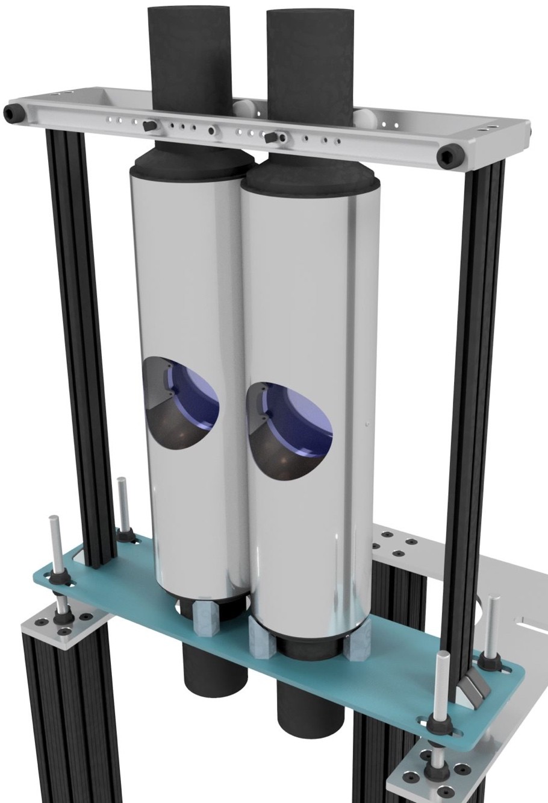
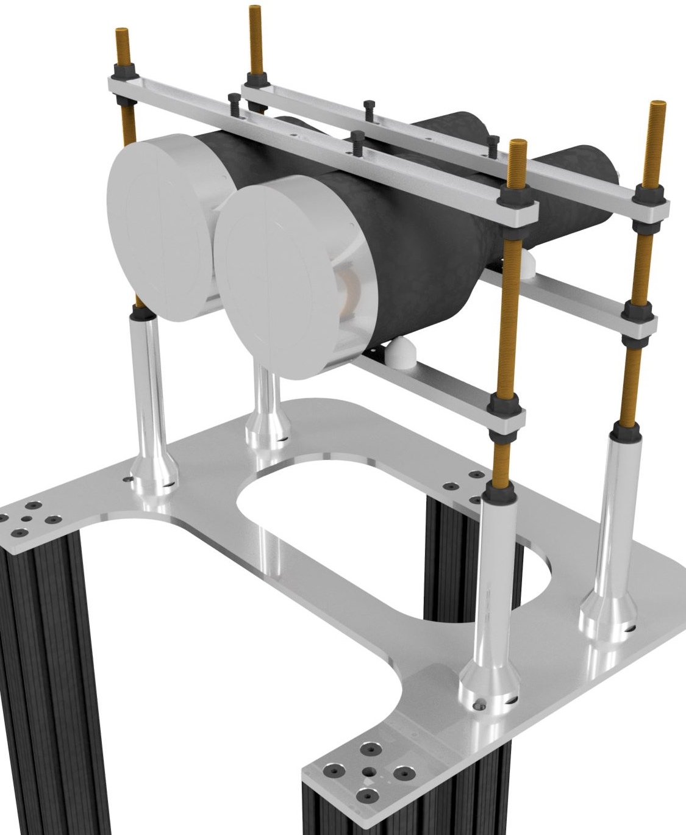
Single pixel detectors
A commercial ²³⁵U loaded fission chamber is installed at ~7.8 m from the neutron source, to monitor the flux.
Two types of single pixel ⁶Li-glass neutron detectors are available
ORELA type: Dual PMT detector. - Chi-nu type : Single PMT detector. Less material in beam PMT in contact with glass Poorer light collection More material in beam
Currently exploring a detection system based on CLYC

Slide 22
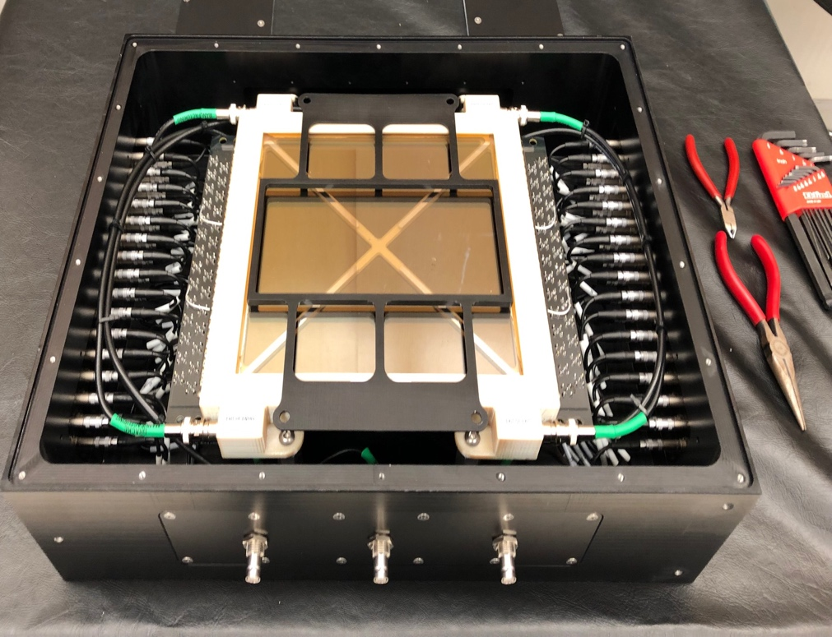
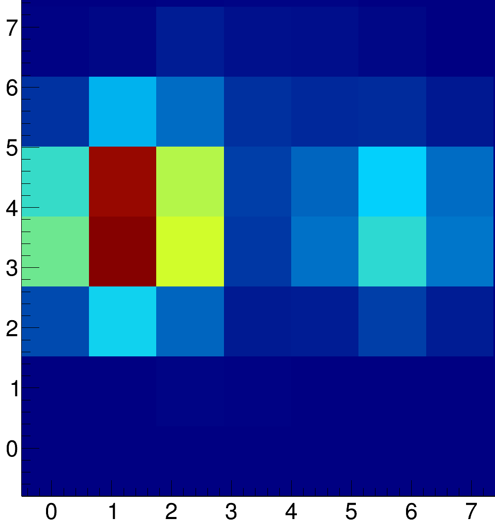
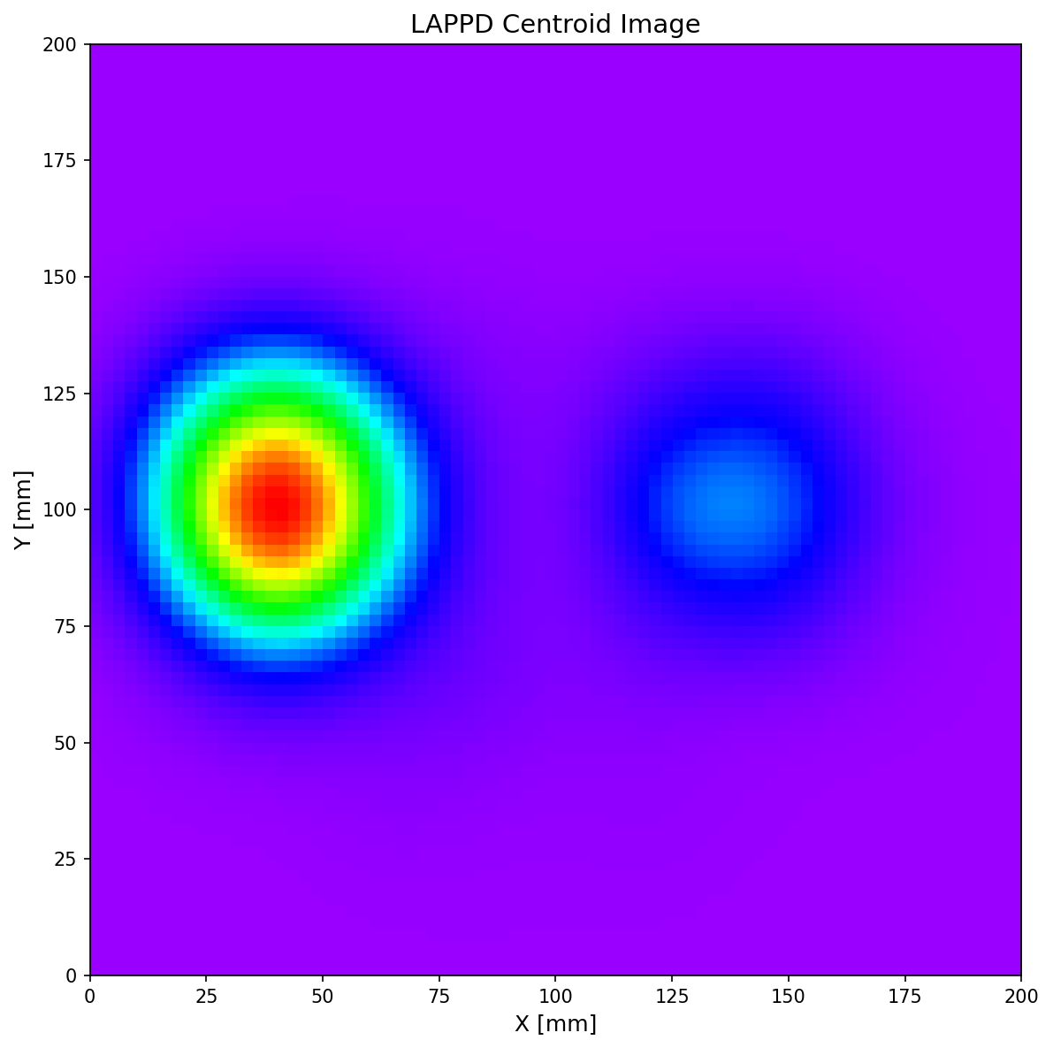
Multipixel detector
The Large Area Picosecond Photo-detector (LAPPD) is a multi-channel plate (MCP) based detector, able to provide spatial information (nominally ~mm)
8 x 8 pads, 20 x 20 cm total coverage area
B. DiGiovine
A. Couture
Th. Stamatopoulos
D. Kral
20 cm
20 cm

Slide 23
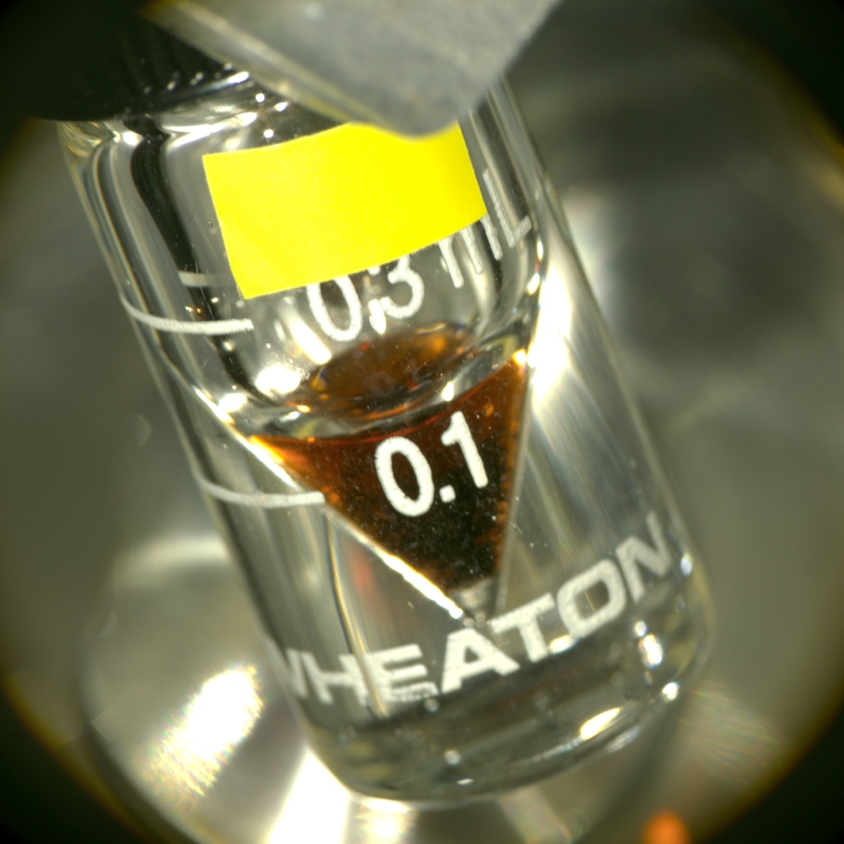
A few highlights

Slide 24
Laundry list
Measured
Will be measured in the near future
Could be measured
¹⁹¹Ir
¹⁹³Ir
^{nat}Cl
^{nat}Cd
^{nat}Gd
^{nat}Bi
¹⁹⁷Au
²³⁹Pu
⁹⁵Mo
^{nat}Cu
¹⁴⁷Sm
¹⁴⁹Sm
⁸⁸Zr
¹³³Cs
⁶³Cu
¹⁰³Rh
¹⁵¹Sm
⁸⁸Y
^{nat}Y
⁴⁰Ar
²³⁹Pu (keV–MeV)
¹⁶⁷⁻¹⁷¹Tm
^{73,74,75}As
^{56,57,58}Co
⁸⁵Kr
³⁶Ar
⁴⁰K
⁷⁰Zn
^{72,73}Ge
^{77,82}Se
^{98,99}Ru
¹⁰⁷Pd
¹⁴⁵⁻¹⁵⁶Eu
^{153,157}Gd
^{160,161}Tb
^{163,166}Ho
¹⁶⁹Er
¹⁷⁵Yb
^{179,180m}Ta
^{173,174}Lu
¹⁸⁵W
¹⁸⁶Ru
¹⁹¹Os
^{110m}Ag
¹³⁴Cs
¹⁴⁷Nd
¹⁴⁷Pm
¹³⁵Xe
³⁵Cl

Slide 25
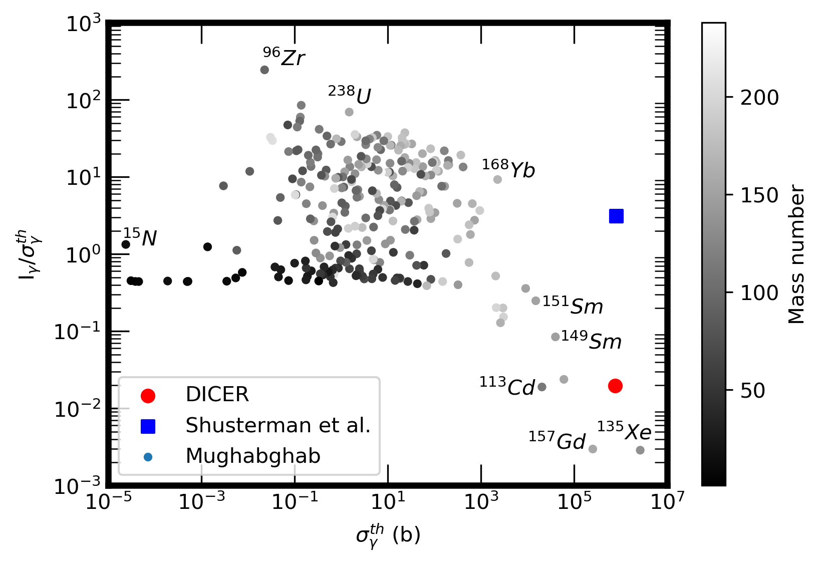
The curious case of ⁸⁸Zr (t_{1/2} = 83.4 days)
LLNL: σ_{γ}^{th} = 0.861(69) Mb Shusterman et al., Nature 565, p 328 (2019)
LLNL: I_{γ} = 2.530(280) Mb Shusterman et al., PRC 103 124614 (2021)
Systematic study taking data from Mughabghab reveals that this is an odd combination

Slide 26
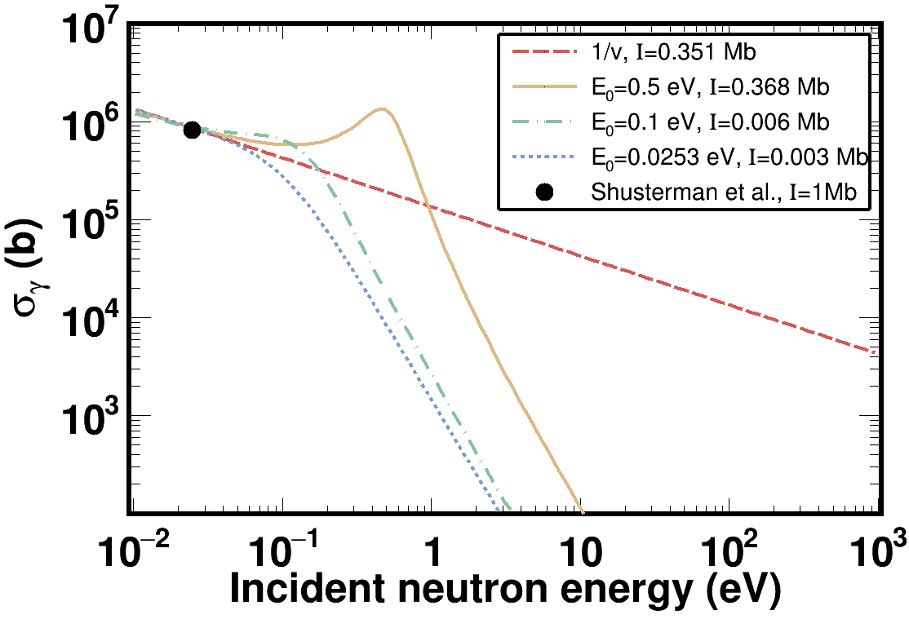
The curious case of ⁸⁸Zr (t_{1/2} = 83.4 days)
It’s even hard to model such combination
SAMMY with different combinations didn’t yield such an enormous I_{γ}.

Slide 27
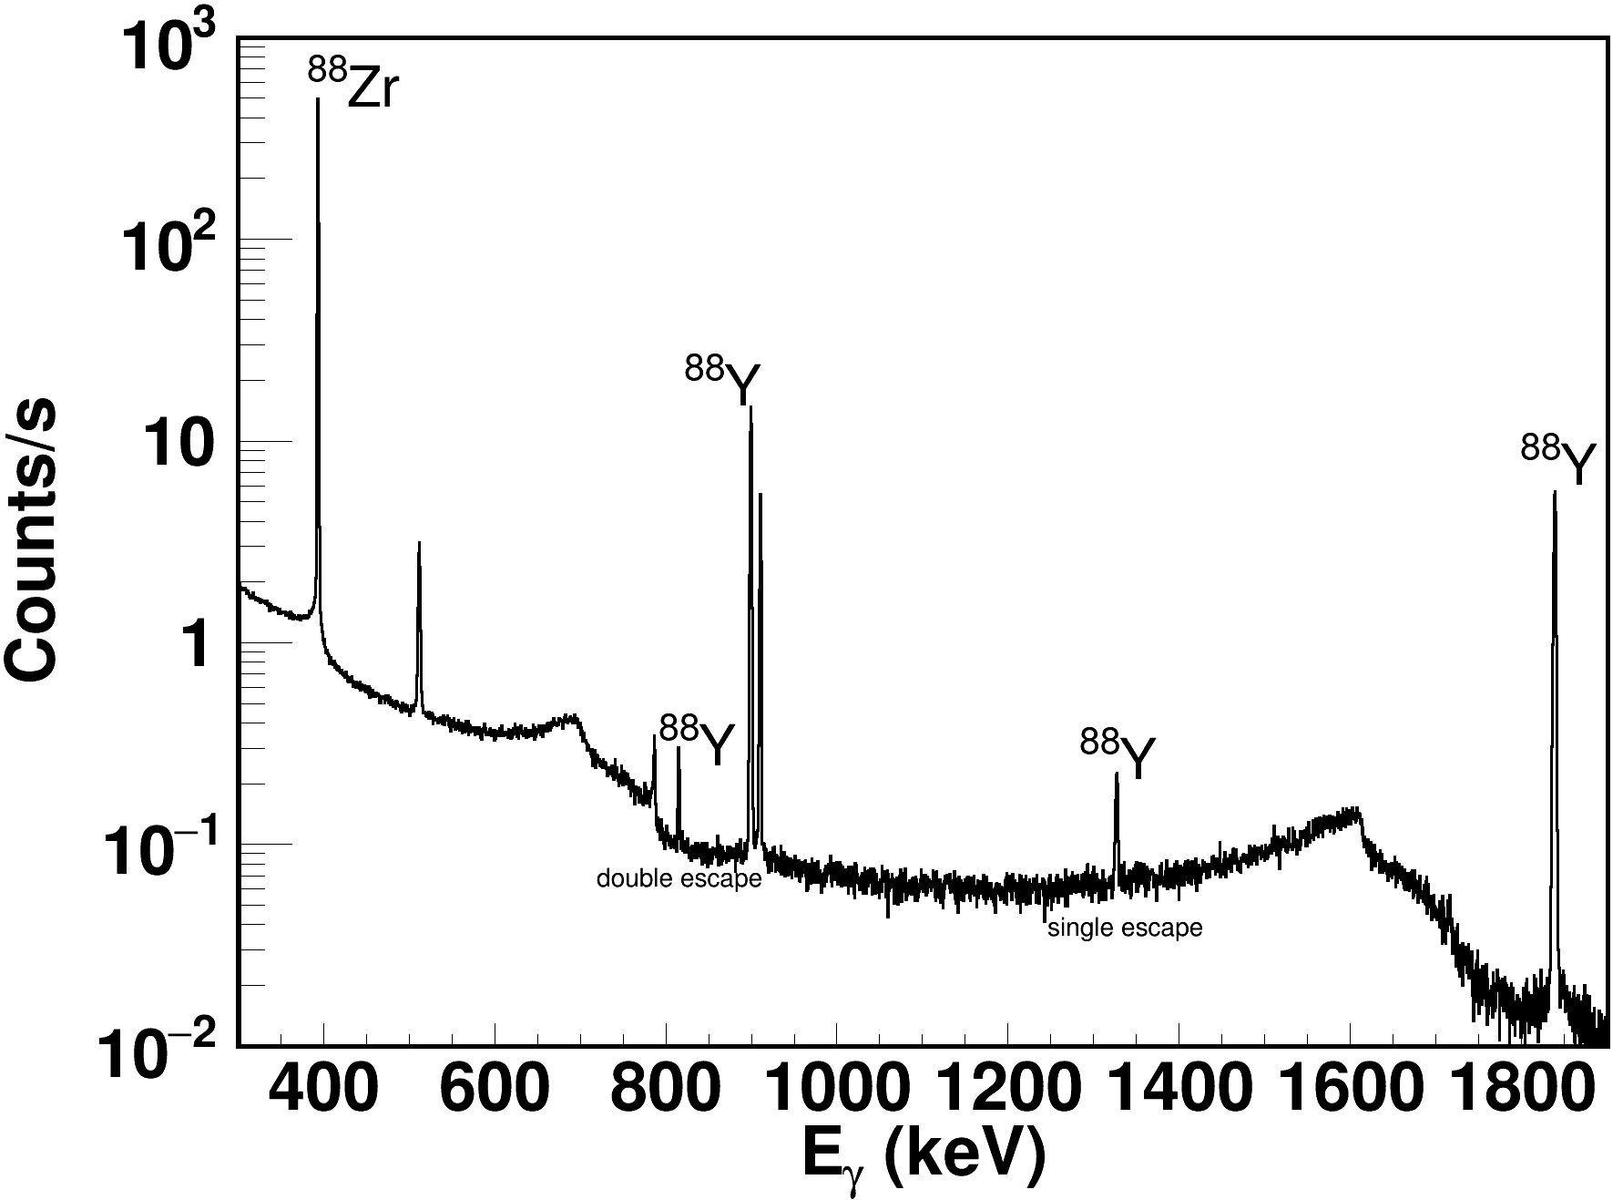
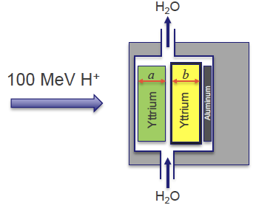
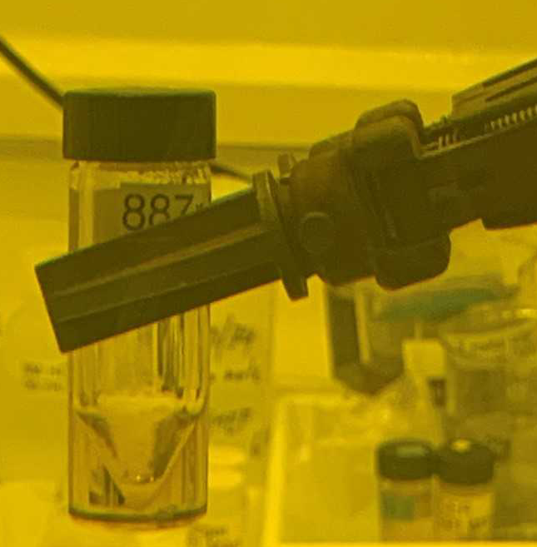
DICER - IPF synergy: The ⁸⁸Zr case – LANL Directed Research
The radioactive sample fabrication relies on the synergy between DICER and IPF
Proton irradiation of a suitable bulk material
Chemical separation and purification (600 mCi, 10 mL ⁸⁸Zr + D₂O●6mol/L DCl )
Gamma spectroscopy
A. Matyskin
V. Mocko
B. DiGiovine
Th. Stamatopoulos
A. Matyskin et al, Scientific Reports 13, 1736 (2023)
A. Stamatopoulos et al., EPJ., Conf. 260, 03006 (2022)
A. Stamatopoulos et al., J. Rad. Nucl. Chem. 331, (2022)

Slide 28
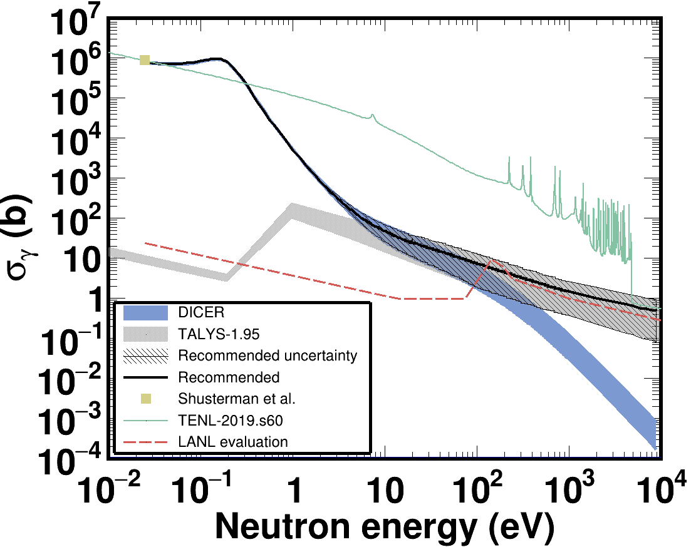
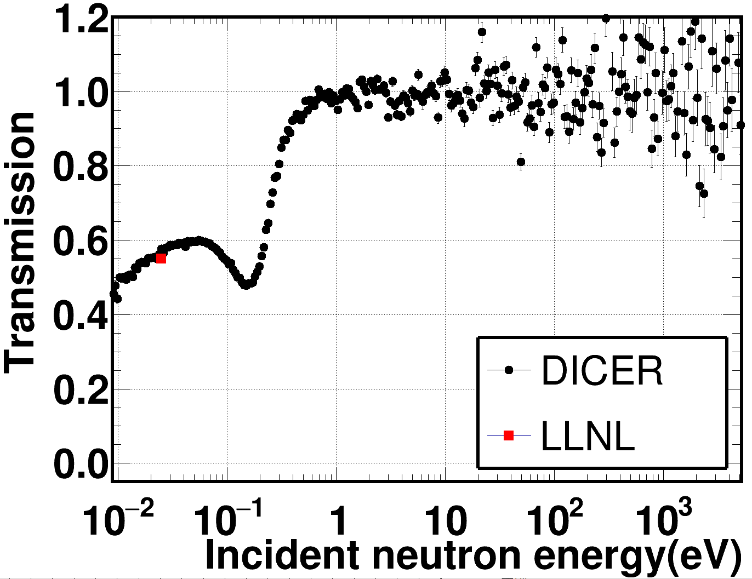
Results
Compatible cross section: σ^{th}_{DICER} = 771(31) kb vs σ^{th}_{LLNL} = 861(69) kb
Incompatible resonance integral: I_{DICER} = 15.21(67) kb vs I_{LLNL} = 2530.0(280) kb
1 keV MACS in agreement with LANL evaluation MACS_{DICER} = 1.6(12) b. vs MACS_{LANL} = 1.1 b

Slide 29
The curious case of ⁸⁸Zr (t_{1/2} = 83.4 days)

Slide 30
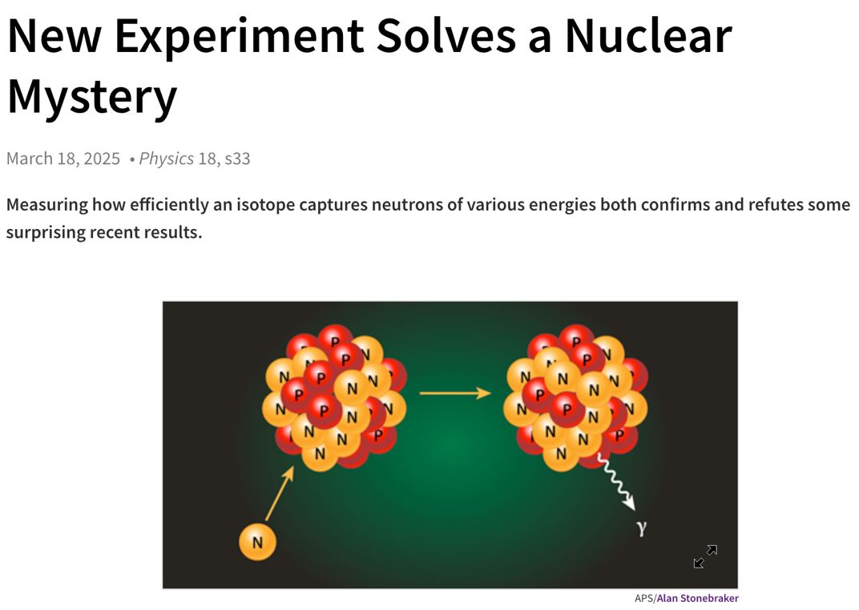
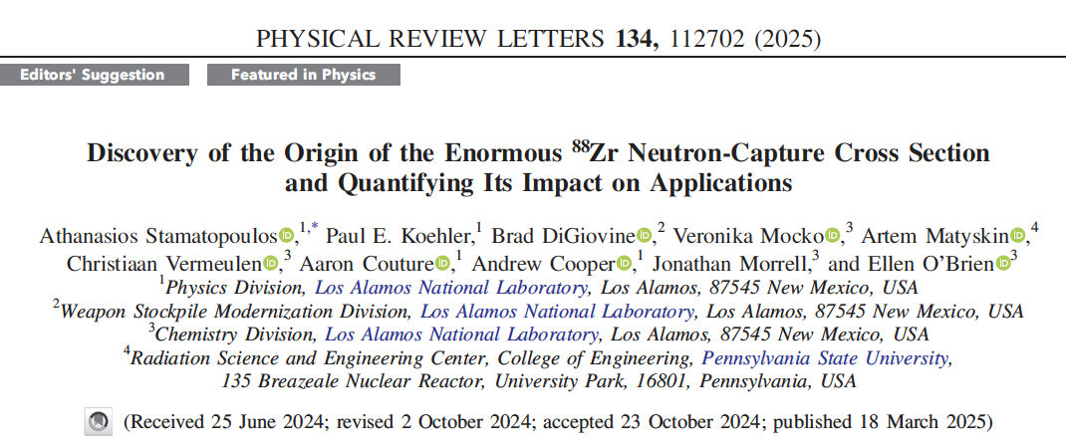
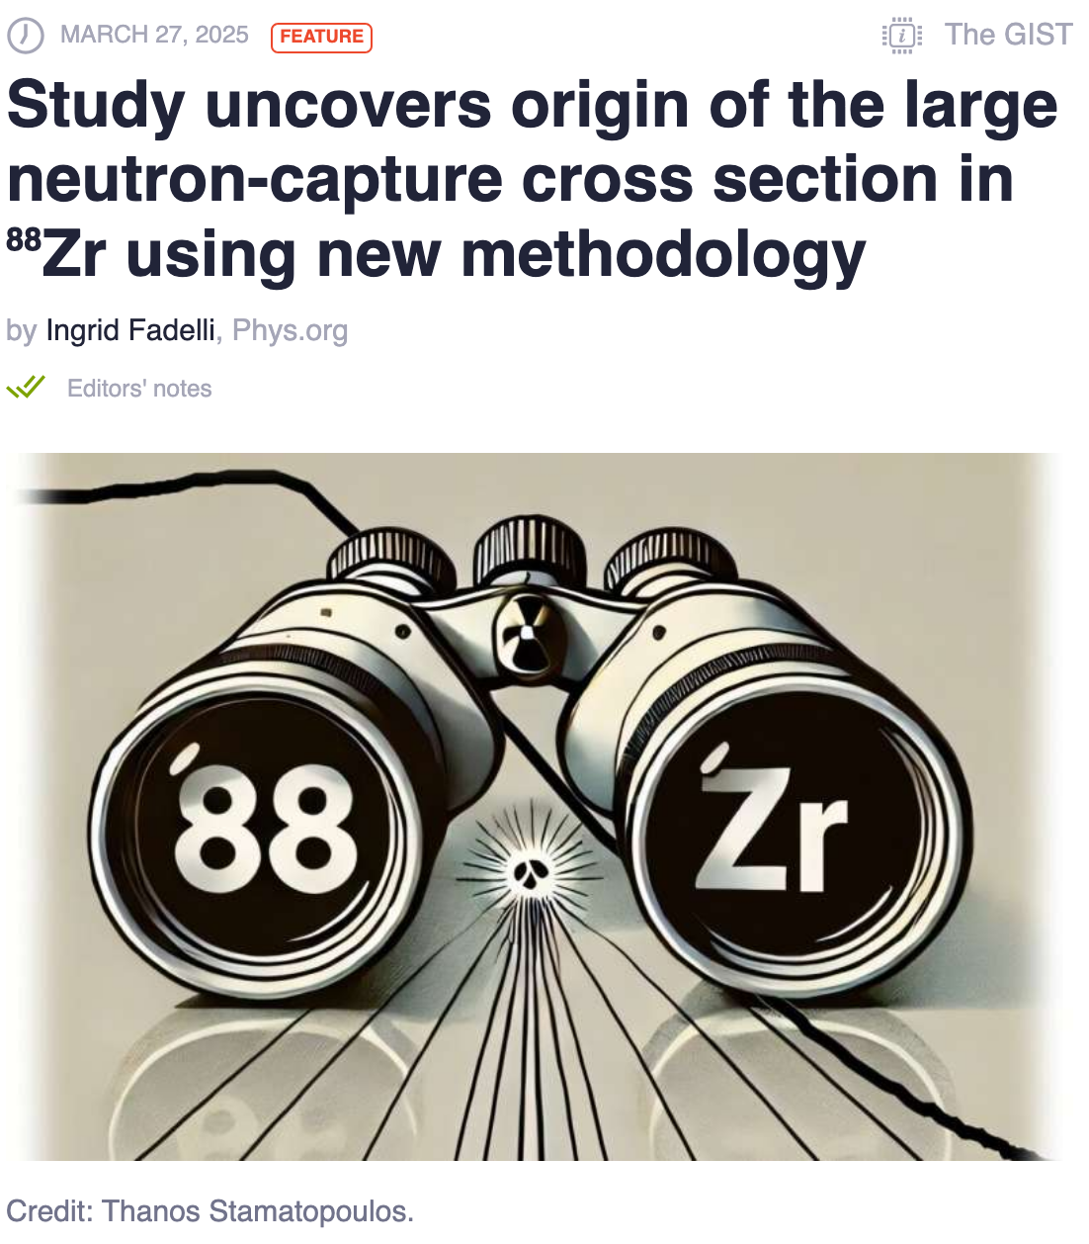
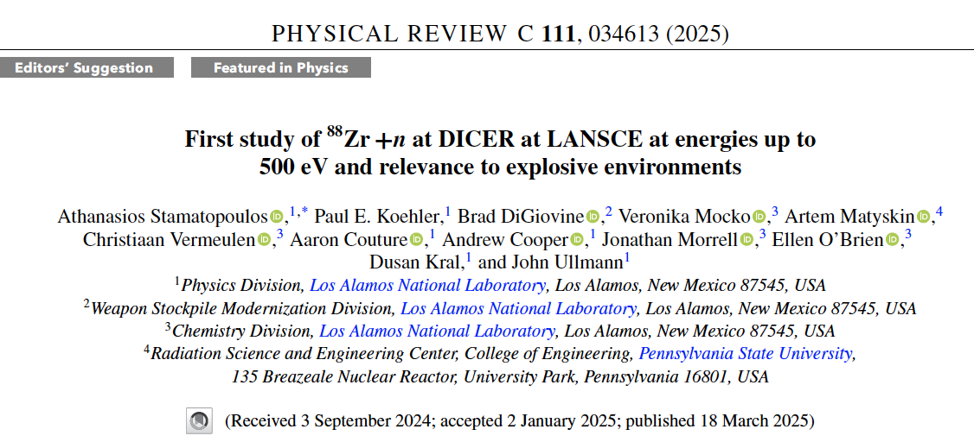
The curious case of ⁸⁸Zr (t_{1/2} = 83.4 days)
Results published in Phys. Rev. Lett. and C.
Already compiled in EXFOR (2025ST03)
Next ENDF

Slide 31
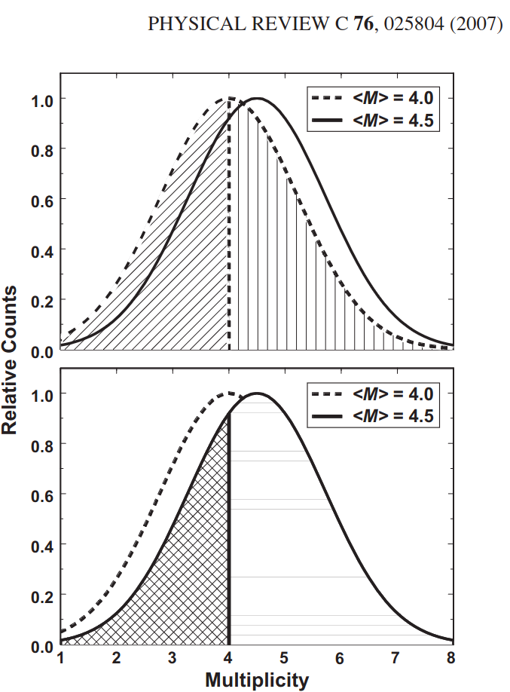
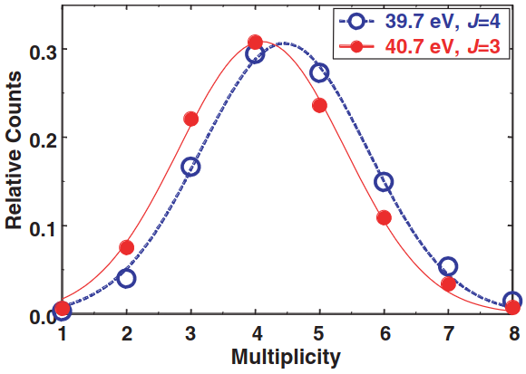
n+¹⁴⁹Sm : Capture and transmission – Nuclear Criticality Safety Program
Detector for Advanced Neutron Capture Experiments (DANCE)
~4π calorimeter
DANCE to get the capture yields
DANCE also provides multiplicities
Different multiplicity distributions for different spins
DANCE is used as a spinometer

Slide 32

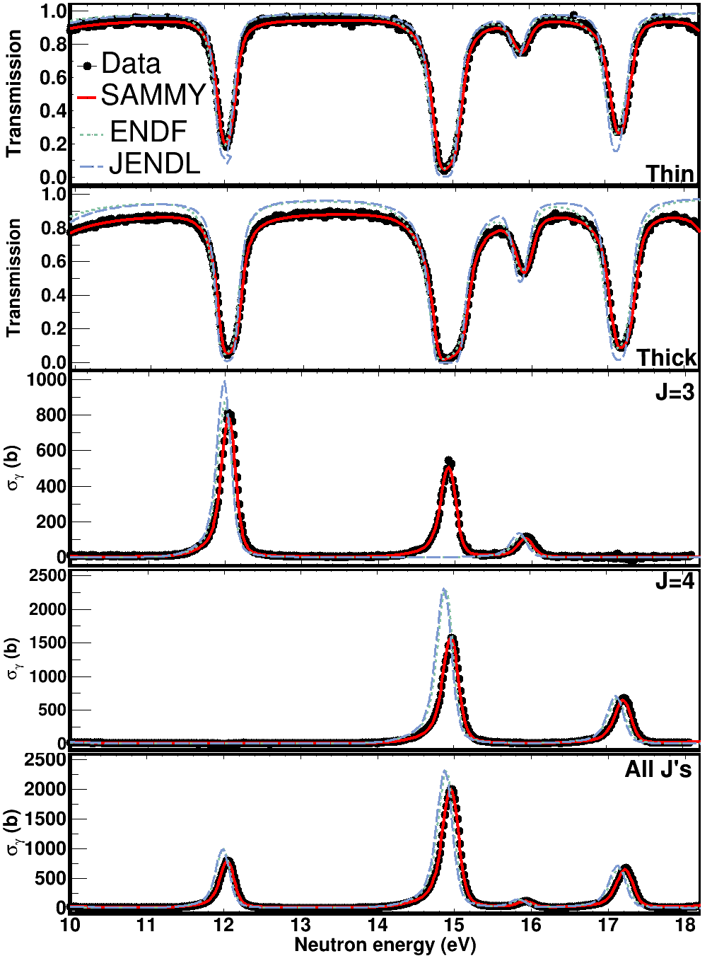
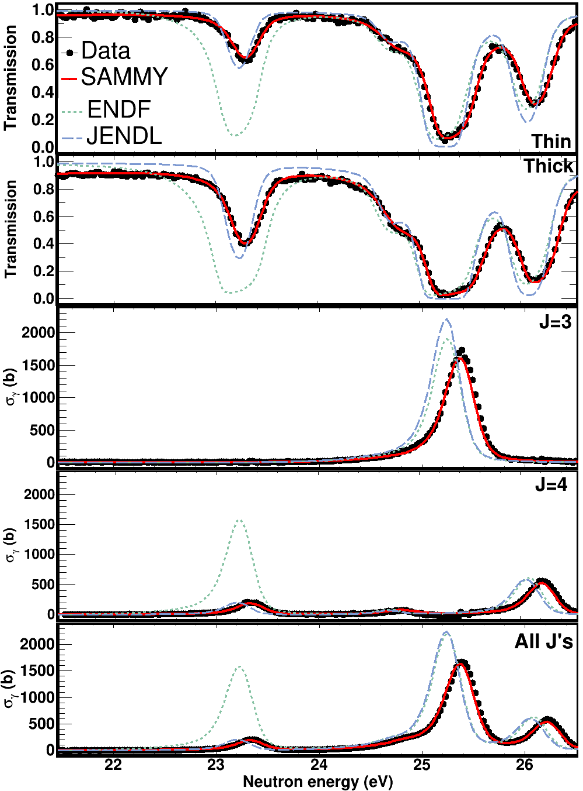
R-Matrix analysis : Resonance parameters
Fits in capture and transmission data using SAMMY
About 40 spins were incorrectly assigned
Resolved 58 new resonances (215 vs 157 in evaluations)
Resolved doublet @ 15 eV
Evaluated Γ_{n} is too large

Slide 33
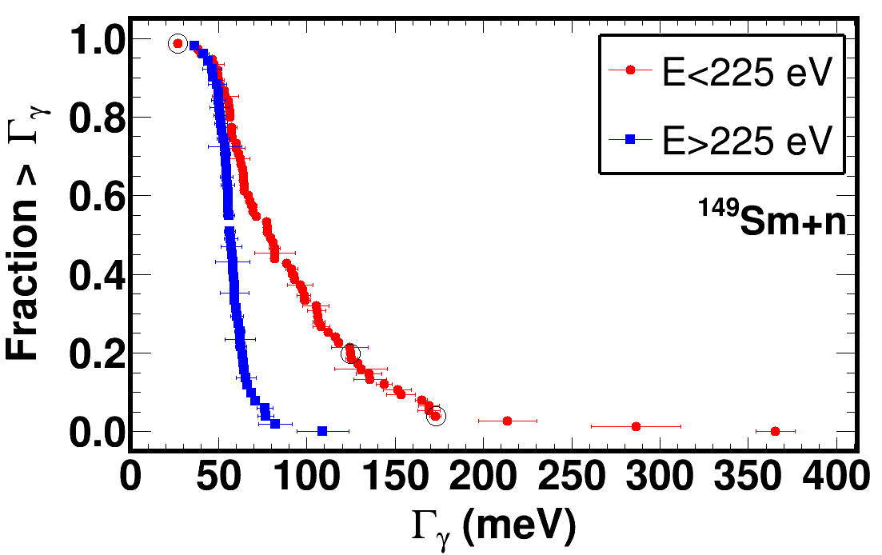
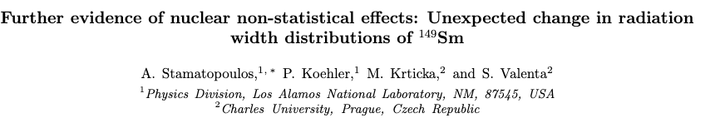

Non-Statistical behavior
Statistically significant change in the Γ_{γ} distributions around 200 eV was observed.
Findings will be submitted for publication to Phys. Rev. Lett. (similar findings in ¹⁴⁷Sm)
Phys. Rev. Lett.
Phys. Rev. C

Slide 34



Non-Statistical behavior - more
Sm work gave rise to an interesting observation
Neutron-capture cross sections are exhibiting a statistically significant oscillating behavior

Slide 35






Phys. Rev. X 15, 021086
A few more highlights
²³⁹Pu
¹³³Cs
^{63C}u
²³⁹Pu data are needed for criticality safety (<1% unc)
Hard due to ²⁴⁰Pu
Identified 100 mg 99.99%
DICER only needs 1 mg!
Improving evaluations
¹³³Cs data are needed for criticality safety (<1% unc)
Hard to do a measurement on pure Cs: pyrophoric
Hazard minimization
Through the PARADIGM project, we’re employing ML to identify differential and integral experiments and reduce time in nuclear data evaluations: 3 vs 25 years!
Cost reduction

Slide 36
A sneaky peak in the near future – ⁸⁸Y

Slide 37


Development of a 0.1 mm collimator
A smaller collimator will enable measurements on even smaller/more radioactive/more exotic samples i.e. 88Y
1 mm / 15 mg → 200 Ci / 7.4 TBq
0.1 mm / 150ug 88Y -> 2 Ci/74 GBq
Beta version fabricated and tested
Currently fabricating the collimator
Enclosed in 250 kg of Tungsten for shielding purposes

Slide 38




Development of microjet printing
Radioactive sample fabrication through “3D” printing
Custom-made printer for use in hot-cells
Capability to characterize the sample
Grain of salt

Slide 39



Chemistry development
Challenging to identify a chemical compound that is suitable for transmission
YCl₃ could work but there is too much Cl
YOCl is great but hasn’t been verified
We developed a chemical process and verified the conversion of YOCl from YCl₃ at 650 ºC
X-Rays beams at SLAC
Hyper Spectral X-Ray Imaging at LANL
Neutron beams at LANL/DICER
DICER
HXI

Slide 40





Experiment
Sample loading
with a robotic arm
Experiments scheduled in the following months
Irradiation of SrCl2 in IPF to make ⁸⁸Y through (p,n) reactions
Neutron transmission of ⁸⁸YOCl at DICER
Robotic arm
SrCl₂
Inconel
casing
Test ⁸⁸Y solution
3D printed collimator

Slide 41


Development of DICER64
Through an early career award, a new DICER variant at 64 m is being developed
Data taken to understand the performance and assess the feasibility of a new instrument
Promising results: significantly improved signal/background compared to DICER
Testing the idea of simultaneous transmission and prompt-gamma activation analysis (PGAA)/neutron capture measurements

Slide 42





















Justin Jorgenson
Ryan Amberger
Nataly Panczyk
Evelyn
Bond

Slide 43




Thank you for your attention!

Slide 44

Thank you for your attention!

Slide 45
⁹Back-up slides

Slide 46





The technique in a nutshell
Cases where the most probable reactions are capture and scattering
Similar to cross sections, resonance widths are:
$$Γ_{tot}≡Γ=Γ_{γ}+Γ_{n}$$
Capture
Total
Scattering
Total
Capture
Scattering
At resonance energies:
Each resonance can be analytically described by its Energy and Width
At intermediate energies (keV):
$$Γ_{γ}=Γ−Γ_{n}$$
$$σ_{γ}=f(Γ, Γ_{n}, D0)$$

Slide 47




Metrology and alignment
Universal Spatial Metrology Network (USNM)
“Monuments” are installed in the flight path cave: blue fixed points in the flight path aka the reference system.
Stations have 5&6 Degrees of Freedom: precision alignment systems
Collimators are fiducialized
Fiducials: red fixed points on the elements that need to be positioned in a reference system
Laser trackers are used to locate the position of the collimators in the flight path cave
Alignment over the 30 m length must be held to very tight tolerances.
Alignment to better than 20um and 0.010⁰

Slide 48


Sanity checks
Flux monitor
Binocular collimator
Does the binocular idea work?
Flux * efficiency: Left vs Right
Paddle configuration: should not affect the flux monitor

Slide 49

Example
What can be extracted from a resonance:
Assuming a single Breit-Wigner resonance, the capture cross section is proportional to: $σ_{γ} \sim \frac{Γ_{n}Γ_{γ}}{Γ}=\frac{Γ_{n}Γ_{γ}}{Γ_{n}+Γ_{γ}}$
If Γ_{n} >> Γ_{γ} then σ ~ Γ_{γ} . In that case the radiation width can be extracted from the resonance, but the neutron width can’t.
If Γ_{n} << Γ_{γ} then σ ~ Γ_{n} . In that case the radiation width can’t be extracted from the resonance, but the neutron width can.

Slide 50



Slide 51



Development of filling station
Operations have to take place in a hot cell with a remote handling capability

Slide 52



WNR – High energy neutrons
(n,f), FY, (n,z), …
General purpose
SREFT (n,f), SPIDER and LENZ
PFNS
Scattering
(n,z)
Irradiation of Chips
Electronics
Irradiation of Chips
Electronics
LENZ
(n,z)
Chi-nu, CoGNAC

Slide 53

The Los Alamos Neutron Science Center - LANSCE
500-800 MeV protons
keV – MeV neutrons
meV – keV neutrons

Slide 54


Lujan Center – Low energy neutrons
SPIDER (n,f), FY, ...
LENZ (n,z)
DICER (n,tot), “(n,γ)”
Lujan Center
DANCE (n,γ), (n,f) tag

Slide 55

The Mark-III (M3) neutron source (RIP in 2022)
800MeV protons impinge on a 2-way split W target.
Nominally 20 Hz duty cycle (tunable down to 1 Hz)
Nominally 145 ns proton pulse width FWHM (tunable down to 9 ns)
DICER pointed to the liquid hydrogen moderator
Upper target for nuclear physics
Lower target for material science

Slide 56

PARADIGM

