Slide 1




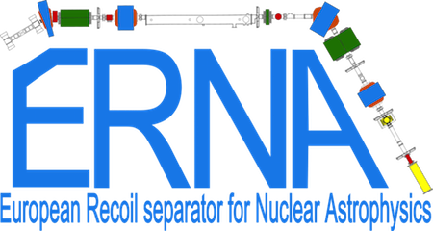
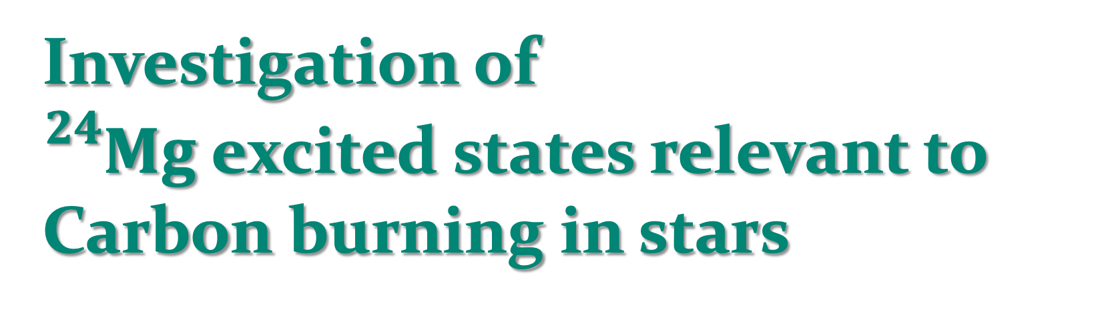
Investigation of
${}_{}^{24}{Mg}$excited states relevant to Carbon burning in stars
Federica Ercolano
University of Napoli ’’Federico II’’
INFN – Napoli Division

Slide 2
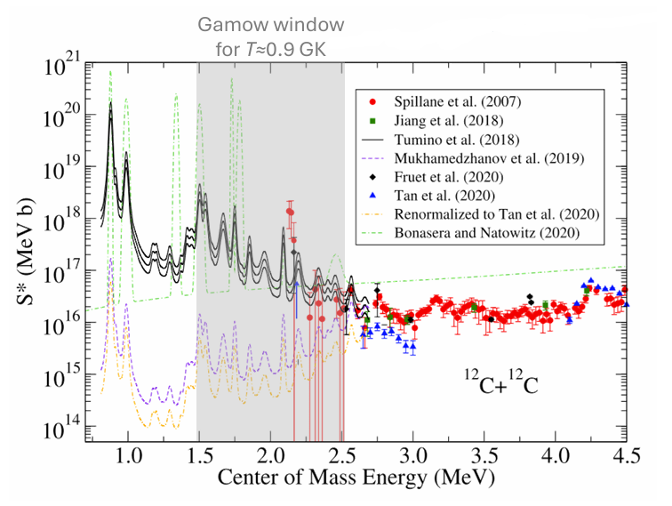
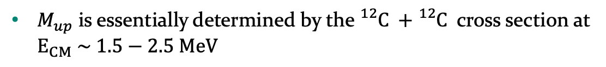



Nuclear astrophysics motivation
According to its initial mass, a star can experience several burning processes
mass
The minimum initial mass of a star able to experience C-burning is called $M_{up}$
Massive stars: H, He, C, O, Ne, Si → neutron star, black hole
$M_{up}$ is essentially determined by the ${}_{}^{12}C +{}_{}^{12}C$ cross section at $E_{CM} \sim 1.5−2.5 MeV$
$$M_{up}^{∗}$$
H, He, C →
oxygen-neon white dwarf
Several datasets and models available
$$M_{up}$$
Low & intermediate mass: H, He → carbon-oxygen white dwarf
Very large uncertainty below 2.5 MeV
Adapted from O. Straniero et al., 2016 J. Phys.: Conf. Ser. 665 012008
${}_{}^{12}C$ + ${}_{}^{12}C$ fusion reaction astrophysical S factor adapted from Aliotta M. et al., J. Phys. G: Nucl. Part. Phys. 49(2022)
22 May 2026
Notes:
Reaction rates at stellar temperatures are necessary for a complete picture of stellar evolution

Slide 3
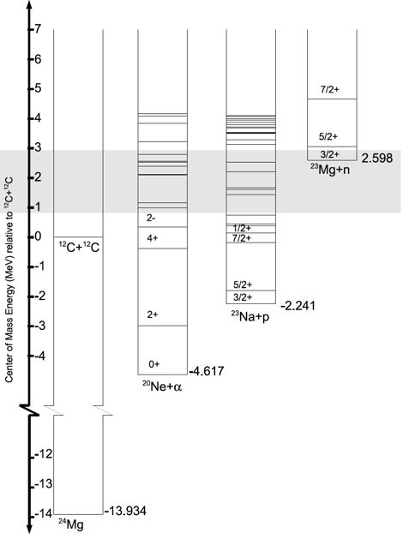
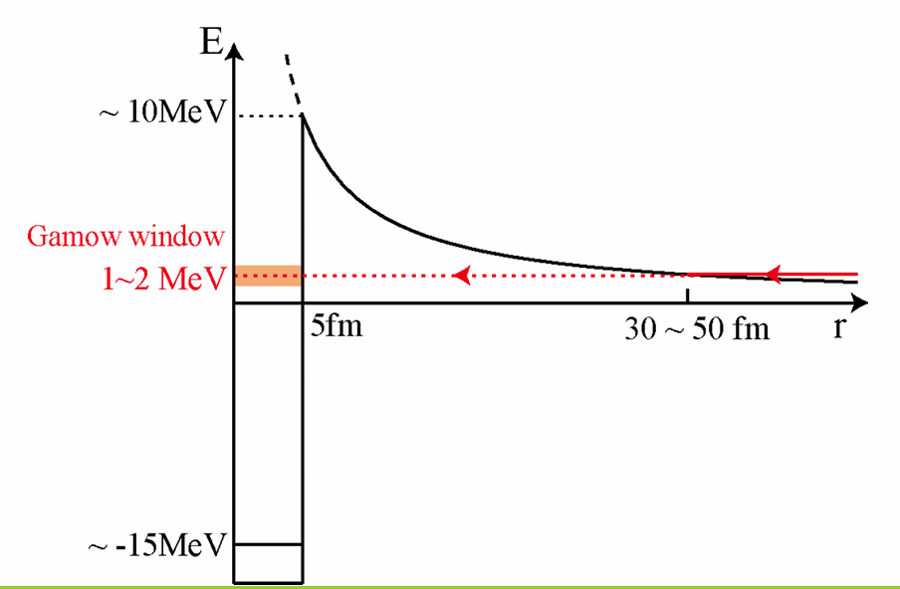
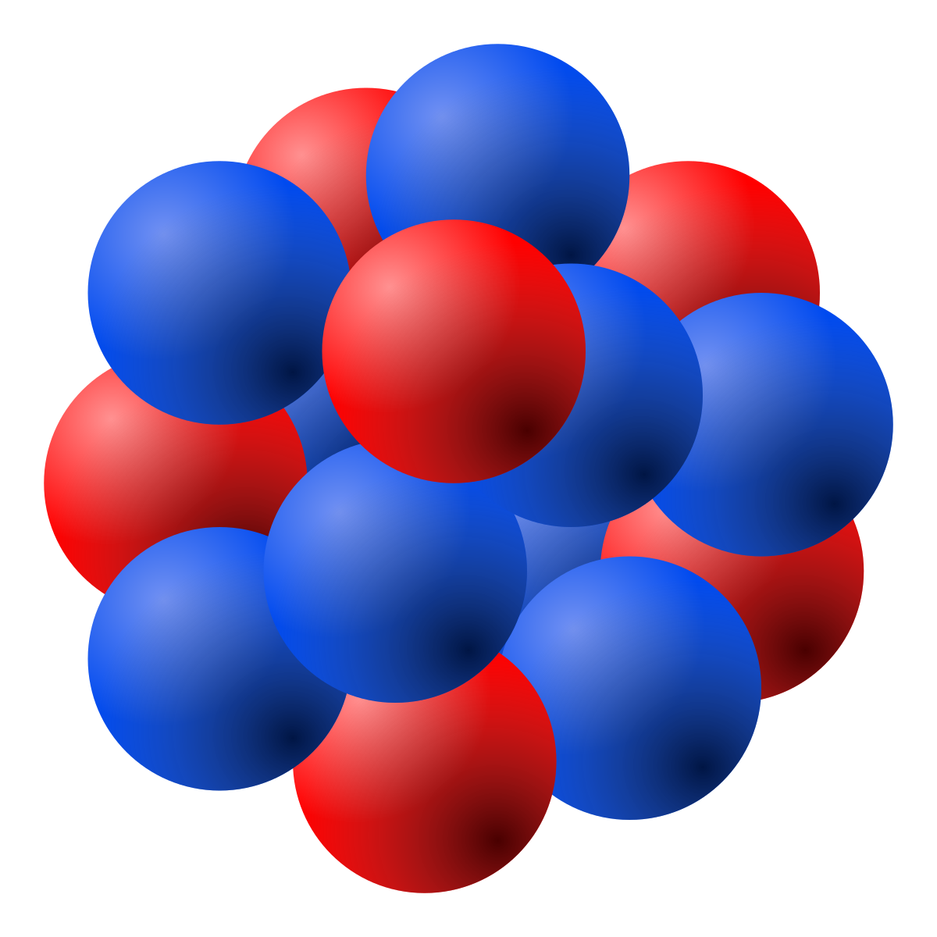
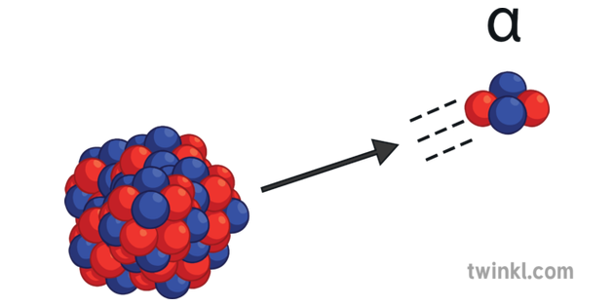

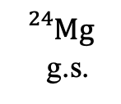


From stellar processes to nuclear spectroscopy
$${}_{}^{12}C$$
$${}_{}^{12}C$$
$${}_{}^{24}{Mg}\left(α,α^{′}\right){}_{}^{24}{{Mg}^{∗}}$$
Fusion reaction in the Gamow window strongly suppressed by the Coulomb barrier
α
$${}_{}^{24}{Mg}$$
g.s.
This reaction unaffected by Coulomb barrier ➝ more experimentally accessible
Approach suggested by T. Yasutaka and M. Kimura, Physics Letters B 823 (2021)
22 May 2026

Slide 4
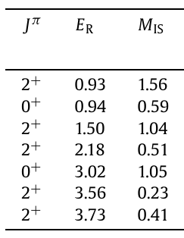
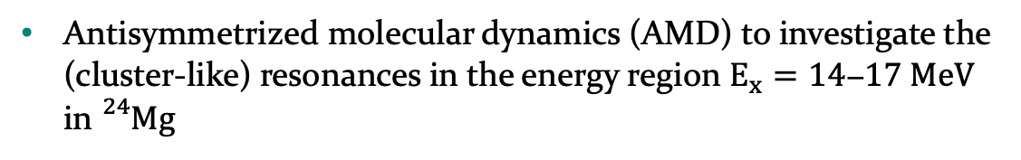
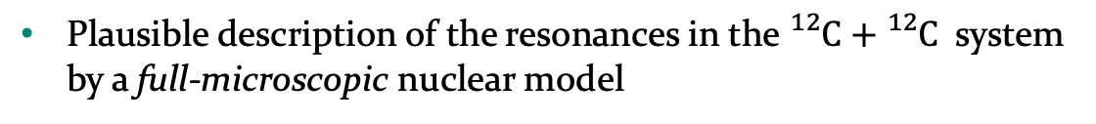
From stellar processes to nuclear spectroscopy
T. Yasutaka and M. Kimura, Physics Letters B 823 (2021)
Plausible description of the resonances in the ${}_{}^{12}C+{}_{}^{12}C$ system by a full-microscopic nuclear model
Antisymmetrized molecular dynamics (AMD) to investigate the (cluster-like) resonances in the energy region $E_{x}=14\text{−}17 MeV$ in ${}_{}^{24}{Mg}$
Calculated resonance energies in MeV and isoscalar transition matrix elements in Weisskopf unit.
22 May 2026
Notes:
The description of deep sub-barrier resonances is challenging and demanding
The primary reaction channels involve the rearrangement of many nucleons and the strong channel coupling
Nuclear models usually adopt phenomenological potentials to mimic such complex reaction dynamics.

Slide 5
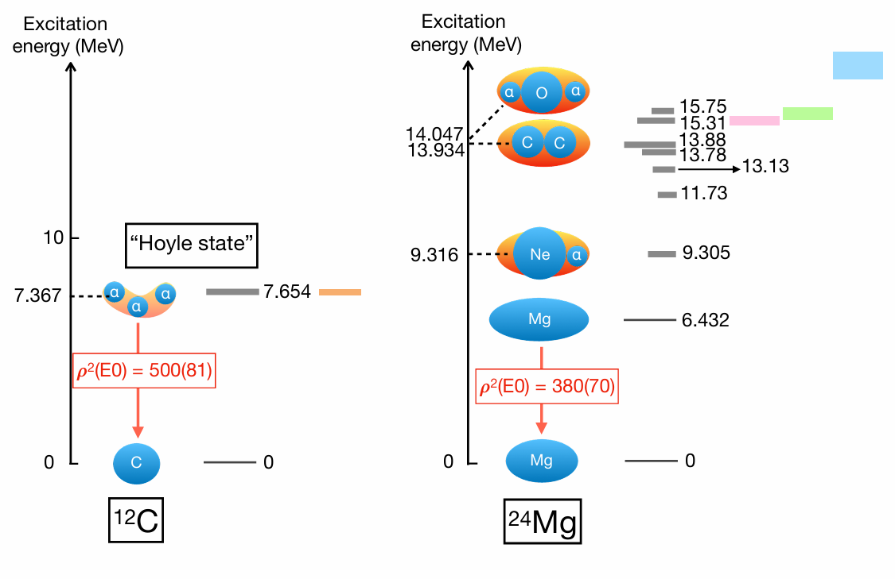



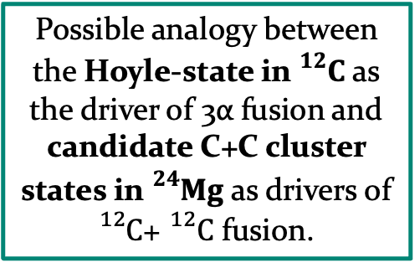
From stellar processes to nuclear spectroscopy
Electric monopole (quadrupole) transitions from g.s. to states (resonances) with cluster configuration are considerably enhanced.
A. Yamada et al., PTP120, 1139 (2008)
type 1a supernovae ( $T_{9}$ = 1.8)
Possible analogy between the Hoyle-state in ${}_{}^{12}C$ as the driver of 3α fusion and candidate C+C cluster states in ${}_{}^{24}{Mg}$ as drivers of ${}_{}^{12}C$+ ${}_{}^{12}C$ fusion.
massive stars ($T_{9}$ = 0.6)
superbursts ($T_{9}$ = 0.4)
P. Adsley et al., PRL 129.10 (2022)
22 May 2026
Notes:
Energetics are crucial in driving the system towards a particular cluster configuration → Ikeda diagrams (1968) → clusters are expected to emerge close or slightly below the cluster separation energy.

Slide 6
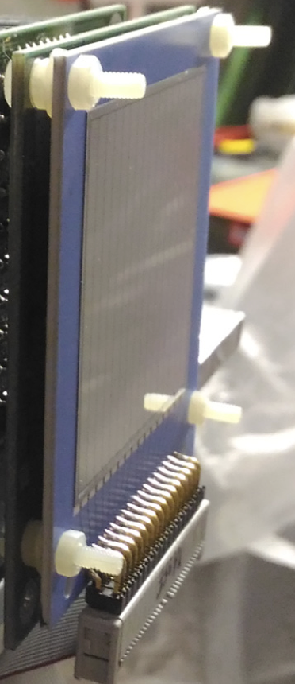
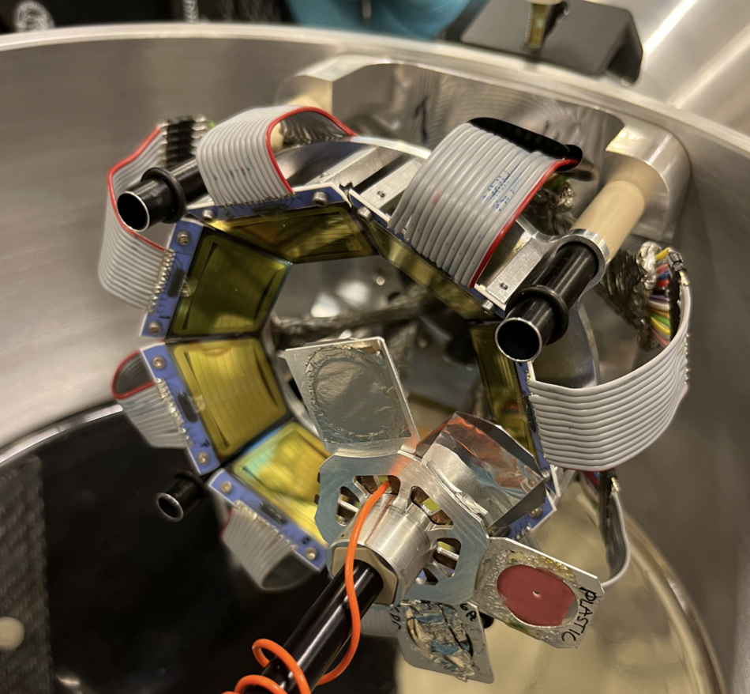
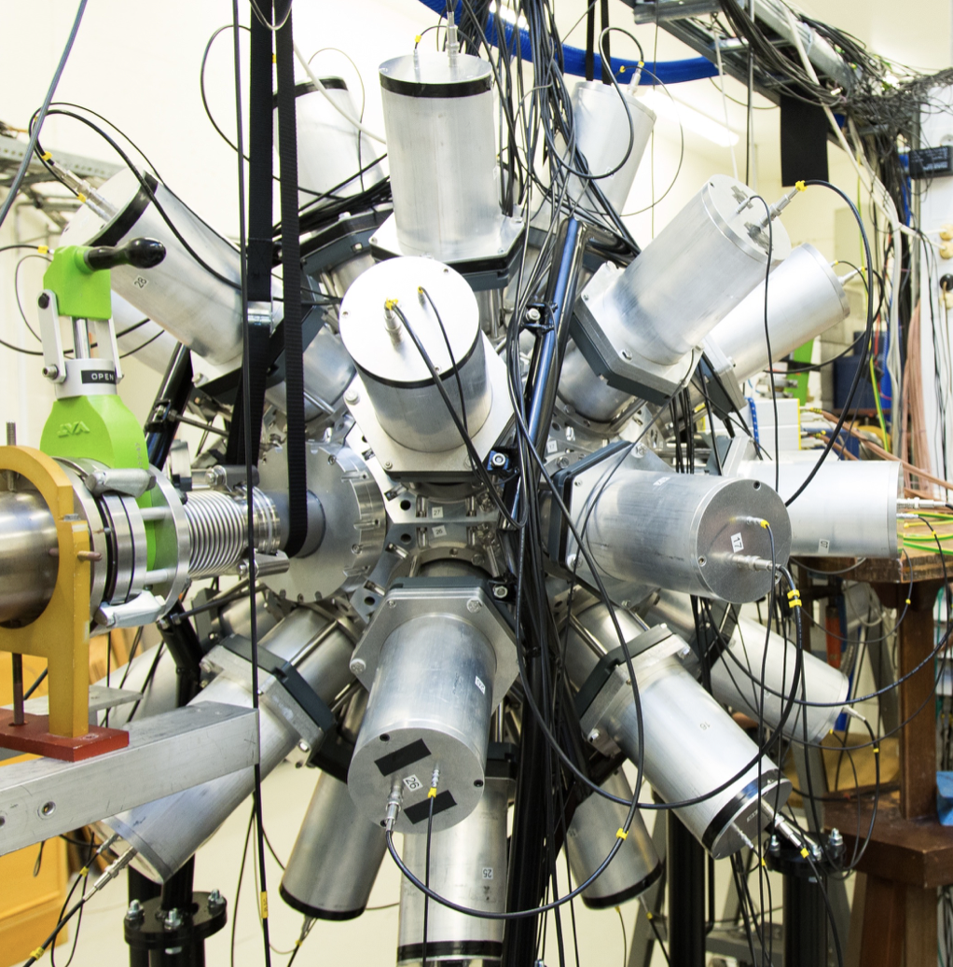
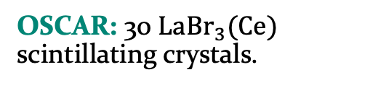

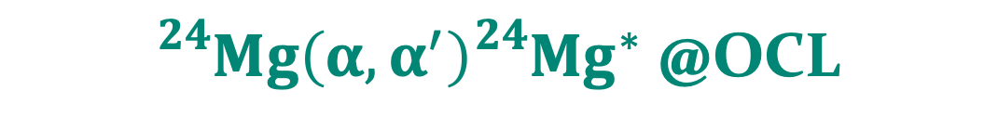


${}_{}^{24}{Mg}\left(α,α^{′}\right){}_{}^{24}{{Mg}^{∗}}$ @OCL
beam: ${}_{}^{4}{He}$@30 MeV
target: self-supporting ${}_{}^{24}{Mg}$
OSCAR: ΔE-E telescope; first stage (20 μm) segmented into 16 Si strips, followed by 4x4 matrix of 16 Si pads.
SiRi: modular array of 8 ΔE-E Si detectors; ΔE (130 $μm)$ segmented into 8 annular strips.
D. Dell’Aquila et al. /Nuclear Inst. and Methods in Physics Research, A 877 (2018).
M. Guttormsen et al. /Nuclear Instruments and Methods in Physics Research A 648 (2011).
OSCAR: 30 ${LaBr}_{3}(Ce)$ scintillating crystals.
F. Zeiser et al. / Nuclear Inst. and Methods in Physics Research, A 985 (2021).
22 May 2026

Slide 7
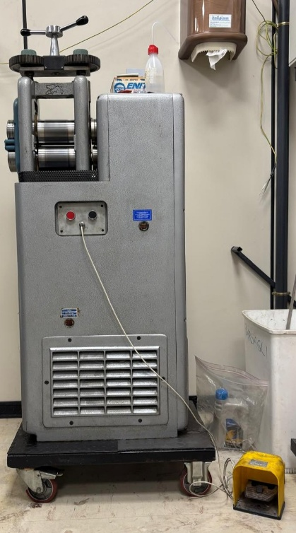
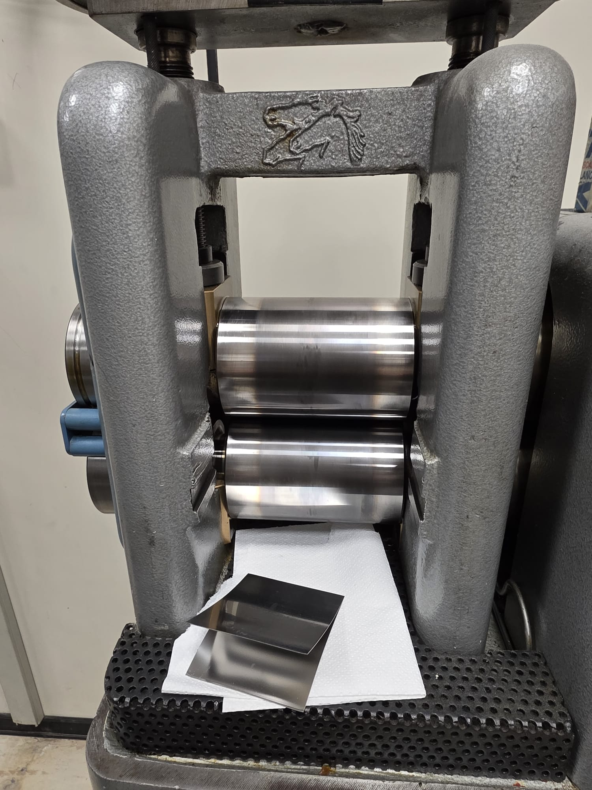
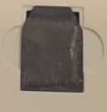
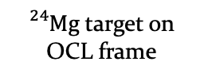
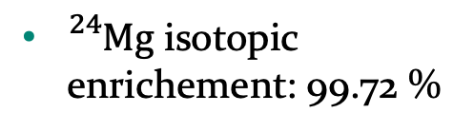
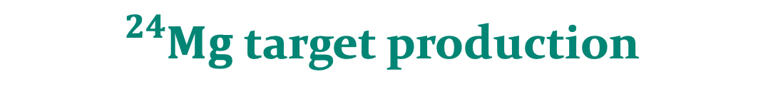
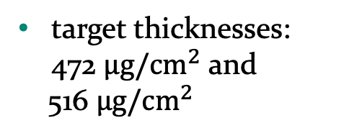
${}_{}^{24}{Mg}$ target production
${}_{}^{24}{Mg}$ isotopic enrichement: 99.72 %
cold-rolling technique
target thicknesses: 472 $μg/{cm}^{2}$ and
516 $μg/{cm}^{2}$
${}_{}^{24}{Mg}$ target on OCL frame
Targets produced by A. Massara (INFN-LNS)
22 May 2026

Slide 8
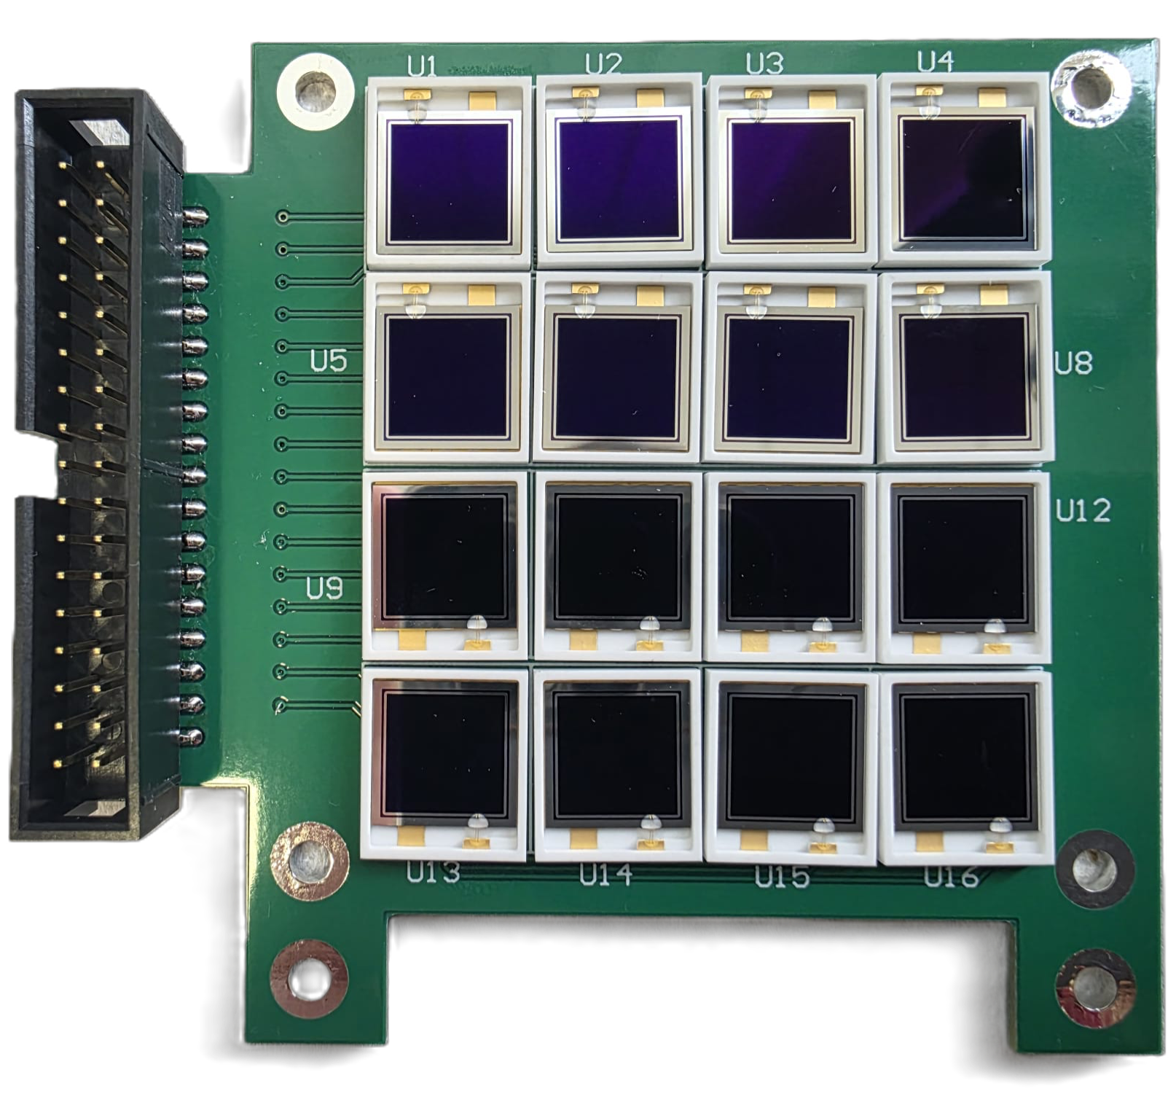
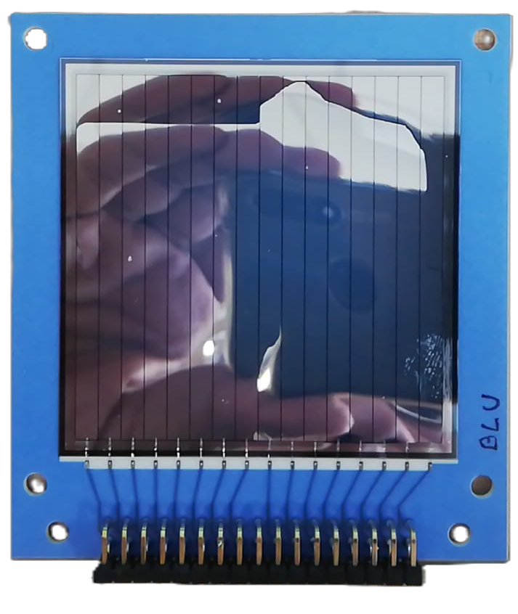
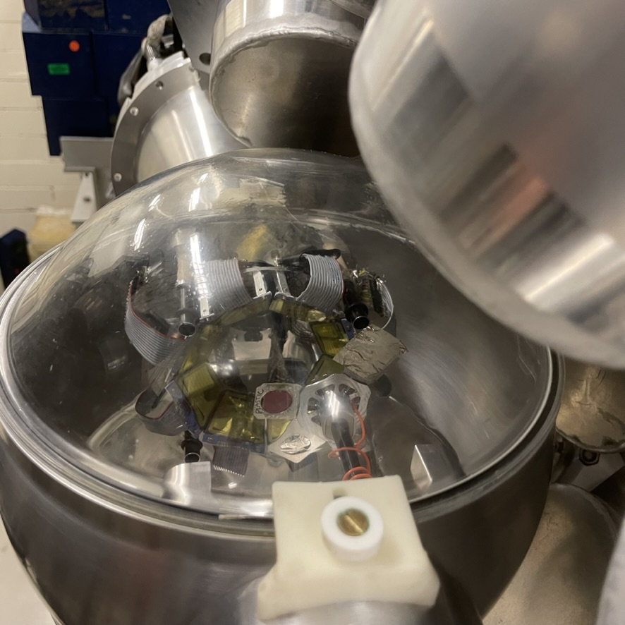
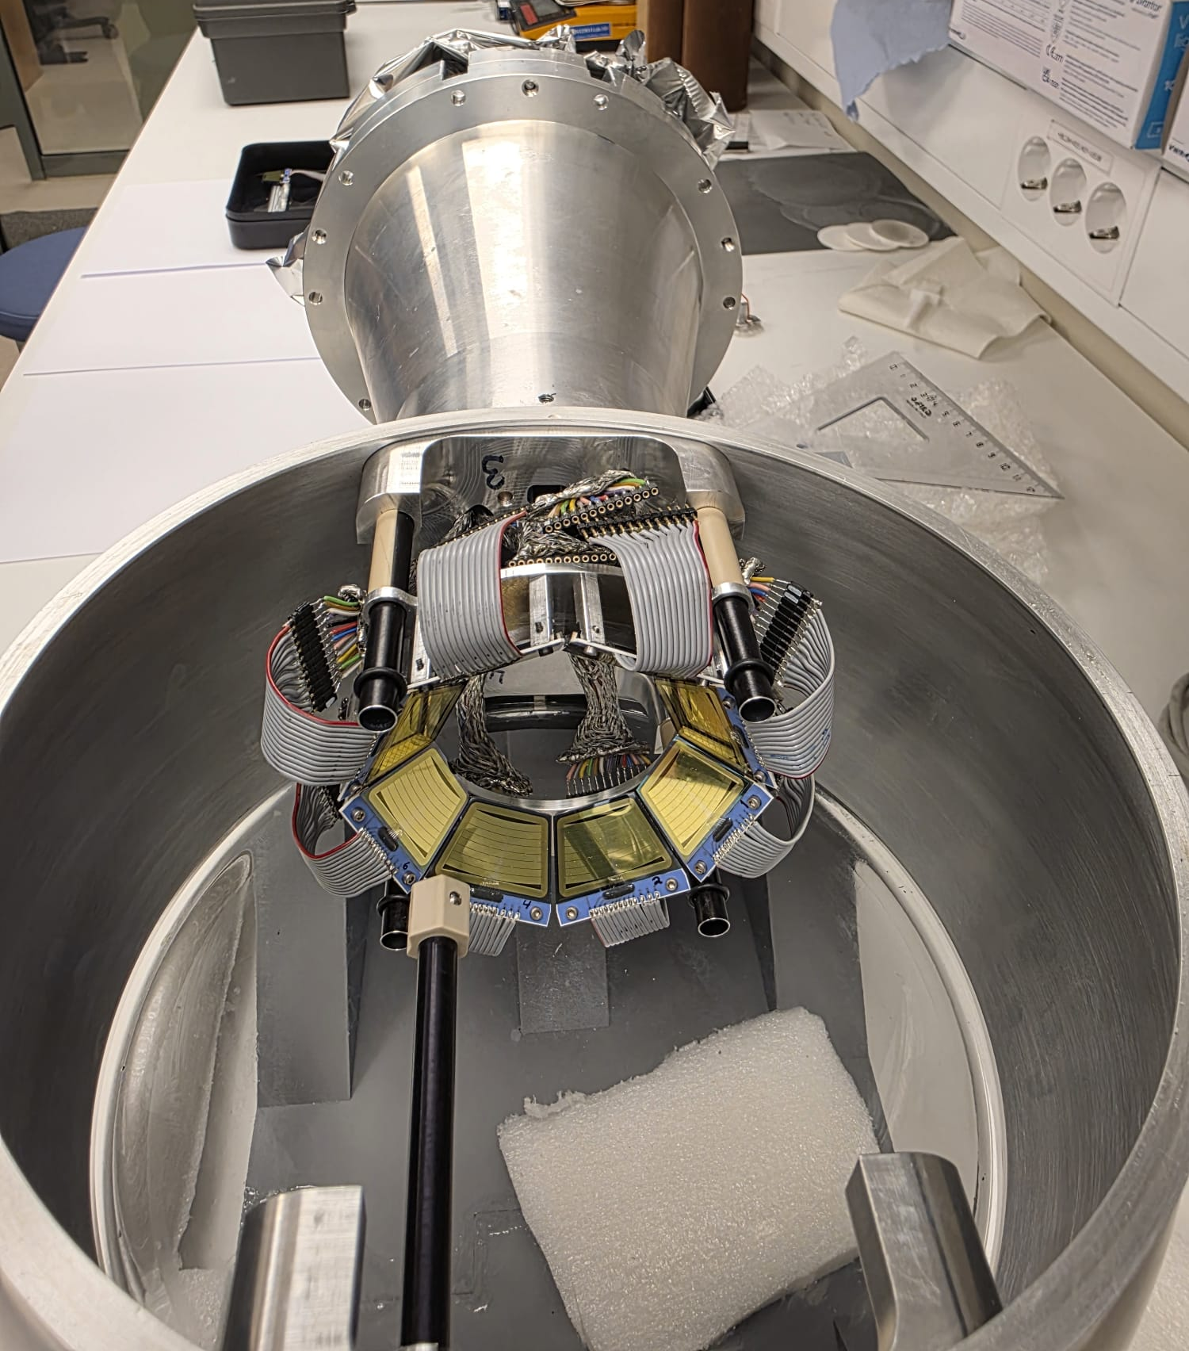
Particle detectors placement
OSCAR first stage
OSCAR second stage
OCL reaction chamber + SiRi
the intersections of the 16 strips with 16 pads make a total of 64 combinations (pseudo-telescopes) per module
22 May 2026

Slide 9
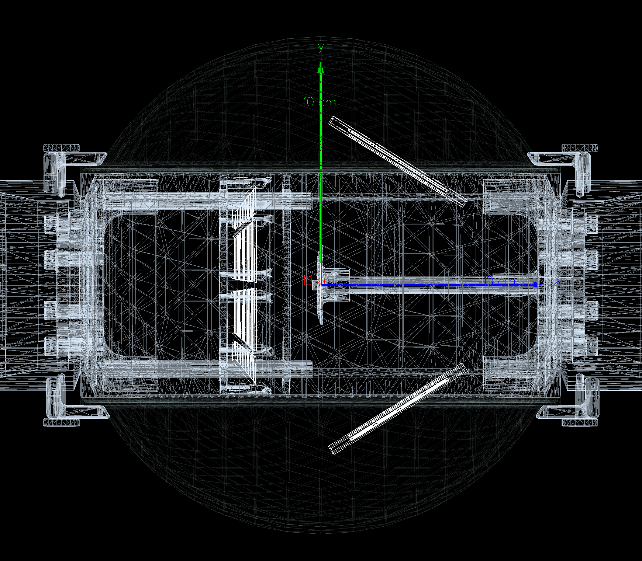
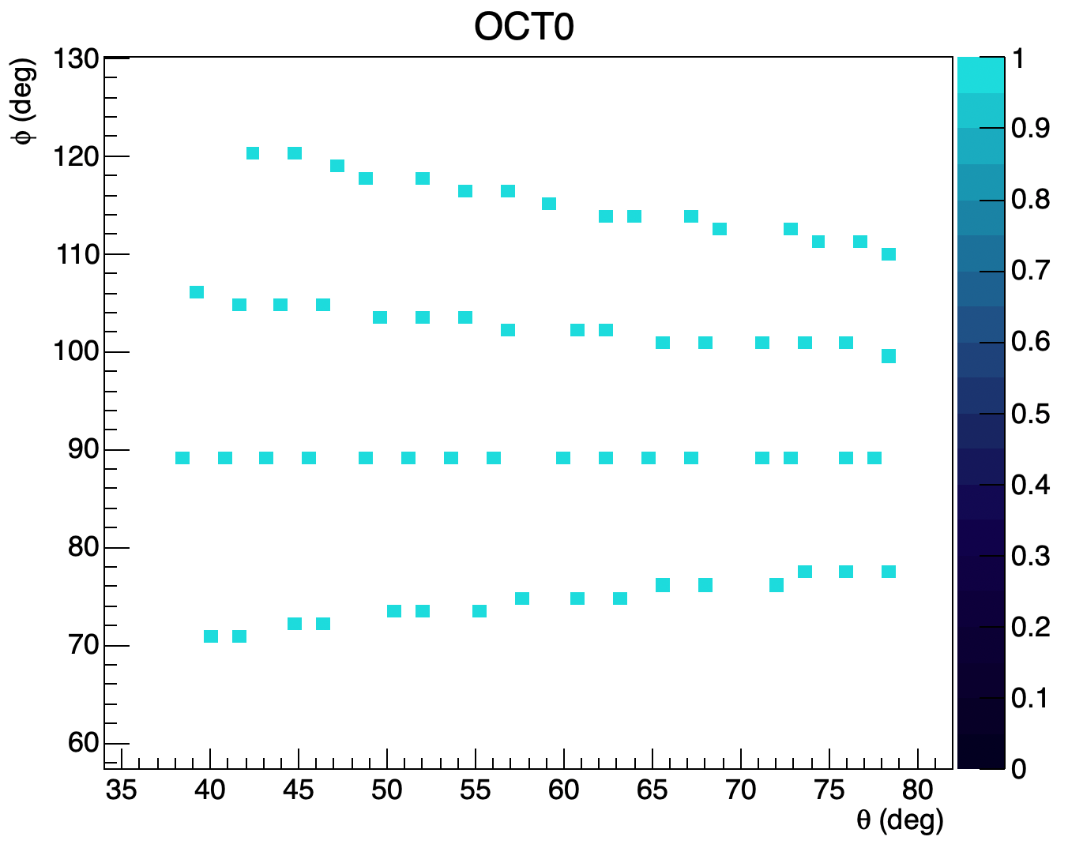
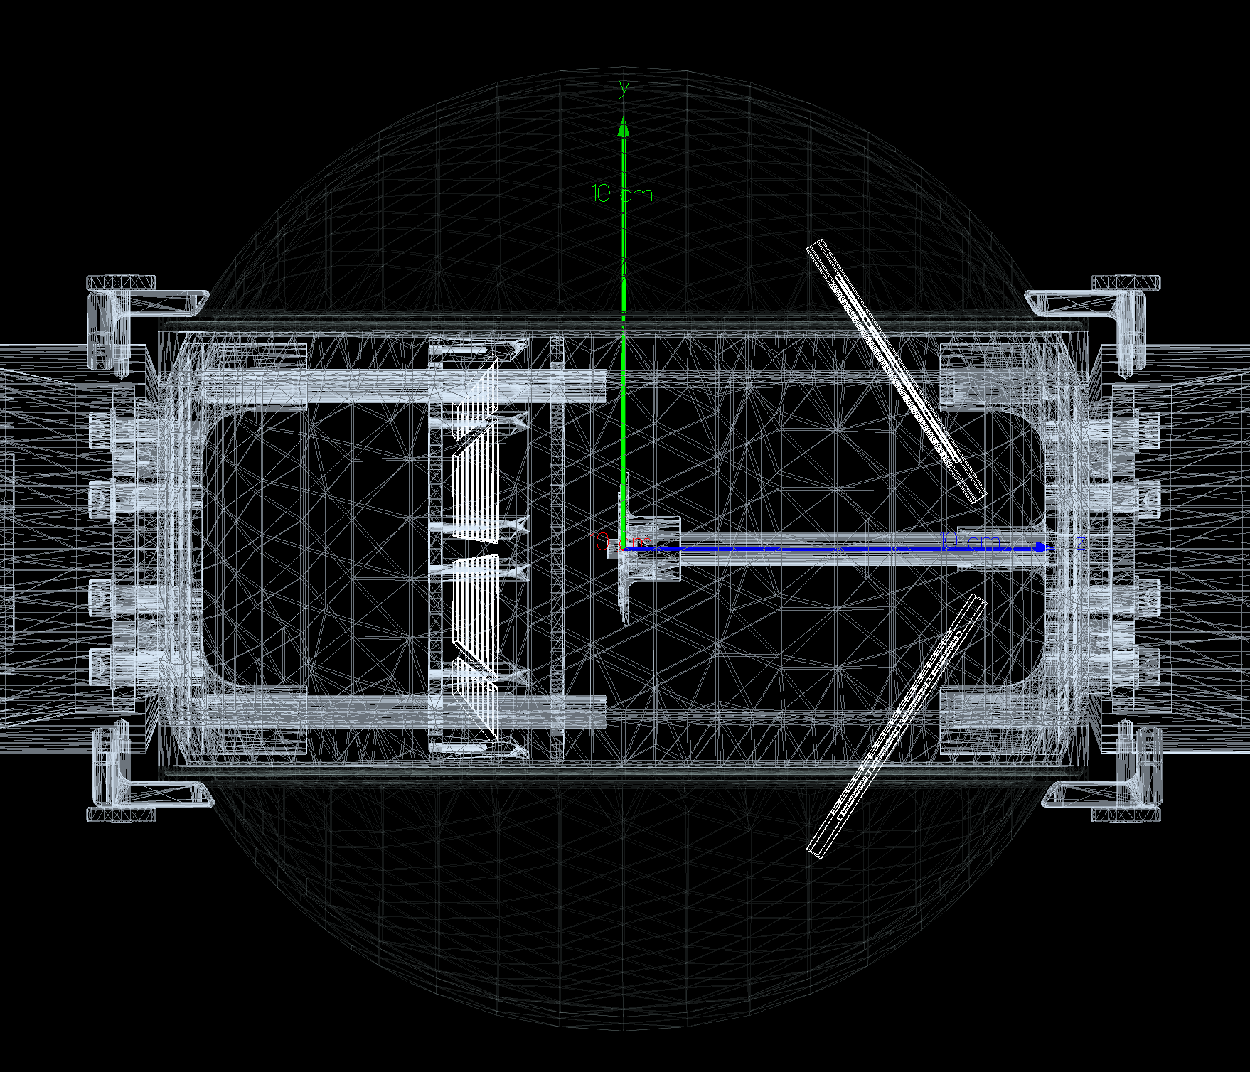
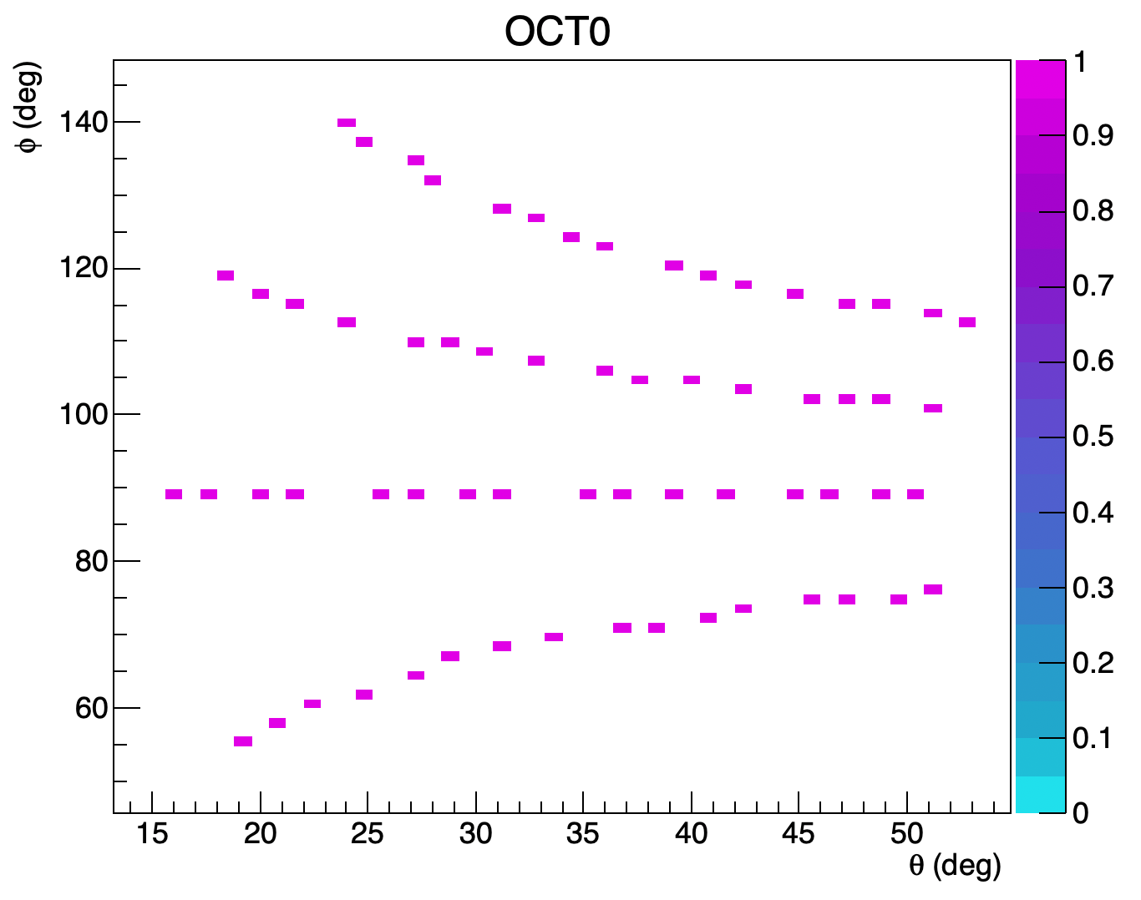
Particle detectors placement
Configuration 1
Configuration 2
G4 reproduction of the OCL reaction chamber
22 May 2026

Slide 10
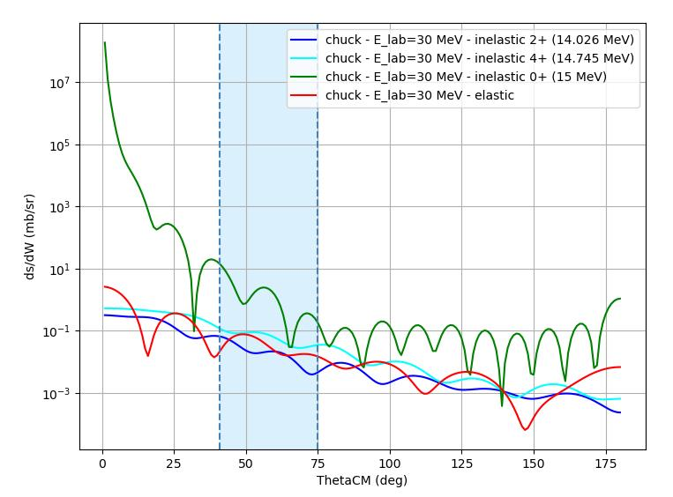

Feasibility study
Chuck3 evaluations
Geant4 simulations
Start point: reaction occurs → $α′$ + ${}_{}^{24}{{Mg}^{∗}}$
Particle momenta: computed using
relativistic kinematics
Emission directions: randomly sampled according to CHUCK3 angular distributions
22 May 2026

Slide 11
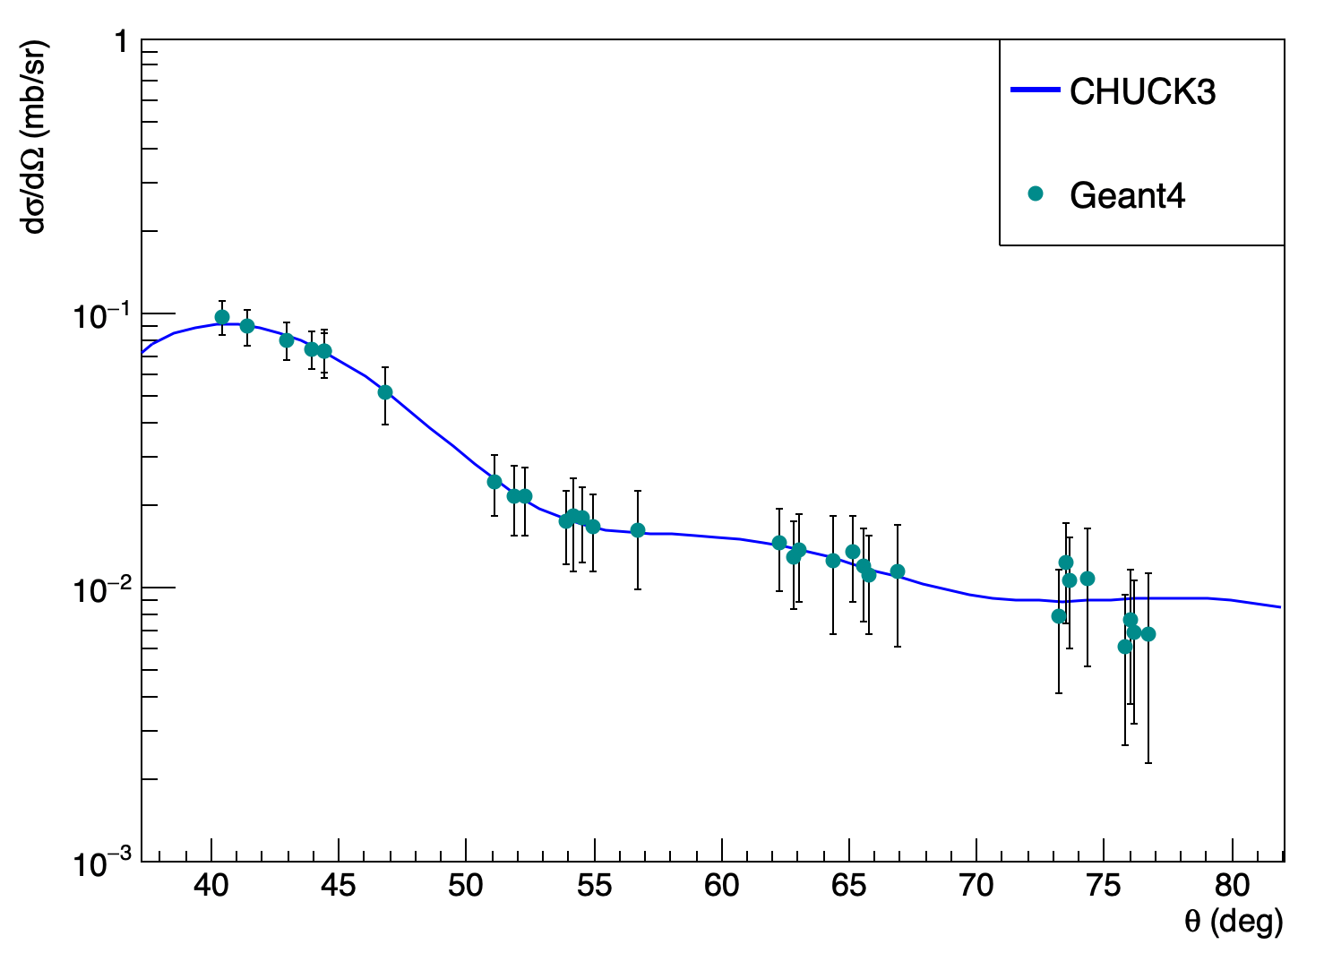
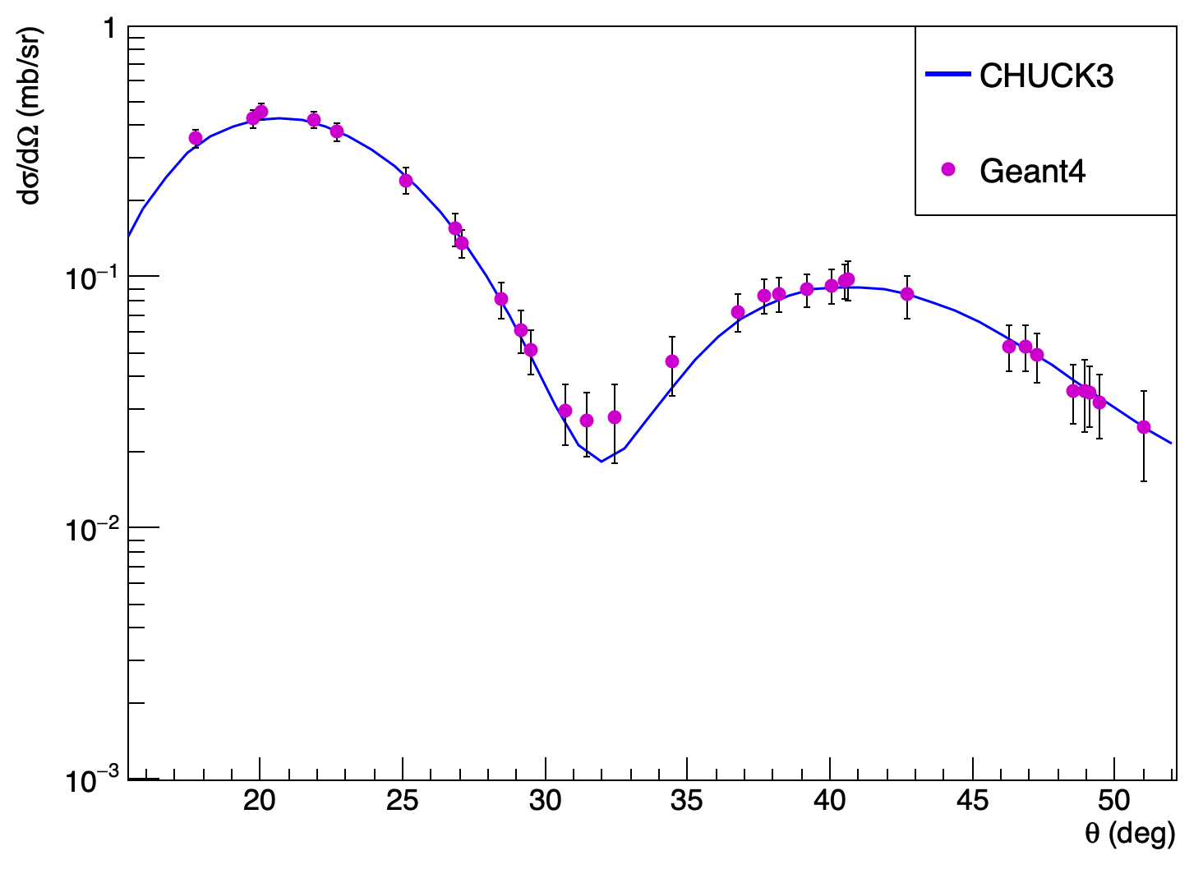
Angular distributions from scattered ⍺ particles
Configuration 1
Configuration 2
the segmentation of OSCAR-particle in configuration 2 could be exploited to determine the $J^{π}$ of the ${}_{}^{24}{Mg}$ states
22 May 2026

Slide 12
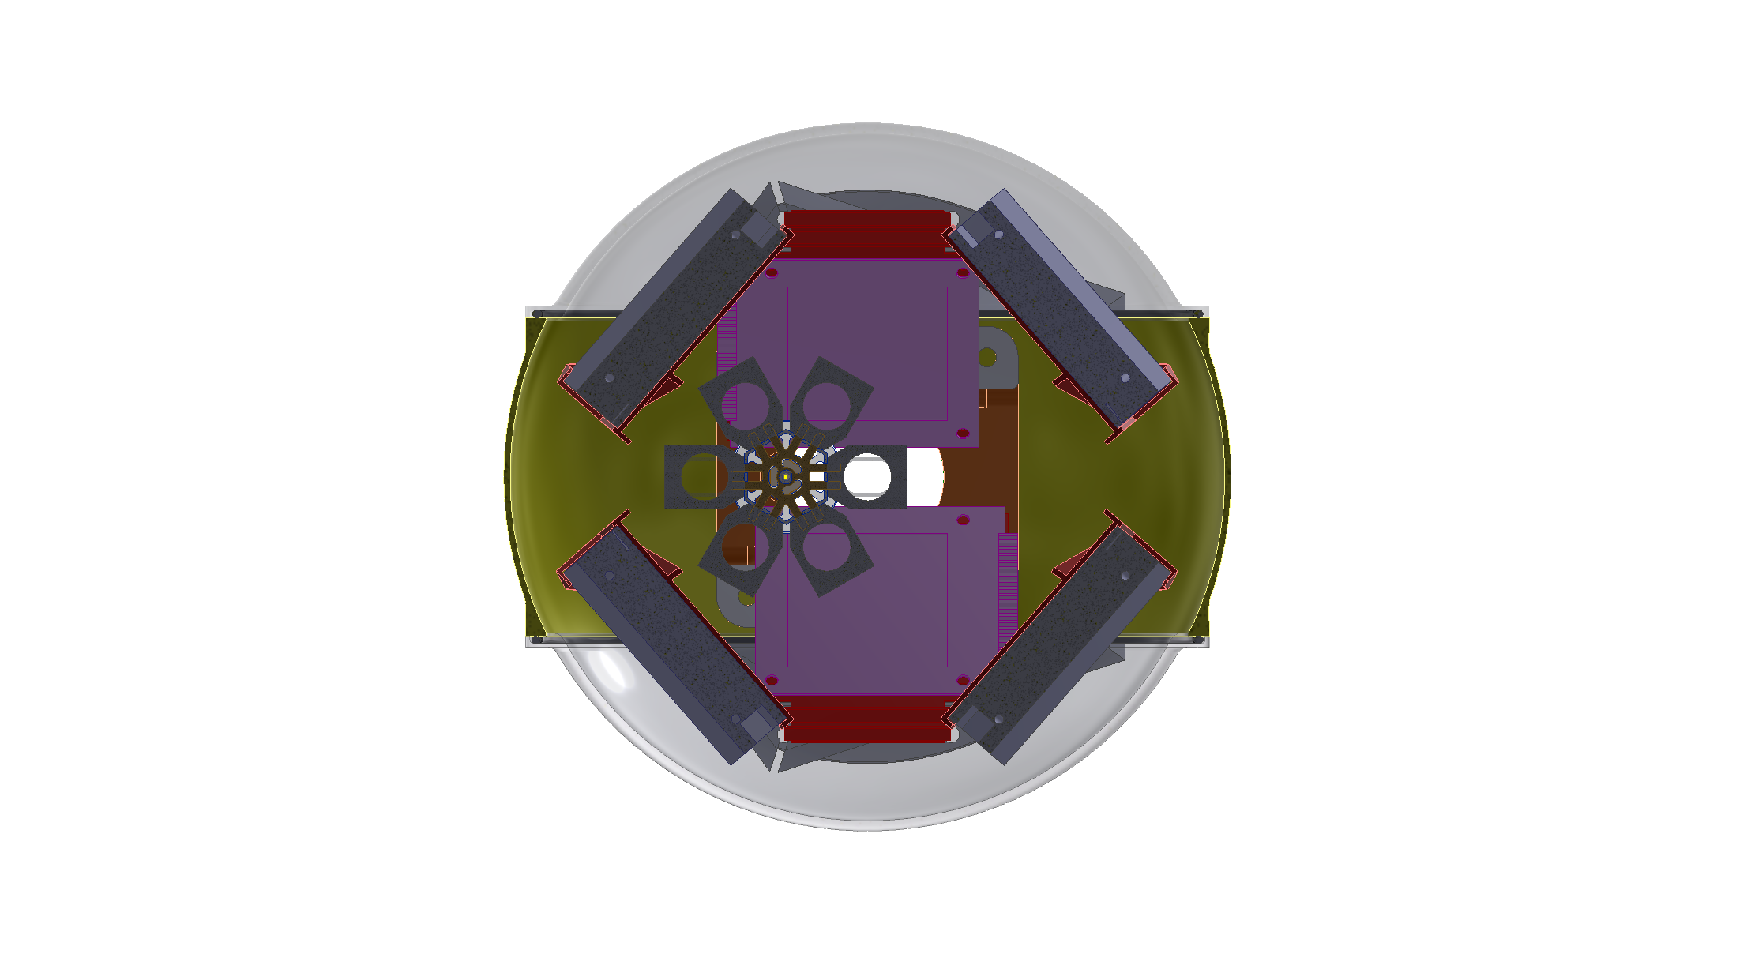
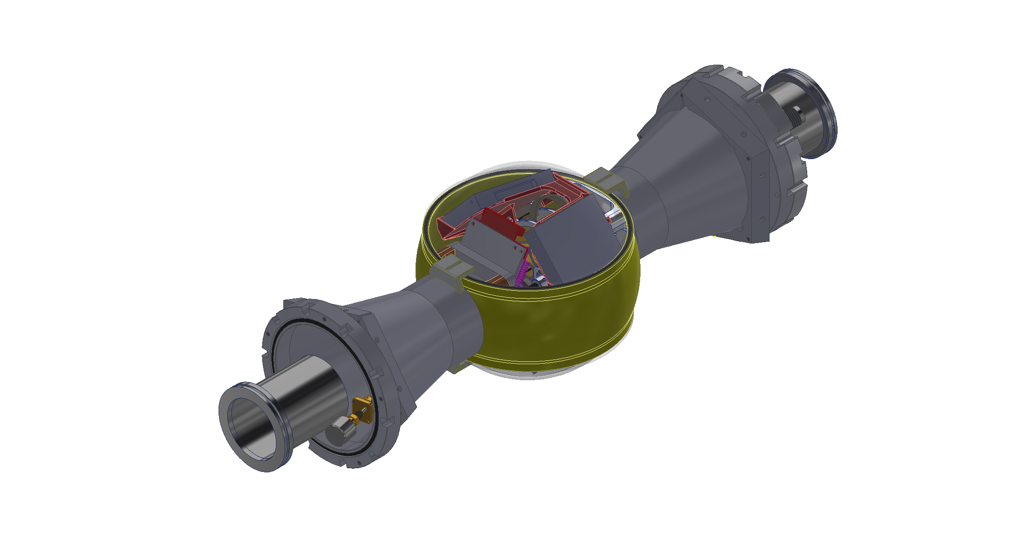
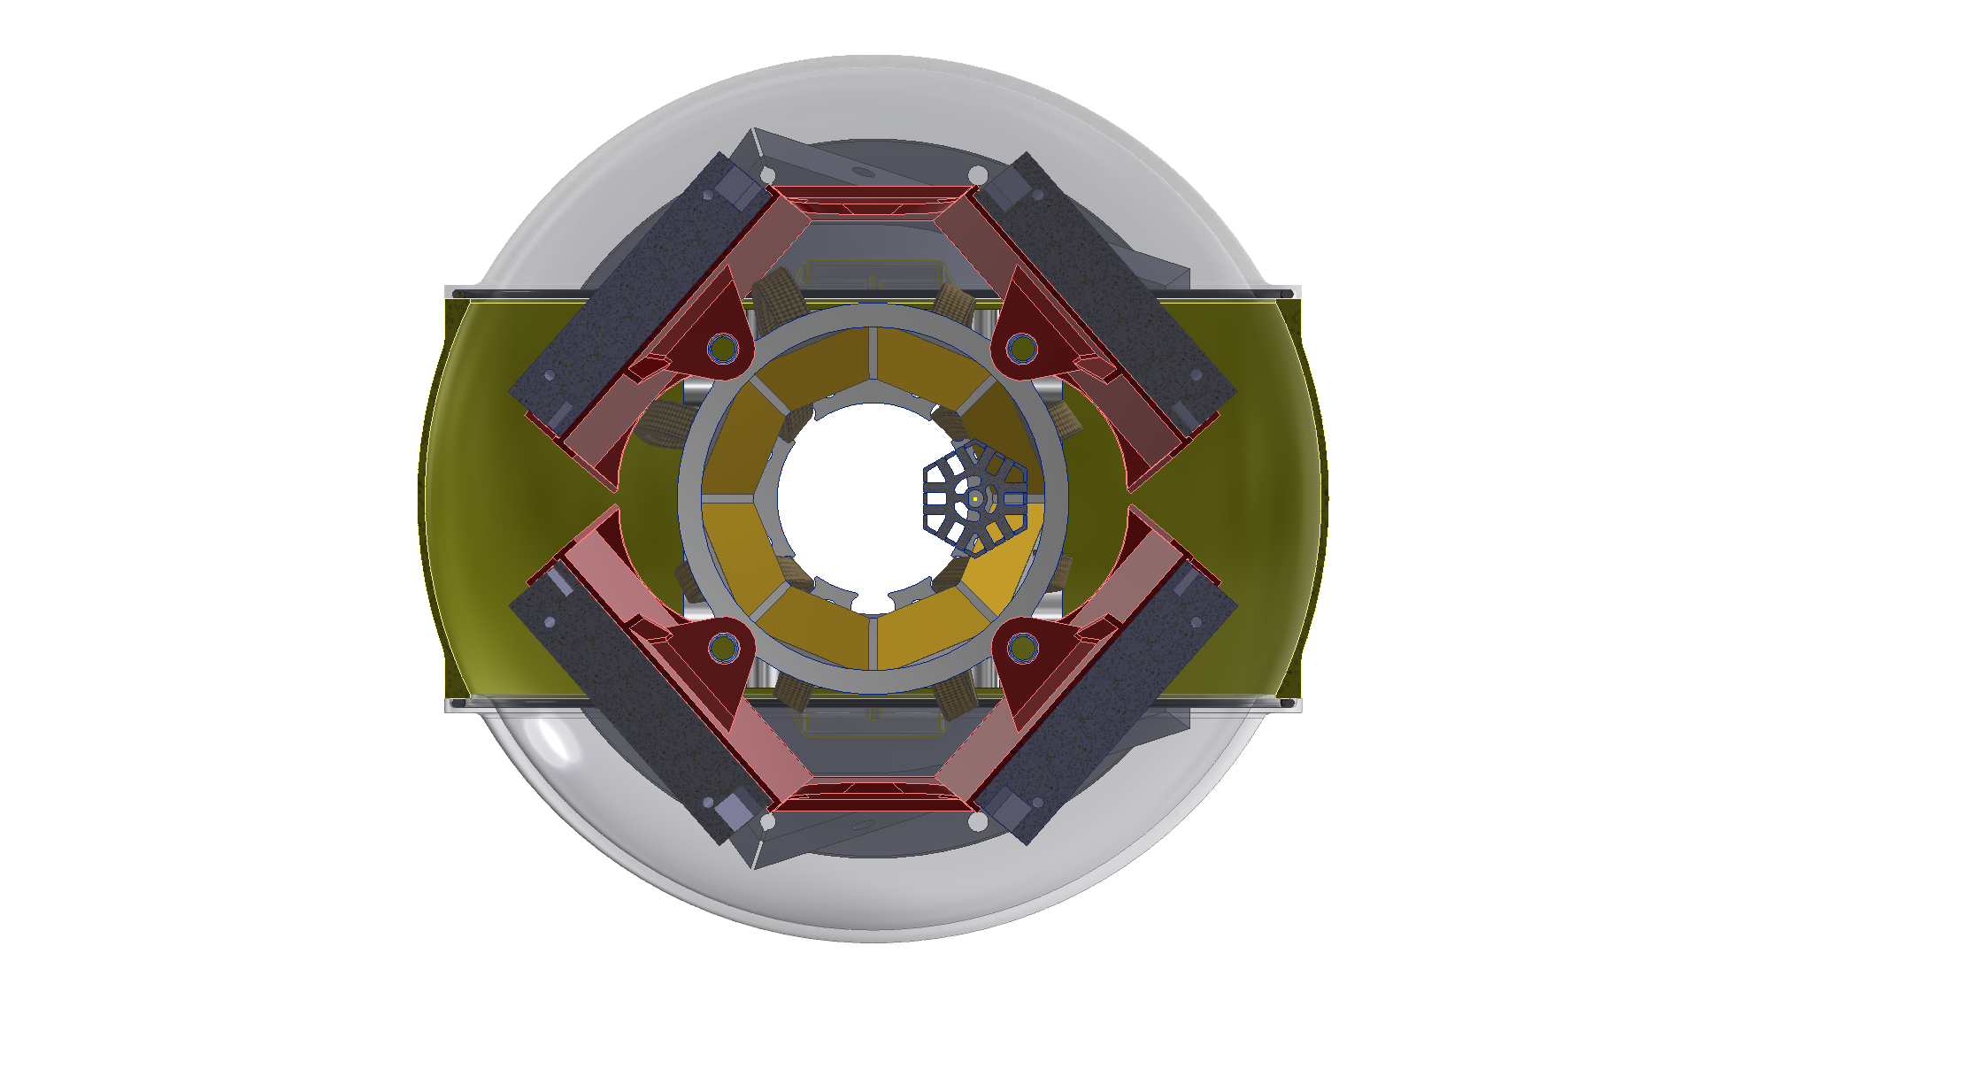
Setup challenges
Downstream view of the reaction chamber
OSCAR detector and preamplifier holders designed by J. A. Ringnes (who also provided these pictures)
Upstream view of the reaction chamber
22 May 2026

Slide 13
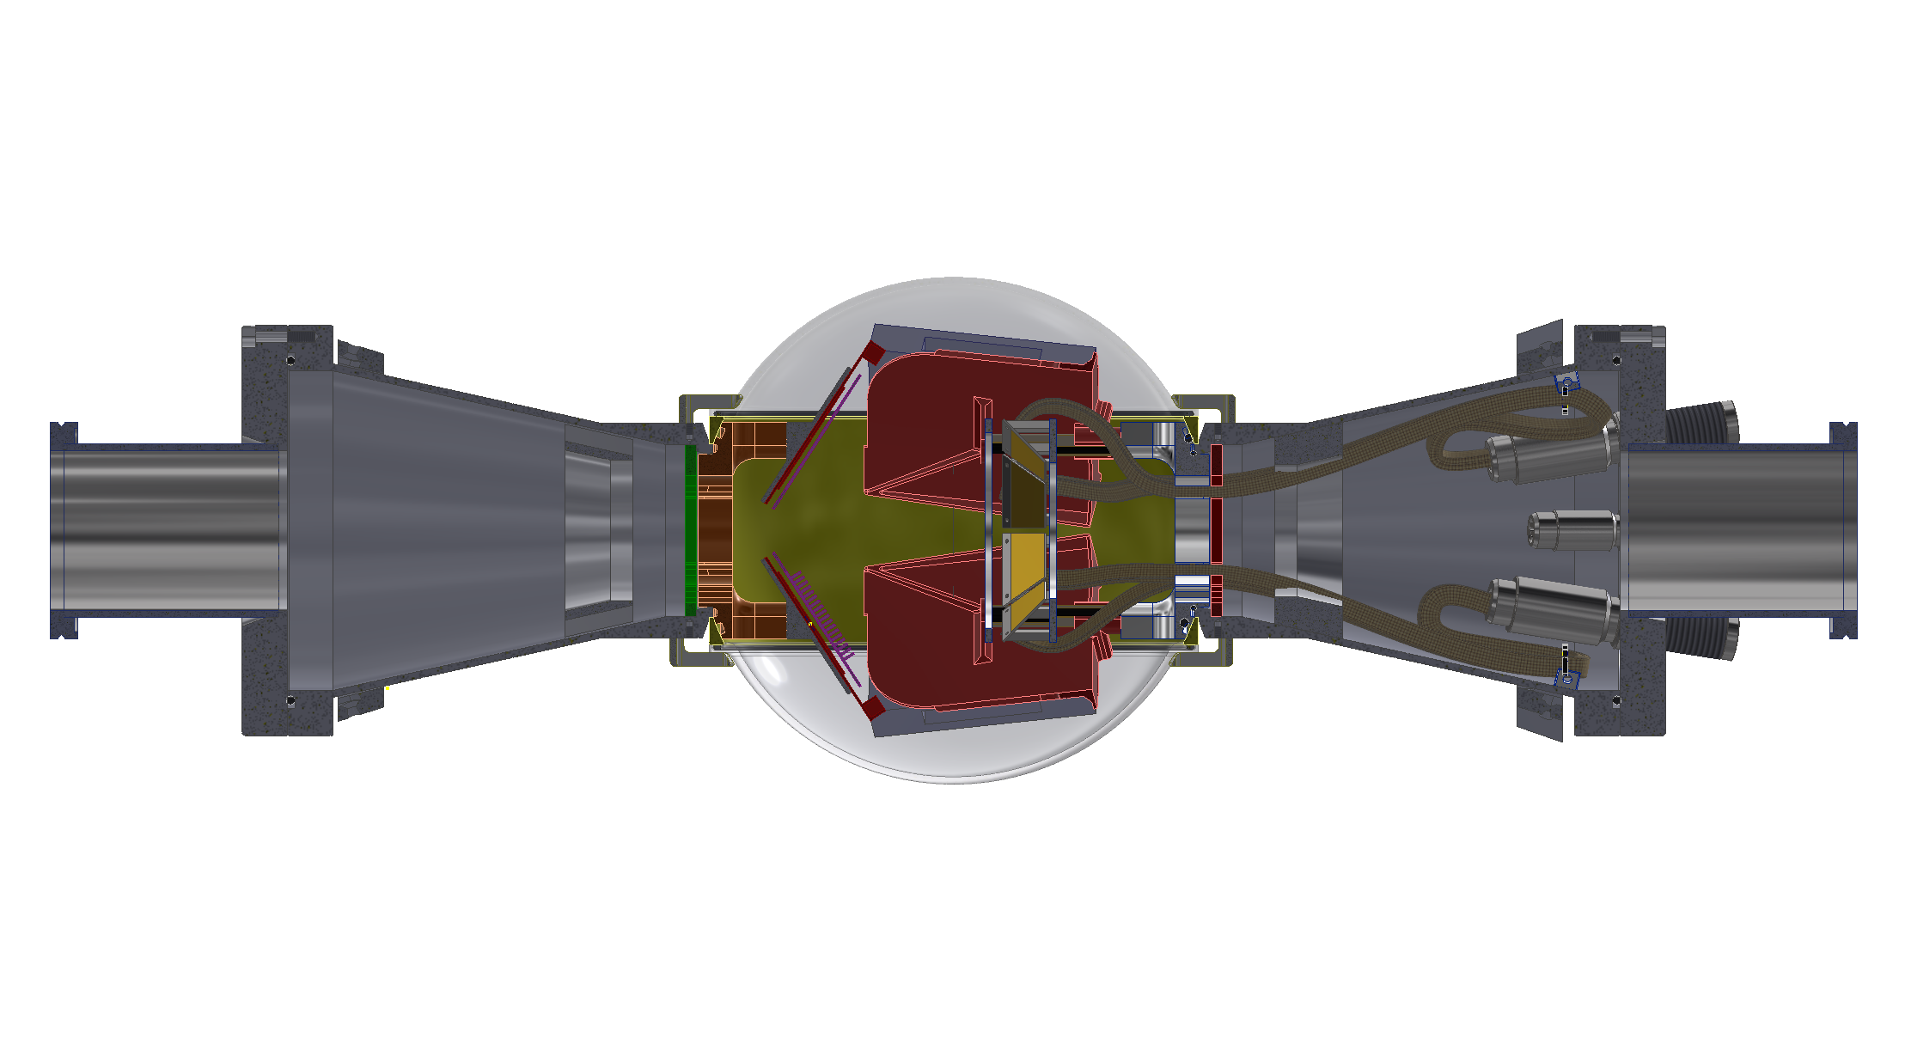
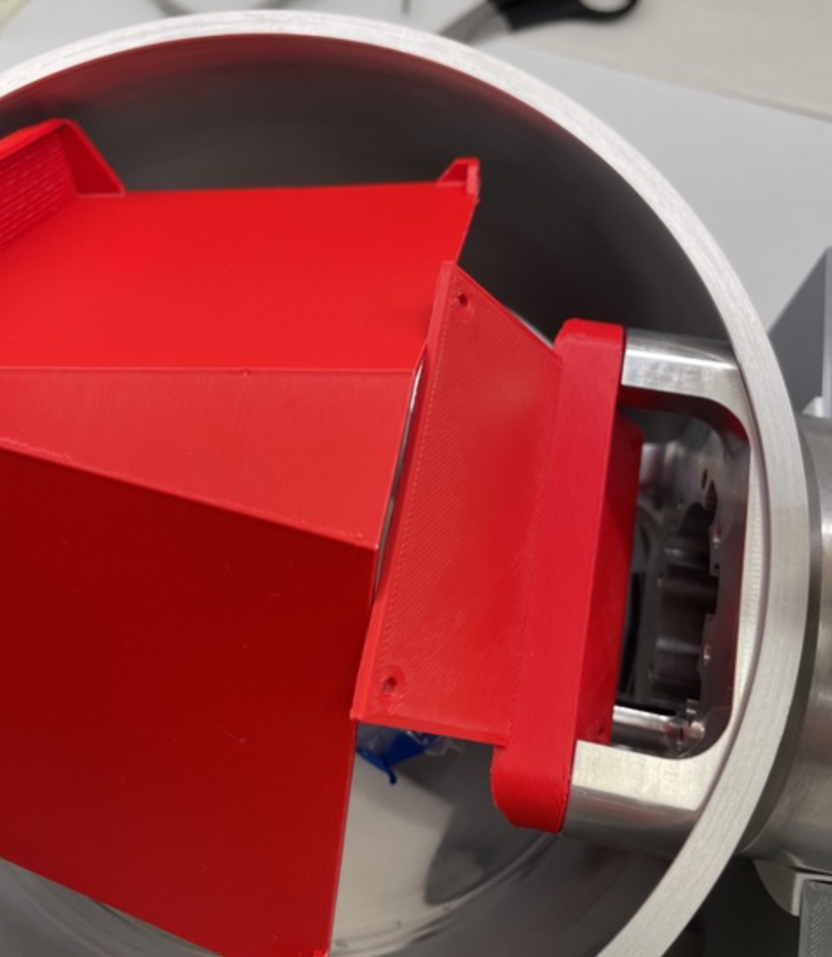
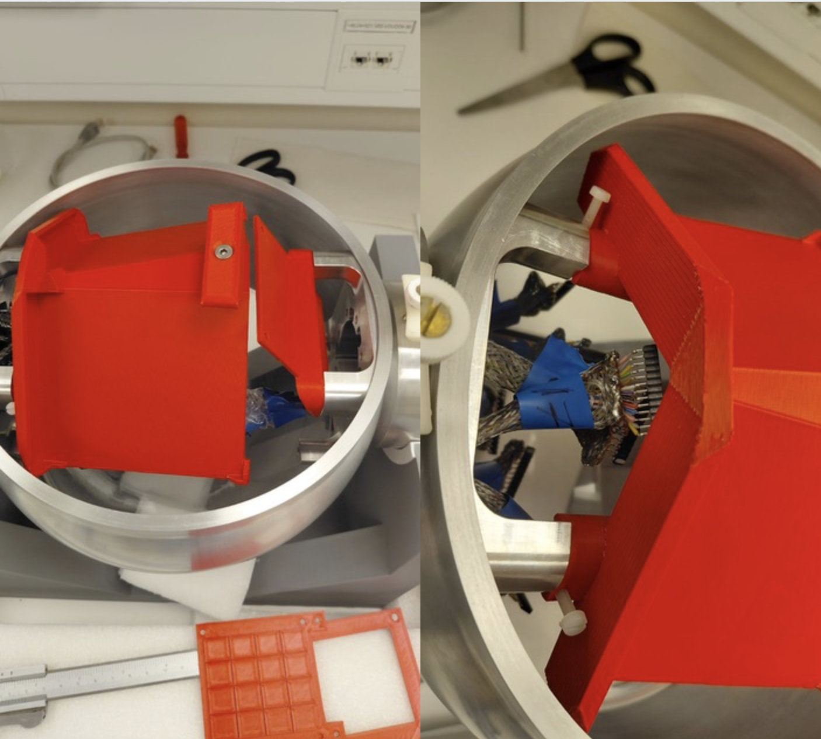
Setup challenges
OSCAR detector and preamplifier holders designed by J. A. Ringnes
Previous versions of the holders
22 May 2026

Slide 14
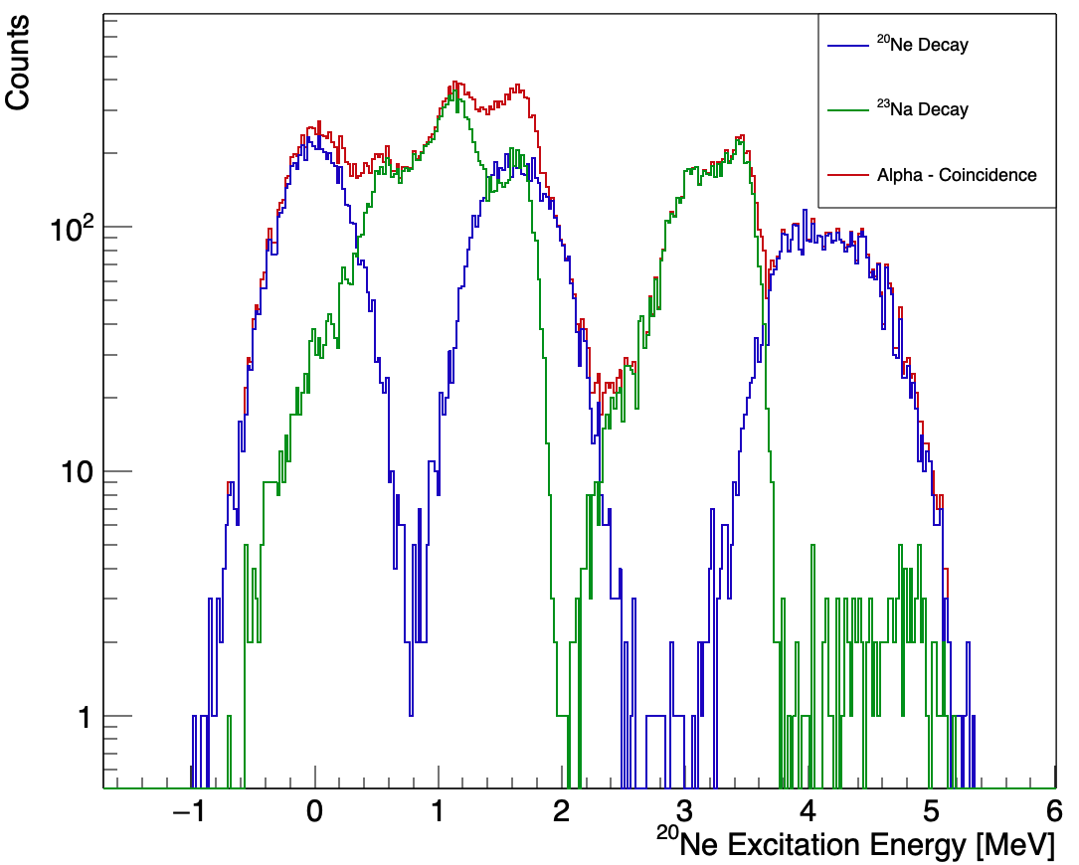
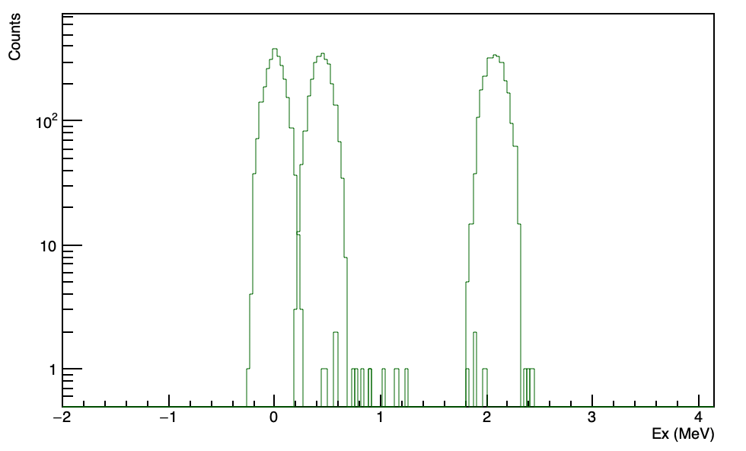
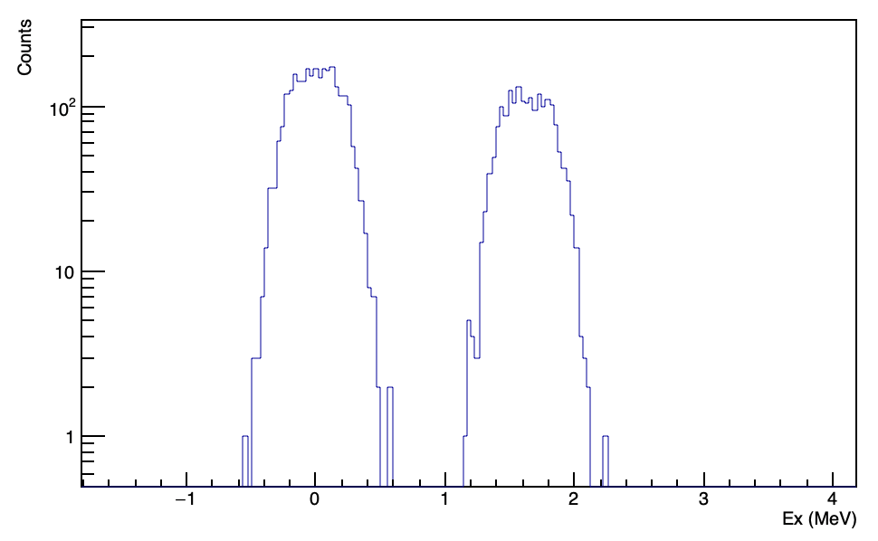


















Particle – particle coincidences
$$α^{′}+{}_{}^{24}{{Mg}^{∗}}$$
$$p_{0}$$
$$α^{′}+p_{0}+{}_{}^{23}{{Na}_{g.s.}}$$
$$p_{1}$$
$$α^{′}+p_{1}+{}_{}^{23}{{Na}_{1^{°}}}$$
$$p_{2}$$
$$α_{0}$$
$$α^{′}+p_{2}+{}_{}^{23}{{Na}_{2^{°}}}$$
$$α^{′}+α_{0}+{}_{}^{20}{{Ne}_{g.s.}}$$
$$α_{1}$$
$$α_{2}$$
$$α^{′}+α_{1}+{}_{}^{20}{{Ne}_{1^{°}}}$$
$$α^{′}+α_{2}+{}_{}^{20}{{Ne}_{2^{°}}}$$
p0
p1
p2
$α$0
$$α1$$
${}_{}^{20}{Ne}$ excitation spectrum from G4 simulations
Particle coincidence: OSCAR + SiRi
particle - particle - $γ$coincidences
particle - particle angular correlations
${}_{}^{20}{Ne}$ excitation spectrum from G4 simulations
Particle coincidence: OSCAR + OSCAR
22 May 2026

Slide 15
Thank you for your attention
Collaboration
F. Ercolano, A. Di Leva, G. Imbriani, D. Dell’ Aquila, M. Vigilante, P. Di Meo , R. M. Gesuè, A. Best (Napoli)
I. Lombardo, M. D’Andrea, A. Massara, A. Tumino, M. La Cognata (Catania)
K. C. W. Li, V. W. Ingeberg, W. Paulsen, J. S. Ringnes (Oslo)
R. Neveling, L. Donaldson, P. Jones (iThemba)
Thanks to NNRC for supporting the visit to Oslo

