Slide 1


Microscopic Giant Dipole Response and Nuclear Level Densities within Covariant Energy Density Functional Theory
Yuan Tian*, Ruirui Xu, Xi Tao, Jimin Wang, Zhigang Ge
China Nuclear Data Center(CNDC)
China Institute of Atomic Energy(CIAE)
P.O.Box 275-41,Beijing 102413, P.R.China
E-Mail: tiany@ciae.ac.cn
Notes:
Good morning everyone. My talk is about microscopic giant dipole response and nuclear level densities within covariant energy density functional theory. The motivation is nuclear reaction data evaluation. In statistical reaction calculations, photon strength functions and nuclear level densities are two essential inputs. Phenomenological models work well near known regions, but their predictive power becomes limited for unstable nuclei and poorly measured systems. Therefore, our goal is to develop microscopic PSF and NLD based on a unified CDFT framework.

Slide 2

Introduction
Giant dipole resonance
Conclusion and outlook
Nuclear Level Densities

Slide 3
INTRODUCTION

Slide 4
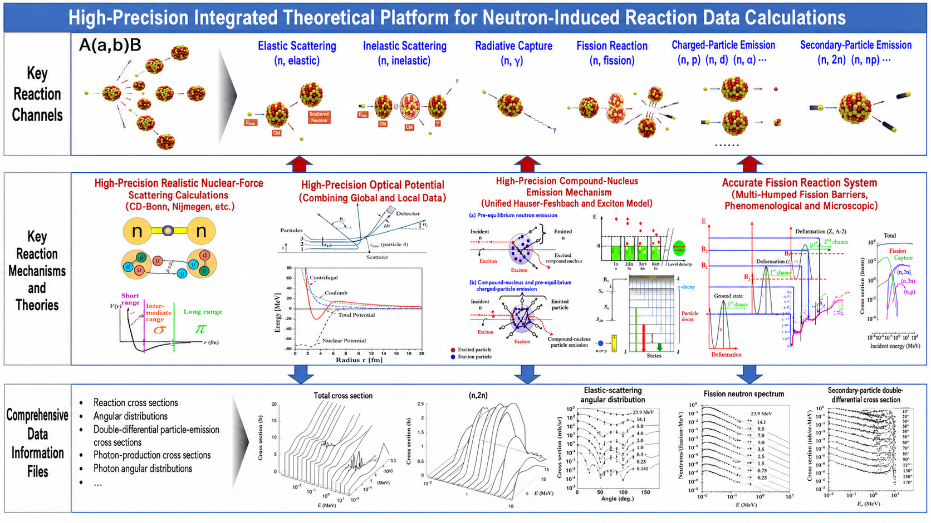

Slide 5
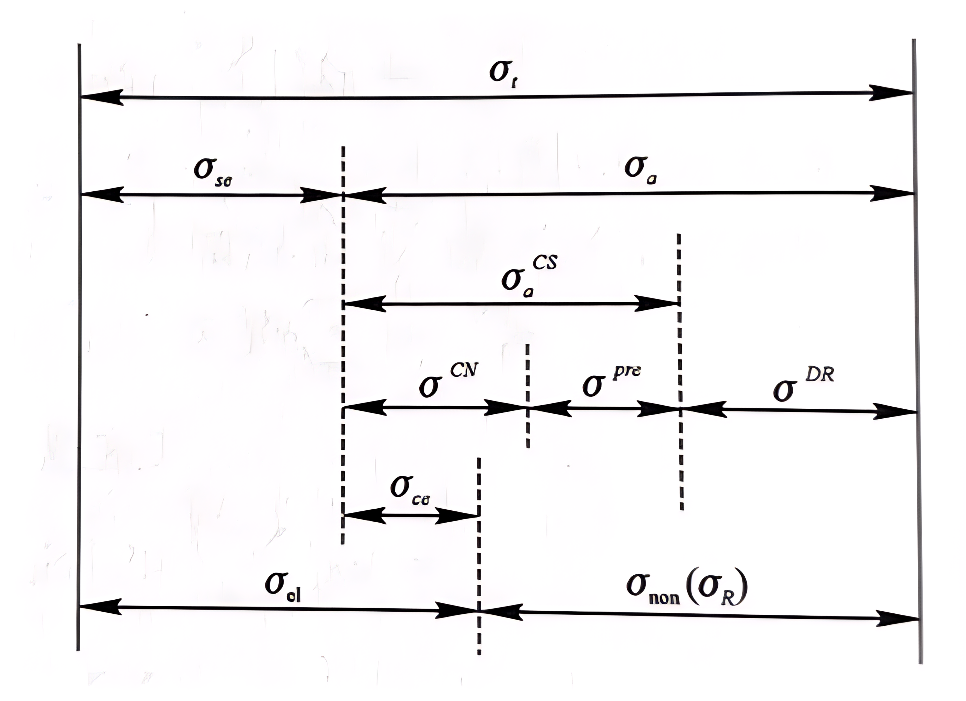
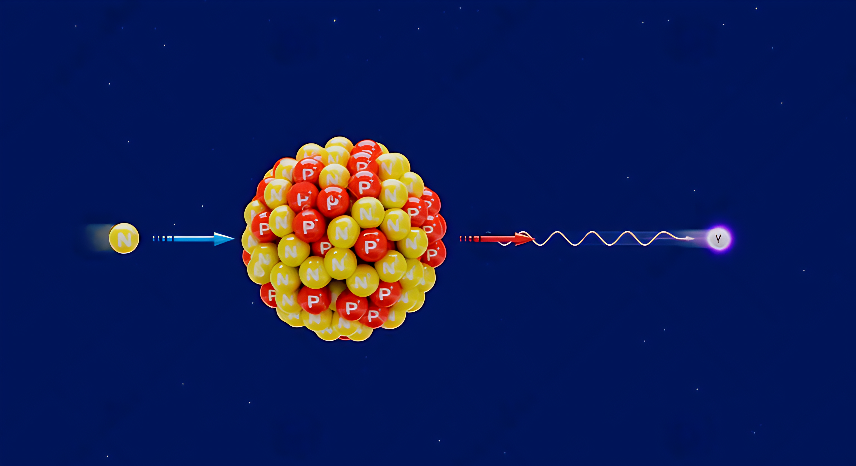
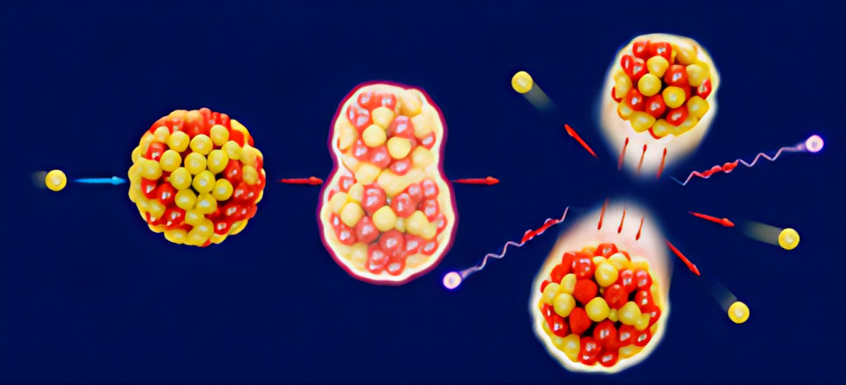
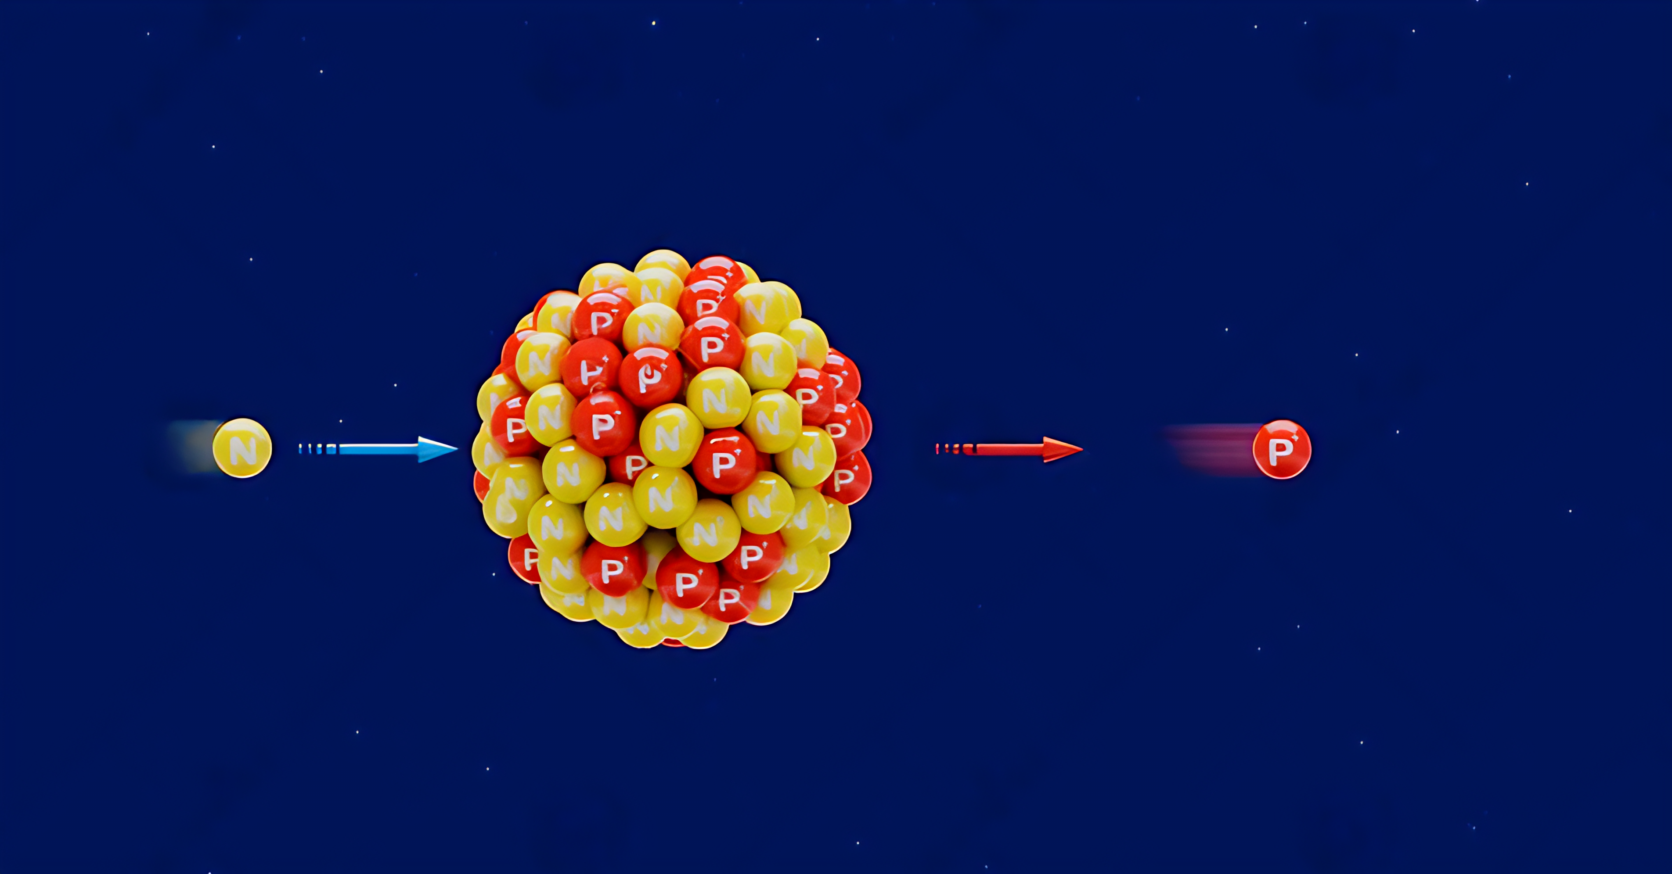
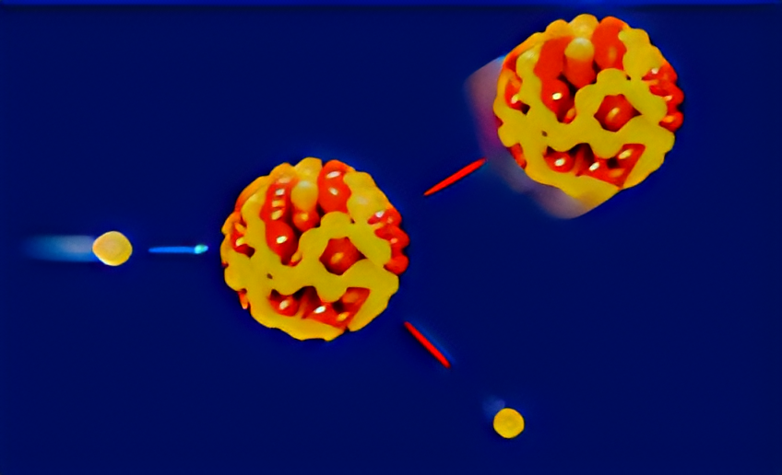
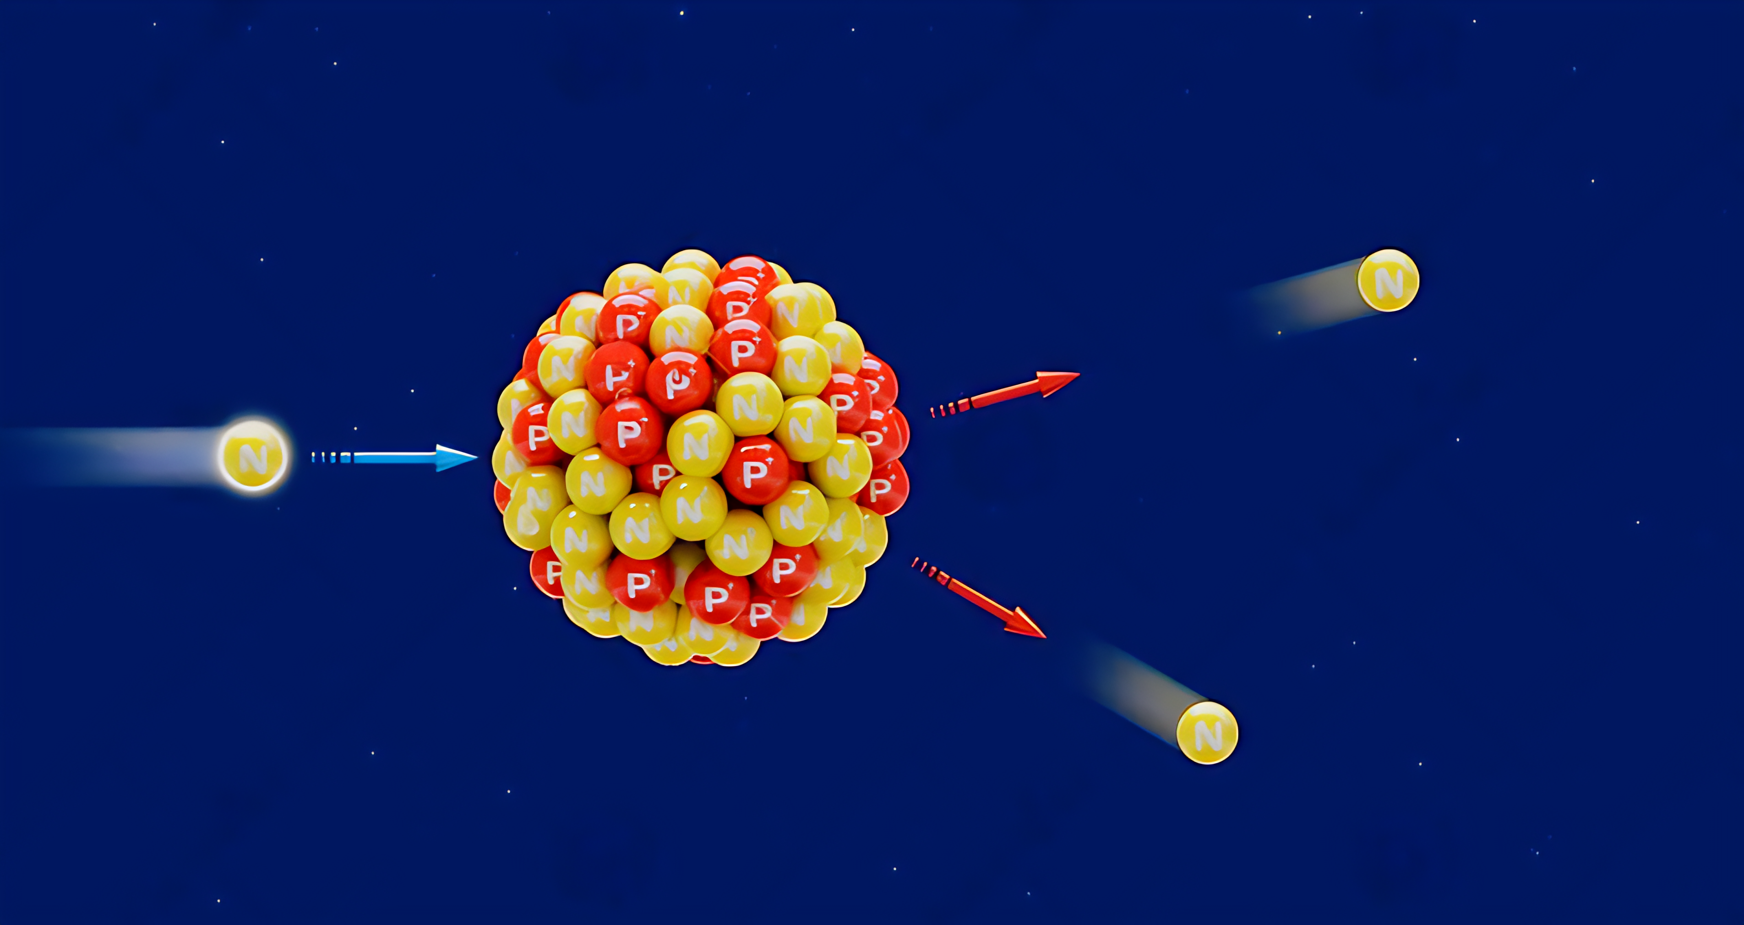
Microscopic GDR and Level Density
Radiative Capture Reaction
Photon Strength Function (RQRPA)
Nuclear level density(RHB)
Fission Reaction
Multi-humped Fission Barrier (RHB)
Nuclear level density (RHB)
One-particle emission reactions
unified Hauser-Feshbach and exciton model
Nuclear level density (RHB)
Elastic Reaction
Optical potential model
(CTOM or RHB)
Multi-particle emission reactions
Hauser-Feshbach
Nuclear level density (RHB)

Slide 6
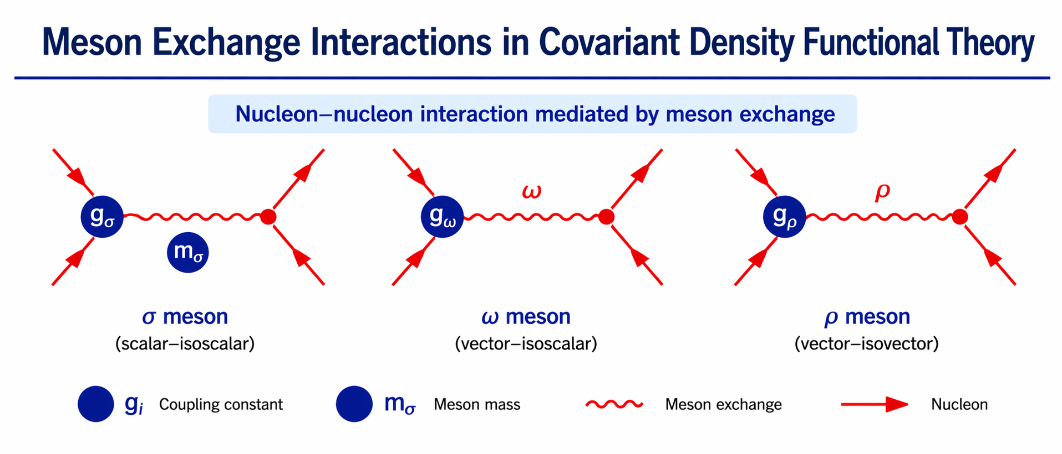
Covariant density functional theory:
C. Fuchs, LNP (2004)
Taken from Prof. Peter Ring’s talk

Slide 7
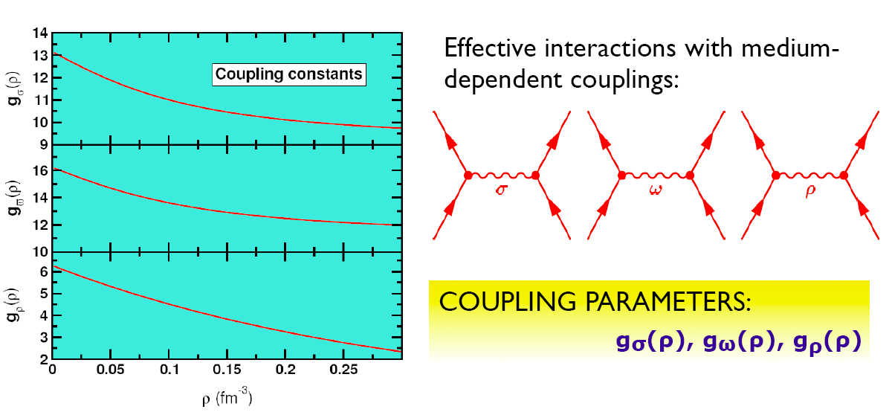
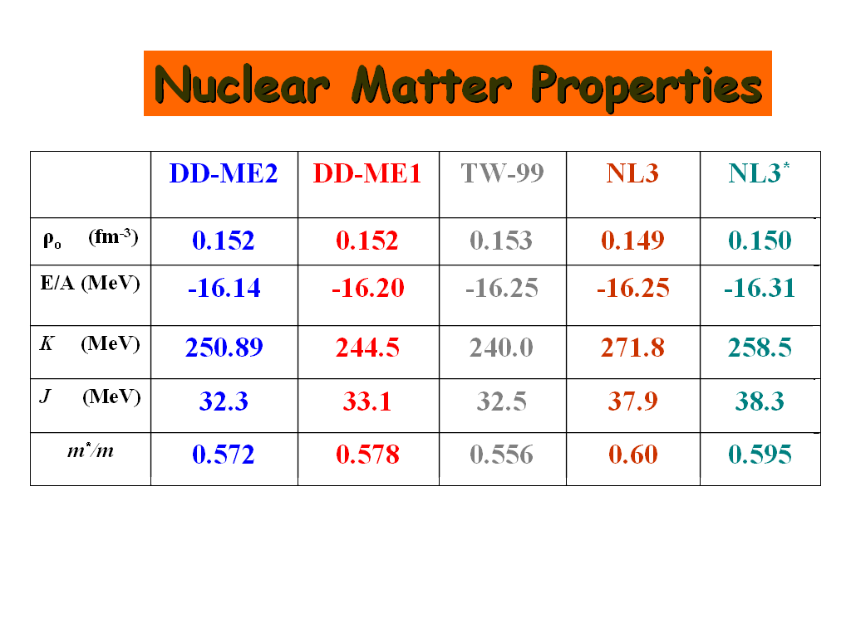
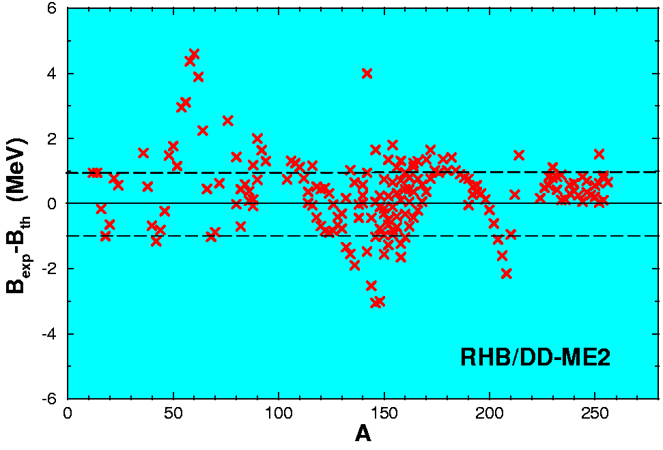
Density Dependent coupling constants:
Typel, Wolter, NPA 656, 331 (1999)
Niksic, Vretenar, Finelli, P.R., PRC 66, 024306 (2002): DD-ME1
Lalazissis, Niksic, Vretenar, P.R., PRC 78, 034318 (2008):DD-ME2
masses: Dm = 900 keV
radii: Dr = 0.015 fm

Slide 8
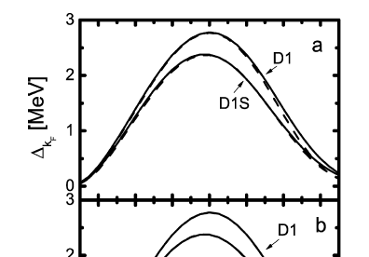
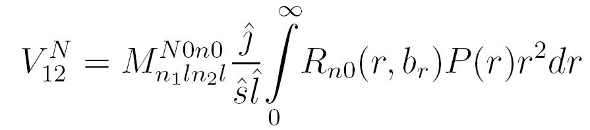
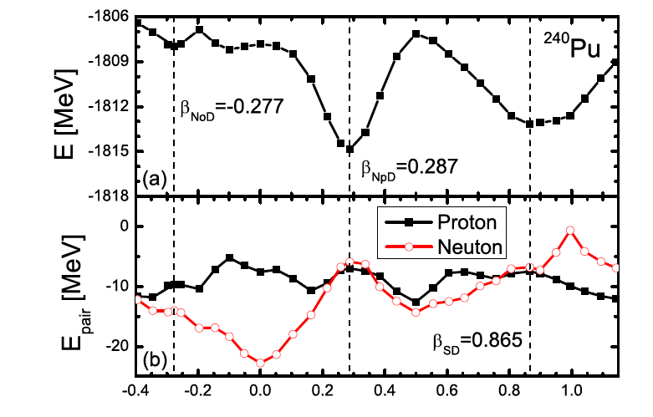
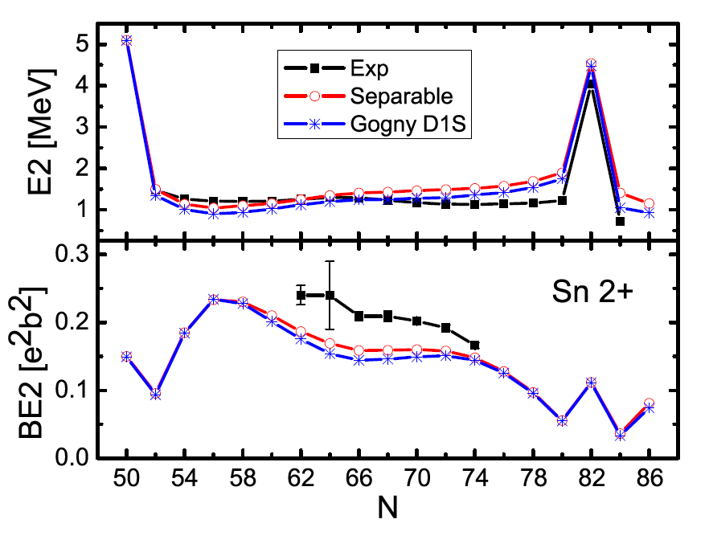
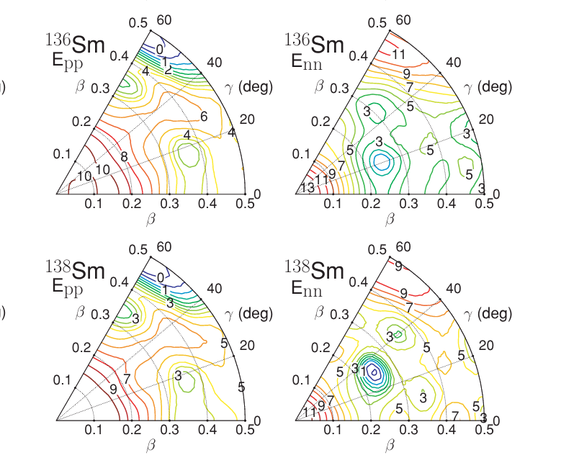
Separable pairing interaction（TMR）
Work | Contribution | Citations
Tian, Ma & Ring PLB 676, 44 (2009) | Finite-range separable pairing force for nuclear DFT | 400+
Tian, Ma & Ring PRC 80, 024313 (2009) | Axially deformed RHB calculations | 100+
Tian, Ma & Ring PRC 79, 064301 (2009) | Relativistic QRPA extension | 80+
Nikšić, Vretenar, Tian, Ma & Ring PRC 81, 054318 (2010) | 3D/triaxial RHB calculations | 120+

Slide 9
Giant Dipole Resonance

Slide 10
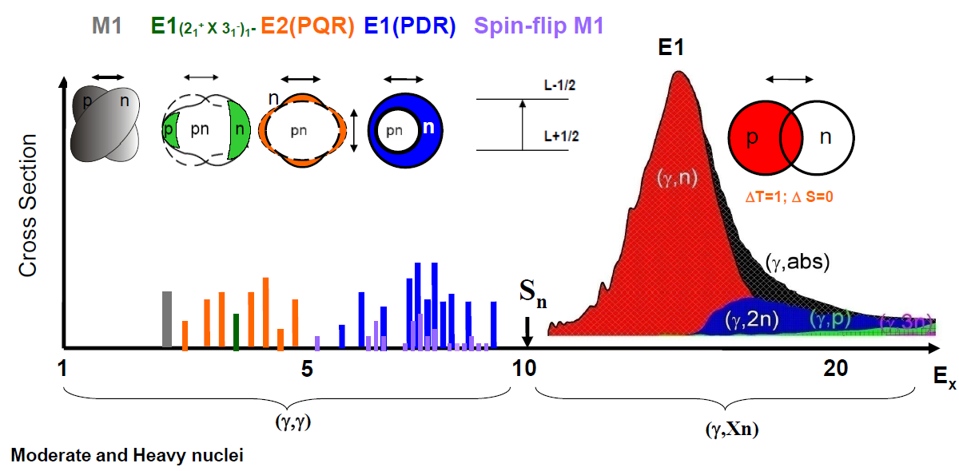
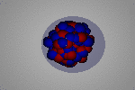
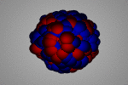
Radiative Capture Reaction
Two-phonon
excitation
Pygmy-quadrupole
resonance
Pygmy-dipole
resonance
Giant M1
resonance
Giant Dipole Resonance
E1 (GDR)
Scissors mode
Spin-flip M1
2₁⁺
3₁⁻
E (MeV)
Theoretical prediction of Pygmy Quadrupole Resonance: N. Tsoneva, H. Lenske, Phys. Lett. B 695 (2011) 174.
N.Tsoneva, ERICE14
Notes:
巨偶极共振 (Giant Dipole Resonance, GDR)
E1 (GDR): 发生在高能区，主要涉及核子之间的集体振动，其中质子和中子以相反方向移动。
侏儒四极共振 (Pygmy Quadrupole Resonance, PQR)
E2 (PQR): 出现在较低能量区域，通常与较少数的核子振动有关，尤其是表面核子的集体运动。
侏儒偶极共振 (Pygmy Dipole Resonance, PDR)
E1 (PDR): 类似于PQR，但主要是质子和中子群体之间的振动，能量较低。
其他共振模式
剪刀模式 (Scissors mode, M1): 主要与偶极子的集体激发有关，通常发生在非常低的能量区域。
双声子激发 (Two-phonon excitation): 涉及更复杂的集体振动模式。
巨磁偶极共振 (Giant M1 Resonance): 涉及核内自旋翻转，通常出现在更高能区。
伽马共振的能量分布图
图中展示了各种伽马共振模式随能量变化的分布情况，标示了不同共振模式的能量区域。这些共振模式的激发能量从几MeV到几十MeV不等，涉及不同的核反应机制。

Slide 11
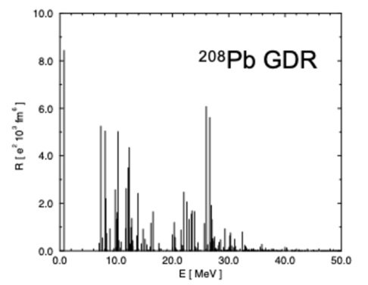
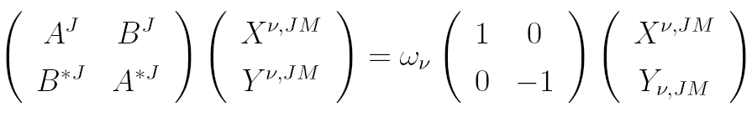
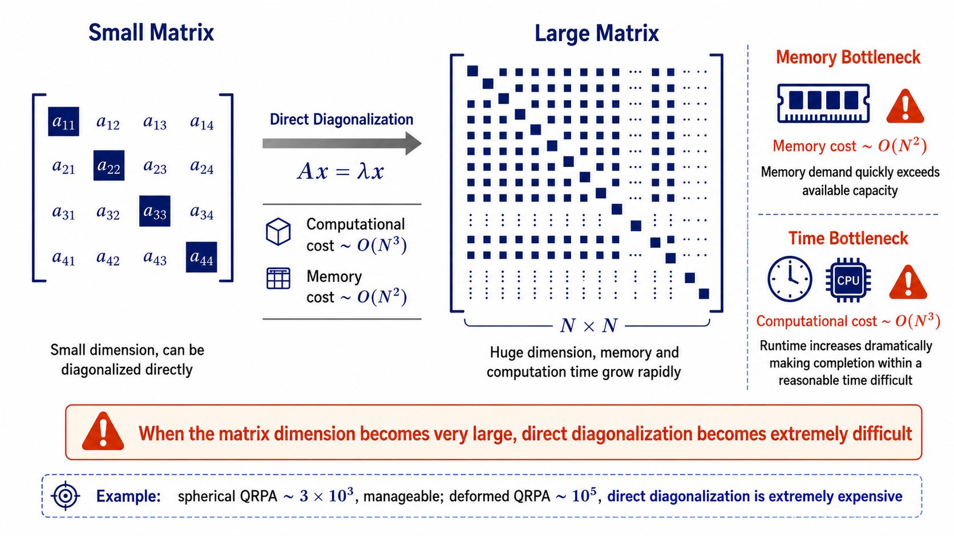
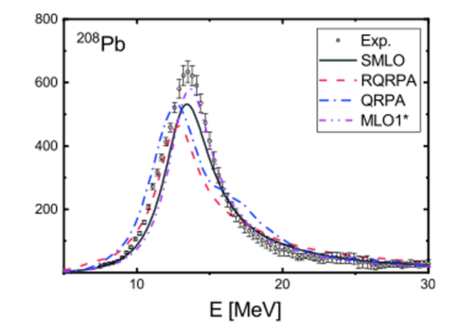
RQRPA: using the diagonalization approach
requires the introduction of a width to obtain the excitation curve

Slide 12
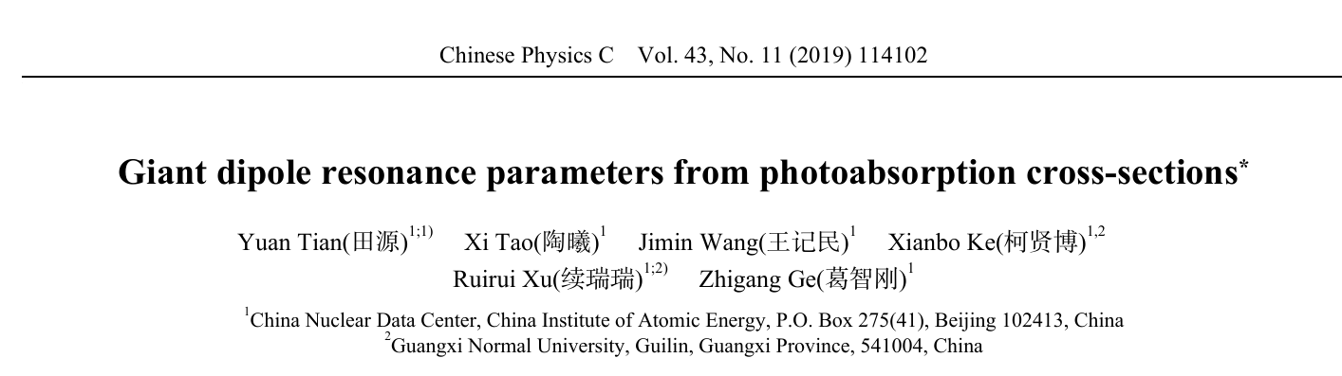
RQRPA: for the spherical nuclei

Slide 13
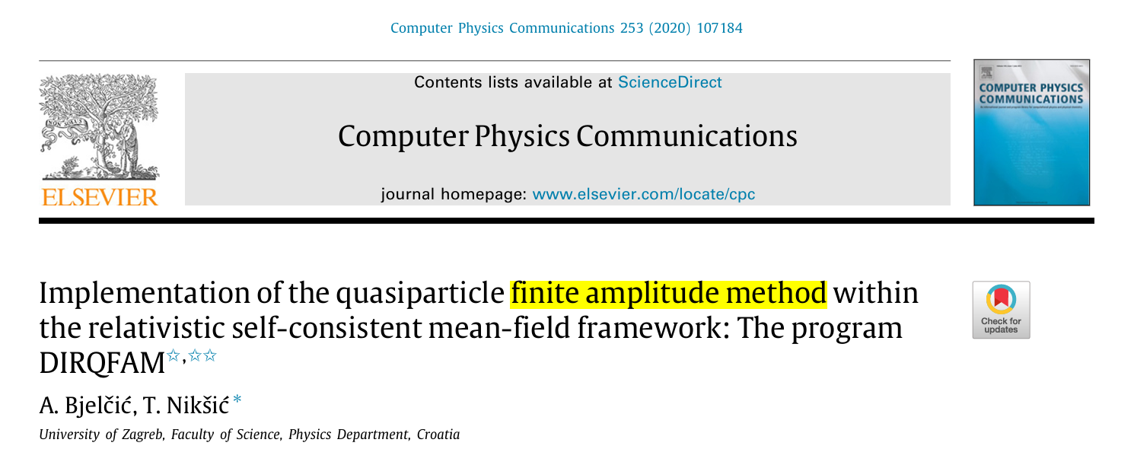
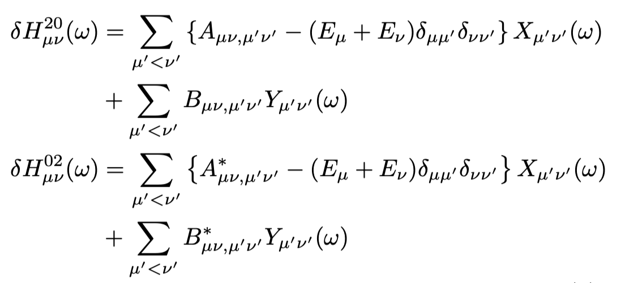
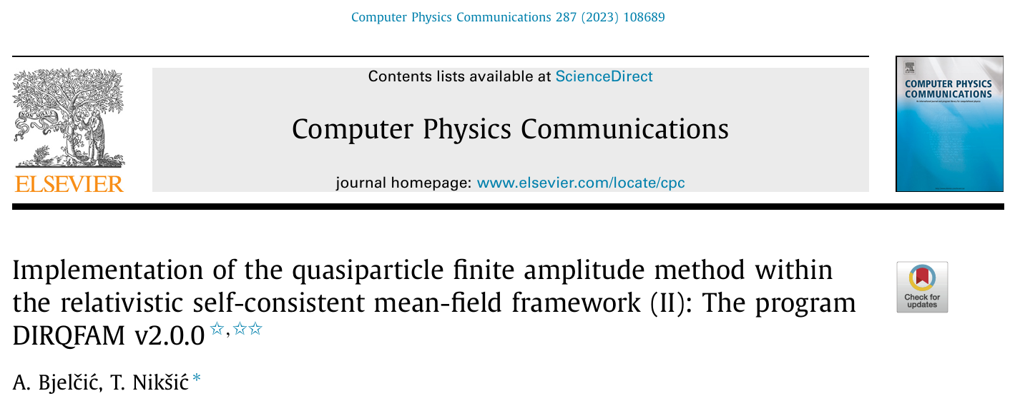
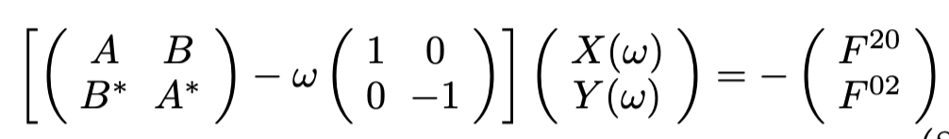
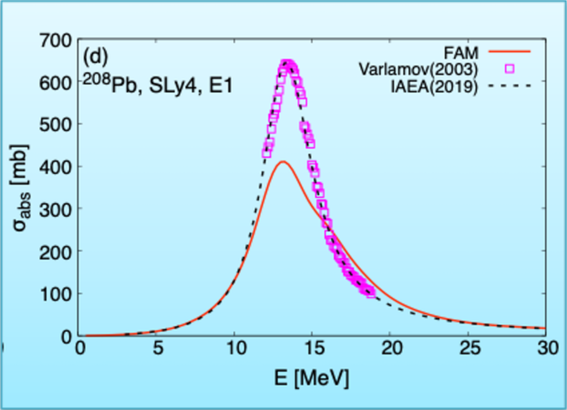
FAM solves the linear response equations through a self-consistent iterative approach
Restricting calculations to fixed-size widths makes it difficult to reproduce experimental data

Slide 14
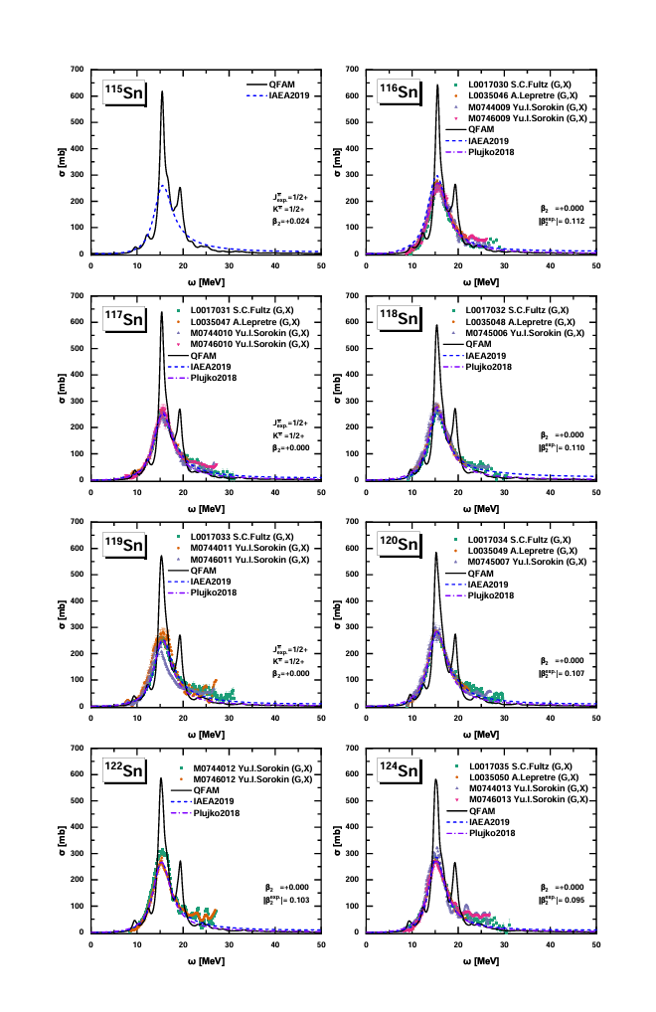
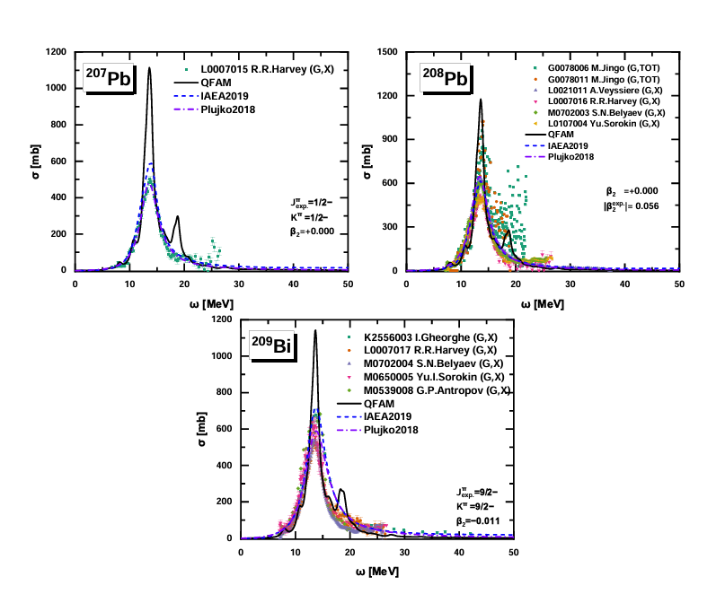
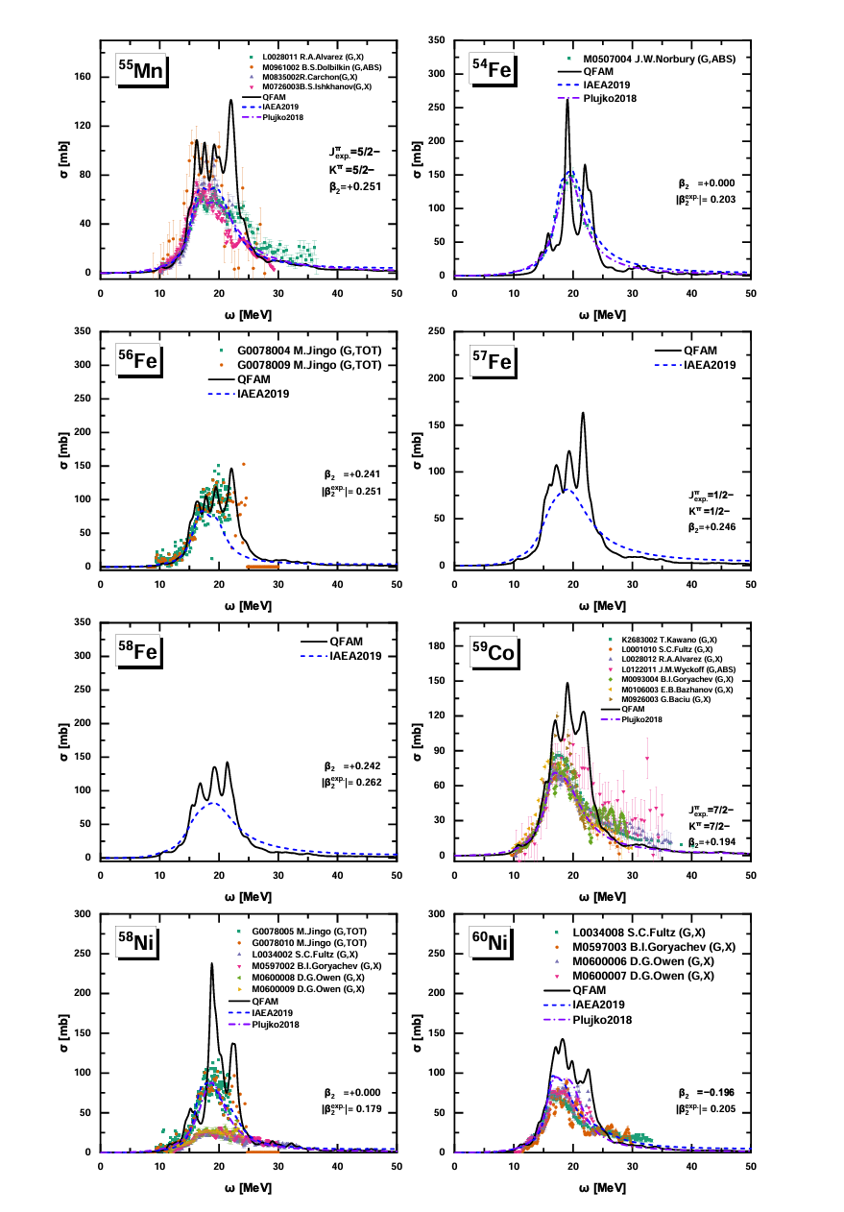
Radiative Capture Reaction
Photoabsorption cross sections for 235 stable nuclei, ranging from ⁴⁰Ca to ²⁰⁹Bi, were investigated by the quasiparticle finite amplitude method (QFAM) using relativistic poin coupling interaction DD-PC1, with extensions to odd-A nuclei.
Atomic Data and Nuclear Data Tables
Volume 168, February 2026, 101770

Slide 15
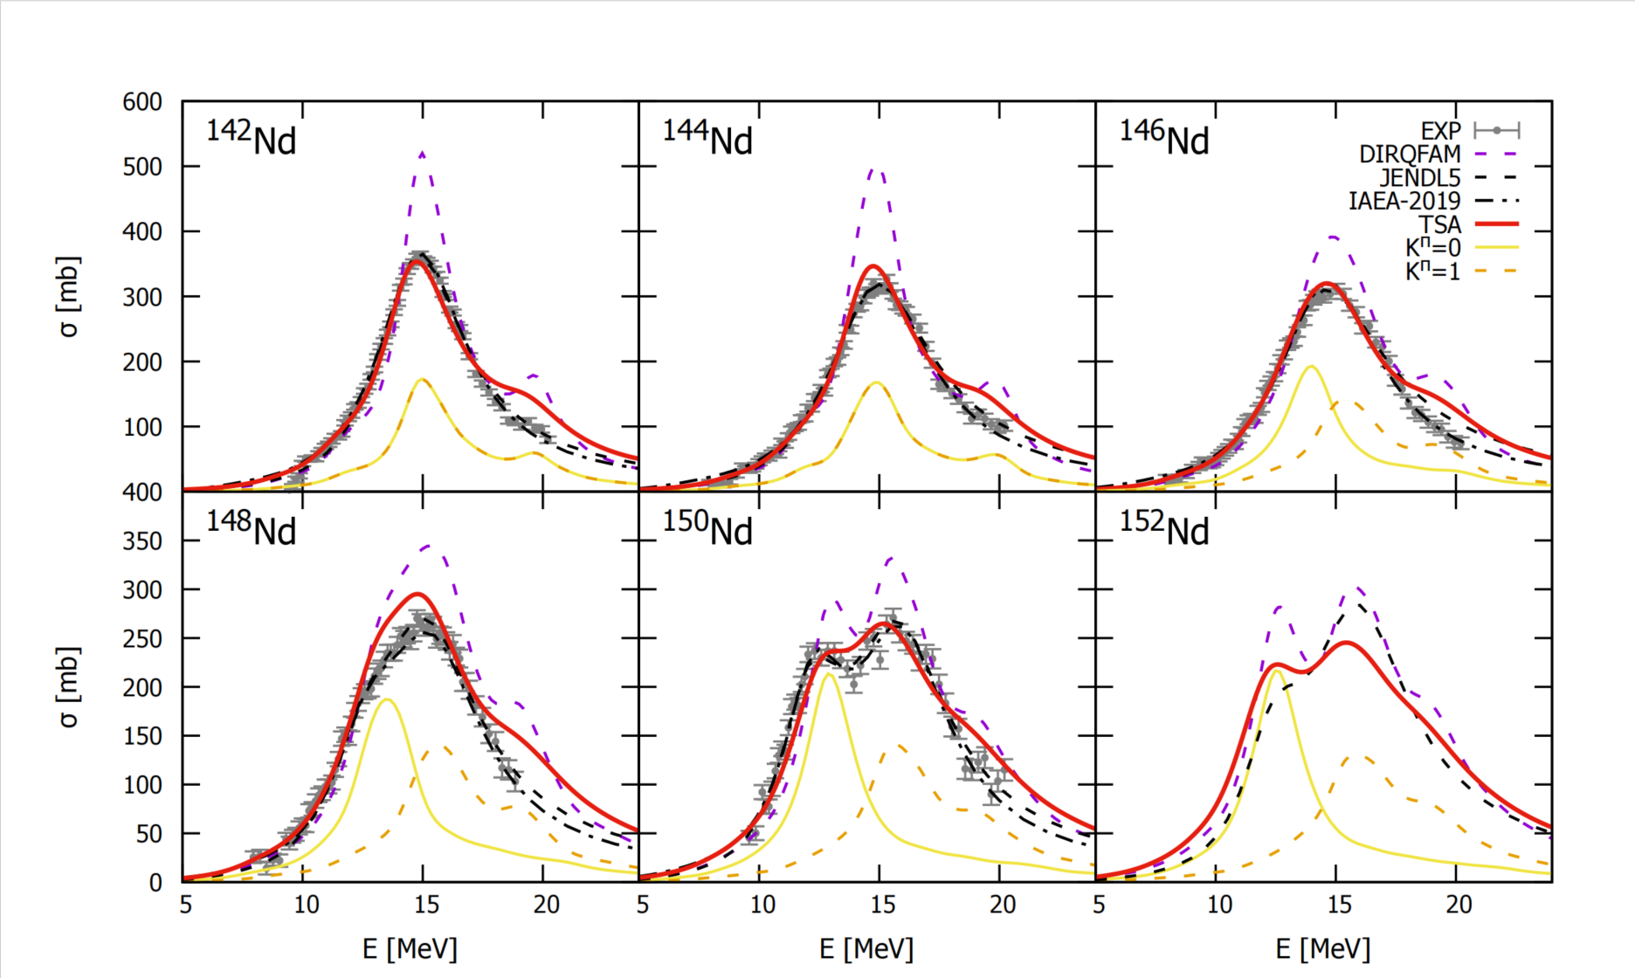
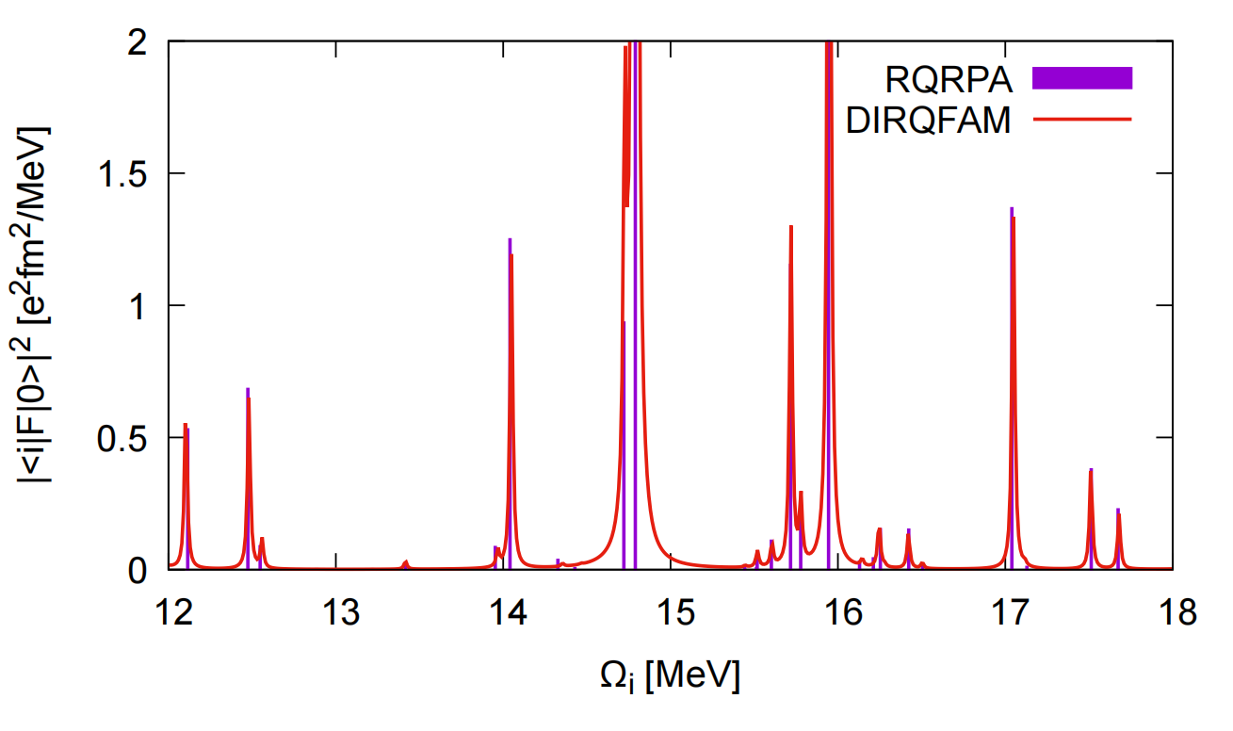
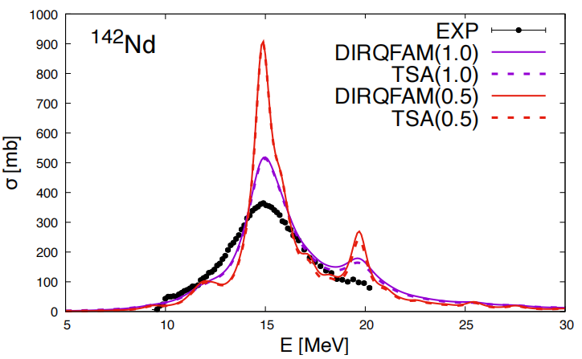
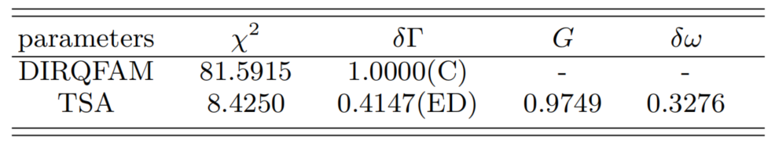
Energy-dependent width improves QFAM description of GDR
This paper investigates the photon absorption cross-sections of even-even nuclei within the Nd isotope chain. By fitting energy-dependent widths, the deviation between the original QFAM results and experimental values was reduced by an order of magnitude；
Nuclear Science and Techniques (2025) 36:241

Slide 16
Nuclear Level Densities

Slide 17
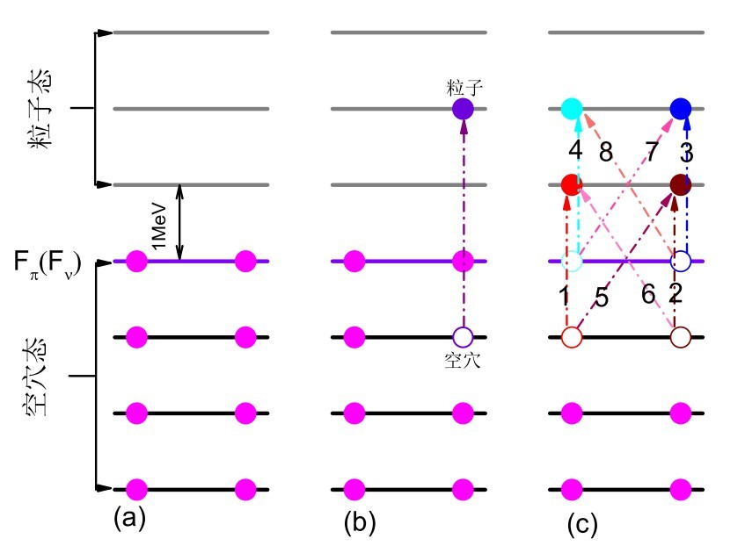
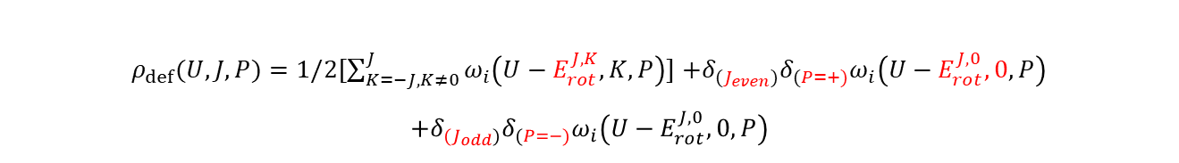
Microscopic nuclear level densities based on CDFT
Single particle levels (CDFT)
combinatorial method
Particle-hole state densities
rotational and vibrational effects
$ρ_{sph}\left(U,J,P\right)=$ $ω_{i}\left(U,M=J,P\right)−ω_{i}\left(U,M=J+1,P\right)$
$ρ_{def}(U,J,P)=1/2[\sum_{K=−J,K≠0}^{J}{ω_{i}\left(U−E_{rot}^{J,K},K,P\right)}]$ $+δ_{(J_{even})}δ_{(P=+)}ω_{i}\left(U−E_{rot}^{J,0},0,P\right)$
$$+δ_{{(J}_{odd})}δ_{(P=−)}ω_{i}\left(U−E_{rot}^{J,0},0,P\right)$$
Nuclear level density
Global microscopic nuclear level densities within the HFB\ plus combinatorial method for practical applications
Hilaire, S. / Goriely, S. 2006 Nuclear Physics A , Vol. 779 p. 63 - 81

Slide 18
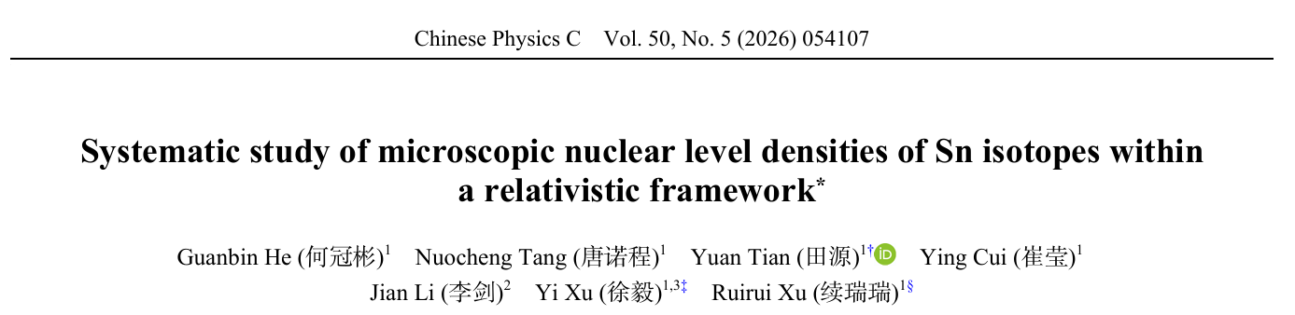
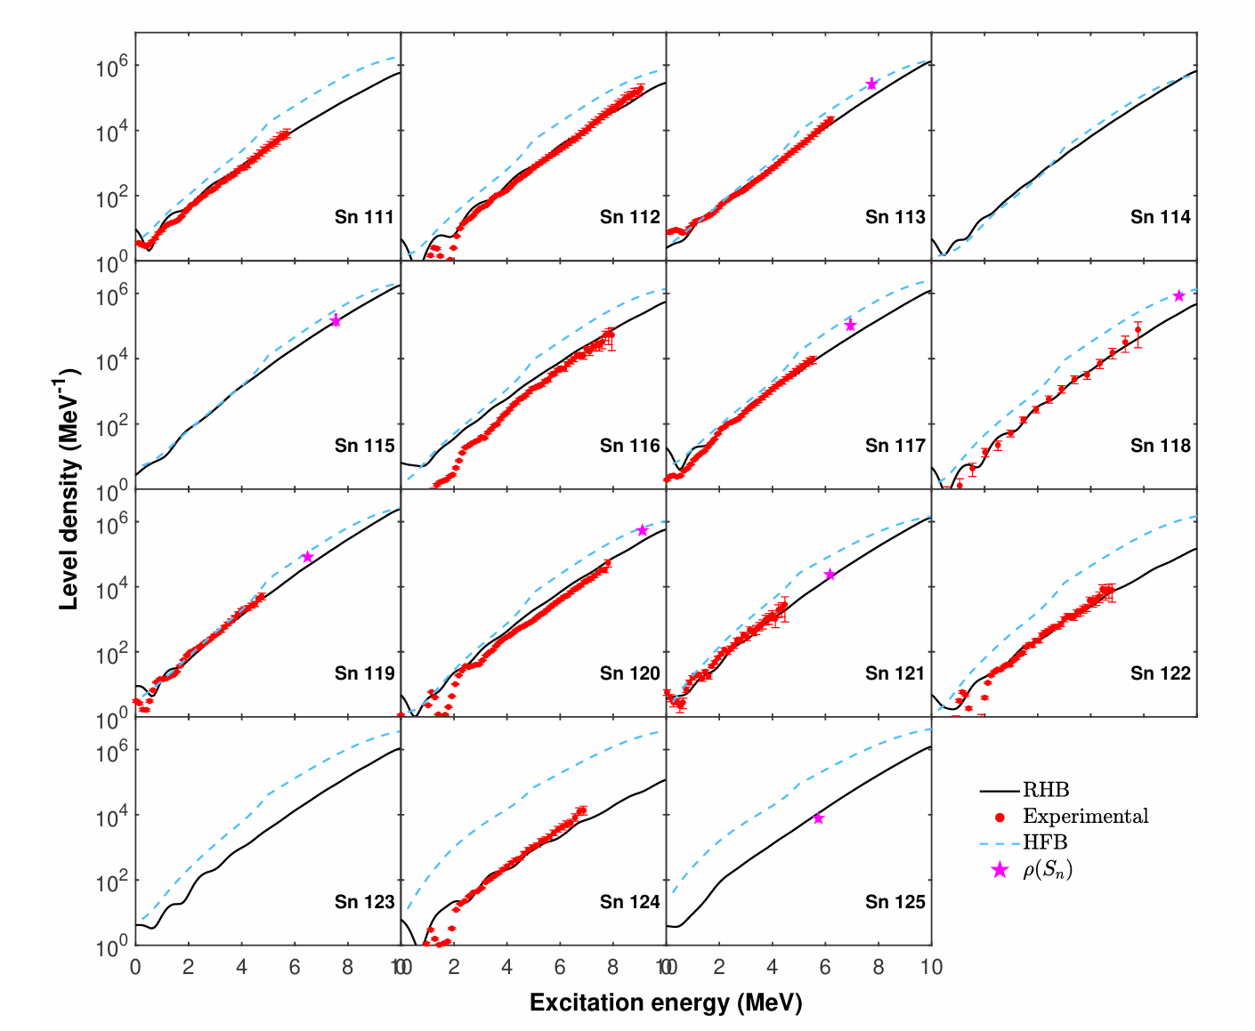
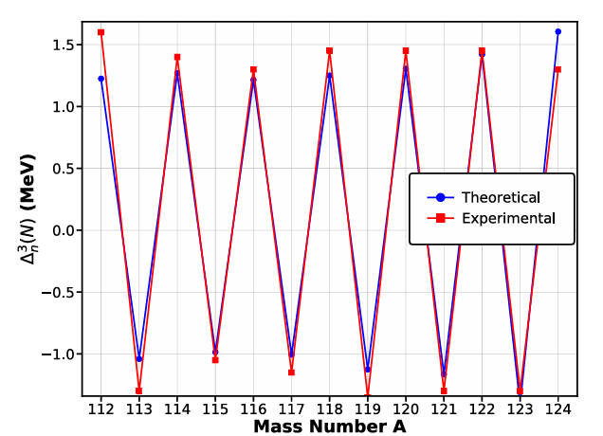
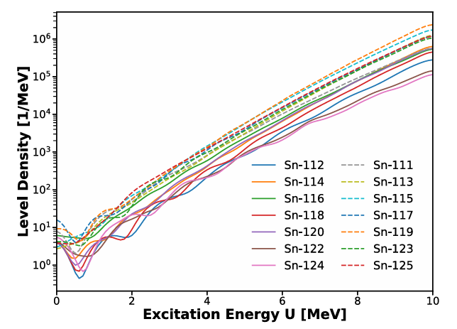
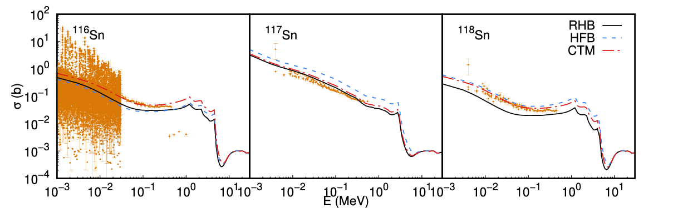

Slide 19
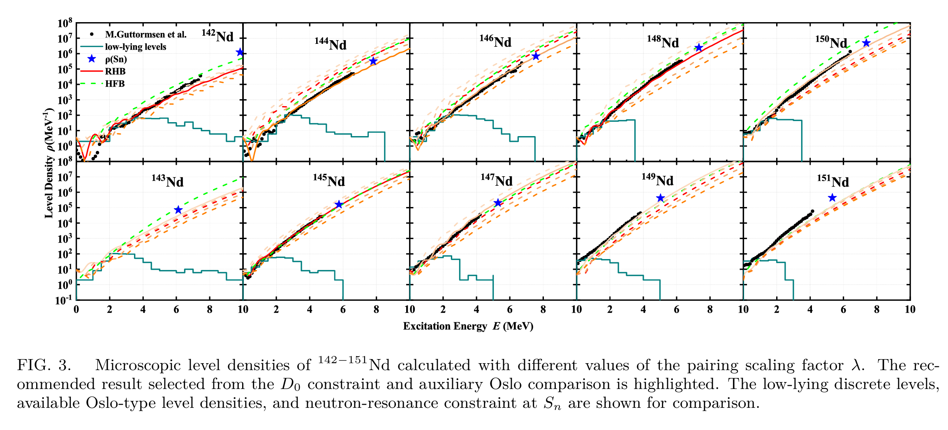
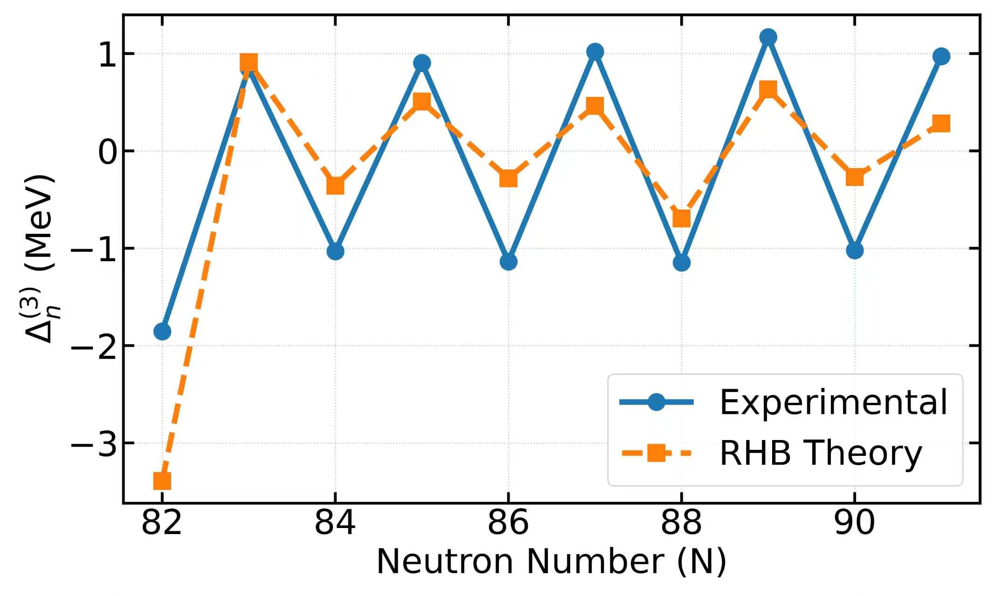
Pairing effect on the Microscopic Level Density
Pairing sensitivity:
The default pairing strength tends to underestimate pairing correlations in Nd isotopes. By scaling the pairing strength from 0.8 to 1.2, we find that microscopic level densities are strongly correlated with pairing correlations, especially in the low-excitation-energy region. This indicates that pairing optimization is essential for reliable microscopic NLD predictions.
In preparation

Slide 20
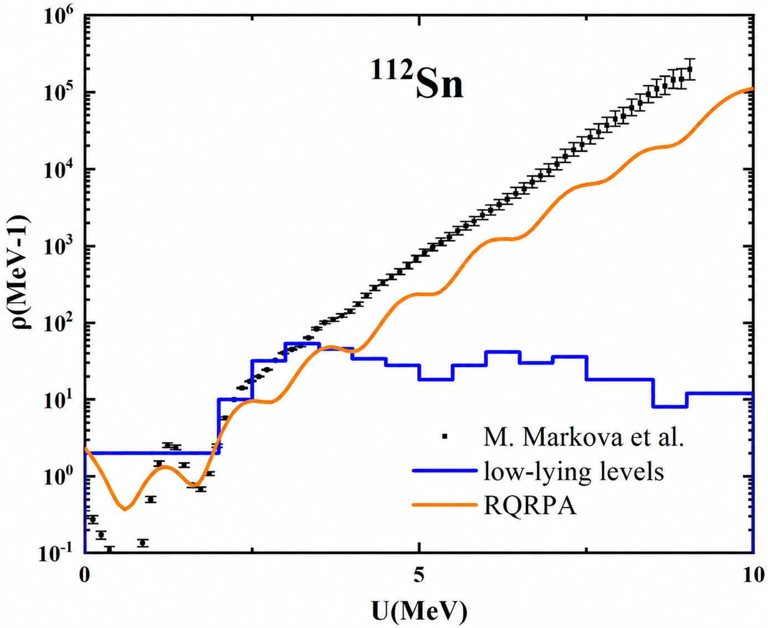
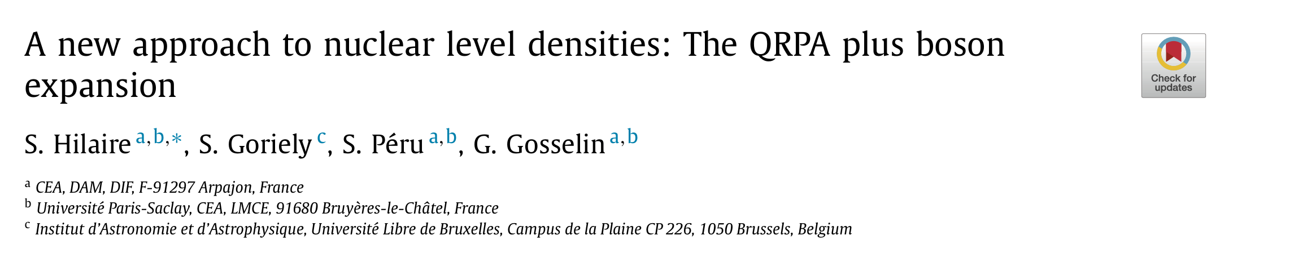

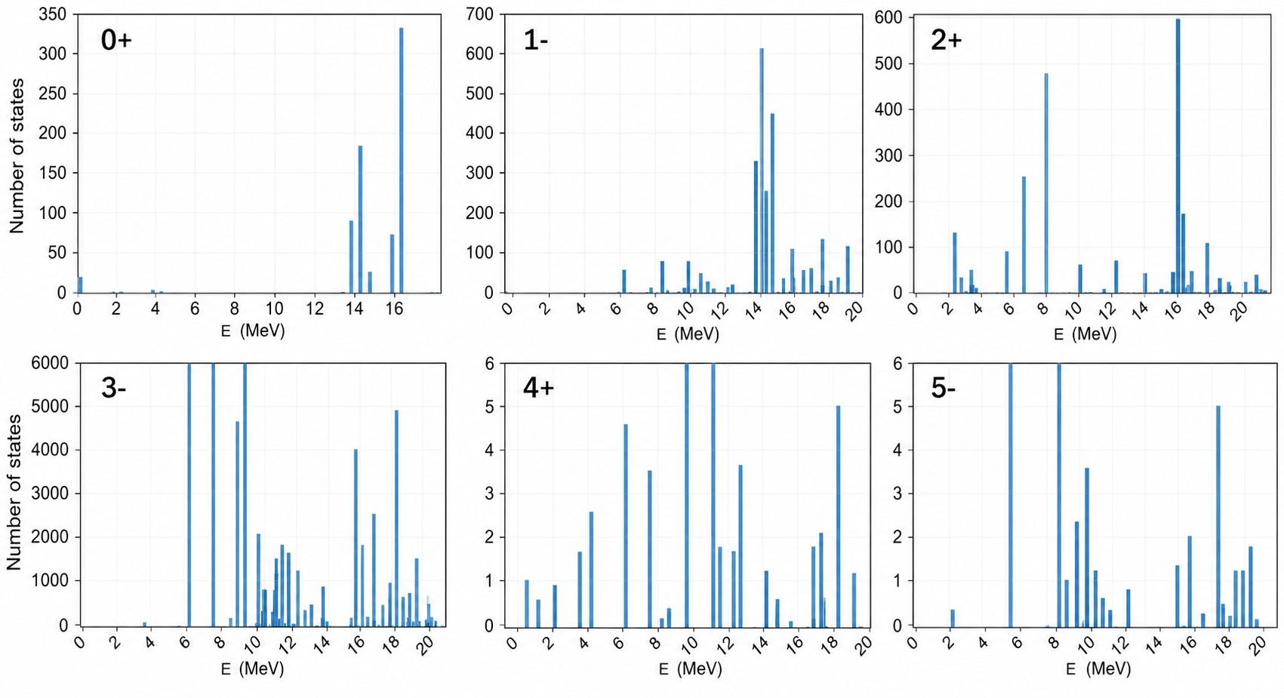
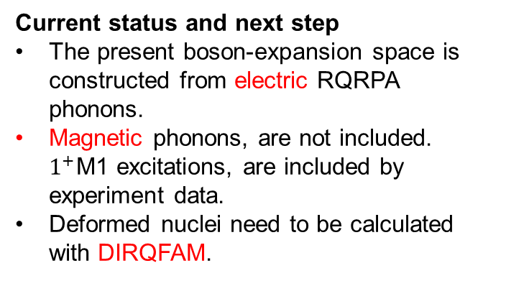
RQRPA + Boson expansion
Preliminary
Current status and next step
The present boson-expansion space is constructed from electric RQRPA phonons.
Magnetic phonons, are not included. $1^{+}$M1 excitations, are included by experiment data.
Deformed nuclei need to be calculated with DIRQFAM.

Slide 21
CONCLUSION AND OUTLOOK

Slide 22
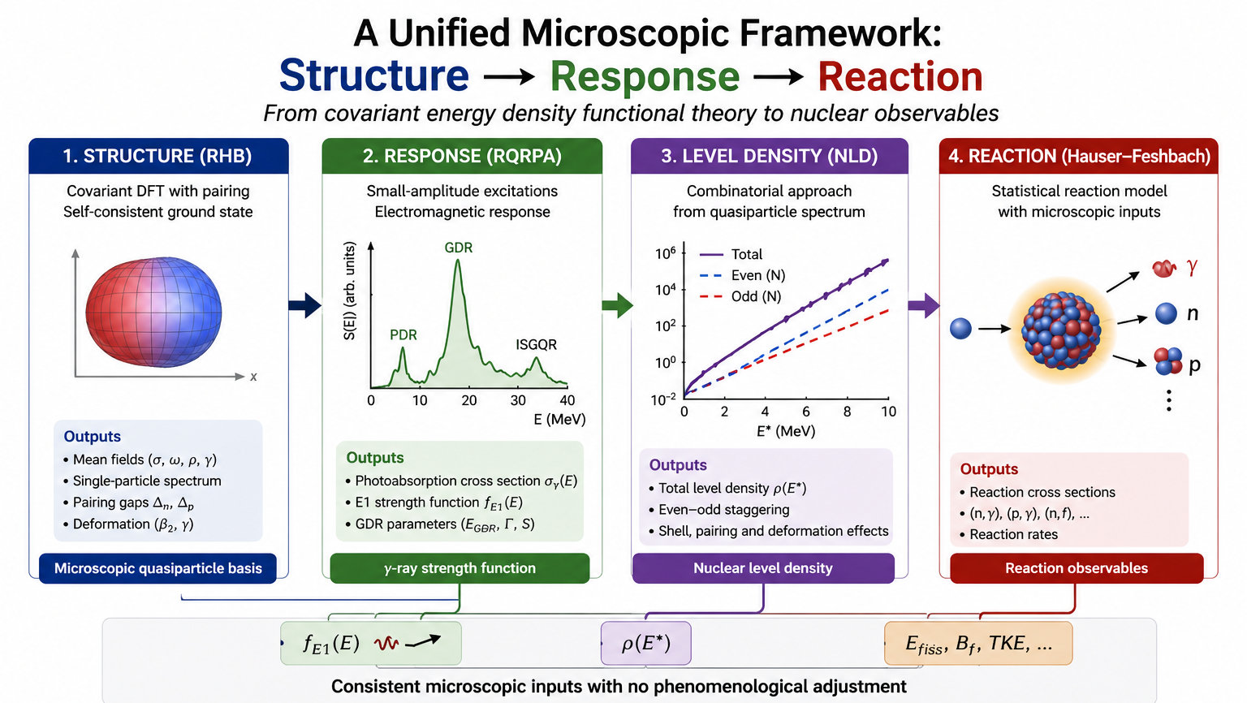

Slide 23


Physics Letters B 689 (2010) 72–8
Phys. Lett. B 849 (2024) 138448
A self-consistent microscopic treatment of pairing correlations in finite nuclei is essential for improving predictions of giant dipole resonances, fission barriers, and nuclear level densities.

Slide 24


Thank you for your attention !

Slide 25



Collaborate with Prof. Yuan from ZhongShan University

Slide 26



Uncertainties of nuclear level density estimated using Bayesian neural networks
Chinese Physics C Vol. 48, No. 8 (2024) 084105

Slide 27


Application for Nd isotope

