Slide 1

The electric dipole response of nuclei with Z<50
10th Workshop on Nuclear Level Densities and Gamma Strength – 19 May 2026
TEODORA-MARIA SEBE

Slide 2
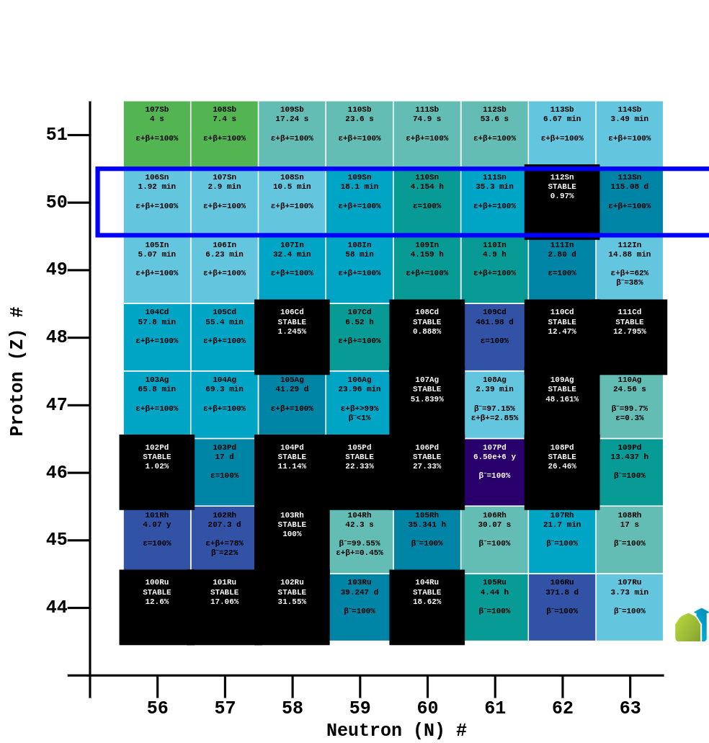
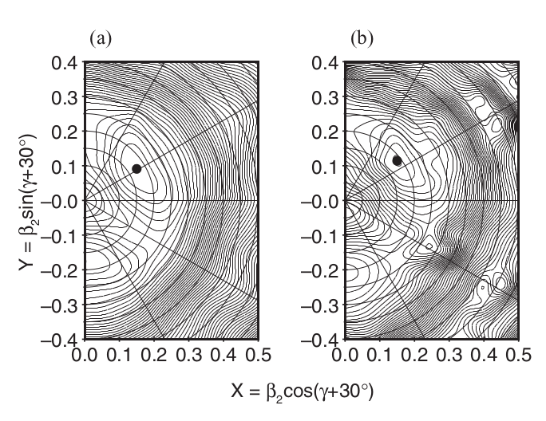
Objectives
Determination of the E1 strength
Determination of the dependence of the E1 strength in the transition region from vibrational to rotational nuclei
The low-lying E1 states in the transitional Pd nuclei are expected to be weak and strongly fragmented
Potential energy surfaces of the lowest-lying band structures in ¹⁰⁶Pd calculated within the tilted-axis cranking model (C.E. He et al., Phys. Rev. C 86, 047302 (2012))
Position of the ¹⁰⁶Pd nucleus in the nuclear chart (https://www.nndc.bnl.gov/nudat3/)
1

Slide 3
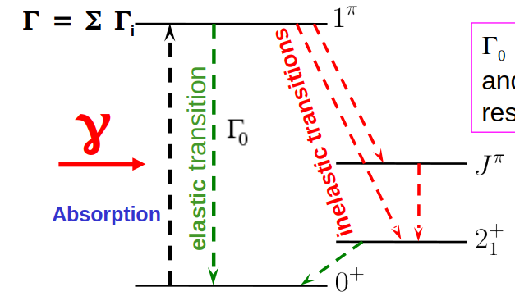
Investigation method
Spectroscopic quantities in NRF experiments:
integrated photonuclear resonance cross sections I_{s,f}
parity quantum numbers π of nuclear levels
γ -ray transition energies E_{γ}
total level widths Γ
level lifetimes τ
spin quantum numbers J of nuclear levels
decay transition strengths B(Π L; J _{π} → J_{f f} )
multipole-mixing ratios δ of γ -ray transitions
…
2

Slide 4
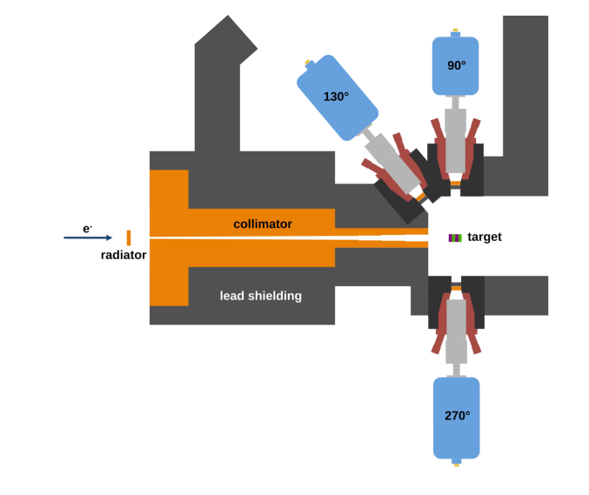
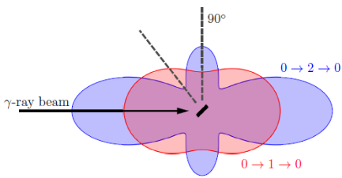
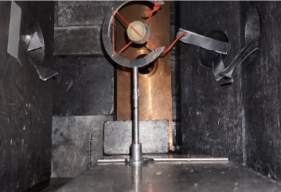
Experimental Setup
The NRF experiment has taken place at TU Darmstadt, at DHIPS (Darmstadt High Intensity Photon Setup)
130
2
Schematic view of DHIPS (Romig, PhD thesis)
DBS
ENDPOINT ENERGY: 8.7 MeV
¹⁰⁶Pd target
3

Slide 5
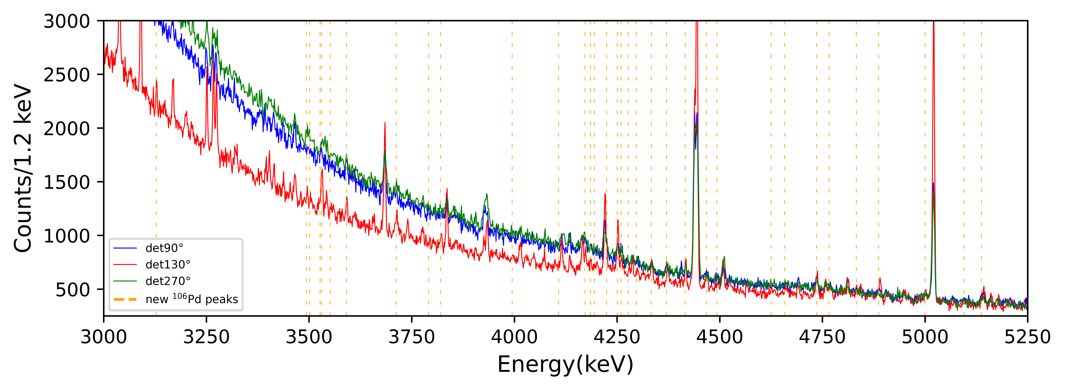
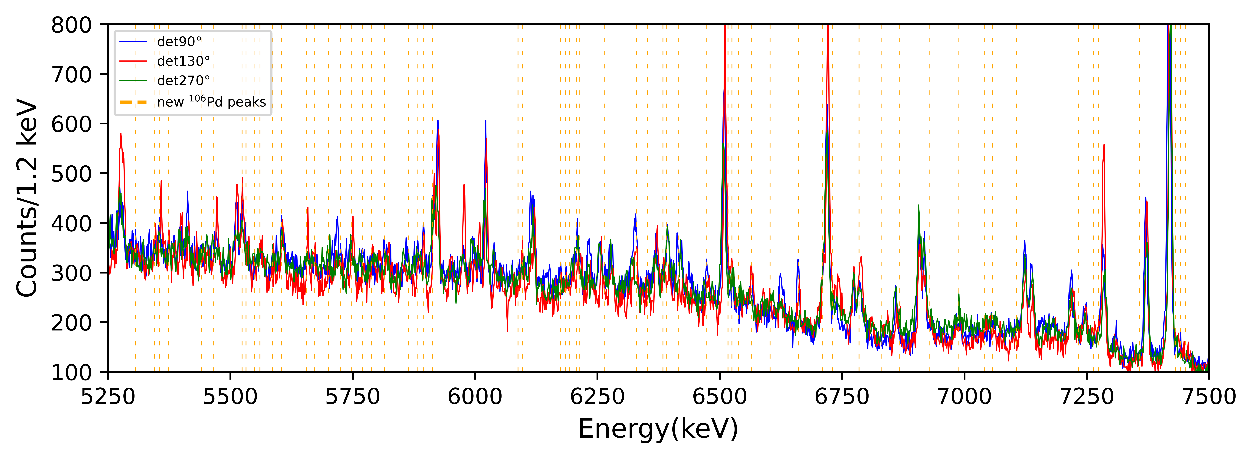
¹⁰⁶Pd Spectra in the 3.5-7.5 MeV region
¹¹B
¹¹B
¹¹B
4

Slide 6
¹⁰⁶Pd Spectra in the 3.5-7.5 MeV region
72 new ¹⁰⁶Pd peaks associated to dipole transitions
4

Slide 7
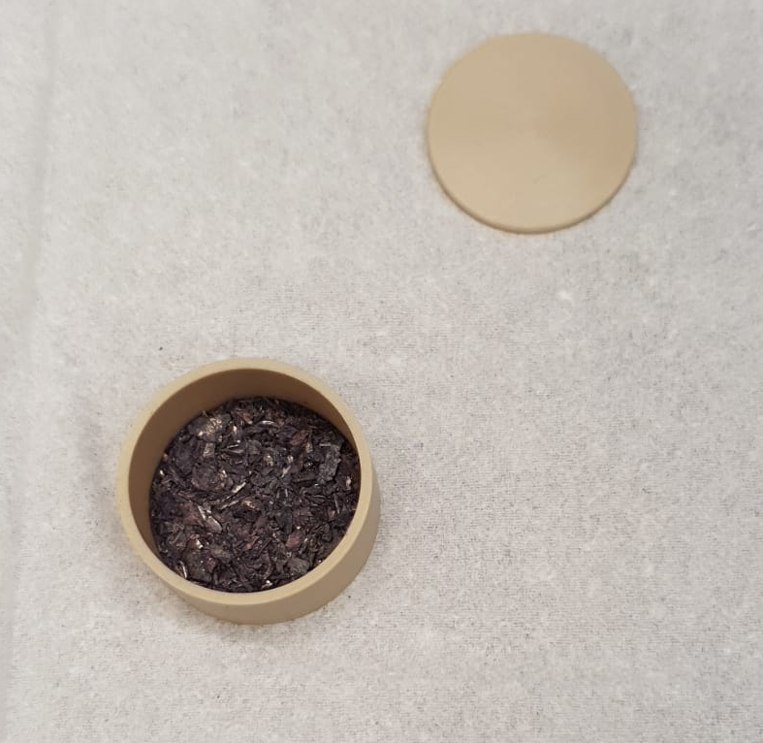
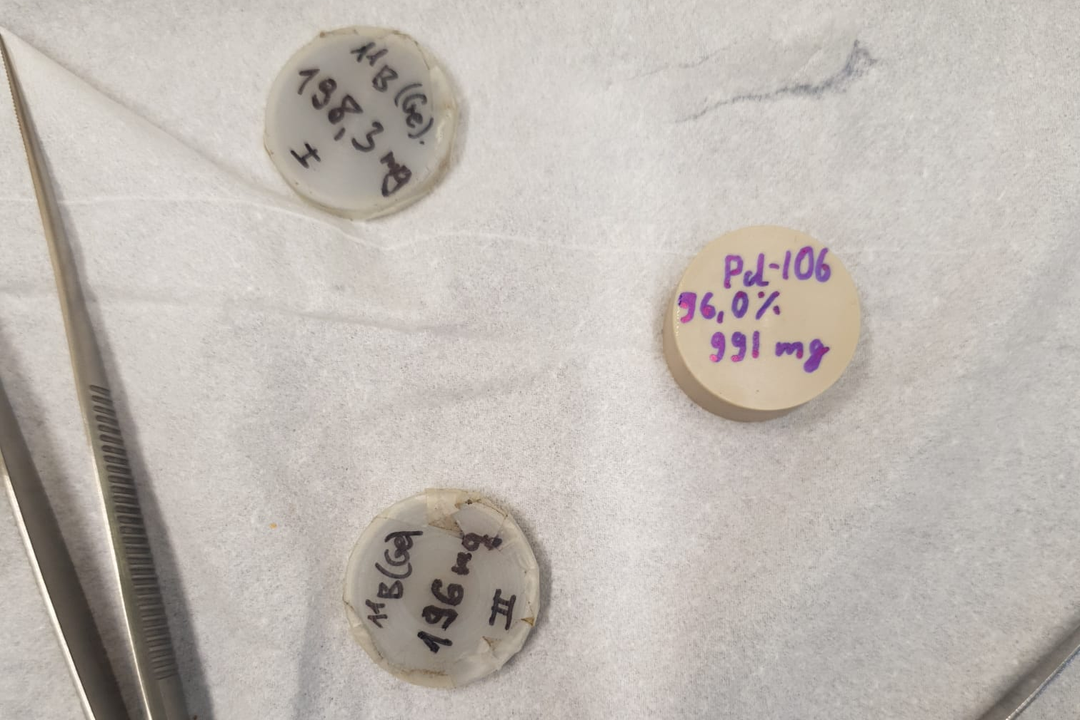
NRF Reactions: Number of Target Nuclei
Final goal: calculating the integrated cross section
rel
Number of counts
¹⁰⁶Pd mass: 0.991(1)g
Fitting
5

Slide 8
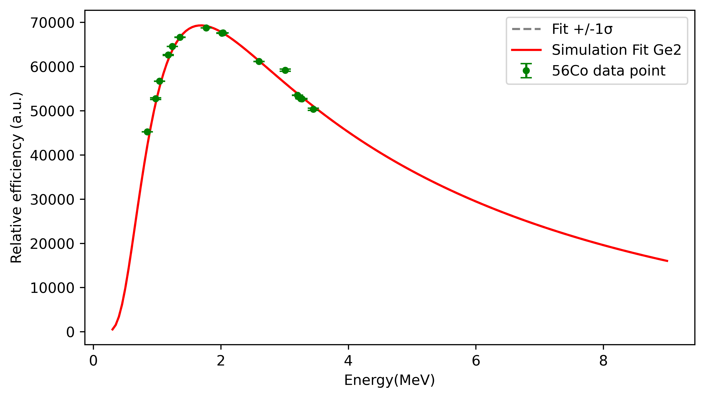
NRF Reactions: Efficiency calibrations
rel
Number of counts
Number of target nuclei
Fitting
Weighting
Relative efficiency (arb. u)
A ⁵⁶Co source was used for calibrations
GEANT4 simulations were used to determine the efficiency for the rest of the spectra
6

Slide 9
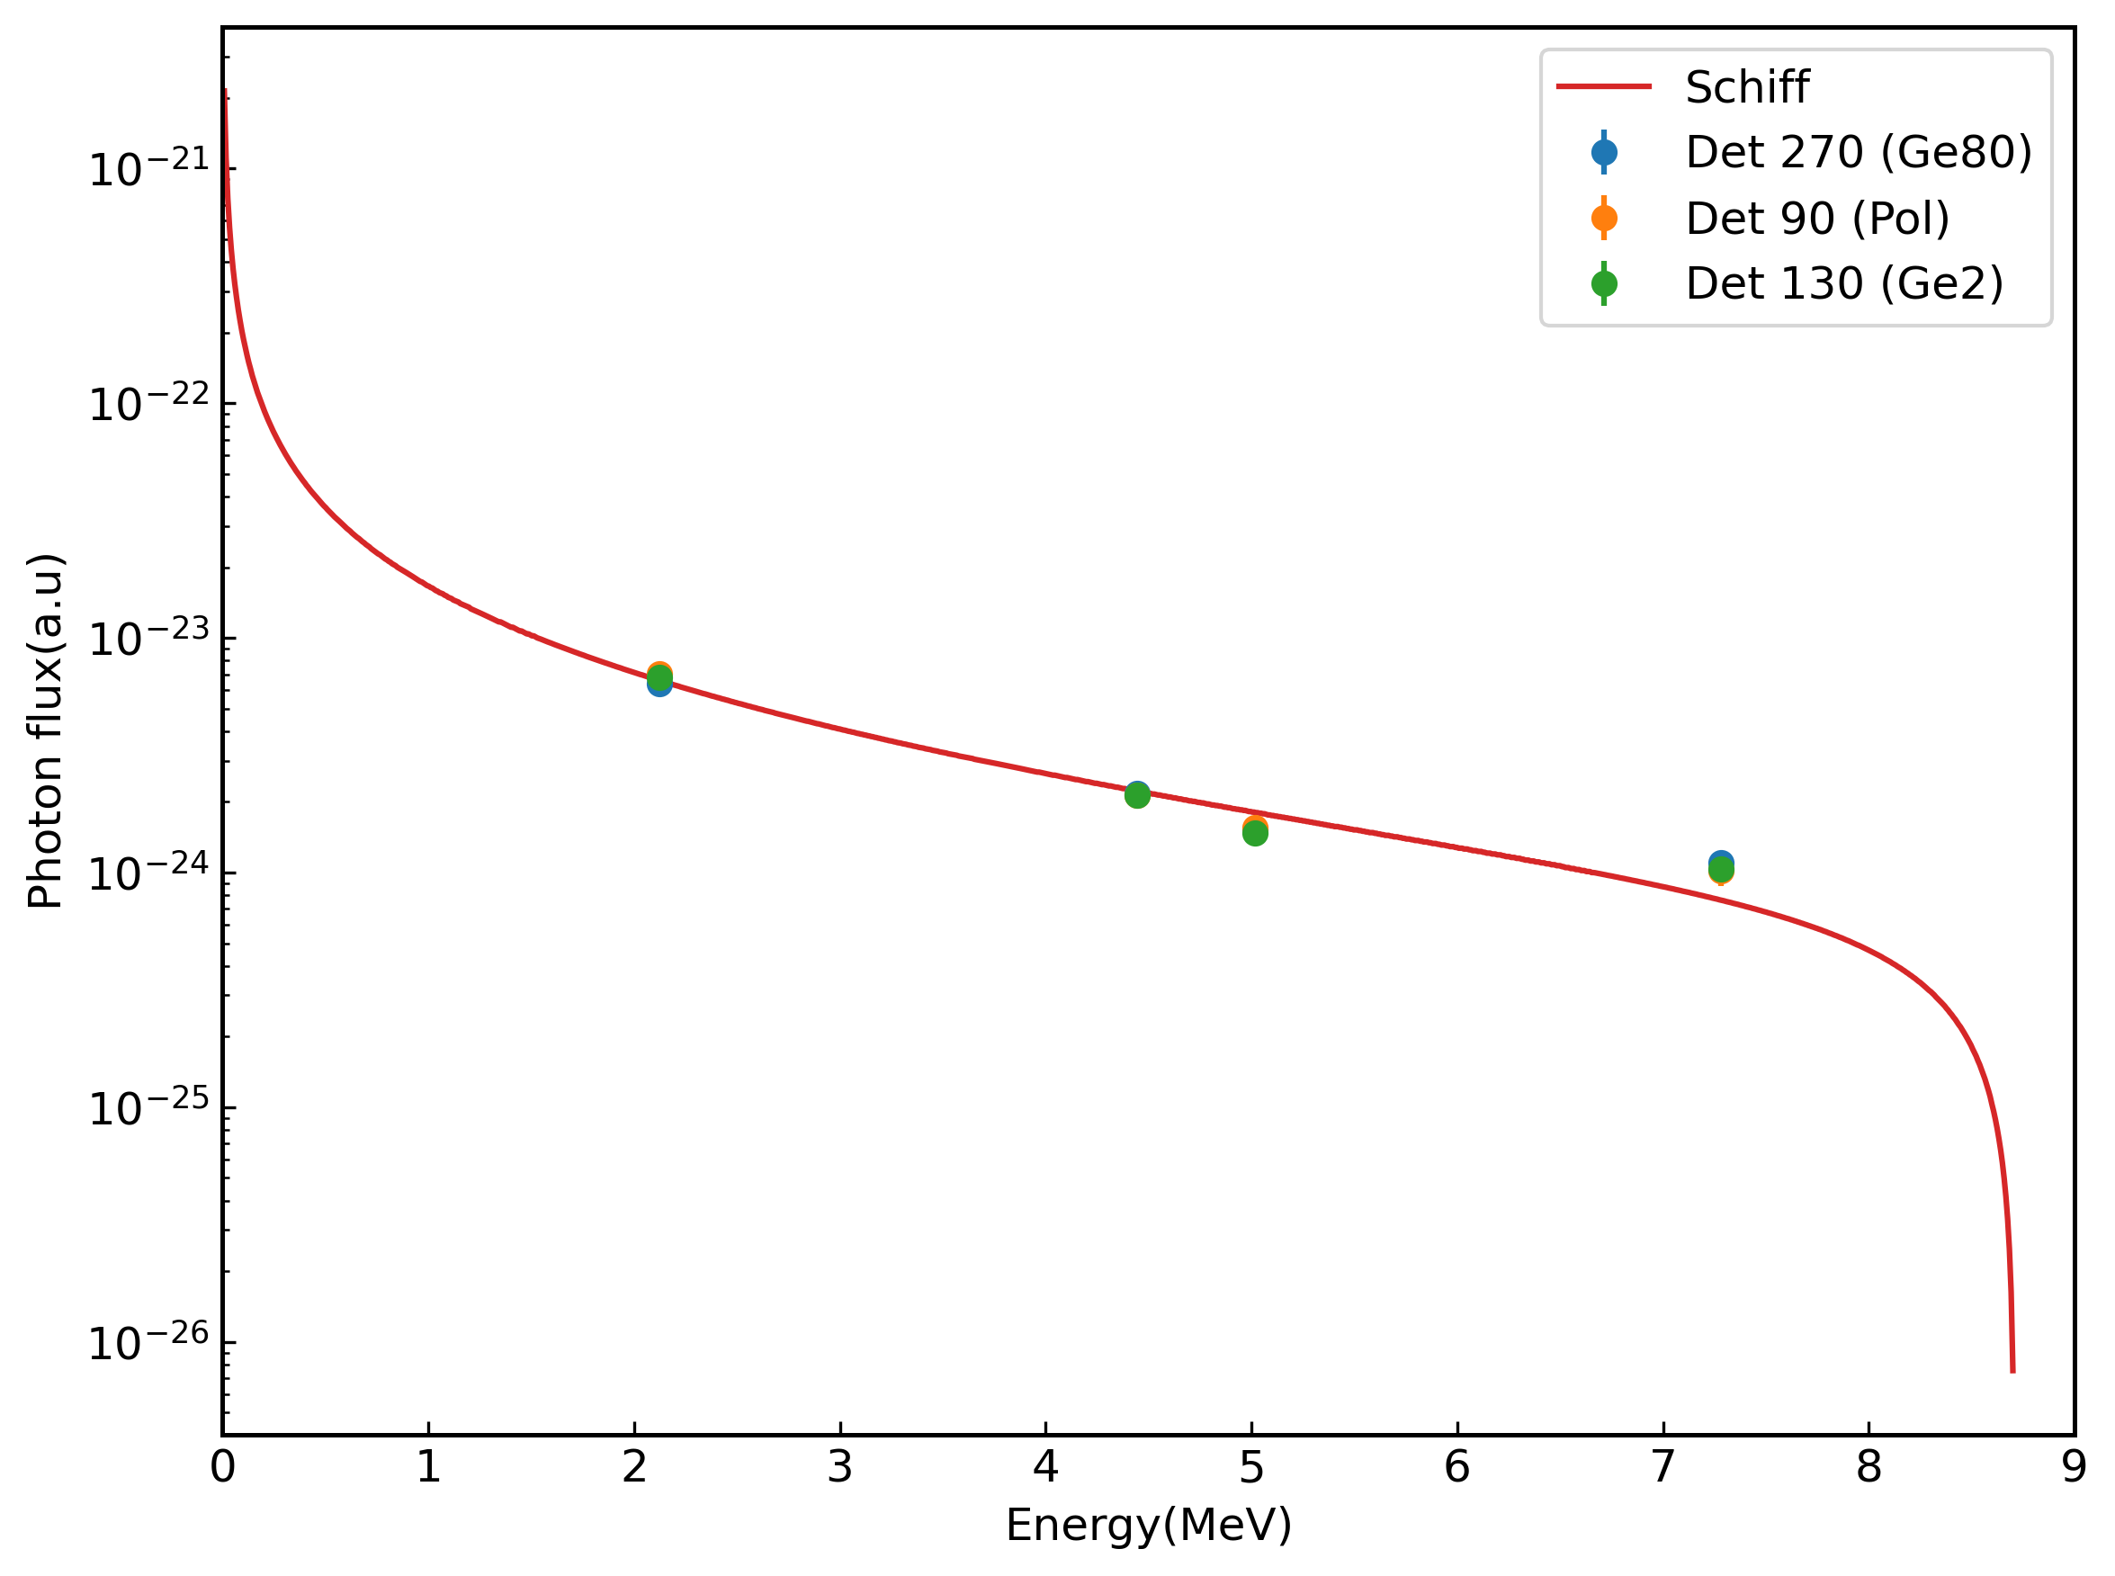
NRF Reactions: Photonflux calibrations
rel
Number of counts
Number of target nuclei
Relative efficiency
Fitting
GEANT4 Simulations
Weighting
Photon flux (arb. u)
Energy (MeV)
Obtained from Schiff's formula
7

Slide 10
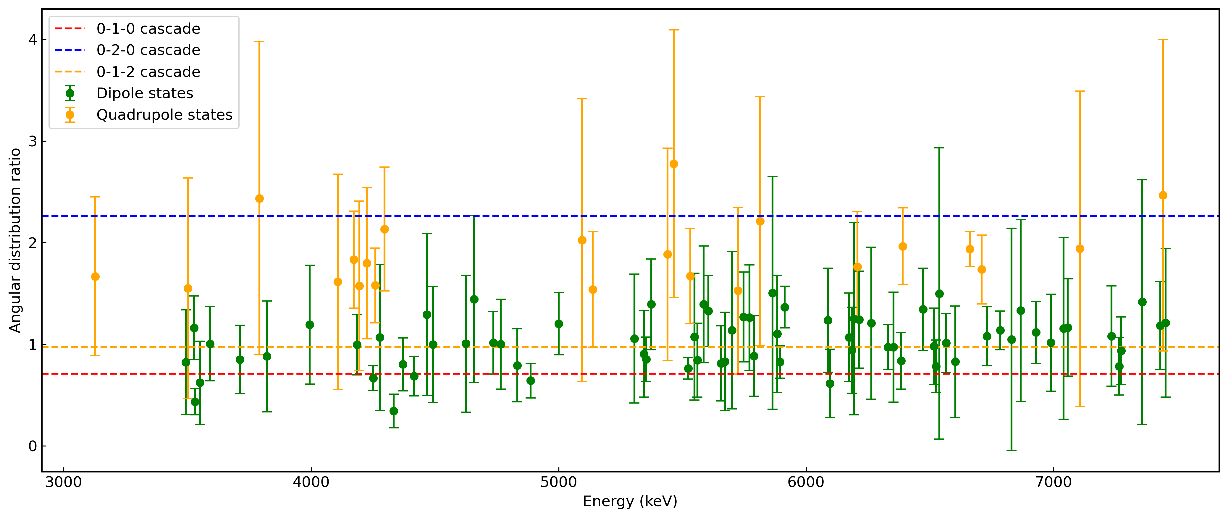
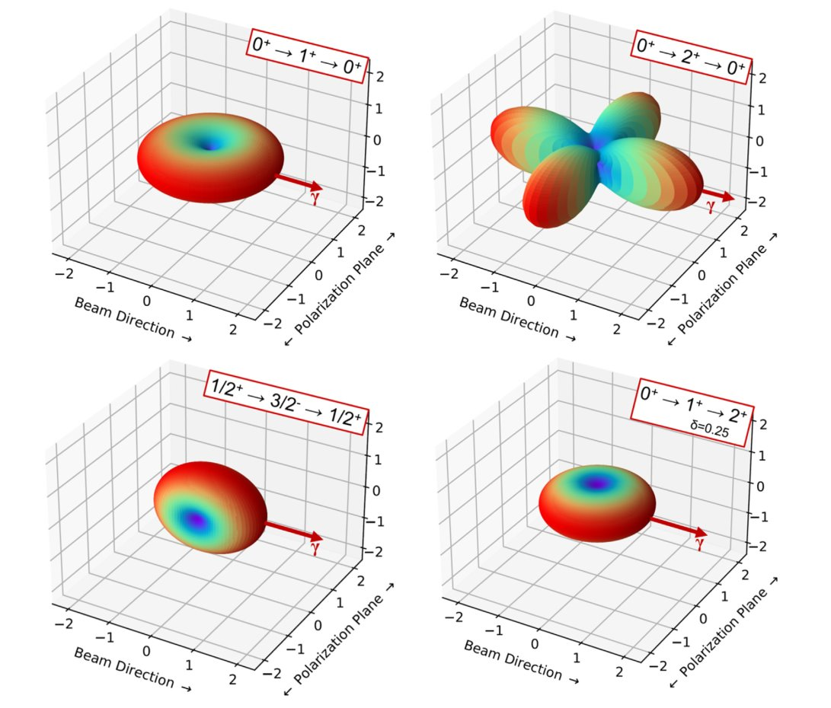
NRF Reactions: Angular distribution
°
rel
Depends on the spins of the states involved in the cascade
Can be calculated from the theory of electromagnetism and yield for an unpolarized photon beam
3-D plots of the angular distribution of (γ⃗ , γ′ ) NRF intensity about a fully linearly polarized photon beam (Pγ = 1) entering from the left (A. Zilges, , D.L. Balabanski, J. Isaak, N. Pietralla, Progress in Particle and Nuclear Physics 122 (2022) ))
8

Slide 11
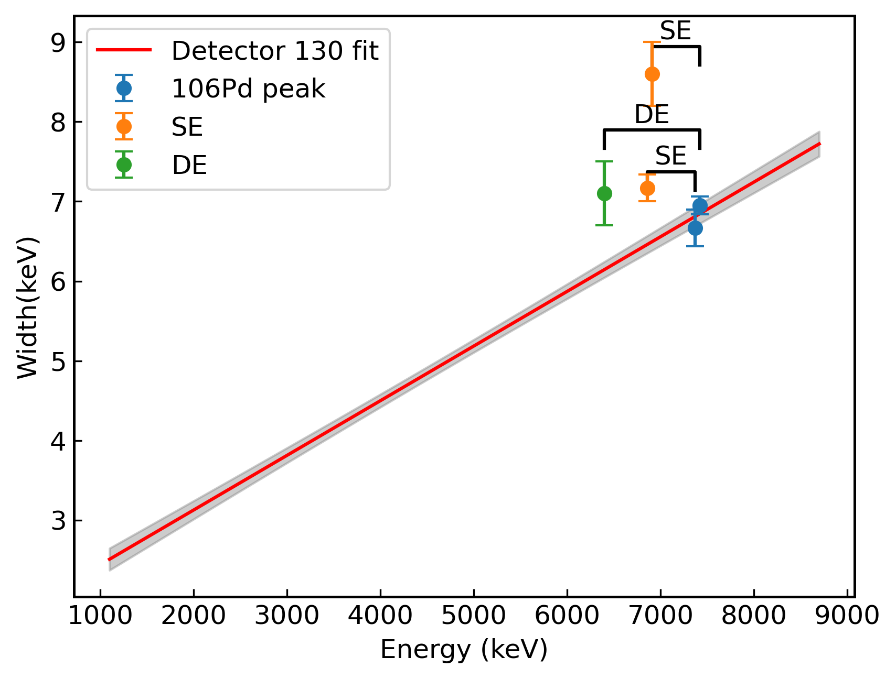
Single-Escape calibrations
Example of width interpretation in case of a 2+ transition and a SE in a peak
+ 2⁺ transition
Main issue: the first 2+ level is situated at 511.82 keV
Makes it difficult to differentiate between a SE and a transition to the first 2+
9

Slide 12
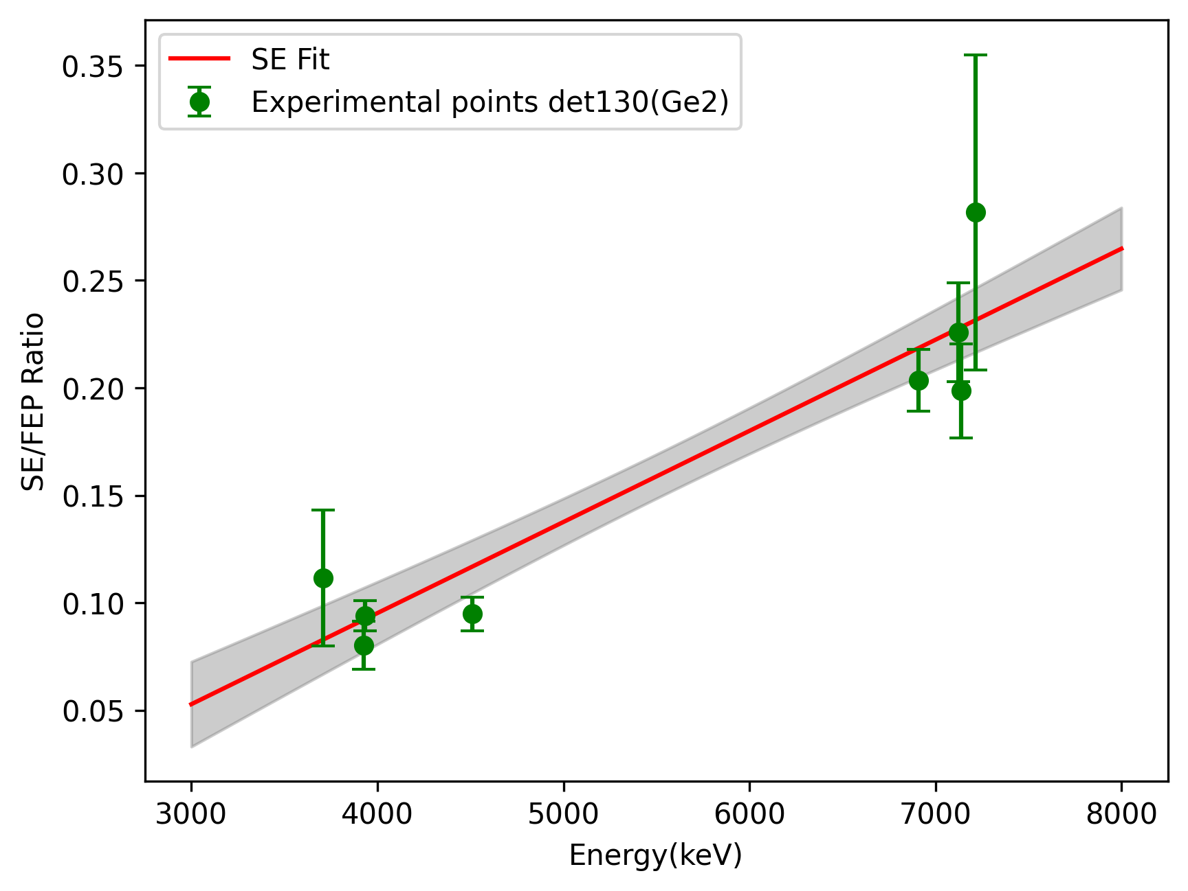
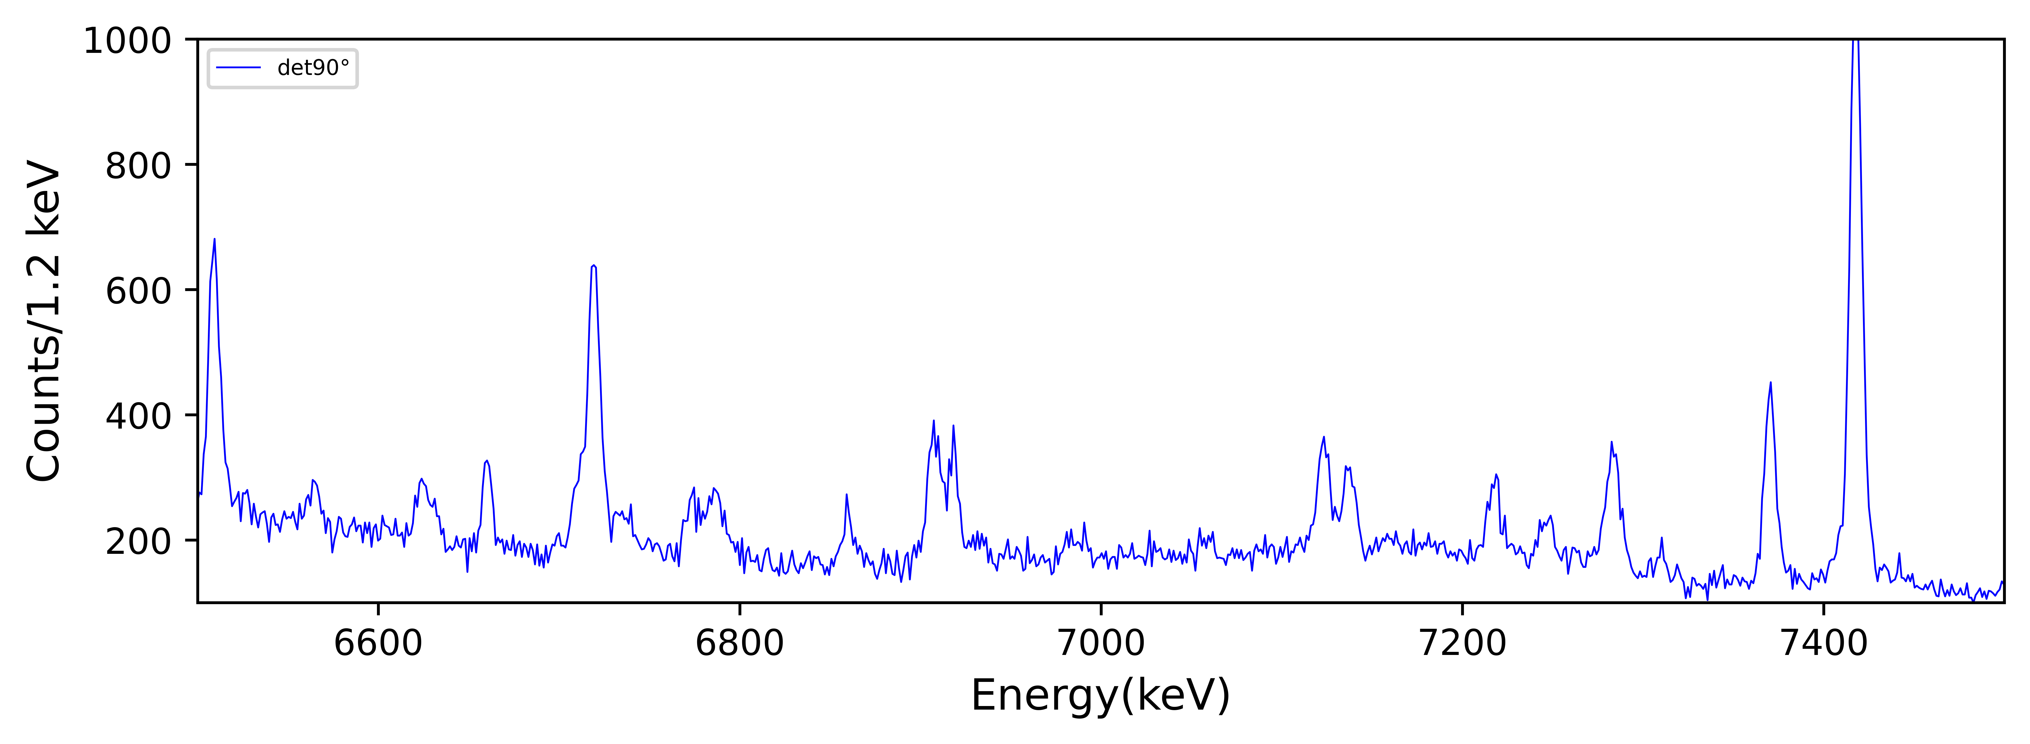
Single-Escape calibrations
SE calibration for the detector at 130 degrees
(n,gamma)
SE of the(n,gamma)
¹¹B
10

Slide 13
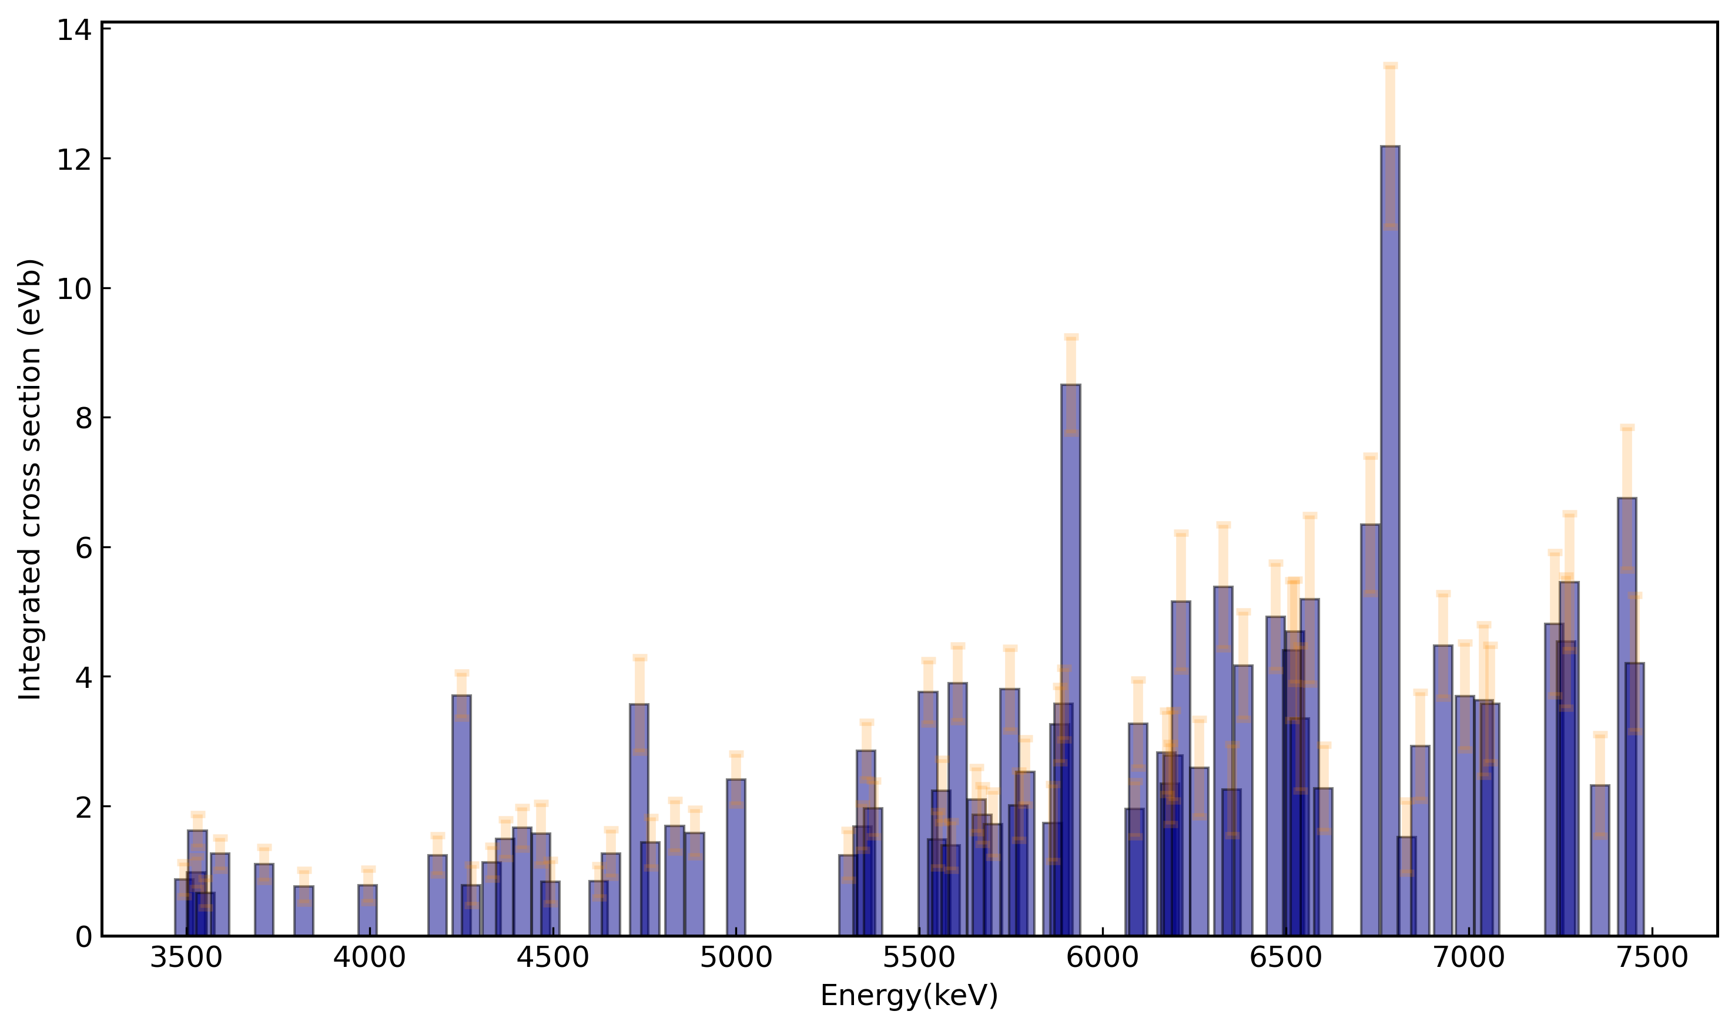
Integrated cross sections
The integrated cross section for the excited state – g.s transitions has been calculated, revealing the shape of the PDR.​
11

Slide 14

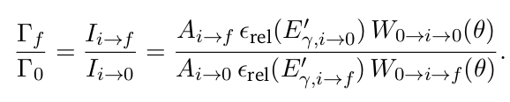
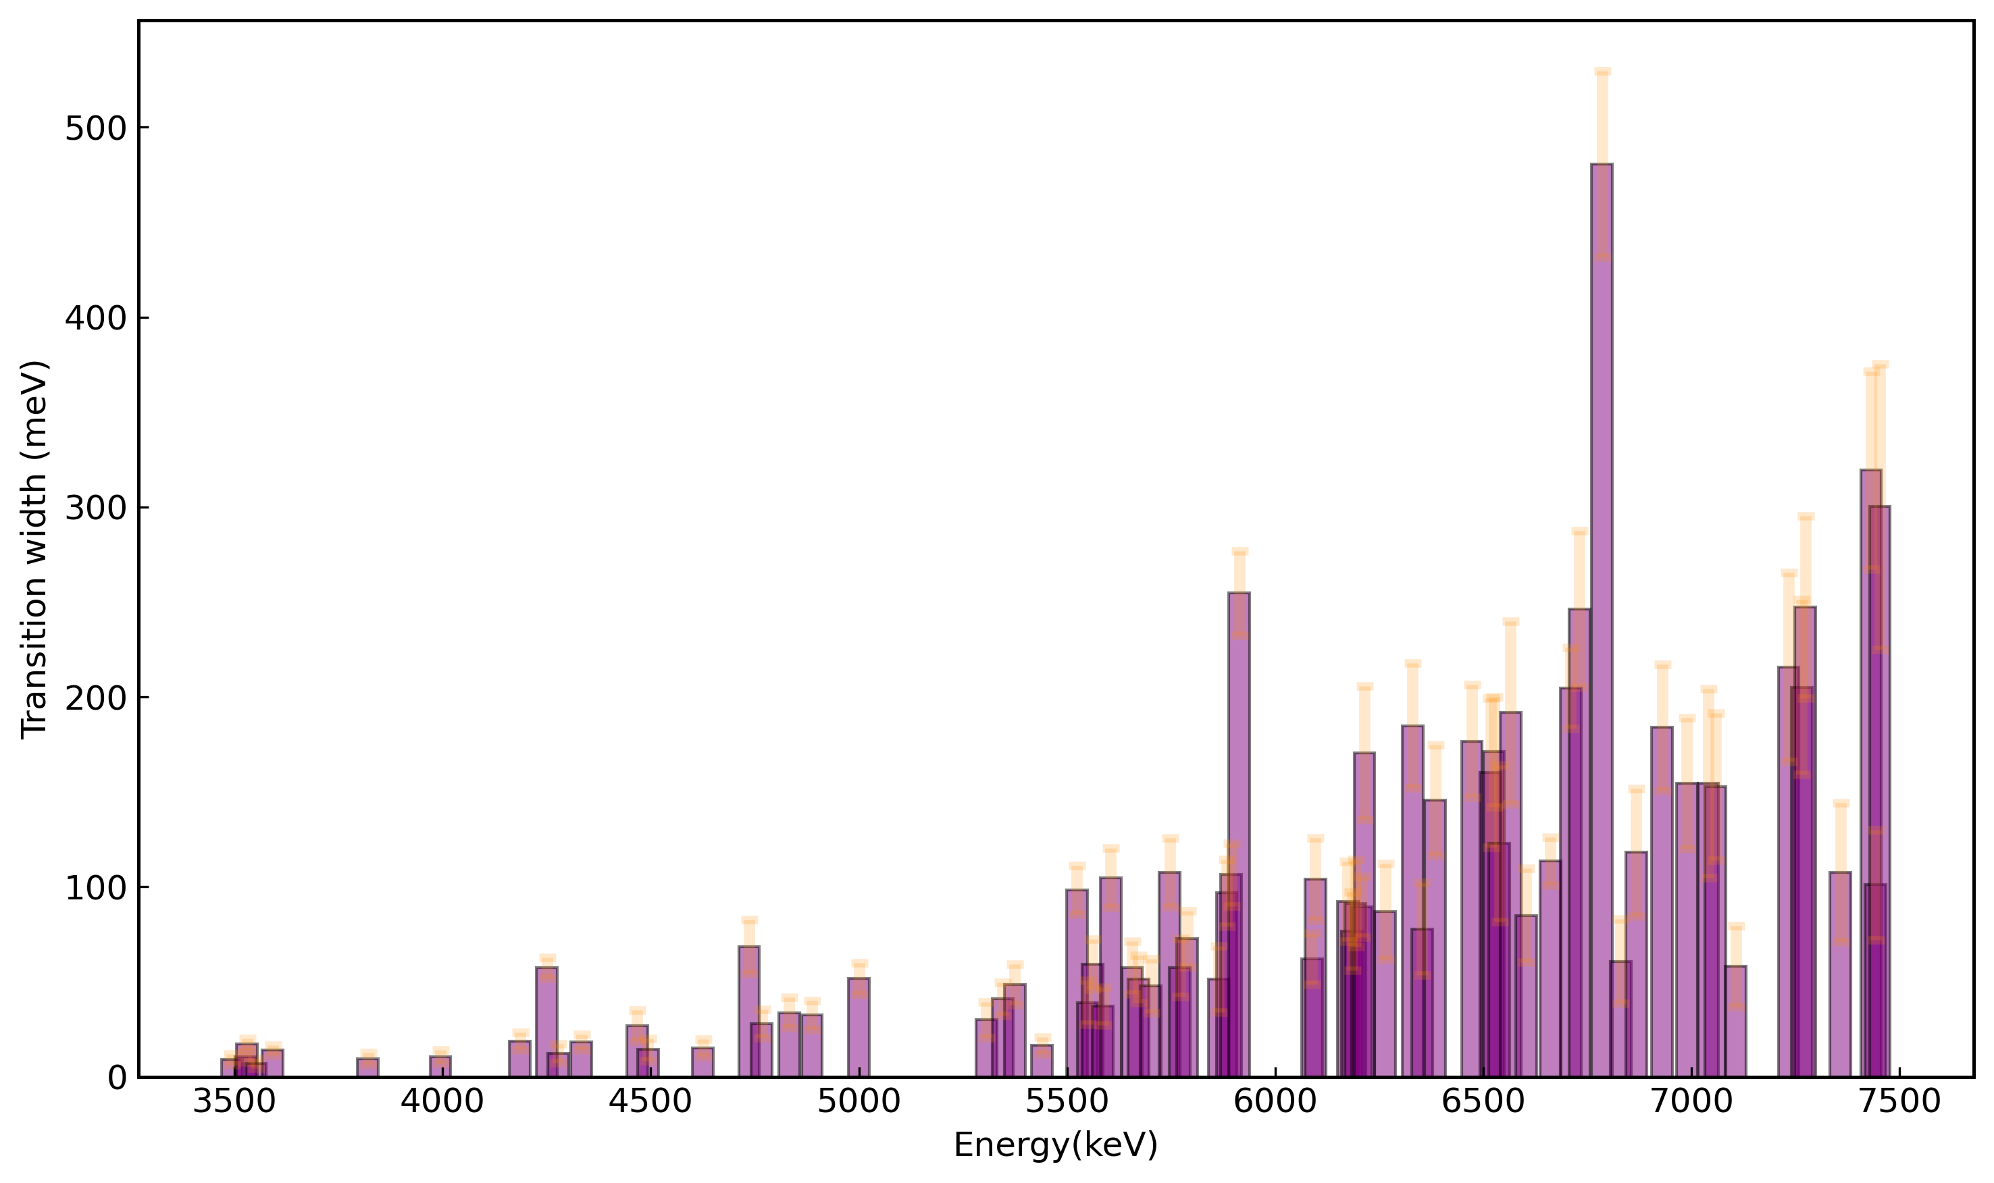
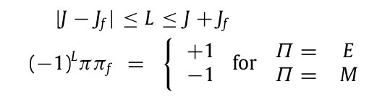
Branching ratios
Branching ratios can be obtained from:
Conditions for a peak to be obtained from a branching transition instead of a ground-state transition:
1.The photon emitted after such a branching transitions has the energy E_{γ′} ≈ E_{i} − E_{f}
2. After looking into the angular distribution, checking if the transition is among the favoured ones
12

Slide 15
Branching to other 2⁺ states - examples
4333
1
5894
1
7233
1
3820
4766
5671
1562
2⁺
1128
2⁺
1128+1229+1133
2⁺+4⁺+0⁺
511
2⁺
511
2⁺
511
2⁺
0
0⁺
0
0⁺
0
0⁺
13

Slide 16
Branching to other 2⁺ states - examples
4333
1
5894
1
7233
1
No. transitions to the 1st 2⁺: 5 (5.37% of the total no. transitions)
No. transitions to the 2nd 2⁺: 3 (3.22% of the total no. transitions)
No. transitions to the 3rd 2⁺: 2 (2.15% of the total no. transitions)
3820
4766
5671
1562
2⁺
1128
2⁺
1128+1229+1133
2⁺+4⁺+0⁺
511
2⁺
511
2⁺
511
2⁺
0
0⁺
0
0⁺
0
0⁺
13

Slide 17
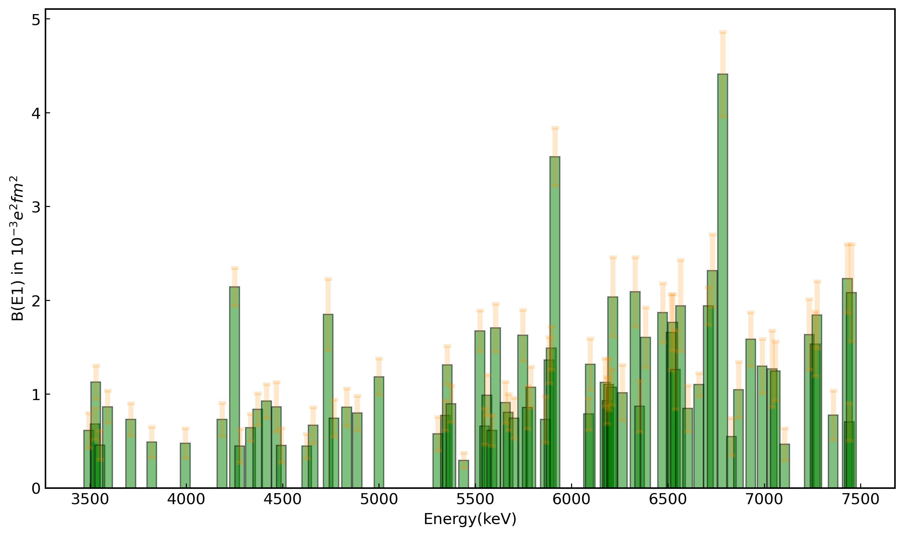
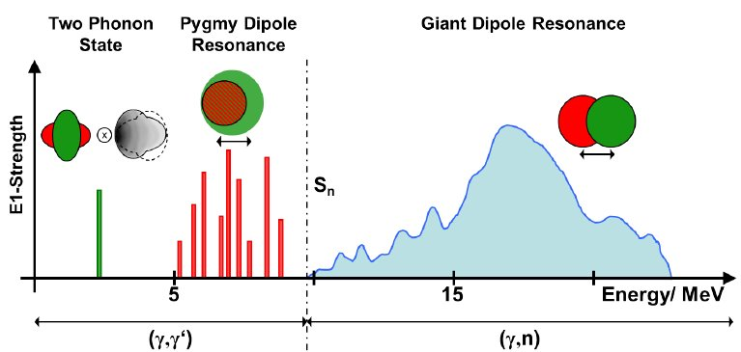
B(E1)
The PDR shape can be observed after the final calculations of the reduced dipole transition strength.
14

Slide 18
Conclusions and Outlook
72 new ¹⁰⁶Pd dipole transitions have been uncovered
Preliminary results for the integrated cross section and the reduced transition strength have been calculated
Another experiment at TU Darmstadt will take place this year, at a lower energy, reducing the effects from feeding
In order to determine the parities, another experiment at TUNL Labs is necessary
15

Slide 19
Thank you for your attention!

Slide 20
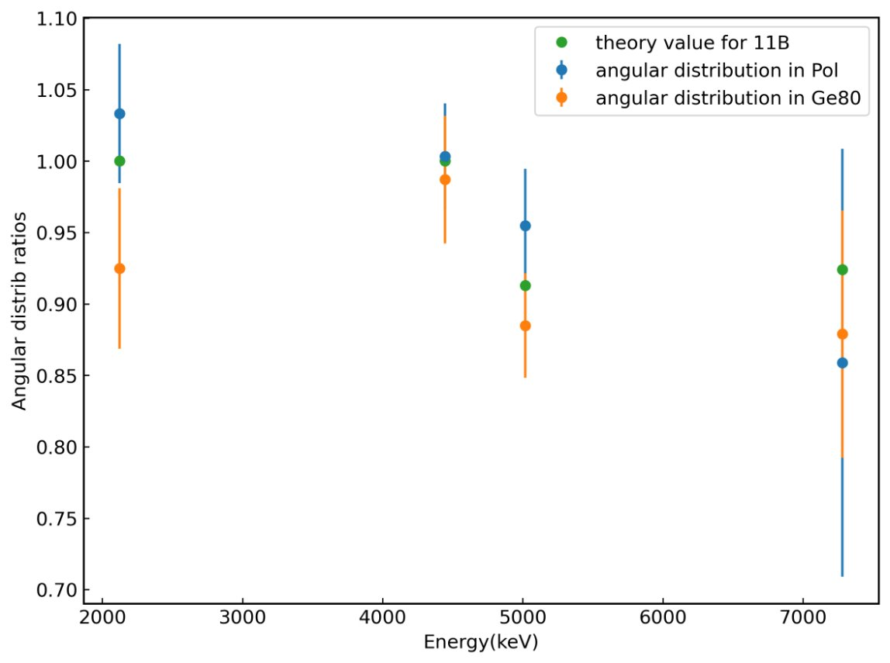
NRF Reactions: Checkpoint in ¹¹B
The angular distributions for the ¹¹B calibration points were calculated and compared to literature values
The results seem to agree
9

