Slide 1



The measurement of gamma-decay in photo-nuclear reaction on ¹²C、¹³C for the PANDORA project
The University of Osaka
Yumaro Suzuki

Slide 2
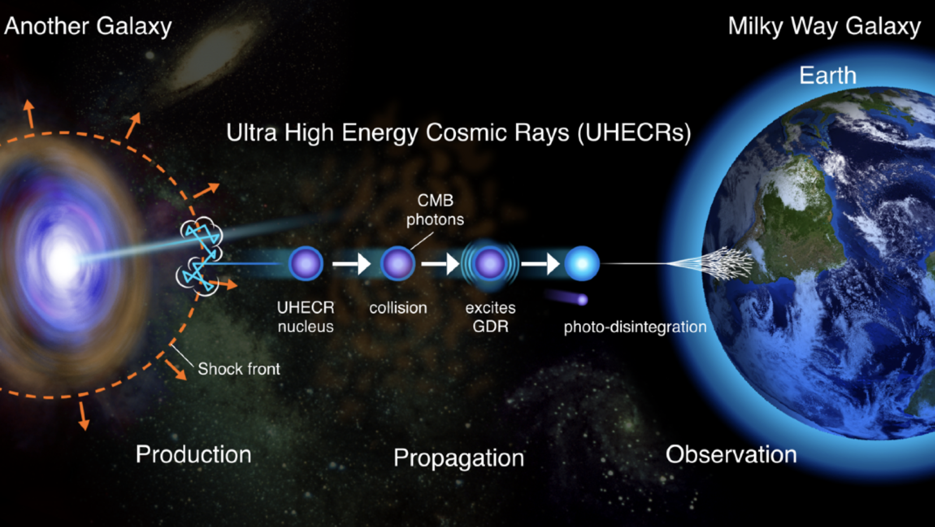
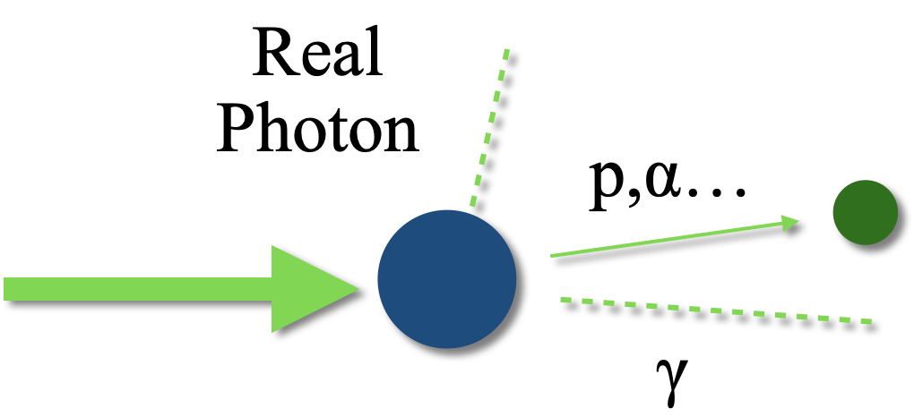


1
PANDORA project
Research on photonuclear reaction of light nuclei to understand Ultra-high energy cosmic rays.
PANDORA project
Iso-Vector Giant Dipole Resonance (IVGDR) makes an important role in photonuclear reaction of UHECRs.
Nuclei which is IVGDR decays immediately emitting particles and gamma-rays.
~${10}^{−4\sim 0}$eV
Particle decay measurement (Si detector)
Gamma decay measurement (LaBr₃ detector)
~>${10}^{18}$eV

Slide 3
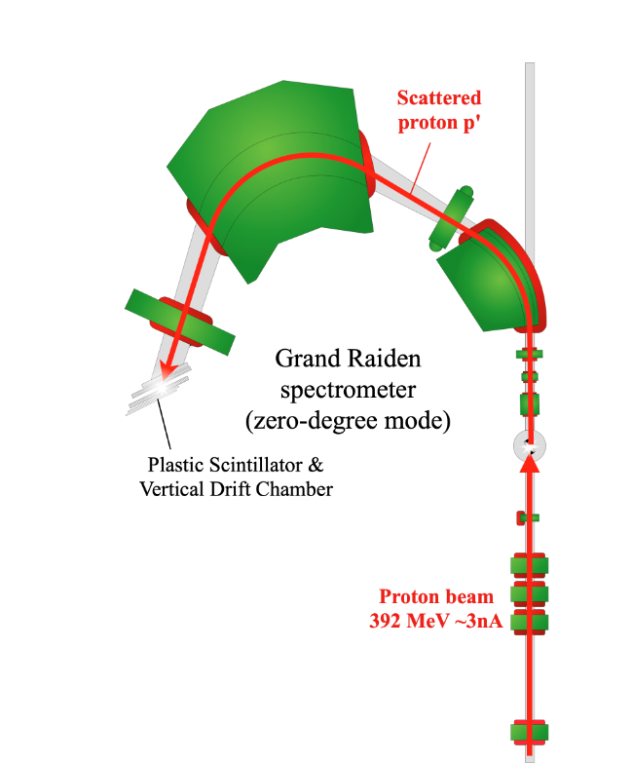
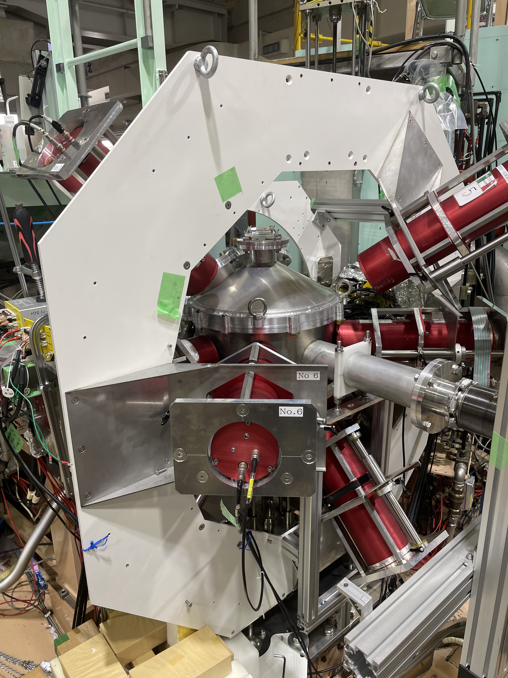
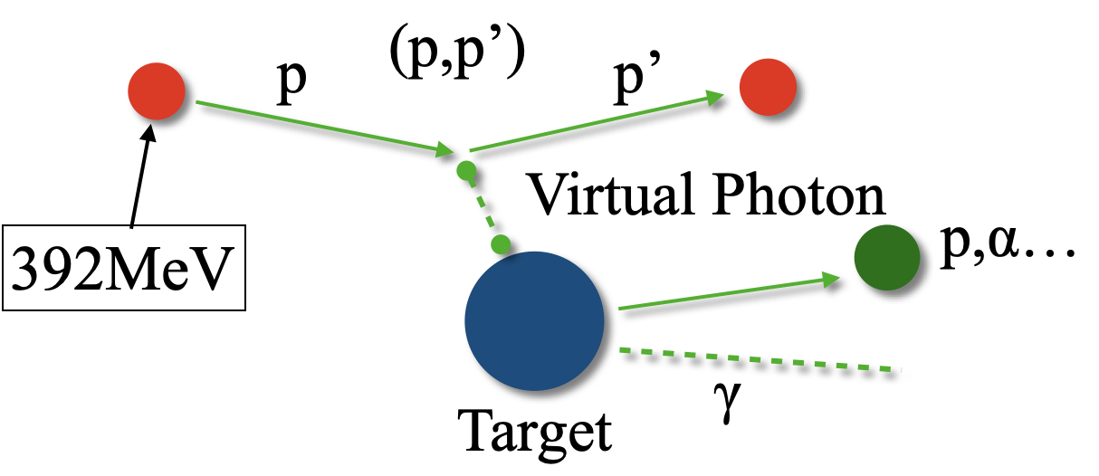
2
Gamma decay measurement
Grand Raiden spectrometer (GR).
LaBr₃ detector
GR is a spectrometer that uses a magnetic field to separate the protons scattered after irradiation of a target by energy.
LaBr₃ detector is an inorganic scintillator.
We placed eight LaBr₃ detectors around the scattering chamber to detect the γ – ray.
Scattering chamber
Target
LaBr₃
89mm
220mm ~ 270mm
203mm

Slide 4

3
Gamma decay measurement
Gamma ray measurement
γ
GDR
Neutron decay branching ratios can be calculated
Compare the proton decay result with the Si detectors
Neutron decay
Proton decay
Comprehensive study of gamma decay of Giant Resonance
Daughter nucleus
Daughter nucleus
There are many gamma rays
Direct decay from GDR
Gamma decay after particle decays
γ
γ

Slide 5
Preliminary result

Slide 6
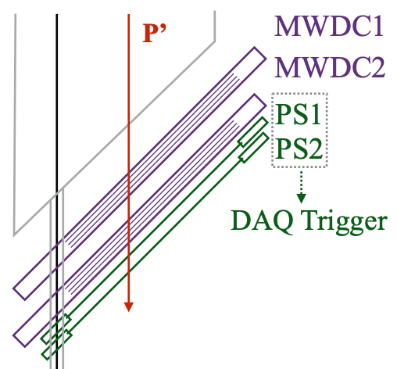
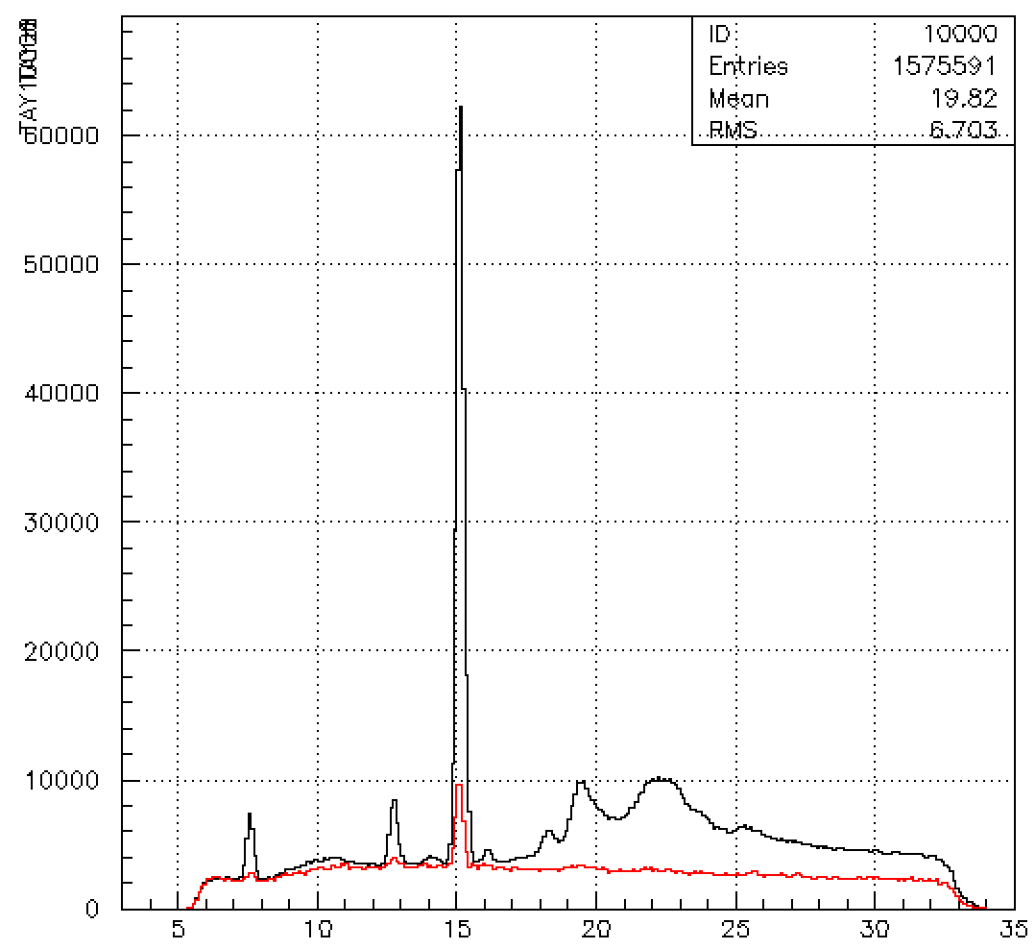
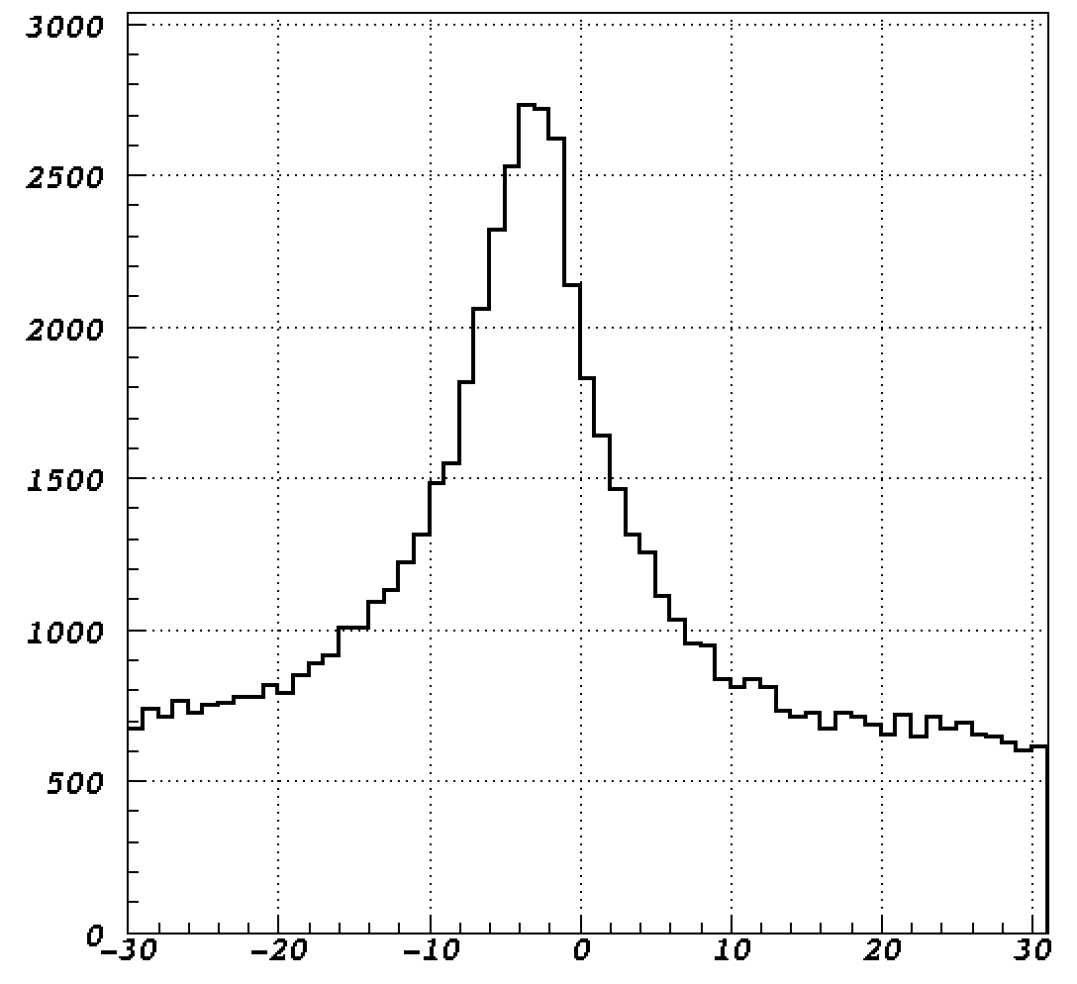
Focus point of true event
4
GR analysis
Vertical focal plane
Focal plane
Black : Before B.G subtraction
Red : B.G
Counts
Counts
Proton ID by PS
Y [mm]
¹²C E_{x} energy [MeV]

Slide 7
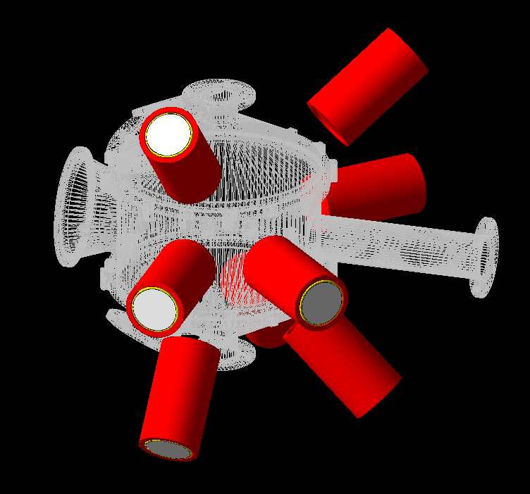
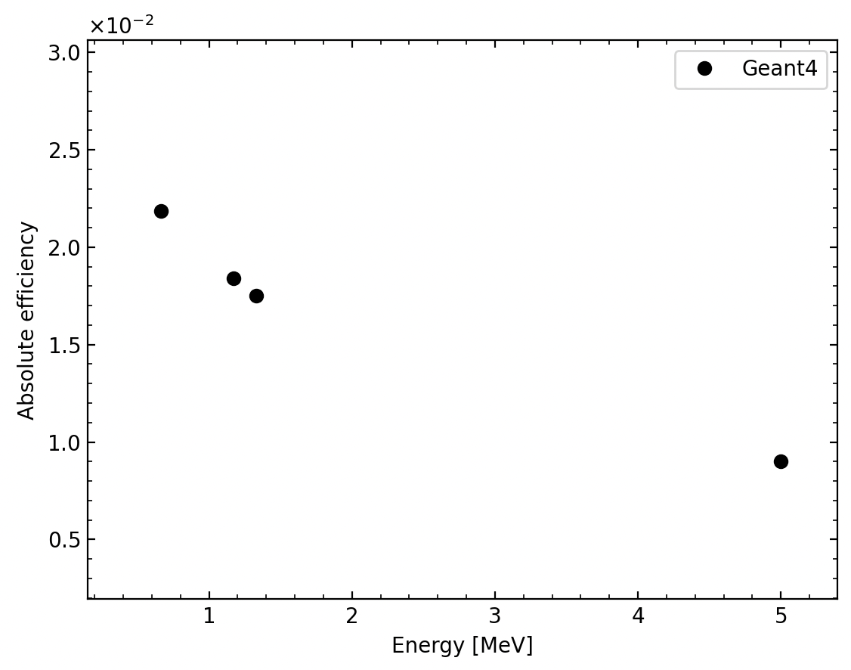
5
Branching ratio & Efficiency
Branching ratio
$\frac{ AX\left(p, { p}^{′}γ\right) counts}{AX\left(p, p^{′}\right) counts} × \frac{100}{efficiency}$ [%]
Efficiency for full energy peak up to 5 MeV

Slide 8
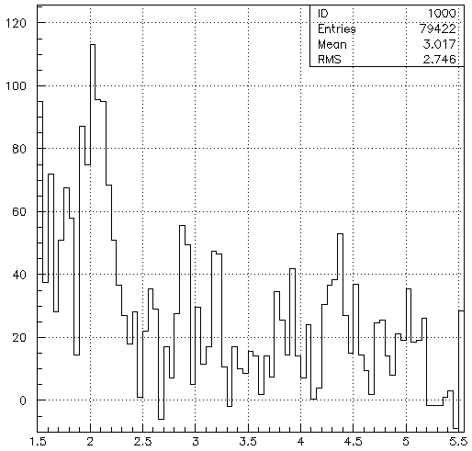
6
¹²C 0 degree
Branching ratios
Branching ratio
¹¹C + ¹¹B : E₁=11.0 [%]
$\frac{ 12C\left(p, { p}^{′}γ\right) counts}{12C\left(p, p^{′}\right) counts} × \frac{100}{efficiency}$ [%]
¹¹C + ¹¹B : E₂=7.2 [%]
Neutron decay
n
Proton decay
¹¹C : E₁=2.00[MeV]
p
¹¹C Excitation
¹¹B : E₁=2.13[MeV]
¹¹B Excitation
4.3MeV
4.4MeV
¹²C
GDR
𝛾
¹¹C : E₂=4.32[MeV]
𝛾
2MeV
Counts
2.1MeV
¹¹B : E₂=4.45[MeV]
¹¹C Ground state
¹¹B Ground state
LaBr₃ detector
LaBr₃ detector
¹²C Ground state
E-γ [MeV]

Slide 9
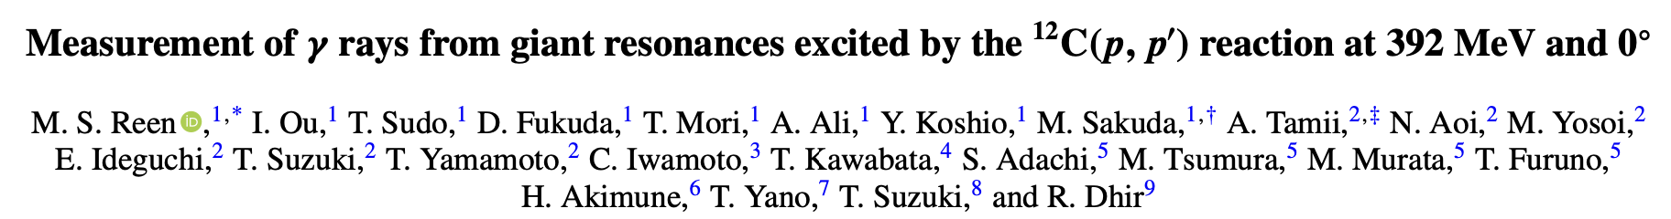
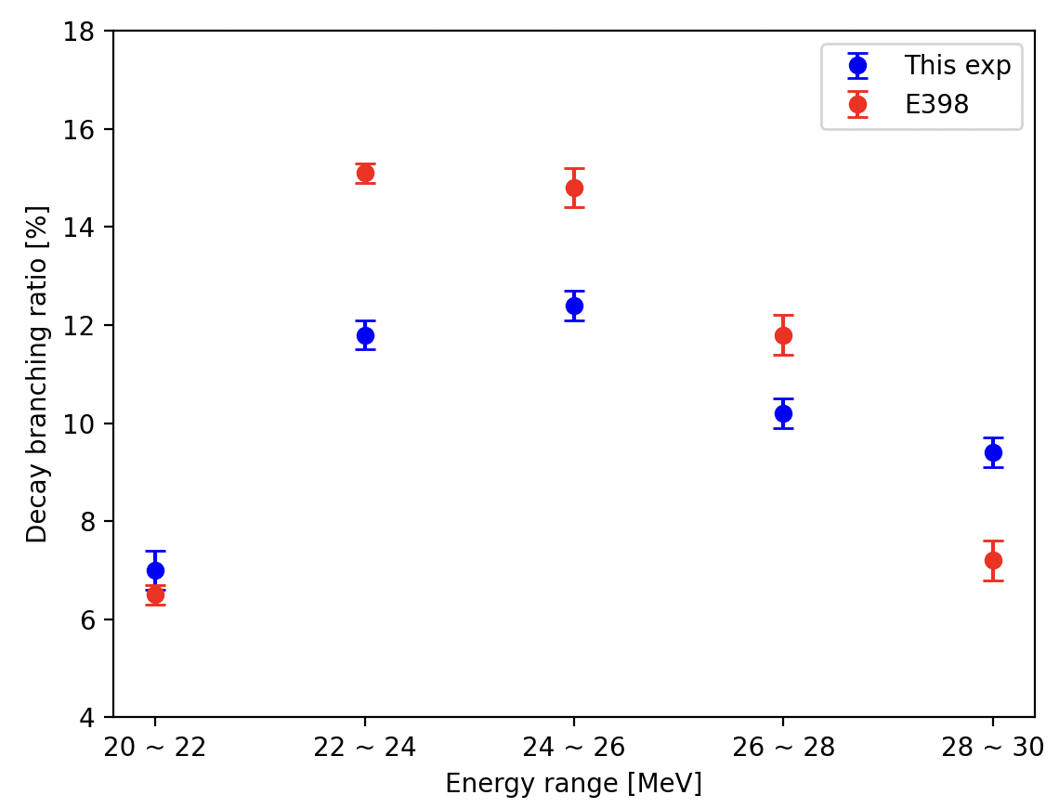
7
¹²C 0 degree
E398
¹¹C : E₁=2.00[MeV]
392 MeV 0deg (p,p’)
¹²C target
Gamma-decay measurement from GDR
NaI scintillator
¹¹B : E₁=2.13[MeV]
Counts
E-γ [MeV]

Slide 10
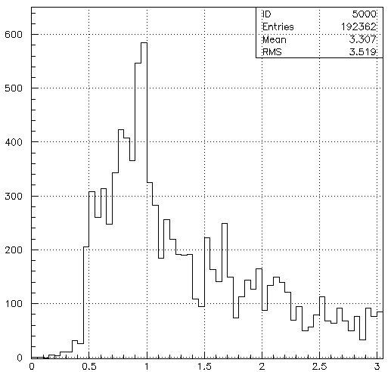
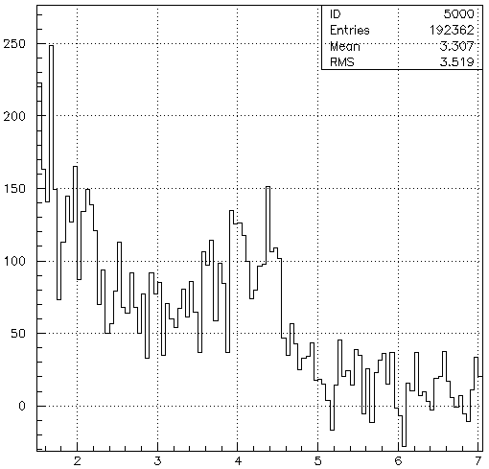
8
¹³C 0 degree
Branching ratios
Branching ratio
¹²C : E₁= 7.6[%]
$\frac{ 13C\left(p, { p}^{′}γ\right) counts}{13C\left(p, p^{′}\right) counts} × \frac{100}{efficiency}$ [%]
¹²B : E₁= 7.9[%] E₂= 2.3[%]
¹²B : E₁=0.95[MeV]
¹²C : E₁=4.44[MeV]
Counts
Counts
¹²B : E₂=1.67[MeV]
E-γ [MeV]
E-γ [MeV]

Slide 11

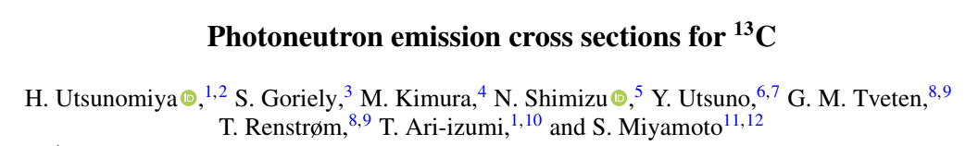
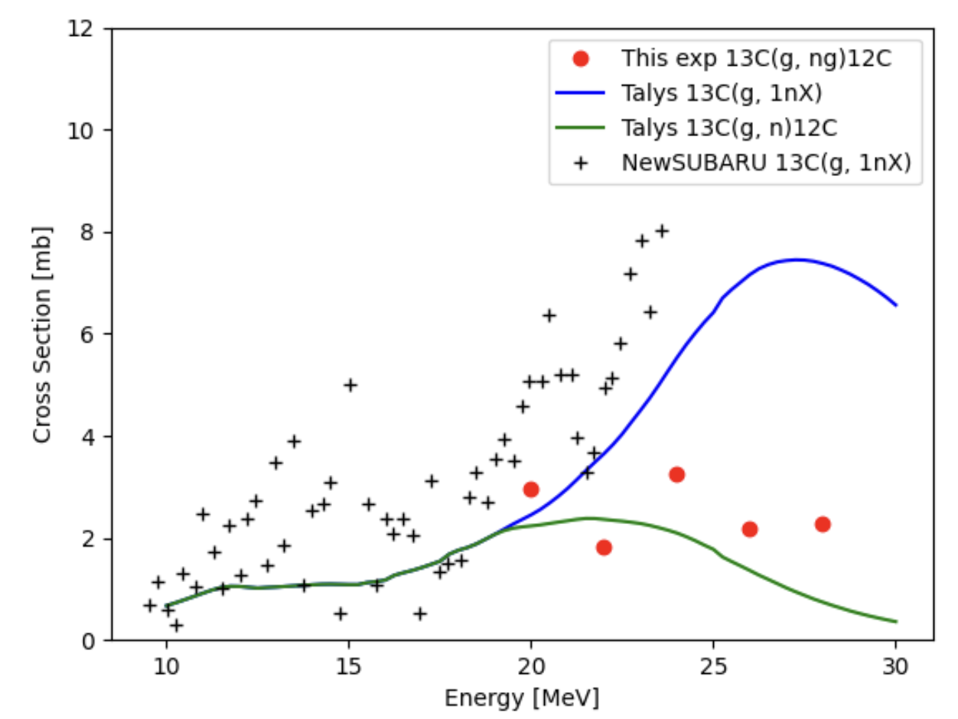
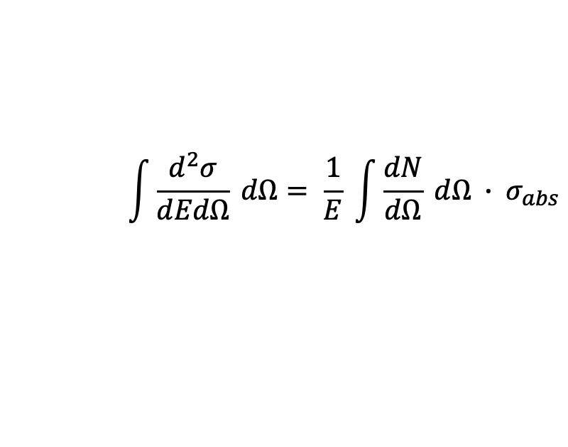
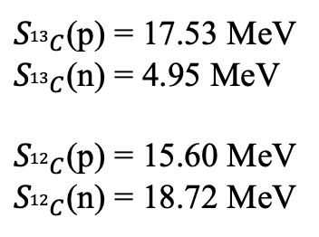

9
¹³C 0 degree
$$\int{\frac{d^{2}σ}{dEdΩ} dΩ= \frac{1}{E} \int{\frac{dN}{dΩ} dΩ ∙ σ_{abs}}}$$
$$σ_{\left(γ,ng\right)}= σ_{abs} ∙ Branch(γ,ng)$$
$S_{13C}$(p) = 17.53 MeV
$S_{13C}$(n) = 4.95 MeV
$S_{12C}$(p) = 15.60 MeV
$S_{12C}$(n) = 18.72 MeV

Slide 12
Summary

Slide 13
10
Summary
Expected gamma-ray peaks appear in the analysis using the LaBr₃ detectors.
Efficiency simulation on the Geant4 was done.
Branching ratios and cross sections are roughly calculated.
Analysis on finite angle data and MDA is needed

Slide 14
Thank you

Slide 16
Presentation Backup

Slide 17
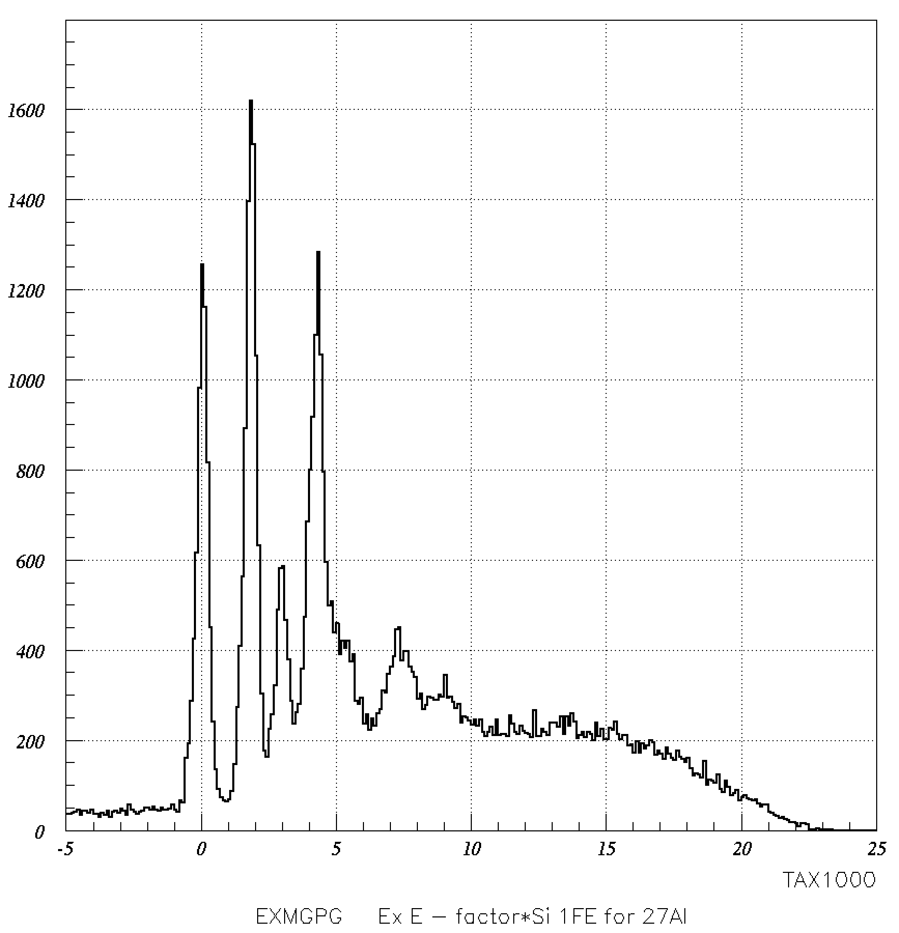
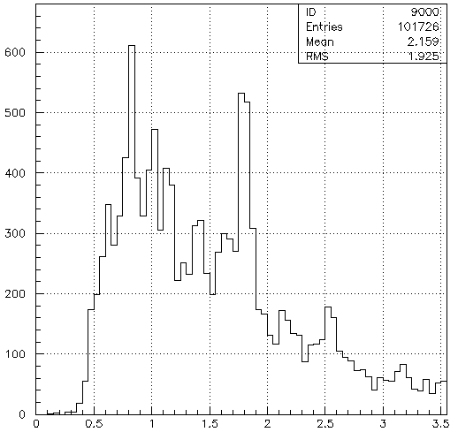
10
²⁷Al 0 degree
Branching ratios
Branching ratio
²⁶Al : E₃= 13.9[%]
$\frac{ 12C\left(p, { p}^{′}γ\right) counts}{12C\left(p, p^{′}\right) counts} × \frac{100}{efficiency}$ [%]
²⁶Mg : E₁= 22.8[%] E₂= 8.4[%]
Analyzed by Y.Sasagawa
²⁶Al : E_{3γ}= 0.83[MeV]
E₁ = 1.81[MeV]
²⁶Mg : E_{7γ}=1.00[MeV]
²⁶Al : E_{7γ}=1.01[MeV]
E₂ = 2.94 [MeV]
²⁶Mg : E_{2γ}=1.13[MeV]
E₈ = 4.32 [MeV]
²⁶Mg : E_{10γ}=1.41[MeV]
E₉ = 4.33 [MeV]
²⁶Al : E_{4γ}=1.34[MeV]
counts
E₁₀ = 4.35 [MeV]
Counts
²⁶Al : E_{5γ}= 1.62[MeV]
²⁶Mg : E_{1γ}=1.81[MeV]
²⁶Mg : E_{8~10γ}=2.5[MeV]
²⁶MgEX [MeV]
E-γ [MeV]

Slide 18
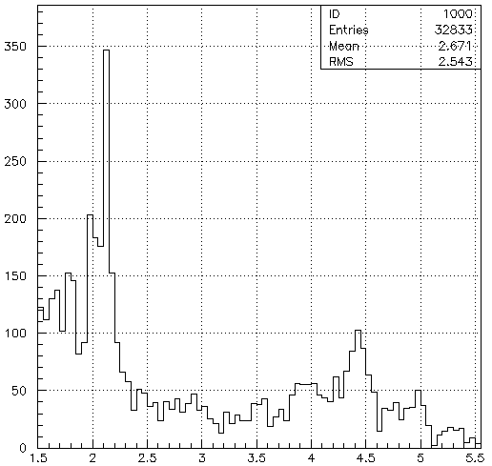
6
¹²C 4.5 degrees
Branching ratios
Branching ratio
¹¹C + ¹¹B : E₁=15.7 [%]
$\frac{ 12C\left(p, { p}^{′}γ\right) counts}{12C\left(p, p^{′}\right) counts} × \frac{100}{efficiency}$ [%]
¹¹C + ¹¹B : E₂= 10.5[%]
Neutron decay
n
¹¹C : E₁=2.00[MeV]
p
Proton decay
¹¹C Excitation
¹¹B : E₁=2.13[MeV]
¹¹B Excitation
4.3MeV
4.4MeV
¹²C
GDR
𝛾
¹¹C : E₂=4.32[MeV]
𝛾
2MeV
counts
2.1MeV
¹¹B : E₂=4.45[MeV]
¹¹C Ground state
¹¹B Ground state
LaBr₃ detector
LaBr₃ detector
¹²C Ground state
E-γ [MeV]

Slide 19
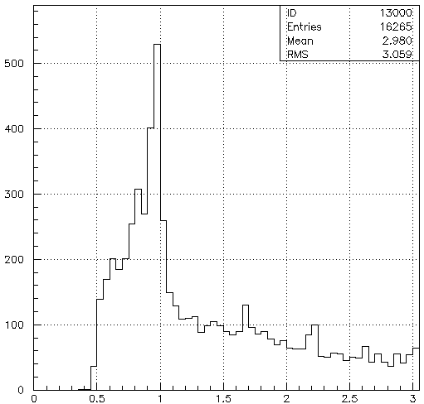
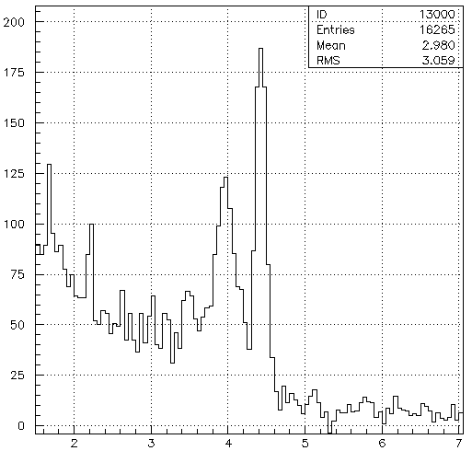
7
¹³C 4.5 degrees
Branching ratio
GR analysis has not been done yet
$\frac{ 13C\left(p, { p}^{′}γ\right) counts}{13C\left(p, p^{′}\right) counts} × \frac{100}{efficiency}$ [%]
¹²B : E₁=0.95[MeV]
¹²C : E₁=4.44[MeV]
counts
counts
¹²B : E₂=1.67[MeV]
E-γ [MeV]
E-γ [MeV]

Slide 20
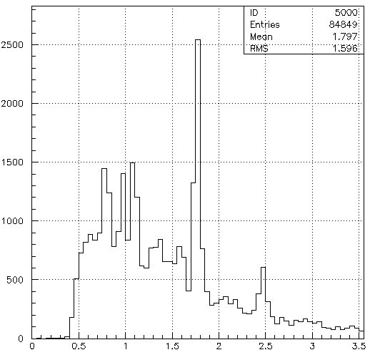
9
²⁷Al 4.5 degrees
Branching ratio
GR analysis has not been done yet
$\frac{ 12C\left(p, { p}^{′}γ\right) counts}{12C\left(p, p^{′}\right) counts} × \frac{100}{efficiency}$ [%]
Analyzed by Y.Sasagawa
²⁶Al : E_{3γ}= 0.83[MeV]
E₁ = 1.81[MeV]
²⁶Mg : E_{7γ}=1.00[MeV]
²⁶Al : E_{7γ}=1.01[MeV]
E₂ = 2.94 [MeV]
²⁶Mg : E_{2γ}=1.13[MeV]
E₈ = 4.32 [MeV]
²⁶Mg : E_{10γ}=1.41[MeV]
E₉ = 4.33 [MeV]
²⁶Al : E_{4γ}=1.34[MeV]
counts
E₁₀ = 4.35 [MeV]
counts
²⁶Al : E_{5γ}= 1.62[MeV]
²⁶Mg : E_{1γ}=1.81[MeV]
²⁶Mg : E_{8~10γ}=2.5[MeV]
²⁶MgEX [MeV]
E-γ [MeV]

Slide 21
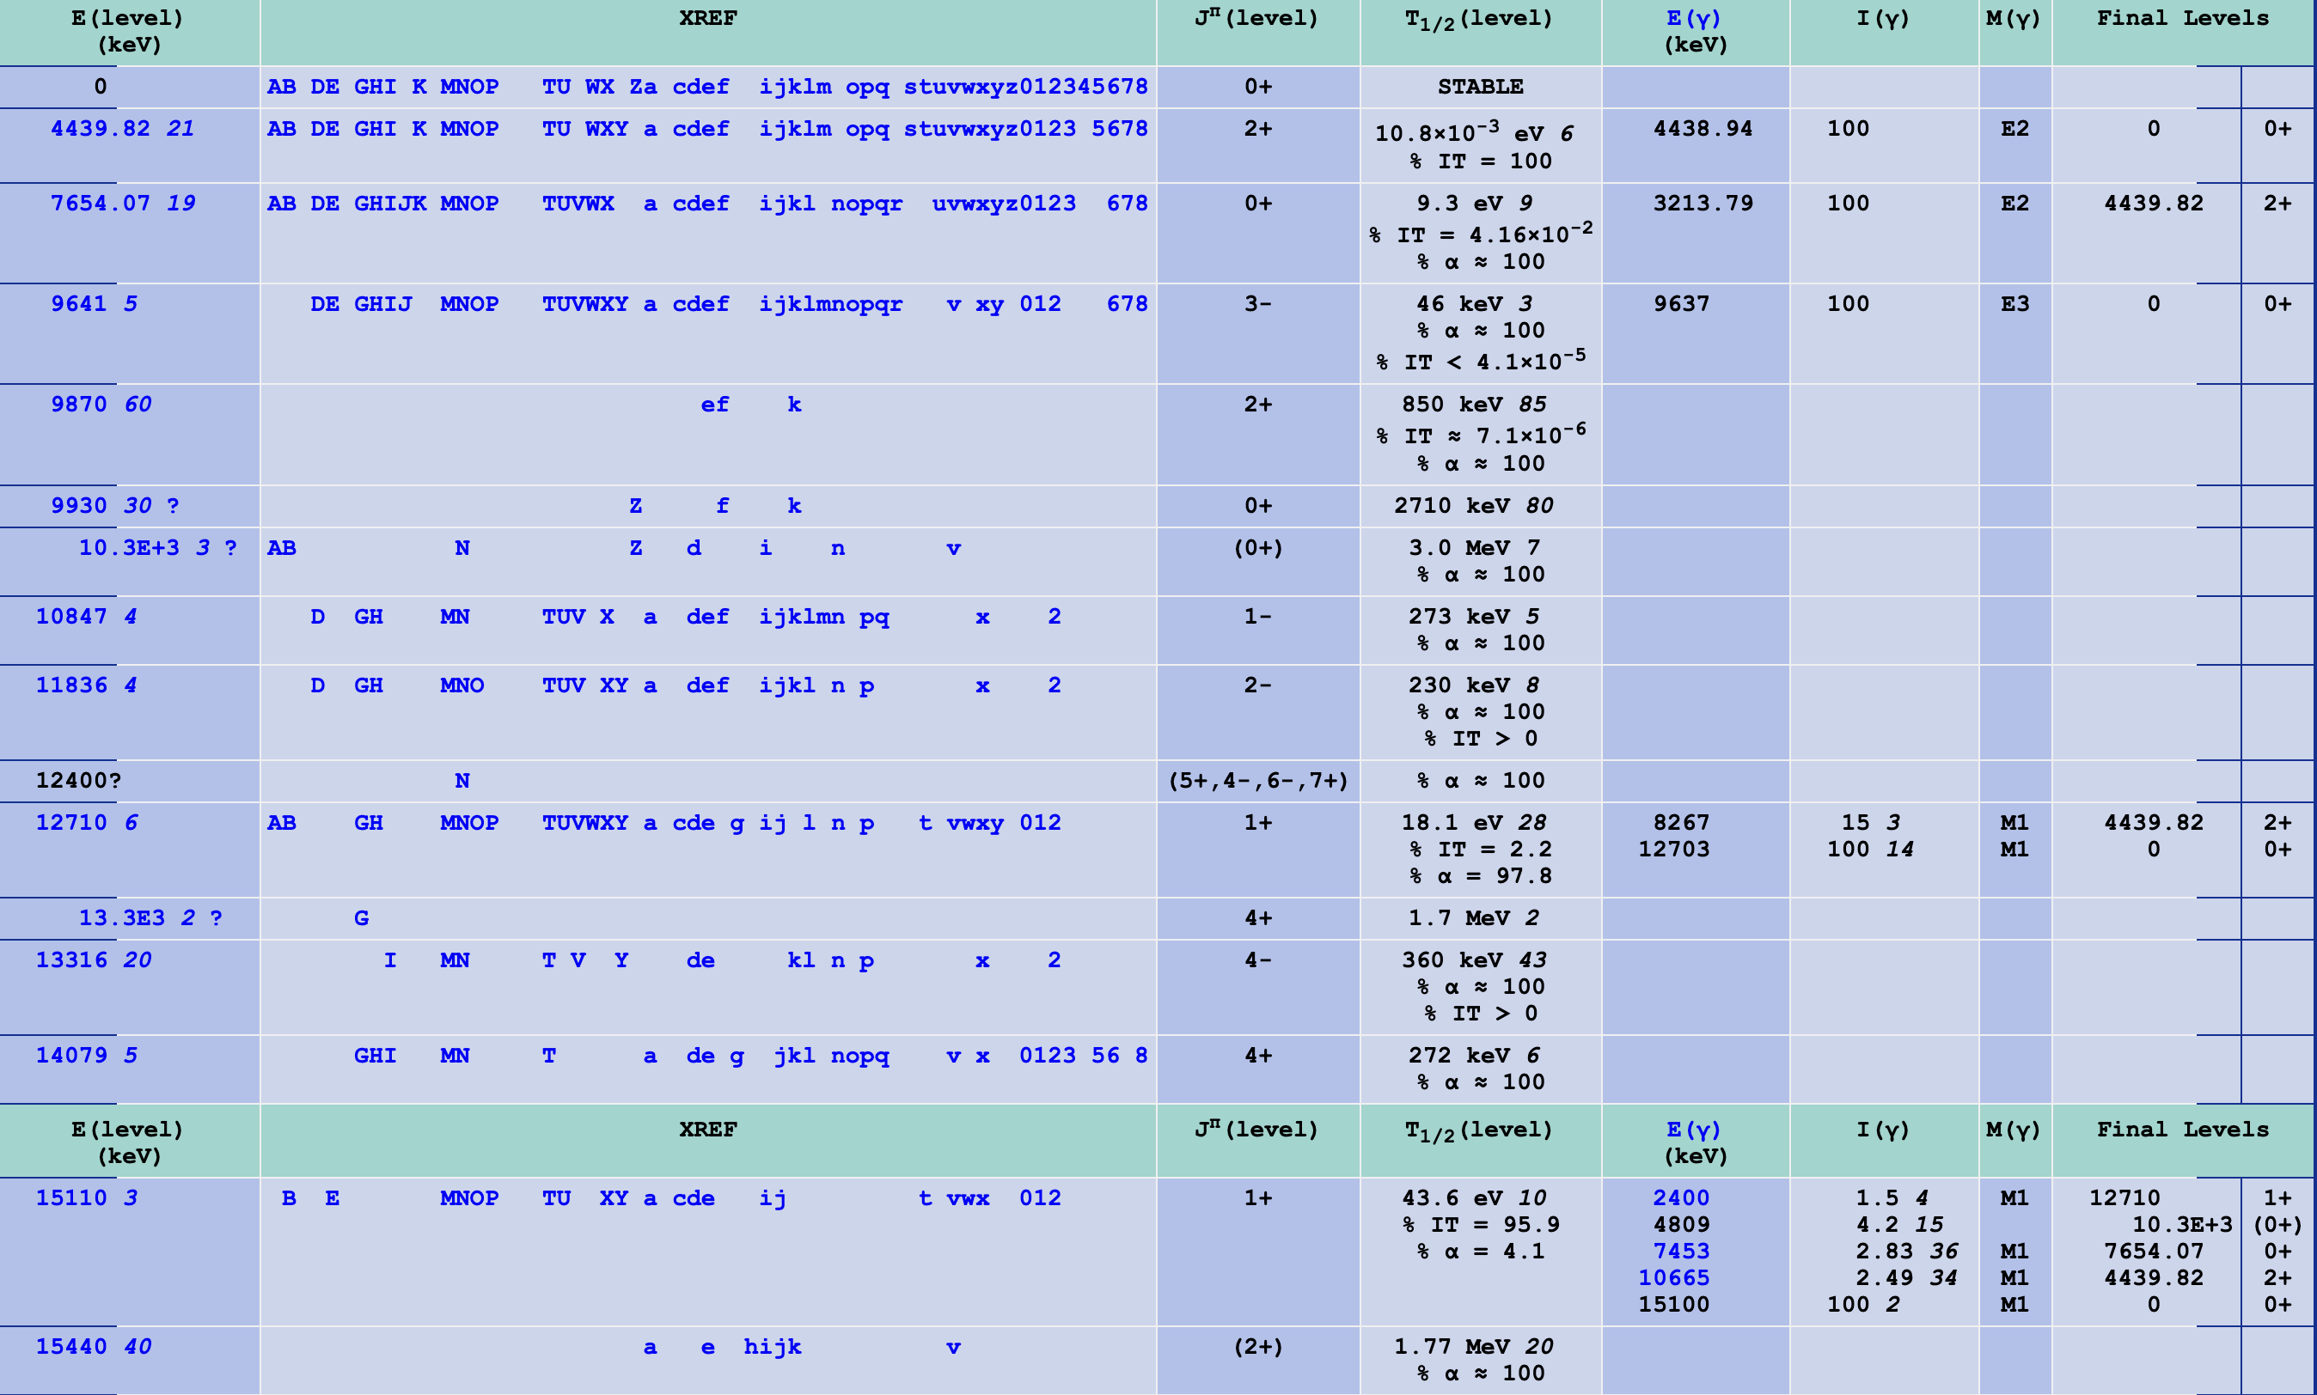

Slide 22
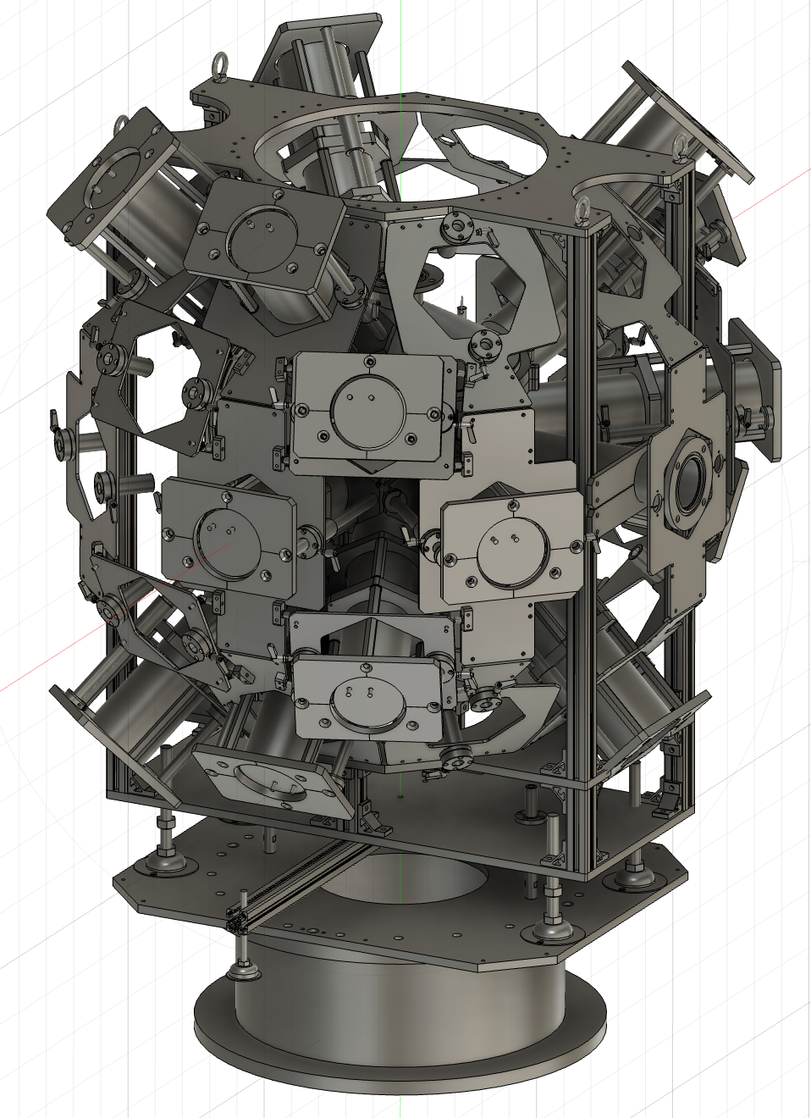
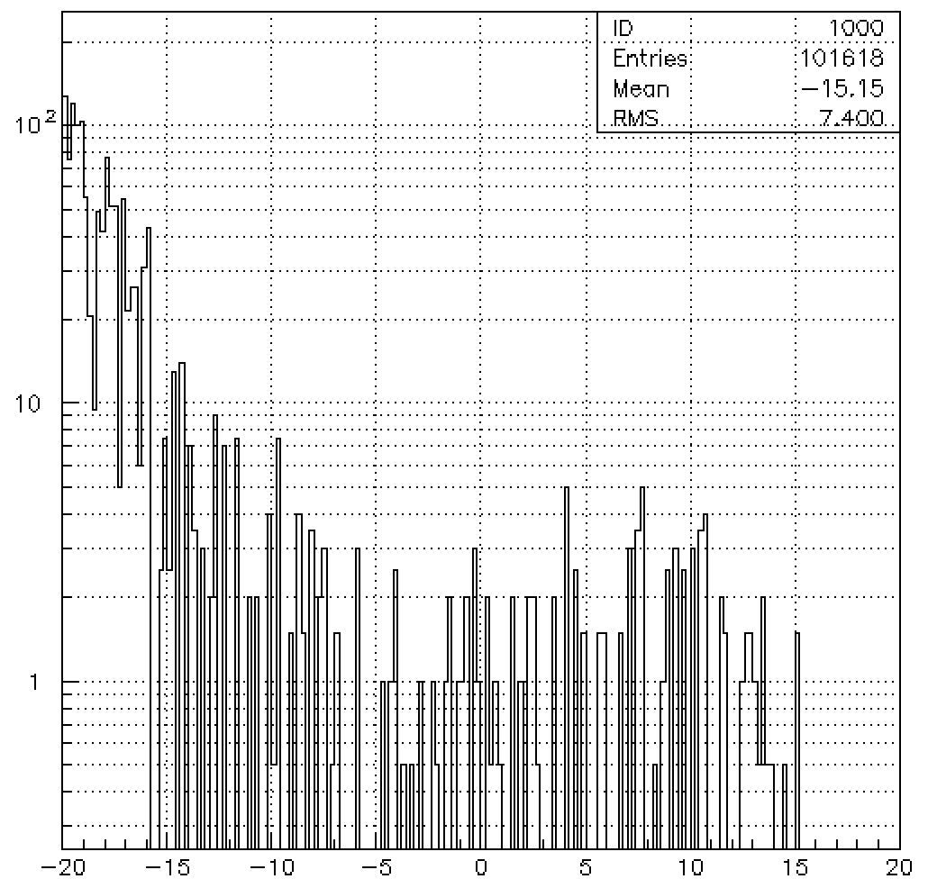
ELPIS
(Expanded LaBr₃ array for PANDORA Investigations with GR Spectrometer)
beam

Slide 23
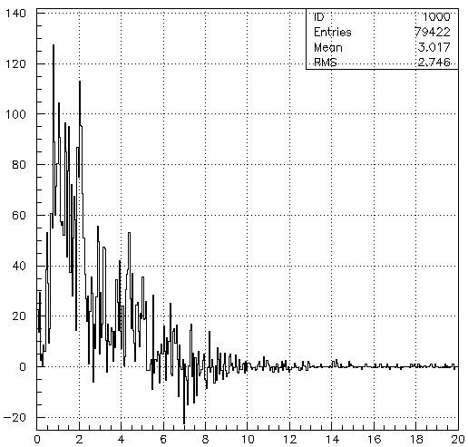
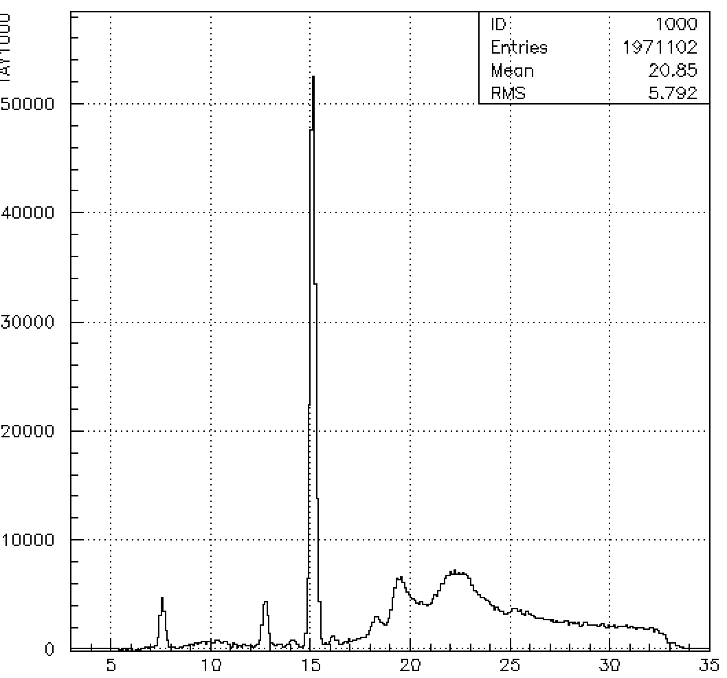
12C 0 degree

Slide 24
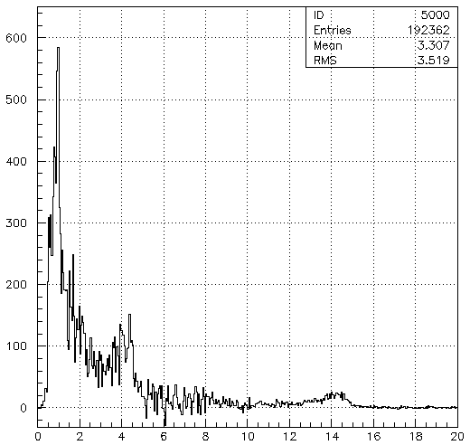
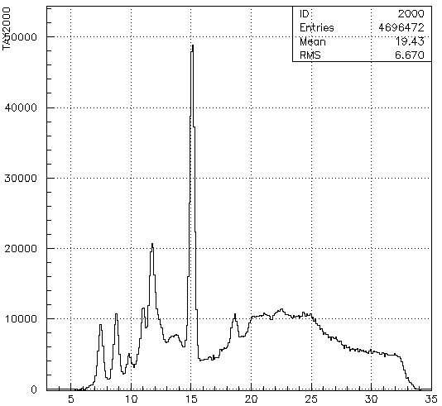
13C 0 degree

Slide 25
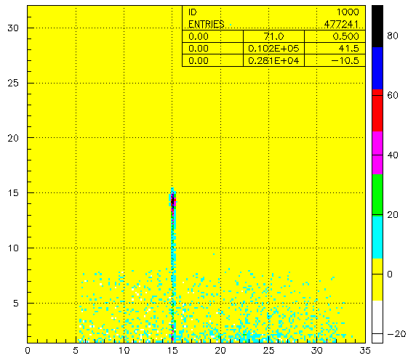
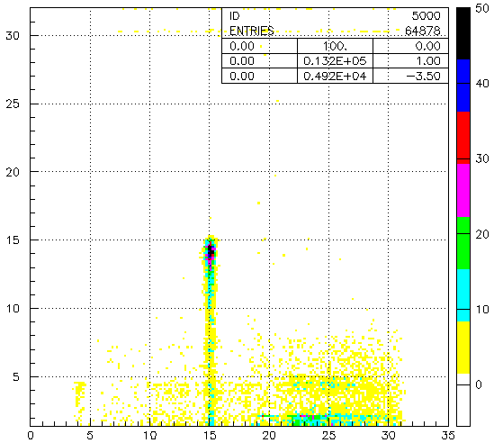
12C 0 degree
12C 0 degree
GDR
GDR
E-γ [MeV]
E-γ [MeV]
GREX [MeV]
GREX [MeV]

Slide 26
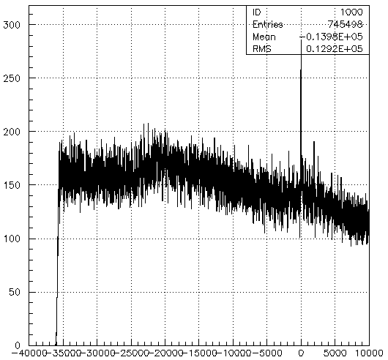
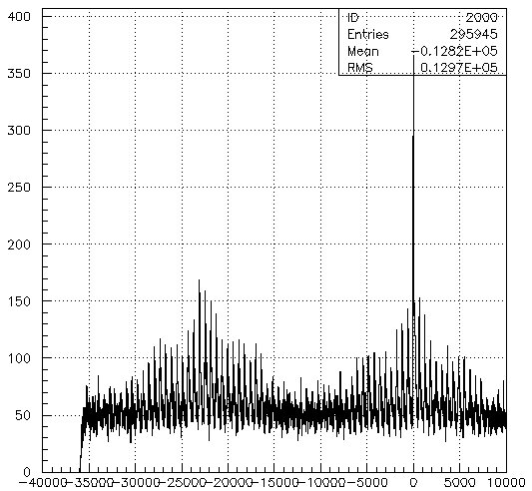
TDC data

Slide 28
4
GDR & decays
Targets : ¹²C, ¹³C
Scattering angles : 0°, 4.5°
GDR : 17 ~ 27 MeV
¹²C
¹³C
Neutron decay
n
Neutron decay
n
p
Proton decay
p
Proton decay
¹¹C Excitation
¹²C Excitation
¹¹B Excitation
4.3MeV
¹²B Excitation
15.1MeV
4.4MeV
¹²C
GDR
1.67MeV
¹³C
GDR
𝛾
𝛾
𝛾
2MeV
𝛾
4.4MeV
2.1MeV
0.95MeV
¹¹C Ground state
¹²C Ground state
¹¹B Ground state
¹²B Ground state
LaBr₃ detector
LaBr₃ detector
LaBr₃ detector
LaBr₃ detector
¹²C Ground state
¹³C Ground state

Slide 29
5
GDR & decays
Targets : ²⁷Al
Scattering angles : 0°, 4.5°
GDR : 15 ~ 25 MeV
²⁷Al
Neutron decay
n
p
Proton decay
²⁶Al Excitation
²⁶Mg Excitation
0.83MeV
1.13MeV
²⁷Al
GDR
𝛾
1.8MeV
𝛾
²⁶Al Ground state
²⁶Mg Ground state
LaBr₃ detector
LaBr₃ detector
¹²C Ground state

Slide 30
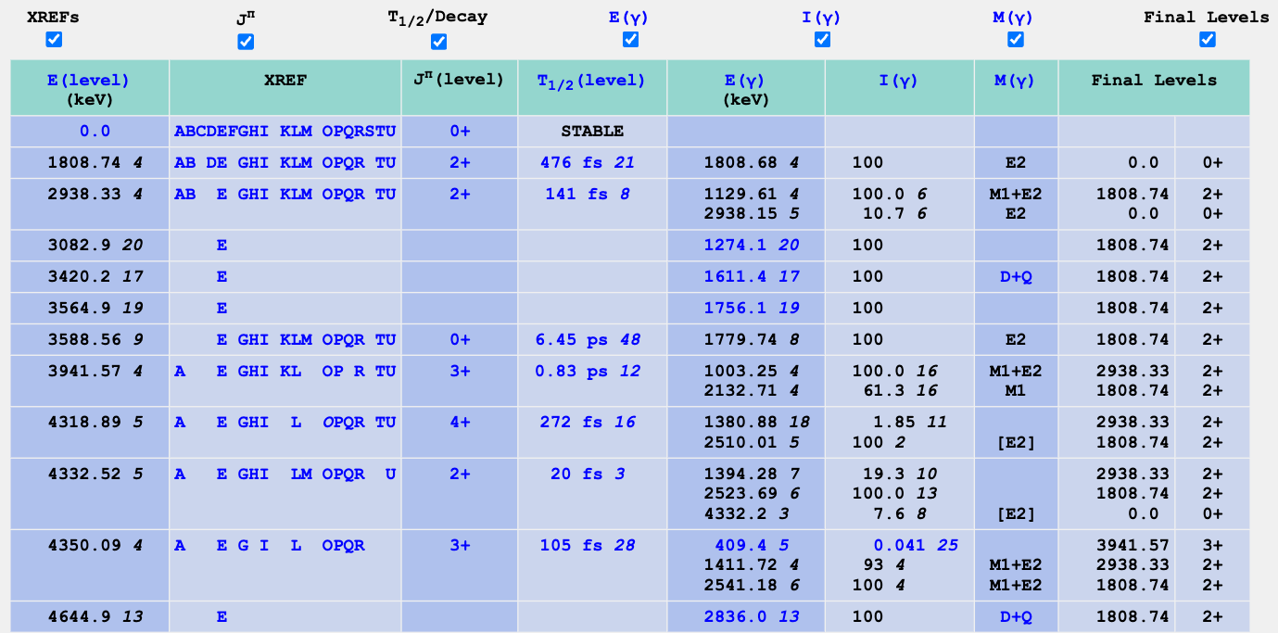
Proton decay (²⁶Mg)
GDR : 15 ~ 25 MeV
S(p) = 8.3 MeV

Slide 31
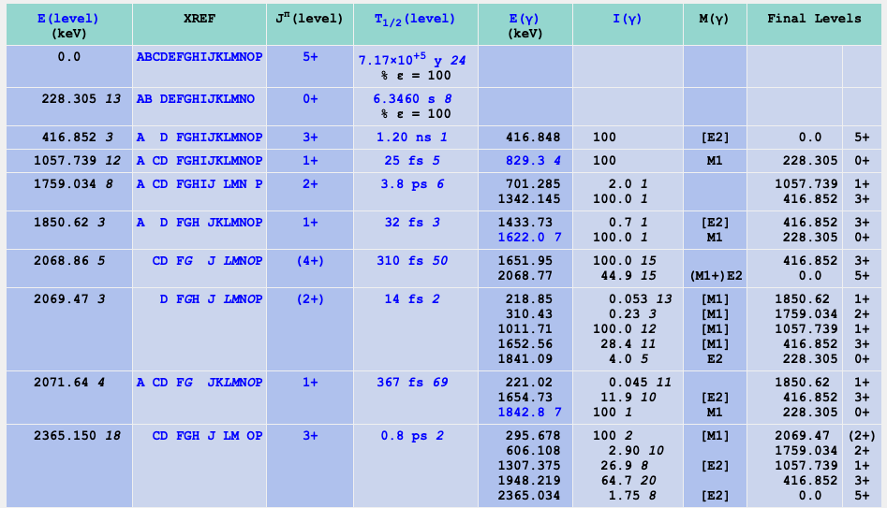
Proton decay (²⁶Al)
GDR : 15 ~ 25 MeV
S(n) = 13.1 MeV

Slide 32
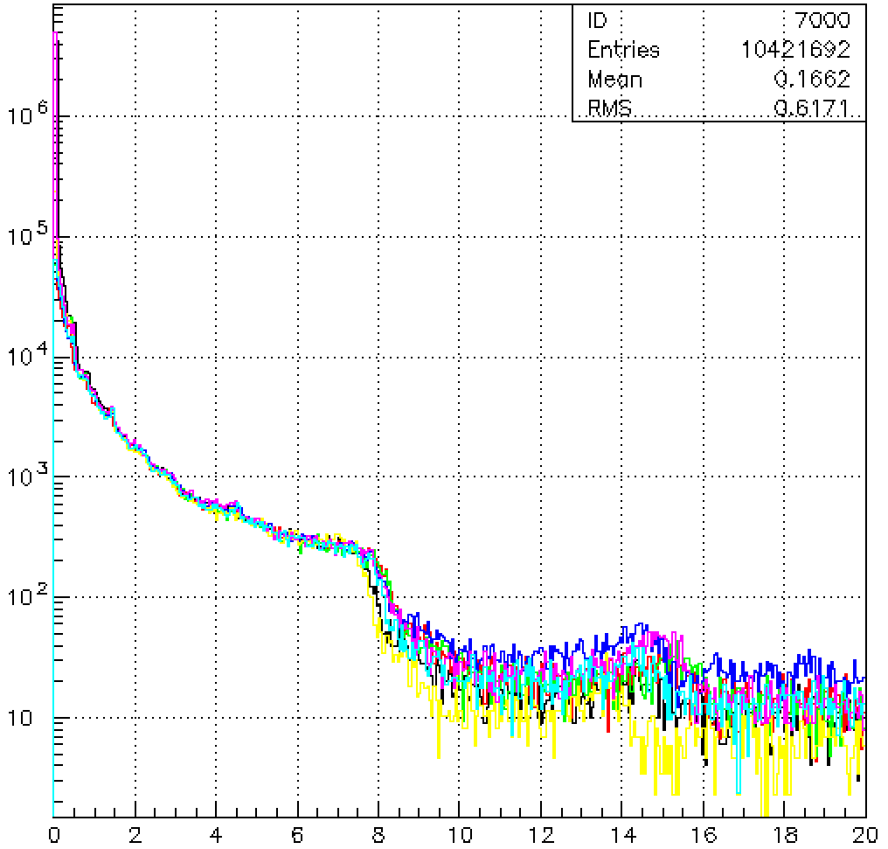
Calibration

Slide 33
LaBr₃ setup on next experiment

Slide 34
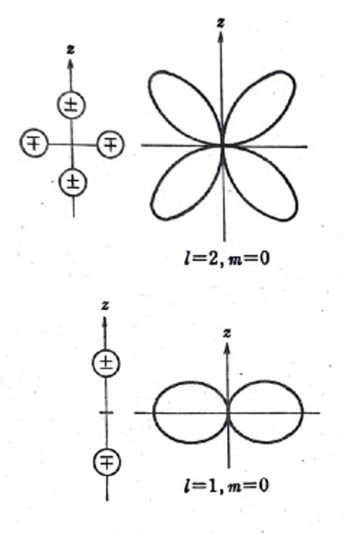
ELPIS
11
2nd PANDORA experiment
(Expanded LaBr₃ array for PANDORA Investigations with GR Spectrometer)
The number of LaBr₃ detectors will be 16.
Angles : 45$°$, 90$°$, 112.5$°$, 135$°$
4 detectors for each angle.
beam
beam
E2, M2 gamma ray
beam
E1, M1 gamma ray

Slide 35
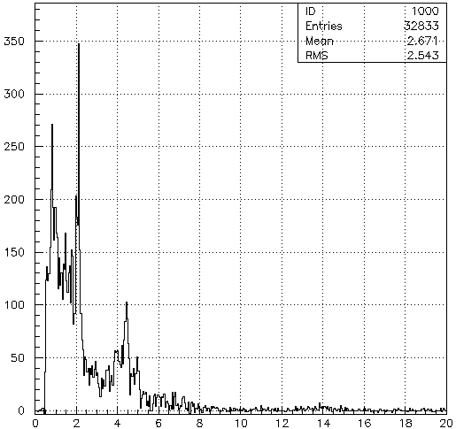
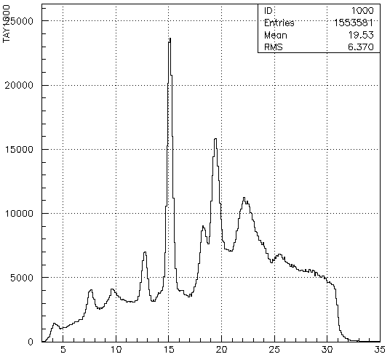
12C 4.5 degrees

Slide 36
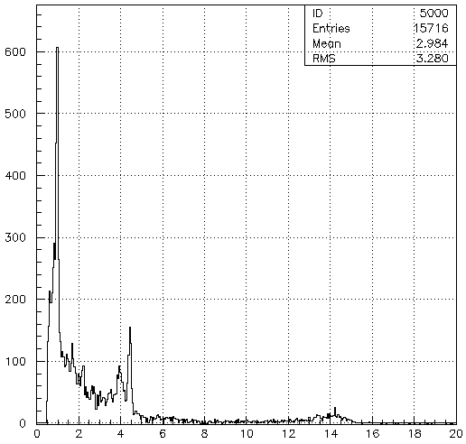
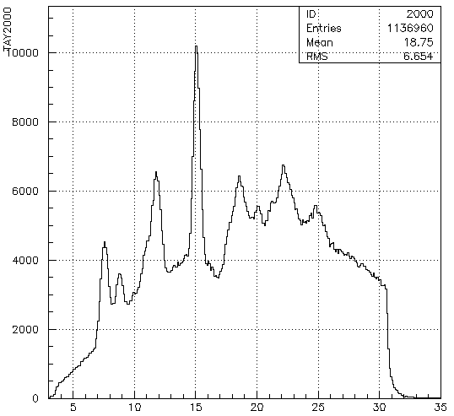
13C 4.5 degrees

Slide 37
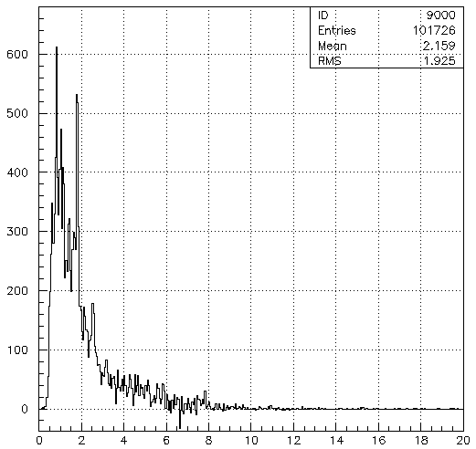
27Al 0 degree

Slide 38
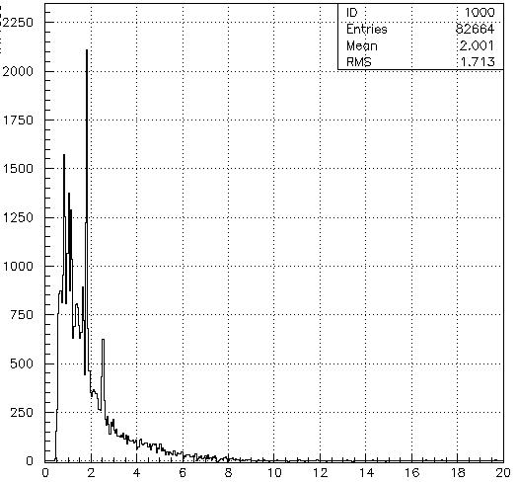
27Al 4.5 degrees

Slide 39
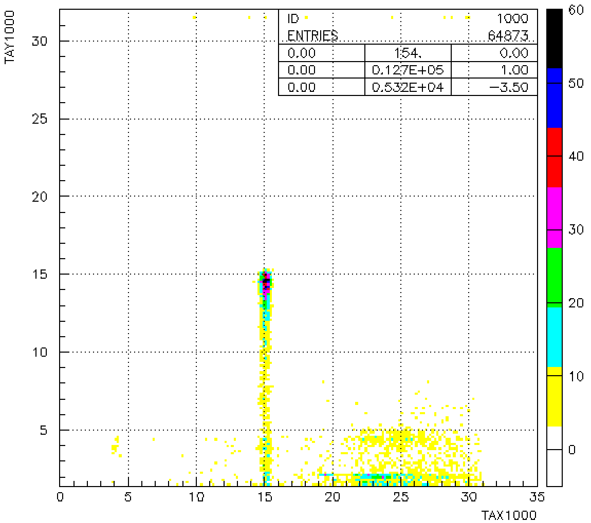
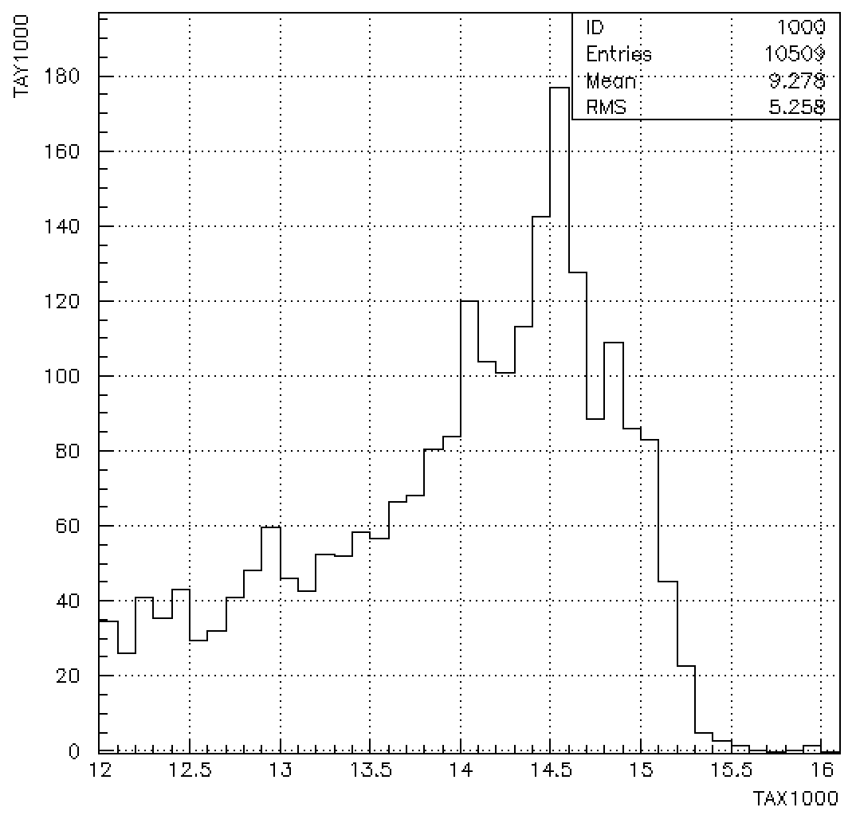
4
Branching ratios & Efficiency
Branching ratio
Efficiency was roughly calculated using the results of another thesis.
$\frac{ AX\left(p, { p}^{′}γ\right) counts}{AX\left(p, p^{′}\right) counts} × \frac{100}{efficiency}$ [%]
detector efficiency @ 15.1 MeV
Renormalized multiplying by ratio
$\frac{Number of 15.1 MeV γ −ray}{Number of 15.1 MeV excited state × 0.873}$
= 0.014
14.4 ~ 15.8
Efficiency
E-γ [MeV]
counts
GREX [MeV]
E-γ [MeV]
Energy [MeV]

