Slide 1
Optimized Statistical Property Parameterization using Machine Learning
PNNL: Stephanie Lyons
LLNL: Anthony Ramirez, Anton Tonchev
Ohio U: Andrea Richard, Alexander Voinov,
Amadie Wijenarayana
UNC/TUNL: Akaa Daniel Ayangeakaa,
Logan Schaedig
This work was supported by the Office of Defense Nuclear Nonproliferation Research and Development within the U.S. Department of Energy’s National Nuclear Security Administration.
Notes:
Image: Abstract Data Visualization – Stock Photo

Slide 2
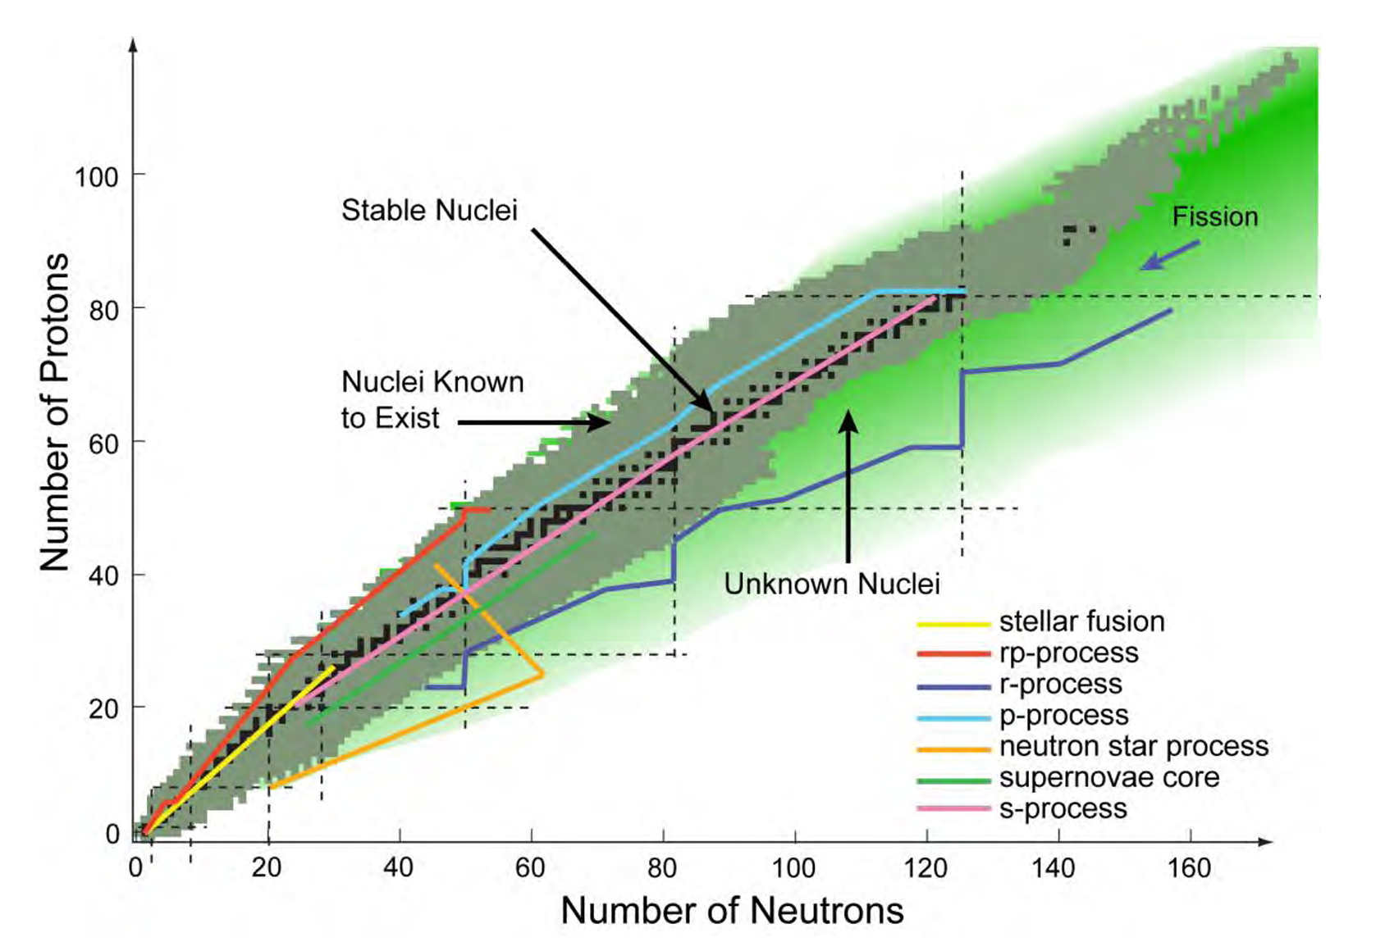
From slow- to rapid- neutron capture, rates are needed to improve our understanding of nucleosynthesis at the extremes

Slide 3
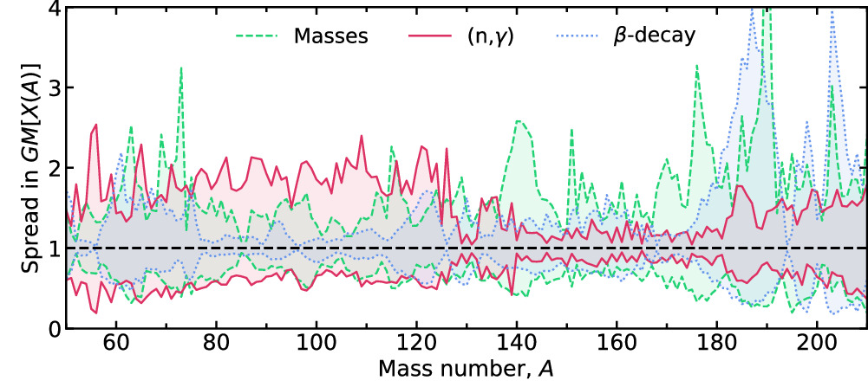
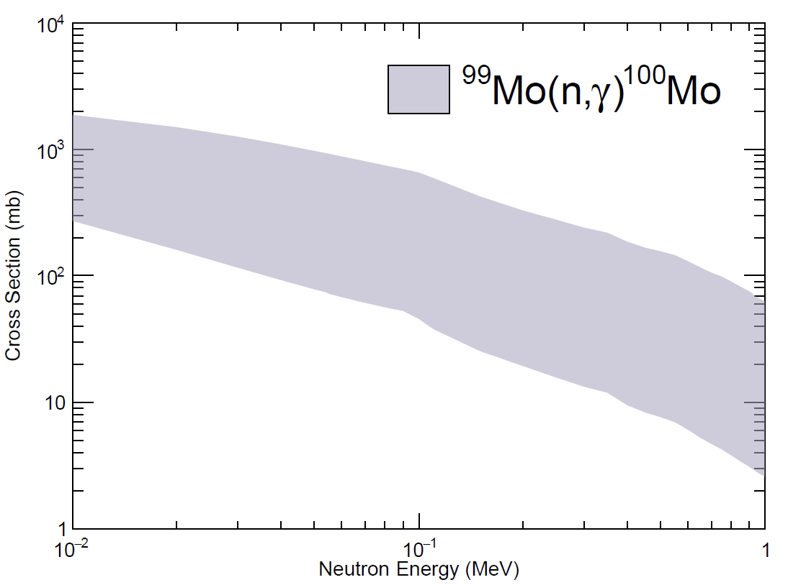
Statistical properties are necessary to calculate reaction cross-sections, especially far from stability
OMP
NLD
γSF
Hauser-Feshbach
calculated cross sections
Predicted isotopic mass fraction uncertainties are dominated by (n,γ) rates for weak r-process (A<120). Mumpower et al. (2024)

Slide 4
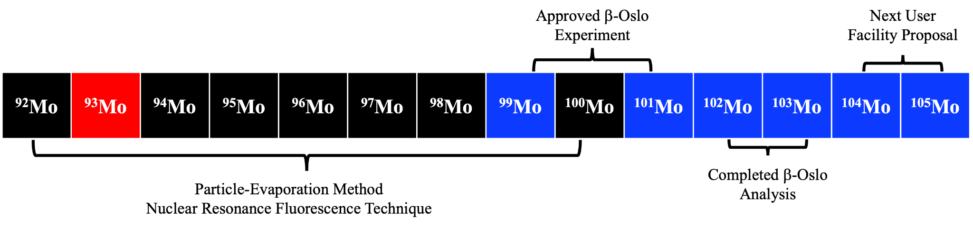
A Systematic Study of Mo Isotopes
✅
✅
✅
✅
PNNL/Ohio U
^{99,101}Mo at nuCARIBU
^{104,105}Mo at FRIB/nuCARIBU
via Beta-Oslo Method
Ohio U.
NLD at EAL via Part. Evap.
LLNL/UNC
gSF at HIGS via NRF
Compile results to generate systematic study of statistical property evolution and resolve uncertainties from previous approaches. Provide rich dataset for theory development.

Slide 5
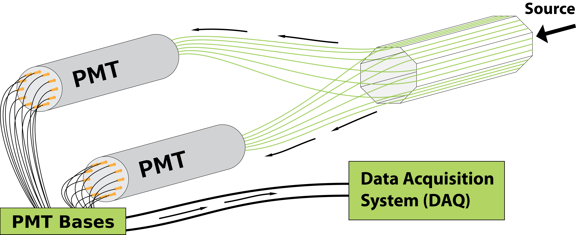



Radioactive Ion Beams: ANL Experiment Updates
nuCARIBU experiments are planned for this year
Summing NaI (SuN) is being moved back to ANL this April
Approved experiment for this summer:
β-decay of neutron-rich ¹⁰⁰⁻¹⁰²Nb
  β-Oslo Method: NLDs, gSFs, and (n,γ) rates
  Total Absorption Spectroscopy: β-decay strength
SuN
SuNTAN

Slide 6

Stable Beam Measurements
Ohio U. (EAL): Particle Evaporation Experiments for NLD
  First experiments performed FY25 – See A. Wijenarayana’s Poster
  Next experiment: FY26
UNC/TUNL (HIγS): NRF Technique for γSF
  First experiments performed in FY25: ^{98,100}Mo
  Next experiments → extend to ⁹²Mo
Association for Research at University Nuclear Accelerators

Slide 7
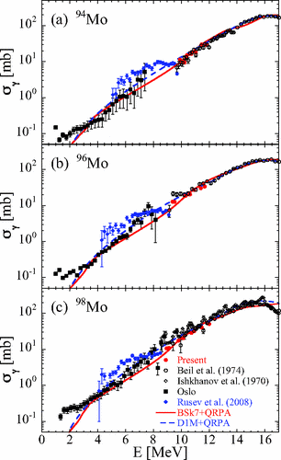
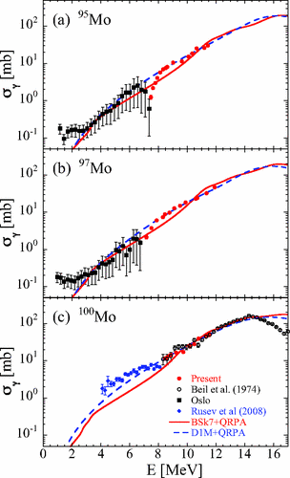
Current state of available literature* on Mo
Reference | Isotopes | Method
B. S. Ishkhanov et al. (1970) | 92, 98 | Photonuclear
H. Beil et al. (1974) | 92, 94, 96, 98, 100 | Photonuclear
M. Guttormsen et al. (2005) | 93, 94, 95, 96, 97, 98 | Oslo Method
R. Chenkova et al. (2006) | 93, 94, 95, 96, 97, 98 | Oslo Method
G. Rusev et al. (2009) | 92, 94, 96, 98, 100 | NRF
H. Utsunomiya et al. (2013) | 94, 95, 96, 97, 98, 100 | Photonuclear
Pulling and qualifying the data for use in ML development:
NLDs
  First database development :
  Pulling and digitizing literature and legacy data.
γSFs
  IAEA PSF Database!
Cross section comparisons from Utsunomiya et al. Predictive models from Skyrme HFB+QRPA (BSk7+QRPA) and Gogny HFB+QRPA (D1M+QRPA).
* Non-exhaustive

Slide 8
Neutron-Capture Cross-section Calculations
TALYS results for all NLD and γSF formalisms available.
GDR constrains the models well at higher excitation energies
Observed clear resonance that develops for neutron-capture on even-mass isotopes
Can we add predict the best combination of parameters as we move away from stability?

Slide 9
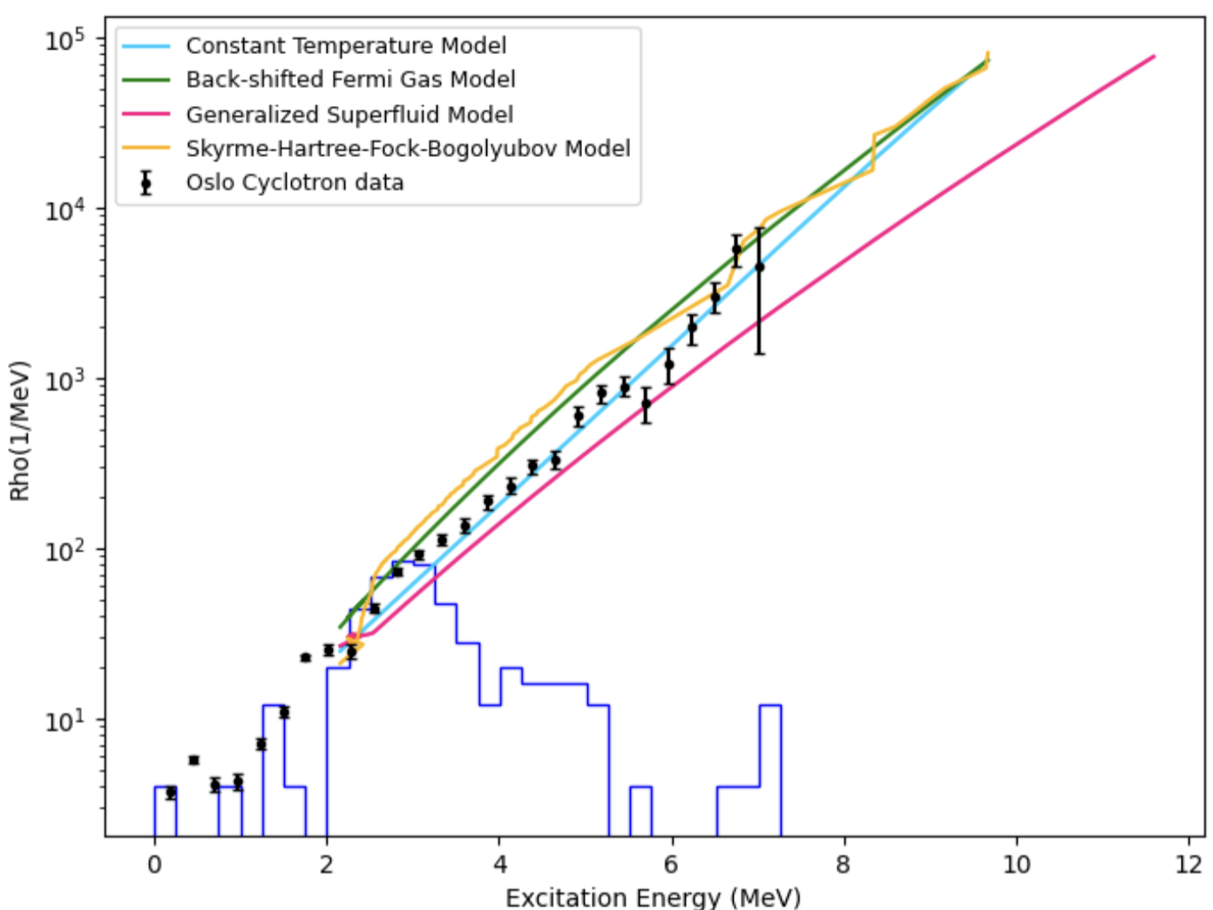
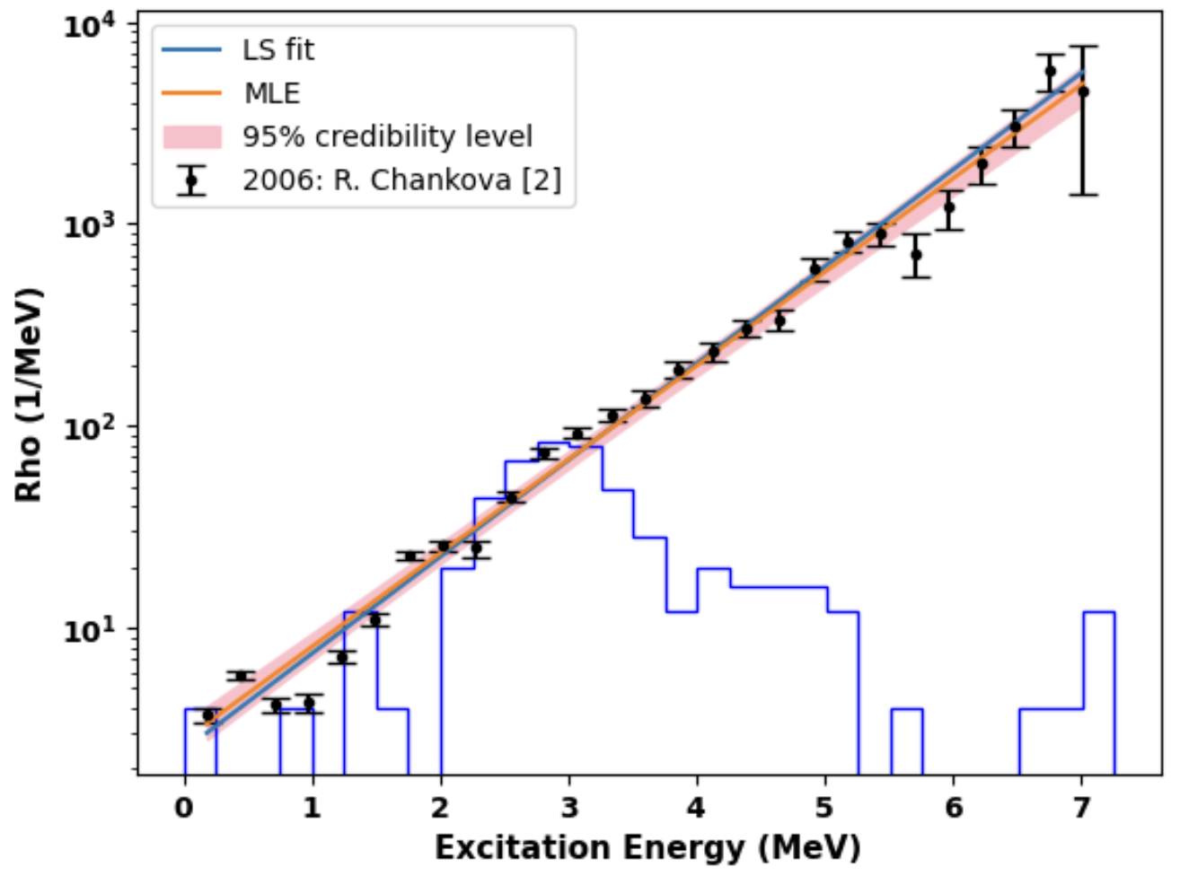
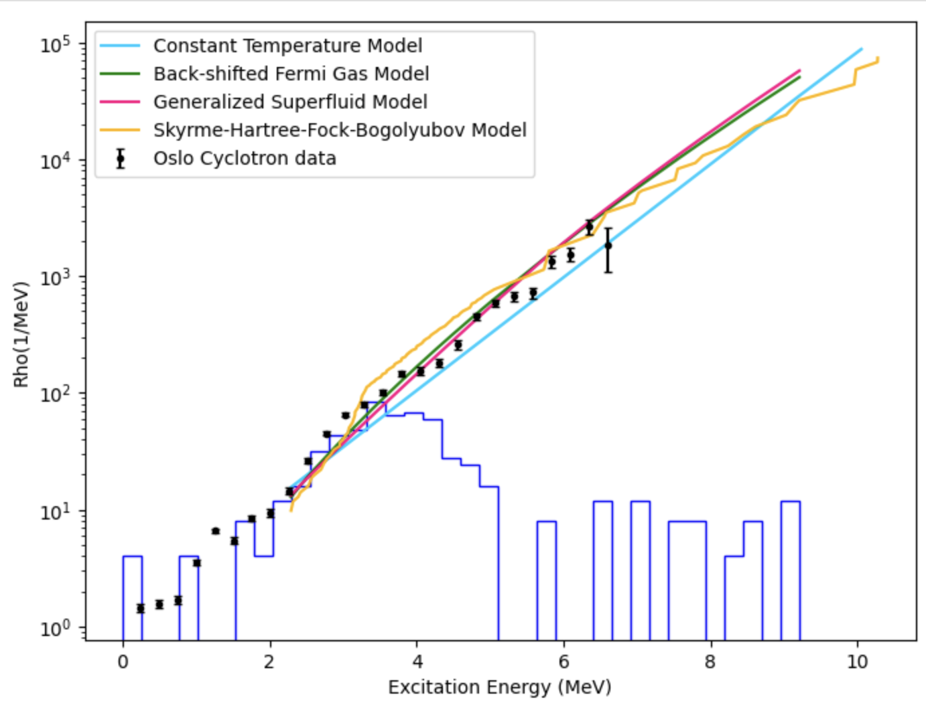
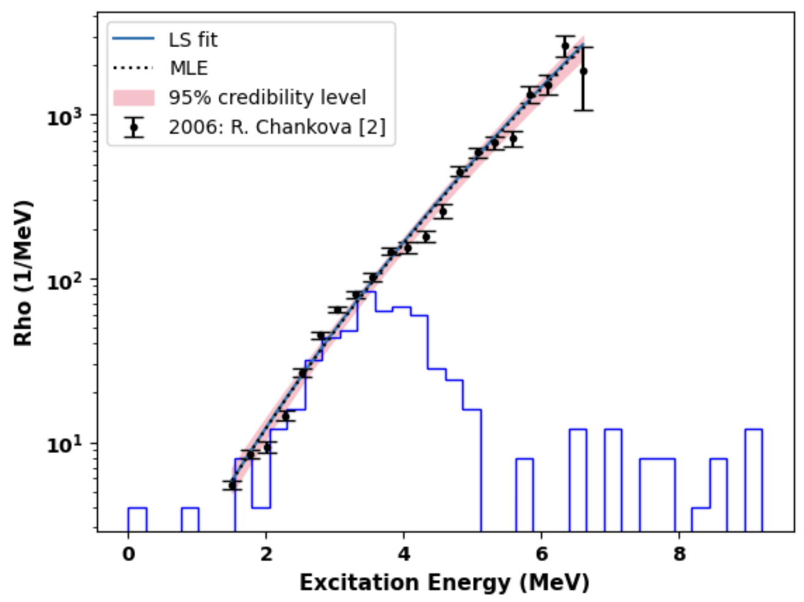
Nuclear Level Density Systematic Studies
Oslo Method data available for ⁹³⁻⁹⁸Mo
No single model can reproduce all NLDs using default parameters
Explore existing NLD data using Bayesian Optimization
CTM best described odd mass isotopes
BSFG best described even mass isotopes
Skyrme-HFB level densities from numerical tables were evaluated as well.
⁹³Mo
⁹⁴Mo
See poster by A. Wijenarayana

Slide 10
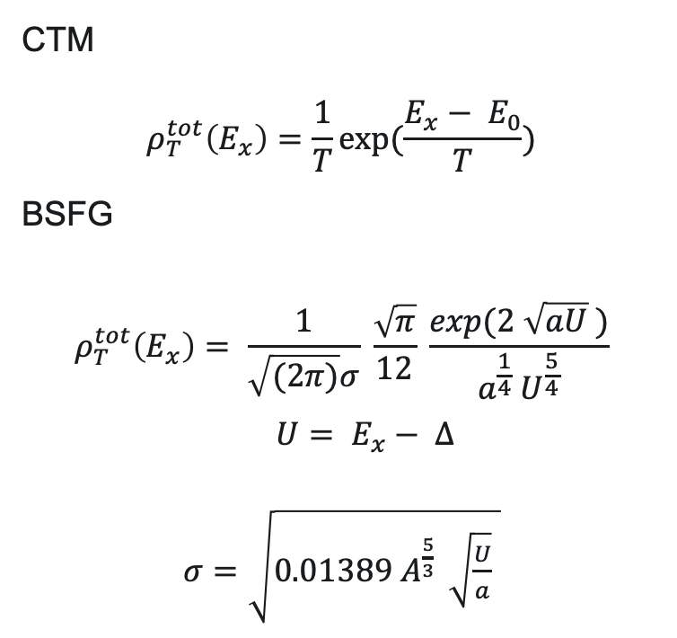
TALYS vs. Bayesian Fit Parameters
TALYS Bayesian Fits
CTM
$$ρ_{T}^{tot}\left(E_{x}\right)=\frac{1}{T}\exp{(\frac{E_{x}− E_{0}}{T})}$$
BSFG
$$ρ_{T}^{tot}\left(E_{x}\right)= \frac{1}{\sqrt{(2π)}σ} \frac{\sqrt{π}}{12} \frac{\exp{(2 \sqrt{aU} )}}{a^{\frac{1}{4}} U^{\frac{5}{4}}}$$
$U= E_{x}− ∆$
$σ=\sqrt{0.01389{ A}^{\frac{5}{3} } \sqrt{\frac{U}{a}} }$

Slide 11
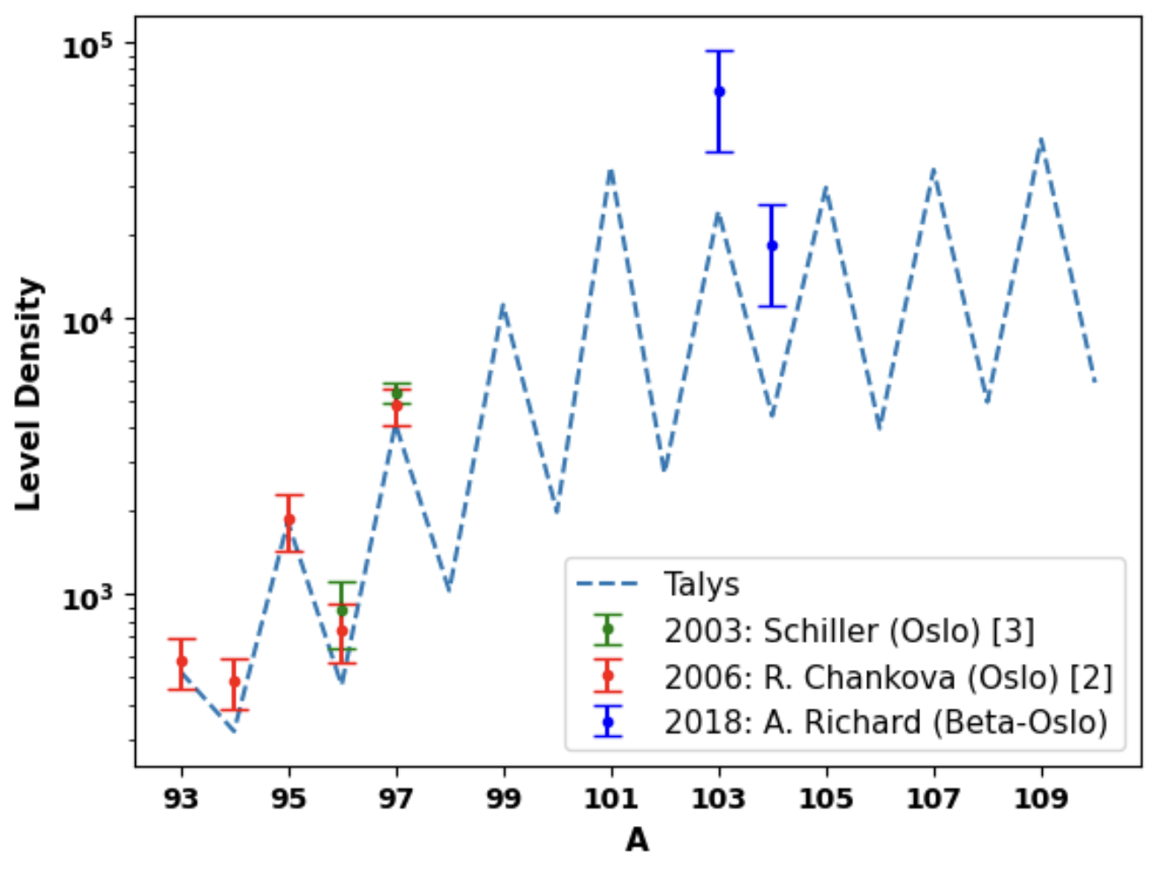
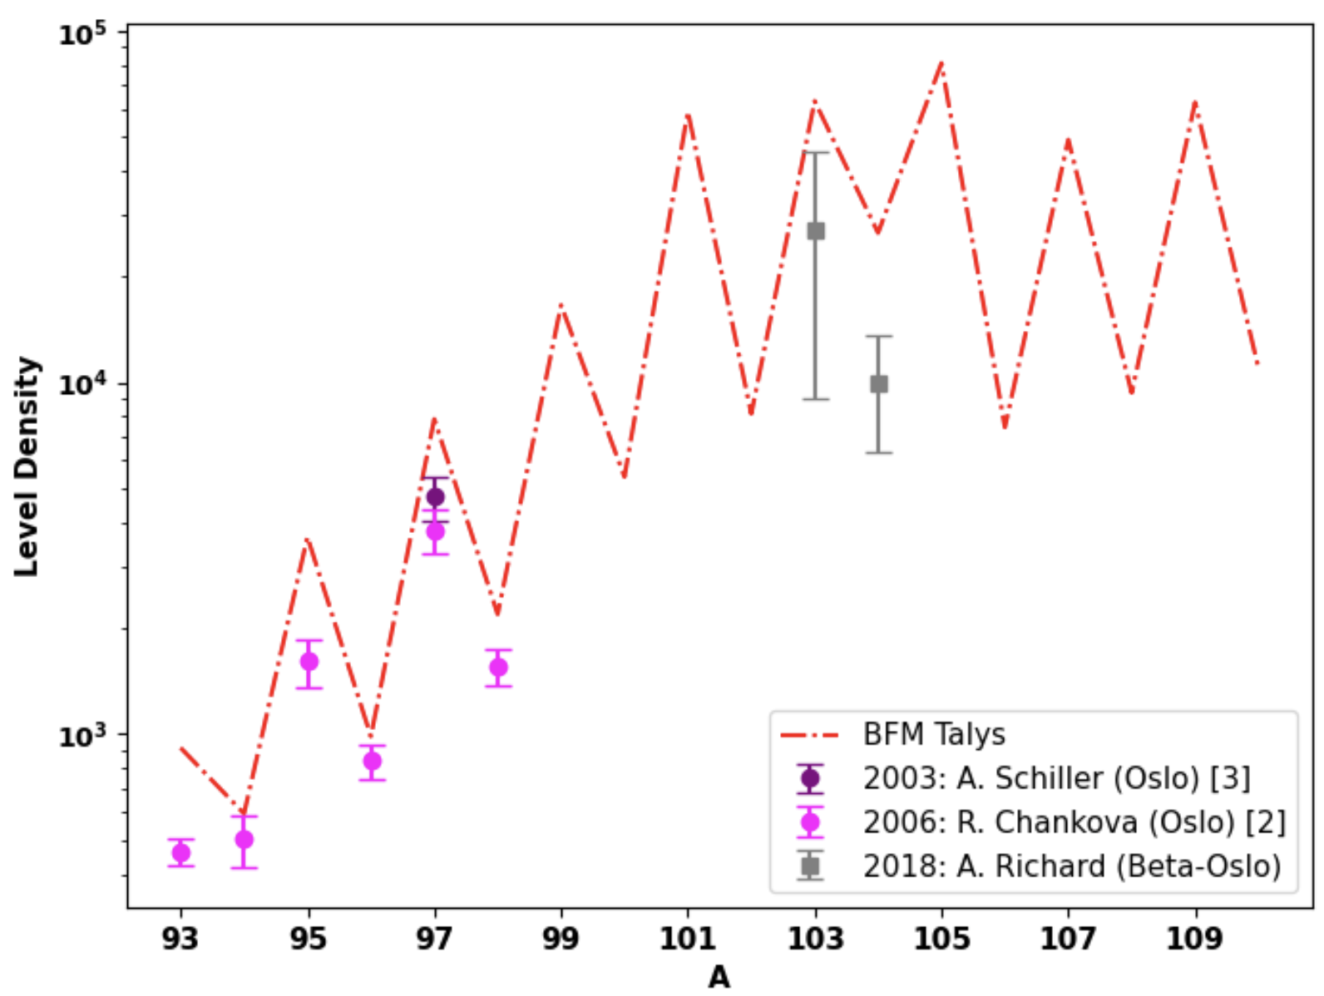
Systematic Studies of the Molybdenum Isotopes
Parameters extracted from Bayesian analysis provide trends across the Mo isotopic chain
Constant Temperature Model
Back-Shifted Fermi Gas Model
Observed deviation from trend for radioactive ^{103,104}Mo NLDs
See poster by A. Wijenarayana

Slide 12
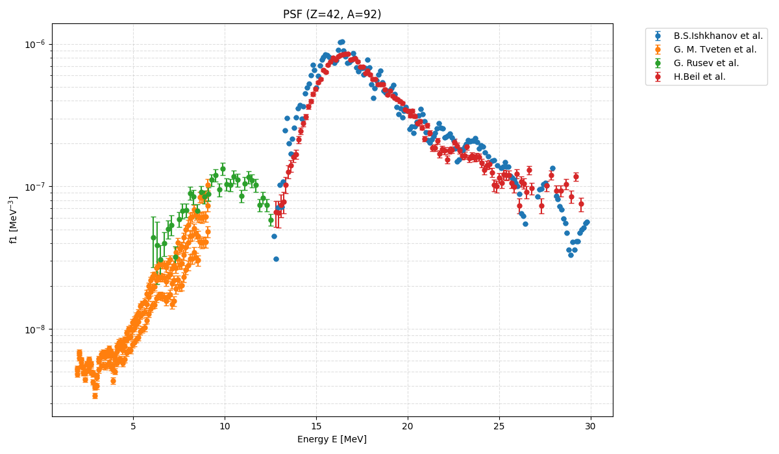
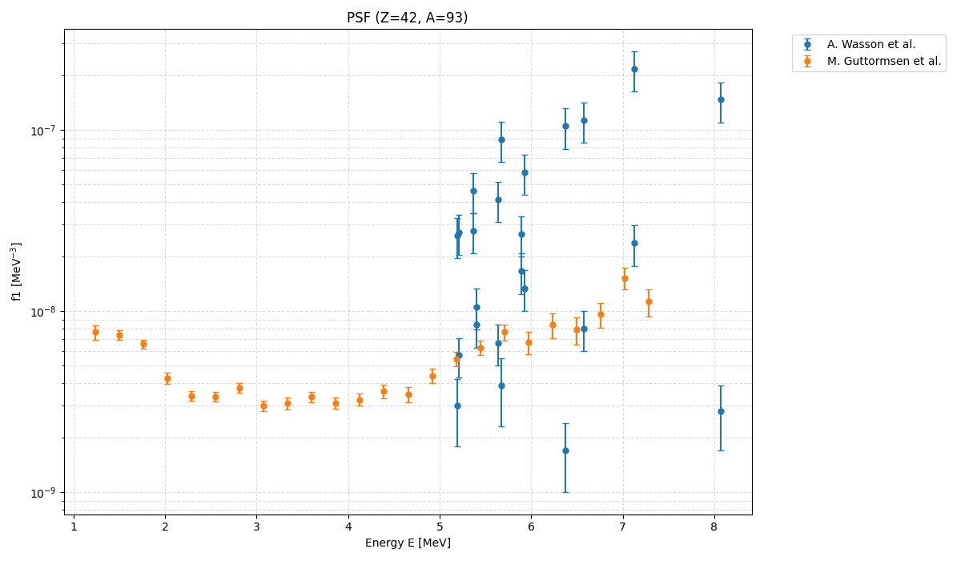
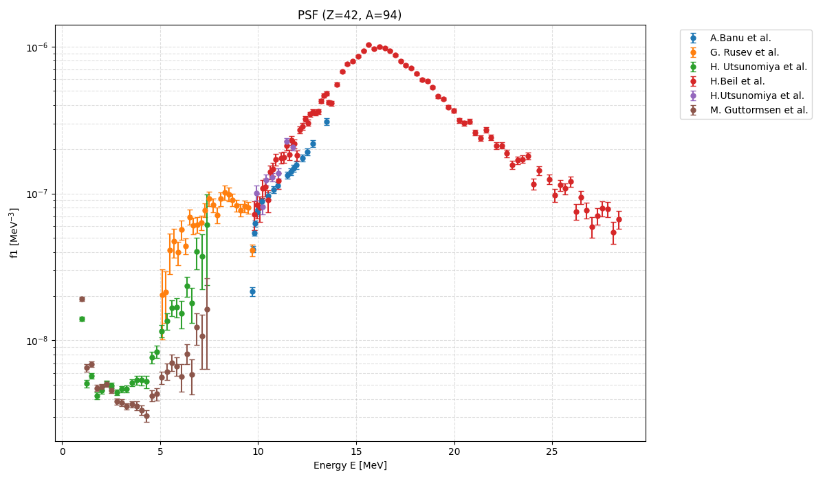
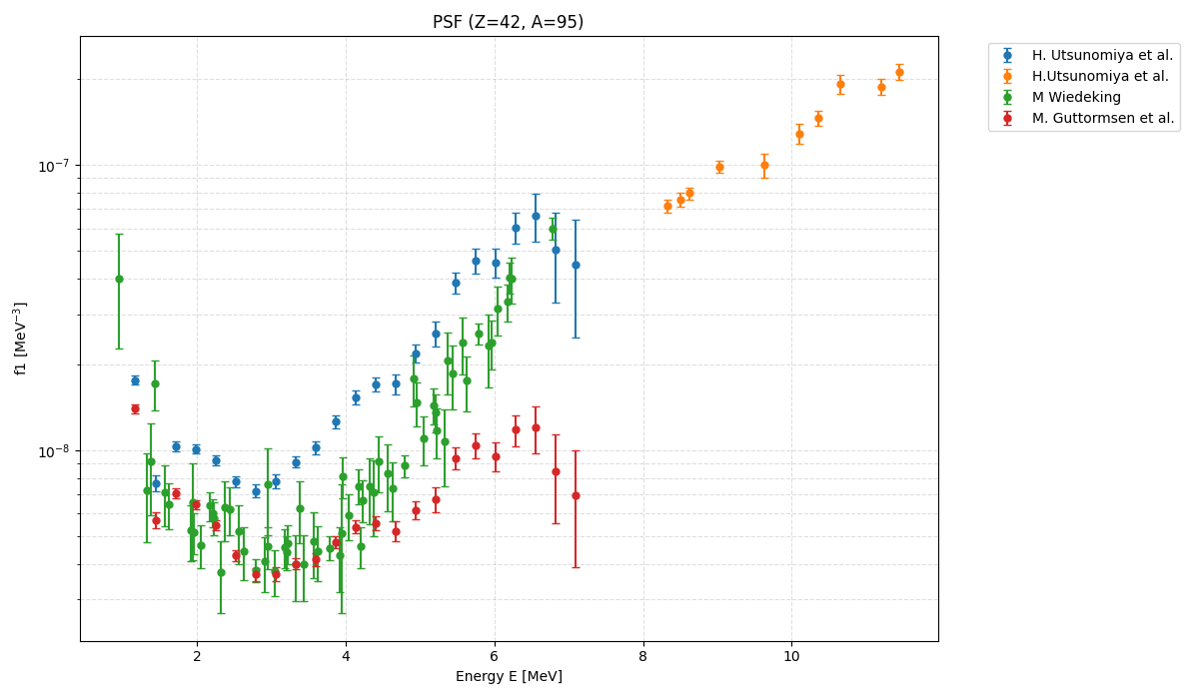
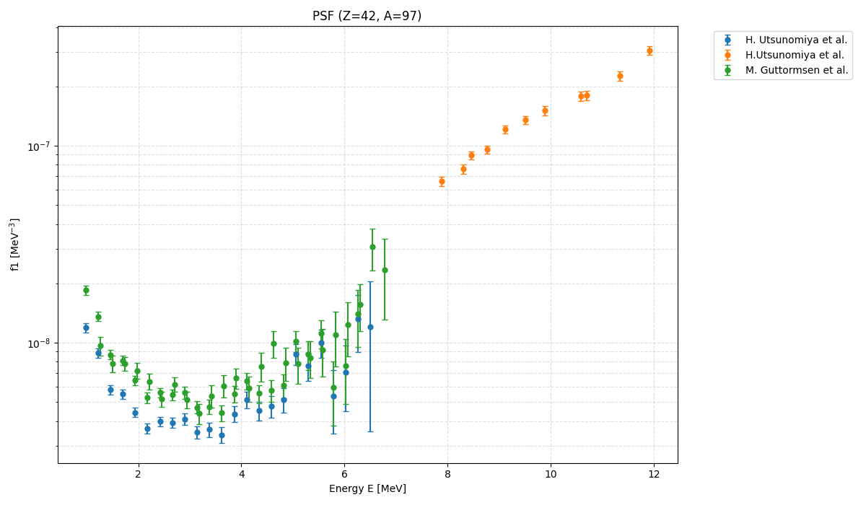
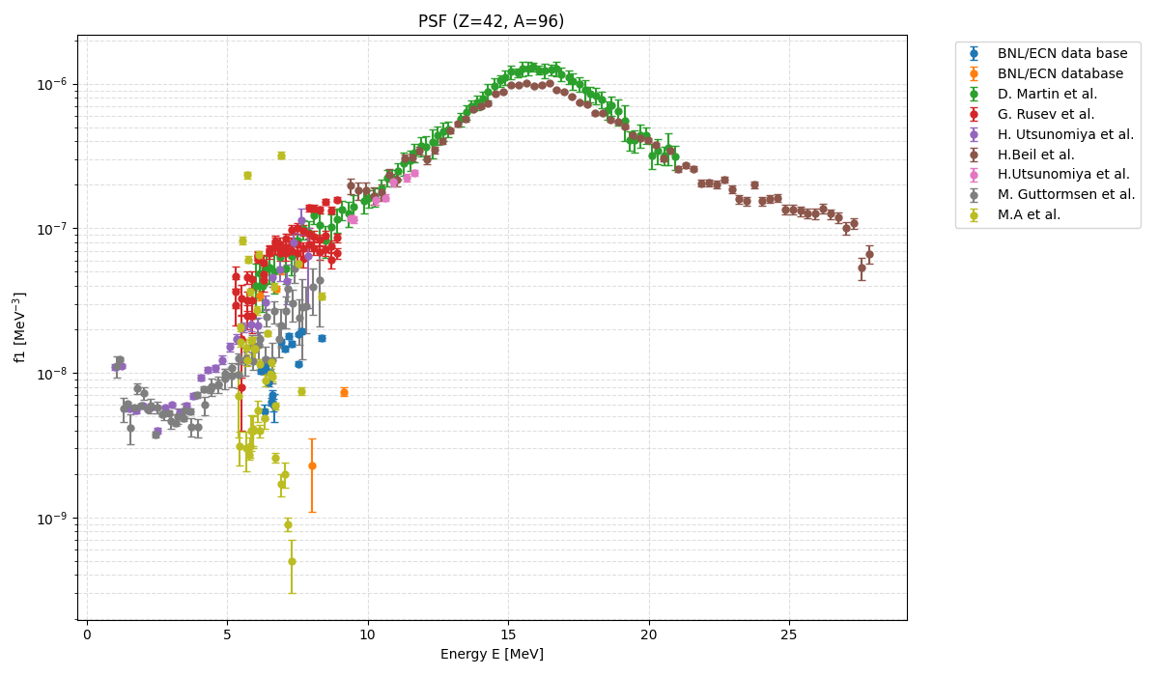
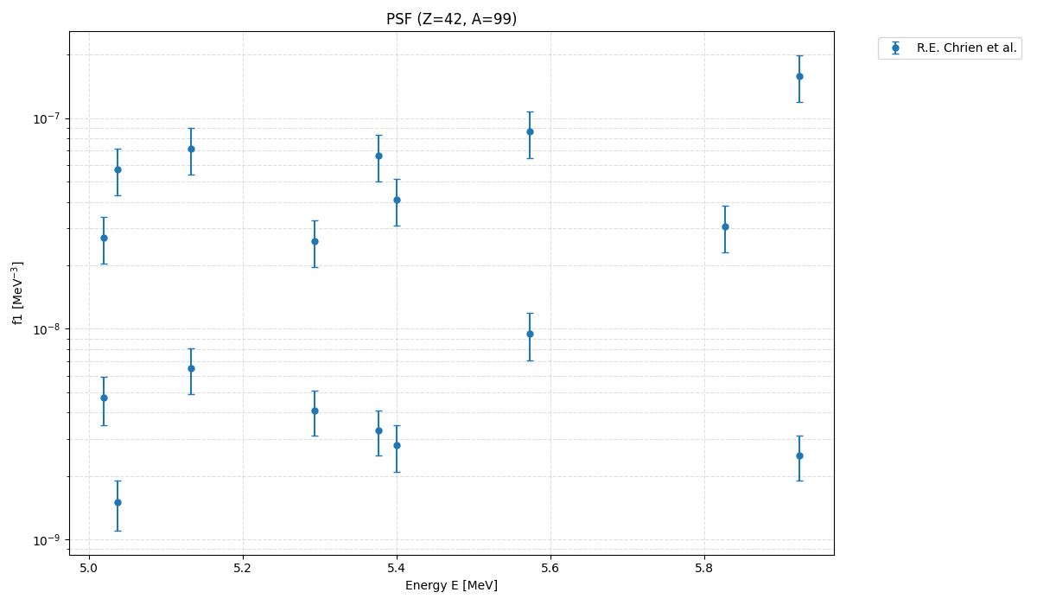
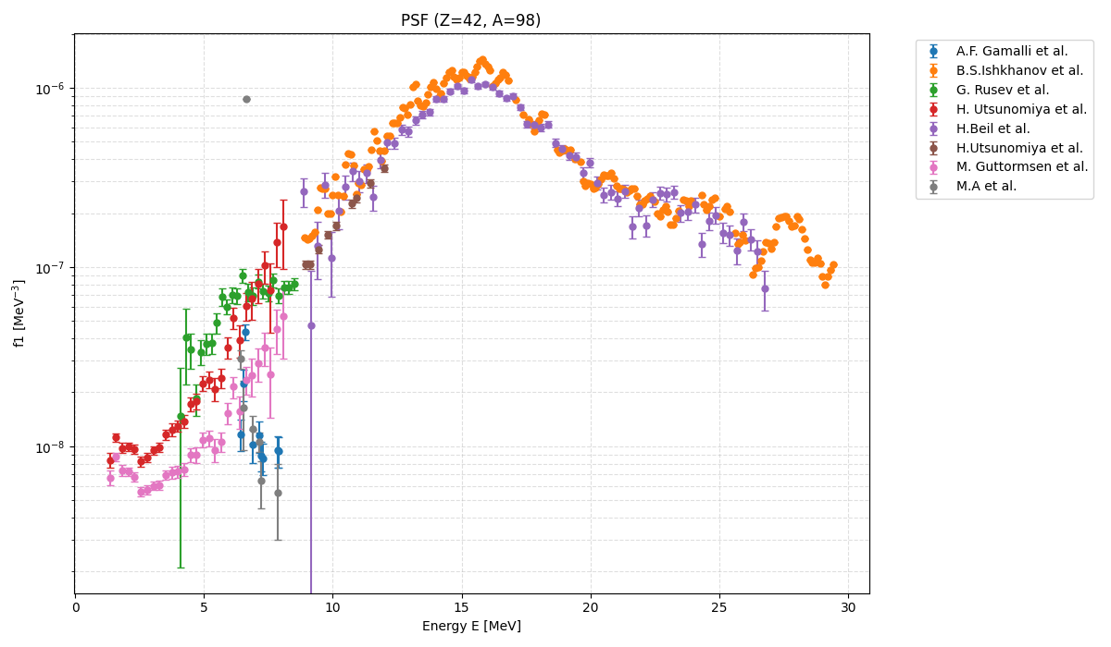
Photon Strength Function Systematic Studies
IAEA PSF Database provides the best starting point for data curation. Even-nuclei have the most

Slide 13
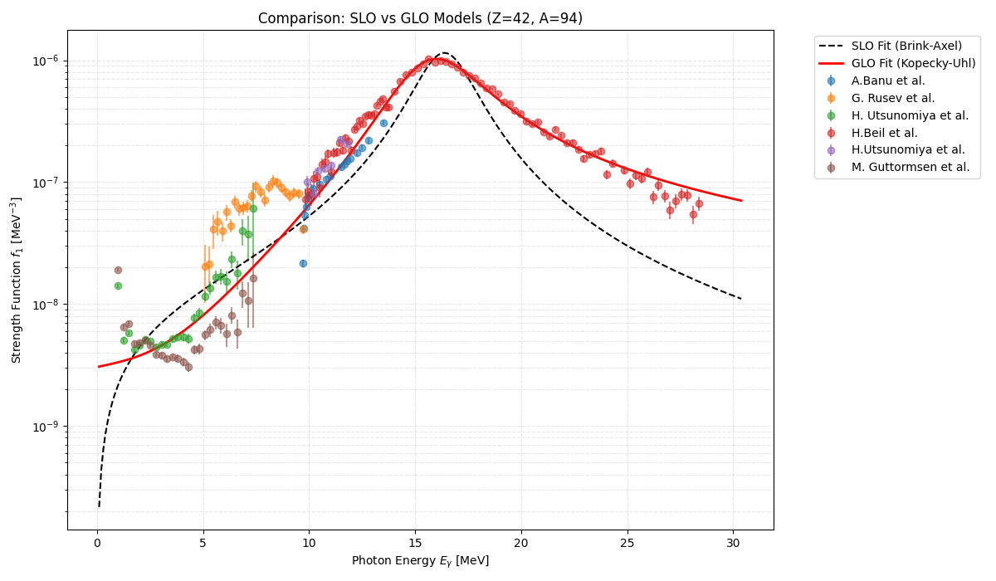
Preliminary Model
Parameterization and Trends
Starting with the basic SLO and GLO and fitting the available data.
Improved data curation required for the odd-A isotopes.
Overall GLO captures the low-energy and GDR data better than the SLO
Next steps are to compare to other formalisms including microscopic model calculations.

Slide 14
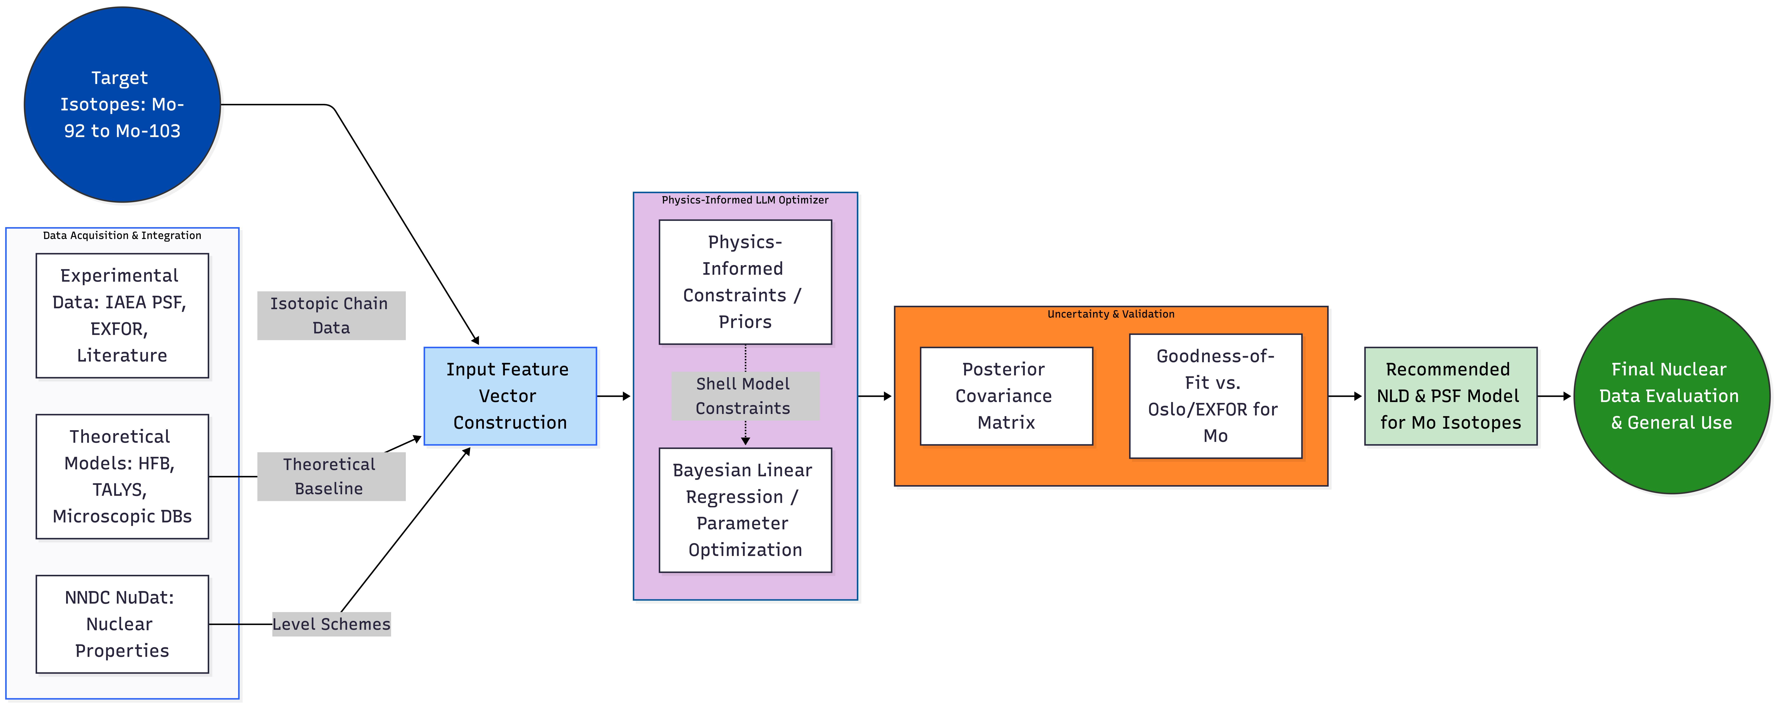
Can we leverage the observed trends to build a physics-informed ML algorithm that can better predict these quantities?
Physics Informed
LLM Optimizer
Uncertainties
& Validation
Goodness of fit between models & nearby data
Diagram generated by Google Gemini and Mermaid Live Editor v11.14.0

Slide 15
Summary & Future Work
OMP
NLD
γSF
Hauser-Feshbach
calculated cross sections
Bayesian analysis of Mo NLDs show odd-even trends that appear to deviate for short-lived nuclei
  Particle evaporation experiments will enable model independent NLD determination to validate current observations
  Accepted Beta-Oslo experimental campaign at ANL for ^{99,101}Mo
  Plans to submit for ^{105,106}Mo to test trends
Preliminary analysis of Mo γSFs show
  NRF studies underway at HIγS to resolve ^{98,100}Mo
  Plans to submit NRF proposal for ^{92,94}Mo
  Plans to submit for ^{105,106}Mo to test trends

Slide 16
Thank you!
This work was supported by the Office of Defense Nuclear Nonproliferation Research and Development within the U.S. Department of Energy’s National Nuclear Security Administration.

Slide 17
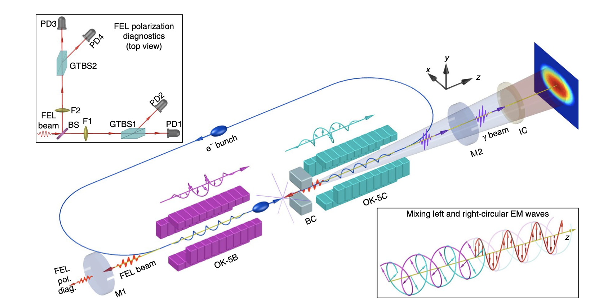
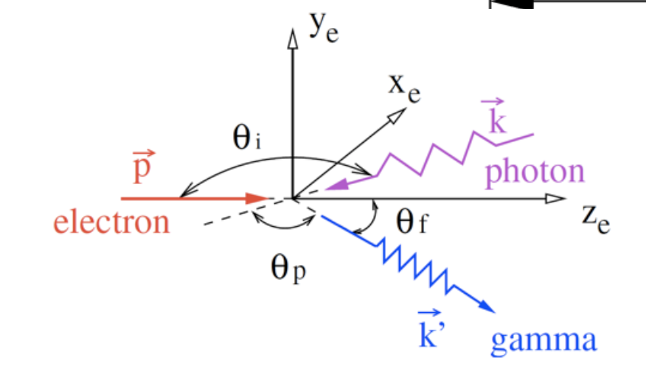
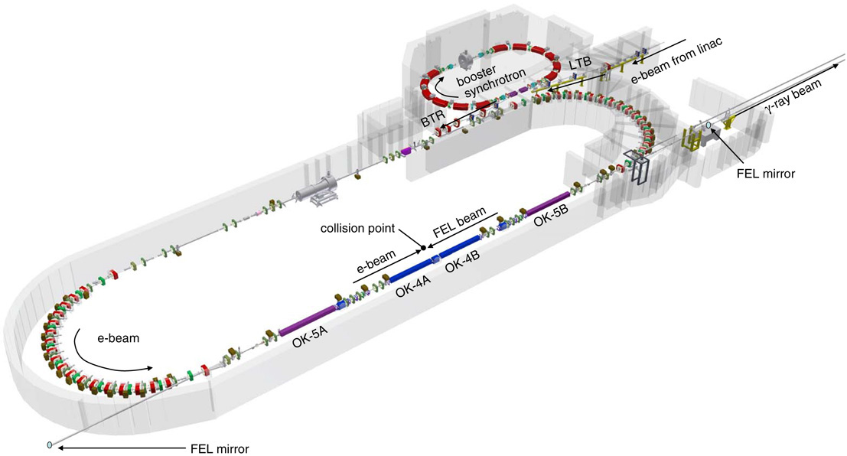
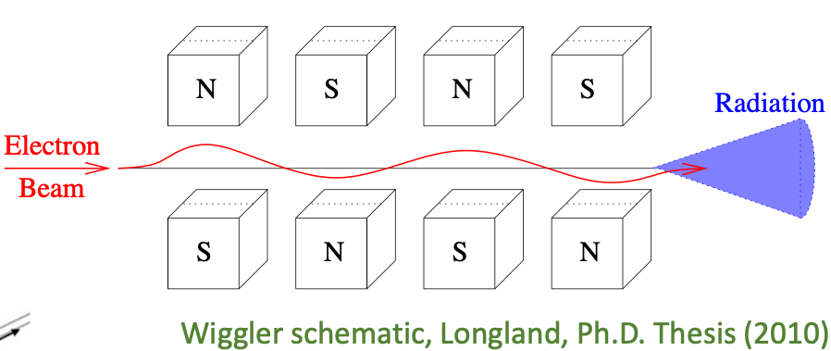
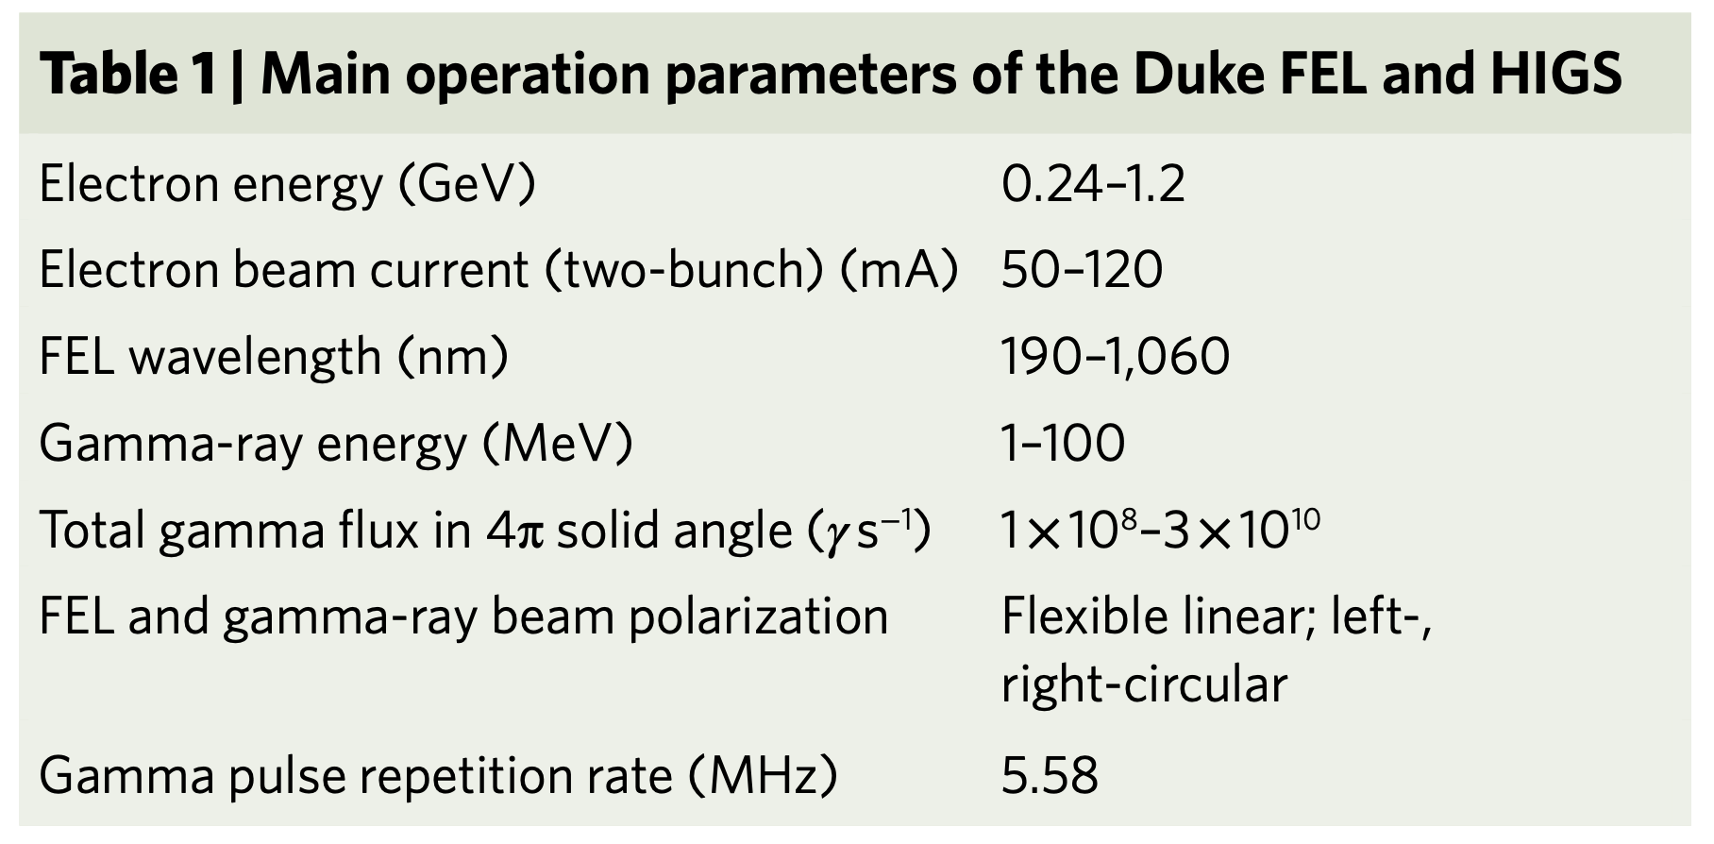
The HIγS Facility
The High Intensity Gamma-ray Source is a Compton-backscattering γ-ray source dedicated for nuclear science research.
J. Yan et al., Nature Photonics 13, 629 (2019)
Linear polarization: ≈ 99 %
Circular polarization: > 93 %
Photon flux: 10⁹ γ s⁻¹
Bandwidth: 2-5 % of beam energy
See poster by L Schaedig

Slide 18
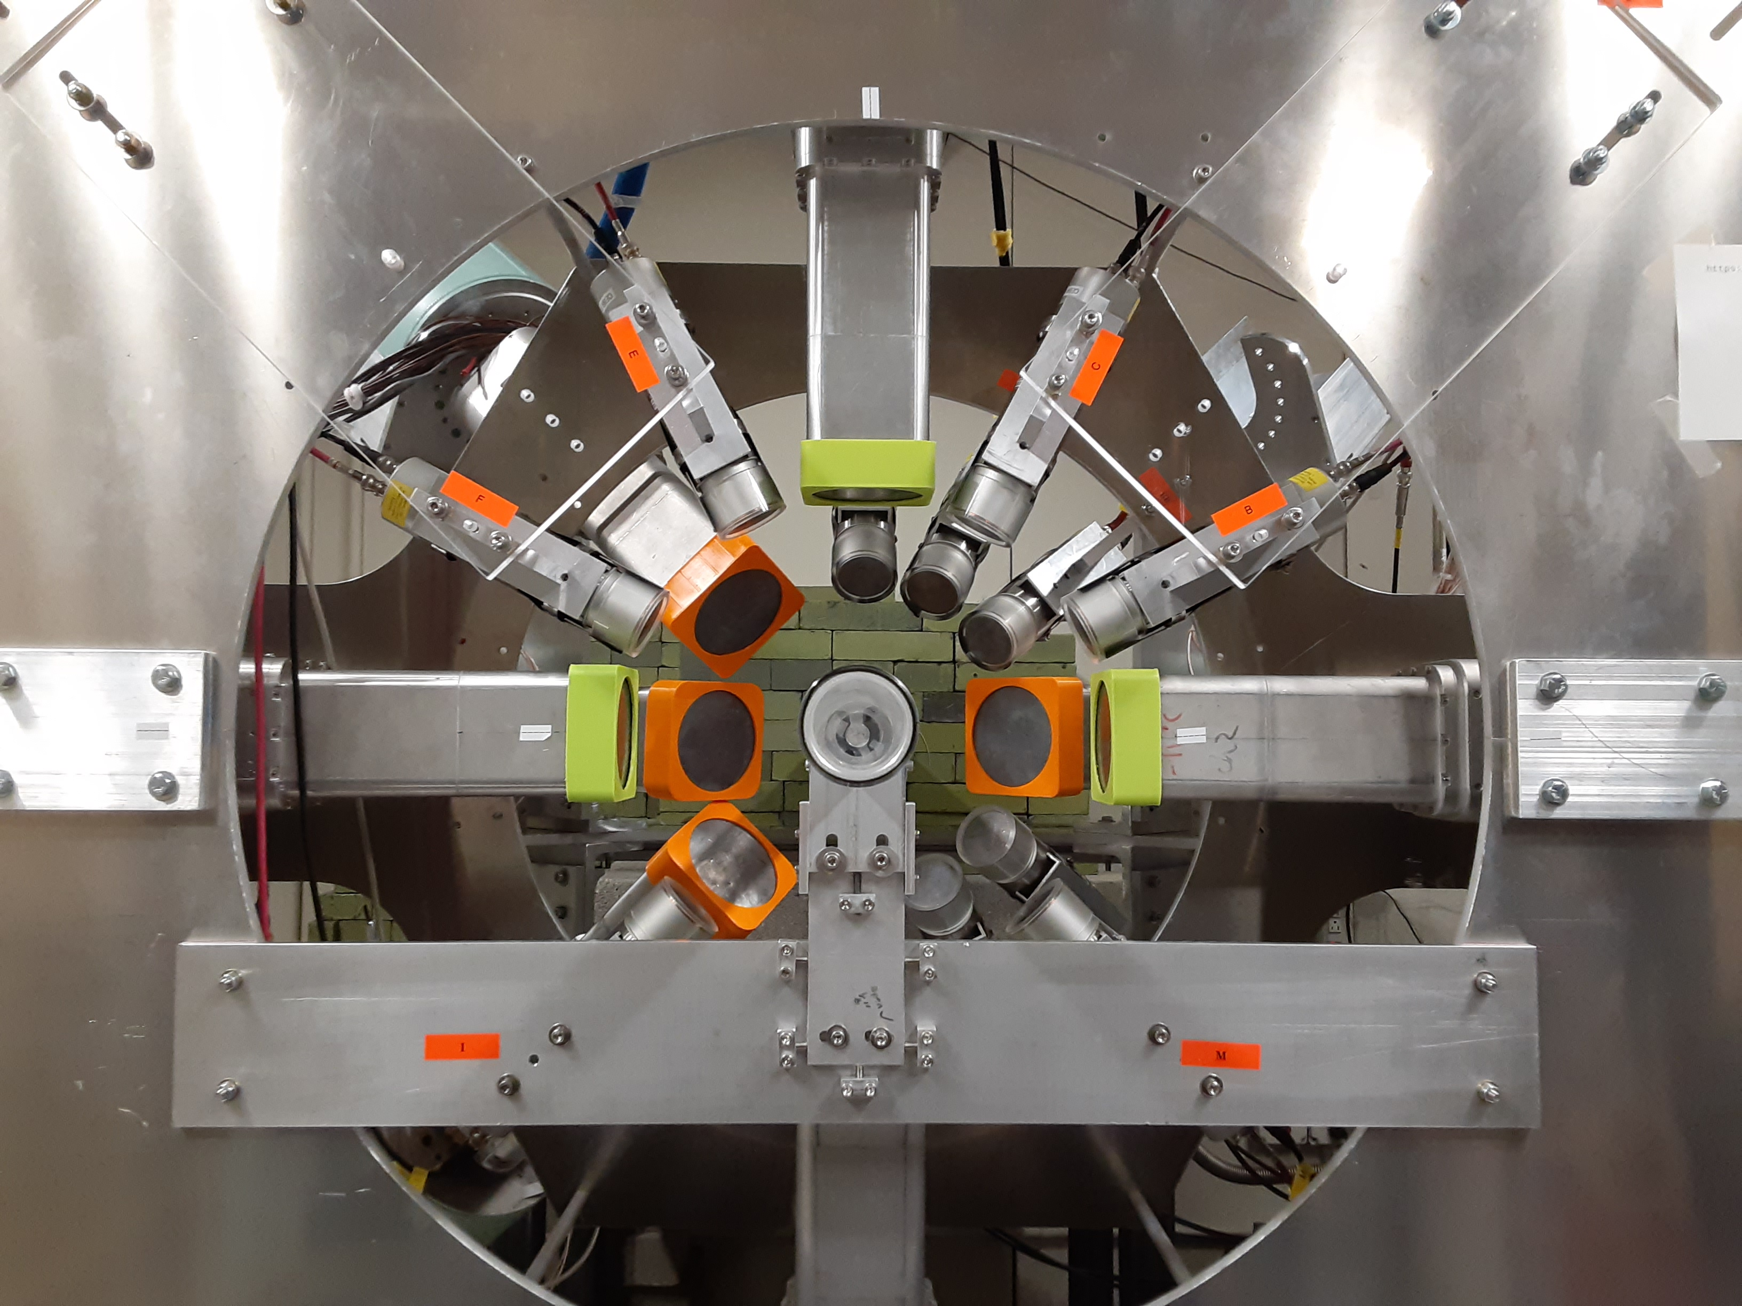
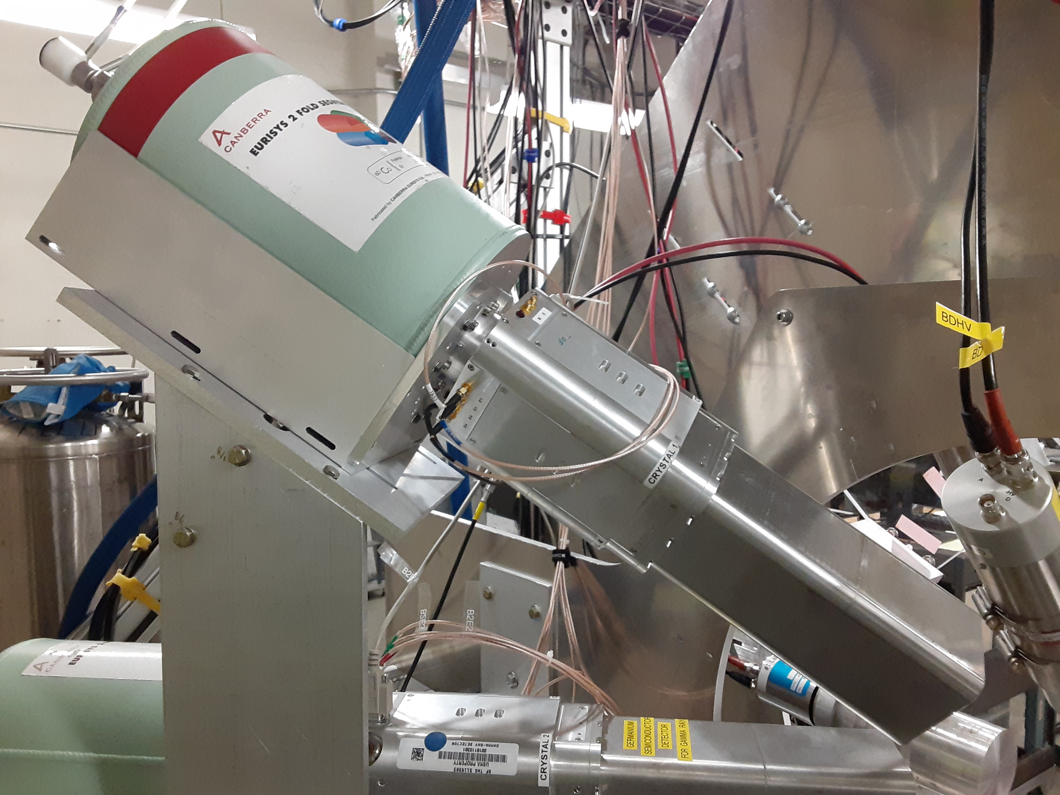
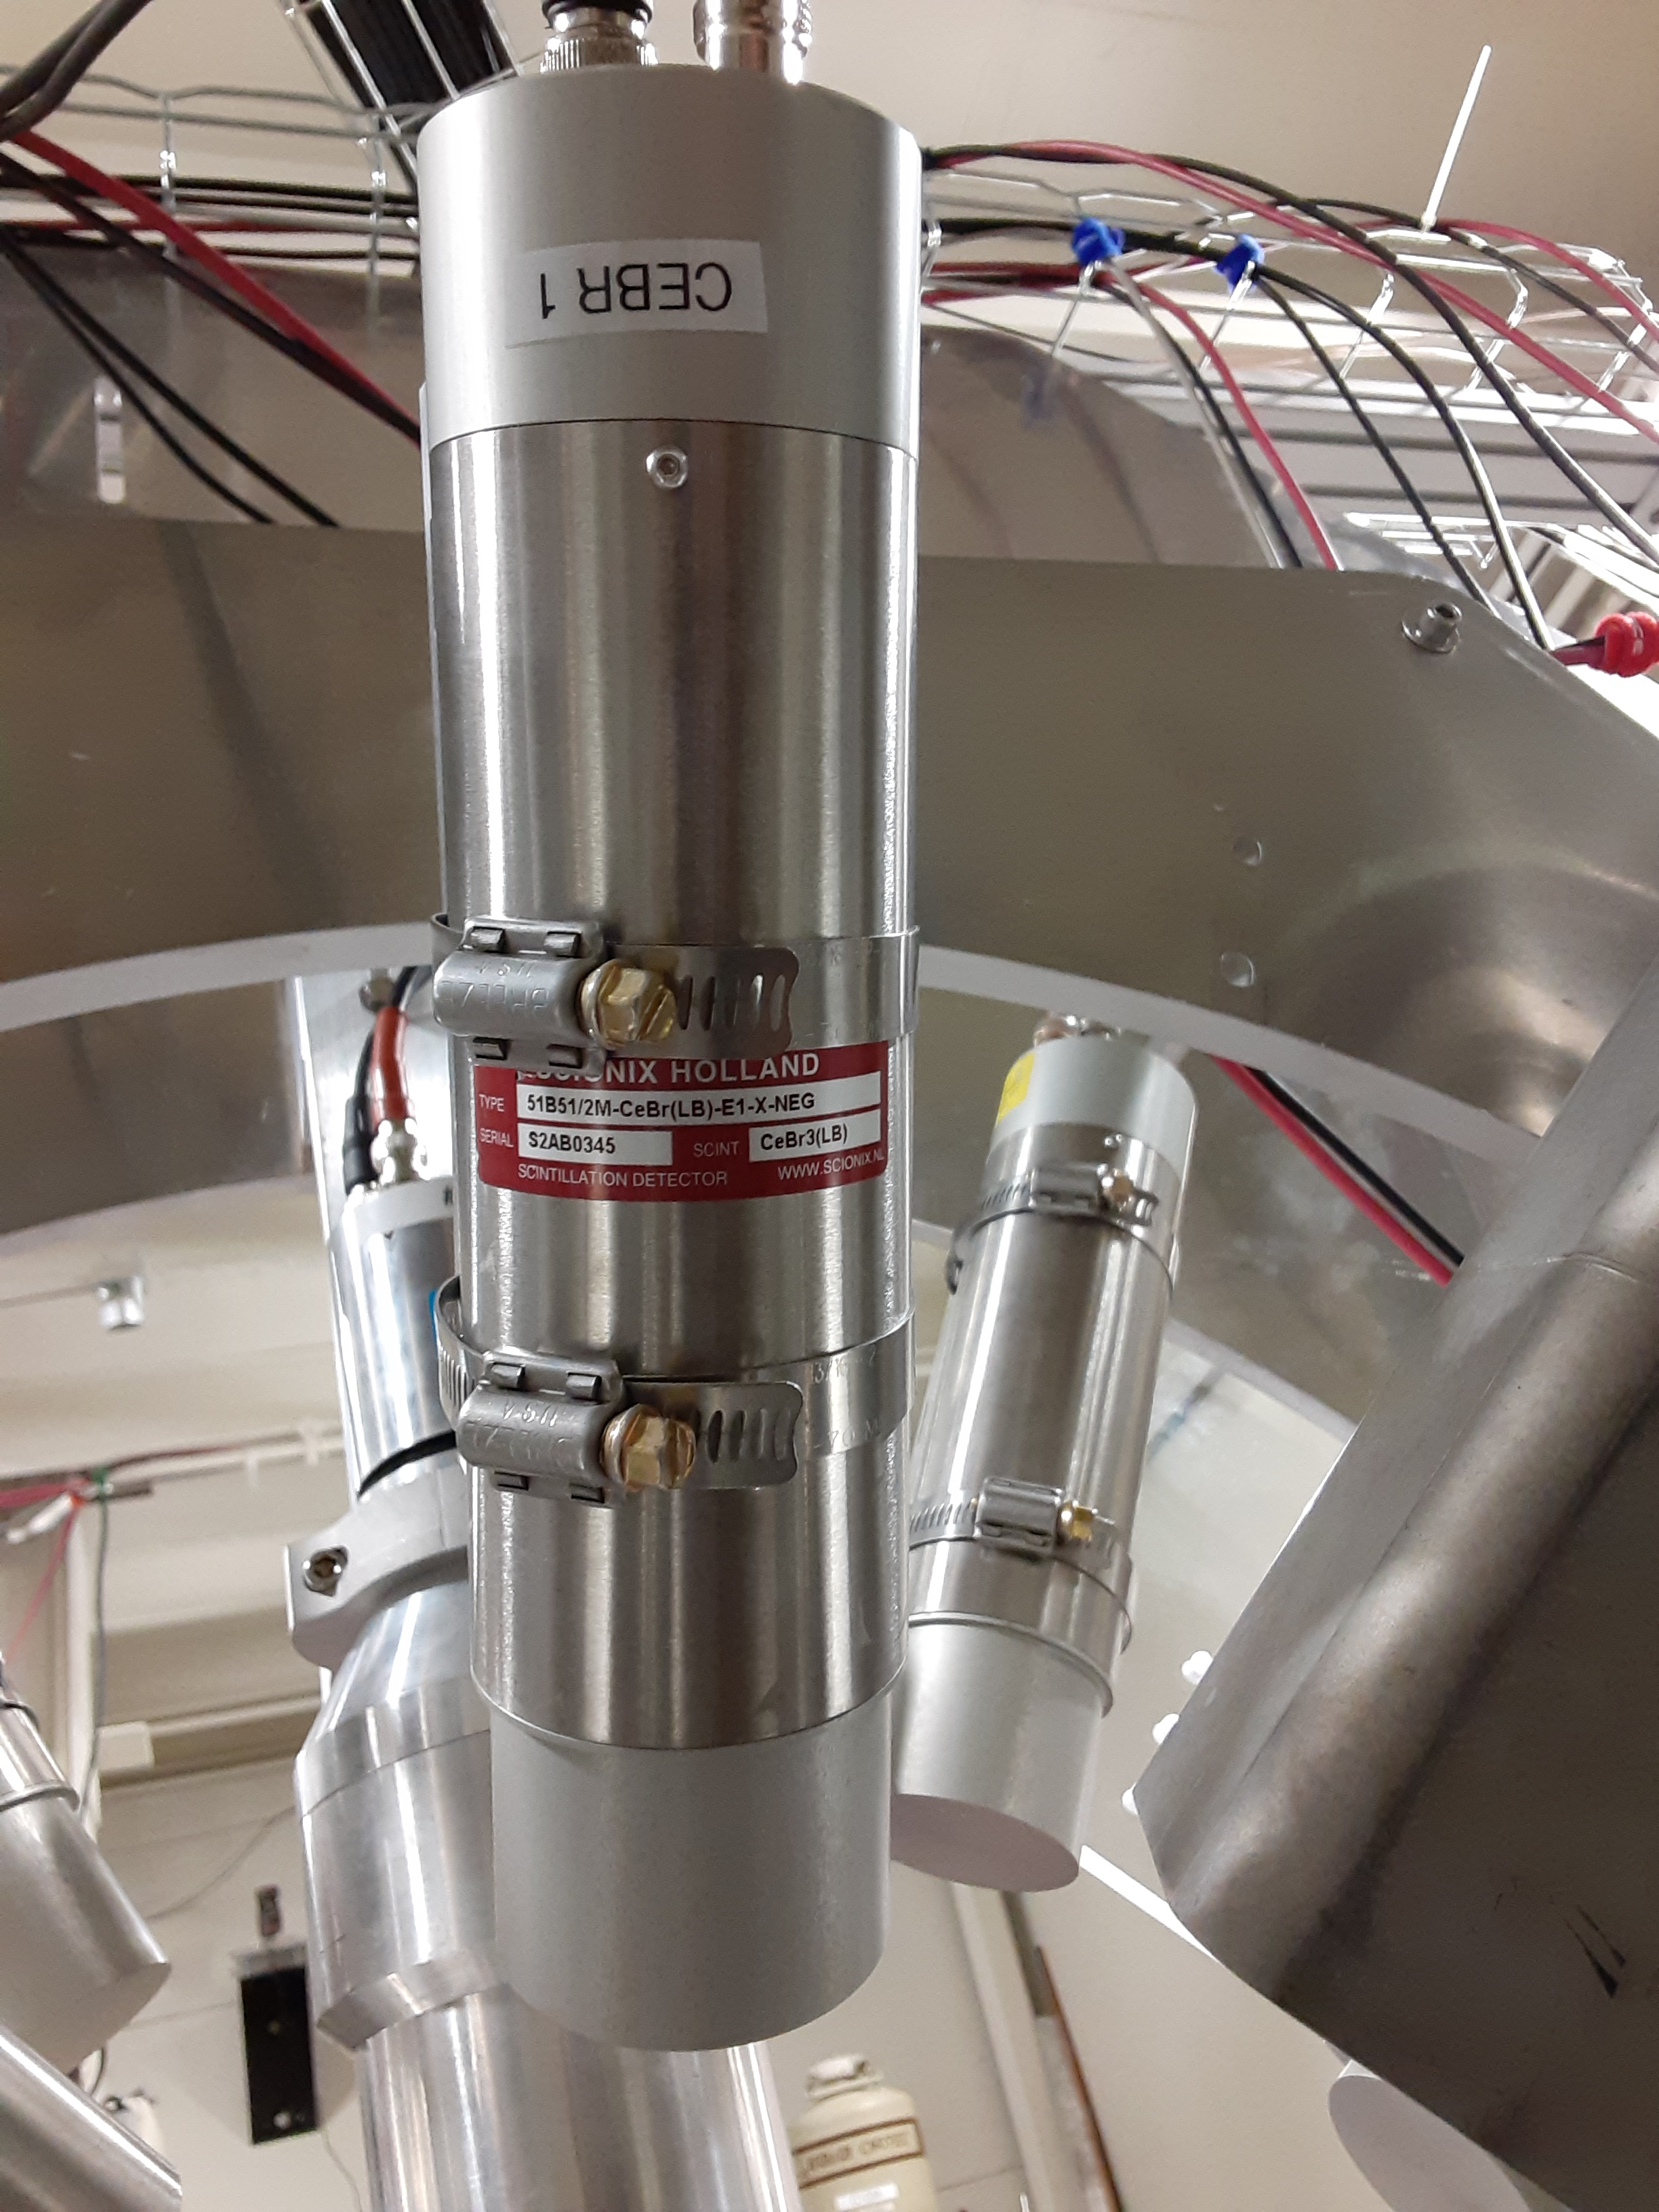
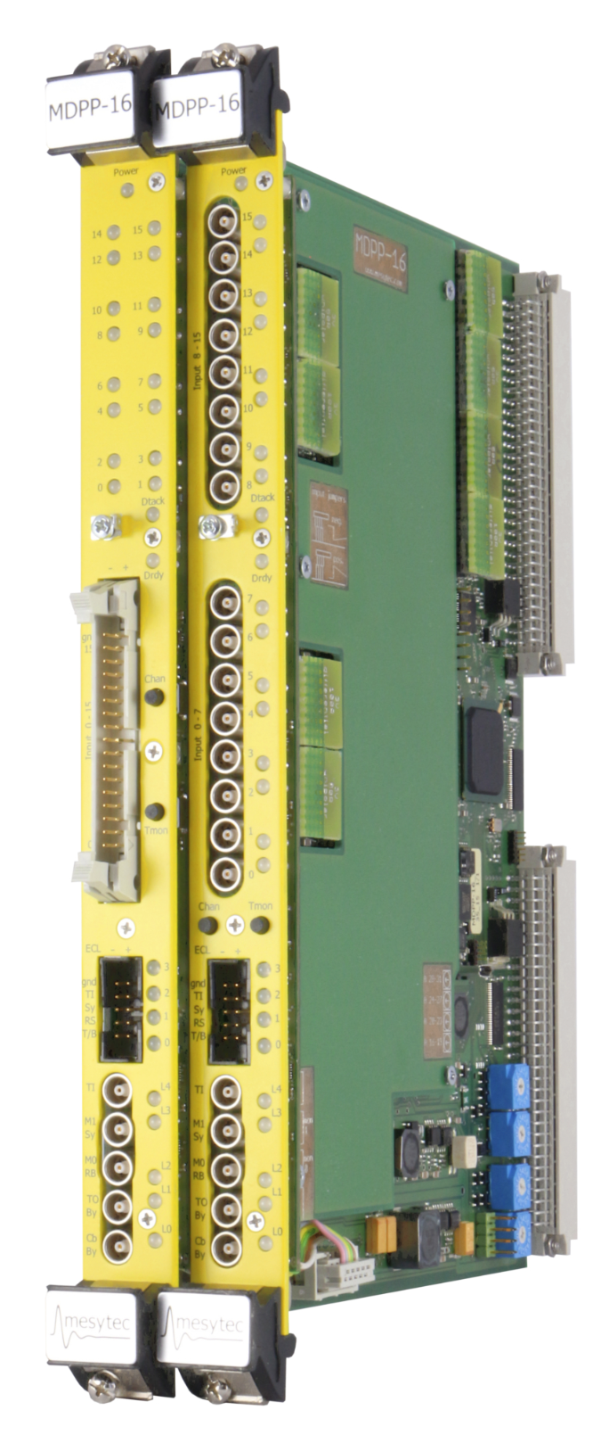
Detection Capabilities at HIγS: The Clover Array
HPGe
CeBr
10 (16) clover-type HPGe** and 12 (2′′ × 2′′) CeBr detectors.
Higher HPGe rates due to segmentation.
Higher granularity.
No intrinsic radioactivity.
Solid angle coverage: 14%
**Provided by the Clovershare Consortium, the
US Naval Academy, the US Army Research Lab,
and TUNL
A. D. Ayangeakaa, U. Friman-Gayer, and R. V. F. Janssens Innovation News Network: https://www.innovationnewsnetwork.com/nuclear-structure/10491/
For certain applications: LaBr₃
Mesytec Hardware
See poster by L Schaedig

Slide 19
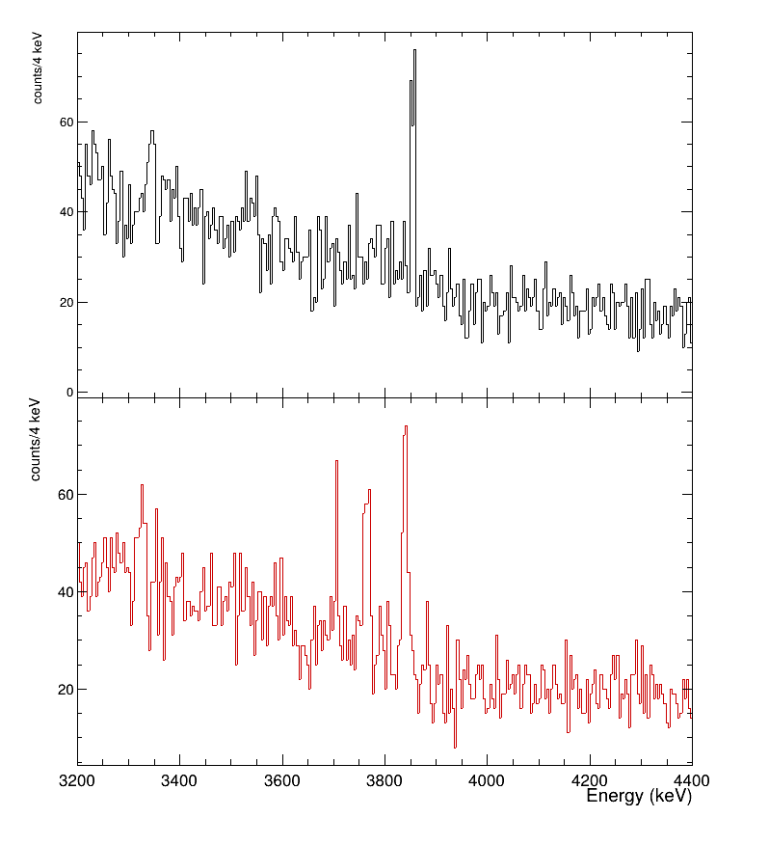
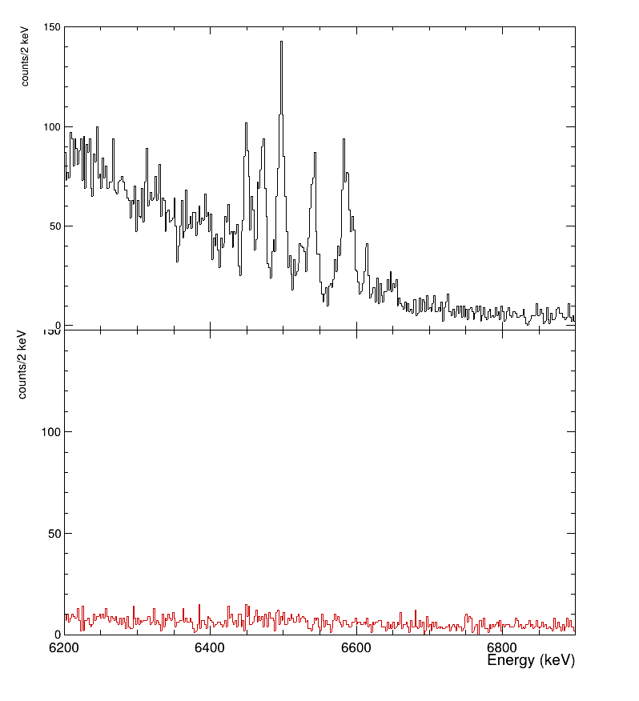

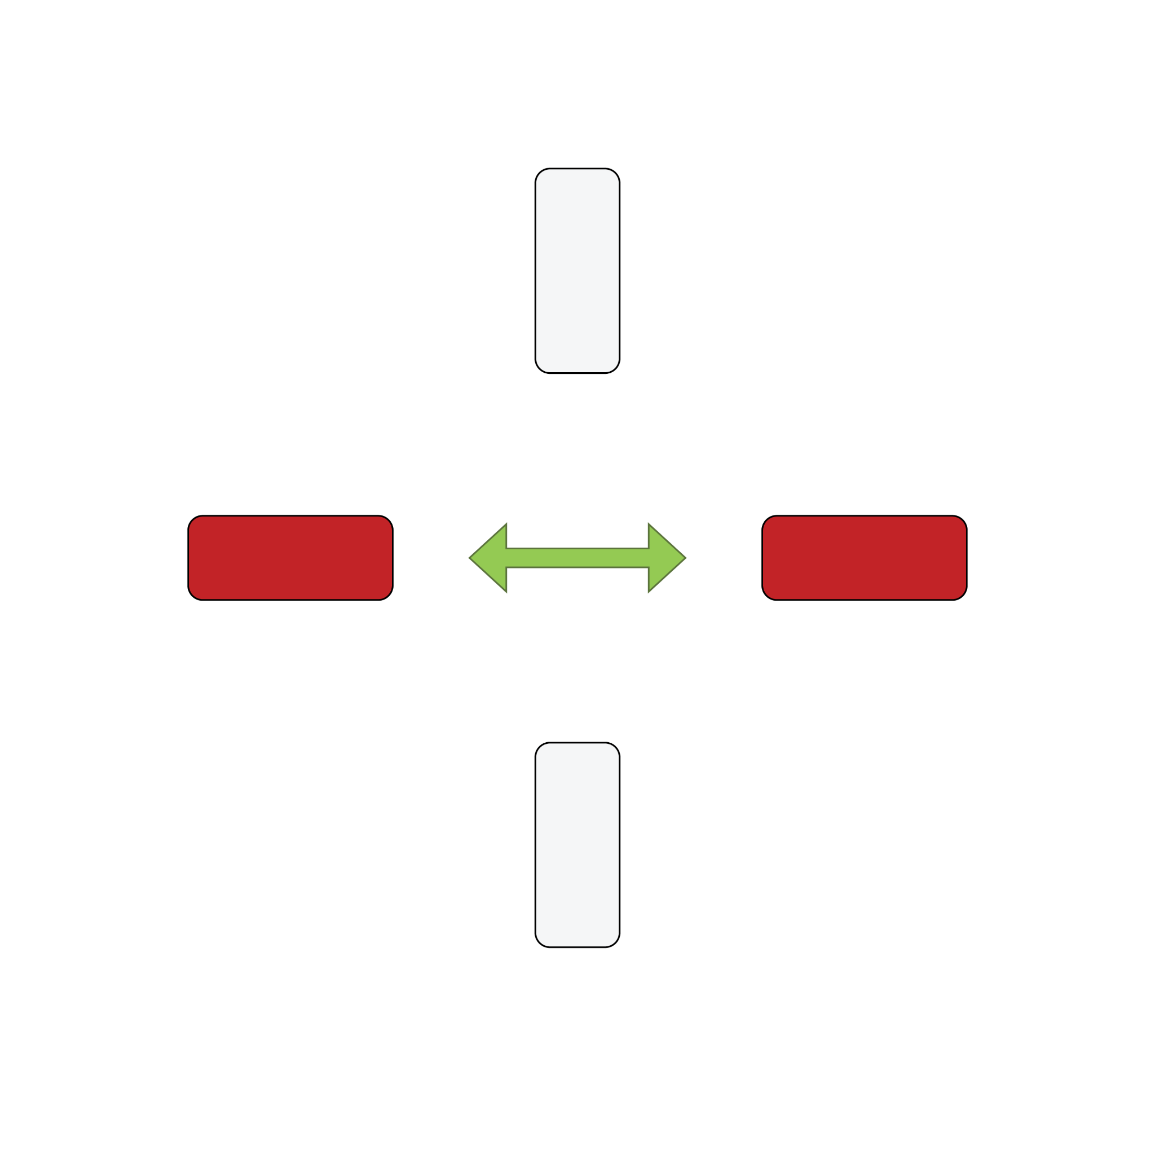
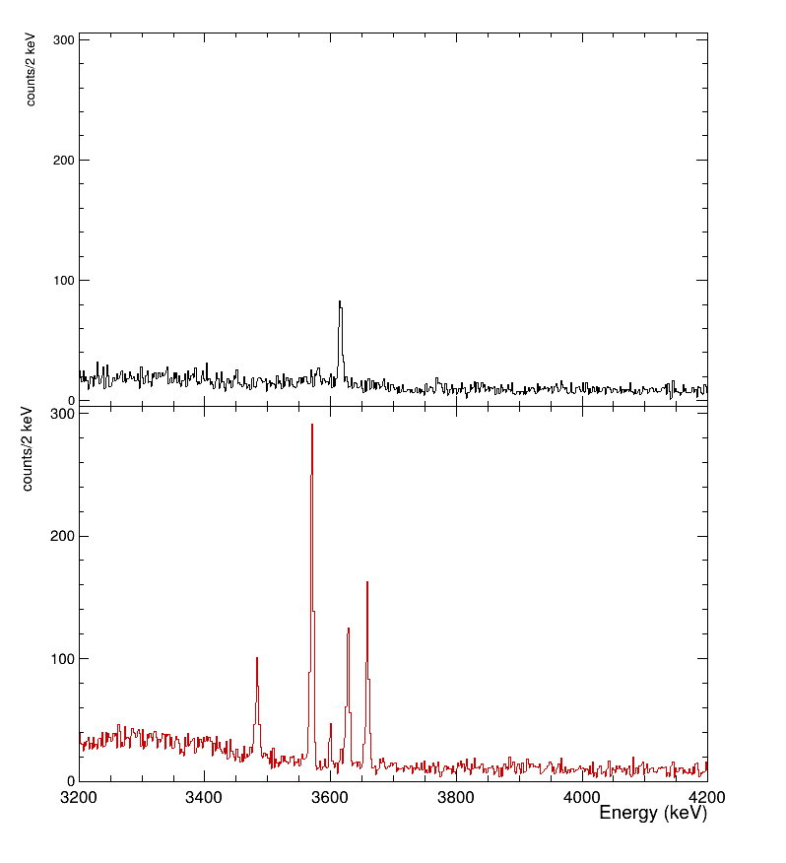
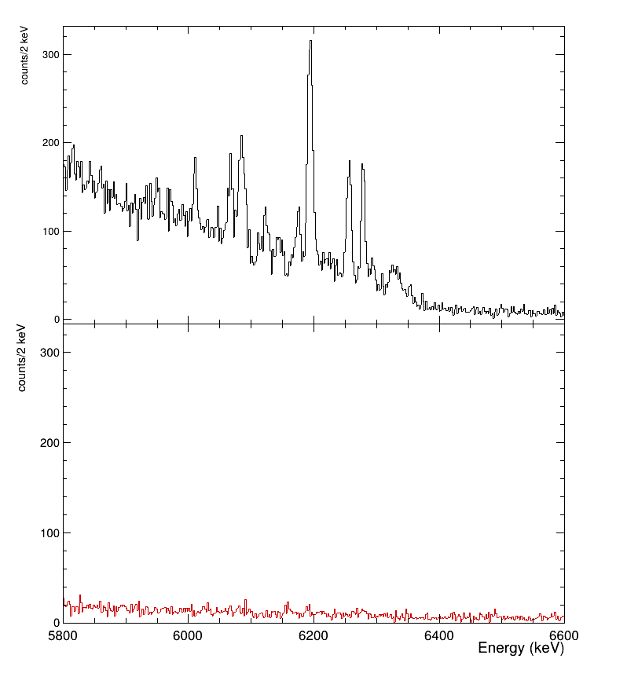
NRF spectra from ⁹⁸Mo(γ,γ’) and ¹⁰⁰Mo(γ,γ’) reactions
Beam energy: 3.77 MeV
Beam energy: 6.50 MeV
Beam energy: 3.60 MeV
Beam energy: 6.21 MeV
⁹⁸Mo
¹⁰⁰Mo
NRF spectra taken at different beam energies show a clear distinction between electric and magnetic dipole transitions with respect to a horizontally linearly polarized photon beam
See poster by L Schaedig

Slide 20
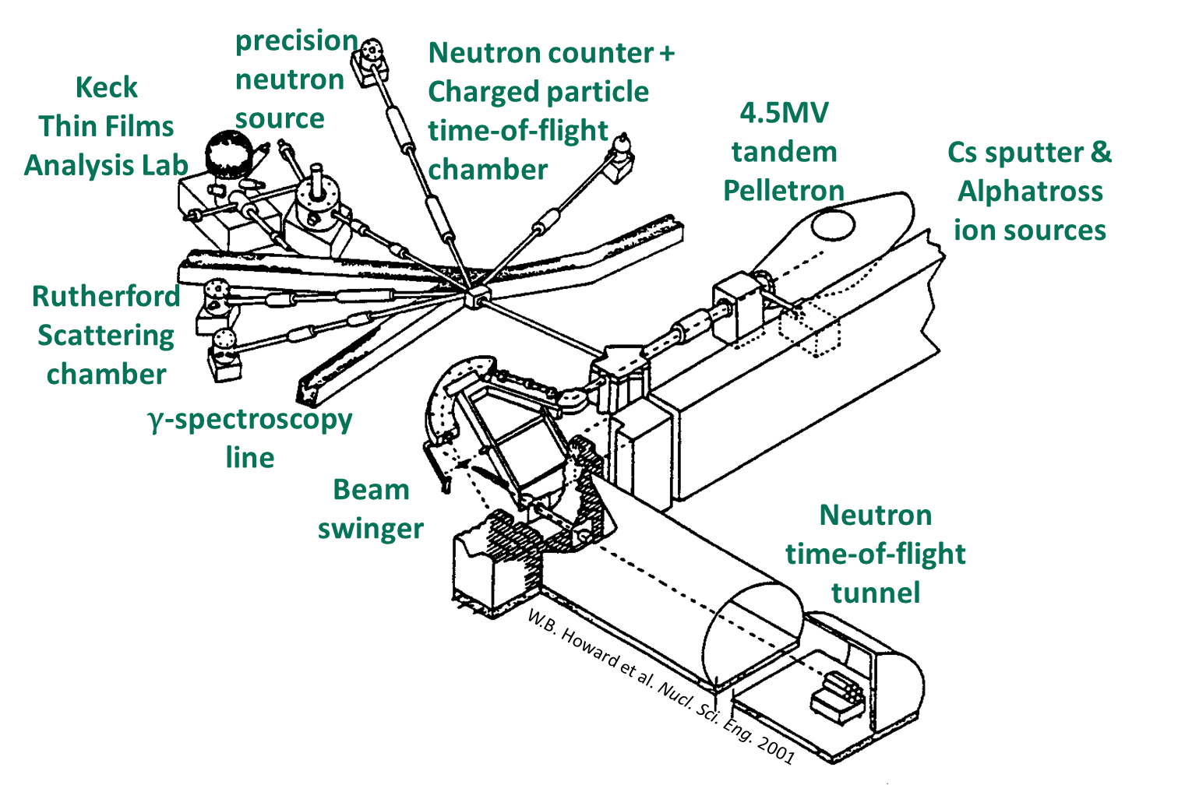
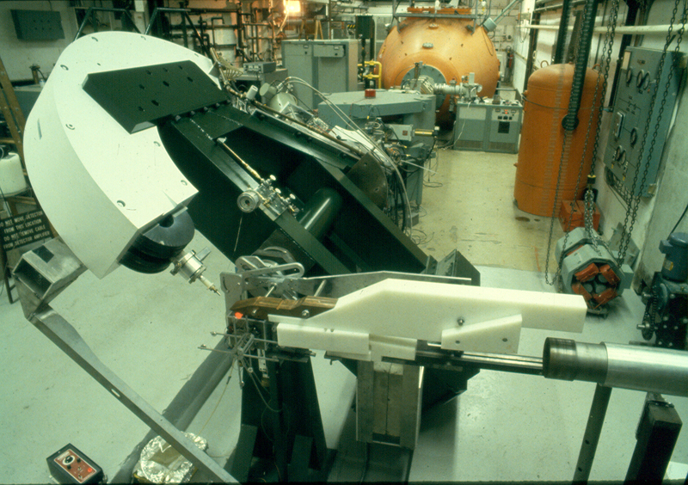


Statistical Nuclear Physics at Ohio University
4.5-MV Tandem Accelerator
Pelletron charging system, upgraded to Alphatross He ion source
Unique beam swinger and 30-m TOF tunnel
Specializations: TOF techniques, neutrons

Slide 21
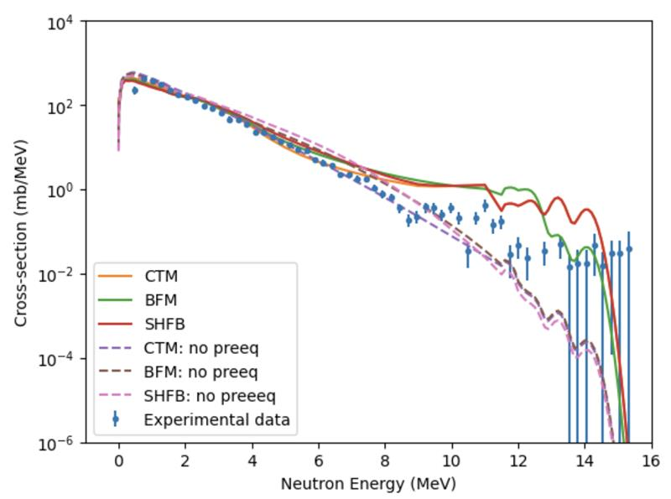

Statistical Nuclear Physics at Ohio University
Measure particle spectra (p, n, …) using TOF
Obtain differential cross sections
Extract NLD from shape of cross section
Input NLD into Hauser Feshbach calculation
⁹²Nb(p,n)⁹³Mo and ⁹²Nb(d,n)⁹⁴Mo experiments performed at the EAL in August 2025
Analysis underway by A. Wijenarayana (OU)
⁹²Nb(d,n)⁹⁴Mo
Preliminary
Follow-up measurements:
(d,p), (p,p’), (n,n’) reaction mechanisms being explored
See poster by A. Wijenarayana

