Slide 1


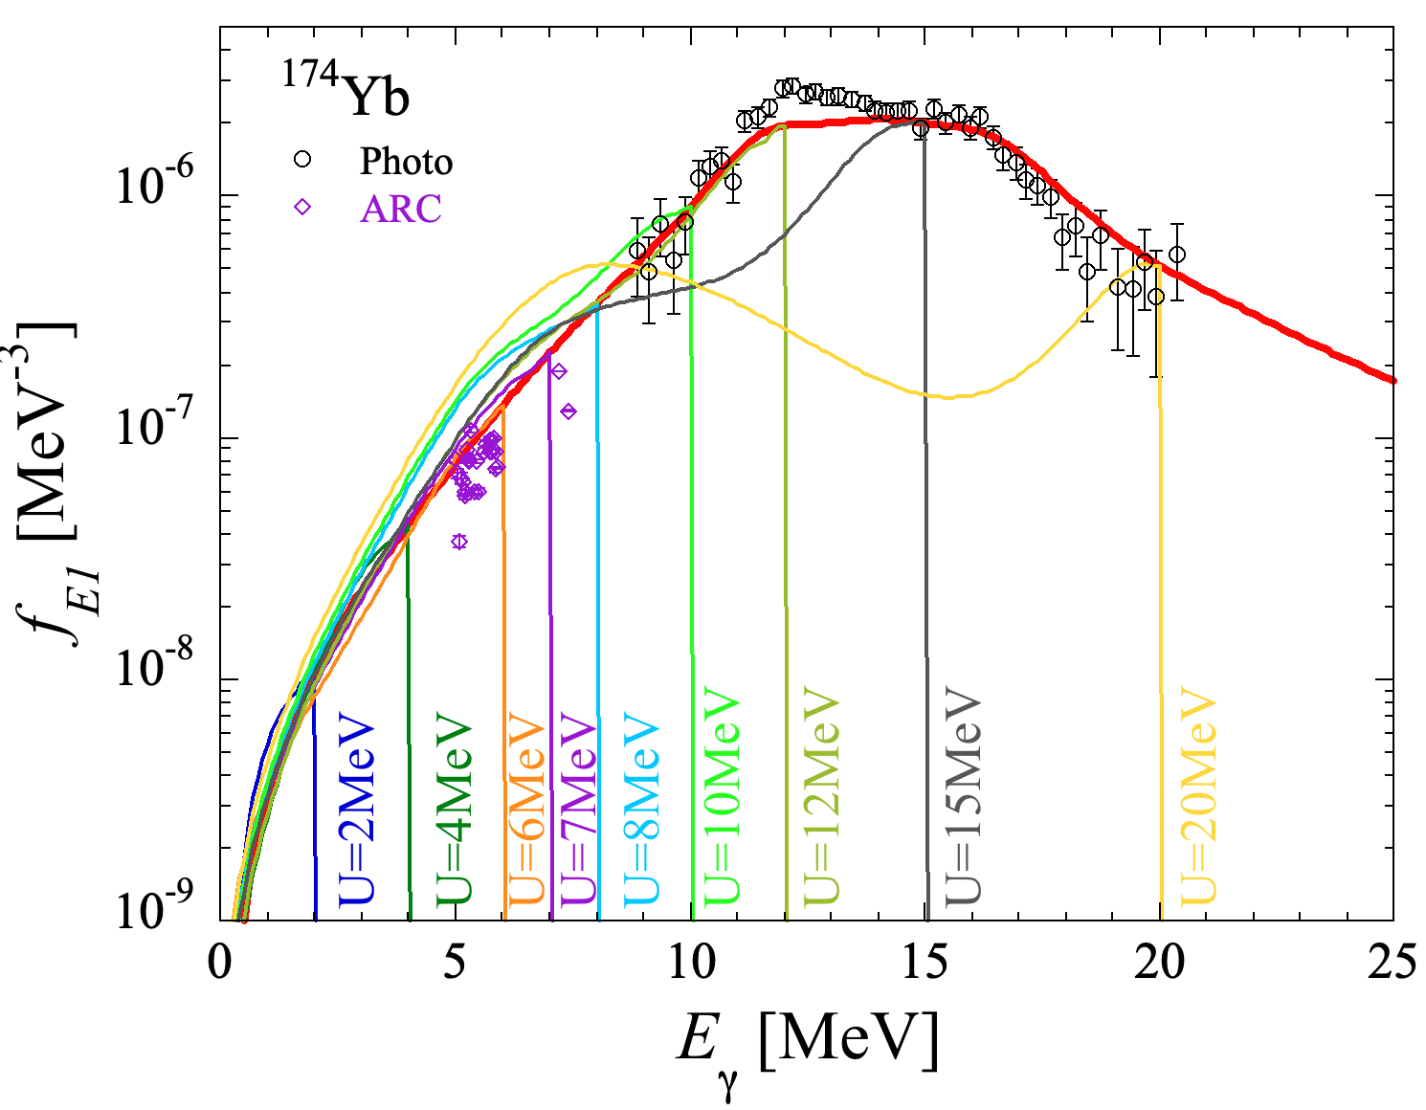
Some aspects and applications of Photon Strength Functions
S. Goriely (IAA-ULB)
In collaboration with
S. Hilaire, S. Péru, A Koning, W. Ryssens, S. Martinet, A. Choplin

Slide 2
CONTENT
Spin- and Parity-dependent QRPA PSF
De-excitation E1 & M1 QRPA PSF
Spin- and Parity-dependent PSF
Impact on the radiative n-capture cross section
Impact of the NLD and PSF uncertainties on the p-process in SN explosions
Parameter vs Model uncertainties
Some comments on the Oslo method and its application to radiative n-capture
On the importance of the resonance parameters

Slide 3
From the photoabsorption PSF to the de-excitation PSF
(U_{i})
D1M+QRPA
(E₀,J₀,π₀)
with

Slide 4
Smooth de-excitation PSF at an initial energy U_{i}
f_{E1} de-excitation PSF
f_{M1} de-excitation PSF
Negligible low-energy E1 enhancement
Significant low-energy M1 enhancement

Slide 5
What about the Spin- and Parity-dependent
de-excitation strength function ?
(U_{i},J_{i},π_{i})
(E₀,J₀,π₀)
For deformed even-even nuclei, the (J,π)-dependent PSF reads
The mean (J,π)-independent PSF:
The reciprocity theorem implies:
Note: (J,π)-dependent PSF can be of particular relevance in the analysis of experiments with limited numbers of initially populated spin and parities (e.g the β-Oslo)

Slide 6
Smooth (J,π)-dependent de-excitation PSF at an initial energy U_{i}
E1 de-excitation PSF
J=1–
J=7–
J=0⁺
J=2⁺
(U_{i} =7MeV,J_{i},π_{i})
E1

Slide 7
π-dependent de-excitation PSF at an initial energy U_{i}
E1 de-excitation PSF
(U_{i} =7MeV,π_{i})
E1

Slide 8
Smooth (J,π)-dependent de-excitation PSF at an initial energy U_{i}
M1 de-excitation PSF
J=1⁺
J=8⁺
J=6⁺
J=2⁺
J=1–
(U_{i} =7MeV,J_{i},π_{i})
M1

Slide 9
π-dependent de-excitation PSF at an initial energy U_{i}
M1 de-excitation PSF
(U_{i} =7MeV,π_{i})
E1

Slide 10
Application to radiative neutron captures
Introduction in TALYS (v.2.22) of a (J,π)-dependent PSF !
Photoabsorption PSF
U-dependent de-excitation PSF
(U,J,π)-dependent de-exc PSF

Slide 11
Application to radiative neutron captures
Introduction in TALYS (v.2.22) of a (J,π)-dependent PSF !

Slide 12
Application to radiative neutron captures
Introduction in TALYS (v.2.22) of a (J,π)-dependent PSF !
Notes:
Sn(74Ge)=10.195MeV

Slide 13
... To be followed ...
multi-phonon excitations ?
(similar issue with spherical nuclei)
J=1⁺
J=1–
J=1–
J=3–
Notes:
Sn(74Ge)=10.195MeV

Slide 14
CONTENT
Spin- and Parity-dependent QRPA PSF
De-excitation E1 & M1 QRPA PSF
Spin- and Parity-dependent PSF
Impact on the radiative n-capture cross section
Impact of the NLD and PSF uncertainties on the p-process in SN explosions
Parameter vs Model uncertainties
Some comments on the Oslo method and its application to radiative n-capture
On the importance of the resonance parameters

Slide 15
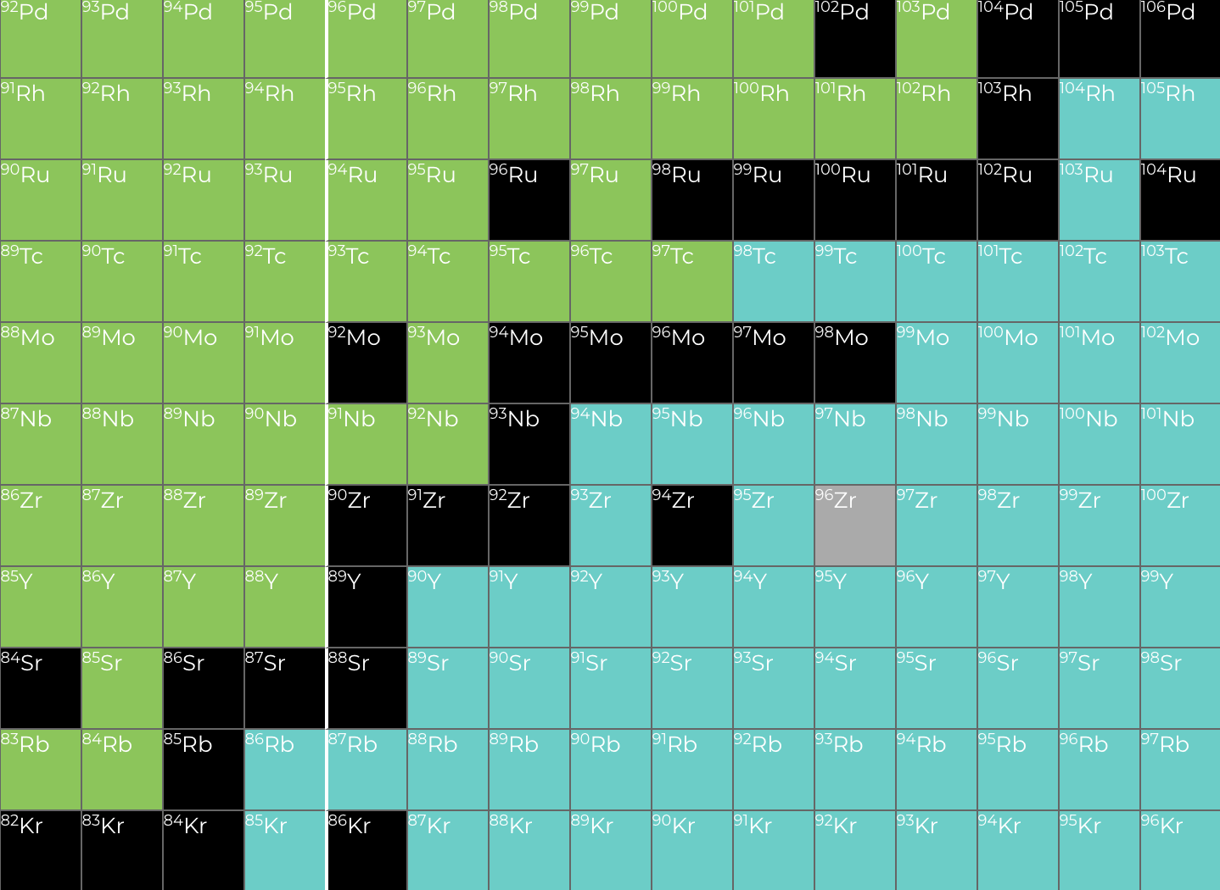
The p-process nucleosynthesis
P-process responsible for 35 stable n-deficient nuclei: the p-nuclei (no p-element)
Neutron capture s-, i- and r-processes cannot synthesize neutron-deficient isotopes
Proton drip
Neutron drip
The p-process nucleosynthesis
SNII & SNIa
τ ~ 1s & T ~ 2-3 10⁹ K
Photodisintegrations (γ,n), (γ,p), (γ,α) for ~2000 nuclei
Many nuclear masses and β⁺-decay rates known experimentally
Almost no n-, p- and α-capture photorates and reverse rates known experimentally

Slide 16
Quantification of nuclear uncertainties
Two types of uncertainties affecting theoretical inputs, e.g (n,γ) rates
Parameter
(Statistical)
Model
(Systematic)
Parameter or Model variations must be constrained by experimental data
e.g
Only NLD/PSF parameters s.t. (n,γ) with f_{rms}≤ 2
Only NLD/PSF models s.t. (n,γ) with f_{rms}≤ 2
Uncorrelated parameter variations
Rates correlated by the model
1. Quantification of uncertainties affecting experimentally unkown rates
(Backward-Forward Monte Carlo)
2. Propagation of uncertainties to astrophysical simulations taking correlations into account

Slide 17
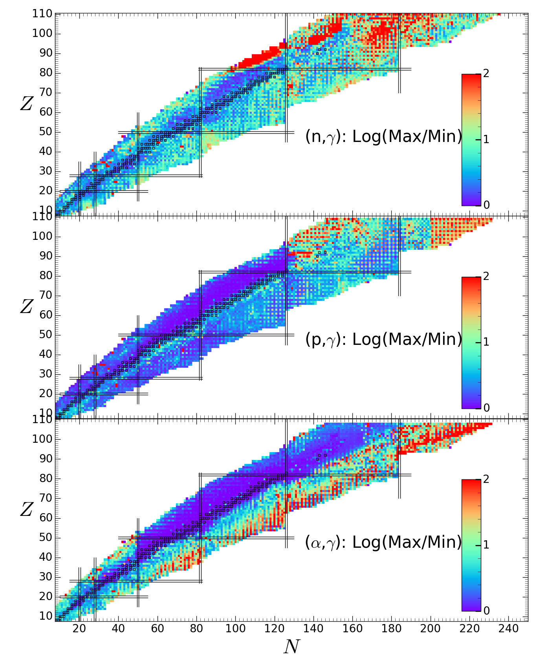
Impact of NLD/PSF uncertainties on the (n,γ), (p,γ), (α,γ) rates
“Uncorrelated” parameter uncertainties
Correlated model uncertainties
[... though (n,γ), (p,γ), (α,γ) are correlated ...]

Slide 18
Impact of NLD/PSF uncertainties on the p-process nucleosynthesis
Overproduction of p-nuclei in the core of an exploding 25M_{o} Z=0.001 v/v_{c}=0.4 star
(Choplin et al. 2022)
Uncorrelated parameter uncertainties
Correlated model uncertainties
Highly dominated by (γ,n) parameter uncertainties
Reduction of the model & parameter uncertainties through
More experimental constraints
Improved nuclear models
Their reliability, i.e. their physical robustness
Their accuracy, i.e. their capacity to reproduce experimental data

Slide 19
Impact of NLD/PSF uncertainties on the p-process nucleosynthesis
Similar parameter uncertainties for three different SN models

Slide 20
Main (γ,n) uncertainty drivers for p-process
Main drivers:
Stable or close-to-stable targets
Photodisintegration of p-nuclei
Martinet et al., A&A submitted (2026)
Notes:
Distribution of the core drivers in the $(N,Z)$ plane for the three astrophysical sites considered in this work (''averaged-layer'' method): the W7 SNIa model, the $25\,M_\odot$ model at solar metallicity (M25z14), and the rotating $25\,M_\odot$ model at low metallicity (M25z01S4). Each p-nuclide is shown as a colored square. The driver reactions are shown as circles connected to the corresponding p-nucleus, with the sign along the connecting line indicating whether the reaction is correlated or anti-correlated with the final abundance. The colored outer ring around each driver indicates in which astrophysical site(s) the reaction is identified as a core driver. Grey circles and grey connecting lines indicate the branching regions for temperatures between $T=1.5$ and $3.4~10^9$~K derived independently from the photodisintegration-rate analysis

Slide 21
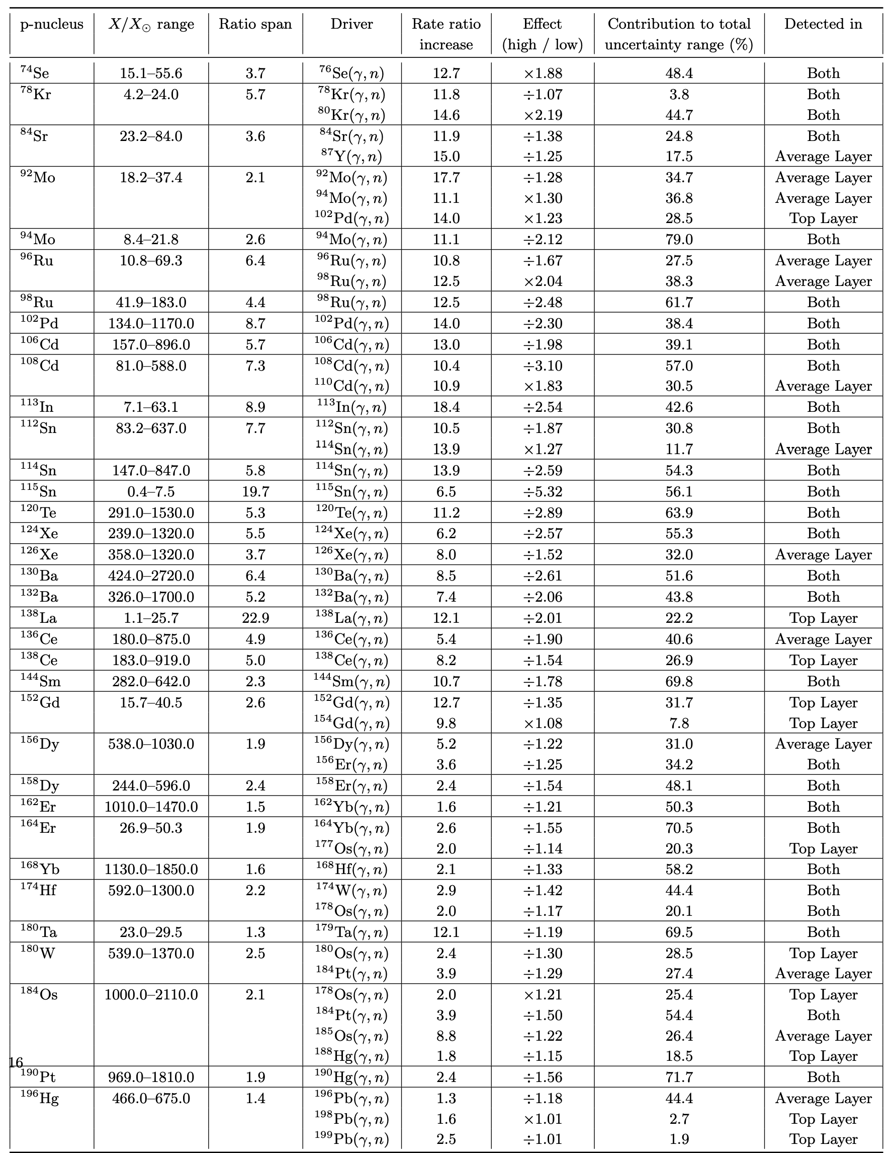
List of main (γ,n) uncertainty drivers for p-process
Main drivers:
Stable or close-to-stable targets
Photodisintegration of p-nuclei
Martinet et al., A&A submitted (2026)

Slide 22
CONTENT
Spin- and Parity-dependent QRPA PSF
De-excitation E1 & M1 QRPA PSF
Spin- and Parity-dependent PSF
Impact on the radiative n-capture cross section
Impact of the NLD and PSF uncertainties on the p-process in SN explosions
Parameter vs Model uncertainties
Some comments on the Oslo method and its application to radiative n-capture
On the importance of the resonance parameters

Slide 23
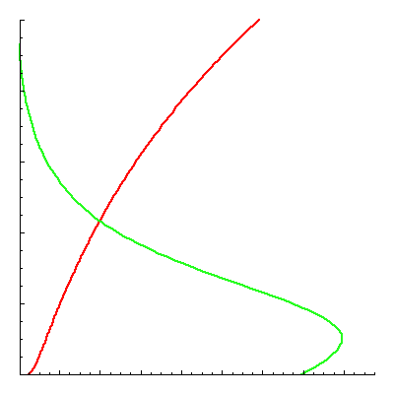
Hauser-Feshbach model for radiative neutron capture reactions
(E_{f},J_{f},π_{f})
E_{n}
S_{n}
S_{α}
n + (Z,A-1)
(Z,A)
α + (Z-2,A-2)
Target Nucleus
Compound Nucleus
Residual Nucleus
since T_{n}(J^{π}) >> T_{γ}(J^{π}): E_{n}~ keV
S_{n}+E_{n}
(U,J,π)
ρ
f_{XL}
GS

Slide 24
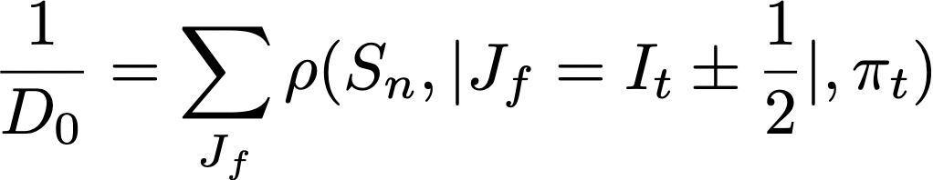
Resonance parameters:
S-wave resonance spacing: D₀
D₀=ΔE/(N_{r}-1)
Total radiative width: <Γ_{γ}>
S_{n}+E_{n}
(U,J,π)
ρ
where
f_{XL}
GS
Used to normalise PSF
Used to normalise NLD
(or fixed by the Shape Method)

Slide 25
3 x12 different sets of (NLD,PSF)
with different
<Γ>₀ and D₀
Exp

Slide 26
3 x12 different sets of (NLD,PSF)
with different
<Γ_{γ}>₀ and D₀
24 different sets of (NLD,PSF)
constrained on
<Γ_{γ}>₀/D₀
Exp

Slide 27
24 different sets of (NLD,PSF)
constrained on
<Γ_{γ}>₀/D₀
±15%

Slide 28
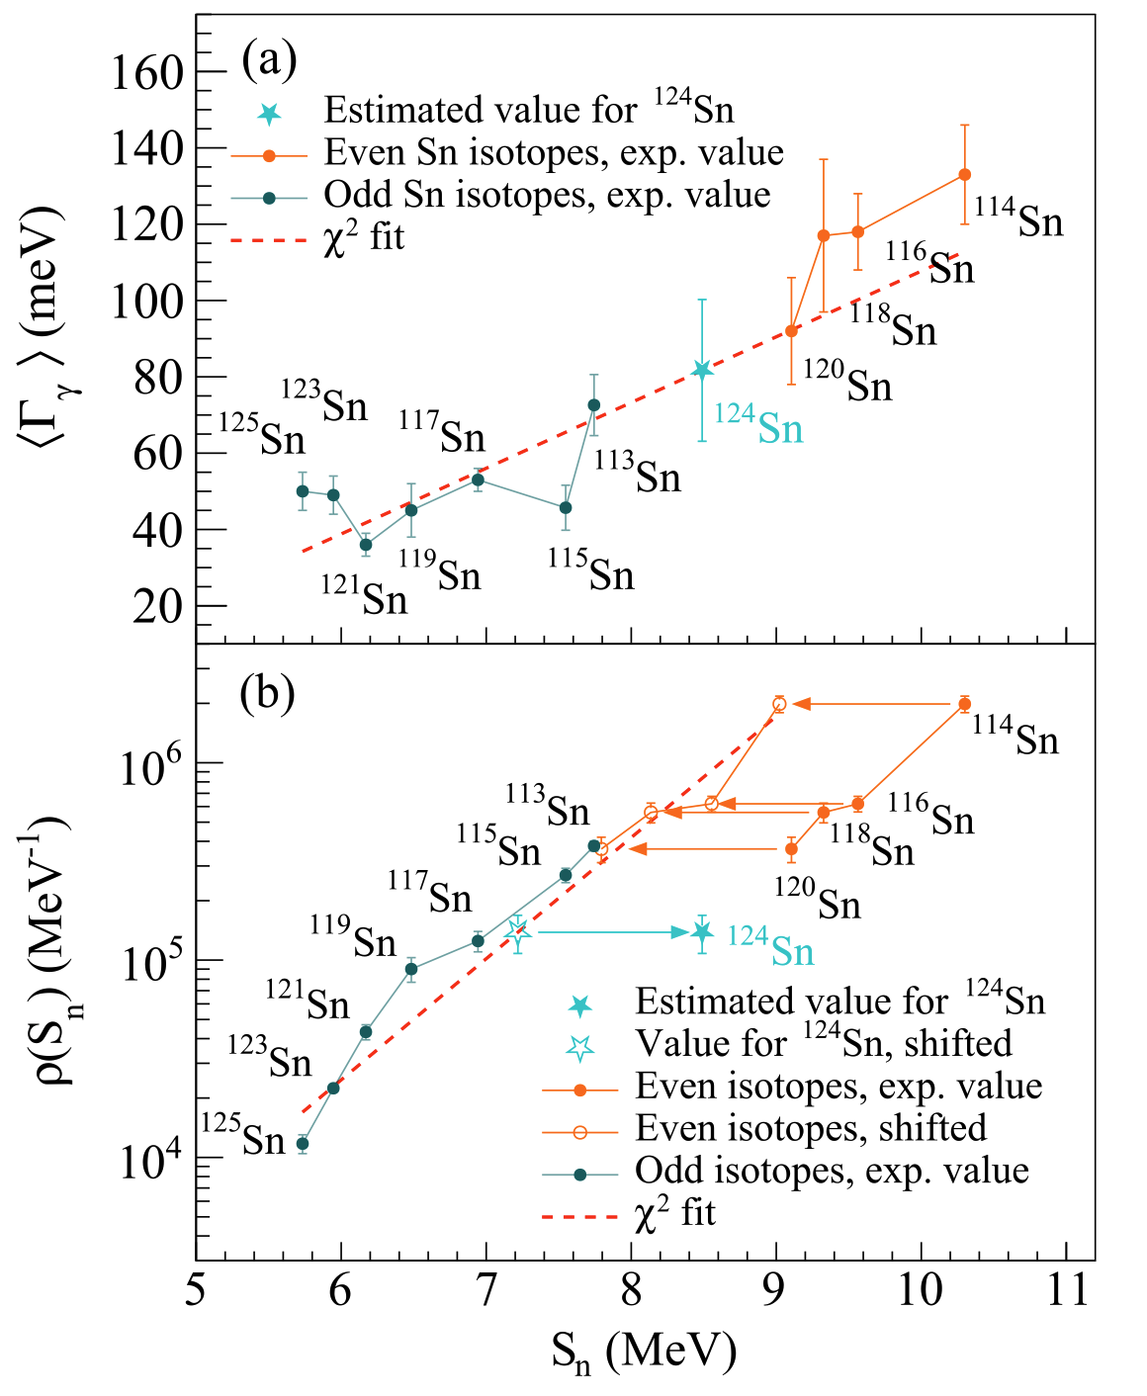
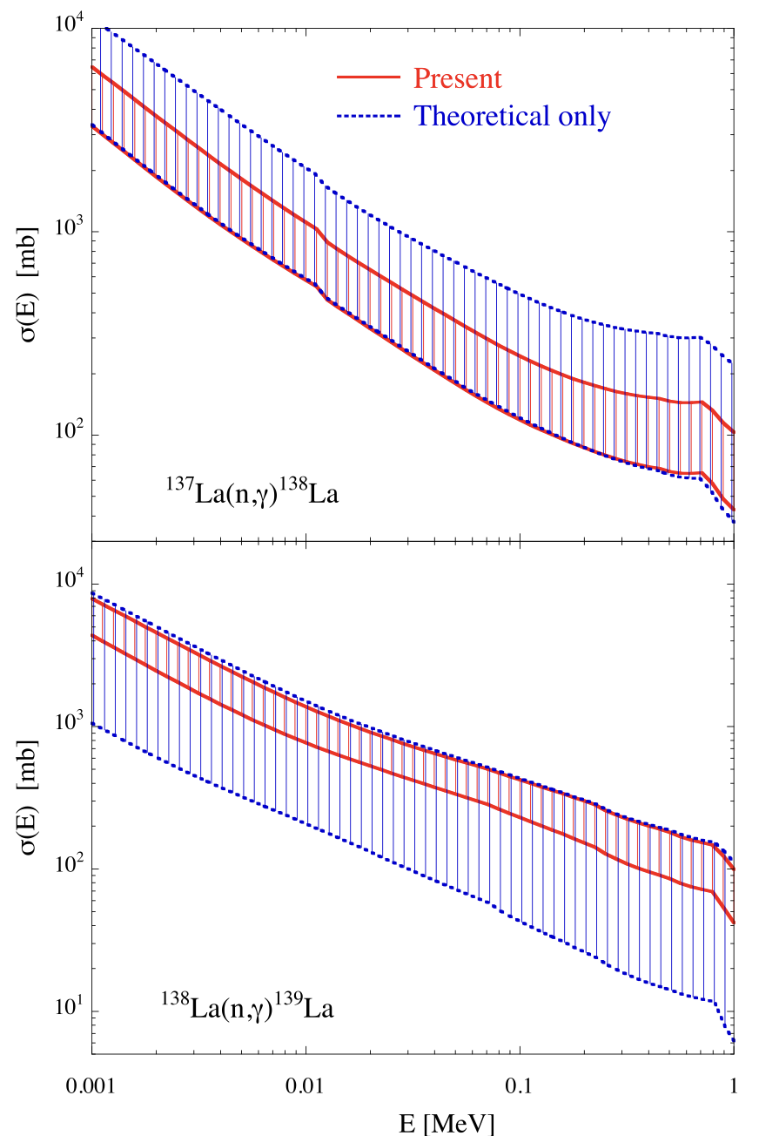
Any systematic on <Γ_{γ}>₀ or D₀ essentially sets the radiative neutron capture cross section, relatively independently from the detailed NLD and PSF !
<Γ_{γ}>
D₀
Markova et al. (2022)

Slide 29
Conclusions
D1M+QRPA calculation of the (J,π)-dependent de-excitation PSF
Complex (J,π) dependence
Extra low-energy M1 strength similar to the SM predictions
Light and spherical nuclei still under investigation (contribution from multi-phonon excitations ?)
NLD and PSF impact on the p-process
Photoneutron parameter uncertainties dominate
More experimental constraints
Improved nuclear models
Normalisation of the PSF within the Oslo approach for n-capture application
The key quantity to estimate (n,γ) cross section remains <Γ_{γ}>/D
More work is needed to constrain (n,γ) cross section when resonance parameters are not available, even within the Shape Method

Slide 30
THANK YOU
FOR
YOUR ATTENTION

