Slide 1
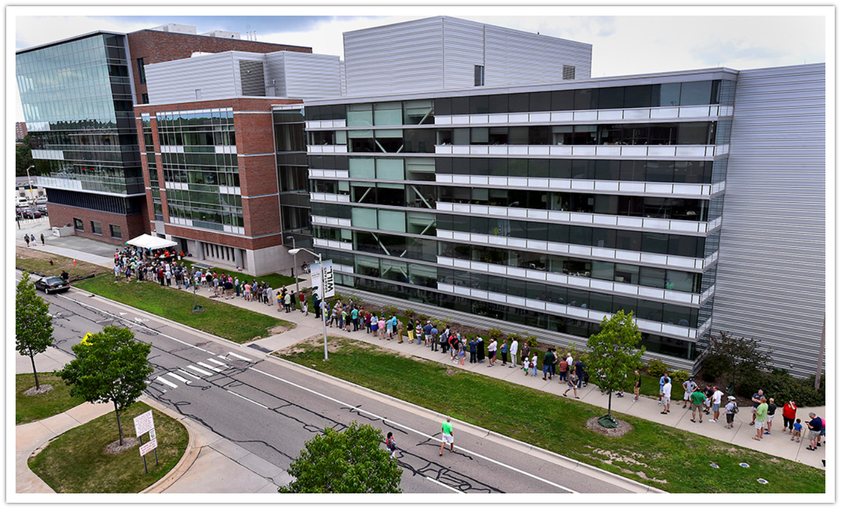
Determining the electric or magnetic nature of the low-energy enhancement in nuclei (and isomers)
S.N. Liddick
FRIB/MSU
5/19/2026

Slide 2
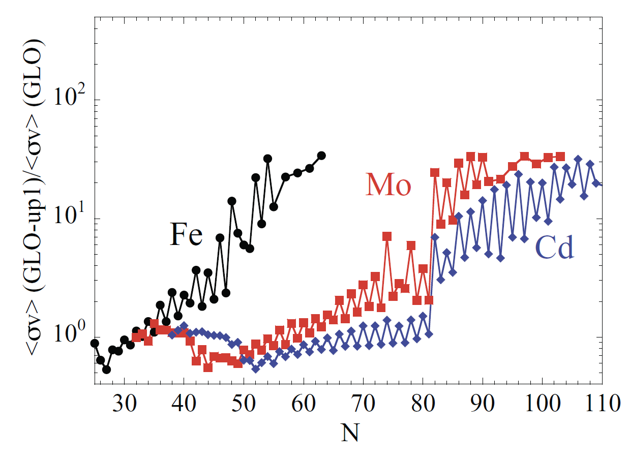
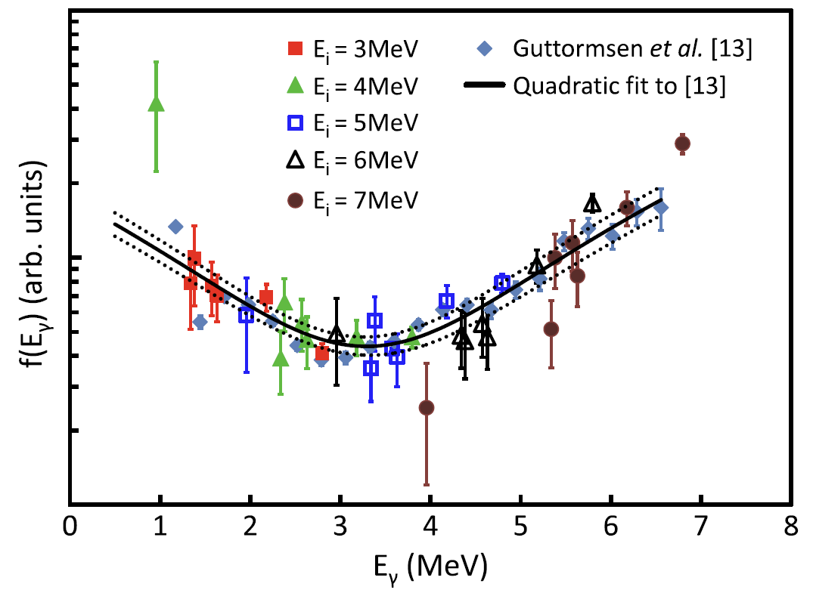
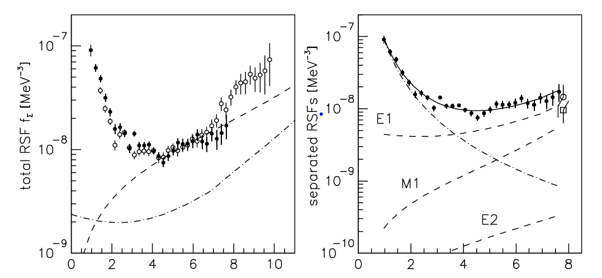
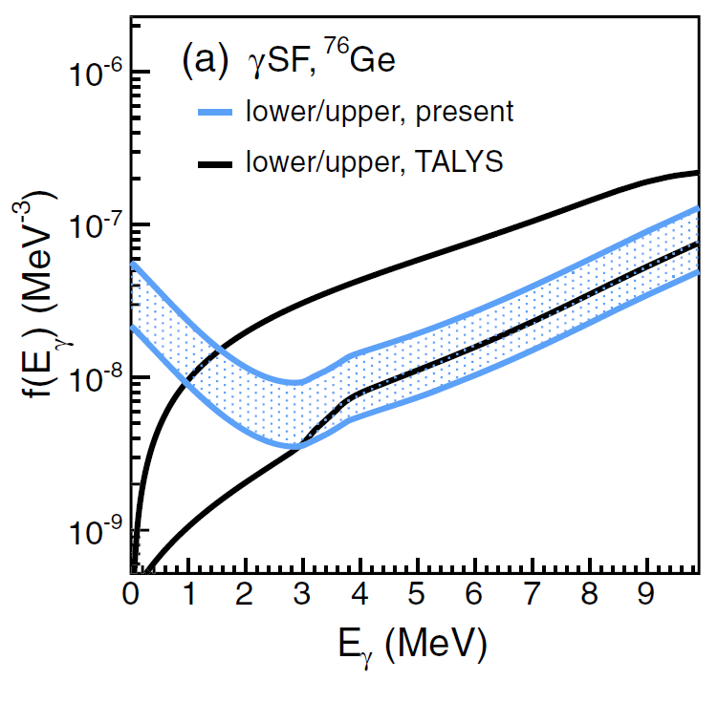
The Low-Energy Enhancement
Impact on (n,γ)
Observation in ⁹⁵Mo
First Observation in ^{56,57}Fe
A.C. Larsen S. Goriely, PRC 82, 014318 (2010)
A. Voinov et al., PRL 93, 142504 (2004)
βOslo
A. Spyrou, S.N. Liddick, A.C. Larsen, M. Guttormsen et al., PRL 113, 232502 (2014)
M. Weideking et al., PRL 108, 162503 (2012)
LEE observed
Impact on (n,g) demonstrated
LEE confirmed
βOslo
Today
2004
2010
2012
2013
2013
2014
2017
2025

Slide 3
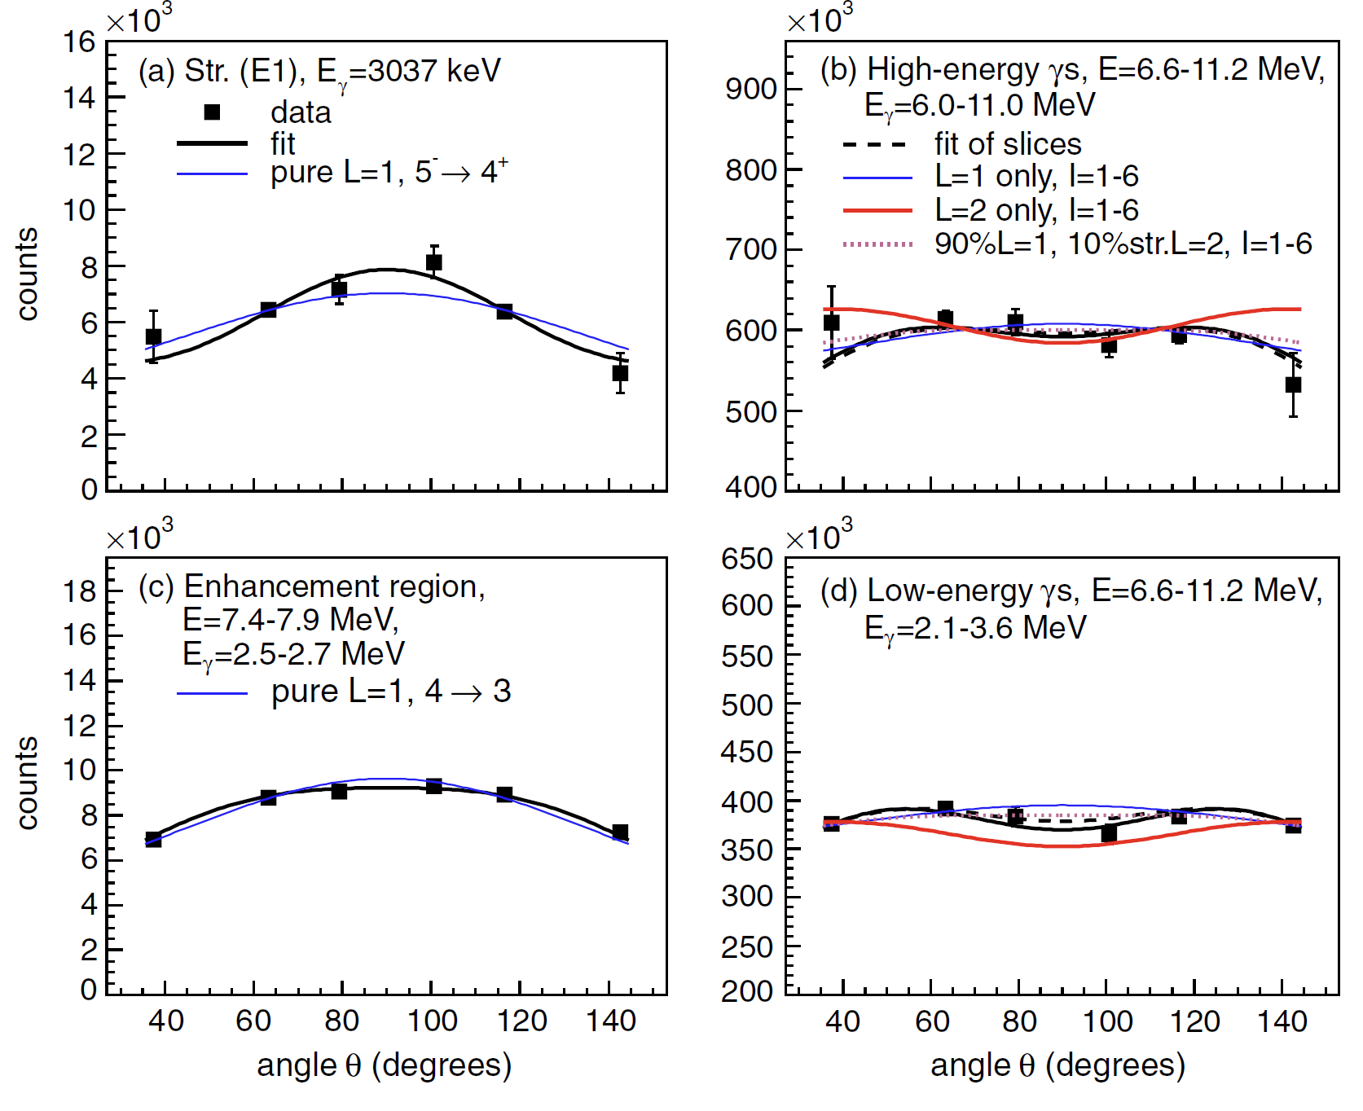
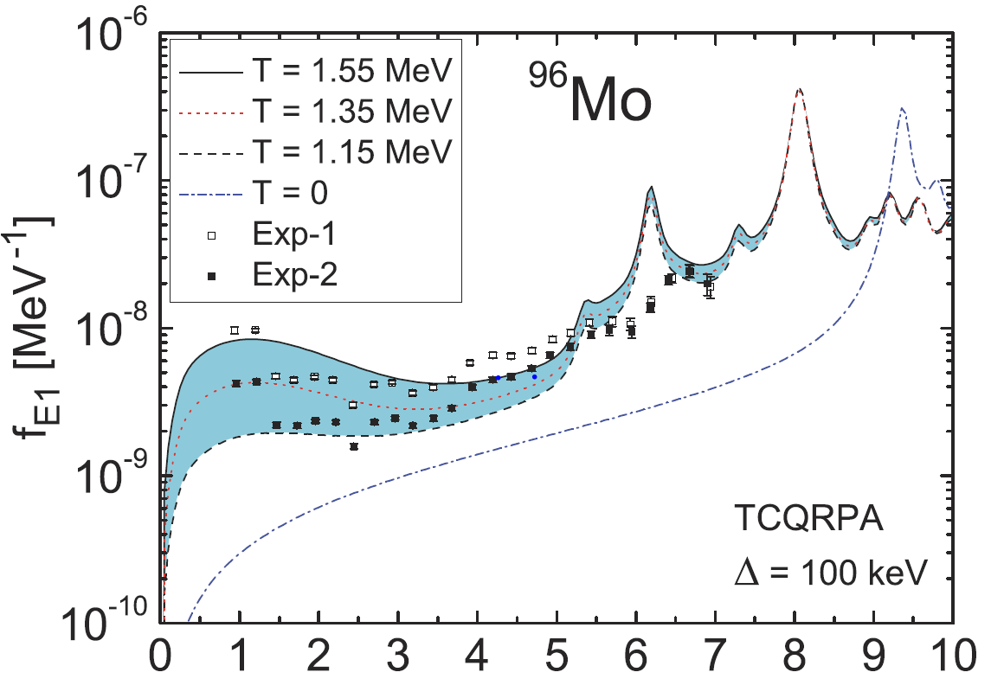
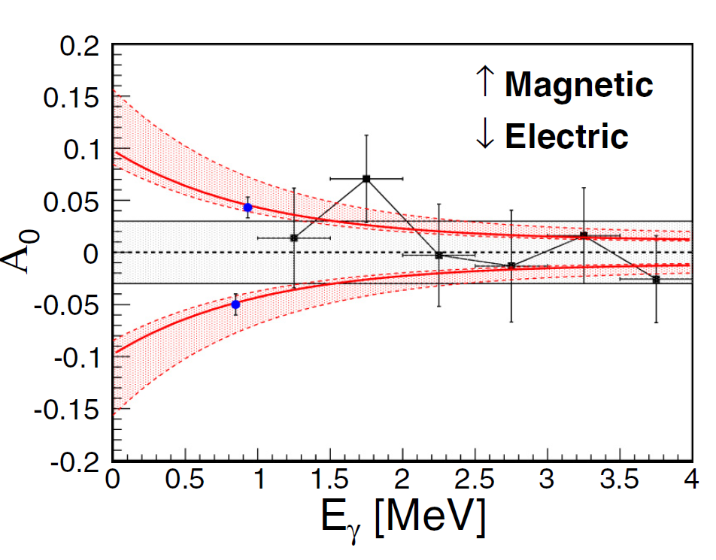

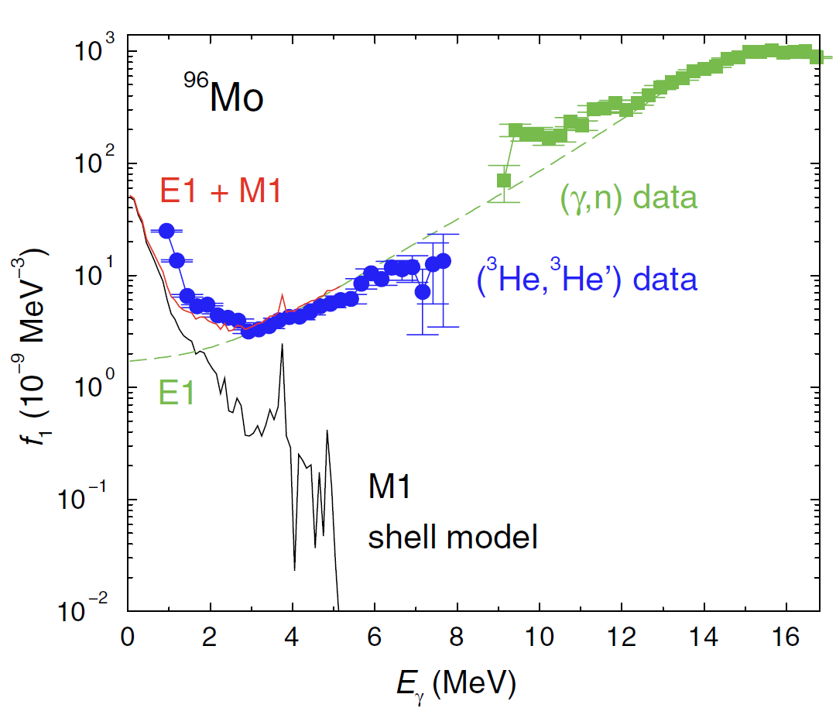
Characteristics of the Low-Energy Enhancement
Dipole confirmed
Theory – E1
Suggestion of M1?
E. Litvinova et al., PRL 88, 031302(R) (2013)
Theory – M1
R. Schwengner et al., PRL 111, 232504 (2013)
M. Jones et al., PRL 97, 024327 (2017)
A.C. Larsen et al., PRL 111, 242504 (2013)
Dipole demonstrated
Exp measurement attempts
LEE observed
Impact on (n,g) demonstrated
LEE confirmed
E1/M1 theory
βOslo
Today
2004
2010
2012
2013
2013
2014
2017
Many other studies
2025

Slide 4
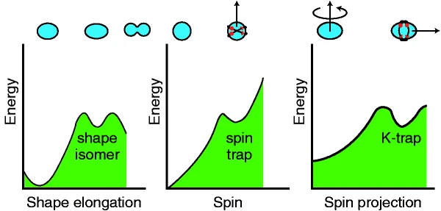
Isomeric States Contain Fingerprints of Underlying Nuclear Structure
Half-life greater than a fraction of nanoseconds.
Wide range of excitation energies and half-lives.
Wide range of spins and parities within a single nucleus
Sometimes simple configurations.
Many can be related to a few single-particle shell-model states.
Energies, half-lives, J^{π} can inform nuclear models.
1/2⁻
9⁻
142.7
77
1⁺
0
9/2⁺
¹⁸⁰Ta
0
^{99m}Tc
P. Walker, G. Dracoulis Nature 399, 35 (1999)
A. Andreyev et al., Nature 405, 430 (2000)

Slide 5
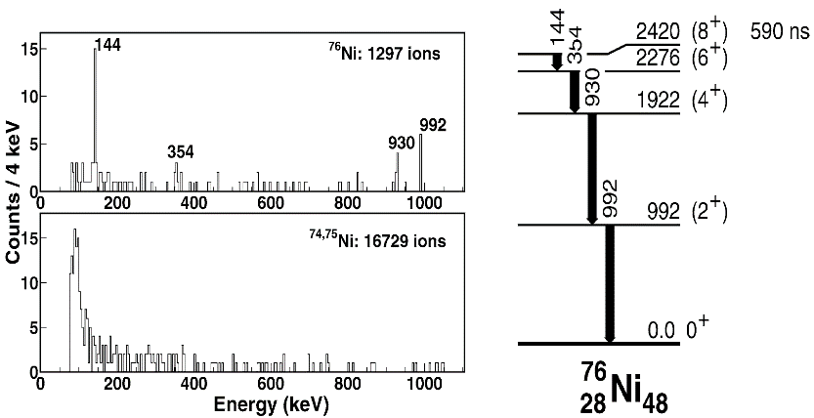
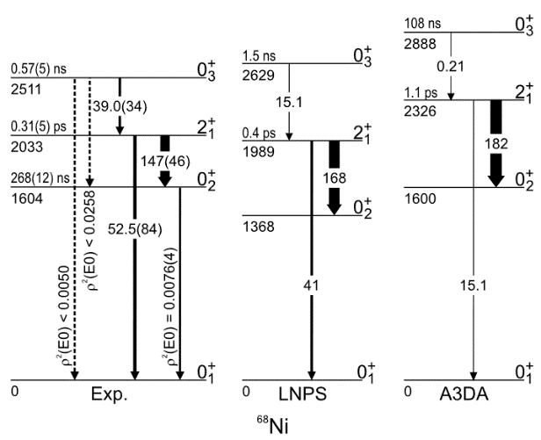
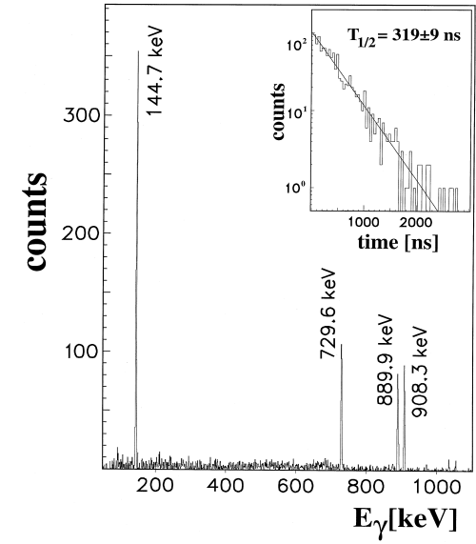
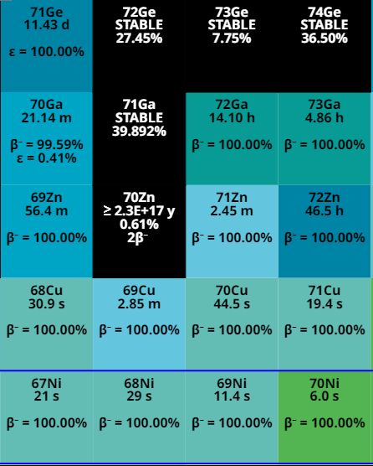
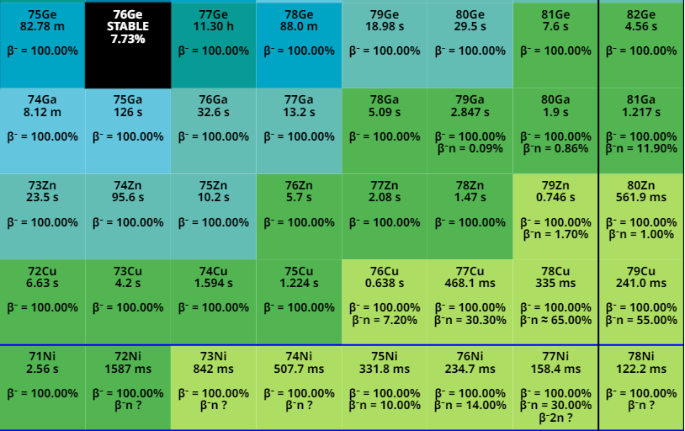
Isomeric States Contain Fingerprints of Underlying Nuclear Structure (and they’re everywhere)
Wide variety of isomeric states in mass 70-80 isotopes.
Focus on mass 70
J.M. Daugas, et al., Physics Letters B 476, 213 (2000)
B. P. Crider et al., Phys. Lett. B 763 (2016) 108-113
R. Grzywacz et al., Phys. Rev. Lett. 81 766 (1998);
C. Mazzocchi et al., Phys. Lett. B 622 45 (2005);
A. L. Morales et al., Phys. Lett. B 781 706 (2018);

Slide 6
Isomeric States in ⁷⁰Cu Lead to Specific Spin Ranges in ⁷⁰Zn
⁷⁰Cu has three different isomeric states:
6⁻ ground state (t_{1/2} = 44.5 s)
3⁻ 101-keV state (t_{1/2} = 33 s)
1⁺ 243-keV state (t_{1/2} = 6.4 s)
All three states undergo β decay to high energy states in ⁷⁰Zn (Q_{β} = 6.58 MeV). The three states are separable.
Within the allowed approximation, β decay will populate within ΔJ=1 and same parity as the parent J^{π}.
Offers the ability for multiple studies on γSF and NLD as a function of spin in child nucleus
1⁺
243
93%
3⁻
101
52%
6⁻
0
⁷⁰Cu
100%

Slide 7
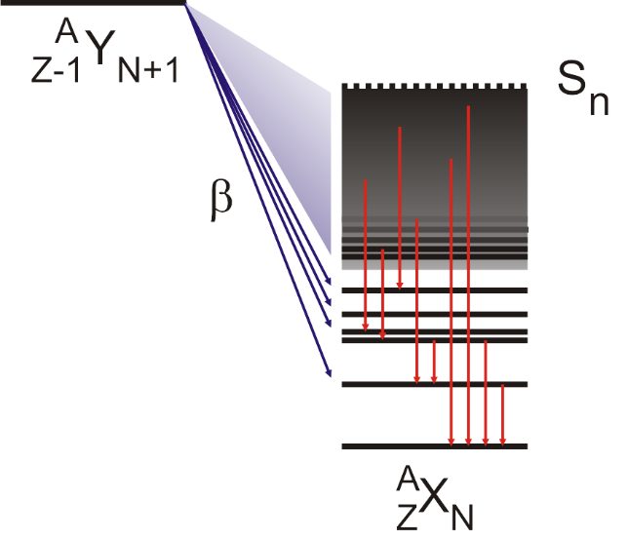
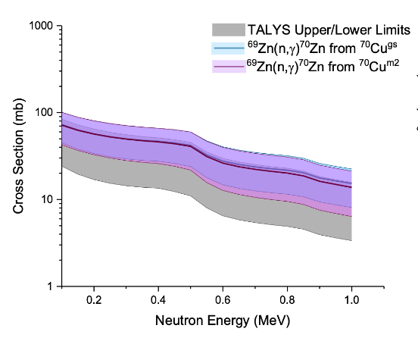
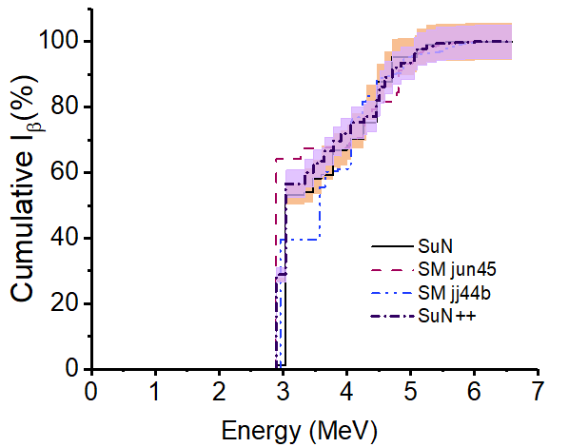
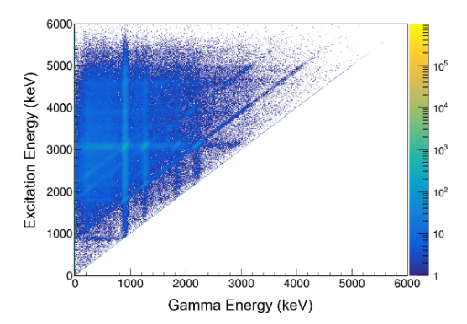
Using beta decay and total absorption spectroscopy to infer critical nuclear data
Measure beta decay of nucleus using TAS.
Extract critical nuclear data for structure, astrophysics, and stockpile stewardship
I_{β}
avg. e⁻/γ energy
n/γ competition
nuclear level density,
γ-ray strength function,
gBA tests
Spin cutoff studies
neutron capture cross section
SuN
1⁺
243
3⁻
101
93%
6⁻
0
52%
⁷⁰Cu
100%
6⁻

Slide 8
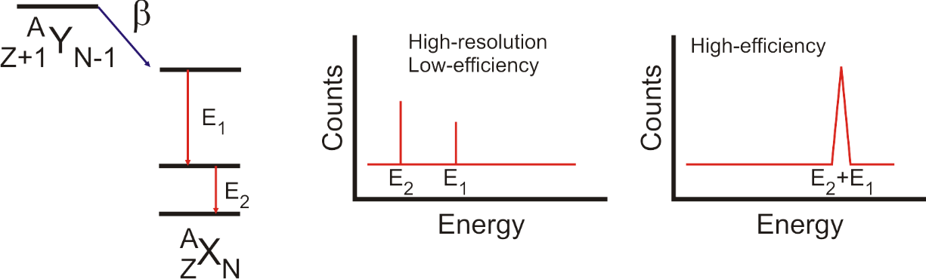
Using beta decay total absorption spectroscopy to infer neutron capture cross sections
Measure beta decay of nucleus.
Extract level densities and gamma-ray strength function
Need total excitation energy of the daughter isotope.
Can’t use beta-decay electron (three body process)
Instead, measure total emitted photon energy.
Require high detection efficiency.
Extract nuclear level density and γ-ray strength function.
Insert both quantities into a statistical reaction model to constrain (n,γ) rate.
Simon et al., NIM A 703 (2013): 16-21

Slide 9
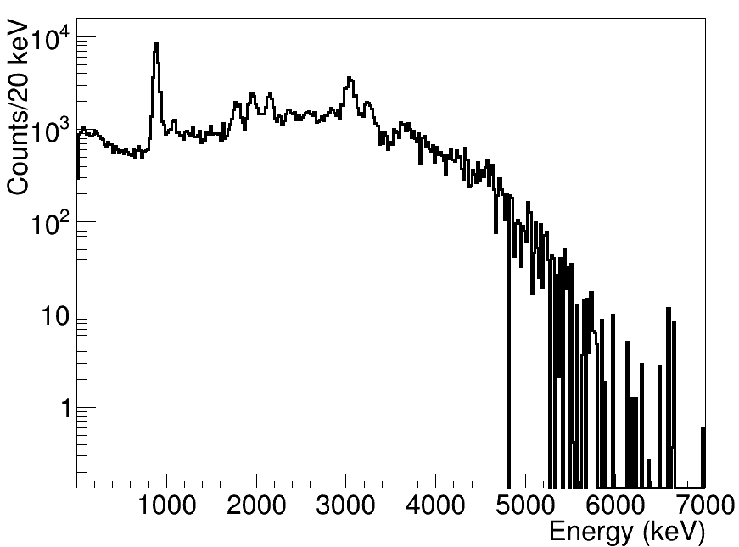
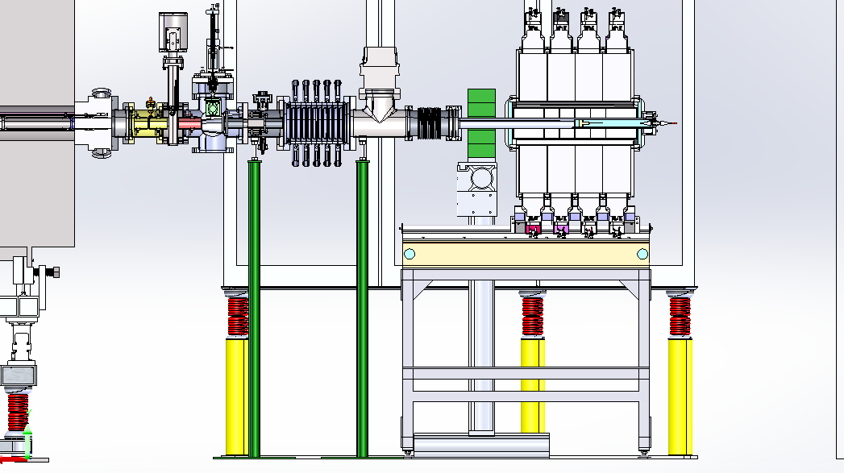
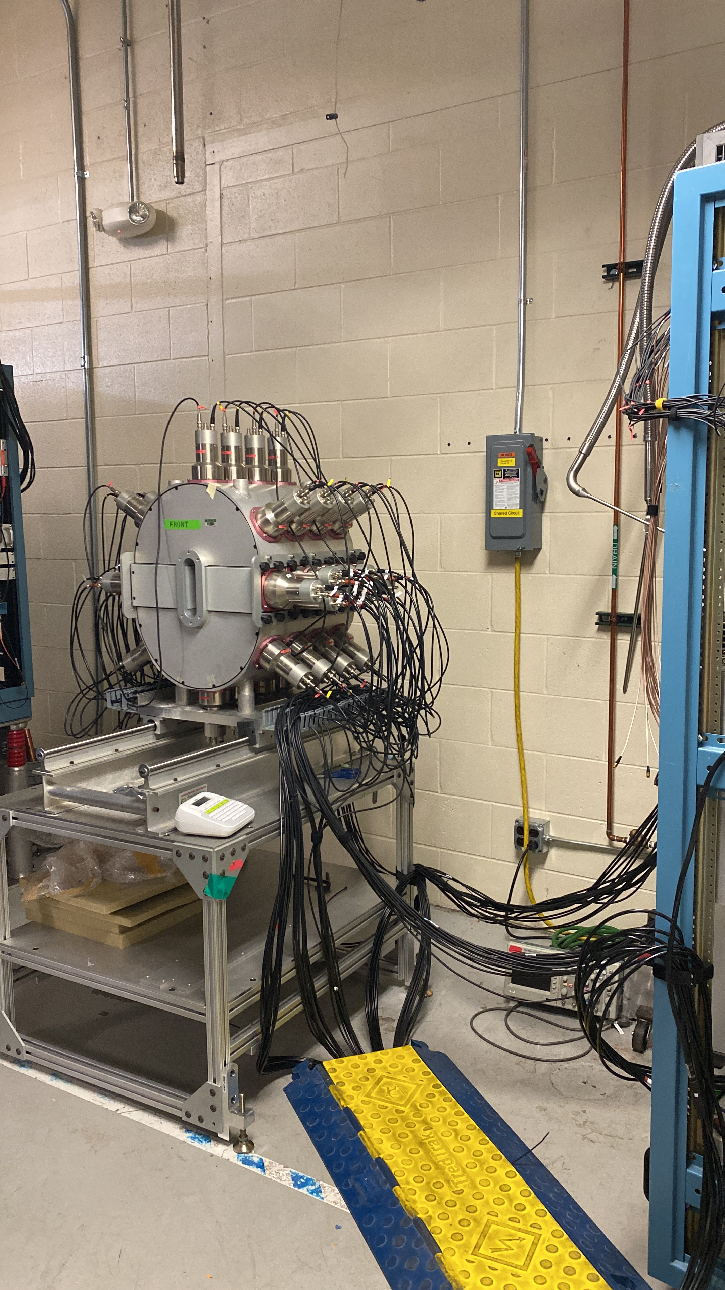
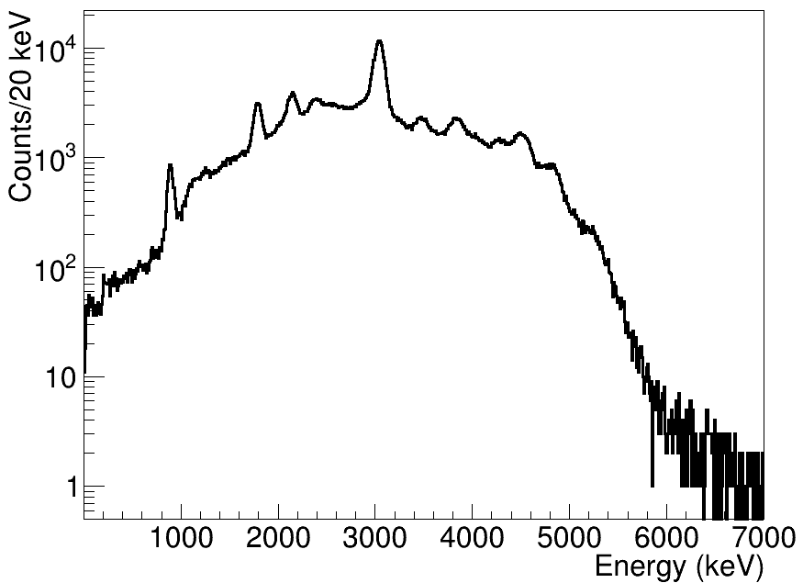
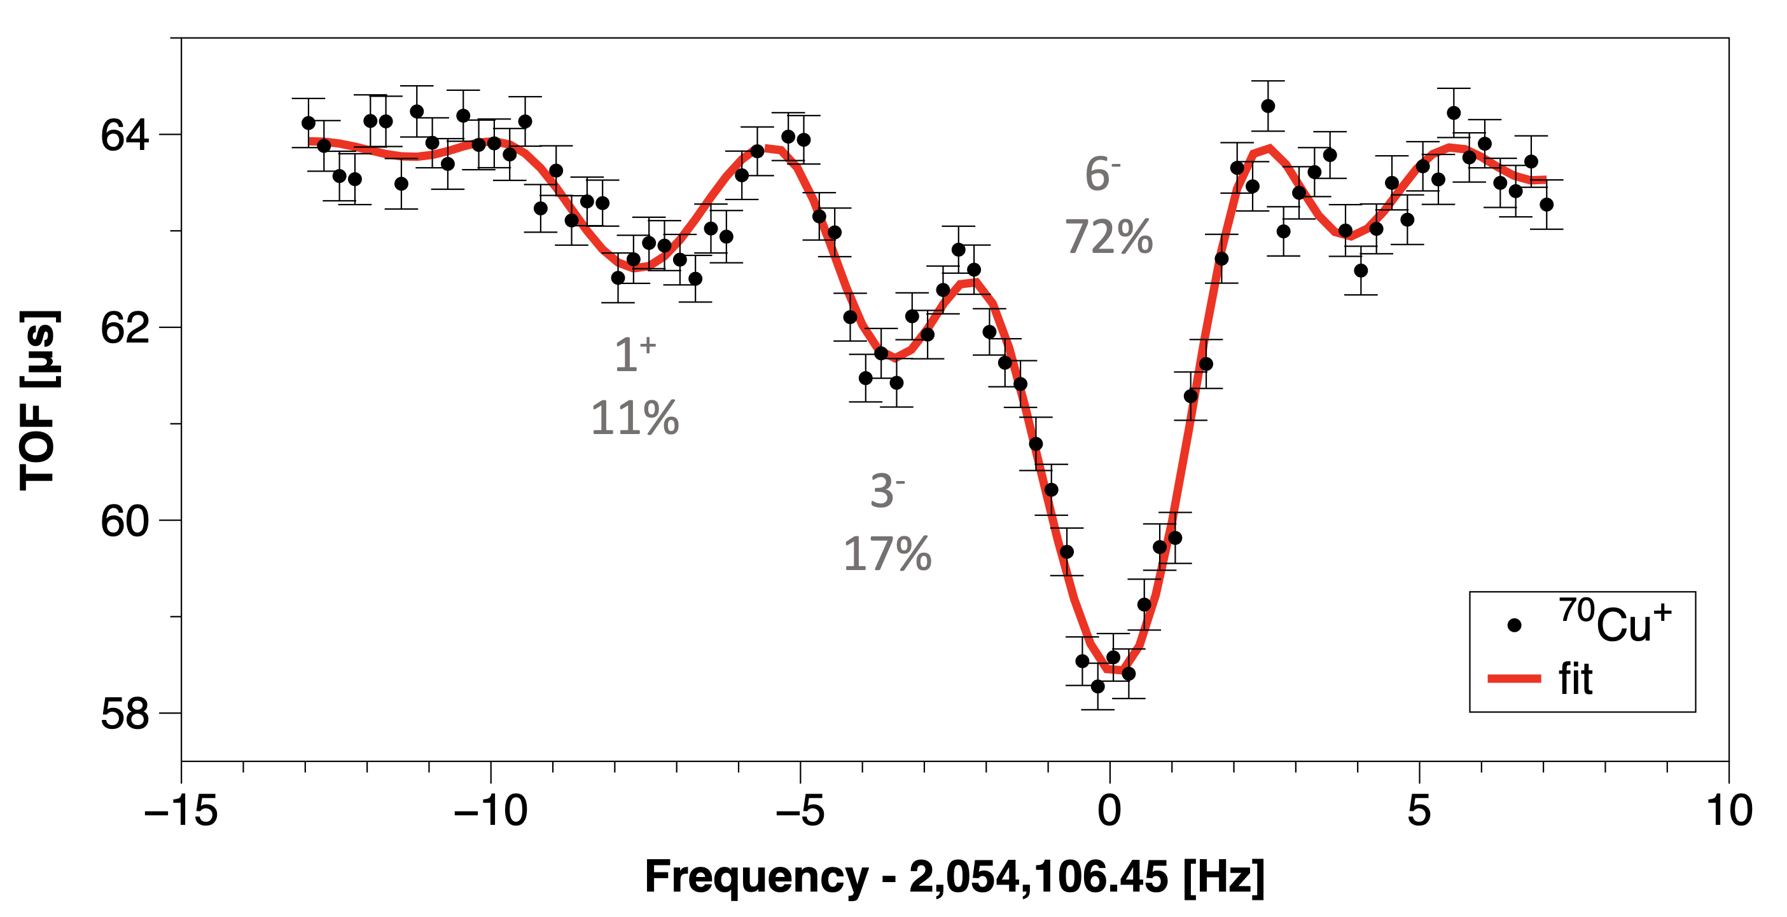
Isomers Produced, Isolated, and Delivered
Beam containing ⁷⁰Cu ions produced, separated (ARIS), thermalized (Gas Cell) and isomers isolated and delivered (LEBIT) to experimental end-station
⁷⁰Cu^{m2}
⁷⁰Cu^{gs}
6⁻
72%
1⁺
11%
3⁻
17%
SuN was upgraded to SuN++, 12 NaI and 8 CeBr₃ detectors added
Simon et al., NIM A 703 (2013): 16-21
Ringle et al., NIM A 604 (2009): 536-547
Cooper et al., NIM A 763 (2014): 543-546
E. Ronning, et al., Phys. Rev. C (accepted)

Slide 10
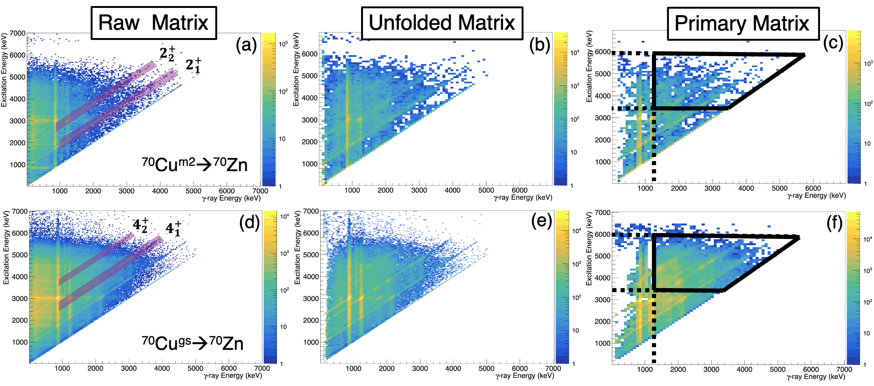
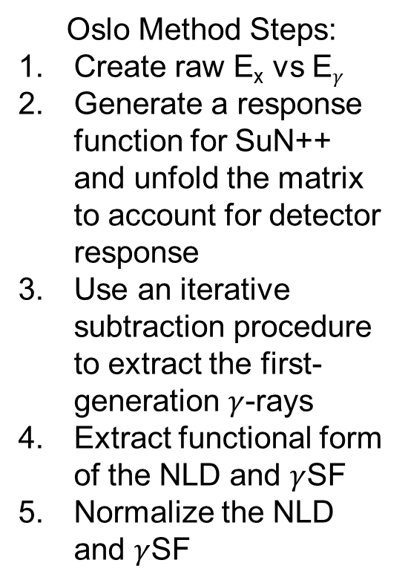
Oslo Method To Get Functional Form of γSF
Oslo Method Steps:
Create raw E_{x} vs E$γ$
Generate a response function for SuN++ and unfold the matrix to account for detector response
Use an iterative subtraction procedure to extract the first-generation $γ$-rays
Extract functional form of the NLD and $γ$SF
Normalize the NLD and $γ$SF
⁷⁰Cu^{m2}
M. Guttormsen, et. al., Nucl. Inst. And Meth. in Phys. Res. A, 255, 518-523 (1987)
M. Guttormsen, et. al., Nucl. Inst. and Meth. in Phys. Res. A, 374, 371-376 (1996).
A. Schiller, A. et al., Nucl. Inst. and Meth. in Phys. Res. A, 447, 498-511 (2000).
A. Spryou, et al., Phys. Rev. Lett. 113 232502 (2014).

Slide 11
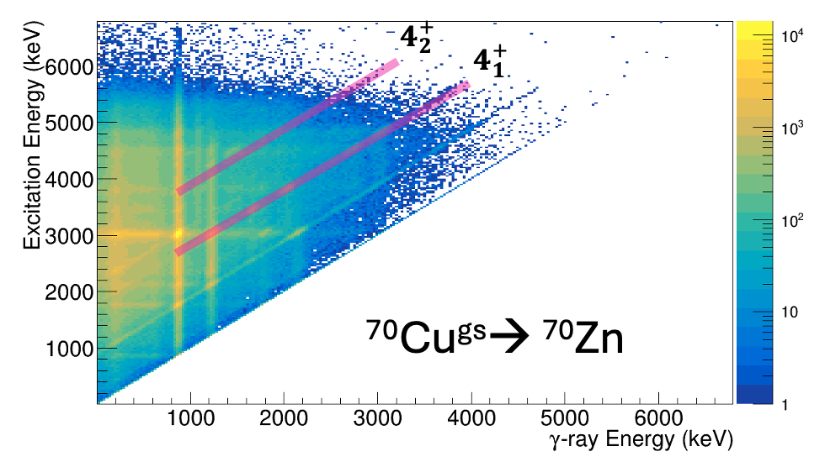
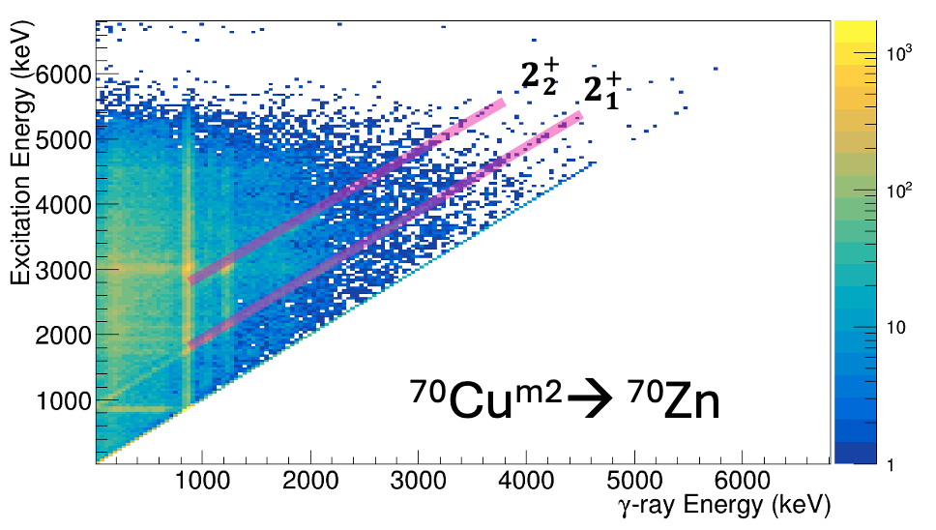
The Shape Method
Use shape method to extract model independent slope of the γSF following β decay
Requires similar known spin and parity states
Two 2⁺ states following the decay of ⁷⁰Cu^{m2}.
Two 4⁺ states following the decay of ⁷⁰Cu^{gs}.
“Diagonals observed in the E_{x} vs E_{γ} matrix corresponding to all four states.
6⁻
⁷⁰Cu
β⁻
4⁺
2693
2⁺
2665
2⁺
2538
(1,2,3)⁺
2375
0⁺
2141
Need a level scheme
2⁺
1957
4⁺
1787
2⁺
1759
0⁺
1071
2⁺
885
0⁺
0
⁷⁰Zn
M. Wiedeking, et al., Phys. Rev. C, 104 014311 (2021).
D. Mücher, et al., Phys. Rev. C, 107 L011602 (2023).

Slide 12
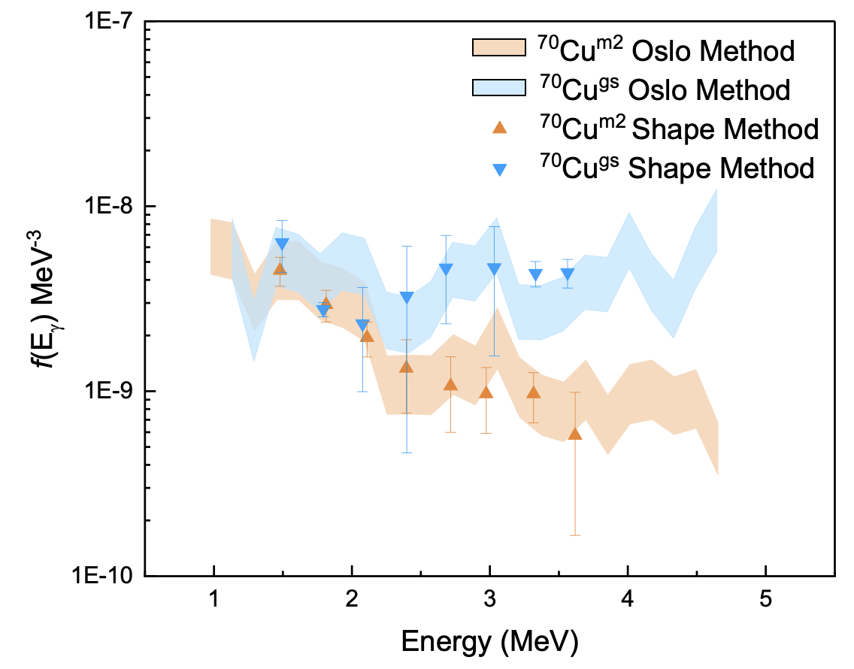
⁷⁰Zn $γ$-ray Strength Function ($γ$SF)
Functional form of γSF from β-Oslo method matched to γSF slope from Shape Method
Shapes between the γSF extracted following the decay of ⁷⁰Cu^{m2} and ⁷⁰Cu^{gs} are different.
E. Ronning, et al., Nature, (submitted)

Slide 13
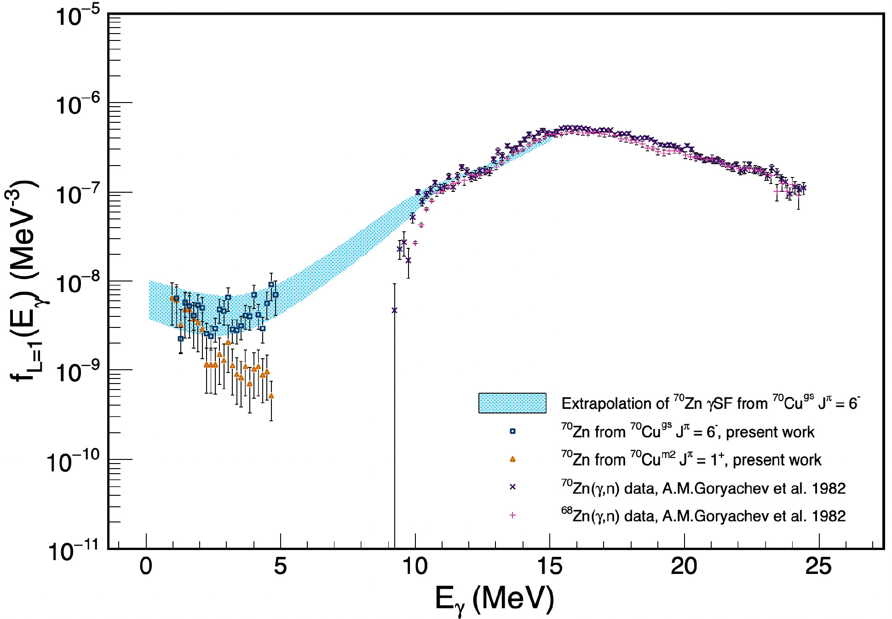
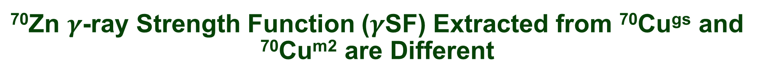
⁷⁰Zn $γ$-ray Strength Function ($γ$SF) Extracted from ⁷⁰Cu^{gs} and ⁷⁰Cu^{m2} are Different
Match the γSF extrapolation to tail of GDR.
GDR data taken from:
⁷⁰Zn(𝛾,n)⁶⁹Zn
⁶⁸Zn(𝛾,n)⁶⁷Zn
Shapes between the γSF extracted following the decay of ⁷⁰Cu^{m2} and ⁷⁰Cu^{gs} are different.

Slide 14
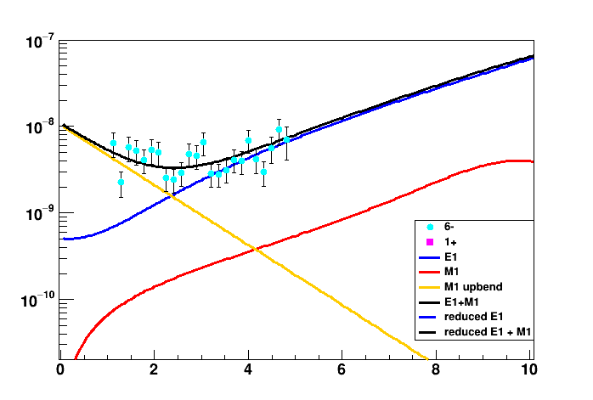
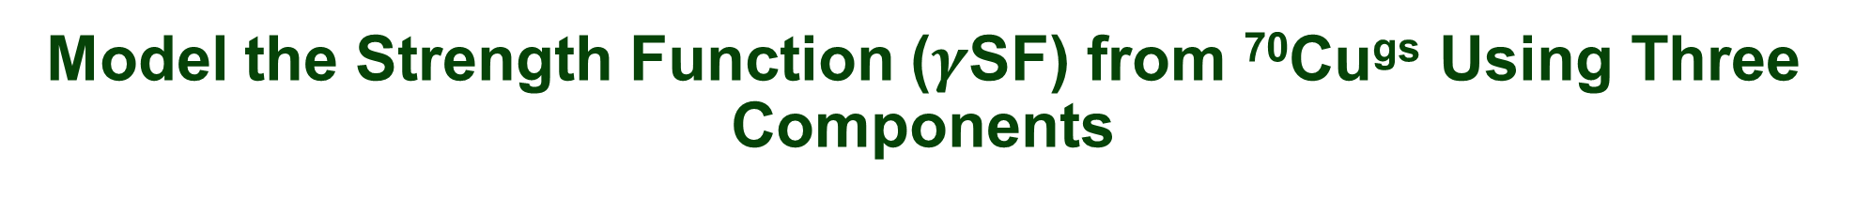
Model the Strength Function ($γ$SF) from ⁷⁰Cu^{gs} Using Three Components
Model the γSF with three components taken from TALYS (option 8, model 2 for M1)
E1
M1
M1 exponential upbend
Constrain M1 component to be an order of magnitude less than E1 (based on data from neighboring nuclei).
Fit three components to experimental data allowing relative amplitudes of E1 and exponential upbend to vary.
⁷⁰Cu^{gs} 6⁻
f_{L=1} (E_{γ}) (MeV⁻³)
Energy (MeV)

Slide 15
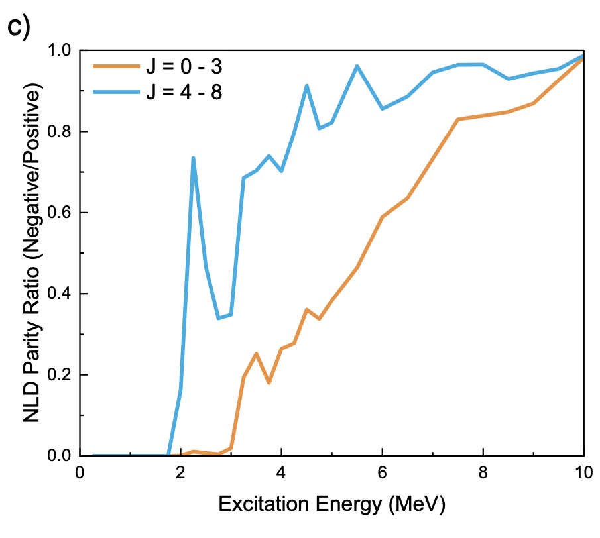
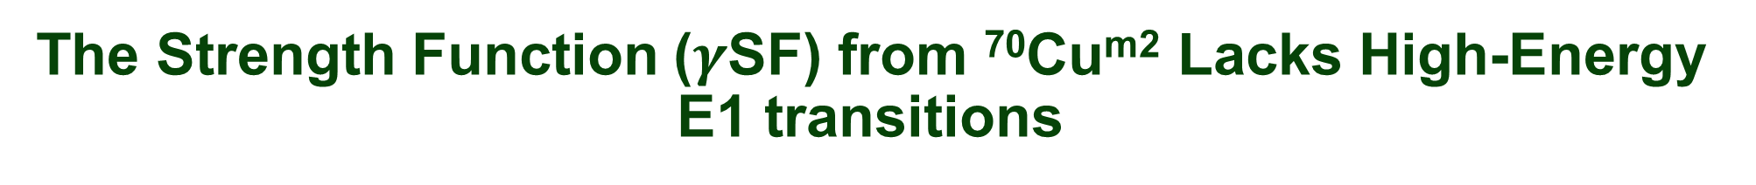
The Strength Function ($γ$SF) from ⁷⁰Cu^{m2} Lacks High-Energy E1 transitions
1⁺
6⁻
In decay of ⁷⁰Cu^{m2} state (Q_{β} = 6.58 MeV) positive parity states from spin 0-2 are populated.
Below ~3 MeV in ⁷⁰Zn only positive parity states are present.
In the decay of the 1+ state:
high-energy transitions between the initial population and the low-energy level scheme must proceed through M1 transitions.
⁷⁰Cu
β⁻
^{E1}
^{M1}
⁷⁰Cu
β⁻
^{E1}
^{M1}
0⁺,1⁺,2⁺
5⁻,6⁻,7⁻
4⁺
2693
4⁺
2693
2⁺
2665
2⁺
2665
2⁺
2538
2⁺
2538
(1,2,3)⁺
2375
(1,2,3)⁺
2375
0⁺
2141
0⁺
2141
2⁺
1957
2⁺
1957
4⁺
1787
4⁺
1787
2⁺
1759
2⁺
1759
0⁺
1071
0⁺
1071
2⁺
885
2⁺
885
0⁺
0
0⁺
0
⁷⁰Zn
⁷⁰Zn

Slide 16
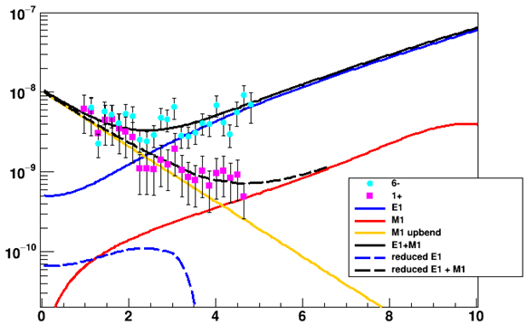
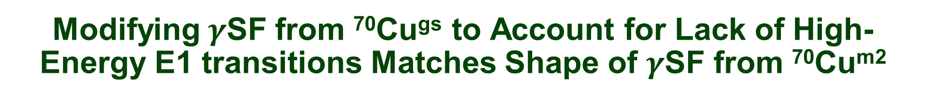
Modifying$γ$SF from ⁷⁰Cu^{gs} to Account for Lack of High-Energy E1 transitions Matches Shape of $γ$SF from ⁷⁰Cu^{m2}
Use parity asymmetry from TALYS and reduce E1 strength by a weighted factor to account for the absence of states which allow E1 transitions.
The ⁷⁰Cu^{m2} data lies along the reduced curve.
f_{L=1} (E_{γ}) (MeV⁻³)
⁷⁰Cu^{m2}
Energy (MeV)

Slide 17
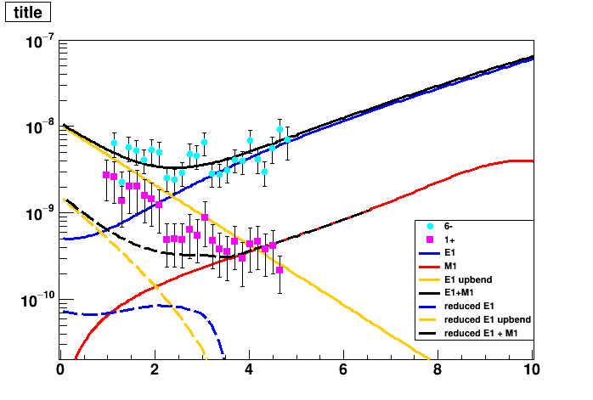

Modifying$γ$SF from ⁷⁰Cu^{gs} Assuming an E1 LEE Does Not Match Shape of $γ$SF from ⁷⁰Cu^{m2}
Performed identical analysis assuming an E1 upbend instead of an M1 upbend.
The curves to not match
Demonstrates that the upbend is M1.
f_{L=1} (E_{γ}) (MeV⁻³)
Energy (MeV)

Slide 18
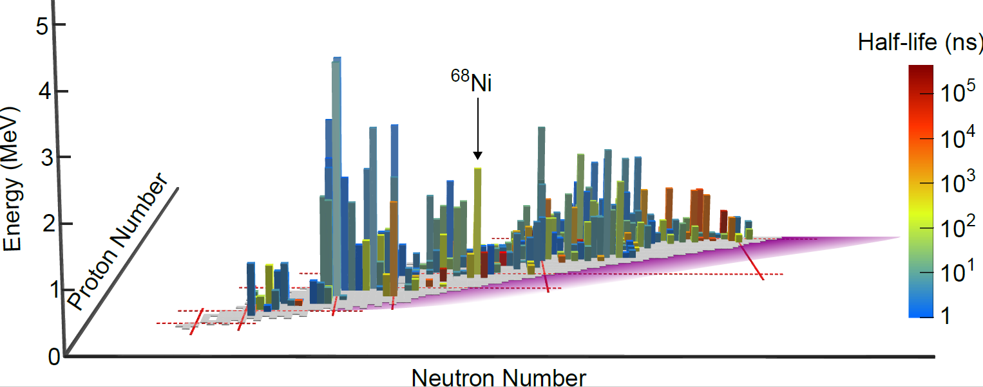
A Wealth of Isomeric States Exist to Perform Future Studies: nuclear isomeric skyline
Nuclear chart up to Z=51 (Sb)
Nuclei with known half-lives between 1-500 ms
Height represents decay energy and color represents half-life

Slide 19
Summary
The LEE is M1
Isomeric states offer an important mechanism to prepare specific, known sets of spins and parities. Enables explorations of:
Strength functions from well defined set of initial states
Partial level densities
Spin cutoff parameters
Isomer decays
Questions/Discussion:
In ⁷⁰Cu, is the γSF modified, or do we just not have the available states for transitions to occur? (philosophical)
Where do we expect the LEE enhancement?
Related to deformation?
How well can we constrain spin cutoff parameters? (future work)

Slide 20
















Acknowledgements
Michigan State University/FRIB
Beta-Group
S.N. Liddick
M. Mogannam
A. Hartley
A. Doetsch
J. Berkman
D. Scriven
SuN-Group
A. Spyrou
C. Harris
J. Owens-Fryar
H. Berg
A. Tsantiri
K. Bosmpotinis
S. Uthayakumaar
K. Taft
B. Greaves, R. Coleman
P. A. DeYoung
P. A. DeYoung
S. Lyons, E. Good
A. C. Larsen, M. Guttormsen
H. Arora
G. W. Misch, M. Mumpower, T. Sprouse, A. Gross, S. Cupp
B. Crider
T. Gaballah
LEBIT Group
A. Richard
C. Robin, J. E. Larsson
R. Ringle, S. Campbell, C. Ireland, H. Erington, F. Maier, I. Yandow, A. Hamaker, D. Puentes
R. Sandler
K. Childers
M. Wiedeking
A. Chester, R. Lubna, M. K. Smith, C. Sumithrarachchi, S. Schwartz, B. A. Brown, J. Huffman
A. Sweet, D. Bleuel, T. Ogunbeku, R. Jain
This work is supported by the US Department of Energy National Nuclear Security Administration through Grant No. DOE-DE-NA0003906

Slide 21
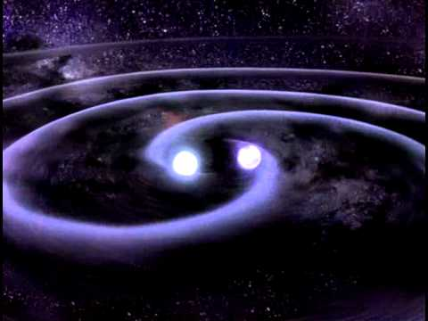
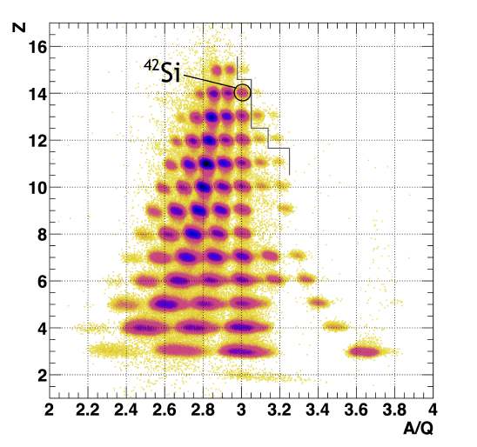
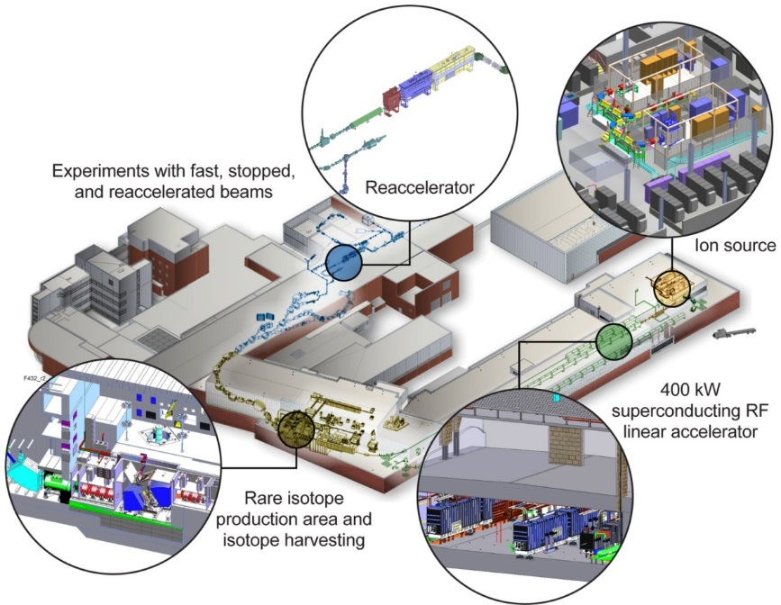
Thanks Questions?

Slide 22

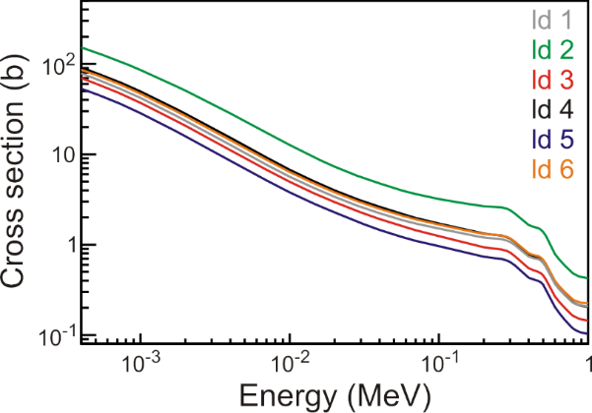
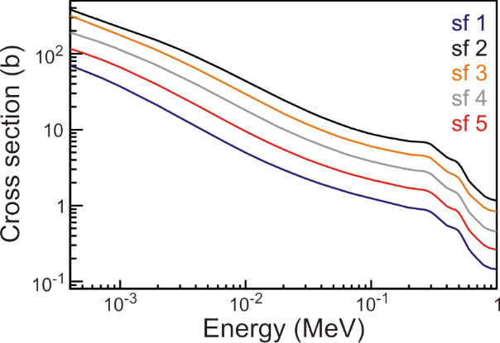
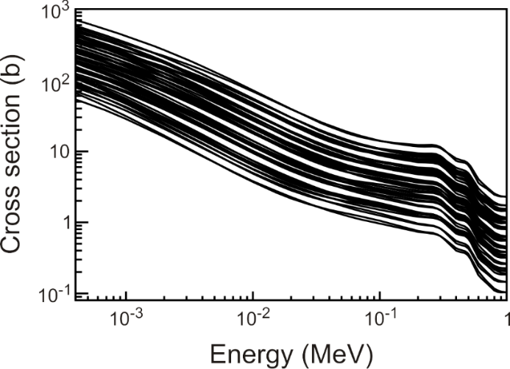
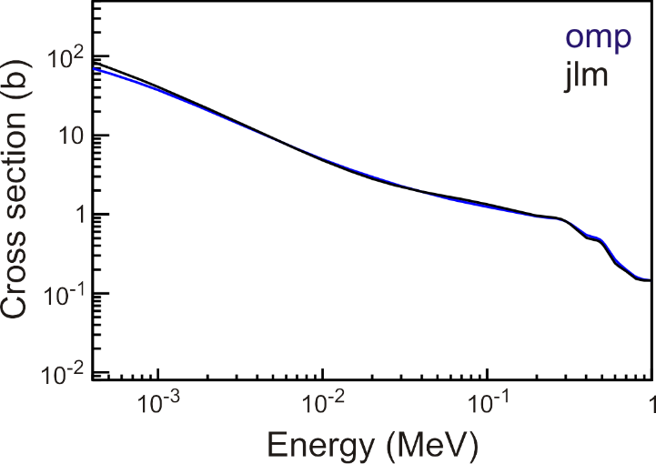
Nuclear level densities and γ-ray strength functions are the dominate uncertainties in (n,γ) calculations
Hauser – Feshbach
Nuclear Level Density
Constant T+Fermi gas, back-shifted Fermi gas, superfluid, microscopic
γ-ray strength function
Generalized Lorentzian, Brink-Axel, various tables
Optical model potential
Phenomenological, Semi-microscopic
Level density
γ-strength function
OMP
ALL
⁹⁵Sr(n,γ)⁹⁶Sr
TALYS

Slide 23
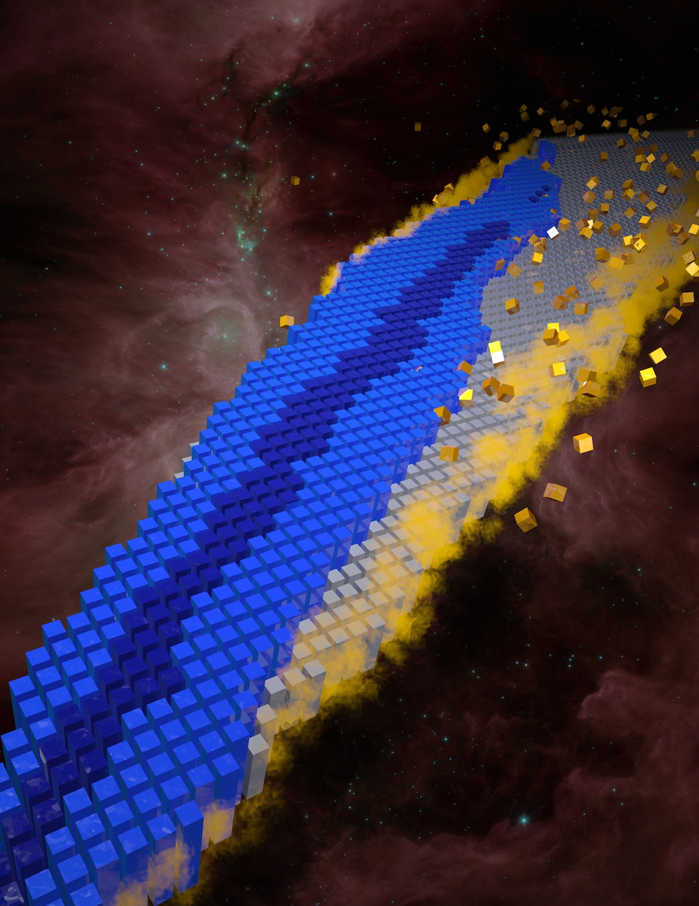
Nuclear Science Challenges
Comprehensive and predictive model of atomic nuclei.
Evolving structure of atomic nuclei as a function of protons and neutrons from first principles.
Understanding the origin of the elements.
Explosive nucleosynthesis
Use of atomic nuclei to test fundamental symmetries.
Search for new applications of isotopes and solutions to societal problems.
A. Sproles, Oak Ridge National Laboratory
2015 Long Range Plan for Nuclear Science

