Slide 1







Oslo Studies Near ⁹²Nb and the Implications for Stellar Production of the Cosmochrornometer ⁹²Nb
Oslo Workshop
05/21/2026
@Oslo, Norway
Neshad D. Pathirana
(Ph.D. Candidate)

Slide 2
Outline
Supernovae Study of ⁹²Nb
Neutrino Study of ⁹²Nb
Charge-Exchange Oslo Method

Slide 3

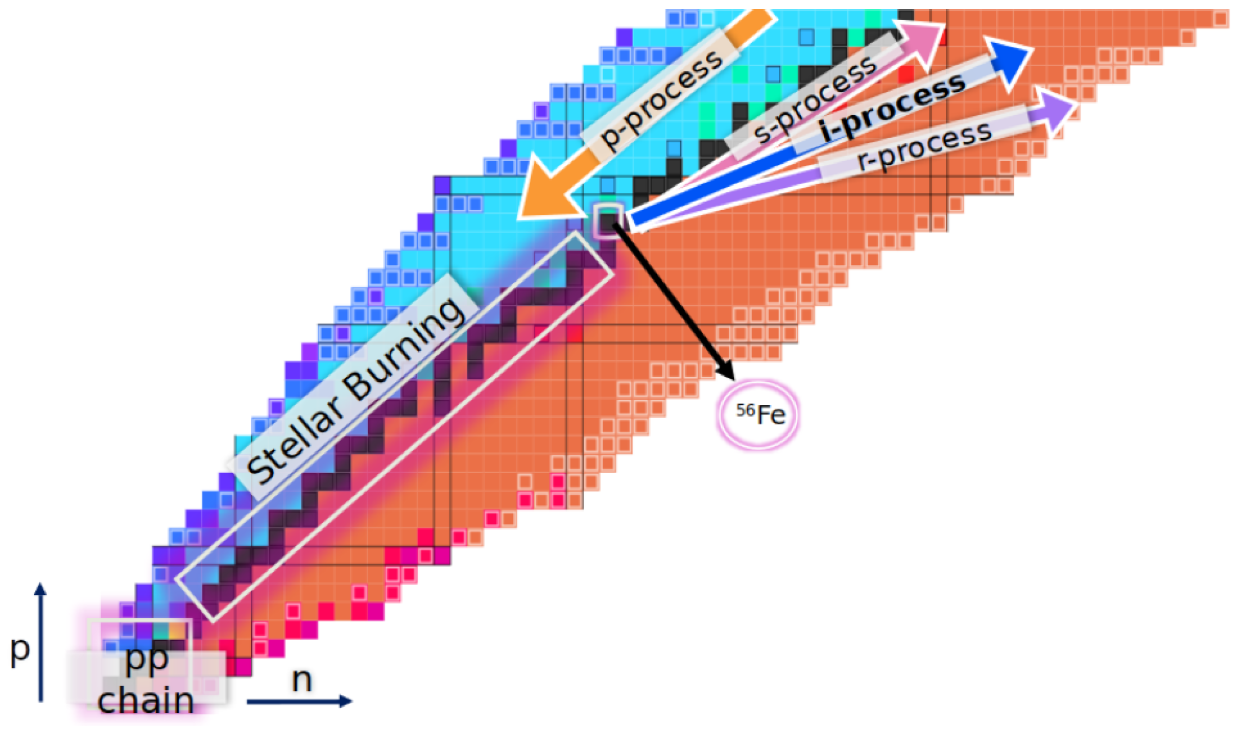




How the Elements are Made in the Universe: p-process Nucleosynthesis
Bandyopadhyay et al., Universe 11, 229 (2025)
A smaller group of rare, proton-rich isotopes (p-nuclei) cannot be produced efficiently by the s-, i- and r-processes and require distinct mechanisms referred to as the p-process
Several mechanisms have been proposed under the broader p-process umbrella in different astrophysical environments:
$γ$-, $rp$-, $υp$-, $υ/υr$-processes
Heavy elements beyond Fe are mostly produced by these processes
 |  | p
Elements up to Fe are produced by stellar fusion
Lightest elements are produced during the Big Bang and later in stellar interiors

Slide 4

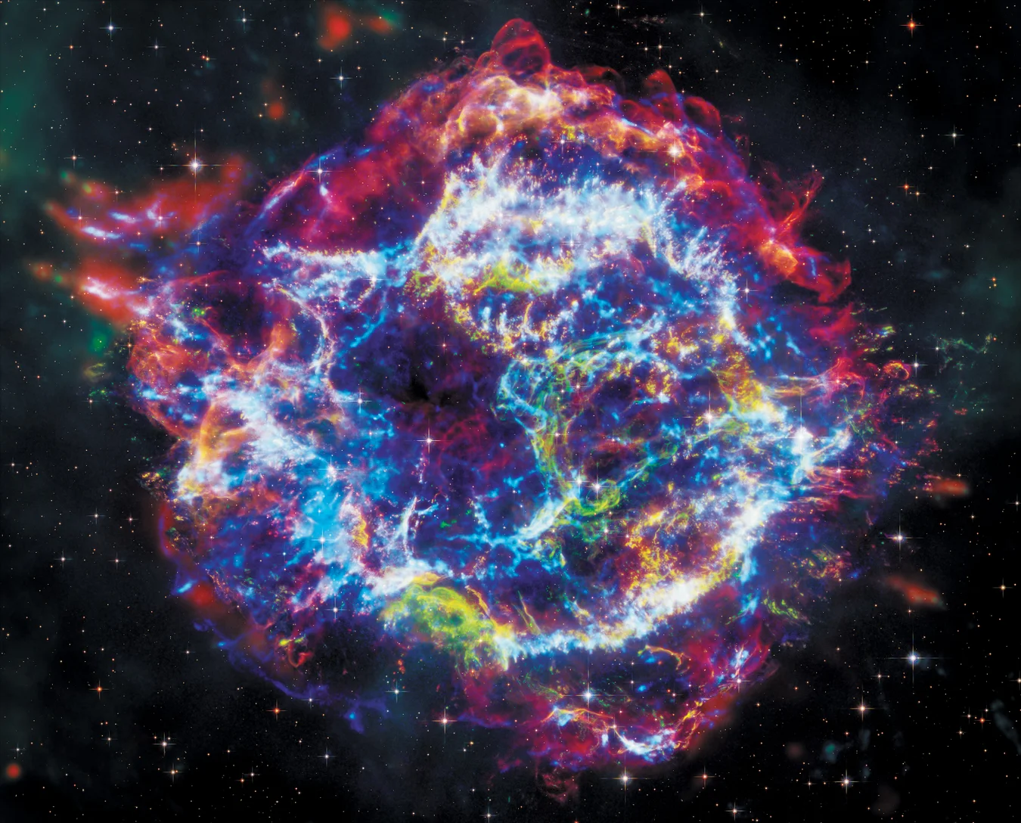
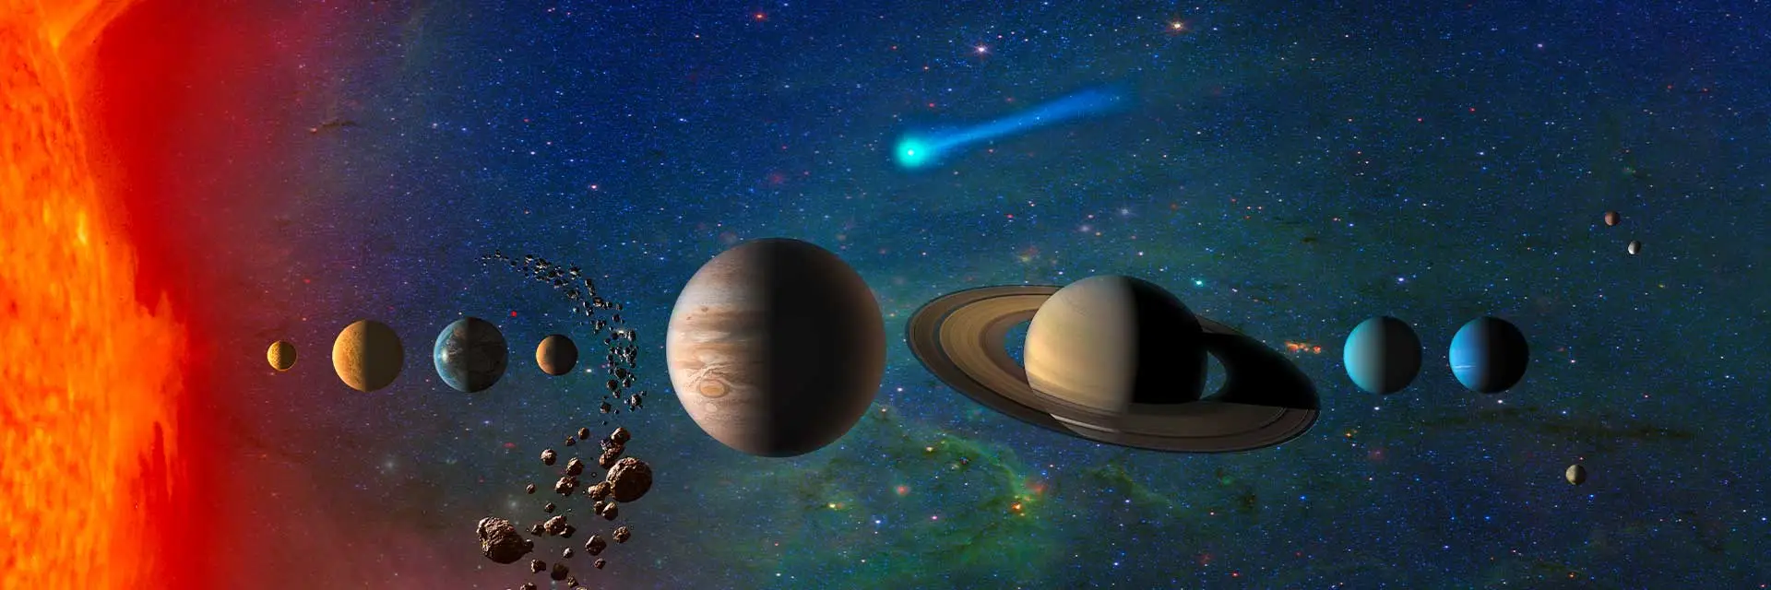
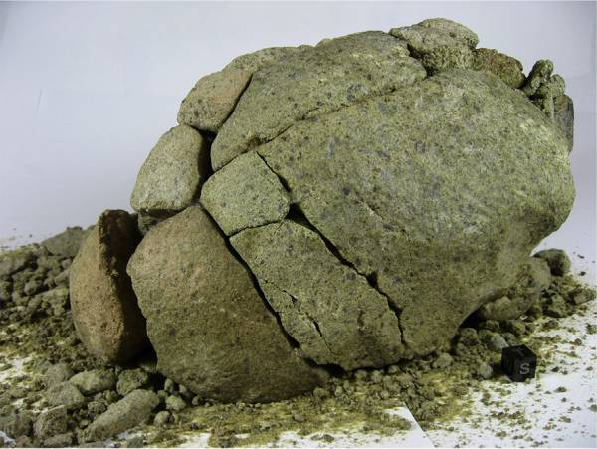


Today’s Topic is Another p-Nucleus: ⁹²Nb
Short-lived radionuclides (SLRs), with half-lives of 0.1–100 Myr, are powerful chronometers of Solar System formation
Among the 19 known SLRs, ⁹²Nb is one of the few confirmed proton-rich SLRs
It’s synthesized in supernovae environments and became extinct shortly after the formation of the Solar System
Its former presence is inferred from excesses in its EC-decay daughter, ⁹²Zr , measured in meteorites from both the inner and outer Solar System^{i,ii}
half-life $≈$ 34.7 Myr
⁹²Nb
⁹²Zr
Supernovae
Solar System formation
Meteoric Analysis
Cassiopeia A Supernovae (JWST-NASA)
(NASA)
NWA 6074 (Hibiya et al., (2019))
Harper, C. L., Jr. 1996, ApJ, 466, 437
Haba et.al, (2021) Proc. Natl. Acad. Sci. U.S.A. 118 (8)

Slide 5
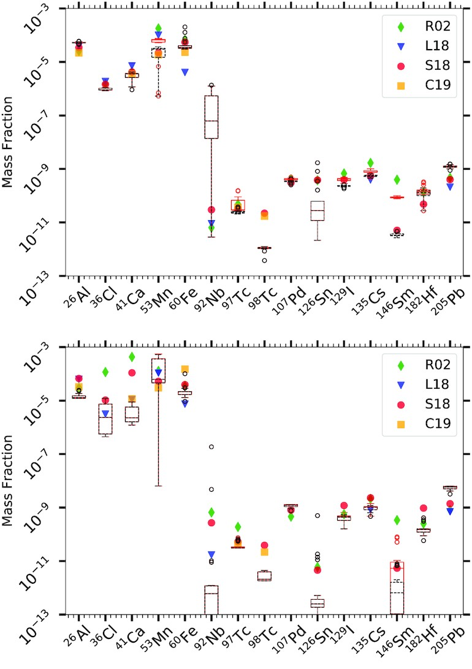
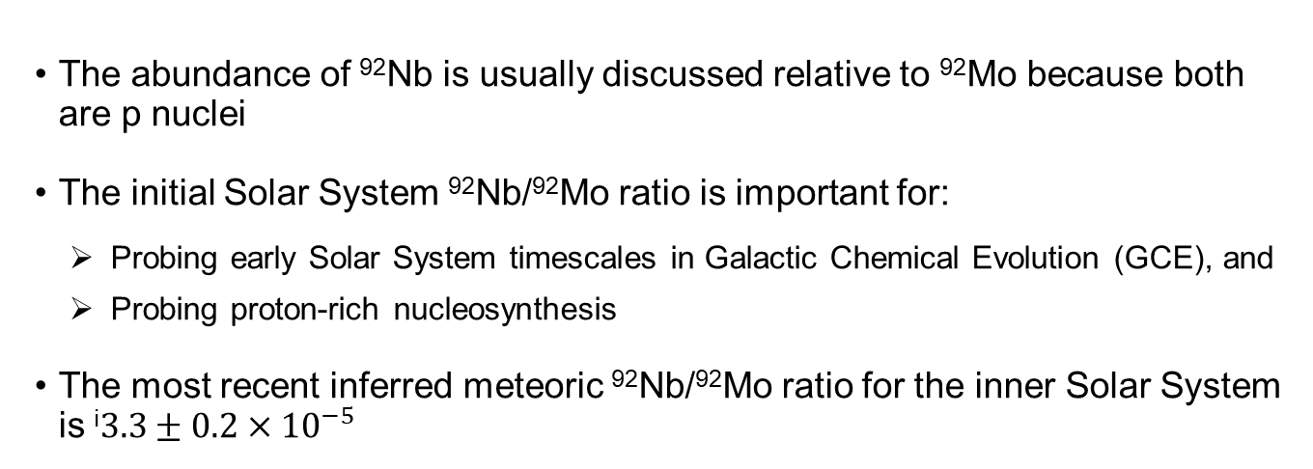
Why is ⁹²Nb Important?
The abundance of ⁹²Nb is usually discussed relative to ⁹²Mo because both are p nuclei
The initial Solar System ⁹²Nb/⁹²Mo ratio is important for:
Probing early Solar System timescales in Galactic Chemical Evolution (GCE), and
Probing proton-rich nucleosynthesis
The most recent inferred meteoric ⁹²Nb/⁹²Mo ratio for the inner Solar System is ^{i}$3.3±0.2×{10}^{−5}$
15 𝑀⨀
Interpreting this meteoritic ratio is currently limited by both astrophysical and nuclear-physics uncertainties in ⁹²Nb production. For example:
If ⁹²Nb were produced only in Type Ia supernovae, the inferred meteoric ⁹²Nb/⁹²Mo ratio would be ~50% lower to match time scales from other SLRs: Lugaro (2016)
Among the 15 SLRs, the production of ⁹²Nb is one the most uncertain in CCSNe stellar models: Lawson (2022)
20 𝑀⨀
Lawson et. al, MNRAS 511, 886–902 (2022)
Haba et.al, (2021) Proc. Natl. Acad. Sci. U.S.A. 118 (8)

Slide 6
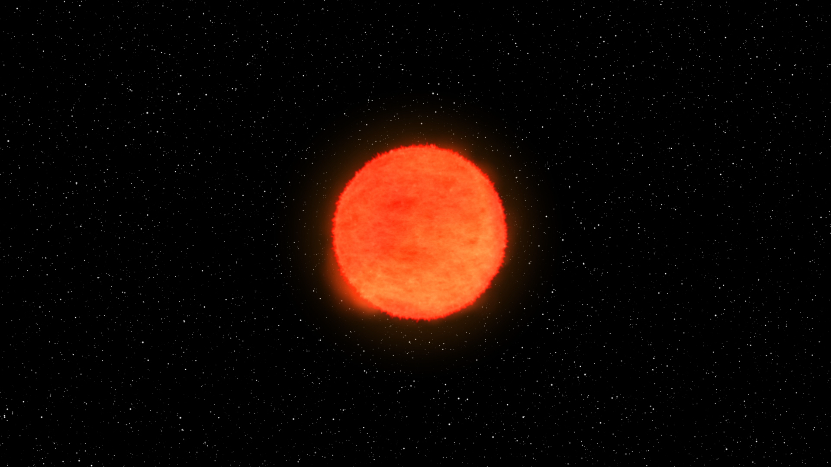
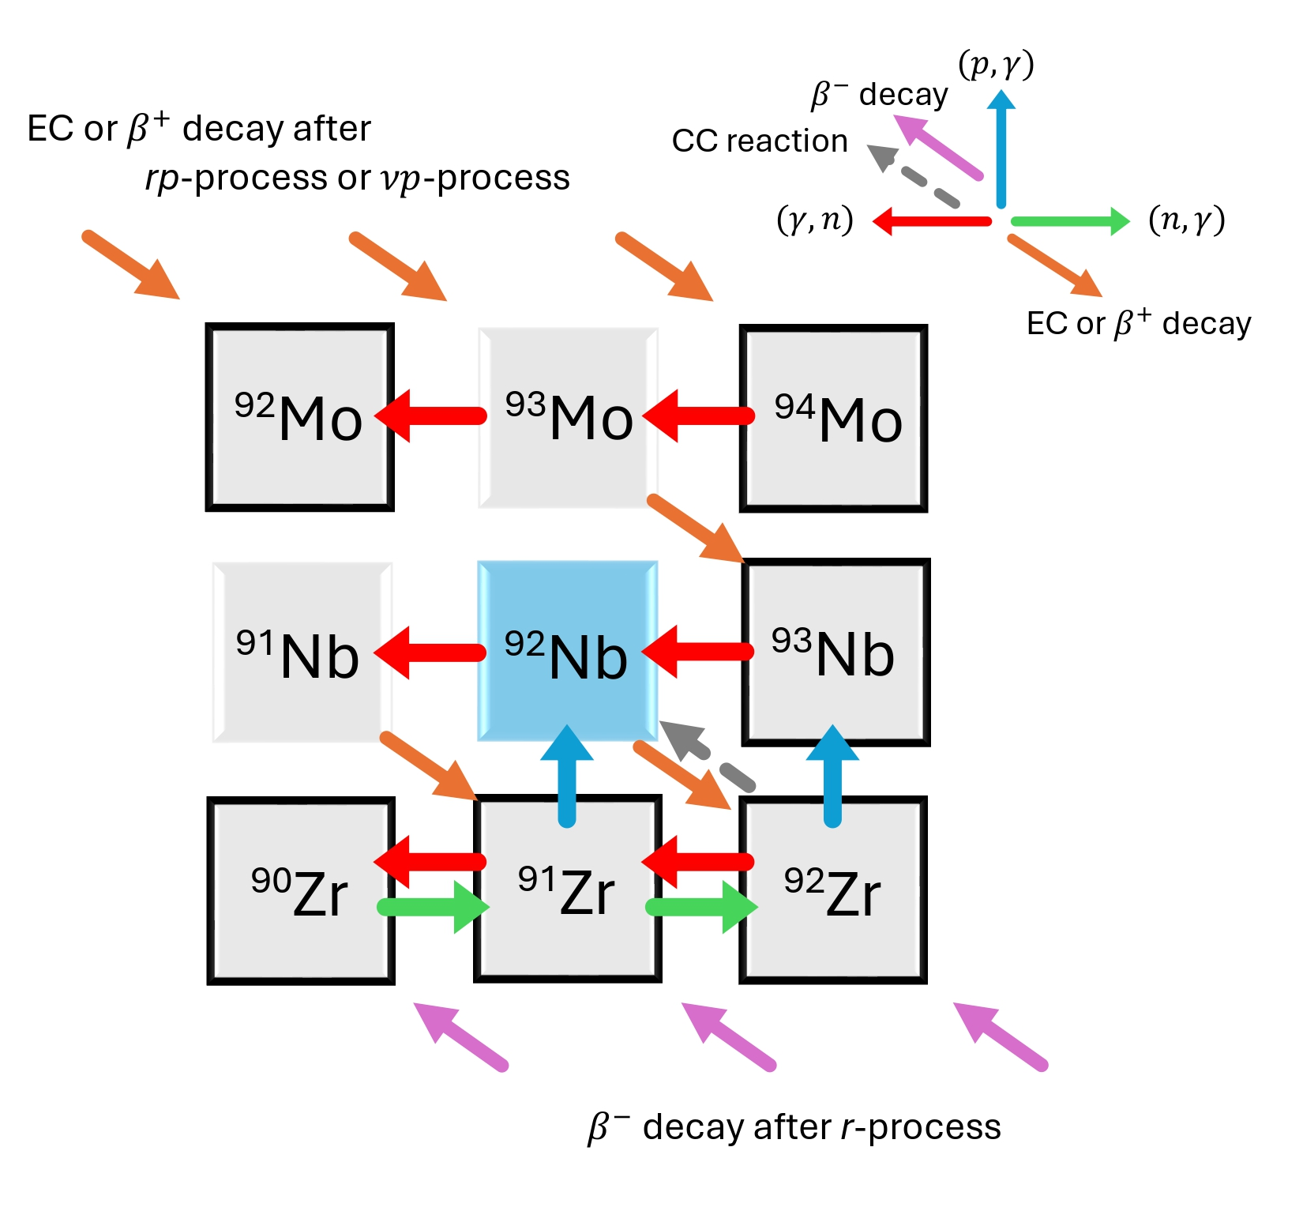

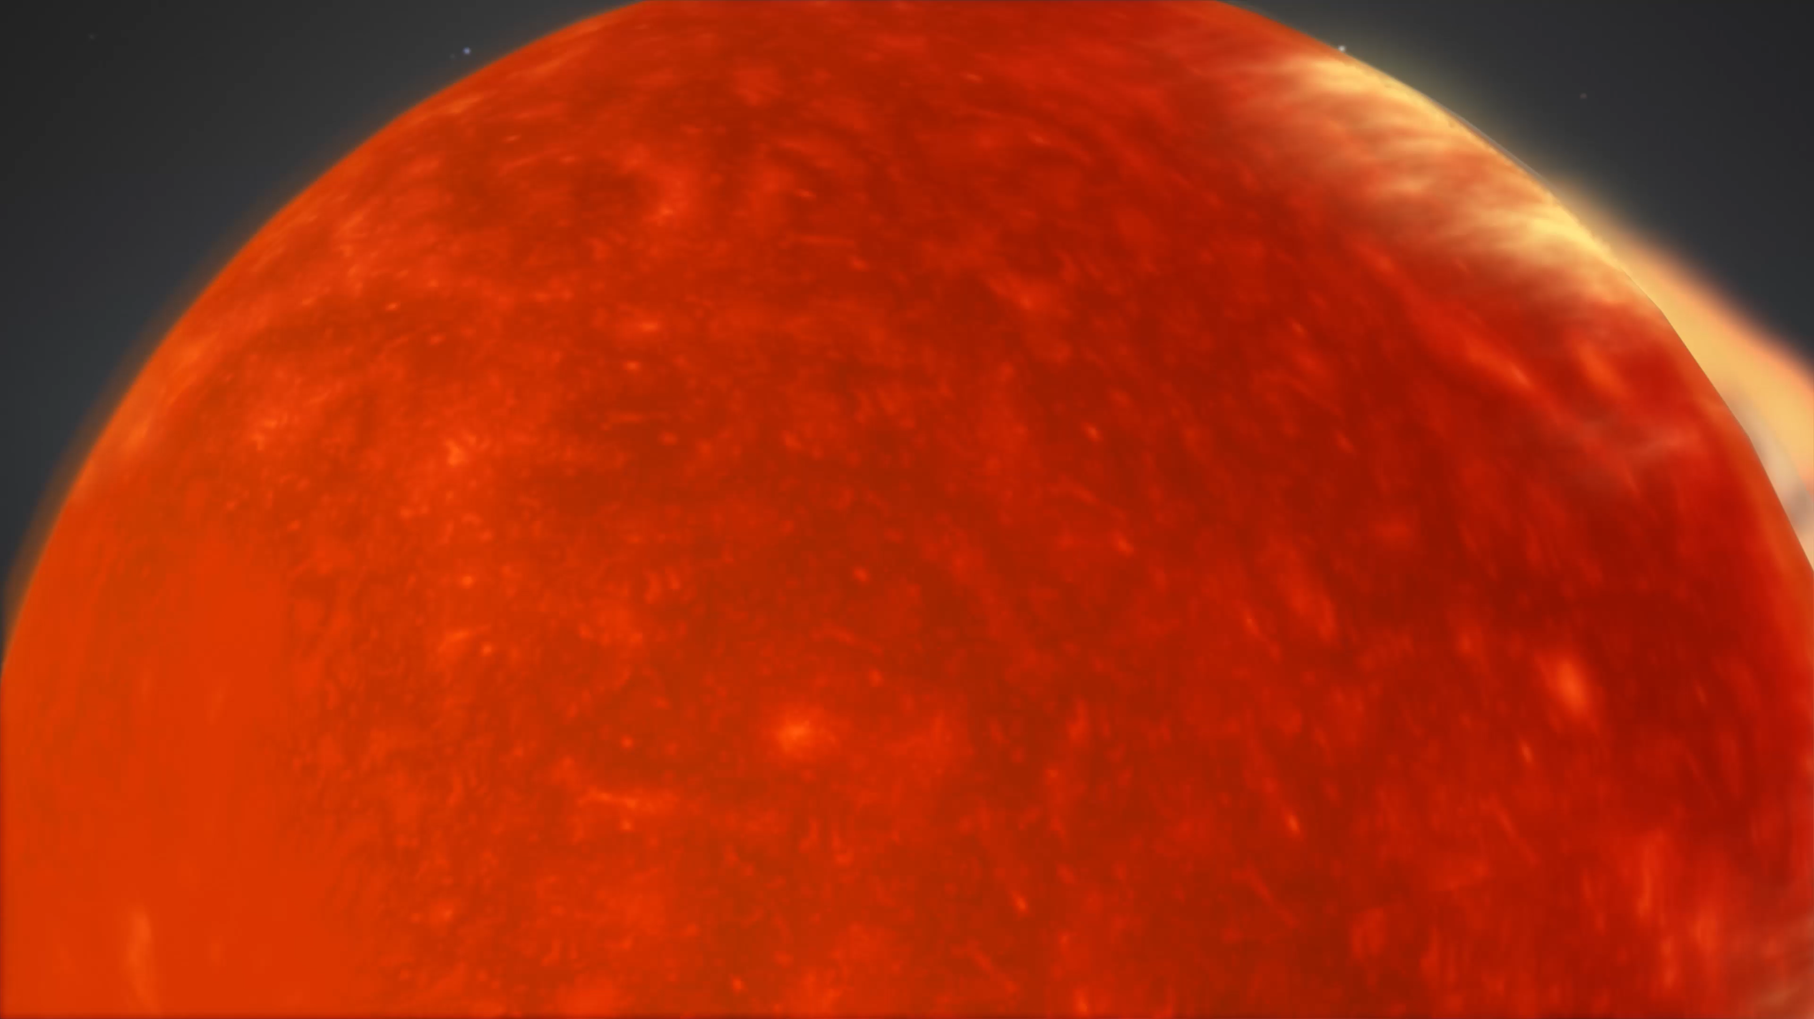


Possible Production Sites of ⁹²Nb
The origin of ⁹²Nb remains uncertain because it is shielded by the stable isobars ⁹²Zr and ⁹²Mo
Core-Collapse supernovae (CCSNe)
NASA
$γ$-process^{i}
$ν$/$νr$-process^{ii}
$α$-process^{i}
direct nuclear reactions in supernova explosions
Type Ia Supernovae (SNe Ia)
https://fineartamerica.com
NASA
Proton number
$γ$-process^{iii}
Neutron number
Lugaro, Proc. Natl. Acad. Sci. U.S.A. 113 (4) 907-912 (2016)
T. Hayakawa et al., Ap.J.Lett. 779, L9 (2013)
C. Travaglio et al., Ap.J. 795: 141 (2014)

Slide 7
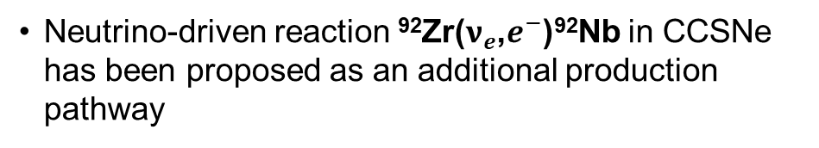
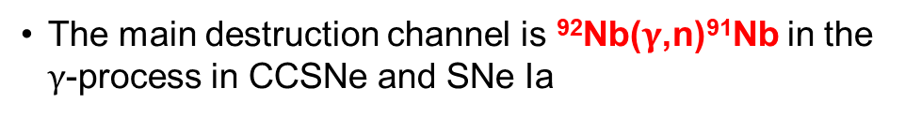
What Matters Most for ⁹²Nb Production?
NASA
1
The main destruction channel is ⁹²Nb($γ$,n)⁹¹Nb in the $γ$-process in CCSNe and SNe Ia
2
Neutrino-driven reaction ⁹²Zr($ν_{e}$,$e^{−}$)⁹²Nb in CCSNe has been proposed as an additional production pathway
Neither reaction has direct experimental constraints yet, whereas most other relevant reactions are better constrained and have smaller impact
1
https://fineartamerica.com
2
NASA
Proton number
The goal is to constraint these two reactions experimentally and evaluate their impact in GCE
Neutron number
Lugaro, Proc. Natl. Acad. Sci. U.S.A. 113 (4) 907-912 (2016)
C. Travaglio et al., Ap.J. 795: 141 (2014)
T. Hayakawa et al., Ap.J.Lett. 779, L9 (2013)
1

Slide 8
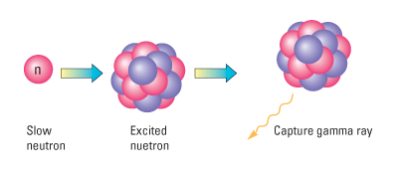
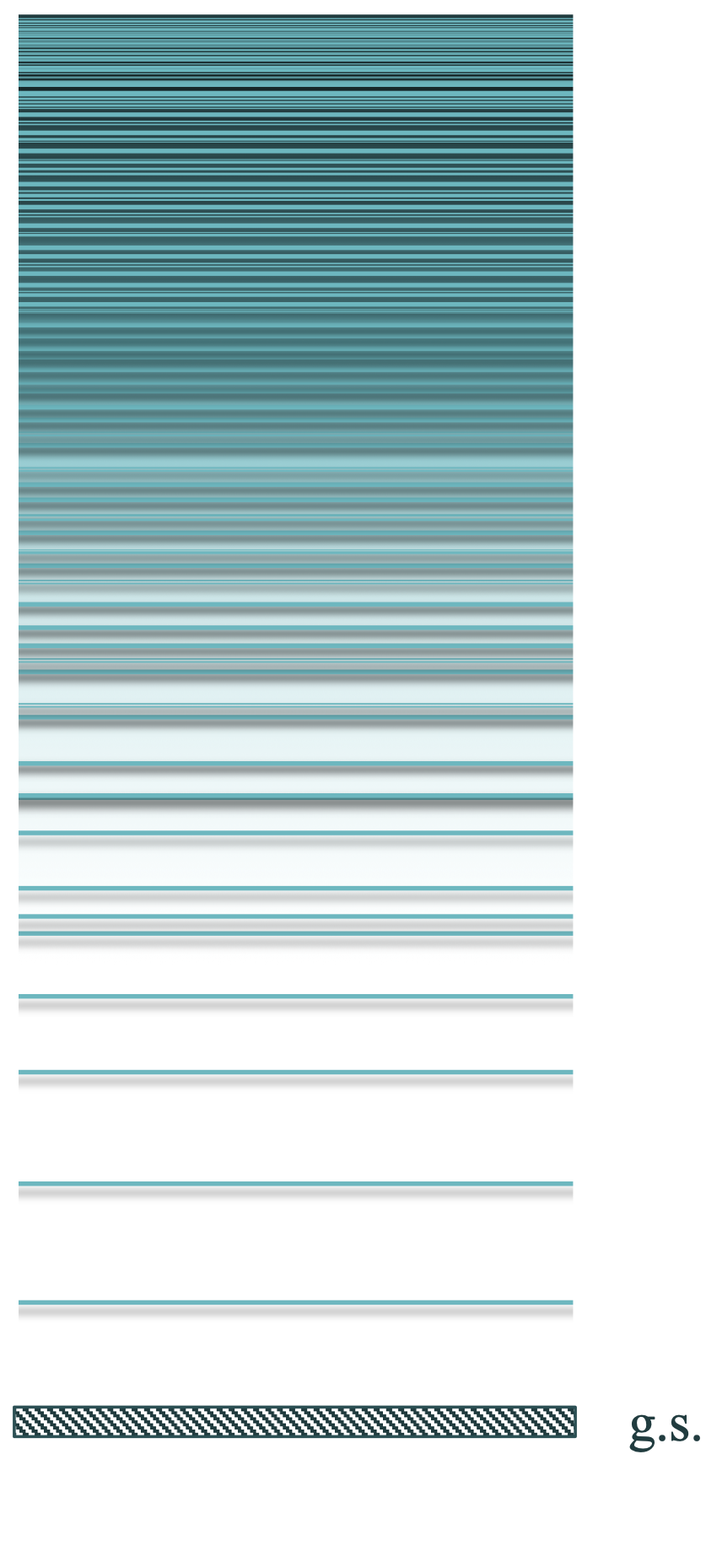
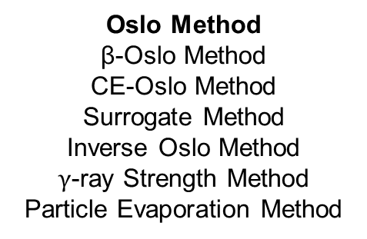
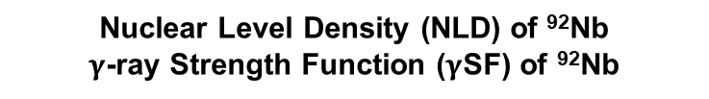
How Can We Constrain the ⁹¹Nb(n,$γ$)⁹²Nb Reaction?
Direct measurements
⁹¹Nb
Nuclear Experiments
Beta decays
Transfer reactions
Surrogate reactions
Knockout/pickup reactions
Charge-Exchange reactions
Not feasible because ⁹¹Nb is unstable and there is no practical neutron target for inverse kinematic measurements
⁹²Nb*
Indirect measurements
Hauser-Feshbach
Calculations
Can access the same compound nucleus and can be applied for short-lived nuclei
Oslo Method
β-Oslo Method
CE-Oslo Method
Surrogate Method
Inverse Oslo Method
$γ$-ray Strength Method
Particle Evaporation Method
Odd-odd nucleus near N=50
Optical Model Potential (OMP)
⁹²Nb
Nuclear Level Density (NLD) of ⁹²Nb
$γ$-ray Strength Function ($γ$SF) of ⁹²Nb
^{Target nucleus}

Slide 9
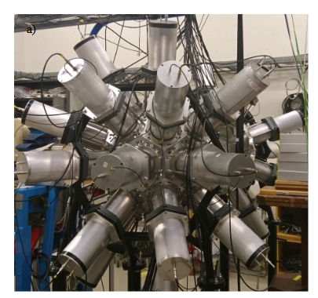
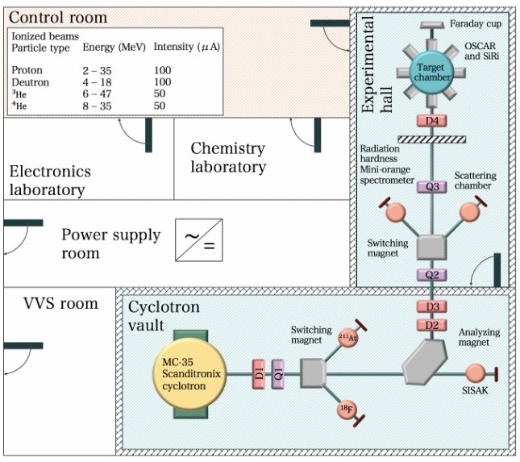
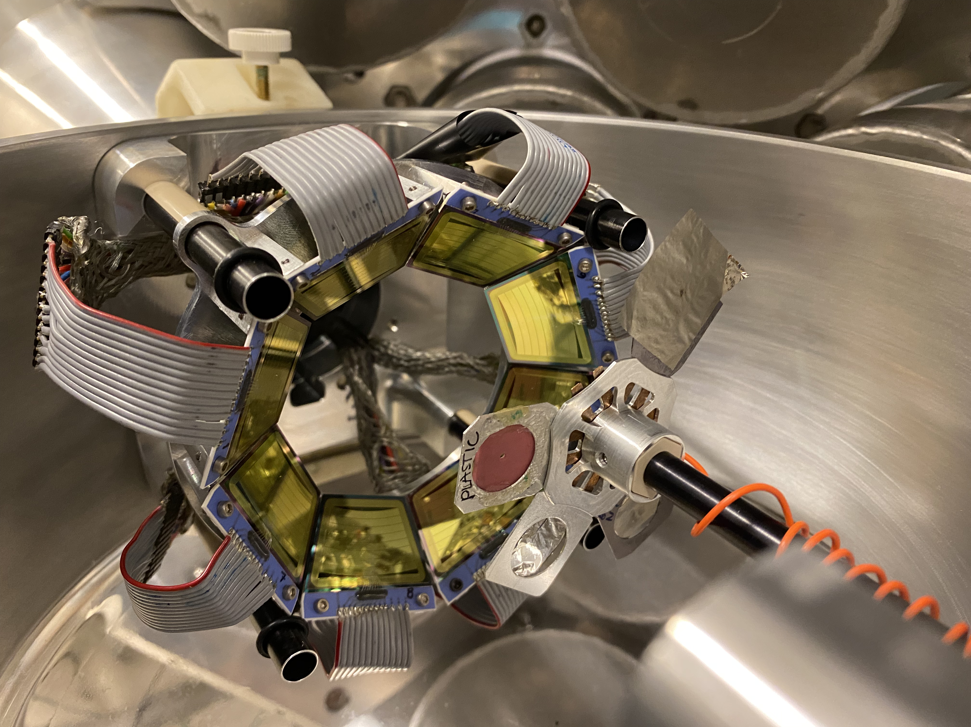
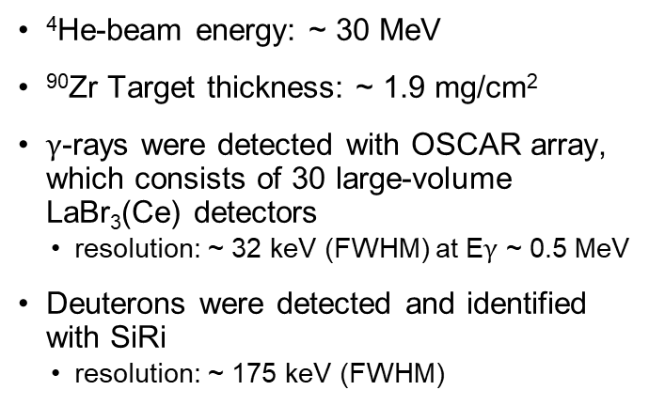
⁹⁰Zr(α,d+$\text{γ}$)⁹²Nb Experiment at Oslo Cyclotron Laboratory
OSCAR
The experiment was run in forward kinematics using the SiRi^{i} particle telescope in coincidence with the Oslo SCintillator ARray (OSCAR^{ii})
⁴He-beam energy: ~ 30 MeV
⁹⁰Zr Target thickness: ~ 1.9 mg/cm²
$\text{γ}$-rays were detected with OSCAR array, which consists of 30 large-volume LaBr₃(Ce) detectors
resolution: ~ 32 keV (FWHM) at E$\text{γ}$ ~ 0.5 MeV
Deuterons were detected and identified with SiRi
resolution: ~ 175 keV (FWHM)
M.Markova’s M.Sc. thesis
SiRi
M.Markova’s M.Sc. thesis
Captured by A.C. Larsen
M. Guttormsen et al., Nucl. Instrum. Methods Phys. Res., Sect. A 648, 168 (2011)
F. Zeiser et al., Nucl. Instrum. Methods Phys. Res., Sect. A 985, 164678 (2021)

Slide 10
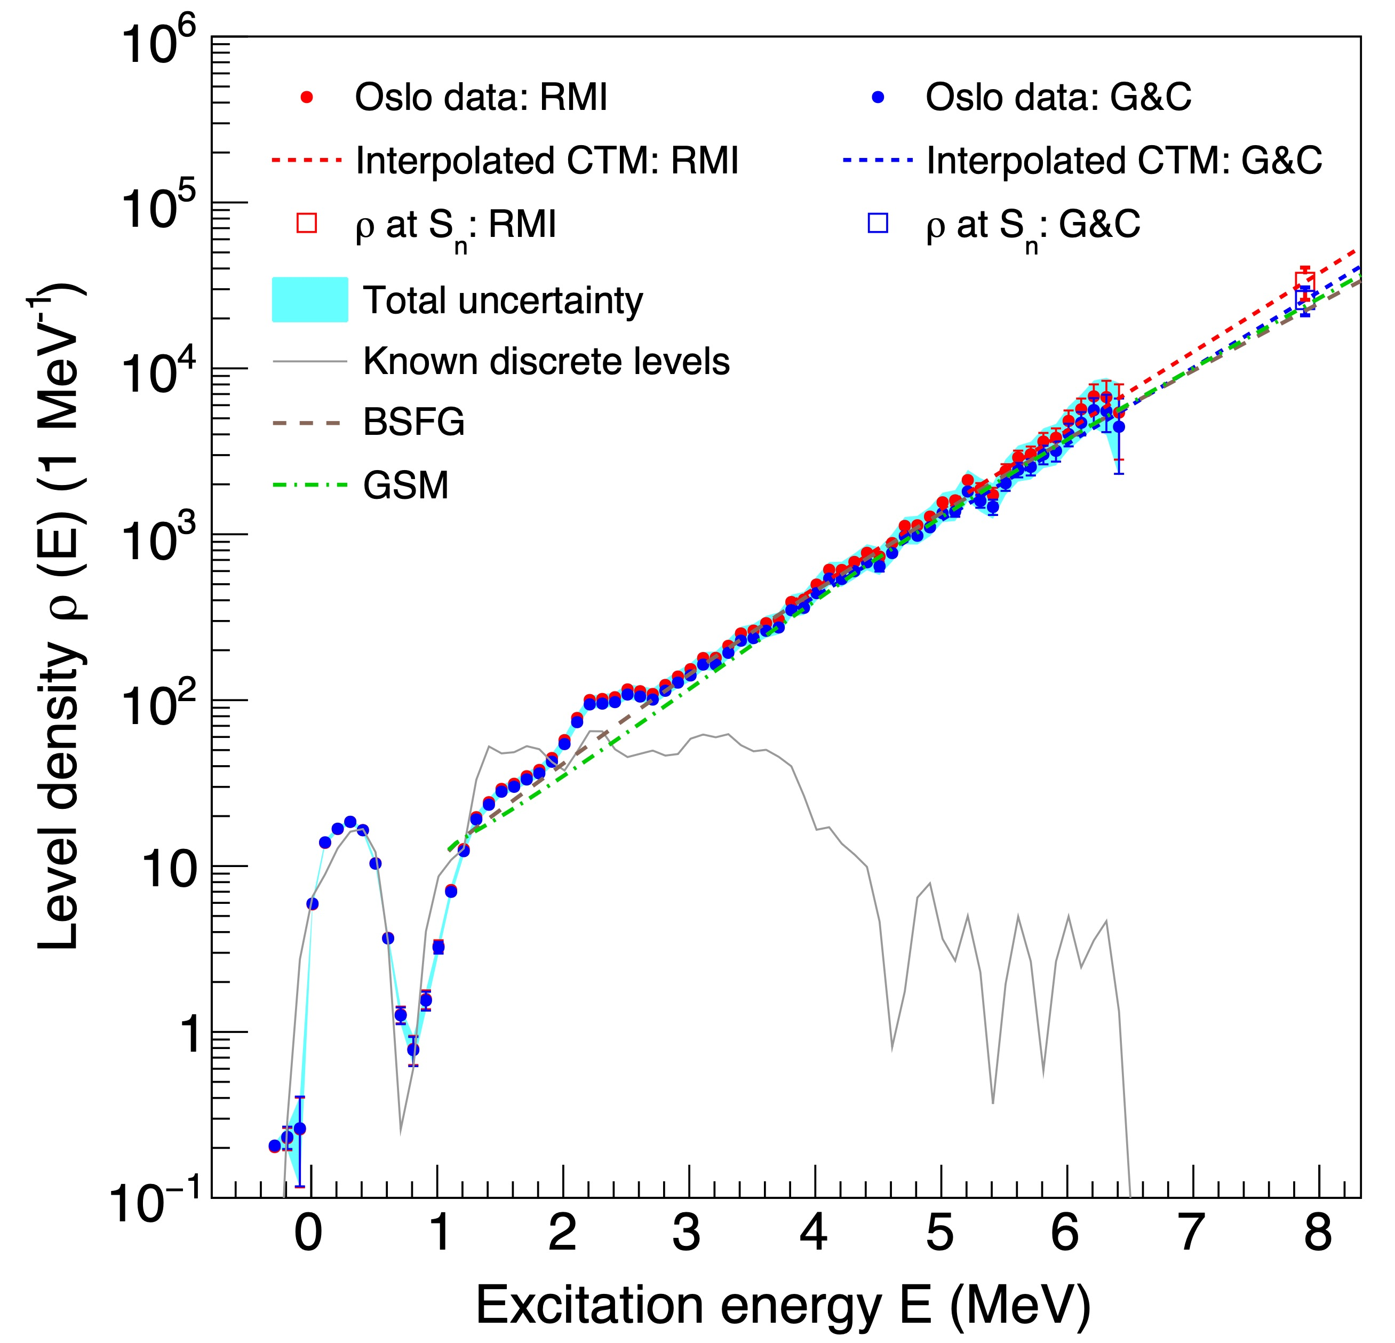
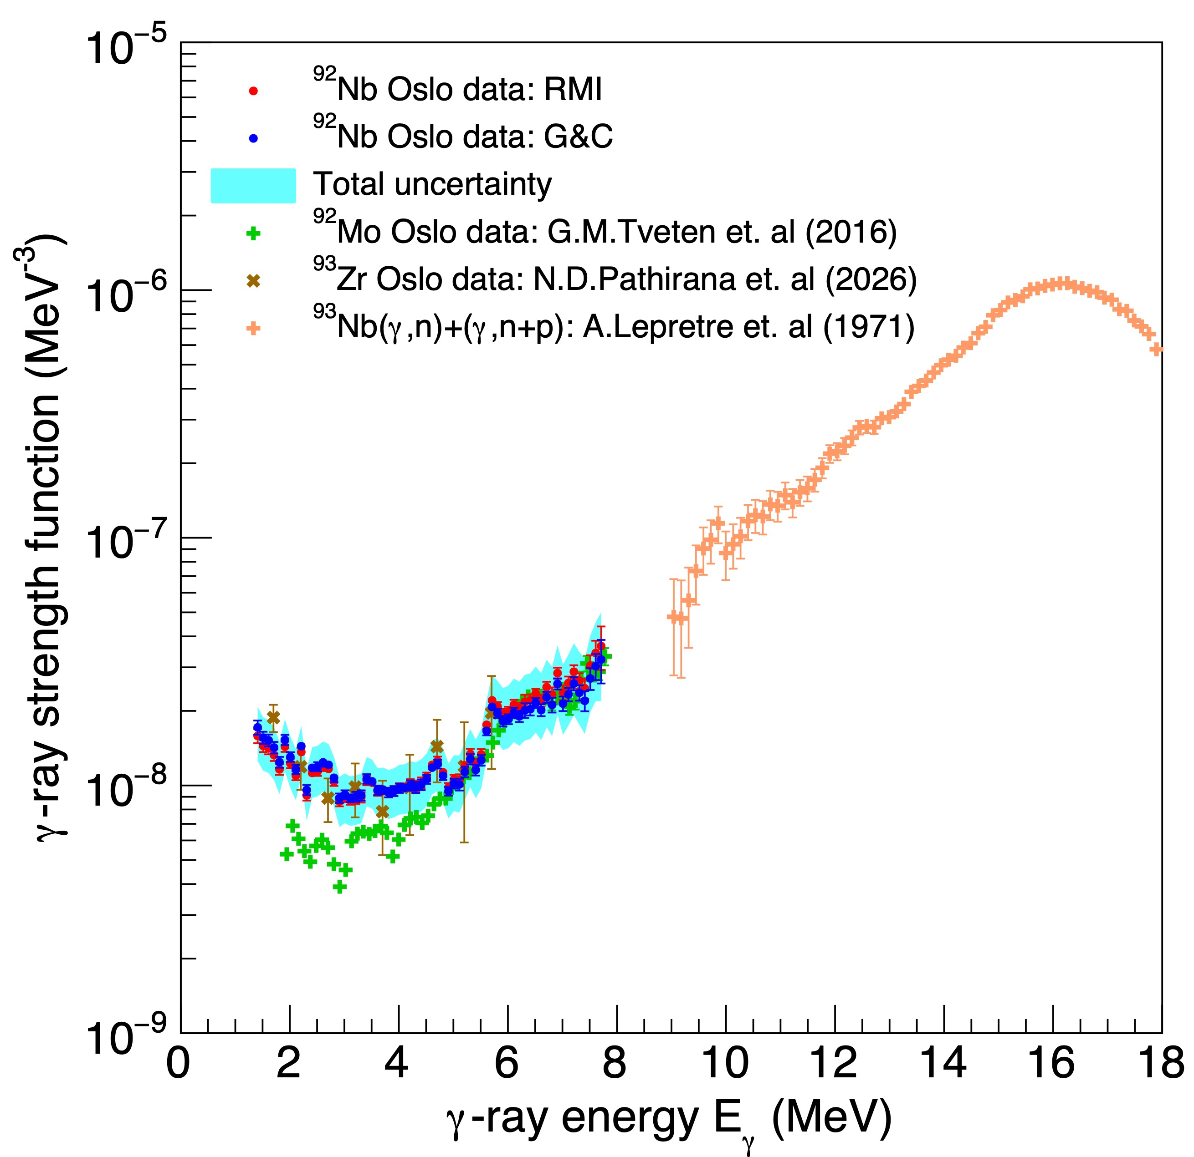
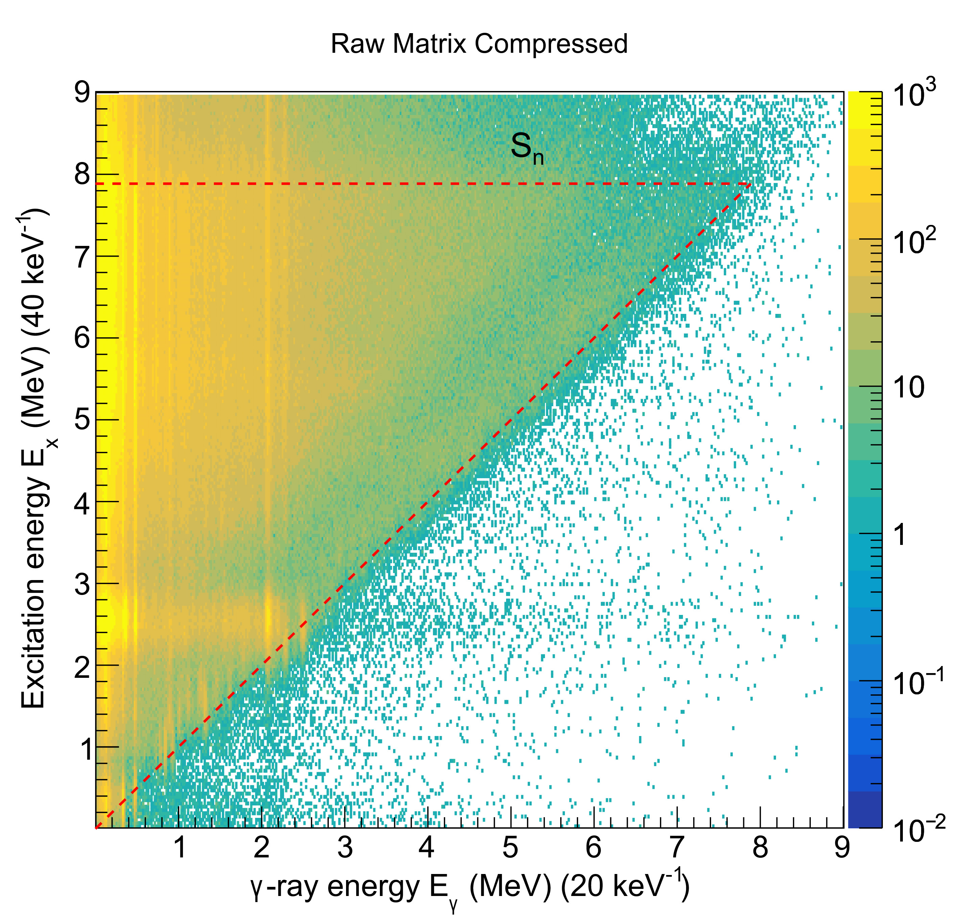
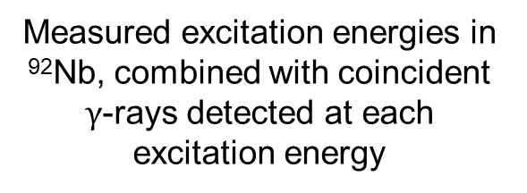
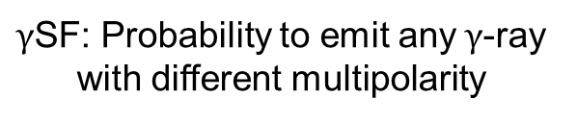


Experimentally Extracted NLD and $\text{γ}$SF of ⁹²Nb
Nuclear Level Density of ⁹²Nb
$γ$-ray Strength Function of ⁹²Nb
Measured excitation energies in ⁹²Nb, combined with coincident $γ$-rays detected at each excitation energy
⁹²Nb Particle-$γ$ Coincidence Matrix
NLD: Number of levels per MeV as a function of E_{x}
$γ$SF: Probability to emit any$γ$-ray with different multipolarity
Oslo Method

Slide 11
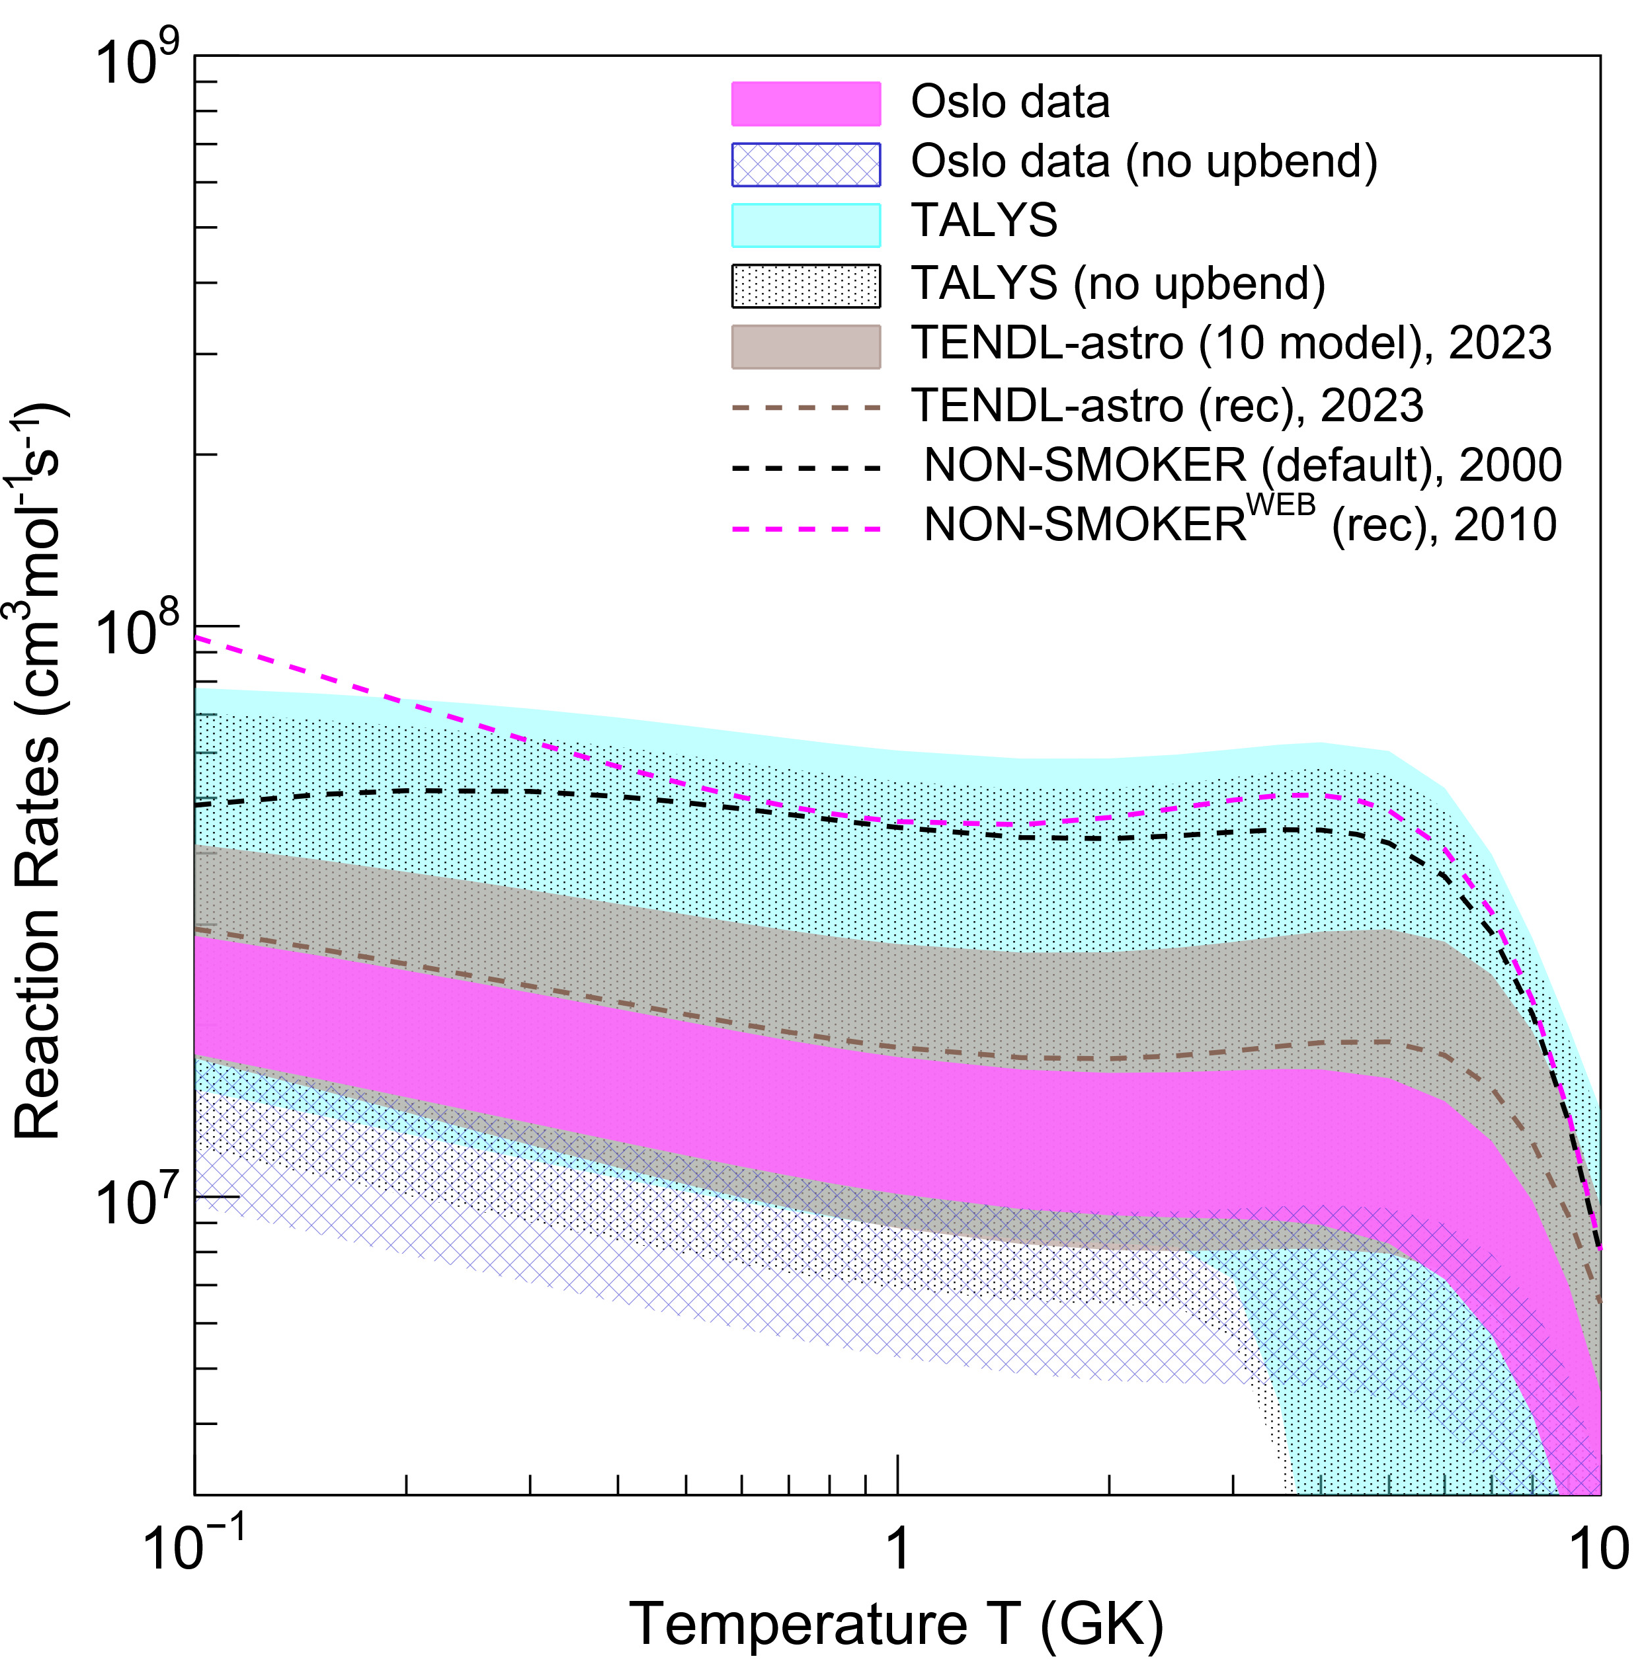
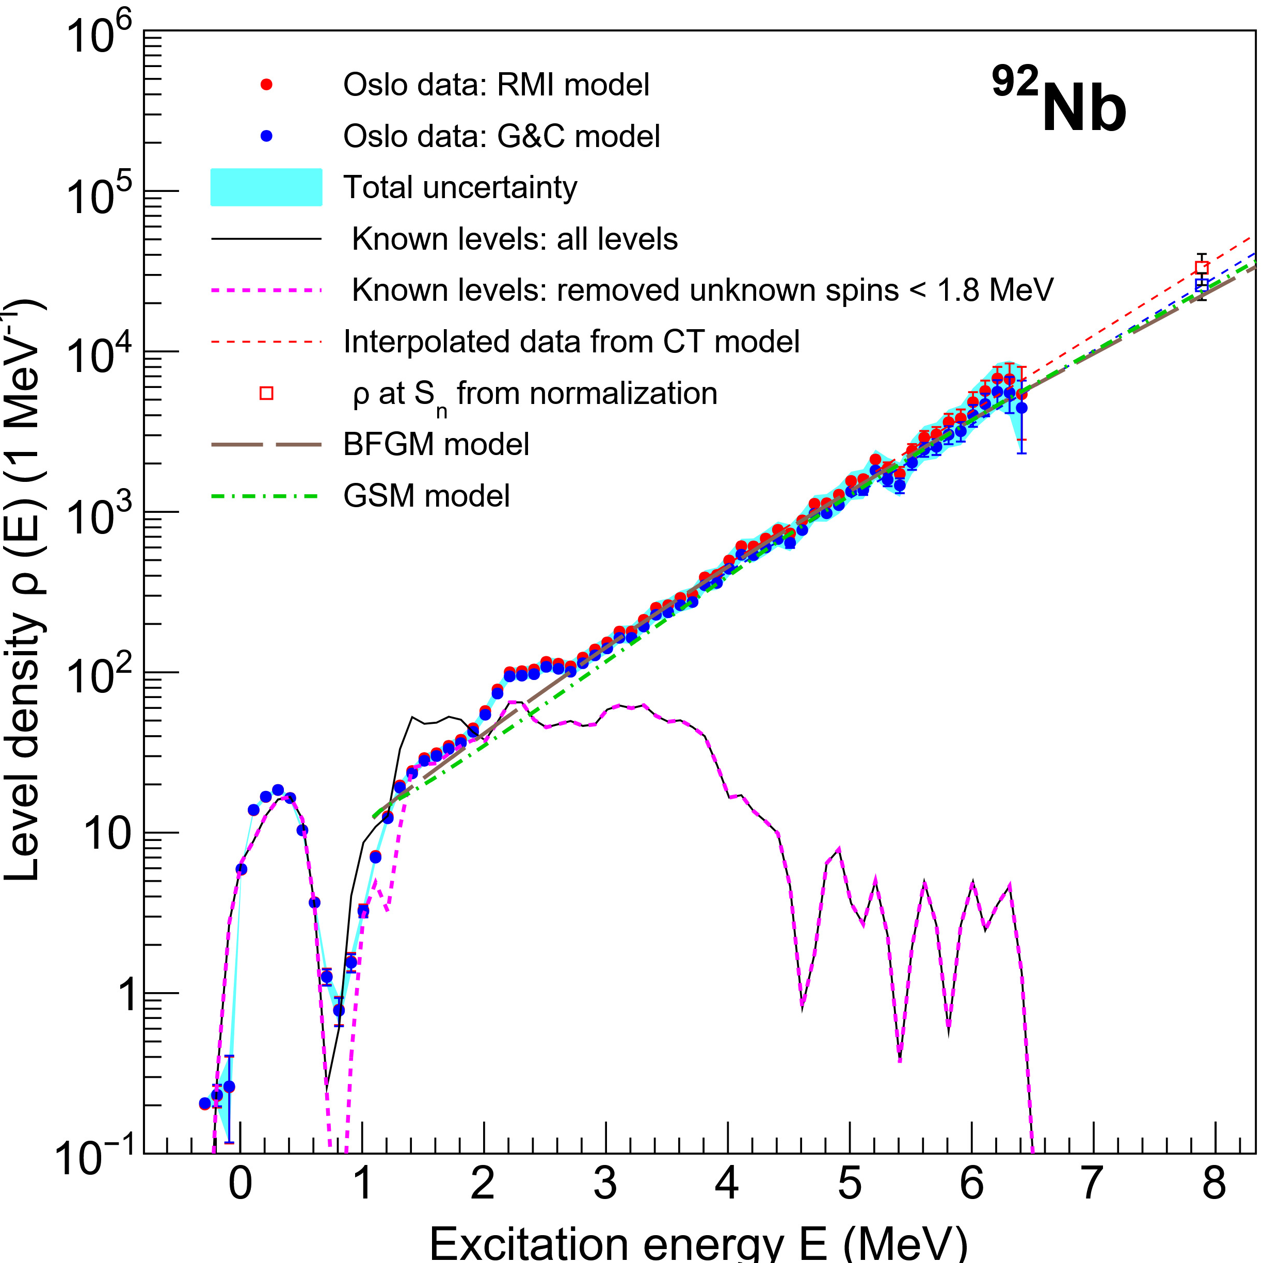
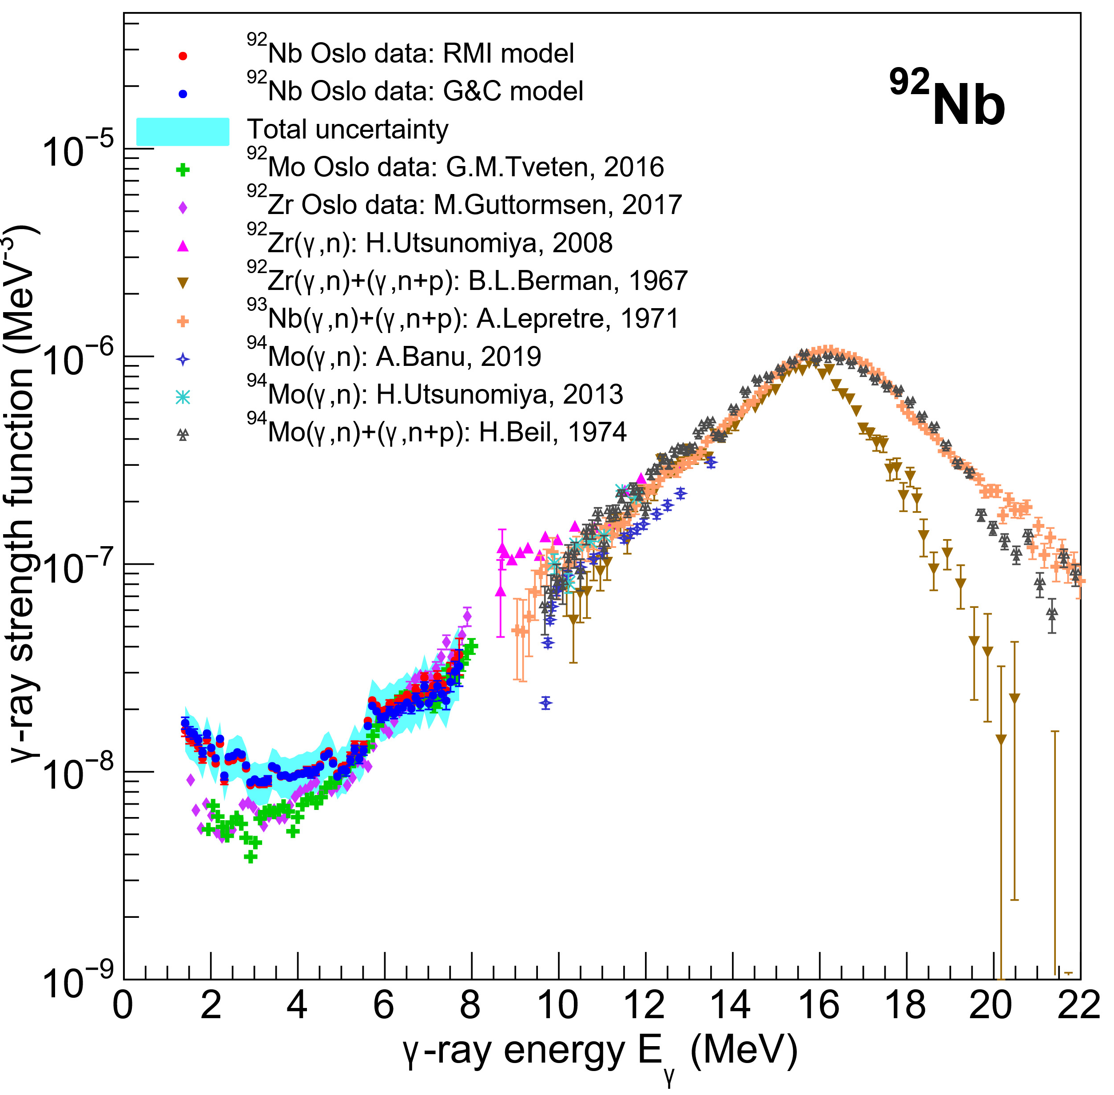



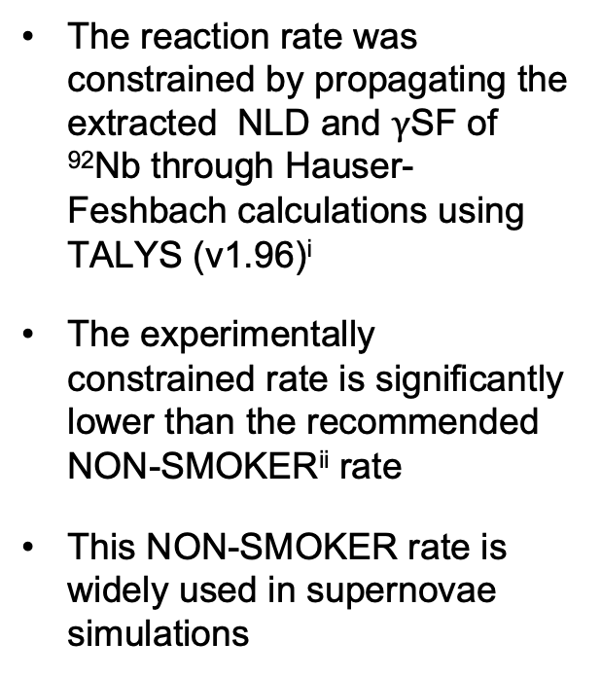

Constrained ⁹¹Nb(n,$\text{γ}$)⁹²Nb Reaction Rate
⁹¹Nb(n,$γ$)⁹²Nb Reaction Rate
Nuclear Level Density of ⁹²Nb
The reaction rate was constrained by propagating the extracted NLD and $γ$SF of ⁹²Nb through Hauser-Feshbach calculations using TALYS (v1.96)^{i}
The experimentally constrained rate is significantly lower than the recommended NON-SMOKER^{ii} rate
This NON-SMOKER rate is widely used in supernovae simulations
$γ$-process
$α$-process
Hauser-Feshbach
$γ$-ray Strength Function of ⁹²Nb
19-34%
19-48%
A. Koning et al., Eur. Phys. J. A (2023) 59:131
R.H. Cyburt et al., (2010), ApJS, 189, 240

Slide 12
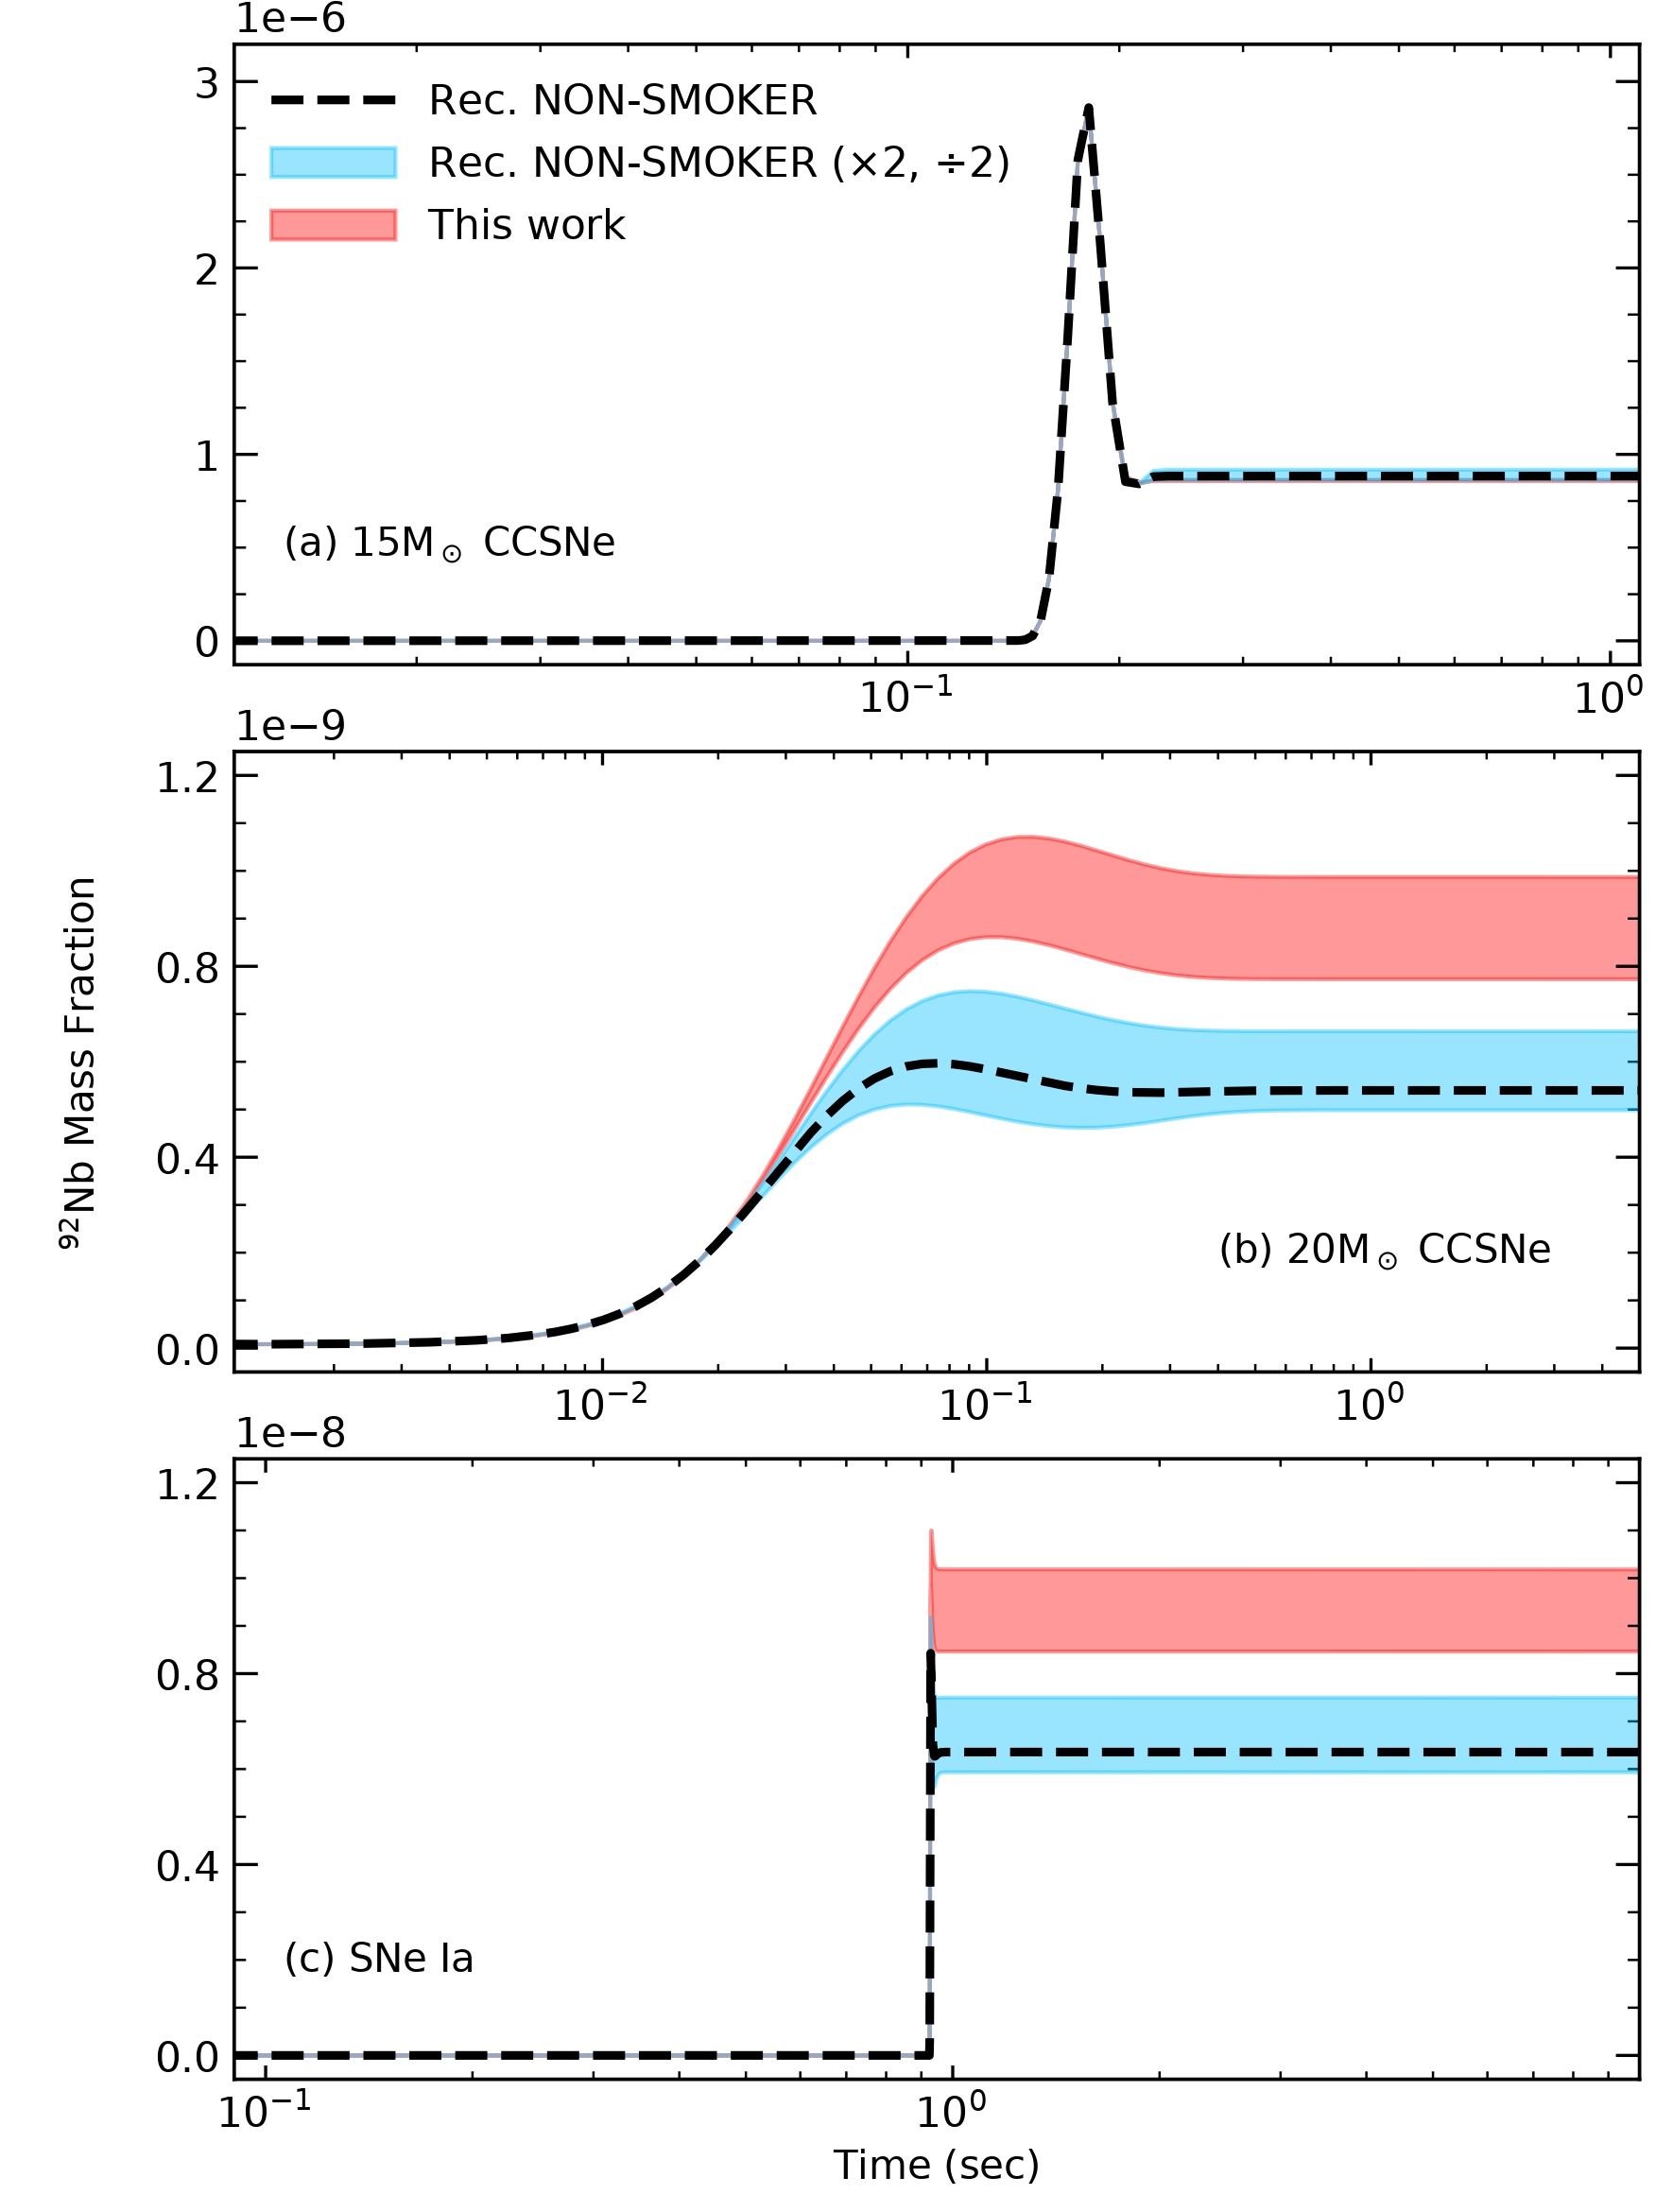
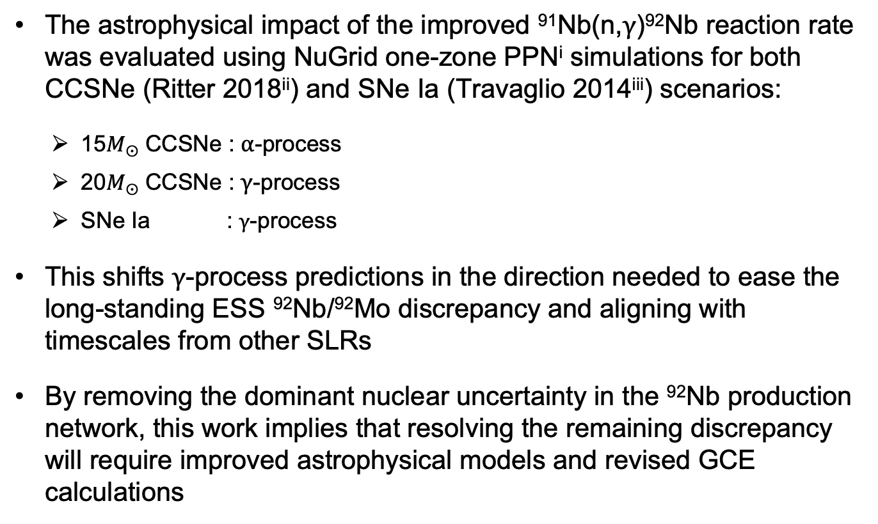
CCSNe and SNe Ia Simulations and Impact on GCE
Resulted ⁹²Nb Mass Fractions
The astrophysical impact of the improved ⁹¹Nb(n,$γ$)⁹²Nb reaction rate was evaluated using NuGrid one-zone PPN^{i} simulations for both CCSNe (Ritter 2018^{ii}) and SNe Ia (Travaglio 2014^{iii}) scenarios:
15𝑀⨀ CCSNe : $α$-process
20𝑀⨀ CCSNe : $γ$-process
SNe Ia : $γ$-process
This shifts $γ$-process predictions in the direction needed to ease the long-standing ESS ⁹²Nb/⁹²Mo discrepancy and aligning with timescales from other SLRs
By removing the dominant nuclear uncertainty in the ⁹²Nb production network, this work implies that resolving the remaining discrepancy will require improved astrophysical models and revised GCE calculations
no-change in ⁹²Nb abundance
(a) 15𝑀⨀ CCSNe
50-90% enhancement in ⁹²Nb abundance
⁹²Nb Mass Fraction
(b) 20𝑀⨀ CCSNe
(c) Sne Ia
Time (sec)
F. Herwig et al., PoS NIC X 053 (2009) 023.
Ritter et al., MNRAS 480 (2018) 538–571
C. Travaglio et al., Ap.J. 795: 141 (2014)

Slide 13
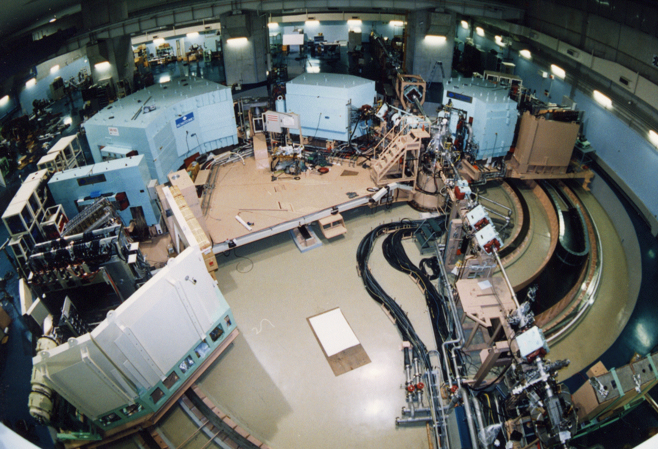
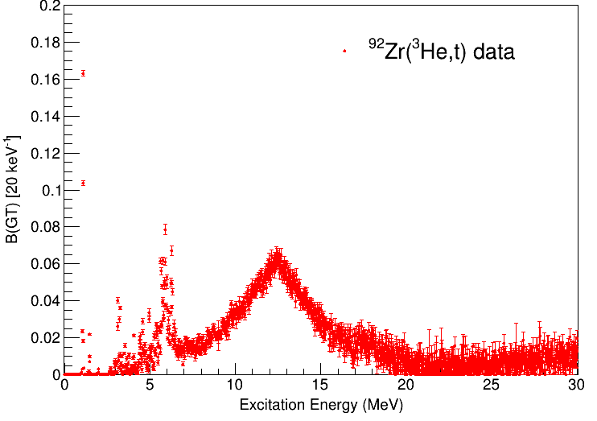
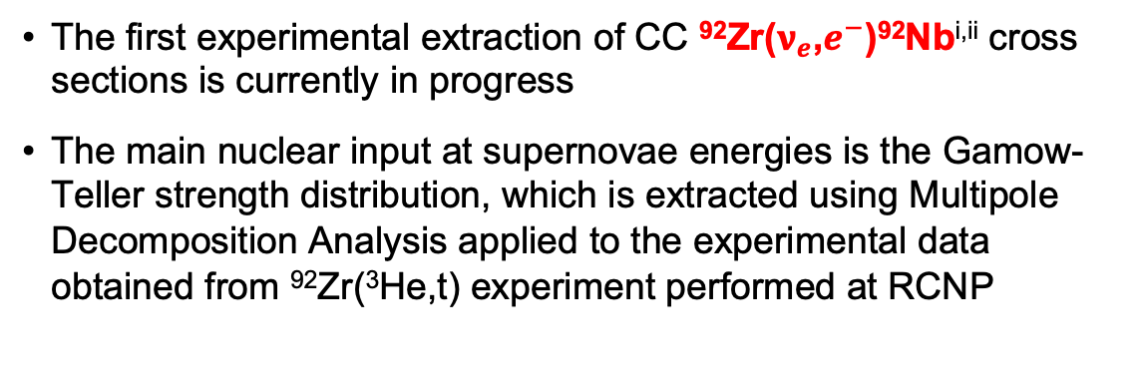
Experimental Study of ⁹²Nb Production via Charged-Current Neutrino Reaction
2
The first experimental extraction of CC ⁹²Zr($ν_{e}$,$e^{−}$)⁹²Nb^{i,ii} cross sections is currently in progress
The main nuclear input at supernovae energies is the Gamow-Teller strength distribution, which is extracted using Multipole Decomposition Analysis applied to the experimental data obtained from ⁹²Zr(³He,t) experiment performed at RCNP
NASA
B(GT) distribution
1
2
Target
NASA
1+ state at 1.089 MeV
Proton number
Beam
³He
Focal Plane of GR
Neutron number
https://www.rcnp.osaka-u.ac.jp/
T. Hayakawa et al., Ap.J.Lett. 779, L9 (2013)
Z. Xiong et al., Phys. Rev. Lett. 132, 152701 (2024)

Slide 14
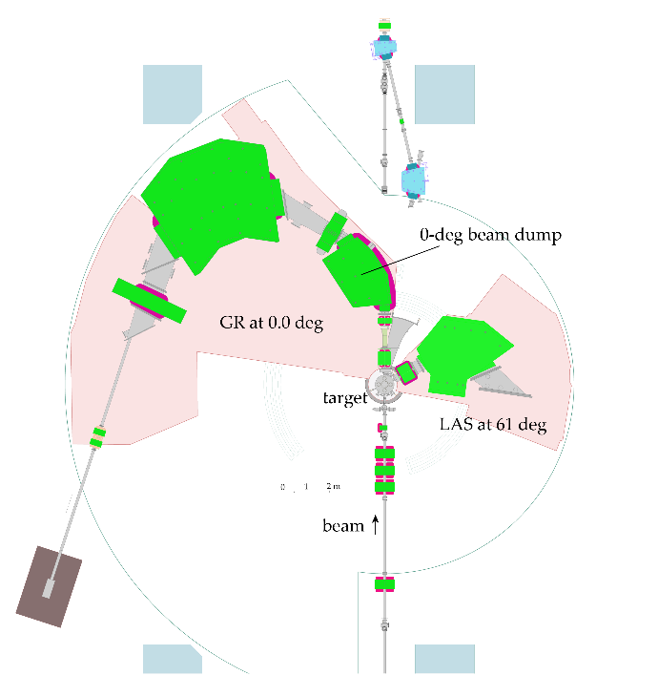
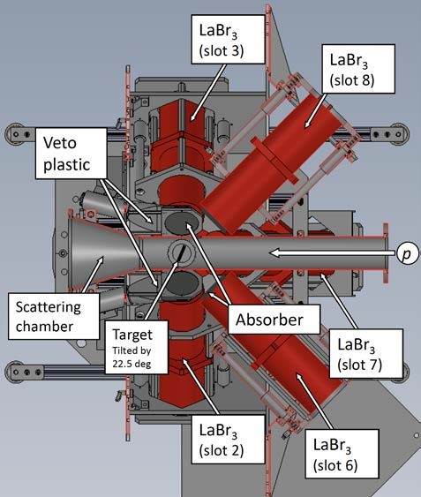
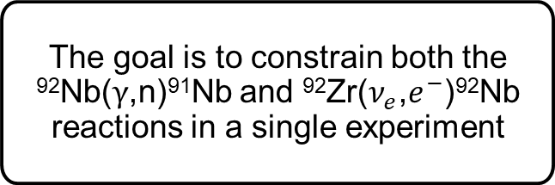
It is Planned to Run a ⁹²Zr(³He,t+$\text{γ}$) Experiment at RCNP
The goal is to constrain both the ⁹²Nb($γ$,n)⁹¹Nb and ⁹²Zr($ν_{e}$,$e^{−}$)⁹²Nb reactions in a single experiment
Target
1
2
1
2
Focal Plane of GR
Beam
³He
methods
Charge-Exchange
Oslo Method
Multipole Decomposition
Analysis
https://www.rcnp.osaka-u.ac.jp/
The experiment will be run in forward kinematics using the Grand Raiden Spectrometer (GR) in coincidence with the Scintillation Gamma-Ray Detector (SGD) array
³He beam energy: 420 MeV
⁹²Zr Target thickness: ~ 4 mg/cm²
Tritons will be detected and identified in the focal plane of the GR in the 0º setting
The SGD array will consist of 8 large-volume LaBr₃ detectors (3.5” in diameter and 8” deep)
A. Tamii, N. Kobayashi c
A. Tamii, N. Kobayashi c

Slide 15
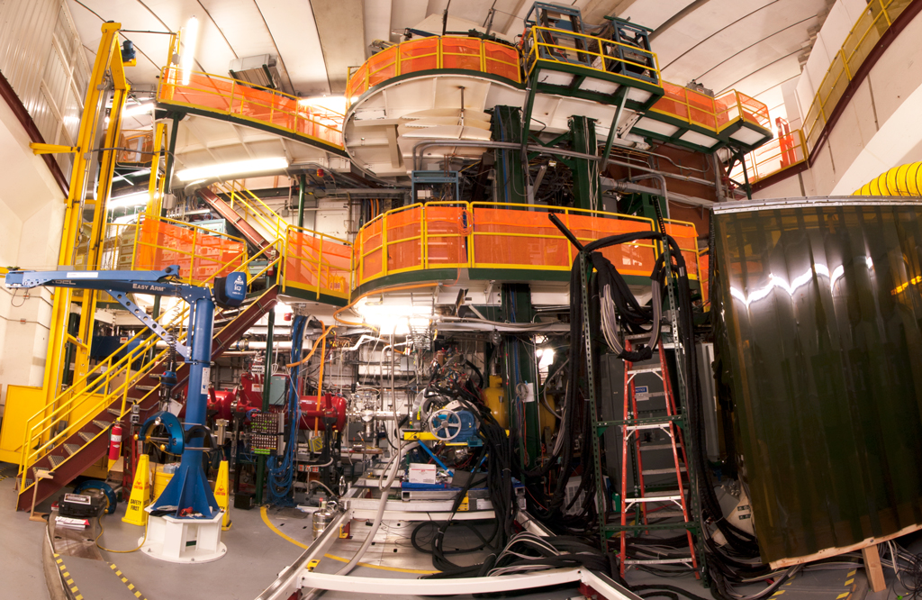

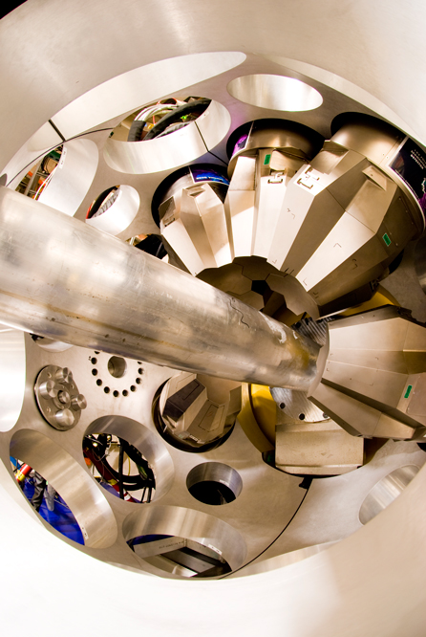
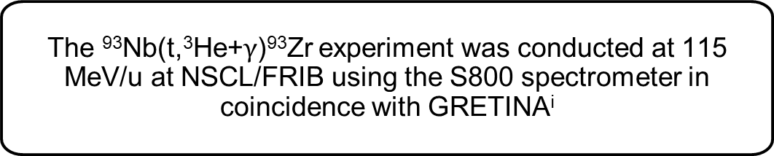
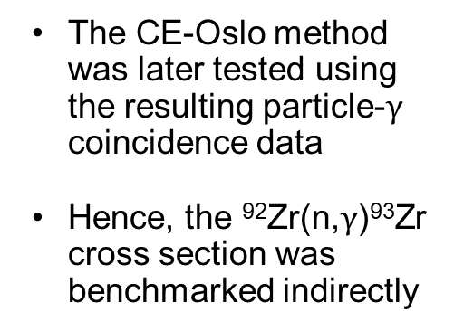

First Application of the Charge-Exchange Oslo Method: Experiment Details
⁹³Nb(t,³He+$\text{γ}$)⁹³Zr experiment setup at FRIB
The ⁹³Nb(t,³He+$\text{γ}$)⁹³Zr experiment was conducted at 115 MeV/u at NSCL/FRIB using the S800 spectrometer in coincidence with GRETINA^{i}
Gretina
γ-detection
The primary purpose was to measure Gamow-Teller Transitions from ⁹³Nb to ⁹³Zr
³He ejectiles
S800
⁹²Nb | ⁹³Nb | ⁹⁴Nb
⁹¹Zr | ⁹²Zr | ⁹³Zr
³H (115 MeV/u)
~3M pps
target (~34 mg/cm²)
The CE-Oslo method was later tested using the resulting particle-$\text{γ}$ coincidence data
Hence, the ⁹²Zr(n,$\text{γ}$)⁹³Zr cross section was benchmarked indirectly
β-decay
(t,³He+γ) beam with S800 Spectrograph +GRETINA
Photo from S. Noji
Proton number
s-process
Neutron number
Gamma-Ray Energy Tracking In-beam Nuclear Array
B.Gao et al., PhysRevC.101.014308, 2020

Slide 16
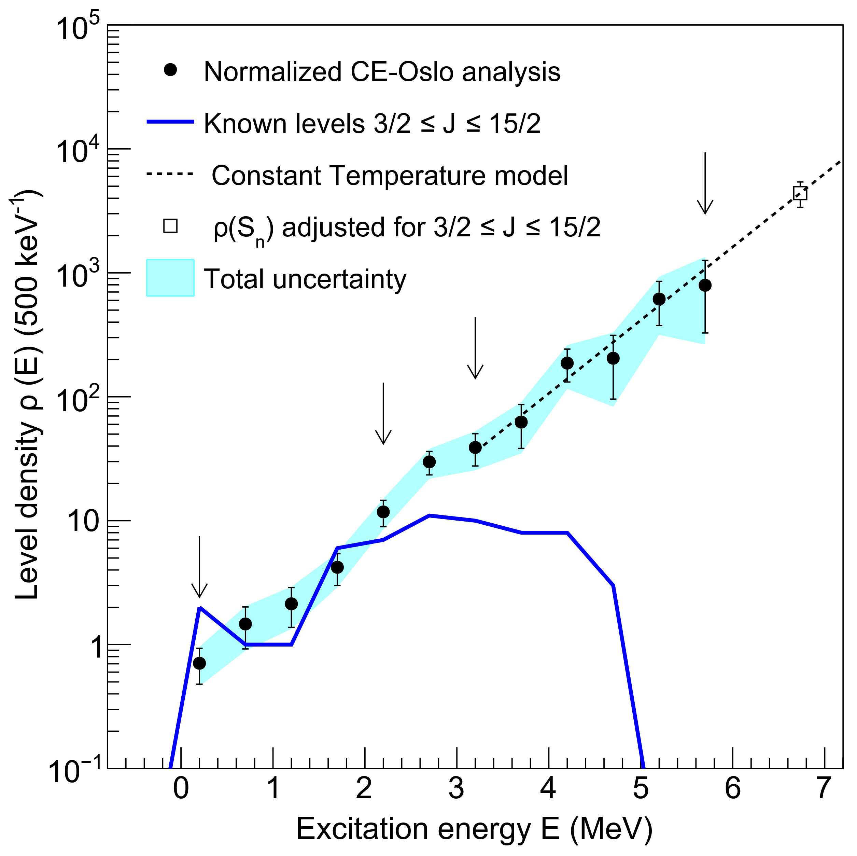
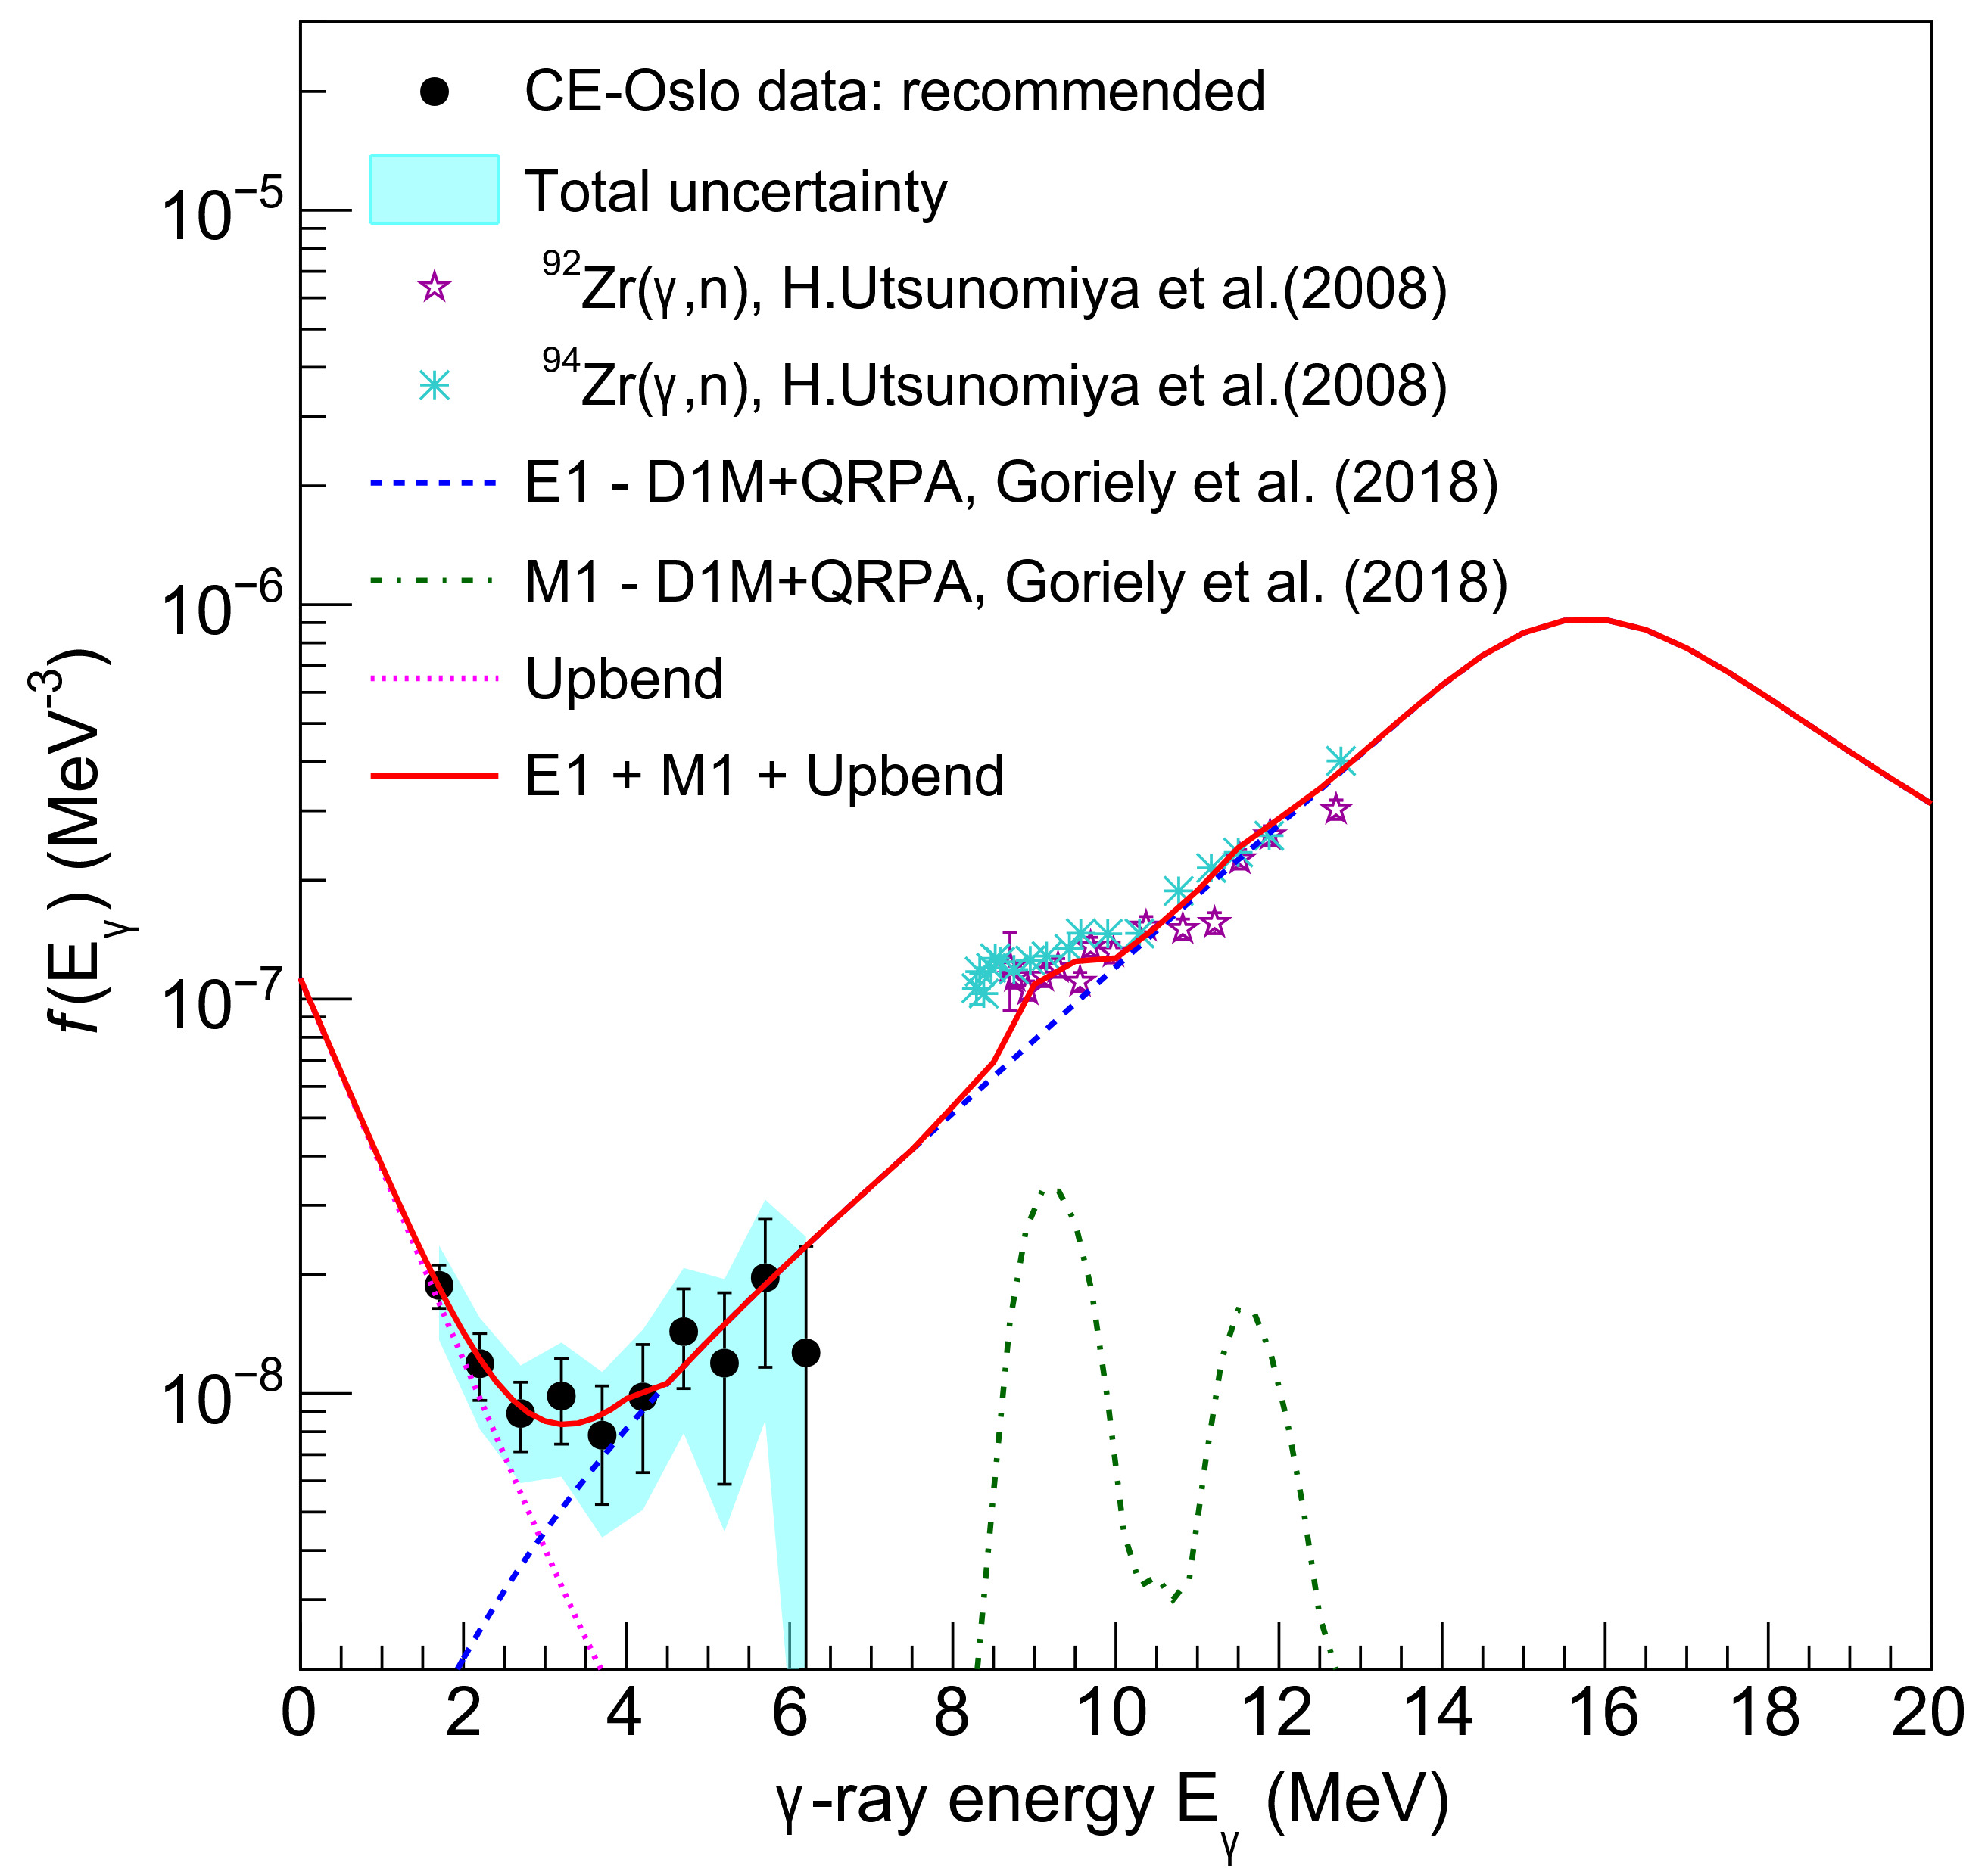
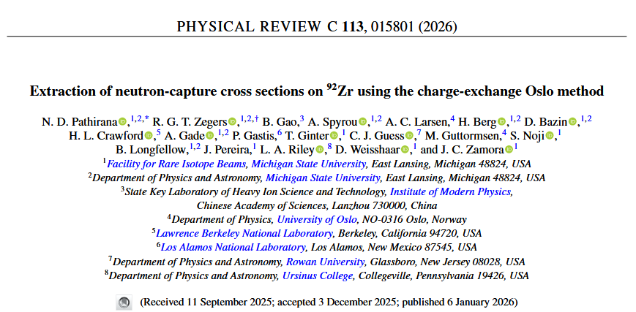
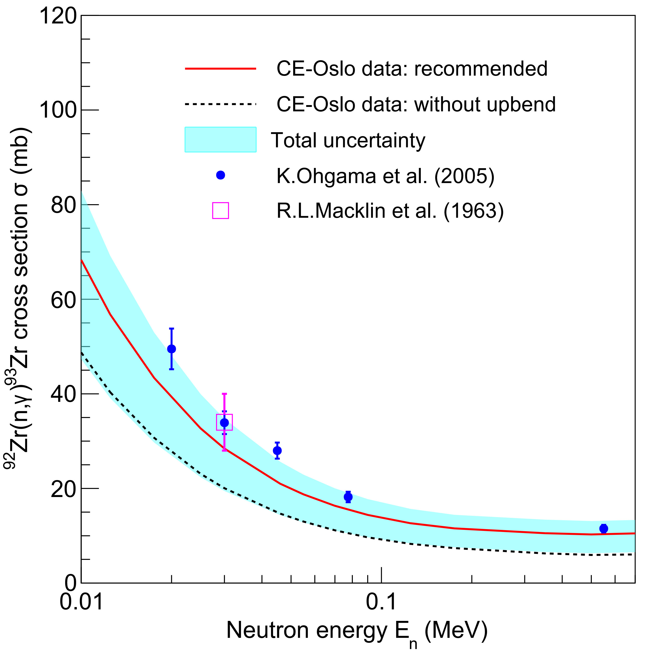
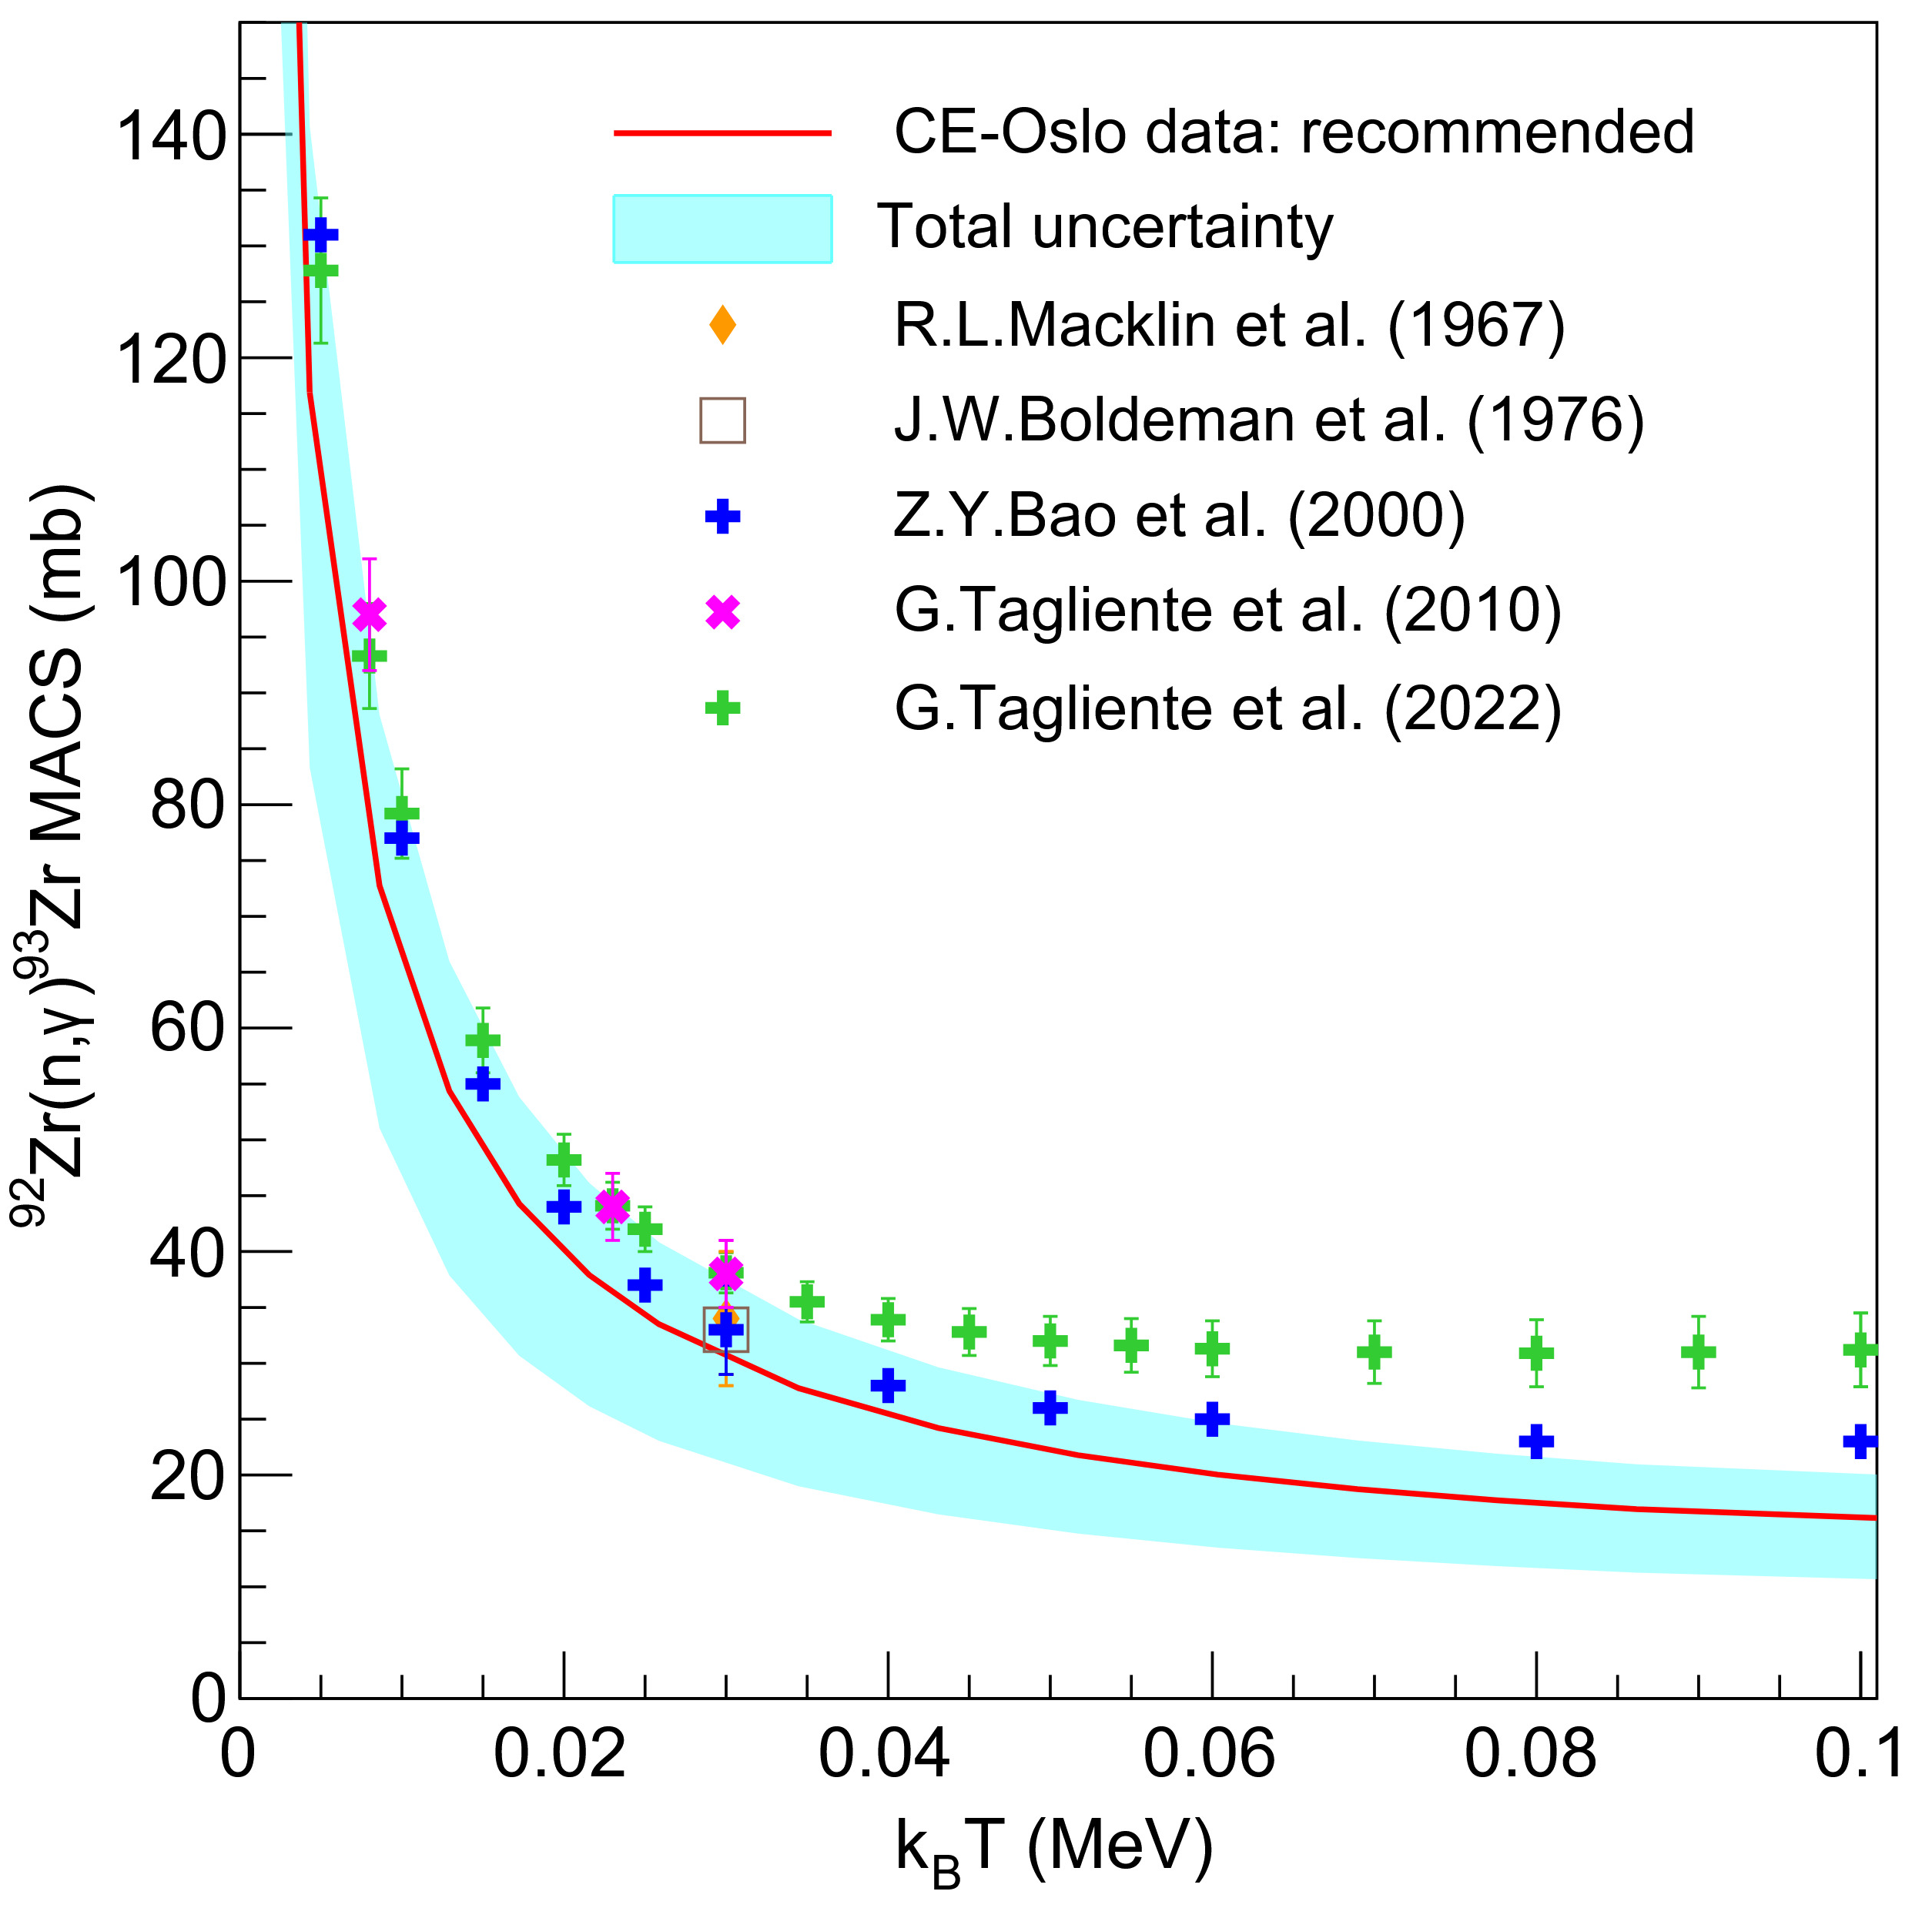

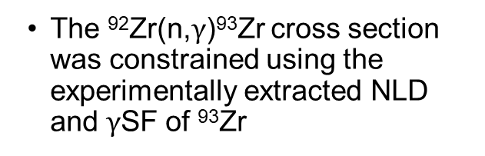



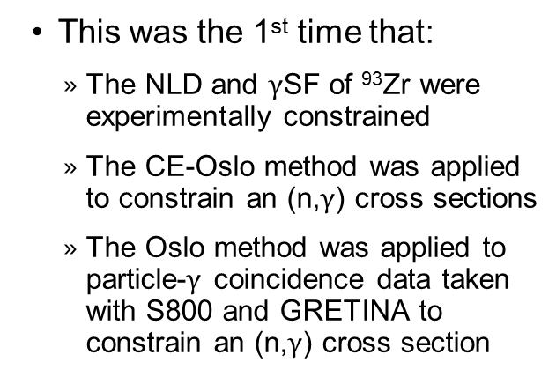
First Application of the Charge-Exchange Oslo Method: Results
Nuclear Level Density of ⁹³Zr
$\text{γ}$-ray Strength Function of ⁹³Zr
The ⁹²Zr(n,$\text{γ}$)⁹³Zr cross section was constrained using the experimentally extracted NLD and $\text{γ}$SF of ⁹³Zr
This was the 1st time that:
The NLD and $\text{γ}$SF of ⁹³Zr were experimentally constrained
The CE-Oslo method was applied to constrain an (n,$\text{γ}$) cross sections
The Oslo method was applied to particle-$\text{γ}$ coincidence data taken with S800 and GRETINA to constrain an (n,$\text{γ}$) cross section
⁹²Zr(n,$\text{γ}$)⁹³Zr Cross Section
⁹²Zr(n,$\text{γ}$)⁹³Zr MACS
The results were published in Physical Review C 113, 015801 as the first application of the CE-Oslo Method

Slide 17
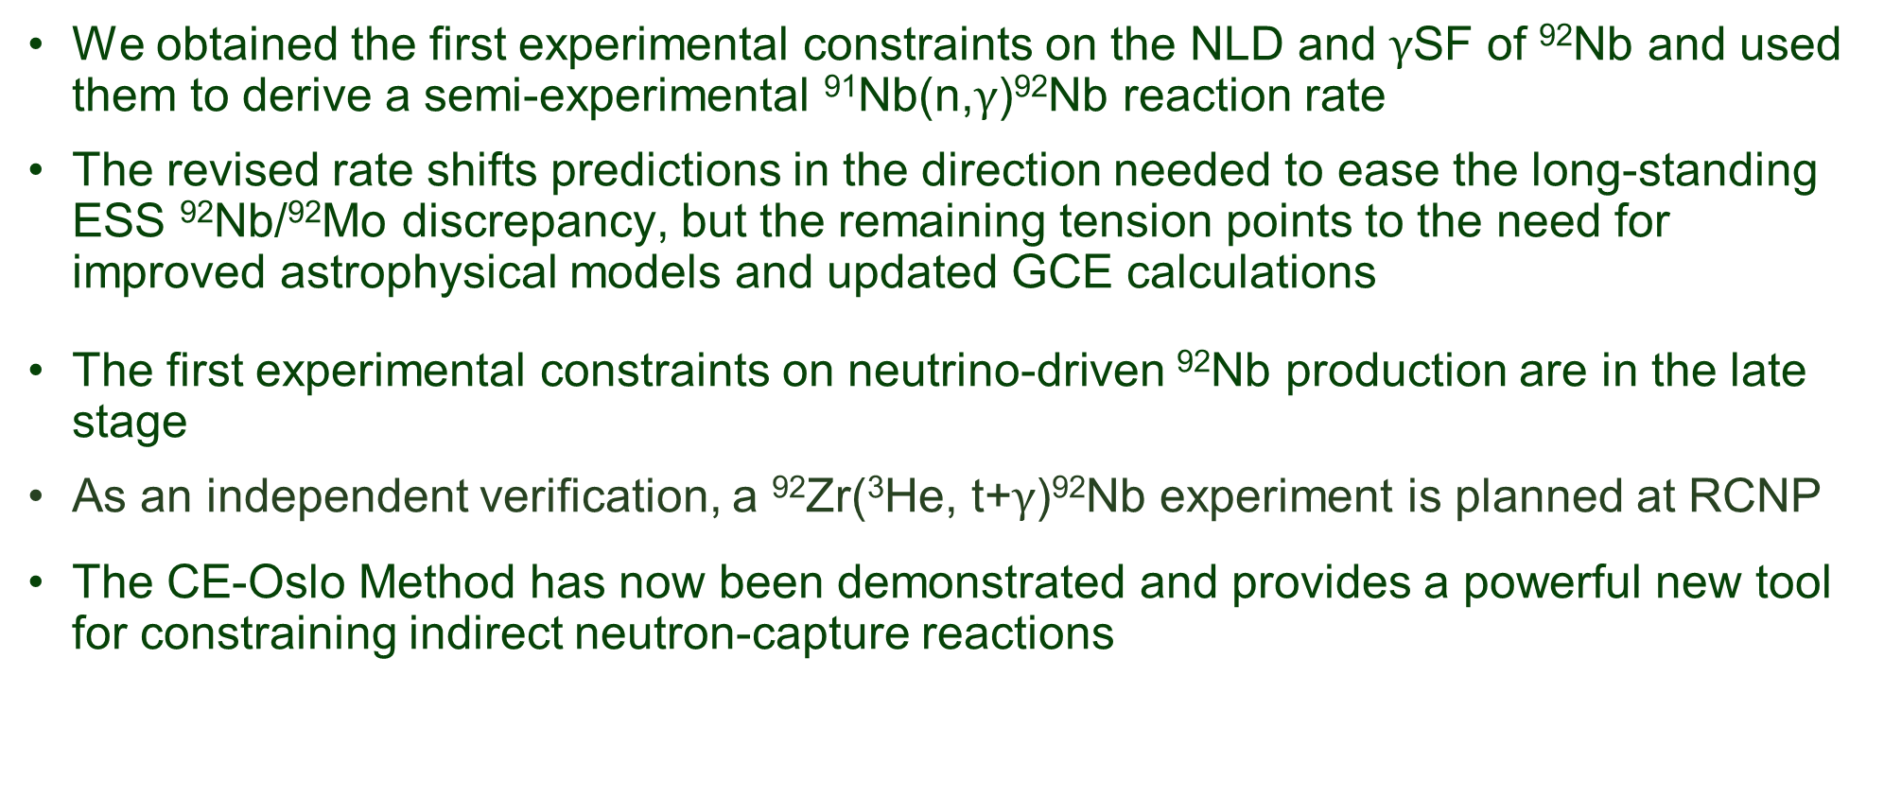
Summary
We obtained the first experimental constraints on the NLD and $\text{γ}$SF of ⁹²Nb and used them to derive a semi-experimental ⁹¹Nb(n,$\text{γ}$)⁹²Nb reaction rate
The revised rate shifts predictions in the direction needed to ease the long-standing ESS ⁹²Nb/⁹²Mo discrepancy, but the remaining tension points to the need for improved astrophysical models and updated GCE calculations
The first experimental constraints on neutrino-driven ⁹²Nb production are in the late stage
As an independent verification, a ⁹²Zr(³He, t+$\text{γ}$)⁹²Nb experiment is planned at RCNP
The CE-Oslo Method has now been demonstrated and provides a powerful new tool for constraining indirect neutron-capture reactions

Slide 18














Thank You!
@RCNP
S. Noji
J. Zamora
R.G.T. Zegers
(PhD supervisor)
H. Fujita
Y. Fujita
A. Tamii
H. Berg
A. Spyrou
@OCL
M. Guttormsen
V.W. Ingeberg
A.C. Larsen
M. Markova
S. Siem
N. Paar
A. Ravlic
R. Smolović
@FRIB
@ANL
U. Battino
P. Denisenkov
M. Pignatari
C. Travaglio
A. Tsantiri
P. von Neumann-Cosel
@Felsenkeller
Research is supported by National Science Foundation Grant No: PHY-2209429 - Windows on the Universe: Nuclear Astrophysics at the FRIB
Travel support

Slide 19


⁹²Nb Levels @ENSDF

Slide 20

⁹²Nb Levels @ENSDF

Slide 21

Recalibrated 92Nb Excitation Energy Spectrum
10- at 2.580 MeV + ……
GS+…
Same, but in log scale

Slide 22


92Nb Primary Matrix (New-Final!!!)

Slide 23



Estimation of ⁹²Nb Systematic Level Density at S_{n}
The Robin (theoretical) and D2rho-RIPL3 and Mughabghab (semi-experimental) calculated systematic level densities at Sn for the Br–Ag range were plotted separately for odd-odd nuclei with respect to atomic number
The results from D2rho-Mughabghab were fitted with a quadratic function (y=exp(ax²+bx+c))
The error σ at A=92 was calculated using the fitting parameters $p_{i,j}=a,b,c$

Slide 24


Estimation of ⁹²Nb Average Radiative Width $Γ_{γ0}$
The neutron resonance 𝚪_{𝜸𝟎} from both RIPL3 and Mughabghab were plotted separately for odd-odd nuclie in Br–Ag range with respect to A
The results from Mughabghab were fitted with a linear function (y=ax+b)
The error σ at A=92 was calculated using the fitting parameters $p_{i,j}=a,b$:

Slide 25

⁹²Nb NLD Comparison with Theoretical NLDs
Our experimentally extracted NLDs were compared with all available theoretical NLD models from TALYS
Beyond 3 MeV, the slope of our NLDs is comparable to the slope with the Back-Shifted Fermi Gas model (BFGM) and the Generalized Superfluid Model (GSM)

Slide 26


⁹²Nb $\text{γ}$SFs Comparison with Theoretical E1 $\text{γ}$SFs
Our experimentally extracted $\text{γ}$SFs were compared with all available theoretical E1 $\text{γ}$SF models from TALYS

Slide 27
TENDL-astro 2023 and NON-SMOKER
Settings | TENDL-astro 2023 (rec) | NON-SMOKER (default)
Model | Hauser–Feshbach | Hauser–Feshbach
NLD | Skyrme force-from Hilaire's combinatorial tables | BSFG (corr. FRDM)
GSF | Gogny D1M HFB+QRPA | Lorentzian (GDR)
OMP | Koning-Delaroche | JLM
MASS | Goriely HFB-Skyrme table | FRDM
Width Fluctuation | Moldauer model | Hofmann-Richert-Tepel-Weidenmueller model

Slide 28





How Can We Constrain ⁹²Zr($ν_{e}$,$e^{−}$)⁹²Nb Reaction Rate?
Direct measurements
$$e^{−}$$
Indirect measurements
Not really feasible to measure directly
The dominant contribution is the charged-current (CC) neutrino interactions
At astrophysical energies, the CC cross section is dominated by Gamow-Teller B(GT) and Fermi B(F) transitions from the ground state of ⁹²Zr
The CE experiments at ~ 100 MeV/u provide a way to extract these transition strengths through Multipole Decomposition Analysis (MDA)
The CE differential cross section at zero momentum transfer (q~0) is proportional to B(GT) and B(F)
⁹²Nb*
Charge-Exchange
(CE) reaction
$$ν_{e}$$
n
p
g.s.
⁹²Nb
⁹²Zr
⁹²Zr
⁹²Nb
³He
³H
$$ν_{e}$$
$$e^{−}$$
(³He,t)
⁹²Zr
⁹²Nb

Slide 29




Experimental Differential Cross Sections and the Multipole Decomposition Analysis (MDA)
At near $0^{0}$ scattering angles, transitions with small angular-momentum transfers ($\text{∆}\text{L}\text{ ≤ 2,3}$) are preferred
To decompose contributions from different $\text{∆}\text{L}$, MDA^{i} was performed by fitting the measured differential cross sections with theoretical angular distributions over the covered scattering angles
Excitation energy spectrum for angles 0-2 deg
1+ state at 1.089 MeV
MDA
$${\left.\frac{dσ}{dΩ}\left(θ\right)\right|}_{exp}={\sum_{i}{c_{i}}\left.\frac{dσ}{dΩ}\left(θ\right)\right|}_{{∆L}_{i}}$$
The theoretical angular distributions were calculated using the Distorted Wave Born Approximation (DWBA)
R.G.T Zegers, Handbook of Nuclear Physics, Springer, (2023)

Slide 30




Extracted B(GT) Distribution and Progress on CC ⁹²Zr($ν_{e}$,$e^{−}$)⁹²Nb Cross Sections
The experiment was run in forward kinematics using the Grand Raiden Spectrometer^{i} (GR)
Experimental B(GT) was extracted from the ΔL=0 component obtained from the MDA
Target
$${\left.\frac{dσ}{dΩ}\left(q=0\right)\right|}_{(3He,t)}= \hat{σ}B(GT)$$
Focal Plane of GR
Beam
³He
For zero momentum transfer
B(GT) distribution
$$σ\left(E_{ν}\right)= \frac{G_{F}^{2}}{π}F_{CC}\left[\frac{E_{i}E_{f}}{s}\right]E_{l} \left|p_{l}\right| \left\{B\left(F\right)+B(GT)\right\}$$
https://www.rcnp.osaka-u.ac.jp/
1+ state at 1.089 MeV
The extraction of CC neutrino-⁹²Zr cross sections is currently in progress in collaboration with a theory group at the University of Zagreb
These results will provide the first experimental constraints on this reaction
The experimentally constrained ⁹²Zr($ν_{e}$,$e^{−}$)⁹²Nb cross sections will provide a key test neutrino-driven ⁹²Nb production in CCSNe
R.G.T Zegers, Handbook of Nuclear Physics, Springer, (2023)

