Slide 1
Systematic Study of Nuclear Level Density Models for Unresolved Resonance Region Evaluations using SAMMY
Justin Loringª, Vladimir Sobesª, Jesse M. Brown^{b}
ªUniversity of Tennessee, Department of Nuclear Engineering, Knoxville, Tennessee 37996
^{b}Oak Ridge National Laboratory, Oak Ridge, Tennessee 37830
Notes:
Introduction, I’m from UTK working with Vlad and Jesse
(if they don’t introduce me)
Title

Slide 2
Hypothesis
Level density data alone has not constrained LD models ^{[1-3]}
Cross section data in the unresolved resonance region (URR) could constrain LD models
[1] S. Goriely, A.-C. Larsen, and D. Mucher, “Comprehensive test of nuclear level density models,” Physical Review C, vol. 106, no. 4, p. 044315, 2022.
[2] A. Koning, S. Hilaire, and S. Goriely, “Global and local level density models,” Nuclear Physics A, vol. 810, no. 1, pp. 13–76, 2008.
[3] A. V. Voinov, S. M. Grimes, C. R. Brune, M. J. Hornish, T. N. Massey, and A. Salas, “Test of nuclear level density inputs for hauser-feshbach model calculations,” Phys. Rev. C, vol. 76, p. 044602, Oct 2007.
Notes:
My starting point for this study is that currently available level density data has not constrained which level density model is the ‘best’, at least not over a wide range of nuclei.
We need more data to constrain level densities. In this study I am looking at cross section data in the unresolved resonance region as the additional source of information to potentially constrain these models.

Slide 3
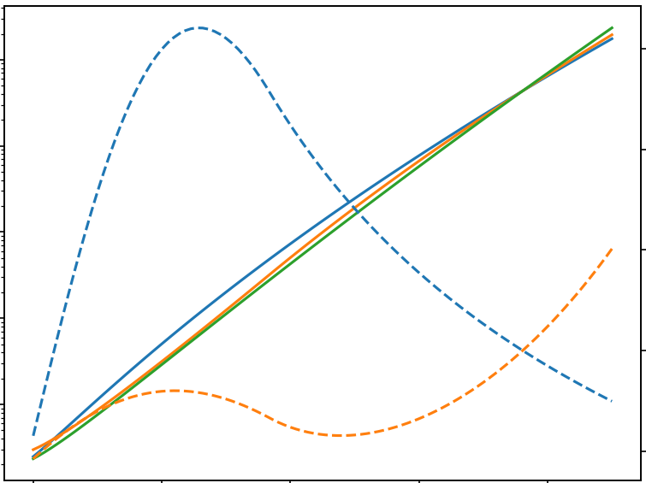
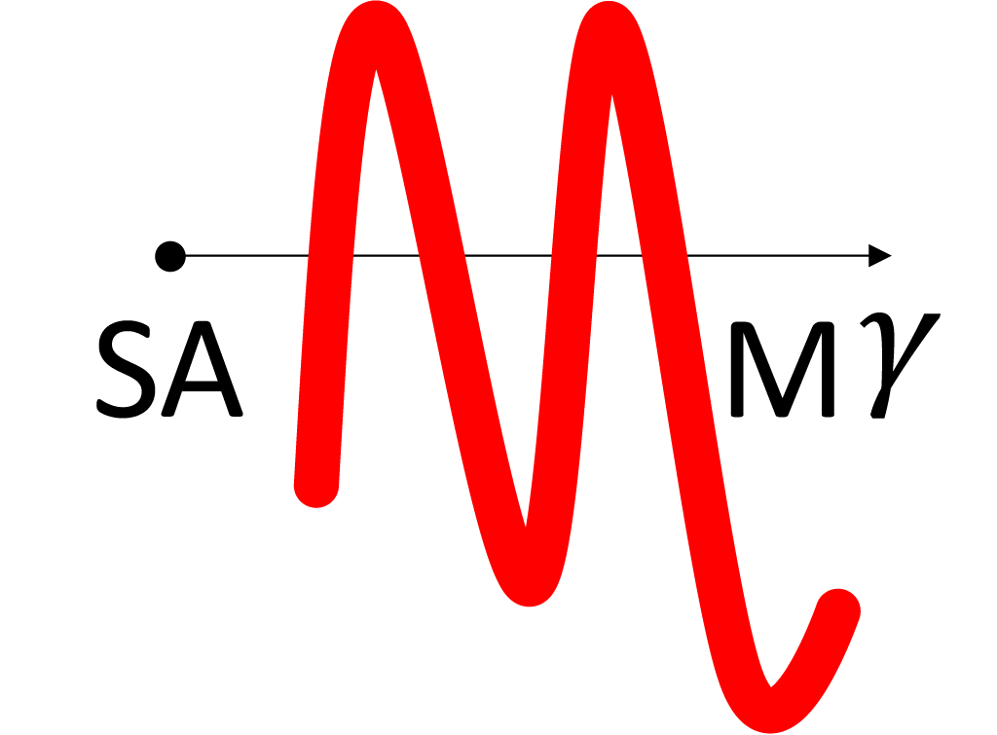
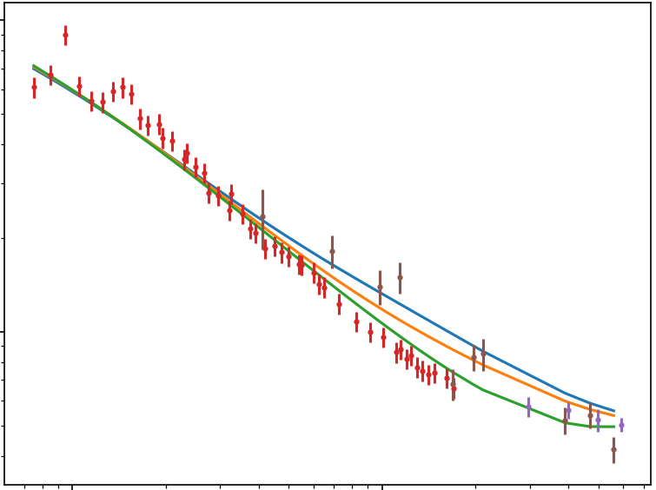
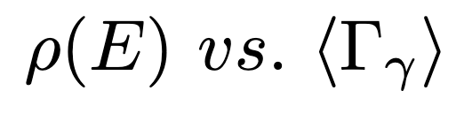
Outline
Method of Comparing LD Models
Implementation in SAMMY
Cross Section Evaluation Results
Conclusions and Future Work
Notes:
Here is an outline of my presentation.
I’ll start with my method of comparing level density models using cross section data
Then I’ll discuss the implementation in SAMMY, a cross section evaluation code.
I’ll show some initial results
And then my conclusions and future work

Slide 4
Comparing LD Models with XS Data
Hauser-Feshbach Model ^{[4]}
Fit to XS data with multiple LD models
Determine quality of fit (chi-squared metric)
[4] W. Hauser and H. Feshbach, “The inelastic scattering of neutrons,” Phys. Rev., vol. 87, pp. 366–373, Jul 1952.
Notes:
I’ll start with why – why look at cross section data in the URR.
We get average cross section data using the Hauser-Feshbach model, which I believe most of you are quite familiar with
Of course, level density is an important input to this model. This makes cross section calculations directly sensitive to the level density.
The idea is to fit URR cross section data using multiple level density models
And see which one does the best– that is provides the best fit, which we can measure with the chi-squared goodness of fit metric.

Slide 5
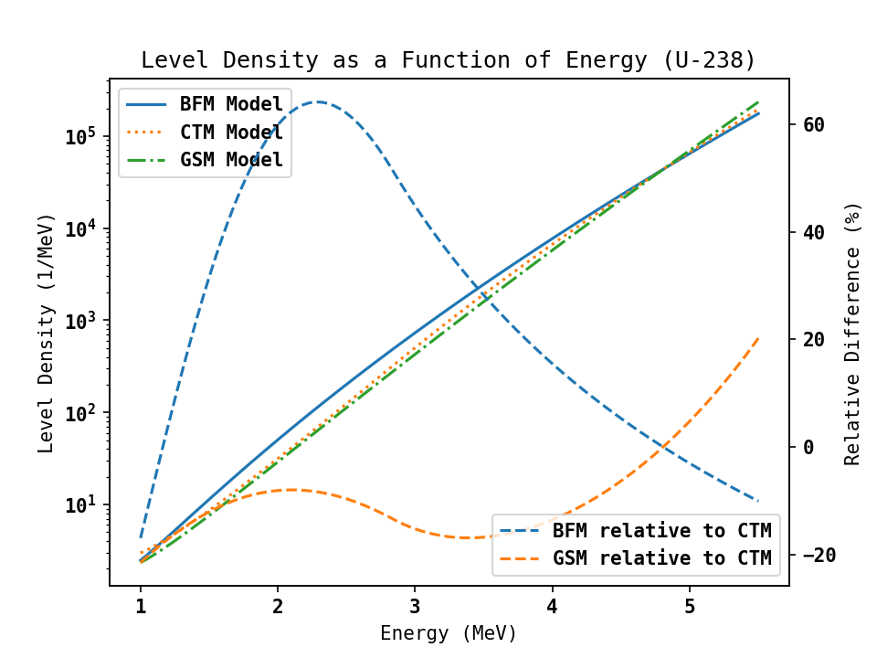
Level Density as a Function of Energy
Exponential spanning many orders of magnitude
Phenomenological models agree at S_{n}
Differences amplified at large energies
Notes:
We’re all quite familiar with the level density, so I’ll use this slide to emphasize the practical differences between level density models.
I’m only looking at phenomenological models here, so the level density is fit to data in order to tune level density parameters
I’m using discrete level density data at low energies and the average resonance spacing at the neutron separation energy, so these will constrain the level density most strongly at low energies and at S_n, which we see in this figure.
In practice that means the models will diverge more as energy increases in the URR.

Slide 6
Level Density Models Considered
Constant Temperature Model (CTM, also called Gilbert-Cameron Composite model) ^{[5]}
Back-shifted Fermi Gas Model (BFM) ^{[6]}
Generalized Superfluid Model (GSM) ^{[7]}
Models also implemented in TALYS ^{[8]} and EMPIRE ^{[9]}
[5] A. Gilbert and A. G. W. Cameron, “A composite nuclear-level density formula with shell corrections,” Canadian Journal of Physics, vol. 43, no. 8, pp. 1446–1496, 1965.
[6] M. Grossjean and H. Feldmeier, “Level density of a fermi gas with pairing interactions,” Nuclear Physics A, vol. 444, no. 1, pp. 113–132, 1985.
[7] A. Ignatiyuk, G. Smirenkin, and A. Tishin, “Phenomenological description of the energy dependence of the level density parameter,” Sov. J. Nucl. Phys, vol. 21, p. 255, 1975.
[8] Koning, Arjan, Hilaire, Stephane, and Goriely, Stephane, “TALYS: modeling of nuclear reactions,” Eur. Phys. J. A, vol. 59, no. 6, p. 131, 2023.
[9] M. Herman, R. Capote Noy, and M. Sin, “EMPIRE-3.2 malta-modular system for nuclear reaction calculations and nuclear data evaluation,” 2013.
Notes:
The level density models I have implemented are the constant temperature model, back-shifted Fermi gas model, and generalized superfluid model.
For reference these are the same models that are implemented in TALYS and EMPIRE

Slide 7
SAMMY
Primarily an R-Matrix code developed at ORNL ^{[10]}
Contains a Hauser-Feshbach code by F. Fröhner ^{[11]}
SAMMY in the URR fits average resonance parameters using a Bayesian update process
Open source
[10] N. M. Larson, “Updated user’s guide for SAMMY: Multilevel r-matrix fits to neutron data using bayes’ equations,” Oak Ridge National Lab. (ORNL), Oak Ridge, TN (United States), Tech. Rep., 2008.
[11] F. H. Frohner, “Evaluation of the unresolved resonance range of 238u,” Nuclear Science and Engineering, vol. 103, no. 2, pp. 119–128, 1989.
Notes:
Now I’ll talk about SAMMY the code I am using for this study
SAMMY is primarily an R-Matrix code developed at ORNL for evaluations in the resolved resonance region
But it also contains a Hauser-Feshbach code originally by Frohner for unresolved region calculations.
As in the resolved, SAMMY uses a complete Bayesian update process to achieve a least-squares best fit to the input data and parameters
And SAMMY is open source so you all can use the tools I have written as well.

Slide 8
LD Models in SAMMY
Previously used CTM with no uncertainty analysis
LD models are now a user choice
LD parameters are fit to level density and cross section data
Only partial cross sections are impacted
Notes:
Before I started on this project, SAMMY used just the constant temperature model, and there was no way of providing uncertainty on the level density
With my additions, level density models are a user choice
And are fit to both level density and cross section data provided to the code
This means the cross section solution will directly respond to given level density data (and vice-versa!)
In SAMMY, Hauser-Feshbach is only used for partial cross sections, so those are the only ones that are impacted.

Slide 9
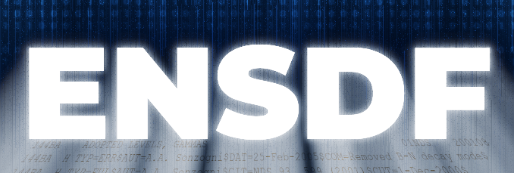


Data Sources and Processing
Level Density
Cross Section
RIPL-3
EXFOR
[12] M. Bhat, “Evaluated nuclear structure data file (ENSDF),” in Nuclear Data for Science and Technology: Proceedings of an International Conference, held at the Forschungszentrum Julich, Fed. Rep. of Germany, 13–17 May 1991. Springer, 1992, pp. 817–821.
[13] R. e. a. Capote, “RIPL - reference input parameter library for calculation of nuclear reactions and nuclear data evaluations,” Nucl. Data Sheets 110, 2009.
[14] V. V. Zerkin and B. Pritychenko, “The experimental nuclear reaction data (EXFOR): Extended computer database and web retrieval system,” Nuclear Instruments and Methods in Physics Re-search Section A: Accelerators, Spectrometers, Detectors and Associated Equipment, vol. 888, pp. 31–43, 2018.
Notes:
To demonstrate this new tool, I’m combining data from a variety of sources to produce my cross section fits.
I’m taking level density data and starting parameters from RIPL-3 and ENSDF and cross section data from EXFOR.
SAMMY produces a simultaneous fit to all these data sources, and we can look at the quality of the fit.

Slide 10
Initial Results

Slide 11
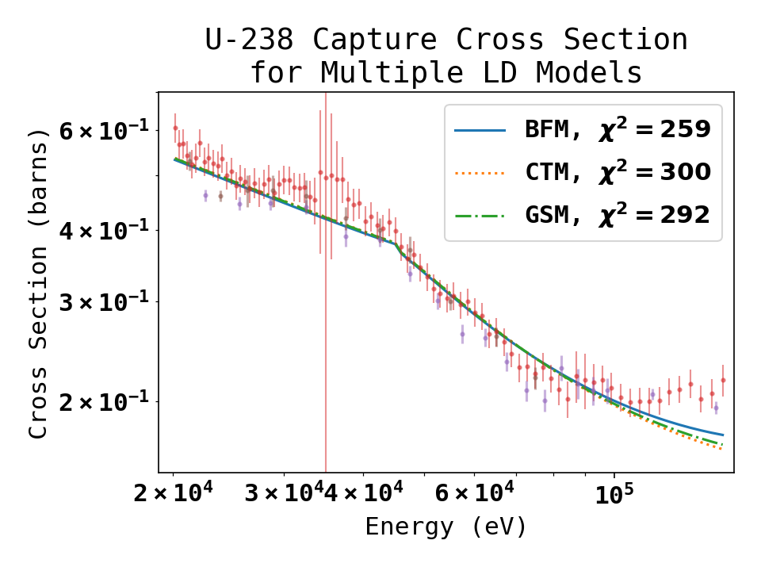
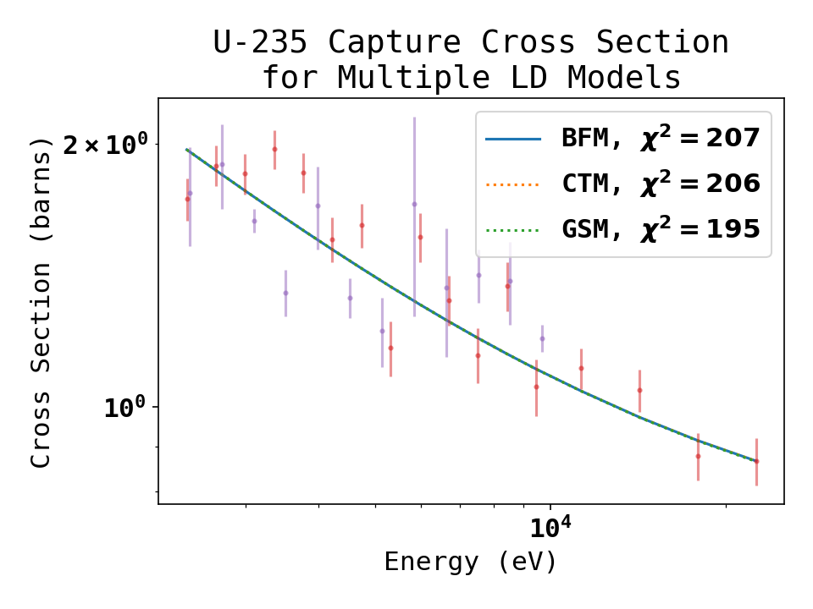
Results for U-238 and U-235
Level density models do not impact cross section after fitting
11
Notes:
I started by looking at Uranium 238 and 235 as isotopes with high quality cross section data
And as you can see in the figures, there really isn’t an impact on the cross section from the different models.
Clearly, there is enough flexibility and uncertainty in the input parameters to compensate for the different models.
If you remember back to my level density figures, I said the level density changes more at higher energies, so I decided to look at isotopes that have a larger URR.

Slide 12
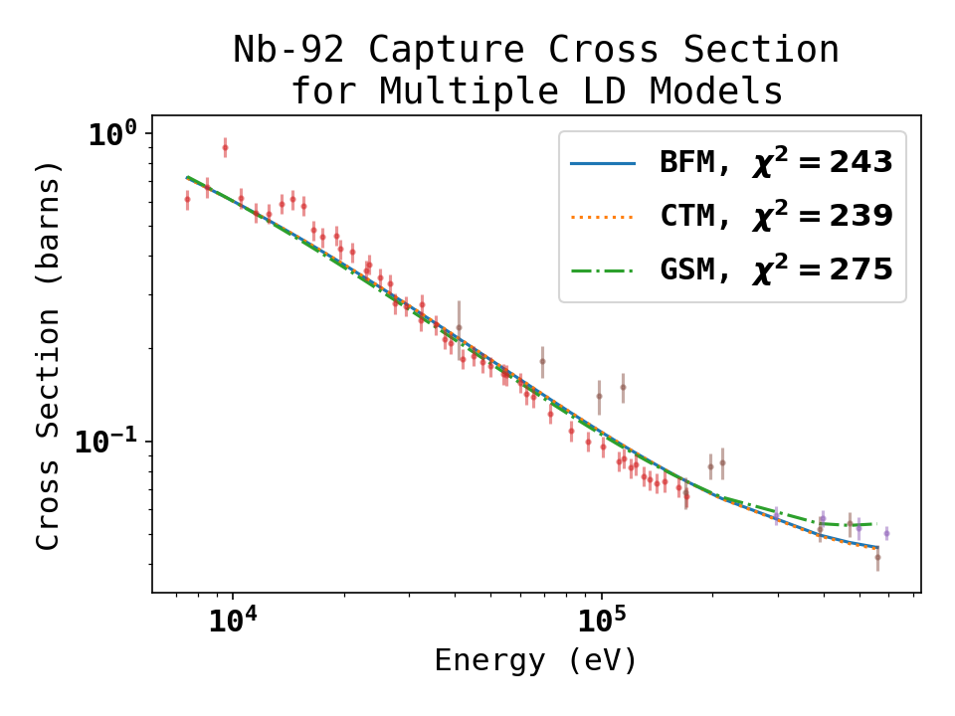
Nb-93 Results
Large URR
Discrepancy with resolved region parameters
12
Notes:
So here is the result for Niobium 93, which has a URR up to 1 MeV above the neutron separation energy.
Even so, we still don’t see much difference in the cross section, except this tail on the superfluid model.
I should note with this data that there is a large discrepancy between the average parameters in the resolved and the URR fit, which might be impacting the quality of the fit.

Slide 13
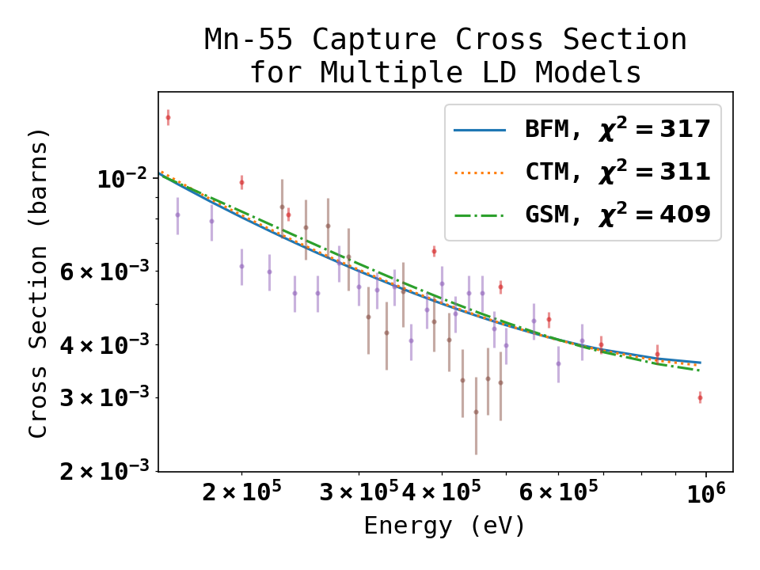
Mn-55 Results
13
Notes:
And finally looking at a lighter isotope, Manganese 55, also with a 1 MeV URR region, but again minimal difference in the cross section.

Slide 14
Conclusions and Future Studies
Cross sections are very similar between models
Study over wide range of isotopes could reveal best LD model
Notes:
That brings me to my conclusions, so at least from these initial results the URR cross section isn’t a strong enough constraint to determine the best level density model.
Seeing as the signal is weak, a potential future study is to look at a large number of isotopes and see if there is any trend in the chi-squared.

Slide 15
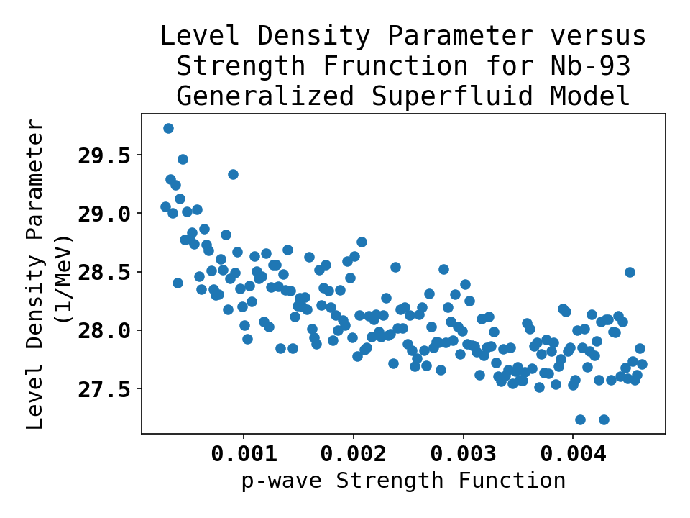
Conclusions and Future Studies
Cross sections are very similar between models
Study over wide range of isotopes could reveal best LD model
Cross section can provide a simultaneous constrain on Hauser-Feshbach parameters
Notes:
Another way to use the cross section information is to look at the relationship between Hauser-Feshbach parameters
So in this figure I have randomly sampled the rest of the URR parameters and we can see there is some constraint between the neutron strength function and the level density parameter, although it is weak.

Slide 16
Conclusions and Future Studies
Cross sections are very similar between models
Study over wide range of isotopes could reveal best LD model
Cross section can provide a simultaneous constrain on Hauser-Feshbach parameters
SAMMY is available: https://code.ornl.gov/RNSD/SAMMY
This material is based upon work supported by the National Science Foundation Graduate Research Fellowship.
Any opinion, findings, and conclusions or recommendations expressed in this material are those of the authors and do not necessarily reflect the views of the National Science Foundation.
Notes:
And finally I’d like to advertise that SAMMY is available, my code will be on the public branch in a few weeks, and you can work with this yourself.
I’d be happy to discuss what other studies you think would be interesting to complete.

Slide 17
Questions?

Slide 18
References
[1] S. Goriely, A.-C. Larsen, and D. Mucher, “Comprehensive test of nuclear level density models,” Physical Review C, vol. 106, no. 4, p. 044315, 2022.
[2] A. Koning, S. Hilaire, and S. Goriely, “Global and local level density models,” Nuclear Physics A, vol. 810, no. 1, pp. 13–76, 2008. [Online]. Available: https://www.sciencedirect.com/science/article/pii/S0375947408005903
[3] A. V. Voinov, S. M. Grimes, C. R. Brune, M. J. Hornish, T. N. Massey, and A. Salas, “Test of nuclear level density inputs for hauser-feshbach model calculations,” Phys. Rev. C, vol. 76, p. 044602, Oct 2007. [Online]. Available: https://link.aps.org/doi/10.1103/PhysRevC.76.04460
[4] W. Hauser and H. Feshbach, “The inelastic scattering of neutrons,” Phys. Rev., vol. 87, pp. 366–373, Jul 1952. [Online]. Available: https://link.aps.org/doi/10.1103/PhysRev.87.366
[5] A. Gilbert and A. G. W. Cameron, “A composite nuclear-level density formula with shell corrections,” Canadian Journal of Physics, vol. 43, no. 8, pp. 1446–1496, 1965.
[6] M. Grossjean and H. Feldmeier, “Level density of a fermi gas with pairing interactions,” Nuclear Physics A, vol. 444, no. 1, pp. 113–132, 1985. [Online]. Available: https://www.sciencedirect.com/science/article/pii/0375947485902945
[7] A. Ignatiyuk, G. Smirenkin, and A. Tishin, “Phenomenological description of the energy dependence of the level density parameter,” Sov. J. Nucl. Phys, vol. 21, p. 255, 1975.
[8] Koning, Arjan, Hilaire, Stephane, and Goriely, Stephane, “TALYS: modeling of nuclear reactions,” Eur. Phys. J. A, vol. 59, no. 6, p. 131, 2023. [Online]. Available: https://doi.org/10.1140/epja/s10050-023-01034-3
[9] M. Herman, R. Capote Noy, and M. Sin, “EMPIRE-3.2 malta-modular system for nuclear reaction calculations and nuclear data evaluation,” 2013.
[10] N. M. Larson, “Updated user’s guide for SAMMY: Multilevel r-matrix fits to neutron data using bayes’ equations,” Oak Ridge National Lab.(ORNL), Oak Ridge, TN (United States), Tech. Rep., 2008.
[11] F. H. Frohner, “Evaluation of the unresolved resonance range of u238,” Nuclear Science and Engineering, vol. 103, no. 2, pp. 119–128, 1989. [Online]. Available: https://doi.org/10.13182/NSE89-A28501
[12] M. Bhat, “Evaluated nuclear structure data file (ENSDF),” in Nuclear Data for Science and Technology: Proceedings of an International Conference, held at the Forschungszentrum Julich, Fed. Rep. of Germany, 13–17 May 1991. Springer, 1992, pp. 817–821.
[13] R. e. a. Capote, “Ripl - reference input parameter library for calculation of nuclear reactions and nuclear data evaluations,” Nucl. Data Sheets 110, 2009.
[14] V. V. Zerkin and B. Pritychenko, “The experimental nuclear reaction data (EXFOR): Extended computer database and web retrieval system,” Nuclear Instruments and Methods in Physics Re-search Section A: Accelerators, Spectrometers, Detectors and Associated Equipment, vol. 888, pp. 31–43, 2018.

Slide 19
Data Sources
EXFOR Subentry Numbers:
U-235
14149003 M. Jandel
10249005 R. B. Perez
23453002 S. Amaducci
40616004 T. A. Mostovaya
12877004 L. W. Weston
23294003 C. Paradela
Nb-93
11329023 H. J. Gibbons
40452003 Yu. Ya. Stavisskii
12670012 W. P. Poenitz
U-238
23234002 F. Mingrone
21334003 M. C. Moxon
23364004 T. Wright
Mn-55
10752004 J. B. Garg
20572006 C. Le Rigoleur
40642002 Ju. Ya. Stavisskii

Slide 20
Extra Slides

Slide 21
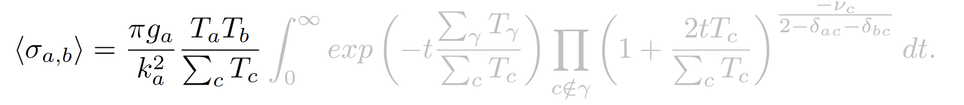
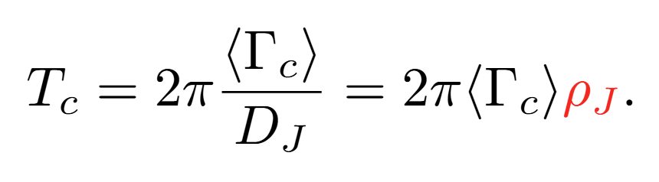
Level Density as a Parameter: Hauser-Feshbach
Level density as a function of energy.
From Ref. [9]

Slide 22
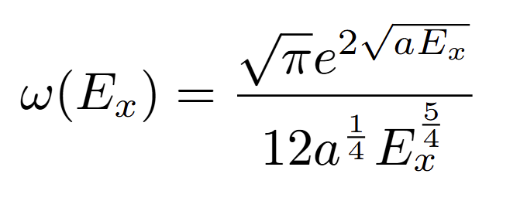
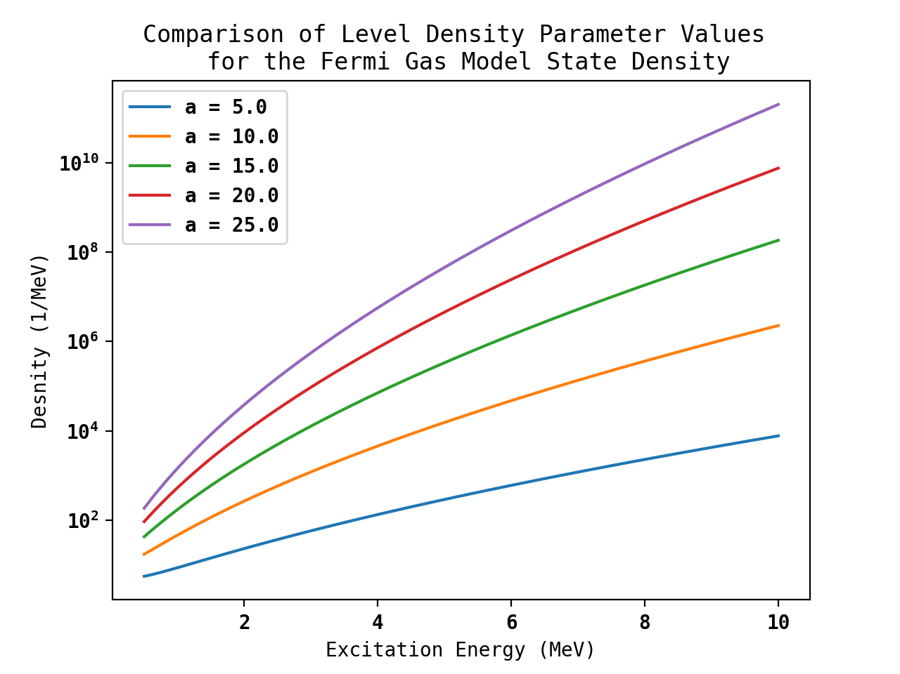
Fermi Gas Model of the Nucleus
Models the nucleus as an ideal gas of two fermion species.
Nucleons do not interact but exist in a potential well.
Most valid at high excitation energies (> 5MeV).
See Refs. [3], [5]

Slide 23
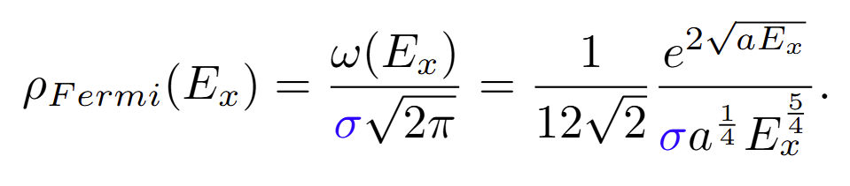
Spin Cutoff Parameter
State density is degenerate in the magnetic quantum number.
Assume a Gaussian distribution of angular momentum, σ is the standard deviation.
See Ref. [3]

Slide 24
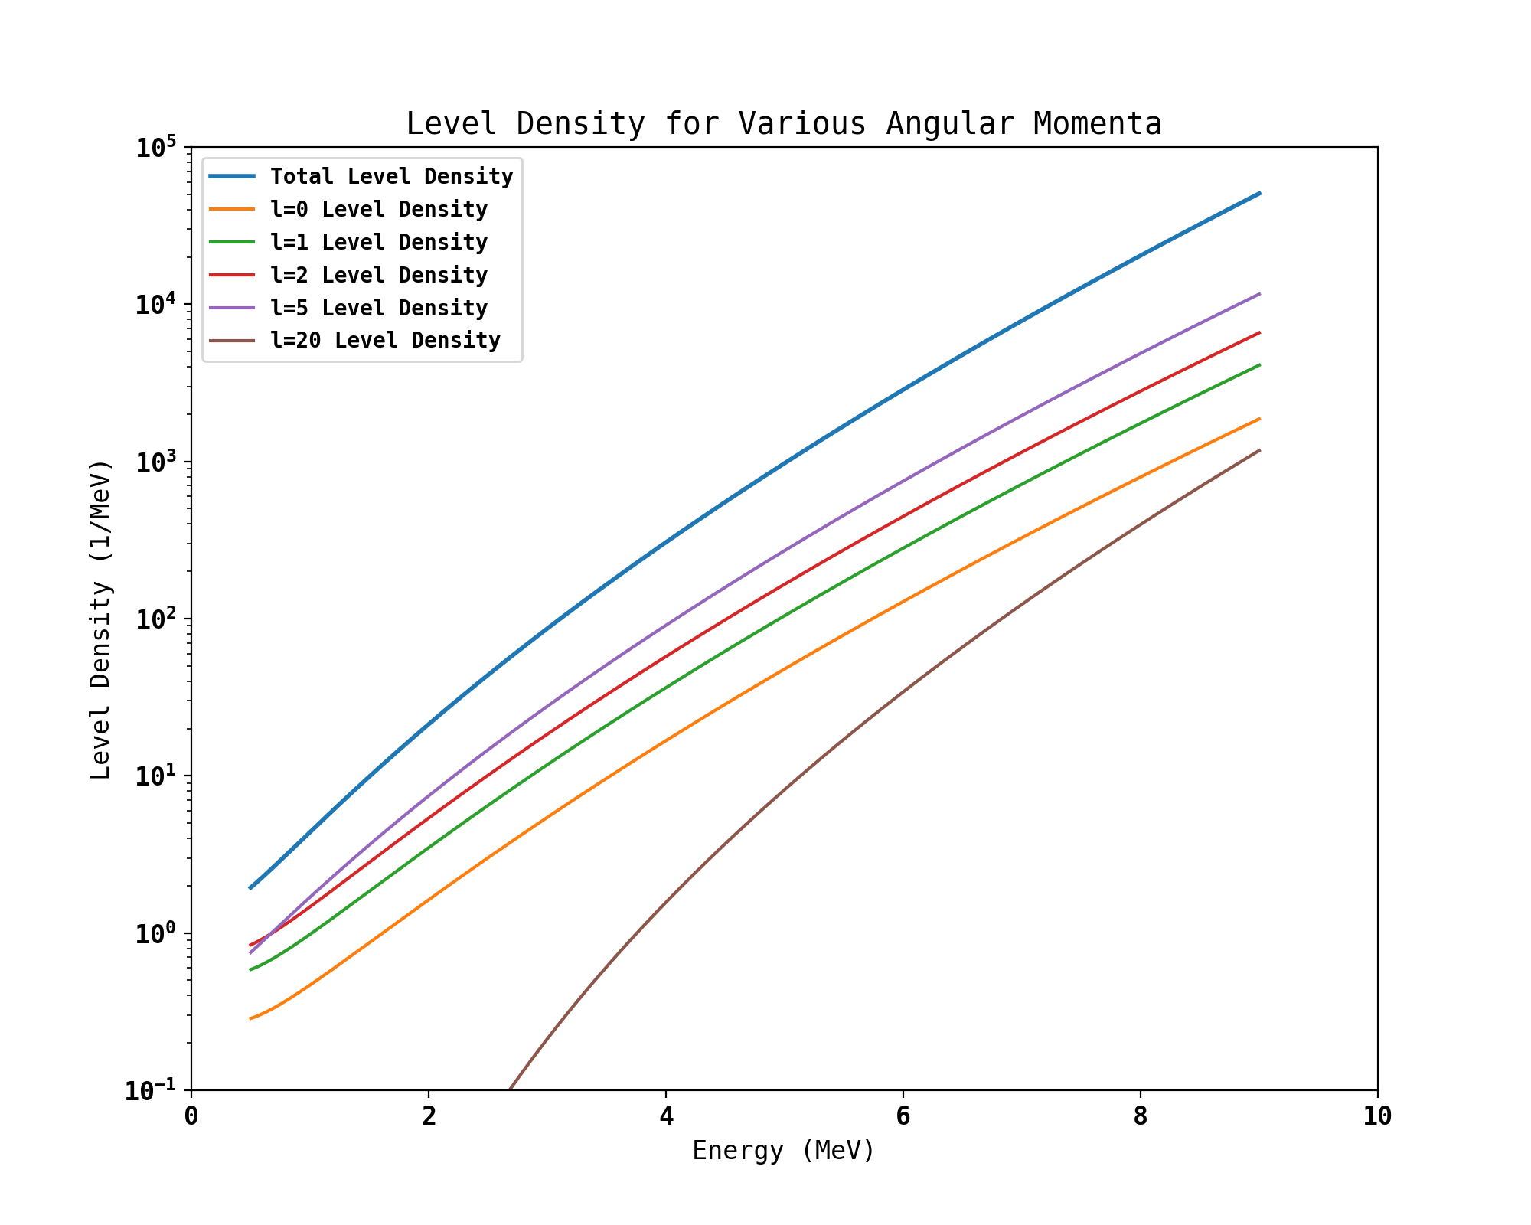
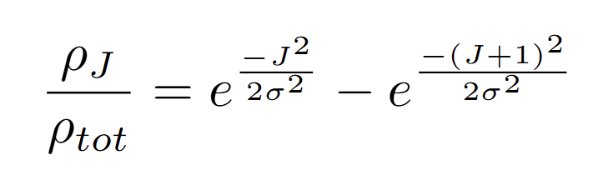
Angular Momentum Distribution
The spin cutoff parameter also determines L-dependent level density.
See Ref. [3]

Slide 25
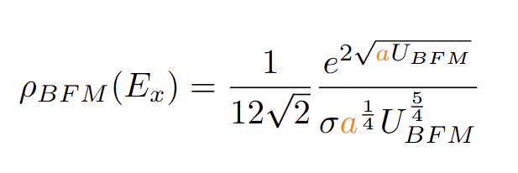
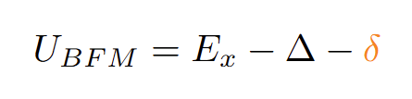
Back-Shifted Fermi Gas Model
Experiments tell us available energy is limited by a pairing energy.
Pairing energy chosen as fit variable.
See Ref. [3]

Slide 26
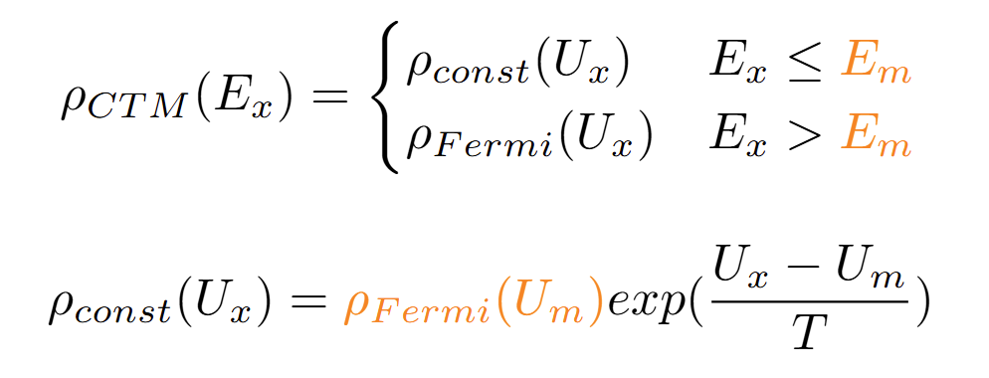

Constant Temperature Model (Gilbert-Cameron)
Divides energies into two regions.
High energy: Fermi gas
Low energy: empirical formula
See Refs. [3], [4]

Slide 27
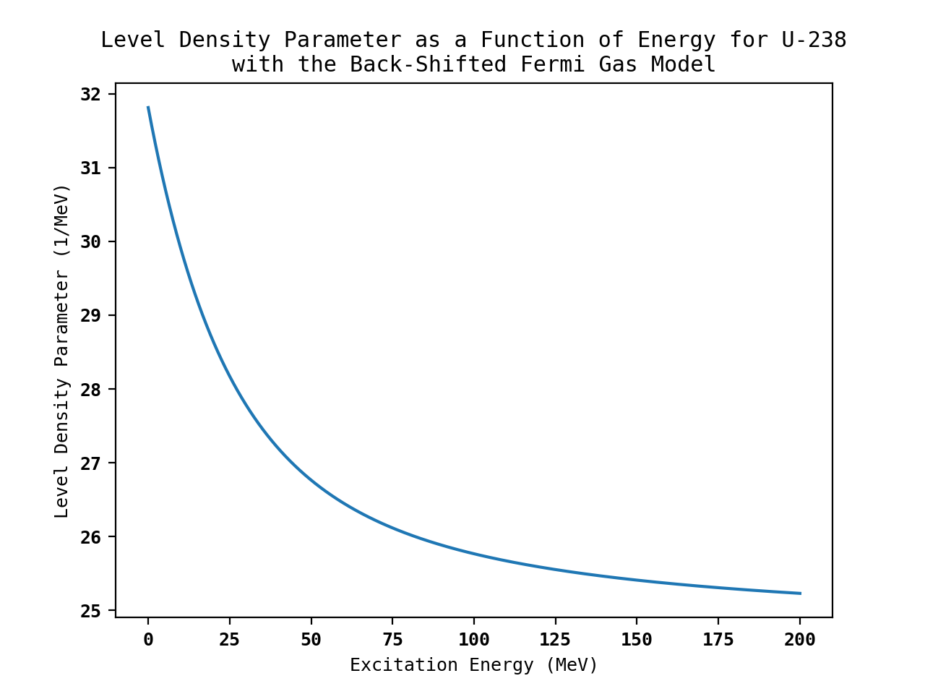
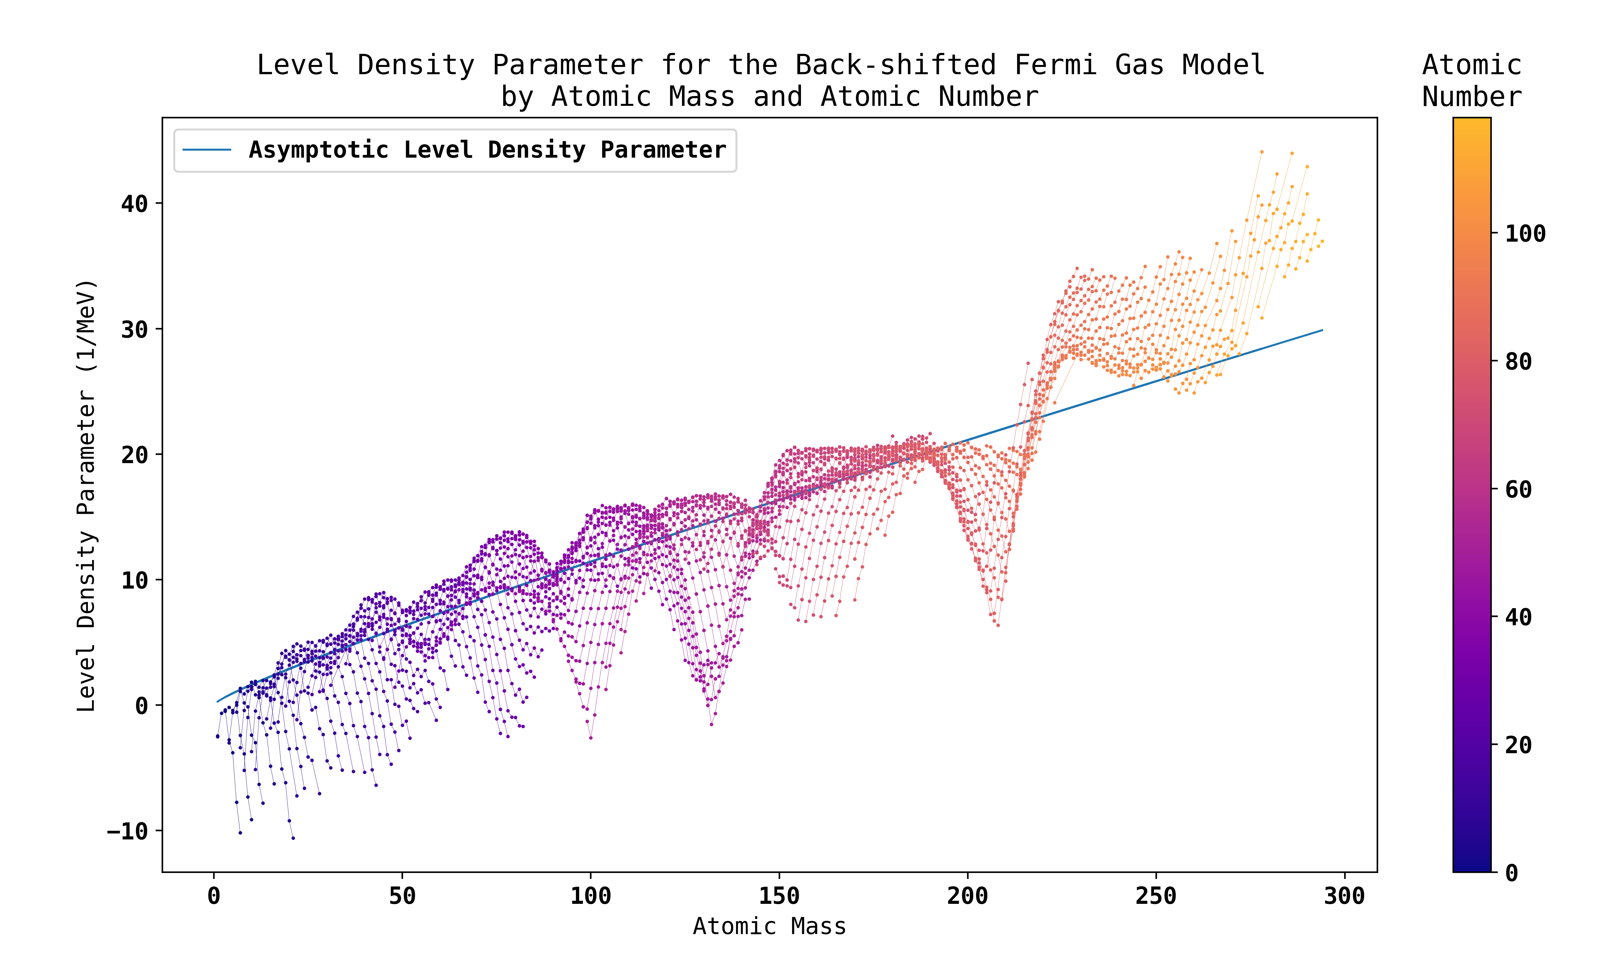
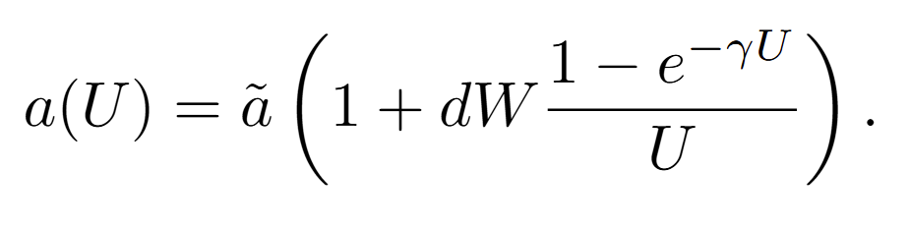
Level Density Parameter Details
See Ref. [5]

