Slide 1



Statistical properties of ¹⁴³Ba and Constraining (n, γ) Cross-Sections in the A=140 region
Hershini Gadaria
22 May 2026

Slide 2
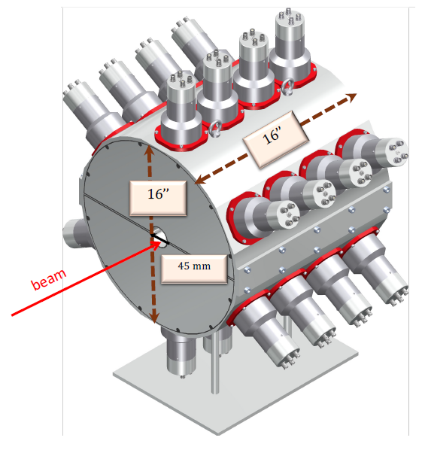
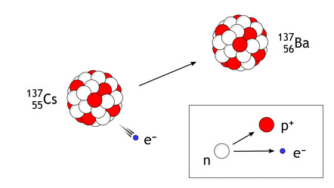
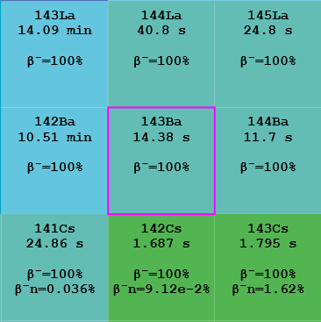
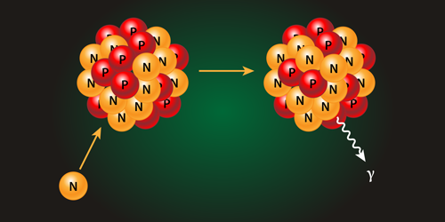
Outline
How are elements beyond iron produced?
Why do we care about neutron-capture reaction rates in the A=140 region?
How do we constrain neutron-capture reaction rates?
What did we do to measure the ¹⁴²Ba(n, γ)¹⁴³Ba reaction rate?
What does our measurement tell us about ¹⁴³Ba?
Preliminary ¹⁴²Ba(n, γ)¹⁴³Ba cross-section
Conclusion and future work
¹⁴³Ba
¹⁴³Cs
¹⁴²Ba
¹⁴³Ba

Slide 3
Outline
How are elements beyond iron produced?
Why do we care about neutron-capture reaction rates in the A=140 region?
How do we constrain neutron-capture reaction rates?
What did we do to measure the ¹⁴²Ba(n, γ)¹⁴³Ba reaction rate?
What does our measurement tell us about ¹⁴³Ba?
Preliminary ¹⁴²Ba(n, γ)¹⁴³Ba cross-section
Conclusion and future work

Slide 4
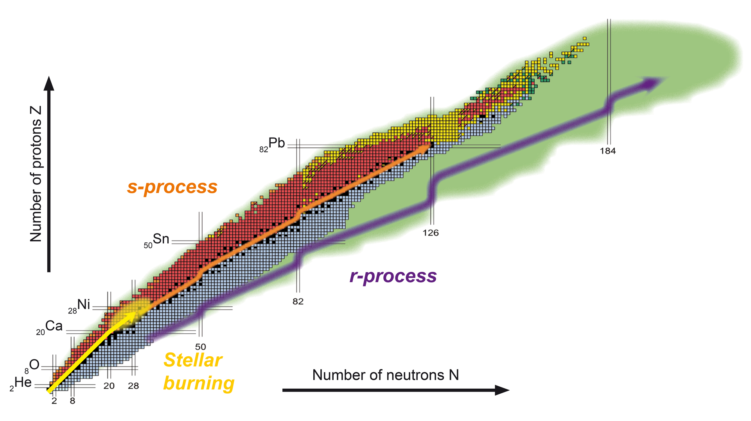
Heavy Element Nucleosynthesis via r-process
First elements created shortly after the Big Bang: H, He, and trace amounts of Li
Nucleosynthesis beyond iron requires processes other than nuclear fusion
The rapid neutron-capture process (r-process)
Responsible for synthesizing about half the isotopes heavier than iron
GW170817¹ confirmed neutron star mergers as a site.
Other possible sites include neutrino-driven winds², magneto-rotational supernovae³ etc.
The region of interest: A = 140
p-process
⁵⁶Fe
[1] Daniel Kasen et al. in Nature 551.7678 (Oct. 2017)
[2] F. K. Thielemann et al. in Particle and Nuclear Physics 66.2 (2011)
[3] C. Winteler et al. in The Astrophysical Journal Letters 750.1 (2012)

Slide 5
Outline
How are elements beyond iron produced?
Why do we care about neutron-capture reaction rates in the A=140 region?
How do we constrain neutron-capture reaction rates?
What did we do to measure the ¹⁴²Ba(n, γ)¹⁴³Ba reaction rate?
What does our measurement tell us about ¹⁴³Ba?
Preliminary ¹⁴²Ba(n, γ)¹⁴³Ba cross-section
Conclusion and future work

Slide 6
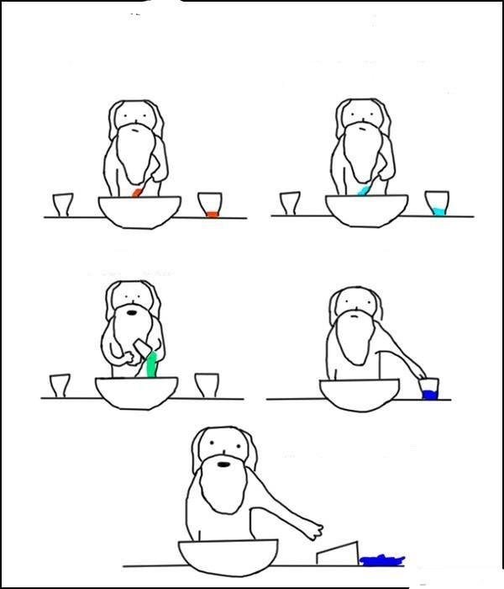
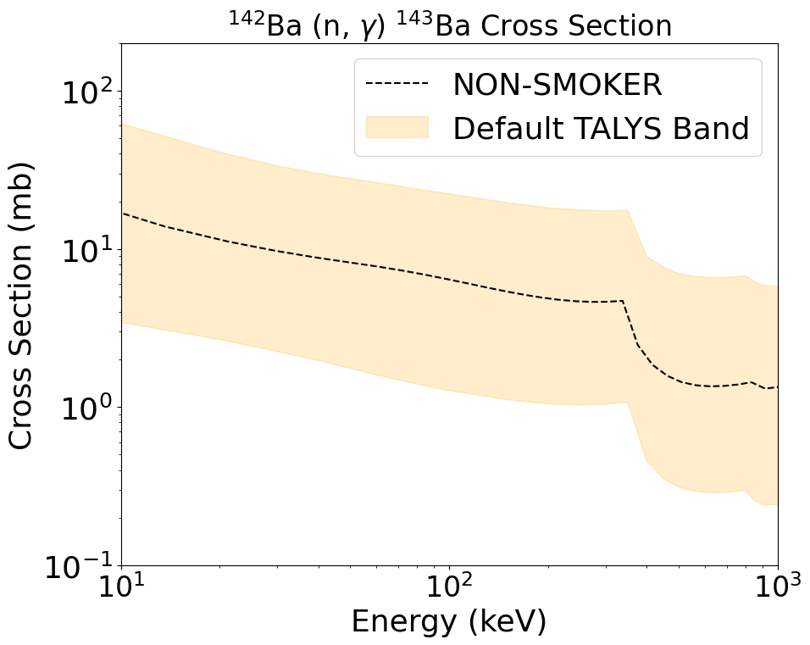
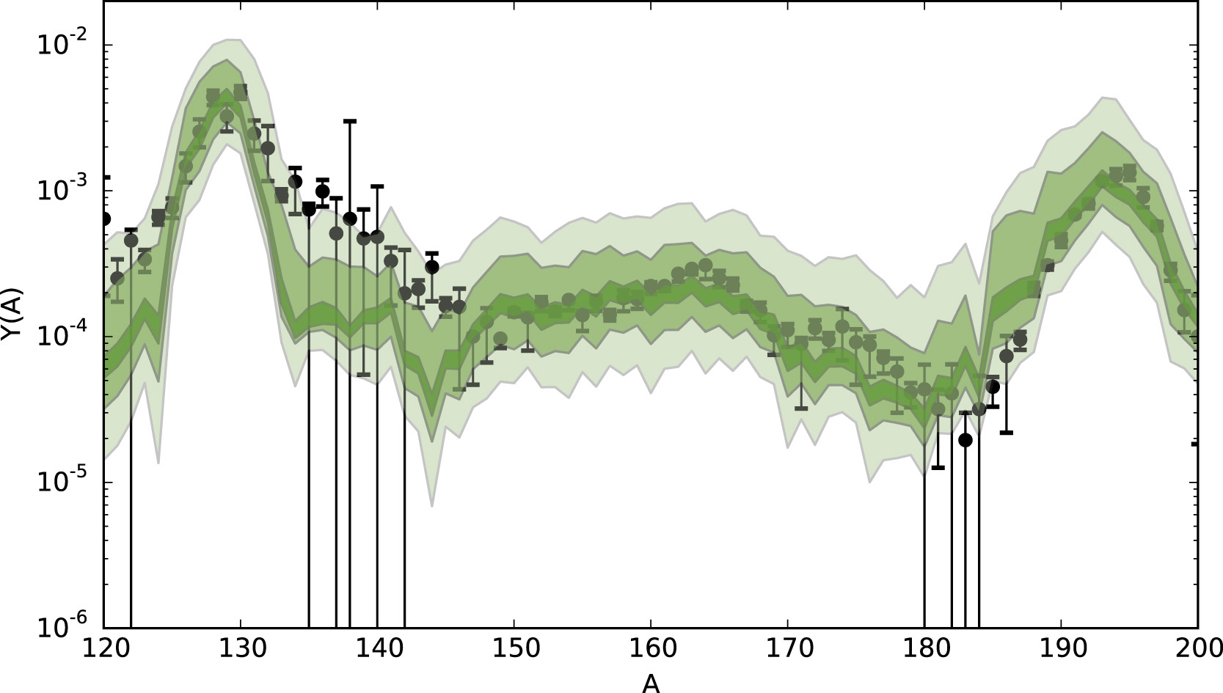
Need to Constrain Neutron-Capture Reaction Rate
Important nuclear inputs
Nuclear masses
β-decay properties
Neutron-capture reaction rates etc.
r-process network calculations underproduce abundances in A=140 region by an order of magnitude¹
Sensitivity studies² have identified neutron-capture reaction rates to have a significant impact on nuclear abundances
¹⁴²Ba(n, γ)¹⁴³Ba
¹⁴⁴La(n,γ)¹⁴⁵La
¹⁴⁵Ce(n,γ)¹⁴⁶Ce
¹⁴⁷Ce(n,γ)¹⁴⁸Ce
Astrophysical
Nuclear
r-process calculations
Uncertainties in nuclear physics
100 – 10 – 2
Light –medium- dark
Y(A)
120
130
140
150
160
170
180
190
200
A
[1] S.N. Liddick et al. in Physical Review Letters 116 (2016)
[2] M.R. Mumpower et al. in Progress in Particle and Nuclear
Physics Vol 86 (2016)

Slide 7
Outline
How are elements beyond iron produced?
Why do we care about neutron-capture reaction rates?
How do we constrain neutron-capture reaction rates?
What did we do to measure the ¹⁴²Ba(n, γ)¹⁴³Ba reaction rate?
What does our measurement tell us about ¹⁴³Ba?
Preliminary ¹⁴²Ba(n, γ)¹⁴³Ba cross-section
Conclusion and future work

Slide 8
Challenges with Direct Measurement Techniques
Experimental limitations on direct measurement of (n,γ)
Short half-lives of nuclei
Challenging to make a neutron target
Efforts are underway to perform direct measurements^{1,2}
Rely on theory, but not entirely..
S_{n} = 4.1 MeV
(n, γ)
¹⁴²Ba + n
¹⁴³Ba
T_{1/2} = 14.3 s
[1] R. Reifarth et al. in Physical Review Accelerators and Beams 20, 044701 (2017)
[2] A. Tarifeño-Saldivia et al. https://arxiv.org/abs/2508.15465

Slide 9
Indirect Techniques are the Way to Go
Experimental limitations on direct measurement of (n,γ)
But can experimentally determine NLD and γSF
Indirect measurement techniques
Oslo method, Coulomb dissociation, Surrogate method etc.
The β-Oslo method is a variation of traditional Oslo method where we populate the nucleus of interest via β⁻-decay
¹⁴³Cs ¹⁴³Ba + e⁻ + v_{e}
¹⁴³Cs
β− decay
Q _{β−} = 6.2 MeV
T_{1/2} = 1.7s
S_{n} = 4.1 MeV
(n, γ)
¹⁴²Ba + n
¹⁴³Ba
T_{1/2} = 14.3 s

Slide 10
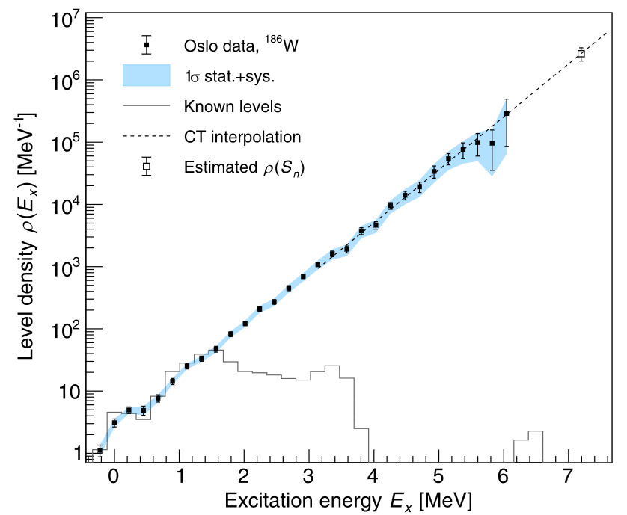
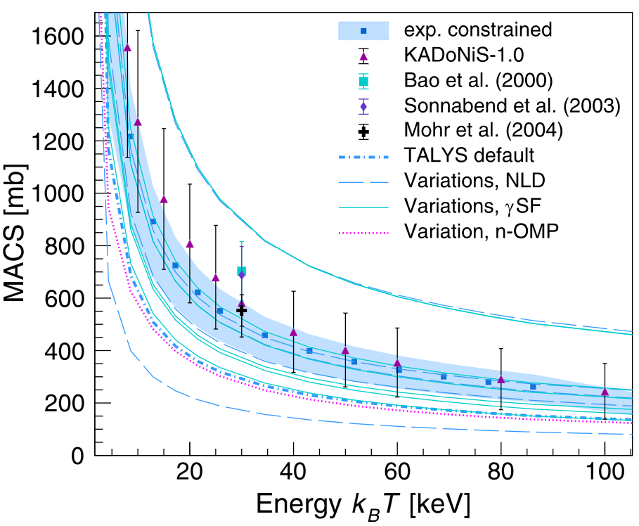
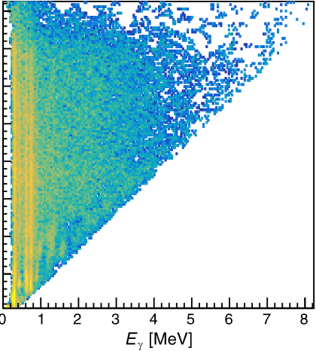
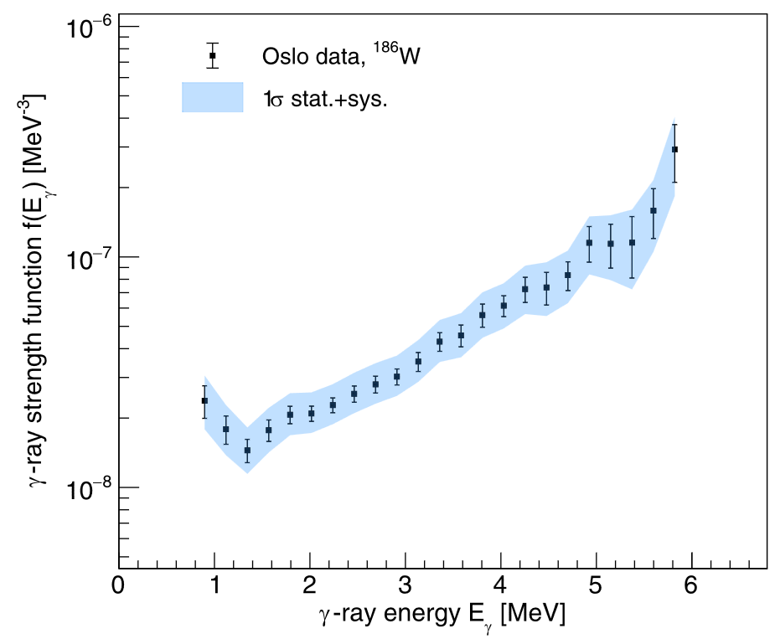
The Oslo Method Constrains Cross-Sections
Populate the compound nucleus of interest
¹⁴³Ba via β- decay of ¹⁴³Cs
Measure Excitation energy (E_{x}) and γ-ray energy (E_{γ})
Obtain the primary γ-ray spectrum
Extract NLD and γSF
Constrain the required cross-section
E_{x} (MeV)
Extract NLD and γSF, normalize them
Unfold and extract primary γ-rays
Obtain cross-section using TALYS
E_{γ} (MeV)
A.C. Larsen et al. in Physical Review C 108, 025804 (2023)

Slide 11
Outline
How are elements beyond iron produced?
Why do we care about neutron-capture reaction rates?
How do we constrain neutron-capture reaction rates?
What did we do to measure the ¹⁴²Ba(n, γ)¹⁴³Ba reaction rate?
What does our measurement tell us about ¹⁴³Ba?
Preliminary ¹⁴²Ba(n, γ)¹⁴³Ba cross-section
Conclusion and future work

Slide 12
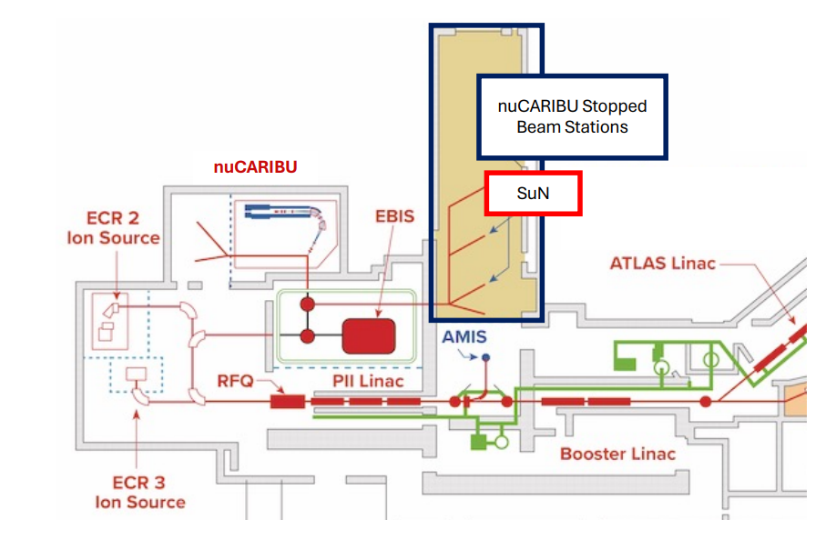
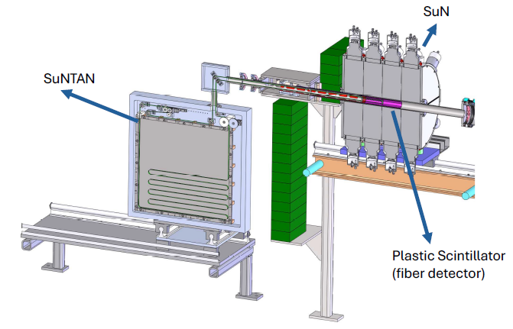
e1795 at Argonne National Laboratory
Beam of ¹⁴³Cs produced by CARIBU
Beam rate of about 3900 pps
Beam implants at the centre of SuN and detect the decay
CARIBU Stopped Beam Stations
CARIBU
SuNSPOT

Slide 13
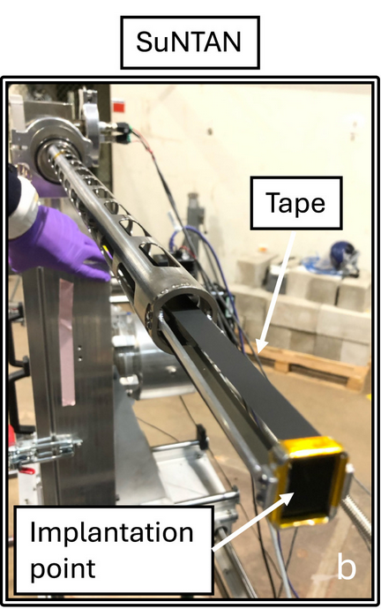
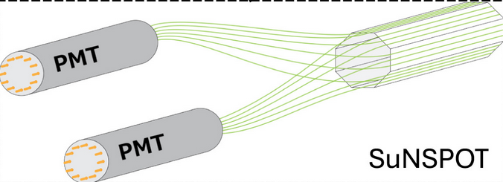
The SuN System
Summing NaI(Tl) Calorimeter (SuN)
Measures γ-ray energy
Total absorption spectrometer (TAS)
98% angular coverage
8 NaI segments with 3 PMTs each
85% summing efficiency
SuNTAN
Implantation surface
Tape system for removing daughter activity
SuNSPOT
Barrel-shaped scintillator detector
Detects β particles
16’’
16’’
beam
45 mm
C.M. Harris et al. in Nuclear Instruments and Methods in Physics, Vol 1084 (2026)

Slide 14
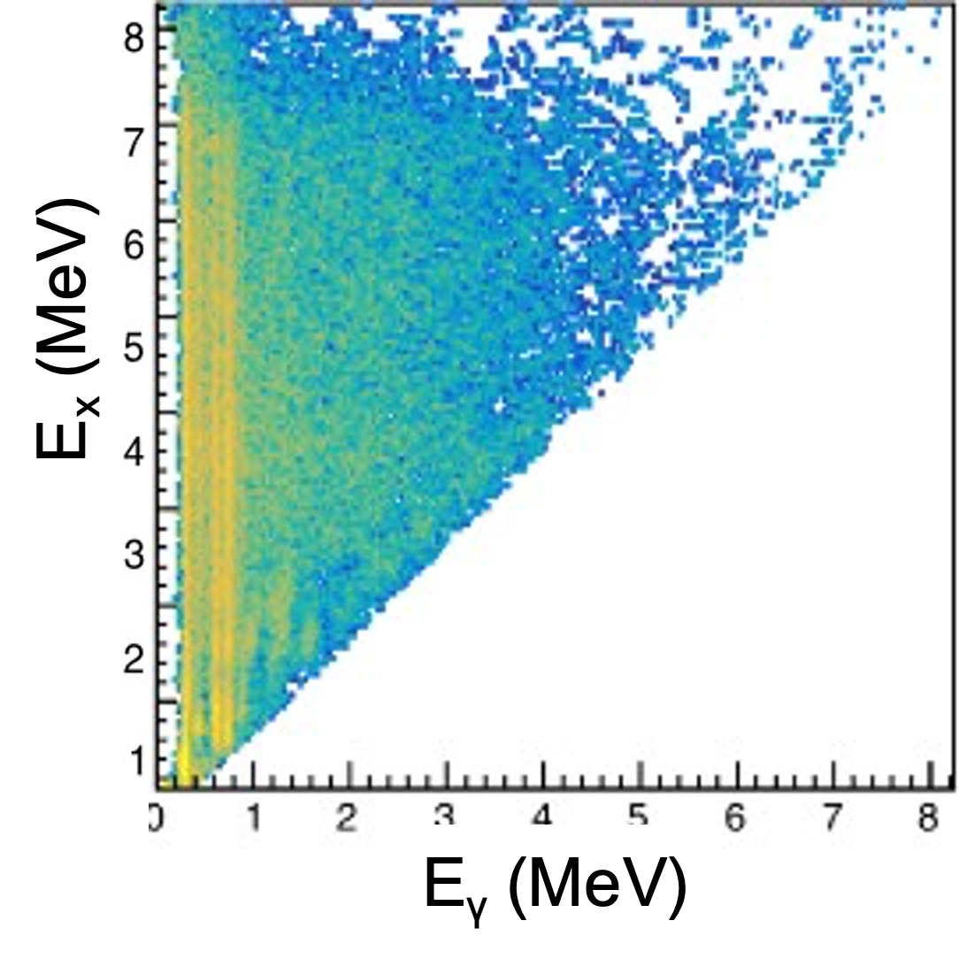
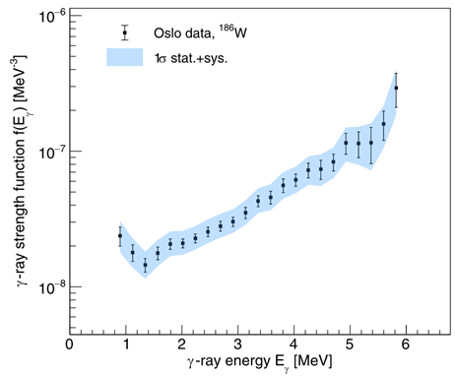
The Oslo Method Constrains Cross-Sections
Populate the compound nucleus of interest
¹⁴³Ba via β- decay
Measure Excitation energy (E_{x}) and γ-ray energy (E_{γ})
Obtain the primary γ-ray spectrum
Extract NLD and γSF
Constrain the required cross-section
Extract NLD and γSF, normalize them
Unfold and extract primary γ-rays
Obtain cross-section using TALYS
A.C. Larsen et al. in Physical Review C 108, 025804 (2023)

Slide 15
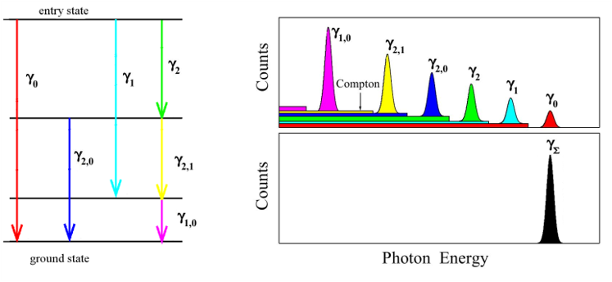
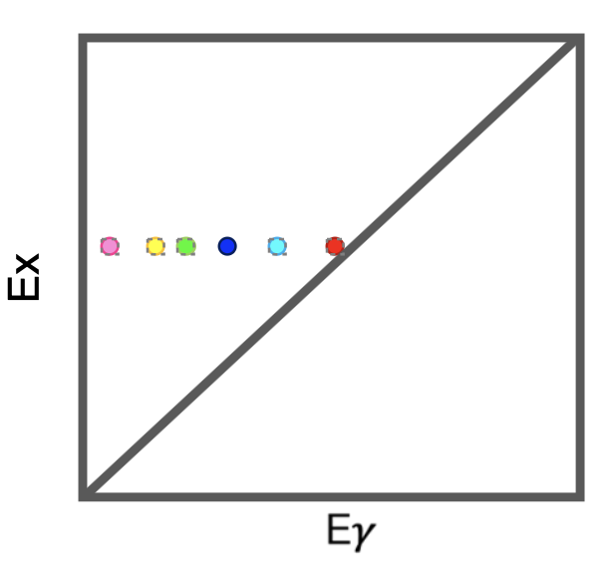
γ–ray Energy Summing
Individual segments record γ–ray energy from cascade
Summing γ–ray energy from one cascade recovers excitation energy
SuN allows simultaneous measurement of the excitation energy and individual γ–ray energies
Excited state
Segments
TAS
Ground state
Measure individual γ–ray energy, Eγ
Recover excitation energy Ex
Raw Matrix for Oslo analysis

Slide 16
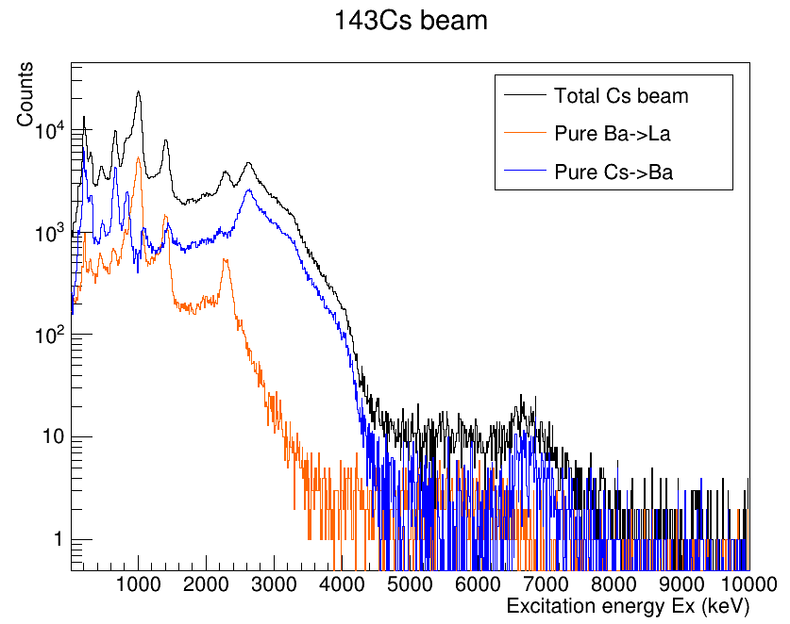
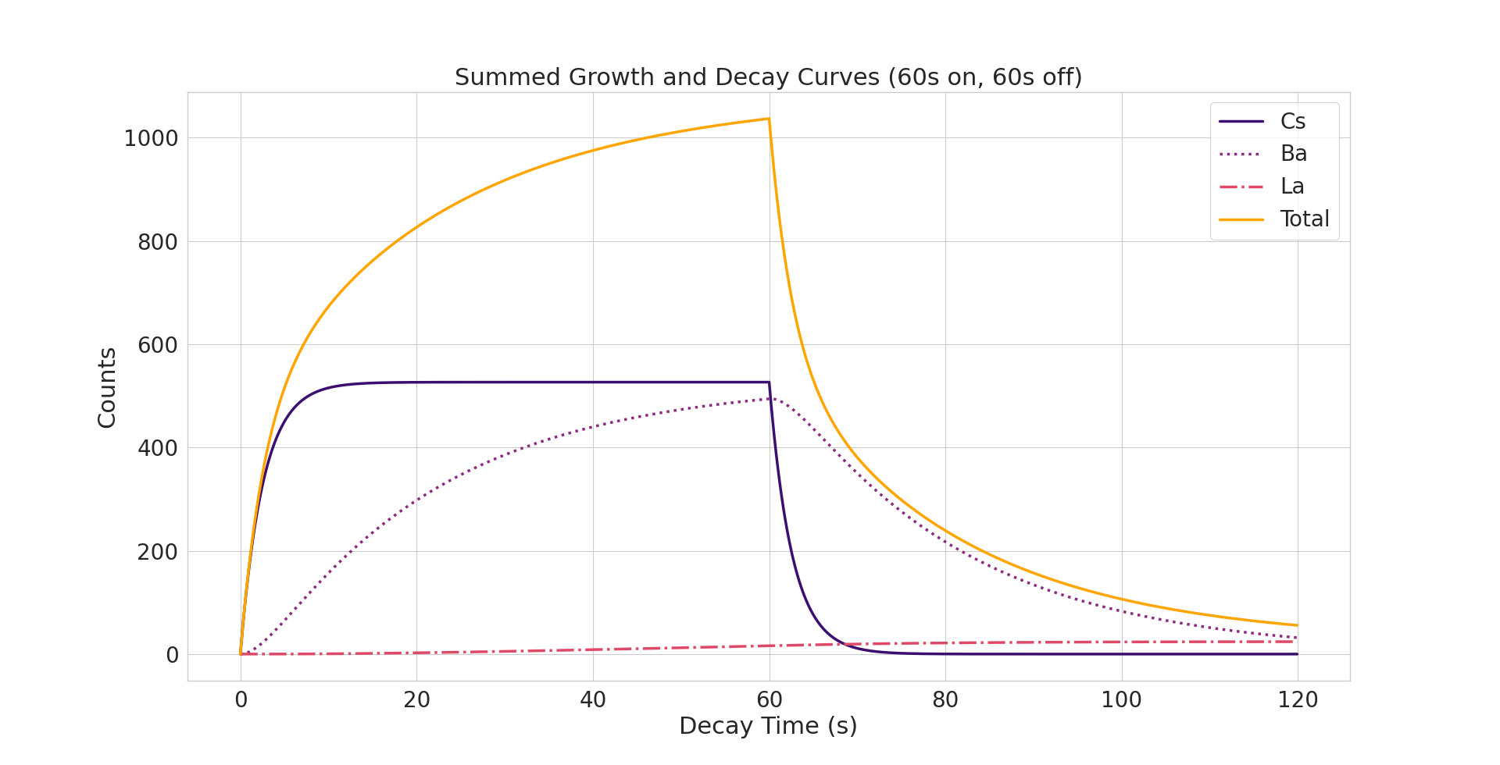
Background Contamination Needs to be Removed
We don’t just record ¹⁴³Cs ¹⁴³Ba
We also record ¹⁴³Ba ¹⁴³La
60s Beam ON, 60s Beam OFF tape cycle
For t>70s, ¹⁴³Ba ¹⁴³La dominates
Subtract ¹⁴³Ba ¹⁴³La for t<40s to get pure ¹⁴³Cs ¹⁴³Ba

Slide 17
The Oslo Method Constrains Cross-Sections
Populate the compound nucleus of interest
¹⁴³Ba via β- decay
Measure Excitation energy (E_{x}) and γ-ray energy (E_{γ})
Obtain the primary γ-ray spectrum
Extract NLD and γSF
Constrain the required cross-section
Extract NLD and γSF, normalize them
Unfold and extract primary γ-rays
Obtain cross-section using TALYS
A.C. Larsen et al. in Physical Review C 108, 025804 (2023)

Slide 18
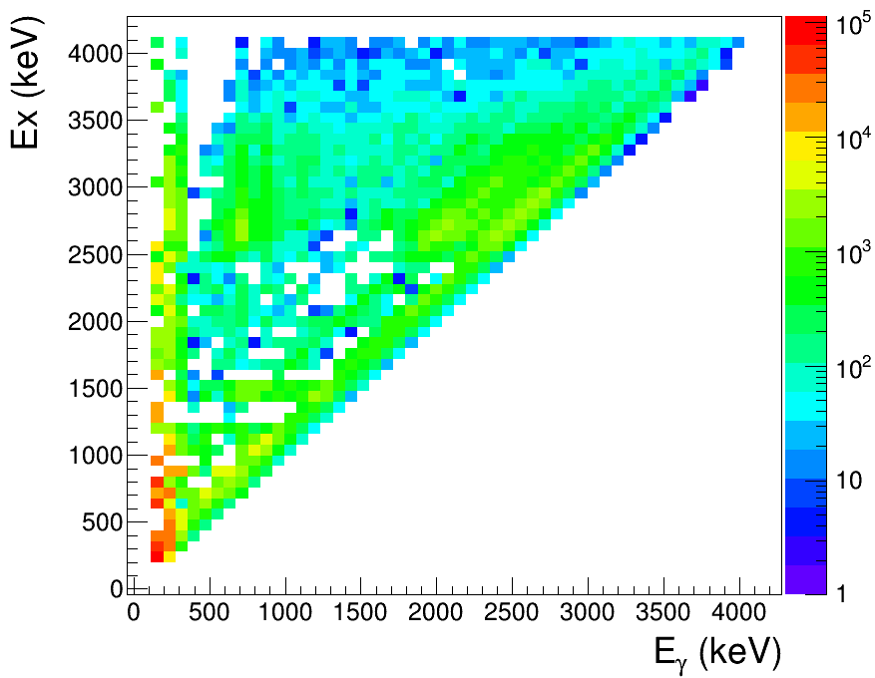
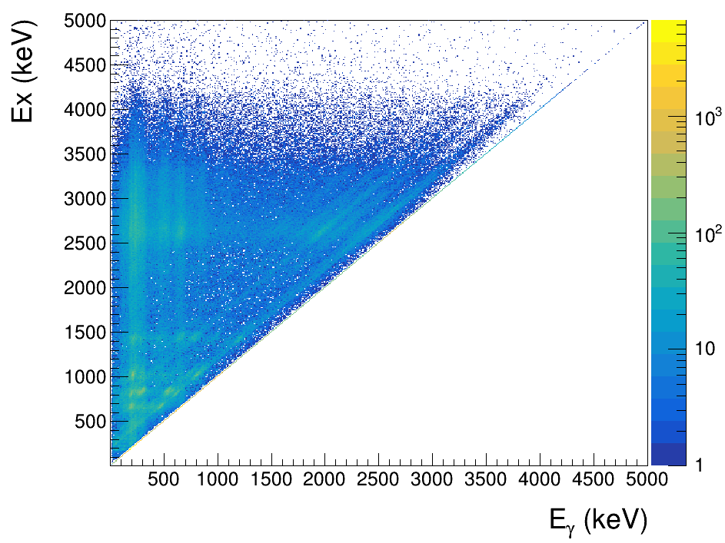

Preliminary Oslo Experimental Matrices
Raw matrix
Primary matrix
Unfold and extract primary γ-rays

Slide 19
The Oslo Method Constrains Cross-Sections
Populate the compound nucleus of interest
¹⁴³Ba via β- decay
Measure Excitation energy (E_{x}) and γ-ray energy (E_{γ})
Obtain the primary γ-ray spectrum
Extract NLD and γSF
Constrain the required cross-section
Extract NLD and γSF, normalize them
Unfold and extract primary γ-rays
Obtain cross-section using TALYS
A.C. Larsen et al. in Physical Review C 108, 025804 (2023)

Slide 20
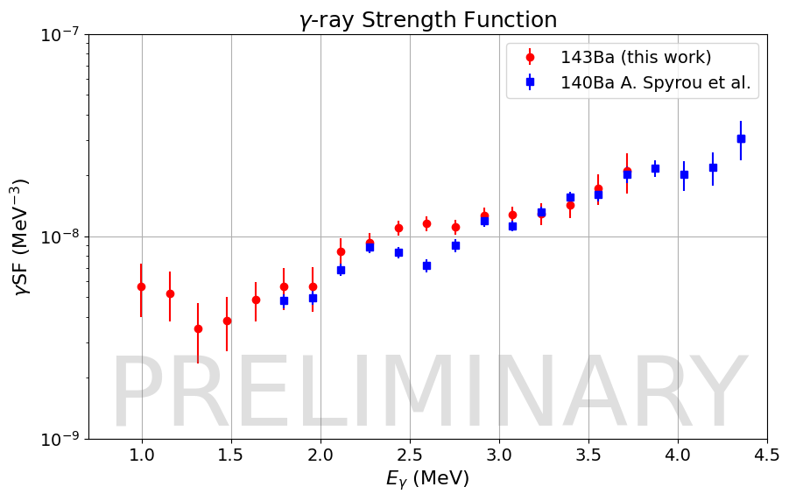
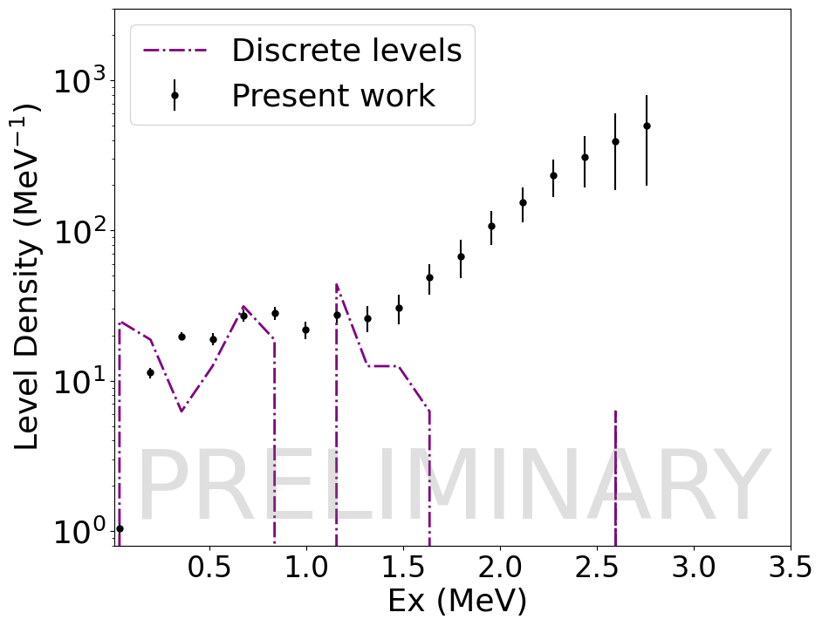
Experimentally Extracted Preliminary NLD and γSF
γSF
Normalized to the γSF of neighbouring nucleus ¹⁴⁰Ba¹
NLD
Lower energies normalized to discrete levels
Higher energy slope fixed from normalization of γSF
[1] A. Spyrou et al. in Physical Review Letters 132, 202701 (2024)

Slide 21
Outline
How are elements beyond iron produced?
Why do we care about neutron-capture reaction rates?
How do we constrain neutron-capture reaction rates?
What did we do to measure the ¹⁴²Ba(n, γ)¹⁴³Ba reaction rate?
What does our measurement tell us about ¹⁴³Ba?
Preliminary ¹⁴²Ba(n, γ)¹⁴³Ba cross-section
Conclusion and future work

Slide 22
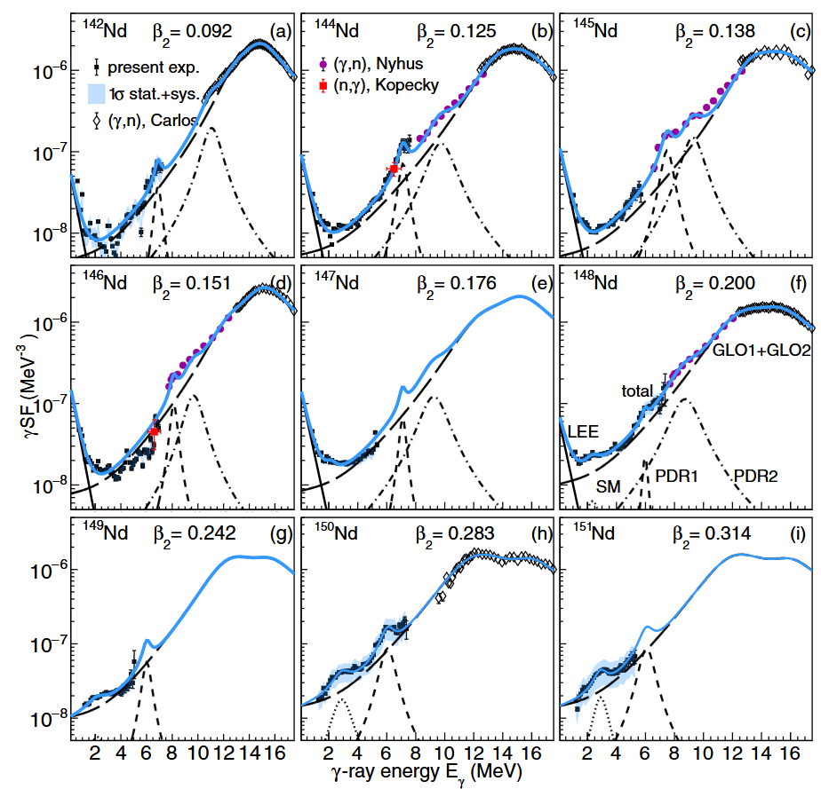
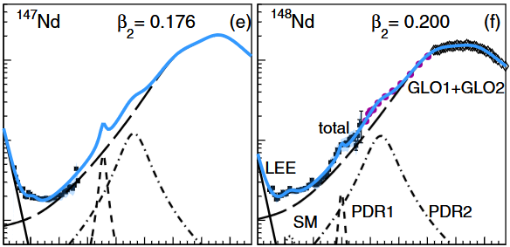
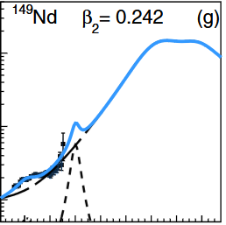

Possibility of Scissors Mode in ¹⁴³Ba
Appears in deformed nuclei¹
0.16 < β₂ for ¹⁴³Ba < 0.19
Deformed proton and neutron clouds rotationally oscillate against each other
Systematic study on Nd isotopes²
γSF(MeV⁻³)
γ -ray energy (MeV)
[1] N. Lo Iudice and F. Palumbo. in Physical Review Letters 41, 1532 (1978)
[2] M. Guttormsen et al. in Physical Review C 106, 034314 (2022)
Animation credits: S. Uthayakumaar

Slide 23
Outline
How are elements beyond iron produced?
Why do we care about neutron-capture reaction rates?
How do we constrain neutron-capture reaction rates?
What did we do to measure the ¹⁴²Ba(n, γ)¹⁴³Ba reaction rate?
What does our measurement tell us about ¹⁴³Ba?
Preliminary ¹⁴²Ba(n, γ)¹⁴³Ba cross-section
Conclusion and future work

Slide 24
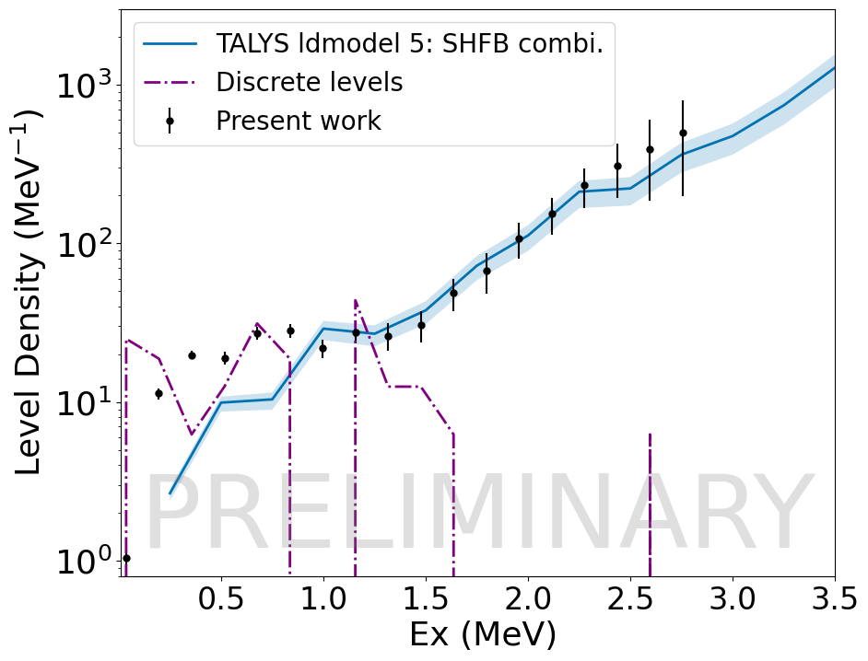
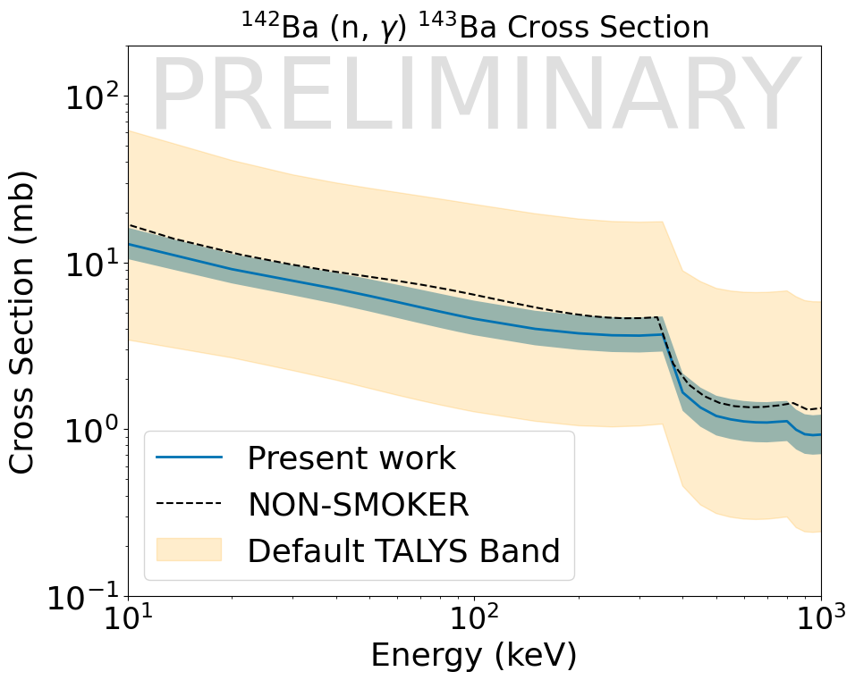
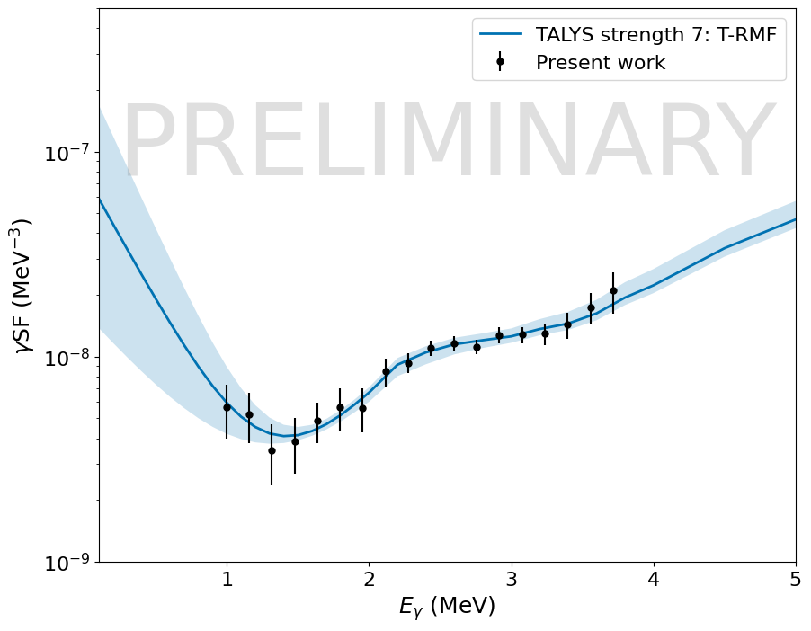
Preliminary TALYS fits and Cross-Section

Slide 25
Outline
How are elements beyond iron produced?
Why do we care about neutron-capture reaction rates?
How do we constrain neutron-capture reaction rates?
What did we do to measure the ¹⁴²Ba(n, γ)¹⁴³Ba reaction rate?
What does our measurement tell us about ¹⁴³Ba?
Preliminary ¹⁴²Ba(n, γ)¹⁴³Ba cross-section
Conclusion and future work

Slide 26
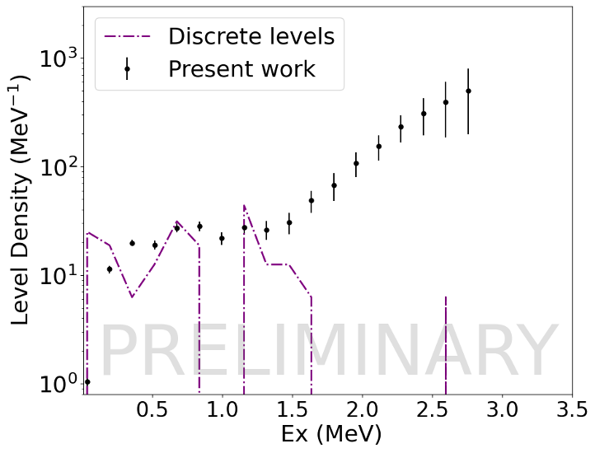
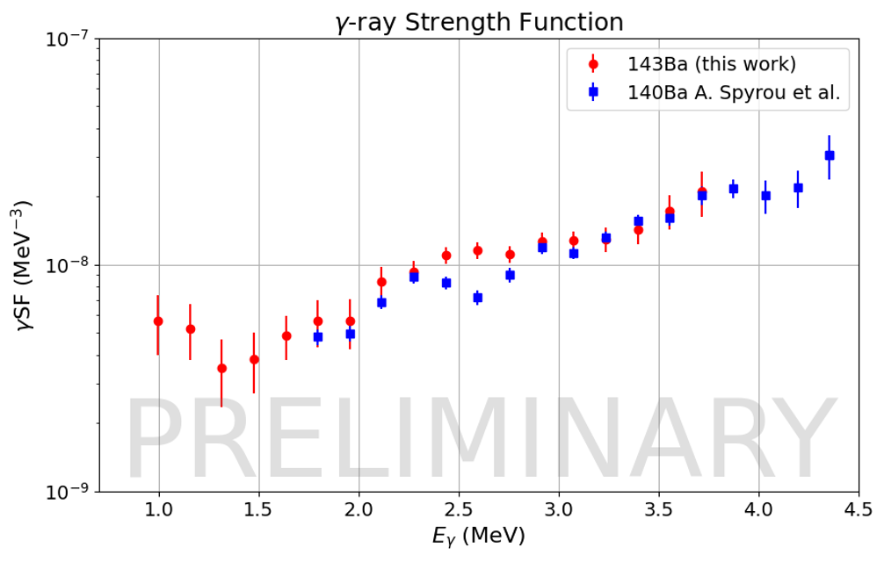
Conclusion and Future Work
The preliminary NLD, γSF of ¹⁴³Ba and ¹⁴²Ba(n, γ) cross-section were experimentally extracted and constrained
Need to evaluate the systematic uncertainties on NLD, γSF, and the cross-section
Investigate the existence of Scissors Mode in ¹⁴³Ba and the implications on r-process nucleosynthesis
Additional measurements in the A=140 region
Proposal accepted at Argonne National Laboratory for ¹⁴⁴La(n,γ)¹⁴⁵La, ¹⁴⁵Ce(n,γ)¹⁴⁶Ce and ¹⁴⁷Ce(n,γ)¹⁴⁸Ce
Principal Investigator: Sydney Coil
Co-Principal Investigator: Hershini Gadaria
More Argonne campaigns with La isotopes

Slide 27

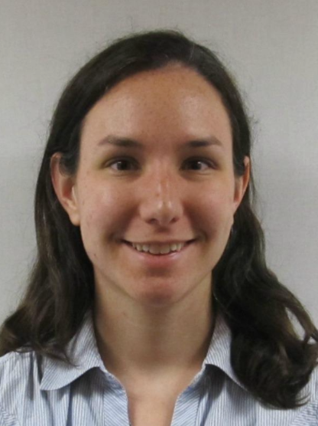

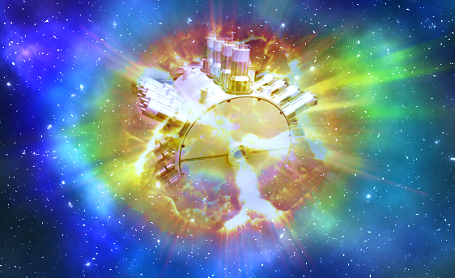







Acknowledgements
Artemisia Spyrou Professor, Group Leader
Mallory Smith,
Staff
Sivi
Uthayakumaar,
postdoc
Amal Sebastian,
Grad.
Student
Paige Garret,
Undergraduate
student
Sydney Coil,
Grad.
student
Hannah
Berg,
Grad.
student
Jordan Owens-Fryar,
Grad.
student
Kostas Bosmpotinis,
Grad. student

Slide 28
Backup slides

Slide 29
Unfolding with MAMA machinery
Raw matrix: 10 keV/ch
Then compress it to 20 keV/ch
Response matrix generation:
Energy resolution: 6%
Includes the contribution of the Photoelectric effect, Compton effect, single and double escape peaks, and annihilation at all the different energies.
Unfolding:
Start with a trial function and fold it with the detector response.
Compare the folded spectrum to the observed spectrum.
If there’s a difference, add this difference to the trial function.
Repeat the process until the folded spectrum looks similar to observed spectrum

Slide 30
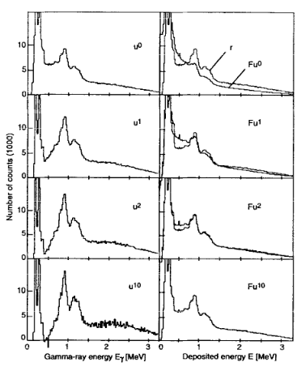
Unfolding process
M. Guttormsen et al. in NIM 374 (1996)

Slide 31
First-generation matrix
Compress the unfolded matrix to 80 keV/ch
Highest excitation energy: 4 MeV
Lowest gamma threshold: 110 keV
Upper threshold for non-stat gamma: 1.1 MeV
Assumption: States populated after first transition have same decay properties as if the second state was fed directly.
Iterative subtraction method

Slide 32

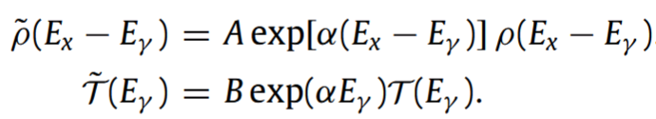
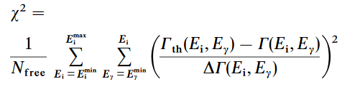
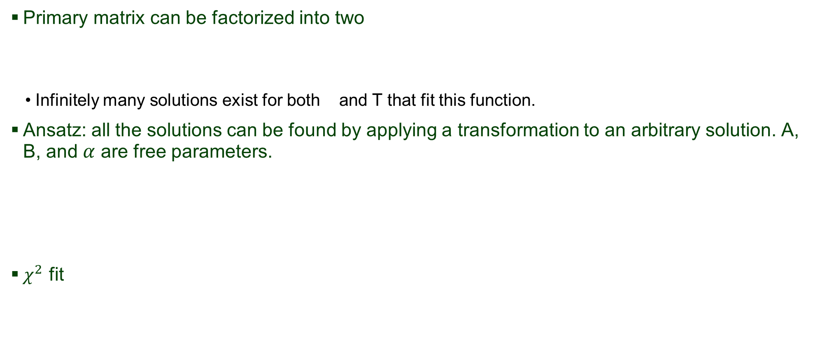

Rhosigchi machinery
Primary matrix can be factorized into two
Infinitely many solutions exist for both and T that fit this function.
Ansatz: all the solutions can be found by applying a transformation to an arbitrary solution. A, B, and $α$ are free parameters.
$χ^{2}$ fit
$ρ$

Slide 33

Rhosigchi machinery
To ensure convergance, the maximum change in the value of $ρ$ and T is restricted within a certain percentage. This percentage is different for different number of iterations.

Slide 34

Counting machinery
T = 0.656
E0 = -0.843
Cumulated histogram N(E_{x}) of the first discrete levels can be well reproduced by an exponential law
Chi2 = 0.1

Slide 35
Coursework
Course | Semester | Grades
PHY820- Classical Mechanics | FS24 | 3.5
PHY851- Quantum Mechanics I | FS24 | 4.0
PHY905- Data Acquisition Lab | FS24 | 4.0
PHY841- Electrodynamics I | SS25 | 4.0
PHY983- Nuclear Astrophysics | SS25 | 4.0
PHY800- Research Methods | SS25 | P
PHY831- Statistical Mechanics | FS25 | 3.5
PHY905- Nuclear Structure | FS25 | 4.0
PHY800- Research Methods | FS25 | P
PHY905- Nuclear Dynamics | SS26 | In progress
PHY999- Doctoral Dissertation | SS26 | P

Slide 36
Career Development Activities
Present a talk with these results at the 10th Workshop on Level Density and Gamma Strength in Oslo, Norway (May, 2026)
Helping commission the detector at Argonne National Lab for a series of upcoming experimental campaigns.
In the past..
Participated in various experimental campaigns at FRIB

