Slide 1

Constraining the ⁹⁵Zr(n,γ) cross section using SONIC at HORUS
Tom Sittig, Dennis Mücher (IKP Cologne)
Neutron Capture cross sections in exotic nuclei in the vicinity of N=82
Institute for Nuclear Physics / University of Cologne | Dennis Mücher | 19.05.26

Slide 2

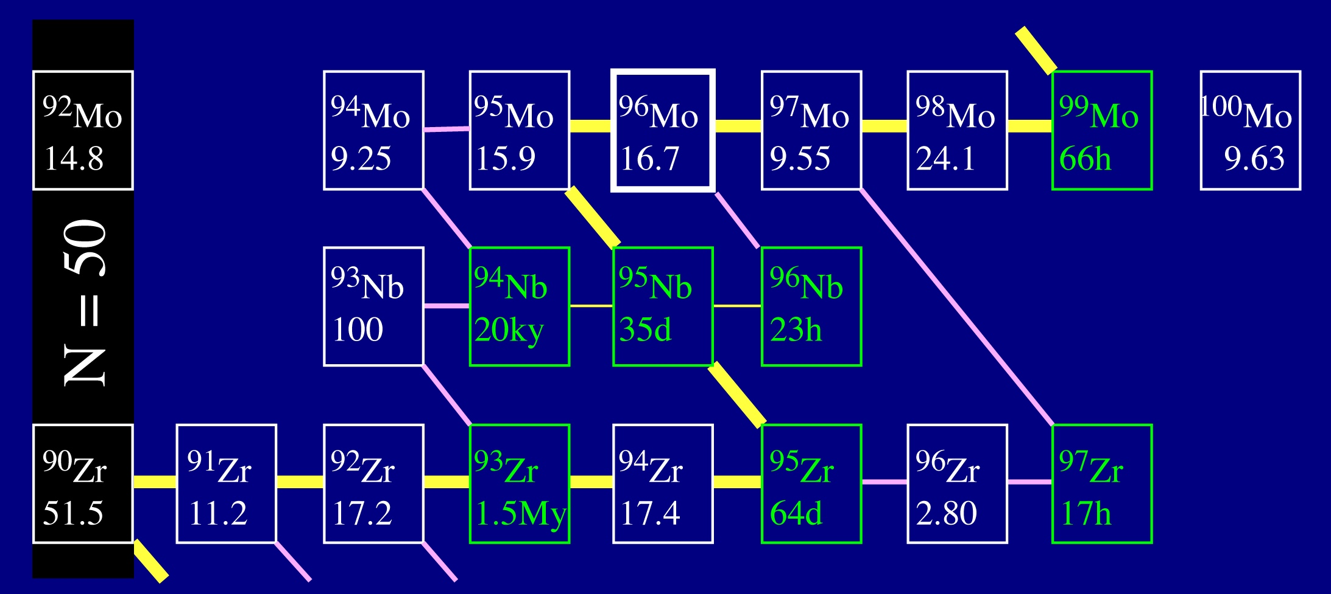
Nucleosynthesis in the Zr & Mo chain
Branchings:
neutron capture by
radioactive species.
image by Falk Herwig & Rene Reifarth

Slide 3
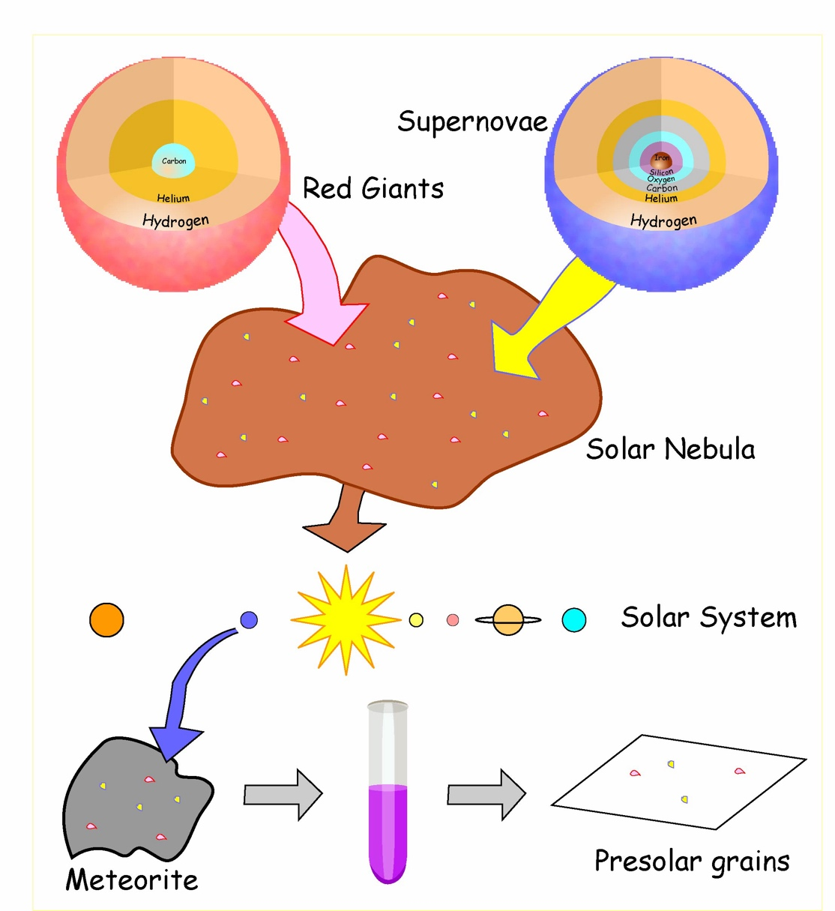
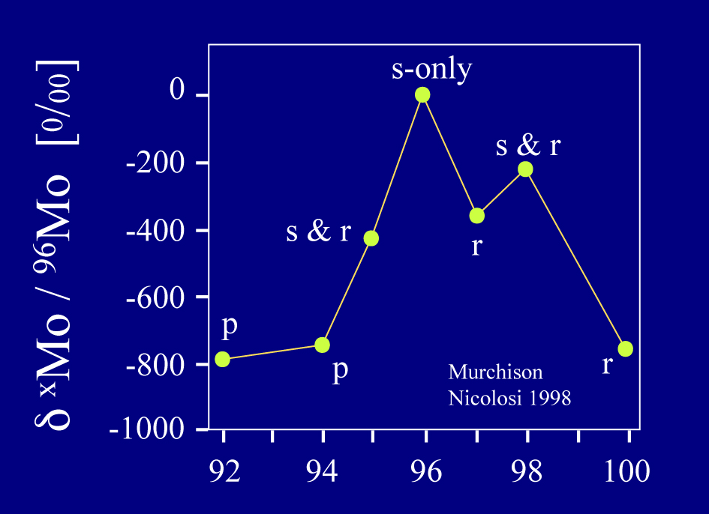
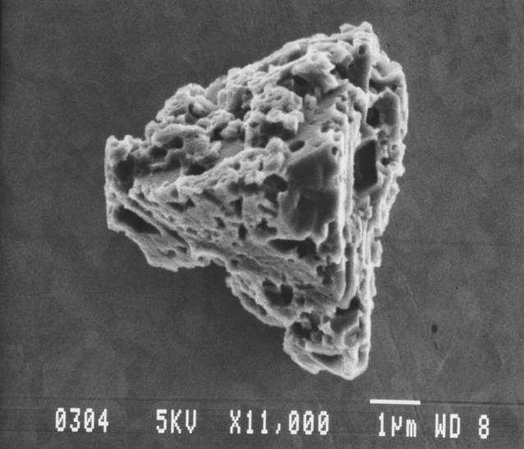
Presolar grains
slide adapted from F. Herwig & R. Reifarth
Pre-solar meteoritic grains provide a powerful diagnostic tool.
Trace signatures of individual stellar sources
High-precision isotopic abundances
Multiple elements now from individual grains

Slide 4
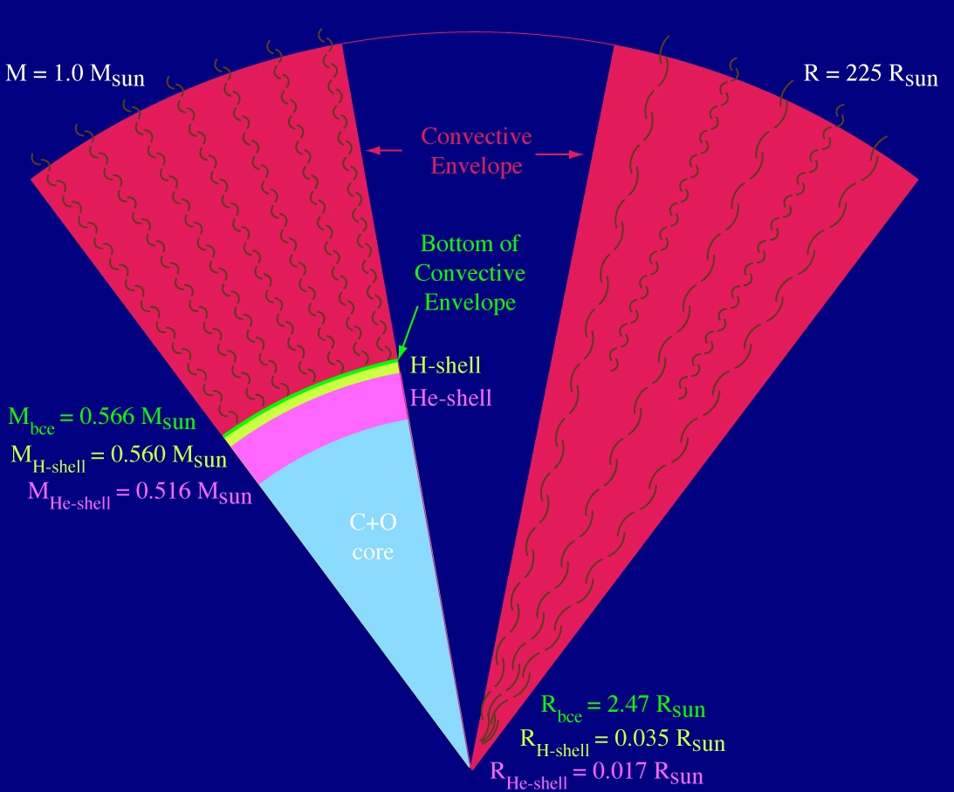
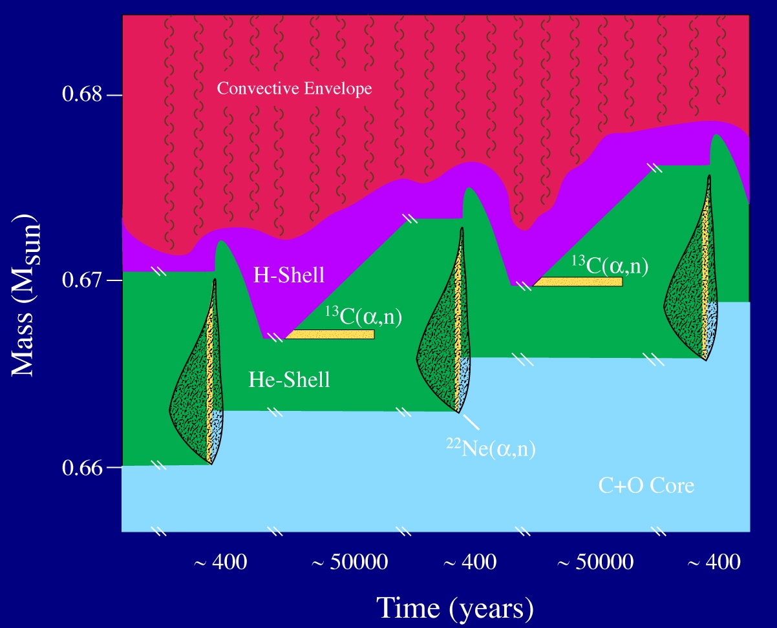
He shell thermal pulses in AGB stars
Global Structure of an AGB star
slide adapted from F. Herwig & R. Reifarth

Slide 5
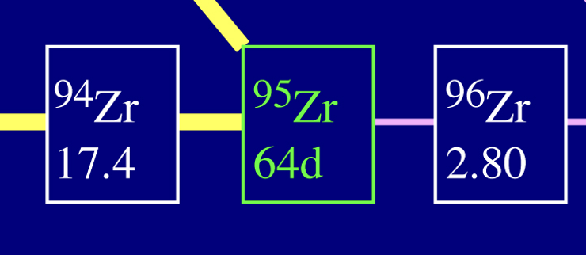
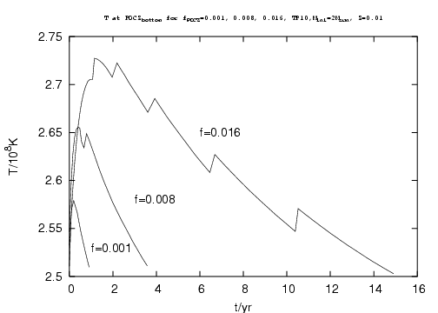
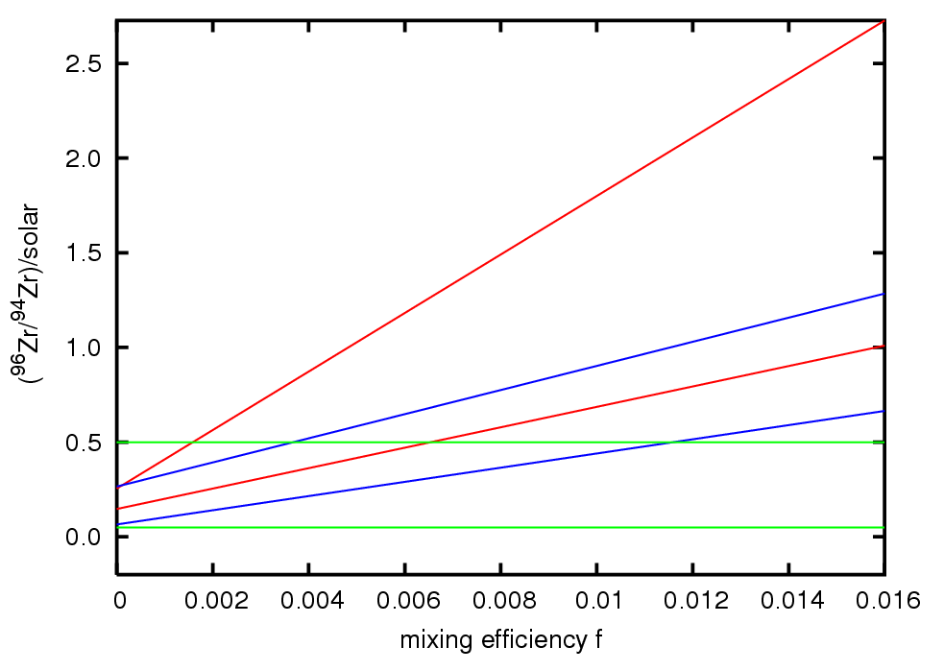
Convective boundary mixing parameter
Global Structure of an AGB star
slide adapted from F. Herwig & R. Reifarth
?
σ = 80 mb
σ = 20 mb
grains

Slide 6
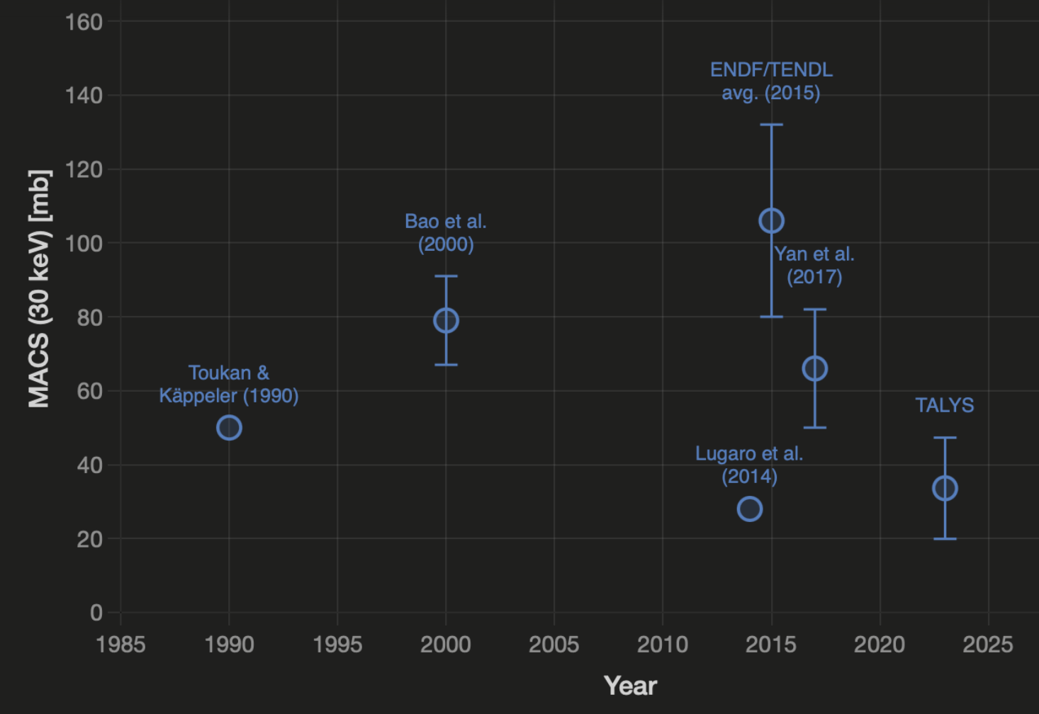
Literature values for ⁹⁵Zr(n,γ) MACS at 30 keV
Global Structure of an AGB star
plot created with Claude
Sonnet 4.6

Slide 7
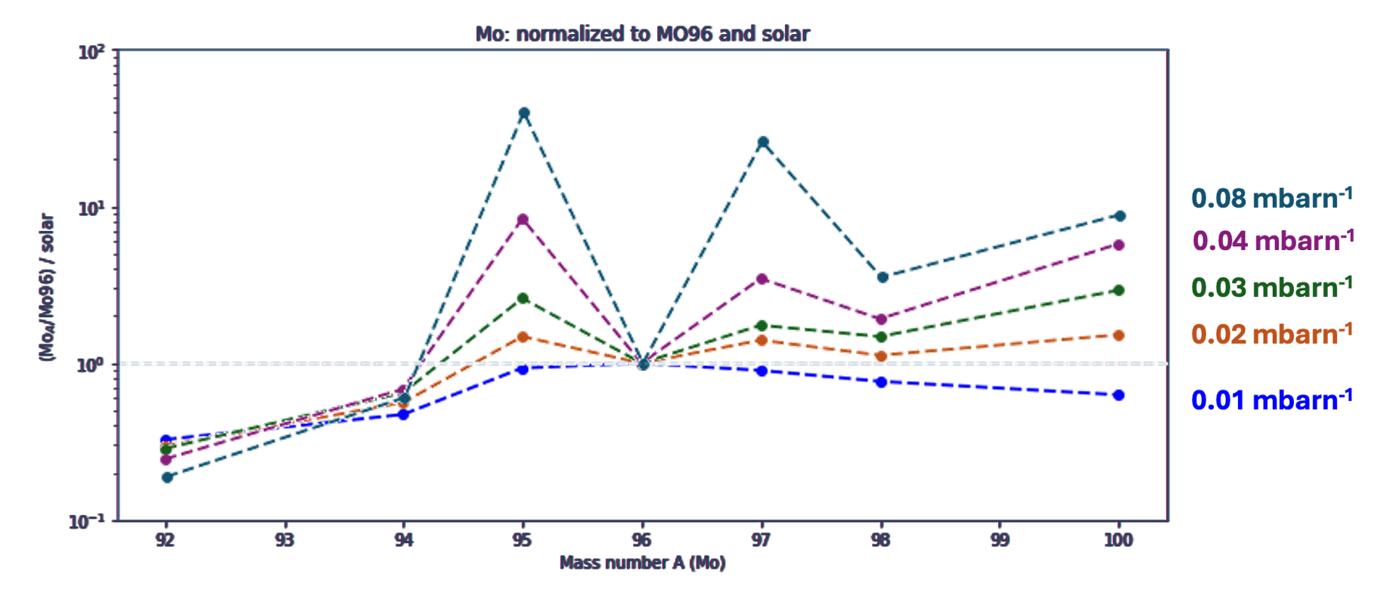

Overabundance of Mo isotopes in presolar grains
⁹⁵Zr branch: thermometer for neutron exposure!
calculations by Nan Liu
M. Pignatarti et al. 2018, Geo. Cos. Act. 221 37

Slide 8
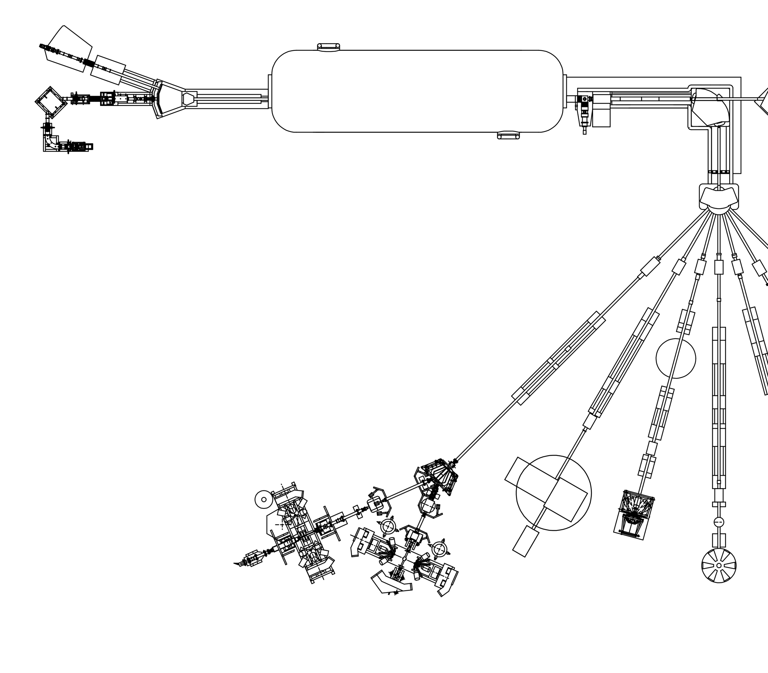
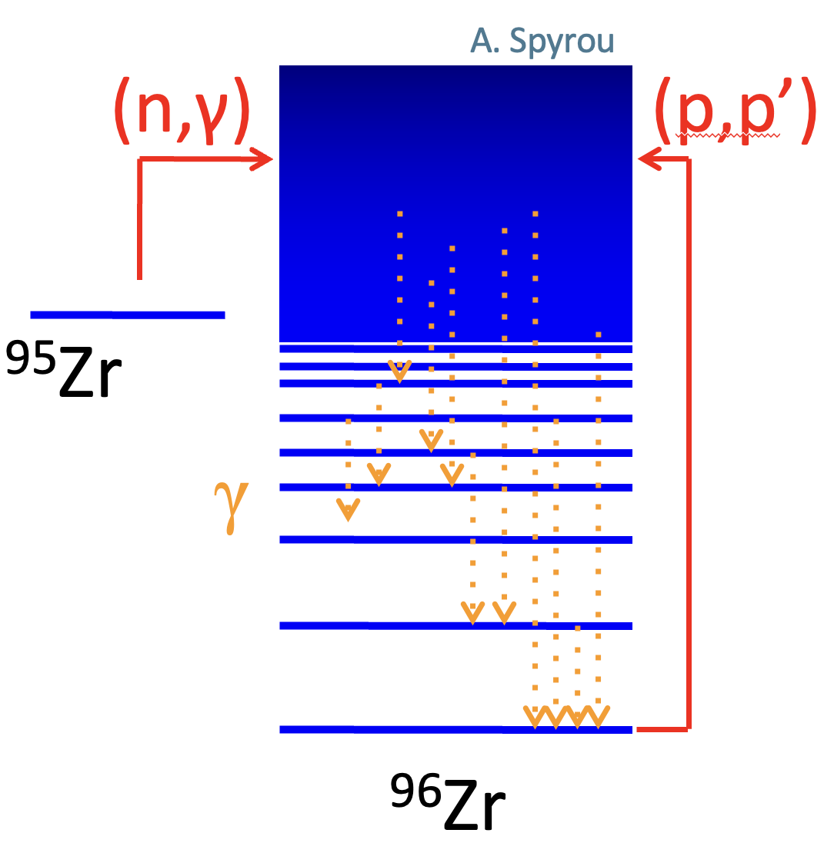
10MV FN Tandem
⁹⁶Zr(p,p’) IKP Cologne
Schematic adapted from
Markus Schiffer
SONIC
HORUS
4

Slide 9
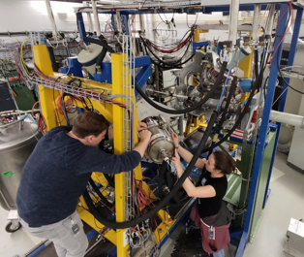
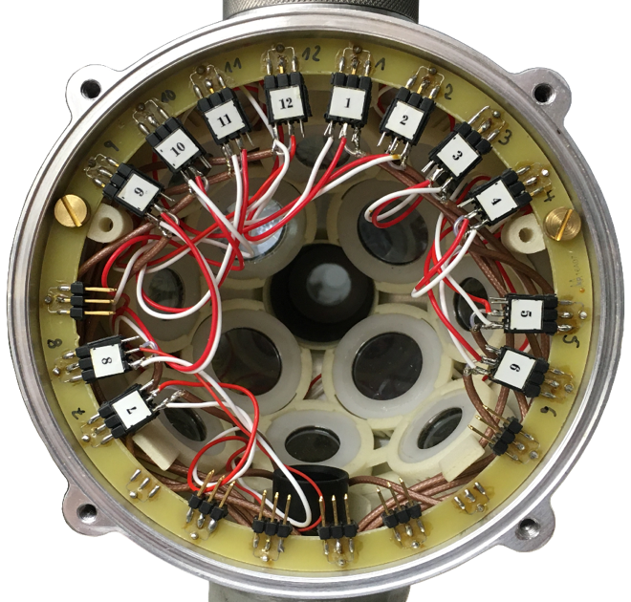
SONIC@HORUS group Andreas Zilges
Schematic adapted from
Markus Schiffer
10MV FN Tandem
12.8 cm
HORUS + SONIC
Up to 14 HPGe detectors
Up to 12 Si-telescopes
SONIC
HORUS
4

Slide 10
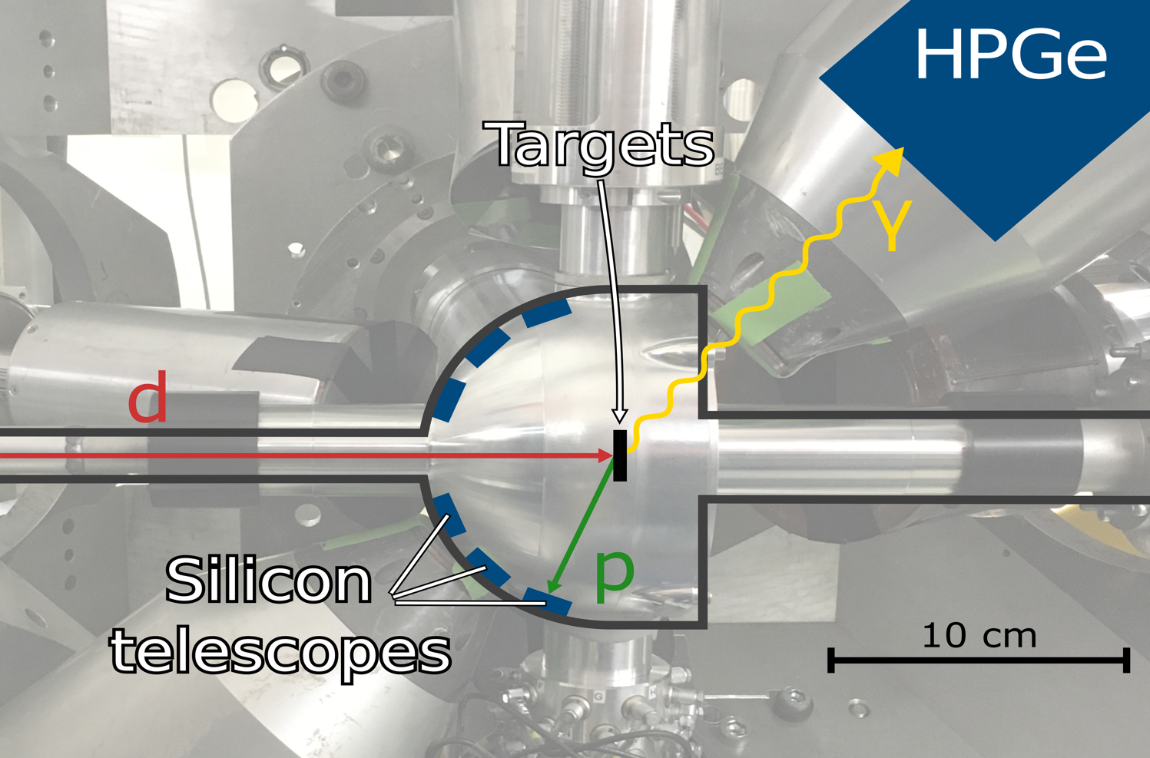
SONIC@HORUS group Andreas Zilges
Schematic adapted from
Markus Schiffer
10MV FN Tandem
SONIC
HORUS
4

Slide 11
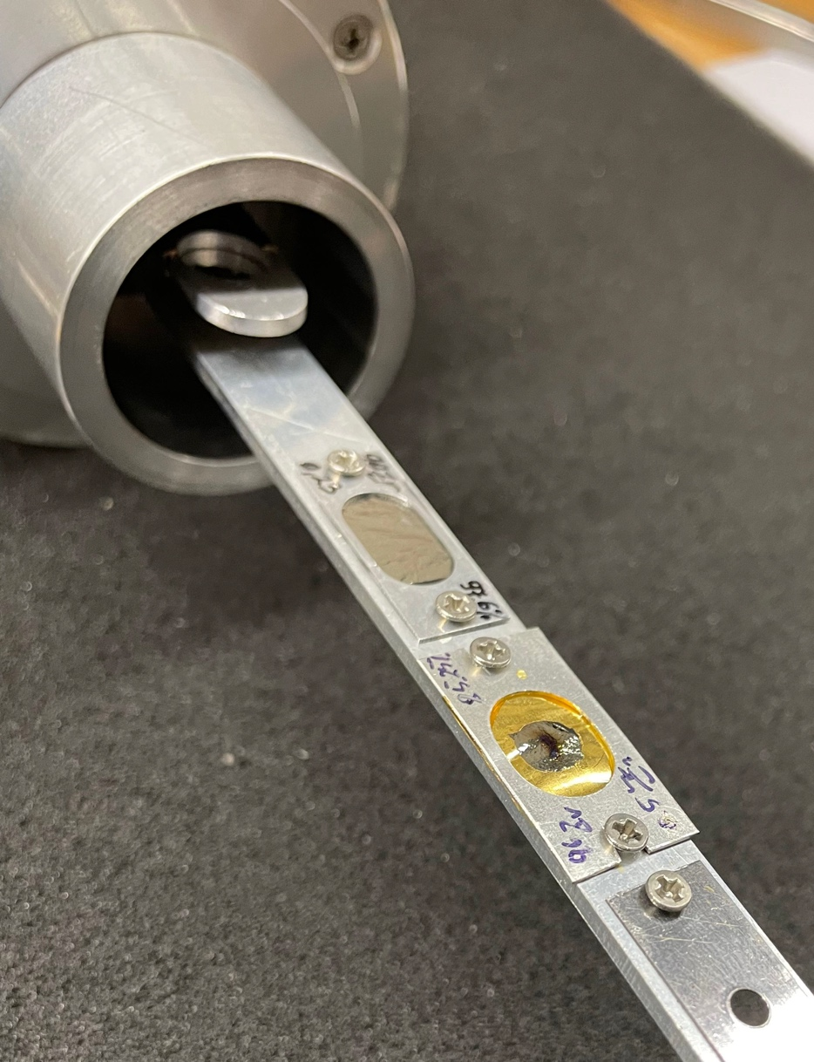
⁹⁶Zr(p,p’) IKP Cologne
Measurement of (p,p’) reaction at 15 MeV
¹²C & ⁹⁰Zr measurements to reduce contaminations in ⁹⁶Zr
Produce ExG spectra for each target
Target | Purity | Thickness | Beamtime | Target Current
¹²C | ~99% | 100 μg/cm² | 5 h | 745 - 820 pA
²⁸Si | ~92% | 950 μg/cm² | 10 h | 3000 - 3800 pA
⁹⁰Zr | 97.6% | 230 μg/cm² | 8 h | 560 - 630 pA
⁹⁶Zr | 85.2% | 500 μg/cm² | 23 h | 450 - 670 pA
⁹⁰Zr
⁹⁶Zr
5
Notes:
Natural isotope abundance of ⁹⁶Zr: 2.8%

Slide 12

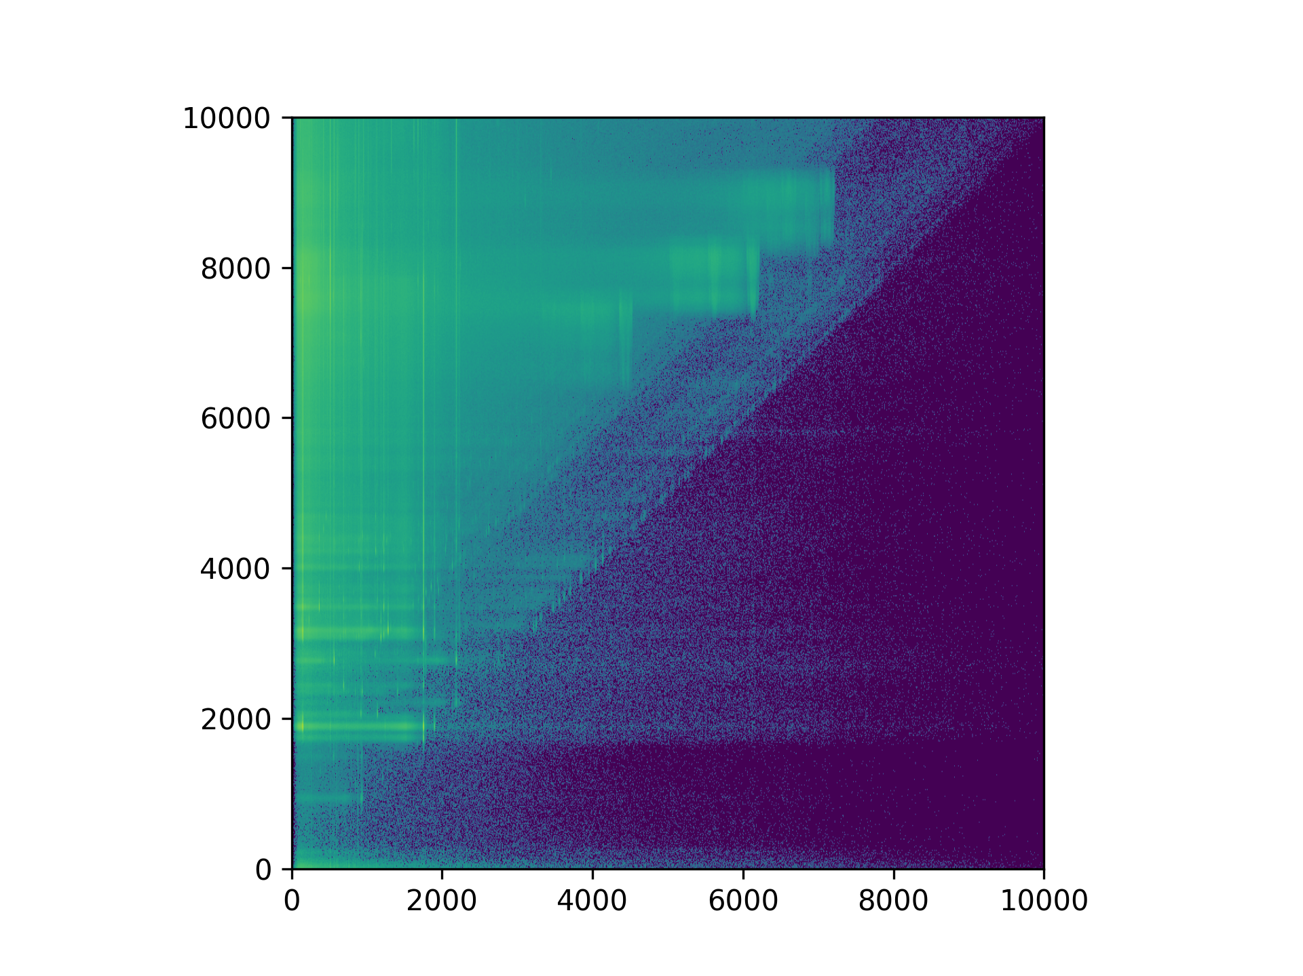
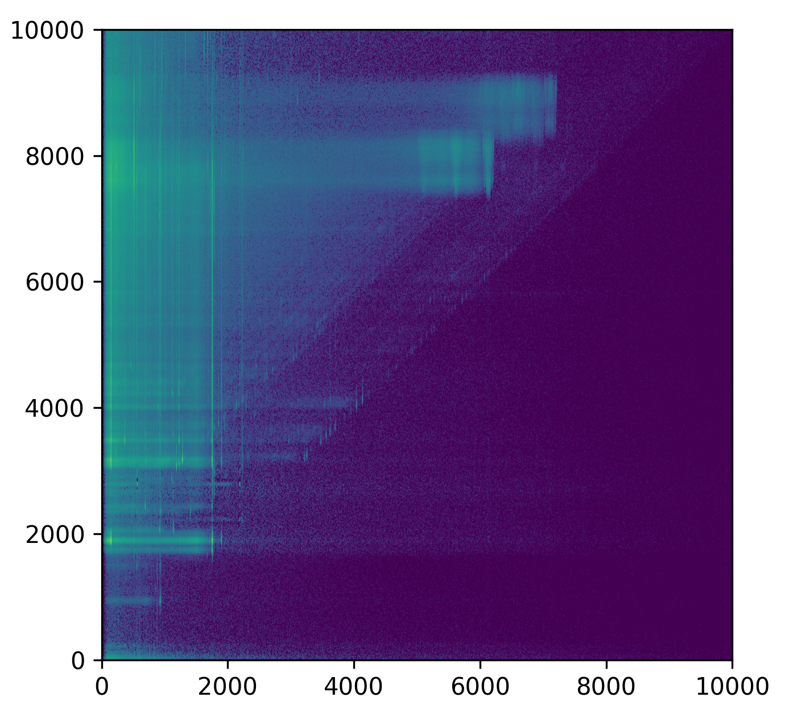

Excitation energy vs γ ray energy matrices
Tom Sitting
MSc. Student
Excitation energy [keV]
Excitation energy [keV]
Excitation energy [keV]
¹²C & ¹⁶O
¹²C & ¹⁶O
⁹⁰Zr 2748 keV
⁹⁰Zr 2748 keV
⁹⁶Zr 1750 keV
⁹⁶Zr 1750 keV
⁹⁶Zr
⁹⁶Zr
⁹⁶Zr
Gamma energy [keV]
Gamma energy [keV]
Gamma energy [keV]
7

Slide 13
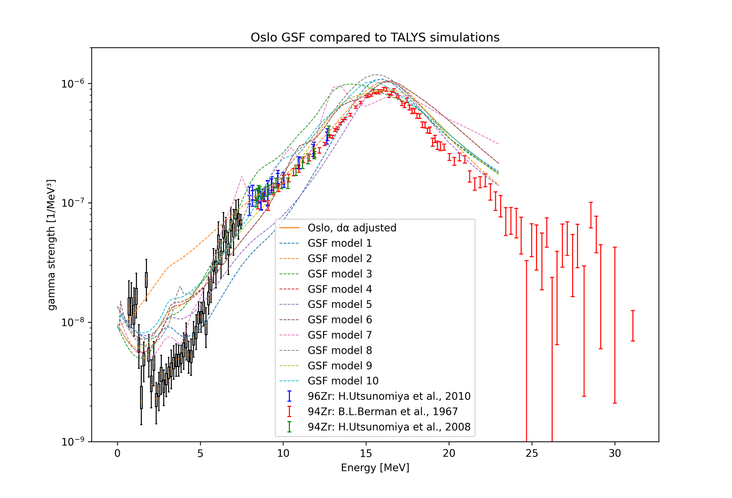
⁹⁶Zr Gamma Strength Function
⁹⁶Zr
PRELIMINARY
9

Slide 14
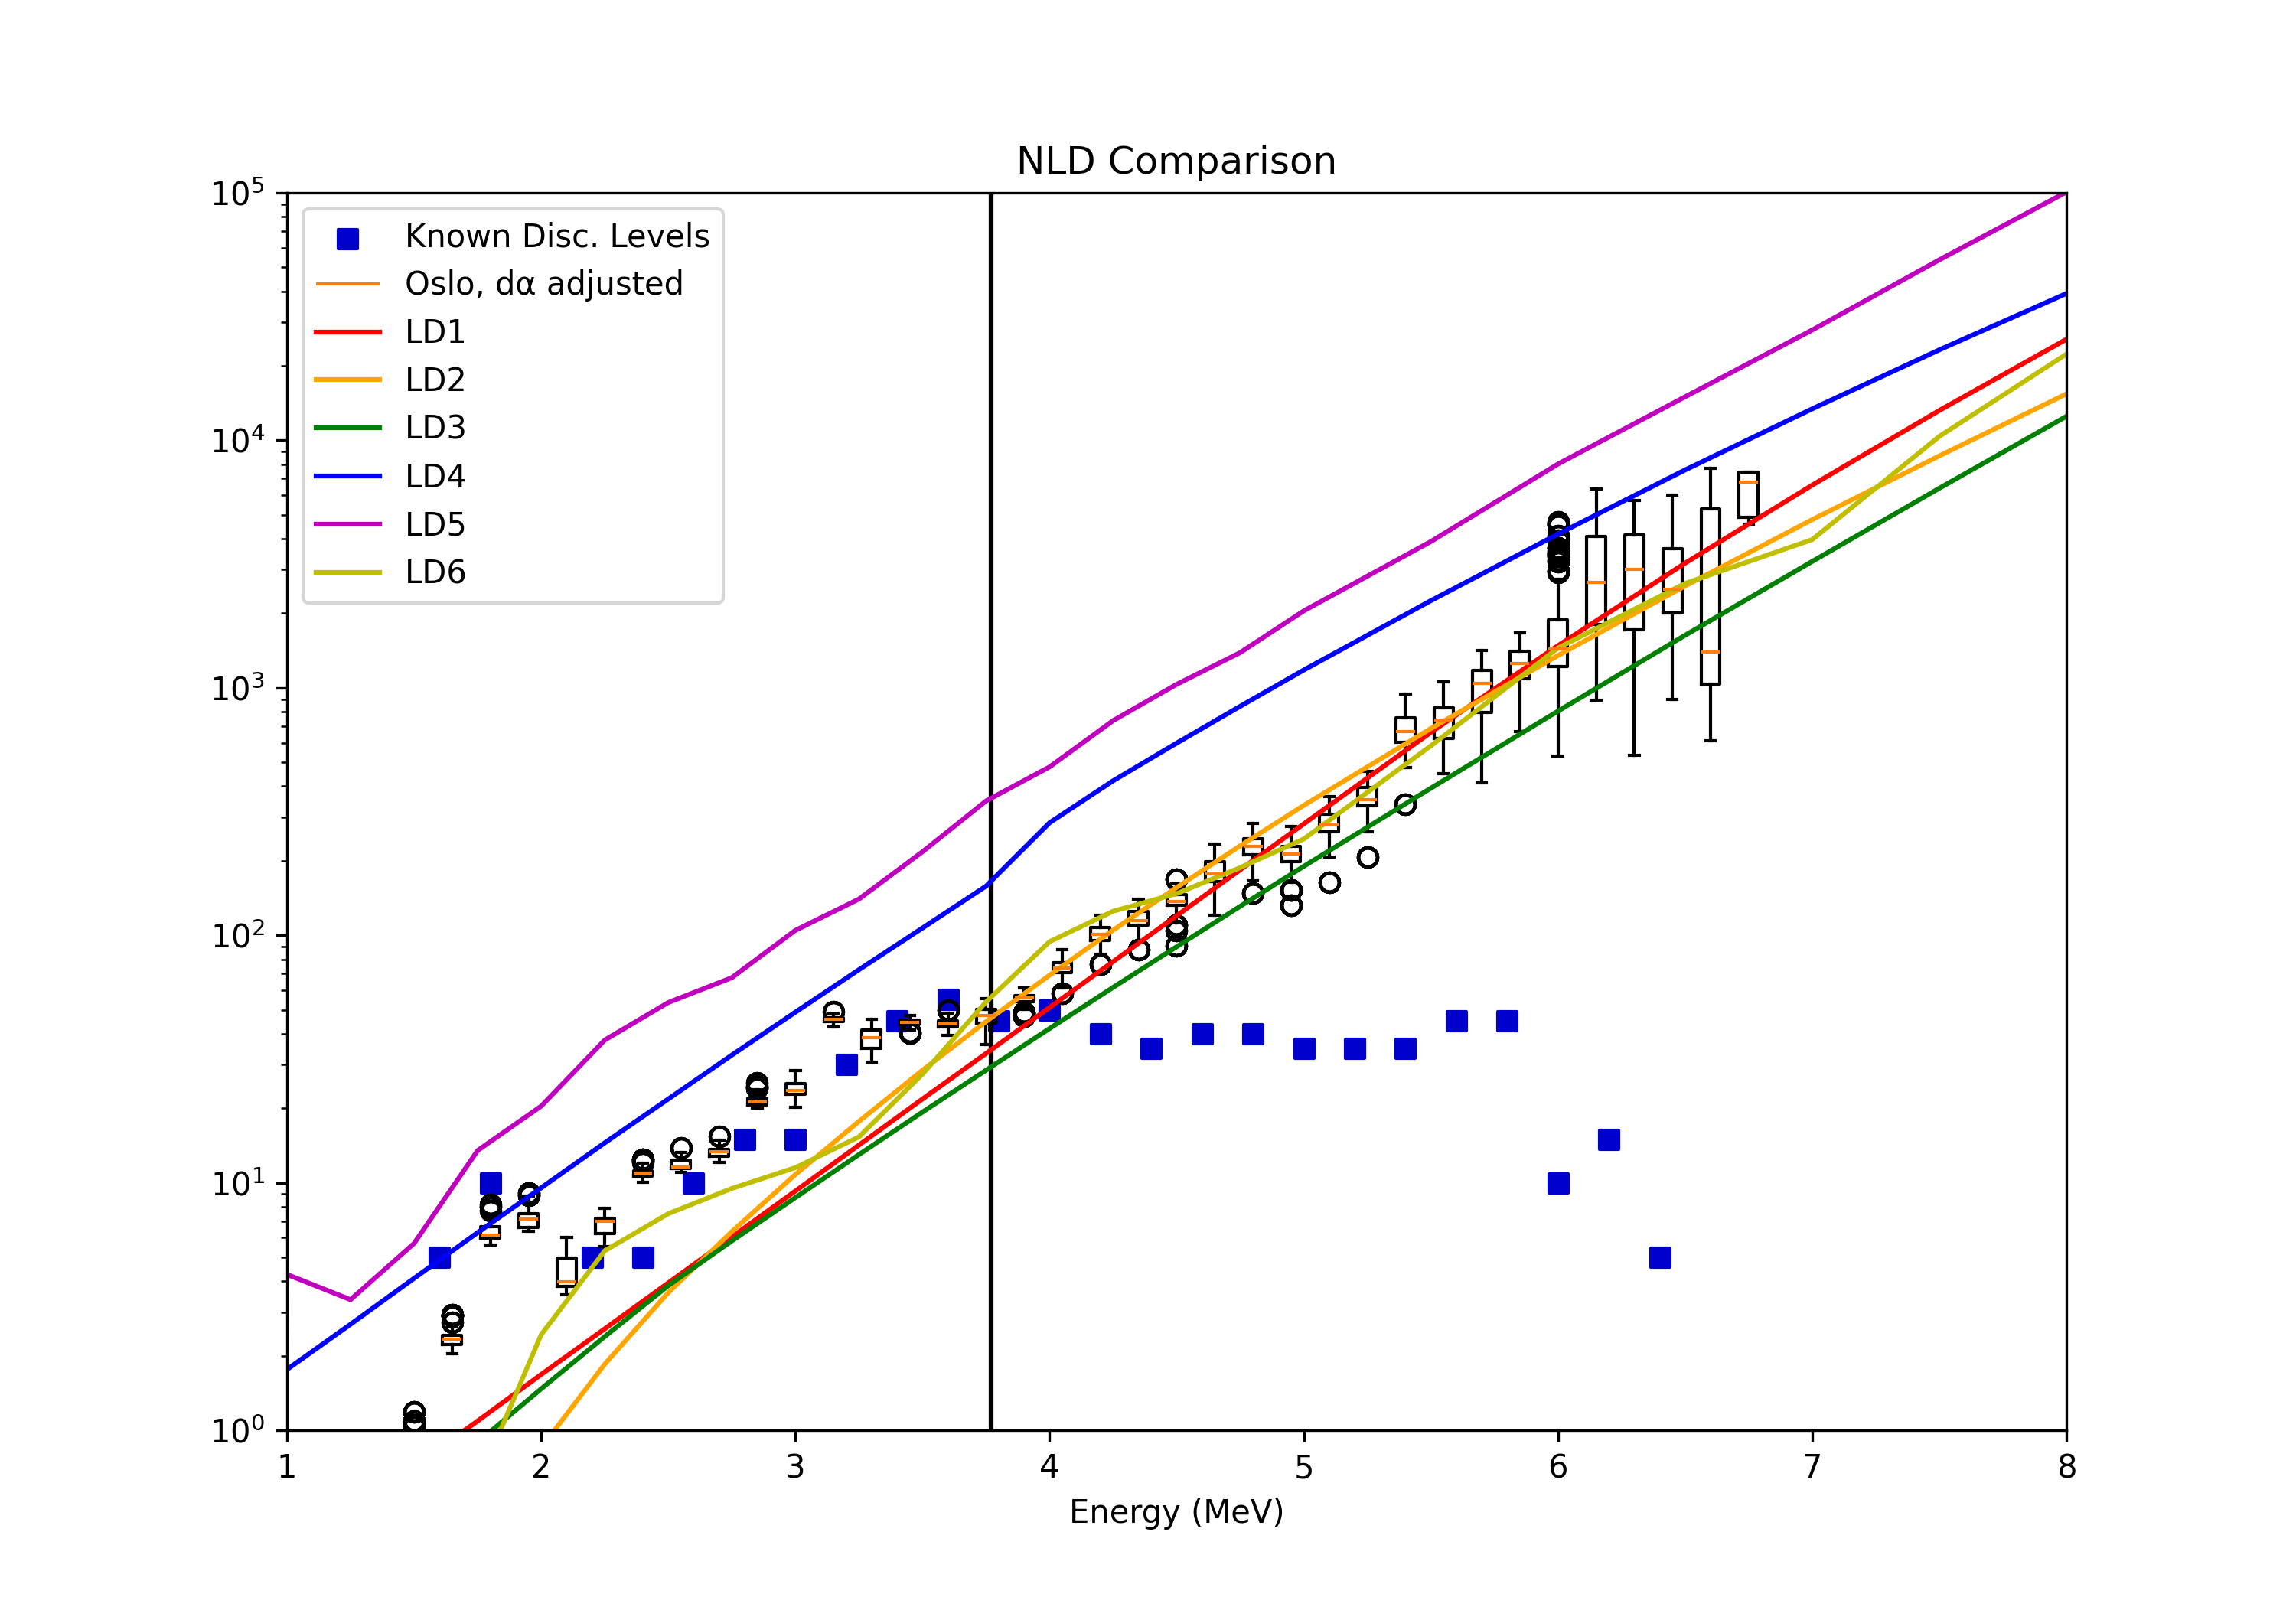
Nuclear Level Density
⁹⁶Zr
PRELIMINARY
#Levels/MeV
10

Slide 15
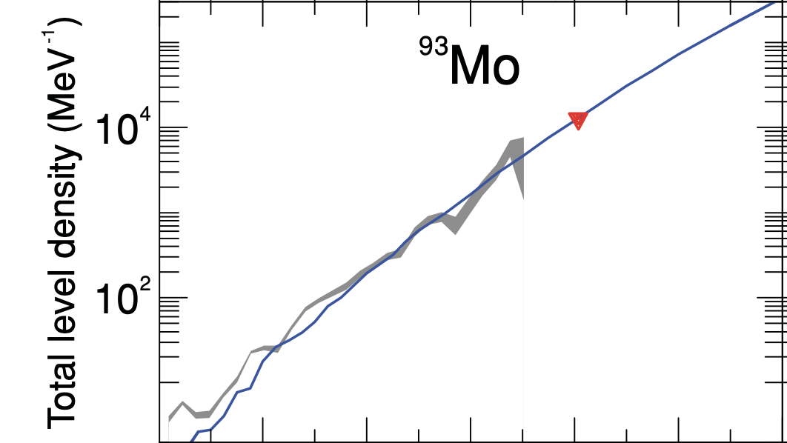
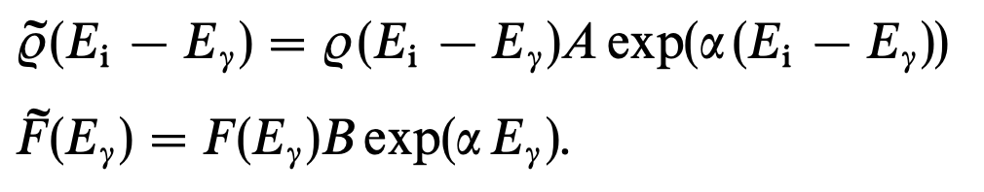
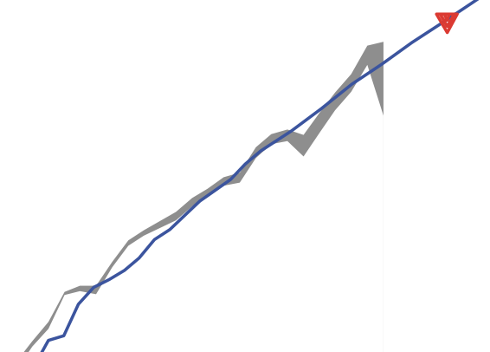
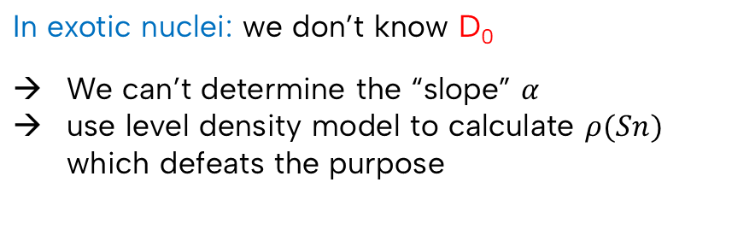
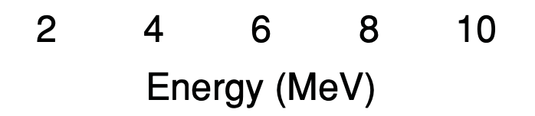
Normalizations and the Oslo Method
Oslo-Data
from D₀
⁹⁰Zr
⁹⁶Zr
S. Goriely, S. Hilaire and A. J. Koning
PRC 78, 064307 (2008)
11

Slide 16
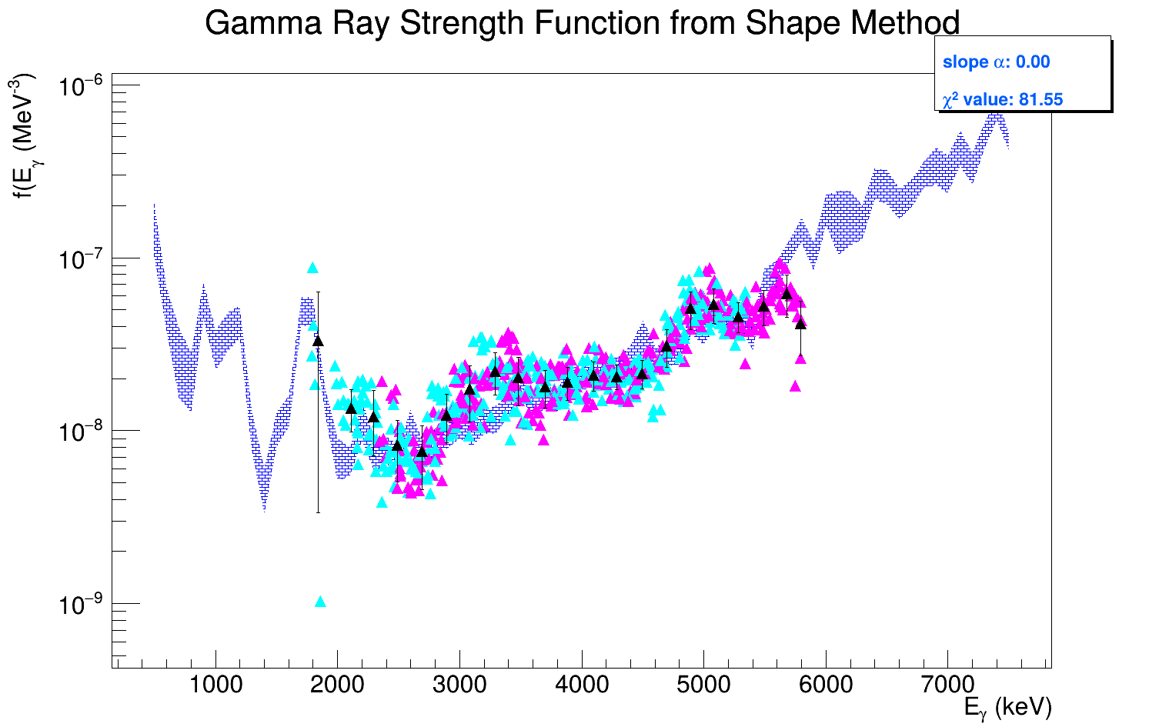
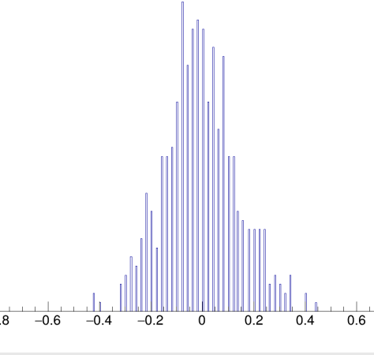
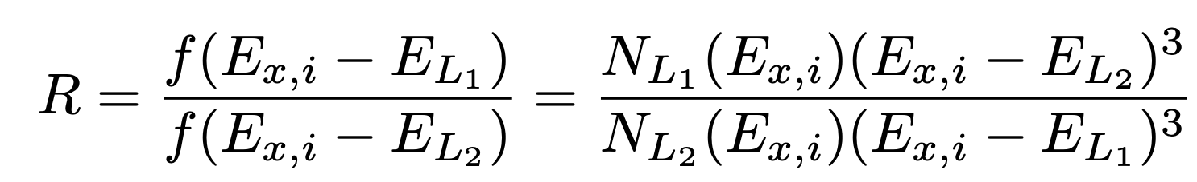
The Shape method for ⁹⁶Zr
Integration bin with sufficient number of states
⁹⁶Zr
2⁺
2⁺
DM et al, Phys. Rev. C 107 (2023)
12

Slide 17
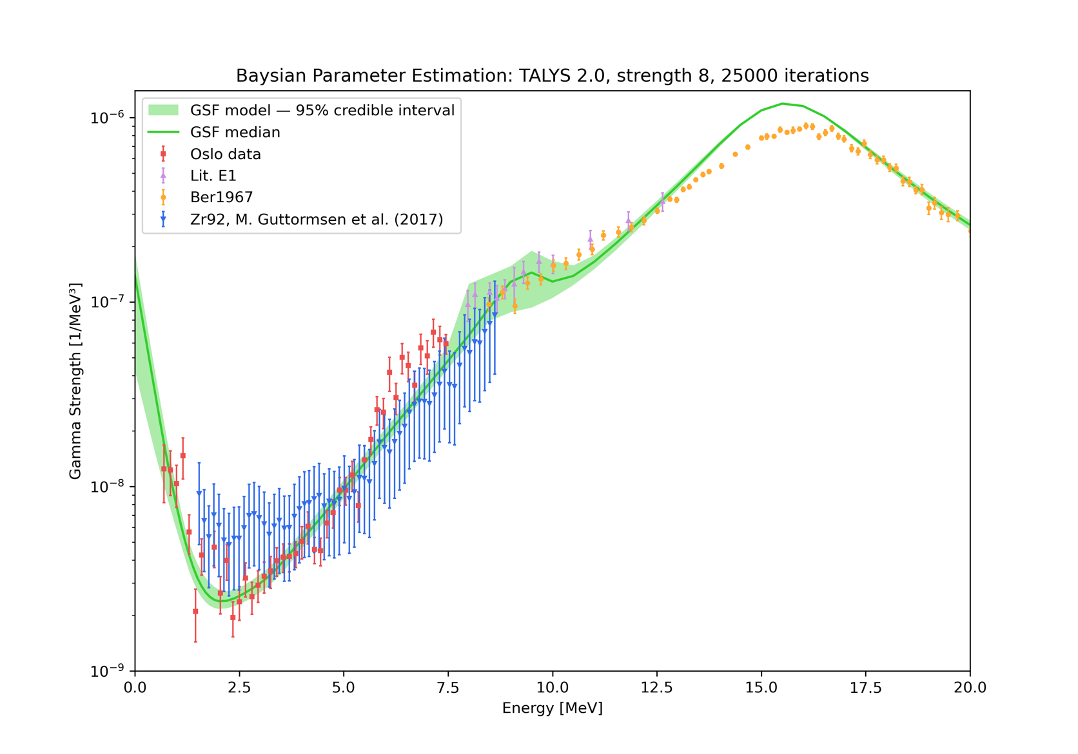
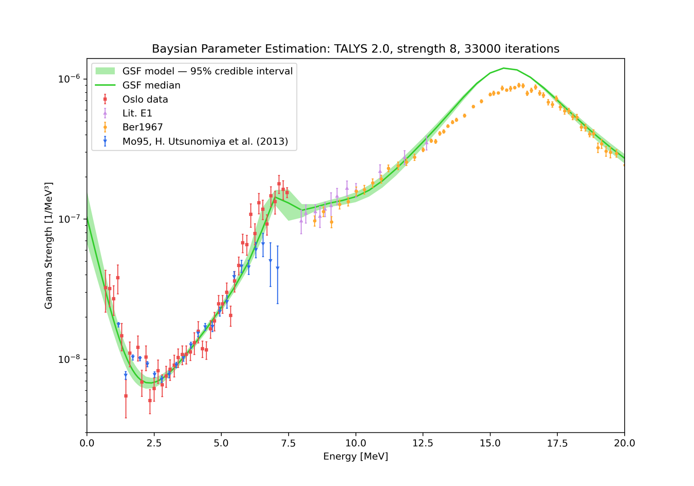
Normalization of the gamma ray strength function
92Zr
95Mo

Slide 18
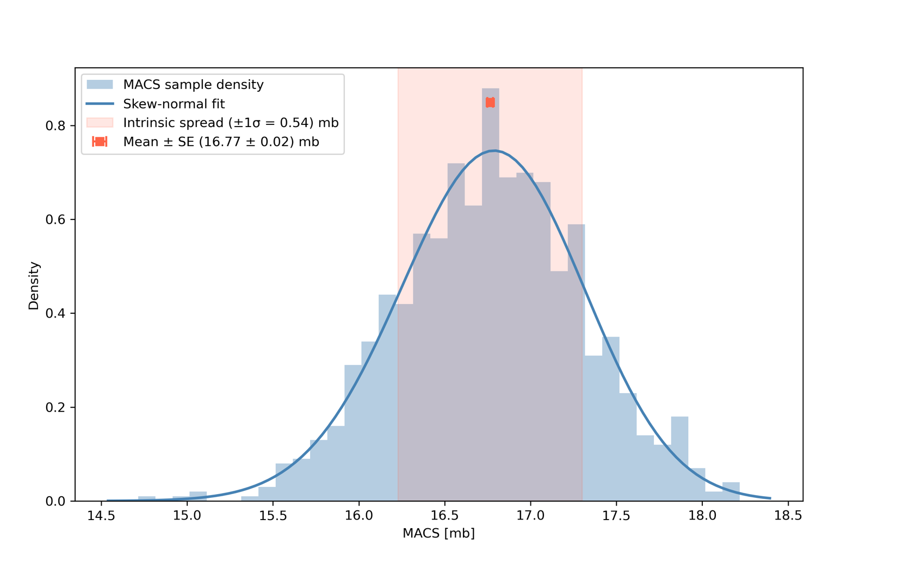
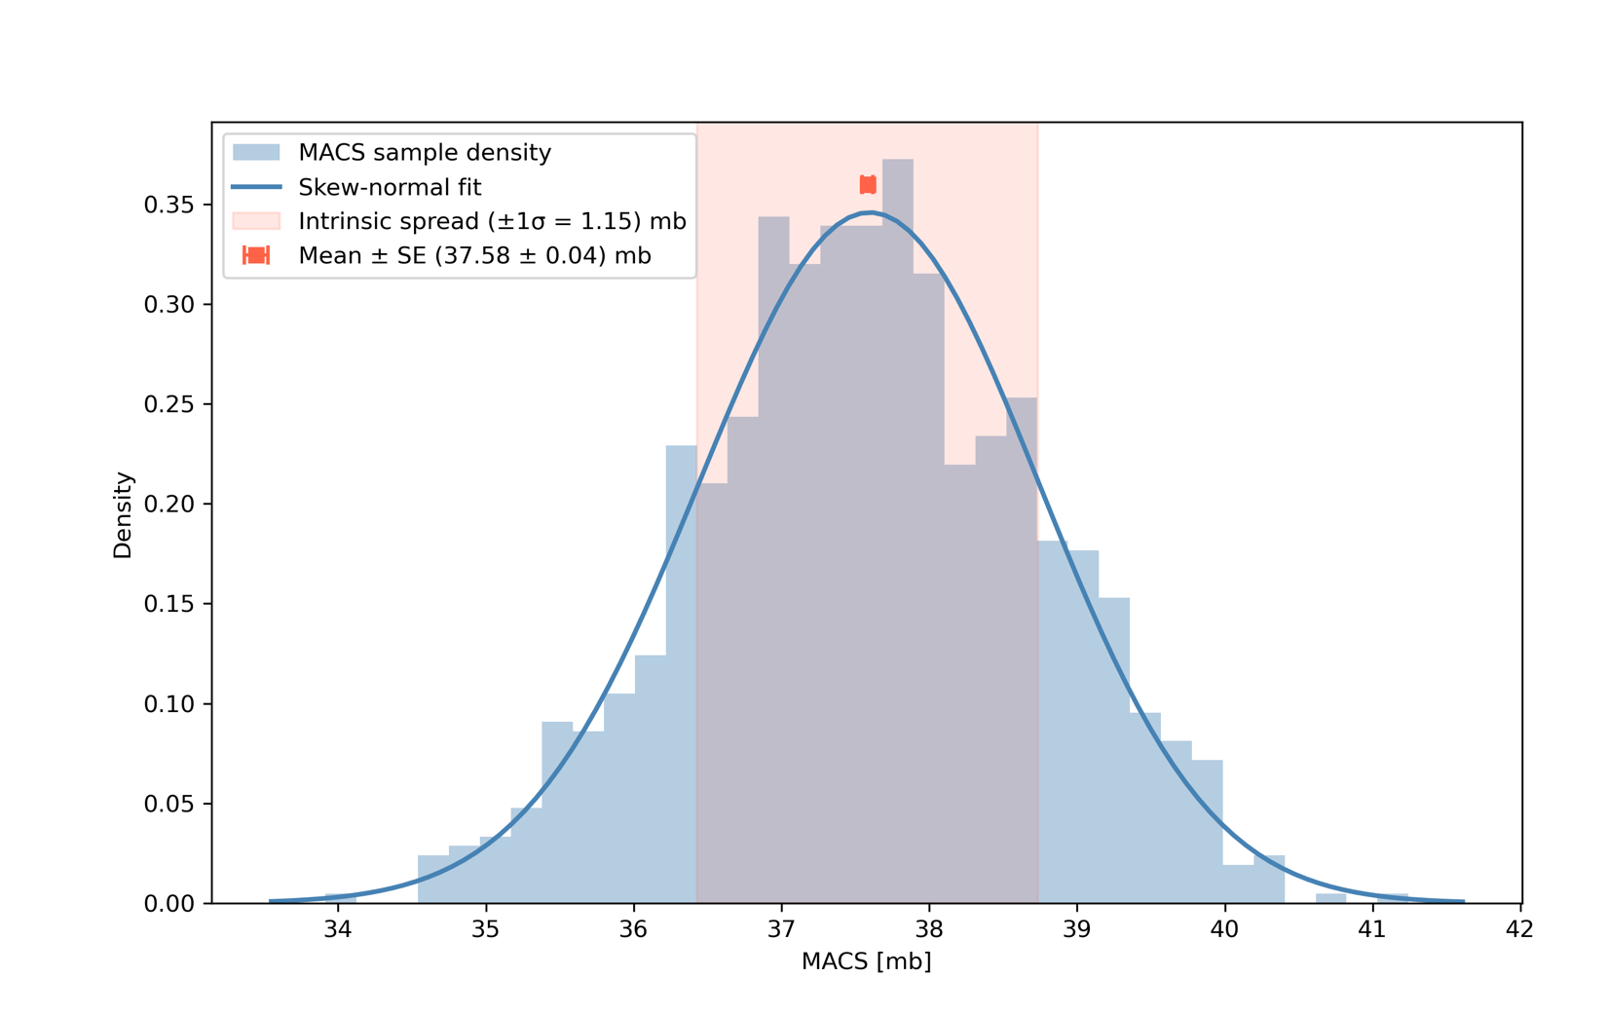
Results for ⁹⁵Zr(n,γ) MACS @30keV
gSF normalized to ⁹²Zr
gSF normalized to ⁹⁵Mo
preliminary
preliminary

Slide 19
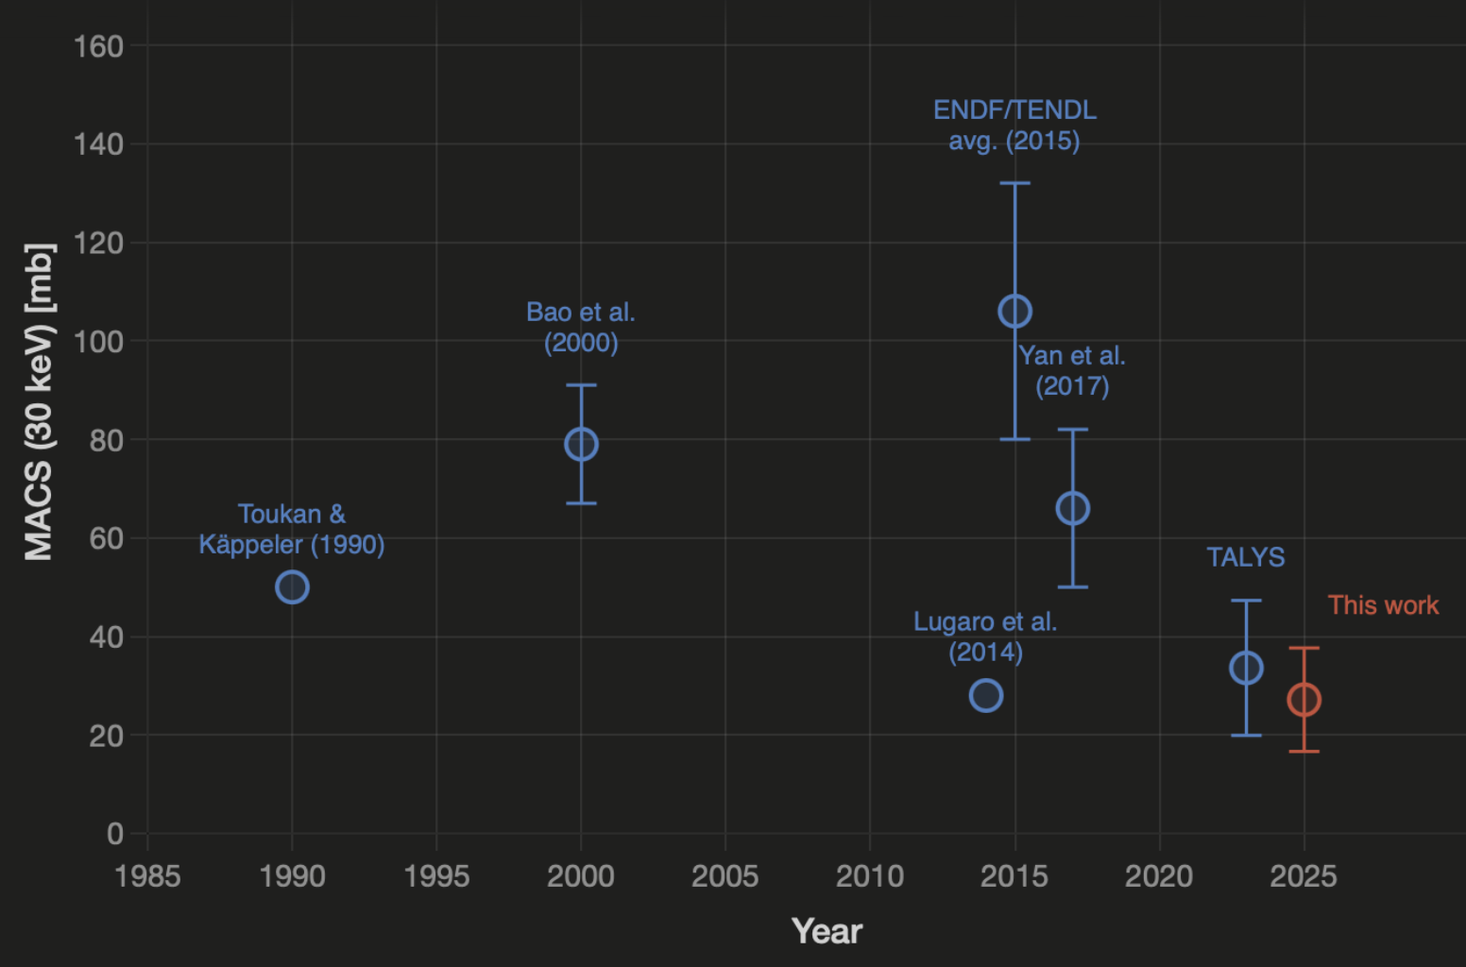
Result for ⁹⁵Zr(n,γ) MACS at 30 keV
Global Structure of an AGB star
preliminary
plot created with Claude
Sonnet 4.6

Slide 20
Impact on Convective boundary mixing parameter
Global Structure of an AGB star
slide adapted from
F. Herwig & R. Reifarth
Preliminary conclusions:
⁹⁵Zr(n,γ) thermometer for neutron exposure &
⁹⁵Zr(n,γ) helps constraining mixing efficiency during He shell flashes in AGB stars
Oslo-data suggest a smaller value for the MACS@30keV of 27+-11 mbarn
this is in line with expectations for a mixing efficiency of f=0.01
σ = 80 mb
σ = 20 mb
grains

Slide 21
Thank you to everyone involved!
Tom Sittig¹, Anna Bohn¹, C. Fransen¹, Magne Guttormsen³, Devin Hymers¹, Abdallah Karaka¹, Ann-Cecilie Larsen³, Markus Müllenmeister¹, Sarah Prill¹, Sebastian Schröder¹, Amal Sebastian², Artemis Spyrou², Michael Weinert¹, Gereon Weingarten¹, A. Zilges¹, Dennis Mücher¹
¹Universitat zu Köln, Institut für Kernphysik, Köln, Germany ²Michigan State University, Facility for Rare Isotope Beams, East Lansing, MI, USA ³Universitetet I Oslo, Fysisk Institutt, Oslo, Norway
Thank you for your attention!

