Slide 1

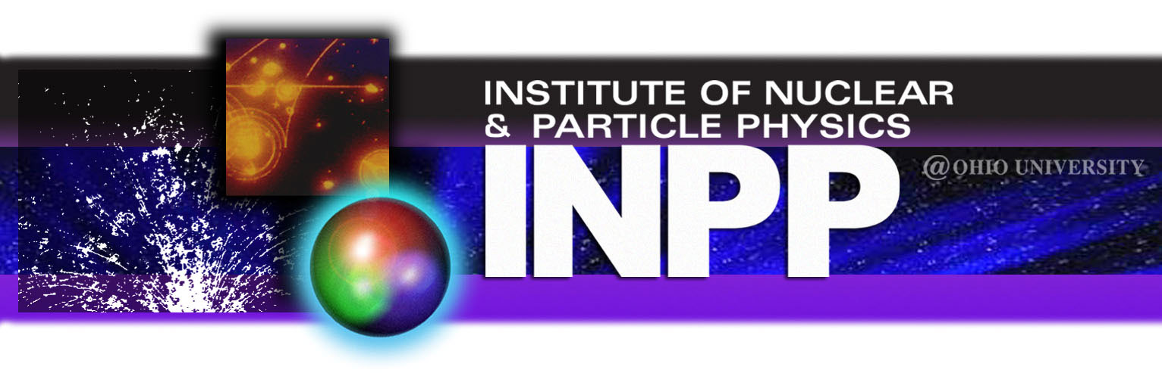
Constraining the Xenon Poison Neutron-Capture Rate for Reactor Design and Nuclear Safeguards
Austin C. Rambo
10th Workshop on Nuclear Level Density and Gamma Strength
Oslo, Norway, May 22, 2026

Slide 2
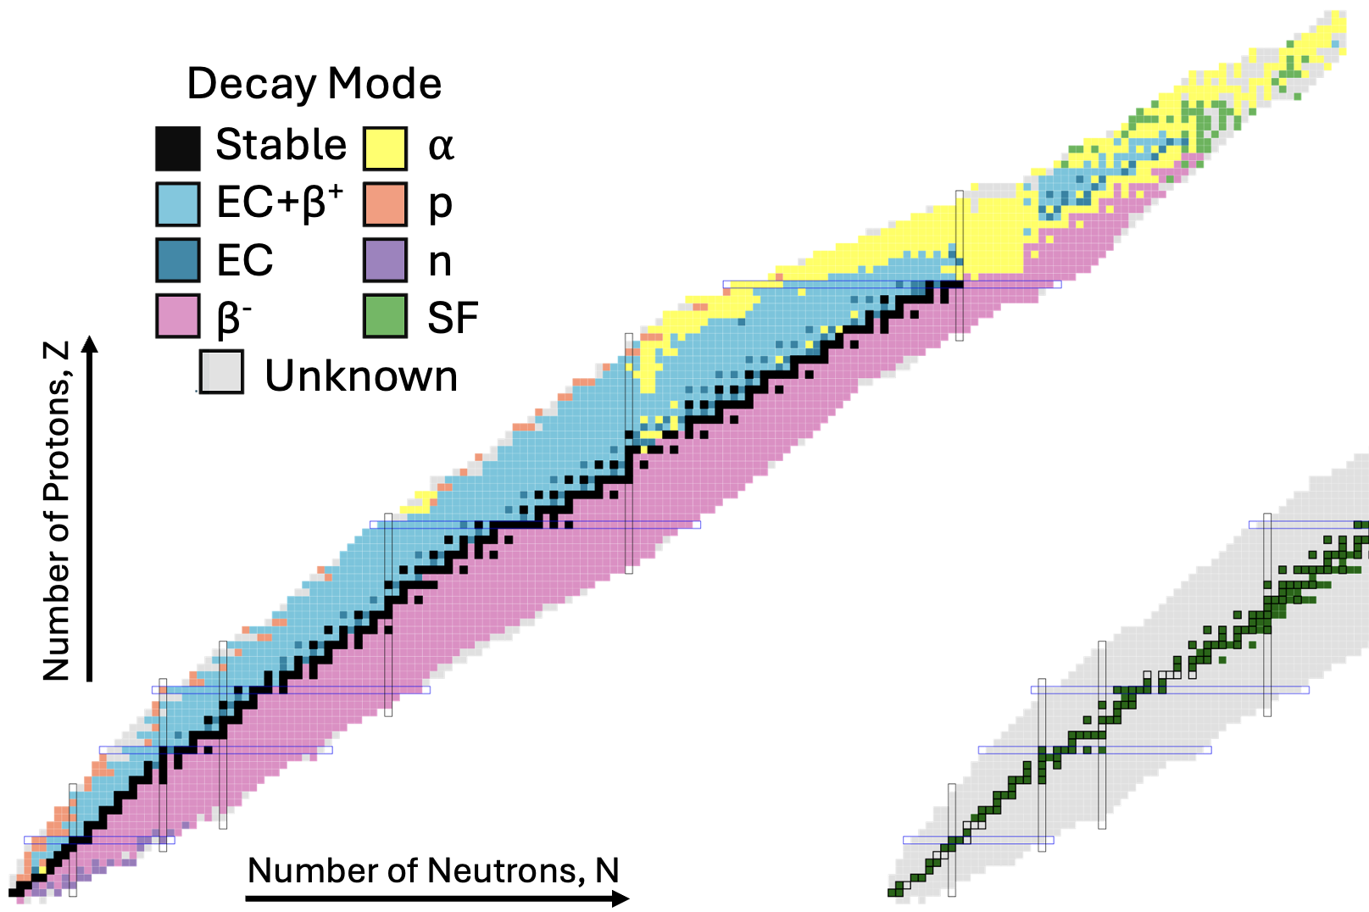

Introduction to Nuclear Reactions
Applications:
National Security
Fission Reactors
Medicine
Astrophysics:
rp-process
s-process
r-process
stellar fusion
… and many more
(n,𝛾)
(p,𝛾)
National Nuclear Data Center, information extracted from the NuDat database, https://www.nndc.bnl.gov/nudat/
A. C. Rambo, 10th NLD & 𝛾SF Workshop 2026
1

Slide 3
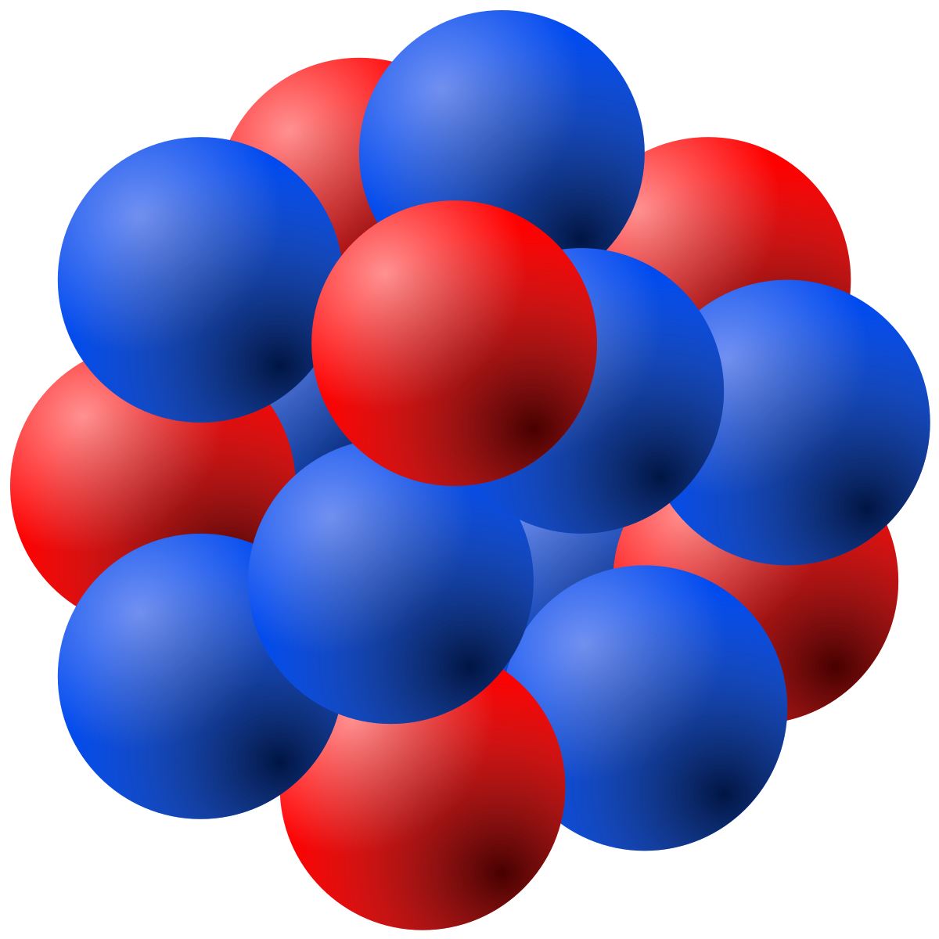

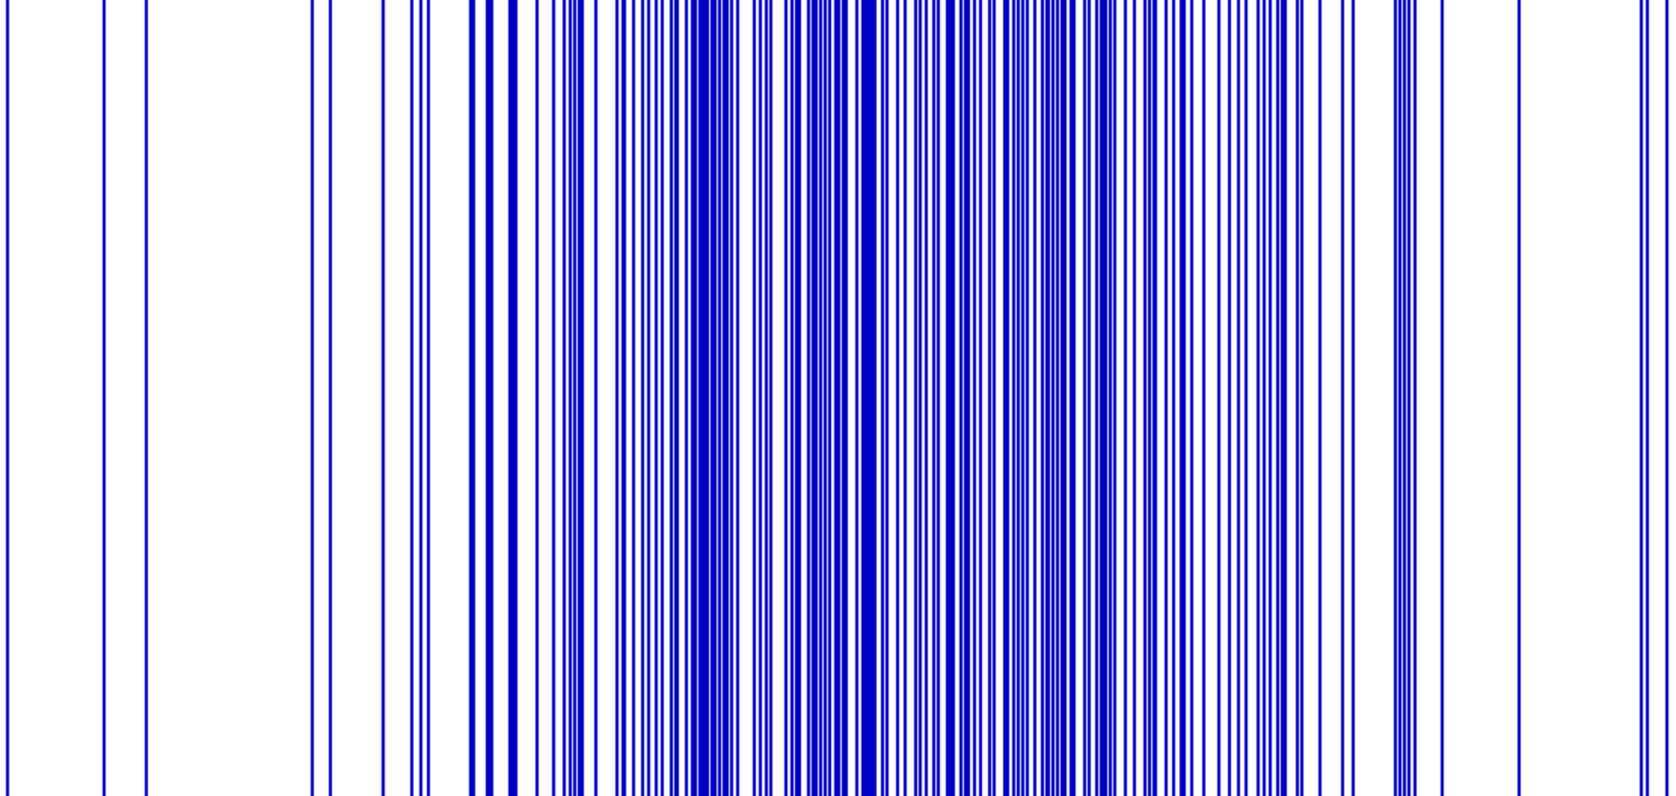
Neutron-Capture Cross Sections
(A, Z-1)
Direct Neutron Capture
𝛾
CN*
β⁻
(d,p) (³He,³He’)
(p,d) (⍺,⍺’)
(p,p’) (t,p) (d,n)
and many more
→
neutron
Target
(A-1, Z)
Compound Nucleus
(A, Z)
Indirect Techniques
Excitation Energy
σ_{(n,𝛾)} from Hauser-Feshbach calculations
Nuclear Level Density (NLD)
𝛾-ray Strength Function (𝛾SF)
Optical Model Potential (OMP)
large uncertainties
A. C. Rambo, 10th NLD & 𝛾SF Workshop 2026
2

Slide 4
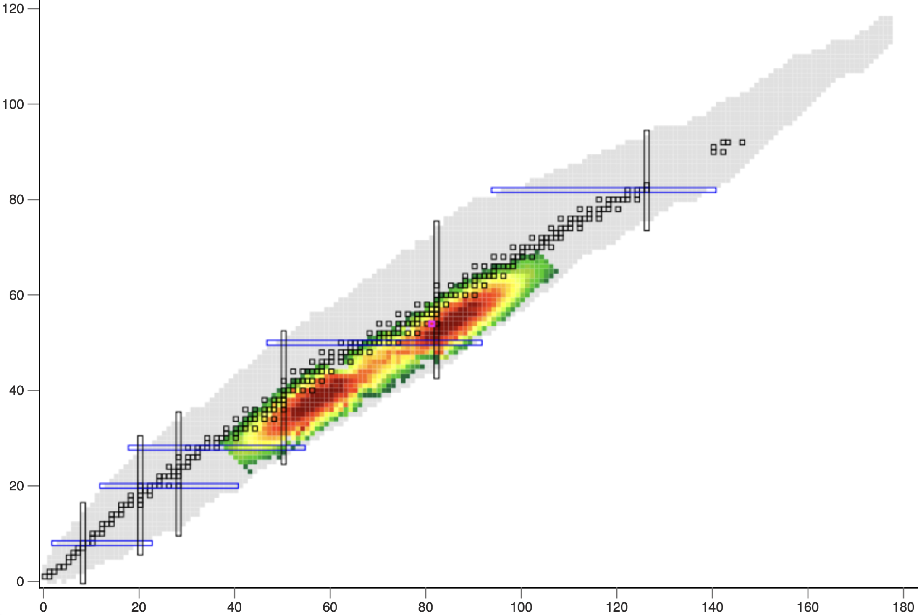
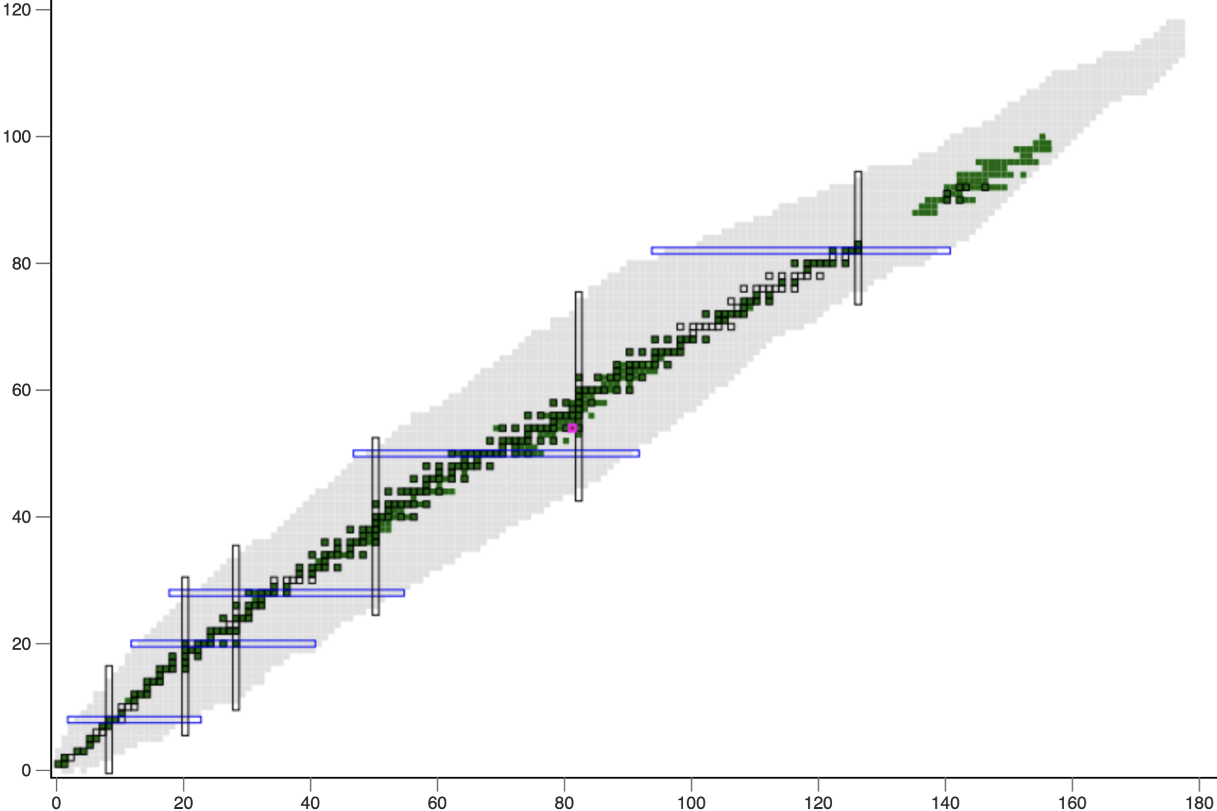
The Xenon Poison
²³⁵U Thermal Neutron Fission Yields
Thermal Neutron-Capture Cross Sections
¹³⁵Xe
¹³⁵Xe(n,𝛾)
Proton # (Z)
Neutron # (N)
Neutron # (N)
National Nuclear Data Center, information extracted from the NuDat database, https://www.nndc.bnl.gov/nudat/
A. C. Rambo, 10th NLD & 𝛾SF Workshop 2026
3

Slide 5
Motivations for Constraining ¹³⁵Xe(n,𝛾)
Determine the strength of the strongest thermal neutron poison at non-thermal energies for new Gen IV reactor designs and safety margins.
Better estimate changes in the atmospheric background abundance of ¹³⁵Xe produced from new sources for the International Monitoring System (IMS).
Constrain the abundance of barium produced from the astrophysical intermediate neutron capture (i-) process in Carbon Enhanced Metal Poor (CEMP) stars.
Goal: Constrain ¹³⁶Xe NLD & 𝛾SF → constrain ¹³⁵Xe(n,𝛾)
A. C. Rambo, 10th NLD & 𝛾SF Workshop 2026
4

Slide 6
Current ¹³⁵Xe(n,𝛾)¹³⁶Xe Cross Section
A. C. Rambo, 10th NLD & 𝛾SF Workshop 2026
5

Slide 7
Current ¹³⁵Xe(n,𝛾)¹³⁶Xe Cross Section
A. C. Rambo, 10th NLD & 𝛾SF Workshop 2026
6

Slide 8

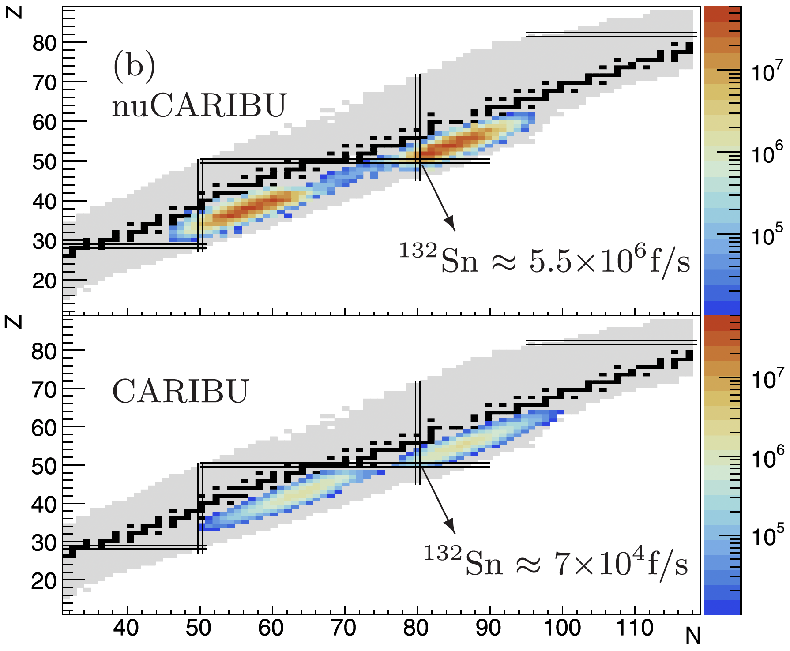
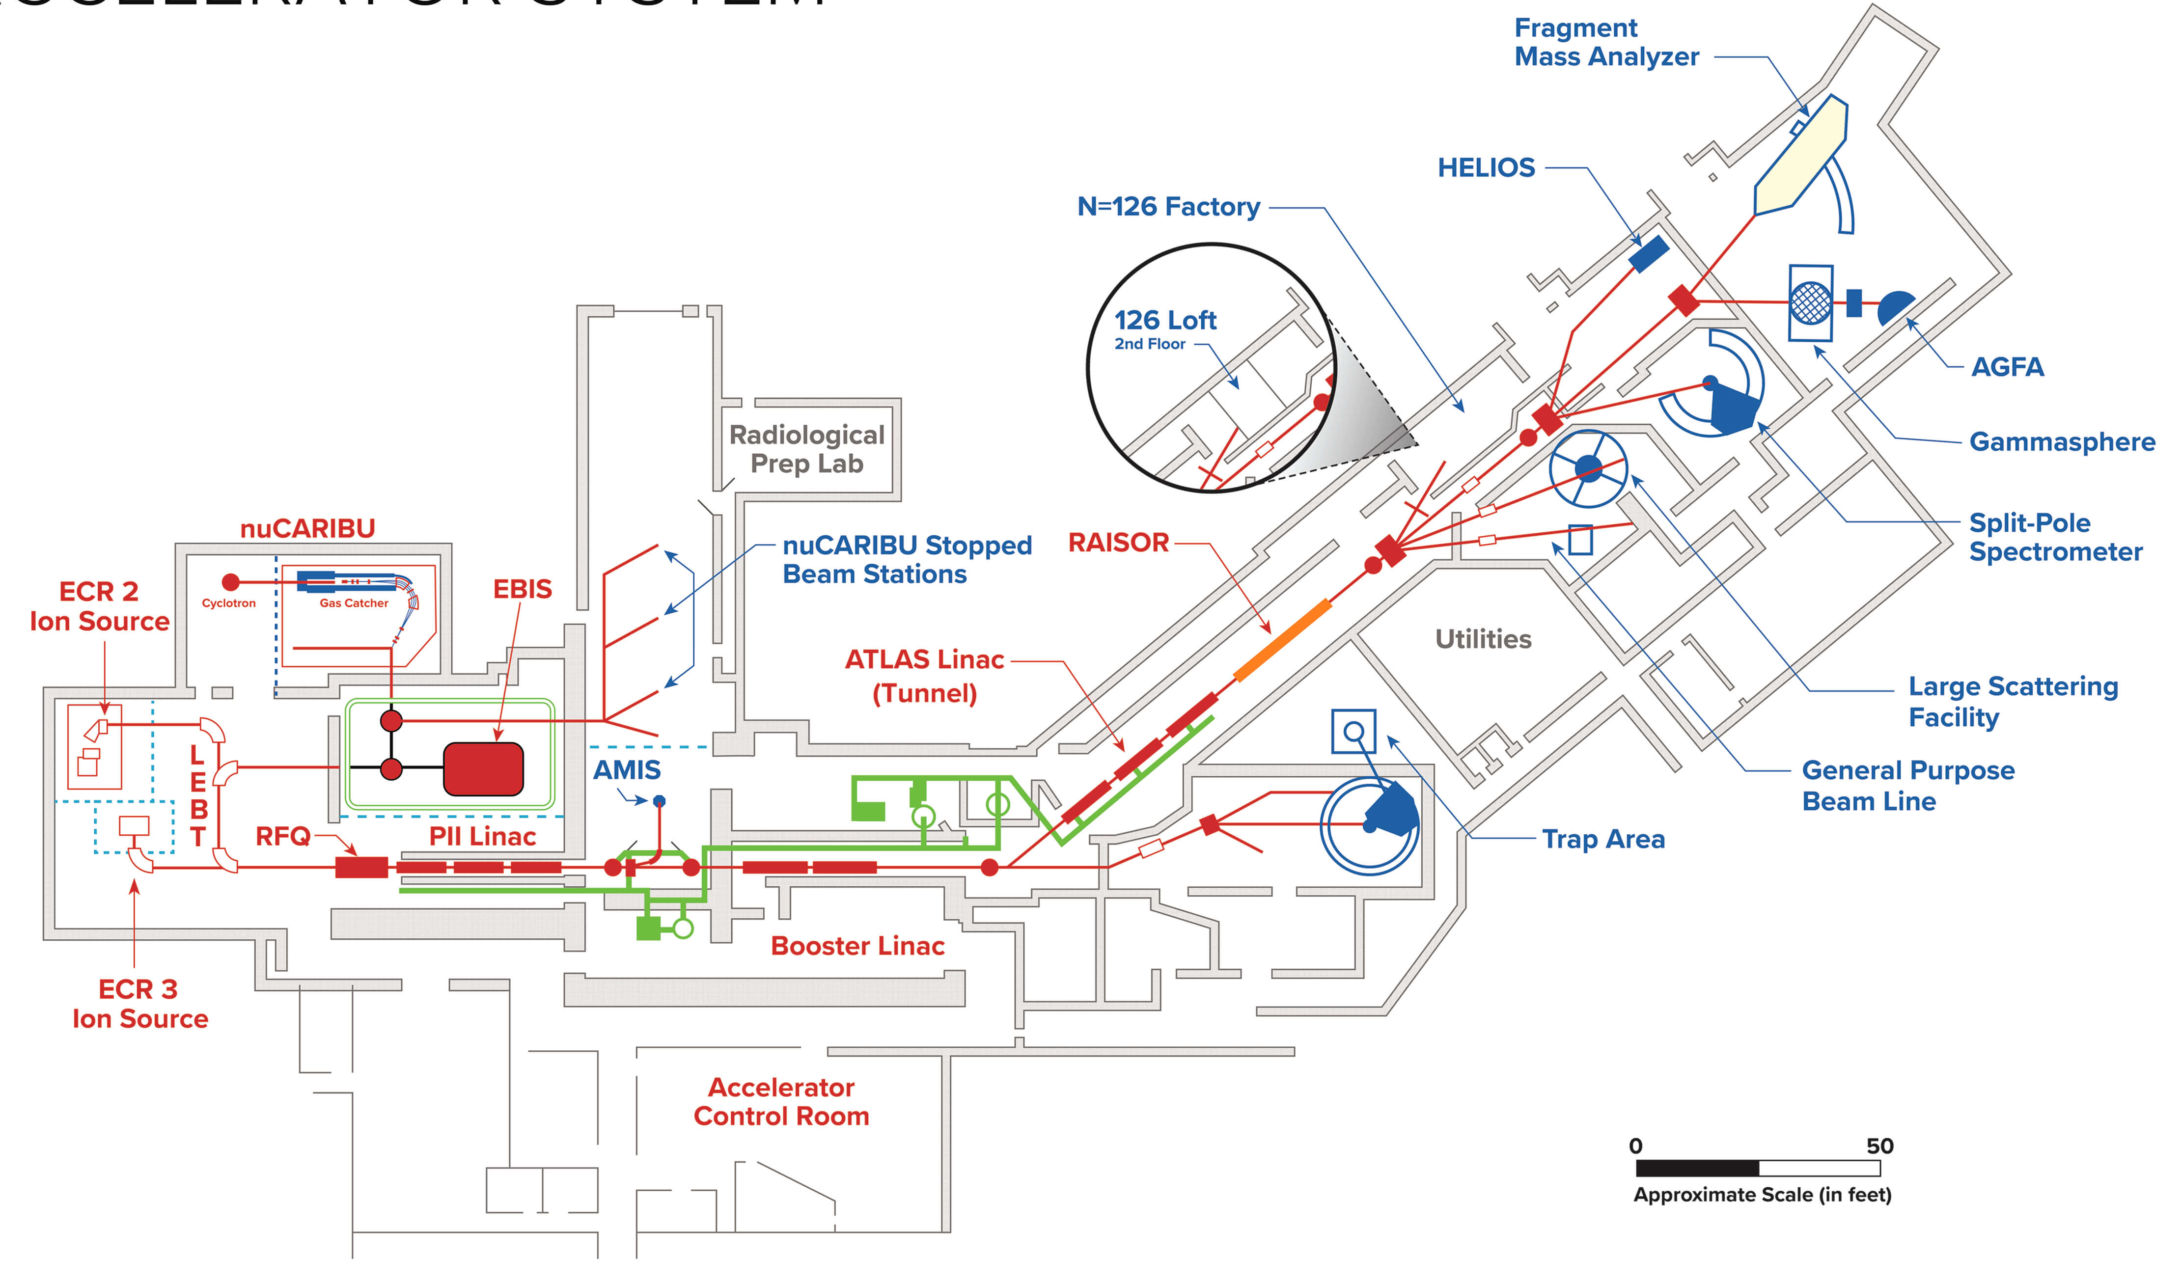
Experiment 1 of 2: β-Oslo at ANL
Facility upgrade! CARIBU → nuCARIBU
ATLAS
https://www.anl.gov/atlas/reference/atlas-facility-layout-with-beam-locations
J. Song, G. Savard, et al., Phys. Rev. C, 109, 024605, (2024)
A. C. Rambo, 10th NLD & 𝛾SF Workshop 2026
7

Slide 9
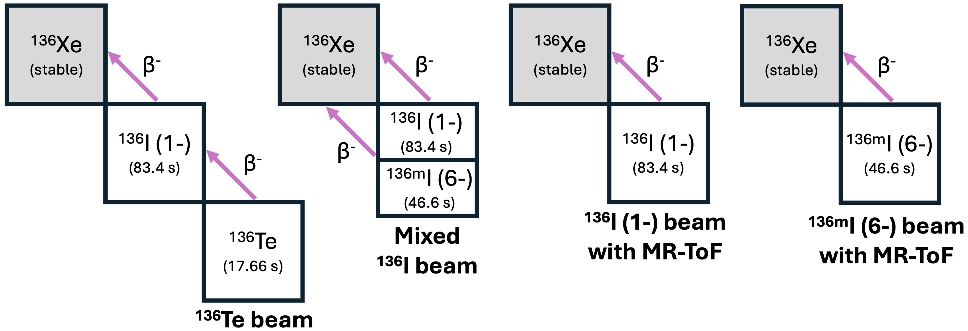
nuCARIBU Beam Settings
Narrow spin distribution
Narrow spin distribution
Broad spin distribution
Narrow spin distribution
A. C. Rambo, 10th NLD & 𝛾SF Workshop 2026
8

Slide 10
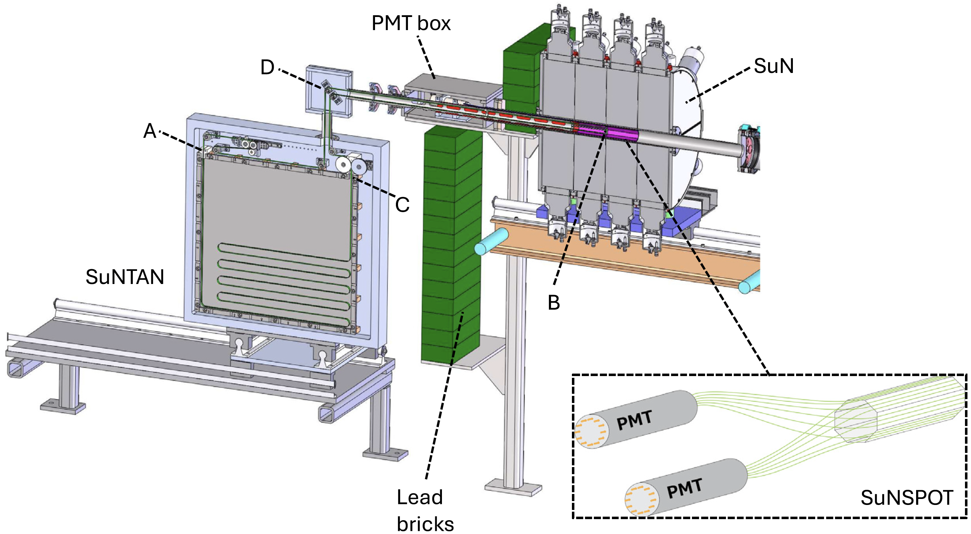
Using SuNTAN at ANL
Measure 𝛾 cascades
Goal: Measure β⁻-𝛾 coincidences for ¹³⁶Xe Oslo matrix
¹³⁶I & ¹³⁶Te Beams
Detect β⁻ decays
C. M. Harris, M. K. Smith, A. Spyrou, et al., Nucl. Instrum. Methods Phys. Res. Sect. A, 1084, 171185, (2026)
A. C. Rambo, 10th NLD & 𝛾SF Workshop 2026
9

Slide 11
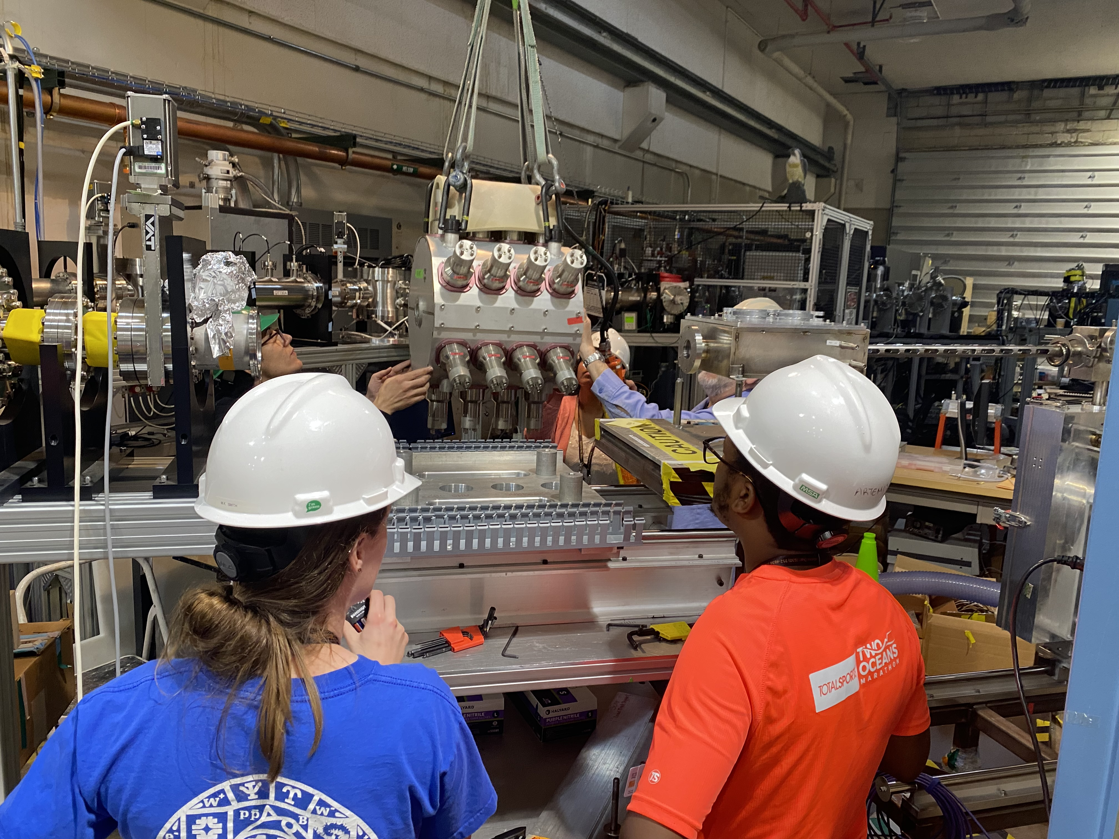
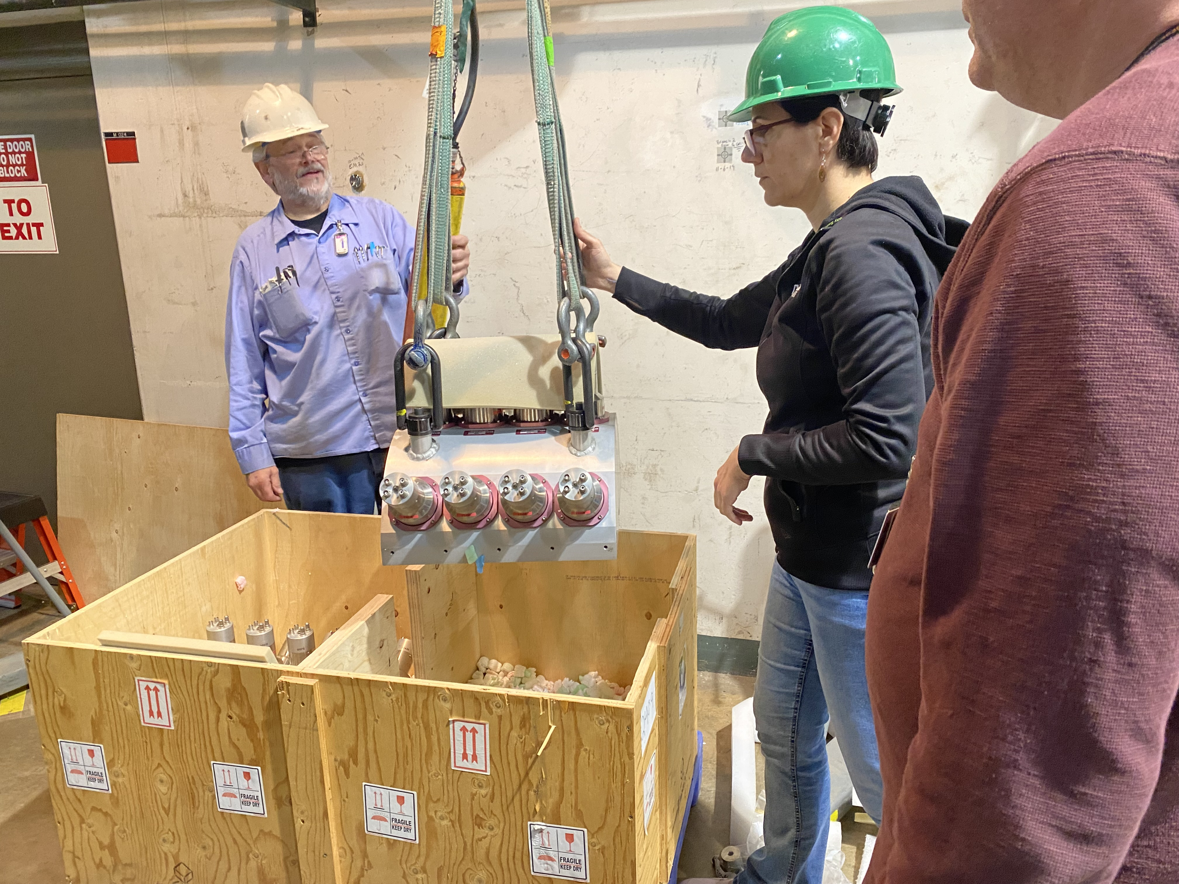
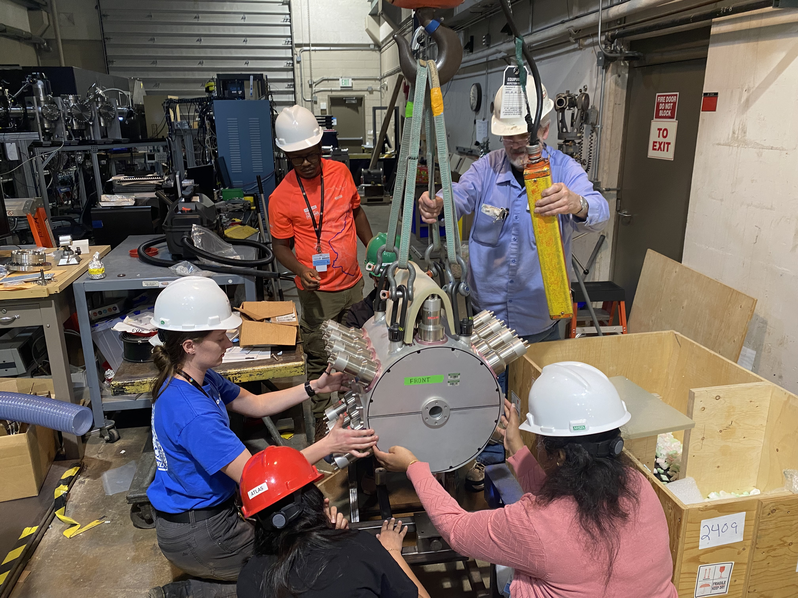
Moving SuN to ANL
Experiment will run July 13-18, 2026
A. C. Rambo, 10th NLD & 𝛾SF Workshop 2026
10

Slide 12
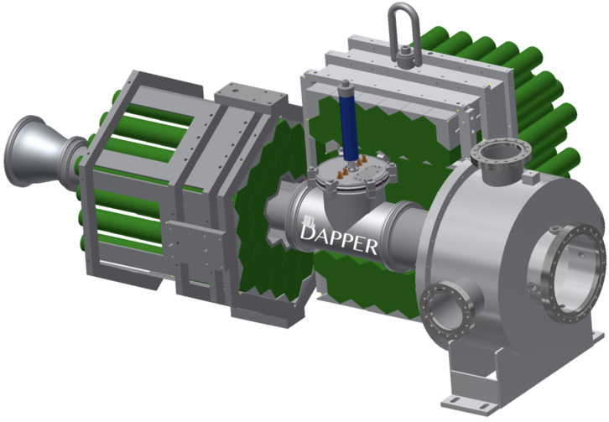

Experiment 2 of 2: Inverse-Oslo at TAMU
Detector Array for Photons, Protons, and Exotic Residues
Measure 𝛾 cascades
Goal: Measure p-𝛾 coincidences for ¹³⁶Xe Oslo matrix
14 MeV/u ¹³⁶Xe Beam for p(¹³⁶Xe,p’𝛾)¹³⁶Xe
Measure scattered protons
A.B. McIntosh, A.D. Abbott, M.Q. Sorensen, et al., Nucl. Phys. A, 1057, 123038, (2025)
A. C. Rambo, 10th NLD & 𝛾SF Workshop 2026
11

Slide 13
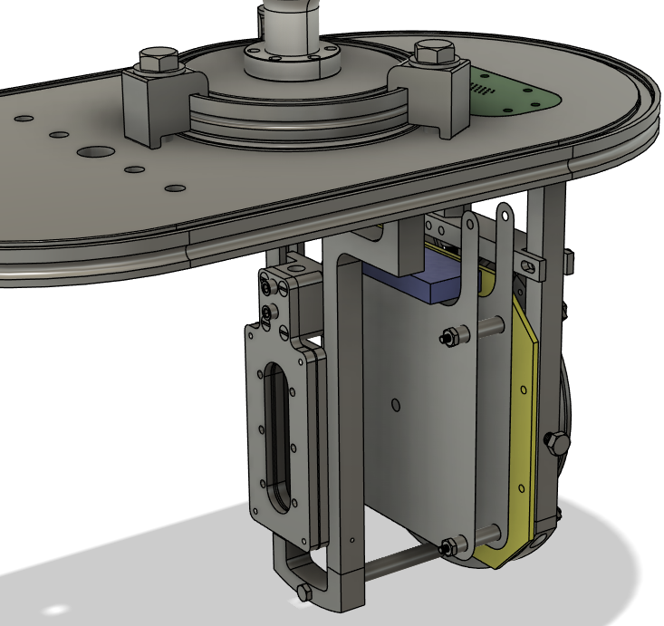
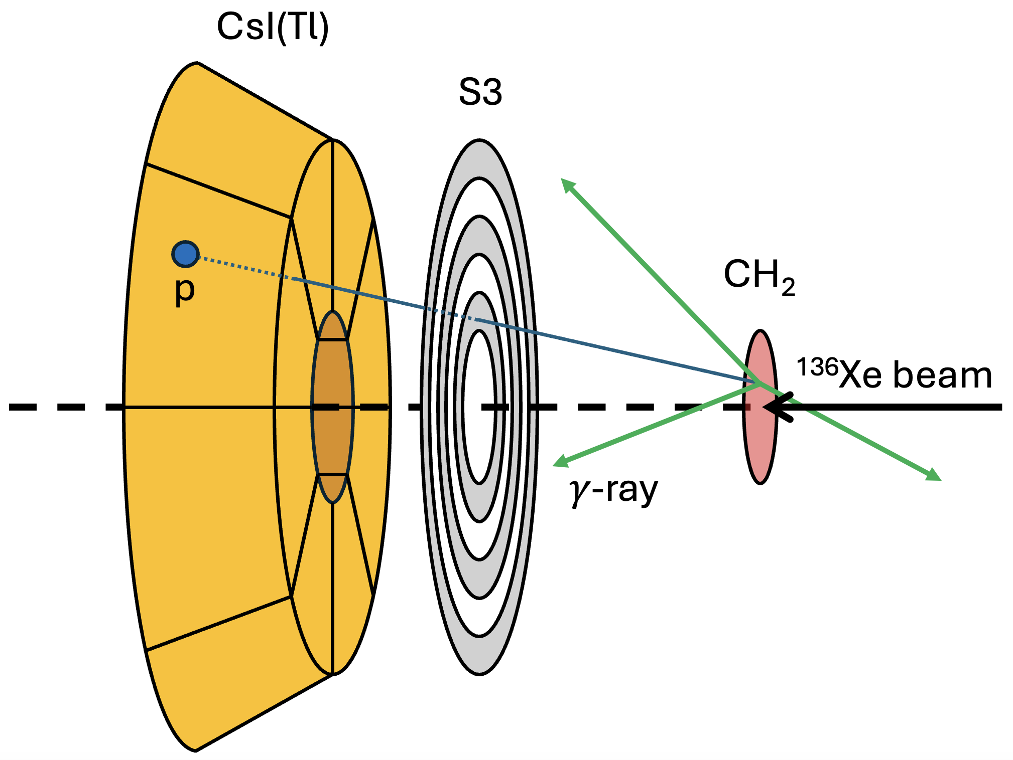
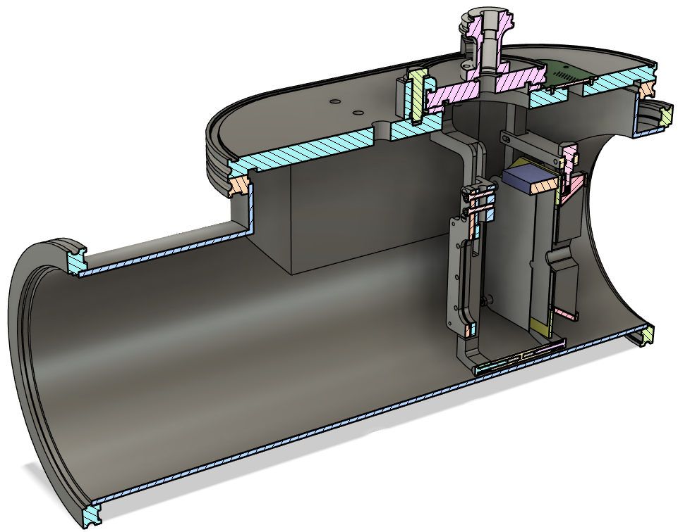
DAPPER Upgrades
New 𝚫E-E telescope for detecting charged particles at forward angles
New chamber to hold 𝚫E-E telescope and target
C₂H₄
¹³⁶Xe beam
Design courtesy of D. Shelden
A. C. Rambo, 10th NLD & 𝛾SF Workshop 2026
12

Slide 14
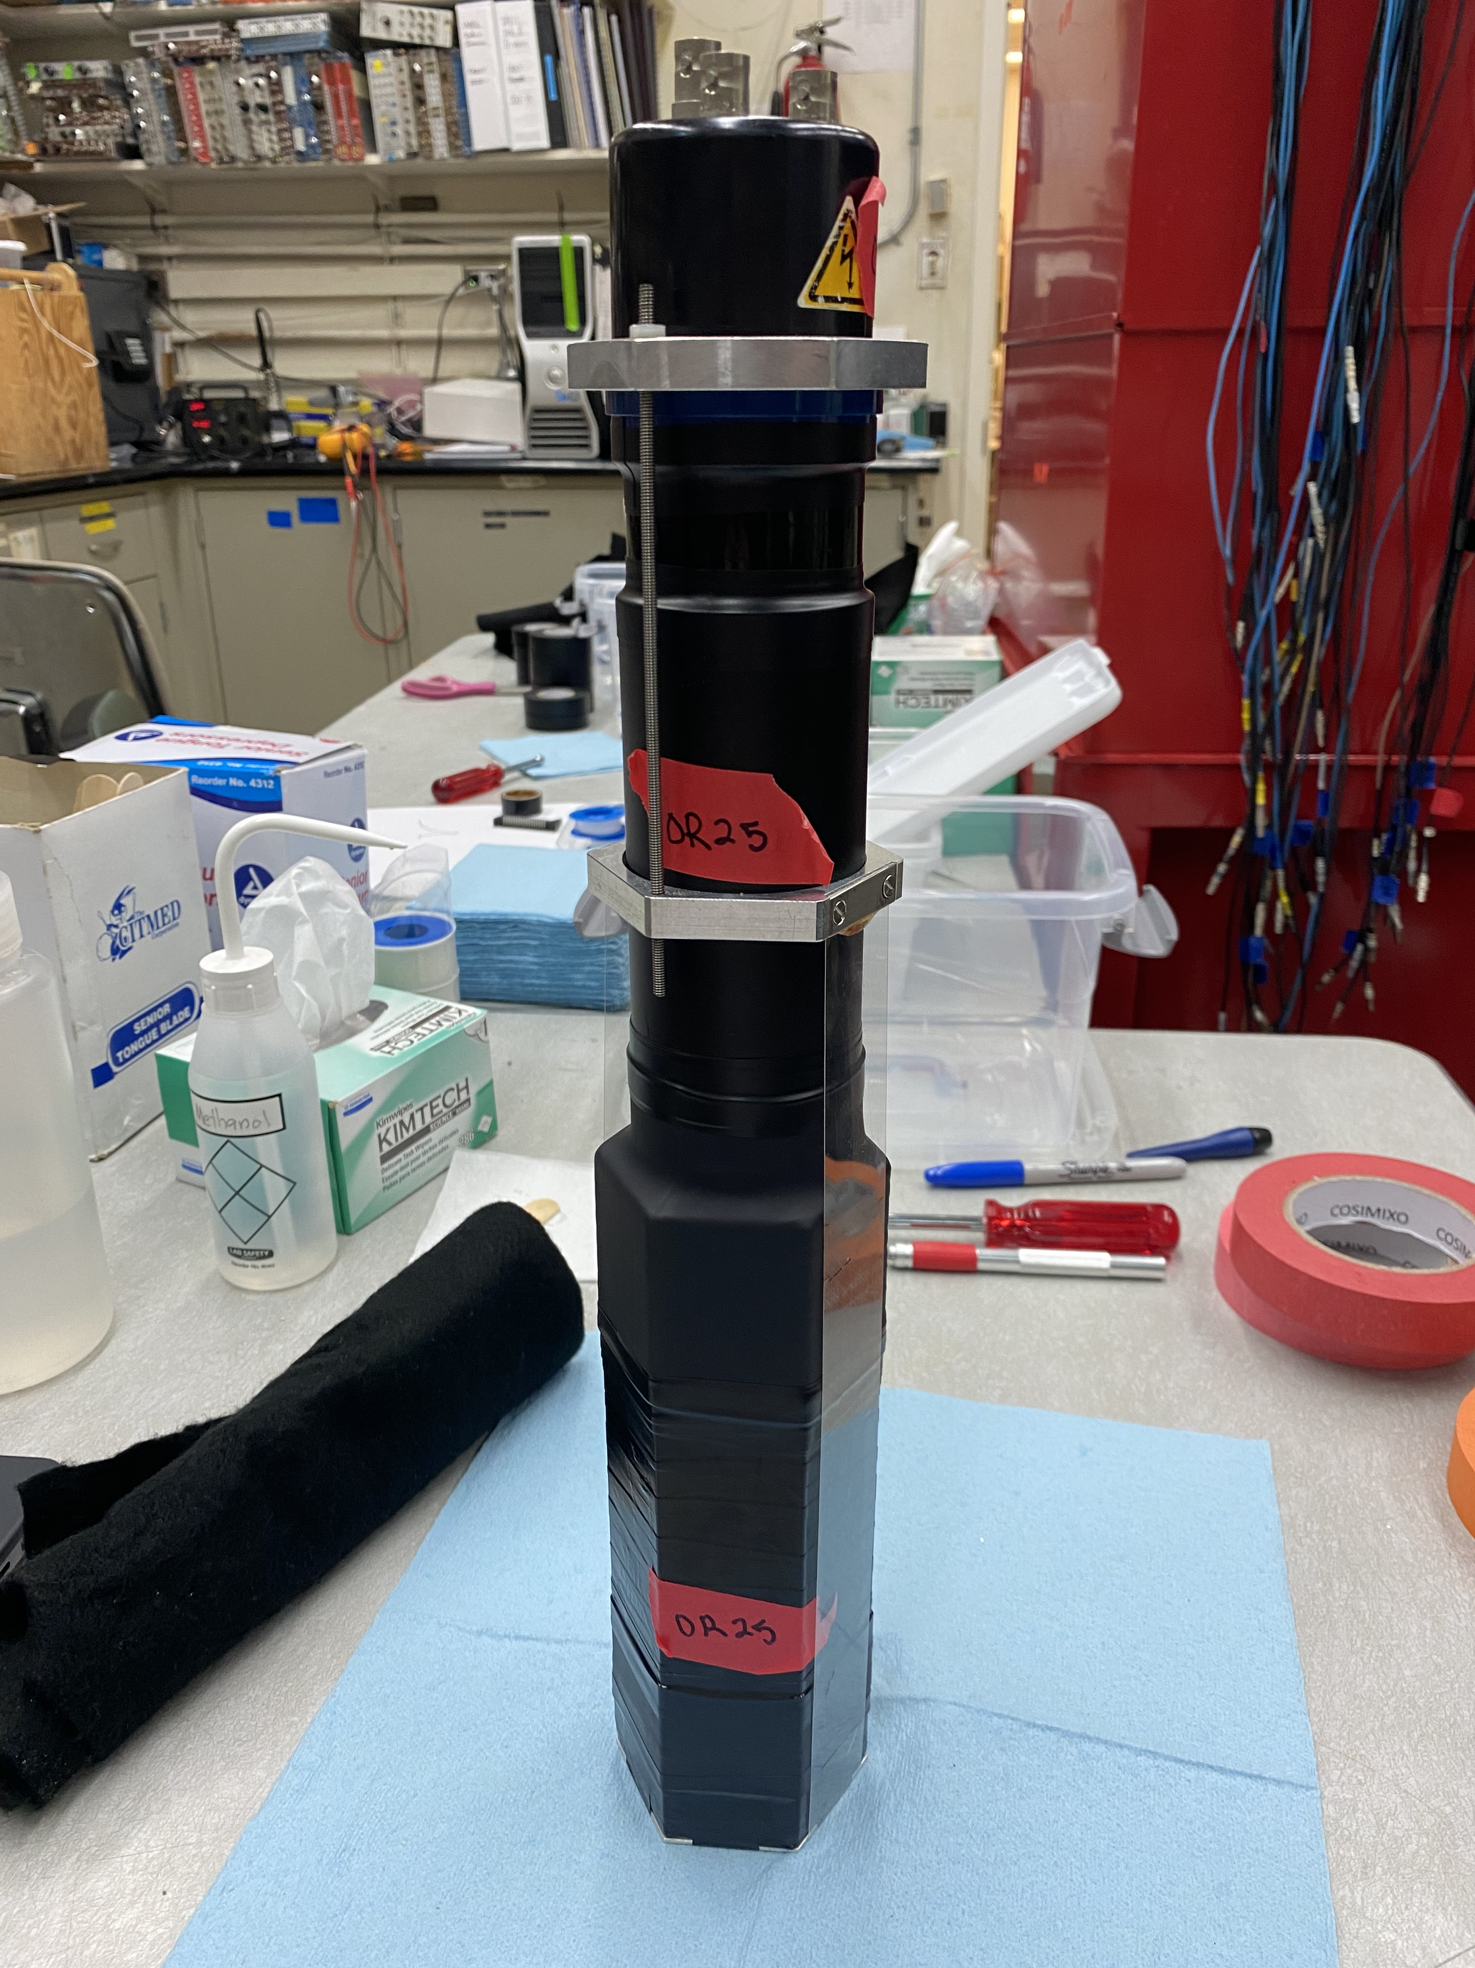
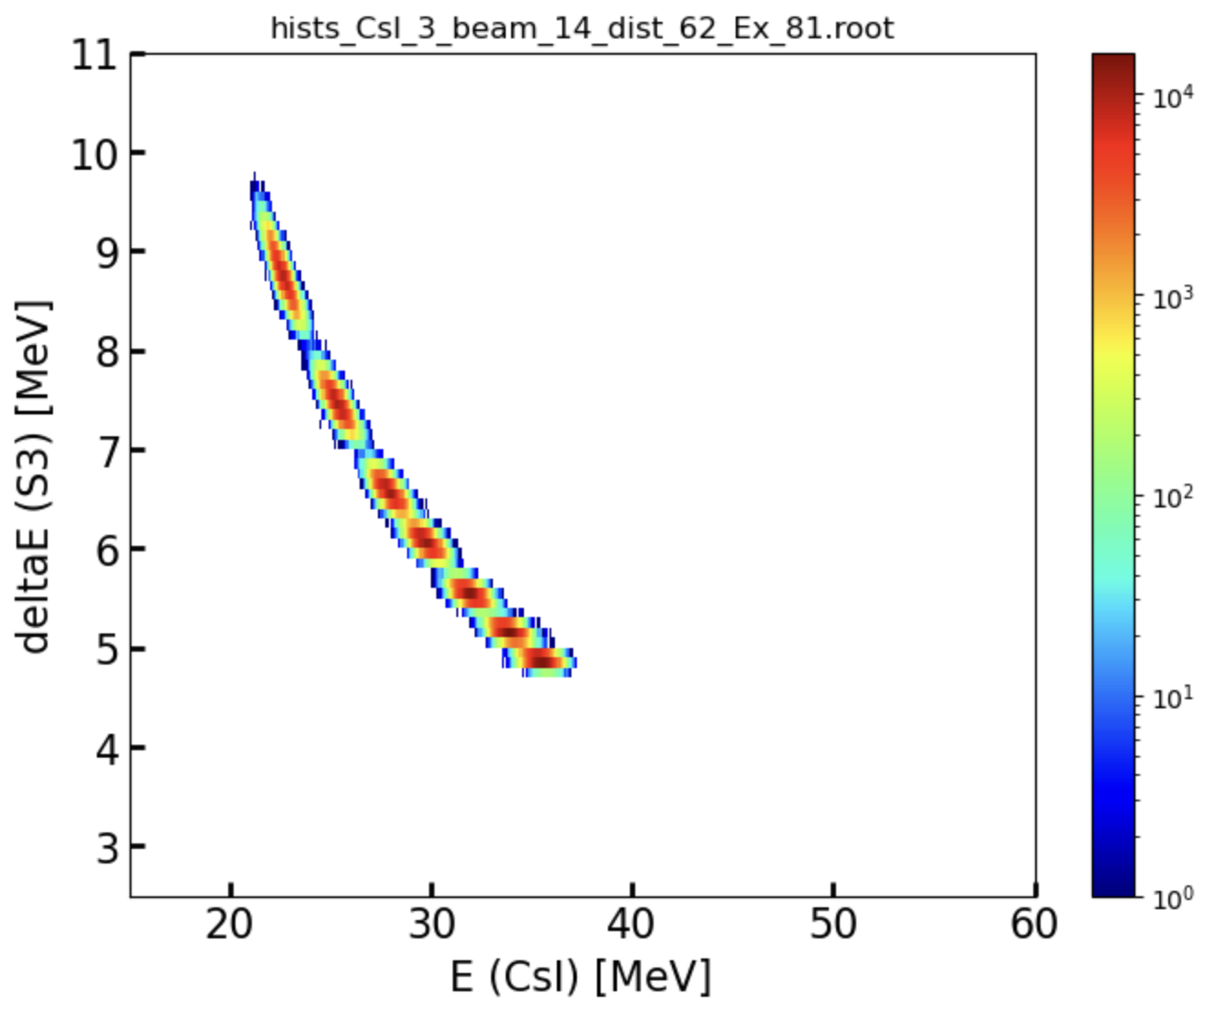
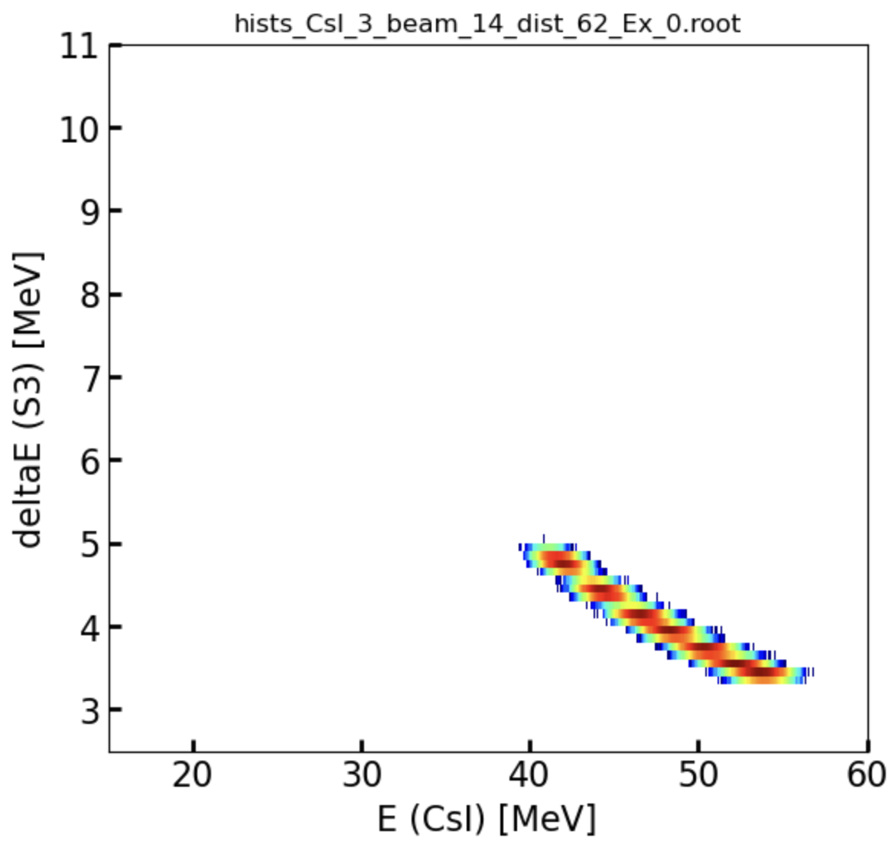
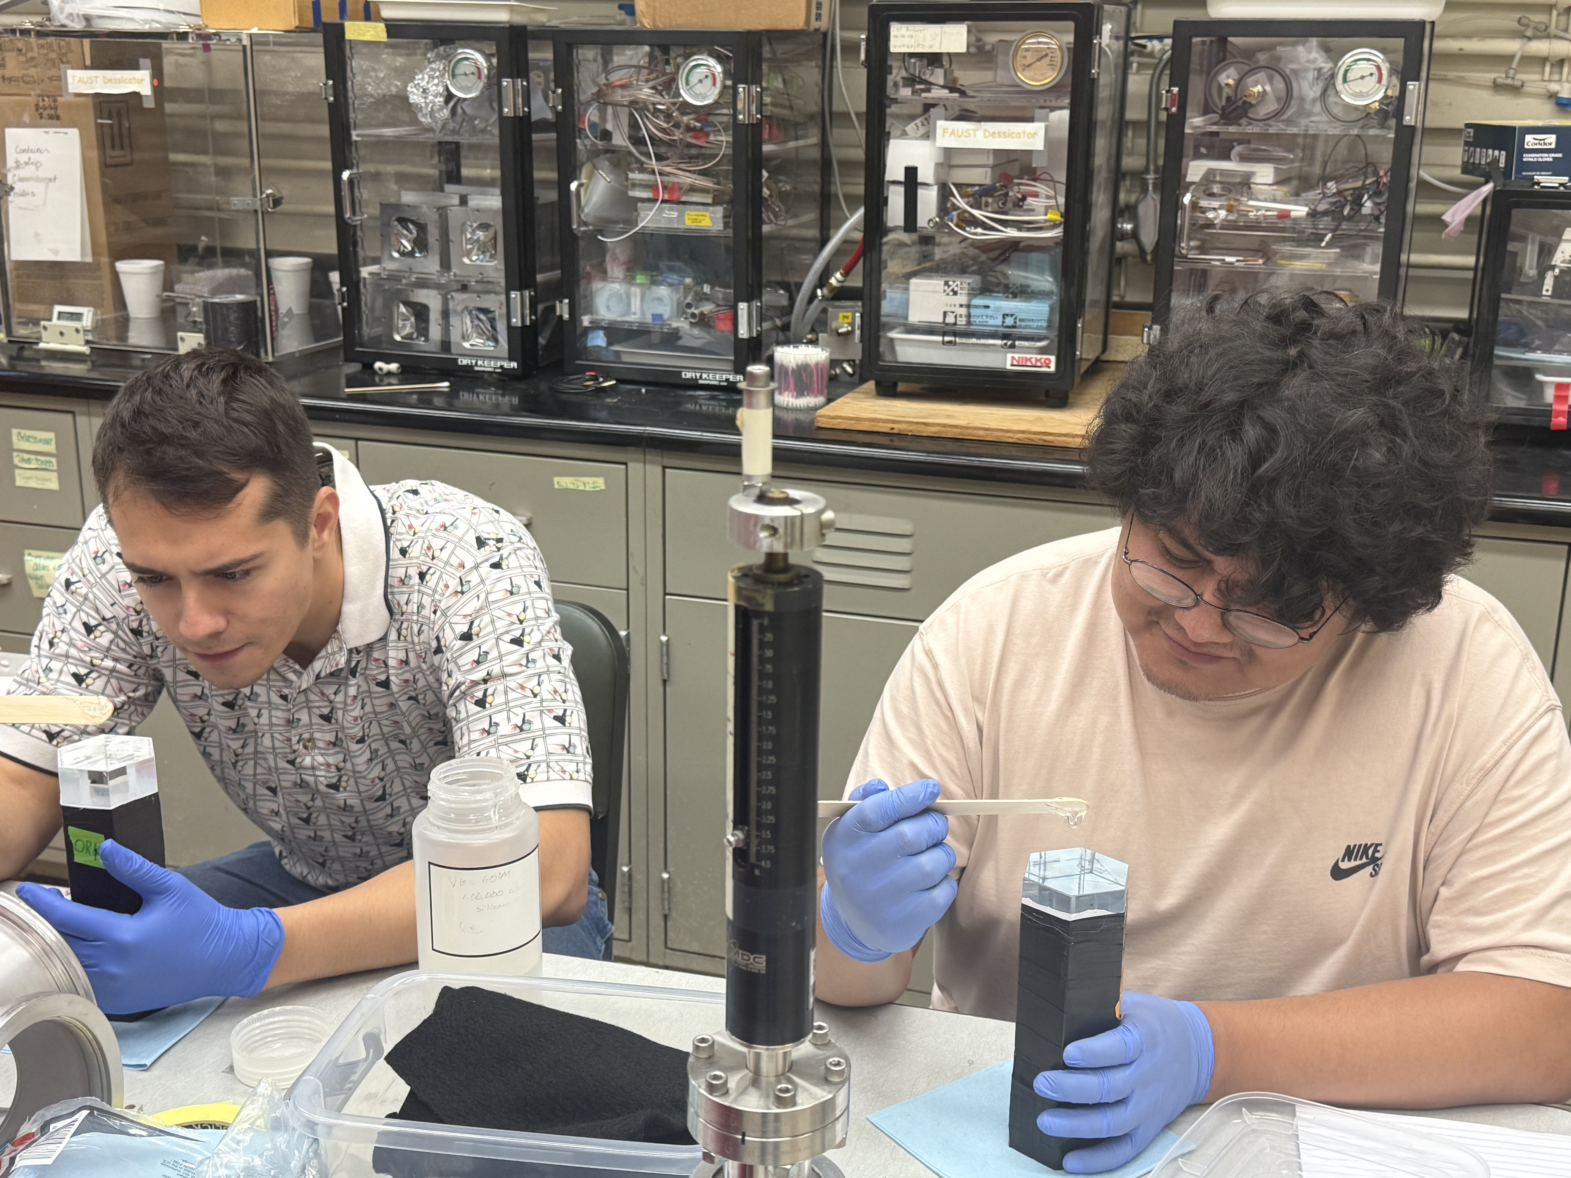
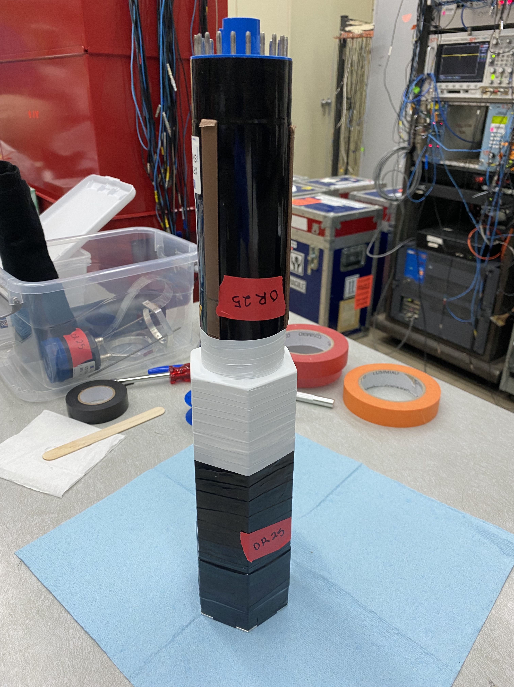
Other Preparation Work
TRIM and TALYS calculations for optimizing 𝚫E-E telescope geometry and resolution
Recoupling and testing DAPPER’s 128 BaF₂ crystals and PMTs
TRIM resolutions from 14 MeV/u ¹³⁶Xe
Protons from Ex = S_{n}
Protons from Ex = 0 MeV
Experiment will run Fall 2026
A. C. Rambo, 10th NLD & 𝛾SF Workshop 2026
13

Slide 15
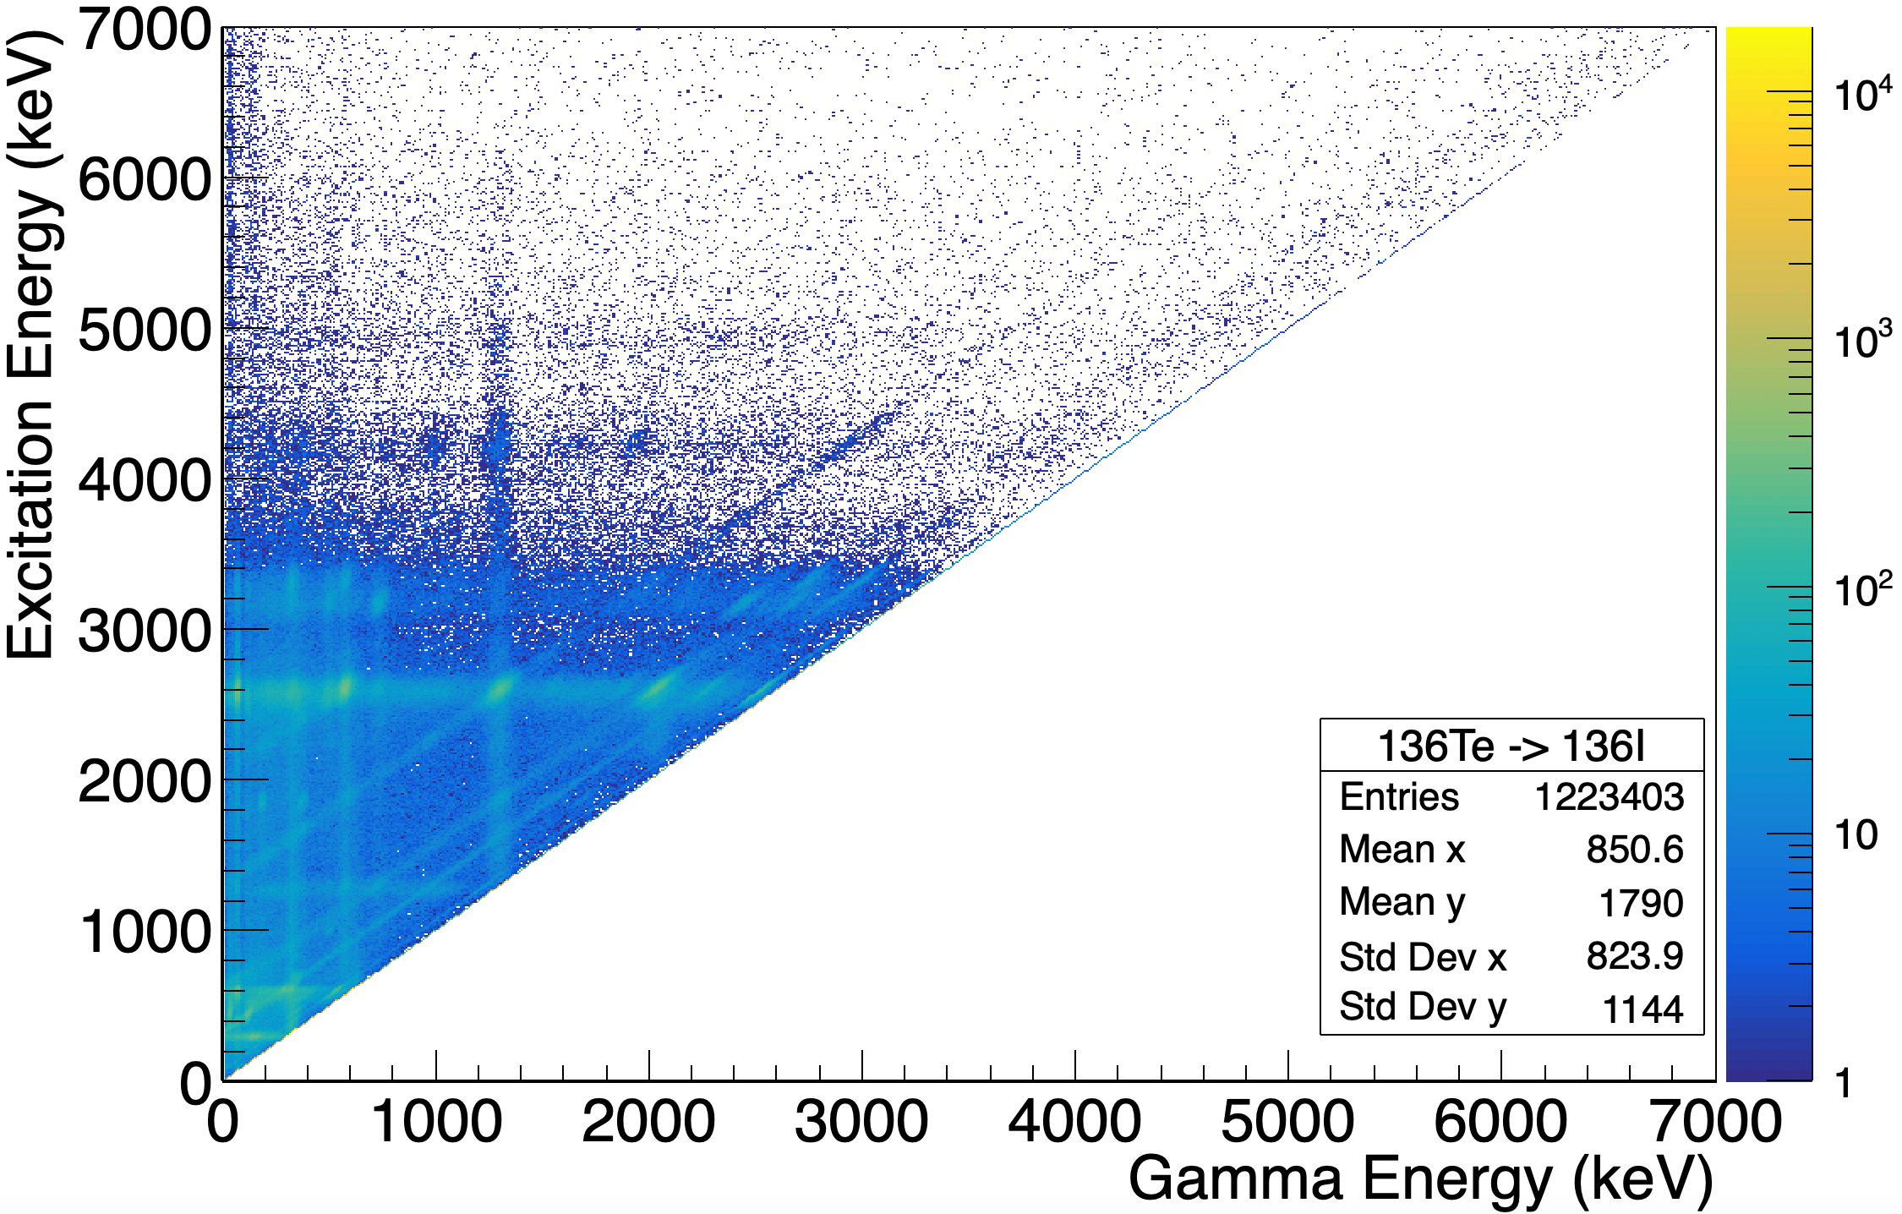
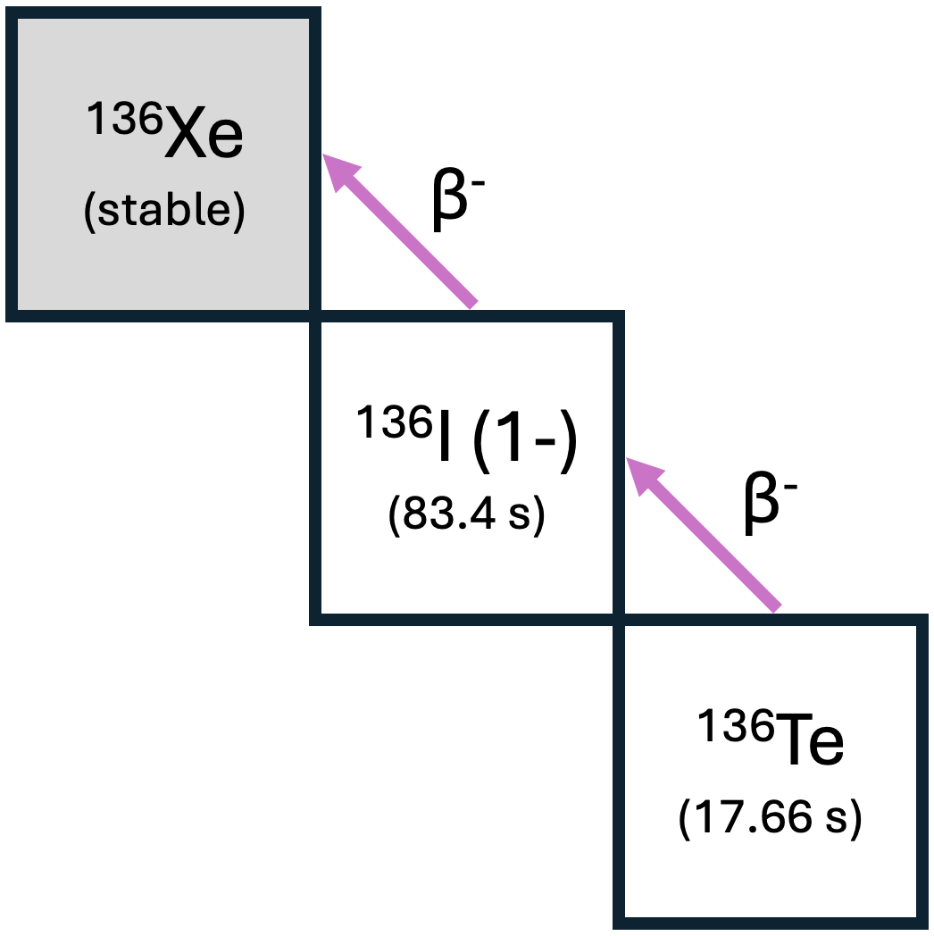
Previous Experiment: e1742 @ ANL (2020)
PI: A. Spyrou
Q_{β-} (¹³⁶Te) = 5.120 MeV
S_{n} (¹³⁶I) = 3.837 MeV
¹³⁶I NLD & 𝛾SF for ¹³⁵I(n,𝛾)
Raw Oslo matrix provided by A. L. Richard
A. C. Rambo, 10th NLD & 𝛾SF Workshop 2026
14

Slide 16
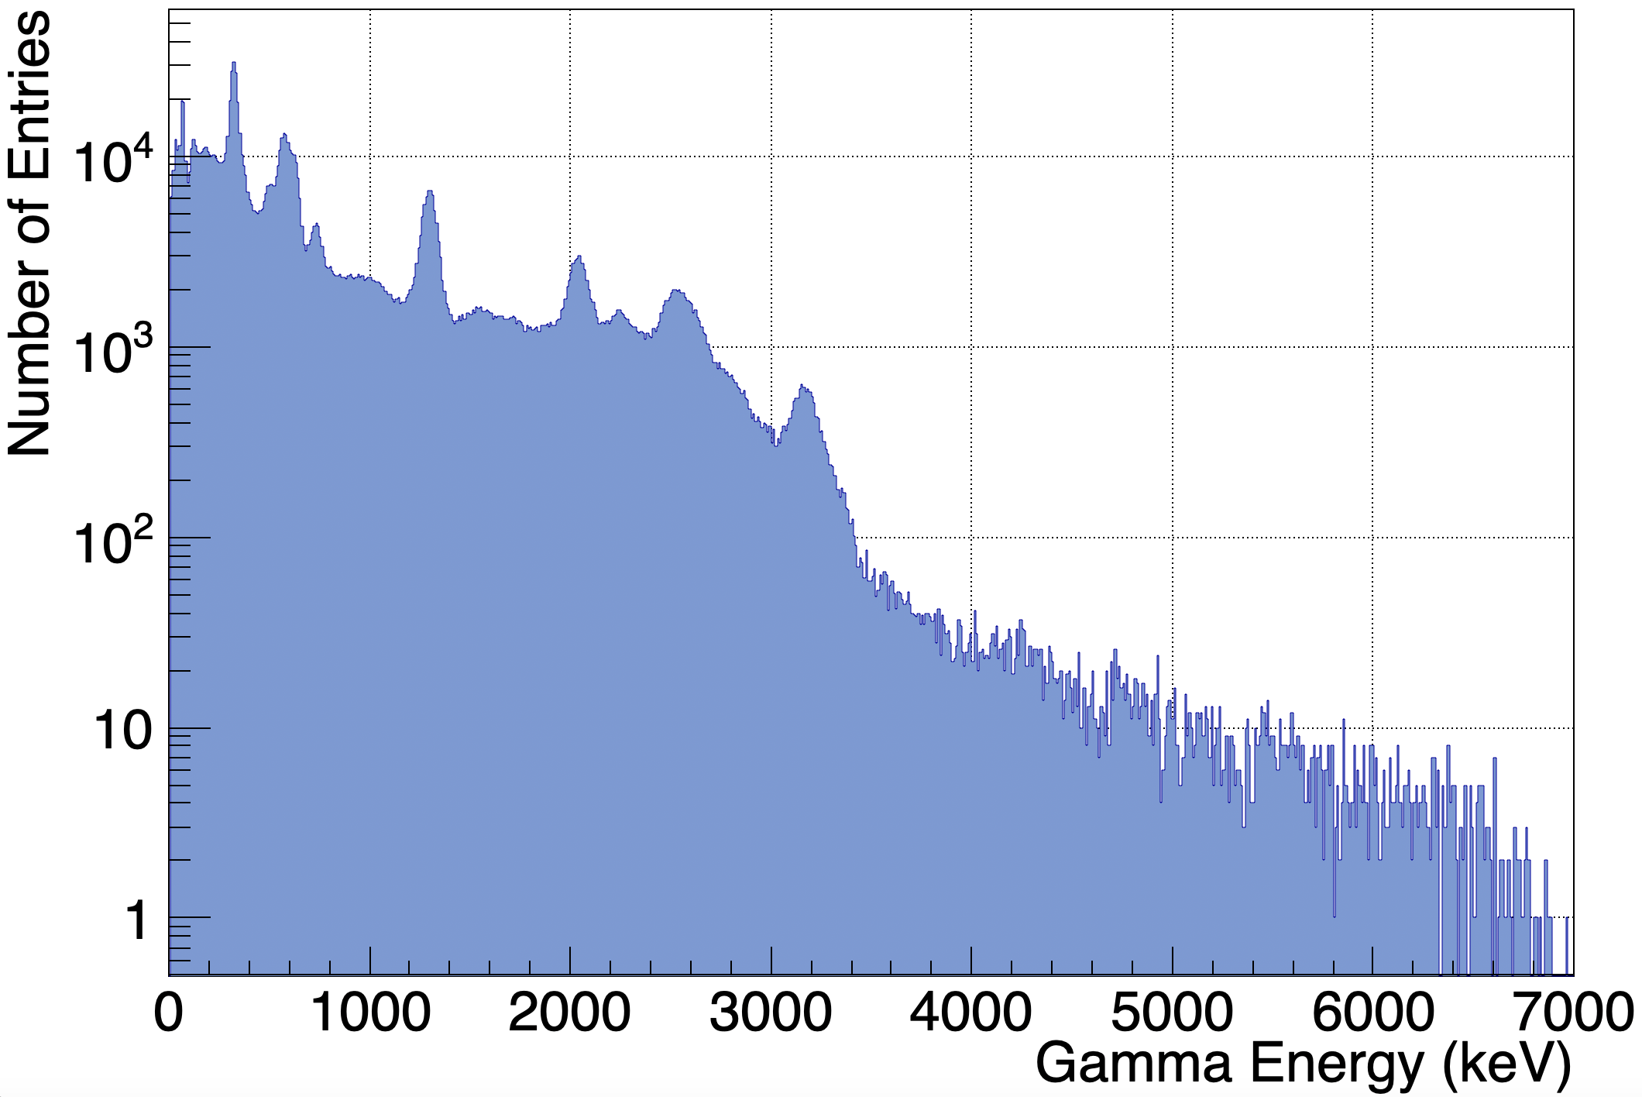
Previous Experiment: e1742 @ ANL (2020)
S_{n} (¹³⁶I) = 3.837 MeV Q_{β-} (¹³⁶Te) = 5.120 MeV
Useful for ¹³⁶Xe NLD & 𝛾SF
S_{n} (¹³⁶Xe) = 8.087 MeV
¹³⁶Xe 2+ @ 1.313 MeV
I_{β}(%) = 28.8
Q_{β-} (¹³⁶I) = 6.884 MeV
¹³⁶I NLD & 𝛾SF for ¹³⁵I(n,𝛾)
Data provided by A. L. Richard
A. C. Rambo, 10th NLD & 𝛾SF Workshop 2026
15

Slide 17
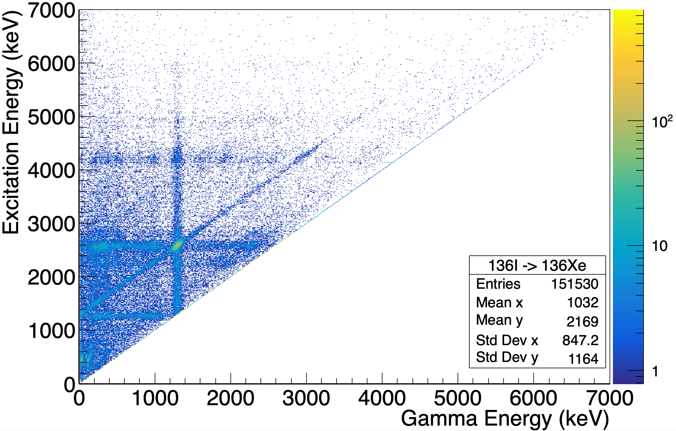
¹³⁶Xe Granddaughter in e1742
S_{n} (¹³⁶Xe) = 8.087 MeV
Q_{β-} (¹³⁶I) = 6.884 MeV
Useful for ¹³⁶Xe NLD & 𝛾SF
¹³⁶Xe 2+ @ 1.313 MeV
I_{β}(%) = 28.8
Raw Oslo matrix provided by A. L. Richard
A. C. Rambo, 10th NLD & 𝛾SF Workshop 2026
16

Slide 18
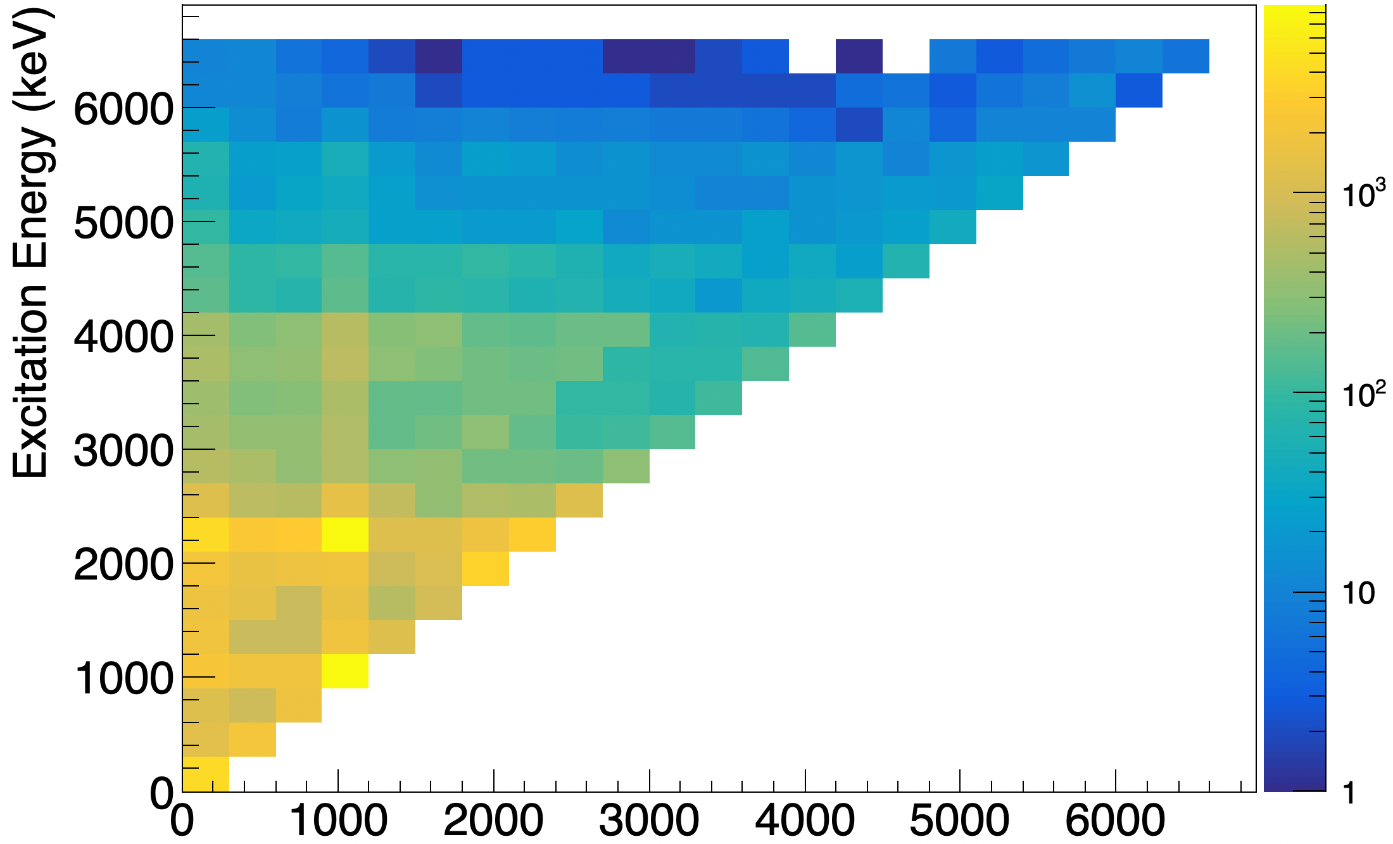
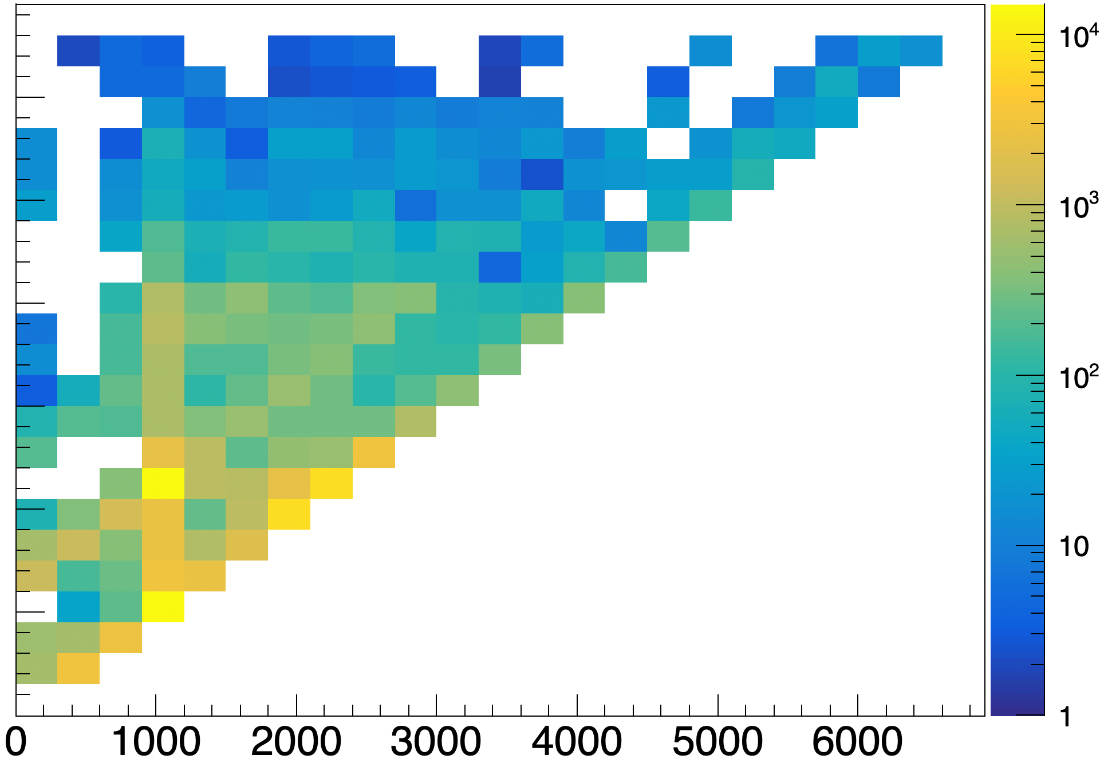
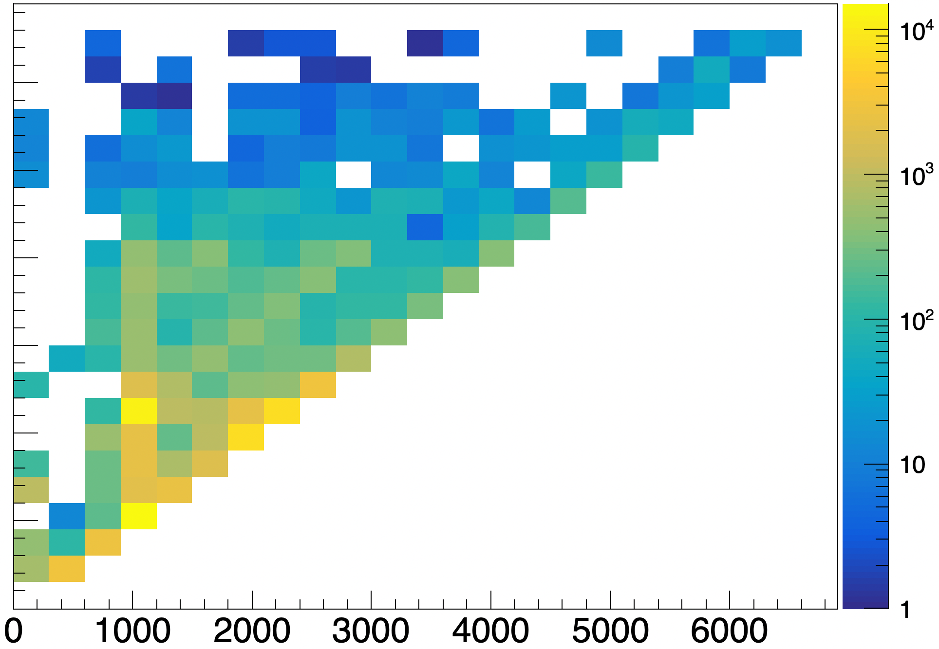
¹³⁶Xe Preliminary Analysis – 300 keV/ch
Raw Matrix
Unfolded
1st Generation
Gamma Energy (keV)
A. C. Rambo, 10th NLD & 𝛾SF Workshop 2026
17

Slide 19
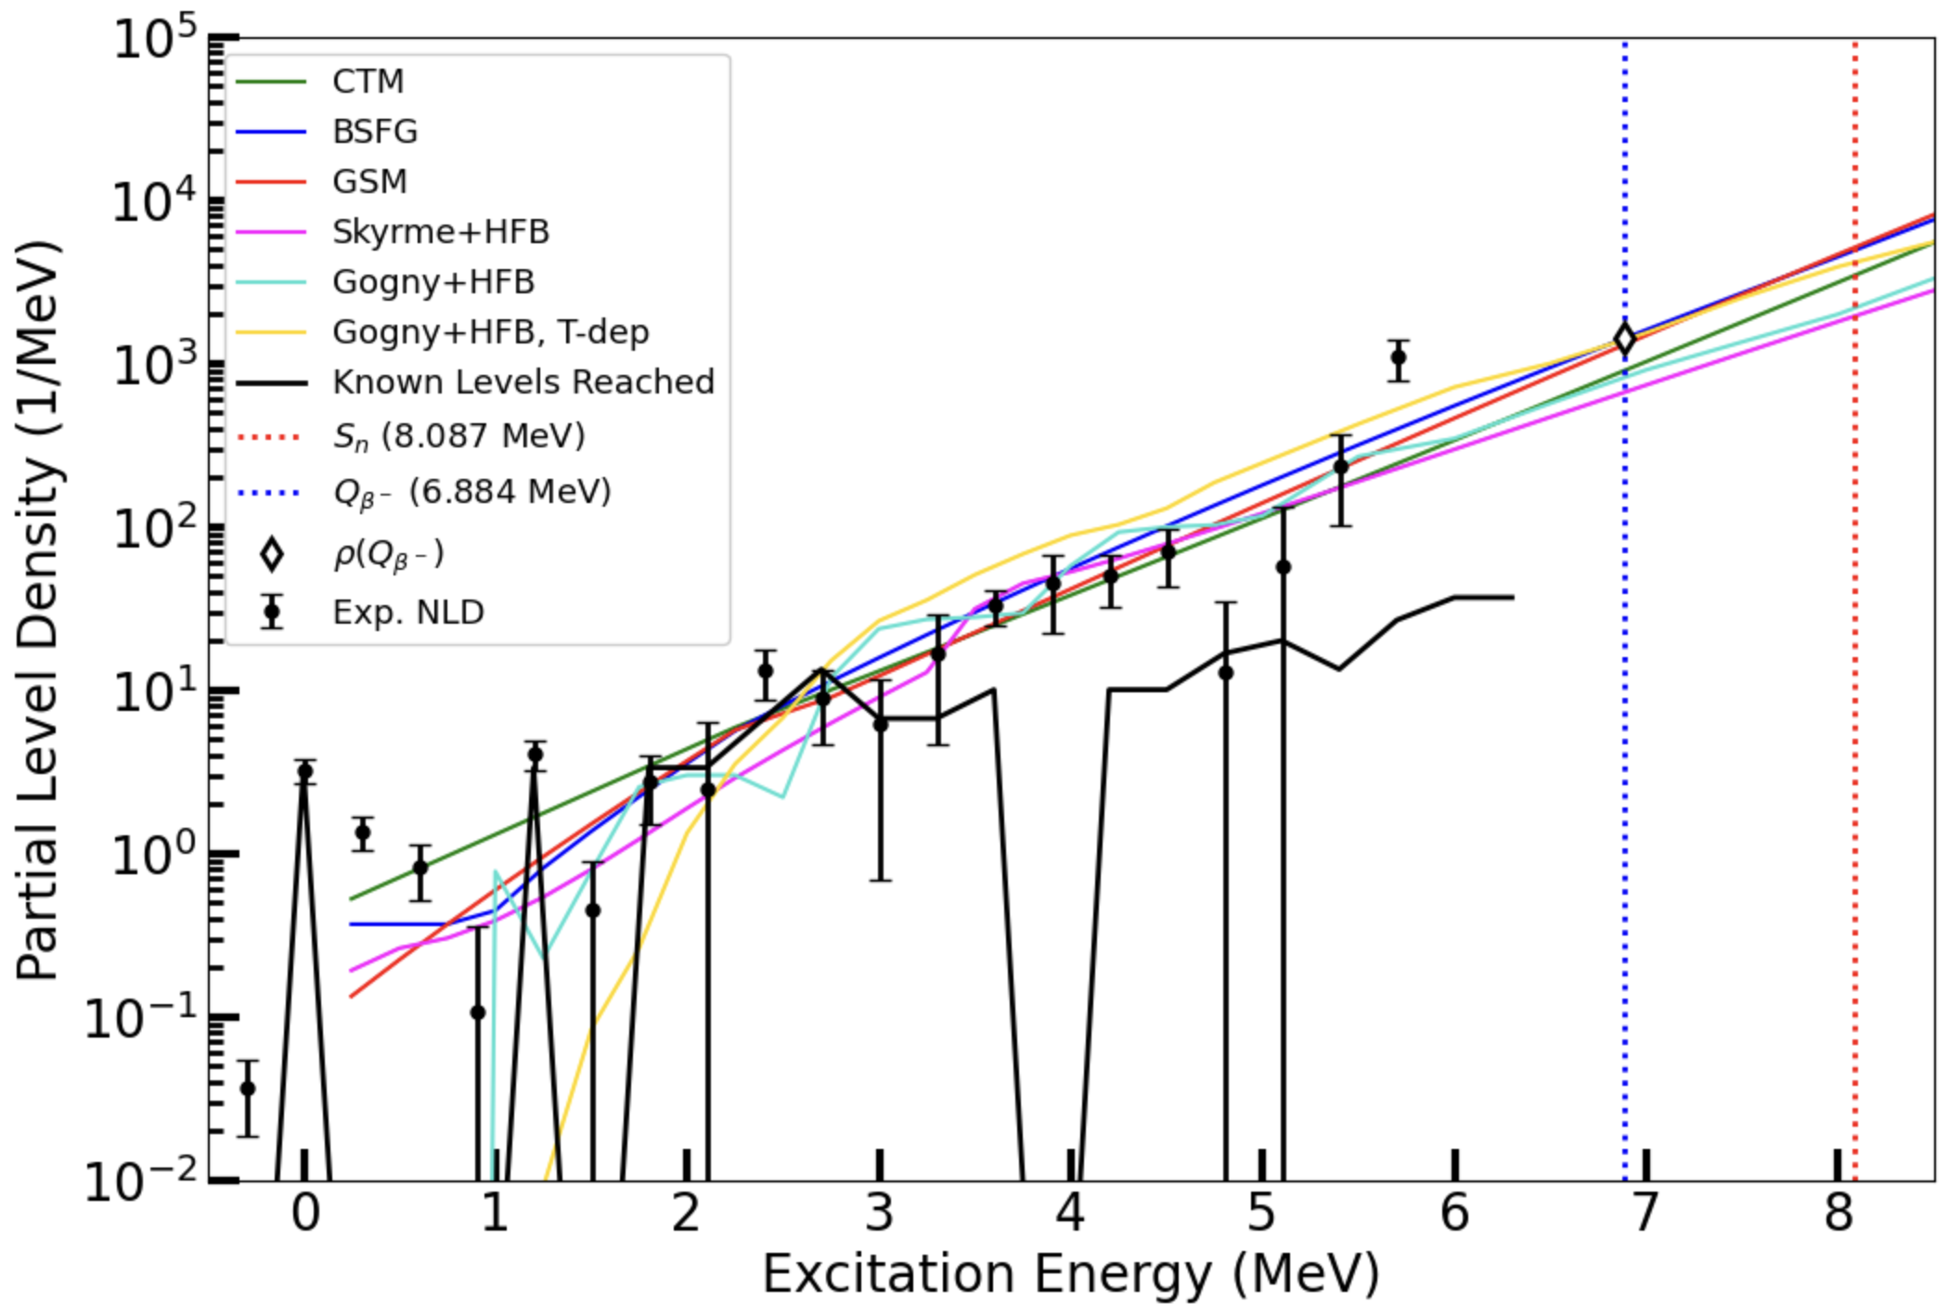
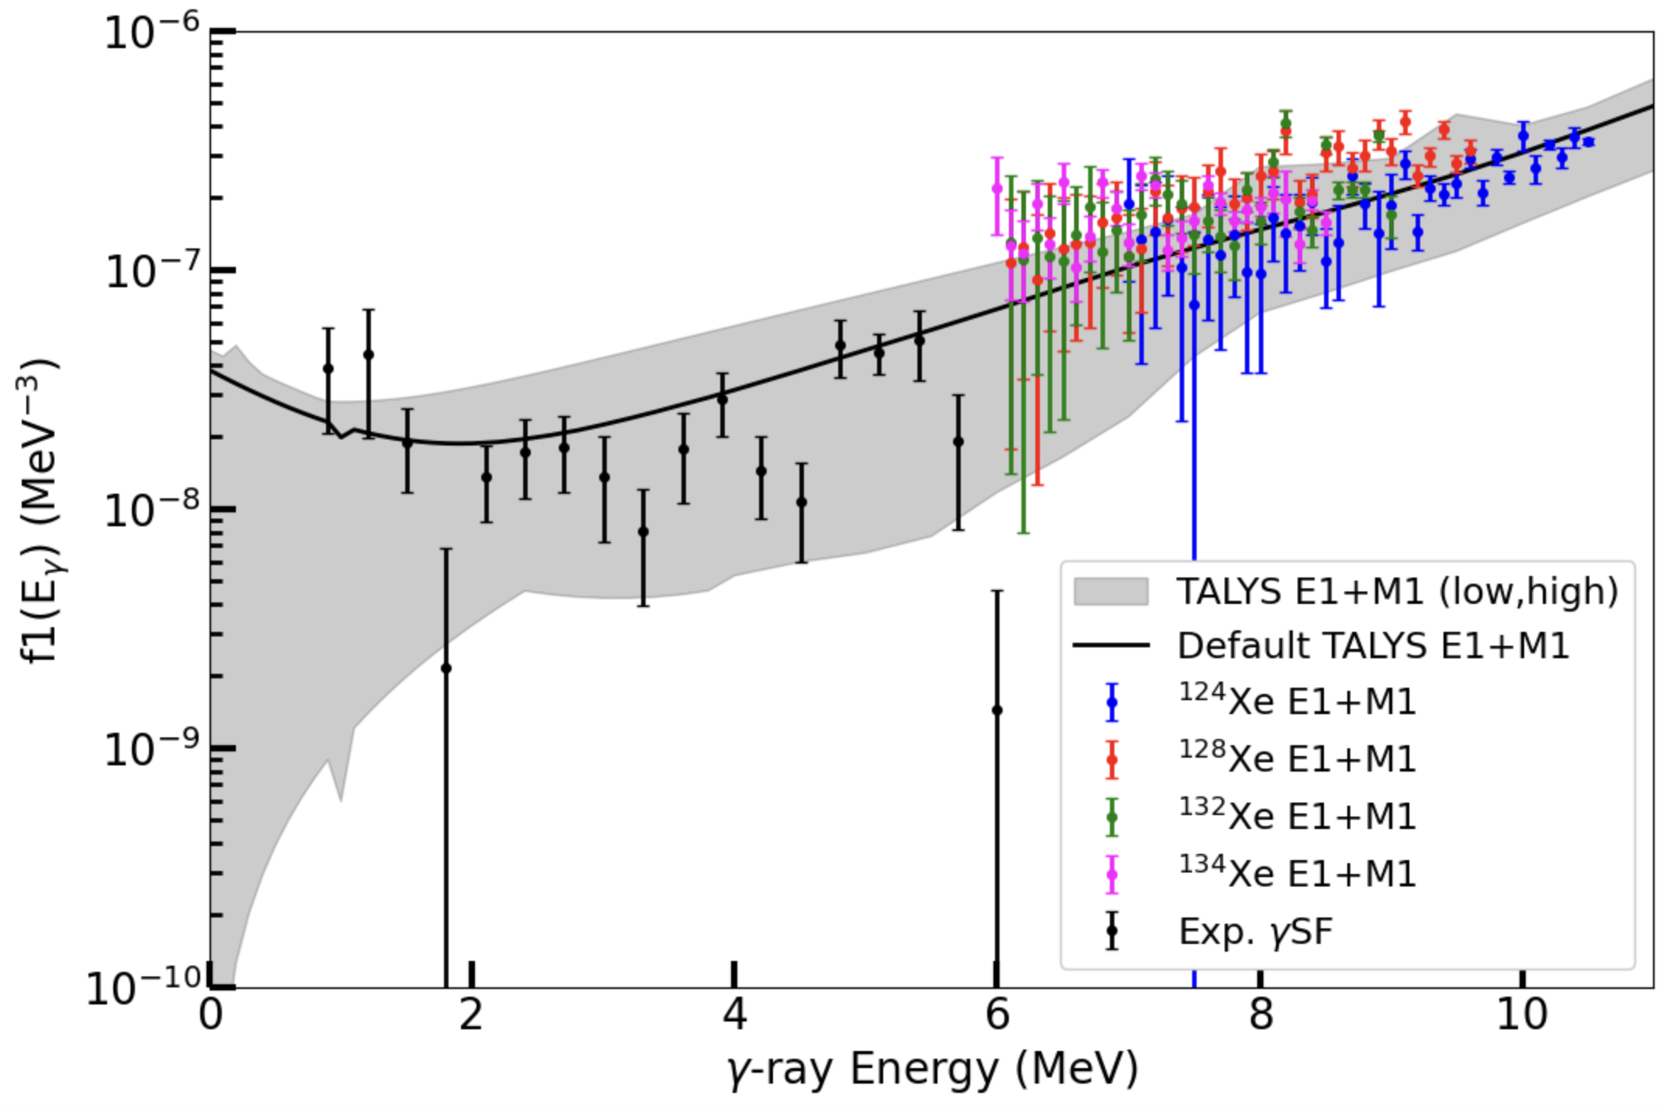
Preliminary ¹³⁶Xe NLD & 𝛾SF – 300 keV/ch
July β-Oslo experiment will use 𝛾SF normalizations from Shape Method and ¹³⁶Xe(𝛾,𝛾’) data from HI𝛾S (if available)
𝛾SF data extracted from IAEA Photon Strength Function Database, version v2024.1, https://nds.iaea.org/PSFdatabase
A. C. Rambo, 10th NLD & 𝛾SF Workshop 2026
18

Slide 20
Summary
Goal: Constrain ¹³⁵Xe(n,𝛾) by constraining ¹³⁶Xe NLD & 𝛾SF
Experiment 1: β-Oslo at ANL with nuCARIBU ¹³⁶Te & ¹³⁶I beams
  Running July 13-18, 2026
Experiment 2: Inverse-Oslo at TAMU with DAPPER p(¹³⁶Xe,p’𝛾)¹³⁶Xe
  Running Fall 2026
Preliminary analysis from ANL e1742 (2020)
  ¹³⁶Xe granddaughter
A. C. Rambo, 10th NLD & 𝛾SF Workshop 2026
19

Slide 21






Thank You!
A. L. Richard
D. L. Bleuel
A. Sweet
S. M. Lyons
M. Wiedeking
A. Spyrou
S. Liddick
A. B. McIntosh
K. Hagel
J. Gauthier
D. Shelden
A. Alvarez
Many more …
This work was supported by the Office of Defense Nuclear Nonproliferation Research and Development within the U.S. Department of Energy’s National Nuclear Security Administration and performed under the auspices the U.S. Department of Energy by Lawrence Livermore National Laboratory under Contract DE-AC52-07NA27344 and Berkeley Lab under Contract AC02-05CH11231.
A. C. Rambo, 10th NLD & 𝛾SF Workshop 2026
20

