Slide 1


Investigating the low-energy enhancement in Zr isotopes
Artemis Spyrou
Amal Sebastian
National Science Foundation

Slide 2
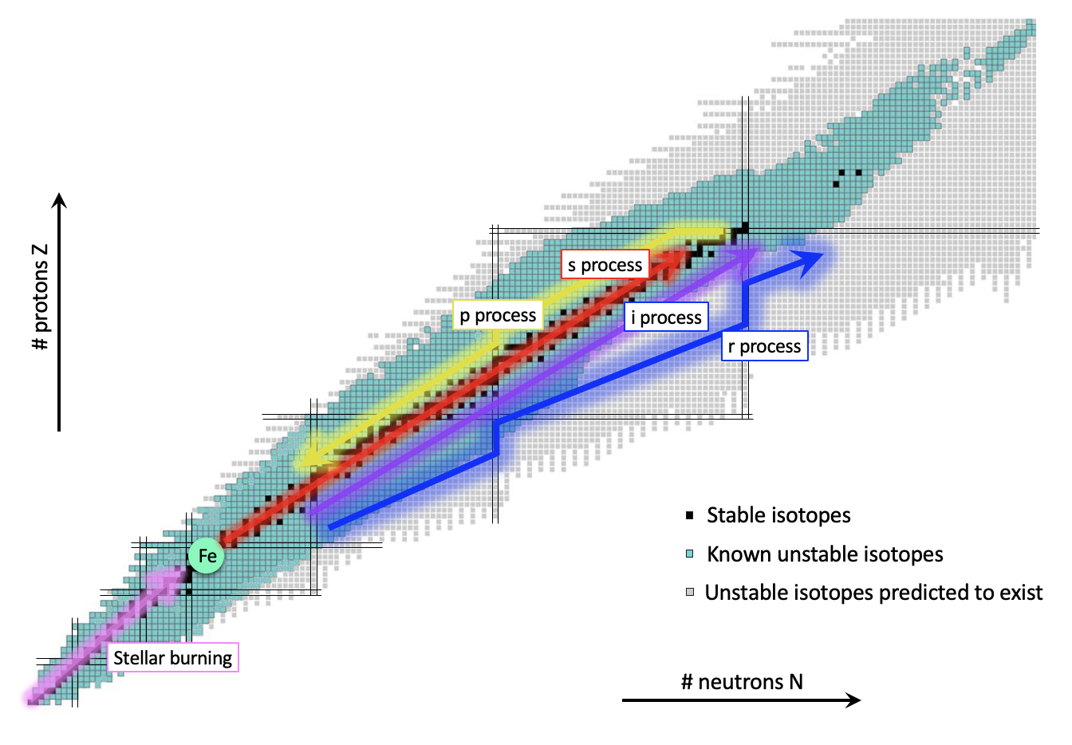
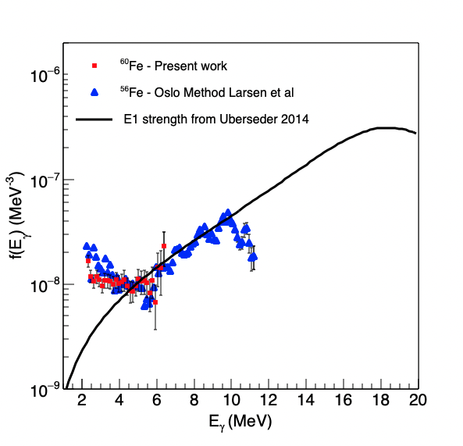
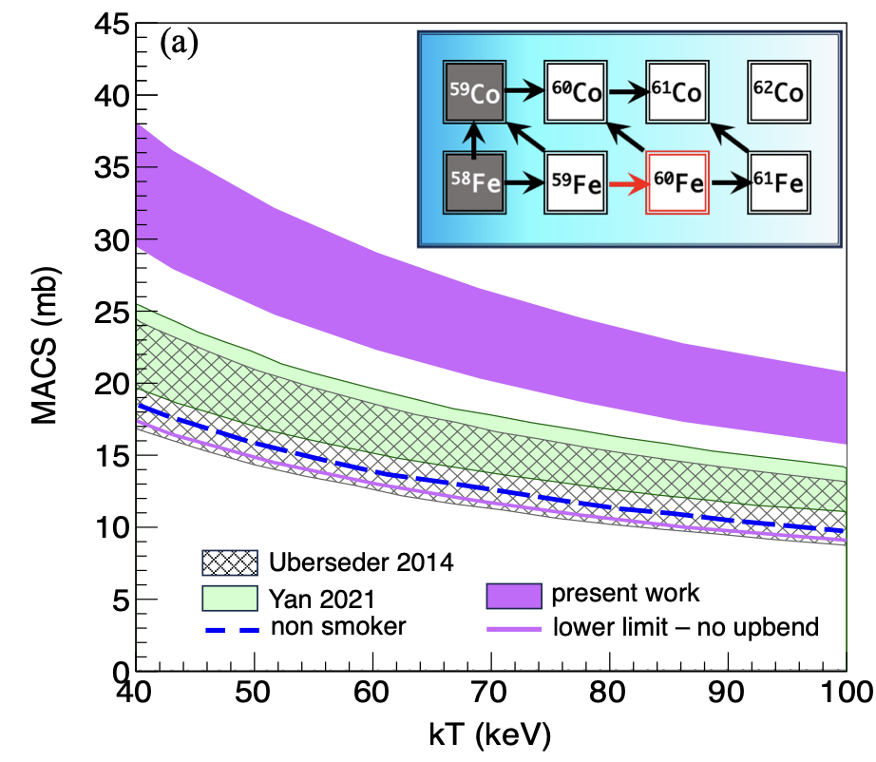
Motivation
The low energy enhancement can have significant impact on a neutron-capture cross sections when determined via indirect techniques
Particularly important for explosive astrophysical environments which include nuclei far from stability
⁶⁰Fe
⁵⁹Fe(n,γ)⁶⁰Fe
AS et al, Nature Comms 2024
Wiedeking et al, Nature Reviews 2025

Slide 3
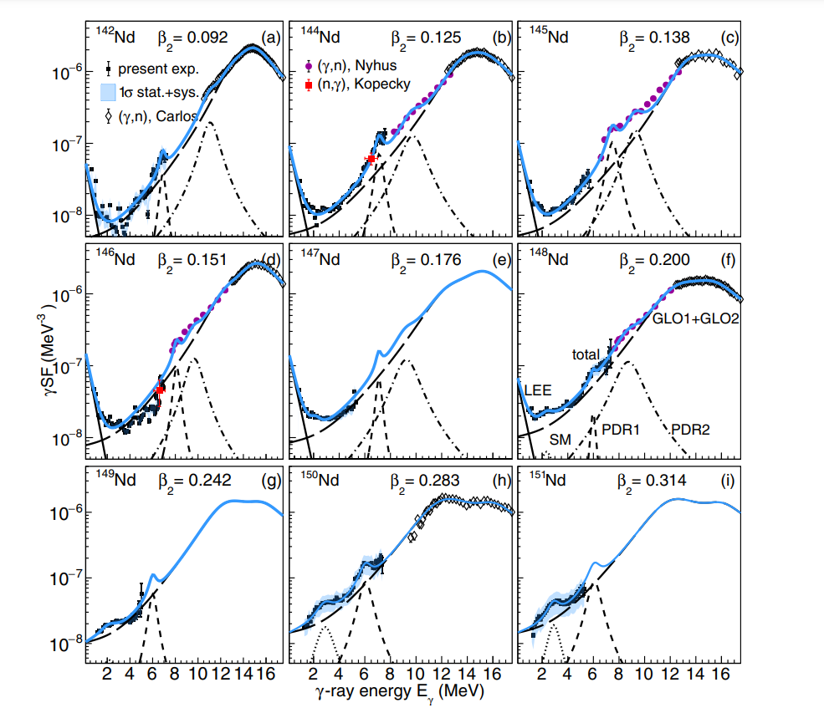

Evolution of upbend as a function of deformation
M. Guttormsen et al., Physical Review C 106, 034314 (2022)
Deformation in Nd isotopes
spherical
deformed
β₂= 0.092
β₂= 0.109
β₂= 0.125
β₂= 0.138
β₂= 0.151
β₂= 0.176
β₂= 0.200
β₂= 0.242
β₂= 0.283

Slide 4
Evolution of upbend as a function of deformation
M. Guttormsen et al., Physical Review C 106, 034314 (2022)
Deformation in Nd isotopes
spherical
deformed
β₂= 0.092
β₂= 0.109
β₂= 0.125
β₂= 0.138
β₂= 0.151
β₂= 0.176
β₂= 0.200
β₂= 0.242
β₂= 0.283
Deformation in Zr isotopes
90Zr
92Zr
94Zr
96Zr
98Zr
100Zr
0.092
0.10
0.088
0.06
0.06
0.347
⁹⁰⁻⁹⁸Zr: β₂ = 0.06 -0.1
Abrupt change at ¹⁰⁰Zr: β₂ = 0.36

Slide 5
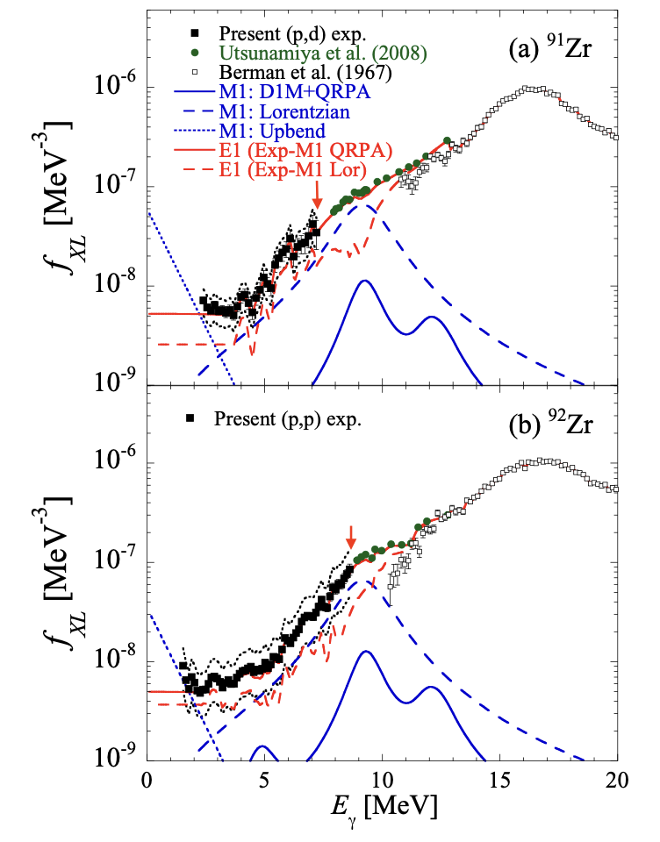
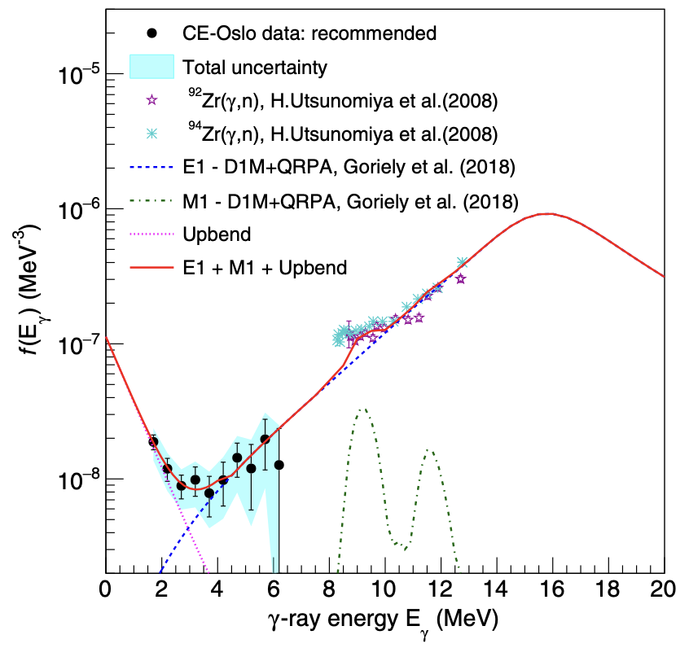


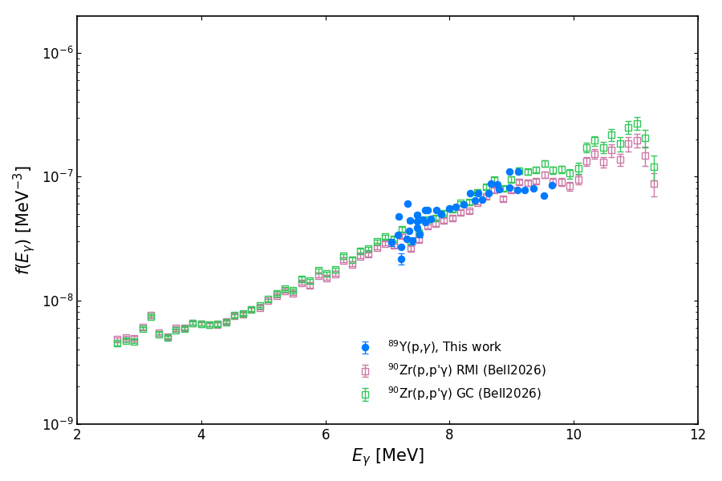


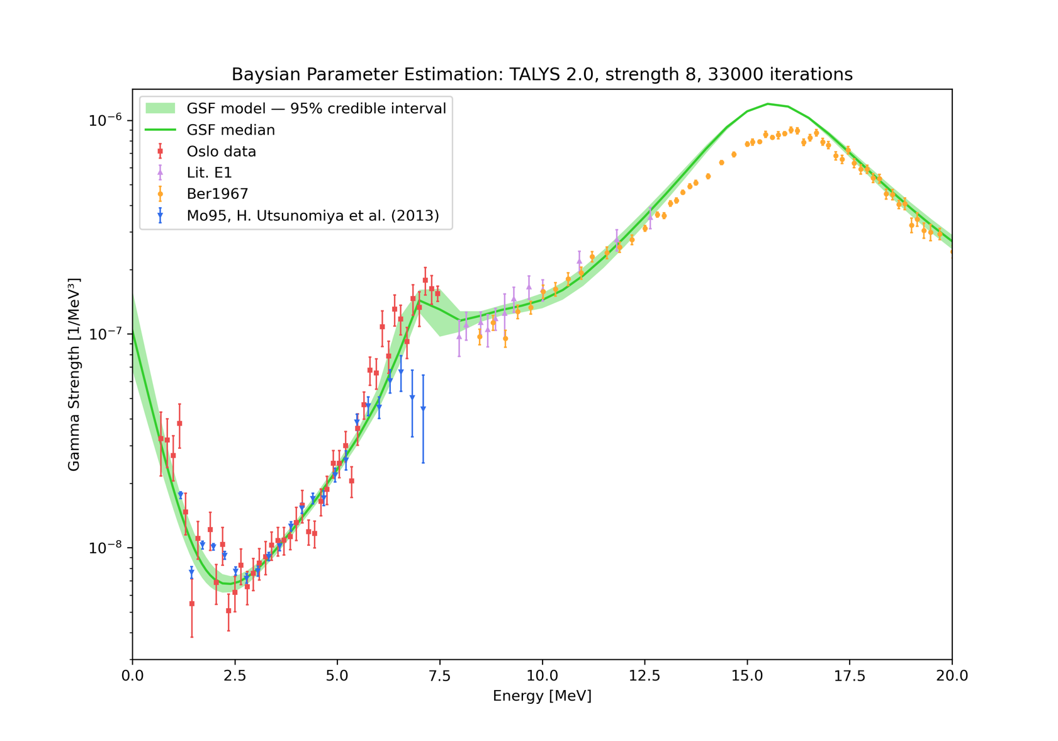
Existing measurements along the Zr isotopic chain
Guttormsen et al. PRC 96, 024313 (2017)
Pathirana et al. PRC 113, 015801 (2026)
⁹¹Zr
⁹³Zr
L. Bell – Submitted 2026
K. Malatji – Oslo 2026
⁹⁰Zr
T. Sitting – In preparation
⁹²Zr
⁹⁶Zr
90Zr
92Zr
94Zr
96Zr
98Zr
100Zr
0.092
0.10
0.088
0.06
0.06
0.347

Slide 6
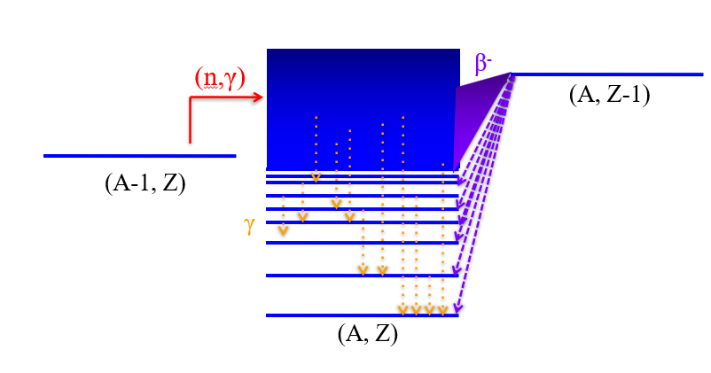
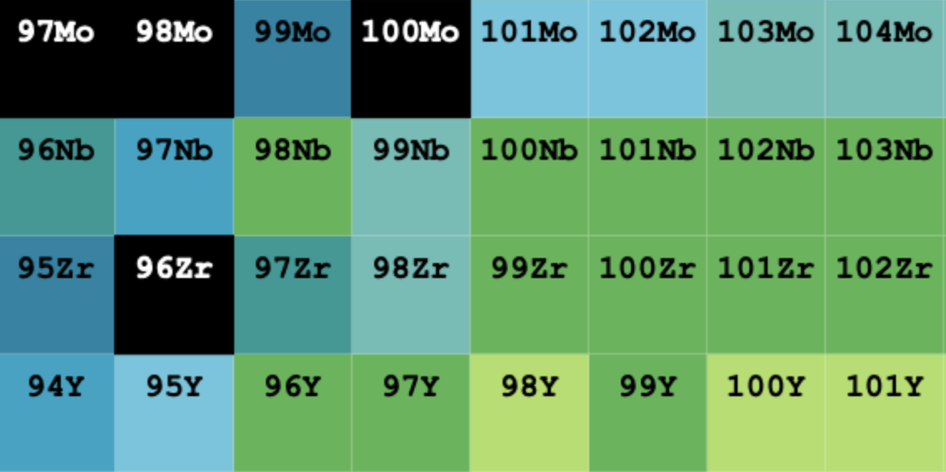
Using the β Oslo method to populate neutron-rich Zr
(d,p)
(³He,³He)
Oslo
Surrogate
(p,t)
(³He,⁴He)
(p,⁴He), (p,p), CE
Extracting Nuclear Level Densities and γ-ray Strength Functions

Slide 7
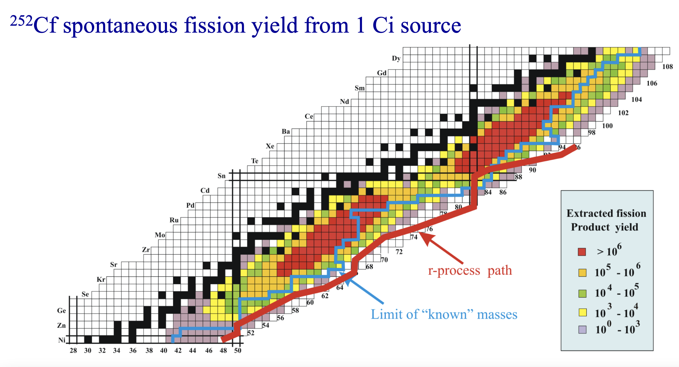

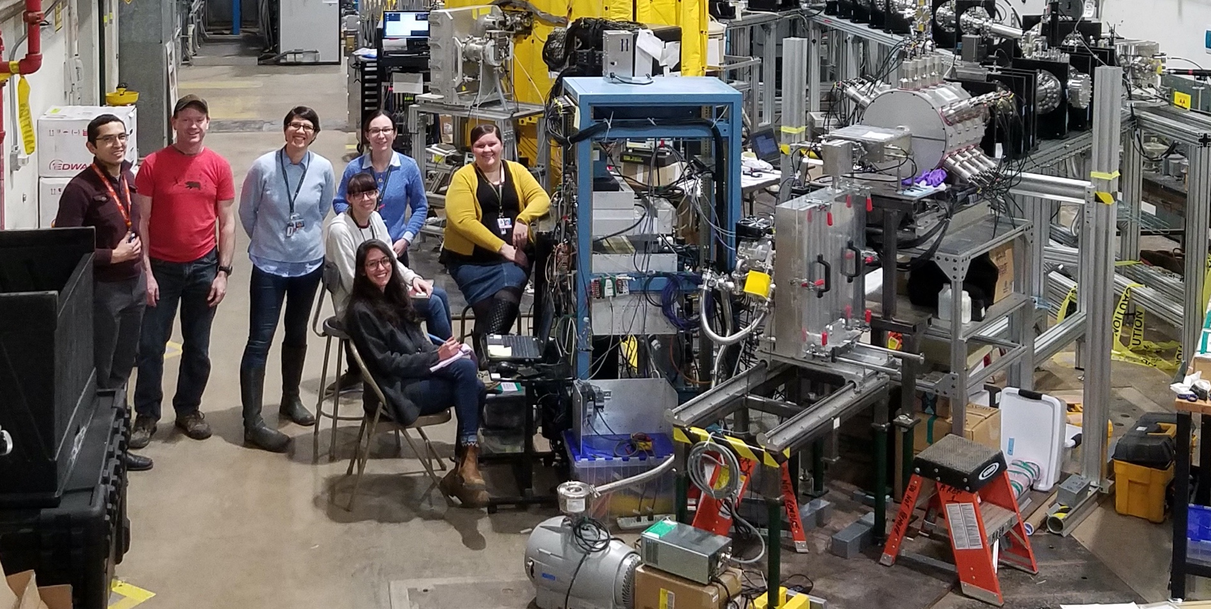
CARIBU Facility @ Argonne National Lab
Exp. PI: Mallory Smith
The SuN setup @ ANL
beam
SuN
SuNTAN
⁹⁷⁻¹⁰⁰Y

Slide 8
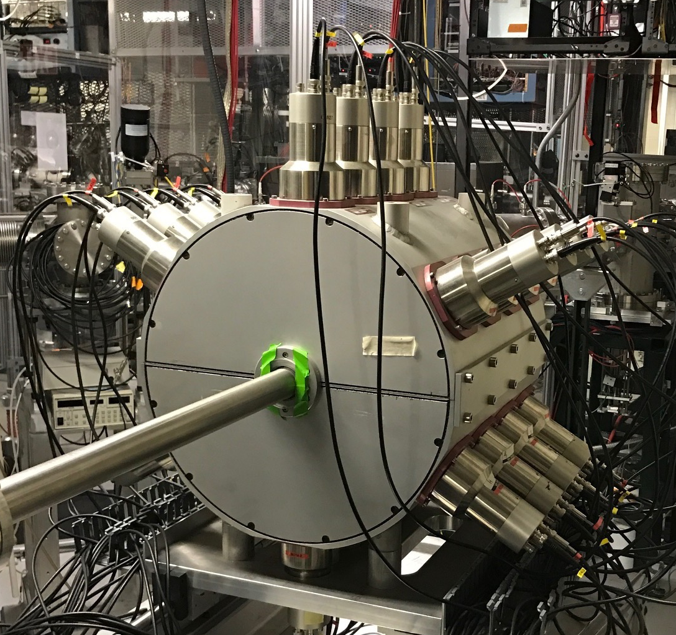
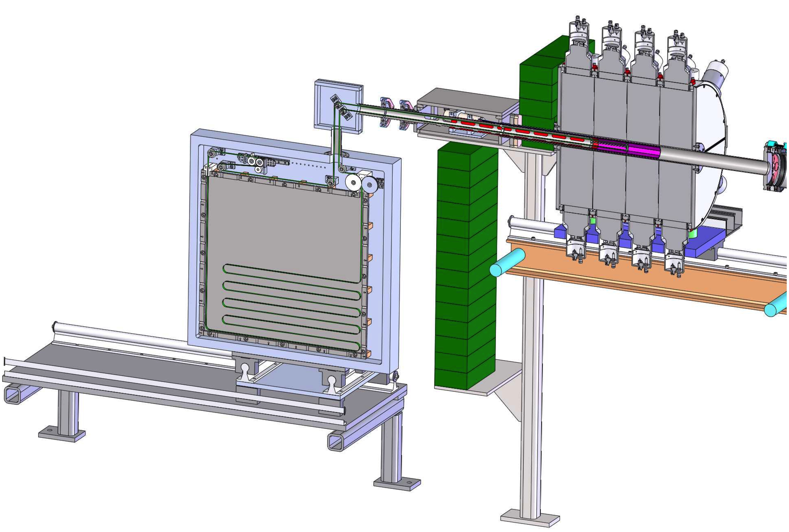
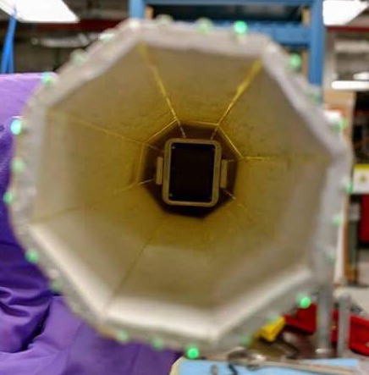
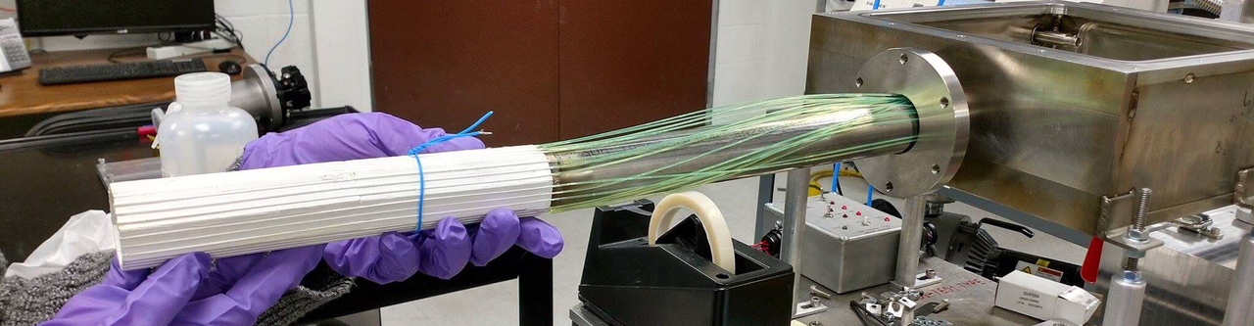
The SuN setup
SuN
γ-Total Absorption Spectrometer
SuNTAN
Tape transport system
beam
SuNSPOT
β-detection
Hope College
Design by LSU and ANL
A. Simon, et al., Nucl. Instr. Meth A 703, 16 (2013)
C. Harris et al. Nucl. Instr. Meth. A 1084 (2006) 171185

Slide 9
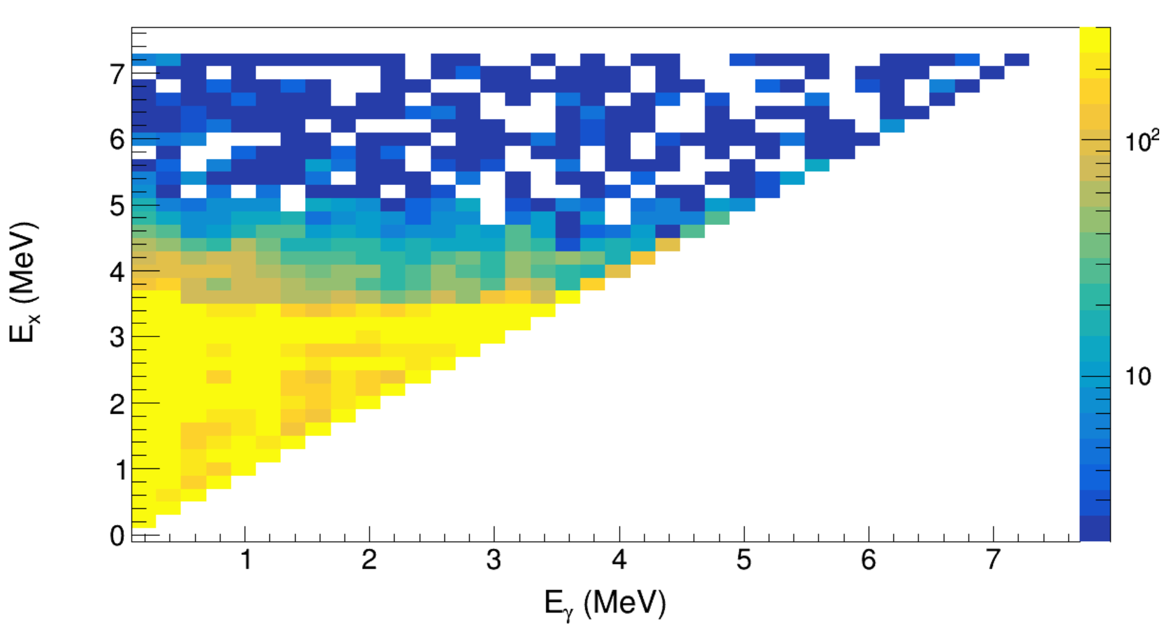

Results for ⁹⁷Zr
⁹⁶Zr
⁹⁷Zr
β⁻
(n,γ)
⁹⁷Y
Raw matrix for β-oslo analysis
γ
⁹⁷Y-> ⁹⁷Zr
Q_{β} = 6.8 MeV
S_{n} =5.56 MeV
A. Sebastian et al. PRC - Submitted

Slide 10
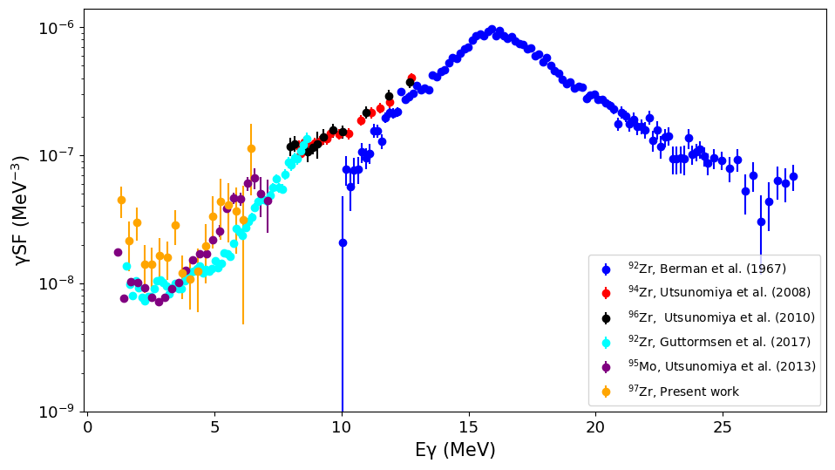
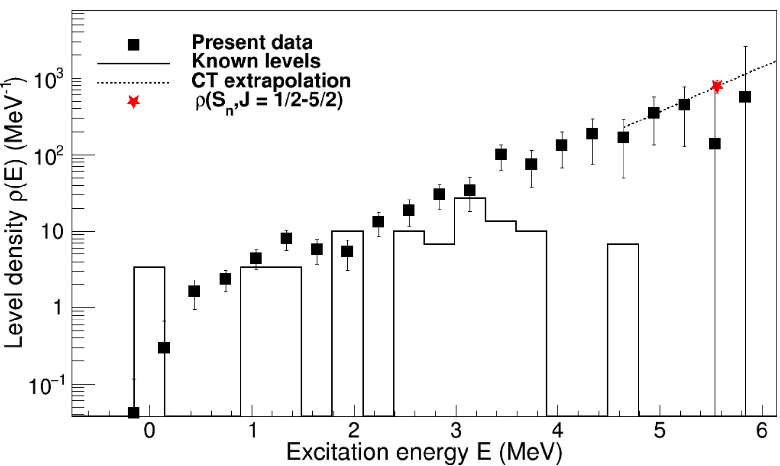
Extracted Partial NLD and γSF
Normalization points:
Low-lying discrete levels.
D0 (converted to partial NLD@S_{n})
Γ_{γ}
ρ(S_{n}= 1/2-5/2) = 787 /MeV
A. Sebastian et al. PRC - Submitted

Slide 11
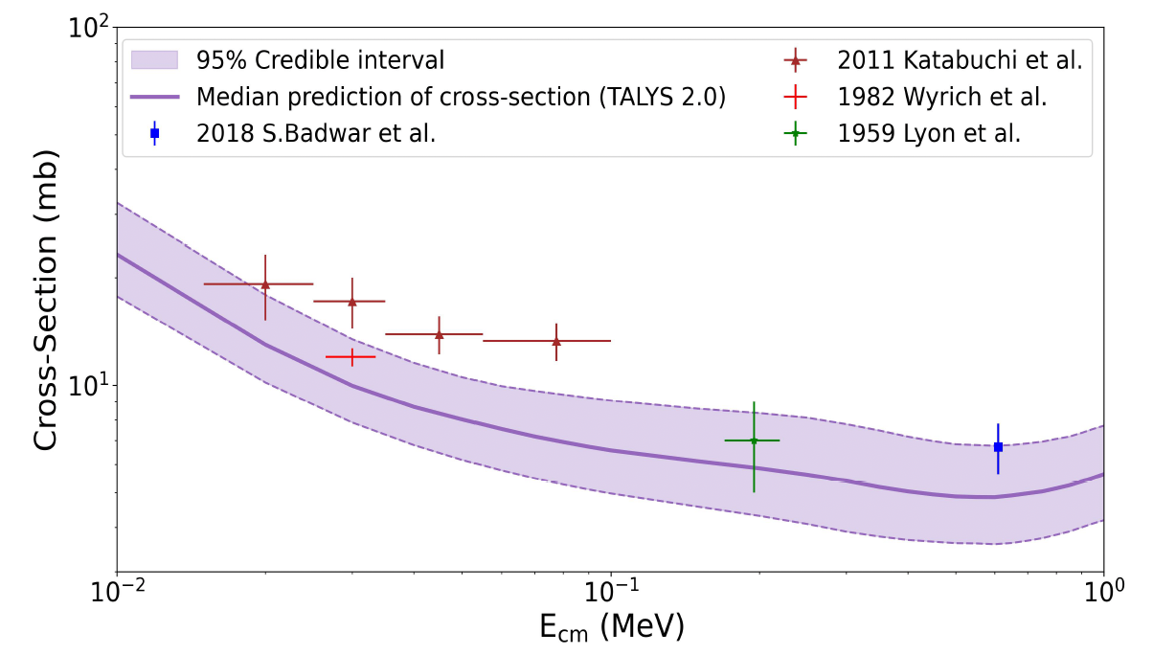
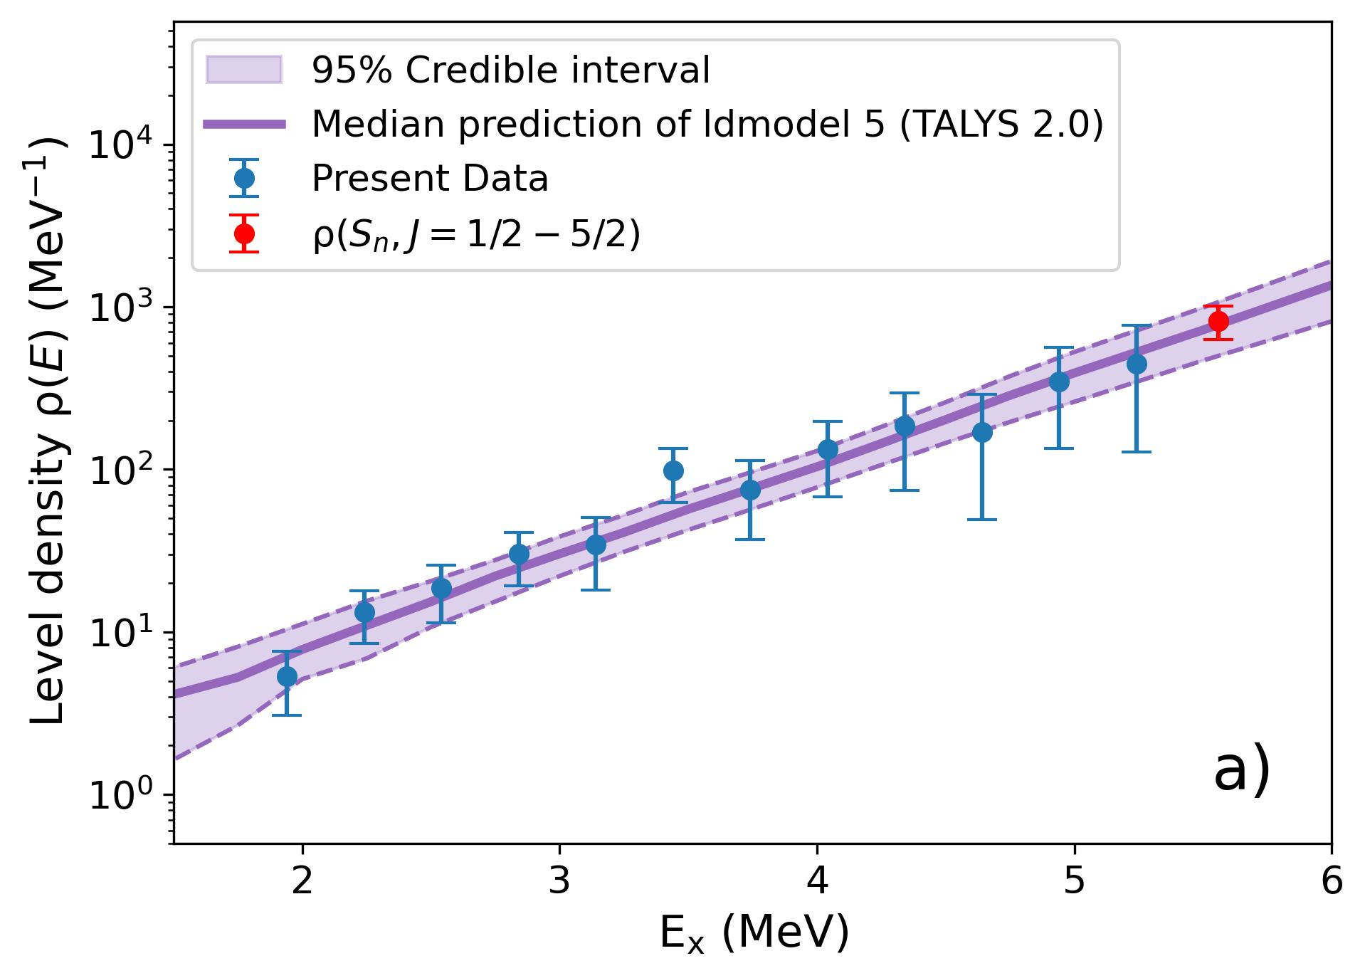
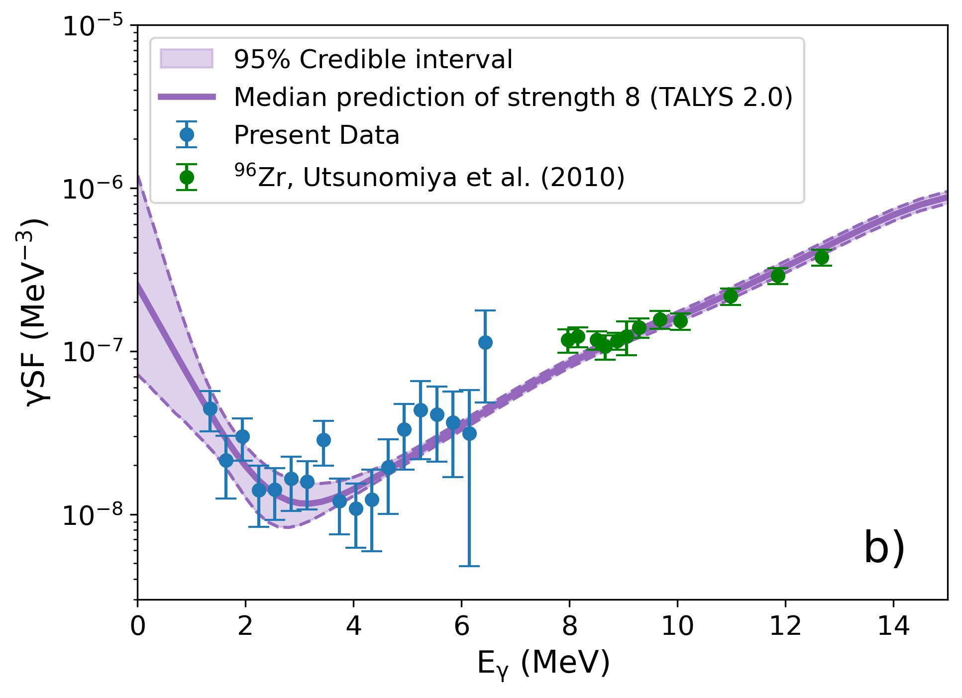
Bayesian Analysis to fit our data and input to TALYS
A Bayesian framework in combination with Metropolis–Hastings Markov Chain Monte Carlo(MCMC) algorithm was used to fit the experimental data
Extracted ⁹⁶Zr(n,γ)⁹⁷Zr reacvtion cross section in good agreement with direct measurements
A. Sebastian et al. PRC - Submitted

Slide 12
Existing measurements along the Zr isotopic chain
Guttormsen et al. PRC 96, 024313 (2017)
Pathirana et al. PRC 113, 015801 (2026)
⁹¹Zr
⁹³Zr
L. Bell – Submitted 2026
K. Malatji – Oslo 2026
⁹⁰Zr
T. Sitting – In preparation
⁹²Zr
⁹⁶Zr
90Zr
92Zr
94Zr
96Zr
98Zr
100Zr
0.092
0.10
0.088
0.06
0.06
0.347
⁹⁷Zr
A. Sebastian et al. PRC - Submitted

Slide 13
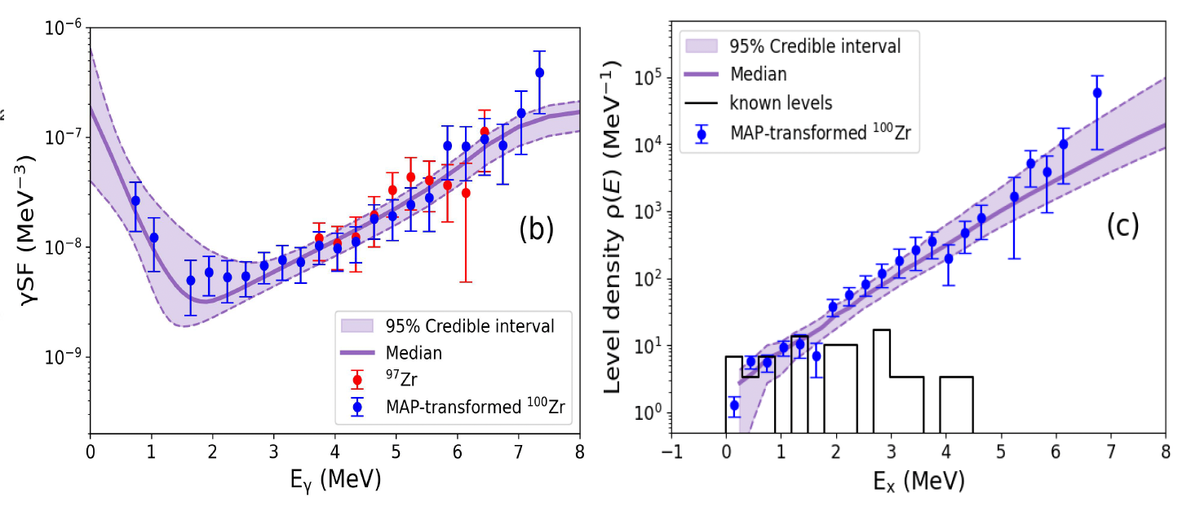
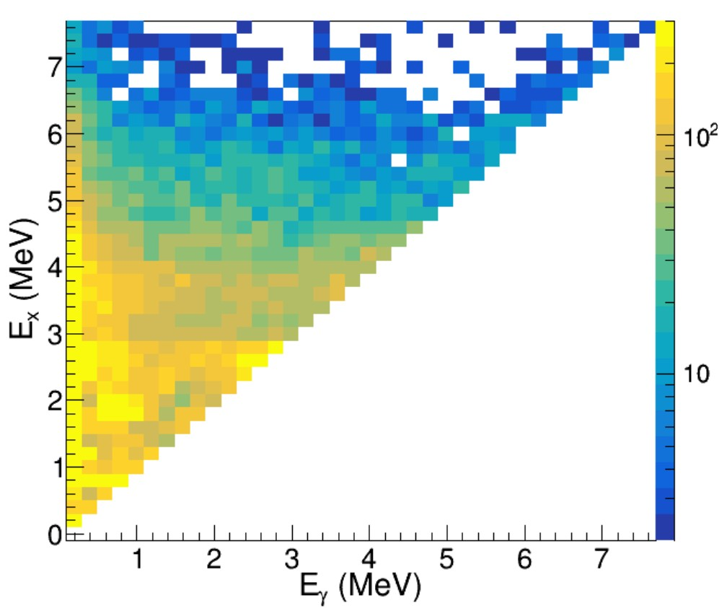
β-Oslo Method on ¹⁰⁰Zr
Raw matrix
¹⁰⁰Zr
β⁻
¹⁰⁰Y
Normalization points:
Low-lying discrete levels
γSF fixed to the ⁹⁷Zr slope at Eγ>3 MeV
  Note: slope consistent with other Zr isotopes
A. Sebastian et al. In Preparation

Slide 14
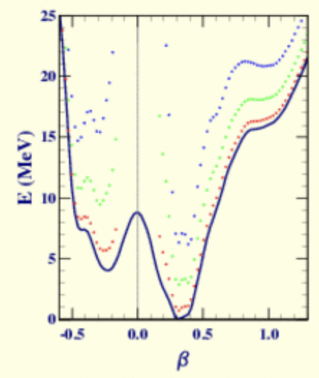
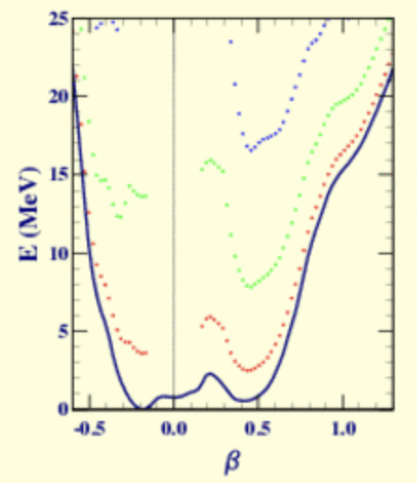
Interpretation: Shape Coexistence in ¹⁰⁰Zr
100Zr
0.347
151Nd
¹⁰⁰Zr
¹⁵¹Nd
0.314
S_{n}
S_{n}
Calculations by:
Stephane Goriely
Stephane Hilaire
Sophie Peru
A. Sebastian et al. In Preparation

Slide 15
Interpretation: Shape Coexistence in ¹⁰⁰Zr
100Zr
0.347
¹⁰⁰Zr
S_{n}
Calculations by:
Stephane Goriely
Stephane Hilaire
Sophie Peru
Goriely et al. Physics Letters B 868 (2025) 139677
A. Sebastian et al. In Preparation

Slide 16

Summary
By Alex Parsons, MSU
Summary
Summary
β-Oslo method applied to ^{97,100}Zr
The evolution of the low energy enhancement in the γSF is not a simple dependence on the ground state deformation.
Systematically investigate other nuclei with similar structures
Identify cases where we can investigate the excitation energy dependence of the upbend

Slide 17
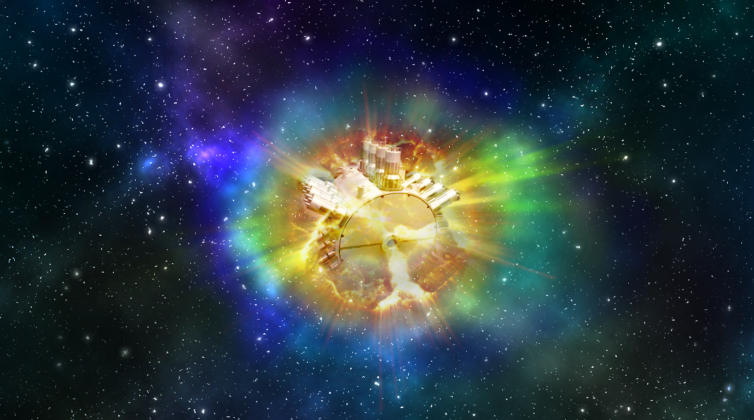











Collaboration
A.C. Larsen
M. Guttormsen
S.N. Liddick
A. Chester
A.C. Dombos
A. Hartley
P. Giuliani
M. Mogannam
T. Ogunbeku
Current SuN group
H. Berg
K. Bosmpotinis
S. Coil
C. Harris
H. Gadaria
J. Owens-Fryar
A. Sebastian
M. K. Smith
A. Tsantiri
S. Uthayakumaar
J. Clark
D. Santiago-Gonzalez
G. Savard
D. Muecher
  S. Lyons
  E. Good
A. Sweet
D. Bleuel
  M. Wiedeking
  A. Richard
S. Goriely
S. Hilaire
S. Peru
  P. DeYoung
  M. Wiedeking
C. Dembski
S. Lyons
E. Good

