Slide 1
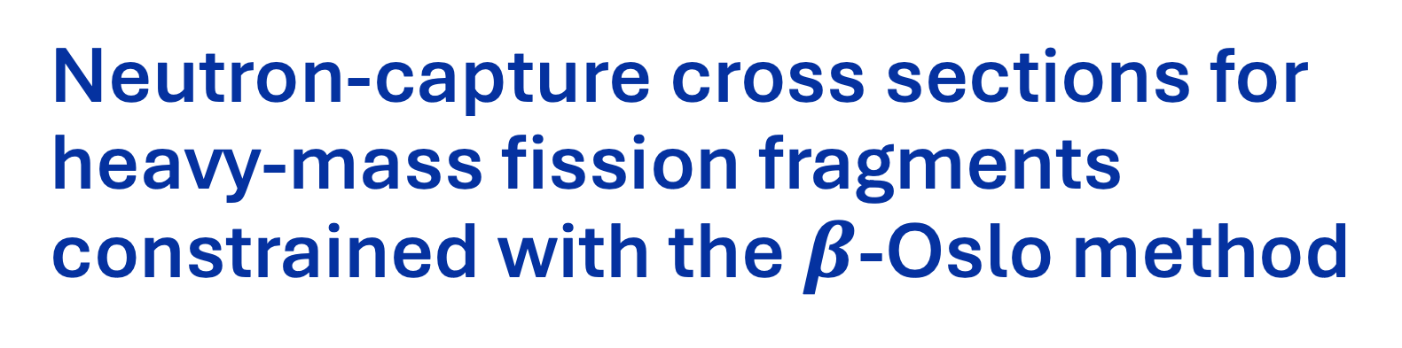
Neutron-capture cross sections for heavy-mass fission fragments constrained with the $β$-Oslo method
10th Workshop on Nuclear Level Density and Gamma Strength
May 18 to 22, 2026
Dr. Adriana Sweet | PLS/NACS

Slide 2
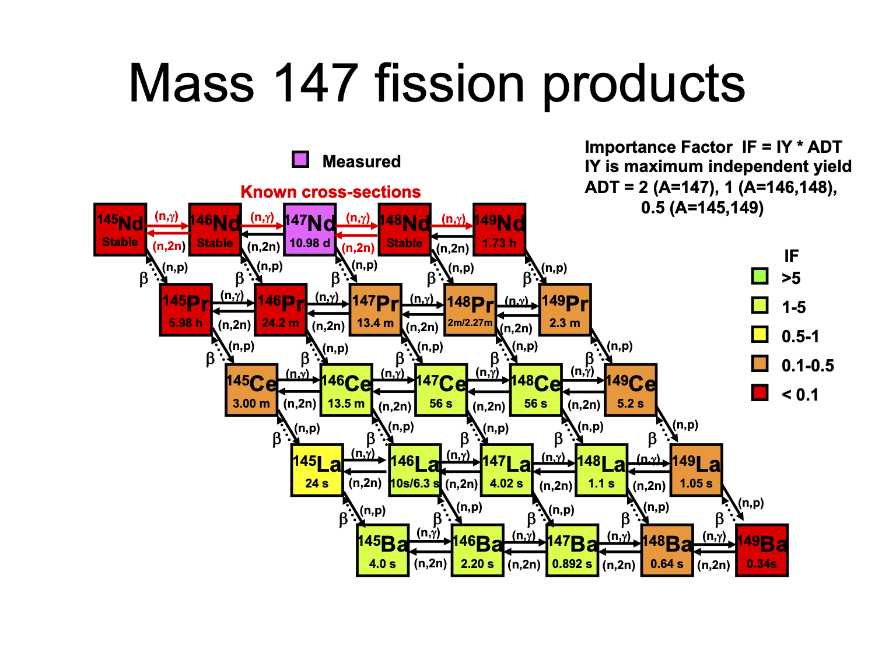
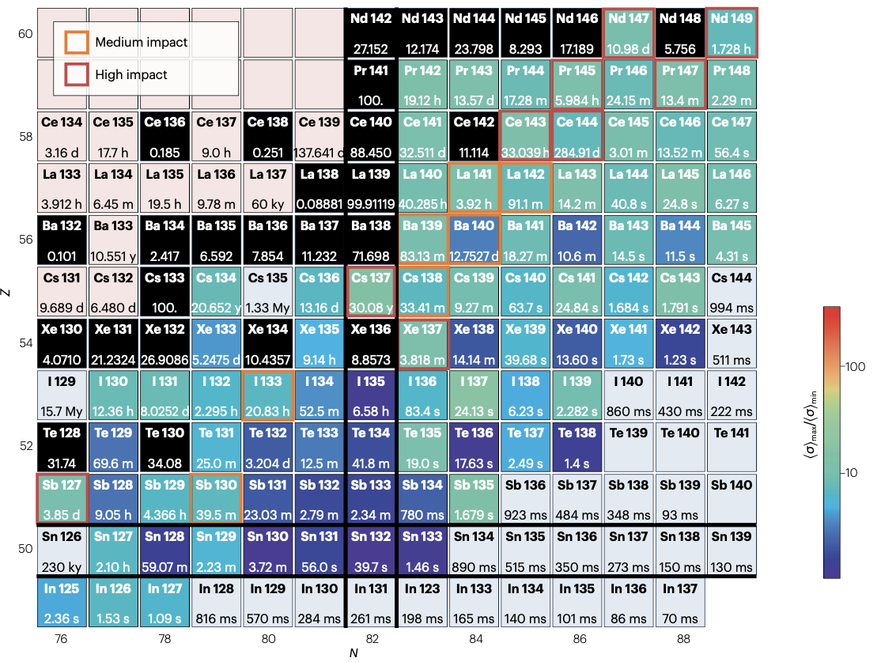
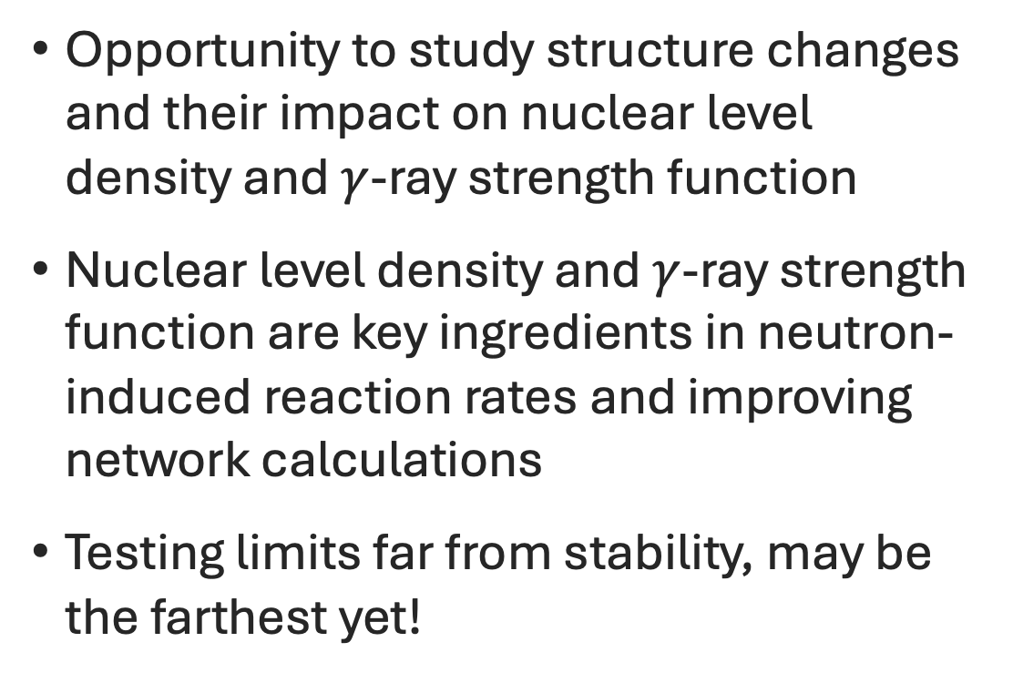
Shedding light on the structure of exotic nuclei: 9 nucleons from the last stable La
Opportunity to study structure changes and their impact on nuclear level density and $γ$-ray strength function
Nuclear level density and $γ$-ray strength function are key ingredients in neutron-induced reaction rates and improving network calculations
Testing limits far from stability, may be the farthest yet!
Neutron reaction rates relevant to the i-process
¹⁴⁷La
¹⁴⁸La
M.A. Stoyer, private communication reaction networks for A=147
M. Wiedeking, et al., Nat Rev Phy B7B, 696-712 (2025)
Notes:
Check how far we have gone in the past. Is 9 the most?
As an example, the reaction network in the vicinity of the A=147 mass
chain is presented in Fig. 2 [Car17, Sto22]. Our goal is to significantly reduce the capture reaction rate uncertainty with experimental data, and
thus, improve our capability to estimate how the decay pathways of fission products differ between laboratory
measurements and extreme neutron-rich environments important to security and astrophysical applications.

Slide 3
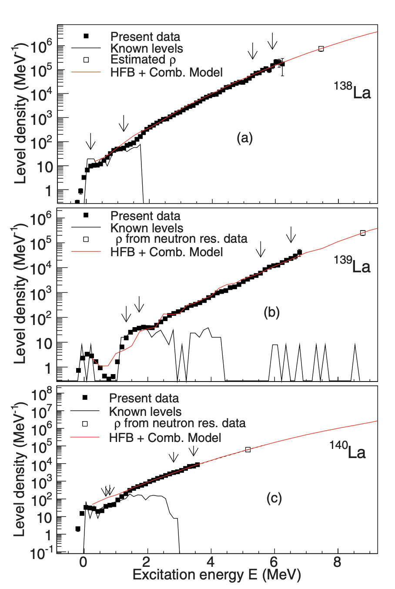
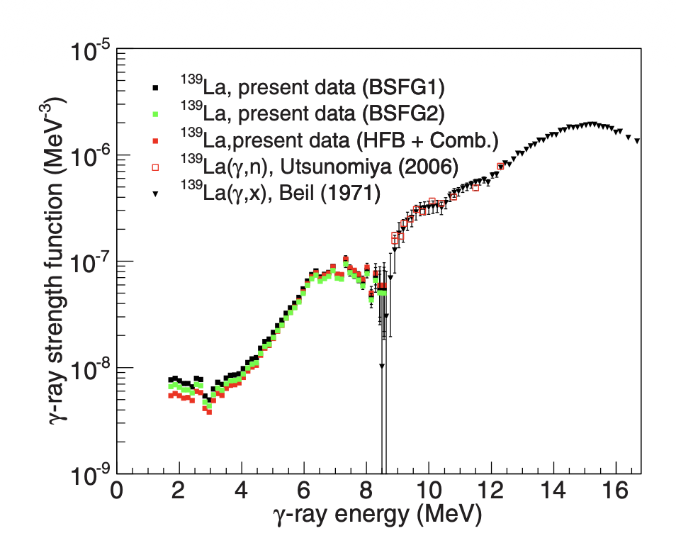
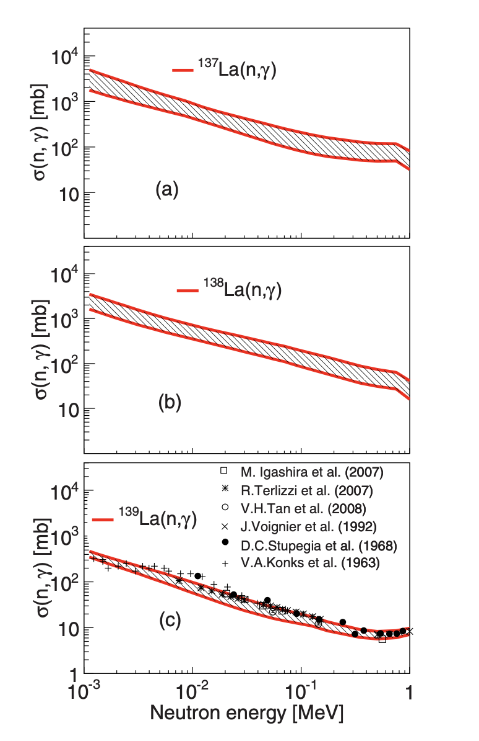
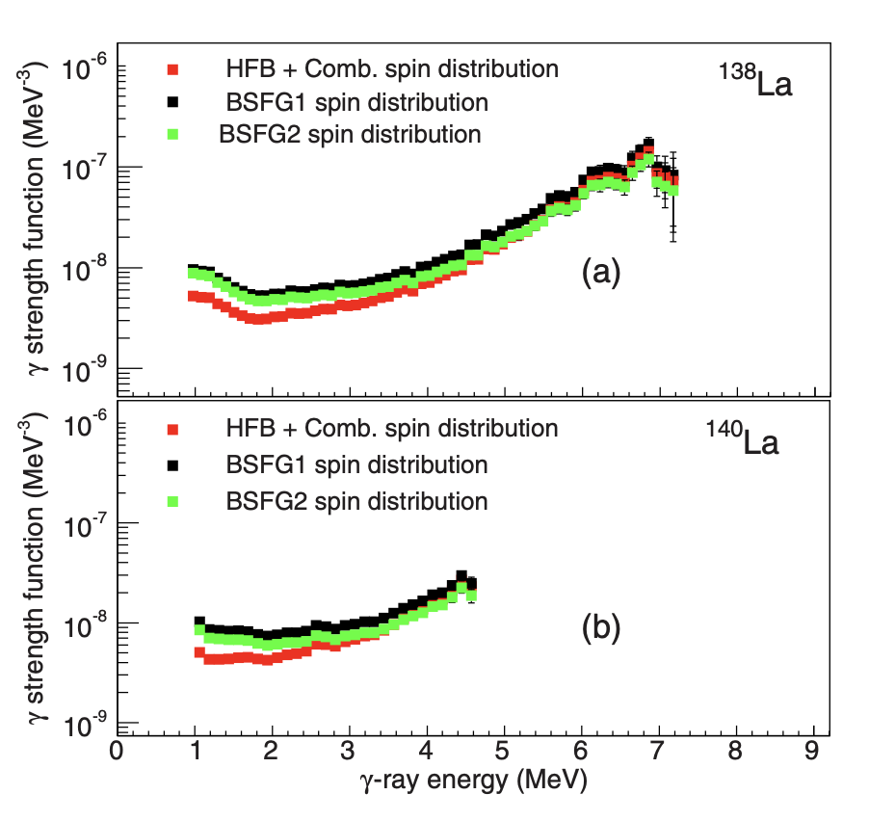
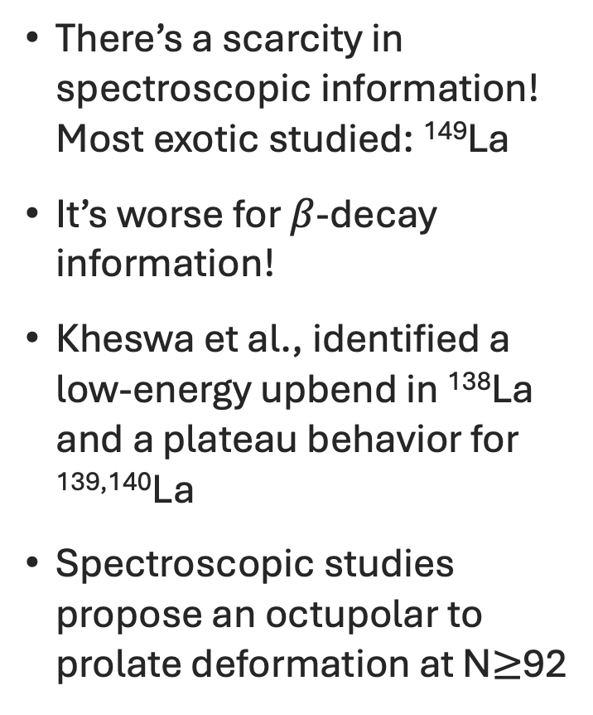
La isotopes were measured here in Oslo!
There’s a scarcity in spectroscopic information! Most exotic studied: ¹⁴⁹La
It’s worse for $β$-decay information!
Kheswa et al., identified a low-energy upbend in ¹³⁸La and a plateau behavior for ^{139,140}La
Spectroscopic studies propose an octupolar to prolate deformation at N$≥$92
B.V. Kheswa et al., Phys. Rev. C 95, 045805 (2017)
A. Jaries et al., Phys. Rev. Lett. 134, 042501 (2025)

Slide 4
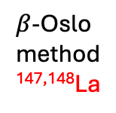


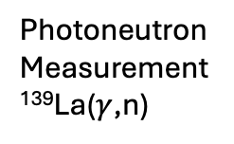
What do we know so far about the photon strength function for La isotopes?
Experimental $γ$-ray strength data for La
TENDL 2025 ($γ$, n) cross section for La
Photoneutron
Measurement
¹³⁹La($γ$,n)
Nuclear
Resonance
Fluorescence
¹³⁹La
Oslo
method
^{138,139,140}La
Upcoming
nuCARIBU
experiment
$β$-Oslo
method
^{147,148}La
B. V. Kheswa et al., Phys. Rev. C 95, 045805 (2017); A. Makinaga et al., Phys. Rev. C 82, 024314 (2010); L.B.Rice, L.N.Bolen, W.D.Whitehead, Phys. Rev. 134, B557, (1964); R.Bergere, R.Beil, A.Veyssiere, Nucl. Phys. A121, 463, (1968); H.Beil, R.Bergere, P.Carlos, A.Lepretre, A.Veyssiere, A. Parlag, Nucl. Phys. A172, 426, (1971); T.K.Deague, R.J.J.Stewart, Nucl.Phys. A191, 305, (1972); H.Utsunomiya,A.Makinaga,S.Goko,T.Kaihori,H.Akimune, et al., J,PR/C, 74, 025806, (2006); T.Kawano, Y.S.Cho, P.Dimitriou, et al., J,NDS,163,109,(2020); TENDL-2025

Slide 5
What do we know so far about the photon strength function for La isotopes?
Experimental $γ$-ray strength data for La
TENDL 2025 ($γ$, n) cross section for La
Photoneutron
Measurement
¹³⁹La($γ$,n)
Nuclear
Resonance
Fluorescence
Oslo
Method
^{138,139,140}La
Upcoming
nuCARIBU
experiment
¹³⁹La
B. V. Kheswa et al., Phys. Rev. C 95, 045805 (2017); A. Makinaga et al., Phys. Rev. C 82, 024314 (2010); L.B.Rice, L.N.Bolen, W.D.Whitehead, Phys. Rev. 134, B557, (1964); R.Bergere, R.Beil, A.Veyssiere, Nucl. Phys. A121, 463, (1968); H.Beil, R.Bergere, P.Carlos, A.Lepretre, A.Veyssiere, A. Parlag, Nucl. Phys. A172, 426, (1971); T.K.Deague, R.J.J.Stewart, Nucl.Phys. A191, 305, (1972); H.Utsunomiya,A.Makinaga,S.Goko,T.Kaihori,H.Akimune, et al., J,PR/C, 74, 025806, (2006); T.Kawano, Y.S.Cho, P.Dimitriou, et al., J,NDS,163,109,(2020); TENDL-2025

Slide 6
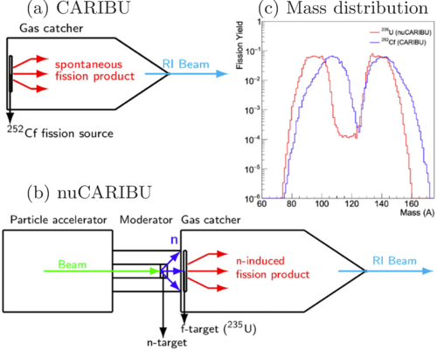
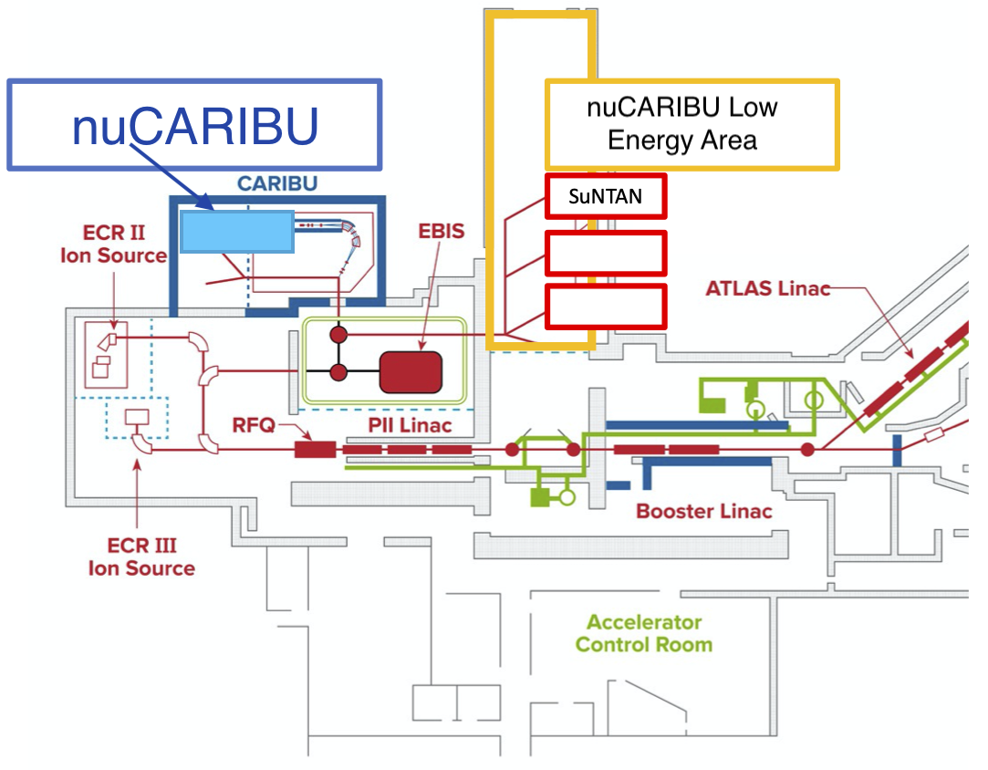
What’s new at ATLAS/nuCARIBU facility?
DOE nuclear physics national user facility
Neutron induced fissions on ²³⁵U
Neutrons generated by ⁷Li(p,n)⁷Be
Shift fission fragment spectrum with gains in A<100 & 120<A<150
First low-energy radioactive beam extracted last summer & scheduling experiments in progress
^{147,148}Ba beam experiment expected to run by end of year 🤞
nuCARIBU facility schematic by Guy Savard
J. Song G. Savard, J. Greene, and J. A. Nolen, Phys. Rev. C. 109, 024605 (2024)

Slide 7
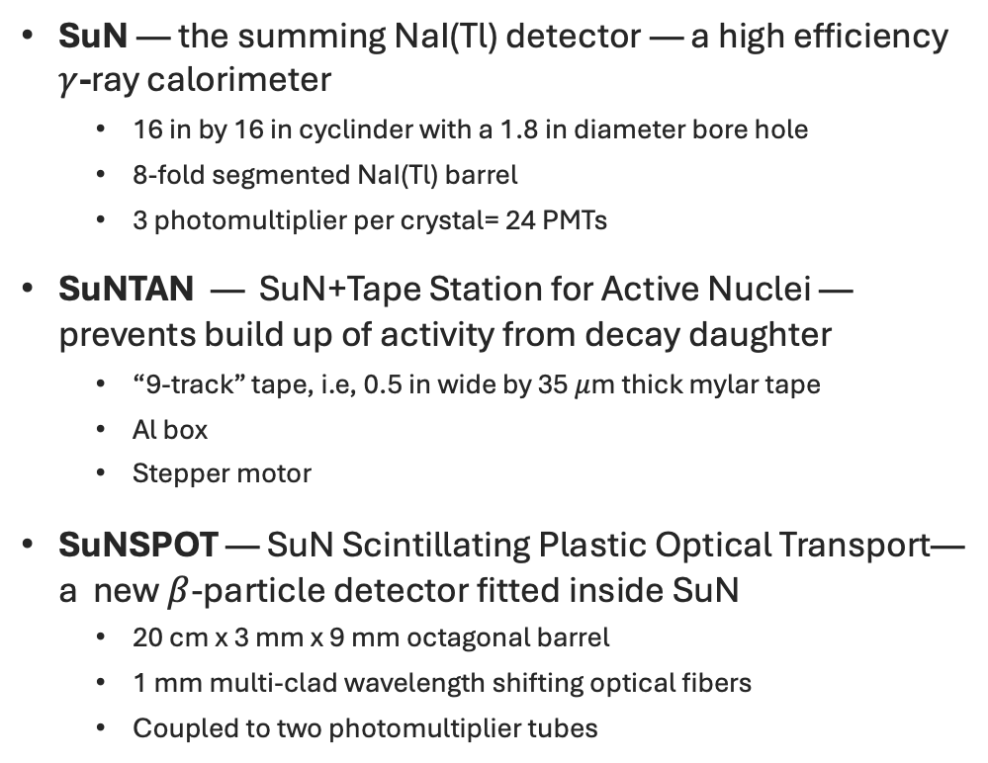
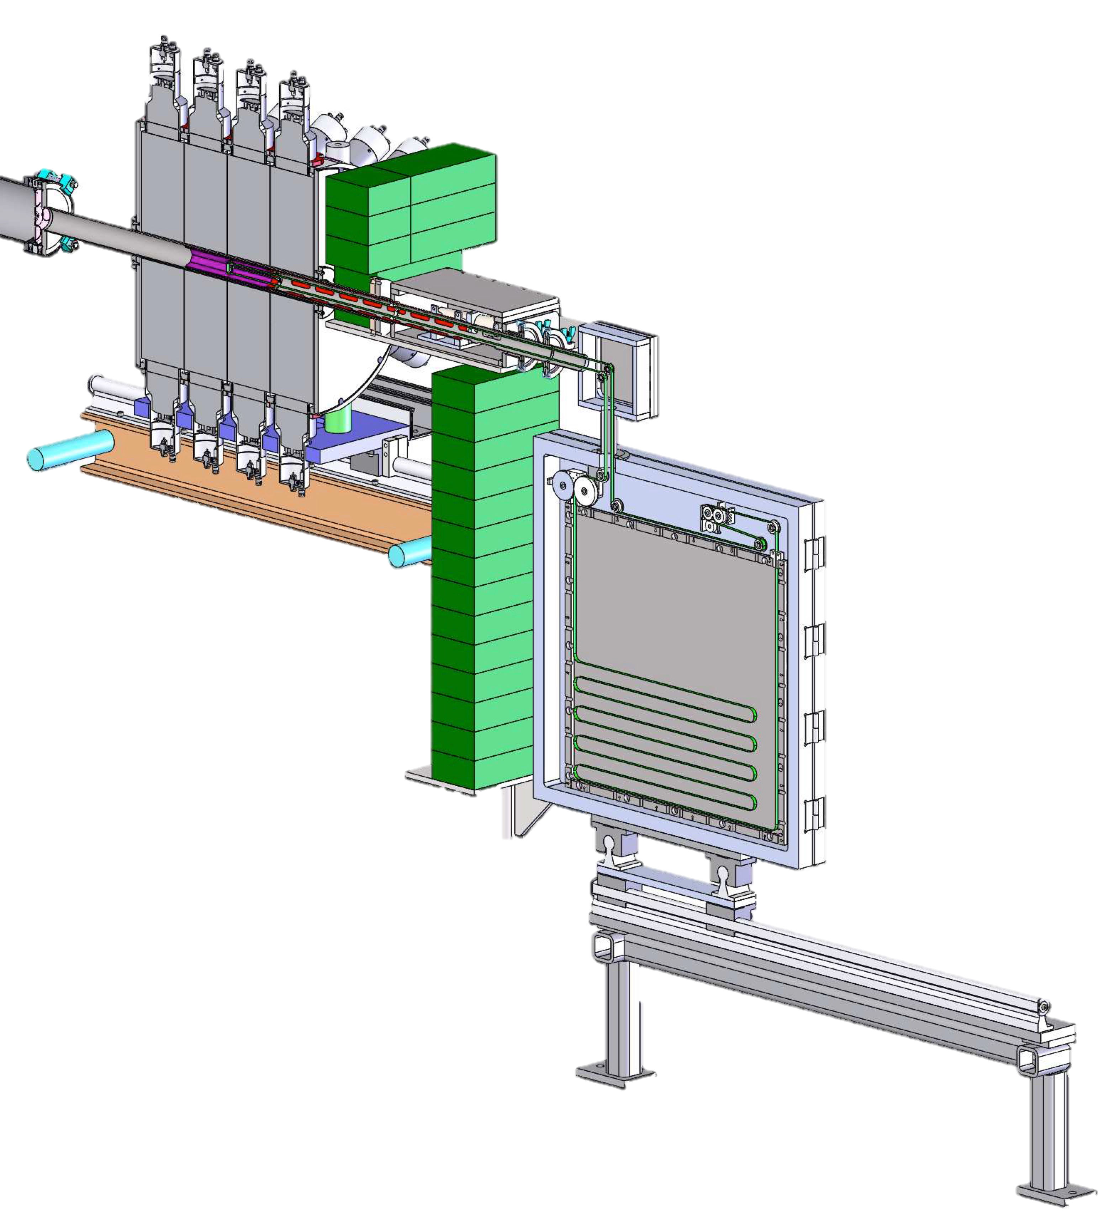


Experimental setup at nuCARIBU
SuN — the summing NaI(Tl) detector — a high efficiency $γ$-ray calorimeter
16 in by 16 in cyclinder with a 1.8 in diameter bore hole
8-fold segmented NaI(Tl) barrel
3 photomultiplier per crystal= 24 PMTs
SuNTAN — SuN+Tape Station for Active Nuclei — prevents build up of activity from decay daughter
“9-track” tape, i.e, 0.5 in wide by 35 $μ$m thick mylar tape
Al box
Stepper motor
SuNSPOT — SuN Scintillating Plastic Optical Transport— a new $β$-particle detector fitted inside SuN
20 cm x 3 mm x 9 mm octagonal barrel
1 mm multi-clad wavelength shifting optical fibers
Coupled to two photomultiplier tubes
⁹⁵Rb beam
$$β$$
$$γ$$
A. Simon, S. J. Quinn, A. S., et al., Nucl. Instr. Meth A 703 16 (2013)
C. M. Harris, et al., Nucl. Instr. Meth A 1084 (2026)
E. K. Ronning, et al., Nucl. Instr. Meth A 1082 (2026)

Slide 8

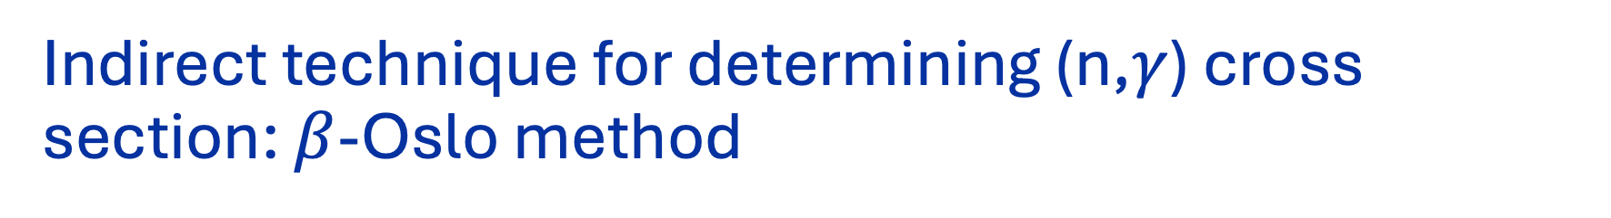

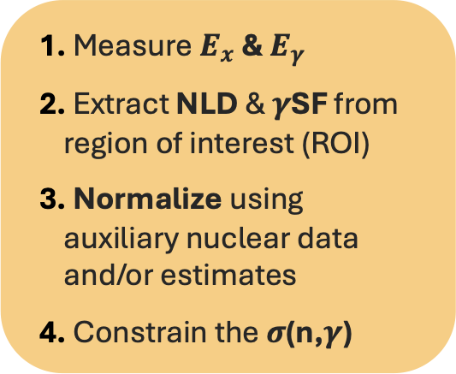




Indirect technique for determining (n,$γ$) cross section: $β$-Oslo method
Q$β$= 6.414 MeV
S_{n}= 5.336 MeV
¹⁴⁷Ce
¹⁴⁷Ba
S_{n}
$$β$$
$β$-Oslo Method assumes:
¹⁴⁶La
¹⁴⁷La
$$P\left(E_{x},E_{γ}\right)∝ ρ\left(E_{x}−E_{γ}\right) 𝒯(E_{γ})$$
E$x1$
Measure $E_{x}$ & $E_{γ}$
Extract NLD & $γ$SF from region of interest (ROI)
Normalize using auxiliary nuclear data and/or estimates
Constrain the $σ$(n,$γ$)
¹⁴⁷Ba
¹⁴⁸Ce
E$x2$
¹⁴⁷La
¹⁴⁸La
¹⁴⁷La
¹⁴⁸Ba
(First gen.) M. Guttormsen et al., NIM A 255, 518 (1987)
(Unfolding) M. Guttormsen et al., NIM A 374, 371 (1996)
ENDF https://nds.iaea.org/exfor/endf.htm
TENDL-astro https://www.astro.ulb.ac.be/tendl-astro.html;
Rochman et al., Nuc. Phys A 1053, 122951 (2025)
(Extract NLD&PSF) Schiller et al., NIM A 447, 498 (2000)
(bOM) Spyrou et al., Phys. Rev. Lett. 113, 232502 (2014)

Slide 9
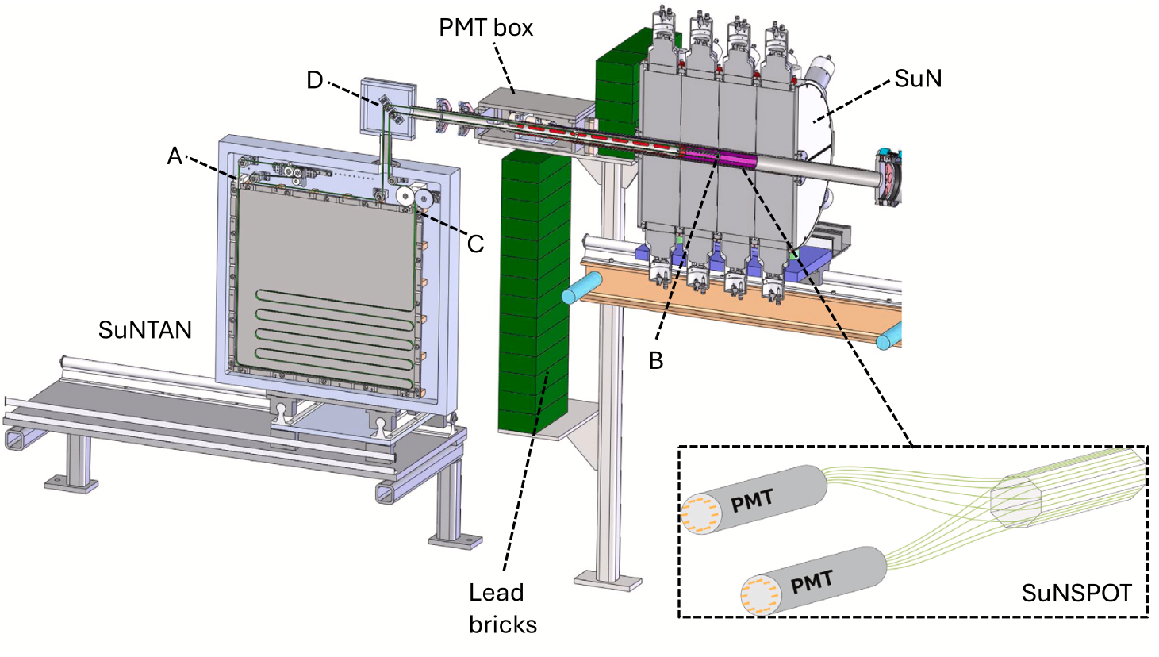
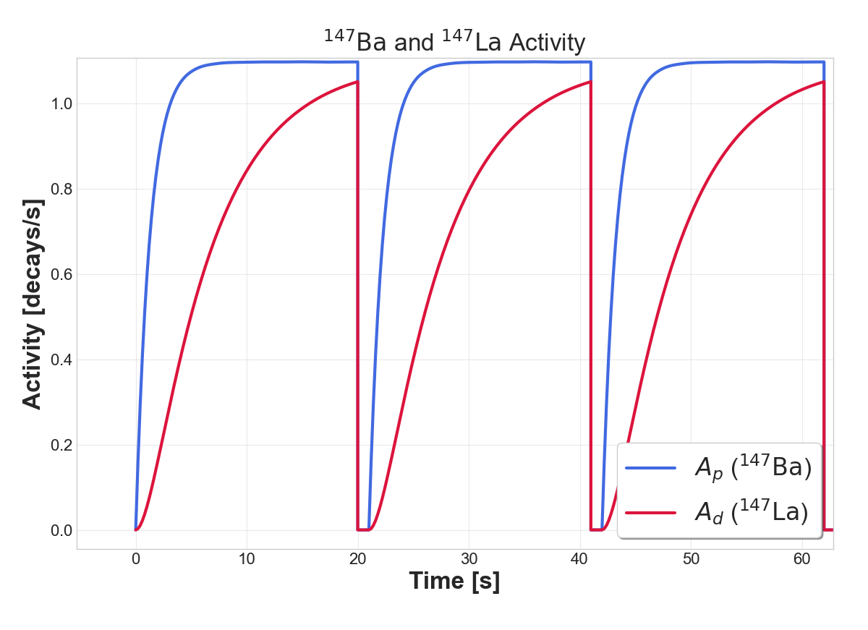
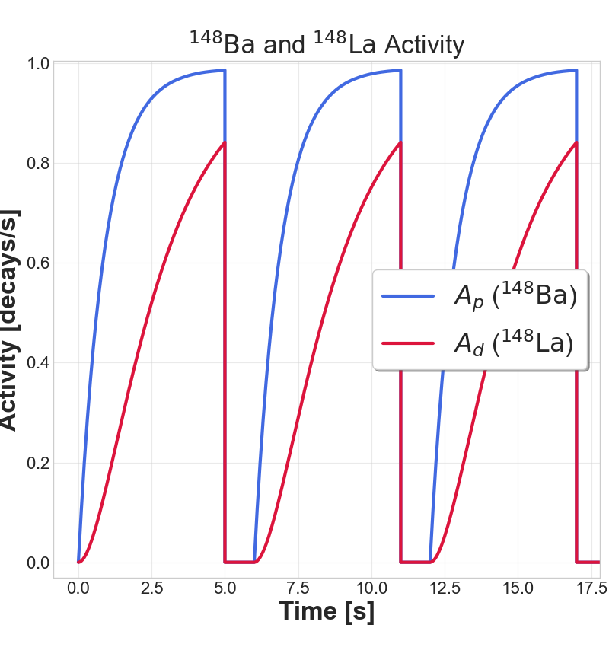

Radioactive beams of ¹⁴⁷Ba and ¹⁴⁸Ba
t_{1/2}= 56 s
t_{1/2}= 57 s
¹⁴⁷Ce
¹⁴⁸Ce
¹⁴⁶La
¹⁴⁷La
t_{1/2}= 4 s
¹⁴⁷La
¹⁴⁸La
t_{1/2}= 1.411 s
t_{1/2}= 0.894 s
t_{1/2}= 0.619 s
¹⁴⁷Ba
¹⁴⁸Ba
UC Berkeley, Undergraduate Nathan Alejandria
Activity [decays/s]
Activity [decays/s]
Time [s]
Time [s]
Notes:
More than ever need to characterize the beta decay

Slide 10




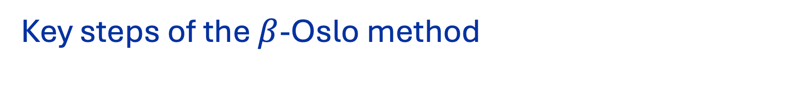
Key steps of the $β$-Oslo method
First generation $γ$ rays
First generation 𝛾 rays
Unfold the raw measurement
Isolate the first $γ$ ray emitted from each excited state
Isolate the first 𝛾 ray emitted from each excited state
Nuclear level density (NLD) and $γ$-ray strength function ($γ$SF)
Nuclear level density (NLD) and 𝛾-ray strength function (𝛾SF)
Normalize NLD and $γ$SF
Normalize NLD and 𝛾SF
Anchor NLD to discrete levels at low energy & to estimate total level density at the neutron separation energy
Adjust for $β$-decay populated states
Adjust for 𝜷-decay populated states
Measure $γ−β$ coincidence with TAS detector
Measure 𝛾−𝛽 coincidence with TAS detector
Develop decay specific detector response function
Scale $γ$SF to estimated average total radiative width
Scale 𝛾SF to estimated average total radiative width
First generation $γ$ rays represent the probability to decay from an initial E_{i} to final E_{f} by emitting a $γ$ with energy E$γ$
First generation 𝛾 rays represent the probability to decay from an initial E_{i} to final E_{f} by emitting a 𝛾 with energy E_{𝛾}
Hypothetical ¹⁴⁷La
¹⁴⁷La
t_{1/2}= 4 s
UC Berkeley, Undergraduate Nathan Alejandria
S_{n}= 5.336 MeV
$J_{allowed}^{π}$=3/2-, 5/2-, 7/2-
Excitation Energy (keV)
Generated
with RAINIER
¹⁴⁷Ba
t_{1/2}= 0.894 s
Q$β$= 6.414 MeV
$J^{π}$=5/2-
Primary
$γ$-ray Energy (keV)
(Extract NLD&PSF) Schiller et al., NIM A 447, 498 (2000)
(bOM) Spyrou et al., Phys. Rev. Lett. 113, 232502 (2014)
(RAINIER) L.E.Kirsch, L.A.Bernstein. NIM A. 892 (2018)
(First gen.) M. Guttormsen et al., NIM A 255, 518 (1987)
(Unfolding) M. Guttormsen et al., NIM A 374, 371 (1996)

Slide 11
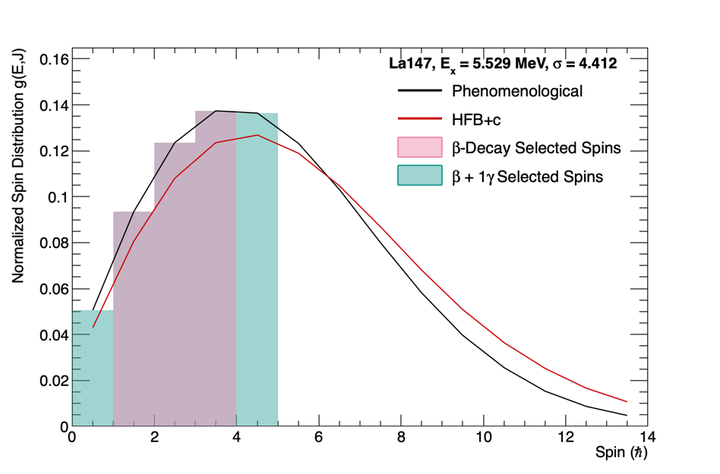
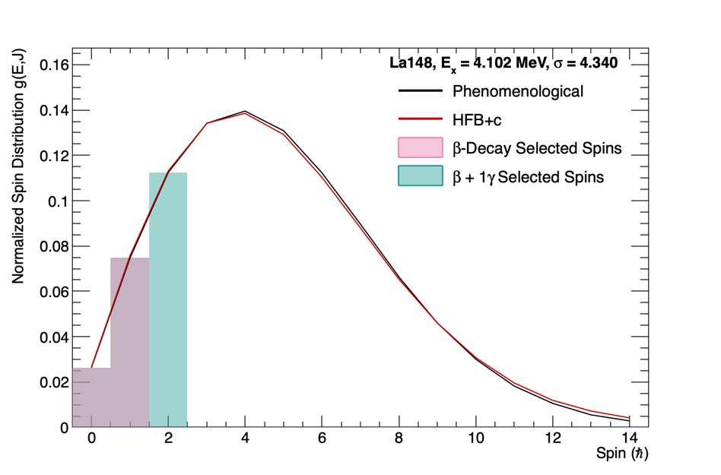
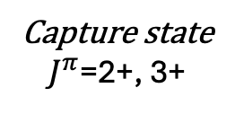

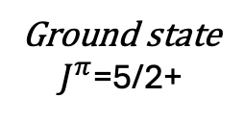
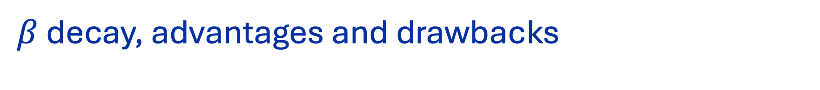
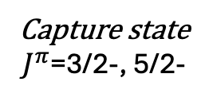
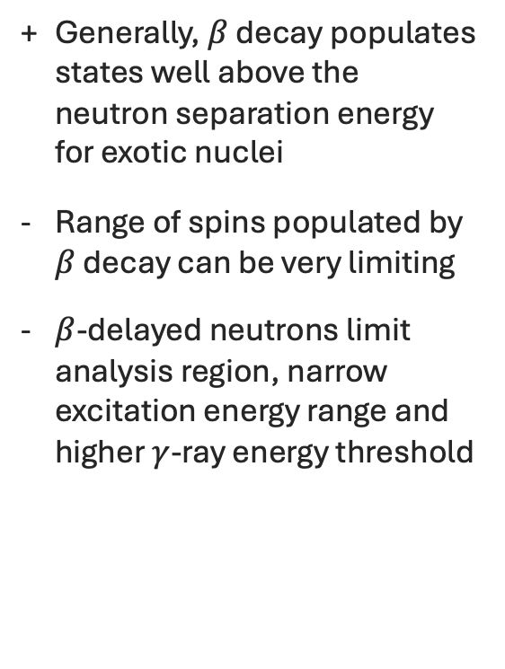
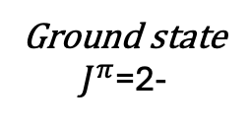
$β$ decay, advantages and drawbacks
$β$ decay
s-wave neutron capture
Generally, $β$ decay populates states well above the neutron separation energy for exotic nuclei
Range of spins populated by $β$ decay can be very limiting
$β$-delayed neutrons limit analysis region, narrow excitation energy range and higher $γ$-ray energy threshold
¹⁴⁶La
¹⁴⁷La
Ground state
$J^{π}$=2-
Capture state
$J^{π}$=3/2-, 5/2-
¹⁴⁷La
¹⁴⁸La
Ground state
$J^{π}$=5/2+
Capture state
$J^{π}$=2+, 3+
Notes:
Make only 2 spin distribution plots showing the black, red and bars
Fabio’s paper

Slide 12
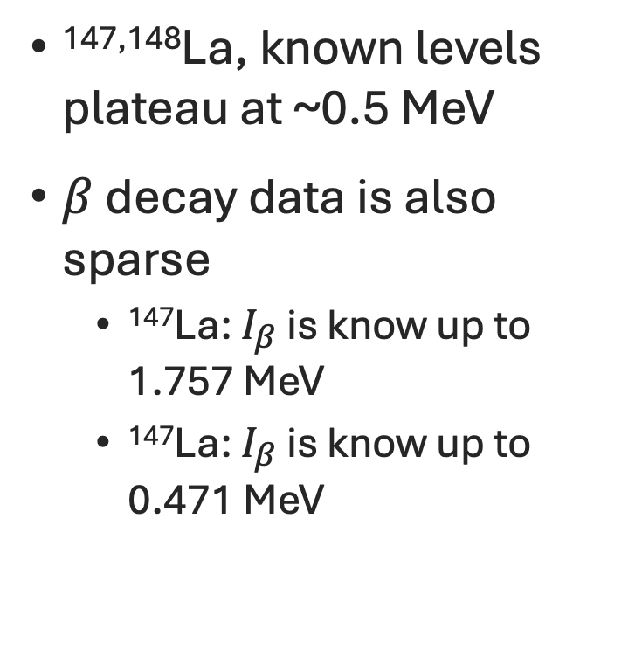
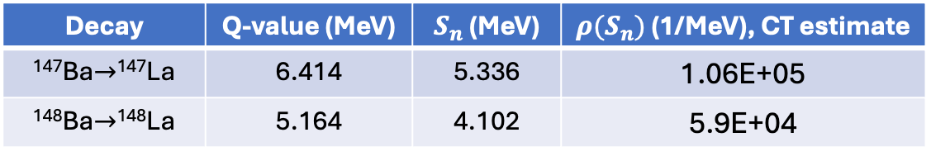
Challenges ahead for extracting the nuclear level density
Decay | Q-value (MeV) | $S_{n}$(MeV) | $ρ(S_{n})$ (1/MeV), CT estimate
¹⁴⁷Ba$→$¹⁴⁷La | 6.414 | 5.336 | 1.06E+05
¹⁴⁸Ba$→$¹⁴⁸La | 5.164 | 4.102 | 5.9E+04
^{147,148}La, known levels plateau at ~0.5 MeV
$β$ decay data is also sparse
¹⁴⁷La: $I_{β}$ is know up to 1.757 MeV
¹⁴⁷La: $I_{β}$ is know up to 0.471 MeV
Even-A La
Odd-A La
¹⁴⁰La, Oslo method
¹³⁹La, Oslo method
Know levels
Know levels
B. V. Kheswa et al., Phys. Rev. C 95, 045805 (2017)
Notes:
147La complete 31 0.620100
148La 24 0.500220

Slide 13
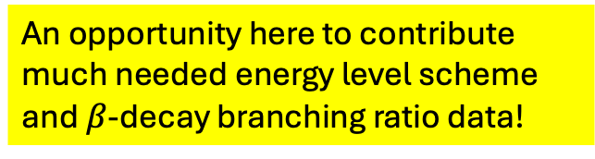
Challenges ahead for extracting the nuclear level density
Decay | Q-value (MeV) | $S_{n}$(MeV) | $ρ(S_{n})$ (1/MeV), CT estimate
¹⁴⁷Ba$→$¹⁴⁷La | 6.414 | 5.336 | 1.06E+05
¹⁴⁸Ba$→$¹⁴⁸La | 5.164 | 4.102 | 5.9E+04
^{147,148}La, known levels plateau at ~0.5 MeV
$β$ decay data is also sparse
¹⁴⁷La: $I_{β}$ is know up to 1.757 MeV
¹⁴⁷La: $I_{β}$ is know up to 0.471 MeV
Even-A La
Odd-A La
¹⁴⁰La, Oslo method
¹³⁹La, Oslo method
¹⁴⁸La
Known levels
¹⁴⁷La
Known levels
An opportunity here to contribute much needed energy level scheme and $β$-decay branching ratio data!
B. V. Kheswa et al., Phys. Rev. C 95, 045805 (2017)
Notes:
147La complete 31 0.620100
148La 24 0.500220

Slide 14
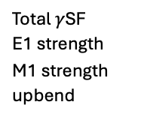
Experiment preparation using synthetic data generated with RAINIER
Hypothetical ¹⁴⁷La
Hypothetical ¹⁴⁷La
PRELIMINARY
PRELIMINARY
Total NLD
Reduced NLD
Total NLD
Reduced NLD
Input NLD
Total $γ$SF
E1 strength
M1 strength
upbend
Model combinations and restricted spin-ranges will be used to quantify systematic unertainty.

Slide 15
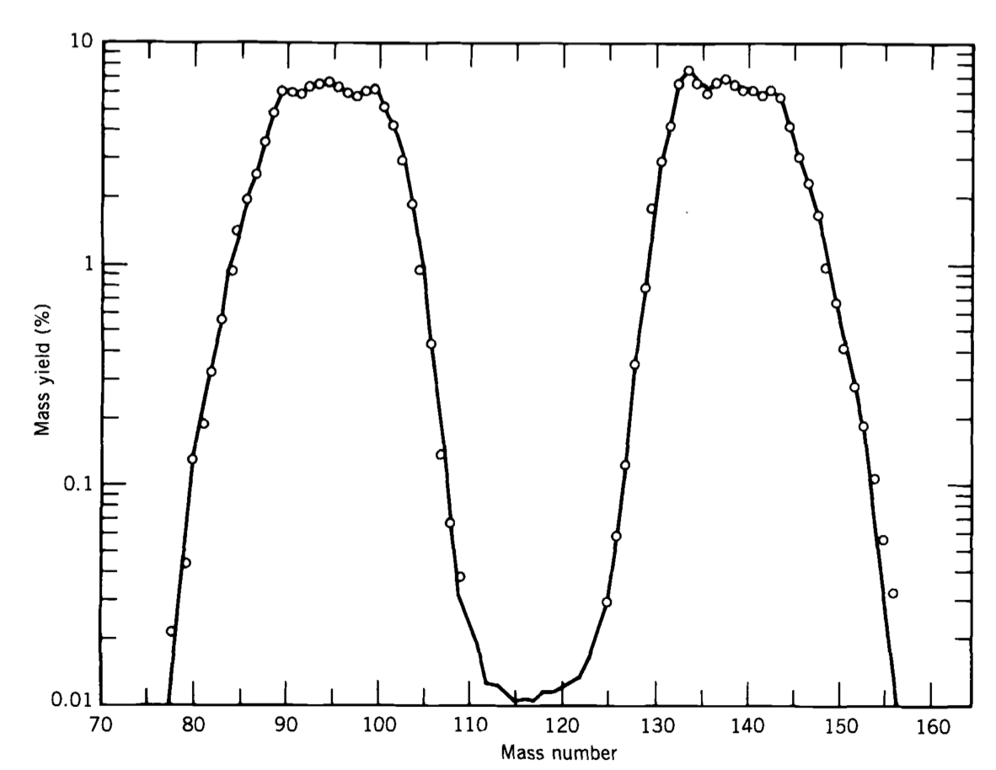
Sr
La
Switching gears
Krane, K.S. (1988) Introductory Nuclear Physics. Wiley John & Sons, New York.

Slide 16
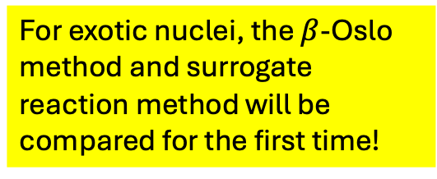
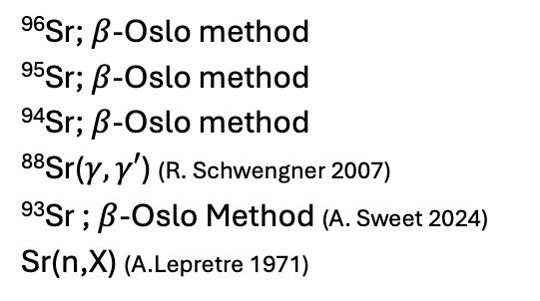
Back to the lighter side of the fission fragment curve
PRELIMINARY
⁹⁴Sr
⁹⁵Sr
⁹⁶Sr; $β$-Oslo method
⁹⁵Sr; $β$-Oslo method
⁹⁴Sr; $β$-Oslo method
⁸⁸Sr($γ,γ′$) (R. Schwengner 2007)
⁹³Sr ; $β$-Oslo Method (A. Sweet 2024)
Sr(n,X) (A.Lepretre 1971)
PRELIMINARY
⁹⁶Sr
For exotic nuclei, the $β$-Oslo method and surrogate reaction method will be compared for the first time!
See Prof. Andrea Richard’s talk tomorrow!

Slide 17


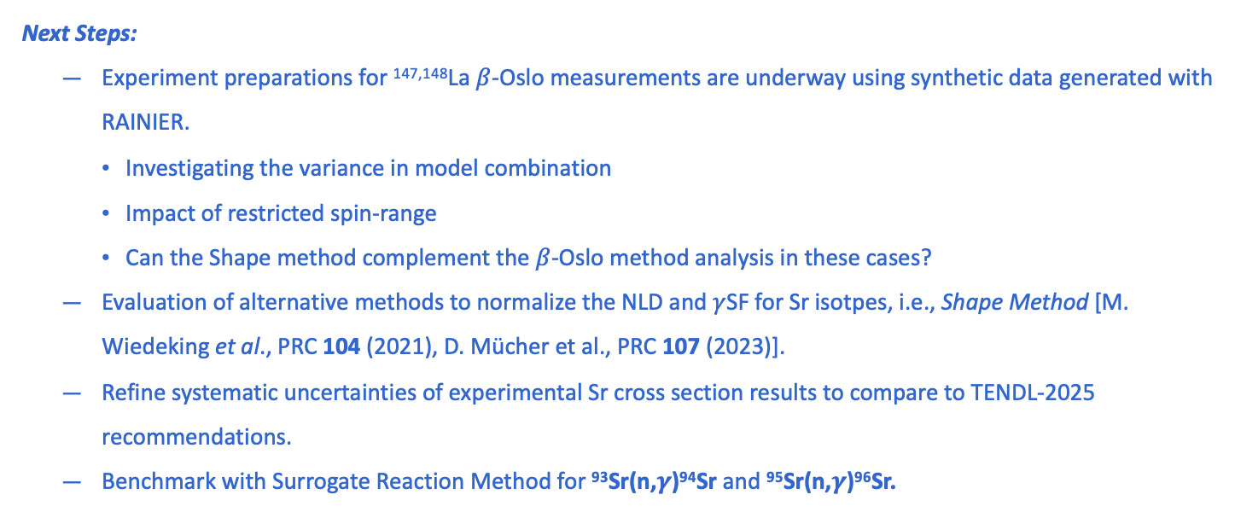
Summary and Outlook
La isotopes are needed to improve reaction network calculations.
La isotopes are an interesting case due to possible octupole correlations.
A decrease in E1 strength enhancement with increasing N
Chance to investigate near expected structure change at N = 92
Spectroscopy data is sparse! An opportunity to contribute much needed $β$-decay data.
Next Steps:
Experiment preparations for ^{147,148}La $β$-Oslo measurements are underway using synthetic data generated with RAINIER.
Investigating the variance in model combination
Impact of restricted spin-range
Can the Shape method complement the $β$-Oslo method analysis in these cases?
Evaluation of alternative methods to normalize the NLD and $γ$SF for Sr isotpes, i.e., Shape Method [M. Wiedeking et al., PRC 104 (2021), D. Mücher et al., PRC 107 (2023)].
Refine systematic uncertainties of experimental Sr cross section results to compare to TENDL-2025 recommendations.
Benchmark with Surrogate Reaction Method for ⁹³Sr(n,$γ$)⁹⁴Sr and ⁹⁵Sr(n,$γ$)⁹⁶Sr.
Hypothetical ¹⁴⁷La
Excitation Energy (keV)
Generated
with RAINIER
Primary
$γ$-ray Energy (keV)

Slide 18









Thanks to
Lawrence Livermore National Laboratory
D. L. Bleuel (co-PI), N. D. Scielzo
Lawrence Berkeley National Laboratory
L. A. Bernstein, M. Wiedeking
UC Berkeley
N. Alejandria, B. L. Goldblum, T. A. Laplace, J. Vujic
Michigan State University/Facility for Rare Isotope Beams
H. C. Berg, A. Chester, E. C. Good, C. M. Harris, A. Hartly, S. N. Liddick, M. J. Mogannam, T. H. Ogunbeku,
G. J. Owens-Fryar, M. K. Smith, A. Spyrou, A. Tsantiri
Ohio University
A. L. Richard
University of Cologne
D. Mücher
Pacific Northwest National Laboratory
S. M. Lyons
Argonne National Laboratory
J. Clark, G. Savard, D. Santiago-Gonzalez
University of Oslo
A. C. Larsen, M. Guttormsen
Acknowledgment
This work was performed under the auspices of the U.S. Department of Energy by Lawrence Livermore National Laboratory under Contract DE-AC52-07NA27344.

