Slide 1
Testing of level density models with new data from particle evaporation technique
A. V. Voinov
Department of Physics and Astronomy, Ohio University
Plan for the talk
Most popular level density models
Problems with current experimental data to constrain models
Particle evaporation technique and its advantage and limitations
Test of level density models against particle evaporation data for
^{92,94,96}Nb isotopes
01
A.V. Voinov, 10th Workshop on Level Density and Gamma Strength, May 2026

Slide 2
MODEL LANDSCAPE
TALYS 2.2 recommends empirical and microscopic level-density prescriptions
Talys keywords
ldmodel 1
Gilbert-Cameron
Composite constant-temperature plus Fermi-gas description
Phenomenological
models
ldmodel 2
Fermi-gas model
Fermi-gas model with an energy dependent parameter
ldmodel 5
HFB combinatorial
Microscopic Skyrme-Hartree-Fock-Bogolyubov tables from S. Goriely et al., Phys. Rev. C 78 (2008).
Microscopical models
ldmodel 7
BSKG3 triaxial HFB
Updated triaxial combinatorial tables from S. Goriely et al., Phys. Rev. C 113, 014320 (2026).
03
A.V. Voinov, 10th Workshop on Level Density and Gamma Strength, May 2026

Slide 3
LD models background
Both phenomenological (GG and FG) and microscopical models
use neutron resonance spacings (D₀) to constrain parameters
Main uncertainties for model predictions are due to the small fraction of levels associated
with D₀ (about 10-20% of all levels at S_{n}) , and very limited ranges of spins and excitation energy
Shape of LD model function ρ(E)
Spin distribution at S_{n} (spin cutoff factor),
parity distribution
Are neutron resonance spacings data accurate ?
potential problem: systematics uncertainties, related missing
resonances, distinguishing between s and p wave resonances
etc. RIPL-3 and Mughabhab compilations often give different
results
Data in broader spin and energy intervals are needed to improve models !!!
04
A.V. Voinov, 10th Workshop on Level Density and Gamma Strength, May 2026

Slide 4

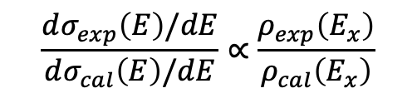
Method
Particle evaporation technique
compound (a+A)
dσ/dE
$$\frac{dσ_{exp}\left(E\right)/dE}{dσ_{cal}\left(E\right)/dE}∝\frac{ρ_{exp}\left(E_{x}\right)}{ρ_{cal}\left(E_{x}\right)}$$
a
b
E_{b}
Discrete levels are used for absolute
Normalization !!!
A
A+a-b
Select appropriate reactions (beam species, energies, targets).
Measure the outgoing particles at backward angles
05
A.V. Voinov, 10th Workshop on Level Density and Gamma Strength, May 2026

Slide 5
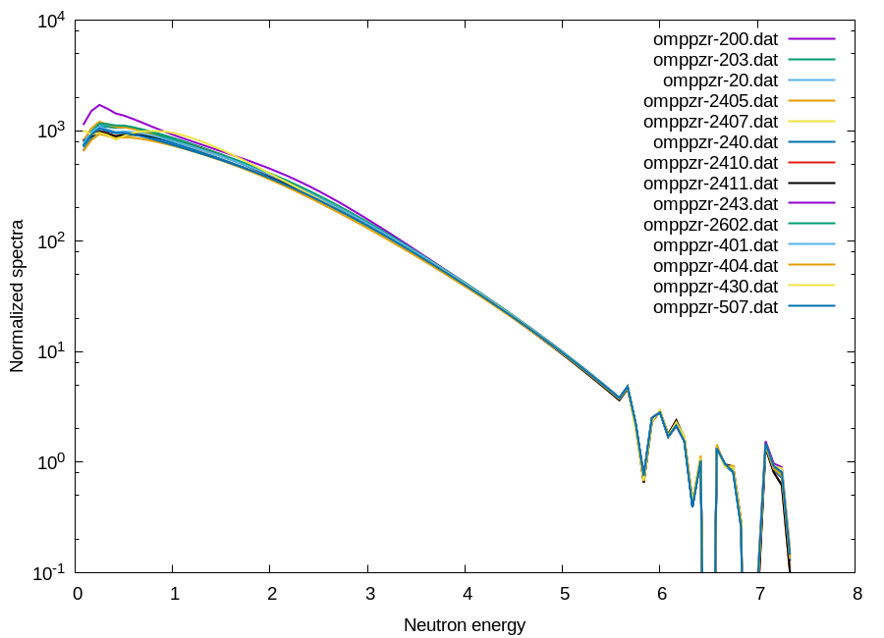
Optical model sensitivity test
Sensitivity test of neutron spectra to optical model parameter sets
⁹⁶Zr(p,n) ⁹⁶Nb
RIPL3 OMP index
± 10%
04
A.V. Voinov, 10th Workshop on Level Density and Gamma Strength, May 2026

Slide 6
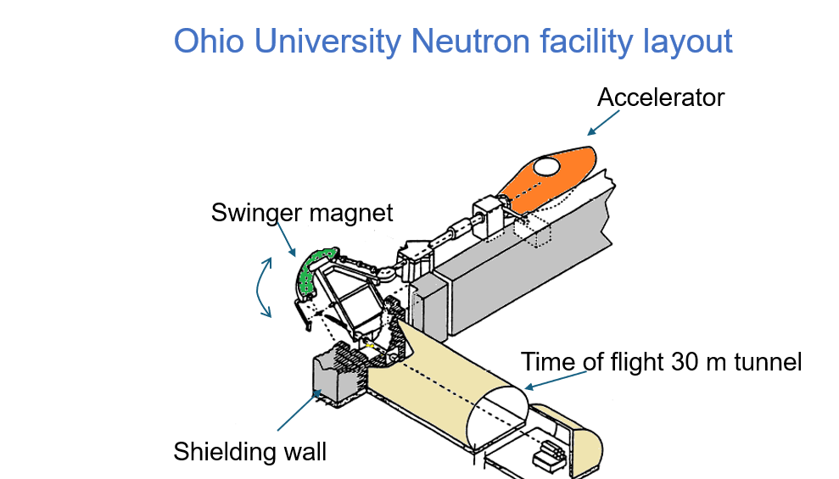
EXPERIMENT
The Swinger facility couples a long underground flight path to neutron TOF spectroscopy.
Experimental details
FACILITY
Edwards Accelerator Laboratory, Ohio University
TECHNIQUE
Underground neutron time-of-flight measurement
REACTION SET
92Zr(p,n)92Nb, 94Zr(p,n)94Nb, 96Zr(p,n)96Nb
BEAM ENERGY
Ep = 8 MeV
Neutron TOF
Swinger
8 MeV
05
A.V. Voinov, 10th Workshop on Level Density and Gamma Strength, May 2026

Slide 7
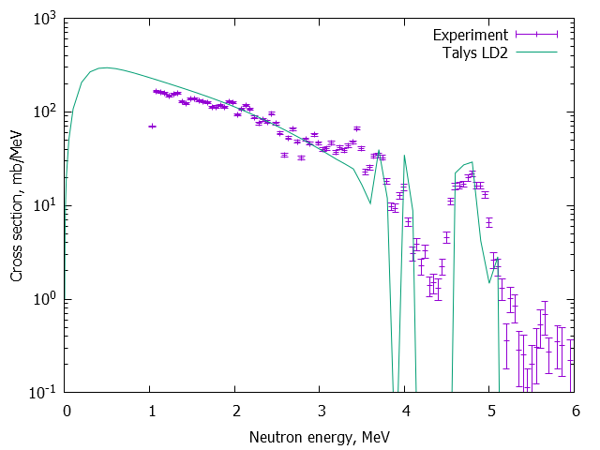
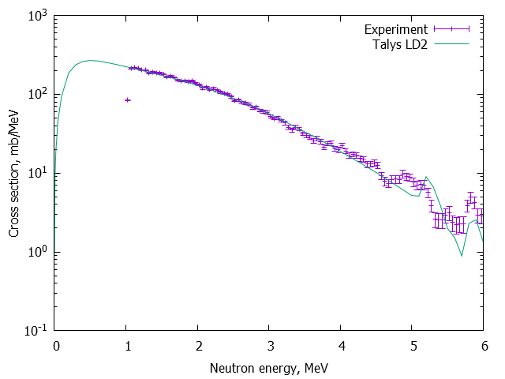
Data vs model calculations
Experimental double differential spectra from ^{92,94,96}Zr(p,n) ^{92,94,96}Nb reactions. E_{beam}=8 MeV
⁹²Zr(p,n) ⁹²Nb
⁹⁴Zr(p,n) ⁹⁴Nb
04
A.V. Voinov, 10th Workshop on Level Density and Gamma Strength, May 2026

Slide 8
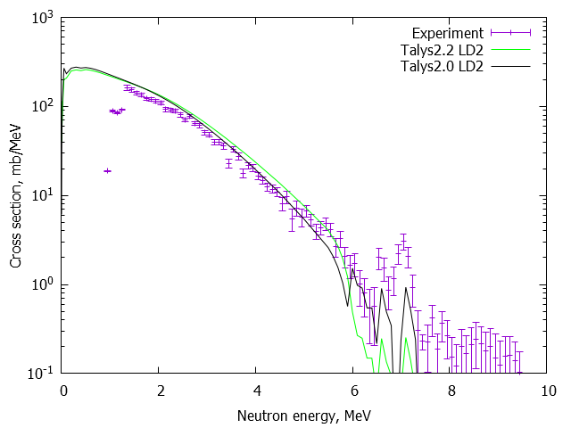
Data vs model calculations
Experimental double differential spectra from ^{92,94,96}Zr(p,n) ^{92,94,96}Nb reactions. E_{beam}=8 MeV
⁹⁶Zr(p,n) ⁹⁶Nb
04
A.V. Voinov, 10th Workshop on Level Density and Gamma Strength, May 2026

Slide 9
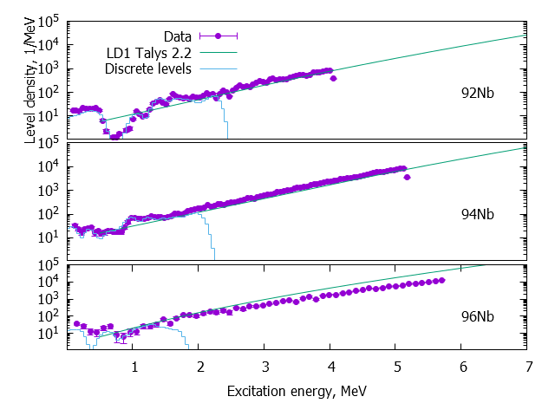
Comparison with models
Experimental data vs Talys GC, ldmodel 1
04
A.V. Voinov, 10th Workshop on Level Density and Gamma Strength, May 2026

Slide 10
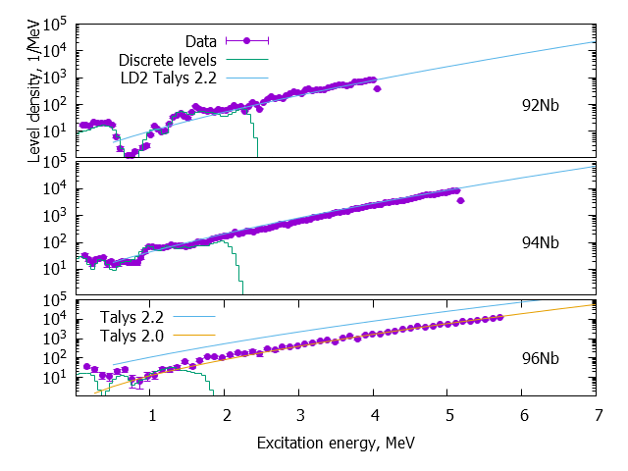
Comparison with models
Experimental data vs Talys FG, ldmodel 2
04
A.V. Voinov, 10th Workshop on Level Density and Gamma Strength, May 2026

Slide 11
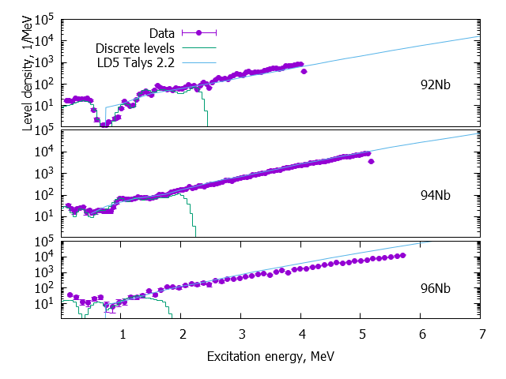
Comparison with models
Experimental data vs Talys, lmodel 5
04
A.V. Voinov, 10th Workshop on Level Density and Gamma Strength, May 2026

Slide 12
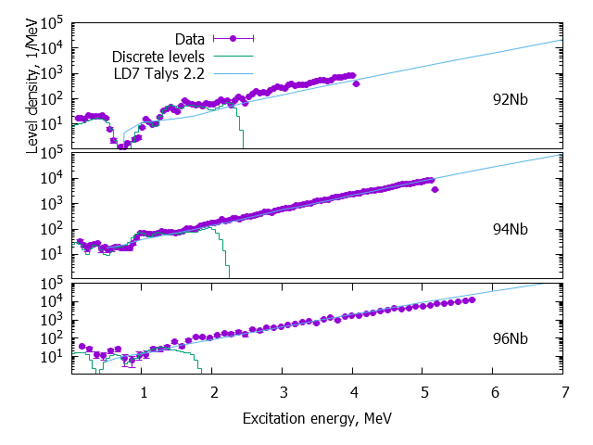
Comparison with models
Experimental data vs Talys, model 7
04
A.V. Voinov, 10th Workshop on Level Density and Gamma Strength, May 2026

Slide 13
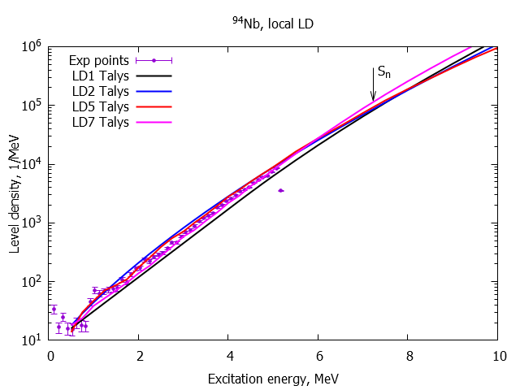
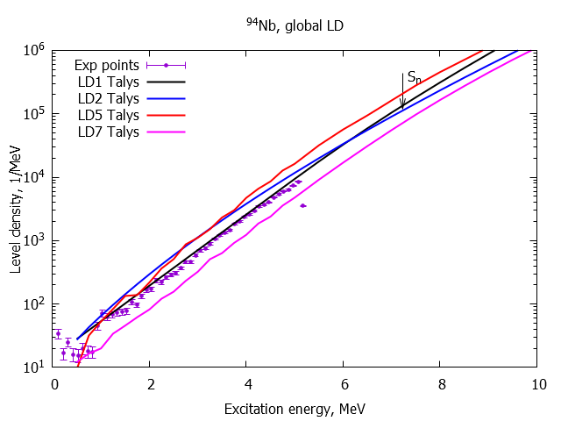
Comparison with models
Local vs global level density models
Microscopic Talys models (5 and 7) are best among local models
GC, (1) is best among global models
04
A.V. Voinov, 10th Workshop on Level Density and Gamma Strength, May 2026

Slide 14
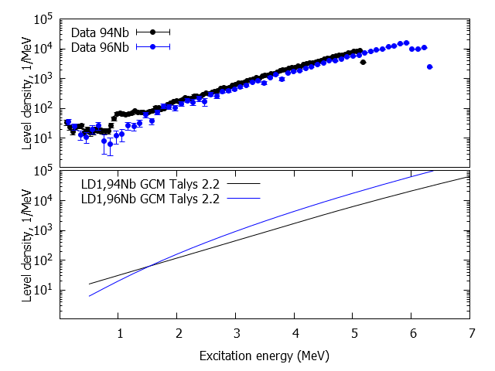
Comparison with models
Comparative plots for ⁹⁴Nb and ⁹⁶Nb, Level density model 1 (GCM)
04
A.V. Voinov, 10th Workshop on Level Density and Gamma Strength, May 2026

Slide 15
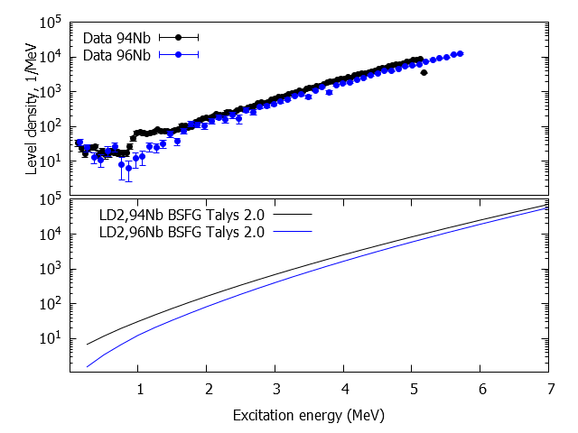
Comparison with models
Comparative plots for ⁹⁴Nb and ⁹⁶Nb, Level density model 2 (FGM)
04
A.V. Voinov, 10th Workshop on Level Density and Gamma Strength, May 2026

Slide 16
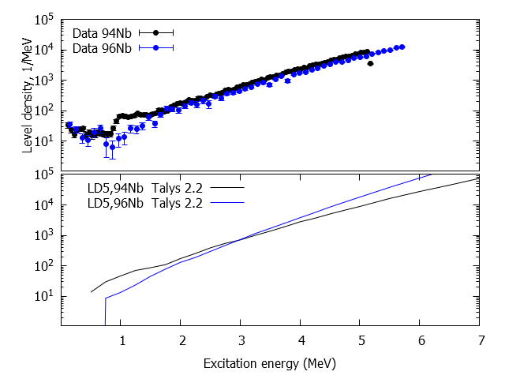
Comparison with models
Comparative plots for ⁹⁴Nb and ⁹⁶Nb, Level density model 5 (HFB)
04
A.V. Voinov, 10th Workshop on Level Density and Gamma Strength, May 2026

Slide 17
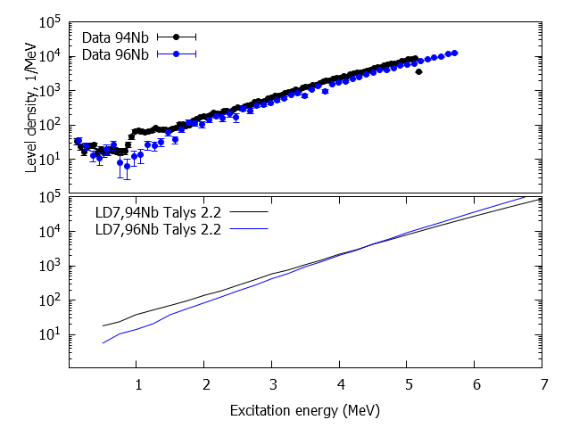
Comparison with models
Comparative plots for ⁹⁴Nb and ⁹⁶Nb,
Level density model 7 (BSKG3 triaxial HFB)
04
A.V. Voinov, 10th Workshop on Level Density and Gamma Strength, May 2026

Slide 18

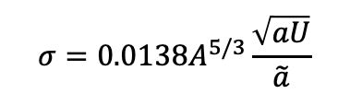
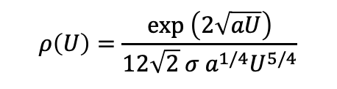


LD models background
Phenomenological models (both GG and FG) are based on
Fermi-gas prescription
$$ρ\left(U\right)=\frac{exp \left(2\sqrt{aU}\right)}{12\sqrt{2} σ a^{1/4}U^{5/4}}$$
$$a\left(U\right)=\tilde{a}\left[1+δW\frac{1−e^{−γU}}{U}\right]$$
A. V. Ignatyuk, G. N. Smirenkin, and A. S. Tishin,
“Phenomenological description of the energy dependence of the level density parameter”, Sov. J. Nucl. Phys. 21, 255 (1975).
$$U=E−∆$$
$$σ=0.0138A^{5/3}\frac{\sqrt{aU}}{\tilde{a}}$$
$$\tilde{a}\left(A\right)=0.072A+0.195A^{2/3}$$
RIPL systematics
$$δW=M_{exp}−M_{LDM}$$
We will fit parameters $\tilde{a}$ and $∆$ to ^{92,94,96}Nb LD data and compare $a\left(4\right)exp$ $a\left(4\right)sys$
04
A.V. Voinov, 10th Workshop on Level Density and Gamma Strength, May 2026

Slide 19
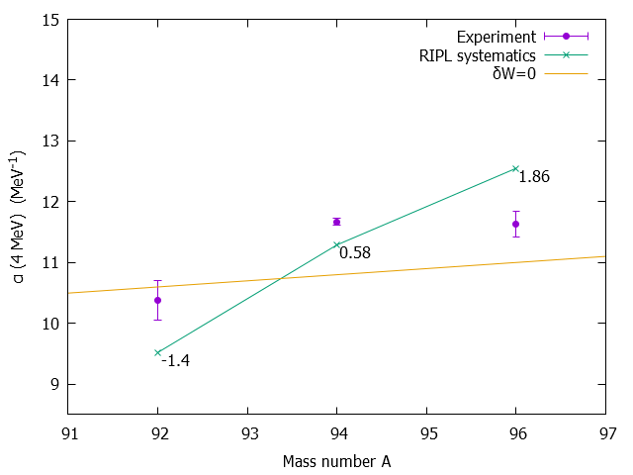


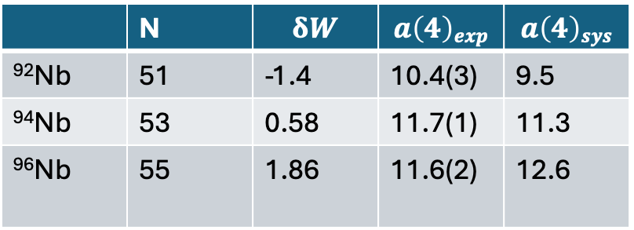

Parameter study
Fermi-gas model parameter study
very preliminary !!!
$$a\left(U\right)=\tilde{a}\left[1+δW\frac{1−e^{−γU}}{U}\right]$$
RIPL systematics
$$\tilde{a}\left(A\right)=0.072A+0.195A^{2/3}$$
$$δW=M_{exp}−M_{LDM}$$
 | N | $$δW$$ | $$a\left(4\right)exp$$ | $$a\left(4\right)sys$$
⁹²Nb | 51 | -1.4 | 10.4(3) | 9.5
⁹⁴Nb | 53 | 0.58 | 11.7(1) | 11.3
⁹⁶Nb | 55 | 1.86 | 11.6(2) | 12.6
Data might not support a strong
dependence on shell corrections δW !!!
04
A.V. Voinov, 10th Workshop on Level Density and Gamma Strength, May 2026

Slide 20
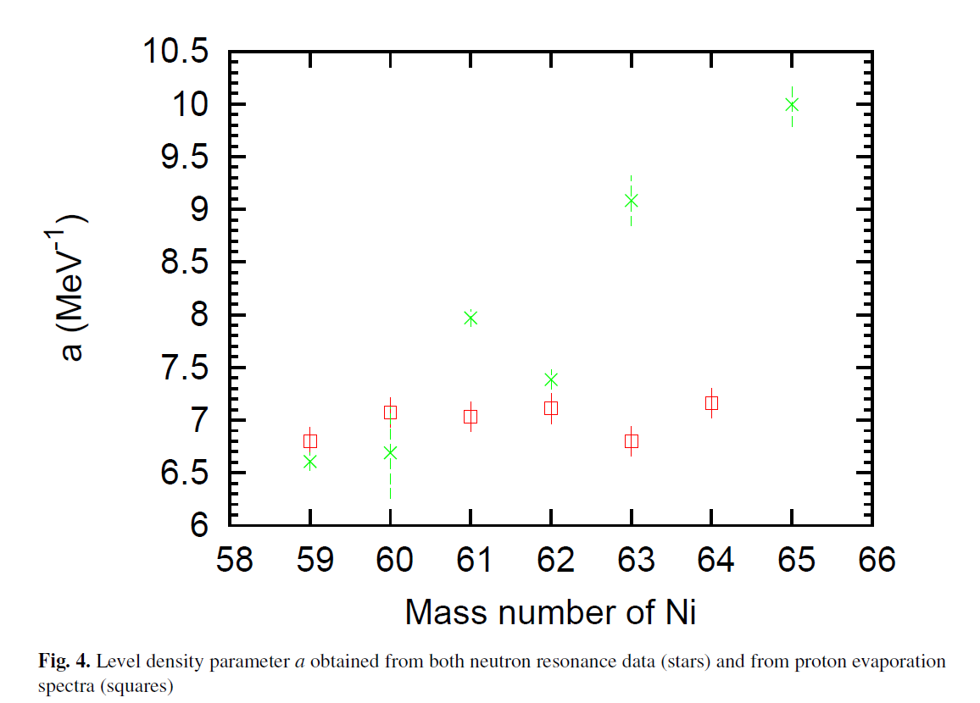
Dependence of the Fermi-gas parameter “a” on the mass number of
Ni isotopes
A.V. Voinov et al, EPJ Web of Conferences 21, 05001(2012)
From neutron resonances
From evaporation spectra
A.V. Voinov, 10th Workshop on Level Density and Gamma Strength, May 2026

Slide 21
Conclusions
Analysis of Nb data from the particle evaporation technique showed a good agreement between models and data for ^{92,94}Nb, while models predict a steeper LD slope for ⁹⁶Nb.
Data do not support a strong level density dependence on shell corrections for the Fermi-gas phenomenological model for ^{92,94,96}Nb
Neutron resonance data are no longer sufficient to serve as the sole basis for model improvements because of their limitations. They need to be complemented by other types of data obtained using different experimental techniques.
04
A.V. Voinov, 10th Workshop on Level Density and Gamma Strength, May 2026

Slide 22
Acknowledgments
Acknowledgments
This work was made possible through the project: Realistic Reaction Evaluations for Fission Products Off Stability in collaboration with BNL (G. Nobre (BNL), D. Brown (BNL), E. Chimanski (BNL), K. Wendt (LLNL) )
supported by the Office of Defense Nuclear Nonproliferation Research and
Development within the U.S. Department of Energy’s National Nuclear Security
Administration.
Faculty, staff and students from the Edwards Accelerator Lab of Ohio University, supported from DOE Office of science and SSAA NNSA program
04
A.V. Voinov, 10th Workshop on Level Density and Gamma Strength, May 2026

