Slide 1


Search for new physics in CMS open data and future colliders
Frontiers in Neutrino, Cosmology, and Astroparticle Physics
  Thursday, January 22th, 2026.

Slide 2
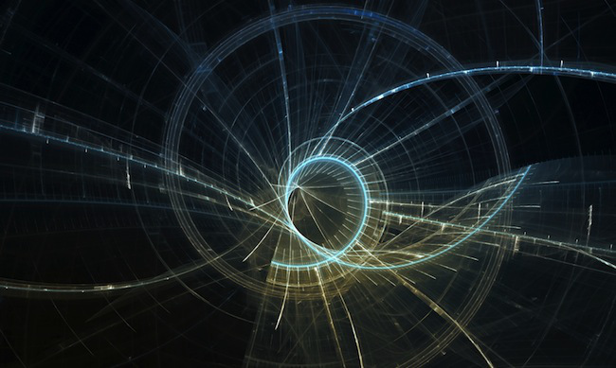
Talk: out-lines
 | Subject
1 | Fields and Unification
2 | What is the LHC?
3 | SM of particle physics
4 | CMS results from BSM models
5 | Introduction - the ILC & ILC detectors
6 | The ILC Physics Program (BSM)

Slide 3
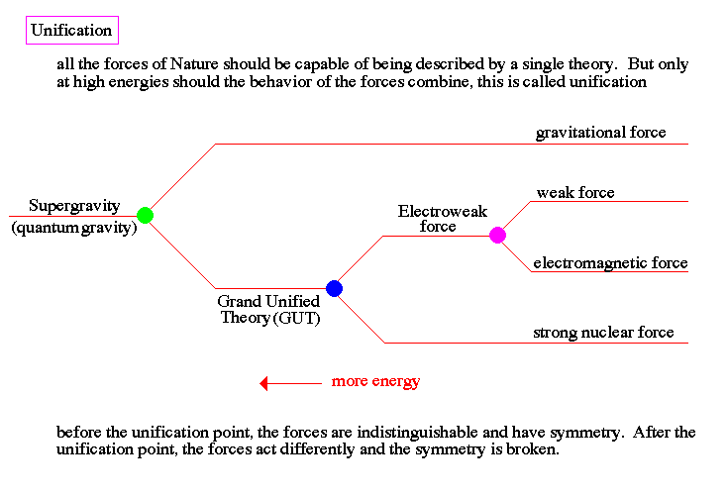

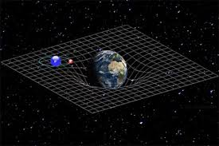
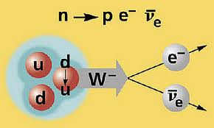
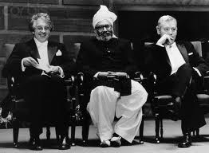
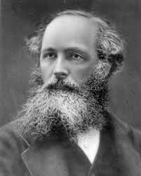
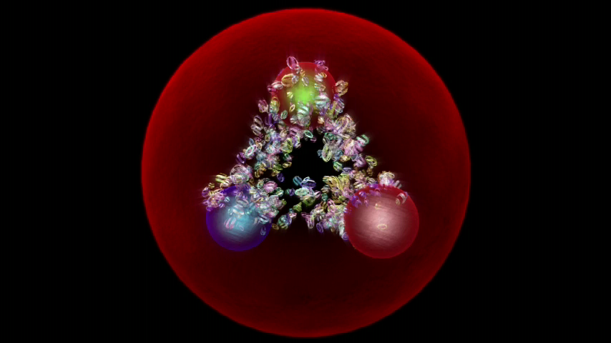
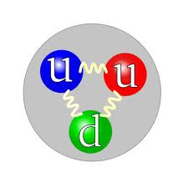
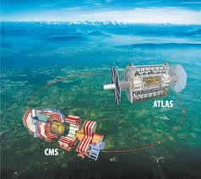
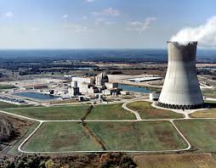
Fields and Unification
“T” scale
10³²K
10²⁷K
10¹⁵K
3K
“E” scale
10¹⁹GeV
10¹⁴GeV
100GeV
10⁻⁴ eV
Theory of Everything
“t” scale
10⁻⁴³sec
10⁻³⁵sec
10⁻¹²sec
5*10¹⁷sec

Slide 4
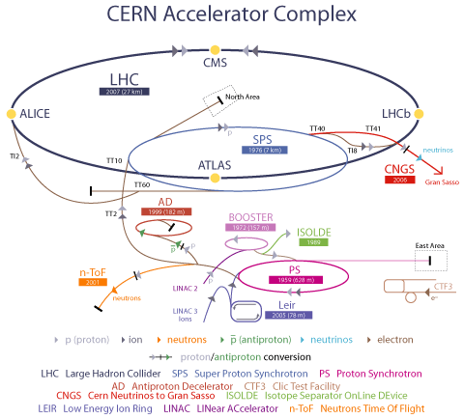
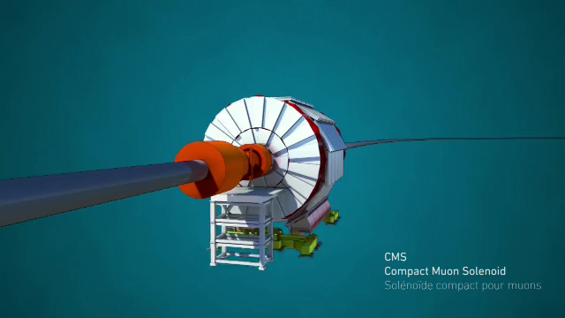
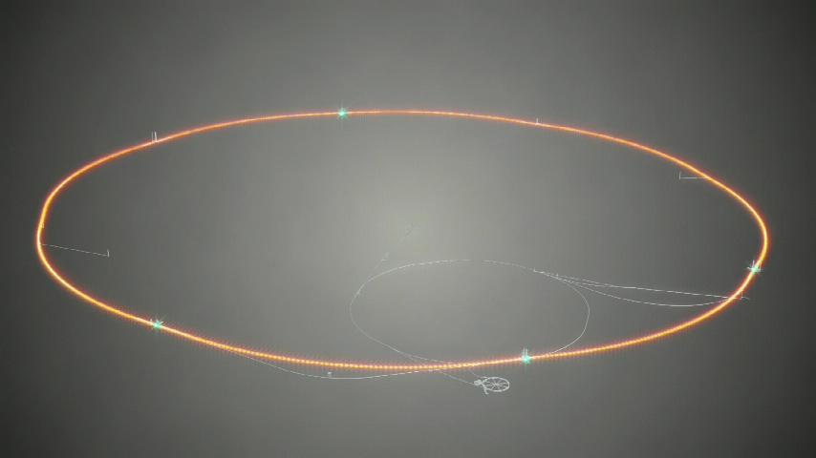

LHC Accelerator Complex

Slide 5

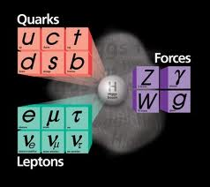

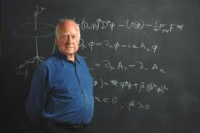
Why Higgs boson is important?
In 1964 Prof. P. Higgs and Prof. F. Englert wrote papers on prediction of new scalar Gauge boson, which appears as a result of the spontaneous symmetry breaking
Prof. F. Englert
Prof. P. Higgs

Slide 6
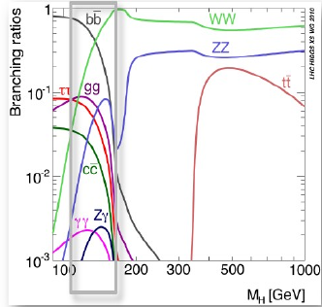
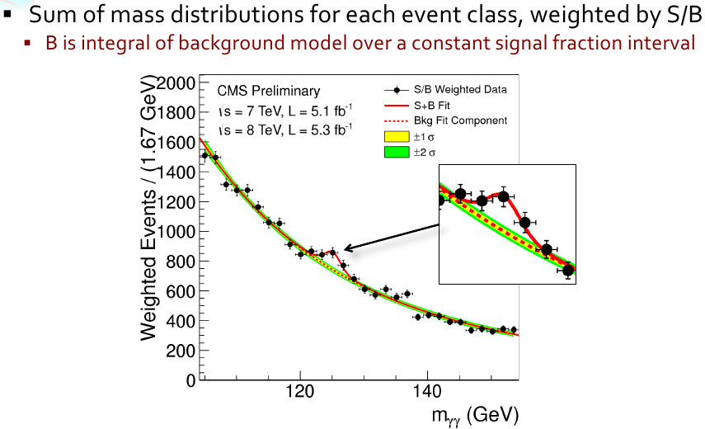
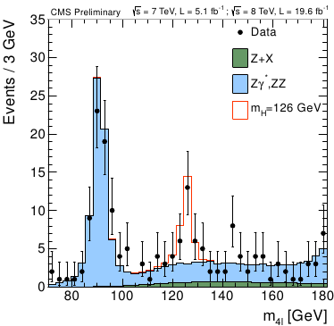

Higgs Boson Production at the LHC

Slide 7
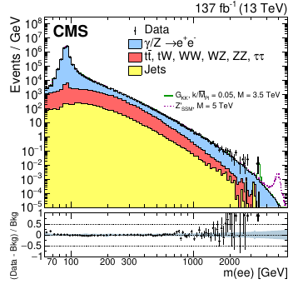
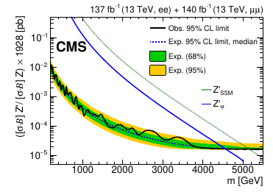
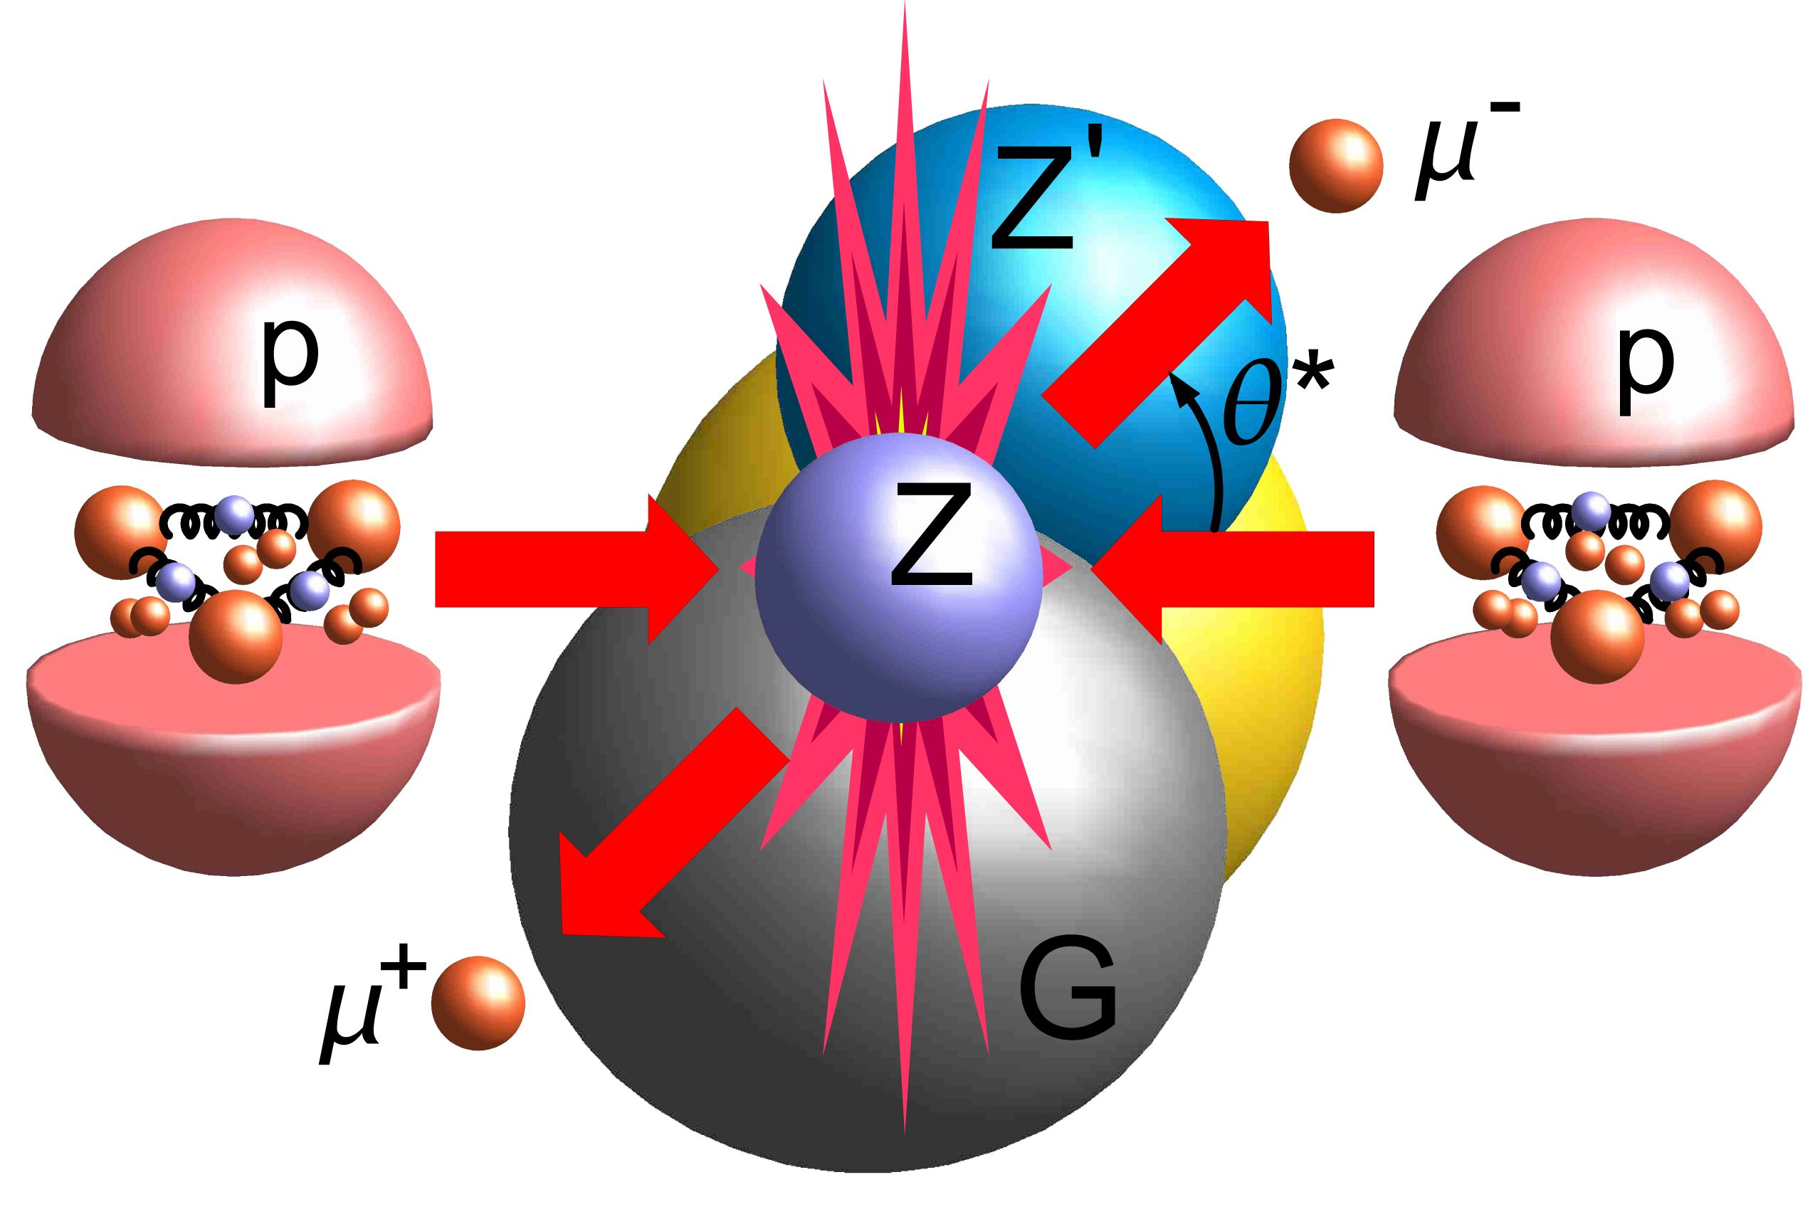
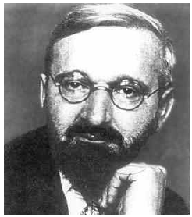
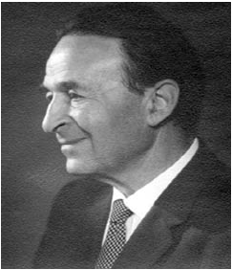

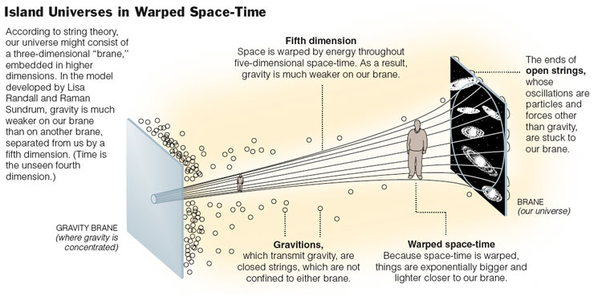
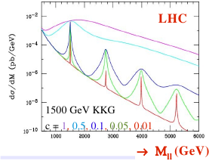
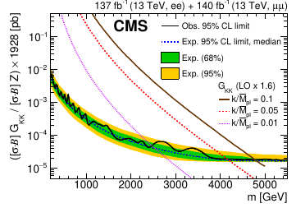
SM problems
Search for new heavy resonant and non-resonant phenomena in dilepton channels
    Kaluza Klien excitations from Extra-dimensions
DOI: 10.1007/JHEP07(2021)208

Slide 8
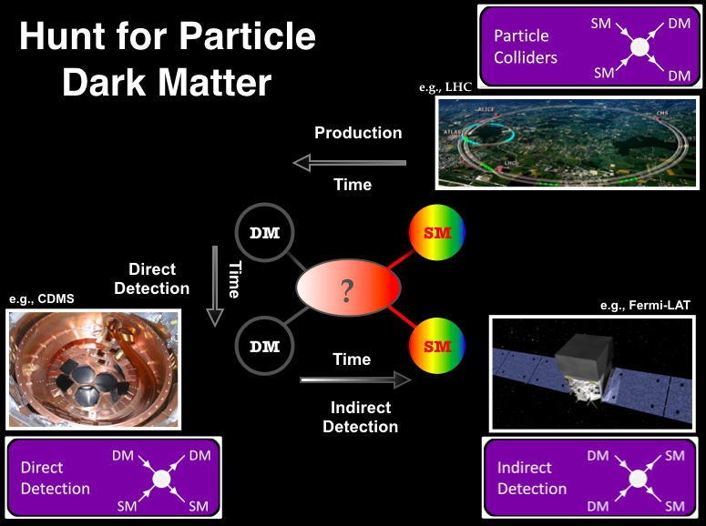
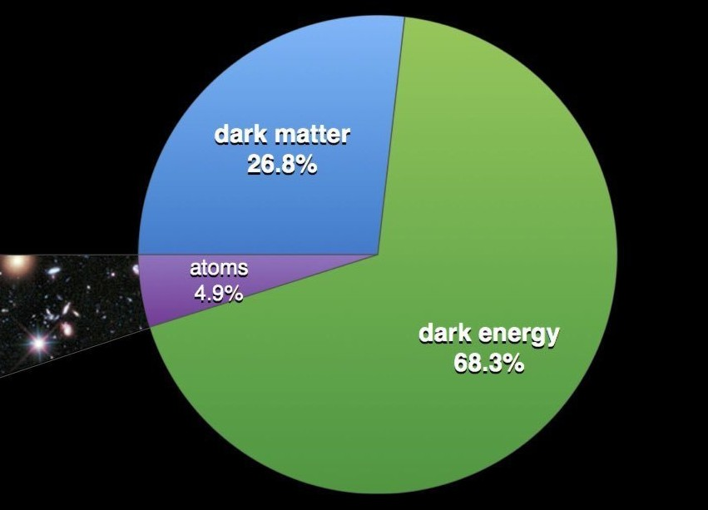
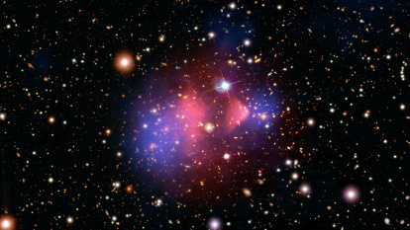
Searches for dark matter

Slide 9
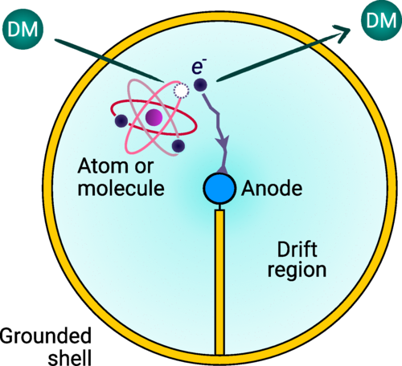
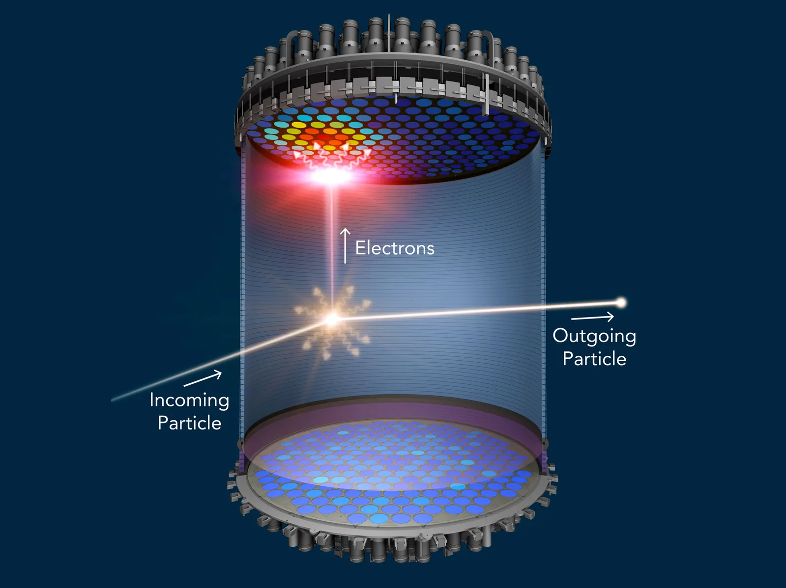
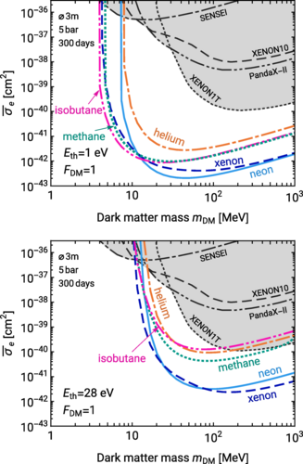
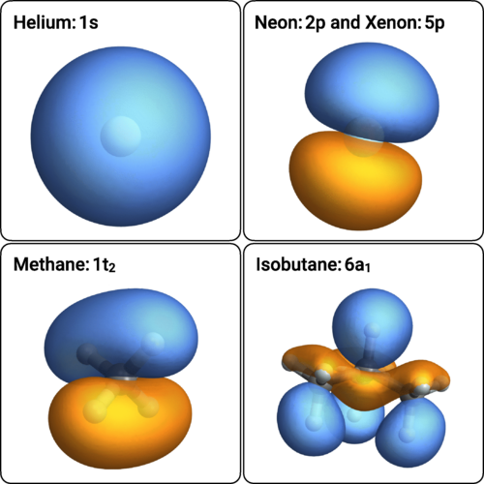
DM direct detection
E_{th} : threshold energy
      Phys. Rev. D 107, 063002 (2023)

Slide 10
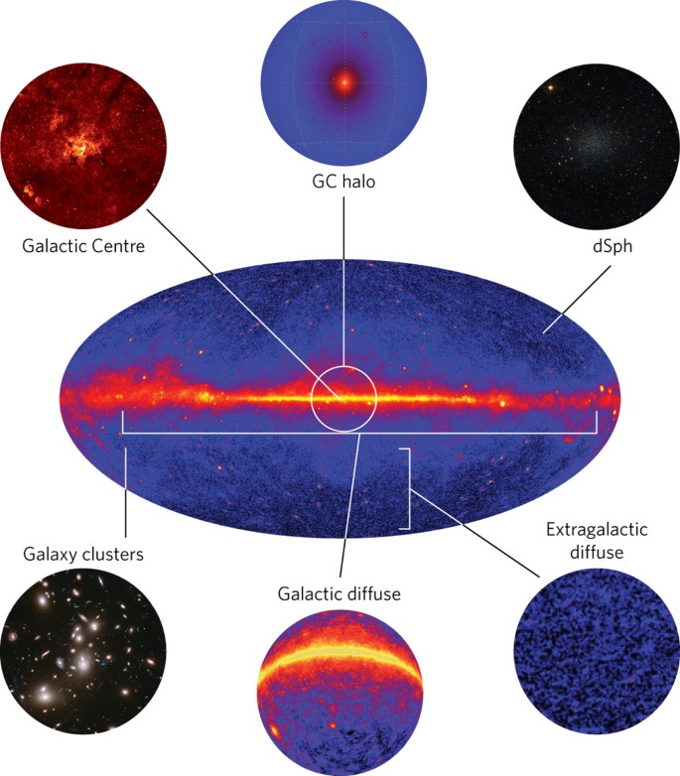
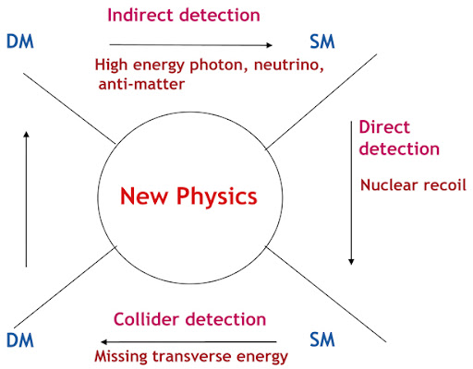
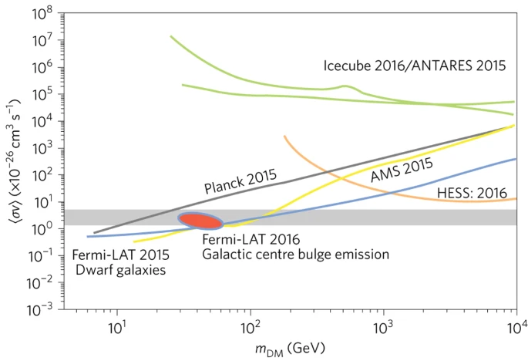
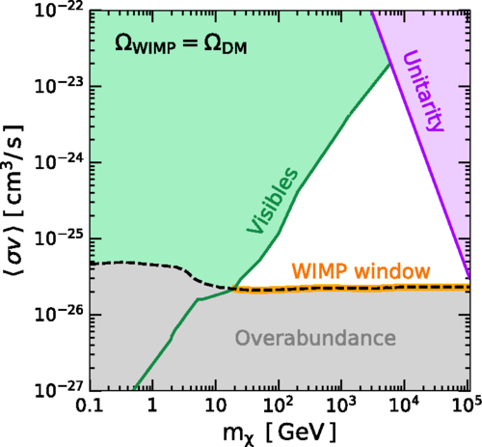
DM in-direct detection
      Nature Physics 13, 224 (2017)
      Phys. Rev. D 98, 023016

Slide 11
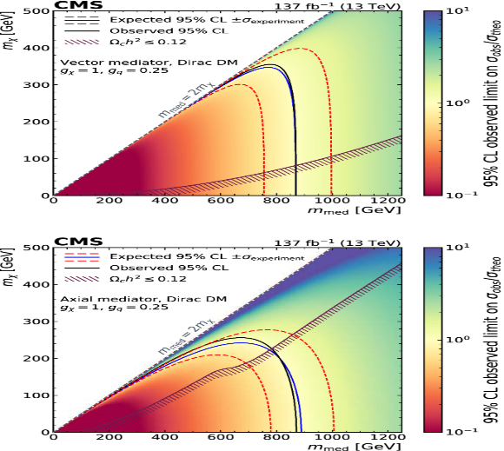
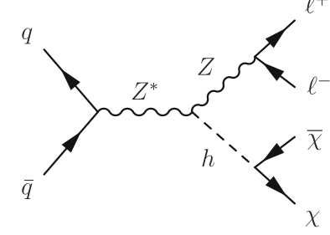
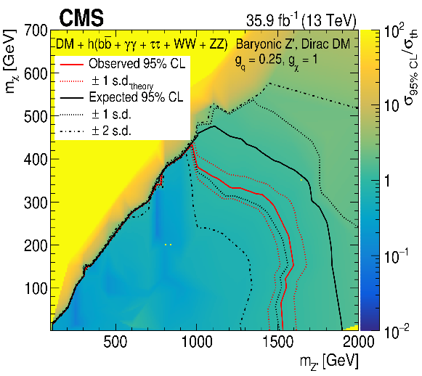
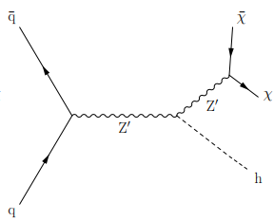
DM collider detection
Search for Dark Matter (DM) using CMS data
      Search for mono-Z + DM
DOI: 10.1140/epjc/s10052-020-08739-5
      Search for mono-Higgs + DM (S. Elgammal, et al.)
          DOI: 10.1007/JHEP03(2020)025
      Search for mono-Z' + DM (S. Elgammal) DOI:10.1103/PhysRevD.111.052015
For vector and axial-vector mediators, they excluded M_{med} < 870 GeV for most values of m_{χ} less than M_{med} /2.
For Baryonic Z’, they excluded M_{Z’} < 1900 GeV for most values of m_{χ} [1, 480] GeV.

Slide 12
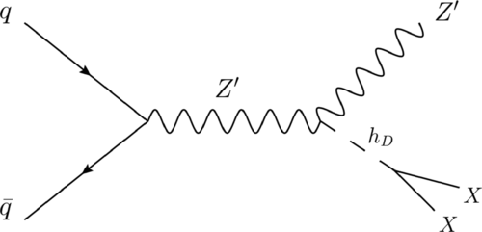
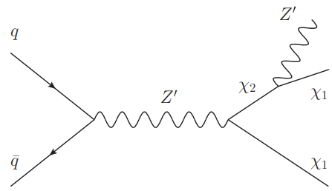
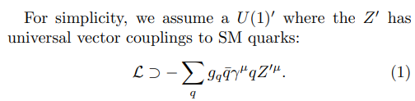


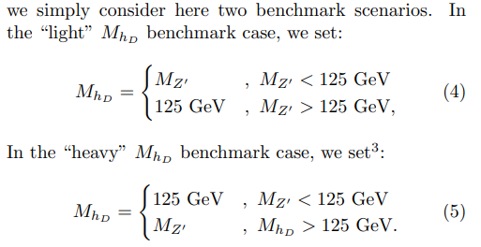
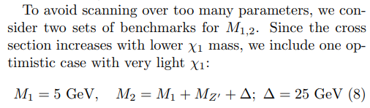
Mono-Z’ model “M. Autran et al. Phys. Rev. D 92, 035007”
Dark Higgs
Light Vector
DOI: https://doi.org/10.1103/PhysRevD.92.035007

Slide 13
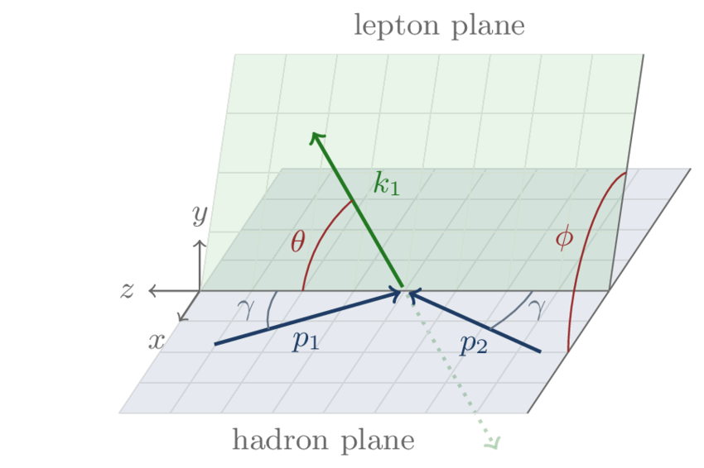
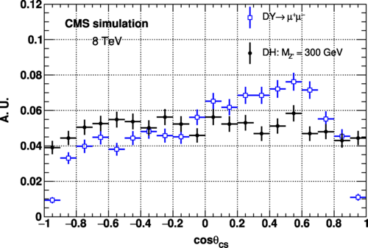

Collins-Soper (CS) frame
μ⁻
μ⁺
Where,
Q the momentum of the dimuon system,
Q_T the transverse momentum of the dimuon system
Q_z the longitudinal momentum of the dimuon system.
In addition, P_{i} is defined as
E_{i} denotes the energy of the muon
      S. Elgammal DOI: https://doi.org/10.1103/PhysRevD.111.052015

Slide 14
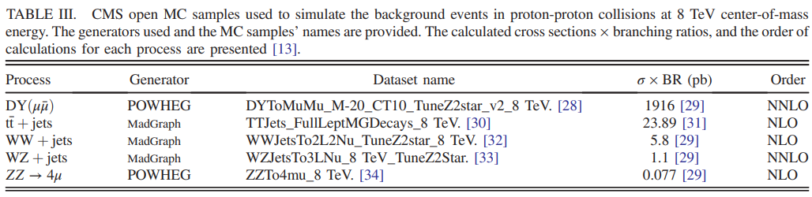
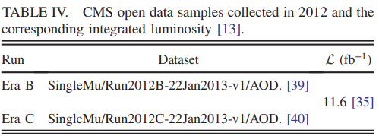
CMS open data portal
https://opendata.cern.ch/
Data format:
  AOD
  MiniAOD
  NanoAOD (the best for non CMS
  users, smaller in size)
Available runs:
- full run-1
- small fration of run-2
- No run-3
      S. Elgammal DOI: https://doi.org/10.1103/PhysRevD.111.052015

Slide 15


Angular distributions (after pre-selection)
      S. Elgammal DOI: https://doi.org/10.1103/PhysRevD.111.052015

Slide 16



Angular distributions (after final-selection)
      S. Elgammal DOI: https://doi.org/10.1103/PhysRevD.111.052015

Slide 17

Summary of this analysis
Our research examined the angular distributions of high mass dimuon pairs in the Collins-Soper frame using datasets released by the CMS open data project. The data we used was obtained from proton-proton collisions during Run-1, at c.m.e = 8 TeV.
We have established a 95% confidence level upper limit for certain model-free parameters. For the DH scenario with coupling values of g_{SM} = 0.25 and g_{DM} = 1.0.
Z’ boson masses below 412 GeV (expected 400 GeV) have been ruled out.
      S. Elgammal DOI: https://doi.org/10.1103/PhysRevD.111.052015

Slide 18

Future collider
2048
2073
energy
2030s

Slide 19


Advantages of e⁺ e⁻ Collisions
elementary particles
  well-defined
      energy,
      angular momentum
uses full COM energy
produces particles
democratically
  can mostly fully
  reconstruct events

Slide 20



The ILC parameters
Parameter Initial stage TDR LHC
C.M. Energy (GeV) 250 500 14000
Length (km) 20 31
Luminosity (x10³⁴) 1.35 1.8
Event size (Hz) 5 5 100
Beam Pulse Period (ms) 0.73 0.73
Beam size (y) at FF (nm) 7.7 5.9
Site Power (MW) 129 163

Slide 21


Search for DM in framework of Mono-Z’ model at the ILC
g_{l}
g_{DM}
The CMS and ATLAS: Z’ does not exist in the mass range between 0.2 to 5.15 TeV.
Therefore, we focus our investigation on the production of light neutral gauge bosons (Z’) in the mass range below 90 GeV at the ILC.
Due to previous restrictions on the value of g_{l} from different experiments as the CMS, ATLAS, and LEP-2 in the range of M_{Z’} values between 10 and 80 GeV, g_{l} needs to be approximately 0.003 [JHEP12(2023)011].
According to [Phys. Rev. D 92, 035007 (2015)], g_{DM} is equal to 1.0.
S. Elgammal (PHYSICAL REVIEW D 110, 055020 (2024))

Slide 22



Mass & MET distributions (after pre-selection)
S. Elgammal (PHYSICAL REVIEW D 110, 055020 (2024))

Slide 23



MET distributions (after final-selection)
S. Elgammal (PHYSICAL REVIEW D 110, 055020 (2024))

Slide 24

Summary of this analysis
If this signal is not observed at the ILC, we set upper limits on the masses of Z’ and dark matter (χ₁) at the 95% CL for the charged muonic channel decay of Z’.
Limits have been set for light vector scenario with g_{l} = 0.003 and g_{DM} =1.0, excluding
M_{Z’} range from 20 to 80 GeV for M_{χ1} ∈ [1, 122] GeV,
Nevertheless excluding M_{χ1} = 170 GeV at M_{Z’} = 22 GeV.
S. Elgammal (PHYSICAL REVIEW D 110, 055020 (2024))

Slide 25


The ILC community
v
v
Hopefully, Egypt will join soon!!!

Slide 26
Thank you!!

Slide 27
Backup slides

Slide 28


Backup of Paper 1

Slide 29

Backup of Paper 2

