Slide 1
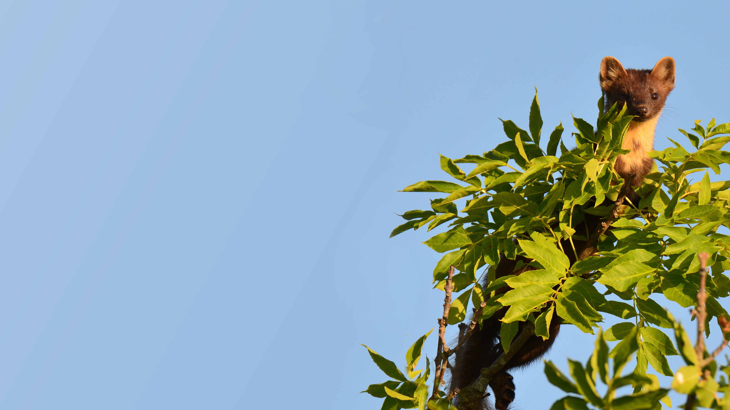
Life After JAI
2025 JAI Fest, 18th December, Imperial College
TALITHA BROMWICH
Pine Marten photo by Ott Rebane: https://www.flickr.com/photos/158940298@N08/
Notes:
Notes

Slide 2
Postdoc Bioinformatics
Leverhulme Centre for Nature Recovery
Mphys Physics
Rewilding Britain
Schmidt Fellowship
University of Sussex Dark matter direct detection DEAP-3600 experiment
University of Edinburgh
Causal link between DNA variations and complex genetic diseases
International standards for monitoring nature recovery, and biodiversity indicators for rewilding
University of Oxford
Nature Positive and NATURE Impacts project with WWF-UK
University of Oxford
ML-enhanced pipelines for estimating food product environmental footprints
2010 - 2014
2014 - 2018
2018 - 2021
2021 - 2022
2022
2022-2024
2023 - now
2025 - now
2026 +
DPhil JAI
MSc Biodiversity Conservation
Wild Business
Senior Research Associate in Food Metrics & Biodiversity
University of Oxford FONT – feedback on nanosecond timescales for future linear colliders
University of Sussex
Over-road habitat connectivity for reintroduced pine martens
Biodiversity footprinting + developing community-led nature recovery guidance
University of Oxford
Environmental footprint of food systems
Notes:
Before getting into the details, I’ll briefly outline the path that got me here.
So I trained originally in particle physics, working on dark matter detection for my master’s and then beamline feedback system at the JAI. I then moved into bioinformatics, before retraining in biodiversity conservation. Since then, my work has focused on conservation opportunity. Mapping and measuring biodiversity impacts — through conservation projects with NGOs, consultancy projects with business, and academic research — and most recently on the environmental impacts of food systems, which I am going to have the opportunity to extend for the next few years through a new fellowship.

Slide 3
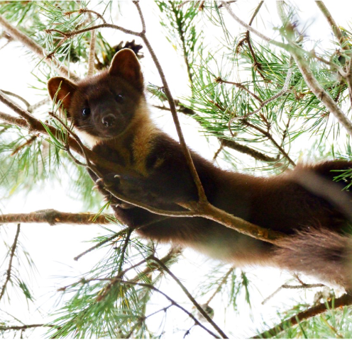
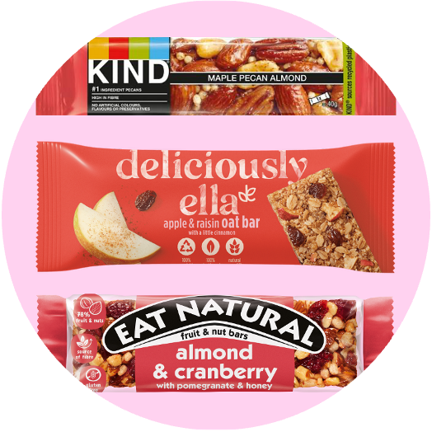
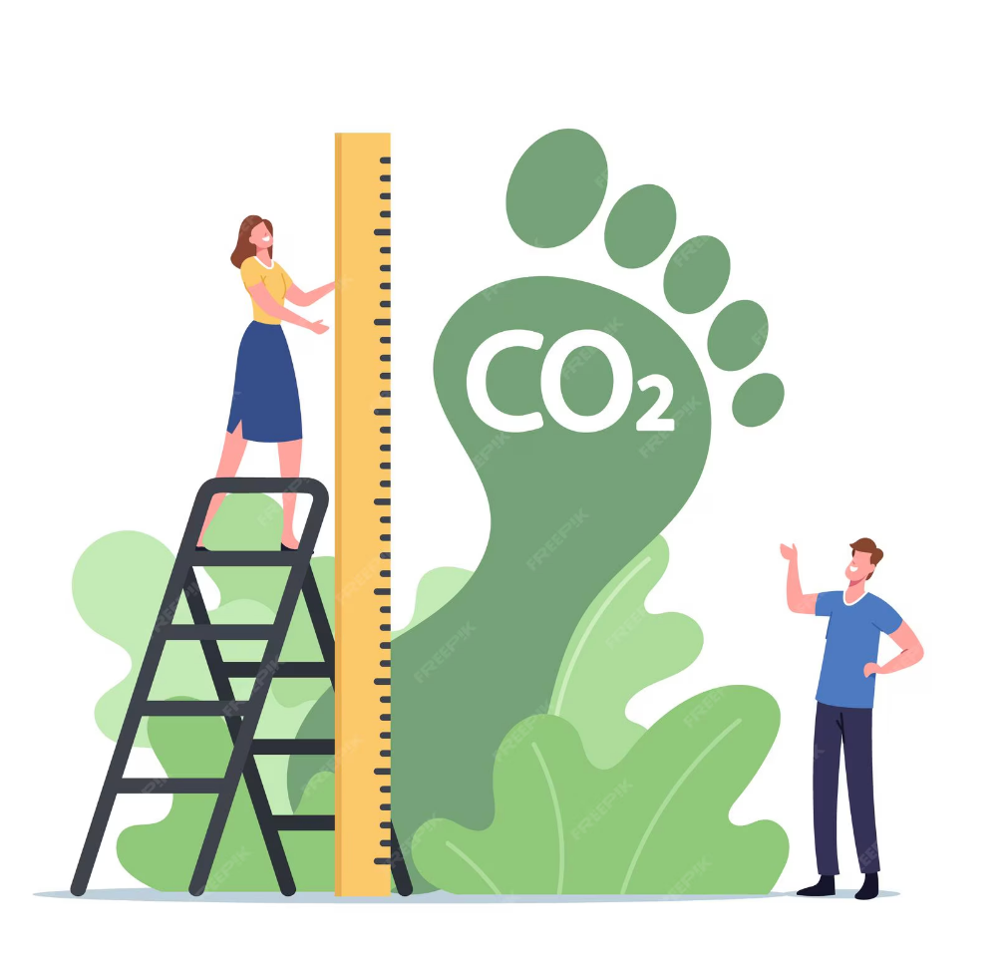
Postdoc Bioinformatics
Leverhulme Centre for Nature Recovery
Mphys Physics
University of Sussex Dark matter direct detection DEAP-3600 experiment
University of Edinburgh
Causal link between DNA variations and complex genetic diseases
University of Oxford
Nature Positive and NATURE Impacts project with WWF-UK
2010 - 2014
2014 - 2018
2018 - 2021
2021 - 2022
2022
2022-2024
2023 - now
2024 - now
2025 - now
DPhil JAI
MSc Biodiversity Conservation
Senior Research Associate in Food Metrics & Biodiversity
University of Oxford FONT – feedback on nanosecond timescales for future linear colliders
University of Sussex
Over-road habitat connectivity for reintroduced pine martens
University of Oxford
Environmental footprint of food systems
Notes:
“Rather than trying to cover everything, today I’ll focus on three projects that illustrate this trajectory.
First, a spatial mapping project supporting pine marten reintroduction with the Wildlife Trusts. Second, work on biodiversity footprinting for large organisations, including the BBC, the Guardian, and the European Space Agency. And third, my current work on estimating and communicating the environmental impacts of food products at scale.”

Slide 4
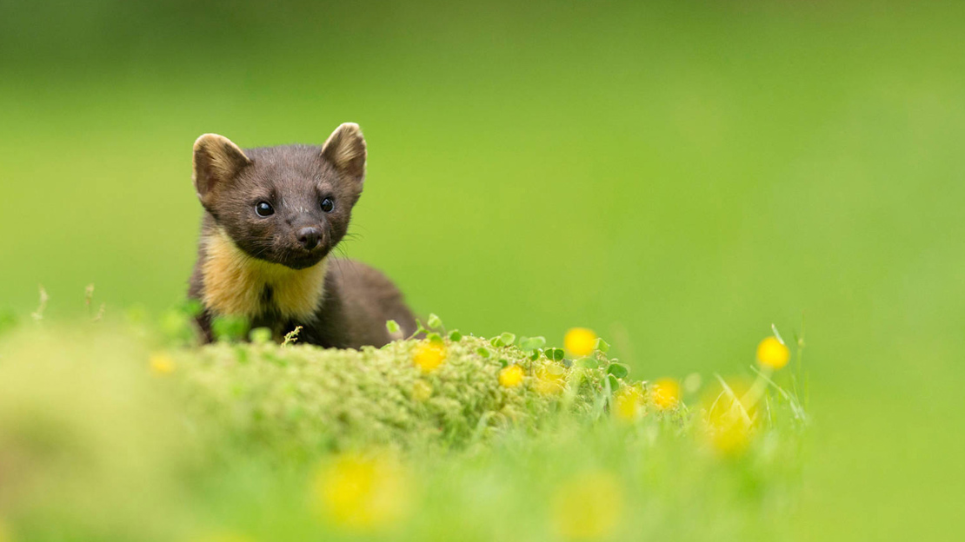
Pine Martens
Over-road canopy connectivity mapping
Notes:
So, starting with some habitat connectivity mapping work and these fascinating little creatures. Pine martens are native to the UK and historically common in ancient woodlands. As predators, they help regulate populations such as grey squirrels, preventing any one species from becoming dominant. This regulation supports more diverse and resilient woodland ecosystems, better able to cope with disease, invasive species, and environmental change.”

Slide 5
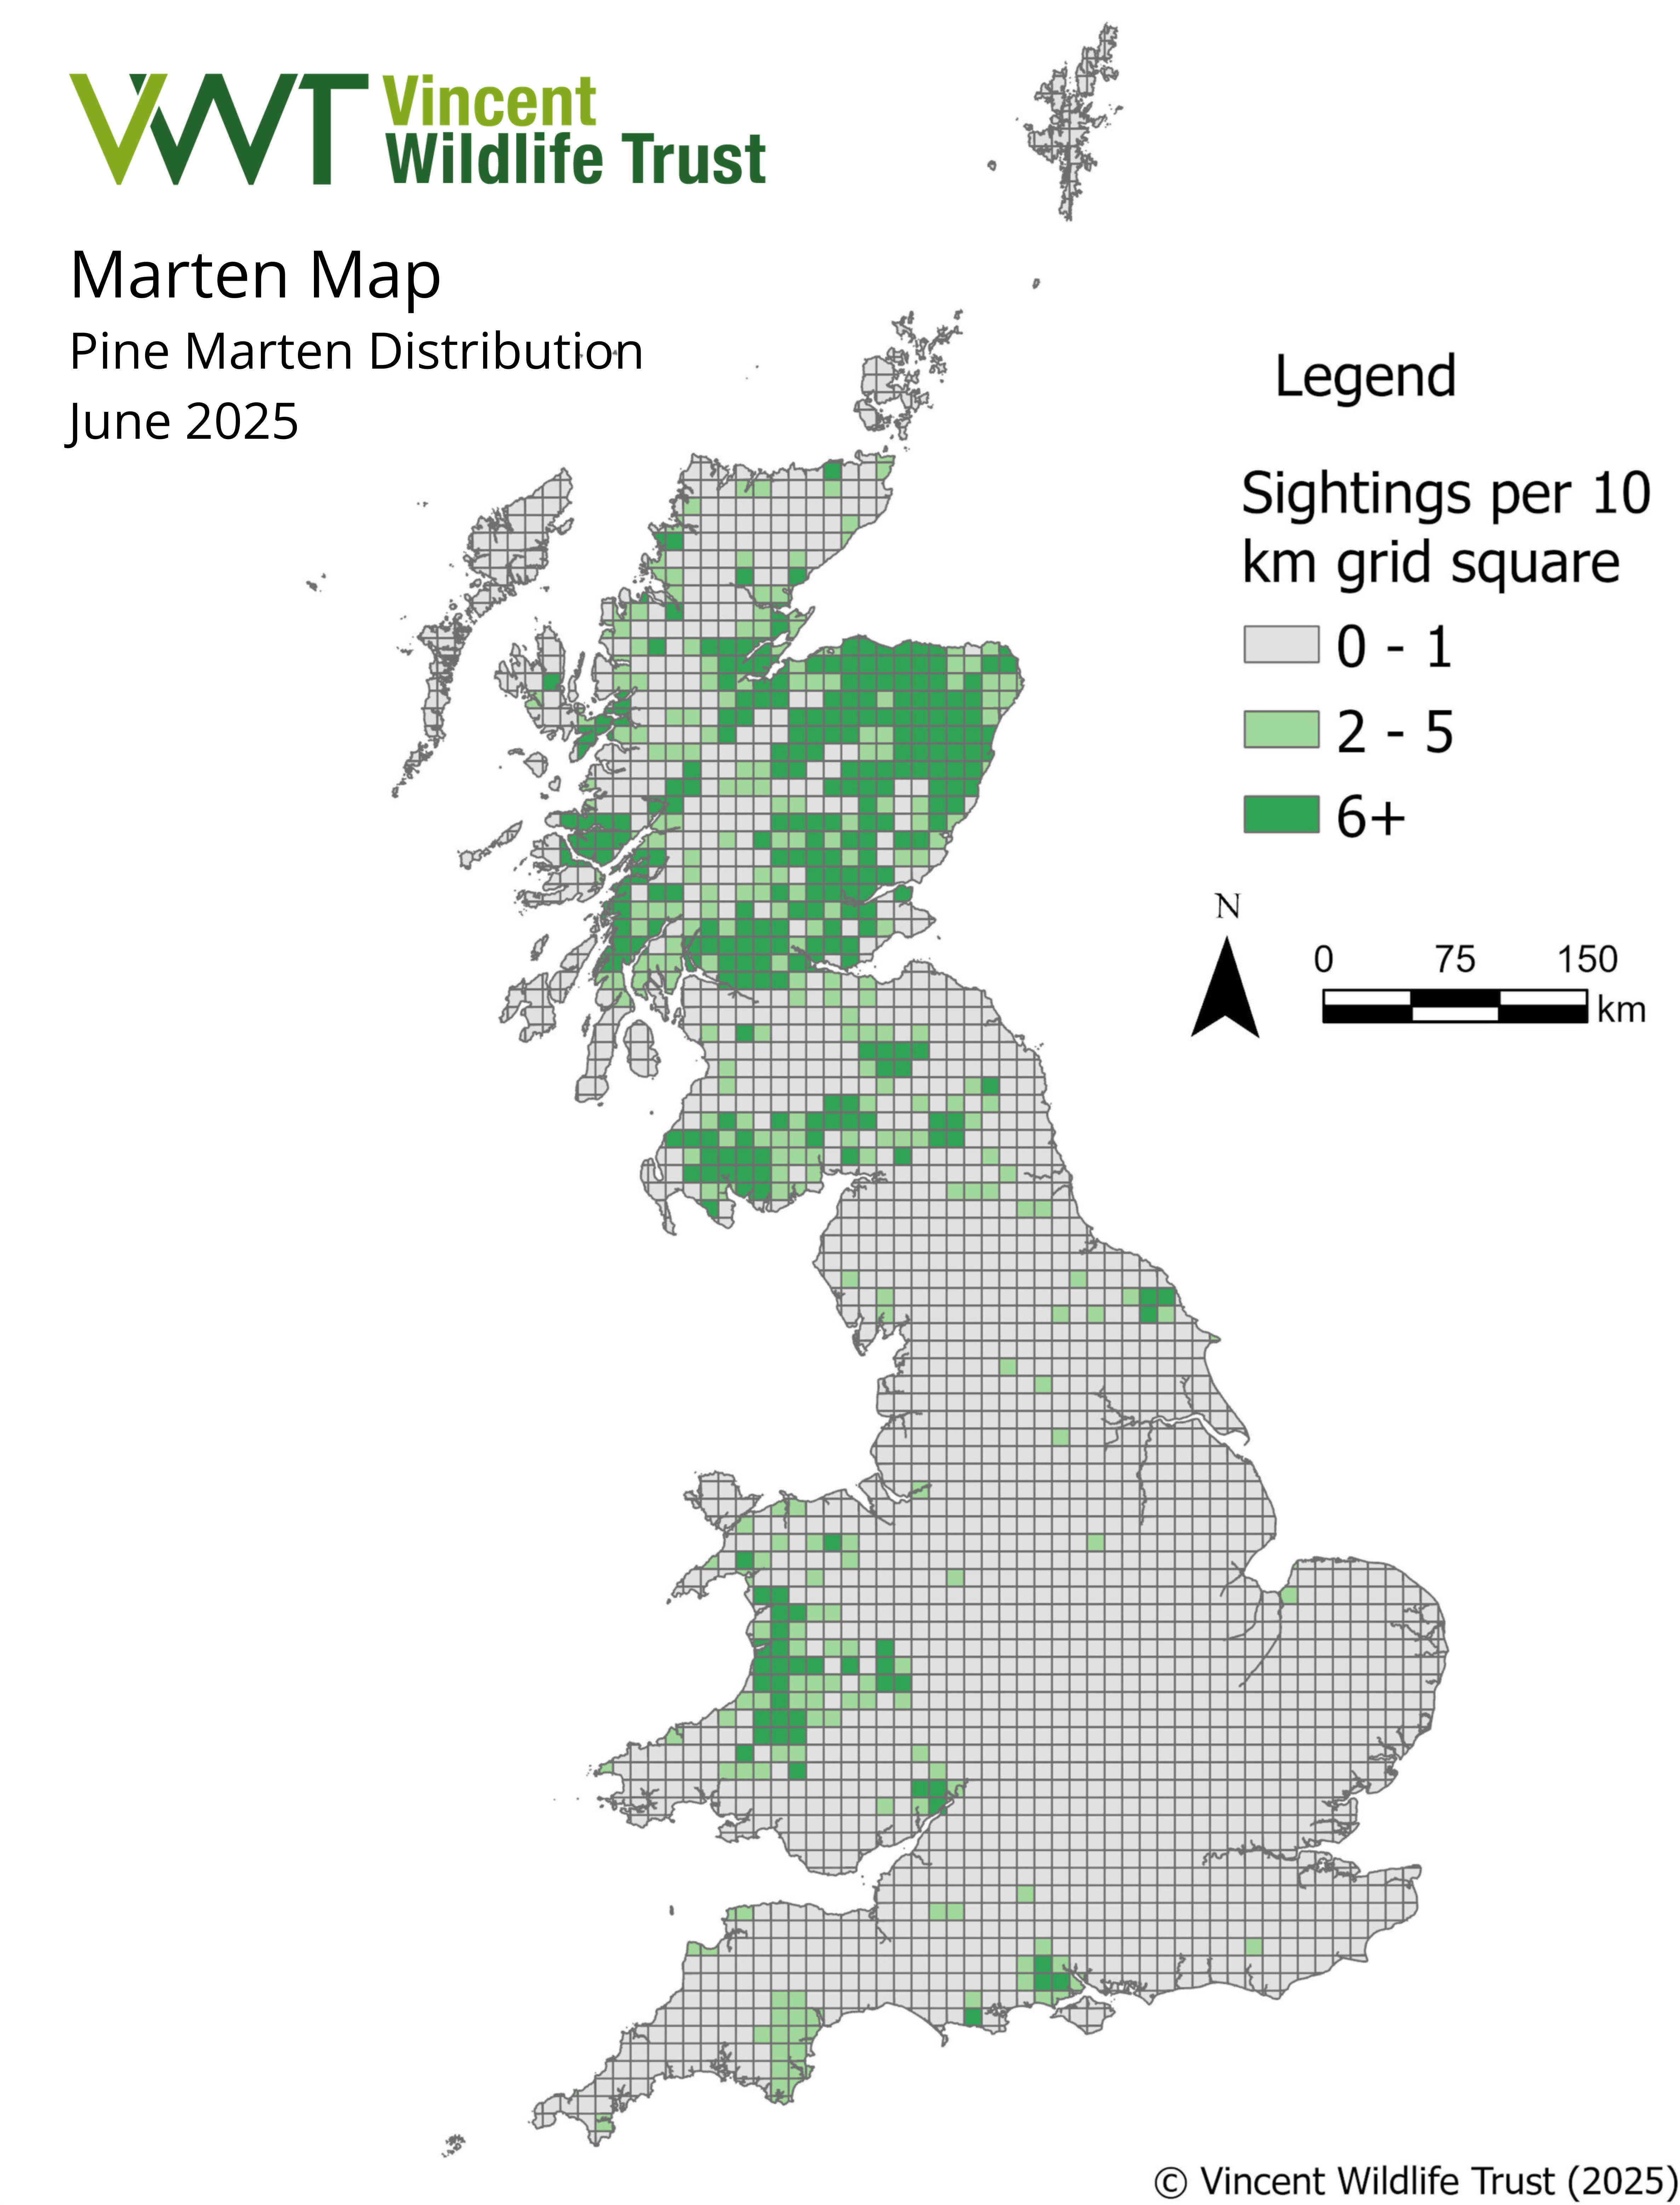
Notes:
Despite their ecological importance, pine martens have been lost from most of the UK. In recent decades there’s been a genuine recovery in Scotland, driven by legal protection, woodland restoration, and carefully managed reintroductions. Similar efforts are now underway in parts of Wales and England, which you may have seen in the news the past couple of years.
However, ecological modelling shows that pine martens are unlikely to naturally recolonise much of England without continued, strategic reintroduction. Dense human populations, fragmented woodland, and extensive road networks create major barriers to movement, increasing mortality risk and limiting connectivity across the landscape.
Despite these barriers, there are areas of England that still contain suitable woodland habitat, such as the Weald of Sussex and Kent, the New Forest and areas of Devon.

Slide 6
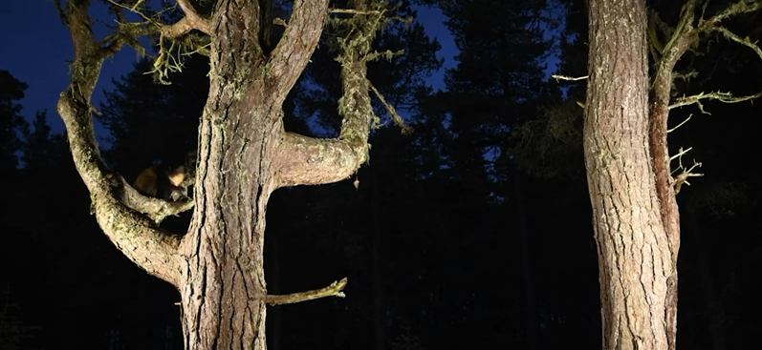
Video: © Terry Whittaker / naturepl.com https://www.youtube.com/watch?v=INgeVOen1Ps
Notes:
Pine martens are highly arboreal — they spend much of their time in trees and often move through the canopy rather than along the ground. And that means canopy connectivity really matters, particularly at road crossings, where collision risk is high.
So my project focused on mapping canopy connectivity across roads at landscape scales, to identify where relatively small, targeted interventions could significantly improve safe movement and support long-term population recovery in potential pine marten reintroduction areas.

Slide 7
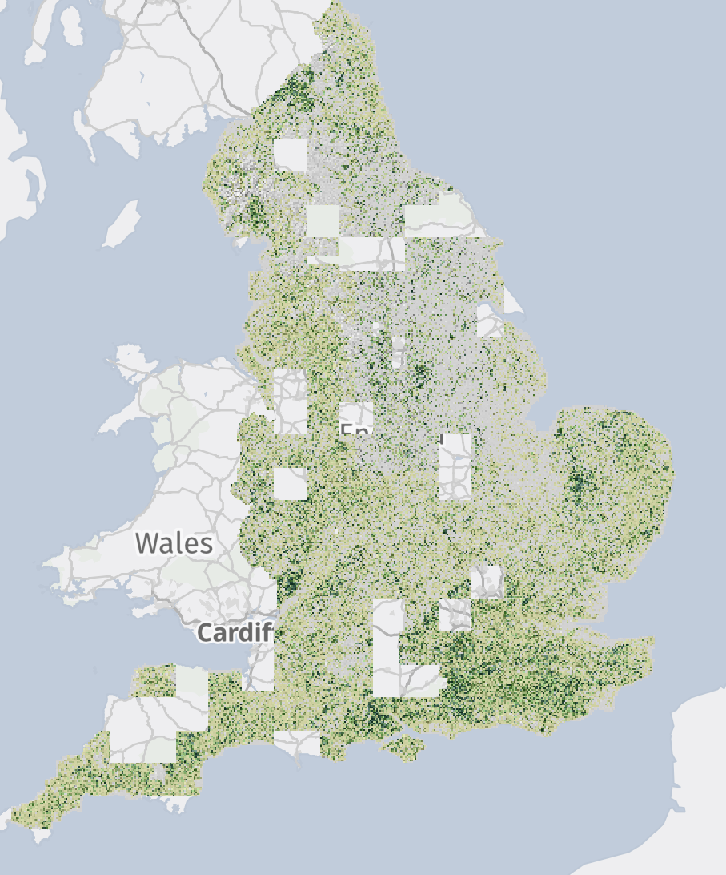
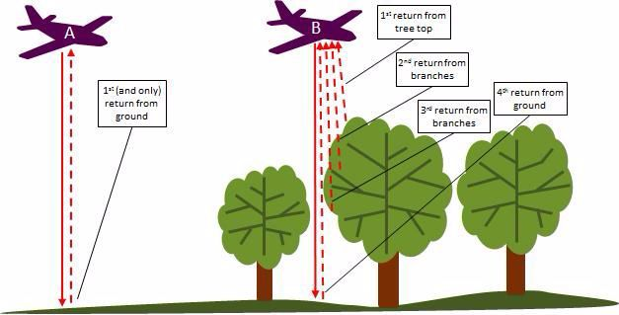
LIDAR MAPPING OF VEGETATION HEIGHT
Vegetation Object Model - GIS modelling using the National LiDAR programme 1m-resolution data with spatial proximity comparisons with OS maps and Sentinel 2 imagery to classify vegetation. Final raster is 1m² pixels of canopy height above ground for all vegetation above 2.5m. Defra Data Services Platform: https://environment.data.gov.uk/DefraDataDownload/
Photos: Environment Agency Geomantics https://experience.arcgis.com/experience/753ad2ebd3554fa696885b8c366c3049/page/LIDAR/?views=LIDAR-Home
Notes:
“The main dataset I used was LiDAR — a remote sensing technique that uses laser pulses to build a three-dimensional picture of the landscape.
By separating returns from the ground and from vegetation, LiDAR lets you reconstruct both the terrain and the structure of the canopy. Subtracting one from the other gives a vegetation height model, which is widely used in ecological and habitat analysis.
Crucially for this project, the Environment Agency is in the process of producing high-resolution LiDAR coverage for all of England, making this kind of analysis possible at landscape scales.”

Slide 8
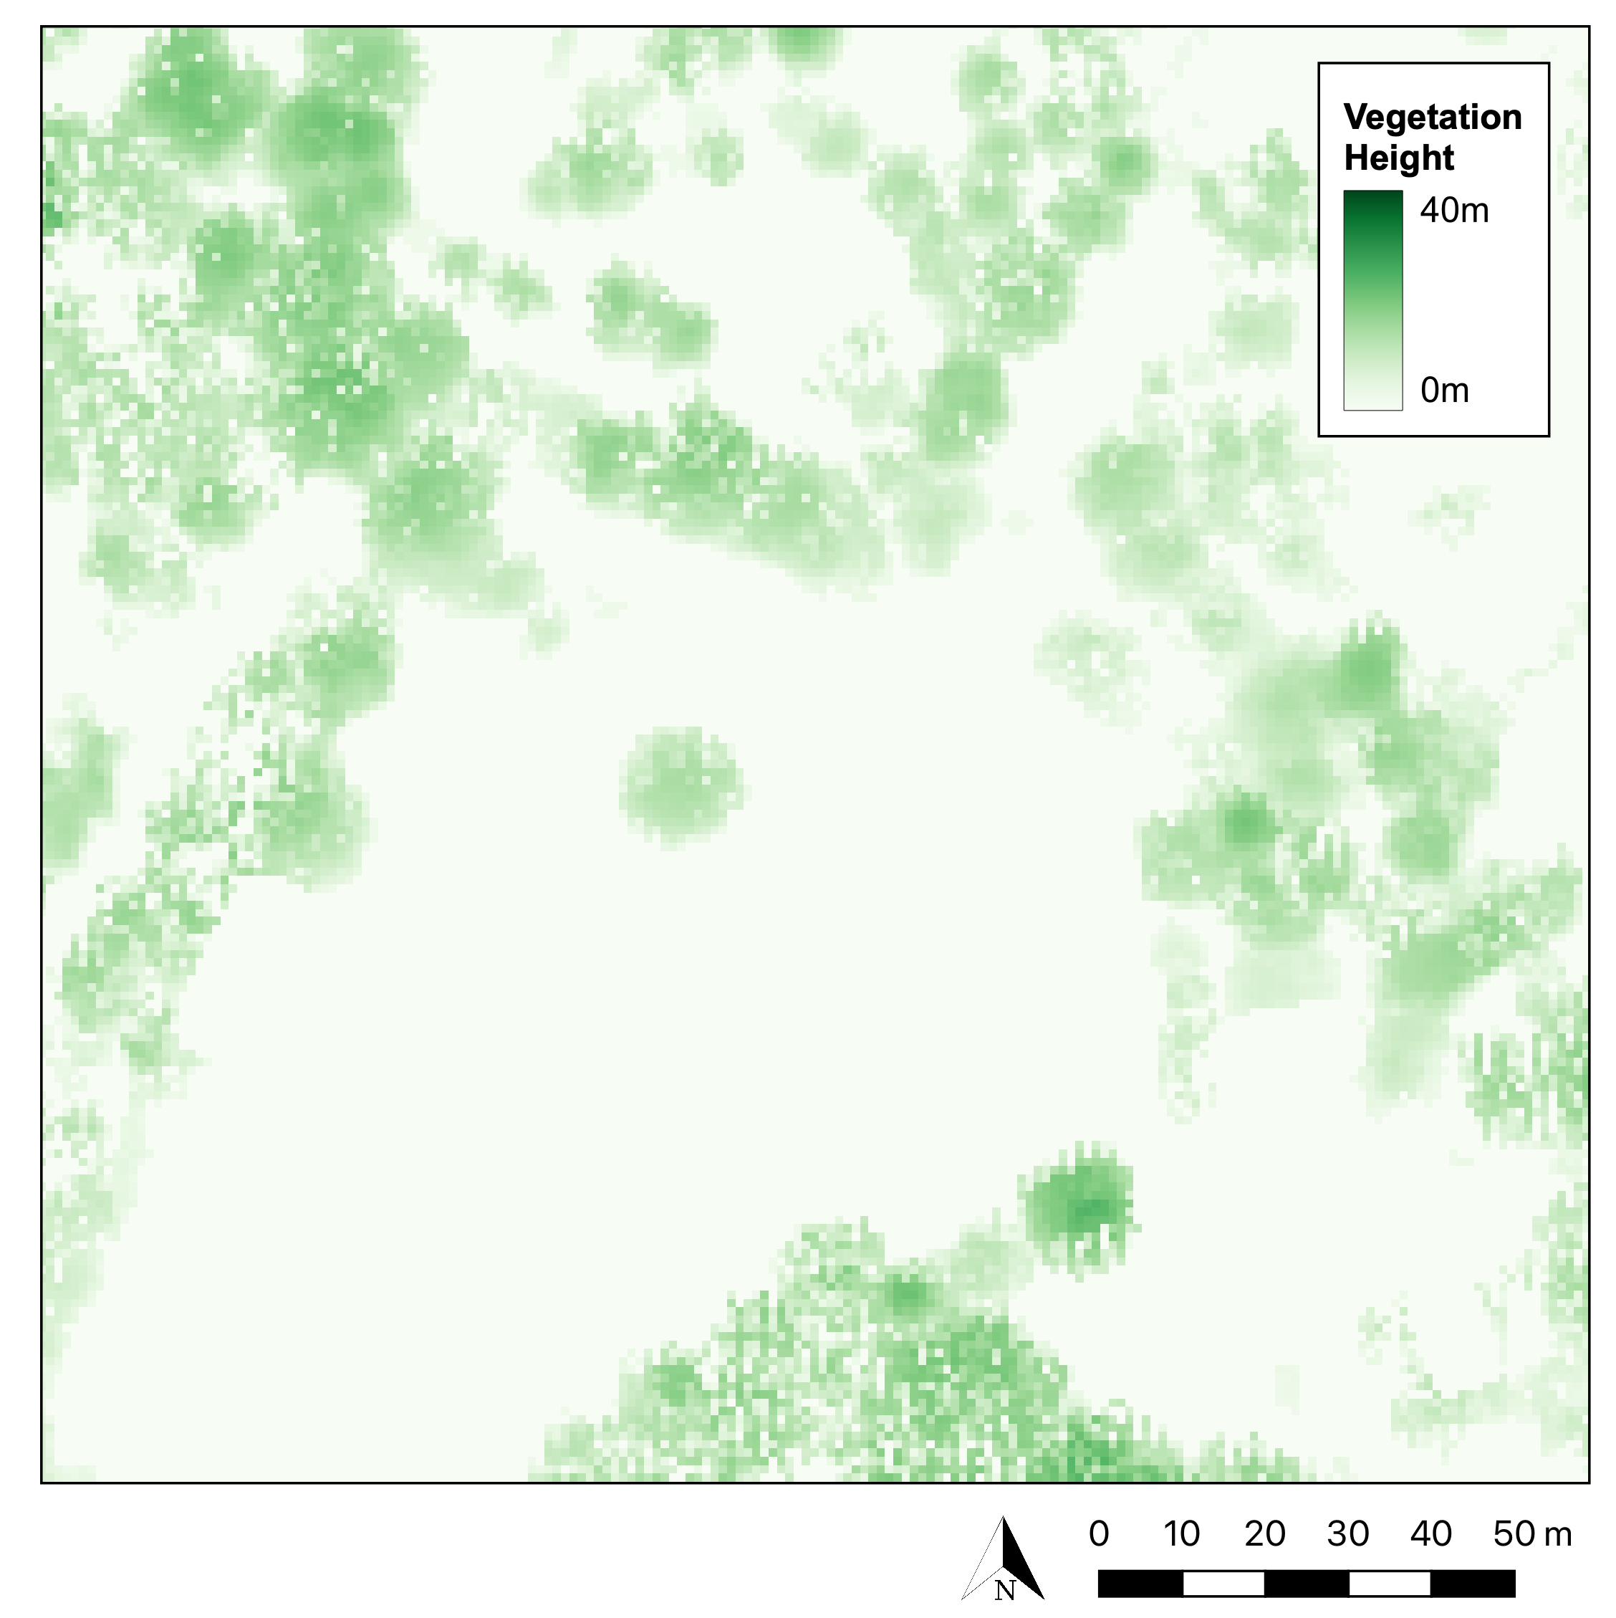
QGIS ANALYSIS
VEGETATION
Vegetation Object Model reclassified to isolate trees. Threshold > 4m.
Contains: National LIDAR Programme Vegetation Object Model on Open Government Licence, https://environment.data.gov.uk/DefraDataDownload/?Mode=survey, Downloaded 2022-06-06.
Notes:
So starting with the vegetation object model, I developed a python-based analysis pipeline to first isolate trees

Slide 9
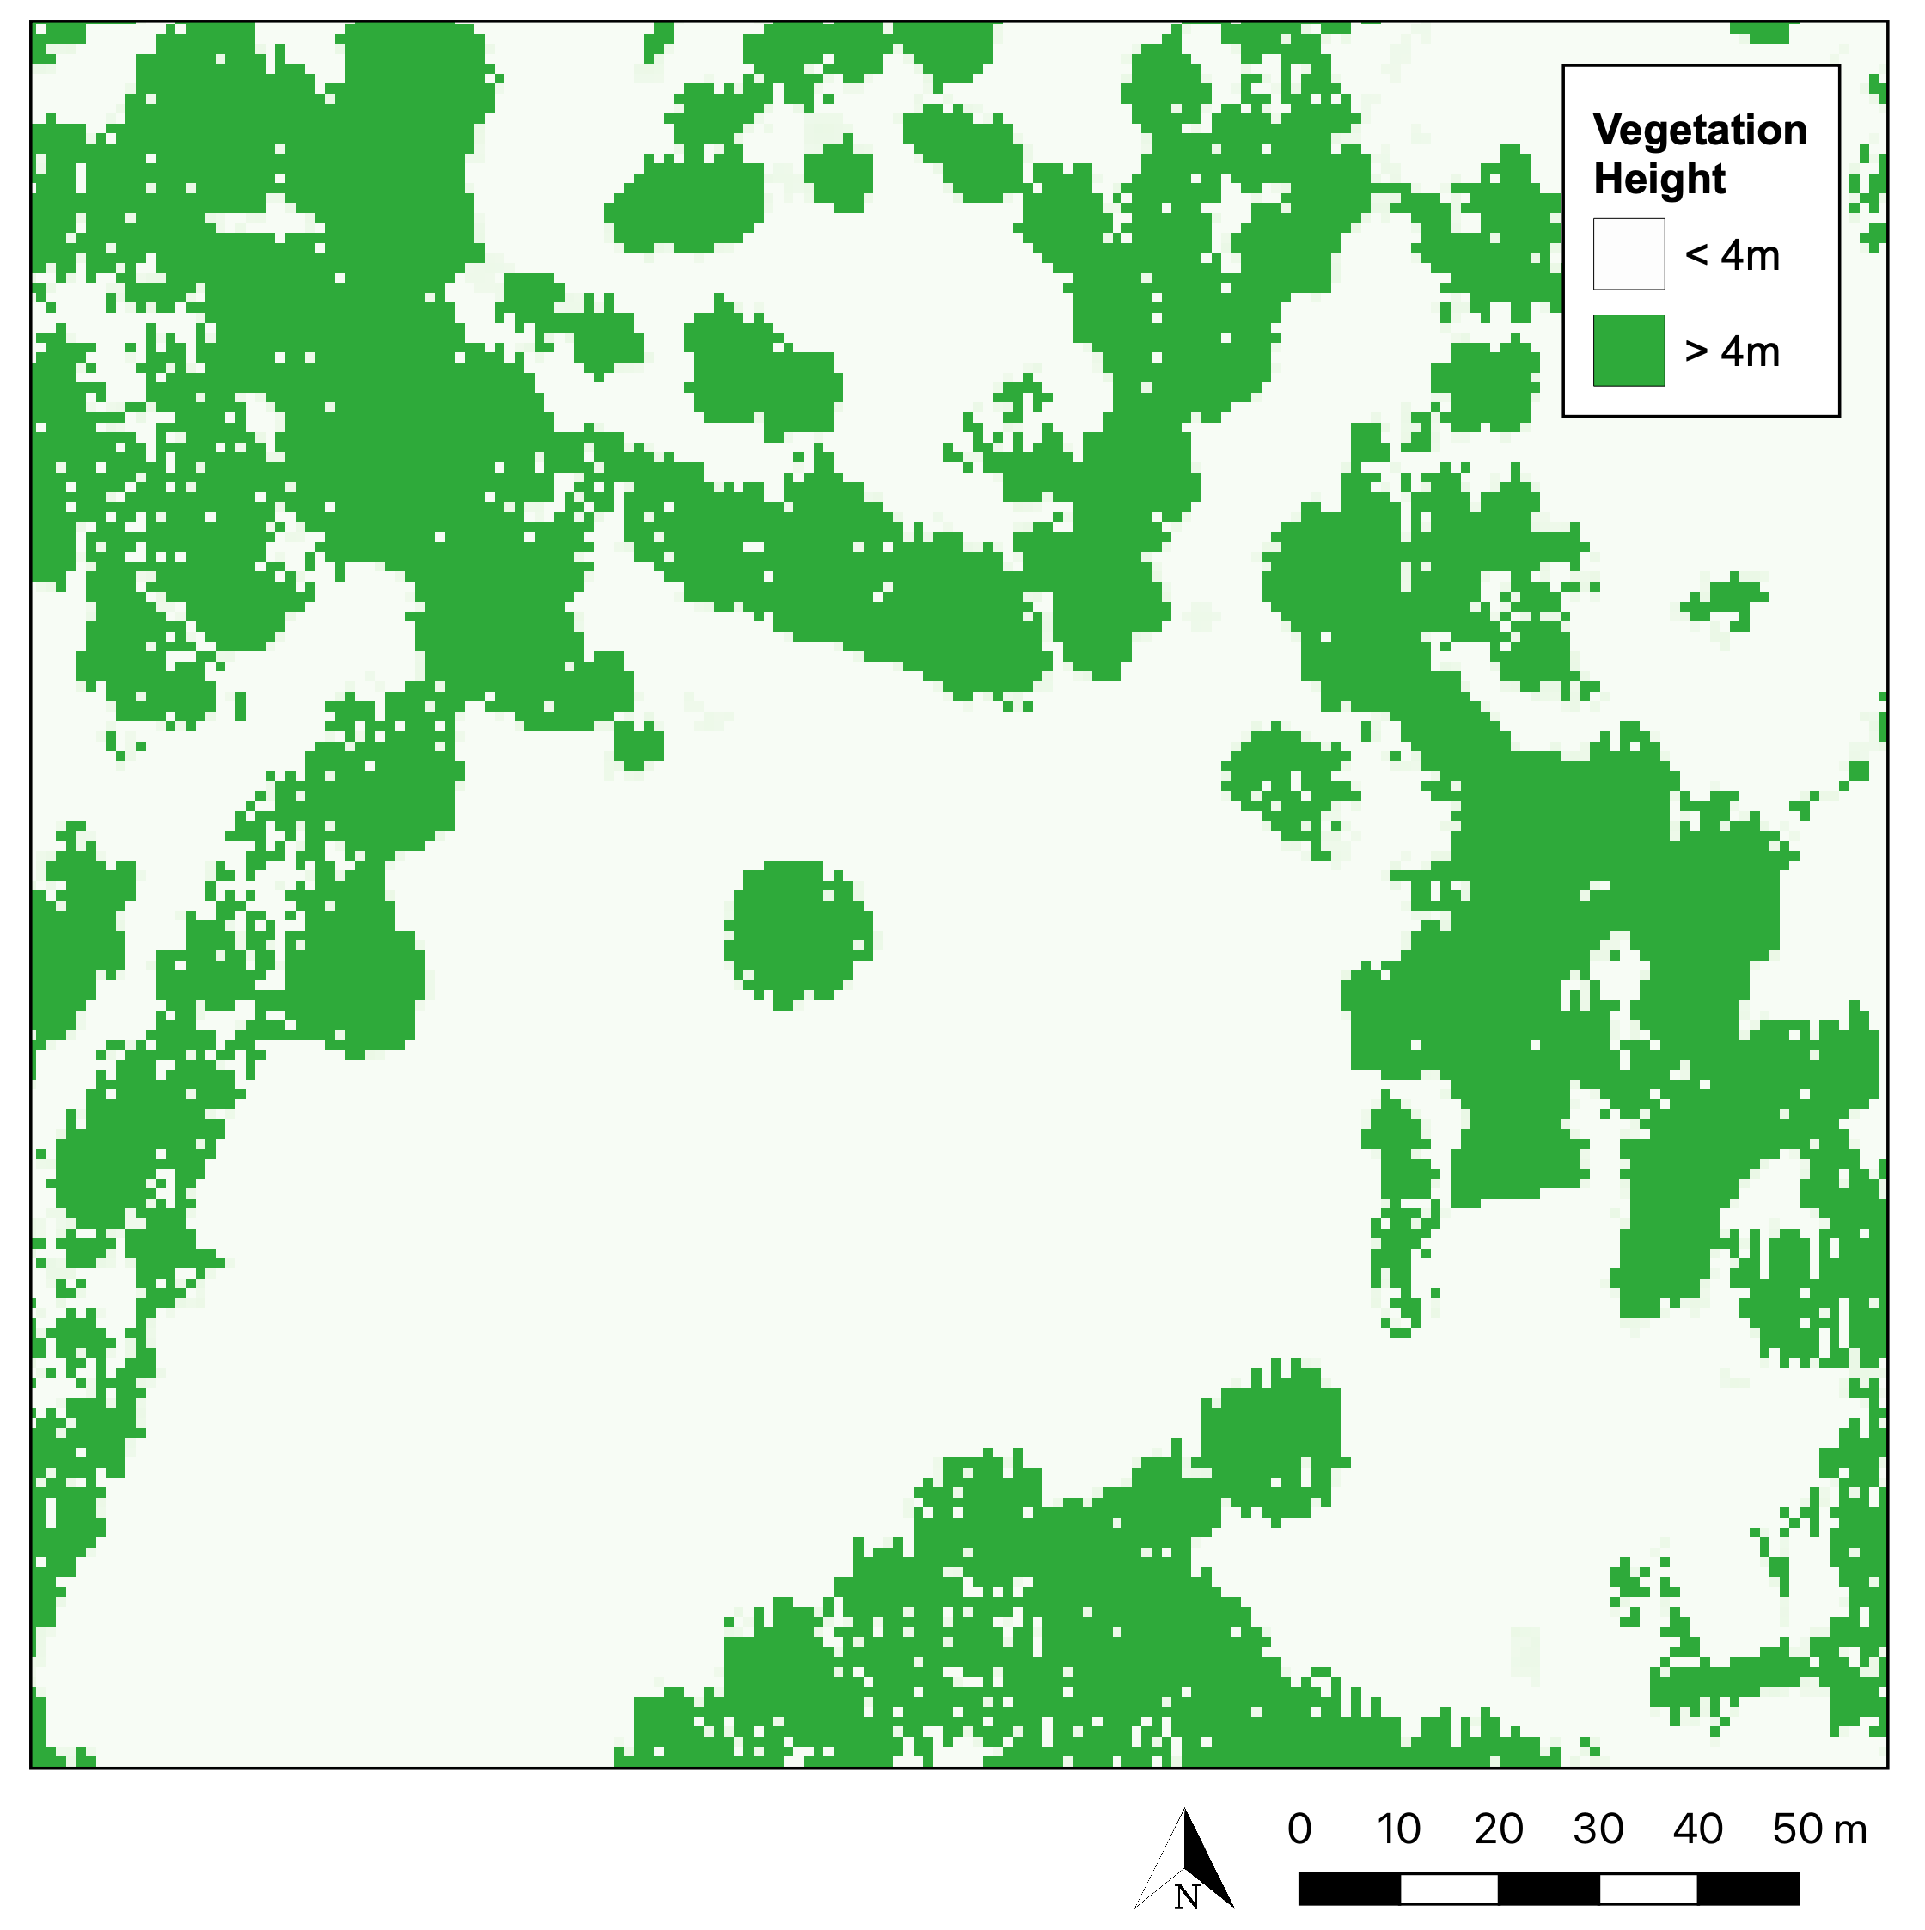
QGIS ANALYSIS
VEGETATION
Vegetation Object Model reclassified to isolate trees. Threshold > 4m.
Contains: National LIDAR Programme Vegetation Object Model on Open Government Licence, https://environment.data.gov.uk/DefraDataDownload/?Mode=survey, Downloaded 2022-06-06.
Notes:
Using a threshold of anything above 4m.

Slide 10
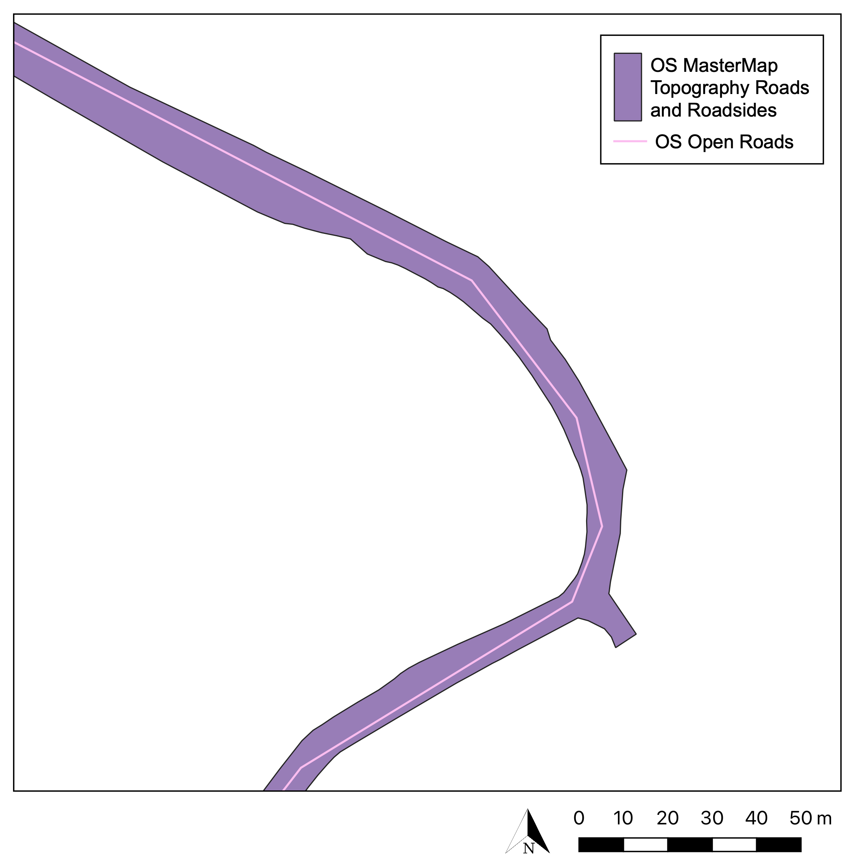
QGIS ANALYSIS
VEGETATION
Vegetation Object Model reclassified to isolate trees. Threshold > 4m.
ROADS
OS MasterMap Topography for road extent. OS Open Roads for road types, names and lengths.
Contains: OS Open Roads on Open Government Licence © Crown copyright and database right 2022 OS MasterMap® Topography Layer [GeoPackage geospatial data], Scale 1:1250, Tiles: GB, Updated: 18 November 2021, Ordnance Survey (GB), using: EDINA Digimap Ordnance Survey Service, https://digimap.edina.ac.uk, Downloaded: 2022-06-07.
Notes:
Utilise OS Maps to identify road extent

Slide 11
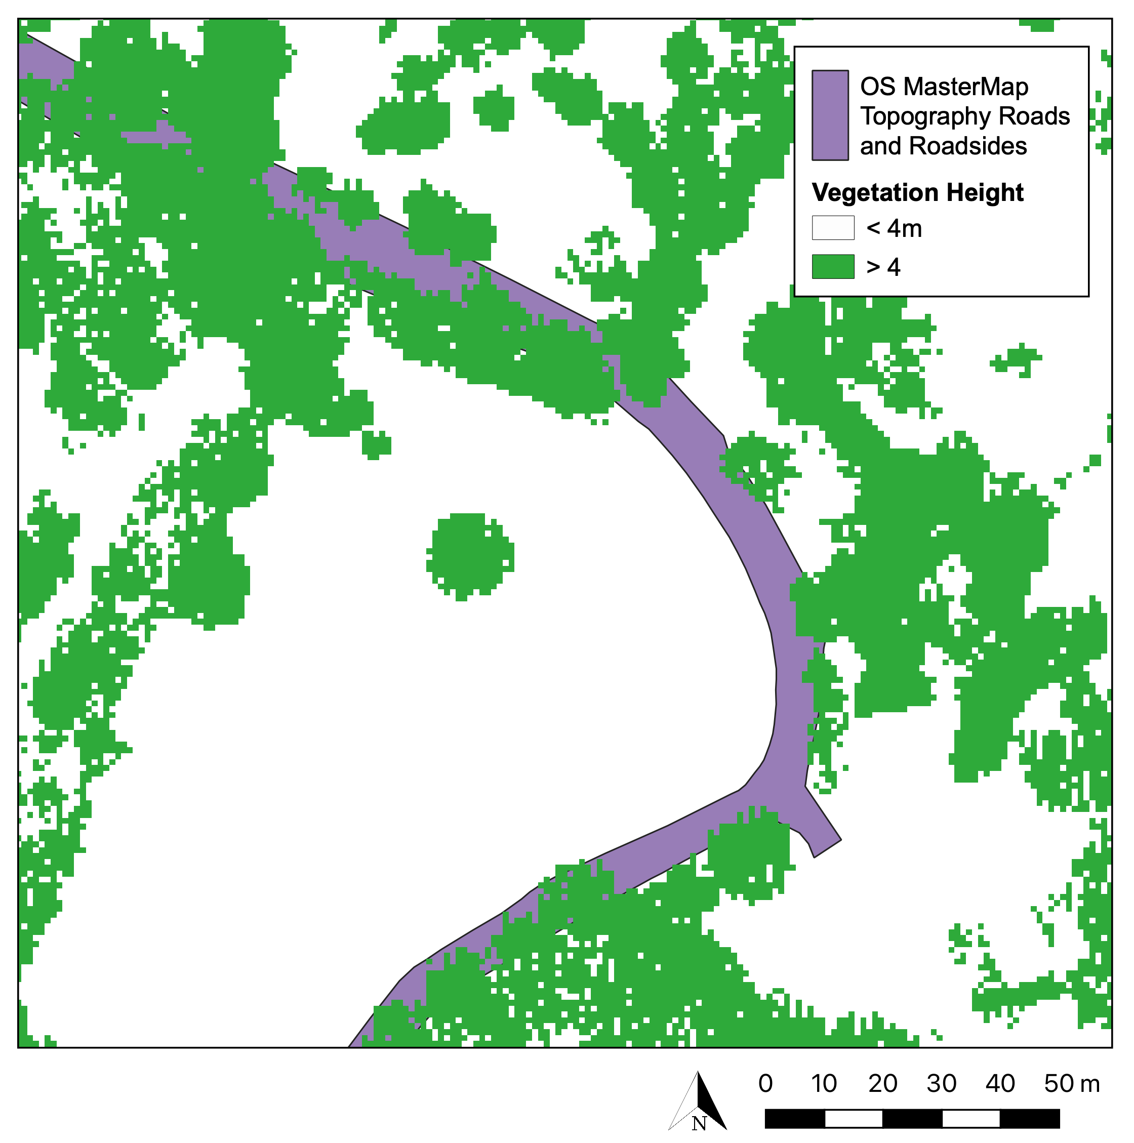
QGIS ANALYSIS
VEGETATION
Vegetation Object Model reclassified to isolate trees. Threshold > 4m.
ROADS
OS MasterMap Topography for road extent. OS Open Roads for road types, names and lengths.
Contains: OS MasterMap® Topography Layer [GeoPackage geospatial data], Scale 1:1250, Tiles: GB, Updated: 18 November 2021, Ordnance Survey (GB), using: EDINA Digimap Ordnance Survey Service, https://digimap.edina.ac.uk, Downloaded: 2022-06-07. National LIDAR Programme Vegetation Object Model on Open Government Licence, https://environment.data.gov.uk/DefraDataDownload/?Mode=survey, Downloaded 2022-06-06.
Notes:
Overlay the vegetation model

Slide 12
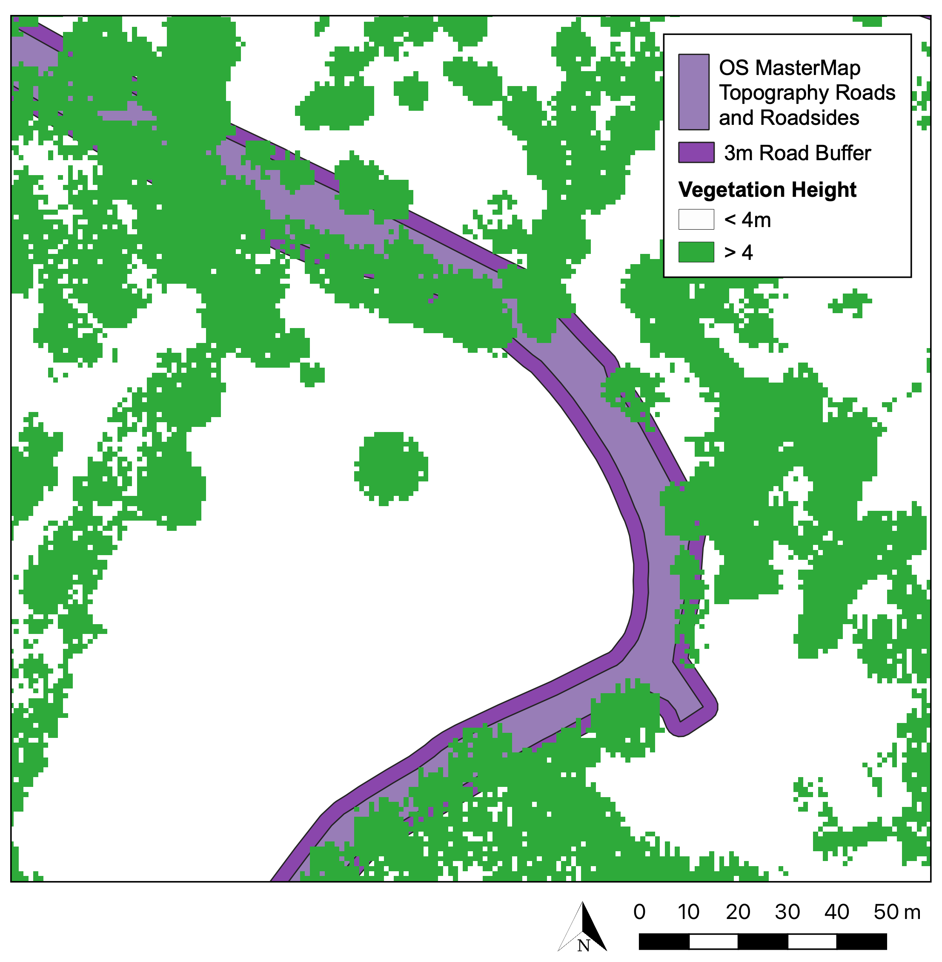
QGIS ANALYSIS
VEGETATION
Vegetation Object Model reclassified to isolate trees. Threshold > 4m.
ROADS
OS MasterMap Topography for road extent. OS Open Roads for road types, names and lengths.
Add 3m road buffer.
Contains: OS MasterMap® Topography Layer [GeoPackage geospatial data], Scale 1:1250, Tiles: GB, Updated: 18 November 2021, Ordnance Survey (GB), using: EDINA Digimap Ordnance Survey Service, https://digimap.edina.ac.uk, Downloaded: 2022-06-07. National LIDAR Programme Vegetation Object Model on Open Government Licence, https://environment.data.gov.uk/DefraDataDownload/?Mode=survey, Downloaded 2022-06-06.
Notes:
Buffer the roads to account for pavements, verges.

Slide 13
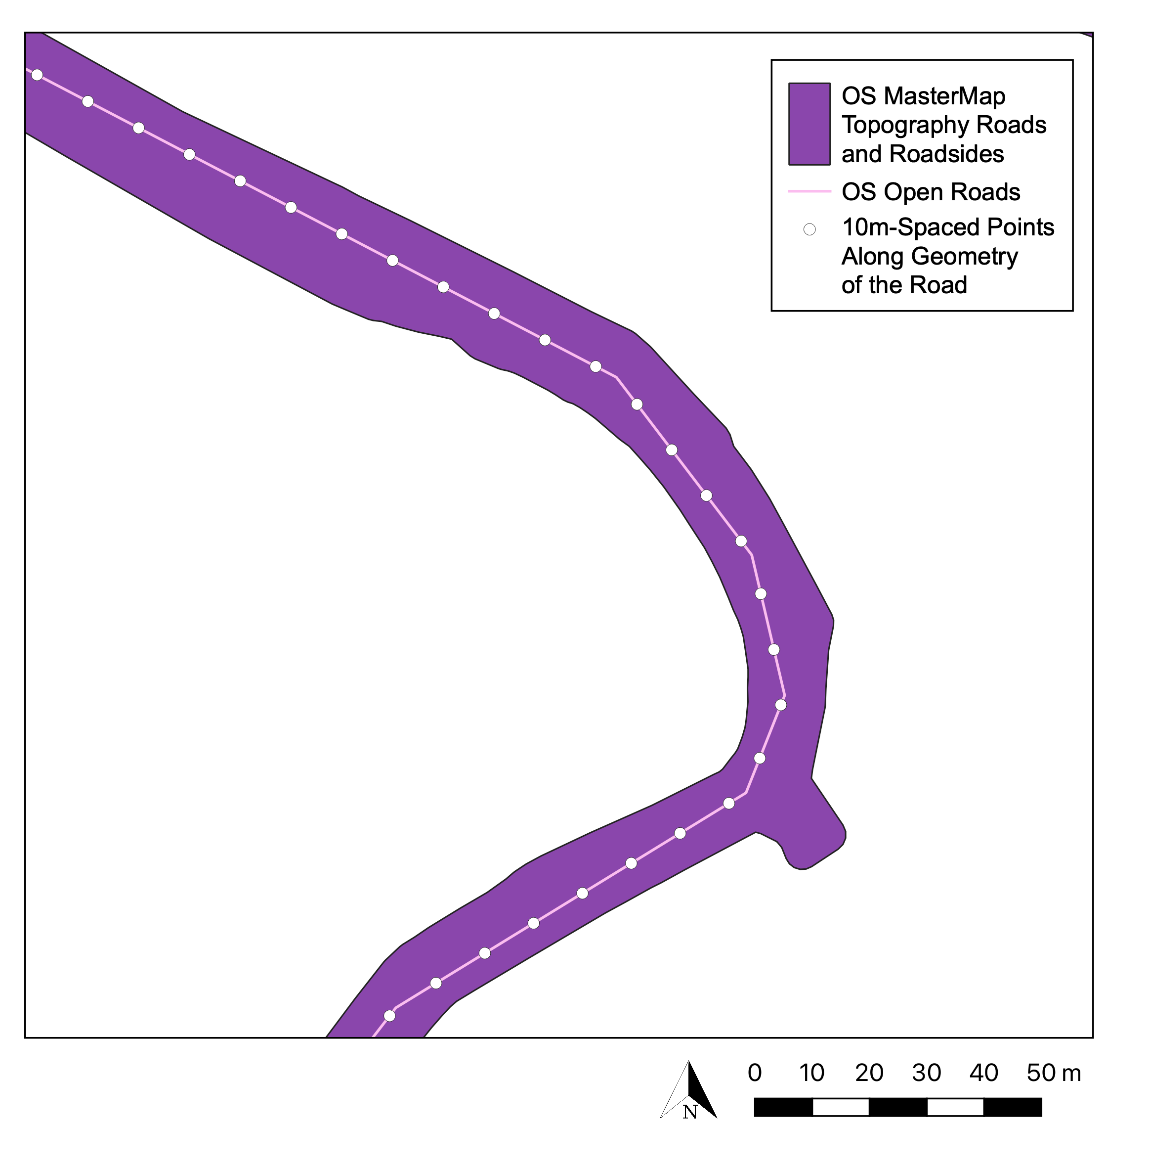
QGIS ANALYSIS
VEGETATION
Vegetation Object Model reclassified to isolate trees. Threshold > 4m.
ROADS
OS MasterMap Topography for road extent. OS Open Roads for road types, names and lengths.
Add 3m road buffer.
GENERATING ROAD SEGMENTS
Points at 10m intervals along OS Open Roads.
Contains: OS Open Roads on Open Government Licence © Crown copyright and database right 2022 OS MasterMap® Topography Layer [GeoPackage geospatial data], Scale 1:1250, Tiles: GB, Updated: 18 November 2021, Ordnance Survey (GB), using: EDINA Digimap Ordnance Survey Service, https://digimap.edina.ac.uk, Downloaded: 2022-06-07.
Notes:
Split the road by placing points at 10m intervals,

Slide 14
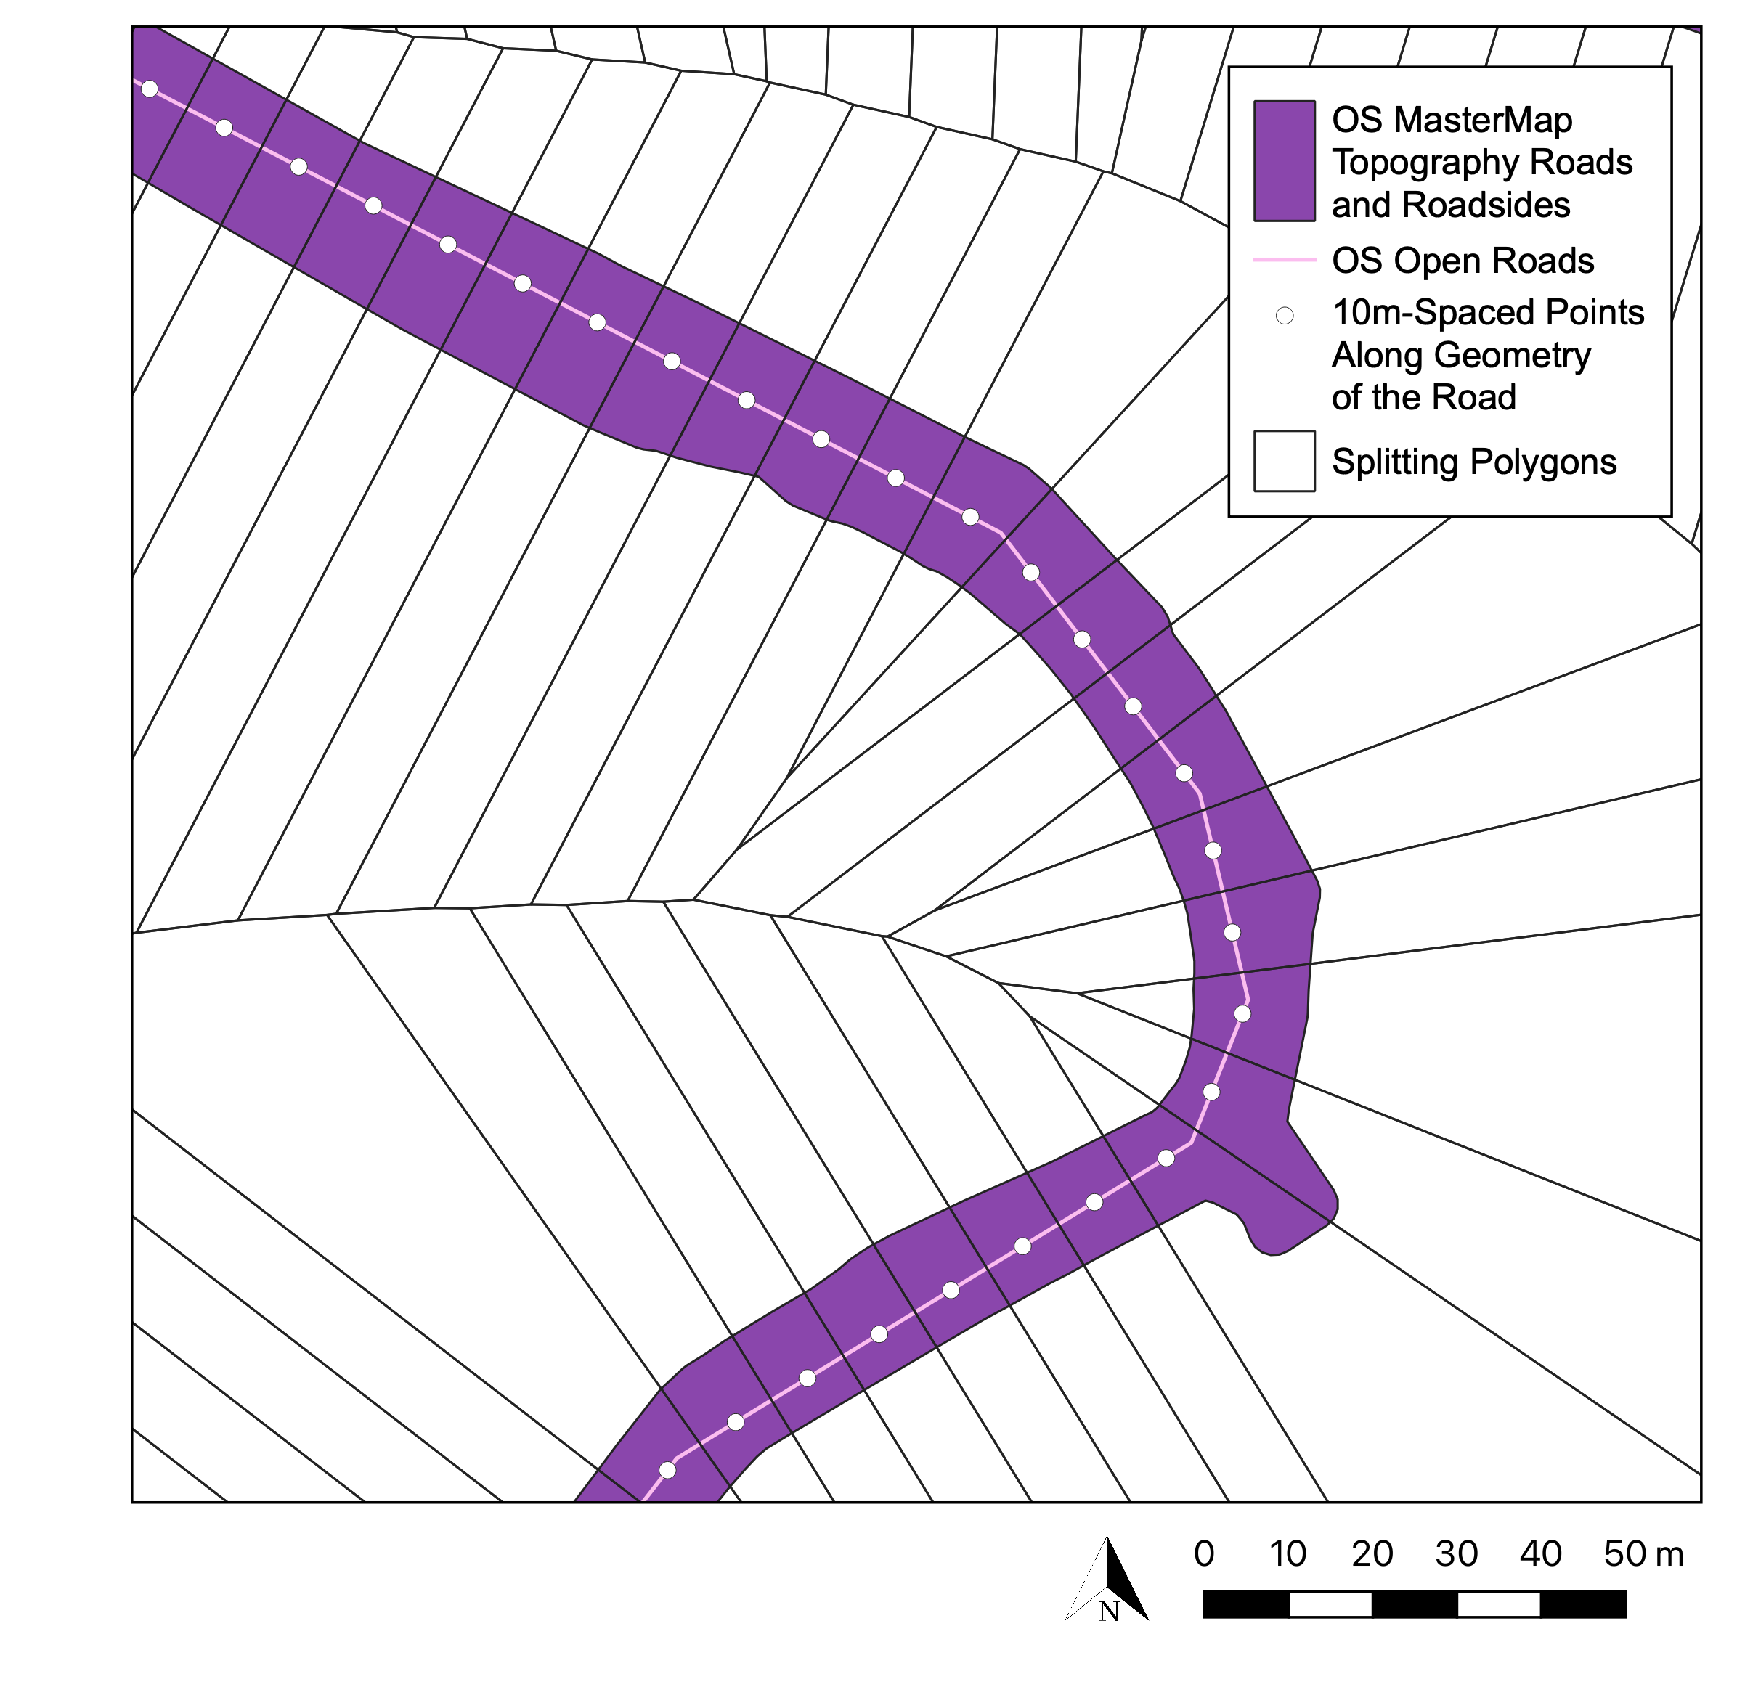
QGIS ANALYSIS
VEGETATION
Vegetation Object Model reclassified to isolate trees. Threshold > 4m.
ROADS
OS MasterMap Topography for road extent. OS Open Roads for road types, names and lengths.
Add 3m road buffer.
GENERATING ROAD SEGMENTS
Points at 10m intervals along OS Open Roads.
Polygons centred around points used to split the road.
Contains: OS Open Roads on Open Government Licence © Crown copyright and database right 2022 OS MasterMap® Topography Layer [GeoPackage geospatial data], Scale 1:1250, Tiles: GB, Updated: 18 November 2021, Ordnance Survey (GB), using: EDINA Digimap Ordnance Survey Service, https://digimap.edina.ac.uk, Downloaded: 2022-06-07.
Notes:
Then segmented it with polygons centred around the dogs.

Slide 15
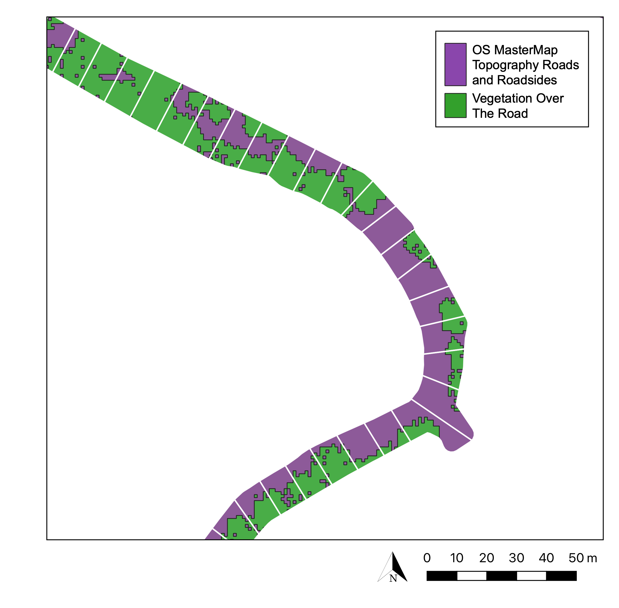
QGIS ANALYSIS
VEGETATION
Vegetation Object Model reclassified to isolate trees. Threshold > 4m.
ROADS
OS MasterMap Topography for road extent. OS Open Roads for road types, names and lengths.
Add 3m road buffer.
GENERATING ROAD SEGMENTS
Points at 10m intervals along OS Open Roads.
Polygons centred around points used to split the road.
PERCENTAGE VEGETATION COVER
Clip vegetation to the extent of the road.
Calculate the percentage cover in each road section.
Contains: OS Open Roads data © Crown copyright and database right 2022. OS MasterMap® Topography Layer [GeoPackage geospatial data], Scale 1:1250, Tiles: GB, Updated: 18 November 2021, Ordnance Survey (GB), Using: EDINA Digimap Ordnance Survey Service, https://digimap.edina.ac.uk, Downloaded: 2022-06-07. National LIDAR Programme Vegetation Object Model on Open Government Licence, https://environment.data.gov.uk/DefraDataDownload/?Mode=survey, Downloaded 2022-06-06.
Notes:
Calculate the percentage vegetation in each segment of road

Slide 16
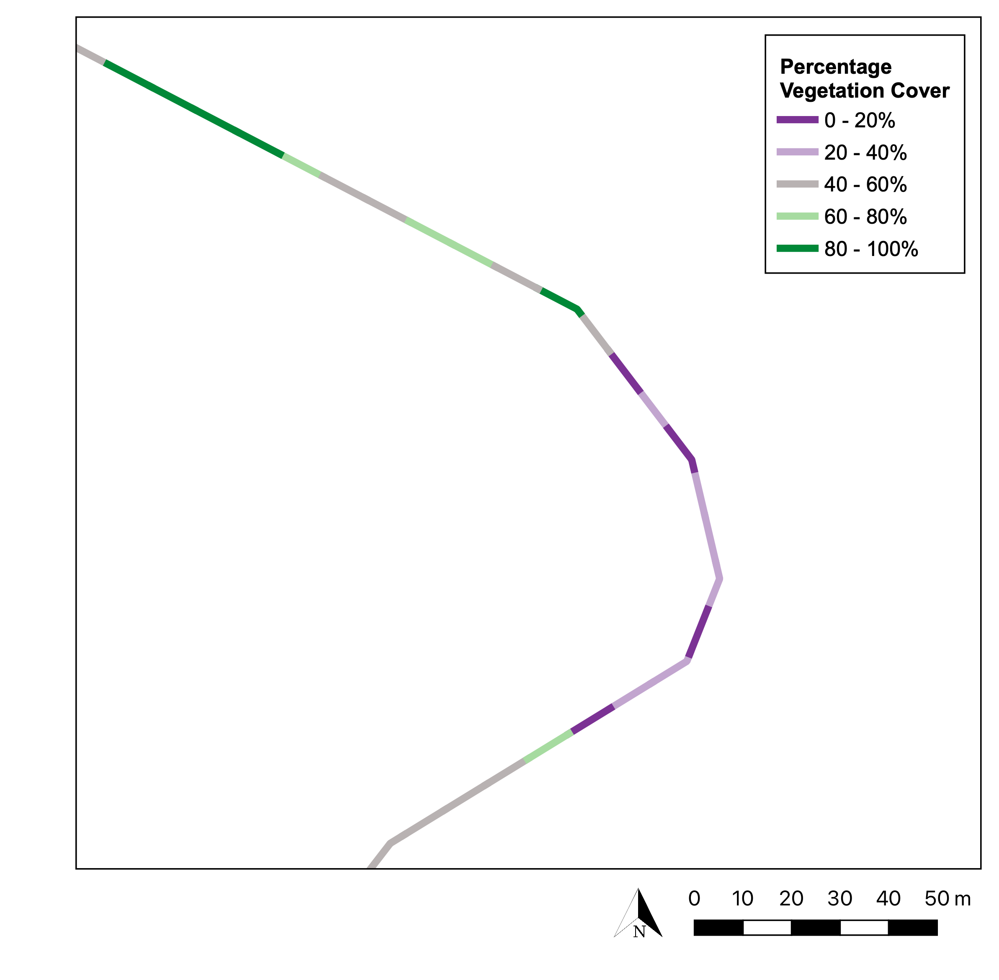
QGIS ANALYSIS
VEGETATION
Vegetation Object Model reclassified to isolate trees. Threshold > 4m.
ROADS
OS MasterMap Topography for road extent. OS Open Roads for road types, names and lengths.
Add 3m road buffer.
GENERATING ROAD SEGMENTS
Points at 10m intervals along OS Open Roads.
Polygons centred around points used to split the road.
PERCENTAGE VEGETATION COVER
Clip vegetation to the extent of the road.
Calculate the percentage cover in each road section.
Overlay OS Open Roads with percentages.
Contains: OS Open Roads data © Crown copyright and database right 2022. OS MasterMap® Topography Layer [GeoPackage geospatial data], Scale 1:1250, Tiles: GB, Updated: 18 November 2021, Ordnance Survey (GB), Using: EDINA Digimap Ordnance Survey Service, https://digimap.edina.ac.uk, Downloaded: 2022-06-07. National LIDAR Programme Vegetation Object Model on Open Government Licence, https://environment.data.gov.uk/DefraDataDownload/?Mode=survey, Downloaded 2022-06-06.
Notes:
Apply those percentages as a feature across the road network

Slide 17
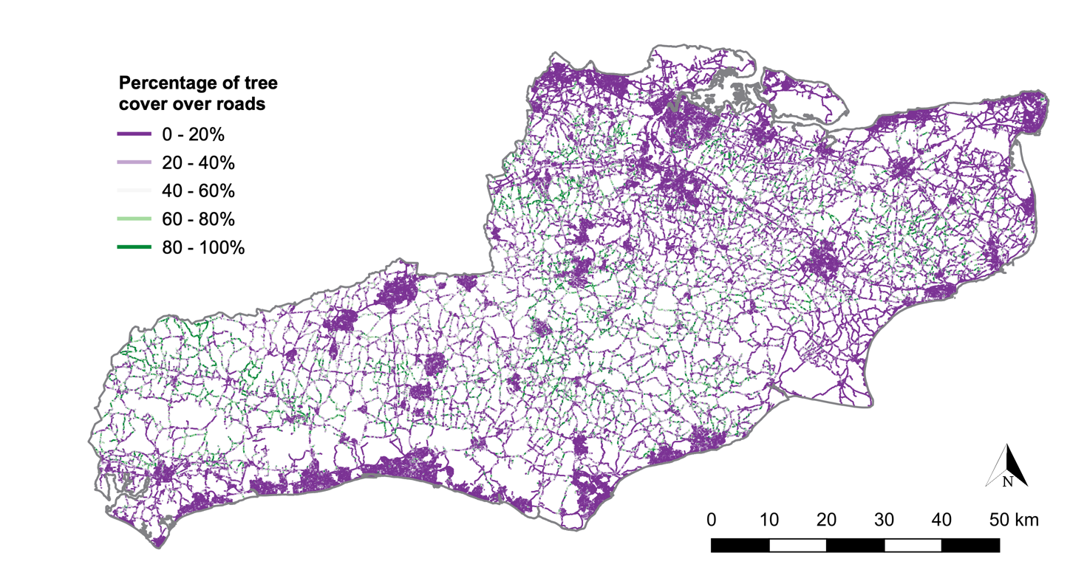
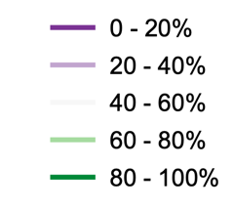
PERCENTAGE VEGETATION COVER
18,901km of road.
2.7% of roads had high-percentage vegetation cover (>90%).
Minor roads had more vegetation cover than any other road type and motorways the least.
Contains: OS Open Roads, and Boundary-Line data © Crown copyright and database right 2022. OS MasterMap® Topography Layer [GeoPackage geospatial data], Scale 1:1250, Tiles: GB, Updated: 18 November 2021, Ordnance Survey (GB), Using: EDINA Digimap Ordnance Survey Service, https://digimap.edina.ac.uk, Downloaded: 2022-06-07. National LIDAR Programme Vegetation Object Model on Open Government Licence, https://environment.data.gov.uk/DefraDataDownload/?Mode=survey, Downloaded 2022-06-06.
Notes:
And scale it across landscapes – so here is the whole road network of Sussex and Kent.

Slide 18
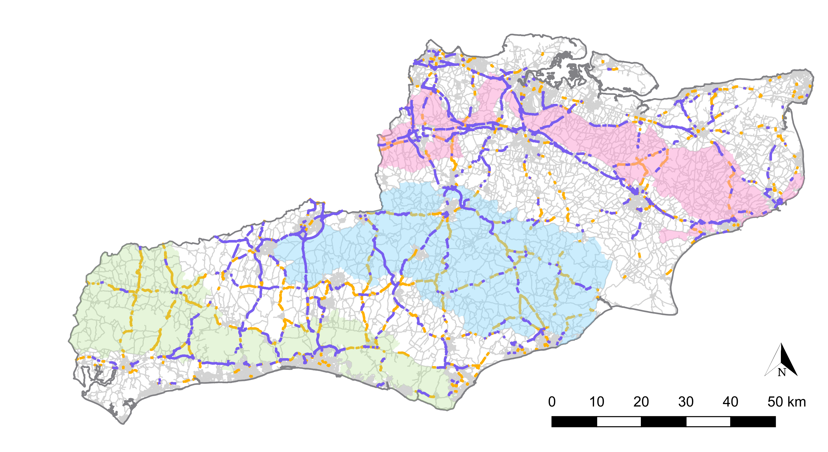
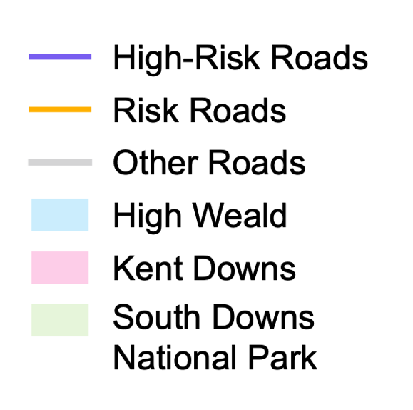

HIGH RISK ROADS FOR PINE MARTENS
Motorways and A-roads are high risk for pine martens.*
Risk roads: Within 75m** of woodland. High-risk roads: Within a ≥5% woodland 1km square and >1km from an arboreal road crossing (>90% vegetation cover in GIS model).
Contains: OS Open Roads, National Forestry Inventory Woodland England 2019 data and Boundary-Line data © Crown copyright and database right 2022. OS MasterMap® Topography Layer [GeoPackage geospatial data], Scale 1:1250, Tiles: GB, Updated: 18 November 2021, Ordnance Survey (GB), Using: EDINA Digimap Ordnance Survey Service, https://digimap.edina.ac.uk, Downloaded: 2022-06-07. National LIDAR Programme Vegetation Object Model on Open Government Licence, https://environment.data.gov.uk/DefraDataDownload/?Mode=survey, Downloaded 2022-06-06.
Notes:
Using these I was able to identify high risk roads – the combination of being a major road, within a certain distance of suitable pine marten woodland habitat, and lacking canopy connectivity across the road. This is now being used across pine marten reintroduction projects to identify high and low risk areas.

Slide 19
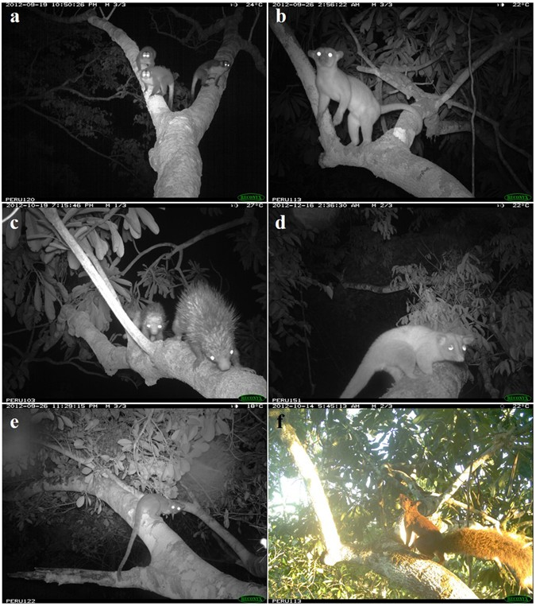
Gregory, T. et al (2017). Natural canopy bridges effectively mitigate tropical forest fragmentation for arboreal mammals. Nature Sci Rep, 7(1), 3892
Notes:
“This approach is not limited to pine martens. It can be applied to habitat mapping for any arboreal species that relies on tree canopies to cross roads or other linear infrastructure, wherever suitable LiDAR data are available.
Here, for example, are four species using natural canopy bridges across pipeline clearings in the southern Amazon.”
(a) Black-headed night monkey (Aotus nigriceps), (b) kinkajou (Potos flavus), (c) streaked dwarf porcupine (Coendou ichillus), (d) brown-eared woolly opossum (Caluromys lanatus).

Slide 20

Biodiversity Footprints
Quantifying how, where, and how much pressure human activities place on nature
Consistent framework for comparing environmental impacts
Identifying major drivers of nature loss
Prioritising actions to reduce harm and support recovery
Notes:
Another major part of my work for the past few years has been exploring biodiversity footprinting as a way of summarising how, where and how much pressure human activities place on nature, in much the same way that a carbon footprint summarises impacts on the climate. It combines information on land use, resource extraction, pollution, and supply chains to estimate how activities affect species and ecosystems, often across multiple locations. While the metrics are imperfect and uncertain, biodiversity footprints provide a consistent framework for comparing impacts, identifying major drivers of nature loss, and prioritising actions to reduce harm and support recovery.

Slide 21

Notes:
A useful way to think about biodiversity footprints is through a simple example we used in a recent paper: a chocolate cake.

Slide 22



Ingredients
Notes:
A single product like this contains many ingredients

Slide 23
Life Cycle Stages
Production
Processing
Packaging
Consumption
Ingredients
End of life
Notes:
and each of those ingredients has multiple life-cycle stages — production, processing, transport, packaging, consumption, and end-of-life.

Slide 24
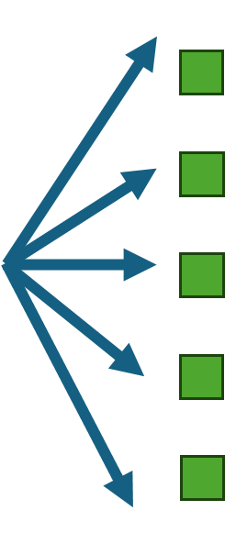
Life Cycle Stages
Production
Processing
Multiple locations and activity types
Packaging
Consumption
Ingredients
End of life
Notes:
Those stages often occur in different locations and involve different types of activity.

Slide 25
Land Use / Habitat loss & Fragmentation
Overexploitation
Life Cycle Stages
Pollution
Production
Water use
Processing
Climate change
Multiple locations and activity types
Packaging
Biodiversity Pressures
Consumption
Ingredients
End of life
Notes:
Each activity creates different pressures on nature: land use and habitat loss from agriculture, over-exploitation of resources, water use and pollution, and greenhouse gas emissions.

Slide 26
Land Use / Habitat loss & Fragmentation
Overexploitation
Life Cycle Stages
Pollution
Production
Water use
Processing
Overall impact on biodiversity
Climate change
Multiple locations and activity types
Packaging
Biodiversity Pressures
Consumption
Ingredients
End of life
Notes:
The impacts of those pressures depend on where they occur, and they affect a wide range of species, not just pine martens, but many, depending on their vulnerabilities to different pressures and ranges.
When you bring this together, you get a biodiversity footprint: a way of identifying where the major impacts occur, and which ingredients and pressure pathways are driving them

Slide 27
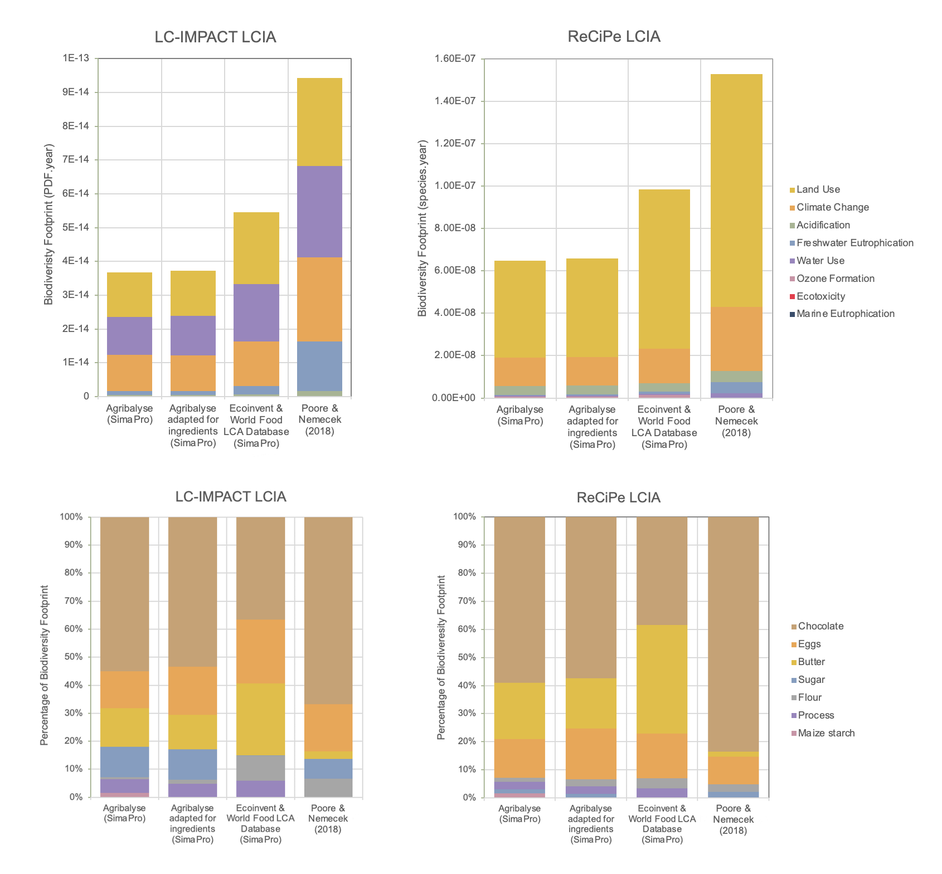
Notes:
In this example, chocolate consistently emerges as a dominant source of impact.

Slide 28
Notes:
You can also break the footprint down by pressure pathway — for example land use, water use, and climate change. The unit we use here is the potentially disappeared fraction of species over a year, which reflects the proportion of species expected to be lost under sustained pressure.

Slide 29
Notes:
One thing we explored in this work was uncertainty. Each bar you see here represents a different modelling approach. What’s interesting is that, regardless of the model, chocolate almost always appears as a major driver in the lower two plots. But the relative importance of different pressure pathways in the top row of plots varies a lot depending on model choices.
The reason for this variability is that the way different environmental pressures translate into biodiversity loss is still modelled in very simplified ways. Many impact models are based on limited systems, capture only certain components of biodiversity, or rely on assumptions that don’t generalise well across regions or taxa.
As a result, while we can often identify robust drivers of impact, like specific ingredients, the relative importance of different pressure pathways is much more uncertain. That uncertainty is large, structural, and often under-acknowledged.
These models are still a starting point — useful for highlighting hotspots and broad patterns — but they need to be used with care, and with uncertainty made explicit rather than hidden.

Slide 30

Notes:
Much of my research in this area has focused on understanding that uncertainty — how much confidence we can place in these numbers, and how they can be used responsibly. They are ultimately acting as a proxy for what could be happening in these complex systems, but they are not capturing all of it, including the way these different impact pathways compound and interact, and they may not reflect what is actually happening on the ground.

Slide 31

Notes:
“That question really matters because these metrics are increasingly used by organisations to design sustainability strategies: deciding what to avoid, what to reduce, and what — if anything — might be offset.

Slide 32

Notes:
I’ve also looked at the relationship between biodiversity and climate footprints. In some cases there are synergies — actions that reduce both. In others there are trade-offs, where climate-focused interventions can worsen biodiversity impacts.

Slide 33

Notes:
This becomes especially challenging when organisations try to balance negative impacts against positive actions, which raises real risks around greenwashing, where organisations say they are doing nice things like planting wild flower meadows, meanwhile their overseas impacts are destroying rainforests.

Slide 34

Notes:
How we communicate both the science and the uncertainty of biodiversity footprinting is therefore crucial.
Even the basic concept of biodiversity is difficult to convey — it spans species, populations, habitats, and ecosystem functions, often in places far removed from where decisions are made. Connecting everyday activities to ecological impacts on the other side of the world is inherently challenging.
Unlike climate, there is no single equivalent of a CO₂ metric. Biodiversity is multidimensional: different pressures affect different components of nature, at different scales, and in different contexts.
That means no single number can capture everything that matters. The challenge is not to oversimplify, but to communicate complexity in a way that still supports meaningful action.”

Slide 35

Notes:
“For all of these reasons, a major part of my work has focused on applying these ideas in real-world case studies — to see what actually happens when organisations try to build sustainability strategies around biodiversity footprinting, with all of its complexity and uncertainty.

Slide 36
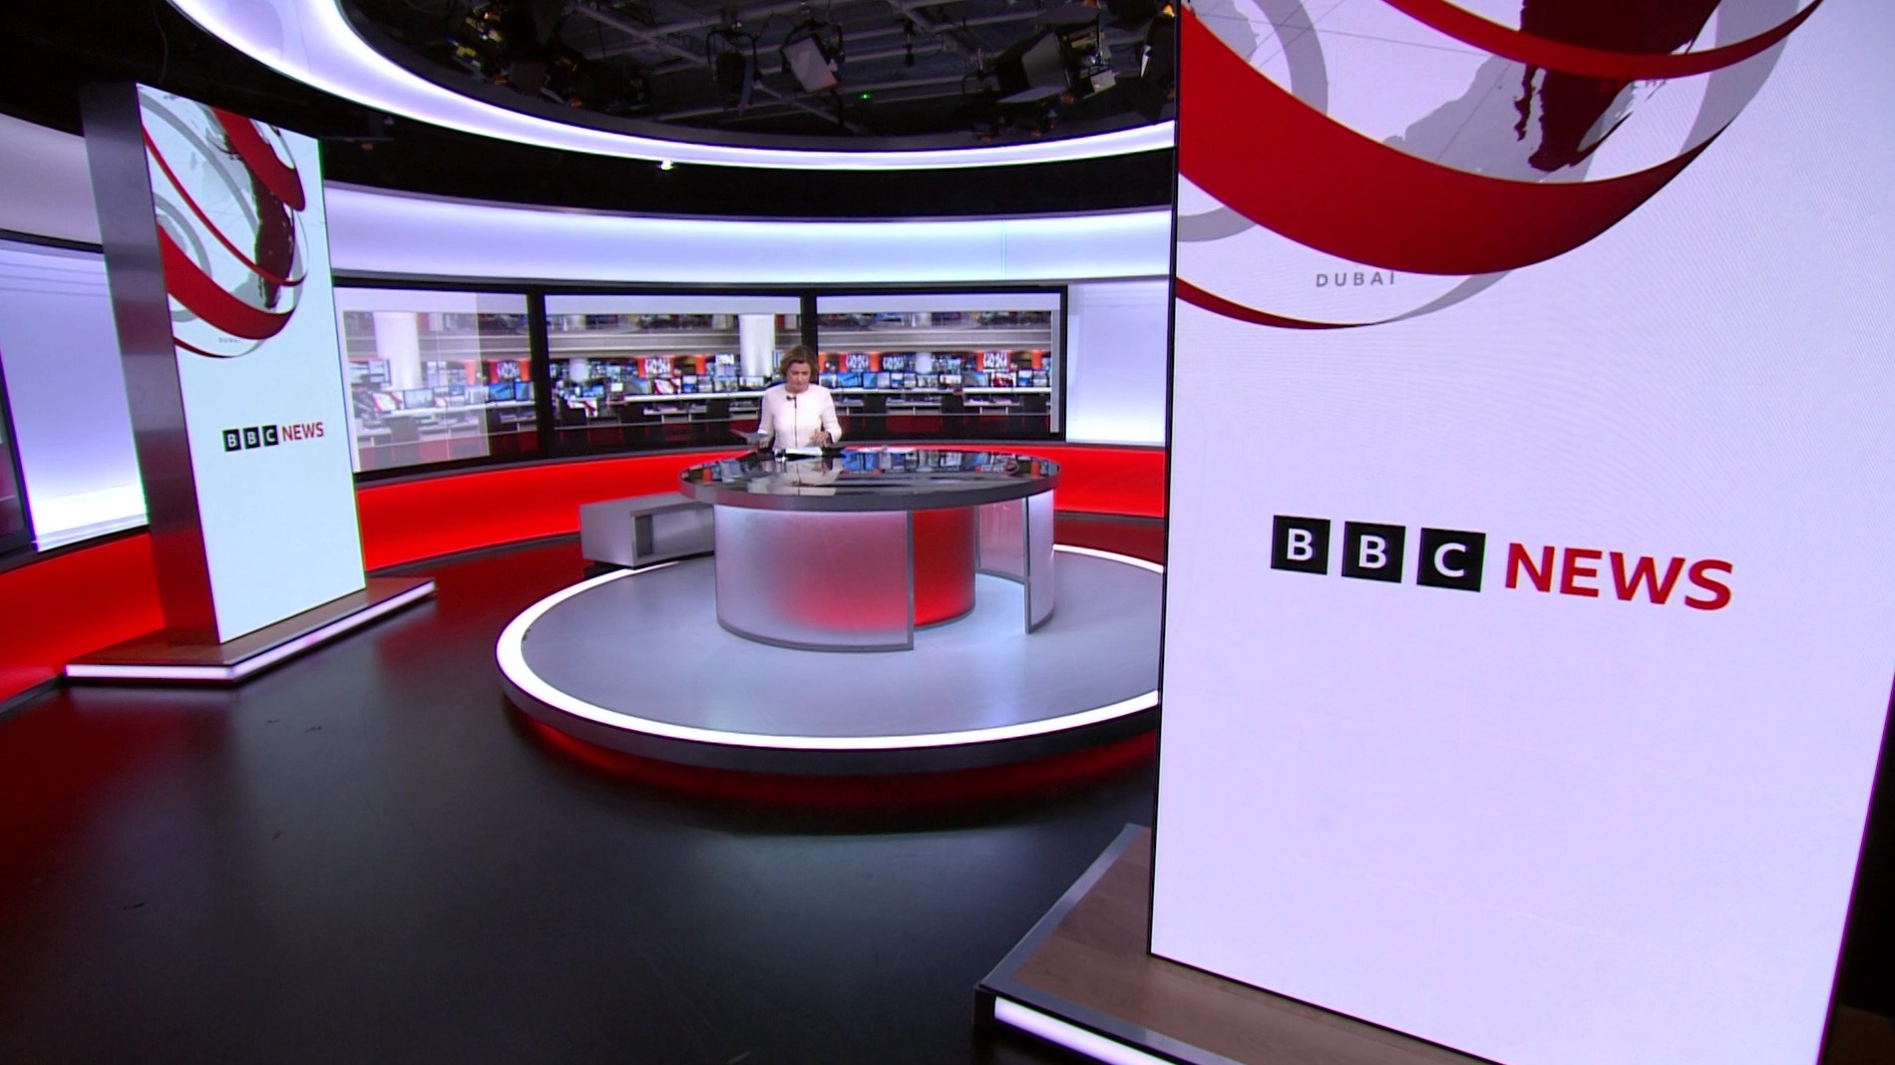
Notes:
I worked with the BBC to assess biodiversity impacts across their entire operation — from buildings and electronic infrastructure at their sites around the world, to supply chains and digital delivery systems.
If you compare watching live on a TV versus streaming it on your laptop, the difference in environmental impact mainly comes down to the device’s energy use and the distribution method. A large TV generally consumes more electricity than a laptop when playing the same content, simply because of its bigger screen and higher power draw — so, all else equal, watching on a laptop tends to use less energy at the device level.
At the distribution level, recent analyses suggest that the energy gap between traditional broadcast and internet streaming is now quite small and narrowing as networks and streaming infrastructure become more efficient. In fact, the difference in hourly energy use between broadcast and streaming can be only on the order of a few watt-hours, and streaming is expected to become more efficient than broadcast over time.
However, the total environmental impact of either option also depends on where your electricity comes from (renewable versus fossil-fuel sources), the efficiency of data networks, and how long and at what resolution you watch. So while a laptop stream tends to be lower-impact than watching on a big TV, neither option is “impact-free,” and the differences are smaller than many people assume.

Slide 37
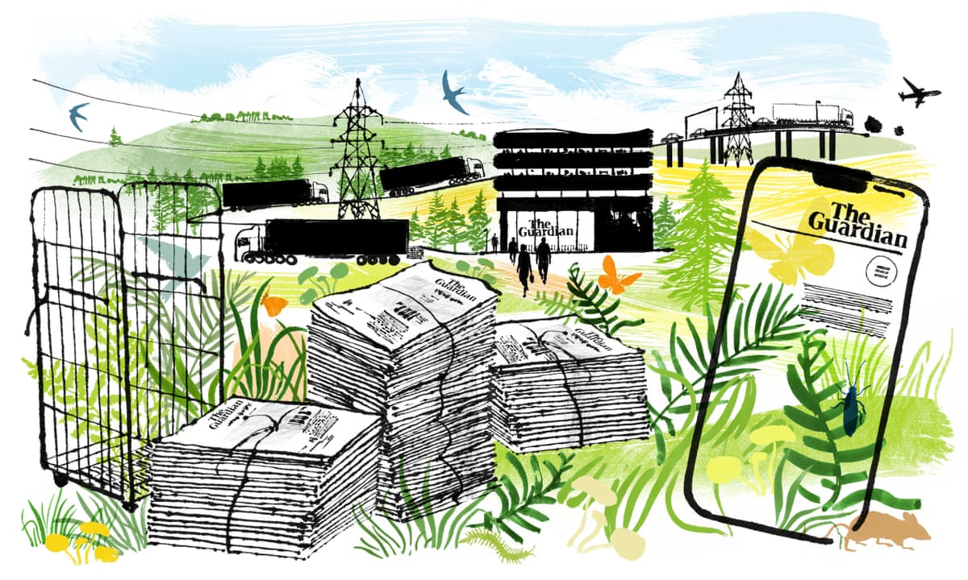
Notes:
With the Guardian, we looked at the impacts of both print and digital media, and they used the results as a public communication exercise to explain biodiversity footprinting to their readers.

Slide 38
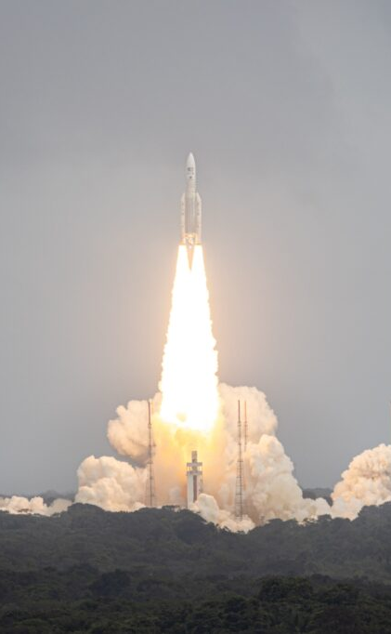
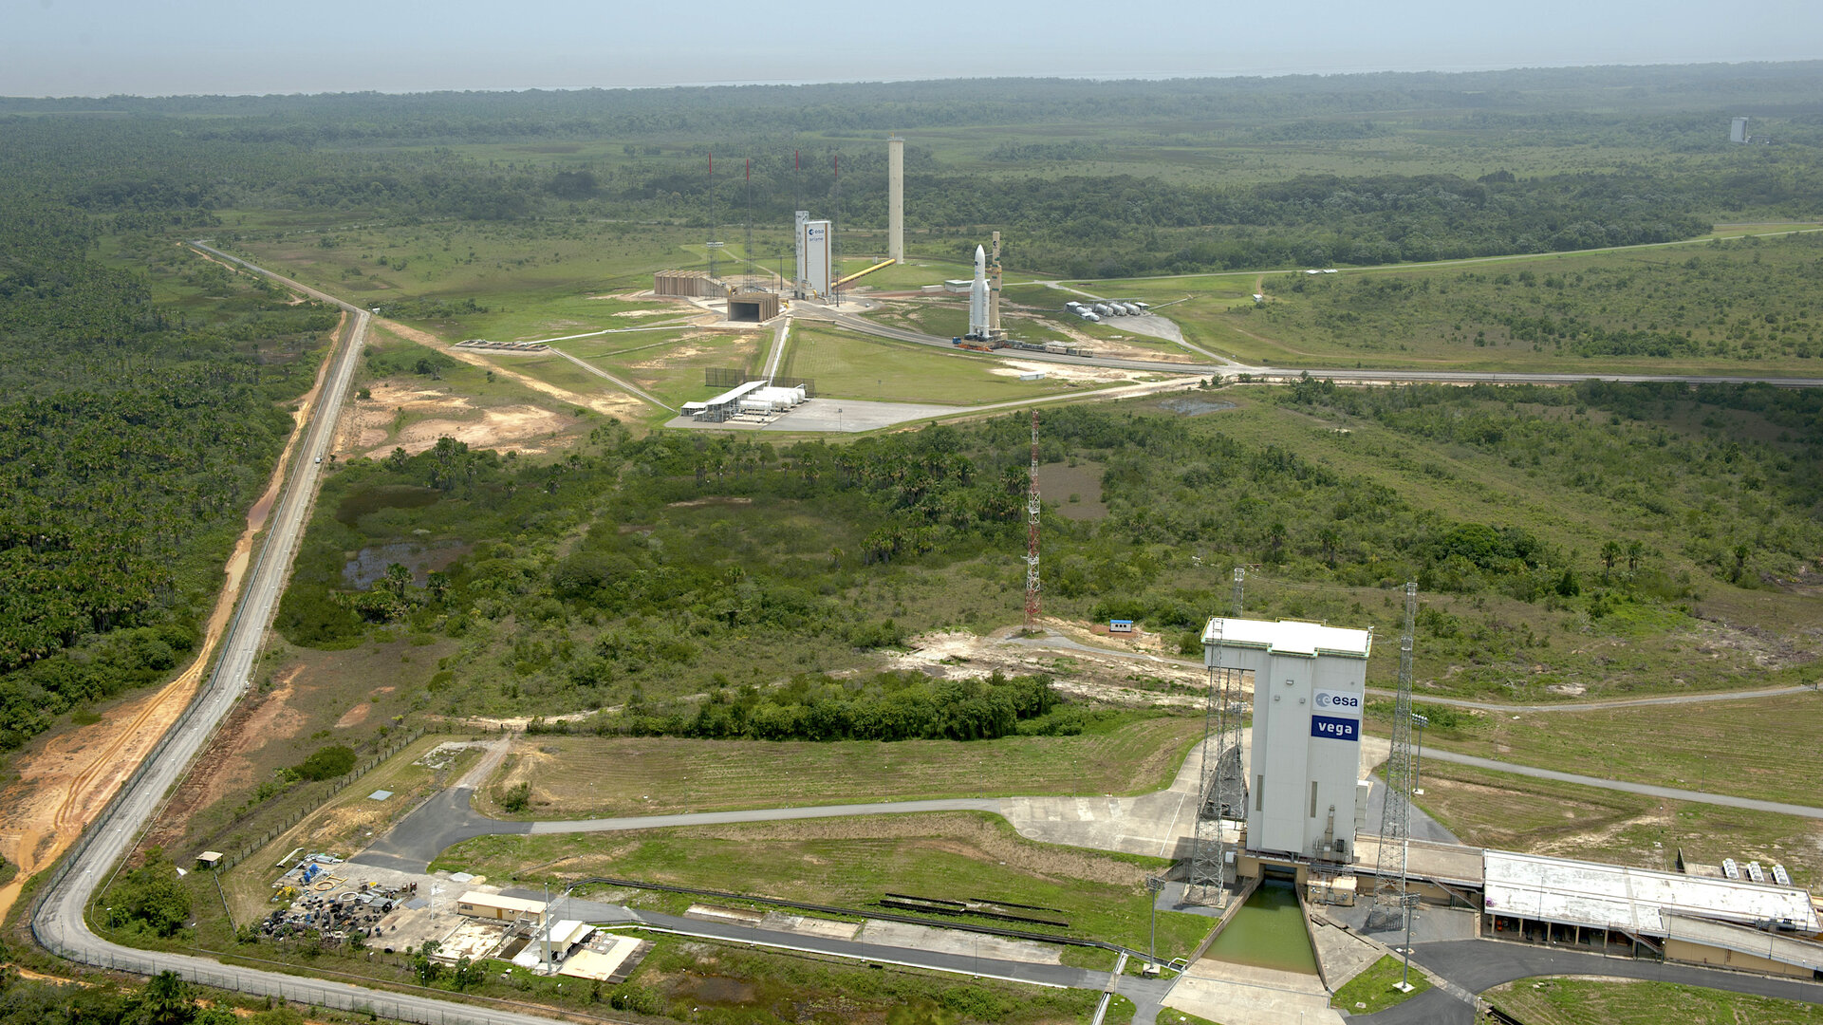
Notes:
More recently, I’ve worked with the European Space Agency, looking at how to even begin assessing biodiversity impacts in the space sector — for example at launch sites like French Guiana, which at the equator is great for the physics of rocket launching, but also sits adjacent to these beautiful rainforests - a major biodiversity hotspot.

Slide 39
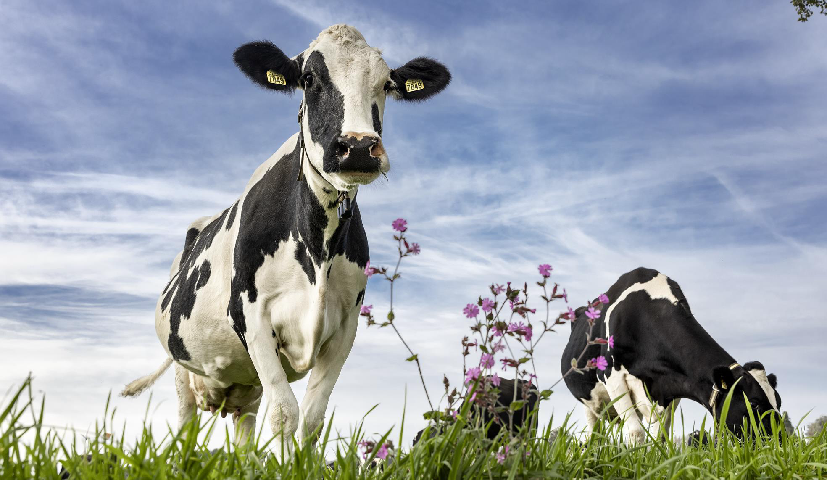
Notes:
I’ve also worked with the Dutch dairy sector to explore what a ‘Nature Positive’ strategy could mean at the farm level, and which indicators might realistically support that transition.”

Slide 40
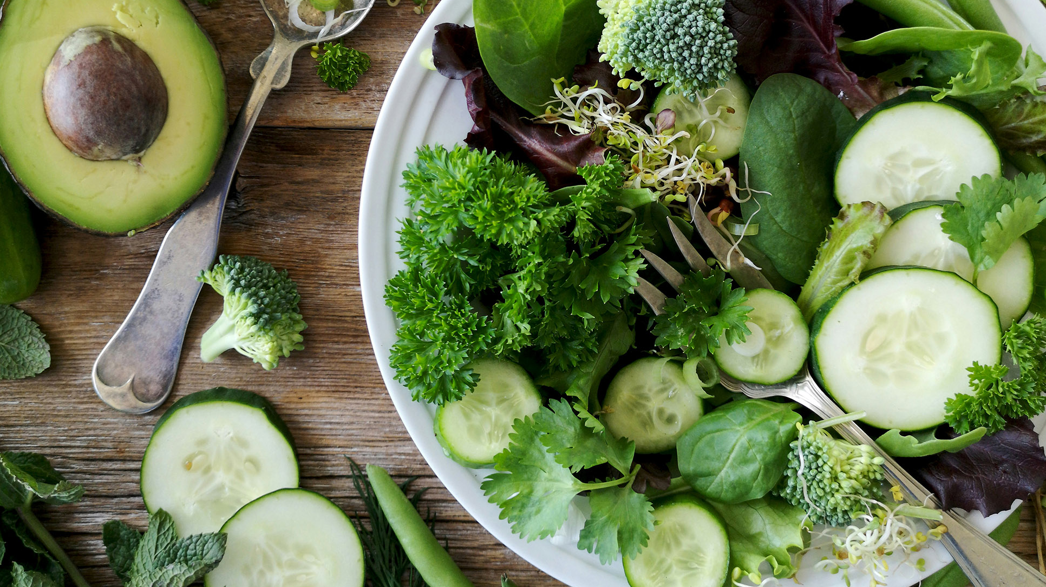
Food systems
Developing and evaluating tools that will help people choose more sustainable and more healthy food and diets
Notes:
These projects naturally led me to focus on food systems, which sit at the centre of biodiversity, climate, and human wellbeing.

Slide 41
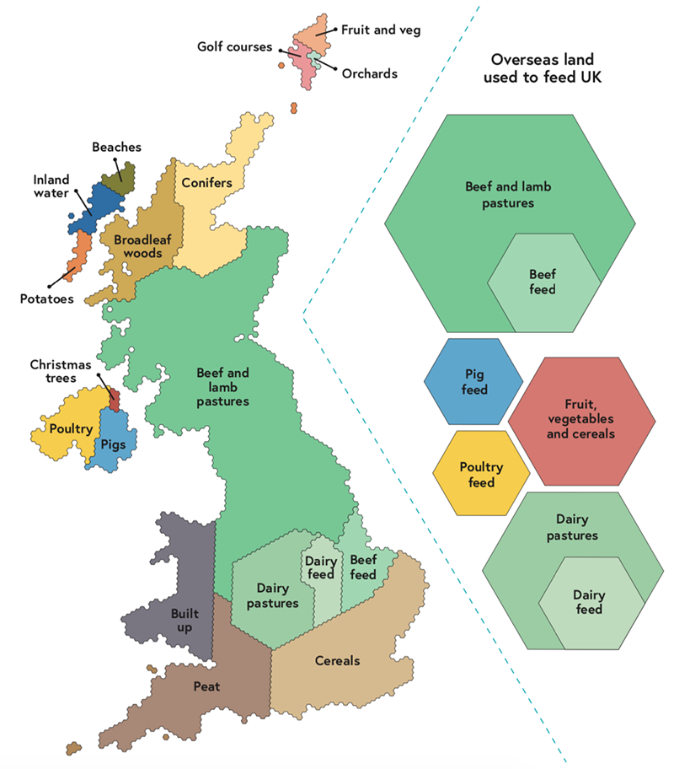
Source: The National Food Strategy, Part II
Notes:
Food production is the largest driver of land-use change globally, which is driving major ongoing species habitat loss. In the UK, this map shows the land area divided up by purpose (not where it actually is). About 70% is devoted to agriculture, mainly livestock and livestock feed and pasture. The right-hand side of the chart, using the same scale, shows how much land is used overseas to produce food for the UK. About half of the total land use takes place overseas. The combined land area for rearing beef and lamb for UK consumption is larger than the UK itself.

Slide 42
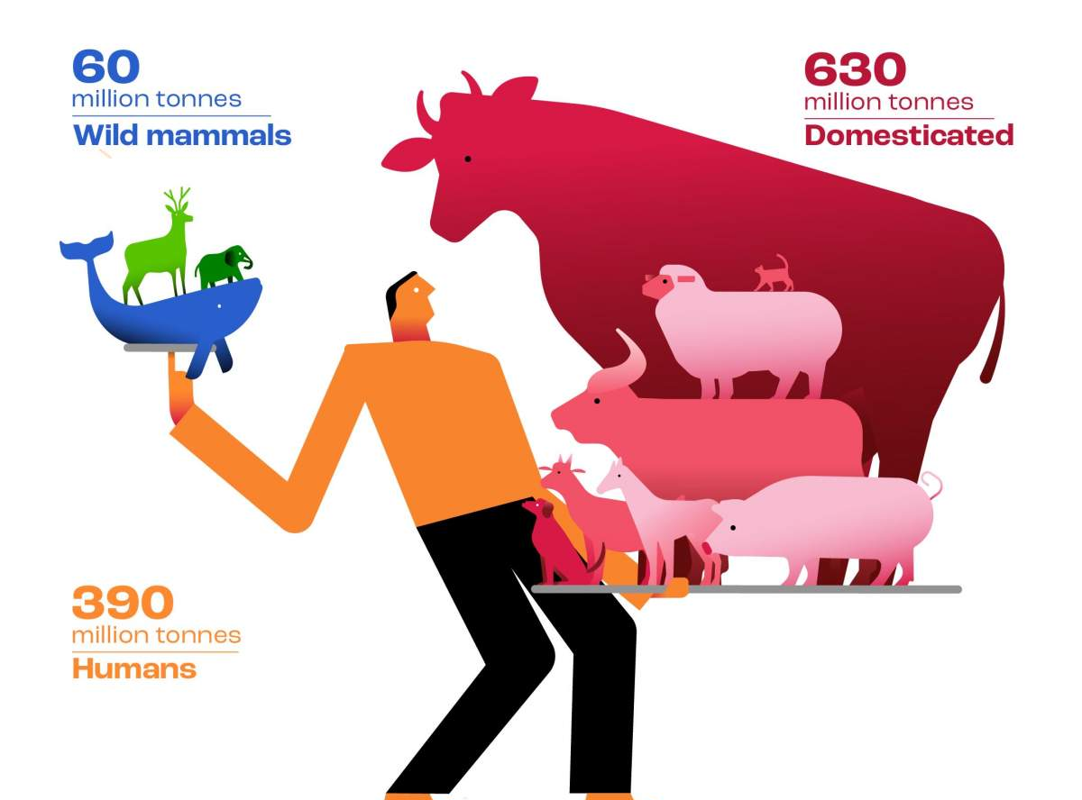
L. Greenspoon, et al, The global biomass of wild mammals, Proc. Natl. Acad. Sci. U.S.A. 120 (10) e2204892120
Source: The National Food Strategy, Part II
Notes:
Globally, only around 6% of the biomass of mammals on Earth is now wild — the rest is dominated by livestock. This has profound implications for biodiversity, climate, and ecosystem resilience.”

Slide 43
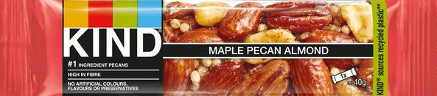
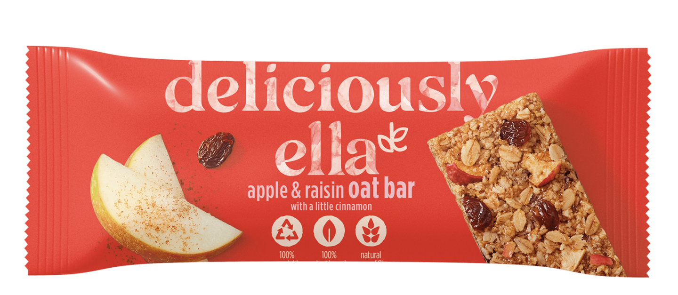
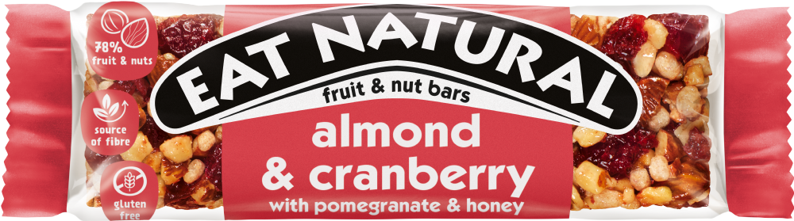
kg GHG
m³ water
m² land
per bar?
Notes:
“Despite this, at the level where choices are actually made — by consumers, organisations, suppliers, producers, and policymakers — we still struggle to answer very basic questions.
Three similar looking products on a supermarket shelf can have very different environmental impacts depending on their ingredient composition. That information is largely invisible.
This makes it difficult to make informed choices, and difficult to design science-based policy.”

Slide 44
Very large & diverse food datasets…
kg GHG
m³ water
m² land
per bar?
Inconsistent
Retail product names and categories are not standardised
Incomplete
Only ~10% of ingredients have percentage composition visible on-pack → 90% must be inferred
Scale
120 UK food categories vs 100,000+ UK products
Notes:
“Food data presents several challenges.
First, it’s inconsistent: similar products are categorised differently across retailers. Second, it’s incomplete: ingredient lists often disclose only a small fraction of actual proportions, leaving most of the formulation unknown. That means up to 90% of the ingredient composition has to be inferred before environmental impacts can be estimated. And third, it doesn’t scale: existing environmental impact datasets cover around a hundred food categories, while real markets contain hundreds of thousands of distinct products.
At that scale, category averages hide enormous variation, and manual assessment becomes impossible.”

Slide 45
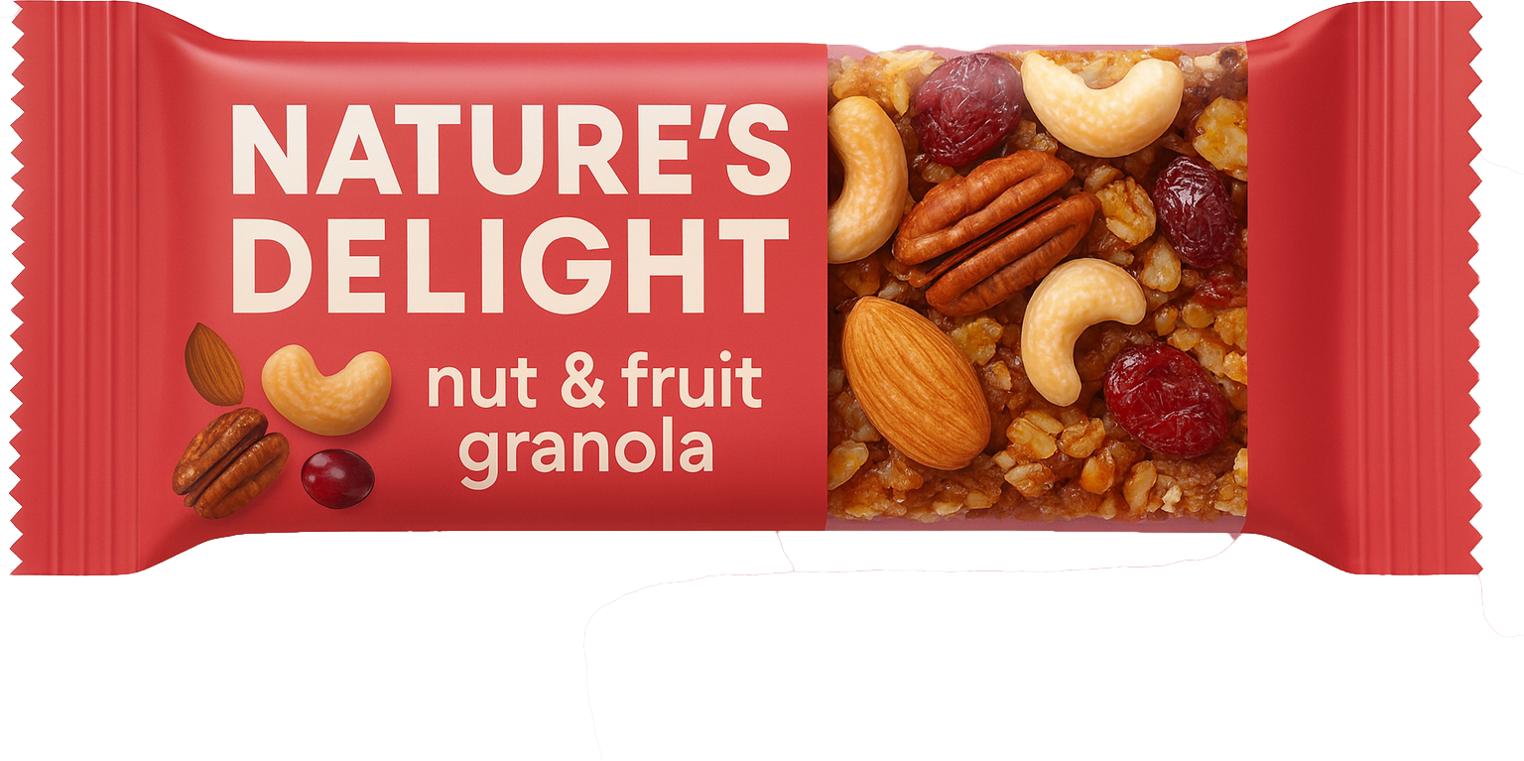
Very large & diverse food datasets…
kg GHG
m³ water
m² land
per bar?
Inconsistent
Goal
Retail product names and categories are not standardised
Better match new products at scale to known environmental impact data
Improve categorisation
Infer likely ingredient compositions
Represent uncertainty
Incomplete
Only ~10% of ingredients have percentage composition visible on-pack → 90% must be inferred
Scale
120 UK food categories vs 100,000+ UK products
Notes:
“This is where I’m hoping to take the work next.
The aim is to develop methods that can estimate the environmental footprint of individual food products, even when information is incomplete.
In my upcoming fellowship I’m going to apply machine learning approaches to better match products to known impact data, improve categorisation, and infer likely ingredient compositions while explicitly representing uncertainty in that process.
The goal isn’t perfect numbers at this stage — it’s better, more transparent information that can support real decisions at scale.

Slide 46






Talitha Bromwich University of Oxford talitha.bromwich@smithschool.ox.ac.uk
The application changed; the analytical approach has stayed the same…
Systems-scale thinking and model-based reasoning
Working rigorously with uncertainty and assumptions
Extracting signal from large, messy, incomplete data
Notes:
“To finish, although my work has moved across disciplines, the underlying approach has stayed the same.
Particle accelerator research trained me to work with complex systems, to treat uncertainty as central, and to extract meaning from large, messy datasets.
Those skills have transferred directly into biodiversity science, environmental policy, and food systems research.
So thank you so much, both for having me as part of the JAI back in the days of my DPhil, and for having me back today to talk to you about my adventures since. Thank you.

